Slide 1
Utilities Infrastructure Modernization (UIM) Project
Interface Coordination Group Kick-Off Meeting
May 9, 2014
Dianne Napier
dnapier@jlab.org
x7475

Slide 2
Topics
Why am I here?
Project Overview/Scope
Project Organization
Project Schedule
Outages, Impacted Groups, & Identify Representatives
Communication Tools
What’s Next?

Slide 3
Why Am I Here?
Many of you have been assisting FM&L with coordination, schedules, etc – Thank you for your continued support
Many of you are new – Welcome!
FM&L has established an Interface Coordination Group (ICG) to plan and coordinate contractor outages and work activities with affected activities/groups at the Lab
Understand the scope, schedule, associated personnel for UIM and how it will affect your group/work area
Are you the representative for your group/work area for this ICG?
Understand what your concerns are for your group/work area during outages
Discuss communication tools in place and improvements if needed for outages.

Slide 4
Scope - Overview
Accelerator Site Electric Distribution Replacement
Accelerator Site Cooling Towers
Communications Infrastructure Upgrade
Cryogenic Test Facility Upgrade
Computer Center cooling and uninterruptable power supply Upgrade

Slide 5
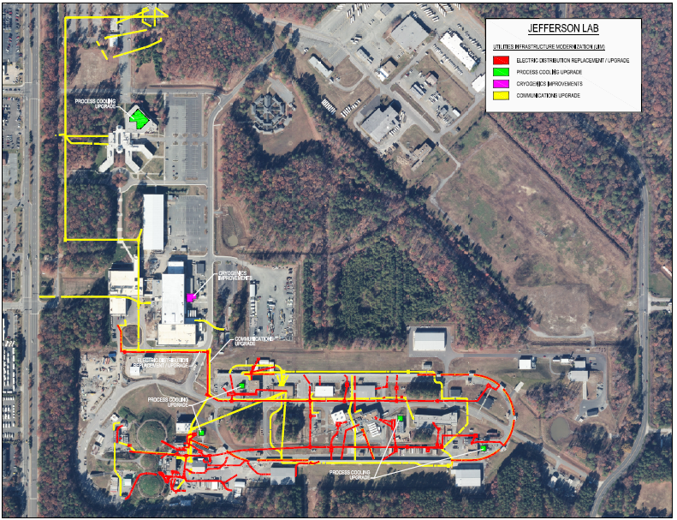
Project Overview

Slide 6
UIM is broken into Phases
CD-3A (AKA Phase A)
Electrical Distribution
Cooling Towers
Headers
Maintenance Tower
End Station
Urgent Communications
CD-3B (AKA Phase B)
Cooling Towers (Remaining)
CD-3C (AKA Phase C)
Computer Center Cooling & Power
Communications
Cryogenics Test Facility (CTF)

Slide 7
Scope - Detailed
Accelerator Site Electric Distribution Replacement - Phase A
Phase I:
Replace accelerator primary and secondary electric feeders and provide increased capacity for electric transfer
Primary and Secondary Power Feeder Replacement
Secondary Substation Modifications to incorporate exterior pad mounted switchboards
Phase II:
Any work not accomplished in phase II
Add Switchgear at CHL
33MVA Substation Integration (cables & connections)
Accelerator Site Cooling Towers – Phases A, B, & C
Replace/consolidate cooling towers,
Replaces 3 tower cells at North Access
Replaces 2 tower cells at South Access
Replaces 3 tower cells at End Station (Bldg. 92)
Demo ESR cooling tower (ESR will be cooled by the North Access towers)
Communications Infrastructure Upgrade – Phase A & C
Provide a fiber-optic pathway and core ring to eliminate single points of failure
Expand the existing optical fiber network backbone via the incorporation of additional single and multi-mode fiber optic OSP cables
Provide an underground optical fiber system to support multiple entry points to the site
Establish two communication utility demarcation facilities

Slide 8
Scope - Detailed
Cryogenic Test Facility Upgrade – Phase C
Expand Cryogenic Test Facility & provide necessary additional equipment
Double the size of the Cryogenics Test Facility (CTF) Building (2,000 SF Addition)
Relocate and refurbish existing equipment as well as install additional equipment to improve safety, plant efficiency and capacity
Upgrade cryogenic piping and support systems
Computer Center cooling and uninterruptable power supply Upgrade – Phase C
Upgrade data processing cooling, & replace data processing UPS
Expansion of the Test Lab Chiller Plant (2,500 SF addition) & 800 ton chiller
Upgrade of underground chilled water piping and distribution within F-Wing Mechanical Room
Electrical modifications associated with the Data Center including a new flywheel/battery UPS

Slide 9
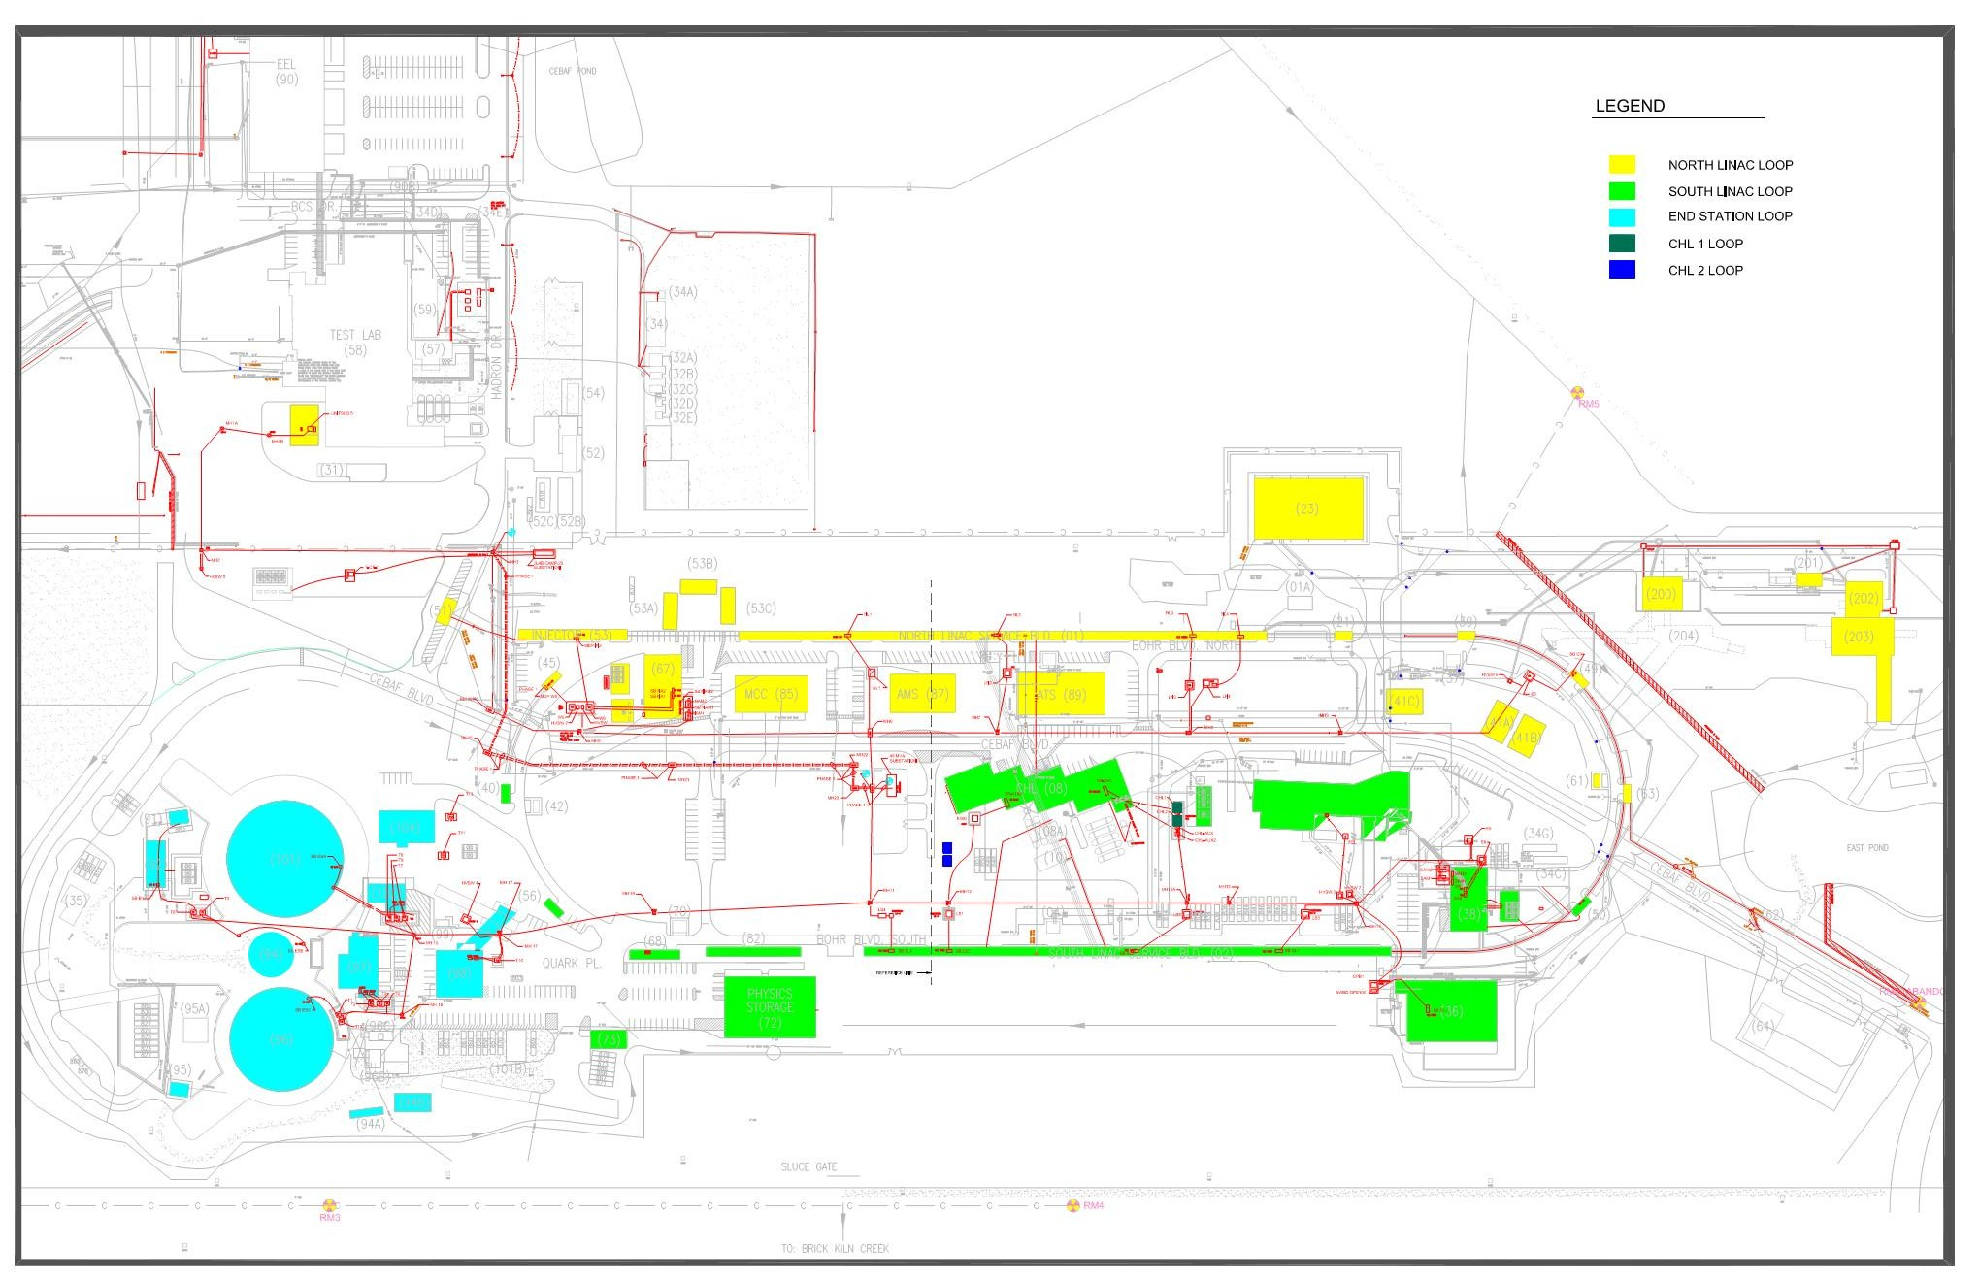
Electrical Distribution Upgrade
JLab Accelerator Site – Loop Designation

Slide 10
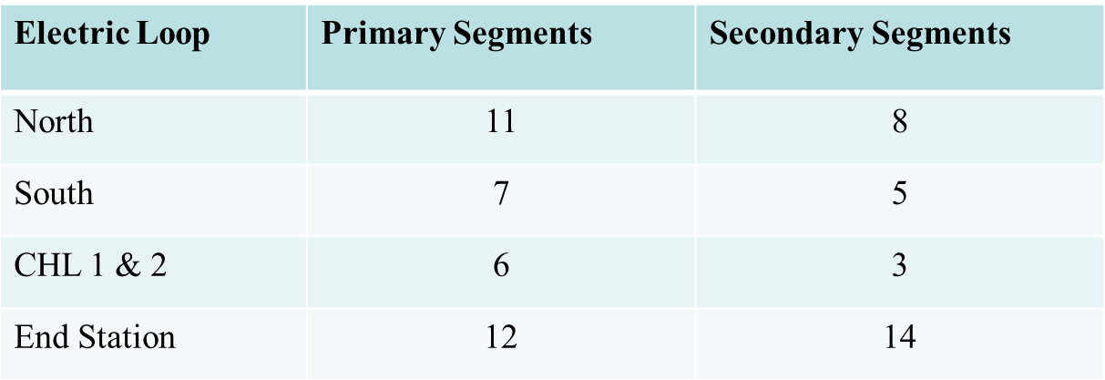
Electrical Distribution Upgrade
Scope: Upgrade primary and secondary Accelerator Site feeders
Replacement of 36 primary segments and 30 secondary segments
Replaces aluminum primary conductors with copper – increases capacity from 10.5 kVA to 13.5 kVA
Create new CHL-2 loop by moving CHL 480V load from South Loop. This reduces South Loop Load. CHL-1 and CHL-2 will be independent.
Split North loop into a Northeast and Northwest loop to reduce load
Install switchboards adjacent to transformers
Notes:
The proposed upgrade of this existing electrical distribution system consists of the following:
• Provide 750 kCMIL copper type ethylene-propylene rubber (EPR) cable rated for 15 kV with 133% insulation level in each of five loops to replace existing 25 year old cables.
• Provide a new 15 kV, 1200 A, switchgear lineup for the CHL Compressor Loop consisting of Schedule 40 PVC conduits in a concrete envelope; a concrete pad for the switchgear and feeders from the switchgear to the padmounted transformers.
Split the North Loop into two loops, the North-East Loop and the North-West Loop and provide a new circuit to supply the new loop.
• Remove existing 480 V, 2500 A circuit breakers from the secondary compartments of padmounted transformers and provide an exterior switchboard adjacent to each of these transformers. Replace existing 600 V and 4160 V secondary cables from the padmounted transformers to the interior switchboards.
• Provide appropriate 15 kV silicone rubber terminations on each primary cable for terminations onto existing load interrupter switches; terminations shall be manufactured by 3M, 5630K Series or similar by Elastimold or approved equal.

Slide 11
Electrical Distribution Upgrade
Schedule
Estimated Schedule Duration– 4 months (2 – 8 week durations)
Construction Phasing (aligned with Accelerator Downs)
Phase 1: May 15 – September 1, 2014
Replace accelerator primary and secondary electric feeders and provide increased capacity for electric transfer
Primary and Secondary Power Feeder Replacement
Secondary Substation Modifications to incorporate exterior pad mounted switchboards
Phase 2: June 1 – August 3, 2015
Any work not accomplished in phase II
Add Switchgear at CHL
33MVA Substation Integration (cables & connections)
Float: FY15 Accelerator Run-time is flexible

Slide 12
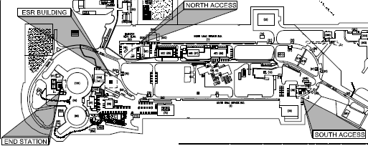
Cooling Tower Upgrade

Slide 13
Cooling Tower Upgrade
Scope: Replace cooling tower cells past service life that support Accelerator and Experimental Hall Operations
South Access Towers
Replace existing 3 towers with 2 larger towers
Install a maintenance tower
Install new header that will connect ARC towers and LINAC towers to create a South Access Building Tower Plant
North Access Towers
Replace existing 5 towers (including ESR) with 3 larger towers
Install a maintenance tower
Install new header will connect ARC Towers and LINAC towers to create a North Access Building Tower Plant
Install piping to connect ESR/4KW loads to North Access Towers
End Station Towers
Replace existing towers with equivalent

Slide 14
Cooling Tower Upgrade Schedule
Schedule
Estimated Schedule Duration– 13 months
Construction Phasing (aligned with Accelerator Downs)
Phase 1: Anticipated Award – June/July 2014
North & South Access Header Modifications
North & South Access Maintenance Towers
End Station Cooling Tower Replacement
Phase 2: Starts once header modifications & maintenance towers are installed
North Access Towers – Demolition & Installation of new towers
South Access Towers – Demolition & Installation of new towers
Extension of Condenser Water Piping to ESR/4KW from North Access Towers
Demolition of ESR Towers

Slide 15
Project Status – Phase 3A
Electrical Distribution – PHASE 3A
Bids in hand; ready for award upon CD-3A (anticipated May 21, 2014)
Accelerator construction availability
May 2014 thru August 2014
June 2015 thru August 2015
Cooling Towers – PHASE 3A/3B
IFB Issued, Site visit 5/12/14, Bid Opening 6/13/14
Estimated Construction Award – July 2014
Communications Upgrade – PHASE 3A
Procurement - Equipment BOM established
Estimated Construction Start – June 2014

Slide 16
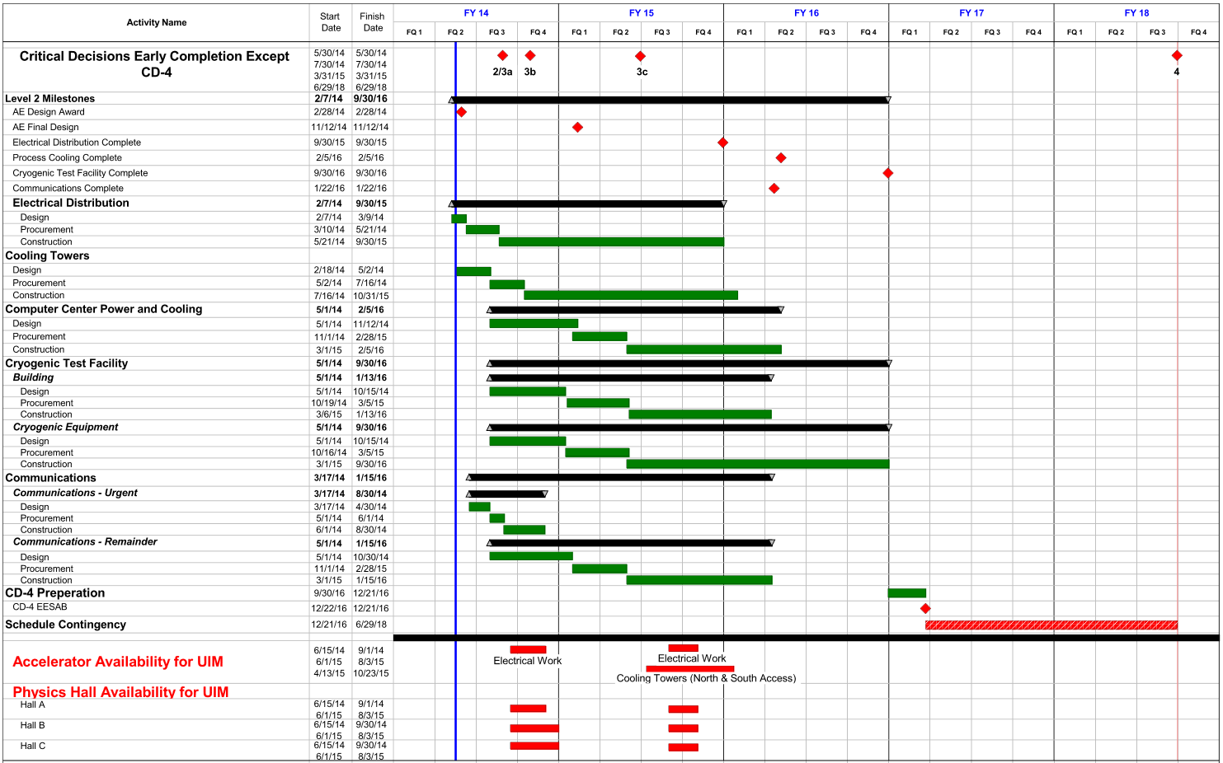
Overview Schedule

Slide 17
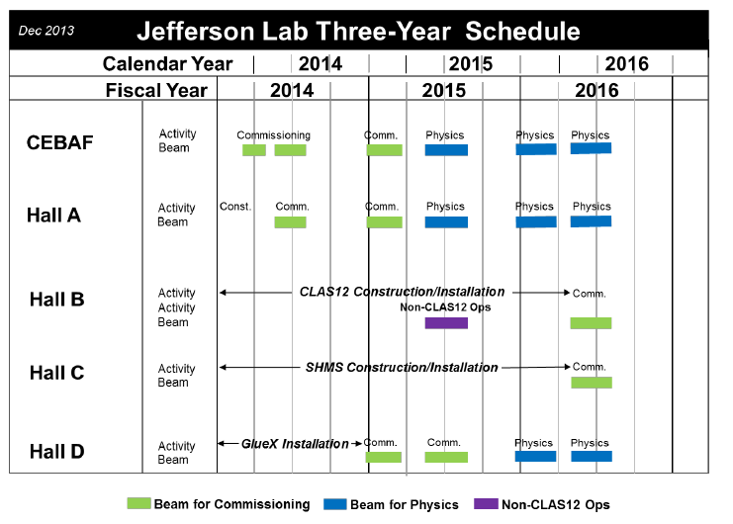
Accelerator Three Year Schedule

Slide 18
Summer 2014 SAD Outages
Electrical – Phase 1 work (Planning for July/August Timeframes)
Replace accelerator primary and secondary electric feeders and provide increased capacity for electric transfer
Primary and Secondary Power Feeder Replacement
Secondary Substation Modifications to incorporate exterior pad mounted switchboards
(8 weeks to accomplish this scope)
The Emergency Power loop supports Critical Accelerator Systems: Safety, Vacuum, Tunnel LHe tunnel inventory…
Power will NOT be interrupted to these system.
Impacted areas: Accelerator Site…
Mechanical – Headers & Maintenance Tower; End Stations
Impacted areas: 1 week outage to do header connections…

Slide 19
Electrical - North Loop – Bldg Outage Analysis
Sample Analysis– next meeting to review each analysis with affected users/systems

Slide 20
Interface Coordination Group
Rusty Sprouse
JLab Project Director
Michele Solaroli
JLab Project Manager
Dianne Napier
Interface Coordinator
Steve Suhring
(Randy Michaud)
Accelerator Operations
Walt Akers
(Javier Gomez)
Physics
Steve Benson
(Jim Coleman)
FEL
Tony Reiley
(Kirk Davis &
Bob Bennett)
SRF
Mat Wright
(Jonathan Creel)
Cryogenics
Bryan Hess
(Andy Kowalski)
Information Technology
Mike Lewellen
Security
Dick Owen
(Todd Kujawa)
EHS&Q
Various
FM&L Design Project Managers
John Riesbeck
(Tim Minga)
Life Safety
TBD
(TBD)
Personnel/Office Relocation
Backups noted in ( )

Slide 21
Communication Tools
UIM Website (this is will be main hub for information): http://www.jlab.org/fm/construction/UIM/index.html
M Drive Shared Folder (Back up to Website): M:\UIM_Interface_Coordination
JLab Insight Webpage → Construction Corner
FM&L Outage Notification System:
https://cc.jlab.org/cgi-bin/infrastructure/Outage/OutageView
ATLis (Accelerator, FEL & Halls):
http://devweb.acc.jlab.org/CSUEApps/atlis/atlis.php
TATL (Testlab): http://devweb.acc.jlab.org/CSUEApps/tatl/atlis.php
SAD Calendar: http://accweb.acc.jlab.org/calendar/
Group Email List: uimicg@jlab.org
Who do I call if I have questions/concerns?
Dianne Napier – Interface Coordinator
Michele Solaroli – Project Manager

Slide 22
What’s Next?
Next meeting: Focus is Electrical Summer 2014 Work (early July through end of August) – planning for May 20th
Review analysis sheets
Identify affected systems
Review planned work from early July and August for affected groups
Identify hard black out dates (dates for outages and dates for NO outages)
Identify Computer & Networking needs during the outages
Upcoming meeting (next few weeks): mechanical/cooling tower outages & impacts for Summer 2014 down
ICG meetings – Once a month

