Slide 1
Pion photo-production in the intermediate energy regime at JLab using GEANT4
Sokhna Bineta Lo AMAR
Cheikh Anta Diop University, Dakar (SENEGAL)

Slide 2
Introduction
Pion photo-production, alternative to probe the matter
Electromagnetic and hadronic Interactions combined
GEANT4, tool to simulate Pion photo-production in comparison with Jefferson Lab physics

Slide 3
Outline
Pion photo-production
Overview of GEANT4
GEANT4 & Hadronic models
Comparison of Cross Sections
Conclusion & future work

Slide 4
Pions photo-production
Study of nucleonic spectrum
Combine electromagnetic & hadronic interactions
Intermediate energy range (1 ~ 30 GeV)

Slide 5
Overview of GEANT4 : Generalities (1/2)
GEANT4 : GEometry ANd Tracking 4
Developed and maintained by an international collaboration
Purpose: simulate the interaction of particles with matter
Application: high-energy, nuclear, space and material sciences to medical physics
Ingredients
Large flexible set of models for physical interactions of leptons and hadrons,
Electromagnetic and hadronic processes (both elastic and inelastic,)
Range : eV to TeV
Extensive support of geometry and visualization tools + advanced scoring and tracking options

Slide 6
Overview of GEANT4 : Generalities (2/2)
Particle-matter interaction
Quantified by cross section for a given process
No automatic implementation for cross section calculation (i.e., defined by users)
JLab & Geant4
Intensively used for its physics and accelerator programs
In all experimental halls (A, B & C) to model various aspects of detector packages and beam diagnostics

Slide 7
GEANT4 & Hadronic models (1/3)
Tens of categories of hadronic models

Slide 8
GEANT4 & Hadronic models (2/3)
Total cross section of elastic & inelastic scattering of GEANT4 models
Physics | QGSP QGSP_BERT QGSP_BERT_EMV QGSP_BERT_EMX QGSP_BERT_TRV QGSP_BIC GSP_BIC_EMY QGSP_FTFP_BERT QGS_BIC FTF_BIC FTFP FTFP_BERT FTFP_BERT_EMV FTFP_BERT_EMX FTFP_BERT_TRV QGSC QGSC_CHIPS QGSC_EMV QGSC_QGSC QBBC_HP QBBCG | LHEP LHEP_EMV | LBE | QGSP_BERT_HP QGSP_BIC_HP | QBBC | QGSC_BERT
Group | G1 | G2 | G2 | G3 | G4 | G5
Energy | 0→100 TeV | ≤10 TeV | ≤350 GeV | 0→100 TeV | 0→100 TeV | 0→100 TeV
Elastic | Same to G2 | Same to G1 |  | Same to G4 | Same to G3
Inélastic | Same to G3 |  |  | Same to G1

Slide 9
GEANT4 & Hadronic models (3/3)
Different models considering incidents particles
Models | Incident particles | Incident energy | Applications
Parameterized Low Energy Parameterized (LEP) High Energy Parameterized (HEP) | p, n, π, K, Λ, Σ, Ω, Ξ, α, t, d. | 0 → ~30 GeV ~10 →15 TeV | Describing showers in detectors
Pre-compound (PRECO) | p, n | 0→170 MeV | Used for nucleon-nucleus interactions at low energies
Cascade Bertini (BERT) Binary (BIC) | p, n, π, K, Λ, Σ⁺, Σ⁻ Ω⁻, Ξ⁻, Ξ⁰ p, n. π⁺, π⁻ | 0 → 10 GeV 0 → 10 GeV 0 → 1.3 GeV | For intermédiates Energies
String Quark –Gluon –String (QGS) Fritiof (FTF) | p, n, K, π. | ~10 → ~ TeV Down to much lower energies ~ 3 GeV | Recommended for use in shielding applications as well as in high energy
Chiral – Invariant – Phase – Space (CHIPS) | μ, π, K, anti-p, anti-baryon Gamma | At rest ~1MeV → ~1GeV | For low to medium range energies
High Precision neutron (HP) | Neutrons | < 20 MeV | Requires detailed for neutron transport Can be used for radiation protection
Low Background experiments (LBE) |  | Low energies
Other Capture Fission Isotope production | In a nucleus Modeling sequence for π⁻ Validation of CHIPS for Pion Neutrons | At rest Low energies < 100 MeV From 100 MeV down to thermal | Useful for activation studies

Slide 10
Comparison of Cross sections (1/4)
Jefferson Lab: Pion photo-production performed in Hall B
GEANT4: Cascade and CHIPS models
Comparison: GEANT4 and SAID
- SAID: Scattering Analysis Interactive Dial-in
(Model supported by a database of world-wide experimental data)
Comparison: GEANT4 & Jefferson Lab experimental data

Slide 11
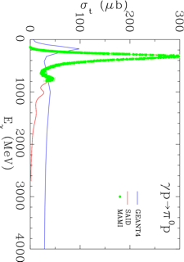
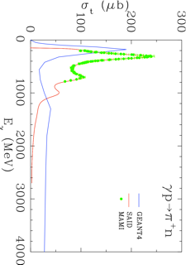
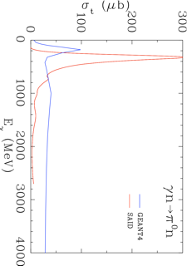
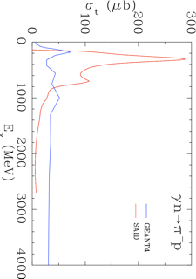
Comparison of Cross sections (2/4)
GEANT4-Cascade/SAID
(a)
(b)
(c)
(d)
Geant4 does not reproduce correctly the behavior of SAID
Some resonance states inexistent in Geant4-Cascade
Threshold distribution misrepresented
Comparison of two different physics

Slide 12
Comparison of Cross sections (3/4)
GEANT4-CHIPS/SAID
(e)
(f)
(g)
(h)
Excellent description of resonant states by CHIPS

Slide 13
Comparison of Cross sections (4/4)
GEANT4-CHIPS/Jlab
(i)
(j)
(k)
Insufficient experimental data for neutron target
Excellent description of JLab resonant states by CHIPS

Slide 14
Conclusion & Future work
GEANT4 allows to describe JLab Pion photo-production
Model: CHIPS
Overestimation Cross Sections
Need for a more selective study to better describe the experiments at JLab
Consider only pions as final state:
Dissociate the final states :

