Slide 1
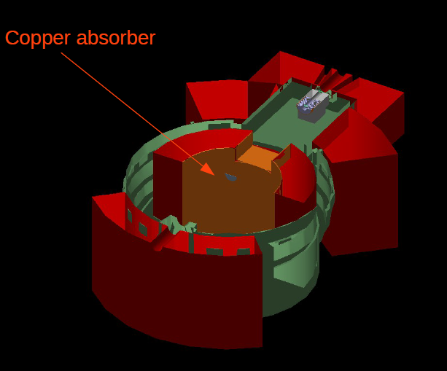
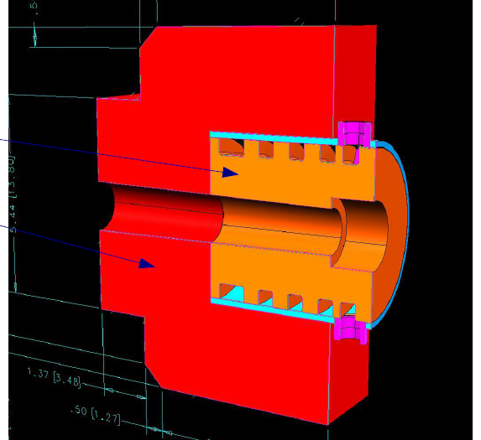
Collimator
The collimator is placed about 85 cm from the target and intercepts scattered electrons from 0.78° to 3.8°
Water cooled Cu-W inner cylinder in a W box
2.1 kW power

Slide 2
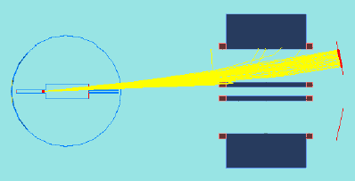
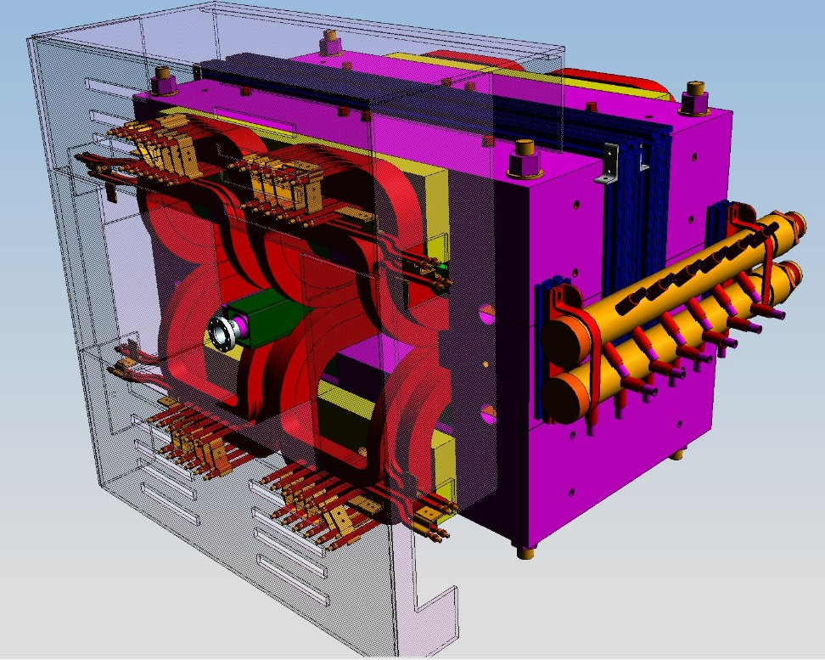
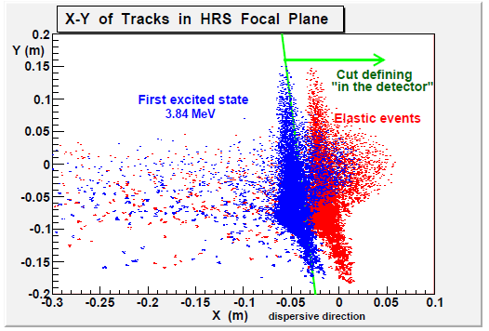
Septum Design
HRS only goes down to 12.5°, need septum to “pre-bend”
Magnetic shielding
Tune for CREX

Slide 3
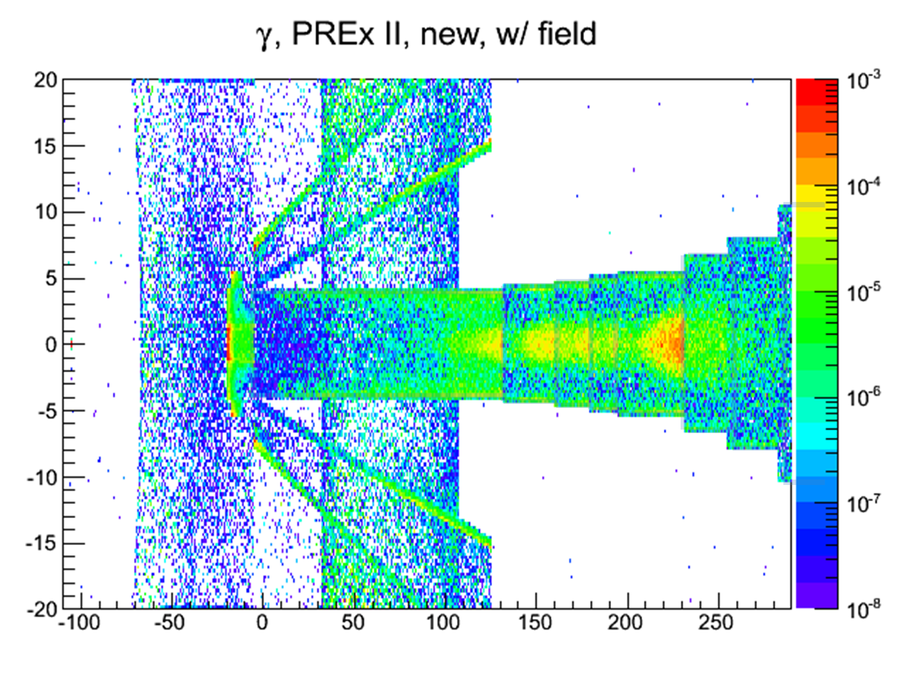
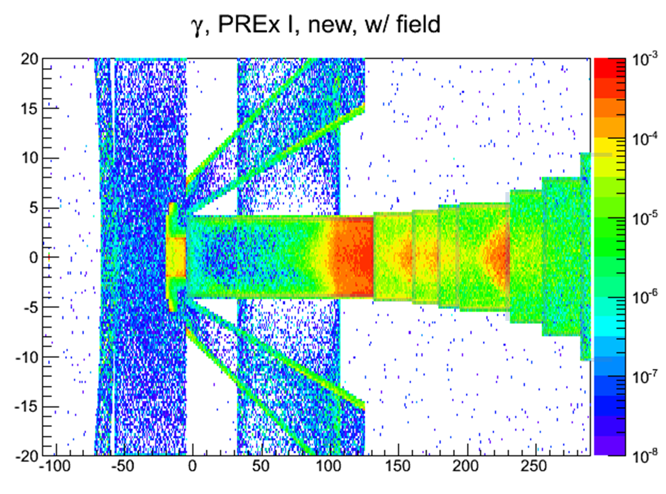
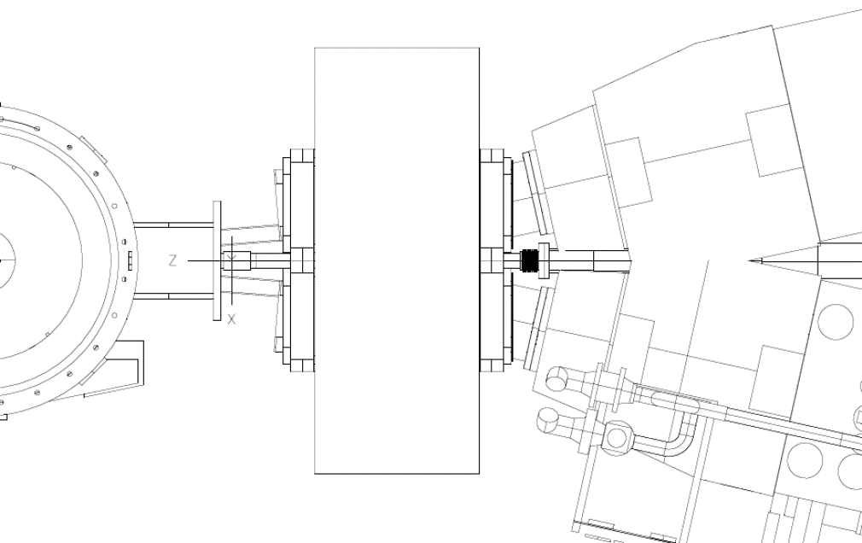
Region Near the Septum
New Collimator
& Shielding
HRS-L
Q1
target
septum magnet
HRS-R
Q1
Former O-Ring location
Collimators

Slide 4
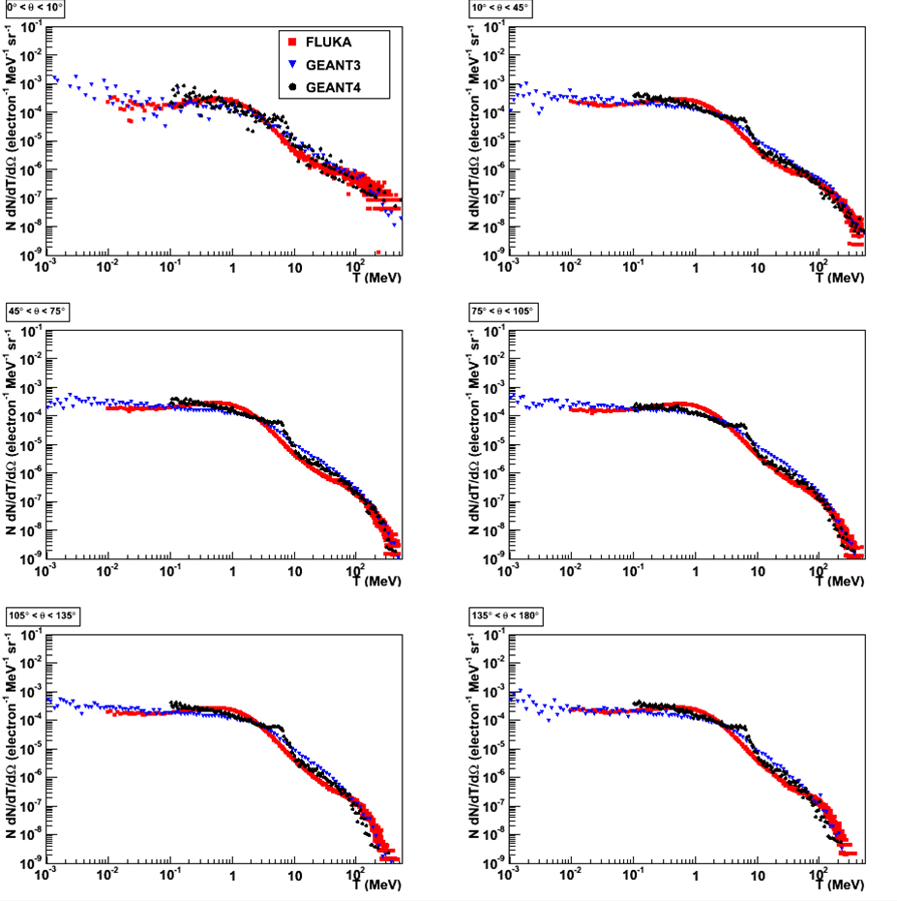
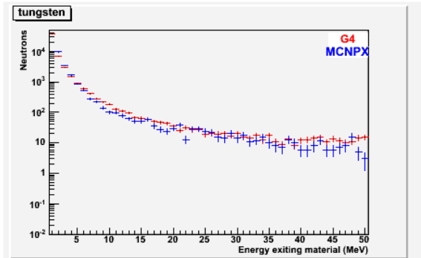
Simulation comparisons
We’ve performed comparisons of neutron energy spectra from various simulation packages:
FLUKA
GEANT3
GEANT4
MCNPX
5 mm Pb
L. Zana
J. Mammei
P. Degtiarenko
D. McNulty

Slide 5
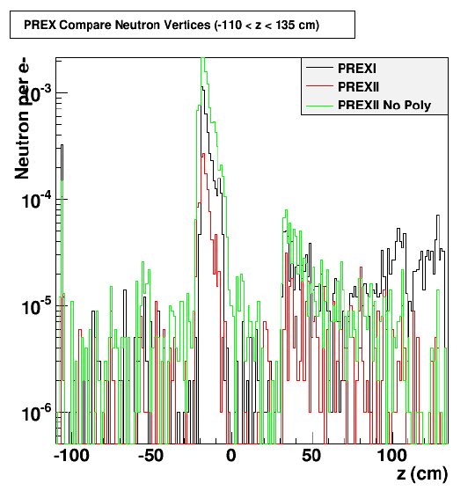
Neutron shielding
PREX II collimator increases neutron production, but localizes it so we can shield it
Background rates from CREX ~10x smaller than PREX II, so shielding scheme for PREX II will be overkill for CREX

Slide 6
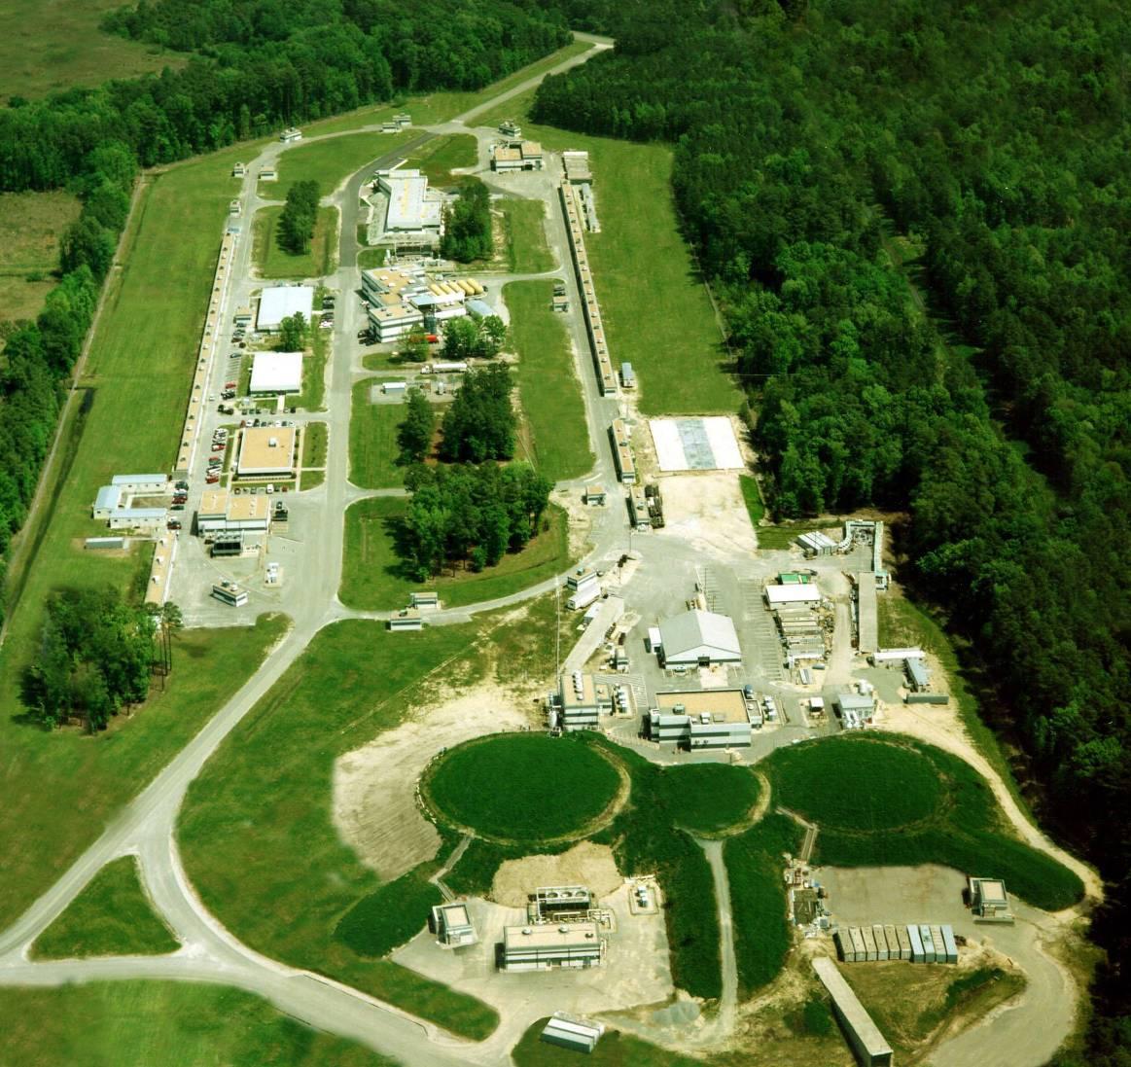

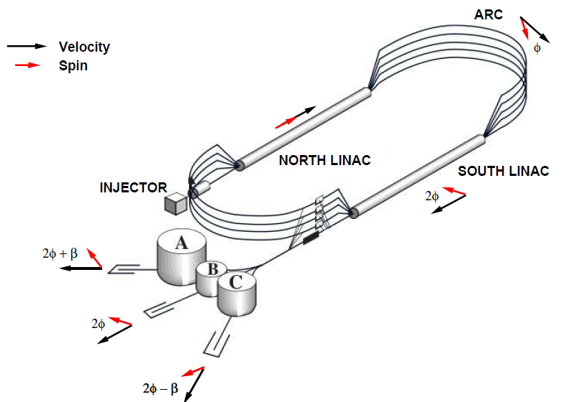
Polarized Beam
@
velocity
spin

Slide 7
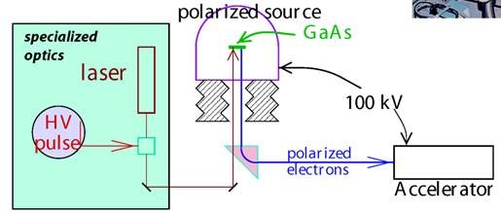
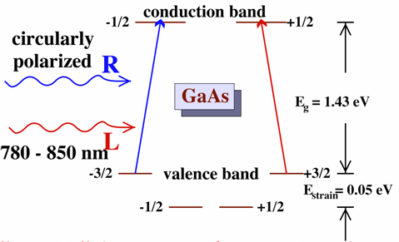
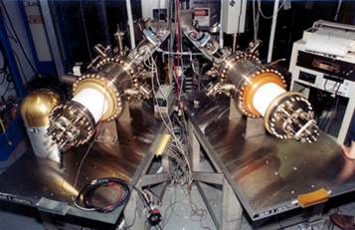
Polarized Electron Source
photoemission of electrons from GaAs
"Bulk" GaAs typical P_{e} ~ 37%
theoretical maximum - 50%
→ "Strained" GaAs = typical P_{e} ~ 80% theoretical maximum - 100%
"Figure of Merit" ∝ I P_{e}²

Slide 8
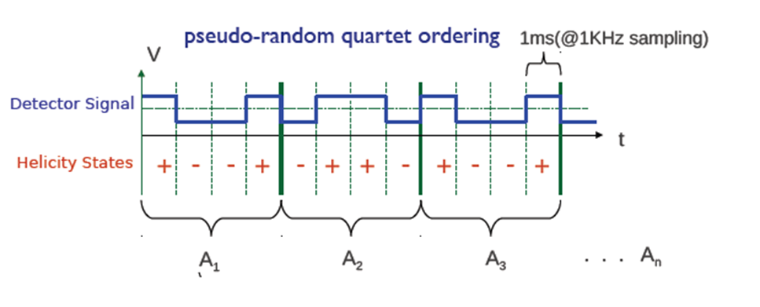
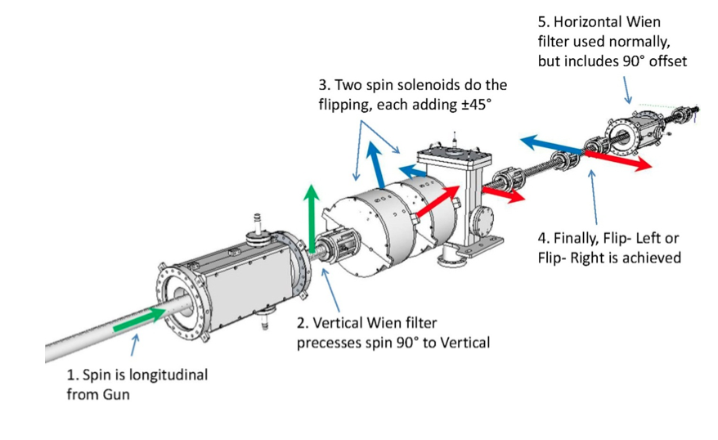
Helicity reversals
Double-wien
IHWP
Rapid, random helicity reversal
Electrical isolation from the rest of the lab
Feedback on Intensity Asymmetry

Slide 9
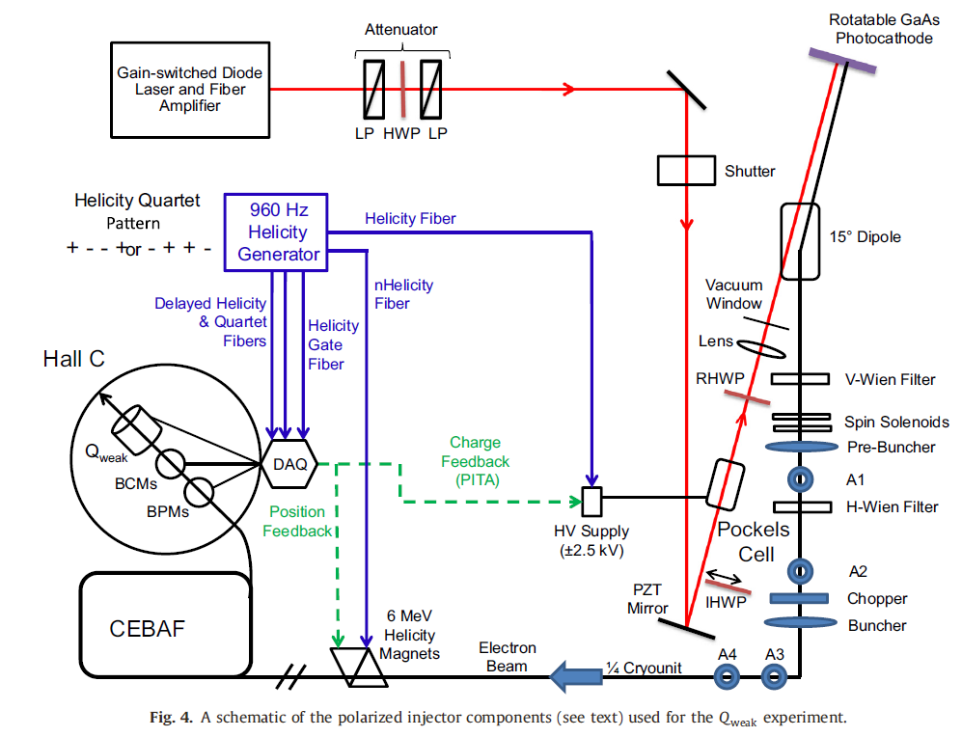
Injector

Slide 10

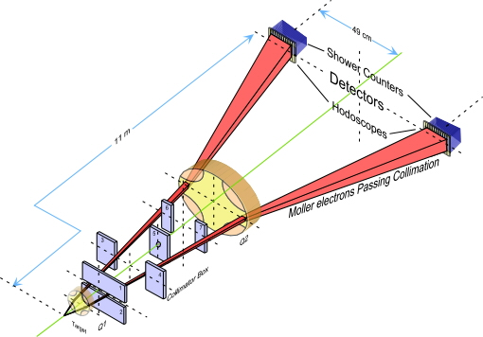
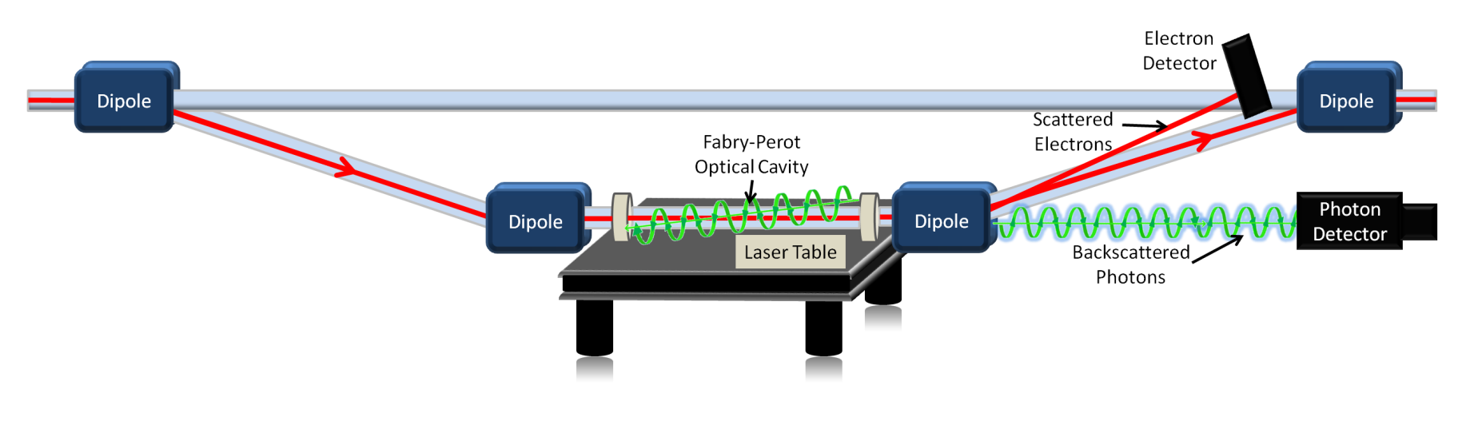
Precision Polarimetry
Qweak requires measurement of the beam polarization to
Strategy: use 2 independent polarimeters
Møller Polarimeter
Use existing Hall C Møller polarimeter to measure absolute beam polarization to <1% at low beam currents
Known analyzing power provided by polarized Iron foil in high magnetic field
Use new Compton polarimeter to provide continuous, non-destructive measurement of beam polarization
Known analyzing power provided by circularly-polarized laser beam
Compton Polarimeter

Slide 11
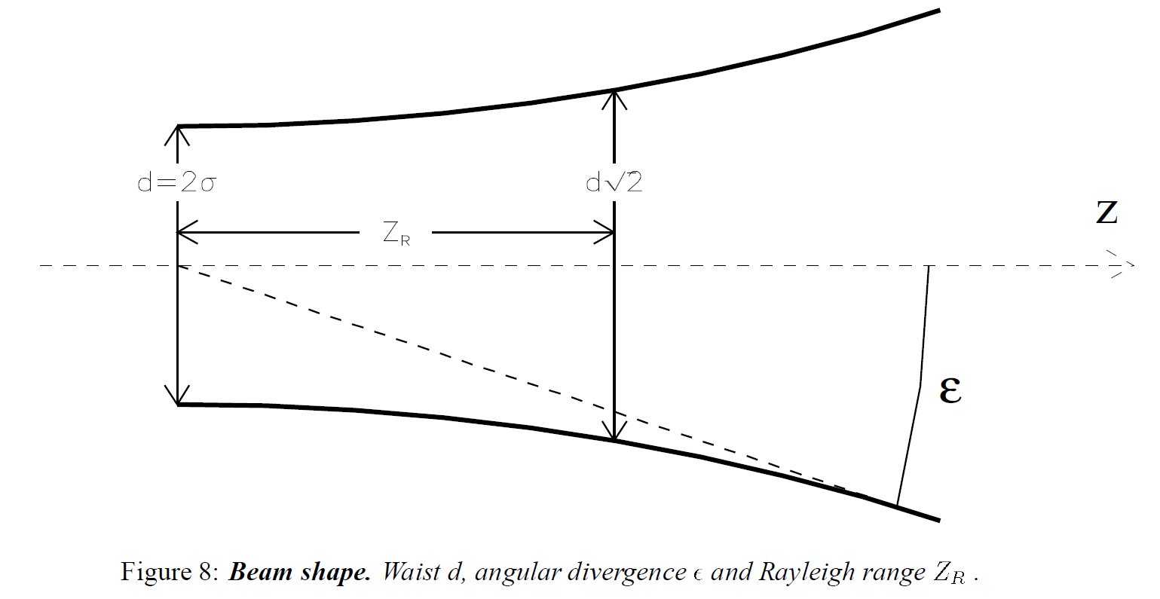
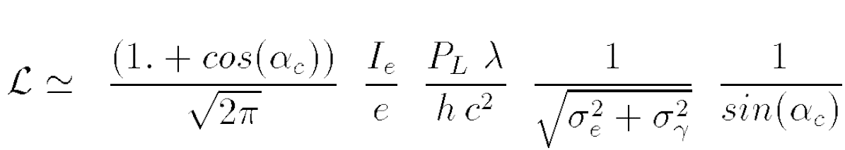
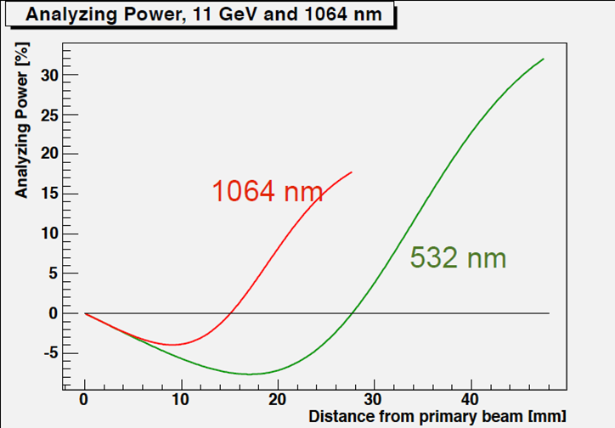
Compton Polarimeter

Slide 12
Typical parameters
From CDR Eq. 22
CDR Eq. 69
(
for Qweak)

Slide 13
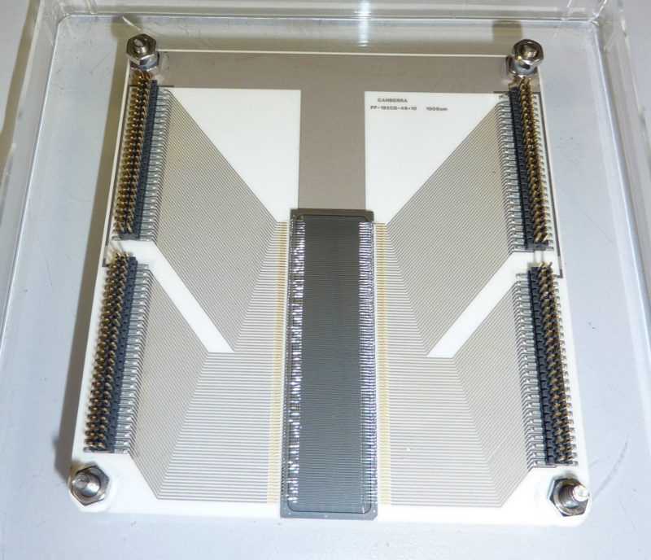
The electrons hit the detector (light grey strips on darker grey substrate) in a thin stripe (shown as orange)
In the real detector protoype there are 192 strips on a 46x10mm² detector, so each strip is about 0.240 mm wide
The width of the beam stripe is about 80 μm
The strips are 0.5 to 1 mm thick
(Not to scale)

Slide 14
for all three runs (344 PAC days)
for diamond
Assume
for silicon
Using these numbers I get a total dose of 27 Mrad per strip for both diamond and silicon (approximately twice that of Qweak detectors)
For the 1064 nm laser and 20kW power I get 108 Mrad

Slide 15
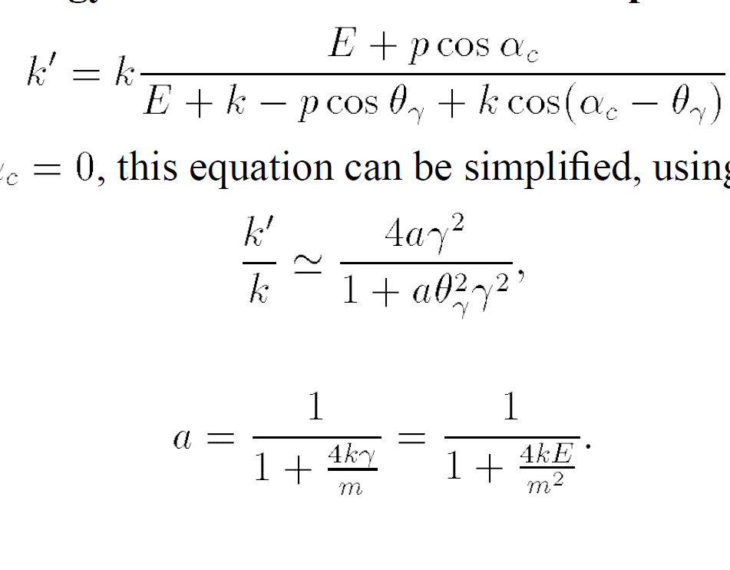
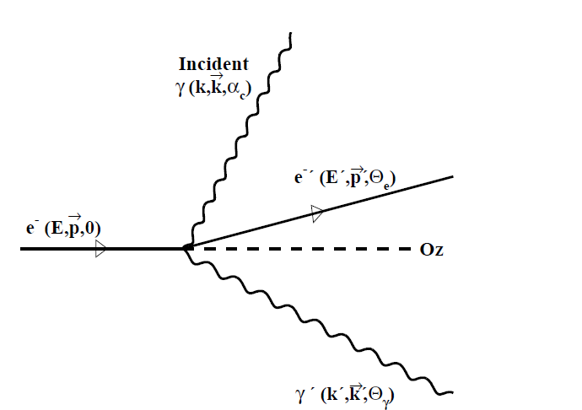
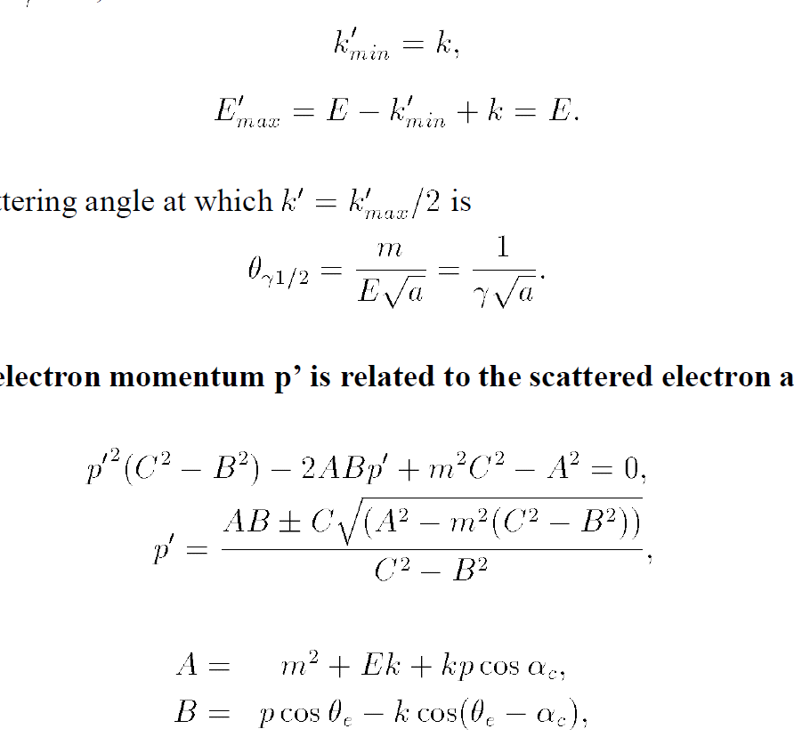
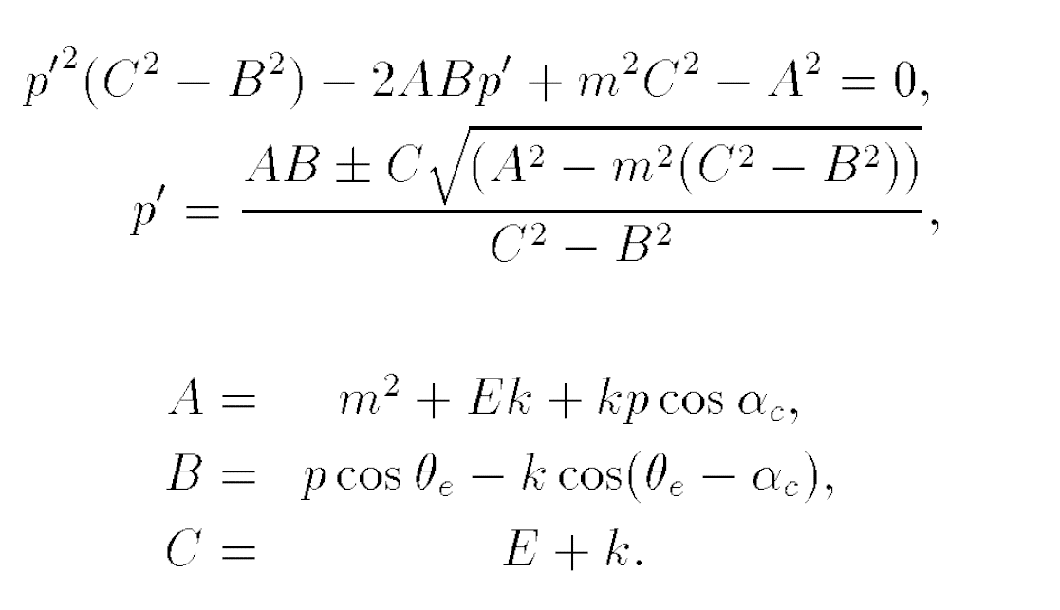
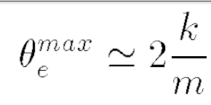
Kinematics of Compton Scattering

Slide 16
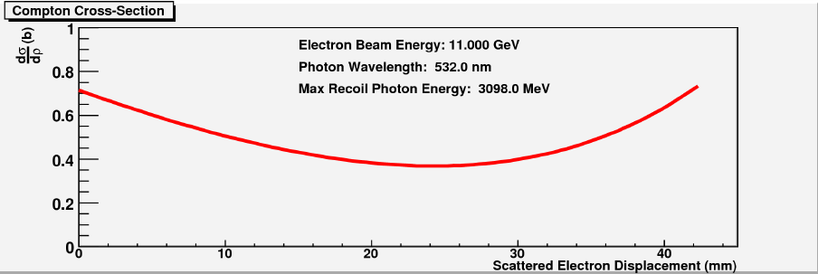
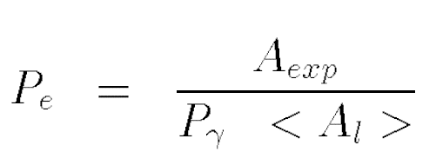
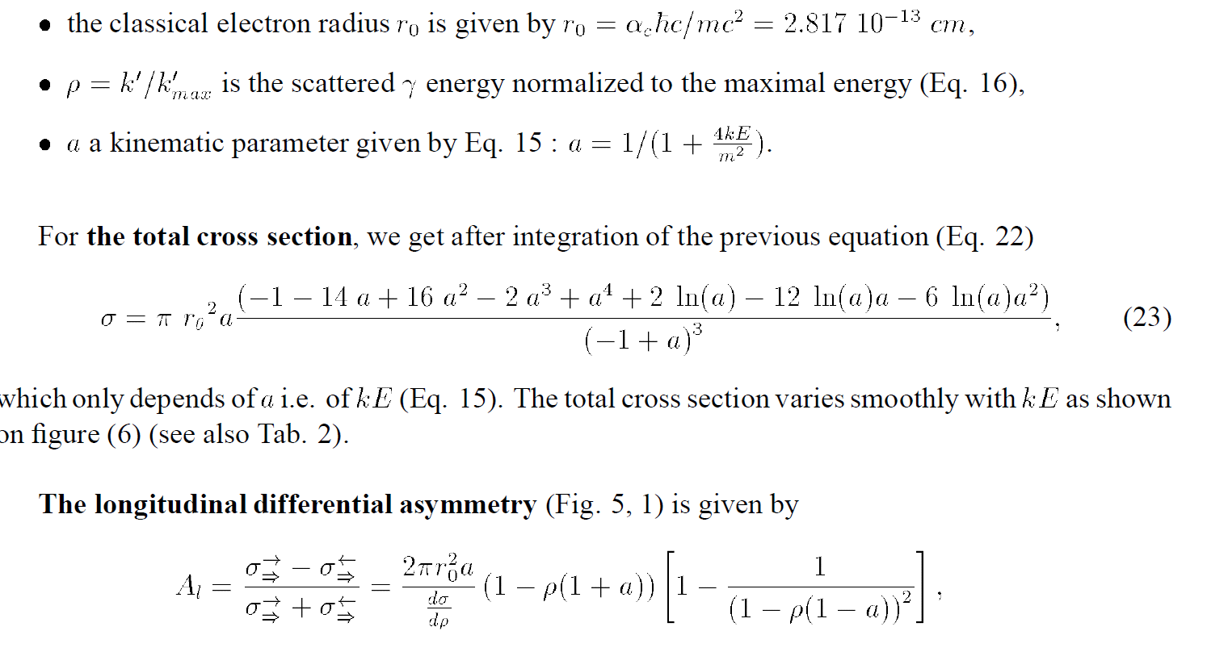
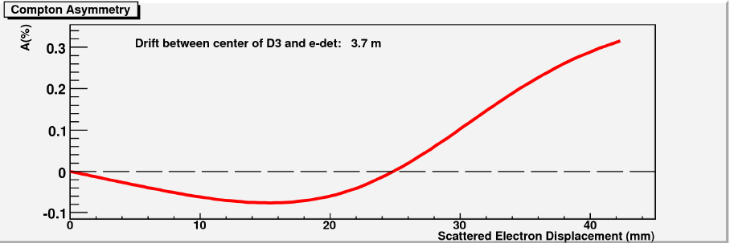
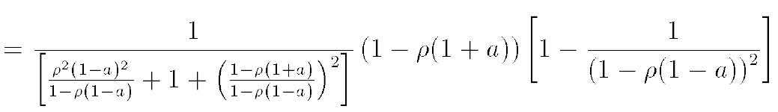
Compton asymmetry

Slide 17
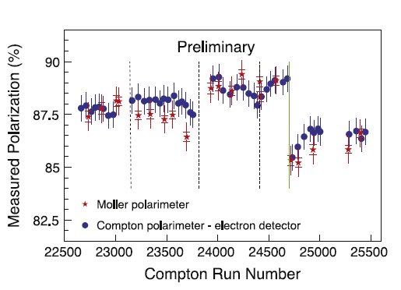
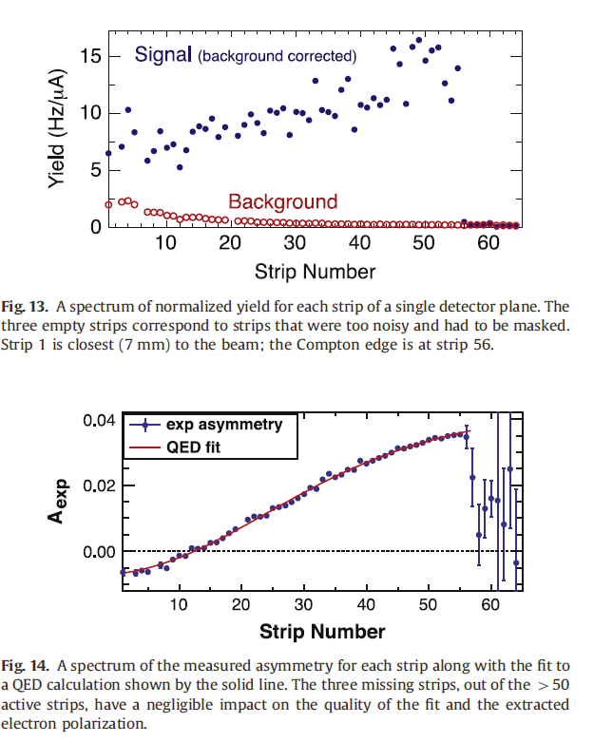
Precision Polarimetry

Slide 18
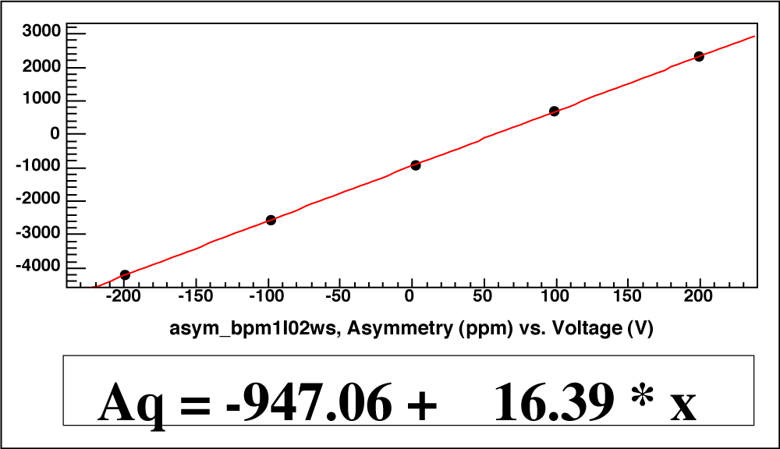
P I T A Effect
Polarization Induced Transport Asymmetry
Intensity asymmetry
Laser at Polarized Source
where
Transport Asymmetry
Scanning the Pockels Cell voltage = scanning the residual linear polarization (DoLP)
Perfect DoCP
Intensity Asymmetry (ppm)
Δ drifts, but slope is ~ stable Feedback on Δ
Pockels cell voltage Δ offset (V)

Slide 19
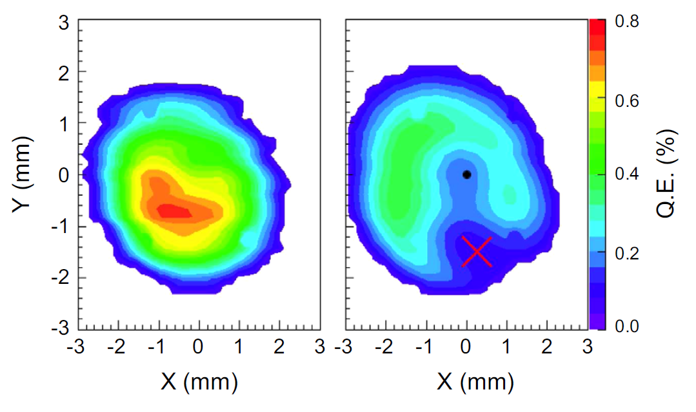
False asymmetries from helicity correlated beam properties

Slide 20
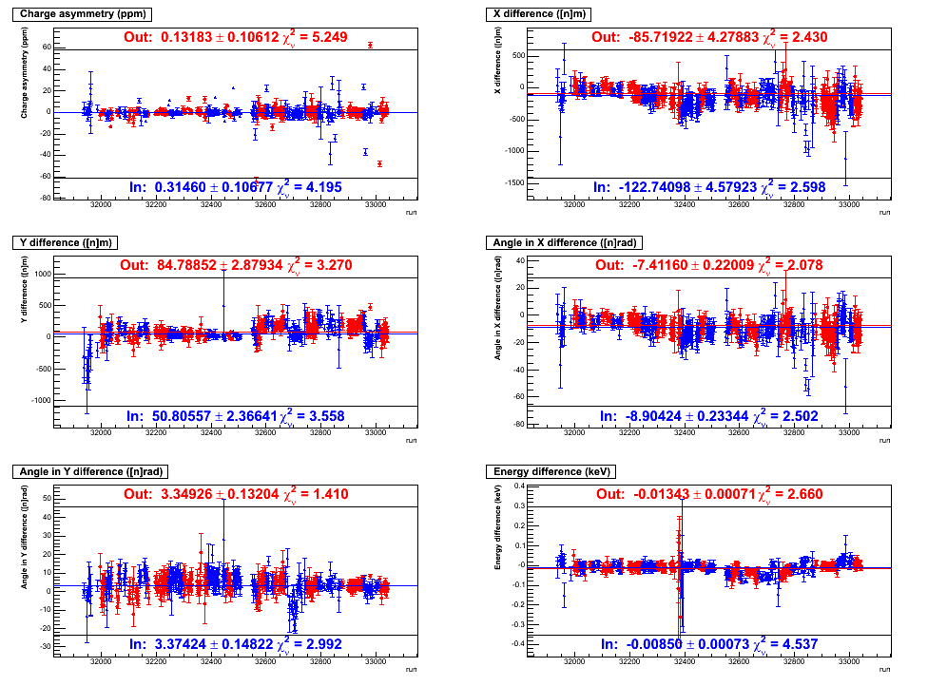
Polarized Beam Properties
During G0
Beam Parameter | Achieved (OUT-IN)/2 | “Specs”
charge asymmetry | 0.09 +/- 0.08 | 2 ppm
x position difference | -19 +/- 3 | 40 nm
y position difference | -17 +/- 2 | 40 nm
x angle difference | -0.8 +/- 0.2 | 4 nrad
y angle difference | 0.0 +/- 0.1 | 4 nrad
energy difference | 2.5 +/- 0.5 | 34 eV
Beam halo (out 6 mm) | < 0.3 x 10⁻⁶ | 10⁻⁶
w/ feedback
Δx (nm)
Charge Asymmetry
Δy (nm)
Δθ_{x} (nrad)
1 nm is one-billionth of a meter. The width of human hair is 50,000 nanometers!!!
Δθ_{y} (nrad)
ΔE (keV)
Run Number

Slide 21
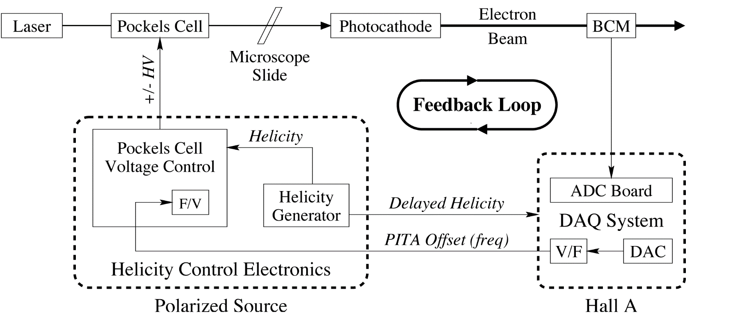
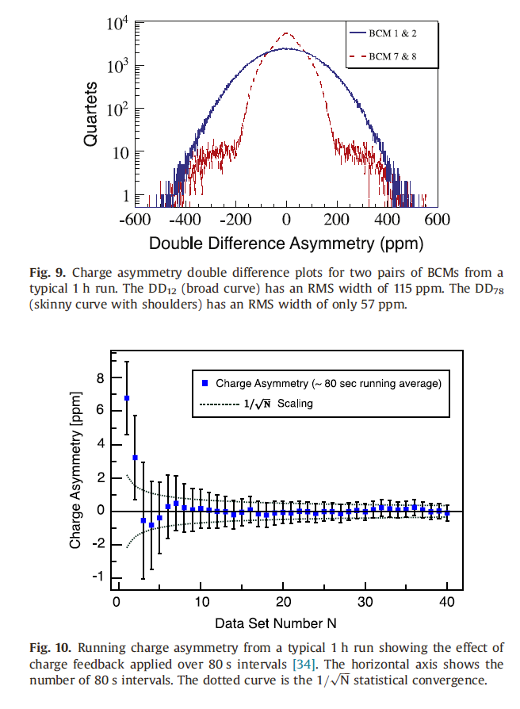
Intensity Feedback
Adjustments
for small phase shifts
to make close to
circular polarization
Low jitter and high accuracy allows sub-ppm
cumulative charge asymmetry in ~ 1 hour
28

Slide 22
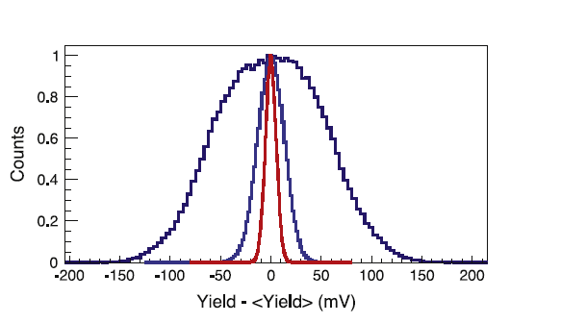

Charge normalization

Slide 23
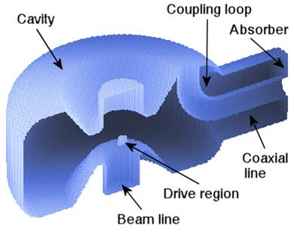
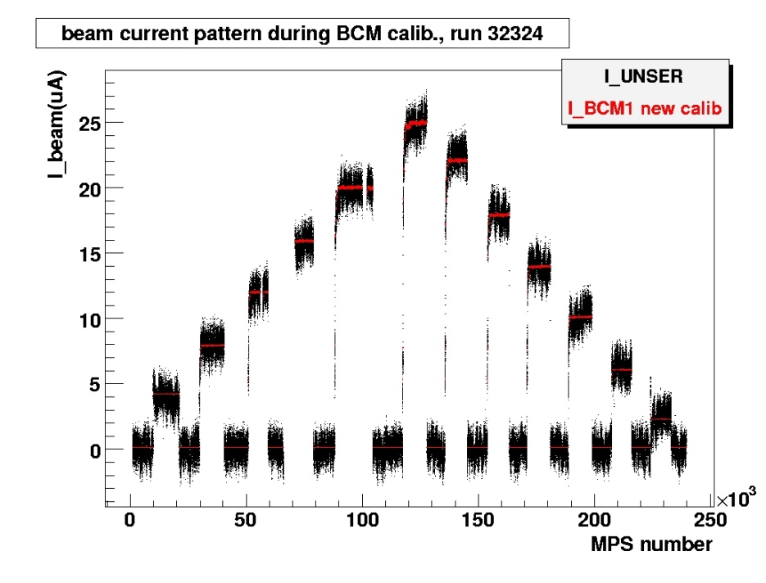
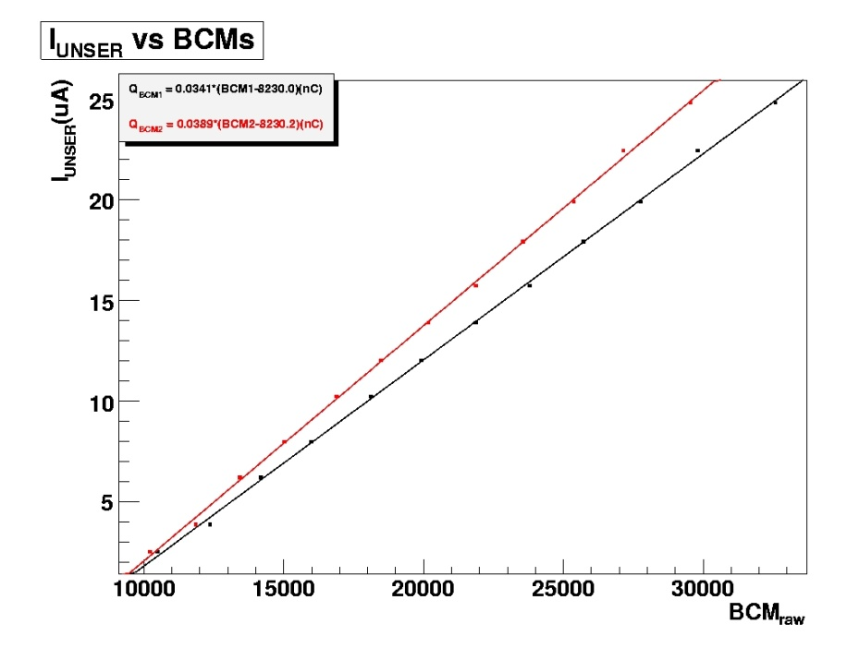
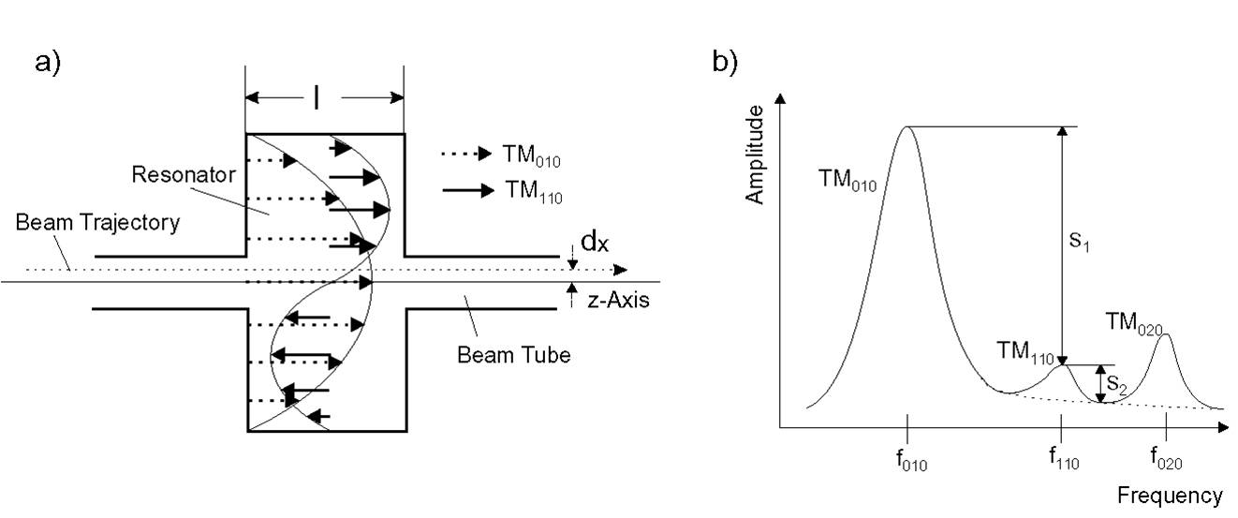
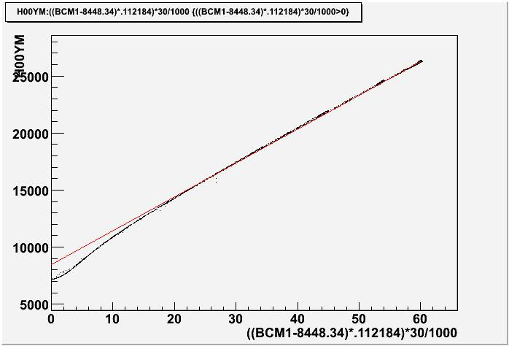
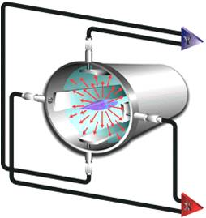
Beam Monitor Calibrations

Slide 24
Experimental Techniques to Reduce the Helicity-Correlation in the Beam
Careful alignment of the Pockels Cell
Steering Scan
Phase Gradient Scan
Intensity Asymmetry (IA) Cell
Rotatable Half Wave Plate (RHWP)
PITA Scan

Slide 25


Linear Regression
Just the sum of the parity-violating and helicity-correlated yields
Assume a linear relationship between
helicity-correlated yield and beam parameters
Correlation slopes, detector responses
This is the measured asymmetry
Making all of the above substitutions
yields this expression
Assume the parity-violating yield is much
bigger than the helicity-correlated yield and
substitute this into the above equation.

Slide 26
Linear Regression (cont…)
After some algebra, you get this really
cool expression, where
Beam parameter difference
Average yield
real asymmetry
false asymmetry due to helicity-correlated fluctuations
But we don’t know the slopes! We use
multiple linear regression to find them.

Slide 27

Multiple Linear Regression
Eliminate residual helicity correlations by correcting yields through linear regression
Just the change in yield due to
helicity-correlations.
Deviations of the measured yield and beam parameter from the means of their parent distributions
least-squares
method
6 equations & 6 unknowns
We can write this in matrix form and invert
to find the slopes

Slide 28
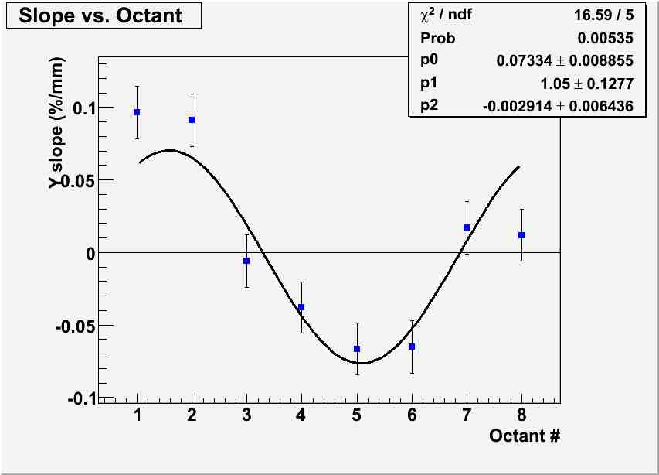

Dependence on Beam Motion
Simulation

Slide 29

Slopes from natural beam motion

Slide 30

Beam Modulation

Slide 31




Geometrical Symmetry
Transverse
Reduce sensitivity to beam fluctuations
k’
k
P_{e}
n
ˆ

Slide 32



Target
World’s highest power cryogenic target ~2.5 kW!
Designed with computational fluid dynamics (CFD) to reduce density fluctuations
46 ppm at 182 µA, 4x4 mm² raster!
Fluid velocity
Notes:
beam current 180 uA 35cm long

Slide 33


Target
Notes:
beam current 180 uA 35cm long

Slide 34



Target Studies

Slide 35



Raster synch

