Slide 1
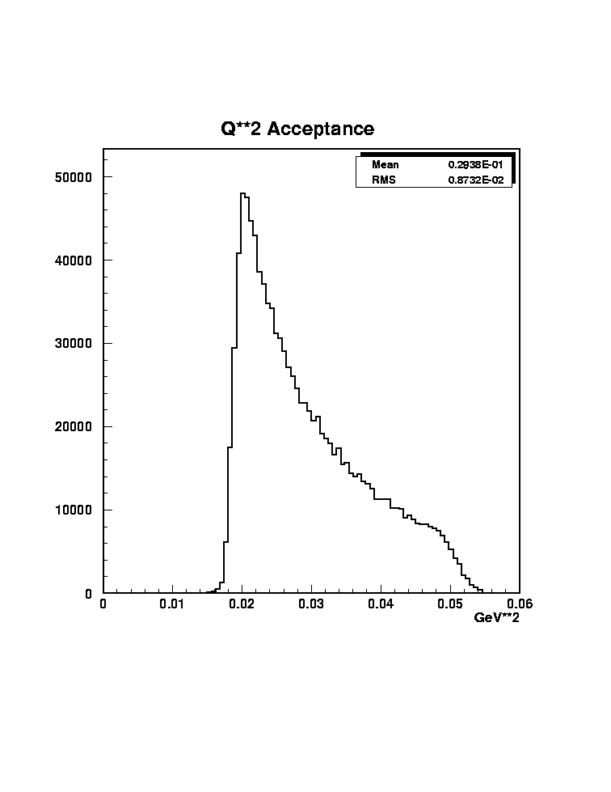
θ_{high,down}
θ_{low,down}
Finite Target Effects
R_{outer}
θ_{high,up}
θ_{low,up}
Assume 5.5 mrads at upstream end of target, instead of center
Collimator precision
Magnet stability
Tracking measurements
R_{inner}
Expected Q² distribution
z_{targ,up}
z_{targ,center}
z_{targ,down}
z_{coll} = | 590 | cm
z_{targ,up} = | -75 | cm
z_{targ,center} = | 0 | cm
z_{targ,down} = | 75 | cm
θ_{low} = | 5.5 | mrad
θ_{high} = | 17 | mrad
From center: |  |  |  | From downstream:
θ_{low,cen} = | 6.200 | mrads |  | θ_{low,down} = | 7.102 | mrads
θ_{high,cen} = | 19.161 | mrads |  | θ_{high,down} = | 21.950 | mrads
R_{inner} = | 3.658 | cm
R_{outer} = | 11.306 | cm

Slide 2
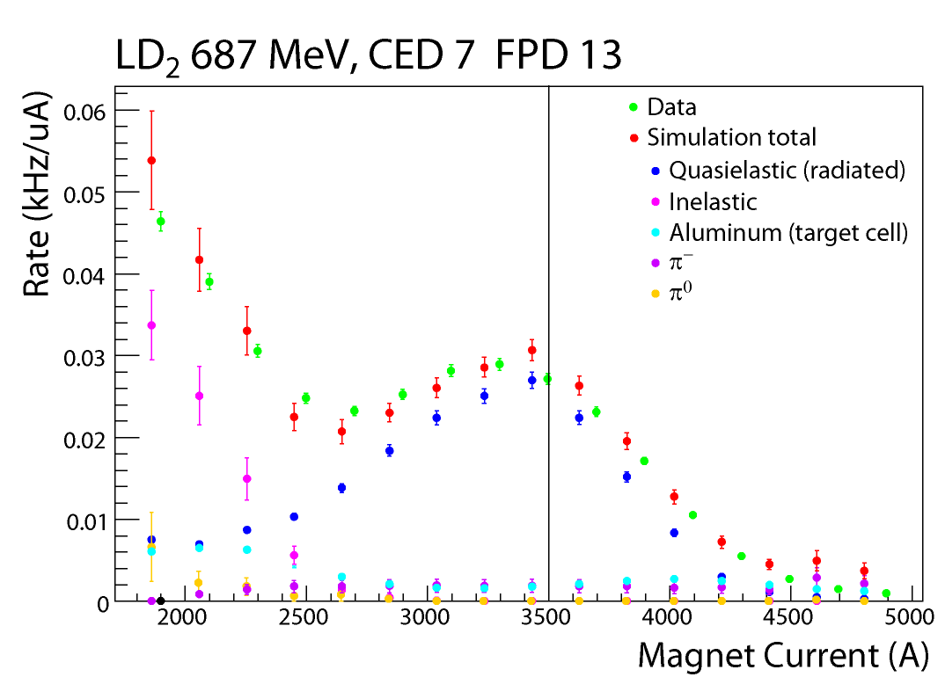
Background Corrections
G0

Slide 3
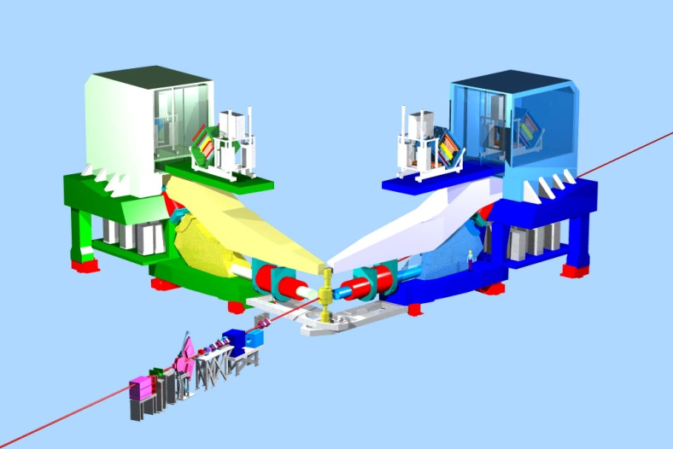
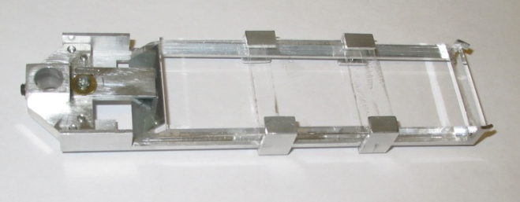
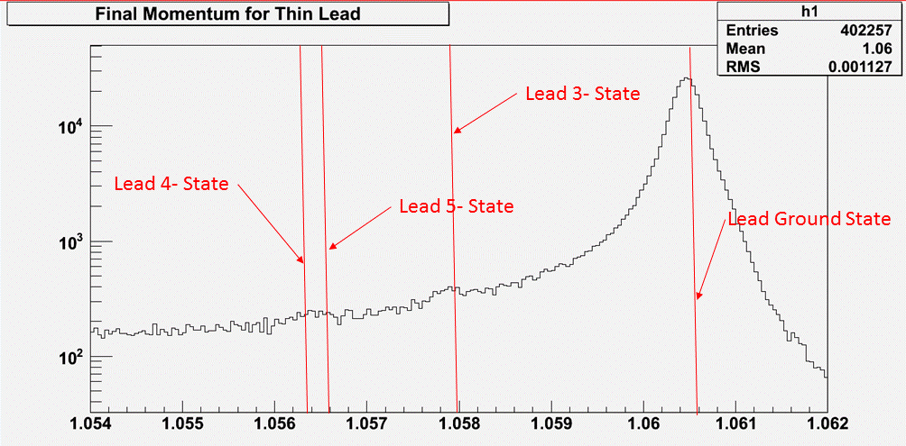
Hall A High Resolution Spectrometers
detector
elastic
inelastic
pure, thin ²⁰⁸Pb target
(2.6 MeV)
target
dipole
quads
Momentum (GeV/c)

Slide 4
Detectors
Different experiments used different detectors but they have similar requirements
The main detector and electronics have to be fast enough to record data on the timescale of the helicity signals
The entire electronics chain including the detectors must be as linear as possible
A set of tracking chambers is used to determine the acceptance

Slide 5
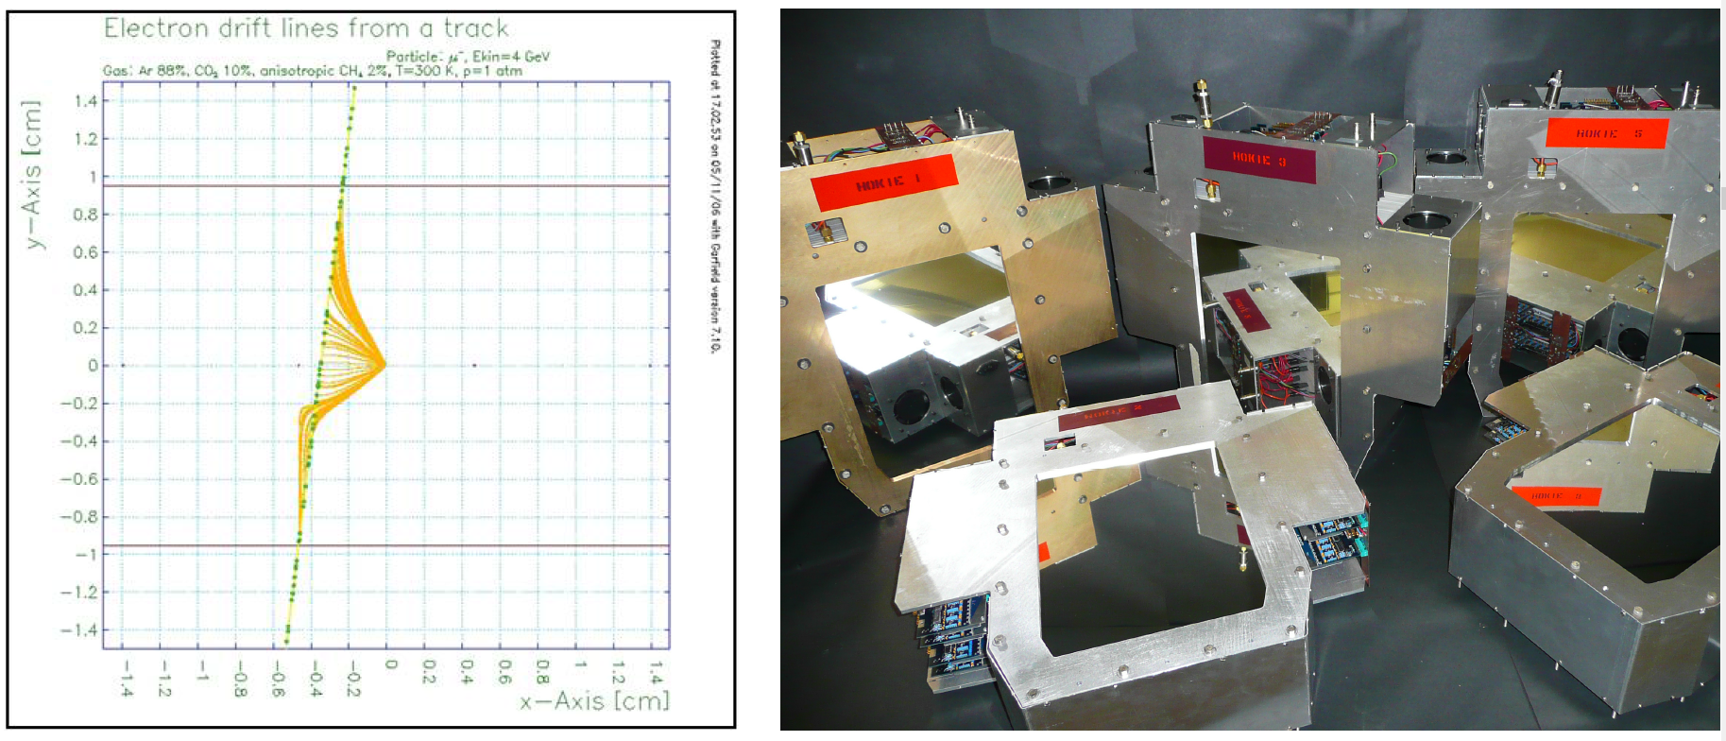
Drift Chambers

Slide 6
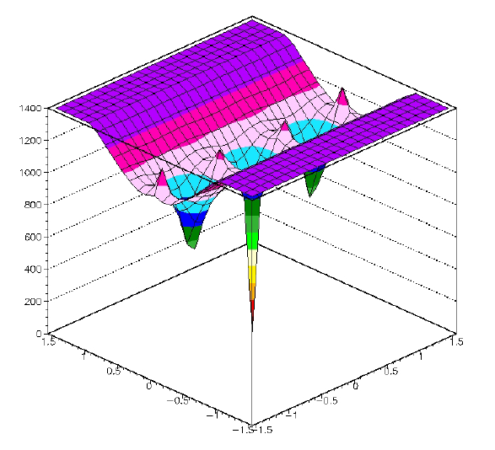
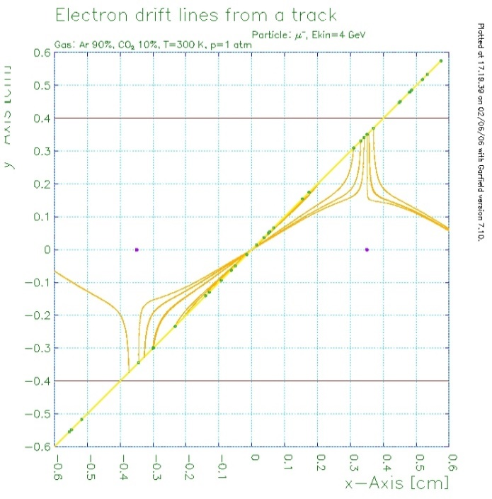
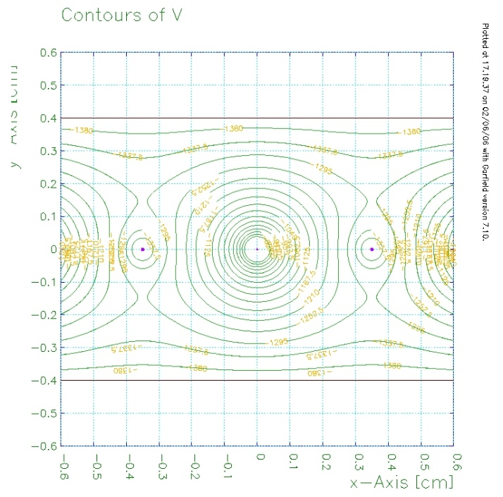
GARFIELD SIMULATIONS

Slide 7
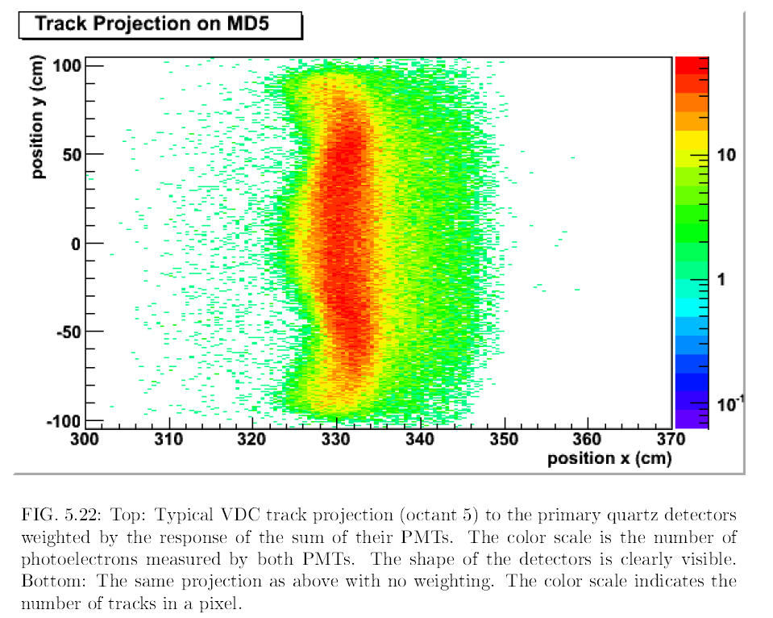
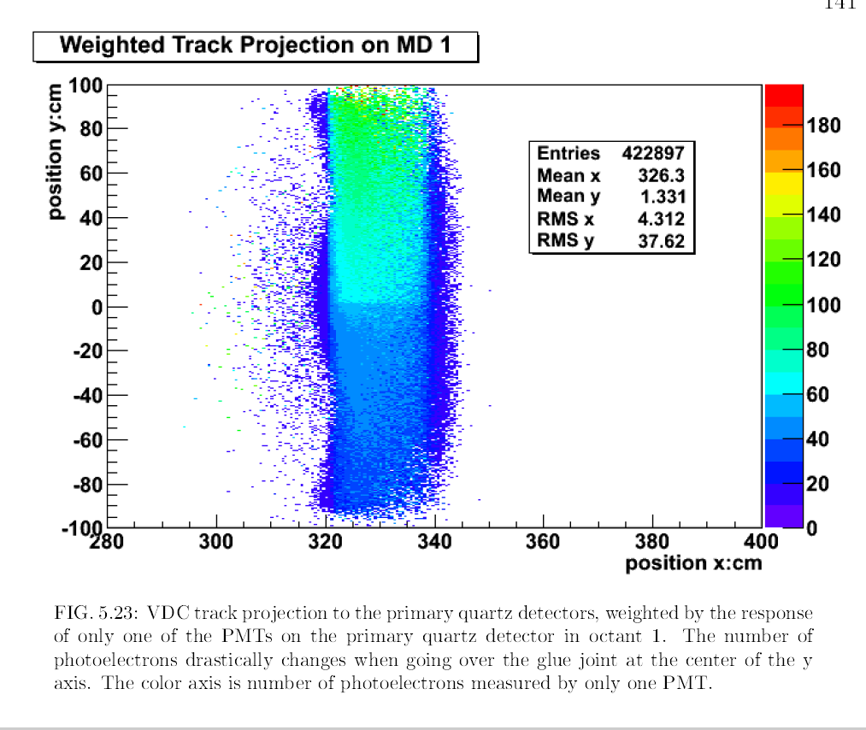
What could go wrong?

Slide 8
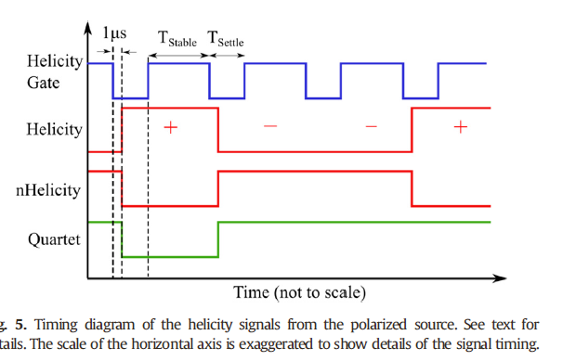
Pockell’s Cell Ringing

Slide 9
Scaler Counting Problem
Electronics sorts detector coincidences (CED_{i} and FPD_{j}) into separate scaler channels
  FPGA-based system in North American electronics (4 octants)
Because of error in FPGA programming, two short (~3 ns) pulses could be sent to scaler in < 7 ns
  ~ 1% of events have such miscounts
Data
Such pulse pairs can cause scaler to drop or add bits
  Detailed simulation of ASIC with propagation delays between (flip flop) elements
Effect on asymmetry is <0.01 A_{phys}
  Test by cutting data; compare with French octants
Simulation

Slide 10
PVES
Ancilliary measurements

Slide 11
Other measurements
Measurements made to understand the systematic uncertainties also have physics interest
Transverse asymmetries for signal reaction
Asymmetry of target backgrounds
  Carbon longitudinal
  Carbon transverse
  Aluminum longitudinal
  Aluminum transverse
Delta production/inelastic asymmetries
Pion production asymmetries
Measurements at non-optimal energies for main experiment

Slide 12
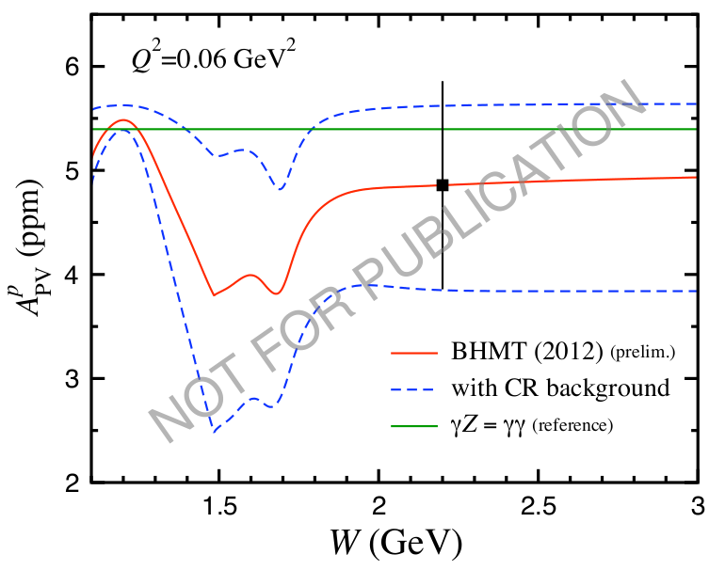
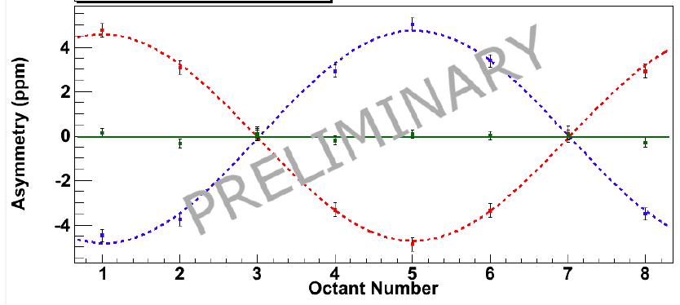
Ancillary Measurements
Proton elastic transverse asymmetry (2-photon exchange)
Nuclear elastic transverse asymmetries (Coulomb distortion)
N→Δ PV measurement at 2 beam energies
Transverse asymmetry in Δ production at 2 beam energies
Non-resonant inelastic PV measurement (γZ box diagram)
Non-resonant inelastic transverse asymmetry
PV asymmetries in pion photoproduction at 3.3 GeV
Transverse asymmetries in pion photoproduction at 3.3 GeV
Non-resonant inelastic PV measurement
Proton elastic transverse asymmetry

Slide 13
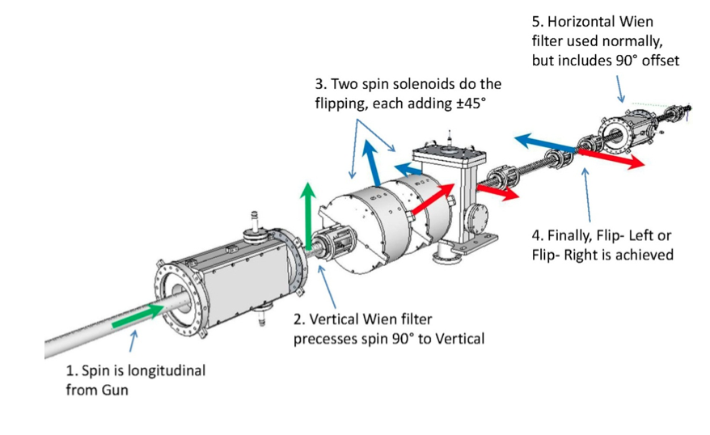
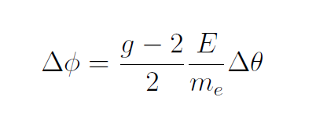
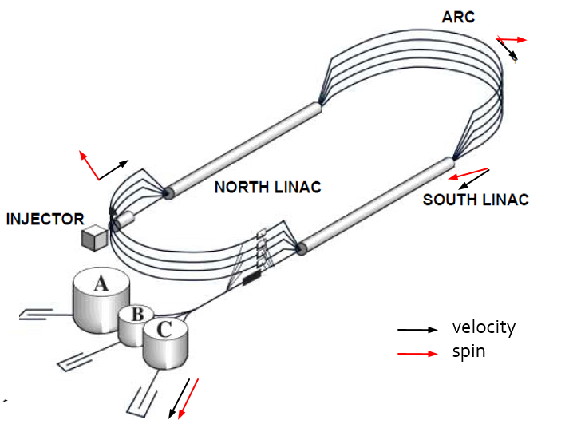
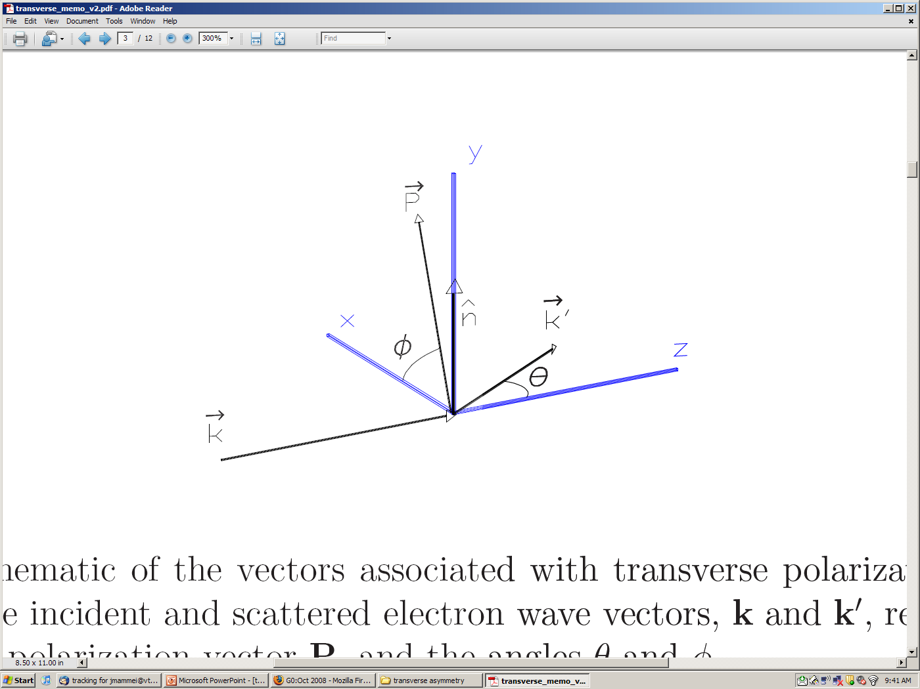
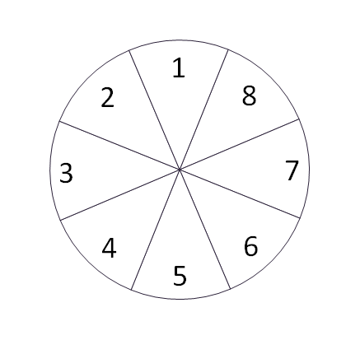
Transverse Polarization
P_{e}
k’
n
ˆ
Notes:
As mentioned earlier the beam normal single spin asymmetries arise because of the interference of two photon exchange with that of single photon exchange. The asymmetry varies as a function of octant because it depends on the direction of the polarization relative to the normal to the scattering plane. For example if an electron is scattered into octant 1, the normal is toward octant 7. Since the asymmetry itself is negative and the dot product produces another negative, the measured asymmetry should be positive in octant 1. Likewise, for an electron scattered into octant 7, the normal is perpendicular to the polarization, so the asymmetry should be 0 in this octant. Indeed this is what we see in the data.
A_n <0
LHS -> octant 1 should be maximum and positive
RHS -> octant 1 (phi=90) should be maximum and positive

Slide 14
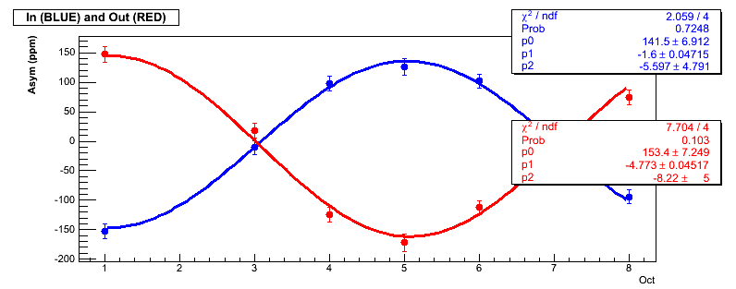
Transverse Parity-conserving Asymmetry
P_{e}
k’
n
ˆ
Notes:
As mentioned earlier the beam normal single spin asymmetries arise because of the interference of two photon exchange with that of single photon exchange. The asymmetry varies as a function of octant because it depends on the direction of the polarization relative to the normal to the scattering plane. For example if an electron is scattered into octant 1, the normal is toward octant 7. Since the asymmetry itself is negative and the dot product produces another negative, the measured asymmetry should be positive in octant 1. Likewise, for an electron scattered into octant 7, the normal is perpendicular to the polarization, so the asymmetry should be 0 in this octant. Indeed this is what we see in the data.
A_n <0
LHS -> octant 1 should be maximum and positive
RHS -> octant 1 (phi=90) should be maximum and positive

Slide 15
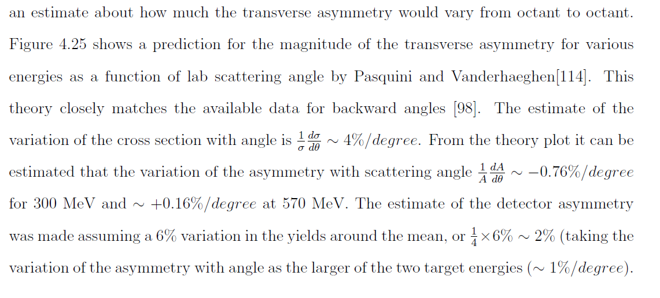




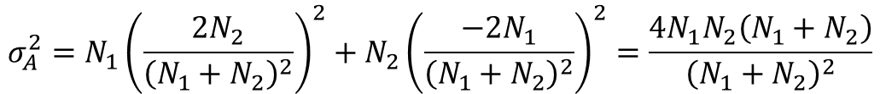
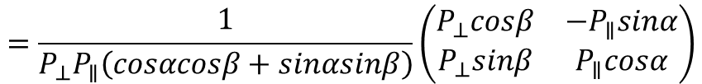
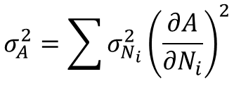


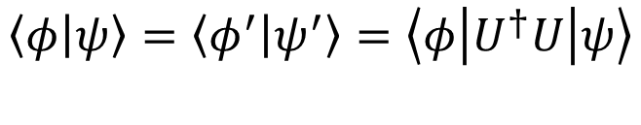
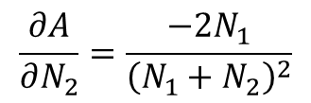
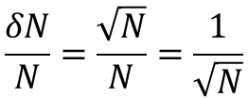
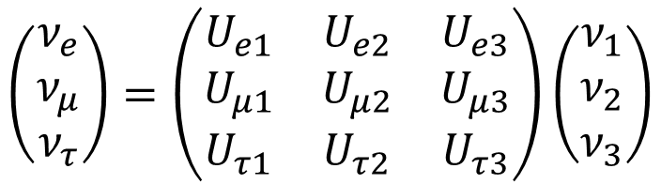

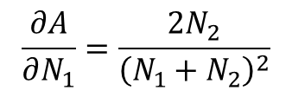
Transverse Correction
$$\frac{A_{m}^{∥}}{P_{∥}}=A_{PV}cosα+ε\left(φ\right)sinα$$
$$⟹$$
$$\left(\begin{matrix}A_{m}^{∥} \\ A_{m}^{⊥}\end{matrix}\right)=\left(\begin{matrix}P_{∥}cosα & P_{∥}sinα \\ {−P}_{⊥}sinβ & P_{⊥}cosβ \end{matrix}\right)\left(\begin{matrix}A_{PV} \\ ε\left(φ\right)\end{matrix}\right)$$
$$\frac{A_{m}^{⊥}}{P_{⊥}}=ε\left(φ\right)cosβ−A_{PV}sinβ$$
$$P=\left(\begin{matrix}a & \text{b} \\ c & d\end{matrix}\right)$$
$$P^{−1}=\frac{1}{detP}\left(\begin{matrix}d & \text{−}\text{b} \\ −c & a\end{matrix}\right)=\frac{1}{ad−cb}\left(\begin{matrix}d & \text{−}\text{b} \\ −c & a\end{matrix}\right)$$
$$\hat{y}$$
$$=\frac{1}{P_{⊥}P_{∥}\left(cosαcosβ+sinαsinβ\right)}\left(\begin{matrix}P_{⊥}cosβ & −P_{∥}sinα \\ P_{⊥}sinβ & P_{∥}cosα\end{matrix}\right)$$
$$\hat{x}$$
$${\overset{⃑}{P}}_{∥}$$
$$\hat{z}$$
$$β$$
$$α$$
$$=\left(\begin{matrix}\frac{cosβ}{P_{∥}cos\left(α−β\right)} & \frac{−sinα}{P_{⊥}cos\left(α−β\right)} \\ \frac{sinβ}{P_{∥}cos\left(α−β\right)} & \frac{cosα}{P_{⊥}cos\left(α−β\right)}\end{matrix}\right)$$
$${\overset{⃑}{P}}_{⊥}$$

Slide 16
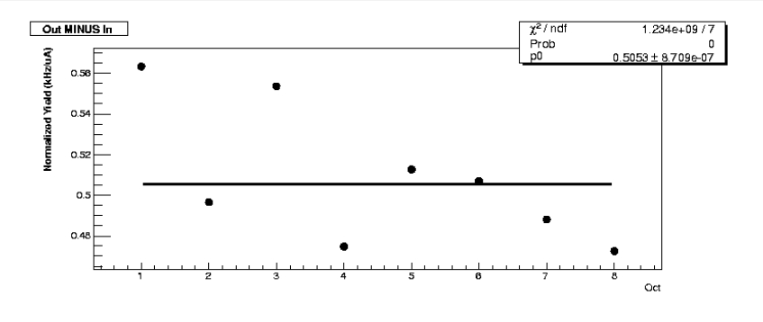
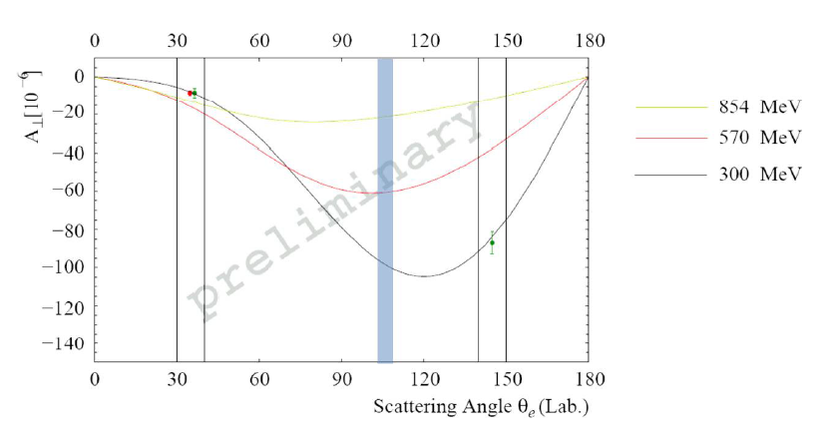
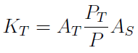

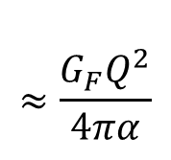
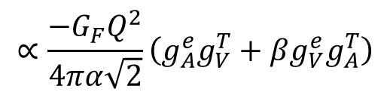
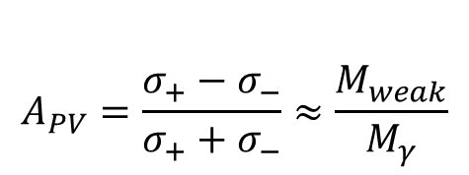
Transverse Correction (cont…)
$$\left(\begin{matrix}A_{PV} \\ ε\left(φ\right)\end{matrix}\right)=\left(\begin{matrix}\frac{cosβ}{P_{∥}cos\left(α−β\right)} & \frac{−sinα}{P_{⊥}cos\left(α−β\right)} \\ \frac{sinβ}{P_{∥}cos\left(α−β\right)} & \frac{cosα}{P_{⊥}cos\left(α−β\right)}\end{matrix}\right)\left(\begin{matrix}A_{m}^{∥} \\ A_{m}^{⊥}\end{matrix}\right)$$
$$A_{PV}=\frac{A_{m}^{∥}cosβ}{P_{∥}cos\left(α−β\right)}−\frac{A_{m}^{⊥}sinα}{P_{⊥}cos\left(α−β\right)}$$
$$P_{∥}\sim P_{⊥}$$
$$=\frac{A_{m}^{∥}}{P}−\frac{A_{m}^{⊥}sinα}{P}$$

Slide 17
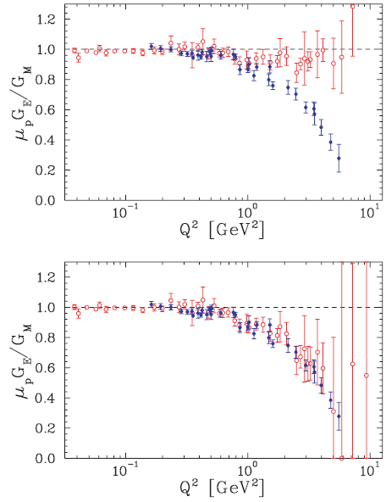
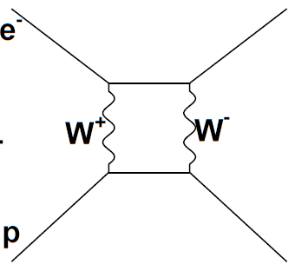
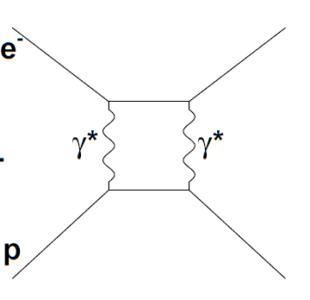
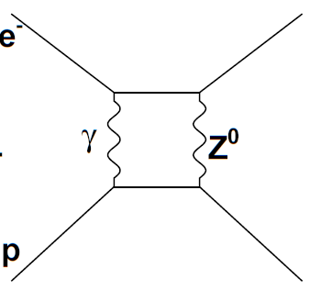
The G^{p}_{E}/ G^{p}_{M} Puzzle – 2γ Exchange Effects
Inclusion of the real part of the
2γ exchange in the cross section
may account for the difference
between measurements of G_{E}/G_{M}
from unpolarized cross section and polarization transfer measurements
without 2PE contributions
Arrington, Melnitchouk, Tjon Phys. Rev. C 76, 035205 (2007)
Understanding the transverse asymmetries tests the theoretical framework that calculates the contribution of γZ and W⁺W⁻ box diagrams that are important corrections to precision electroweak measurements
with 2PE contributions
Notes:
Now I will switch gears to talk about the transverse asymmetry measurement. The ratio of the electric to magnetic form factor of the proton has been measured as a function of Q2 using two different methods – unpolarized cross section measurements, and polarization transfer measurements, which clearly don’t agree. It turns out that the explanation comes from two photon exchange corrections that need to be taken into account in the unpolarized cross section measurements.
The measurement of the transverse asymmetries measures the imaginary part of two photon exchange. Understanding the formalism that calculates this effect will also test the theoretical framework that calculates other two boson exchange diagrams.

Slide 18
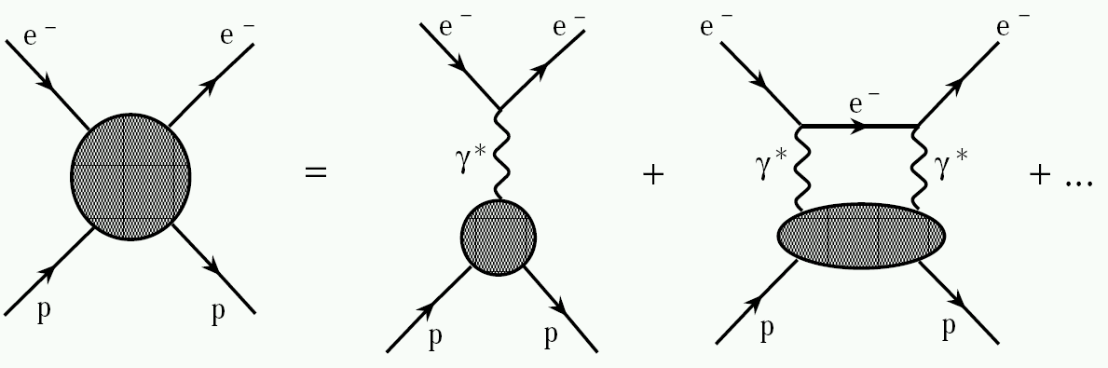
Transverse Analyzing Power
contain intermediate hadronic state information
virtual photon polarization parameter
Notes:
As mentioned earlier the beam normal single spin asymmetries arise because of the interference of two photon exchange with that of single photon exchange. The asymmetry varies as a function of octant because it depends on the direction of the polarization relative to the normal to the scattering plane. For example if an electron is scattered into octant 1, the normal is toward octant 7. Since the asymmetry itself is negative and the dot product produces another negative, the measured asymmetry should be positive in octant 1. Likewise, for an electron scattered into octant 7, the normal is perpendicular to the polarization, so the asymmetry should be 0 in this octant. Indeed this is what we see in the data.
A_n <0
LHS -> octant 1 should be maximum and positive
RHS -> octant 1 (phi=90) should be maximum and positive

Slide 19
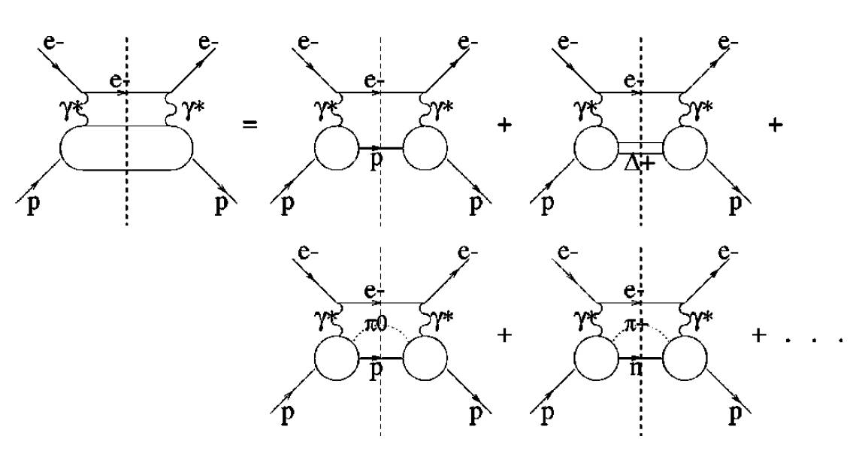
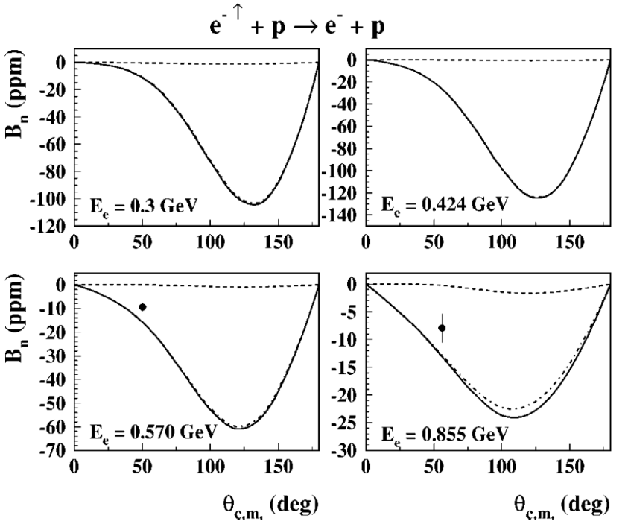
Predictions
Threshold region: HBχPT
L. Diaconescu & M.J. Ramsey-Musolf, Phys. Rev. C70, 054003 (2004)
Resonance region: moderate energy
B. Pasquini & M. Vanderhaeghen, Phys. Rev. C70, 045206 (2004)
High energy forward scattering region: diffractive limit
Afanasev & Merenkov, Phys. Lett. B599, 48 (2004)
Gorchtein, Phys. Lett. B644, 322 (2007)
Hard scattering region: GPDs (Generalized Parton Distributions)
M. Gorchtein, P.A.M. Guichon, M. Vanderhaeghen, Nuc.Phys. A 741:234-248,2004
N
π N
Sum
The predictions of the asymmetry are sensitive to the physics of the
intermediate hadronic state in the 2γ exchange amplitude
“It will be interesting to check that for backward angles, the beam normal SSA indeed grows to the level of tens of ppm in the resonance region.”
Notes:
There are predictions for these asymmetries in various kinematic regimes. The theory relevant to the backward angle G0 kinematics is the resonance region. The predictions are sensitive to the treatment of the intermediate hadronic state. In the plot the asymmetry is almost entirely due to the piN intermediate states, and seems to agree with previous measurements at backward angle. The authors note that it will be interesting to see if the asymemtries do get large.

Slide 20
Analysis Overview
Blinding
Factors
(.75-1.25)
H, D Raw Asymmetries
A_{meas}
Corrections:
Scaler Counting Correction
Rate Corrections from Electronics
Helicity Correlated Corrections
Beam Polarization
Background Asymmetry
Unblind
Transverse Asymmetries
Sinusoidal fit
Notes:
The analysis chain is similar to that of the main measurement. A sinusoidal fit is used to extract the amplitude which is the size of the asymmetry.

Slide 21
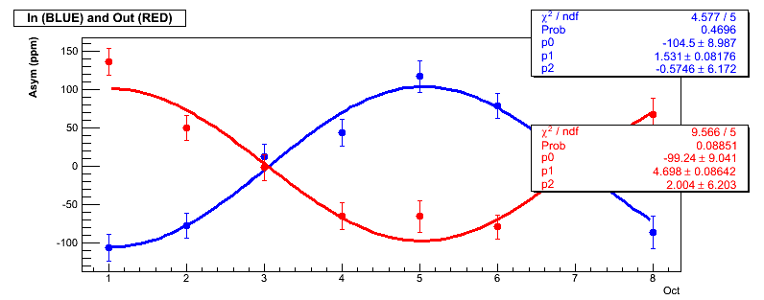
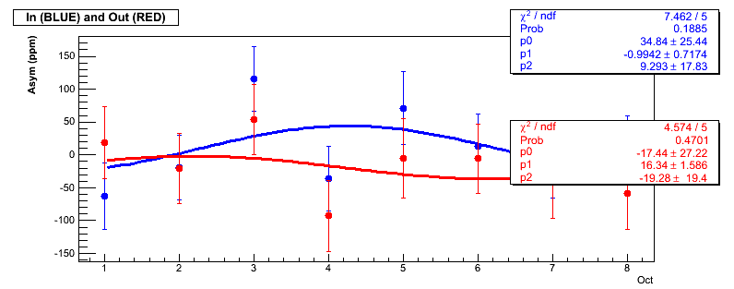
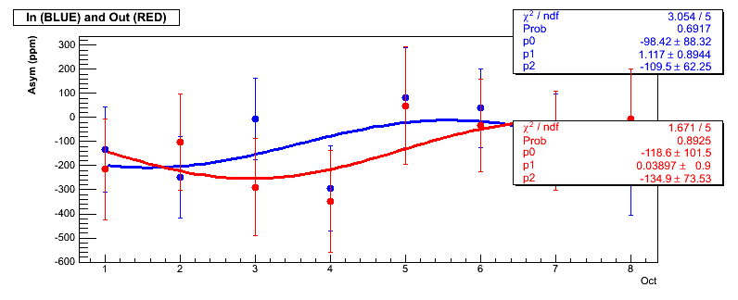
Data Summary
G0 Backward, Transverse:
<θ_{lab}> ~ 108° for all
a total of
~50 hours of beam
Target | Energy (MeV) | Q² (GeV²/c²) | Amount of Data C IN / C OUT
H | 358.8 ± 0.5 | 0.222 ± 0.001 | 1.77 / 1.88
D | 359.5 ± 0.7 | 0.219 ± 0.001 | 1.00 / 1.10
H | 681.7 ± 0.9 | 0.626 ± 0.003 | 1.42 / 1.20
D | 685.9 ± 0.9 | 0.630 ± 0.003 | 0.08 / 0.06
Free fits of the form
PAVI 09 Bar Harbor, ME
Notes:
This is a summary of the data and the relative quality of the low energy data. We didn’t take enough data at the high energy.

Slide 22
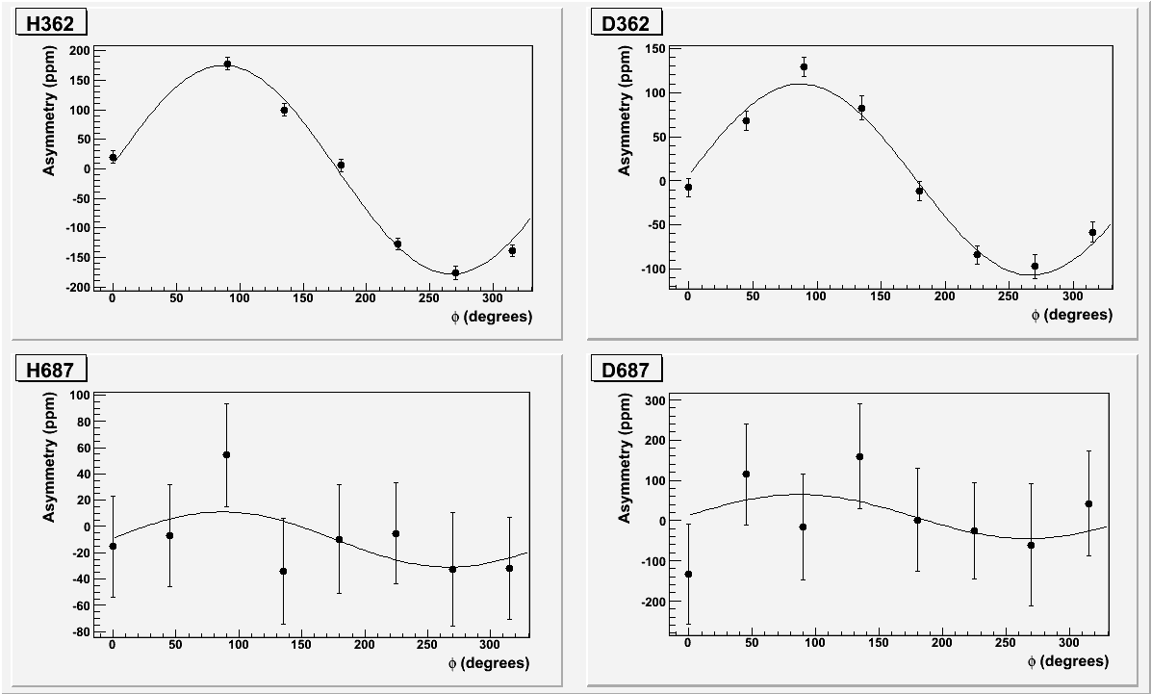
e⁻ Transverse Asymmetries
A=176.2 ± 8.3 ppm
A=108.6 ± 7.4 ppm
A=21.0 ± 23 ppm
A=55.2 ± 78 ppm
Fits of the form
, where = 2.3°
Notes:
The fully corrected asymmetries as a function of phi. The fits have a fixed phase of 2.3 degrees.

Slide 23
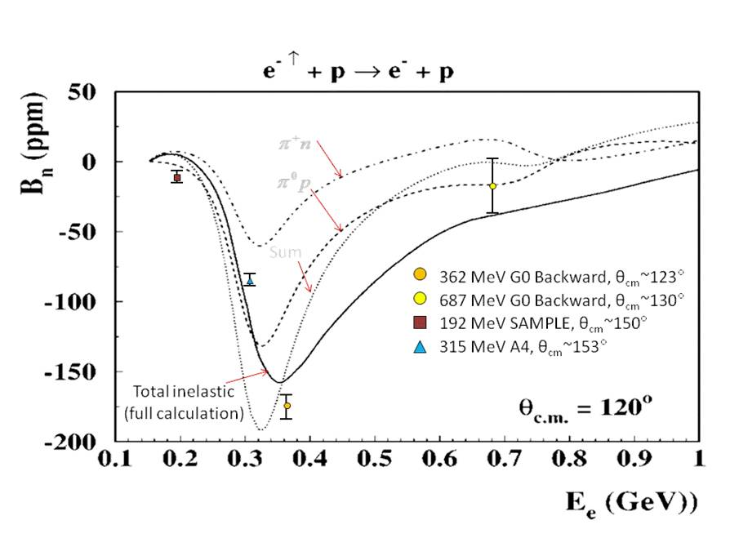
Transverse Results for the Proton
Notes:
Hydrogen results compared to the prediction.

Slide 24
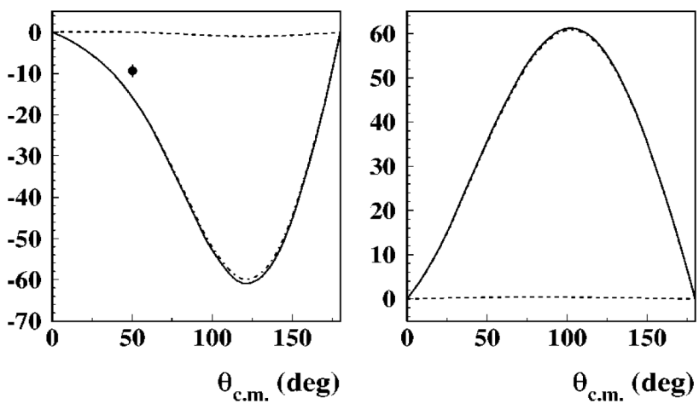
Transverse Results for the Deuteron
In the quasi-static approximation:
362 MeV:
= 23 µb/sr
= 8 µb/sr
687 MeV:
= 2.6 µb/sr
= 1.1 µb/sr
p
n
Energy | Asymmetry (ppm)
 | Neutron (estimated) | Proton
362 MeV | 86 ± 41 | -176.2 ± 9.4
687 MeV | -136 ± 267 | -21 ± 24
E_{beam} =570MeV
Notes:
Estimates of the neutron asymmetry using the deuterium measurement.

Slide 25
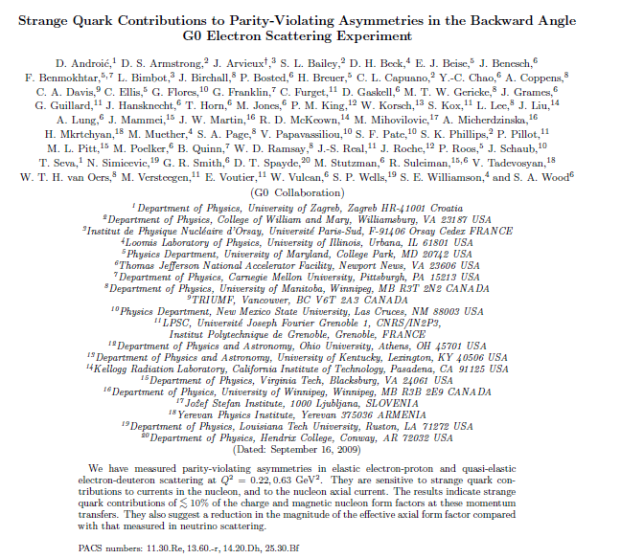
Notes:
The backward angle G0 results have been published in PRL.

Slide 26
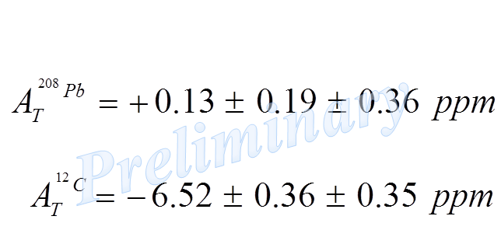
Transverse Asymmetry
A_{T} can be a systematic
error for asymmetric
acceptances
P_{e}
n
k_{e}’
ˆ
k_{e}’
n
LHRS
ˆ
RHRS
Also an interesting independent physics result:
Surprisingly small A_{T} for ²⁰⁸Pb
A_{T} for ¹²C qualitatively consistent
with ⁴He and available calculations
(1) Afanasev ; (2) Gorchtein & Horowitz
Notes:
As mentioned earlier the beam normal single spin asymmetries arise because of the interference of two photon exchange with that of single photon exchange. The asymmetry varies as a function of octant because it depends on the direction of the polarization relative to the normal to the scattering plane. For example if an electron is scattered into octant 1, the normal is toward octant 7. Since the asymmetry itself is negative and the dot product produces another negative, the measured asymmetry should be positive in octant 1. Likewise, for an electron scattered into octant 7, the normal is perpendicular to the polarization, so the asymmetry should be 0 in this octant. Indeed this is what we see in the data.
A_n <0
LHS -> octant 1 should be maximum and positive
RHS -> octant 1 (phi=90) should be maximum and positive

Slide 27

Transverse Asymmetries

