Slide 1
3D Animations for Exploring Nucleon Structure
Waverly Gorman
HUGS 2016

Slide 2
Outline
The Problem
The Solution
Quark Orbital Angular Momentum
Transverse Single-Spin Asymmetry
Conclusion

Slide 3
Problem
Challenging to pretend that a water bottle represents a nucleon, or a quark, or a gluon
Representing 3D processes with compilations of 2D images

Slide 4
Solution
3D computer animations using Blender (free and open source!)
https://www.blender.org/
Awarded the Jefferson Science Associates Minority/Female Undergraduate Research Assistantship
https://www.jlab.org/news/stories/nmsu-undergrad-receives-jsa-research-assistantship

Slide 5
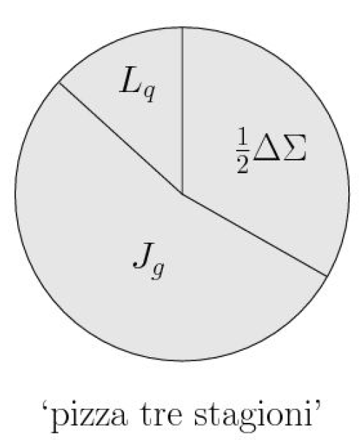
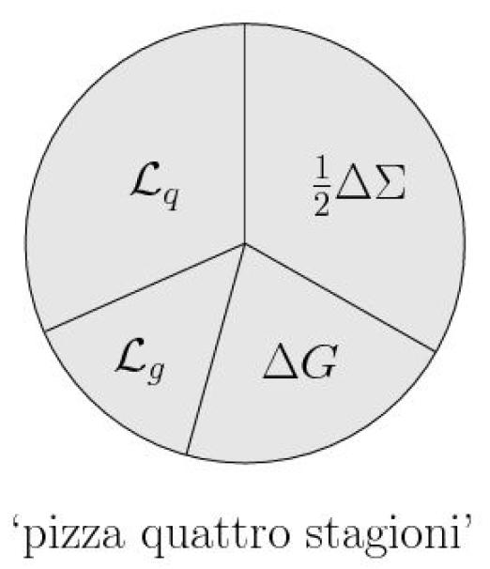
Quark Orbital Angular Momentum
Spin of the nucleon
Ji decomposition
Jaffe-Manohar decomposition

Slide 6
Quark Orbital Angular Momentum
Spin of the nucleon
Ji decomposition
Jaffe-Manohar decomposition

Slide 7
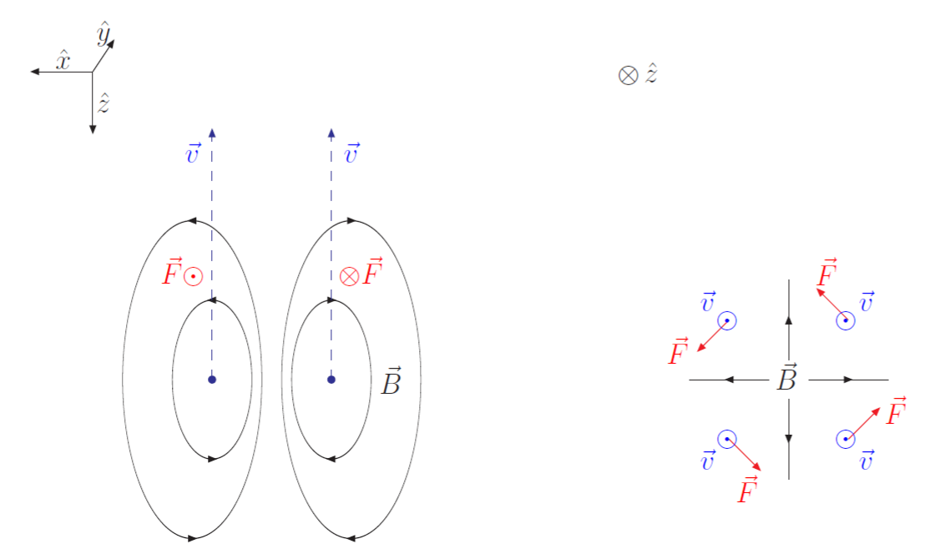
Quark Orbital Angular Momentum
Example:
Torque in magnetic dipole field

Slide 8
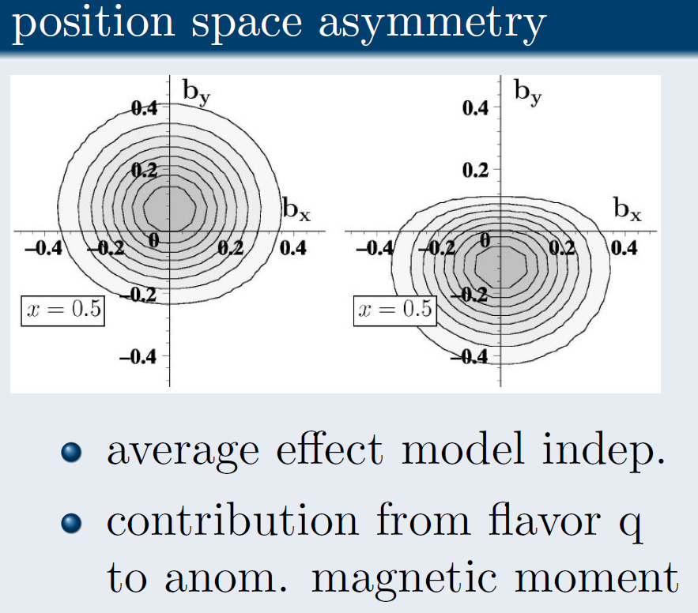
Transverse Single-Spin Asymmetry
(See lectures by M. Diehl)

Slide 9
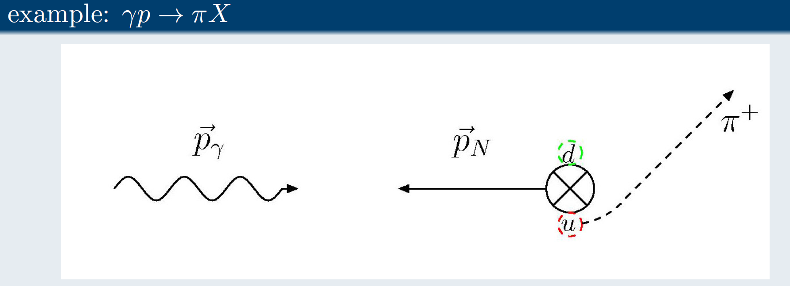
Transverse Single-Spin Asymmetry

Slide 10
Conclusion
Created 3D animations, using Blender, of mechanisms for determining nucleon structure
Quark OAM
Transverse SSA
3D animations are complicated, but worthwhile in the end
2 semesters of work produced 2 movies (but now I am faster)

Slide 11
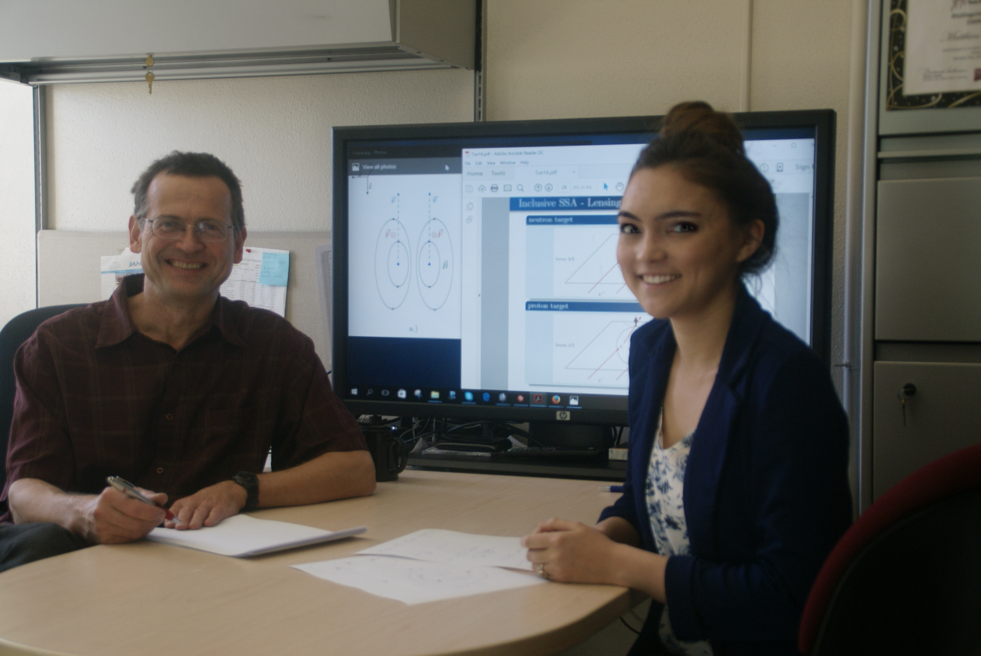
Acknowledgments

