Slide 1
9125B ET Photomultiplier Tubes with a Wavelength Shifting Paint for a Gas Cherenkov Counter
Scott Barcus¹, Bogdan Wojtsekhowski², Todd Averett¹
1: The College of William and Mary
2: Thomas Jefferson National Accelerator Facility
HUGS June 17 2016
1

Slide 2
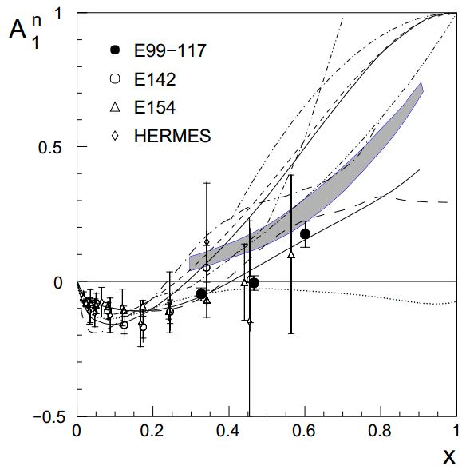
Polarization of Quark in Polarized Neutron (A₁^{n} )
Precision measurement of the neutron virtual photon asymmetry in the deep inelastic scattering (DIS) region.
Previously measured up to x_{Bj}=0.6.
Experiment will measure up to x_{Bj}=0.71 at 6.6 and 8.8 GeV beam energies.
Constrain theoretical predictions.
Relativistic Constituent Quark Model (RCQM) and perturbative QCD (pQCD) predict as x_{Bj} goes to one A₁^{n} will also approach unity.
Direct comparison of pQCD theory and experiment.
Study importance of quark orbital angular momentum.
HUGS June 17 2016
2
Notes:
-A₁^{n} became positive around x_{Bj} =0.5.
-Expect A₁^{n} to approximately double from x=0.6 to x=0.71.
-Shaded area is RQCM prediction.
-pQCD upper solid line.
2

Slide 3
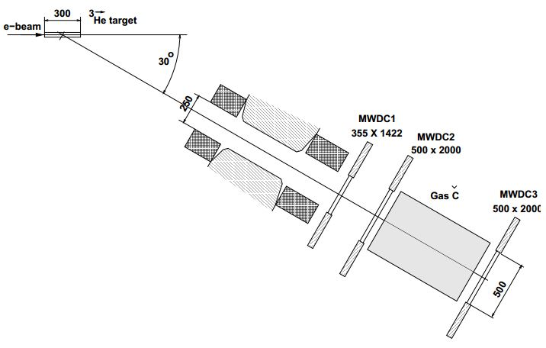
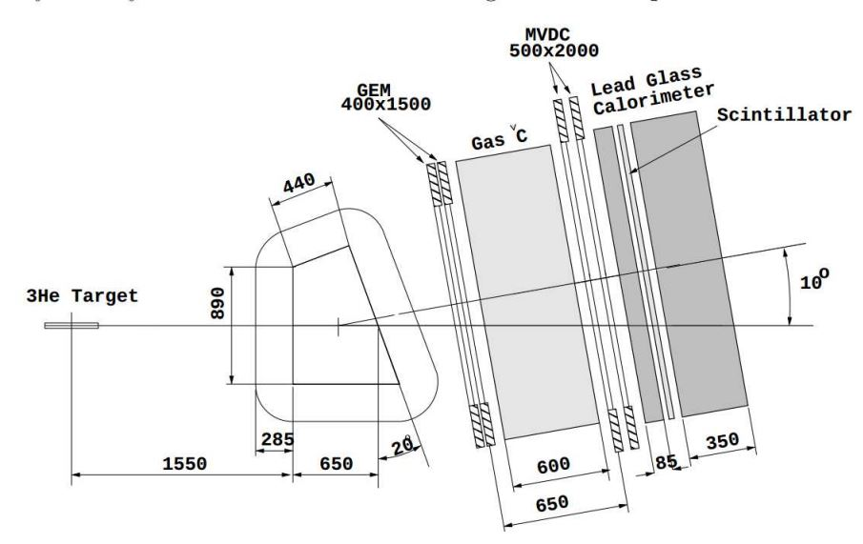
New A₁^{n} Measurement
Scatter electrons off of polarized ³He target.
~50% polarization with 30 μA beam.
Big Bite spectrometer will take most of the data.
Large momentum acceptance.
Large solid angle
Expect at least a factor of two improvement in statistics at low x_{Bj}.
HUGS June 17 2016
3

Slide 4
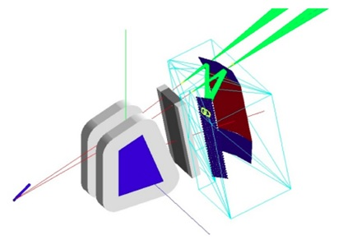
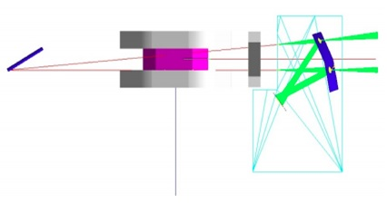
Gas Ring-ImagiNg CHerenkov (GRINCH) Detector
Previous Big Bite gas Cherenkov had very large background.
Source determined to be few MeV photons in beam line.
These photons produced visual photons in glass of 5’’ PMTs. Visual photons kick out Compton electrons which produce Cherenkov radiation in the glass.
Long ADC gate, large cross sectional area, thick glass faces.
Highly sensitive to magnetic fields.
New experiment will run at 30 μA with longer target (50 cm active length).
Expect at least four times the previous rate.
Need new gas Cherenkov detector.
HUGS June 17 2016
4
Notes:
-Especially large on side closest to beam line.

Slide 5
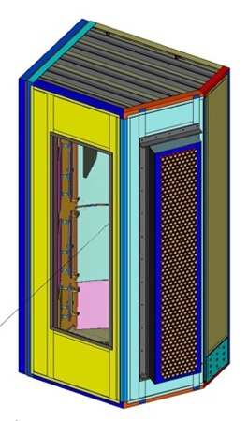
GRINCH Detector
Basic Features.
~510 29mm diameter PMTs.
0.05 times less cross sectional area and three times thinner glass.
PMT array magnetically shielded.
Four Cylindrical mirrors reflect light onto PMTs.
C₄F₁₀
No ADC. Look for timing clusters of about 10 PMTs in 5-10 ns window.
Want to collect as many photoelectrons as possible.
Expect ~36 photoelectrons per event.
Cherenkov spectrum is more intense below the PMTs range.
Apply a wavelength shifting (WLS) paint to shift more photons into the sensitive region.
HUGS June 17 2016
5
Notes:
-More PE since we will always collect fewer than predicted due to losses (absorption etc.)
5

Slide 6
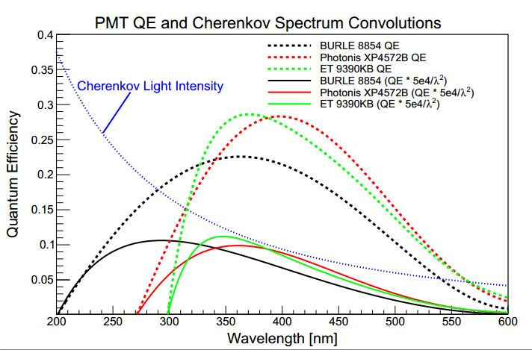
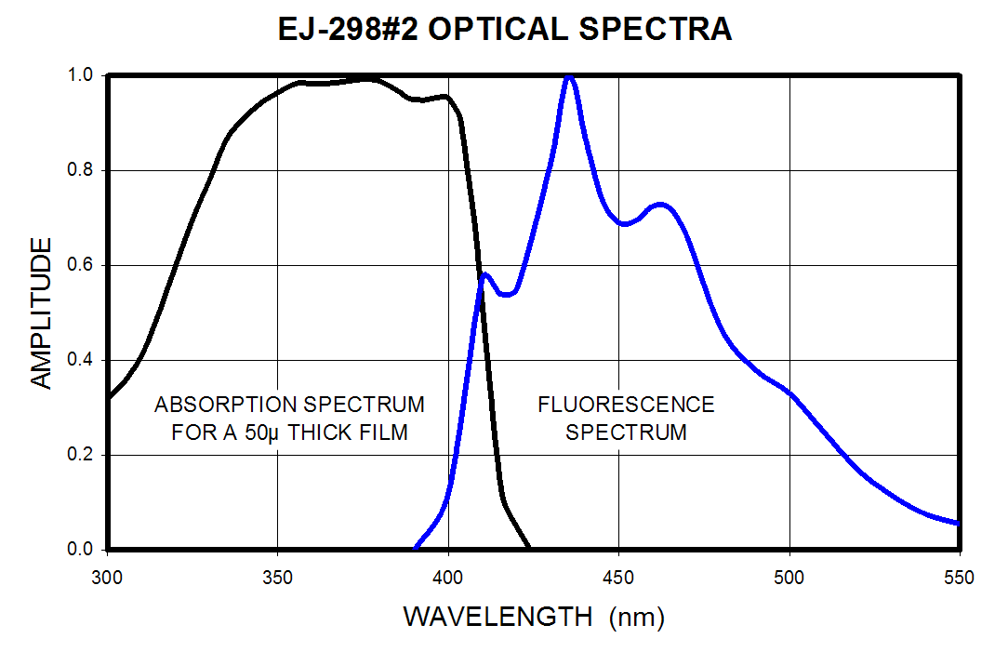
WLS Paint
EJ-299-31E
Composed of polyvinyltoluene (PVT) binder and fluorescent dopants dissolved in a xylene solvent.
Flourescents absorb photons and re-emit them at a higher wavelength
Decay time of 2 ns.
>90% quantum efficiency.
K. Allada et al., PMT Signal Increase Using a Wavelength Shifting Paint, arXiv:1502.01772
HUGS June 17 2016
6

Slide 7
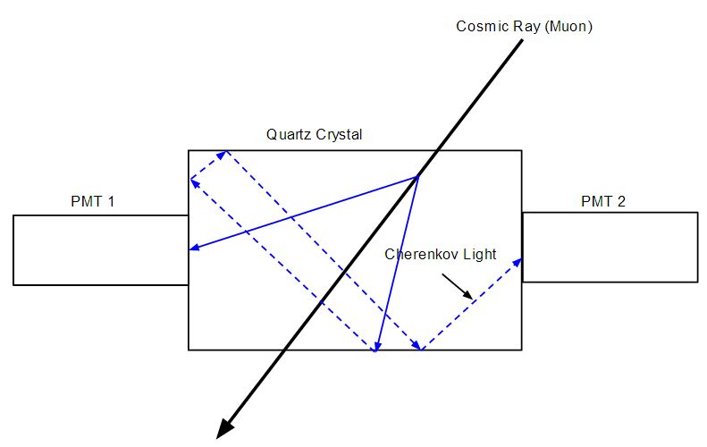
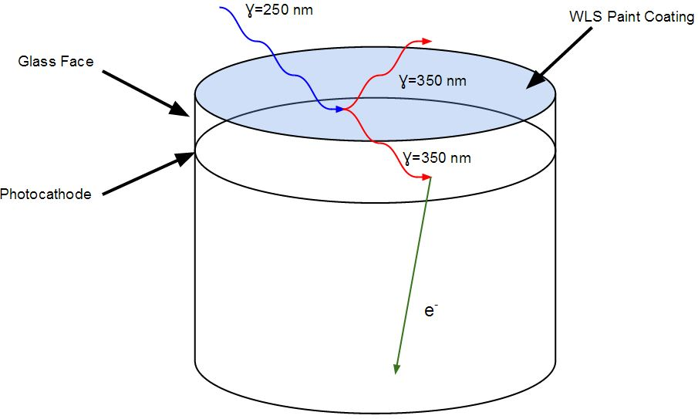
Cherenkov Photons from Cosmic Rays
Method to produce photons with Cherenkov light spectrum.
Cosmic rays striking quartz silica crystal produce Cherenkov radiation.
Spectrum is constant and stable.
HUGS June 17 2016
7
Notes:
-Novel.

Slide 8
Experimental Apparatus
Two PMTs placed touching the crystal with a scintillator above the crystal to form a coincidence.
HUGS June 17 2016
8

Slide 9
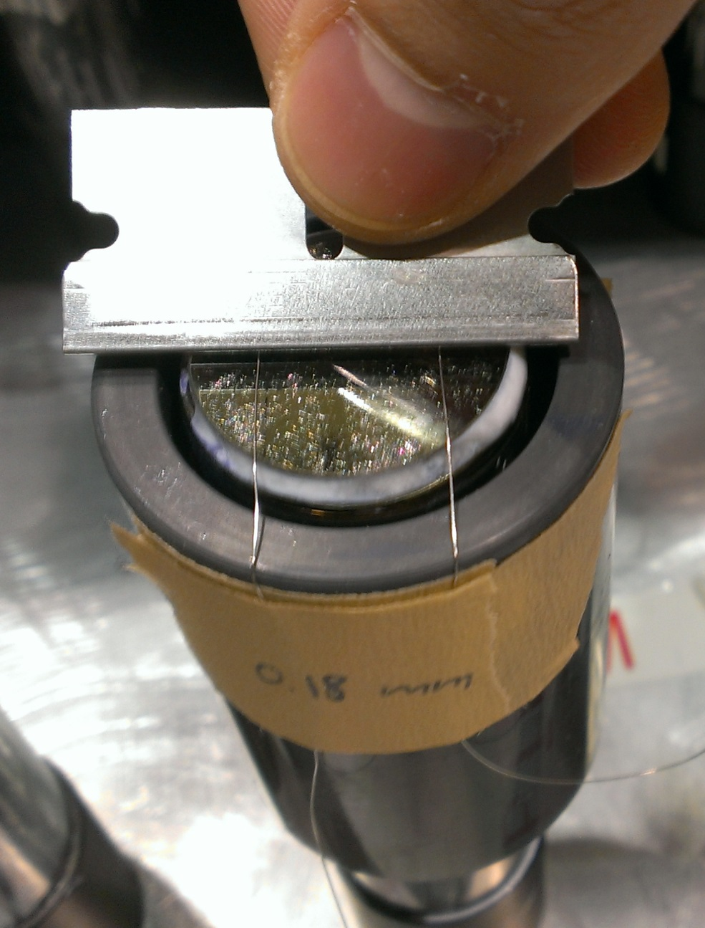
Painting the PMT Faces
How to Apply Paint Uniformly?
Place an open cylinder with two wires stretched across the top over the PMT face.
Apply WLS paint and spread over face with the blunt edge of a razor using the wires as guides.
Wire diameter then determines the paint thickness.
Allow 24 hours to dry.
HUGS June 17 2016
9

Slide 10
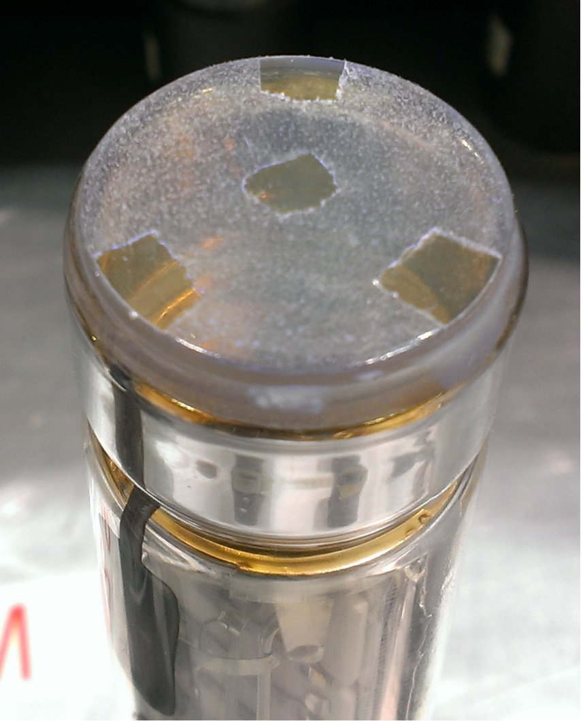
Measuring WLS Effects
Once painted each PMT observes a cosmic spectrum for 21 hours.
Thickness is then measured.
Four small areas of the WLS paint are then scraped with a razor blade.
A coordinate measuring machine then determines the thickness of the paint layer.
WLS paint is then scraped off of the PMT face with a razor and cleaned with alcohol.
HUGS June 17 2016
10

Slide 11
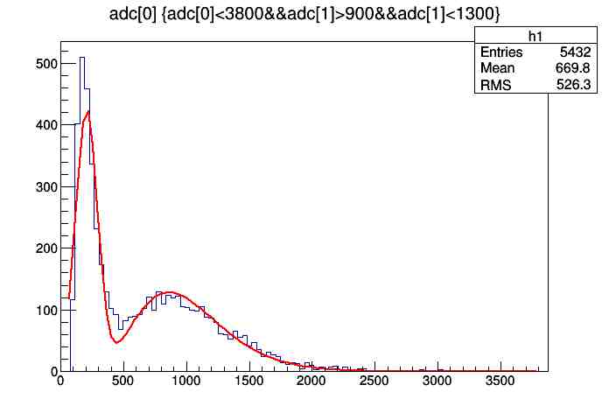
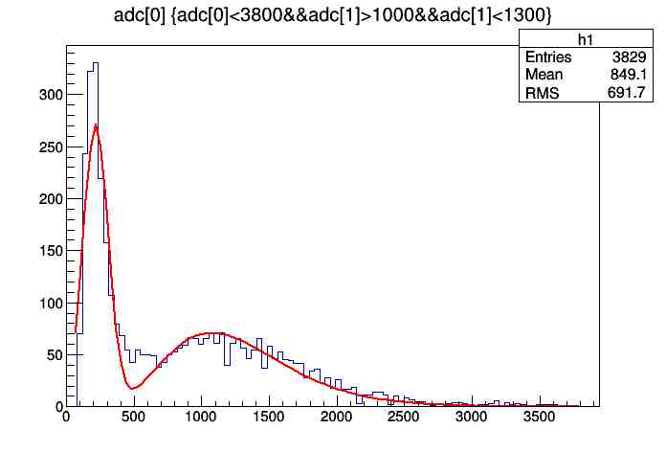
Measuring WLS Effects
Unpainted Tube
Painted Tube
Unpainted PMT then observes cosmic spectrum for 21 hours.
By analyzing the shift in the peak ADC signal the change in the number of photoelectrons can be determined.
This peak is fit by a Gaussian to describe the pedestal and an exponential to describe the peak signal.
The ratio of these fits' parameters gives the change in photoelectrons detected.
HUGS June 17 2016
11
Notes:
-first peak = single PE.

Slide 12
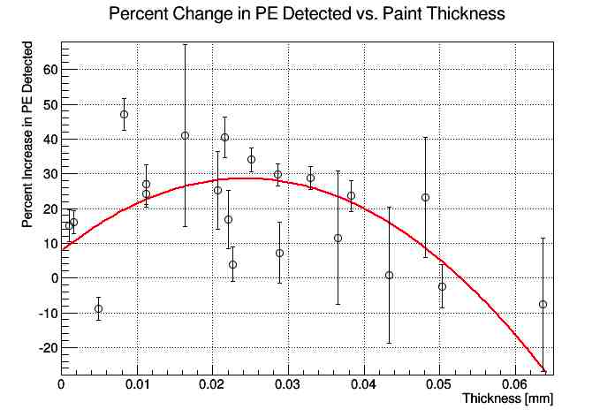
Results
WLS paint increased the number of photoelectrons detected by up to ~48%.
Almost always increased photoelectrons detected.
Paint thickness vs. photoelectrons detected roughly quadratic.
HUGS June 17 2016
12

Slide 13
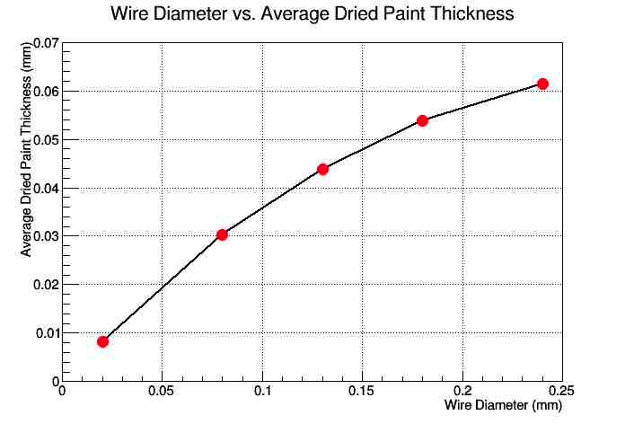
Results
Paint thickness roughly controllable through wire diameter.
Stable region from about 10 – 40 microns.
Choose wire diameter of 80 microns.
Average photoelectron gain of 23.7% for 80 micron wire.
HUGS June 17 2016
13

Slide 14
WLS Paint Model
Do these results make sense?
What do we need to know to check these results?
Cherenkov light spectrum
Known
WLS paint absorption spectrum
Measured by William and Mary
WLS paint emission spectrum
Measured by FermiLab (Dr. Anna Pla-Dalmau)
WLS paint QE
Given by company
Epoxy transmission spectrum
Measured by JLab (Dr. Carl Zorn)
PMT QE (company)
Given by company
HUGS June 17 2016
14

Slide 15
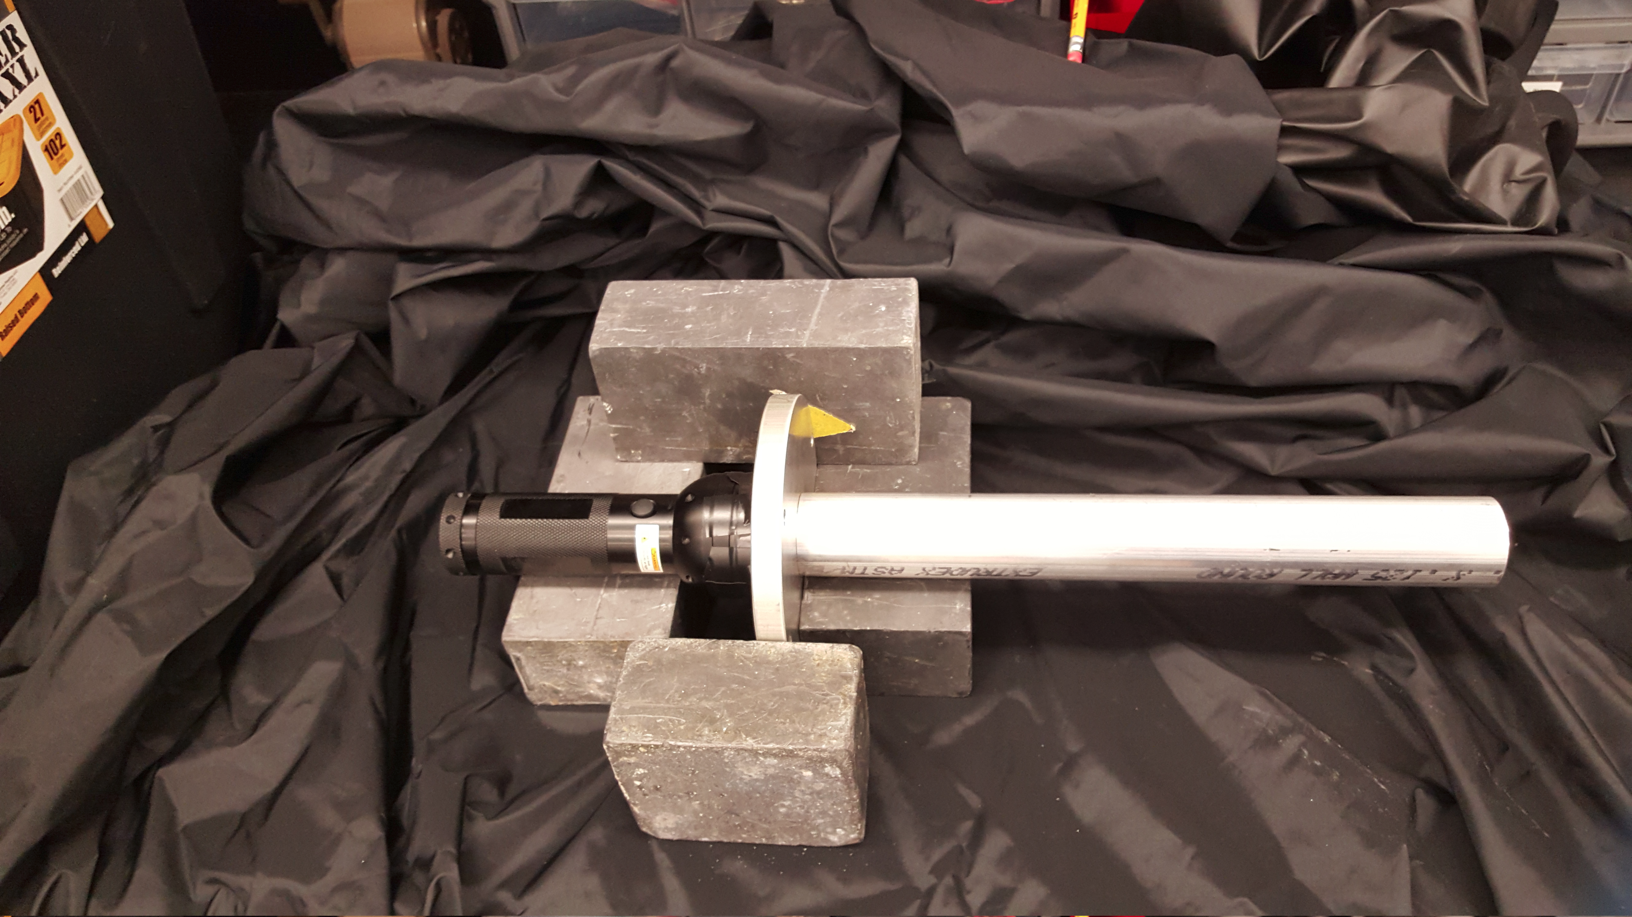
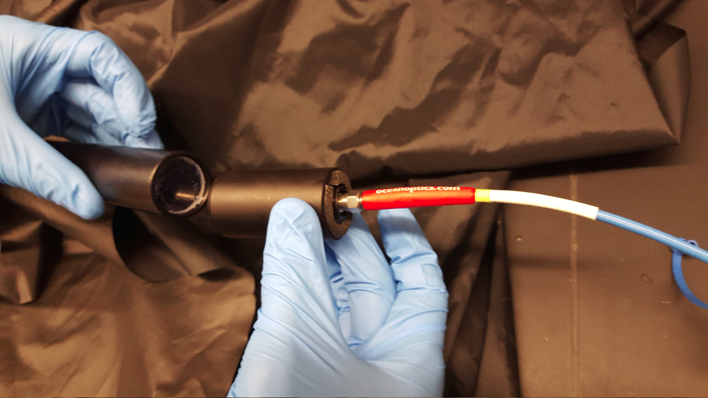
Measuring the Absorption Spectrum
Use a UV flashlight and a spectrometer to measure the absorption spectrum.
Flashlight emits little light in the deep UV (especially below 300 nm).
Need long integration times.
Must break absorption spectrum into three segments.
Deep UV (200-370 nm), Near UV (370-405 nm), Visible (405-615 nm).
HUGS June 17 2016
15

Slide 16
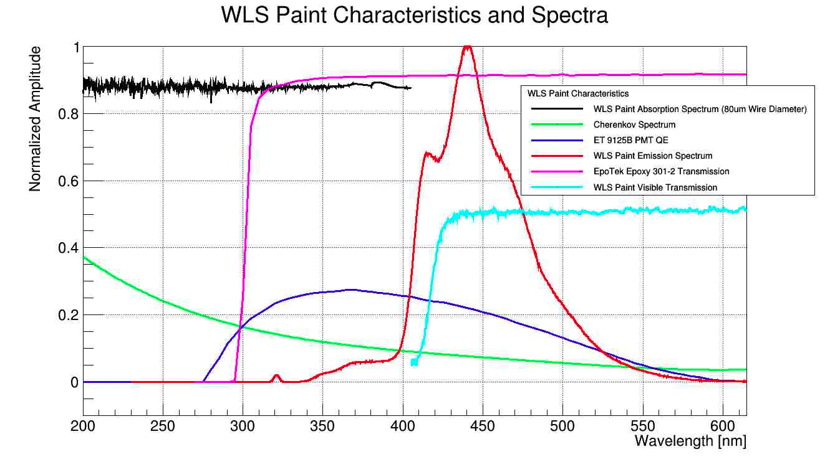
HUGS June 17 2016
16

Slide 17
Calculate Photoelectron Gain from WLS Paint
1. Determine the number of photoelectrons detected by the PMT with the WLS paint.
(a) Determine the total light absorbed and re-emitted by the WLS paint reaching PMT.
(b) Determine the total amount of light transmitted through the paint reaching the PMT.
2. Determine the number of photoelectrons detected by the PMT without the WLS paint applied.
3. Take the ratio to find the gain in photoelectrons due to the WLS paint.
HUGS June 17 2016
17

Slide 18
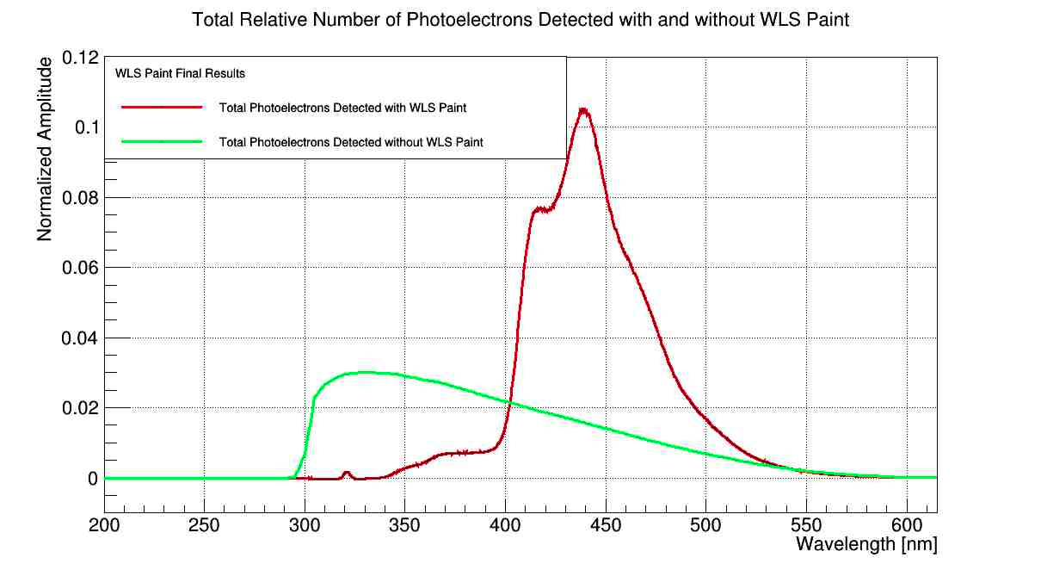
Photoelectron Gain from WLS Paint
HUGS June 17 2016
18

Slide 19
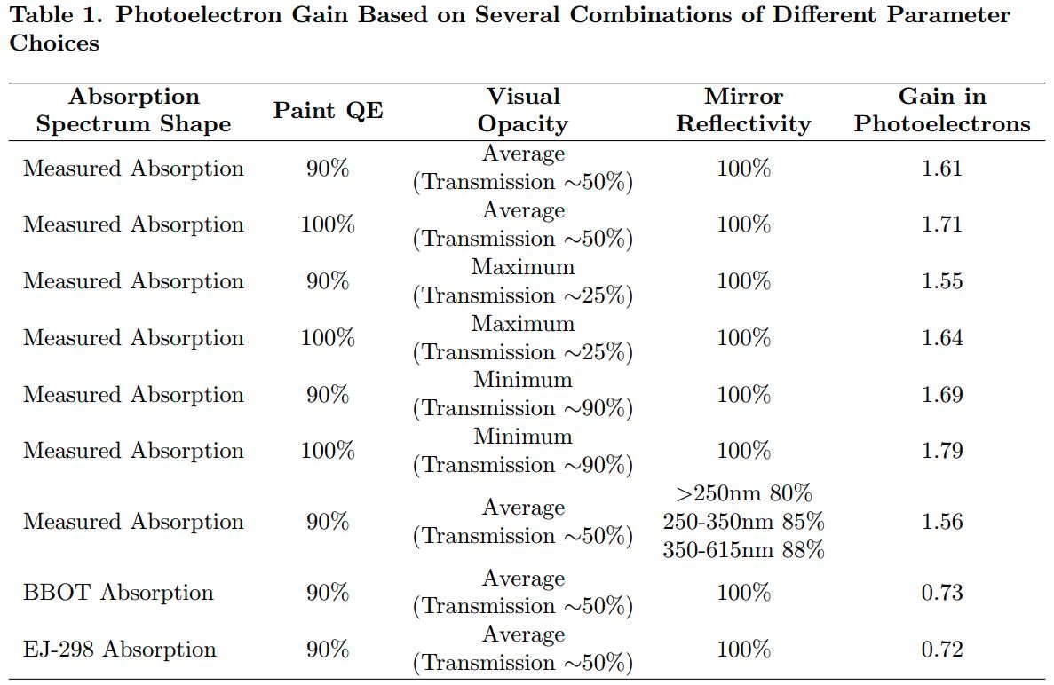
HUGS June 17 2016
19

Slide 20
Conclusions
Cosmic rays can be successfully used to create a Cherenkov spectrum to simulate a detector.
The WLS paint significantly increased the number of Cherenkov Photoelectrons detected.
WLS paint thickness roughly quadratic vs. photoelectron gain.
Model to calculate photoelectron gain is in agreement with experiment.
Upcoming Work:
GEANT4 Monte Carlo
New WLS paints
In situ testing
HUGS June 17 2016
20

Slide 21
Acknowledgments
Collaborators
Dr. Bogdan Wojtsekhowski
Dr. Todd Averett
The W&M Hadronic Physics Group
Department of Energy
JLab
Special Thanks
Kurtis Bartlett
Dr. Carl Zorn
Dr. Anna Pla-Dalmau
HUGS June 17 2016
21

Slide 22
Questions?
HUGS June 17 2016
22

