Slide 1

The Proton Radius Puzzle
- or as I like to call it –
The 51 Parameter Covfefe
Douglas W. Higinbotham (Jefferson Lab)
along with
Vincent Lin (Western Branch High School / Rodman Scholar at University of Virginia )
David Meekins and Brad Sawatzky (Jefferson Lab)
Al Amin Kabir (Kent State)
Blaine Norum (University of Virginia)
Celina Pearson (Virginia Tech)
Ethan Buck, Carl Carlson & Keith Griffioen (William & Mary)
With statistics advice from Simon Širca (Ljubljana) and Sanjoy Mahajan (MIT/Olin College)

Slide 2
All Models Are Wrong
“The most that can be expected from any model is that it can supply a useful approximation to reality: All models are wrong; some models are useful.” - George Box (1919 – 2013)
“With four parameters I can fit an elephant, and with five I can make him wiggle his trunk. “ John von Neumann (1903 – 1957 )
Freeman Dyson presents his model to Enrico Fermi: http://webofstories.com/play/4402

Slide 3

The Five Parameter Elephant
“Drawing an elephant with four complex parameters”
by Jurgen Mayer, Khaled Khairy, and Jonathon Howard, Am. J. Phys. 78 (2010) 648.
https://www.johndcook.com/blog/2011/06/21/how-to-fit-an-elephant/

Slide 4
Occam's Razor
William Occam (1287 – 1347)
One can always explain failing explanations with an ad hoc hypothesis, thus in Science, simpler theories are preferable to more complex ones. (e.g. the Sun centered vs. Earth centered)
Layman’s version of Occam’s Razor is “the simplest explanation is usually the correct one” (i.e. KISS)
In statistical versions of Occam's Razor, one uses a rigorous formulation instead of a philosophical argument. In particular, one must provide a specific definition of simple:
  F test, Akaike information criterion, Bayesian information criterion, etc.
  In statistical modeling of data too simple is under-fitting and too complicated is over-fitting.

Slide 5
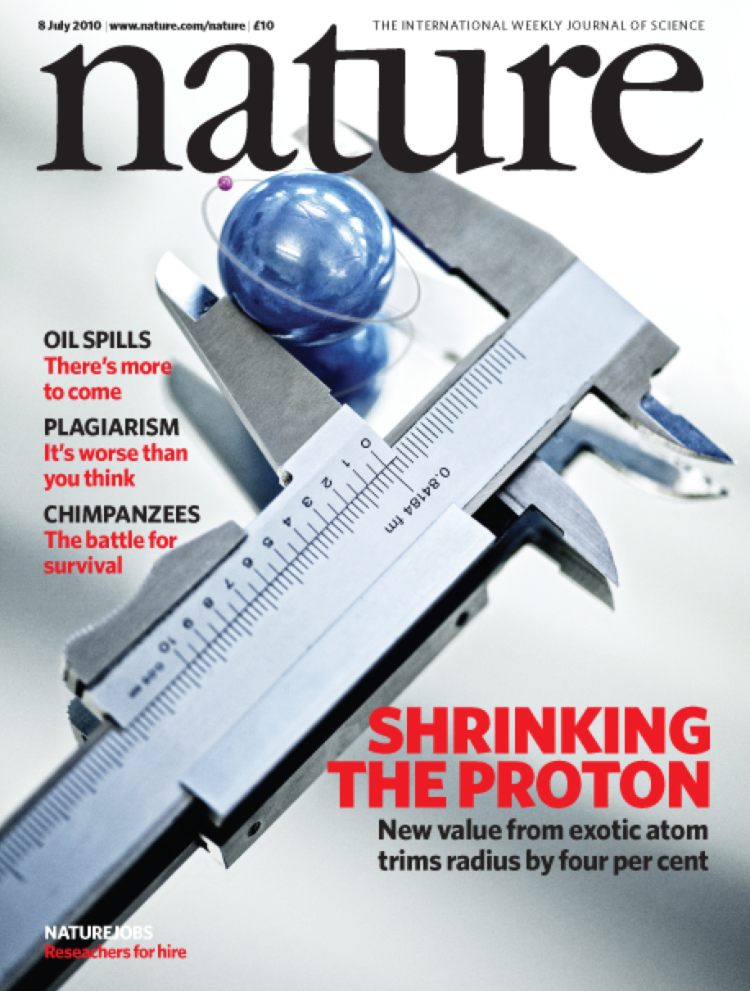
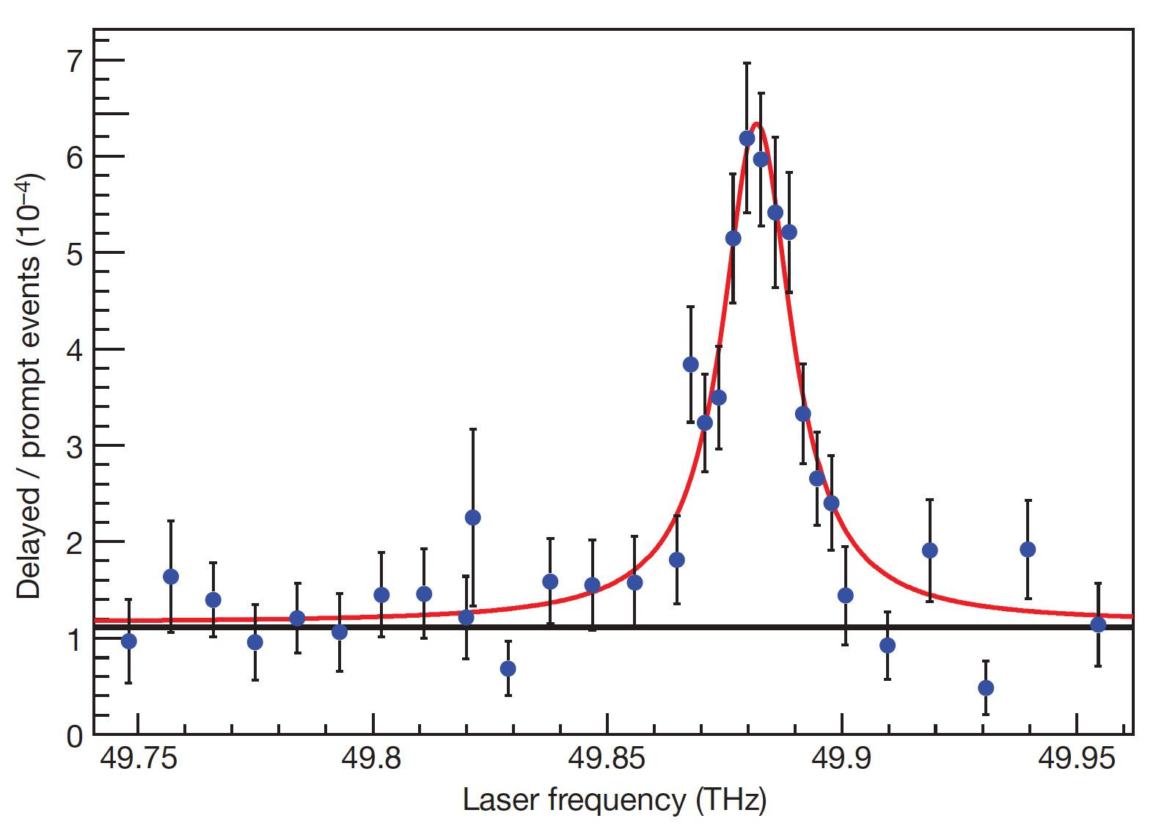
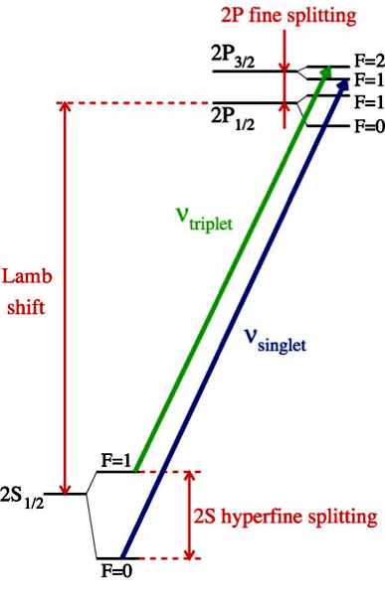
Muonic Hydrogen Data
High precision results from Muonic Lamb shift data give a proton radius of 0.84 fm.
This result contradicts many other extractions which have determined the proton radius to be ~0.88 fm.
E_{2p} – E_{2s} = 209.98 – 5.2262 r_{p}² + 0.0347 r_{p}³ meV
NOTE: The radius in this formula is consistent with other extractions.

Slide 6

Some Of The Possible Explanations
μH experiment wrong ?
eH theory wrong ?
Beyond Standard Model
Lamb shift difference of
310 ± 2 μeV
eH experiment
+ ep scattering wrong ?
- R∞
- 2γ corrections
- low-Q² extrapolation
μH theory wrong ?
- 2γ corrections
- missing QED or EW corrections
- soft hadronic corrections
List of possible explanations from Franziska Hagelstein, University of Mainz

Slide 7
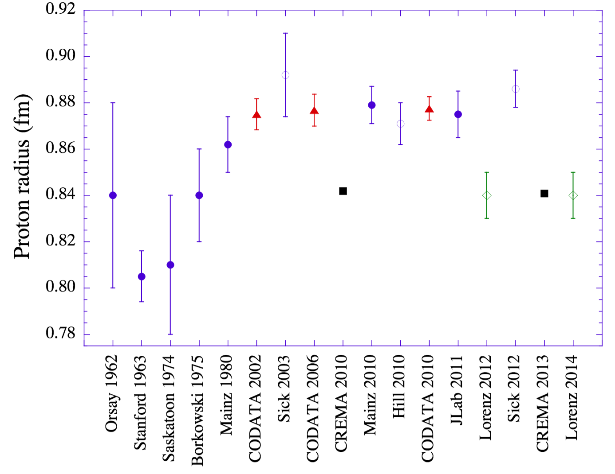
Proton Radius vs. Time
V. Punjabi et al., Eur. Phys. J. A51 (2015) 79.

Slide 8
And Ever Changing Fit Functions
V. Punjabi et al., Eur. Phys. J. A51 (2015) 79.
C.F. and Cross Section Corrections ( 4 < fm⁻² )
Spline & 10th Order Poly (25 < fm⁻²)
G_{E} Quadratic ( 1.4 < fm⁻²)
Dominated by Atomic Hydrogen
Asymmetry (8-18 fm⁻²)
G_{E} Linear ( < 1 fm⁻²)
Muonic
Muonic
Dispersion Relations
And C.F. fits
(large magnetic radius)
G_{E} Linear (< 1 fm⁻²), Proton, & Systematics
G_{E} Linear (<1fm⁻²) & Quadratic (< 3 fm⁻²)

Slide 9
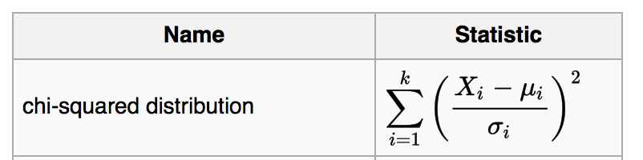
What’s to know about fitting?!
Just fit until you get χ² / ν = 1 and your good? Right…. ?!
(where ν is the degrees of freedom in the fit)
What could possibly go wrong?!
What if the weights (sigma’s) are underestimated or overestimated?
What if I have the wrong model?
What if the data aren’t normally distributed?
What if average reduced χ² is good, but one over-fits one area and under-fits another!!
( It is not trivial and just getting a reduced χ² ~ 1 does not mean you have a good result! )

Slide 10
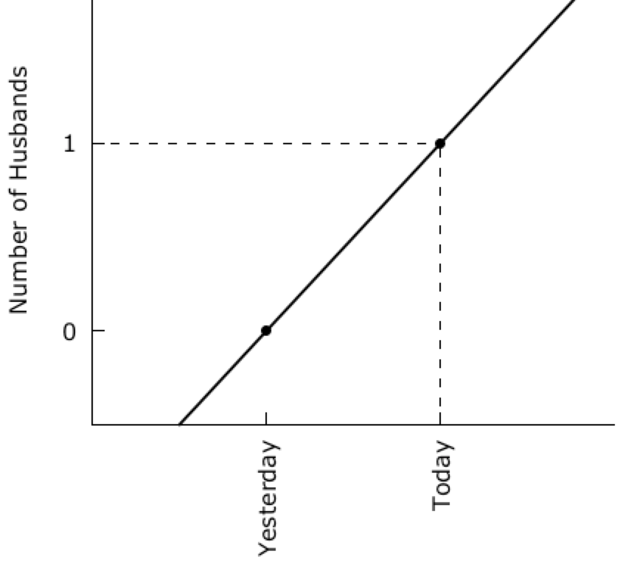
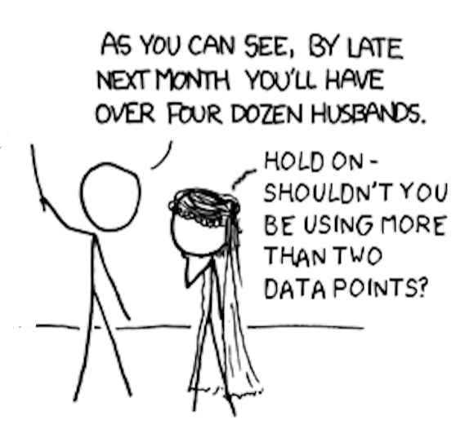
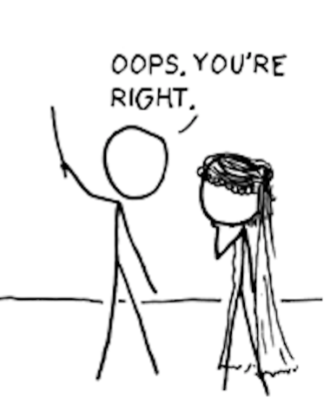
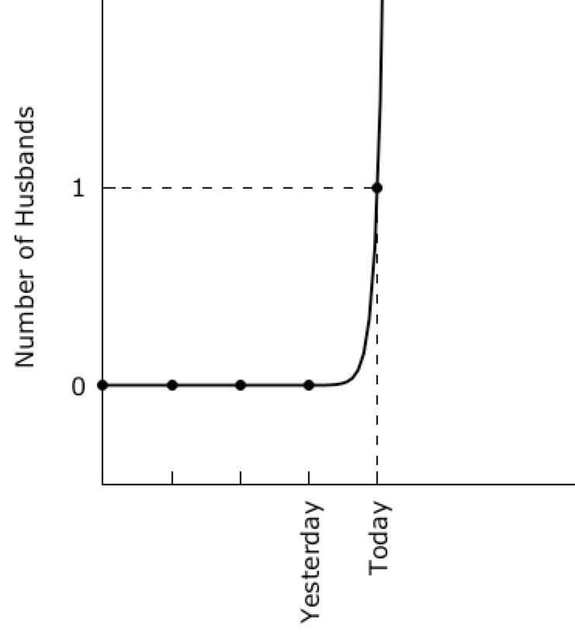
XFCD “My Hobby: Extrapolating”
GNUPLOT OVERFITTING CODE
Using 101,600 Iterations To Converge
#
# gnuplot overfitting of xkcd Husband Data
# modified from https://xkcd.com/605/
# by
# Douglas W. Higinbotham
#
set terminal wxt enhanced font "verdana,12" size 900,450
set nokey
set xtic rotate 90
set ytic 0,1,1
set border 3
set xtics nomirror
set ytics nomirror
set multiplot layout 1,2
set ylabel "Number of Husbands"
f(x)=f0+f1*x
g(x)=g0*exp(g1*x)
fit f(x) '1.dat' using 1:3 via f0,f1
fit g(x) '2.dat' using 1:3 via g0,g1
set arrow from 0,1 to 2,1 nohead dashtype 7 lc 'black'
set arrow from 2,-0.5 to 2,1 nohead dashtype 7 lc 'black'
set xrange [0:3]
set yrange [-0.5:2]
plot '1.dat' using 1:3:xtic(2) lt 7 lc 'black' ,f(x) lw 2 lc 'black'
unset arrow
set xrange [-2:6]
set arrow from -2,1 to 2,1 nohead dashtype 7 lc 'black'
set arrow from 2,-0.5 to 2,1 nohead dashtype 7 lc 'black'
plot '2.dat' using 1:3:xtic(2) lt 7 lc 'black' ,g(x) lw 2 lc 'black'
unset multiplot
pause -1

Slide 11
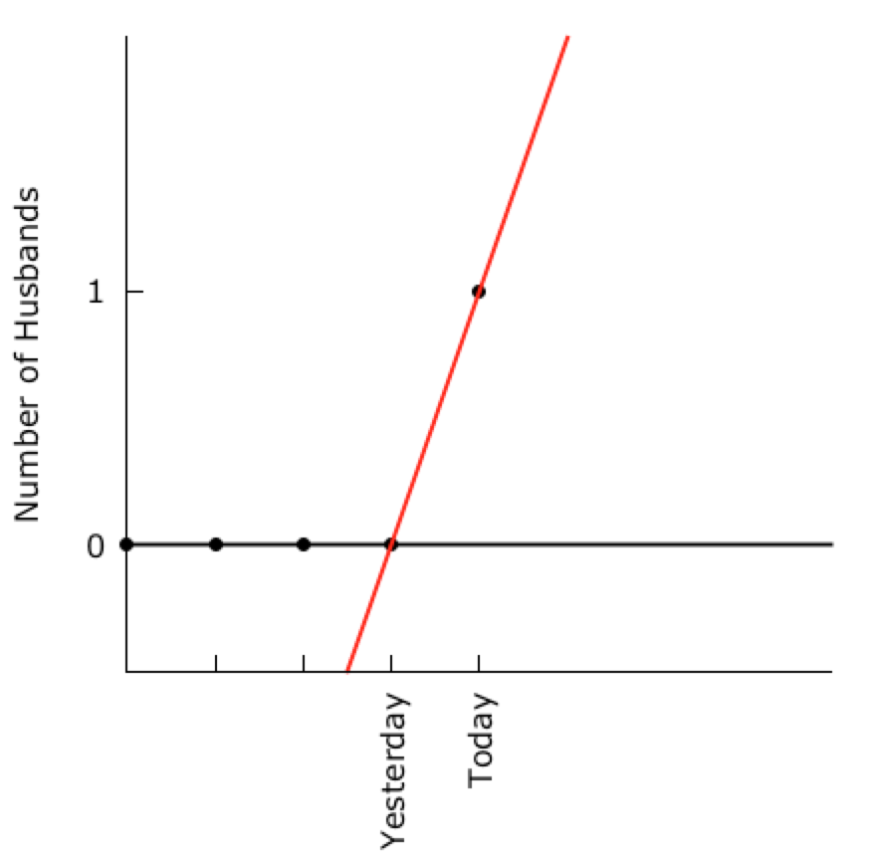
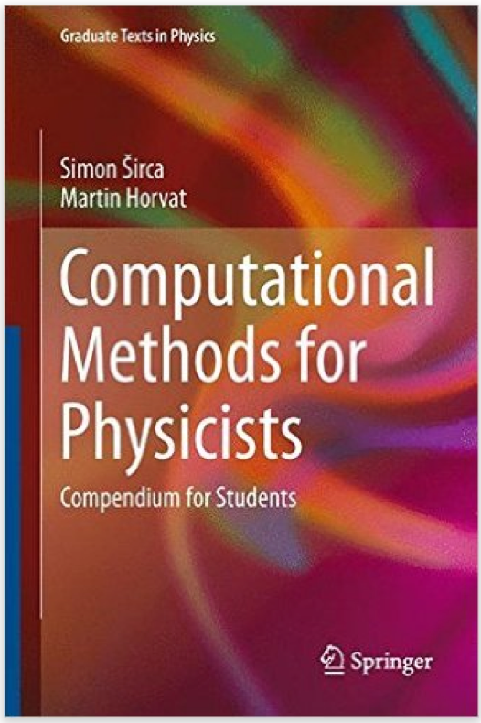
Robust Linear Regression
OOPS, It Was Just An Outlier
“An ever increasing amount of computational work is being relegated to computers, and often we almost blindly assume that the obtained results are correct.”
- Simon Širca & Martin Horvat

Slide 12
How do we make the electron scattering measurements?
Beam of electrons from an accelerator (E)
Place target material in the beam
  Foils are easy, nearly point (typically thin) targets and thickness is easy to determine
  Cryo-targets are challenging (e.g. boiling effects, energy loss)
For elastic hydrogen measure scattered electron (E’) and/or proton.
  Over determined reaction
Spectrometers are used
  Magnetic fields, wire-chambers, reconstructed tracks, sieve data, etc.
Electron Beam
➔

Slide 13
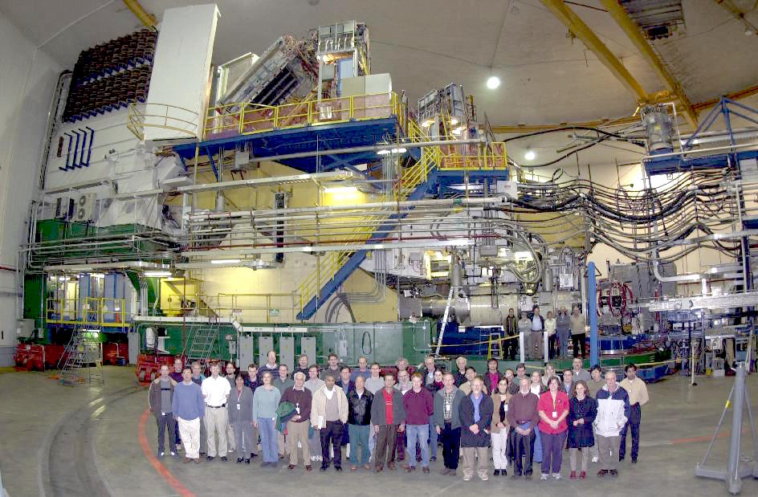
Jefferson Lab Hall A Left Spectrometer

Slide 14
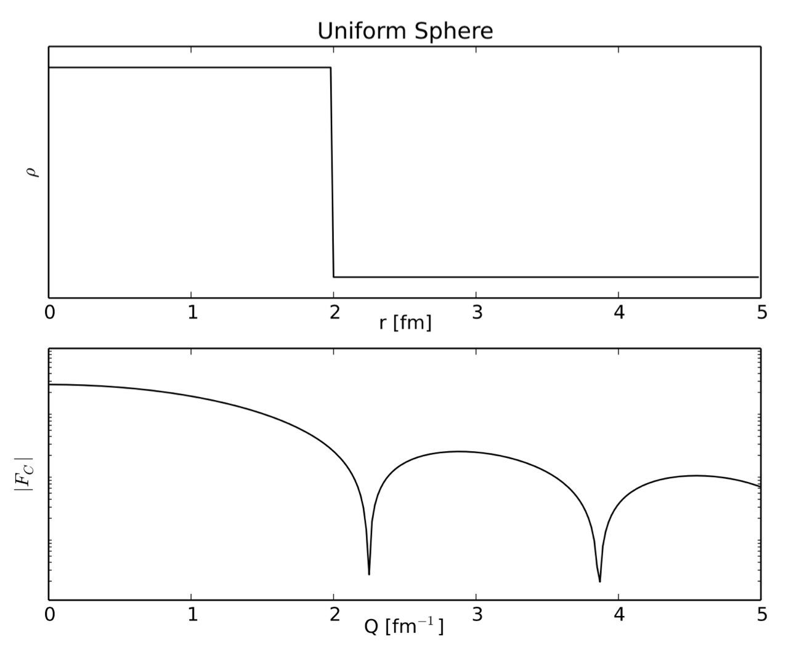
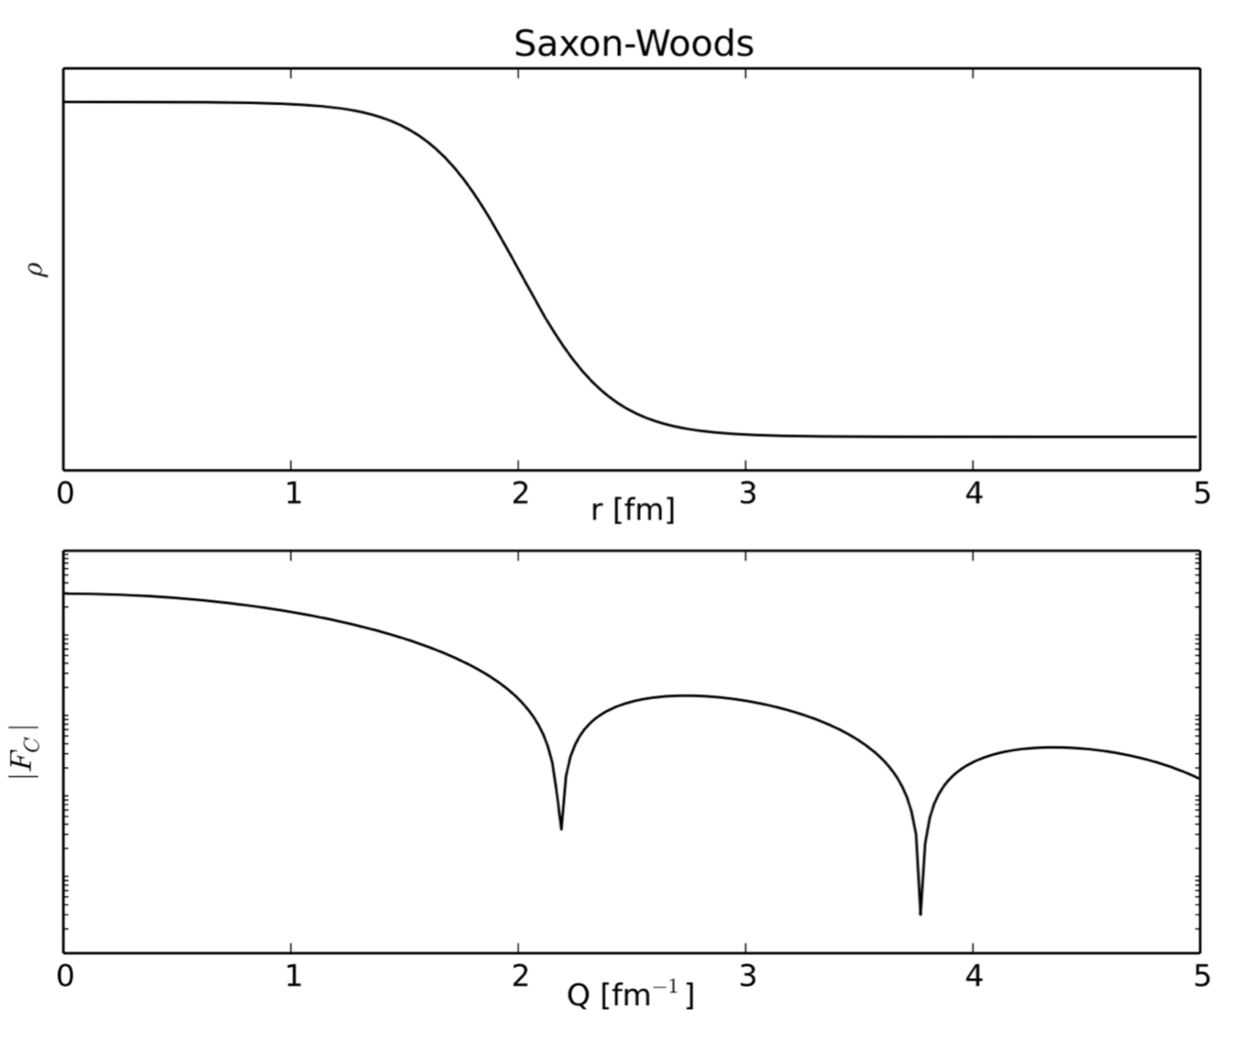
Electron Scattering Charge Radii from Nuclei
Fourier Transformation of Ideal Charge Distributions.
Example Plots Made By R. Evan McClellan (Jefferson Lab Postdoc)
e.g. for Carbon: Stanford high Q² data from I. Sick and J.S. McCarthy, Nucl. Phys. A150 (1970) 631.
National Bureau of Standards low Q² data from L. Cardman et. al., Phys. Lett. B91 (1980) 203.

Slide 15
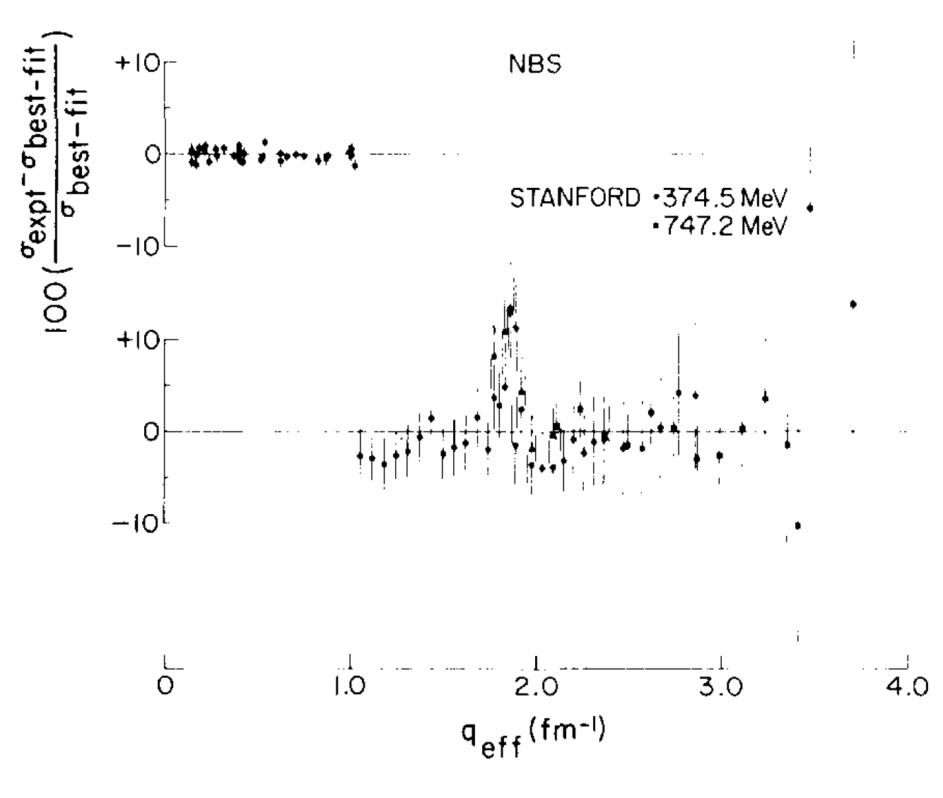
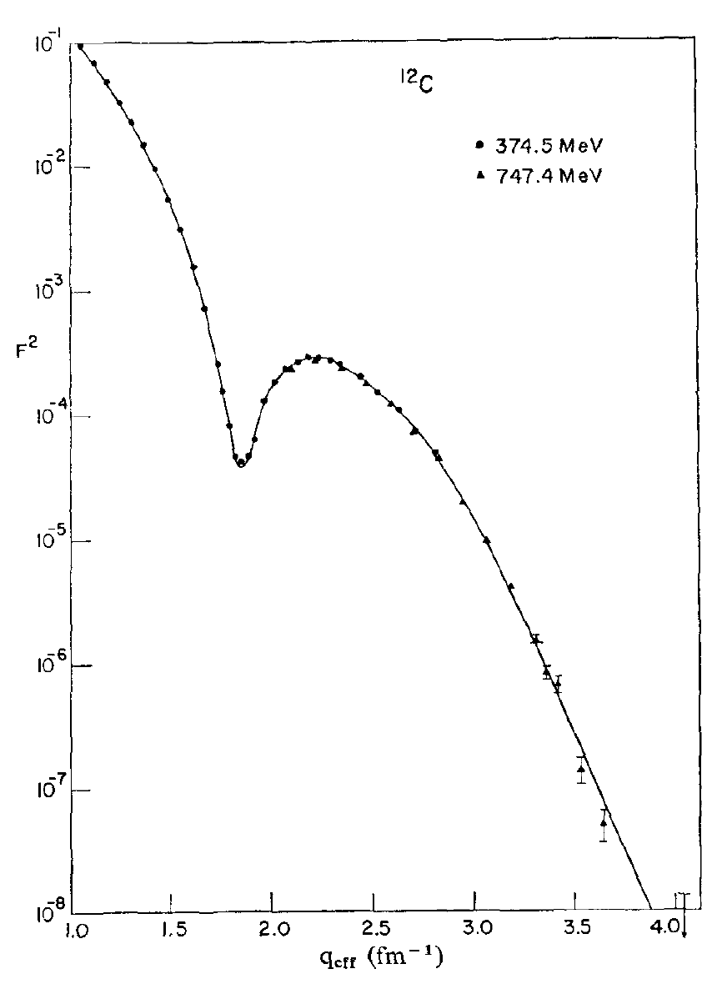
Determining the Charge Radius of Carbon
Stanford high Q² data from I. Sick and J.S. McCarthy, Nucl. Phys. A150 (1970) 631.
National Bureau of Standards (NBS) low Q² data from L. Cardman et. al., Phys. Lett. B91 (1980) 203.
See the L. Cardman’s paper for details of the carbon radius ( 2.46 fm ) analysis.

Slide 16
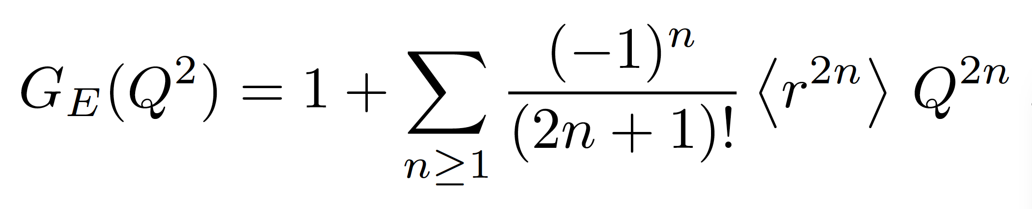
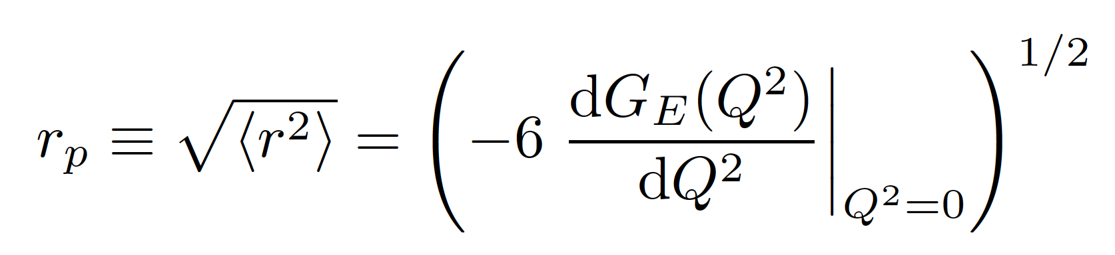
Charge Radius of the Proton
Proton G_{E} has no measured minima and it is too light for the Fourier transformation to work in a model independent way.
Thus for the proton we make use of the fact that as Q² goes to zero the charge radius is proportional to the slope of G_{E}
We don’t measure to Q² of zero, so this is going to be an extrapolation problem.
NOTE: There is general agreement that this definition of r_{P} is consistent with the Muonic results.

Slide 17
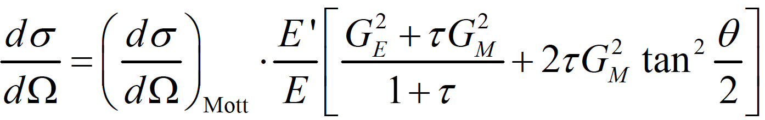
Elastic Electron Scattering
From relativistic quantum mechanics one can derive the formula for electron-proton
scattering where one has assumed the exchange of a single virtual photon.
where G_{E} and G_{M} form factors take into account the finite size of the proton.
G_{E} = G_{E}(Q²), G_{M} = G_{M} (Q²); G_{E}(0)=1, G_{M}(0) = μ_{p}
Q² = 4 E E’ sin²(θ/2) and τ = Q² /4m_{p}²
Elastic cross sections at small angles and small Q²’s are dominated by G_{E} ( JLab PRad Hall B )
Elastic cross sections at large angles and large Q²’s are dominated by G_{M} ( JLab GMP Hall A )
For moderate Q^{2’}s one can separate G_{E} and G_{M} with the Rosenbluth technique (same Q² different E,θ).

Slide 18
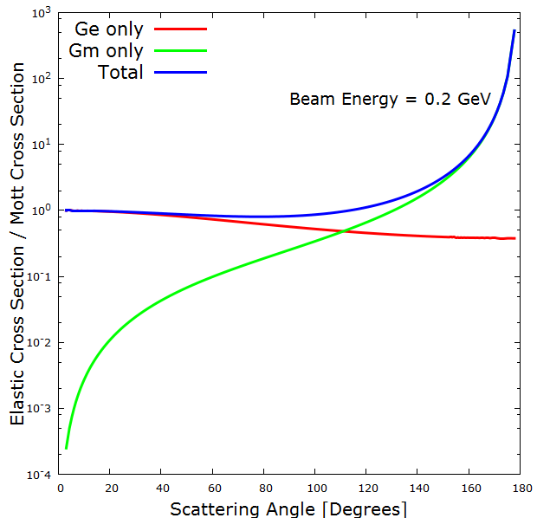
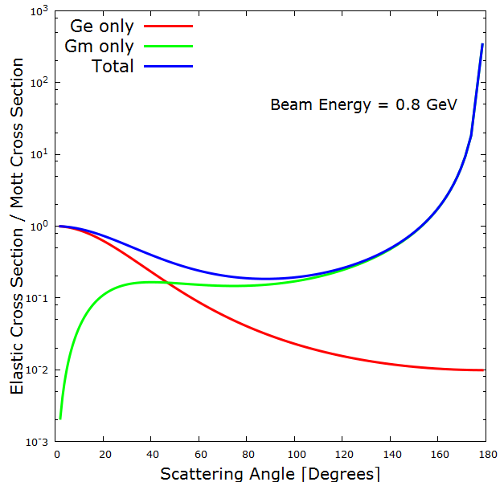
G_{E} and G_{M} Contributions To The Cross Section
Plots by Ethan Buck (Jefferson Lab SULI Student and W&M undergraduate)
Experiments like PRad (Hall B) go to small angle to maximize G_{E} and minimize G_{M} contribution..
Global fits, like typically done with the Mainz 2010 data, need several normalization, G_{E} and G_{M}

Slide 19

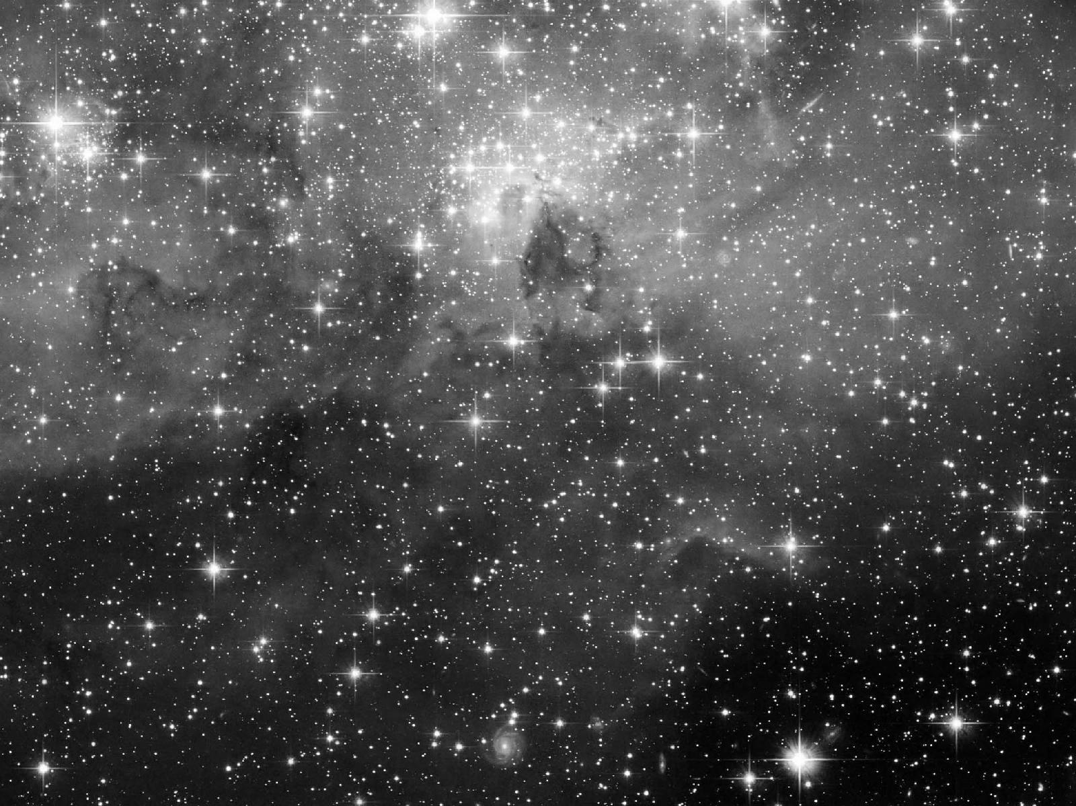
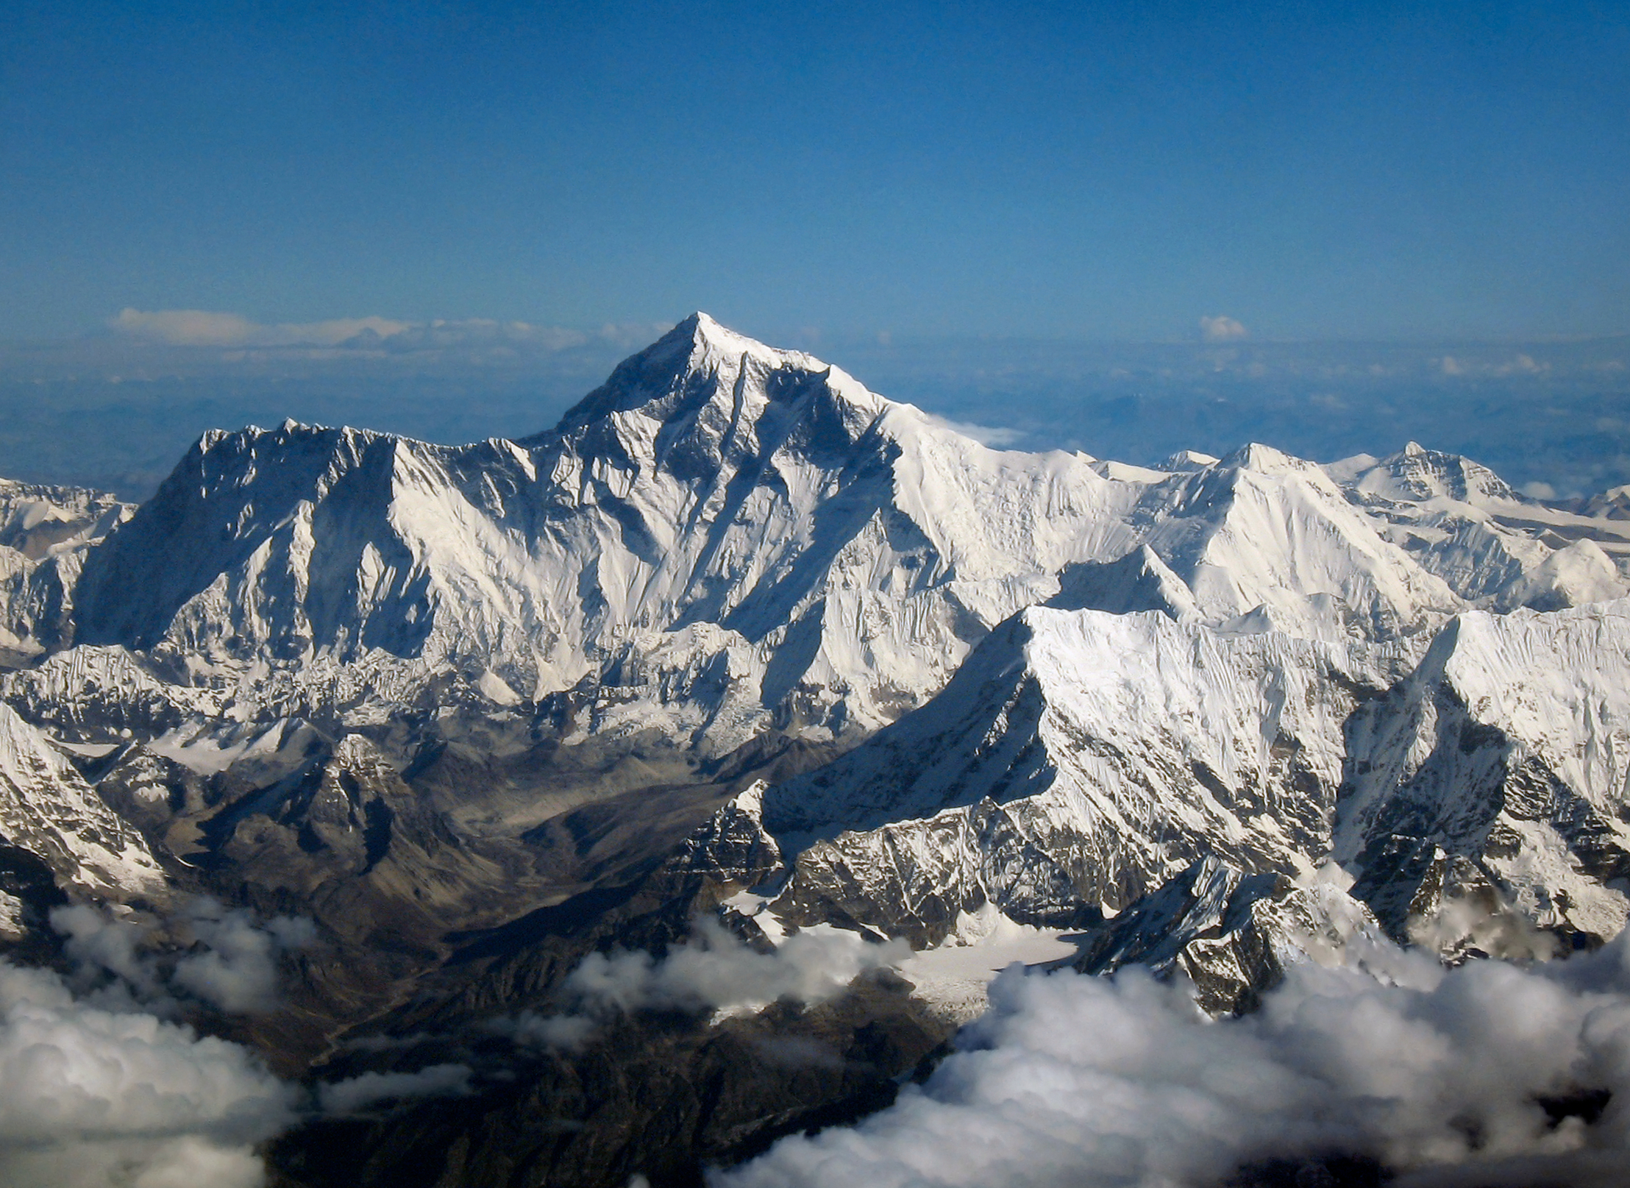
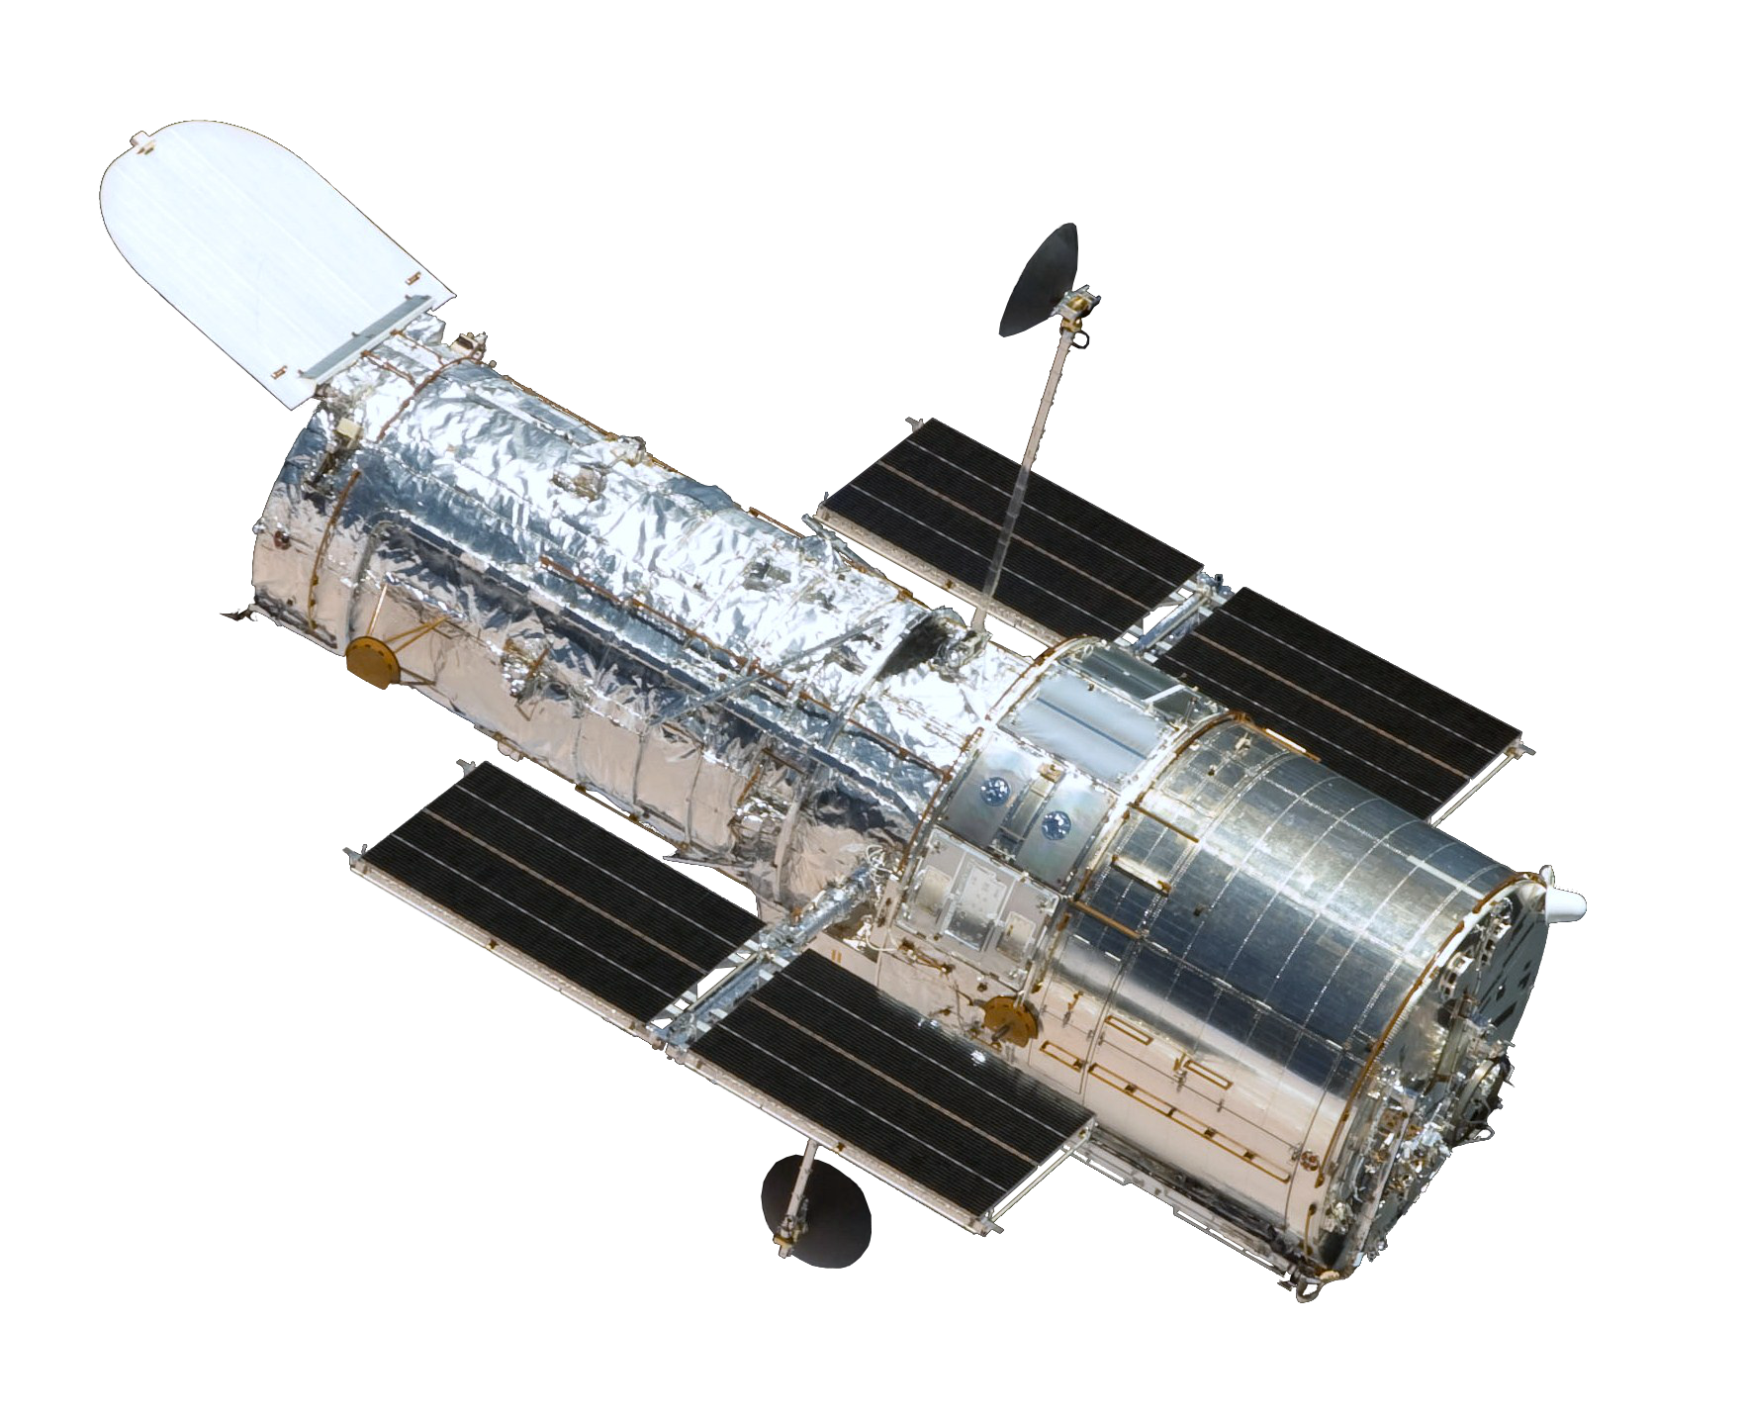
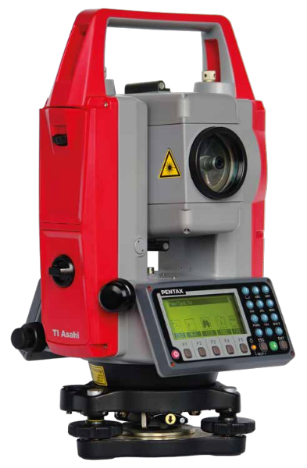
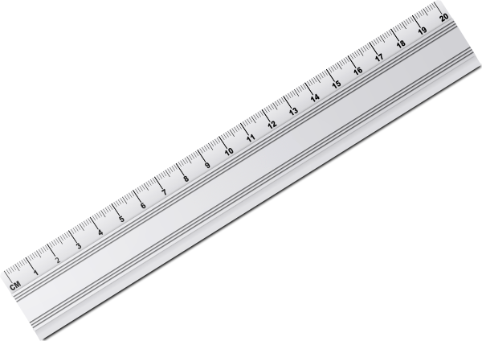
Measurement Is Often A Goldilocks Problem
From Deep Space
From Orbit
On The Planet
Too Far
Just Right
Too Close
A Modern Telescope
Ruler & Some Geometry
Theodolite*

Slide 20
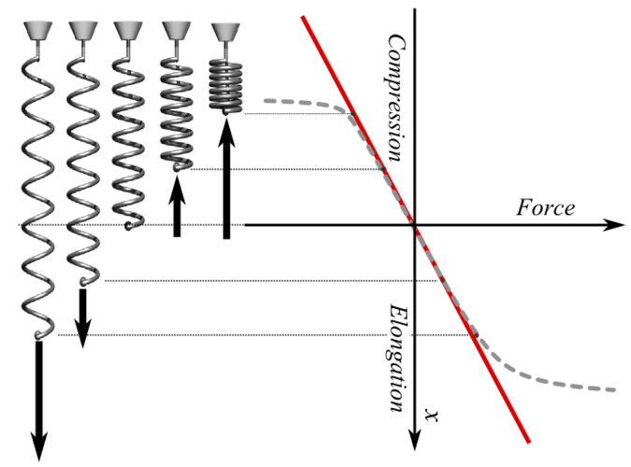
Hook’s Law
Thanks to Markus Diehl for this beautiful analogy to the G_{E} vs. Q² problem.
The spring constant k is easily determined as long as you don’t pull or pull with excessive force.

Slide 21


What is just right for the proton?!
We use Plank’s constant one to relate energy to length in natural units:
  Q² of 1 GeV² = 25.7 fm⁻².
Radius of the proton is ~ 0.84 - 0.88 fm
Thus one can immediately guesstimate that with electron scattering one needs:
  Q² < (1/0.88 fm)² < 1.2 fm⁻² to get the radius of the proton ( equivalent to 0.05 GeV² )
  Q² > 1.2 fm⁻² to understand the details of the edge of the proton ( e.g. a pion cloud, CQCBM, etc. )
  Q² >> 1.2 fm⁻² to understand transition from hadronic to partonic ( e.g. the bound light constitute quarks )
Guesstimation books by Larry Weinstein (ODU)

Slide 22
Extrapolate The Slope of G_{E} Using Low Q² Data
The question is going to be what function to use for the fitting & extrapolating.
The answer to this question STRONGLY effects the answer!
For linear regression using a polynomial function one can use an F-test.
For non-linear regression more complicated techniques are required.

Slide 23
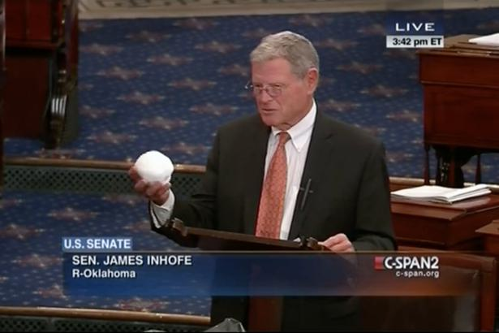
Warning: Danger of Confirmation Bias
In psychology and cognitive science, confirmation bias is a
tendency to search for or interpret information in a way that confirms one's preconceptions, leading to statistical errors.

Slide 24
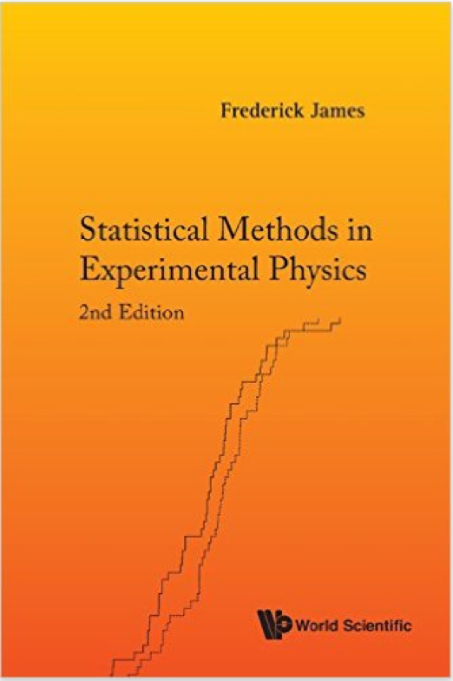
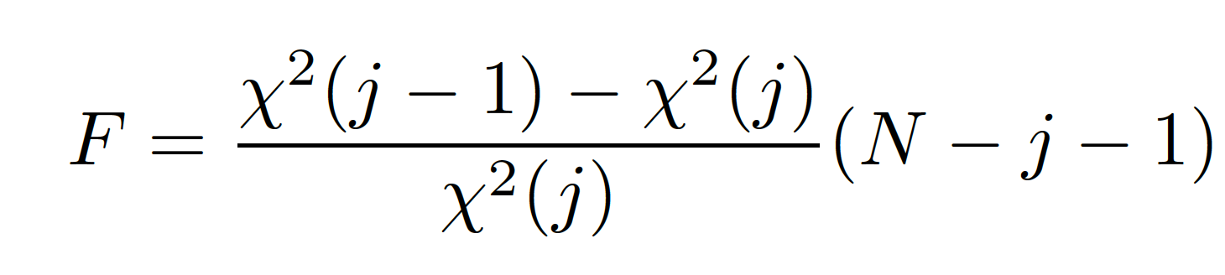
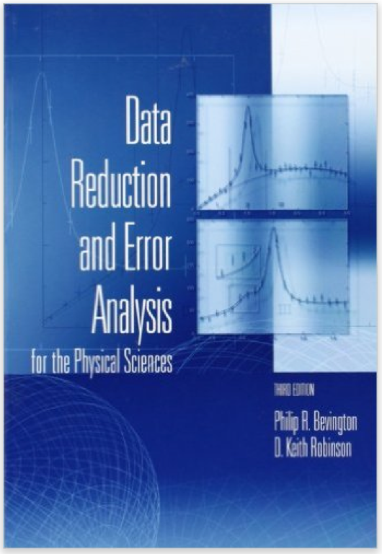
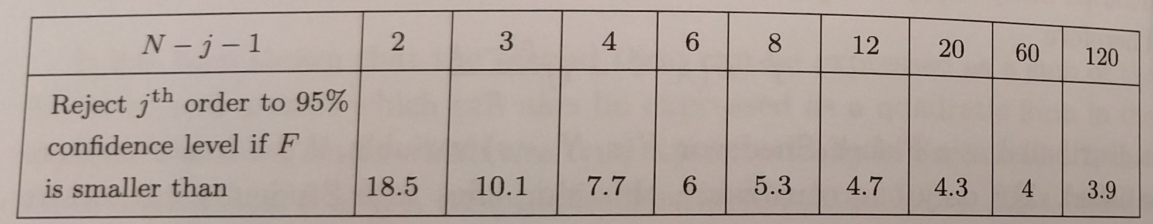
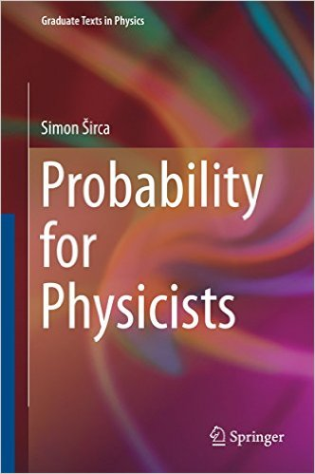
Test of Additional Term
A textbook statistics problem is to quantify when to stop adding terms to a fit of experimental data.
One way to do this is with an F-distribution test.
where j is the order of the fit and N the number points being fit.
Quantifies a statement that adding a term doesn’t significantly improve a fit.
One is free to pick a different alpha, alpha=0.05 is just typical to prevent over-fitting.
(see James 2nd edition page 282, Bevington 3rd edition page 207, or Širca page 268)

Slide 25
Logic of The Test of Adding A Term
Details found in Simon Sirca’s Probability for Physicist Book.
0) We have two models, a simple one with p-1 parameters,
and a complex one with p parameters.
1) Null hypothesis (H0) = "simpler model (lower degree polynomial) is sufficient".
2) Compute the ratio F = [ chi2(p-1) - chi2(p) ] / chi2(p) * (N-p-1)
3) If H0 is correct, the ratio F will be distributed according to
the F(1, N-p-1) distribution, thus:
4) We reject H0 (i.e. we likely need a more sophisticated model)
if (F > F_{1-alpha}(1, N-p-1)) where CL = 1 - alpha, and typically
alpha = 0.05, CL = 1-alpha = 0.95. The value of the cumulative
distribution function F_{1-alpha}(1, N-p-1)) is calculated in:
Mathematica: Quantile[FRatioDistribution[1, N-p-1], 0.95]
R: qf(0.95, df1=1, df2=N-p-1)

Slide 26
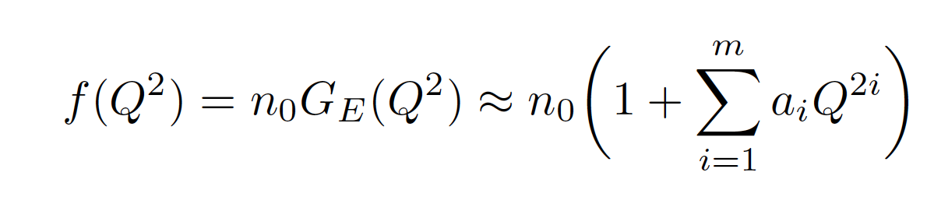
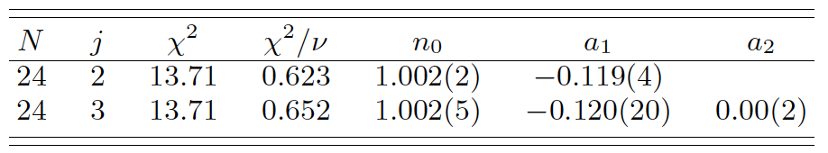
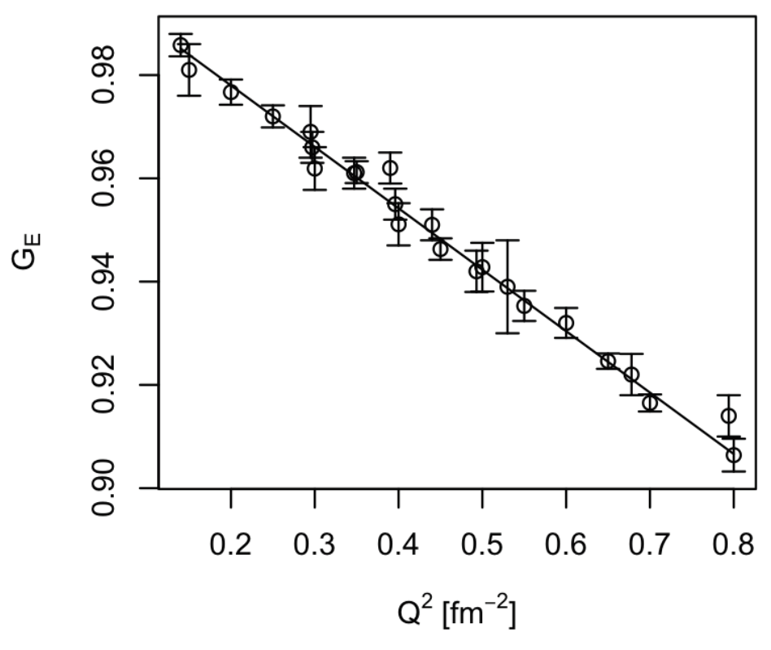
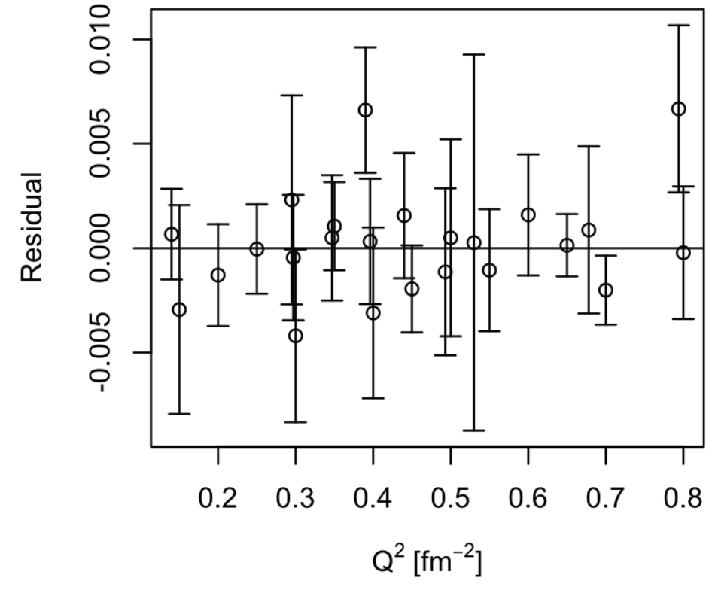
Real World Example
G. G. Simon, C. Schmitt, F. Borkowski, and V. H. Walther, Nucl. Phys. A333 (1980) 381.
J. J. Murphy, Y. M. Shin, and D. M. Skopik, Phys. Rev. C9 (1974) 2125.
F-test rejects fitting with the more complex j=3 (j=m+1) function, that does NOT mean a₂ = 0.
Pohl et.al’s 0.84 fm radius would predict an a₁ value of - 0.1176 since radius = sqrt(-6a₁)

Slide 27
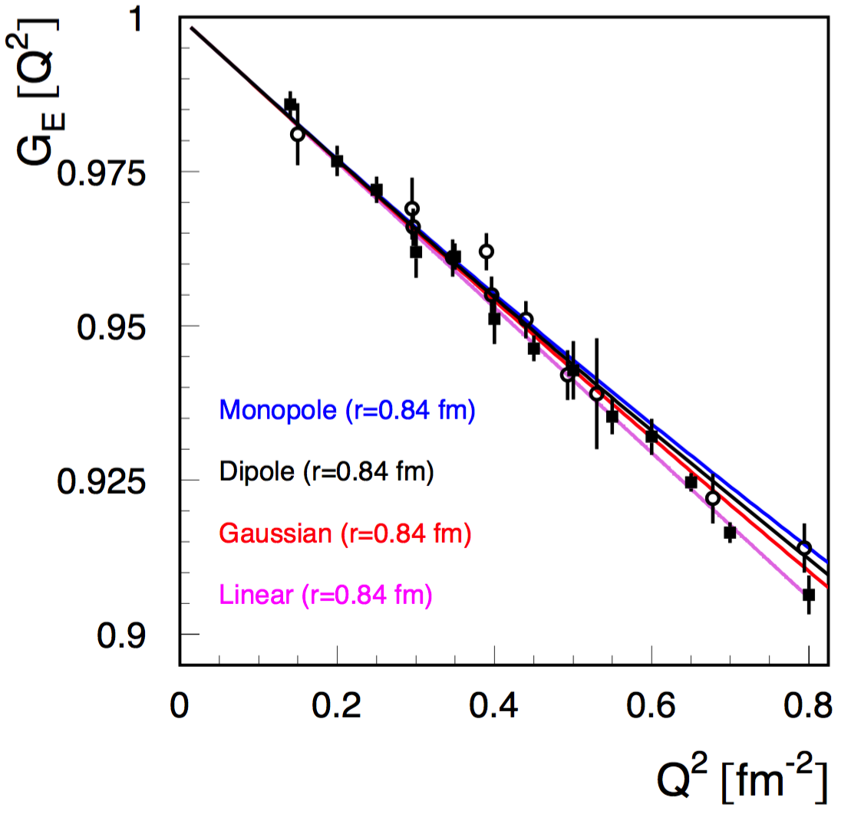
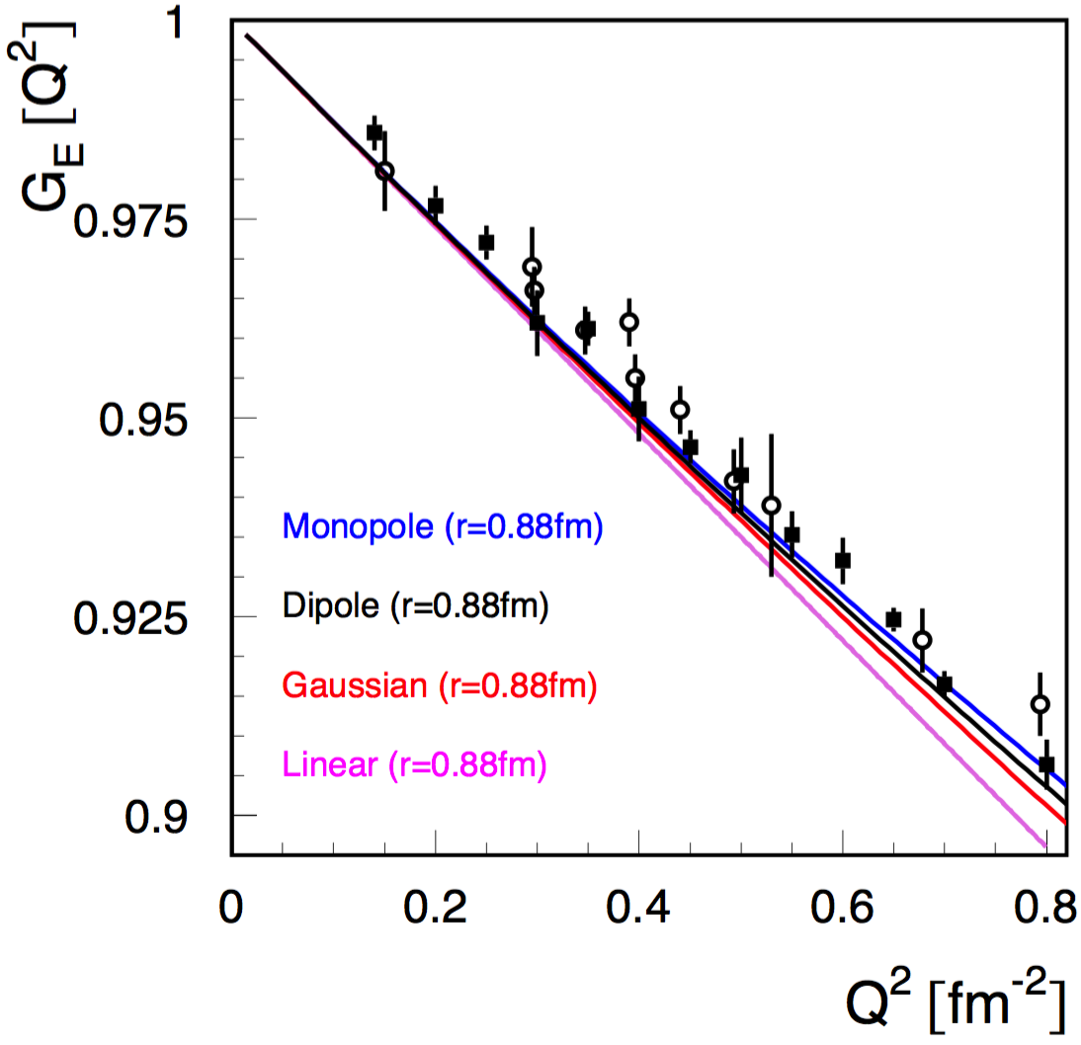
Plotting Published Results & Standard Functions
- These are NOT regressions, just the data as published and standard curves. -
0.84 fm radii
0.88 fm radii
Closed Circles Mainz 1980 results and open circles Saskatoon 1974 results.
Note how for a fixed radius, all functions come together as Q² gets < 0.4 fm⁻².

Slide 28
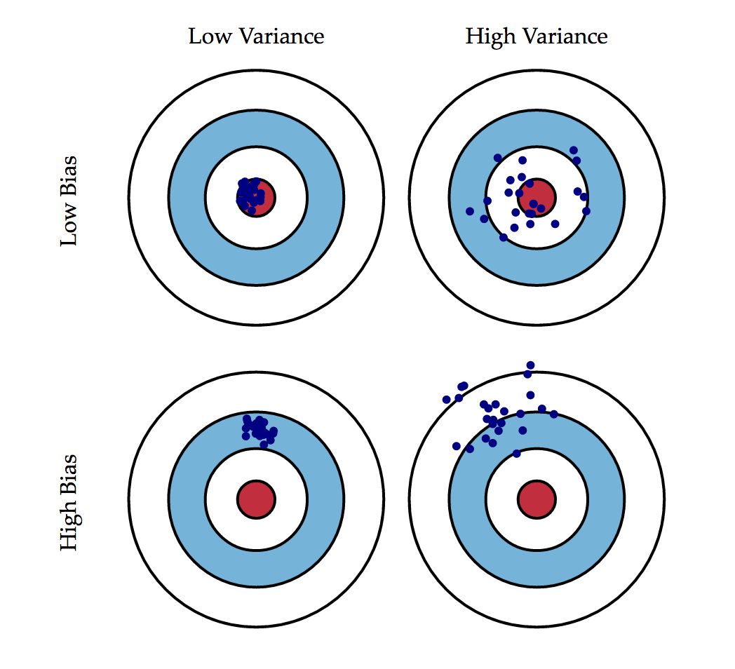
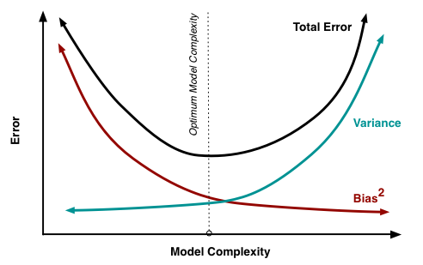
Bias vs. Variance
http://scott.fortmann-roe.com/docs/BiasVariance.html
“Models with low bias are usually more complex (e.g. higher-order regression polynomials), enabling them to represent the training set more accurately. In the process, however, they may also represent a large noise component in the training set, making their predictions less
accurate - despite their added complexity. In contrast, models with higher bias tend to be relatively simple (low-order or even linear regression polynomials), but may produce lower variance predictions when applied beyond the training set.”
NOTE: We run ONE experiment, not the thousands of a Monte Carlo!
(i.e. low bias at the price of high variance is bad)

Slide 29
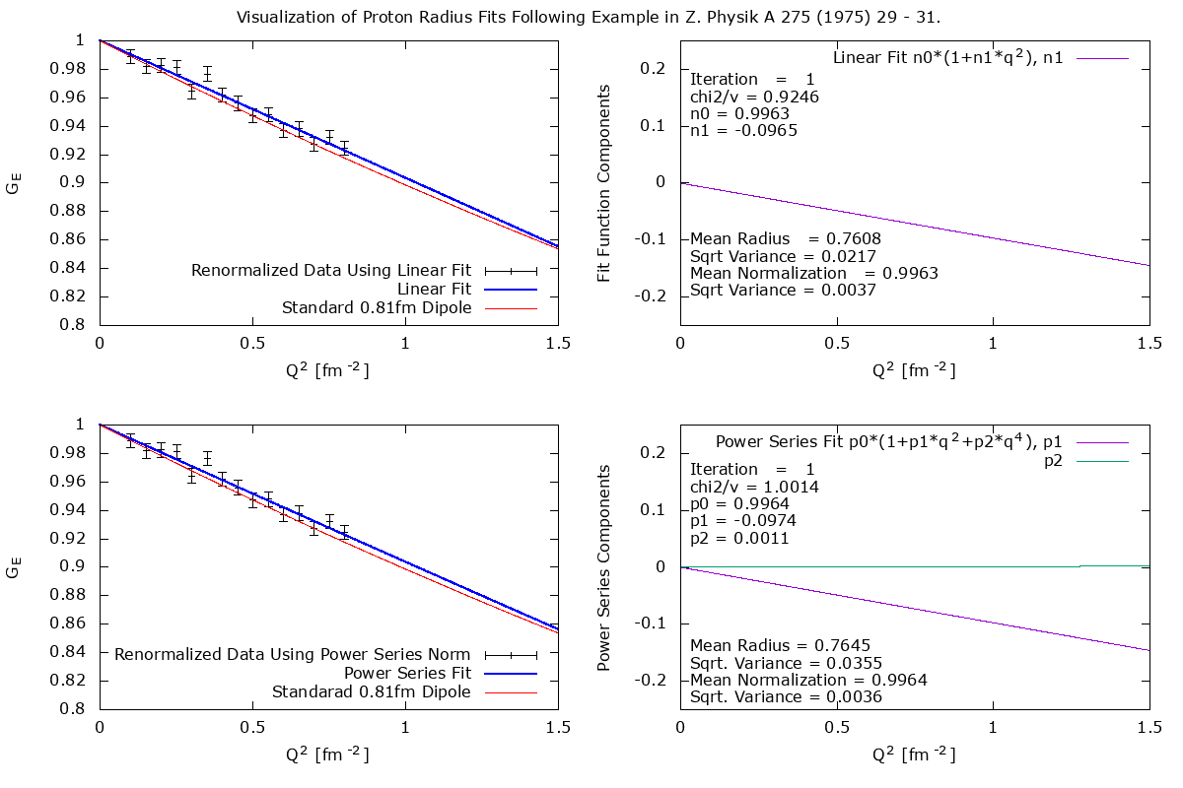
The Bias-Variance Trade-Off

Slide 30
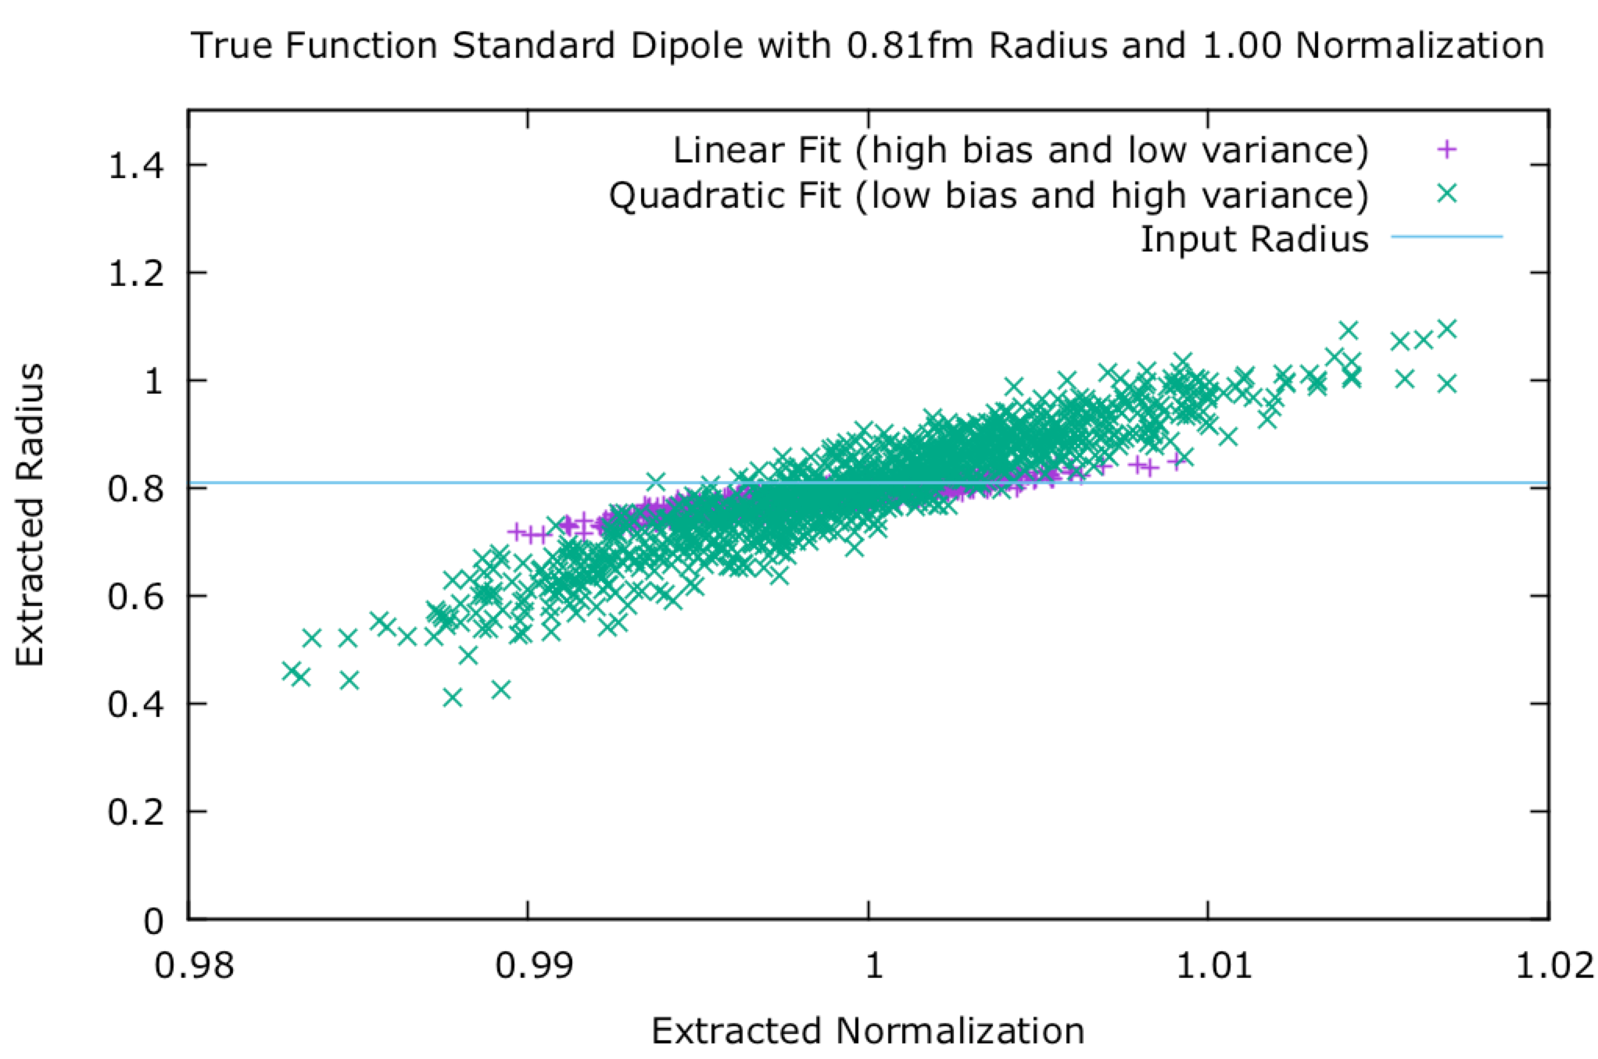
The Bias-Variance Trade-off

Slide 31
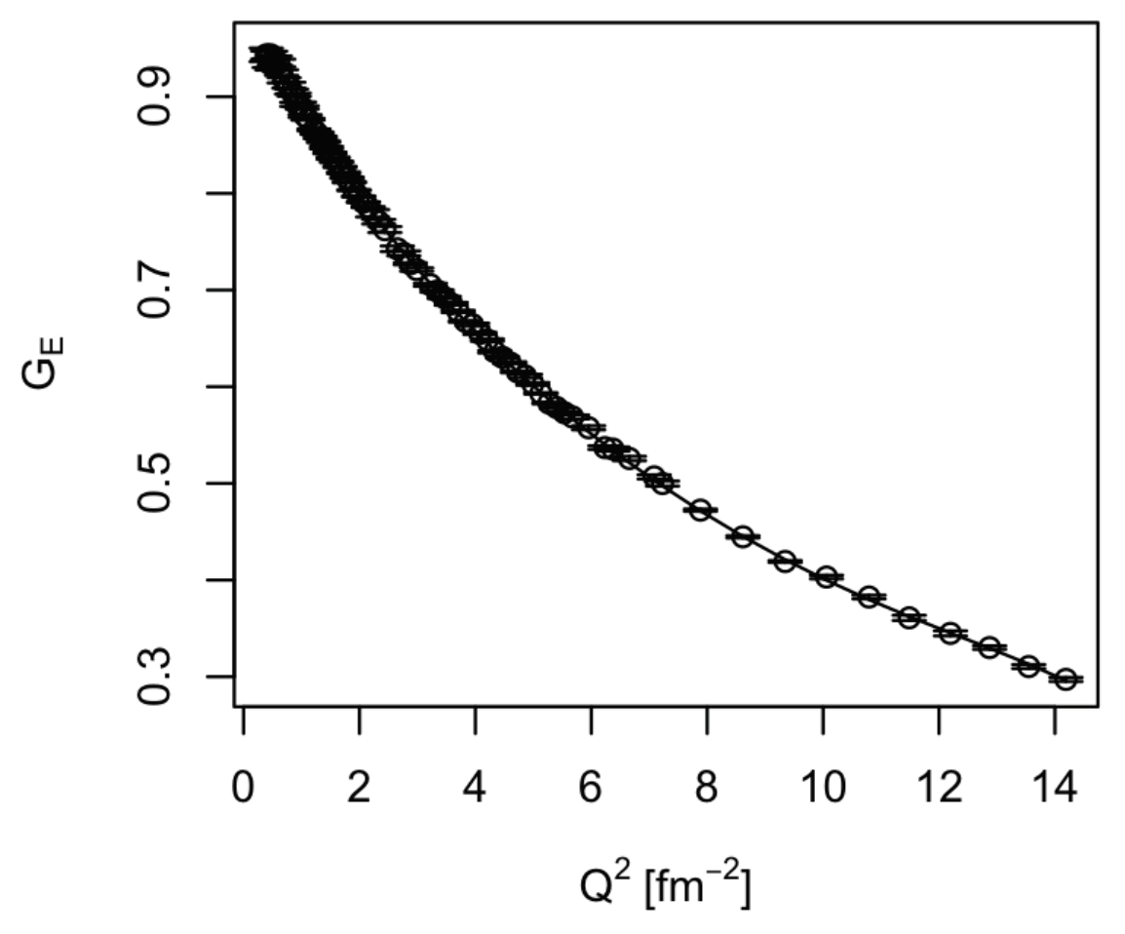
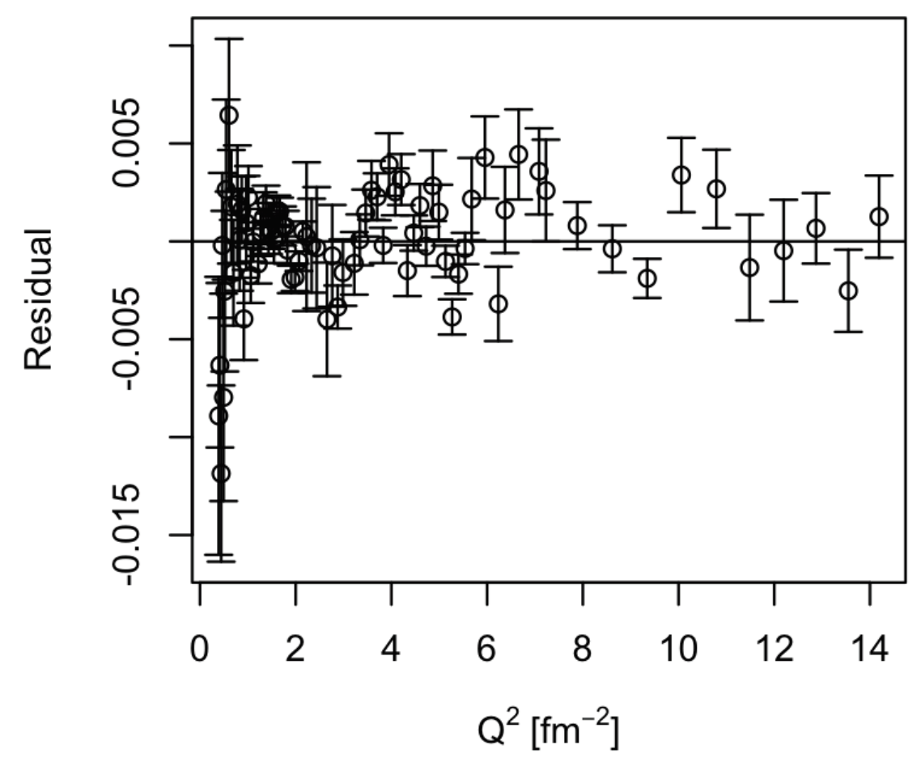
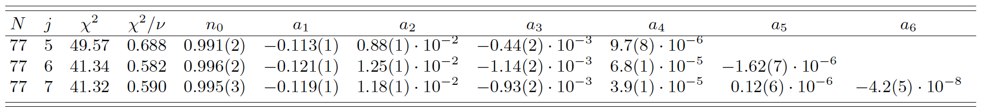
Mainz 2014 G_{E} Rosenbluth Data
Data found in J. Bernauer et al., Phys Rev. C90 (2014) 015206 supplemental material.
Using F-test one rejects the 6th order polynomial, lower orders should be investigated!
BUT one should be very wary of using a high order polynomials to extrapolate beyond the data.

Slide 32
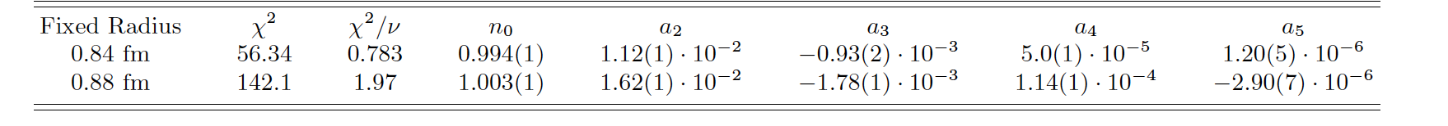
Fixed Radius Fits
DWH et al., Phys. Rev. C (2016).
Again using the Mainz 2014 Rosenbluth results.
Fit a power series with radius fixed to the two competing hypotheses
  0.84 fm from Muonic hydrogen
  0.88 fm from Atomic hydrogen
But high order polynomials cannot extrapolate.

Slide 33
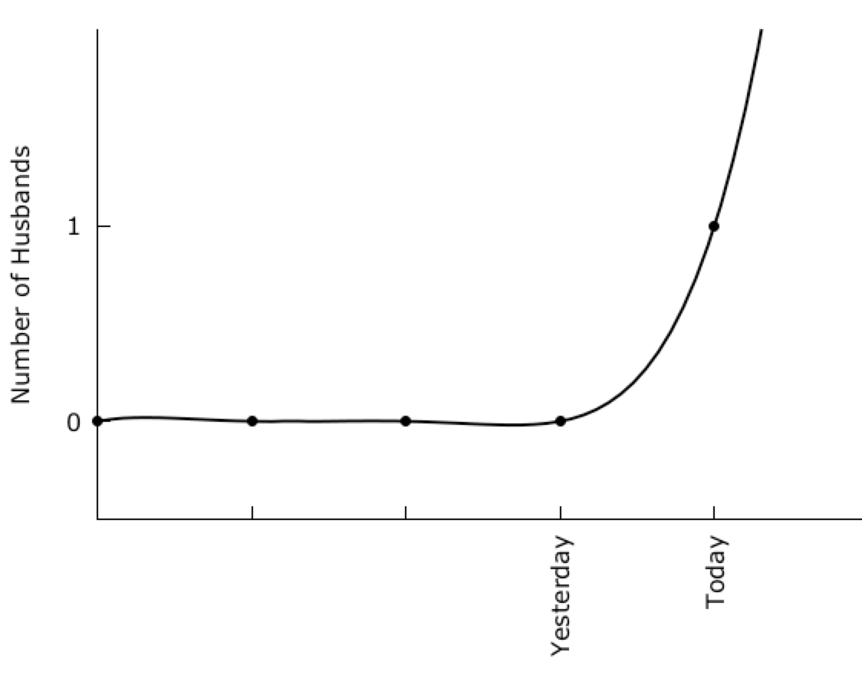
Minimum Chi² Minimum = ZERO
This one is even better then
my two parameter exp. fit!
Fit function f(x) = f0 + f1*x + f2*x^2 + f3*x^3 + f3*x^4
WARNING: Chi² tests will not save you from using an in-appropriate function!

Slide 34
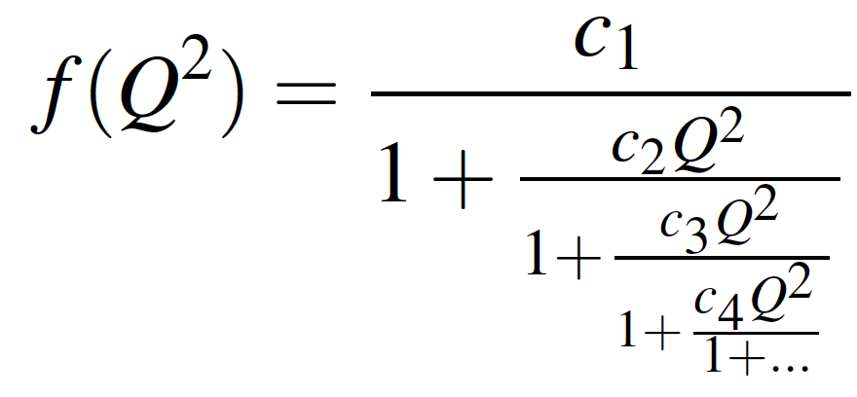
Padé Approximant & Continued Fractions
Pade’ Approximant
Continued Fraction
When it exists, the Pade’ approximant (N,M) of a
Tayler series is unique.
a₀ + a₁ x¹ + a₂ x² … + a^{M} * x^{M}
1 + b₁ x¹ + b₂ x² ... + b^{N} * x^{N}
f(x) =
In our case we want f(x) = n₀ G_{E}(Q²), so
1 + a₁ Q₂ + a₂ Q⁴ … + a^{M*2} * Q^{M*2}
1 + b₁ Q₂ + b₂ Q⁴ ... + b^{N*2} * x^{N*2}
f(x) = n₀
( Henri Padé ~ 1860 )
( Ancient Greeks )
Further reading: Extrapolation algorithms and Padé approximations: a historical survey
C. Brezinski, Applied Numerical Mathematics 20 (1996) 299.

Slide 35
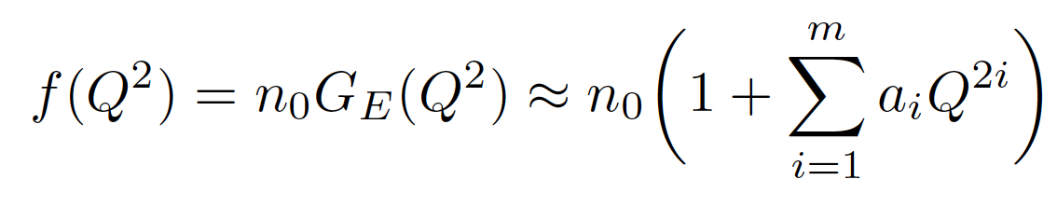

Maclaurin, Padé Approximant & Dipole Fits
Using the Mainz14 Rosenluth Results (where G_{E} & G_{M} well constrained by the data).
Used f test to rule out j=7 ( m = 6 & n₀ term )
WARNING: F test can reject functions, but
It doesn’t tell you which of the remaining is
“best” or most appropriate.
(i.e. inspect the results! )
These fits all give results that favor a proton radius of ~0.84 fm.
Note how Padé and dipole fits extrapolate nicely, while the Maclaurin quickly diverge.
Extrapolate well.

Slide 36


William & Mary Analysis
K. Griffioen, C. Carlson, S. Maddox, Phys. Rev. C93 (2016) 065207.
0.020 GeV² = 0.51 fm⁻²
1 GeV² = 25.7 fm⁻²
Linear and Quadratic Fits of Low Q² Data & Continued Fraction Fits To Q² of 1 GeV² ( 25.7 fm⁻²)
All three results consistent with the 0.84 fm radius of the Muonic hydrogen Lamb shift.
NOTE: Publishing simple explanations that disagreed with complex 0.88 fm results proved to be amazingly challenging.

Slide 37


ChPT Inspired Analysis
M. Horbatsch, E. A. Hessels, and A. Pineda, Phys. Rev. C 95 (2017) 035203.
Idea to use ChPT to constrain moments.
Non-linear model mathematics fits in order to float normalizations.
Colors Indicate Different Floating Normalizations (as defined by Mainz)
Not clear yet to me that the uncertainty is really Gaussian about the mean.
Radius 0.855(11) fm
68% CL

Slide 38

Beyond Simple Fitting: Stepwise Regression
http://spectrum.ieee.org/computing/software/the-2016-top-programming-languages
IEEE Rankings are based mostly on CPU usage (i.e. big data)

Slide 39




Stepwise Regression of G_{E} from 2014 Data
Using Same Stepwise Code
Twice The Range
Still The Same Answer
Pohl et.al’s 0.84 fm radius would predict a slope of - 0.1176 !!

Slide 40
But these values are too small!
The CODATA value of the proton radius is presently 0.8751(60)fm
“The commonly used polynomial of first order yields radius values which are too small.” – Z. Phys. A 275 (1975) 29.
How did they know it was too small ?! (i.e. you need to know the true radius to know what is truly too small.)
Monte Carlo’s are still being used to do this proof except the functions are often even more complex and tend to bend near the end of the data.
Using an F-Test or stepwise regression, the classic data could not support the extraction of a quadratic term for < 0.8 fm⁻² data.
Low Q² G_{E} fits of Griffioen, Carlson, Maddox also do not show a need to include a quadratic term with their Q² < 0.5 fm⁻² fits.
New paper using ChPT calculated moments indicate the expectation is that the moments are relatively small.
So why did Mainz report a large radius with their new data?!

Slide 41

Mainz 2014 1422 Data Points Plotted vs. Q²
Absolutely beautiful data!
Elastic Cross Section / Mott Cross Section
1 fm⁻²
[ GeV/c² ]
25.7 fm⁻²
NOTE: Q² = Q²(E,theta) has a kinematic max., Q²_{max}(E,180º), which these Padé fits nicely reproduce.

Slide 42



Mainz 2014 G_{E} & G_{M} (Blue Band)
Example Results from Bernauer et al., Phys Rev. C90 (2014) 015206.
Blue Bands are the Mainz results and the points are world data.
Mainz data is available within the PRC supplemental material:
http://journals.aps.org/prc/supplemental/10.1103/PhysRevC.90.015206
And a re-binned version is available from Lee, Arrington, and Hill:
http://journals.aps.org/prd/supplemental/10.1103/PhysRevD.92.013013

Slide 43



Bernauer et al.’s Large Proton Radius Comes From A 51 Parameter Covfefe Regression!
plus 31 floating normalizations

Slide 44



Proton Radius vs. Order of Polynomial Fits
MY Fits to the full 1422 points of the Mainz 2014 Data Using A Python Regression Code That Reproduces The PRC Results
- NOT THE SAME X² AS THE EARLIER FITS AS MAINZ FLOATS NORMALIZATIONS WITHOUT PENATLY TERMS -
Fits all include the Mainz’s 31 normalization parameters.
Even with 51 parameters (x2 10 & 31 norms) reduced chi2 never gets to unity.
If uncertainty estimates are increased by 0.001, then 4th order reduced chi2 less then unity.
( see the Dos and don’ts of chi-square - http://arxiv.org/abs/1012.3754 )

Slide 45



So what the heck is going on?! (residual to the dipole functions)
It is the back angle data (i.e. G_{M} dominated) that is driving the “need” for higher order fits.

Slide 46

Classic Test: Use data not included in the fit.
Fits of the full 1422 point Mainz using a Python fitting code based on the Mainz fitting routine.
Function that can extrapolate well tend to give agreement with world G_{M} & a smaller radius…

Slide 47


Simple G_{E} vs. Complex G_{E}
At least it is clear standard dipole doesn’t work well . . .

Slide 48


But Perhaps A Better “Standard” Dipole

Slide 49

Simple Example of a Runge Type Phenomena
Runge, a German mathematician, and physicist, was famous for discovering that going to higher degrees polynomials does not always improve accuracy.
Using standard polynomial fitting functions and some random equal weight data points.
y-axis
Free End Point
x-axis
For electron scattering, there has been a nearly equal spacing from the lowest Q² data to zero
since the Hand review article from 1963. (PRad will address this possible problem.)

Slide 50


PRad: Hall B Proton Radius Experiment
Small angle and small Q² to minimize the effects of G_{M} and provide best measurement of G_{E}
Gas Target (the proton) and GEM Detectors (scattering angles) & CEBAF (the beam energy)
The Collaboration & Jefferson Lab staff did an
amazing job getting this experiment ready and was the first completed experiment for the upgraded CEBAF accelerator.

Slide 51

Expected Precision of PRad Data
DNP PRAD Talks
HC.03 Li Yi (MSU)
HC.04 Weizhi Xiong (Duke)
HC.05 Maxime Levillain (NCAT)
KF.02 Xinzhan Bai (UVA)

Slide 52



New Atomic Hydrogen Lamb Data
0.83(1)fm
Result has been submitted for publication.
Preliminary results from talk given at HC2NP and photos from Trento workshop.
for details see Pohl’s talk at https://indico.cern.ch/event/492464/timetable/#20160930.detailed

Slide 53
Summary
“All models are wrong, some models are” – George Box
Occam’s Razor - Among competing hypotheses, the one with the fewest assumptions should be selected.
Confirmation Bias - Tendency to search for or interpret information in a way that confirms one's preconceptions.
To try to avoid confirmation bias, one can apply statistical modeling techniques such as F-tests, AIC, Stepwise Regression, etc. to determine the function to fit a given set of data.
  R based Stepwise Regression Code Posted Along With Example Data Sets
  http://jeffersonlab.github.io/model-selection/
With these kinds of techniques, electron scattering data produces a proton radius consistent with the Muonic hydrogen data (0.84 fm)
  Higinbotham et al., Phys. Rev. C 93 (2016) 055207
  Griffioen, Carlson, and Maddox, Phys. Rev C 93 (2016) 065207 .
Codes Such As R Provide An Amazing Open Source Statistical Toolbox!
Lots of new proton results coming, including new PRad (Hall B), MUSE, as well as many new Hydrogen Lamb shift measurements and perhaps a new Rydberg constant!

Slide 54
Further Reading
Particle Data Handbook – Statistics Section
  http://pdg.lbl.gov/2015/reviews/rpp2015-rev-statistics.pdf
The Interpretation of Errors – Fredrick James
  http://seal.cern.ch/documents/minuit/mnerror.pdf
Data Analysis Textbooks
  Data Reduction and Error Analysis – Philip Bevington
  Statistical Methods in Experimental Physics – Fredrick James
  Computation Methods for the Physical Science – Simon Širca
  Probability of Physics – Simon Širca
R Programing Language
  https://www.r-project.org/
Estimation
  Street-Fighting Mathematics – Sanjoy Mahajan
  Guesstimation – Larry Weinstein

