Slide 1
Overview of JLab Nuclear Physics Program
General Introduction: Why Electron Scattering?
15+ years of JLab Experiments: Some Highlights
  The Role of Quarks in Nuclear Physics
  CEBAF’s Original Mission Statement
  Nucleon and Pion Elastic Form Factors and
  Transition Form Factors to Nucleon Excited States
  The Onset of the Quark Parton Model: The Quark-Hadron Transition
  Deep Exclusive Reactions and Semi-Inclusive Reactions:
  Beyond One-Dimensional Substructure of Nucleons
  Constraints on Angular Momentum
  Parity Violating Electron Scattering measurements
  The Strange Quark Content of the Proton
  Fundamental Symmetry Tests
On to 12 GeV Science
and in the future an Electron-Ion Collider

Slide 2
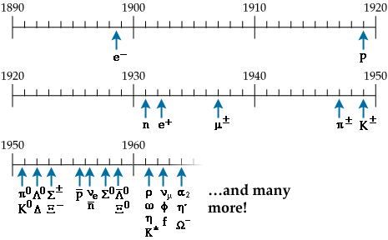
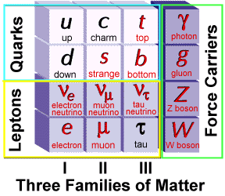
Elementary Particles
Protons , neutrons and electrons (p,n,e) build all the atoms.
Proton and neutrons make up 99.9% of the visible mass in the universe.
Dozens of new particles were discovered in the past century.
Strong interaction: strength can be 100 times the electromagnetic one
leptons (e,μ,ν,..): not involved in strong interaction
hadrons [mesons(π,K,…) and baryons(p,n,…)]: involved in strong interaction
Electron Scattering
Quarks & Gluons: QCD

Slide 3
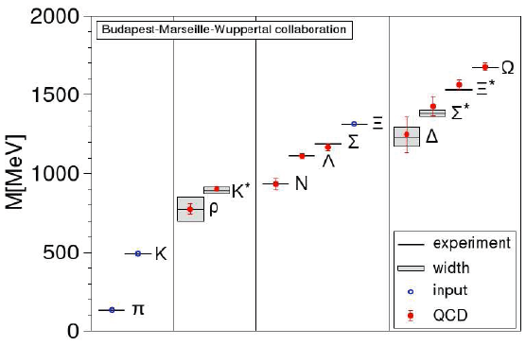
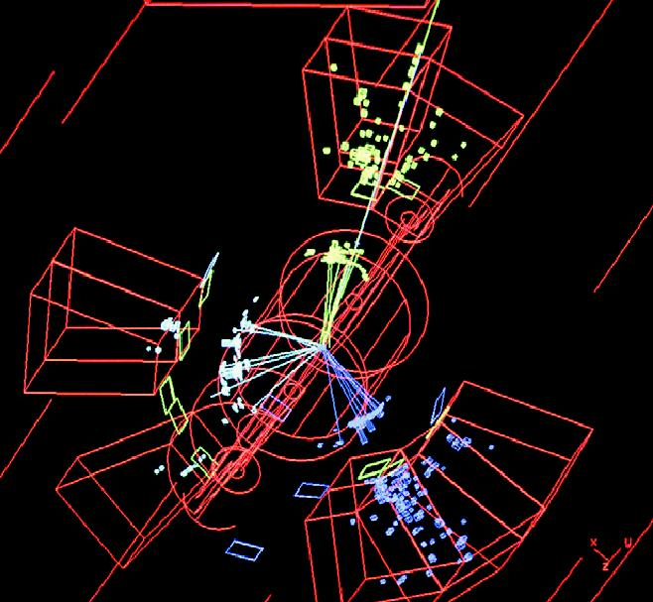
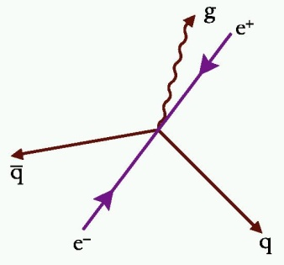
QCD and confinement
QCD
Asymptotic Freedom
Confinement
Small Distance
High Energy
Large Distance
Low Energy
Perturbative QCD
Strong QCD
High Energy Scattering
Hadron Spectrum - no signature of gluons?
Gluon Jets
Observed

Slide 4
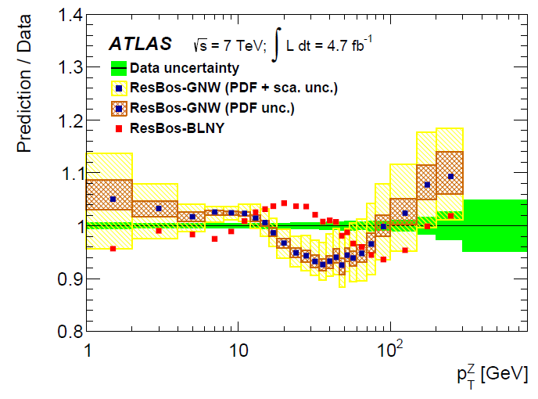
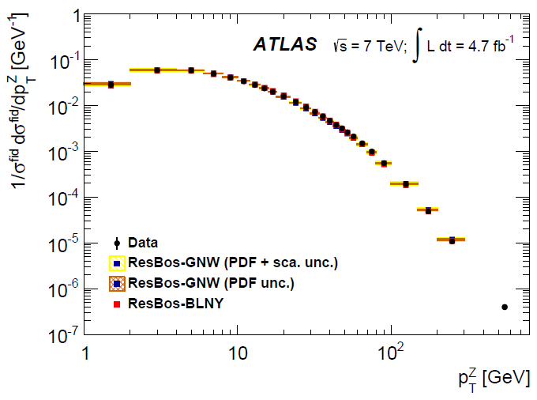
Successful perturbative predictions
Z production at the LHC

Slide 5

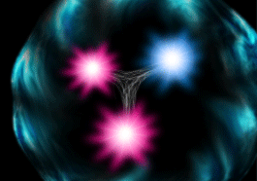
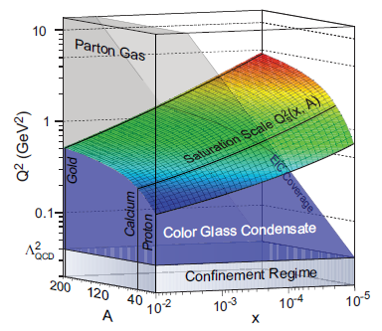
The Structure of the Proton
Naïve Quark Model: proton = uud (valence quarks)
QCD: proton = uud + uu + dd + ss + …
The proton sea has a non-trivial structure: u ≠ d
& gluons are abundant
gluon dynamics
Non-trivial sea structure
The proton is far more than just its up + up + down (valence) structure
Gluon photon:
Radiates
and recombines:

Slide 6
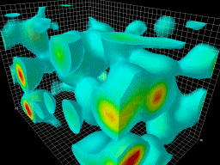
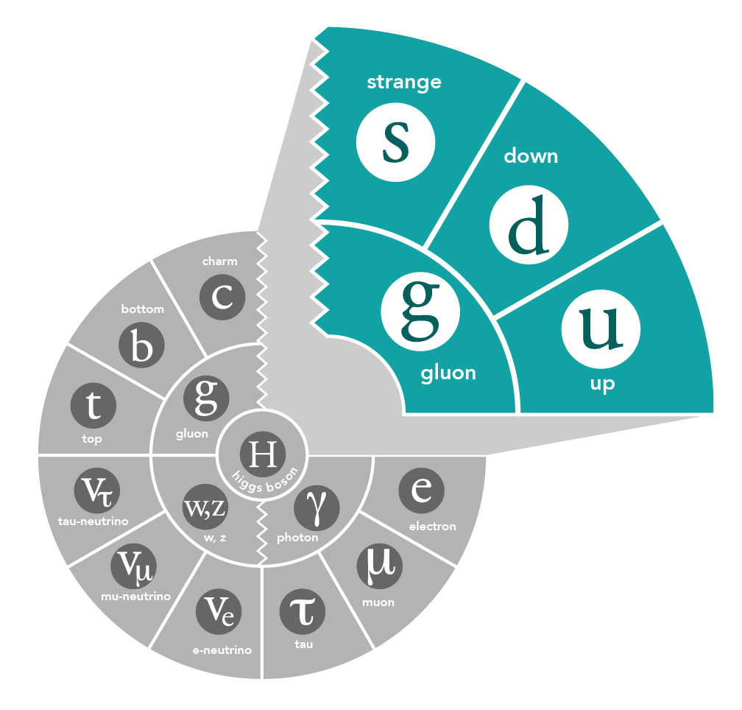
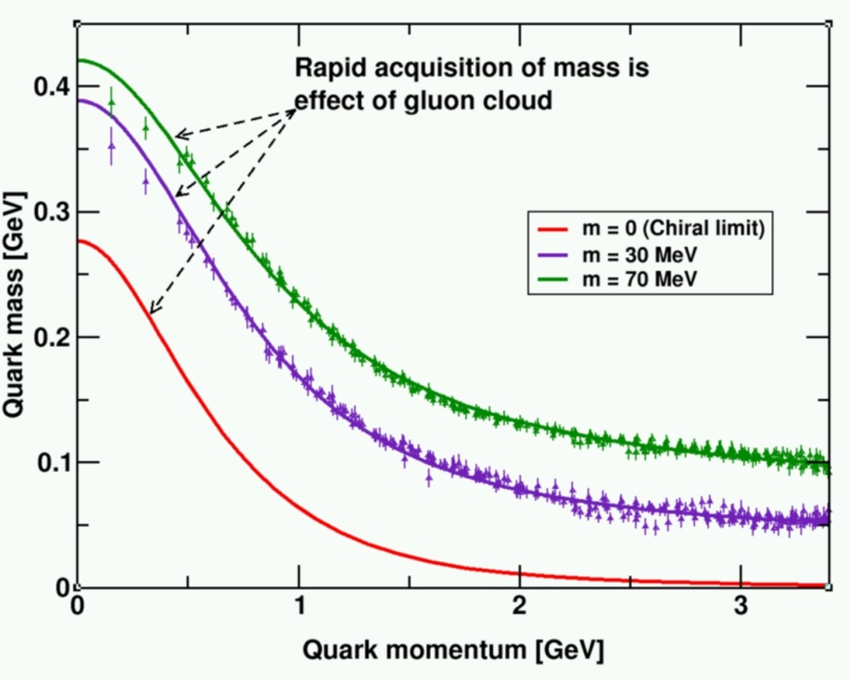
Gluons and QCD
QCD is the fundamental theory that describes structure and interactions in nuclear matter.
Without gluons there are no protons, no neutrons, and no atomic nuclei
Gluons dominate the structure of the QCD vacuum
Facts:
  The essential features of QCD (e.g. asymptotic freedom, dynamical chiral symmetry breaking, and color confinement) are driven by gluons!
  Unique aspect of QCD is the self interaction of the gluons
  Mass from massless gluons and nearly massless quarks
    Most of the mass of the visible universe emerges from quark-gluon interactions
    The Higgs mechanism has almost no role here

Slide 7
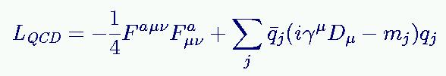



QCD and Nuclei
Gluons mediate the strong (color) force, just like photons mediate the electromagnetic force, but … gluons interact with themselves … which gives QCD unique properties
QCD Lagrangian: quarks and gluons
Nuclear Physics Model is an effective (but highly successful!)
model using free nucleons and mesons as degrees of freedom.

Slide 8
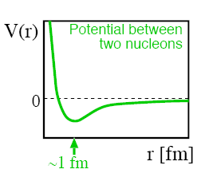
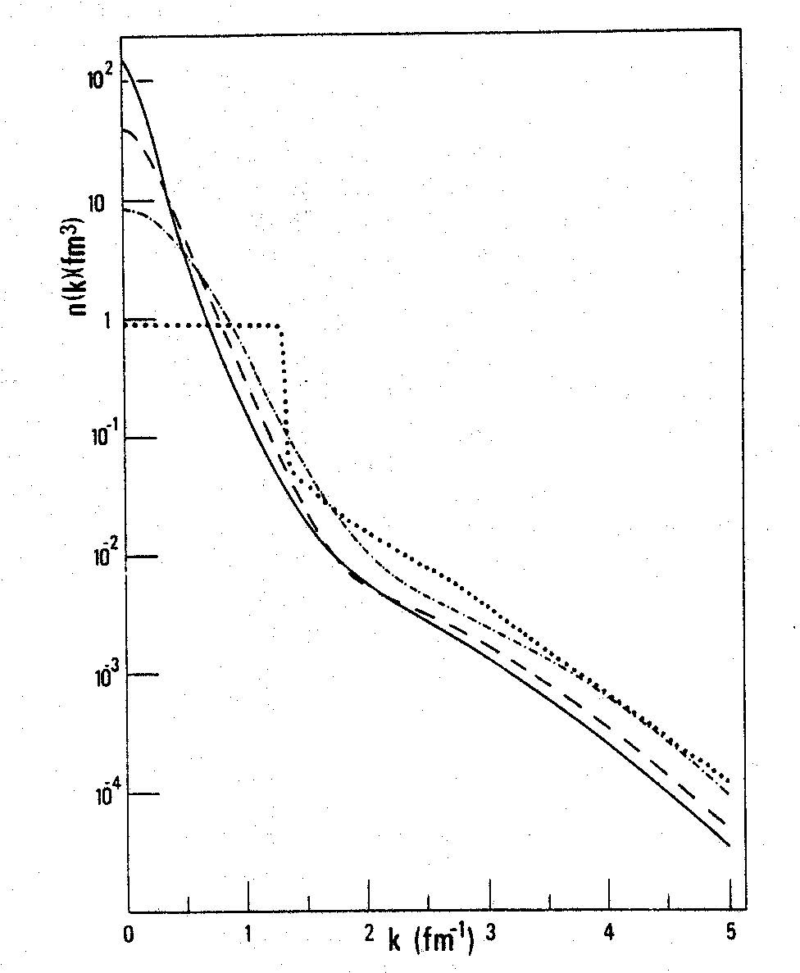

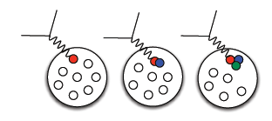
Proton Momenta in the nucleus
Similar shapes for few-body nuclei and nuclear matter at high k (=p_{m}).
Nuclear Matter
Short-range repulsive core gives rise to high proton momenta
β = 0.75
²H
p
n
³He
⁴He
0 200 400 600 800 1000
P (MeV/c)

Slide 9
k’ = (Ε’,k’)
Electron Scattering Kinematics
k = (Ε,k)
Θ
Virtual photon → off-mass shell
q_{μ}q^{μ} = ν² – q² = 0
q = (ν,q)
Define two invariants:
Q² = -q_{μ}q^{μ} = -(k_{μ} – k_{μ}’)(k^{μ}-k’^{μ})
= -2m_{e}² + 2k_{μ}k’^{μ}
(m_{e} ~ 0) = 2k_{μ}k’^{μ}
(LAB) = 2(EE’ – k.k’)
= 2EE’(1-cos(Θ))
= 4EE’sin²(Θ/2)
only assumption: neglecting m_{e}²!!
2) 2Mν = 2p_{μ}q^{μ} = Q² + W² – M²
p = (Μ,0)
Undetected final state X
p’ = (sqrt(p’² + M’²),p’)
Elastic scattering
→ W² = M² → Q² = 2M(E-E’)
(→ p’² = M’² = W²) !!

Slide 10
Electron Scattering at Fixed Q²
Quark (fictitious)
Elastic
ω
Proton
Elastic
Δ
Deep Inelastic
N*
ω

Slide 11
Electron Scattering at Fixed Q²
Elastic
Nucleus
Deep Inelastic
Δ
Quasielastic
N*
ω
Proton
Elastic
Δ
Deep Inelastic
N*
ω

Slide 12
Extracting the (e,e’) cross section
N_{N} (cm⁻²)
e'
N_{e}
e
(ΔΩ_{e}, Δp_{e})
Scattering probability or cross section

Slide 13
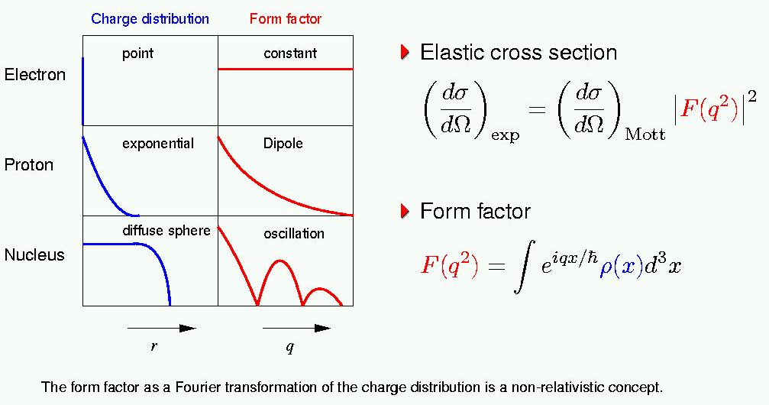
Electron-Charge Scattering
Form Factors characterize internal structure of particles

Slide 14
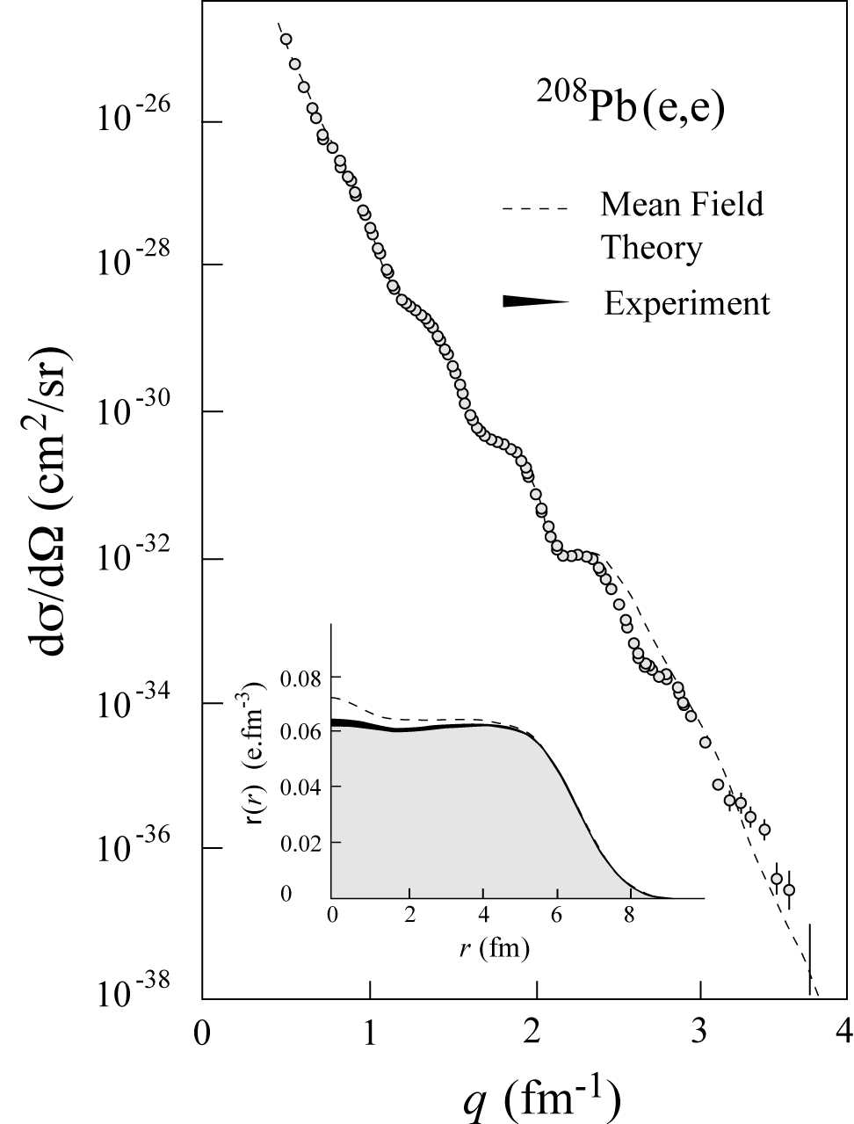
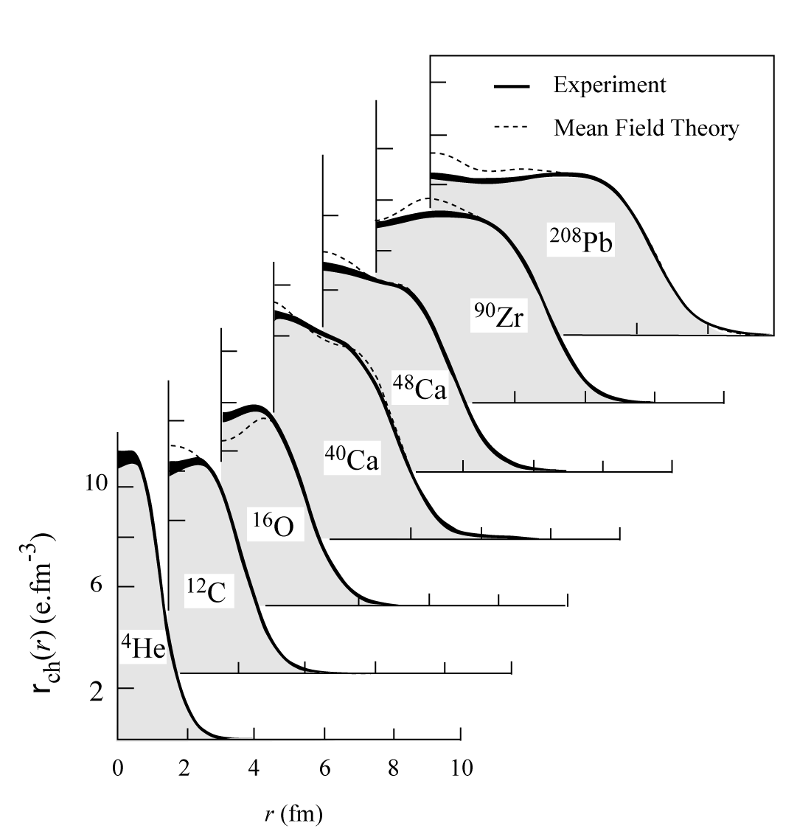
History - Charge Distributions
In ‘70s large data set was acquired on elastic electron scattering (mainly from Saclay) over large Q²-range and for variety of nuclei
“Model-independent” analysis provided accurate results on charge distribution well described by mean-field Density-Dependent Hartree-Fock calculations

Slide 15
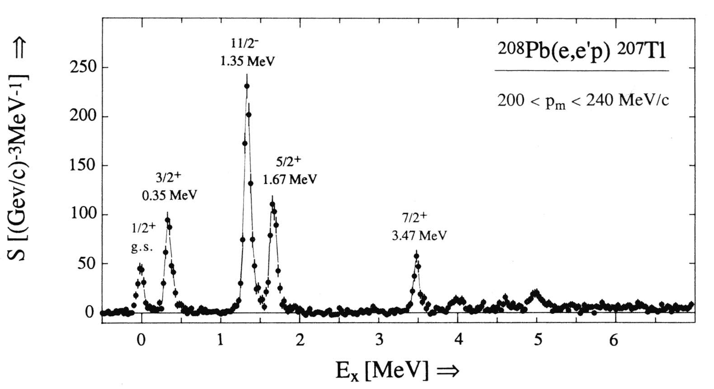
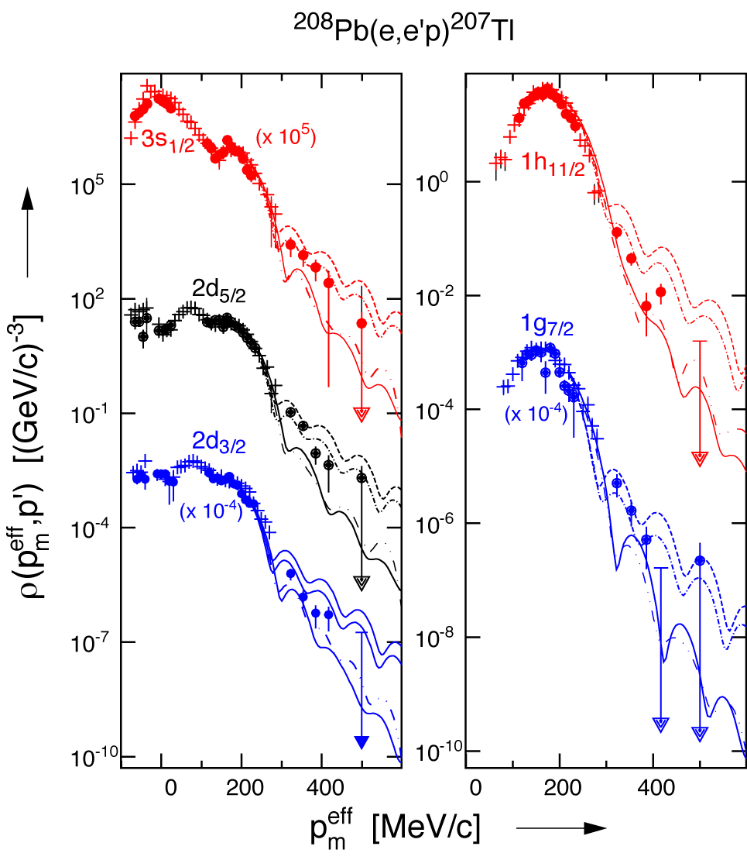
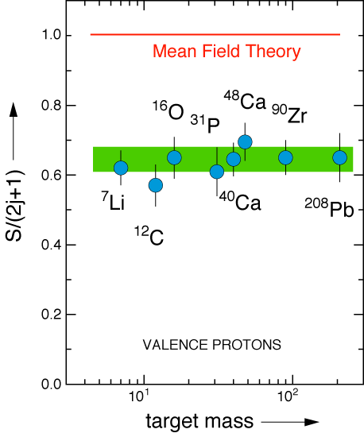
History - Proton Knock-out
ν
in binding
Visualizing the nuclear shell model
in momentum
Missing 20+% in the integral???

Slide 16
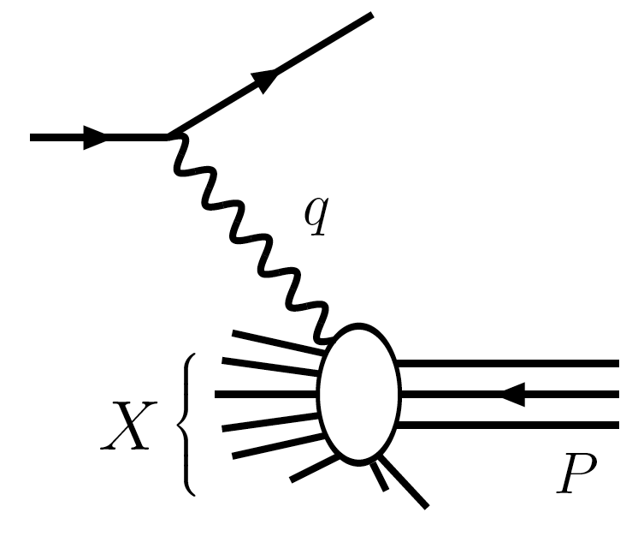
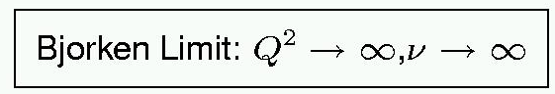
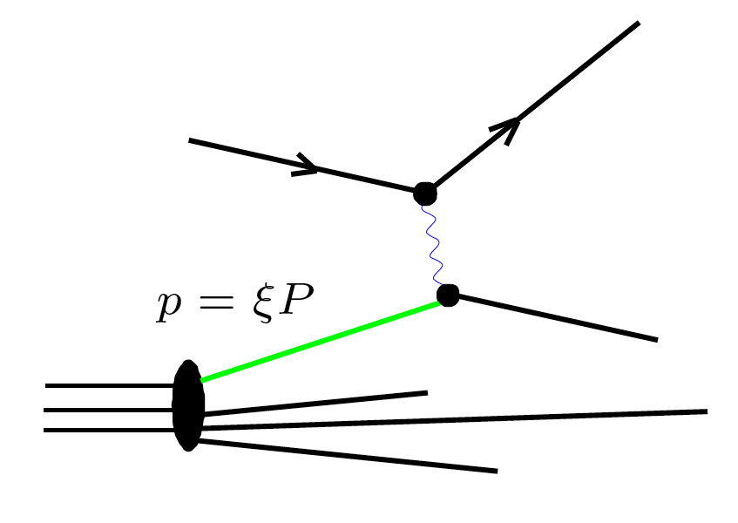



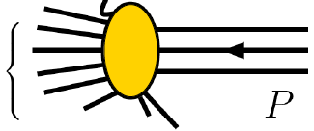






Deep Inelastic Scattering and the Parton Model
Deep Inelastic Scattering – knock a nucleon apart
(Infinite Momentum Frame)
Parton Model : Feynman; Bjorken, Paschos
→ access through Structure Functions F₂ to Parton Distribution Functions
Empirically, DIS region is where logarithmic scaling is observed
Q² > 1 GeV², W² > 4 GeV²

Slide 17
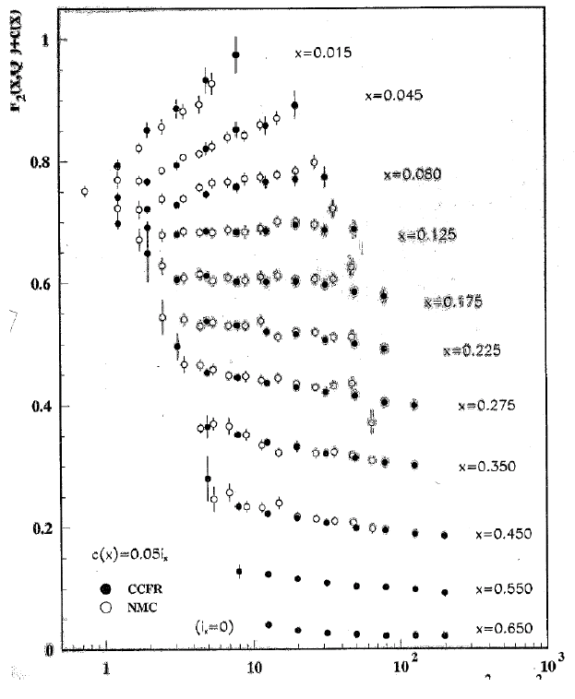
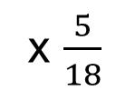
Structure Function by Different DIS Probes
F₂^{μD}
μ DIS
ν DIS
(-)
x $\frac{5}{18}$
F₂^{νN}
F₂(x,Q²) + c(x)
The Classic Example
Extending the scaling found by the venerable SLAC (electron scattering) experiment.
Confirming the basis of the Quark-Parton Model: the expected 5/18 charge weighting works well.
Logarithmic Scaling Violations as anticipated from a renormalizable field theory (QCD) are clearly shown, with both muon and neutrino probes.
Q² (GeV²)

Slide 18
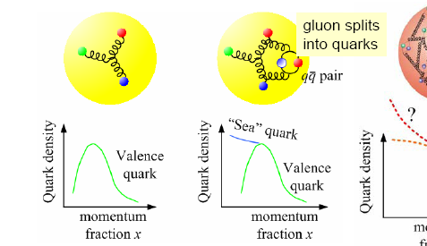
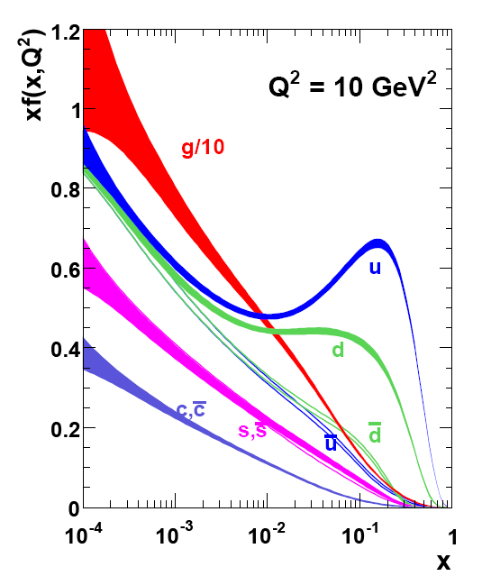
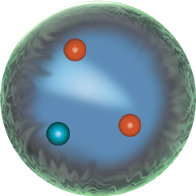
Parton Distribution Functions (PDFs)
PDF q(x): probability that a quark (or gluon) has fraction x of proton’s momentum
proton: uud + uū + dđ + …

Slide 19
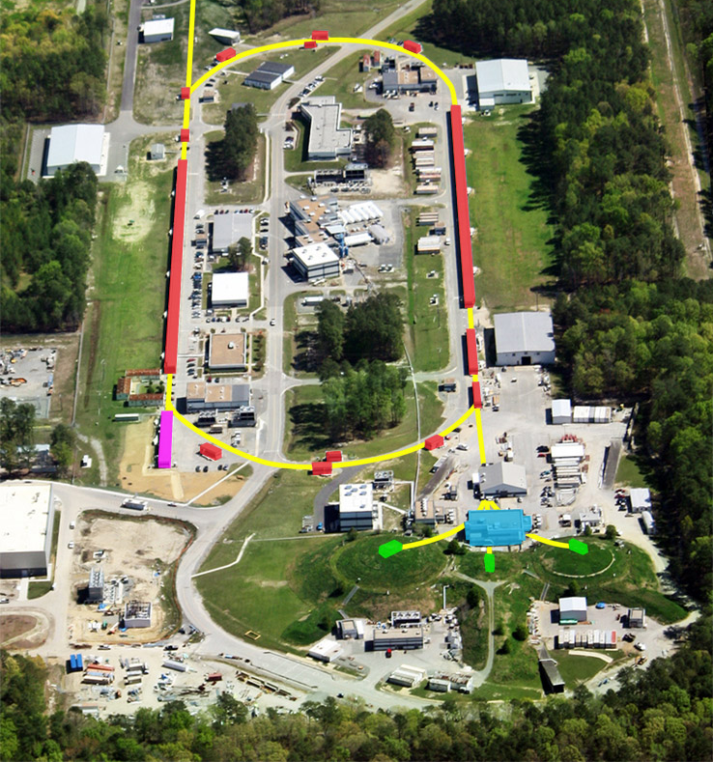
JLab accelerator CEBAF (up to 2012)
D
Continuous Electron Beam
Energy 0.4 ─ 6.0 GeV
200 μA, polarization 85%
3 x 499 MHz operation
Simultaneous delivery 3 halls
Nearly 600 PhDs completed
~1/3 of US PhDs in nuclear physics from CEBAF research
On average 50 undergrads per year involved in research
1598 users in FY17
International: non-US nuclear physics users = 1/3 of total, from 37 countries
A
C
B
FY18: Simultaneous 12-GeV delivery to 4 halls – A, B, C, D

Slide 20
International Character of Jefferson Lab
Remarkable and unique facility, complementary efforts in the international scene for the hadron physics program:
COMPASS at CERN: ~200 GeV muon beam, large acceptance, much lower luminosity.
Mainz (Germany): excellent 2 GeV CW polarized electron beams but limited kinematic reach.
JPARC (Japan): Hadron beam facilities with high intensity kaon and pion beams.
BES (China), BELLE (Japan), BABAR: heavy quark meson spectroscopy in e⁺-e⁻ collisions.
PANDA at GSI (Germany): heavy quark meson spectroscopy in proton-antiproton collisions.
International Users at Jefferson Lab
~1/3 of our 1598 users (FY17) are international, from 37 countries

Slide 21
CEBAF’s Original Mission Statement
Key Mission and Principal Focus (1987):
The study of the largely unexplored transition between the nucleon-meson and the quark-gluon descriptions of nuclear matter.
The Role of Quarks in Nuclear Physics
Related Areas of Study:
Do individual nucleons change their size, shape, and quark structure in the nuclear medium?
How do nucleons cluster in the nuclear medium?
Pushing the Limits of the Standard Model of Nuclear Physics
What are the properties of the force which binds quarks into nucleons and nuclei at distances where this force is strong and the quark confinement mechanism is important?
Charge and Magnetization in Nucleons and Pions
The Onset of the Parton Model

Slide 22
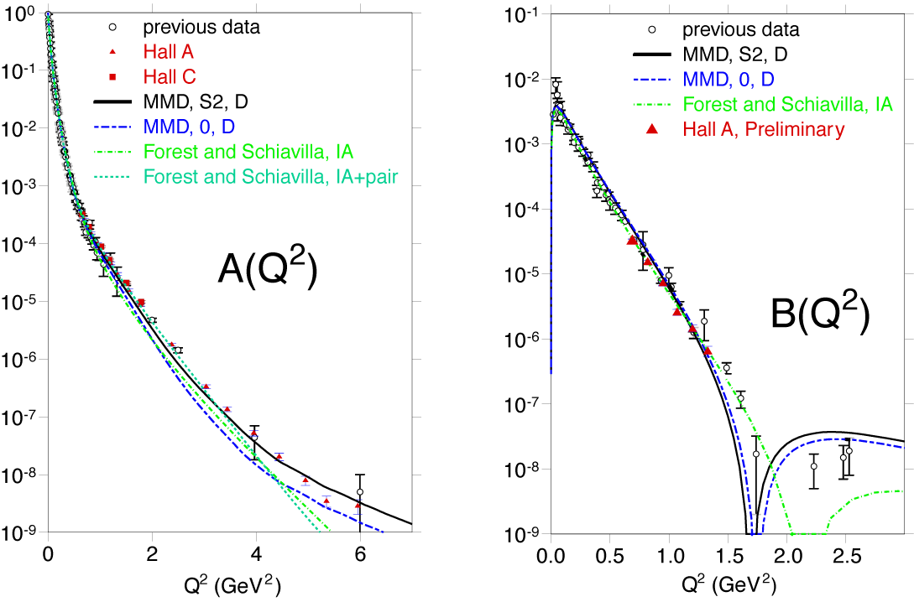
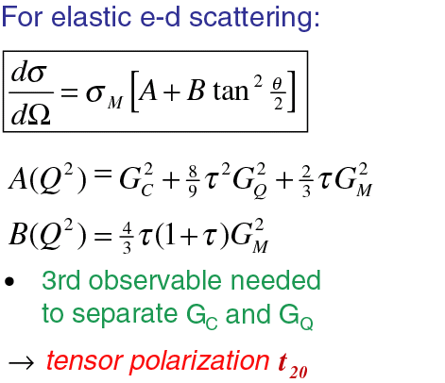
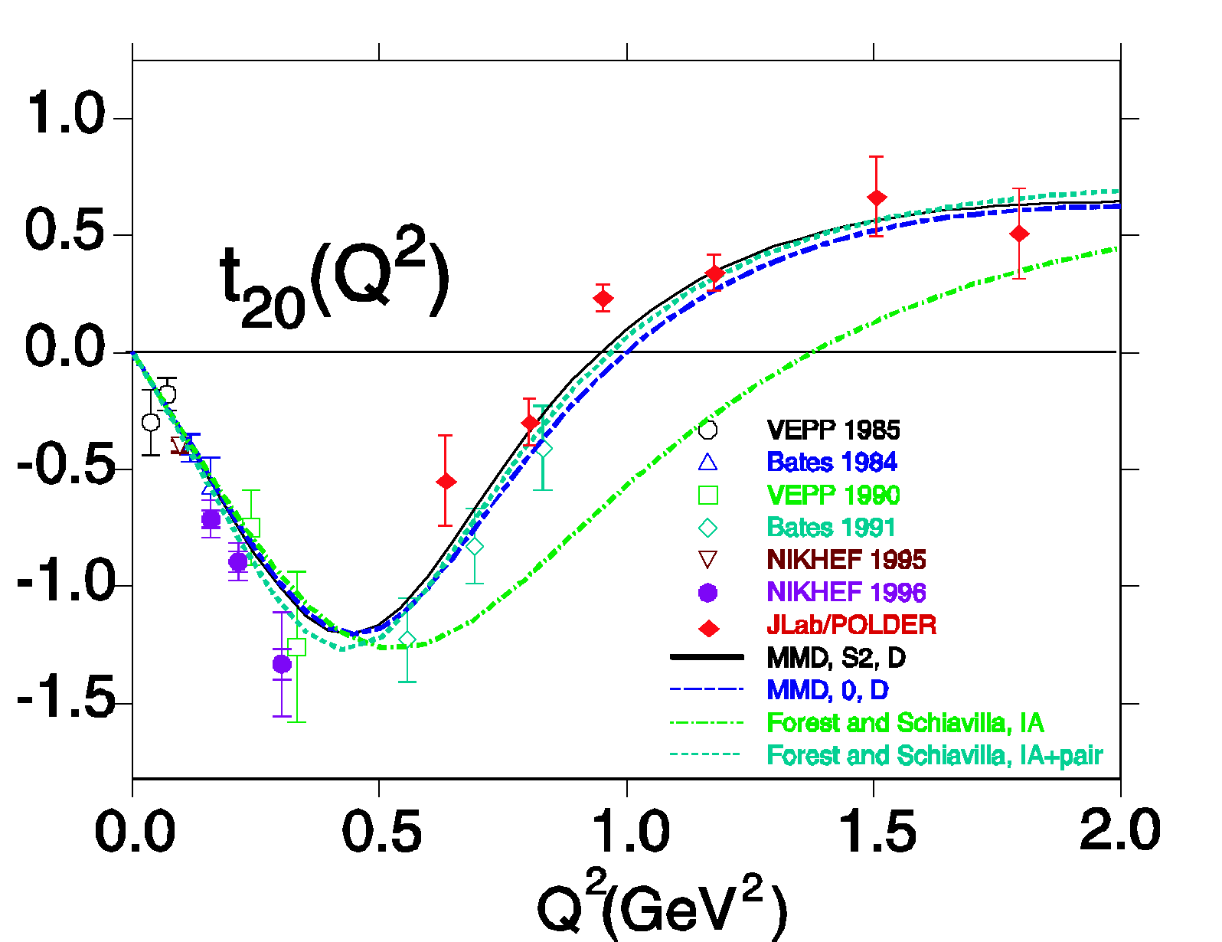
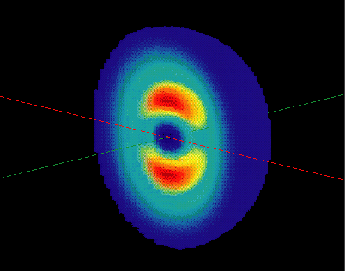

JLab Data Reveal Deuteron’s Size and Shape
Hall A
Combined Data ->
Deuteron’s Intrinsic Shape
The nucleon-based description works down to < 0.5 fm

Slide 23

Is there a Limit for Meson-Baryon Models?
Not really but …
… there might be a more economical QCD description.
Scaling behavior (dσ/dt ∝ s⁻¹¹) for P_{T} > 1.2 GeV/c (see )
quark-gluon description sets
in at scales below ~0.1 fm?

Slide 24
CEBAF’s Original Mission Statement
Key Mission and Principal Focus (1987):
The study of the largely unexplored transition between the nucleon-meson and the quark-gluon descriptions of nuclear matter.
The Role of Quarks in Nuclear Physics
Related Areas of Study:
Do individual nucleons change their size, shape, and quark structure in the nuclear medium?
How do nucleons cluster in the nuclear medium?
Pushing the Limits of the Standard Model of Nuclear Physics
What are the properties of the force which binds quarks into nucleons and nuclei at distances where this force is strong and the quark confinement mechanism is important?
Charge and Magnetization in Nucleons and Pions
The Onset of the Parton Model

Slide 25
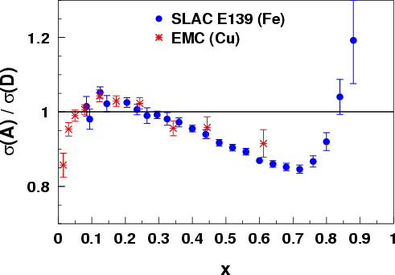
Quarks in Nuclei - History: the EMC Effect
Observation that structure functions are altered in nuclei stunned much of the HEP community 3 decades ago
~1000 papers on the topic; the best models explain the curve by change of nucleon structure, BUT more data are needed to uniquely identify the origin
What is it that alters the quark momentum in the nucleus?
J. Ashman et al., Z. Phys. C57, 211 (1993)
J. Gomez et al., Phys. Rev. D49, 4348 (1994)
x
Notes:
Explain what the EMC effect is.
Point out the three regions and their conventional explanations.
Cannot be fully explained by conventional nuclear physics
Amazing that we still don’t know the answer after nearly a quarter of a century
Coverage extends at least to x=1.5

Slide 26
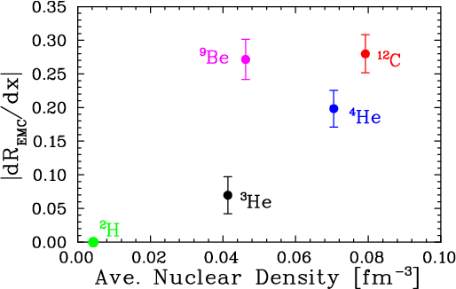
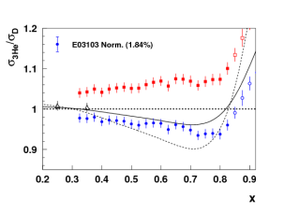
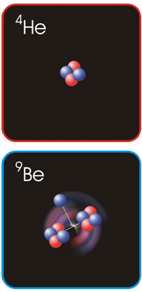
EMC Effect in very light nuclei
EMC effect scales with average nuclear density if we ignore Be
?
Be = 2 α clusters (⁴He nuclei) + “extra” neutron
Suggests EMC effect depends on local nuclear environment
dR/dx = slope of line fit to A/D ratio over region x=0.3 to 0.7
Nuclear density extracted from ab initio GFMC calculation – scaled by (A-1)/A to remove contribution to density from “struck” nucleon
C. Seely, A. Daniel, et al, PRL 103, 202301 (2009)

Slide 27
CEBAF’s Original Mission Statement
Key Mission and Principal Focus (1987):
The study of the largely unexplored transition between the nucleon-meson and the quark-gluon descriptions of nuclear matter.
The Role of Quarks in Nuclear Physics
Related Areas of Study:
Do individual nucleons change their size, shape, and quark structure in the nuclear medium?
How do nucleons cluster in the nuclear medium?
Pushing the Limits of the Standard Model of Nuclear Physics
What are the properties of the force which binds quarks into nucleons and nuclei at distances where this force is strong and the quark confinement mechanism is important?
The Onset of the Parton Model
Use the Nuclear Arena to Study QCD

Slide 28
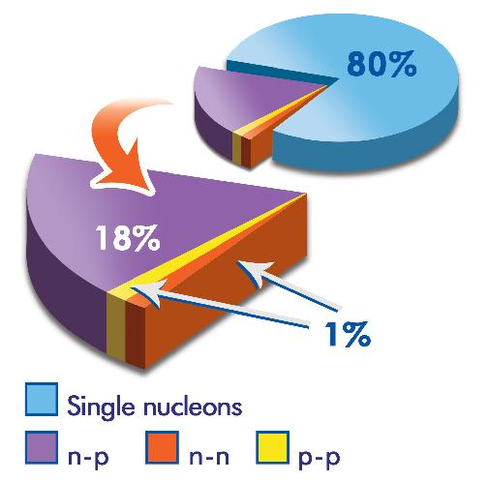
Short Range Correlations in Nuclei
A(e,e’)X, A = ³He, ⁴He, ¹²C, ⁵⁶Fe
A(e,e’pN)X, A =¹²C
Q²/2Mν
Measured Composition ( %)
 | 1N state | 2N SRC
²H | 96 ± 0.7 | 4.0 ± 0.7
³He | 92 ± 1.6 | 8.0 ± 1.6
⁴He | 86 ± 3.3 | 15.4 ± 3.3
¹²C | 80 ± 4.1 | 19.3 ± 4.1
⁵⁶Fe | 76 ± 4.7 | 23.0 ± 4.7
Proton-neutron rate is ~20 x proton-proton rate →
two nucleons close
together are almost
always a p-n pair!
Expected to be due to (short-range) tensor correlations.

Slide 29
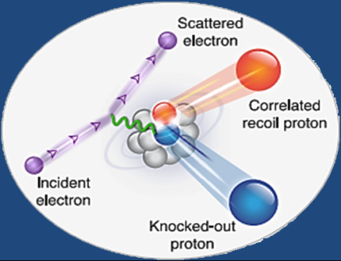
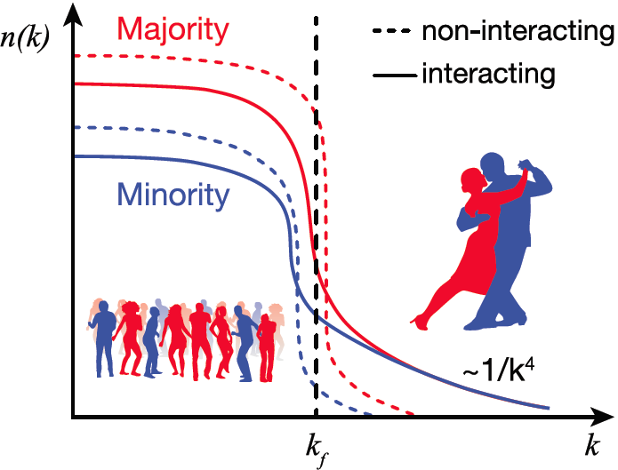
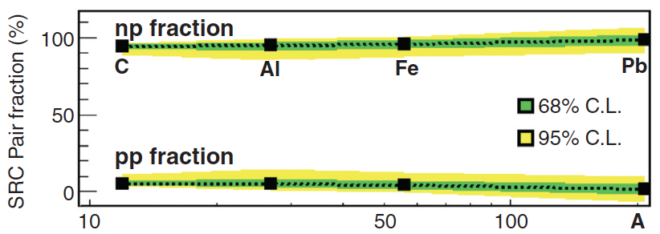
Momentum Sharing in Imbalanced Fermi Systems
O. Hen et al., Science 346 (2014) 614, doi:10.1126/science.1256785
The Jefferson Lab CLAS Collaboration
Selected for Science Express (16 October 2014)
For heavy nuclei, N (#neutrons) > Z (#protons)
“Majority” “Minority”
For non-interacting Fermi gases, neutrons would dominate at all momenta, even above the Fermi momentum k_{F}
In reality, short range nucleon-nucleon correlations dominate the population at k>k_{F}
Isospin dependence of the nucleon-nucleon interaction implies equal numbers of protons and neutrons at k>k_{F}
Experimental Result:
This has implications for the equations of state of neutron stars and atomic interactions in ultra-cold atomic gases.
Notes:
29

Slide 30
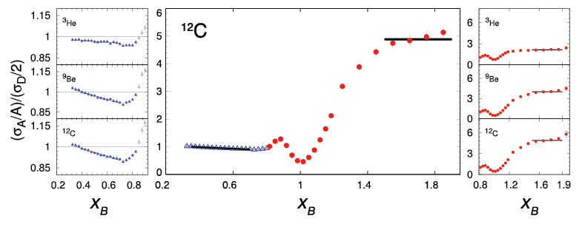
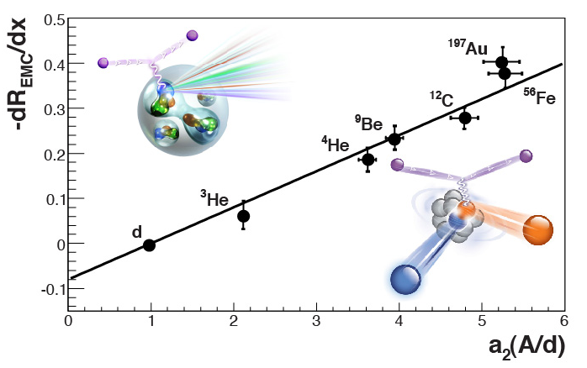
Short-Range Correlations (SRC) and European Muon Collaboration (EMC) Effect Are Correlated
JLab Finding
EMC Slopes
0.35 ≤ x_{B} ≤ 0.7
⁹Be ~
ααn
Fomin et al., PRL 108, 092502 (2012)
SRC Scaling factors x_{B} ≥ 1.4
SRC: nucleons see strong repulsive core at short distances
EMC effect: quark momentum in nucleus is altered
Weinstein et al., PRL 106, 052301 (2011)
How about gluon dynamics and gluon-gluon correlations?

Slide 31
CEBAF’s Original Mission Statement
Key Mission and Principal Focus (1987):
The study of the largely unexplored transition between the nucleon-meson and the quark-gluon descriptions of nuclear matter.
The Role of Quarks in Nuclear Physics
Related Areas of Study:
Do individual nucleons change their size, shape, and quark structure in the nuclear medium?
How do nucleons cluster in the nuclear medium?
Pushing the Limits of the Standard Model of Nuclear Physics
What are the properties of the force which binds quarks into nucleons and nuclei at distances where this force is strong and the quark confinement mechanism is important?
Charge and Magnetization in Nucleons and Pions
The Onset of the Parton Model

Slide 32
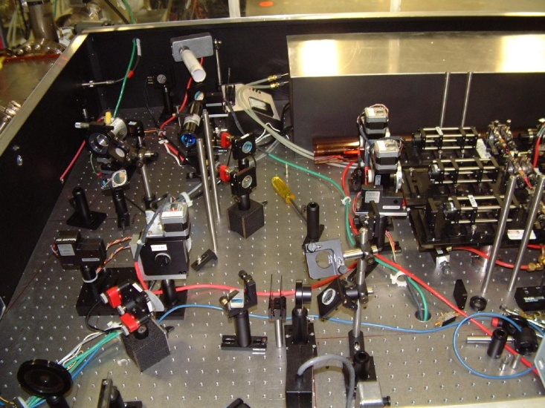
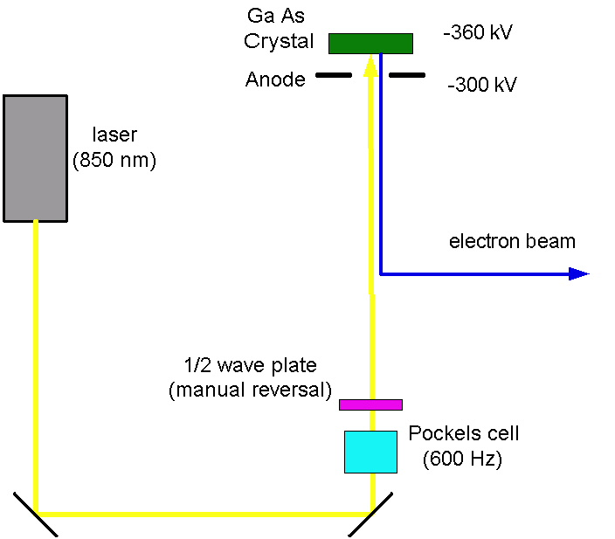
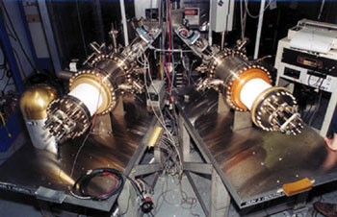
JLab: Polarized Electrons!!!
Electron retains circular polarization of laser beam
Reverse polarization of beam
at rate of 30 Hz
Feedback on laser intensity and position at high rate

Slide 33
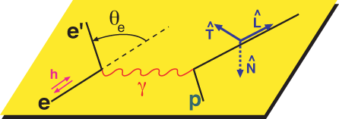


JLab Revolutionized Polarization Experiments!
Precise access to (small) charge form factor of proton utilizing polarization transfer technique: e + p → e’ + p
Spin-dependent scattering
Focal Plane Polarimeter

Slide 34

Proton Charge and Magnetization
2-γ exchange
important
Elastic electron-proton scattering
1) e + p → e’ + p
G_{E}^{p}/G_{M}^{p} constant
2) e + p → e’ + p
G_{E}^{p}/G_{M}^{p} drops with Q²
smaller distance →
Charge & magnetization distributions in the proton are different
charge depletion in interior of proton
JLab Finding
Orbital motion of quarks play a key role
(Belitsky, Ji + Yuan PRL 91 (2003) 092003)
Notes:
34
Note BSM not included in project

Slide 35


What about the neutron?
Hall A
Neutron has no charge, but does have a charge distributions: n = p + π⁻, n = ddu. Use polarization and ²H(e,e’n) to access. “Guarantee” that electron hits a neutron AND electron transfers its polarization to this neutron.
(Polarization Experiments only)
Combining proton and neutron: down quark has more extended spatial charge distribution. Is this due to the influence of di-quarks?

Slide 36


Electron Scattering
Hall B
CLAS
p(e,e’)X
p(e,e’p)X
missing states
2
2π thresh.
1.5
1
Resonances cannot be uniquely separated in
inclusive scattering → measure exclusive processes.
Notes:
While the first resonance contains only the Delta resonance, the
higher mass bumps contain a multiple of known states.
In order to disentangle these states inclusive measurements are
obviously not sufficient, we need to measure exclusive hadronic final states.
(next slide)
Detection of a final state proton allows use of the missing mass technique to isolate ....

Slide 37


Solving the “missing resonances” puzzle
State N(mass)J^{P} | PDG pre 2012 | PDG 2018*
N(1710)1/2⁺ | *** | ****
N(1880)1/2⁺ |  | ***
N(1895)1/2⁻ |  | ****
N(1900)3/2⁺ | ** | ****
N(1875)3/2⁻ |  | ***
N(2120)3/2⁻ |  | **
N(2000)5/2⁺ | * | **
N(2060)5/2⁻ |  | **
Δ(2200)7/2⁻ | * | ***
Star ratings of PDG before 2012 and projections for 2018, following worldwide experimental and theoretical effort.
**** Existence is certain
*** Existence is very likely
** Evidence of existence is fair
* Evidence of existence is poor
*) projected
Notes:
This slides shows a summary of the results in this analysis. The green column shows the rating by the PDG. The two columns show the importance of the strangeness channel in this results.

Slide 38
CEBAF’s Original Mission Statement
Key Mission and Principal Focus (1987):
The study of the largely unexplored transition between the nucleon-meson and the quark-gluon descriptions of nuclear matter.
The Role of Quarks in Nuclear Physics
Related Areas of Study:
Do individual nucleons change their size, shape, and quark structure in the nuclear medium?
How do nucleons cluster in the nuclear medium?
Pushing the Limits of the Standard Model of Nuclear Physics
What are the properties of the force which binds quarks into nucleons and nuclei at distances where this force is strong and the quark confinement mechanism is important?
Charge and Magnetization in Nucleons and Pions
The Onset of the Parton Model

Slide 39



The Revolution in Hadron and Nuclear Structure
Nuclear Physics in terms of protons, neutrons and pion exchange is a very good effective model. Resolution or Momentum transfer Q is negligible
Protons and Neutrons in terms of constituent (valence) quarks is a very decent effective model:
the Constituent Quark Model works surprisingly well.
Resolution or Momentum transfer Q is small
Looking deep inside protons and neutrons:
Quantum fluctuations + special relativity + M = E/c² gives rise to quark-gluon dynamics (structure and interactions).
Resolution or Momentum transfer Q is “large”
The QCD vacuum is not empty, but full of gluon fluctuations: deep in the proton is a wall of gluons
The proton is complex, mass and spin are emergent phenomena
Quantum fluctuations play a role in nucleon structure:
d(x) ≠ u(x)
-
-

Slide 40




Parton Model Ideas Valid @ 6 GeV
Hall A
First measurement in large-x region unambiguously showing that A₁^{n} > 0
(A₁^{n} = 0 in the SU(6) Quark Model)
Allows for Flavor Decomposition:
A₁^{n} in Parton Model ~
x = fraction of nucleon momentum
carried by struck quark

Slide 41



Unified View of Nucleon Structure
W_{p}^{u}(x,k_{T},r_{T}) Wigner distributions
5D Dist.
d²r_{T}
d²k_{T}
TMD PDFs f₁^{u}(x,k_{T}), .. h₁^{u}(x,k_{T})‏
GPDs/IPDs
3D imaging
dx &
Fourier Transformation
d²k_{T}
d²r_{T}
Form Factors
G_{E}(Q²),
G_{M}(Q²)‏
PDFs
f₁^{u}(x), .. h₁^{u}(x)‏
1D

Slide 42
Exploring the 3D Nucleon Structure
After decades of study of the partonic structure of the nucleon we finally have the experimental and theoretical tools to systematically move beyond a 1D momentum fraction (x_{Bj}) picture of the nucleon.
    High luminosity, large acceptance experiments with polarized beams and targets.
    Theoretical description of the nucleon in terms of a 5D Wigner distribution that can be used to encode both 3D momentum and transverse spatial distributions.
Deep Exclusive Scattering (DES) cross sections give sensitivity to electron-quark scattering off quarks with longitudinal momentum fraction (Bjorken) x at a transverse location b.
Semi-Inclusive Deep Inelastic Scattering (SIDIS) cross sections depend on transverse momentum of hadron, P_{h⊥}, but this arises from both intrinsic transverse momentum (k_{T}) of a parton and transverse momentum (p_{T}) created during the [parton → hadron] fragmentation process.
Nuclear Femtography

Slide 43




Towards the 3D Structure of the Proton
Simplest process: e + p → e’ + p + γ (DVCS)
DVCS
e
e
BH
Hall B beam-spin asymmetry data show potential for imaging studies from analysis in x, Q² and t
p
p
F-X. Girod et al., PRL 100, 162002 (2008)
Hall A data for Compton form factor (over limited Q² range) agree with hard-scattering
<-t> = 0.18 GeV²
<-t> = 0.30 GeV²
<-t> = 0.49 GeV²
<-t> = 0.76 GeV²
C. Munoz Camacho et al., PRL 97, 262002 (2006)
Im C’

Slide 44









Features of partonic 3D non-perturbative distributions
Understanding of the 3D structure of nucleon requires studies of spin and flavor dependence of quark transverse momentum and space distributions
Ex. TMD PDF for a given combination of parton and nucleon spins
quark polarization
transverse position and momentum of partons are correlated with the spin orientations of the parent hadron and the spin of the parton itself
transverse position and momentum of partons depend on their flavor
transverse position and momentum of partons are correlated with their longitudinal momentum
U
L
T
T
U
f₁
h₁
Boer-Mulders
nucleon polarization
L
g_{1L}
T
h_{1L}
helicity
spin and momentum of struck quarks are correlated with remnant
quark-gluon interaction play a crucial role in kinematical distributions of final state hadrons, both in semi-inclusive and exclusive processes
worm-gear
T
,
T
T
f_{1T}
g_{1T}
h₁
h_{1T}
Sivers
worm-gear
transversity
pretzelosity

Slide 45





Parity-Violating Asymmetries
Weak Neutral Current (WNC) Interactions at Q² << M_{Z}²
Longitudinally Polarized Electron Scattering off Unpolarized Fixed Targets
(g_{A}^{e}g_{V}^{T} +β g_{V}^{e}g_{A}^{T})
The couplings g depend on both electroweak physics and the weak vector and axial-vector hadronic current, and are functions of sin²Θ_{w}
A
V
Mid 70s goal was to show sin²Θ_{w} was the same as in ν scattering
1990-2010 target couplings probe novel aspects of hadron structure
Ongoing precision measurements with carefully chosen kinematics to probe new physics at multi-TeV high energy scales
V
A

Slide 46

Hall A
Parity Violating Studies on ¹H and ⁴He
The HAPPEx Program: Strange Quark Contributions to the Proton
Open circles: online data
Closed circles: final data

Slide 47

The Spatial distribution of quarks and the proton’s magnetism
Naïve Quark Model: proton = uud (valence quarks)
QCD: proton = uud + uu + dd + ss + …
The proton sea has a non-trivial structure: u ≠ d
How much do virtual strange quark-antiquark pairs contribute to the structure of the proton?
Hall A
proton charge/magnetism
neutron charge/magnetism
proton response to Weak force
up
down
strange

Slide 48


The spatial distribution of quarks and the proton’s magnetism
Hall A
strange quarks do not play a substantial role in the long-range electromagnetic structure of nucleons
proton charge/magnetism
neutron charge/magnetism
proton response to Weak force
up
down
strange
~ 5%
1st Separation using G0, HAPPEx-II & HAPPEx-He, and A4 & SAMPLE data
smaller distance →

Slide 49
Qweak Results → Constraints
Qweak was one of the last 6-GeV era experiments to run, up to FY12
Constraints on the vector-quark, axial-electron weak coupling constants C_{1u} and C_{1d} provided by the Qweak and APV results.
Combined constraint raises the Θ_{h}-independent for generic new semi-leptonic Parity-Violating Beyond the Standard Model physics to 3.6 TeV (mass reach in Λ/g).

Slide 50
Still New Science Highlights of the 6-GeV Era
Final Qweak results published in Nature
The weak charge of the proton – “Qweak”, represents the (tiny) difference of the charge of the proton and it’s mirror image
A glimpse of gluons through deeply virtual compton scattering on the proton, published in Nature Communications 8, 1408 (2017). doi:10.1038/s41467-017-01819-3
State N(mass)J^{P} | PDG pre 2012 | PDG 2018*
N(1710)1/2⁺ | *** | ****
N(1880)1/2⁺ |  | ***
N(1895)1/2⁻ |  | ****
N(1900)3/2⁺ | ** | ****
N(1875)3/2⁻ |  | ***
N(2120)3/2⁻ |  | **
N(2000)5/2⁺ | * | **
N(2060)5/2⁻ |  | **
Δ(2200)7/2⁻ | * | ***
Multiple nucleon resonances now confirmed; highlighted in Particle Data Group (PDG) tables.
EMC effect and correlated nucleons: When one plus one is not two; accepted for publication in Nature.
The pressure distribution inside the proton accepted for publication in Nature

Slide 51


Near-Future Future
Decade of Experiments Approved
Start of 12-GeV Science!
Seeking Realization
The Next QCD Frontier
Confinement
Hadron structure
Nuclear Structure
and Astrophysics
Fundamental Symmetries
Role of Quark Sea and Gluons in Nucleon and Nuclear Structure

Slide 52

CEBAF at Jefferson Lab
INJECTOR
LINAC
RECIRCULATION ARCS
D
2
1
3
A
3
2
B
C
CEBAF Upgrade completed in September 2017
  CW electron beam
  E_{max} = 12 GeV
  I_{max} = 90 μA
  Pol_{max} = 90%
Nuclear experiments at ultra-high luminosities, up to 10³⁹ electrons-nucleons /cm²/ s
World-record polarized electron beams
Highest intensity tagged photon beam at 9 GeV
Ability to deliver a range of beam energies and currents to multiple experimental halls simultaneously
Unprecedented stability and control of beam properties under helicity reversal
CEBAF World-leading Capabilities
Commissioning:
  April 2014: hall A
  October 2014: hall D
  February/March 2017: halls C & B

Slide 53

Jefferson Lab User Growth
“Other Users” include US National Labs and Industry

Slide 54

Initiated Four Hall Operation
μA
A up!
nA
B up!
Beam Current
Pass Change
C up!
μA
D up!
nA
Simultaneous 4-Hall Beam Delivery since Jan 18, 2018
Now operating total 900 kW CW beam power to 4 Halls

Slide 55



12 GeV Science Era in all 4 Halls!
Hall A: In physics operations
  4.5 Experiments completed to date
  First 12 GeV era publications will be this year
  December 15, 2017: First Beam on Tritium Target!
  Series of measurements on nuclear structure & quark properties that use that Helium-3 (2p + n) and Tritium (2n + p) are (Isotope) Mirror Nuclei
Hall B: In physics operations
  Engineering run completed, up to nearly twice design luminosity
  CLAS12 Physics data taking started February 5, 2018!
  Hall B Proton Radius and Heavy Photon Search of pre-CLAS12 measurements publications anticipated
Hall C: In physics operations
  New spectrometer engineering run completed
  Physics data taking started January 19, 2018!
  Series of “simple” measurements on Nucleon and Nuclear Structure that can lead to early publications – 2 Experiments completed to date
Hall D: In physics operations (GlueX)
  Engineering Run Complete: Basis for > dozens papers at both American Physical Society (APS) Division of Nuclear Physics 2016 & 2017 Meetings
  First 12 GeV era publication: 24 April, 2017!
  Working on several other publications
  First physics run (GlueX – search for exotic mesons) started in Spring 2017 and continuing in 2018

Slide 56



12 GeV: 21st Century Science Questions
What is the role of gluonic excitations in the spectroscopy of light mesons?
Where is the missing spin in the nucleon?
What is the role of orbital angular momentum?
Can we reveal a novel landscape of nucleon substructure through measurements of new multidimensional distribution functions?
What is the relation of short-range nuclear structure and parton dynamics?
Can we discover evidence for physics
beyond the standard model
of particle physics?
Excited Glue

Slide 57







12 GeV Scientific Capabilities
Hall B – understanding nucleon structure via generalized parton distributions
Hall D – exploring origin of confinement by studying exotic mesons
Hall A – form factors, future new experiments (e.g., SoLID and MOLLER)
Hall C – precision determination of valence quark properties in nucleons/nuclei
Notes:
57
Note BSM not included in project

Slide 58


Hadron Spectroscopy in the 21st Century
Heavy quarks:
XYZ states in the charmonium sector
Searching for the rules that govern hadron construction
M. R. Shepherd, J. J. Dudek, R. E. Mitchell
Excited Glue
States with Exotic Quantum Numbers

Slide 59

Gluonic Excitations and the mechanism for confinement
QCD predicts a rich spectrum of as yet to be discovered gluonic excitations - whose experimental verification is crucial for our understanding of QCD in the confinement regime.
With the upgraded CEBAF, a linearly polarized photon beam, and the GlueX detector, Jefferson Lab will be uniquely poised to: - discover these states
- map out their spectrum
- measure their properties
12 GeV electrons
States with Exotic Quantum Numbers
Dudek et al.
γ
beam
Excited Glue
DIRC-based Cherenkov will allow access to decay channels with charged kaons

Slide 60



Measuring Elastic Form Factors
PRad: Proton Radius Puzzle
Elastic e-p scattering
Use H gas target &
an electromagnetic
calorimeter
HMS + SHMS: Charged Pion Form Factor
Use precision spectrometers
Precise extraction of F^{p} to Q² = 6 GeV²
recent knowledge → push to high Q² (~10 GeV²)
Pushes to low Q²
(~0) to constrain
the proton radius
SBS: Nucleon Form Factors
Use high luminosity + open geometry + GEM detector
Pushes G_{E}^{p}/G_{M}^{p}, G_{E}^{n}, G_{M}^{n} to high Q² (>10 GeV²)
Luminosity
Where does the dynamics of the q-q interaction make a transition from the strong (confinement) to the perturbative (QED-like) QCD regime?
Allows for flavor separation of charge and magnetization to distance scales deep inside the nucleon
Luminosity, polarization

Slide 61



New Paradigm for Nucleon Structure
5D
TMDs
– Confined motion in a nucleon
(semi-inclusive DIS)
GPDs
– Spatial imaging
(exclusive DIS)
Requires
− High luminosity
− Polarized beams and targets
− Sophisticated detector systems
3D
Major new capability with JLab12

Slide 62



Hard Exclusive Processes → GPDs
The proton’s transverse profile as function of the impact parameter b
Distortions induced by spin direction
N polarization
b_{y}
CLAS12 with help from Halls A & C
b_{x} (fm)
GPD H and E
GPD E only

Slide 63

SIDIS Electroproduction of Pions
Separate Sivers and Collins effects
Sivers angle, effect in distribution function: (φ_{h}-φ_{s})
Collins angle, effect in fragmentation function: (φ_{h}+φ_{s})
Kaons enabled by Hall B RICH (INFN/DOE) and Hall C Aerogel (NSF)
Previous data from HERMES,COMPASS
New landscape of TMD distributions
Access to orbital angular momentum
target angle
hadron angle
Scattering Plane

Slide 64


The Incomplete Nucleon: Spin Puzzle
1
1
ΔΣ
+
L_{q}
+
J_{g}
=
2
2
ΔΣ ~ 0.25 (world DIS)
ΔG similar (?) (RHIC+DIS)
L_{q}?
Longitudinal momentum fraction x and transverse momentum images
Longitudinal momentum fraction x and transverse spatial images
Up quark Sivers Function
TMDs
12 GeV projections: valence quarks well mapped
GPDs

Slide 65

Imaging With JLab @ 12 GeV
Generalized Parton Distributions (GPDs) and Transverse Momentum Distributions (TMDs)
CEBAF Large Acceptance Spectrometer (CLAS12) in Hall B: general survey experiments, large acceptance and medium luminosity
SHMS, High Momentum Spectrometer (HMS) and Neutral-Particle Spectrometer (NPS) in Hall C: precision cross sections for L-T studies and ratios, small acceptance and high luminosity
Super Bigbite Spectrometer (SBS) in Hall A : dedicated large-x TMD study
medium acceptance and high luminosity
Future: Solenoidal Large Intensity Device (SoLID) in Hall A: large acceptance and high luminosity

Slide 66
Parton Dynamics and N-N Correlations
EMC effect: quark momentum in nucleus is altered
N-N Correlations: pairing due to tensor force and strong repulsive core
EMC Slopes 0.35 ≤ x_{B} ≤ 0.7
Luminosity, nuclei
N-N correlated pairs x_{B} ≥ 1.4
12 GeV science quest:
isospin dependence: ³H, ³He, ^{6,7}Li, ⁹Be, ^{10,11}B
spin dependence
“tagged” deep-inelastic scattering off ²H
  with both slow and fast protons
  → BONuS Upgrade, LAD detector

Slide 67

Tomography of ⁴He Nucleus @ 11 GeV
Deep-Virtual Exclusive φ Production projections
JLab DVCS Beam-Spin Asymmetry projections
Spin-0 ⁴He Nucleus makes for much simpler extraction of GPDs → Tomography in terms of q and g
(R. Dupre and S. Scopetta,
EPJA 52 (2016) 159)
x_{B}

Slide 68



Parity Violation at JLab
Strangeness Form Factors (complete)
HAPPEX (Hall A)
G0 (Hall C)
PREX neutron skin
first PREX (²⁰⁸Pb) experiment completed
PREX-II and CREX (⁴⁸Ca) preparation ongoing
Qweak (complete)
proton weak charge
lepto-quark couplings
MOLLER
electron weak charge
purely leptonic
SoLID
  lepto-quark couplings
  lepto-phobic Z’
  d/u, higher-twist
Luminosity, polarization

Slide 69






Nuclear Physics and Neutron Stars
(LIGO)
(JLab)
Z⁰ : Clean Probe Couples Mainly to Neutrons
Measurement of neutron skin at JLab constrains tidal polarizability of neutron stars
Courtesy of NASA/Goddard Space Flight Center
arXiv:1711.06615

Slide 70




Heavy Photon Search
Search for a U(1) Heavy Gauge Boson following up on cosmological observations (PAMELA, AMS)
APEX (Hall A)
Search for 50-500 MeV A’ decaying promptly to e⁺e⁻ pairs
HPS (Hall B)
2015 Engineering Run
1.7 PAC days @ 1.05 GeV
2 GeV data taken in 2016,
under analysis
Search for A’ in “visible”
+ “invisible” decay modes
in region of ⁹Be 17 MeV anomaly
Displaced decay vertex search
2019 Program: more HPS, APEX, also DarkLIGHT?

Slide 71
Near-Future Future
Decade of Experiments Approved
Start of 12-GeV Science!
Seeking Realization
The Next QCD Frontier
Confinement
Hadron structure
Nuclear Structure
and Astrophysics
Fundamental Symmetries
Role of Quark Sea and Gluons in Nucleon and Nuclear Structure

Slide 72



Nuclear Femtography
Science of mapping the position and motion of quarks and
gluons in the nucleus.
Artist’s Conception
of Quark and Gluons
in a proton and nucleus
12 GeV
REQUIRES:
High beam polarization
High electron current
High target polarization
Large solid angle spectrometers
... is just beginning

Slide 73



Electron Ion Collider
NSAC 2007 Long-Range Plan:
“An Electron-Ion Collider (EIC) with polarized beams has been embraced by the U.S. nuclear science community as embodying the vision for reaching the next QCD frontier. EIC would provide unique capabilities for the study of QCD well beyond those available at existing facilities worldwide and complementary to those planned for the next generation of accelerators in Europe and Asia.”
EIC Community White Paper arXiv:1212.1701v3
NSAC 2015 Long-Range Plan:
3rd recommendation – out of 4:
“We recommend a high-energy high-luminosity polarized Electron Ion Collider as the highest priority for new facility construction following the completion of FRIB.”

Slide 74


Cold Matter is Unique
Interactions and Structure are entangled
because of gluon self-interaction.
Observed properties such as mass and spin emerge from this complex system.
EIC needed to explore the gluon dominated region
JLAB 12 to explore the valence quark region

Slide 75



3D Structure of Nucleons and Nuclei
EIC is a machine to completely map the 3D structure of the nucleons and nuclei
We need to measure positions and momenta of the partons transverse to its direction of motion.
These quantities (k_{T}, b_{T}) are of the order of a few hundred MeV.
Also their polarization!
k_{T}, b_{T} (~100 MeV)
Proton and Ion Beam
Need to keep [100 MeV]_{T}/E_{proton,Ion} manageable (~ >10⁻³) ➔ E_{proton} ~< 100 GeV
Electron-Ion Collider: Cannot be HERA or LHeC: proton energy too high
75

Slide 76

EIC Science Questions
How are the sea quarks and gluons, and their spins, distributed in space and momentum inside the nucleon?
How do the nucleon properties emerge from them and their interactions?
How do color-charged quarks and gluons, and colorless jets, interact with a nuclear medium?
How do the confined hadronic states emerge from these quarks and gluons?
How do the quark-gluon interactions create nuclear binding?
How does a dense nuclear environment affect the quarks and gluons, their correlations, and their interactions?
What happens to the gluon density in nuclei? Does it saturate at high energy, giving rise to a gluonic matter with universal properties in all nuclei, even the proton?
gluon emission
gluon recombination
?=?

Slide 77

An Electron-Ion Collider @ Jefferson Lab

Slide 78

JLEIC Realization
Use existing CEBAF for polarized electron injector
Figure 8 Layout: Optimized for high ion beam polarization  polarized deuterons
Energy Range: √s : 20 to 65 - 140 GeV (magnet technology choice)
Fully integrated detector and Interaction Region  complete acceptance, and 3 x 10⁻⁴ resolution for ion beam fragments
JLEIC achieves initial high luminosity, up to above 10³⁴ e-nucleons cm⁻² s⁻¹, with technology choice determining initial and upgraded energy reach

Slide 79


Worldwide Interest in EIC Physics
The EIC Users Group: EICUG.ORG
(students can be included now!)
Formed 2015 – now 794 collaborators, 29 countries, 169 institutions... (May 4, 2018)
Map of institution’s locations

Slide 80








A Laboratory for Nuclear Science
The Jefferson Lab electron accelerator is a unique world leading facility for nuclear physics research, with a strong and engaged international user community
These are exciting times at Jefferson Lab
– Upgraded accelerator operational, Halls commissioned
– Have begun 12-GeV physics program in all Halls
12 GeV program ensures at least a decade of excellent opportunities for discovery
– New vistas in QCD
– Growing program Beyond the Standard Model
EIC science has worldwide interest, moving forward:
– JLab design well developed and low risk, with modest R&D
– Time scale following 12 GeV program is “natural”.

Slide 82

Cool Facts about QCD and Nuclei
Did you know that … ?
If an atom was the size of a football field, the (atomic) nucleus would be about the size of a marble.
Despite its tiny dimensions, the nucleus accounts for 99.9% of an atom’s mass.
Protons and neutrons swirl in a heavy atomic nucleus with speeds of up to some ¾ of c. More commonly, their speed is some ¼ the speed of light. The reason is because they are “strong-forced” to reside in a small space.
Quarks (and gluons) are “confined” to the even smaller space inside protons and neutrons. Because of this, they swirl around with the speed of light.

Slide 83


Cool Facts about QCD and Nuclei
Did you know that … ?
The strong force is so strong, that you can never find one quark alone (this is called “confinement”).
When pried even a little apart, quarks experience ten tons of force pulling them together again.
Quarks and gluons jiggle around at nearly light-speed, and extra gluons and quark/anti-quark pairs pop into existence one moment to disappear the next.
It is this flurry of activity, fueled by the energy of the gluons, that generates nearly all the mass of protons and neutrons, and thus ultimately of all the matter we see.
99% of your mass is due to this stored energy.
Even the QCD “vacuum” is not truly empty.
Long-distance gluonic fluctuations are an integral
part. Quarks have small mass themselves, but attain
an effective larger mass due to the fact that they attract these gluonic fluctuations around them
→ M(up) + M(up) + M(down) ~ 10 MeV << M(proton)

Slide 84




Cool Facts about QCD and Nuclei
Did you know that … ?
Nuclear physicists are trying to answer how basic properties like mass, shape, and spin come about from the flood of gluons, quark/anti-quark pairs, and a few ever-
present quarks
A small fraction of the force between quarks and gluons “leaks out” of protons and neutrons, and binds them together to form tiny nuclei. The long-range part of this process can be well described as if protons and neutrons exchange pions.
Nuclear physicists are only now starting to understand how this “leakage” occurs, and how it results in the impressive variety of nuclei found in nature.
A nucleus consisting of some 100 protons and 150 neutrons can be the same size as one with 3 protons and 8 neutrons.

Slide 85


The Evolution of a Proton – Deep into the Sea
Resolution
=
>
Saturation

Slide 86

Understanding QCD and the Origin of Mass
Nuclear Science:
to discover, explore, and understand all forms of nuclear matter and its benefits to our society
Nuclear matter:
the nucleus
the nucleons
the quarks and gluons
QCD:
A fundamental theory for the dynamics of quarks and gluons
It describes the formation of all forms of nuclear matter
QCD and the Origin of Mass
  Most of the proton’s mass is due to the self-generating gluon field
  Higgs mechanism has almost no role here
  M(up) + M(up) + M(down) ~ 10 MeV << M(proton)

Slide 87
The Electron Ion Collider
For e-N collisions at the EIC:
Polarized beams: e, p, d/³He
e beam 3-10(20) GeV
Luminosity L_{ep} ~ 10³³⁻³⁴ cm⁻²sec⁻¹
100-1000 times HERA
20-~100 (140) GeV Variable CM Energy
1212.1701.v3
A. Accardi et al
For e-A collisions at the EIC:
Wide range in nuclei
Luminosity per nucleon same as e-p
Variable center of mass energy
World’s first
Polarized electron-proton/light ion
and electron-Nucleus collider
Two proposals for realization of the science case -
both designs use DOE’s significant investments in infrastructure
Notes:
87

Slide 88
Electron Scattering
Electrons as probe of nuclear structure have some distinct advantages over other probes like hadrons or γ-rays:
The interaction between the electron and the nucleus is known; it is the electromagnetic interaction with the charge ρ and the current J of the nucleus: V_{int} = ρφ + J.A, where φ and A are the scalar and vector potentials generated by the electron.
The interaction is weak, so that in almost all cases it can be treated in the “one-photon exchange approximation” (OPEA), i.e., two-step processes (two-photon exchange) are small. The exception is charge elastic scattering of the Coulomb field of a heavy-Z nucleus.
The energy (ω) and linear momentum (q) transferred to the nucleus in the scattering process can be varied independently from each other. This is very important, as for a certain |q| one effectively measures a Fourier component of ρ or J. By varying |q| all Fourier components can be determined and from these the radial dependence of ρ and J can be reconstructed.
Because the photon has no charge, only the J.A interaction plays a role, leading to magnetic M_{λ} and electric E_{λ} transitions. In electron scattering, one can also have charge C_{λ} transitions.

Slide 89
Electron Scattering
Electron scattering has also some disadvantages:
The interaction is weak, so cross sections are small, but one can use high electron beam currents and thick targets.
Neutrons are less accessible than protons, since they do not have a net electric charge.
Because electrons are very light particles, they easily emit radiation (so-called Bremsstrahlung). This gives rise to radiative tails, with often large corrections for these processes.

Slide 90
CEBAF’s Original Mission Statement
Key Mission and Principal Focus (1987):
The study of the largely unexplored transition between the nucleon-meson and the quark-gluon descriptions of nuclear matter.
The Role of Quarks in Nuclear Physics
Related Areas of Study:
Do individual nucleons change their size, shape, and quark structure in the nuclear medium?
How do nucleons cluster in the nuclear medium?
Pushing the Limits of the Standard Model of Nuclear Physics
What are the properties of the force which binds quarks into nucleons and nuclei at distances where this force is strong and the quark confinement mechanism is important?
Charge and Magnetization in Nucleons and Pions
The Onset of the Parton Model

Slide 91



Halls A/B/C (6-GeV) Base Equipment (1994-2012)
Hall A (2 HRS)
Hall C (SOS/HMS)
Hall B (CLAS)

Slide 92





Ancillary Equipment and Experiment-Specific Apparatus
2006
2002-2007
G_{E}^{n} Electron Channel Setup
G0 Setup
2004
2005
2005
DVCS Proton Array
BONUS RTPC Detector
ENGE/HKS Setup

Slide 93
Hall B - CLAS (forward carriage and side clamshells retracted)
CLAS has more than 38,000 readout channels
Large angle EC
Panel 2 & 3TOF
Panel 4 TOF
Panel 1 TOF
Region 3 drift chamber
Cerenkov & Forward angle EC
CLAS Overview, B. Mecking & staff, collaborators, NIM A503 (2003) 513

Slide 94



²H(e,e)²H elastic scattering
²H: spin-1 → 3 form factors
to disentangle
Solution: measure tensor
polarization in ²H(e,e’d)
“T20 experiment”
used HMS to detect the scattered electrons and a dedicated magnetic spectrometer on the
floor to detect the recoiling deuteron and measure it’s tensor polarization
1st large installation experiment: 1997

Slide 95



Measurement of the Parity-Violating Asymmetry in eD Deep Inelastic Scattering
Nature 506, 67–70 (06 February 2014)
The Jefferson Lab PVDIS Collaboration
See also News & Views, Nature 506, 43–44 (06 February 2014)
Longitudinally Polarized Electron Scattering from Unpolarized Deuterium
(α [2C_{1u} – C_{1d}] + β [2C_{2u} – C_{2d}])
The present result leads to a determination of the effective electron-quark weak coupling combination 2C_{2u} – C_{2d} that is five times more precise than previously determined.
It is the first experiment to isolate, when combined with previous experiments like Qweak, a non-zero C_{2q} (at 95% confidence level).
This coupling describes how much of the mirror-symmetry breaking in the electron-quark interaction originates from the quarks' spin preference in the weak interaction. The result provides a mass exclusion limit on the electron and quark compositeness and contact interactions of ~5 TeV.
JLab PVDIS
SLAC E122

Slide 96
15+ Years of Physics Experiments at JLab
Experiments have successfully addressed original Mission Statement:
“The study of the largely unexplored transition between the nucleon-meson and the quark-gluon descriptions of nuclear matter”
Highlight 1: The Role of Quarks in Nuclear Physics
Probing the Limits of the Traditional Model of Nuclei
Emphasis has shifted to third sub-area of intended CEBAF research:
“What are the properties of the force which binds quarks into nucleons and nuclei at distances where this force is strong and
the quark confinement mechanism is important?”
Highlight 2: Charge and Magnetization in Nucleons and Pions
Highlight 3: The Onset of the Parton Model at Low Energies
Charge distribution in proton differs from magnetization distribution
Elusive charge distribution of neutron well mapped out to high resolution
Strange quarks play small role in mass of proton.
High quality hadronic structure function data at JLab at 6 GeV have been accumulated spanning the nucleon resonance and low-W² deep inelastic region. The data indicate a surprisingly smooth parton-hadron transition at relatively low Q², allowing, for x > 0.1, an unprecedented access to partons with the 12 GeV Upgrade, allowing to finally go beyond 1-dimensional snapshots.

Slide 97



Pion’s charge distribution
At low Q² (< 0.3 (GeV/c)²): use π + e
scattering → R_{rms} = 0.66 fm
At higher Q²: use ¹H(e,e’π⁺)n
Use a realistic pion electroproduction
  (Regge-type) model to extract F_{π}
In asymptotic region, F_{π} → 8πα_{s} ƒ_{π}² Q⁻²
T. Horn et al., PRL 97 (2006) 192001
G. Huber et al., PRC 78 (2008) 045203
First measurements away from region where F_{π} is simply given by the π radius

Slide 98



Flavor Decomposition in the Nucleon Form Factors
Assume no strange quarks
Use recent G_{E}^{p}/G_{M}^{p}, G_{M}^{n},
and G_{E}^{n}/G_{M}^{n} data
J. Lachniet et al., PRL 102, 192001 (2009)
A. Puckett et al., PRL 104, 242301 (2010)
S. Riordan et al., PRL 105, 262302 (2010)
G. Cates et al., PRL 106, 252003 (2011)
F₁^{d}/F₁^{u} ratio drops with Q² → down quark has more extended spatial charge distribution? Is this due to influence of diquarks?
Flavor separated Pauli to Dirac form factor ratio. Expected to scale asymptotically, with possible log corrections at intermediate Q². Behavior for individual flavors is straight!

Slide 99



Polarization transfer in ⁴He(e,e’p)³H
E93-049 (Hall A): Measured ⁴He(e,e’p)³H in quasi-elastic kinematics
for Q² = 0.5, 1.0, 1.6 and 2.6 (GeV/c)² using Focal Plane Polarimeter
Extracted “Superratio”: (P’_{x}/P’_{z}) in ⁴He/(P’_{x}/P’_{z}) in ¹H
At nuclear matter densities of 0.17 nucleons/fm³,
nucleon wave functions overlap considerably.
RPWIA
RDWIA
+QMC
Medium Modifications of Nucleon Form Factor?
Compared to calculations by Udias without and with inclusion of medium effects predicted by Thomas et al. (Quark Meson Coupling model).

Slide 100
Deeply Virtual Compton Scattering @ 11 GeV
Hall A DVCS scaling check completed
Hall B DVCS on H ongoing
CLAS12 (projected)
A_{LU}
Accepted for Nature

