Slide 1
Waste Transportation Accountability
A Materials Management Role in Environmental Restoration
E.C. (Rick) Dahlin
ILSI
Integrated Logistics Services, Inc.

Slide 2
A New Role for Materials Management
Mission Changes within the DOE since 1988
Hazardous Waste is just another commodity
Traceability is paramount
A solid background in Materials Management is a good fit in environmental restoration, i.e., inventory management and systems techniques, understanding of Quality Assurance, transportation and logistics

Slide 3
The Hazardous Waste Accountability Cycle
Historical Investigation
Application of Integrated Safety Management (ISM) techniques
Development and Execution of Work Packages
Waste Characterization in the Field
Excavation, D&D, Hazard Mitigation, Packaging
Documentation/Transportation
Treatment and Disposal

Slide 4
The Hazardous Waste Accountability Cycle Historical Investigation
Burial Ground 618-7 North of Richland WA along the Columbia River

Slide 5
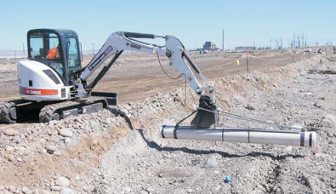
The Hazardous Waste Accountability Cycle Historical Investigation
*Work is prioritized based on environmental risk*
Review of Historical Records
Interviews with Former employees and SME’s
Surveying, sampling and testing to identify potential hazards
618-7 Investigation Results
Plutonium contamination, thorium, uranium, zircaloy chips, lead, beryllium, and cadmium, possible spontaneous ignition

Slide 6
The Hazardous Waste Accountability Cycle Application of Integrated Safety Management (ISM) techniques
Define the Work Scope
Identify Hazards
Establish Controls
No more than five drums exposed at a time
One drum at a time to be removed and contents analyzed
Perform Work
Solicit Feedback

Slide 7
The Hazardous Waste Accountability Cycle Documentation
Onsite Waste Tracking Form (OWTF)
Principal mechanism to track waste from generation to disposal
NOT for DOT off-site shipments
Bar Code traceability cradle to grave
Linked with the Bar Code on the container via hand held scanner when it is loaded and then entered into the:
Waste Management Information System (WMIS)

Slide 8
The Hazardous Waste Accountability Cycle Documentation
OWTF Travels with the Container
Container ID
(RFID)

Slide 9
The Hazardous Waste Accountability Cycle Generating Waste at the Jobsite

Slide 10
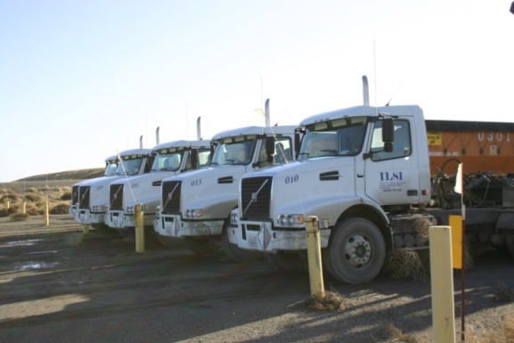
The Hazardous Waste Accountability Cycle Transportation from the Jobsite
Fleet Facts:
20 Trucks
92,500 to 105,500 GVW
40 Drivers, 7 Mechanics,
2 Tire and Lube
2 10 Hour Shifts 4 days
a week
650 Containers
Waste placed in a “Burrito”
(Liners and Tarps)
Average load is 85,000 gross
Volume: 190-240 per day
12 Million Miles Since Inception with 1 at-fault accident

Slide 11
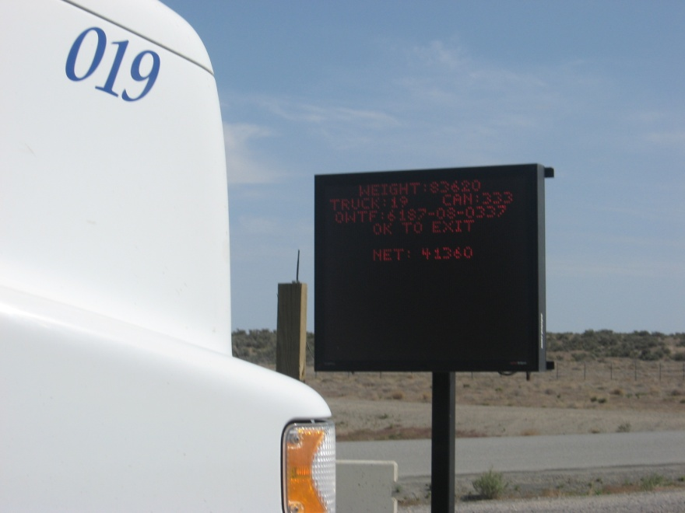
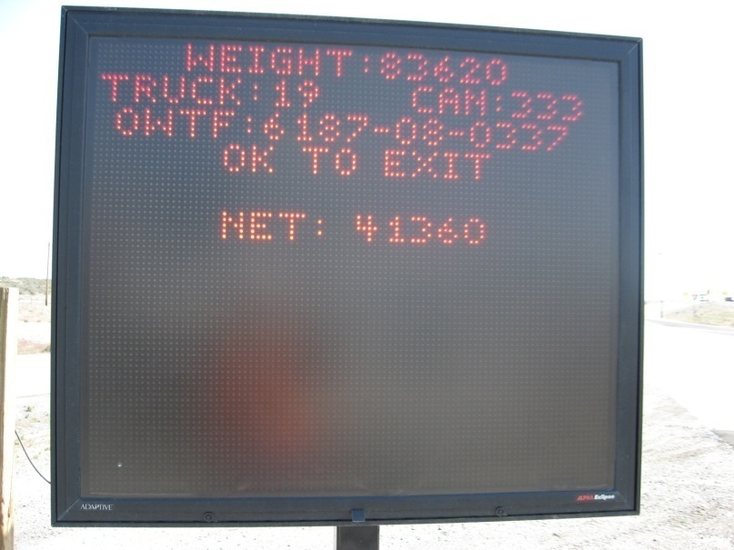
The Hazardous Waste Accountability Cycle WMIS Linked to the Scales
Driver prompted to scan the OWTF
WMIS electronically captures all
information on the shipment
Drivers maintains a back-up log

Slide 12
The Hazardous Waste Accountability Cycle Disposal at the Environmental Restoration Disposal Facility (ERDF)
Dump Ramps established at various levels in the facility

Slide 13
The Hazardous Waste Accountability Cycle Closing the Loop
OWTF completed noting grid
location within the ERDF and
then loaded into WMIS
Cradle to grave traceability

Slide 14
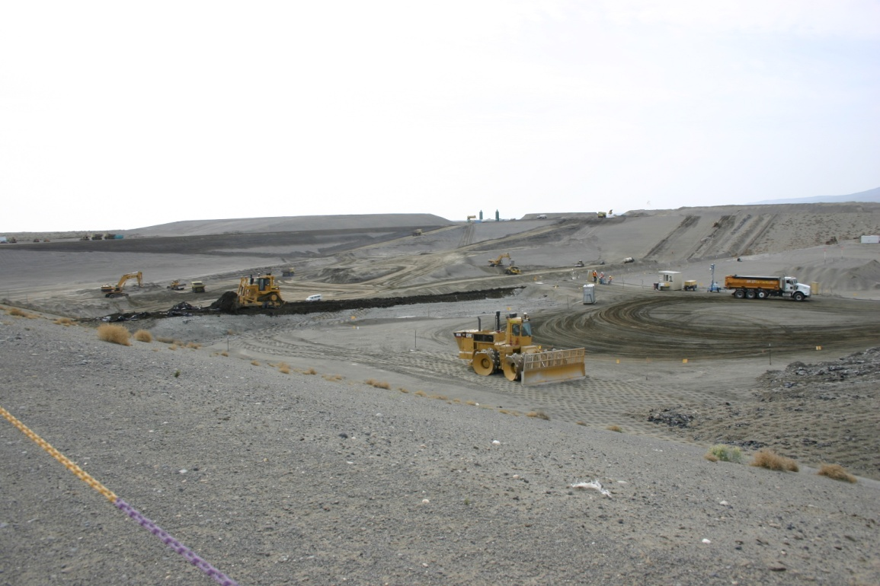
The Hazardous Waste Accountability Cycle ERDF Facts
RCRA Permitted Landfill with 6 Cells
No’s 7 & 8 under construction
12 total planned
1.62 Million Tons capacity per cell
Cells 1 & 2 are full
Cells 3 through 6 in use

Slide 15
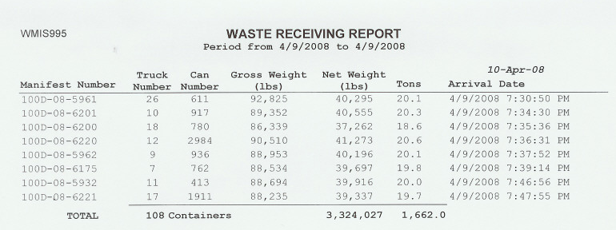
The Hazardous Waste Accountability Cycle Reconciliation of Daily Activities
Scale transactions and Waste receiving reports verified against driver’s logs. Error rate is insignificant

Slide 16
ILSI Integrated Logistics Services, Inc.
A unique and innovative approach to Supply Chain Management
10 Years Accident Free and counting

