Slide 1
Simultaneous Four-Hall Operation for 12 GeV CEBAF
Reza Kazimi
November 2012

Slide 2
What is being proposed?
The existing extraction design allows the simultaneous operation of Hall D, plus two other halls (D+2).
We propose a design that allows the simultaneous operation of all four halls (D+3).
Capability | Planned Design (D+2) | New Design (D+3)
Maximum number of halls receiving beam simultaneously | 3 Halls | 4 Halls
How?
Use a different frequency for the horizontal 5th pass separator (750 MHz instead of 500 MHz).
No changes to lower passes (Hall D wants only 5th pass beam).
Cut the beam bunch repetition rate for the halls taking 5th pass beam in half (to 250 MHz).
Total current to each hall can remain the same.

Slide 3
RF Separator Location
RF Separators
RF separators direct the beam to a hall or recirculate it for additional acceleration.

Slide 4
RF Separation Basics
YA Magnet
(septa)
Beam
To Halls
RF Separator
YB Magnet
Recirculated
Beam
RF separator creates small separation angle (~300 µradians)
YA & YB magnets increase separation

Slide 5
RF Separation – Existing (500 MHz)
A
B
C
Turn on RF separator
Hall Lasers
Hall A: 500 MHz
Beam to Halls
B
B
B
B
B
B
B
B
B
B
Hall B: 500 MHz
B
B
B
B
B
B
B
B
B
Beam
B
B
B
B
Hall C: 500 MHz
B
B
B
B
B
B
B
B
B
B
B
B
B
B
B
B
B
B
B
B
B
B
B
B
B
B
C
B
C
A
B
C
A
B
C
A
B
C
A
C
A
B
C
A
B
C
A
B
B
C
C
A
A
B
B
C
A
B
C
A
B
C
A
B
C
C
C
C
C
C
A
B
C
A
B
C
C
C
C
A
C
A
C
A
C
A
A
C
C
A
C
A
C
A
A
A
A
C
A
C
A
C
A
A
C
C
A
A
C
A
A
A
C
A
C
A
C
A
A
C
A
C
C
A
C
A
C
A
C
A
C
C
A
C
A
C
A
C
A
C
A
C
C
A
C
A
C
A
C
A
C
A
C
A
C
A
C
C
C
A
C
B
C
A
B
C
C
A
C
A
C
A
A
C
C
A
C
A
C
A
A
A
C
C
Accelerator
Frequency
1500 MHz
C
C
Recirculated
Beams
Separator frequency is 1/3 of the fundamental frequency
RF Separator Cavity
500 MHz
Beams begin to separate
A
B
C
A
B
C
A
B
C
A
B
C
A
B
C
A
B
C
A
B
C
A
B
C

Slide 6
D+2 (500 MHz) Hall D Separation
Beam to Halls
B
B
C
B
C
B
C
C
Beam
B
C
C
D
D
B
A
B
C
A
D
Accelerator
Frequency
1500 MHz
A
D
A
D
D
D
A
A
A
Beam to Hall D
5th Pass RF Separator Cavity
500 MHz
Hall D replaces Hall A
(limited to 3-hall operation)

Slide 7
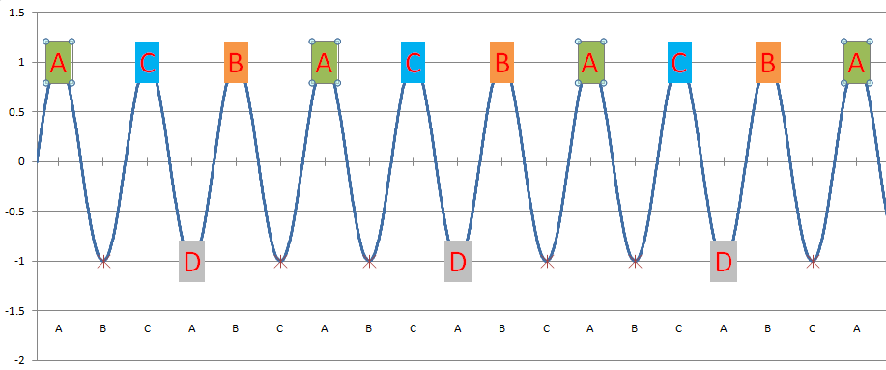
RF Separation – Proposed (750 MHz)
A
B
C
Existing
Frequency
Proposed
Frequency
A/B/C separator is located downstream
C
A
B
C
A
B
C
A
B
Turn on RF separator
Beam to Halls
500 MHz
750 MHz
A
A
C
C
B
B
A
A
A
C
B
A
C
A
C
B
A
C
A
C
B
A
C
C
A
C
A
C
B
A
A
A
C
Beam
A
C
B
A
A
C
A
C
B
A
A
B
A
C
B
A
B
A
C
B
A
B
A
C
B
B
A
C
B
A
C
B
A
B
A
B
C
D
C
B
C
A
C
C
C
C
C
C
B
C
A
C
B
A
C
C
A
B
C
A
B
C
A
B
C
A
C
A
B
C
A
B
C
A
B
B
C
C
A
A
B
B
C
B
A
C
B
A
C
A
A
B
A
C
A
C
B
A
C
B
A
D
A
C
B
A
A
C
A
C
B
A
C
B
A
C
B
C
B
Hall Lasers
Hall A: 250 MHz
Hall B: 250 MHz
Hall C: 250 MHz
C
Accelerator
Frequency
1500 MHz
C
B
A
C
B
C
B
C
B
C
C
A
C
B
C
A
B
C
C
B
A
C
B
B
C
B
A
C
B
B
B
B
C
B
A
C
B
B
C
B
A
C
B
C
B
A
C
B
C
D
C
B
B
A
A
C
C
B
B
Hall D
Beam
(existing hall lasers run at 500 MHz)
Hall D: 250 MHz
Separator frequency is 1/2 of the fundamental frequency
5th Pass RF Separator Cavity
750 MHz
Empty Buckets – Cutting the laser pulse rate for each hall in half (from 500 MHz to 250 MHz) leaves “empty buckets”, which are directed to Hall D
Every other “bucket” goes to Hall D
Four-Hall Operation!
(D+3)
New Hall D laser fills empty buckets at 250 MHz
A
B
C
A
B
C
A
B
C
A
B
C
A
B
C
A
B
C
A
B
C
A
B
C

Slide 8
5th Pass RF Separation Hardware
Horizontal 5th Pass Separator
(kicks out Hall D)
Vertical 5th Pass Separator (Halls A,B,C)
D+2: 500 MHz
D+3: 750 MHz

Slide 9
Comparing D+2 and D+3
 | Planned (D+2) | Proposed (D+3)
Maximum number of halls receiving beam | 3 halls | 4 halls
Beam @ 5th pass (Hall D on) | 500 MHz | 250 MHz
Beam @ 5th pass (Hall D off) | 500 MHz | 500 MHz
Beam @ lower passes | 500 MHz | 500 MHz
The D+3 Tradeoff:
On 5th pass, all halls must run at 250 MHz (half the rep rate), unless Hall D is off.
When Hall D is on, at least one hall must configured for the 5th pass.

Slide 10
Charge/Bunch at 5th Pass
Current | @500 MHz | @250 MHz
180 µA, max for 6 GeV | 0.36 pC/bunch | 0.72 pC/bunch
85 µA, max for 12 GeV | 0.17 pC/bunch | 0.34 pC/bunch
Combined current to Halls A and C will be limited to 85 µA because of 1 mW total power limit.
Charge/bunch for 85 µA at 250 MHz is lower than the charge/bunch for 180 µA at 500 MHz.
The higher charger/bunch has already been demonstrated during 6 GeV operations (Qweak experiment).
The impact of doubling the charge/bunch on experiments limited by accidental rates should be evaluated.

Slide 11
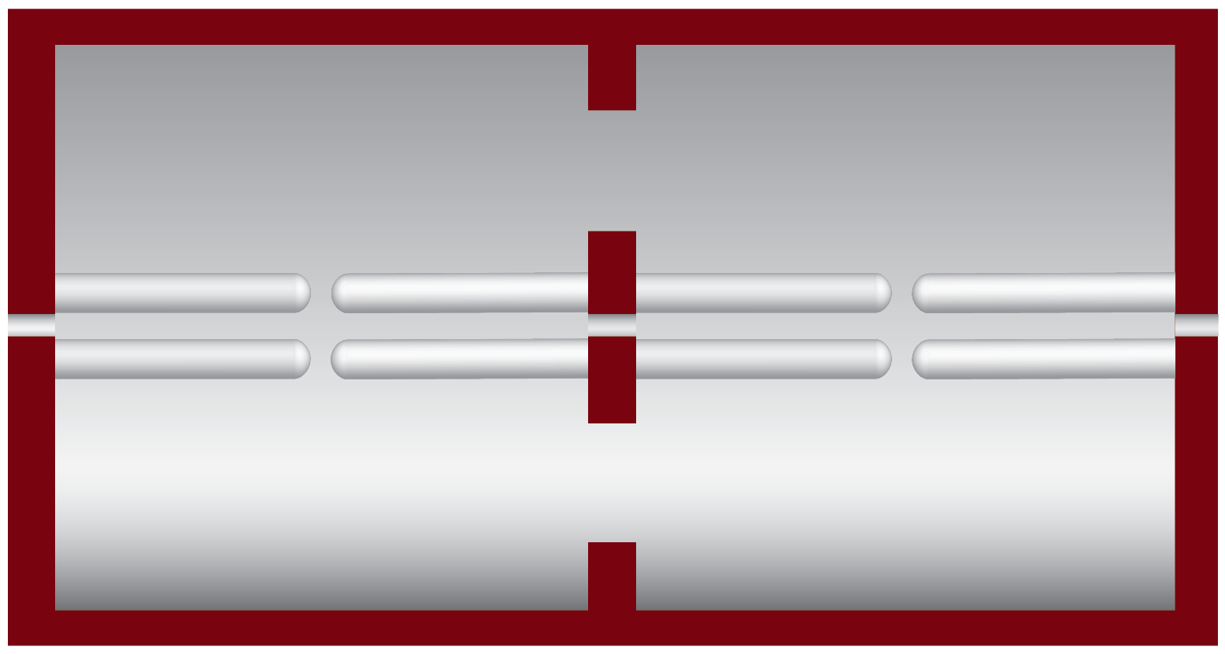
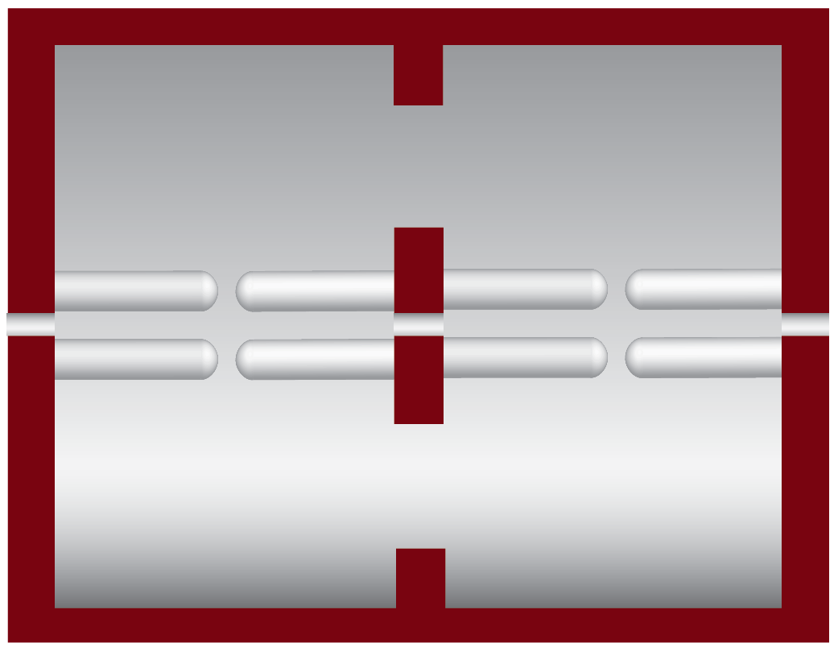
Separator Cavity Design
Beam
500 MHz cavity
Existing 500 MHz design is shortened for 750 MHz
60 cm
40 cm
Beam
750 MHz cavity
Note: vertical cross sections shown

Slide 12
5th Pass Separators
Frequency | 500 MHz | 750 MHz
Beam energy | 11 GeV | 11 GeV
Total separation angle | 300 μrad | 300 μrad
Number of Cavities | 4 | 4
Total RF power | 5.6 kW | 8 kW
RF power per cavity | 1.4 kW | 2 kW
Length of each cavity | 60 cm | 40 cm

Slide 13
Generating 250 MHz Beams
250 MHz beams are required for D+3 to work. 500 MHz beams can also be used depending on the configuration.
Some experiments like to run at lower repetition rates.
A new CEBAF injector low-level laser drive system has been proposed by John Hansknecht that uses elector-optic modulators (a telecom standard) to produce 250 MHz beams.
Only affects front-end laser seed drivers. No changes to laser table components.
Gives any hall a “pushbutton” selectable running frequency of 500 MHz or lower divisions of 250, 125, 62.5, or 31.25 MHz, without affecting other halls.
Replaces the beat frequency modulator—an additional advantage.
Will permit introduction of a 4th laser for Hall D.
~$100K

Slide 14
RF Separator Evolution & Cost
D + 1
6 GeV Configuration
D + 2
D + 3
D+2 & D+3
500 MHz Cavities
500 MHz Cavities
750 MHz Cavities
500 MHz Cavities
Key
Total Cost
D+1 $ 507K
Relocated
New
D+2 1,946K = (D+1) + 1,439K
D+3 2,581K = (D+2) + 635K
Priceless!
D+2 & D+3
2,821K = (D+2) + 875K

Slide 15
Conclusion
It is possible to run all four CEBAF experimental halls simultaneously by changing the 5th pass separator frequency and cutting the beam repetition rates for halls taking beam at the highest pass.
The possibility of keeping the 500 MHz system alongside the 750 MHz system is considered but details need to be studied.
An upgrade to the electron gun laser system will not only allow 4-hall operation but also provide an independently changeable low rep rate beam to each hall.
The 750 MHz system would position us for future possibilities.
The proposed design change can be accomplished within the existing schedule.
A decision must be made before February.

Slide 16
Acknowledgements
Tom Oren | Preparation of the Presentation
Mike Spata | Hardware Needs, Cost, Schedule, …
Haipeng Wang | RF and SRF Design
John Hansknecht | Gun Laser System
Andrew Hutton Arne Freyberger | Encouragement and Presentation
Mont | Posing the Question

Slide 17
End of Presentation
Thank You!

Slide 18
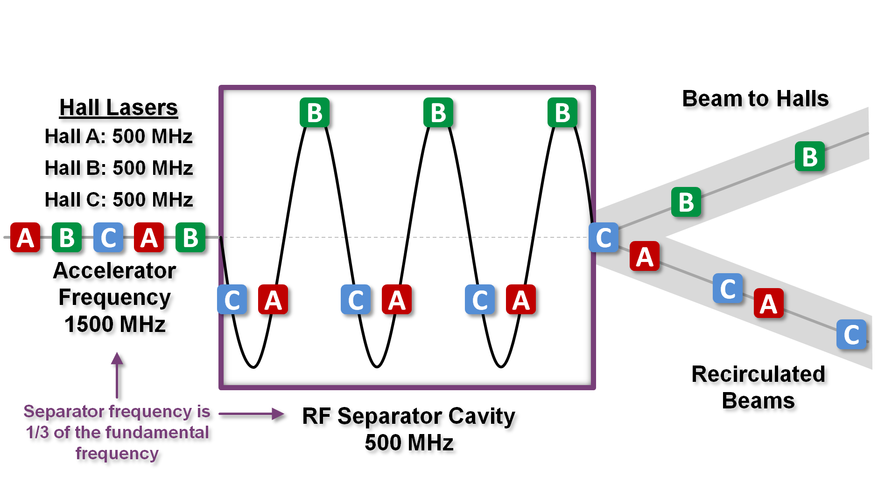
RF Separation – Existing (500 MHz)

Slide 19
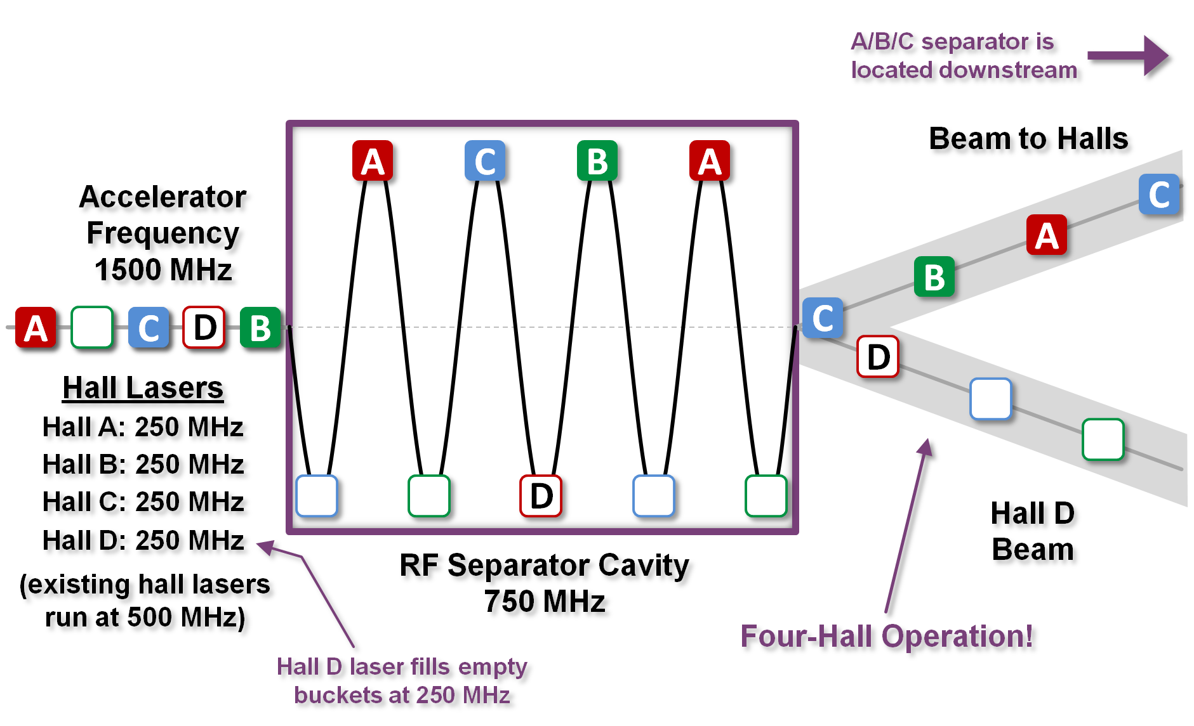
RF Separation – Proposed (750 MHz)

Slide 20
Halls A,B,C 5th Pass Vertical Separation
To Halls A,B,C
C
C
C
C
Beam
C
B
A
C
B
A
B
B
B
C
B
B
Accelerator
Frequency
1500 MHz
A
A
A
A
A
RF Separator Cavity
500 MHz

Slide 21
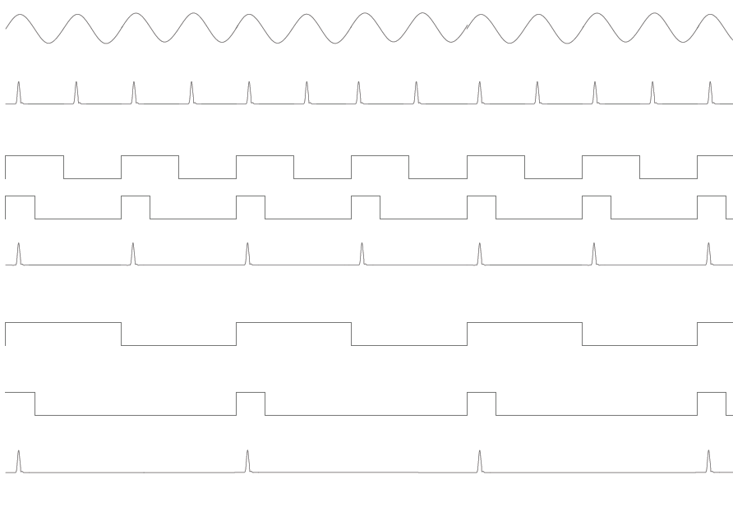
System Timing Diagrams
Timing signal reference from system oscillator (500 MHz)
Laser pulses produced from first LiNb03 modulator (500 MHz)
Digital output from Digitizer in Divide by 2 mode (250 MHz)
Output of “one-shot” circuit when fed the 250MHz signal. (Notice that pulse width can actually be up to 2 ns wide and this would still work if phased properly)
Laser pulses passing through the pulse picker LiNb03 modulator in Divide by 2 mode
Digital output from Digitizer in Divide by 4 mode (125 MHz)
Output of “one-shot” circuit when fed the 125MHz signal. (Notice that pulse width can actually be up to 2 ns wide and this would still work if phased properly)
Laser pulses passing through the pulse picker LiNb03 modulator in Divide by 4 mode
Diagrams are similar all the way to divide by 16 mode which will produce a 31.25 MHz beam.

Slide 22
Complete overview before changes:
Laser Table
HALL A
Fiber
5W amp
1560nm to 780nm conversion
Optics, attenuator, tune mode generator, etc
Seed Laser
Pre-Amp
500MHz rf input
HALL B
Fiber
5W amp
1560nm to 780nm conversion
Optics, attenuator, tune mode generator, etc
Seed Laser
Pre-Amp
500MHz rf input
HALL C
Fiber
5W amp
1560nm to 780nm conversion
Optics, attenuator, tune mode generator, etc
Seed Laser
Pre-Amp
500MHz rf input
Beams to photo-cathode

Slide 23
Upgrade that would add a stand-alone hall D laser.
Laser Table
HALL A
LiNb03 mod #2
Pulse picker
Fiber
5W amp
1560nm to 780nm conversion
Optics, attenuator, tune mode generator, etc
Seed Laser
LiNb03 mod #1
Pre-Amp
500MHz rf input
New control electronics
HALL B
LiNb03 mod #2
Pulse picker
Fiber
5W amp
1560nm to 780nm conversion
Optics, attenuator, tune mode generator, etc
Seed Laser
LiNb03 mod #1
Pre-Amp
500MHz rf input
New control electronics
HALL C
LiNb03 mod #2
Pulse picker
Fiber
5W amp
1560nm to 780nm conversion
Optics, attenuator, tune mode generator, etc
Seed Laser
LiNb03 mod #1
Pre-Amp
500MHz rf input
New control electronics
HALL D
LiNb03 mod #2
Pulse picker
Fiber
5W amp
1560nm to 780nm conversion
Optics, attenuator, tune mode generator, etc
Seed Laser
LiNb03 mod #1
Pre-Amp
500MHz rf input
New control electronics
Beams to photo-cathode

Slide 24
Or . . .
Install both!
Install 500 MHz (D+2) and 750 MHz (D+3) separation systems.
Has not been studied in detail but will likely work.
Aperture problems need to be investigated.
Cost considerations.

Slide 25
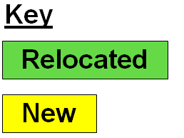
D+1
$507K
D+2
$1,946K
D+3
$2,581K
D+2 & D+3
$2,821K

