Slide 1
Beam Profile Monitor
Status
Immediate Objective
Materials needed
Projections
Conclusion
Anthony Tatum
University of North Carolina Wilmington

Slide 2
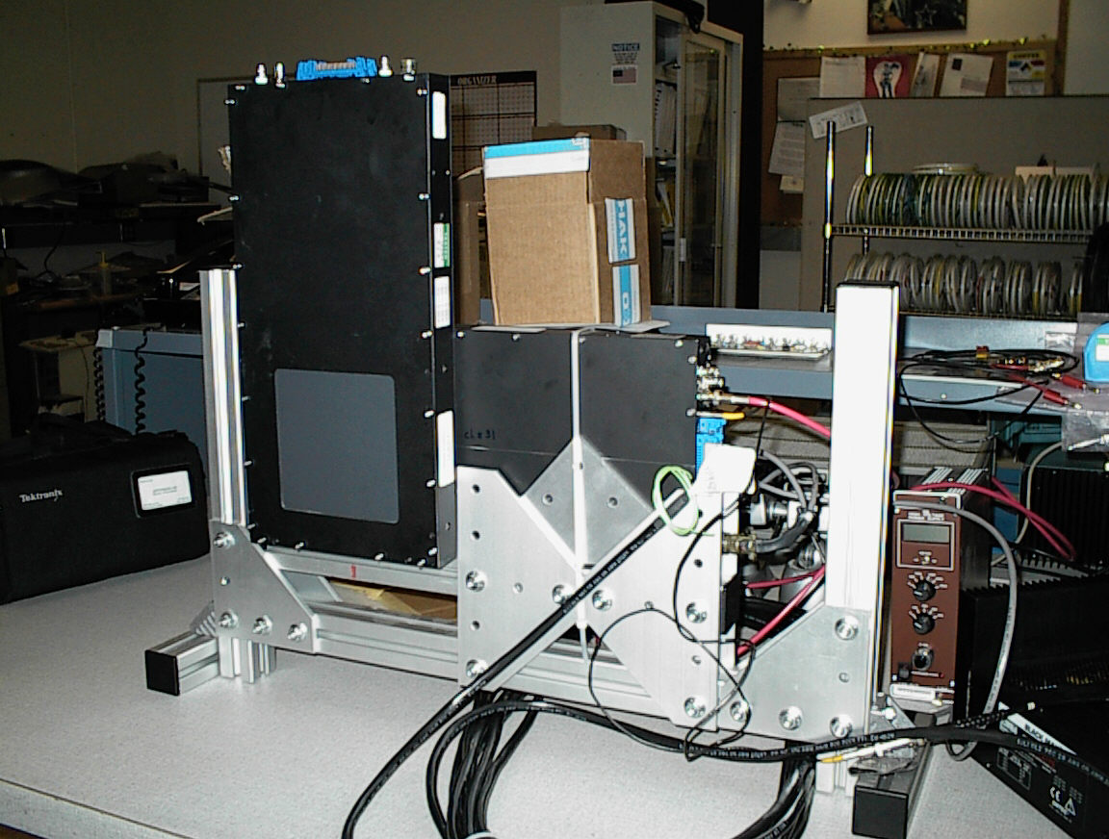
Status
Located in trailer 94 B
Good condition from first observation

Slide 3
Objective
Set up DAQ
Test all channels (x,y), data cables, high and low voltage cables
Evaluate PMT’s, Amplifier, Discriminator
Possible Problems
Optical leakage
Loose connections
Faulty sub-system

Slide 4
Materials Needed
Signal Cables
High and Low voltage cables
High and Low voltage power supply
DAQ system
Carl Zorn
Electronics Group

Slide 5
Projection
Set up entire system for testing
Determine functionality and identify problems if they exist
Expected Completion Friday, July 16th

Slide 6
Conclusion
We’ll have the best looking Beam in town!
Anthony Tatum
atatum@jlab.org
910 538 5975

