Slide 1

Veto Counter Testing
Runyon Colie Woods
UNCW

Slide 2
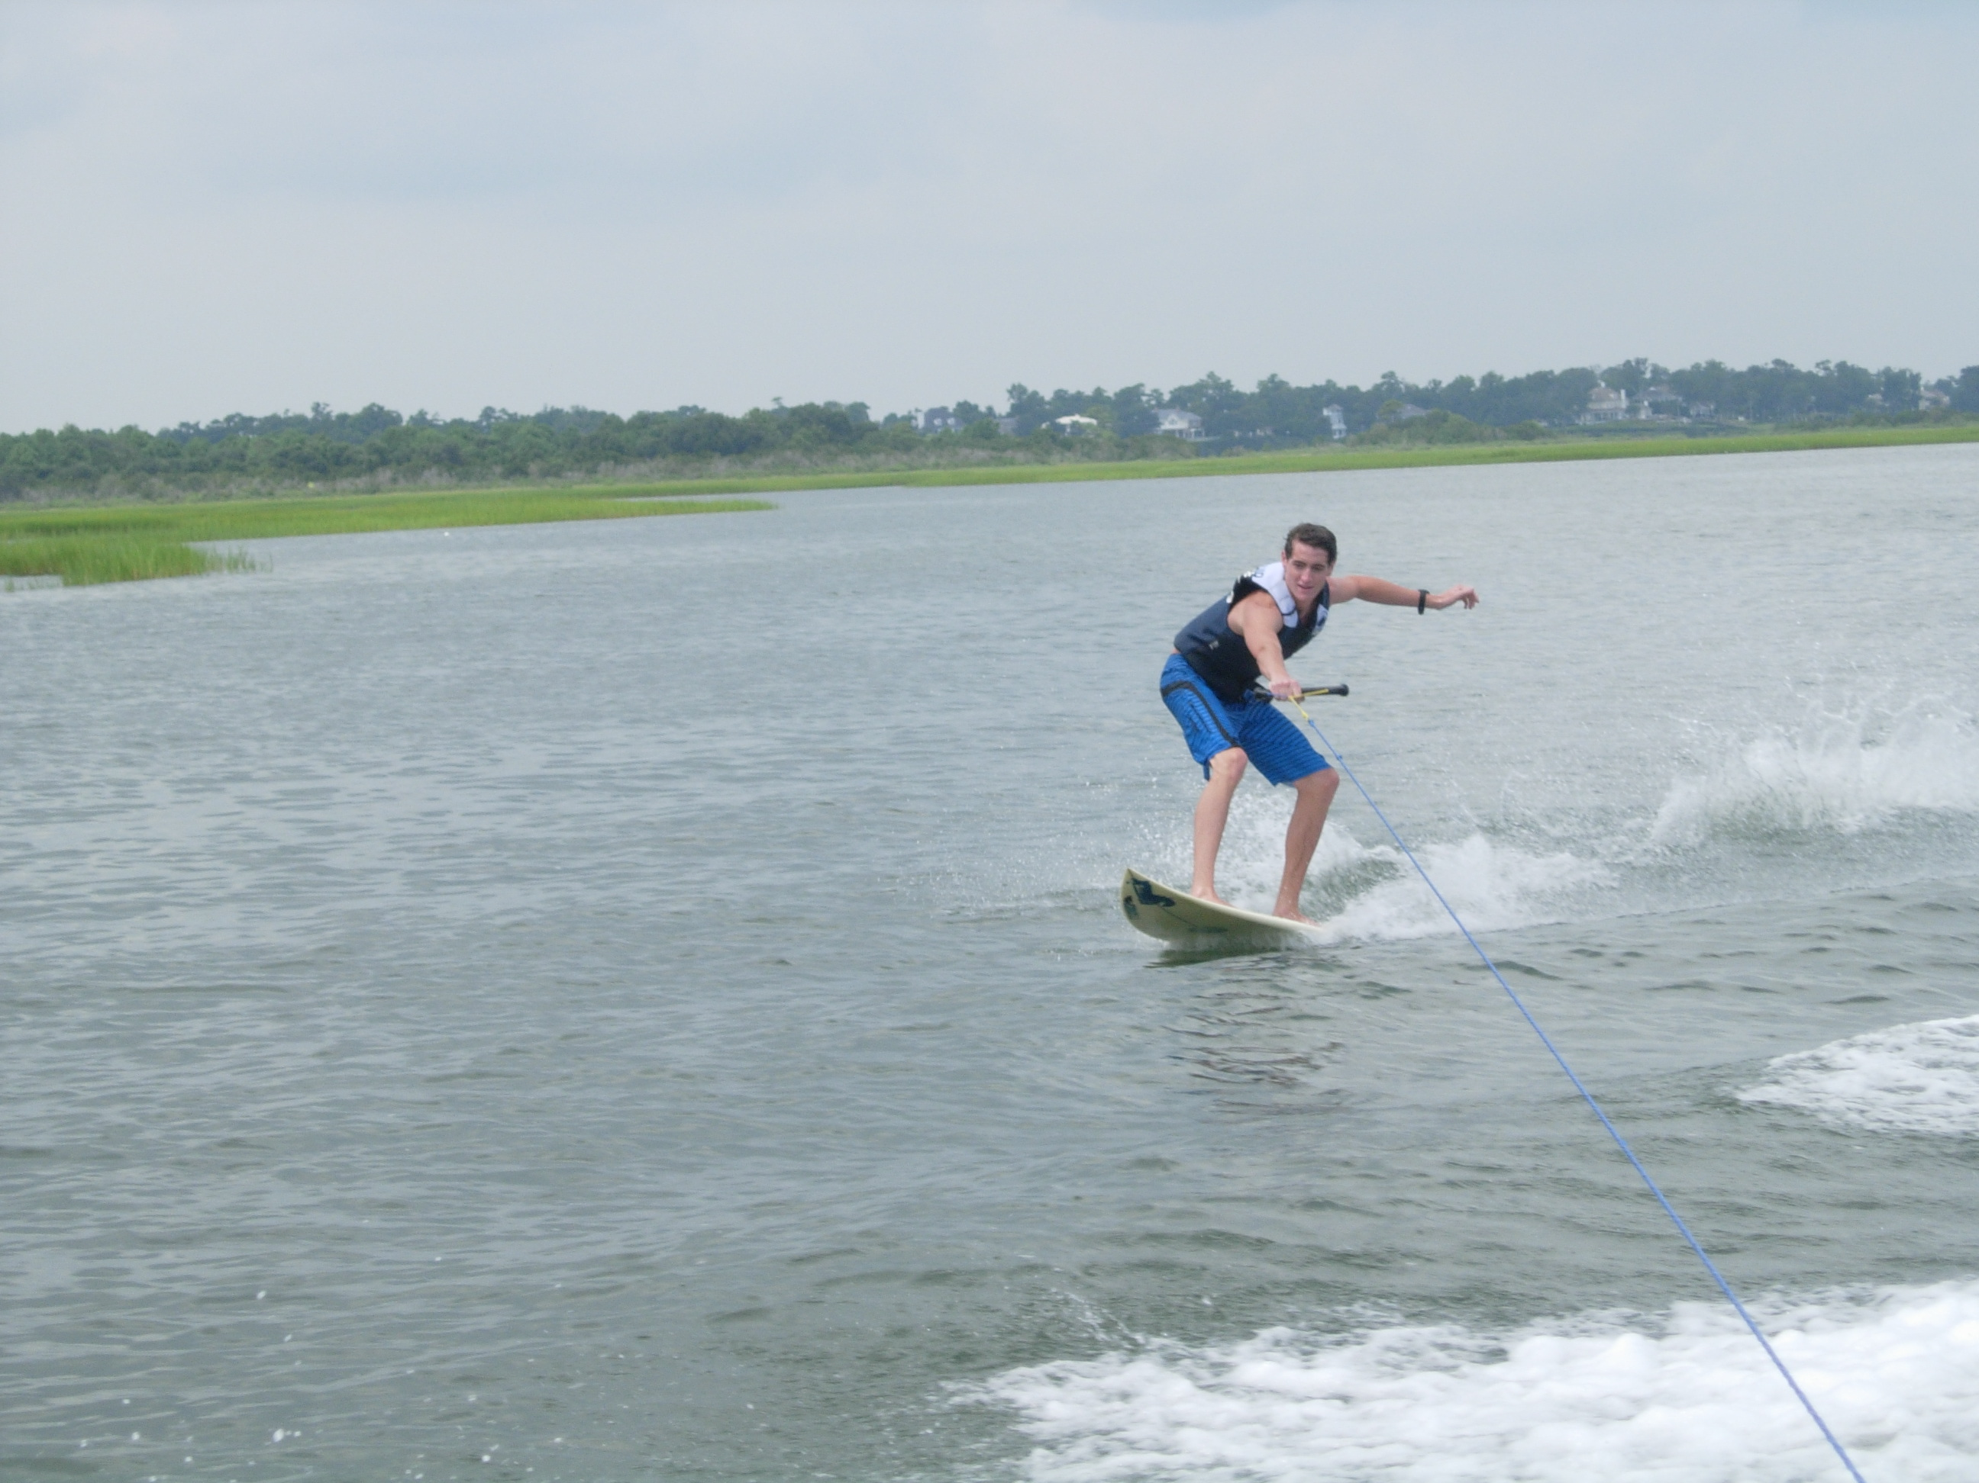
About me
Call me Colie Woods (Co-lee)
Junior Physics Major at UNCW
Great passions in life: sailing, skurfing, surfing, astronomy, and of course veto counters

Slide 3
Veto Counter Status
The veto counter is used to reject charged particle backgrounds incident on the calorimeter.
Located in trailer 94B to the left of the three counting rooms for the halls
I have been given the project of testing the veto counter and ensuring its general functions are working

Slide 4
Necessities
Assigned to this project by Liping Gan
Things I will need:
  A high voltage power supply
  Scilliscope
  How to contact Ashot (email, phone, pager, etc. pick your poison.) without bothering him too much.

