Slide 1
COMPTON ANALYSIS REPORT
PAWEL AMBROZEWICZ
NC A&T
OUTLINE:
Extraction Procedure
Uncertainties
Summary

Slide 2
COMPTON EVENT

Slide 3
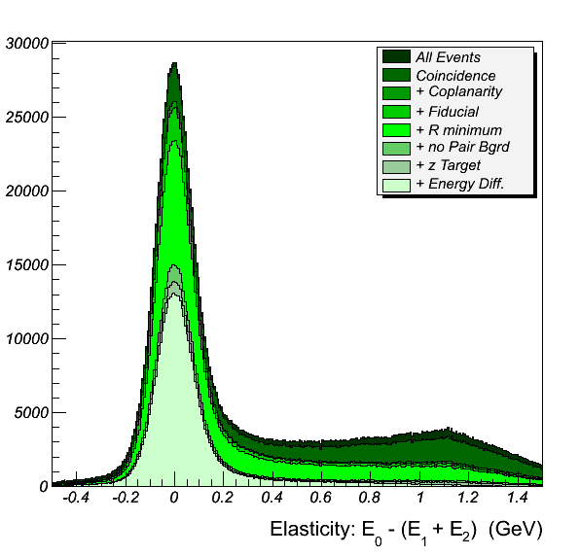
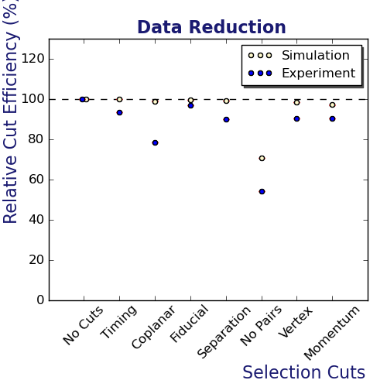
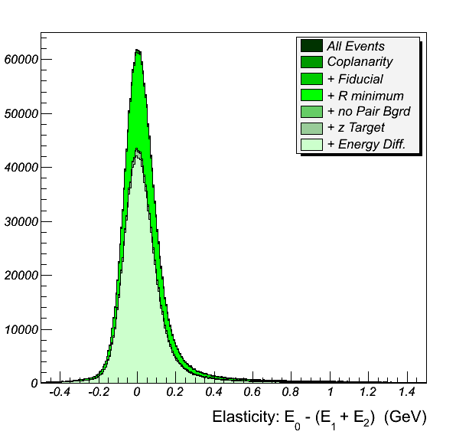
DATA REDUCTION
STATISTICS:
Initial - ~1.5M
Compton - ~0.5M
)

Slide 4
LINE SHAPE YIELD FITS
Excellent theory calculation
Very good apparatus simulation
Data background model
Superior fittting procedure
Elasticity offers perfect features
to carry out the fit:
peaked distribution
radiative effects signature

Slide 5
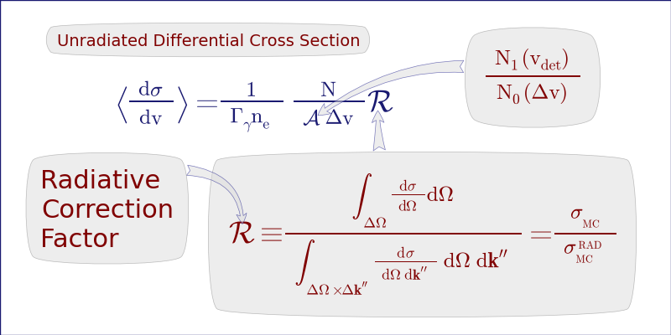
CROSS SECTION EXTRACTION PROCEDURE

Slide 6
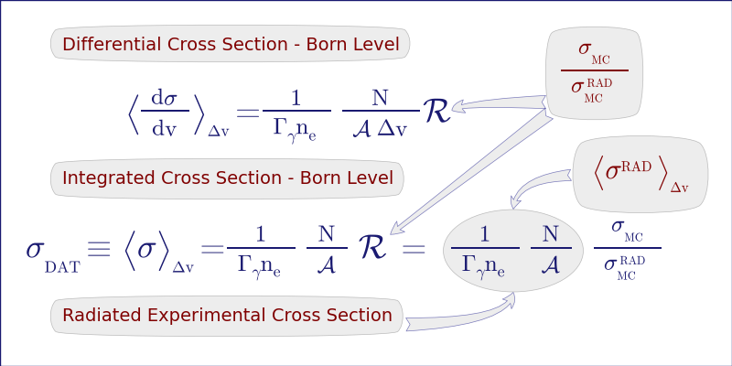
CROSS SECTION EXTRACTION PROCEDURE

Slide 7
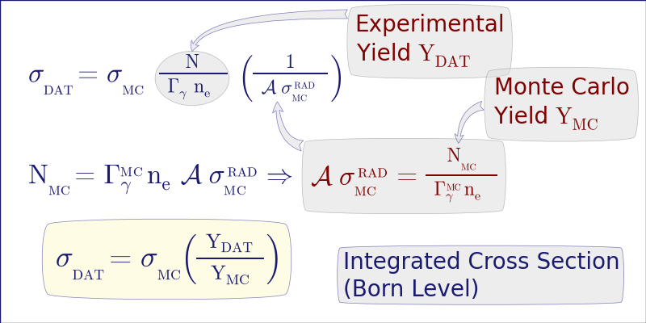
CROSS SECTION EXTRACTION PROCEDURE

Slide 8


CROSS SECTION EXTRACTION PROCEDURE
TOTAL CROSS SECTION
FORWARD SOLID ANGLE
CROSS SECTION

Slide 9
DIFFERENTIAL CROSS SECTION

Slide 10
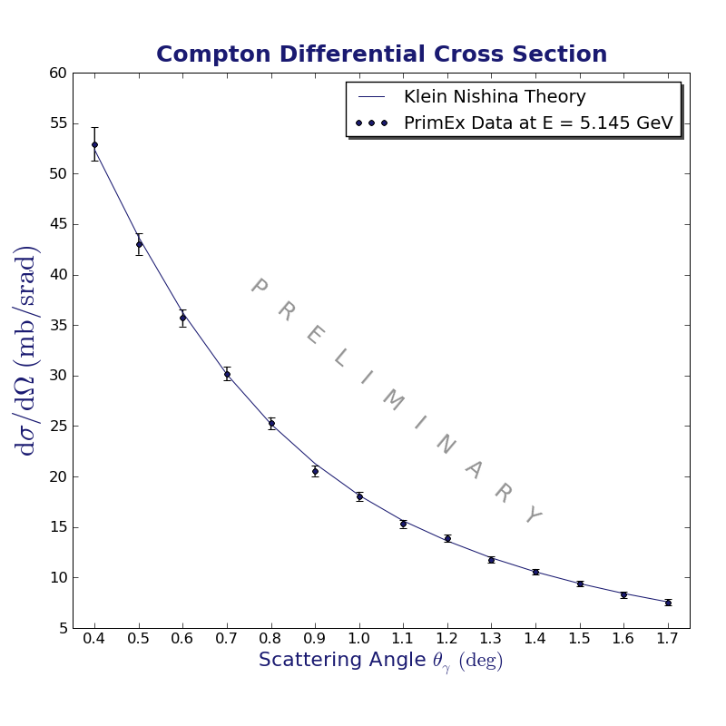
DIFFERENTIAL CROSS SECTION

Slide 11
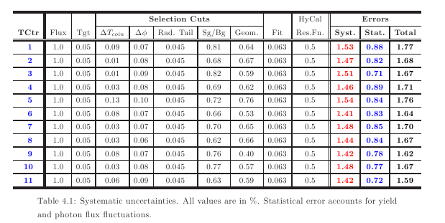
UNCERTAINTIES

Slide 12
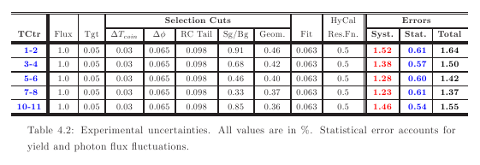
UNCERTAINTIES

Slide 13
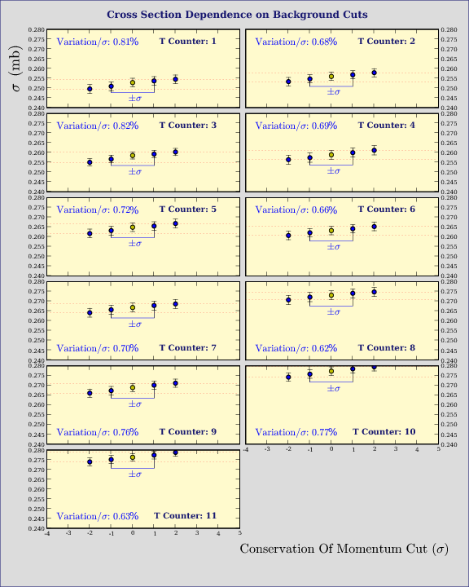
UNCERTAINTIES

Slide 14
SUMMARY
This excellent data set provided:
Good control of systematics
Wide range of results:
- Total cross sections for 11 energy bins
- HyCal Solid Angle cross sections (11 energy bins)
- Differential cross sections
15 angle bins for each energy
Results that compare very well with theory
Results that helped securing PAC approval for
PrimEx-II

