Slide 1

Constraining the glue in the pion through Drell-Yan lepton-pair production
Nina Cao, Harvard University
In Collaboration with:
Wally Melnitchouk, Jefferson Lab
Nobuo Sato, Old Dominion University
Notes:
ADD in collaboration with --- wally and nobuo

Slide 2
Outline
Introduction
Motivation
Methods
Results
Conclusions
Summary

Slide 3
Introduction – The Big Picture
The Overarching Goal:
  Understanding the transverse momentum (p_{T}) spectrum in particle production at low energy reactions using perturbative QCD

Slide 4
Introduction – The Big Picture
The Overarching Goal:
  Understanding the transverse momentum (p_{T}) spectrum in particle production at low energy reactions using perturbative QCD
    Small p_{T} spectrum is described in terms of transverse momentum dependent (TMD) factorization
      TMDs → one of the key elements to describe the nucleon’s structure

Slide 5
Introduction – The Big Picture
The Overarching Goal:
  Understanding the transverse momentum (p_{T}) spectrum in particle production at low energy reactions using perturbative QCD
    Small p_{T} spectrum is described in terms of transverse momentum dependent (TMD) factorization
      TMDs → one of the key elements to describe the nucleon’s structure
    Large p_{T} spectrum described in terms of collinear factorization

Slide 6
Introduction – The Big Picture
The Overarching Goal:
  Understanding the transverse momentum (p_{T}) spectrum in particle production at low energy reactions using perturbative QCD
    Small p_{T} spectrum is described in terms of transverse momentum dependent (TMD) factorization
      TMDs → one of the key elements to describe the nucleon’s structure
    Large p_{T} spectrum described in terms of collinear factorization
    Currently difficult to understand the large p_{T} spectrum in SIDIS (Wang, Gonzalez-Hernandez, Roger, Sato) and in proton-proton DY (Bacchetta, Bozzi, Lambertsen, Piacenza. Steiglechner, Vogelsang)

Slide 7
Introduction – The Big Picture
The Overarching Goal:
  Understanding the transverse momentum (p_{T}) spectrum in particle production at low energy reactions using perturbative QCD
    Small p_{T} spectrum is described in terms of transverse momentum dependent (TMD) factorization
      TMDs → one of the key elements to describe the nucleon’s structure
    Large p_{T} spectrum described in terms of collinear factorization
    Currently difficult to understand the large p_{T} spectrum in SIDIS (Wang, Gonzalez-Hernandez, Roger, Sato) and in proton-proton DY (Bacchetta, Bozzi, Lambertsen, Piacenza. Steiglechner, Vogelsang)
    A reliable description of cross section by TMDs requires an equally solid description of the high p_{T} spectrum using collinear factorization

Slide 8
Introduction – The Big Picture
The Overarching Goal:
  Understanding the transverse momentum (p_{T}) spectrum in particle production at low energy reactions using perturbative QCD
    Small p_{T} spectrum is described in terms of transverse momentum dependent (TMD) factorization
      TMDs → one of the key elements to describe the nucleon’s structure
    Large p_{T} spectrum described in terms of collinear factorization
  Focus of this talk: Pion-Tungsten Drell-Yan

Slide 9
Motivation
Previous research (Barry et al.) [1]:
  Studied p_{T}-integrated data from the pion-proton Drell-Yan process + leading neutron electroproduction

Slide 10
Motivation
Previous research (Barry et al.) [1]:
  Studied p_{T}-integrated data from the pion-proton Drell-Yan process + leading neutron electroproduction
  New constraints on gluon distribution in the pion from small to large x

Slide 11
Motivation
Previous research (Barry et al.) [1]:
  Studied p_{T}-integrated data from the pion-proton Drell-Yan process + leading neutron electroproduction
  New constraints on gluon distribution in the pion from small to large x
  Result: Gluon shares more of the pion’s momentum fraction than expected

Slide 12
Motivation
Previous research (Barry et al.) [1]:
  Studied p_{T}-integrated data from the pion-proton Drell-Yan process + leading neutron electroproduction
  New constraints on gluon distribution in the pion from small to large x
  Result: Gluon shares more of the pion’s momentum fraction than expected
[1]

Slide 13
Motivation
[1]
Notes:
Add box high x

Slide 14
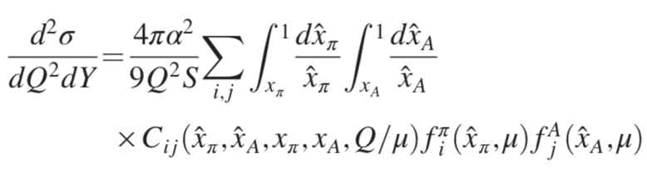
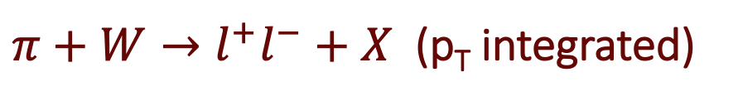
Motivation
Drell-Yan reaction:
$π+W→l^{+}l^{−}+X$ (p_{T} integrated)
[1]
Notes:
Typically exponentially suppressed – put factorization formula from barry et al

Slide 15
Motivation
Drell-Yan reaction:
$π+W→l^{+}l^{−}+X$ (p_{T} integrated)
[1]
Notes:
Typically exponentially suppressed – put factorization formula from barry et al

Slide 16
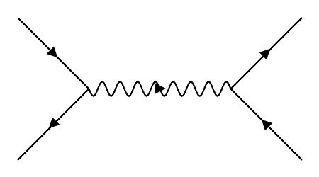
Motivation
Drell-Yan reaction:
$π+W→l^{+}l^{−}+X$ (p_{T} integrated)
[1]
LO contribution to C
Notes:
Typically exponentially suppressed – put factorization formula from barry et al

Slide 17
Motivation
Drell-Yan reaction:
$π+W→l^{+}l^{−}+X$ (p_{T} integrated)
[1]
LO contribution to C
*NOTE: No Gluon Initiated!
Notes:
Typically exponentially suppressed – put factorization formula from barry et al

Slide 18
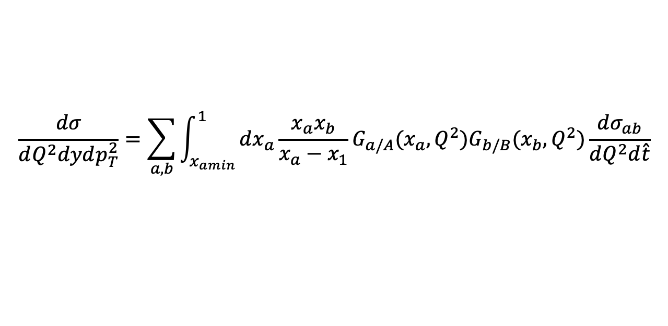

Motivation
Drell-Yan reaction:
$π+W→l^{+}l^{−}+X$ (Large p_{T} differential)
$$\frac{dσ}{dQ^{2}dydp_{T}^{2}}=\sum_{a,b}{\int_{x_{amin}}^{1}{dx_{a}\frac{x_{a}x_{b}}{x_{a}−x_{1}}}G_{a/A}(x_{a},Q^{2})G_{b/B}(x_{b},Q^{2})\frac{dσ_{ab}}{dQ^{2}d\hat{t}}}$$

Slide 19
Motivation
Drell-Yan reaction:
$π+W→l^{+}l^{−}+X$ (Large p_{T} differential)
$$\frac{dσ}{dQ^{2}dydp_{T}^{2}}=\sum_{a,b}{\int_{x_{amin}}^{1}{dx_{a}\frac{x_{a}x_{b}}{x_{a}−x_{1}}}G_{a/A}(x_{a},Q^{2})G_{b/B}(x_{b},Q^{2})\frac{dσ_{ab}}{dQ^{2}d\hat{t}}}$$

Slide 20
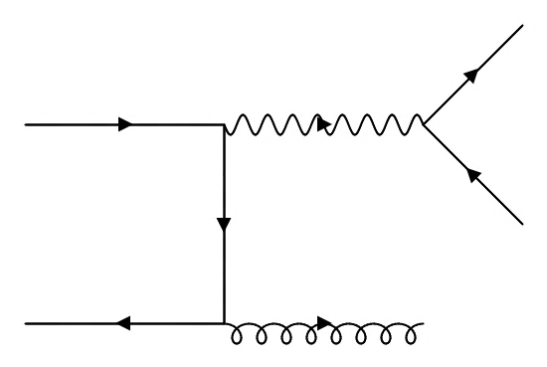
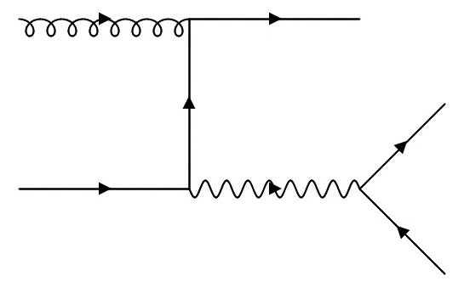
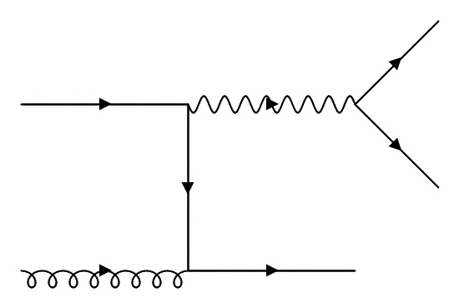
Motivation
Drell-Yan reaction:
$π+W→l^{+}l^{−}+X$ (Large p_{T} differential)
$$\frac{dσ}{dQ^{2}dydp_{T}^{2}}=\sum_{a,b}{\int_{x_{amin}}^{1}{dx_{a}\frac{x_{a}x_{b}}{x_{a}−x_{1}}}G_{a/A}(x_{a},Q^{2})G_{b/B}(x_{b},Q^{2})\frac{dσ_{ab}}{dQ^{2}d\hat{t}}}$$
LO contribution to hard part

Slide 21
Motivation
Drell-Yan reaction:
$π+W→l^{+}l^{−}+X$ (Large p_{T} differential)
$$\frac{dσ}{dQ^{2}dydp_{T}^{2}}=\sum_{a,b}{\int_{x_{amin}}^{1}{dx_{a}\frac{x_{a}x_{b}}{x_{a}−x_{1}}}G_{a/A}(x_{a},Q^{2})G_{b/B}(x_{b},Q^{2})\frac{dσ_{ab}}{dQ^{2}d\hat{t}}}$$
*Gluon Initiated!

Slide 22
Motivation
[1]
Notes:
Add box high x

Slide 23
Motivation
[1]
Notes:
Add box high x

Slide 24
Motivation
PDFs in this region constrained by p_{T} integrated DY
  Gluon distribution is subdominant
[1]
Notes:
Add box high x

Slide 25
Motivation
PDFs in this region constrained by p_{T} integrated DY
  Gluon distribution is subdominant
LO contribution to p_{T} differential DY is from the gluon initiated reactions
[1]
Notes:
Add box high x

Slide 26
Motivation
Idea:
  Studying p_{T}-dependent Drell-Yan data should increase sensitivity to the gluon PDF
  Provides better constraints at higher x
  May provide better insight into how to analyze upcoming COMPASS results
[1]
Notes:
Add box high x

Slide 27

Theoretical Details of DY p_{T} Spectrum
Cross Section in Terms of Different Regions:
$$\frac{dσ}{dQ^{2}dydp_{T}^{2}}=W+FO−ASY+O(\frac{m^{2}}{Q^{2}})$$
[2]
Notes:
Show pt range

Slide 28
Theoretical Details of DY p_{T} Spectrum
Cross Section in Terms of Different Regions:
$$\frac{dσ}{dQ^{2}dydp_{T}^{2}}=W+FO−ASY+O(\frac{m^{2}}{Q^{2}})$$
[2]
W valid for p_{T}/Q <<1
  Characterized in terms of TMD factorization
Notes:
Show pt range

Slide 29
Theoretical Details of DY p_{T} Spectrum
Cross Section in Terms of Different Regions:
$$\frac{dσ}{dQ^{2}dydp_{T}^{2}}=W+FO−ASY+O(\frac{m^{2}}{Q^{2}})$$
[2]
W valid for p_{T}/Q <<1
  Characterized in terms of TMD factorization
FO valid for p_{T} ~ Q
  Characterized in terms of collinear factorization
Notes:
Show pt range

Slide 30
Theoretical Details of DY p_{T} Spectrum
Cross Section in Terms of Different Regions:
$$\frac{dσ}{dQ^{2}dydp_{T}^{2}}=W+FO−ASY+O(\frac{m^{2}}{Q^{2}})$$
[2]
W valid for p_{T}/Q <<1
  Characterized in terms of TMD factorization
FO valid for p_{T} ~ Q
  Characterized in terms of collinear factorization
ASY is the ”interpolating” part
  ASY → W as p_{T} → ∞
  ASY → FO as p_{T} → 0
Notes:
Show pt range

Slide 31
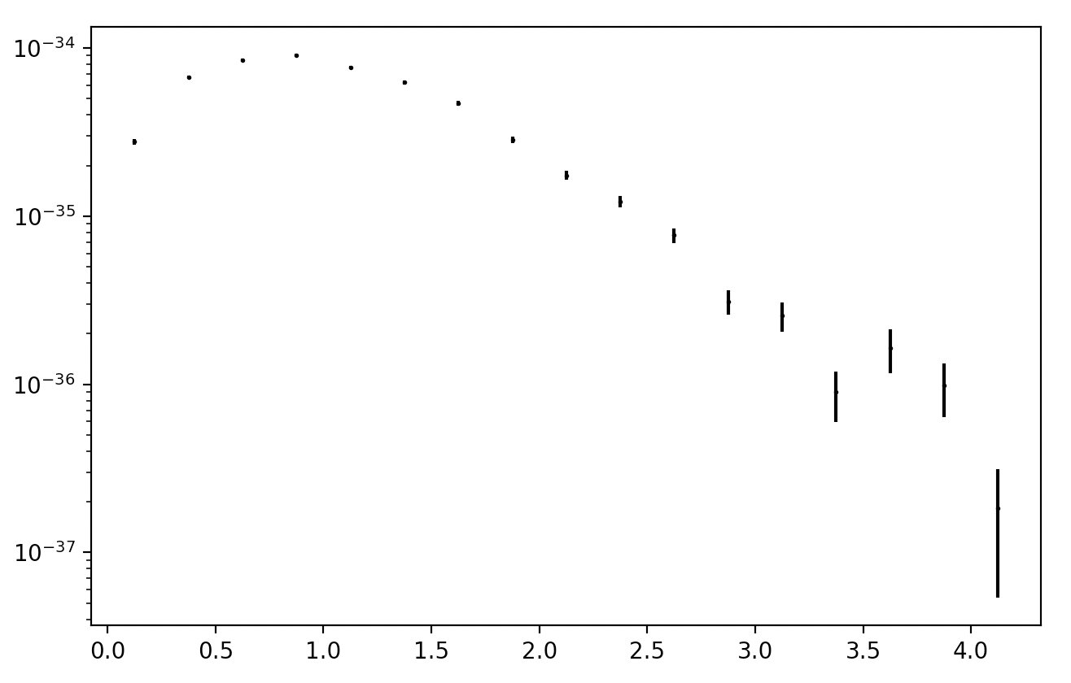

Theoretical Details of DY p_{T} Spectrum
Cross Section in Terms of Different Regions:
$$\frac{dσ}{dQ^{2}dydp_{T}^{2}}=W+FO−ASY+O(\frac{m^{2}}{Q^{2}})$$
[2]
p_{T}
Notes:
Show pt range

Slide 32
Theoretical Details of DY p_{T} Spectrum
Cross Section in Terms of Different Regions:
$$\frac{dσ}{dQ^{2}dydp_{T}^{2}}=W+FO−ASY+O(\frac{m^{2}}{Q^{2}})$$
[2]
Dominant at low p_{T} – determined by TMDs
p_{T}
Notes:
Show pt range

Slide 33
Theoretical Details of DY p_{T} Spectrum
Cross Section in Terms of Different Regions:
$$\frac{dσ}{dQ^{2}dydp_{T}^{2}}=W+FO−ASY+O(\frac{m^{2}}{Q^{2}})$$
[2]
Dominant at high p_{T} – determined by collinear factorization
p_{T}
Notes:
Show pt range

Slide 34
Theoretical Details of DY p_{T} Spectrum
Cross Section in Terms of Different Regions:
$$\frac{dσ}{dQ^{2}dydp_{T}^{2}}=W+FO−ASY+O(\frac{m^{2}}{Q^{2}})$$
[2]
“Matching” term
p_{T}
p_{T}
Notes:
Show pt range

Slide 35
Theoretical Details of DY p_{T} Spectrum
Cross Section in Terms of Different Regions:
$$\frac{dσ}{dQ^{2}dydp_{T}^{2}}=W+FO−ASY+O(\frac{m^{2}}{Q^{2}})$$
[2]
This work focuses on the FO calcuation only
p_{T}
p_{T}
Notes:
Show pt range

Slide 36
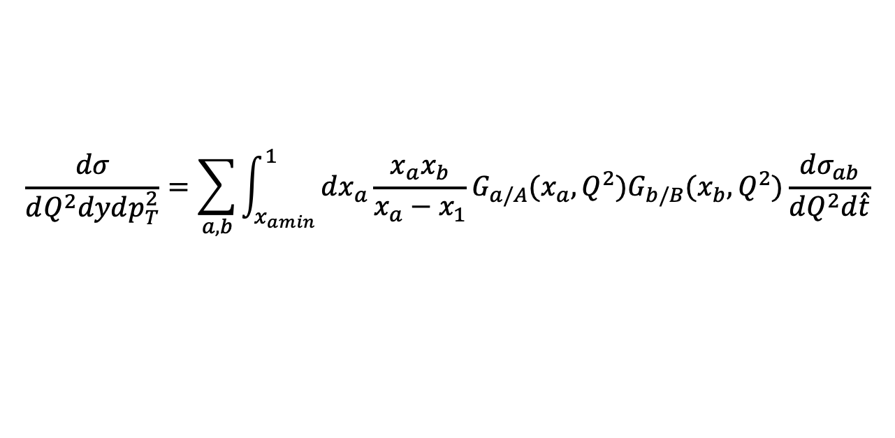
Theoretical Details of DY p_{T} Spectrum
FO Cross Section:
$$\frac{dσ}{dQ^{2}dydp_{T}^{2}}=\sum_{a,b}{\int_{x_{amin}}^{1}{dx_{a}\frac{x_{a}x_{b}}{x_{a}−x_{1}}}G_{a/A}(x_{a},Q^{2})G_{b/B}(x_{b},Q^{2})\frac{dσ_{ab}}{dQ^{2}d\hat{t}}}$$
[4]

Slide 37
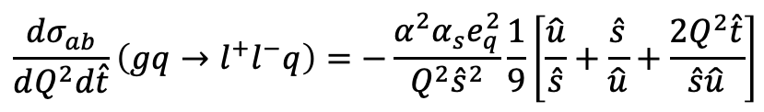
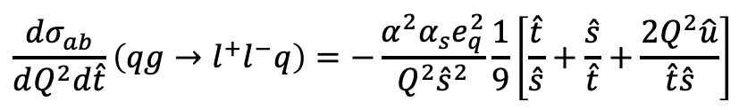
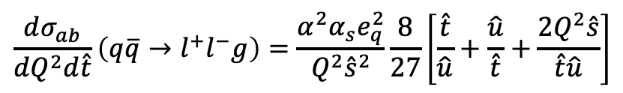
Theoretical Details of DY p_{T} Spectrum
FO Cross Section:
$$\frac{dσ}{dQ^{2}dydp_{T}^{2}}=\sum_{a,b}{\int_{x_{amin}}^{1}{dx_{a}\frac{x_{a}x_{b}}{x_{a}−x_{1}}}G_{a/A}(x_{a},Q^{2})G_{b/B}(x_{b},Q^{2})\frac{dσ_{ab}}{dQ^{2}d\hat{t}}}$$
[4]
$$\frac{dσ_{ab}}{dQ^{2}d\hat{t}}\left(q\overline{q}→l^{+}l^{−}g\right)=\frac{α^{2}α_{s}e_{q}^{2}}{Q^{2}{\hat{s}}^{2}}\frac{8}{27}\left[\frac{\hat{t}}{\hat{u}}+\frac{\hat{u}}{\hat{t}}+\frac{2Q^{2}\hat{s}}{\hat{t}\hat{u}}\right]$$
$$\frac{dσ_{ab}}{dQ^{2}d\hat{t}}\left(qg→l^{+}l^{−}q\right)=−\frac{α^{2}α_{s}e_{q}^{2}}{Q^{2}{\hat{s}}^{2}}\frac{1}{9}\left[\frac{\hat{t}}{\hat{s}}+\frac{\hat{s}}{\hat{t}}+\frac{2Q^{2}\hat{u}}{\hat{t}\hat{s}}\right]$$
$$\frac{dσ_{ab}}{dQ^{2}d\hat{t}}\left(gq→l^{+}l^{−}q\right)=−\frac{α^{2}α_{s}e_{q}^{2}}{Q^{2}{\hat{s}}^{2}}\frac{1}{9}\left[\frac{\hat{u}}{\hat{s}}+\frac{\hat{s}}{\hat{u}}+\frac{2Q^{2}\hat{t}}{\hat{s}\hat{u}}\right]$$
Notes:
Add xamin formula to justify high pt stuff

Slide 38
Theoretical Details of DY p_{T} Spectrum
FO Cross Section:
$$\frac{dσ}{dQ^{2}dydp_{T}^{2}}=\sum_{a,b}{\int_{x_{amin}}^{1}{dx_{a}\frac{x_{a}x_{b}}{x_{a}−x_{1}}}G_{a/A}(x_{a},Q^{2})G_{b/B}(x_{b},Q^{2})\frac{dσ_{ab}}{dQ^{2}d\hat{t}}}$$
[4]
$$\frac{dσ_{ab}}{dQ^{2}d\hat{t}}\left(q\overline{q}→l^{+}l^{−}g\right)=\frac{α^{2}α_{s}e_{q}^{2}}{Q^{2}{\hat{s}}^{2}}\frac{8}{27}\left[\frac{\hat{t}}{\hat{u}}+\frac{\hat{u}}{\hat{t}}+\frac{2Q^{2}\hat{s}}{\hat{t}\hat{u}}\right]$$
$$\frac{dσ_{ab}}{dQ^{2}d\hat{t}}\left(qg→l^{+}l^{−}q\right)=−\frac{α^{2}α_{s}e_{q}^{2}}{Q^{2}{\hat{s}}^{2}}\frac{1}{9}\left[\frac{\hat{t}}{\hat{s}}+\frac{\hat{s}}{\hat{t}}+\frac{2Q^{2}\hat{u}}{\hat{t}\hat{s}}\right]$$
$$\frac{dσ_{ab}}{dQ^{2}d\hat{t}}\left(gq→l^{+}l^{−}q\right)=−\frac{α^{2}α_{s}e_{q}^{2}}{Q^{2}{\hat{s}}^{2}}\frac{1}{9}\left[\frac{\hat{u}}{\hat{s}}+\frac{\hat{s}}{\hat{u}}+\frac{2Q^{2}\hat{t}}{\hat{s}\hat{u}}\right]$$
Notes:
Add xamin formula to justify high pt stuff

Slide 39



Theoretical Details of DY p_{T} Spectrum
FO Cross Section:
$$\frac{dσ}{dQ^{2}dydp_{T}^{2}}=\sum_{a,b}{\int_{x_{amin}}^{1}{dx_{a}\frac{x_{a}x_{b}}{x_{a}−x_{1}}}G_{a/A}(x_{a},Q^{2})G_{b/B}(x_{b},Q^{2})\frac{dσ_{ab}}{dQ^{2}d\hat{t}}}$$
[4]
$$x_{amin}=\frac{x_{1}−τ}{1−x_{2}}$$
$$x_{1}=\frac{\sqrt{Q^{2}+p_{T}^{2}}}{\sqrt{s}}e^{y}$$
$$x_{2}=\frac{\sqrt{Q^{2}+p_{T}^{2}}}{\sqrt{s}}e^{−y}$$

Slide 40



Theoretical Details of DY p_{T} Spectrum
FO Cross Section:
$$\frac{dσ}{dQ^{2}dydp_{T}^{2}}=\sum_{a,b}{\int_{x_{amin}}^{1}{dx_{a}\frac{x_{a}x_{b}}{x_{a}−x_{1}}}G_{a/A}(x_{a},Q^{2})G_{b/B}(x_{b},Q^{2})\frac{dσ_{ab}}{dQ^{2}d\hat{t}}}$$
[4]
$$x_{amin}=\frac{x_{1}−τ}{1−x_{2}}$$
High p_{T} measurements probe higher x
$$x_{1}=\frac{\sqrt{Q^{2}+p_{T}^{2}}}{\sqrt{s}}e^{y}$$
$$x_{2}=\frac{\sqrt{Q^{2}+p_{T}^{2}}}{\sqrt{s}}e^{−y}$$

Slide 41
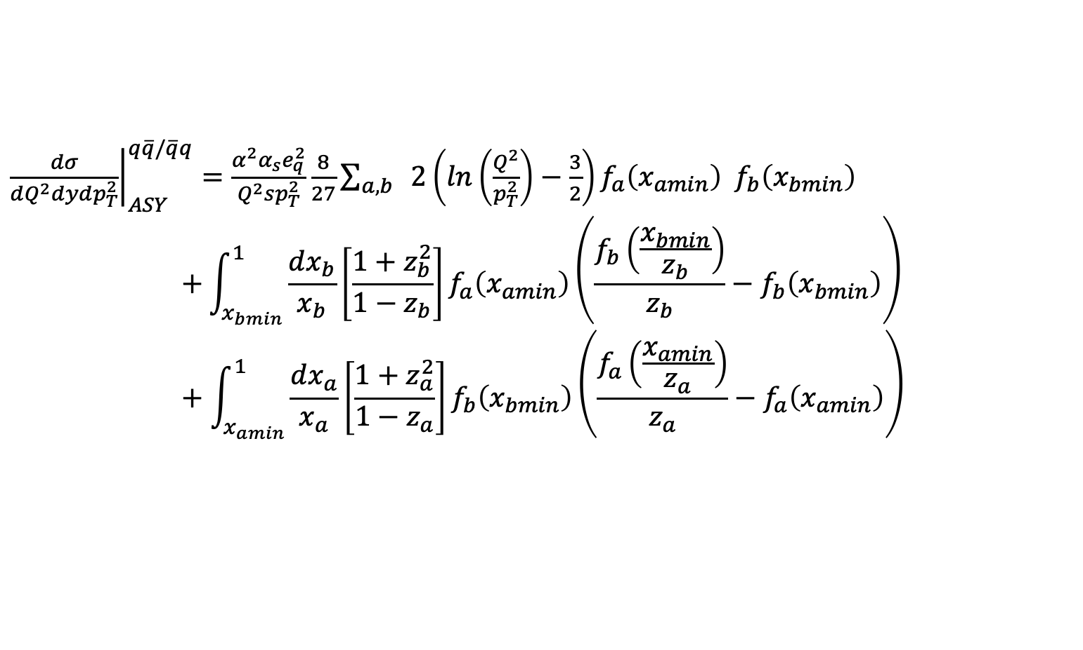
Theoretical Details of DY p_{T} Spectrum
Asymptotic Term: (limit of FO for p_{T} → 0, W for p_{T} →∞)
${\left.\frac{dσ}{dQ^{2}dydp_{T}^{2}}\right|}_{ASY}^{q\overline{q}/\overline{q}q}=\frac{α^{2}α_{s}e_{q}^{2}}{Q^{2}sp_{T}^{2}}\frac{8}{27}\sum_{a,b}{ }$ $2\left(ln\left(\frac{Q^{2}}{p_{T}^{2}}\right)−\frac{3}{2}\right)f_{a}\left(x_{amin}\right){ f}_{b}\left(x_{bmin}\right)$
$$+\int_{x_{bmin}}^{1}{\frac{dx_{b}}{x_{b}}\left[\frac{1+z_{b}^{2}}{1−z_{b}}\right]f_{a}\left(x_{amin}\right)\left(\frac{f_{b}\left(\frac{x_{bmin}}{z_{b}}\right)}{z_{b}}−f_{b}\left(x_{bmin}\right)\right)} +\int_{x_{amin}}^{1}{\frac{dx_{a}}{x_{a}}\left[\frac{1+z_{a}^{2}}{1−z_{a}}\right]f_{b}\left(x_{bmin}\right)\left(\frac{f_{a}\left(\frac{x_{amin}}{z_{a}}\right)}{z_{a}}−f_{a}\left(x_{amin}\right)\right)}$$
[CSS 87]

Slide 42
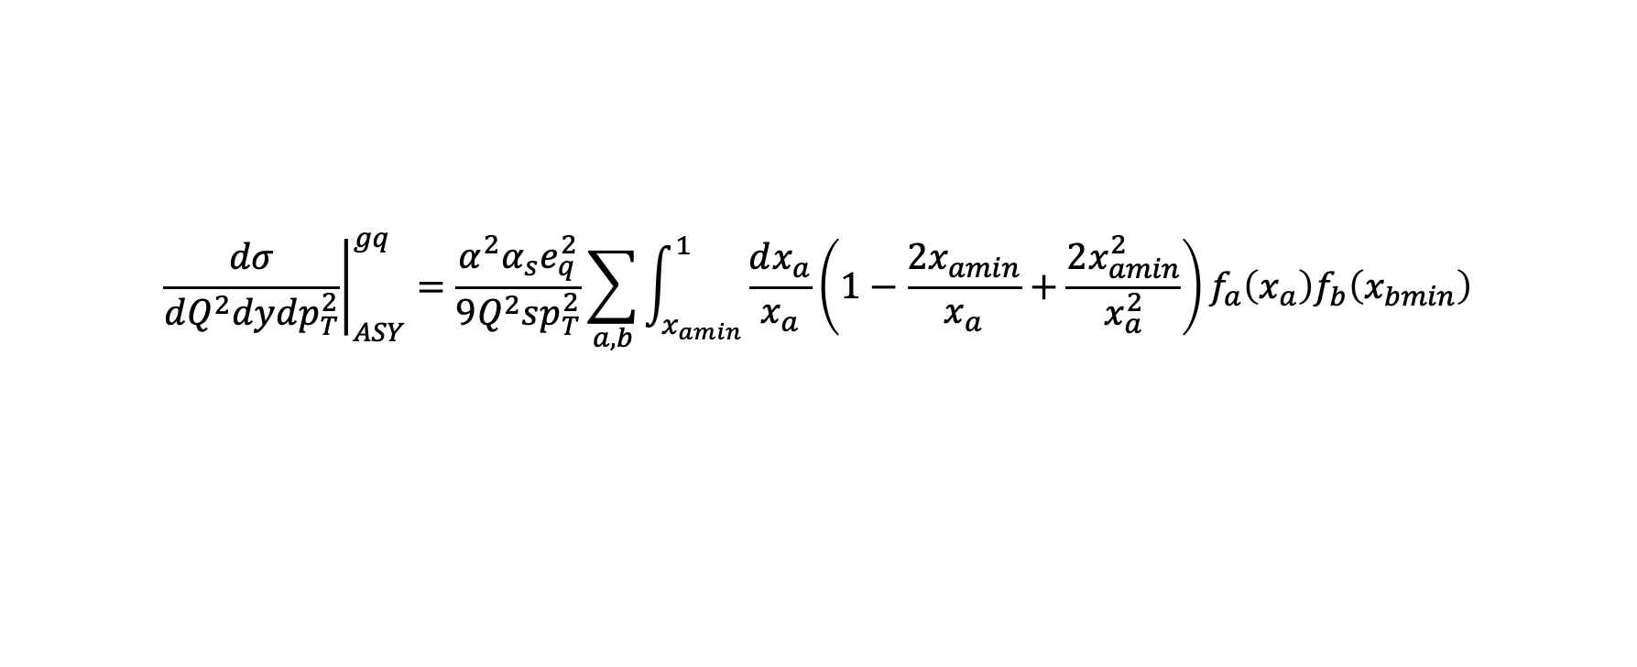
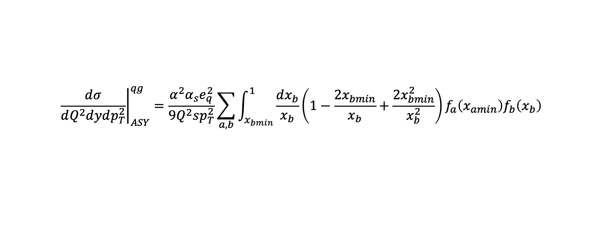
Theoretical Details of DY p_{T} Spectrum
Asymptotic Term: (limit of FO for p_{T} → 0, W for p_{T} →∞)
$${\left.\frac{dσ}{dQ^{2}dydp_{T}^{2}}\right|}_{ASY}^{gq}=\frac{α^{2}α_{s}e_{q}^{2}}{{9Q}^{2}sp_{T}^{2}}\sum_{a,b}{\int_{x_{amin}}^{1}{\frac{dx_{a}}{x_{a}}\left(1−\frac{2x_{amin}}{x_{a}}+\frac{2x_{amin}^{2}}{x_{a}^{2}}\right)f_{a}\left(x_{a}\right)f_{b}\left(x_{bmin}\right)}}$$
[CSS 87]
$${\left.\frac{dσ}{dQ^{2}dydp_{T}^{2}}\right|}_{ASY}^{qg}=\frac{α^{2}α_{s}e_{q}^{2}}{{9Q}^{2}sp_{T}^{2}}\sum_{a,b}{\int_{x_{bmin}}^{1}{\frac{dx_{b}}{x_{b}}\left(1−\frac{2x_{bmin}}{x_{b}}+\frac{2x_{bmin}^{2}}{x_{b}^{2}}\right)f_{a}\left(x_{amin}\right)f_{b}\left(x_{b}\right)}}$$

Slide 43
Phenomenology

Slide 44
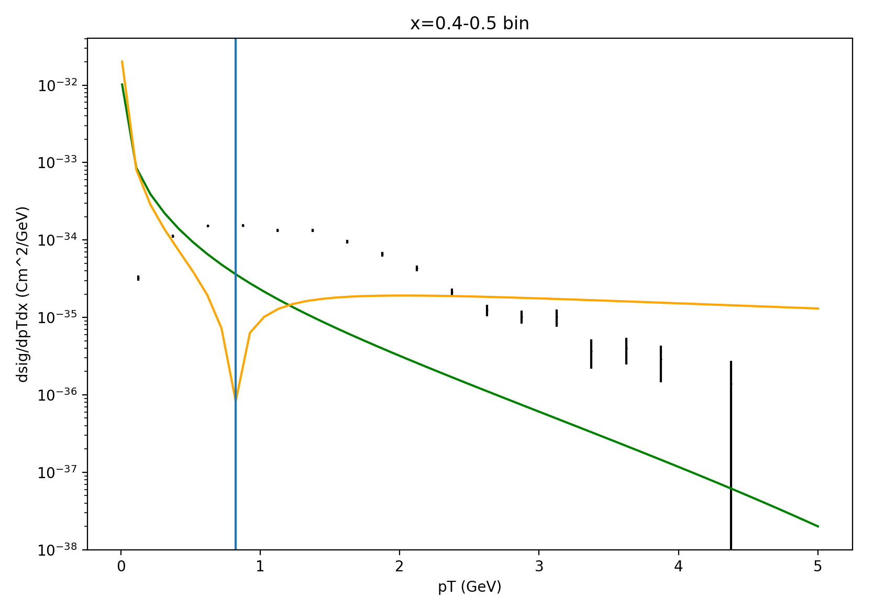
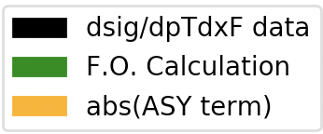
Prediction using Barry et al. PDFs (p_{T} integrated fits)
[1]
[3]
Notes:
Put. Straight prediction from jam fits – pyt arrow

Slide 45
[3]
Notes:
Put vladimirov reference and say TMD references

Slide 46
p_{T} value where the ASY term goes negative
[3]

Slide 47
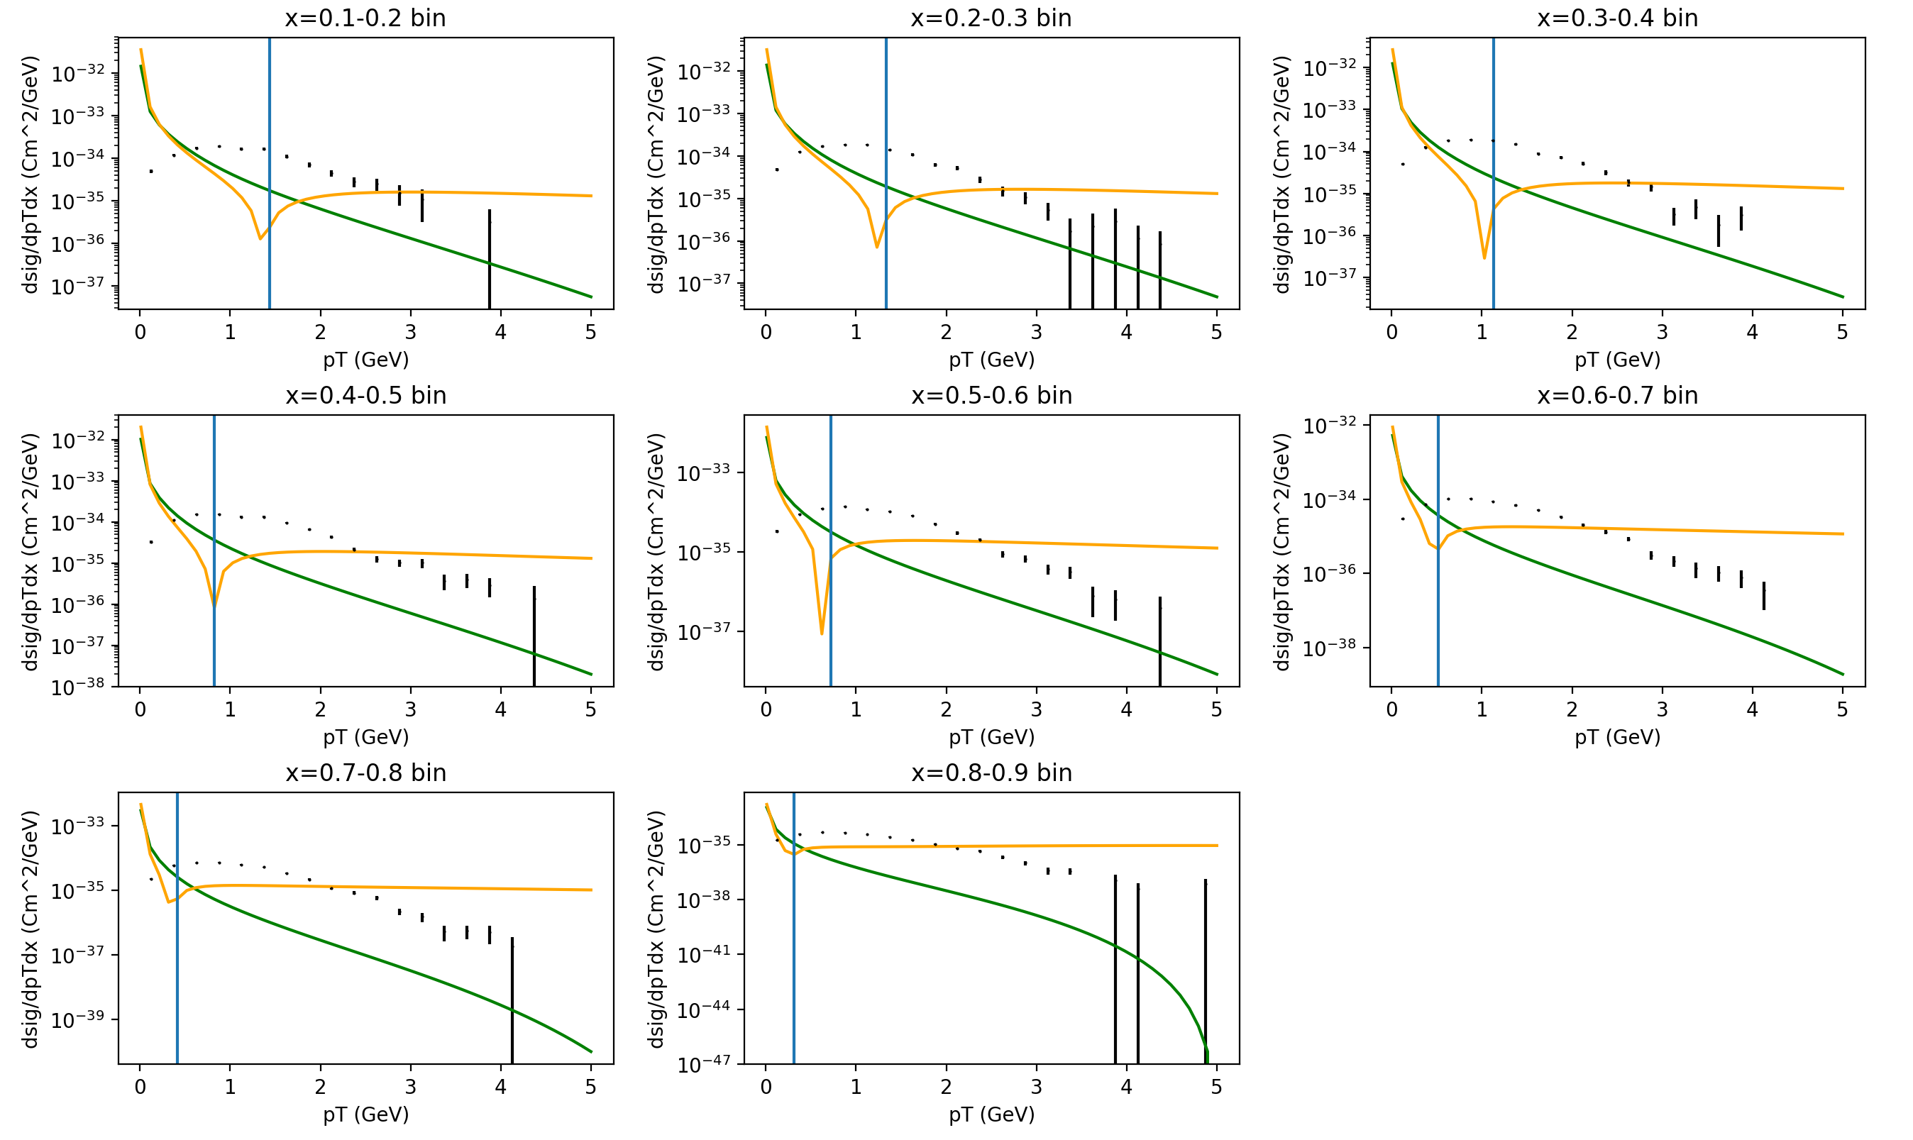
[3]
Notes:
Delete

Slide 48
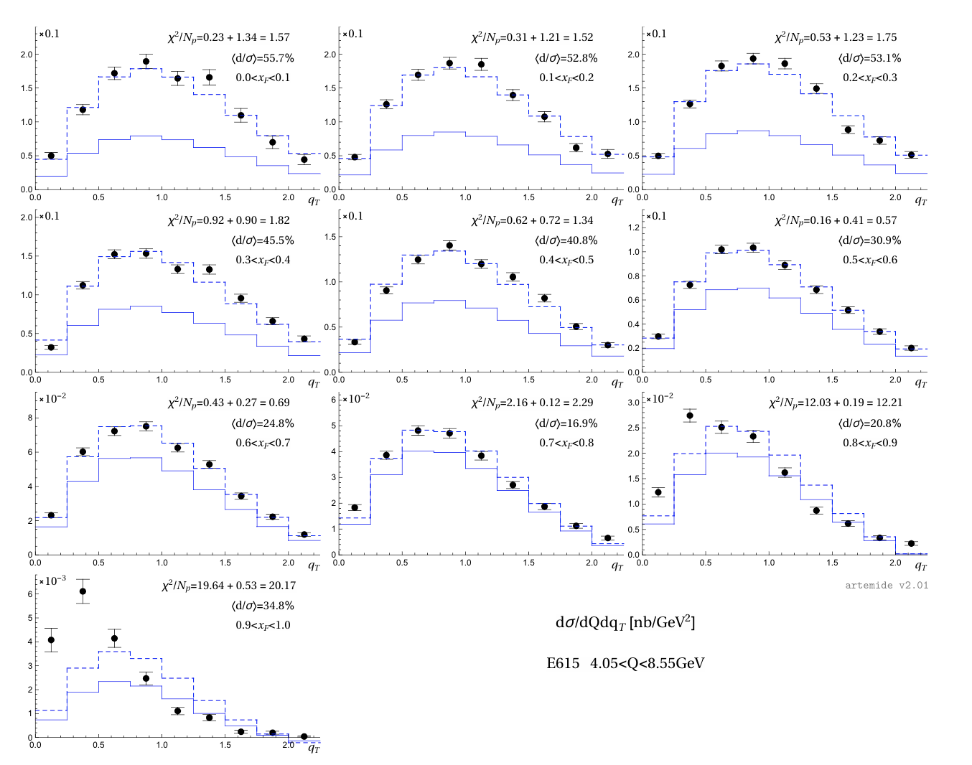
(Vladimirov 2019)
[3]
Notes:
Delete

Slide 49
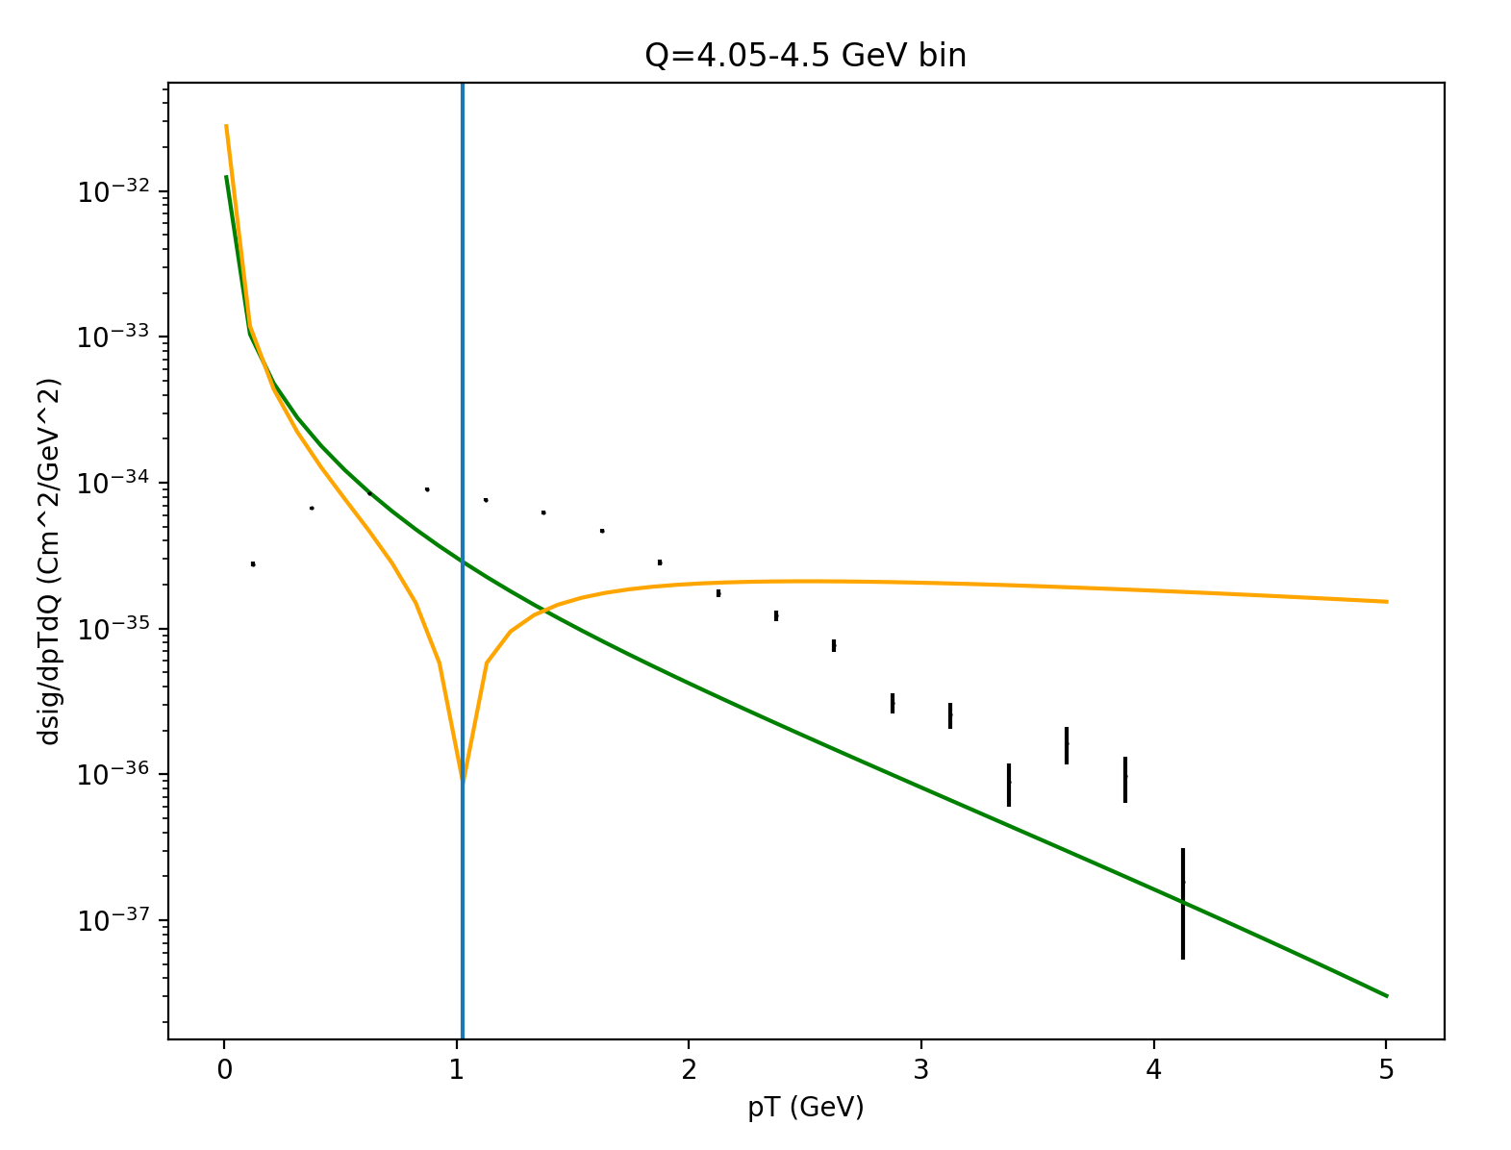
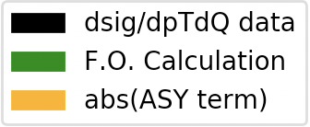
[3]

Slide 50
p_{T} value where the ASY term goes negative
[3]

Slide 51
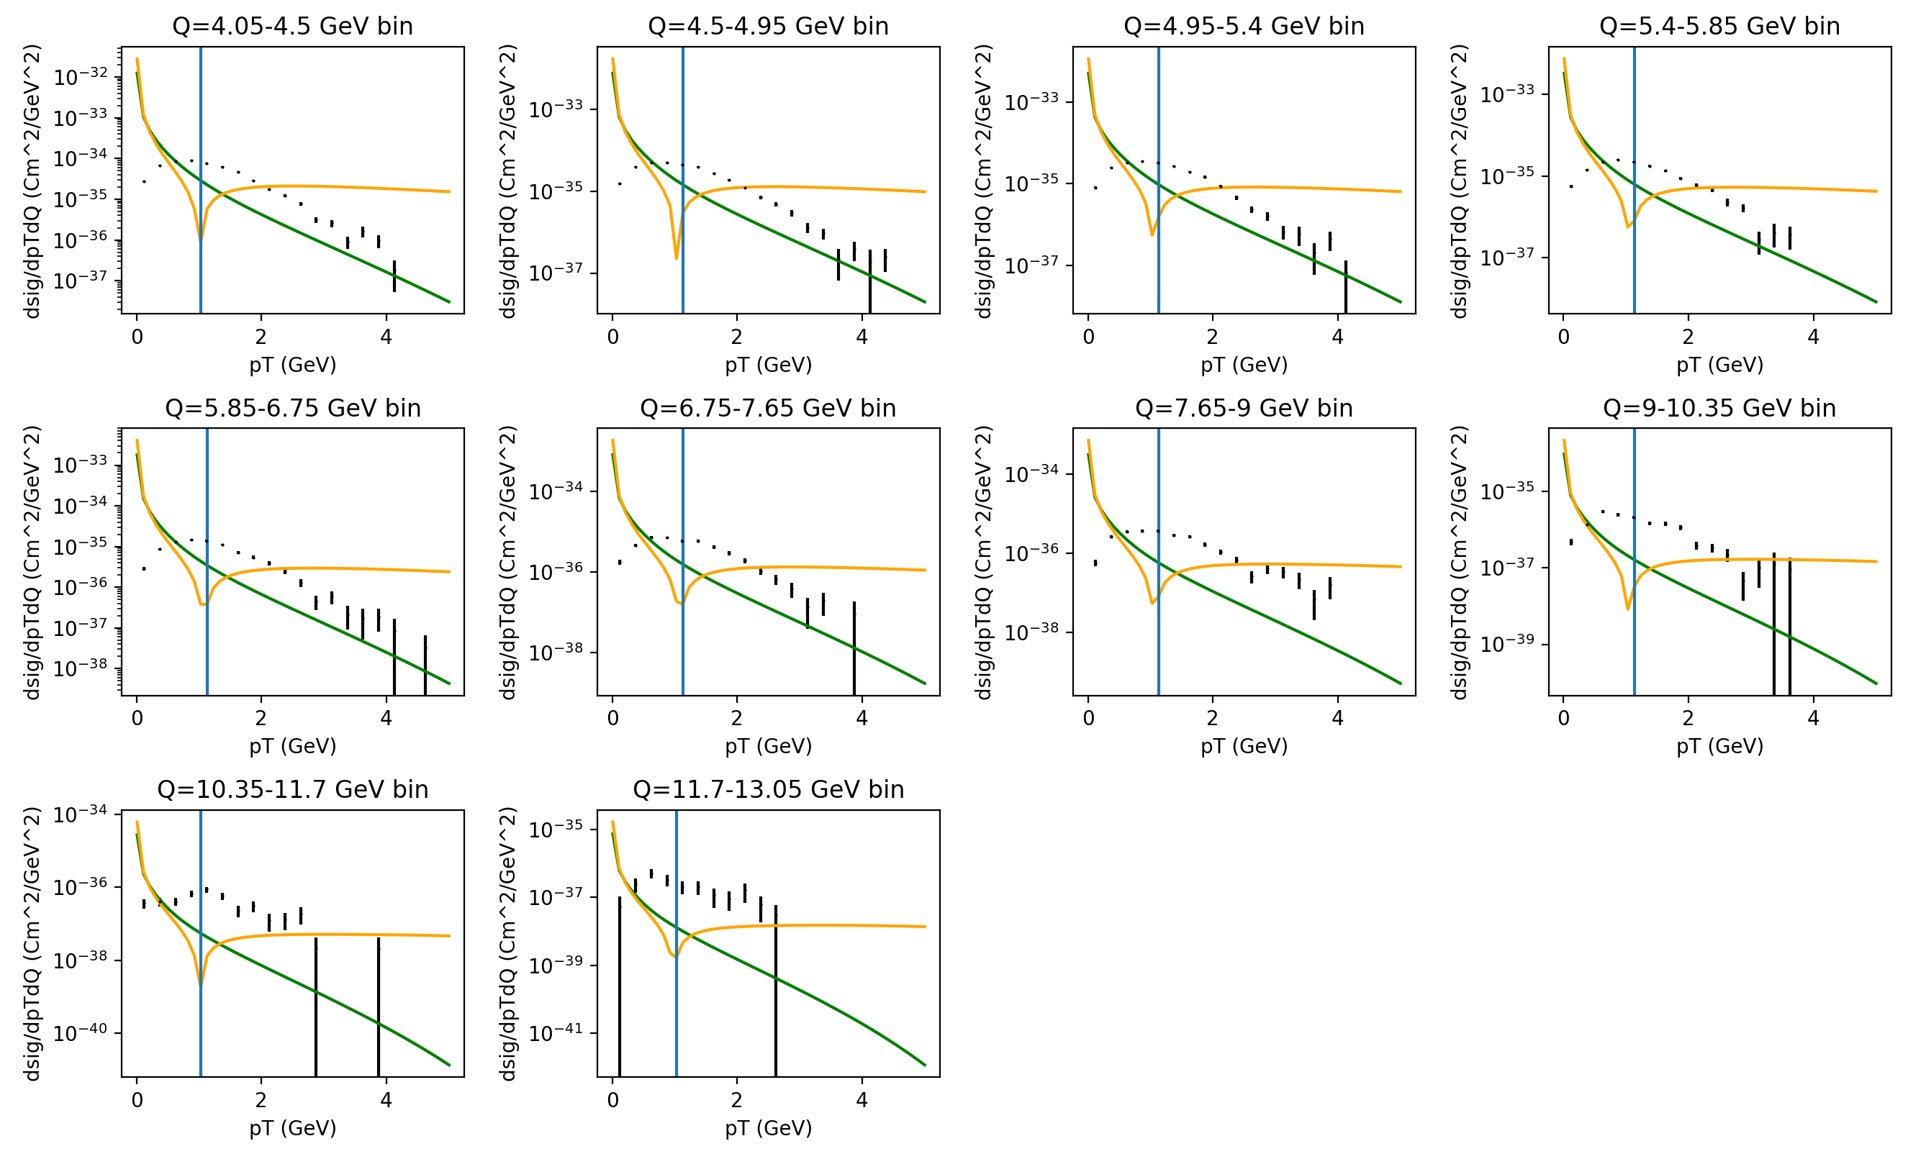
[3]

Slide 52
Preliminary Fits of Data vs. Theory to p_{T} Dependent DY

Slide 53
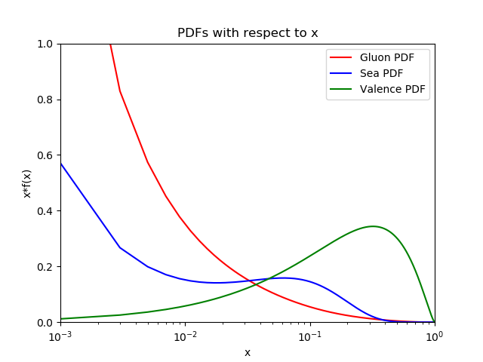
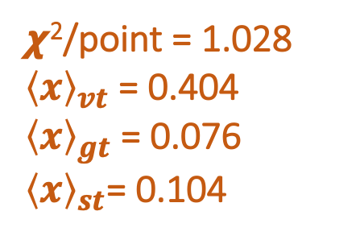
Fit with p_{T} Integrated Data
𝟀²/point = 1.028
${\left\langle x\right\rangle }_{vt}$ = 0.404
${\left\langle x\right\rangle }_{gt}$ = 0.076
${\left\langle x\right\rangle }_{st}$= 0.104
*Gluon PDF divided by 10

Slide 54
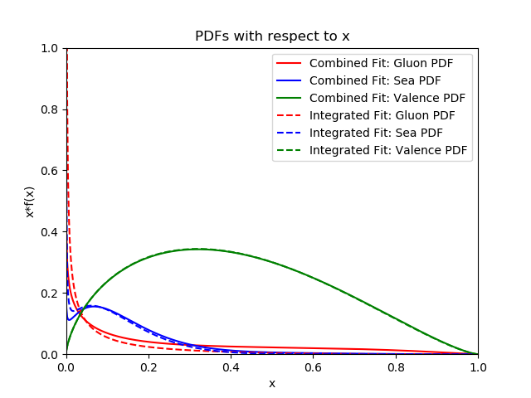
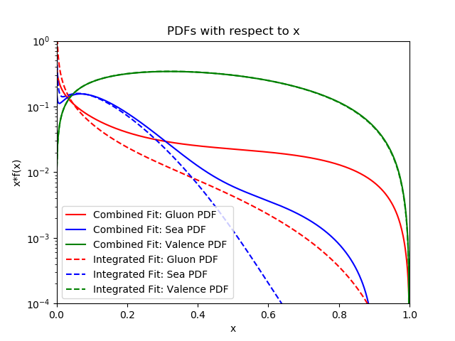
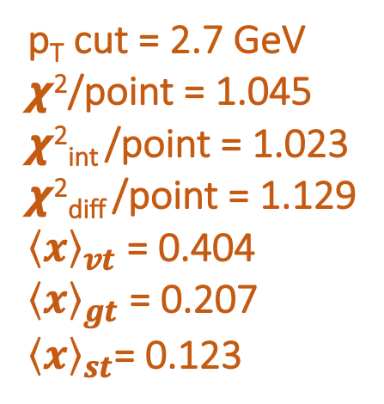
Fit Combining p_{T} Integrated with p_{T} Differential Data
p_{T} cut = 2.7 GeV
𝟀²/point = 1.045
𝟀²_{int} /point = 1.023
𝟀²_{diff} /point = 1.129
${\left\langle x\right\rangle }_{vt}$ = 0.404
${\left\langle x\right\rangle }_{gt}$ = 0.207
${\left\langle x\right\rangle }_{st}$= 0.123
*Gluon PDF divided by 10

Slide 55
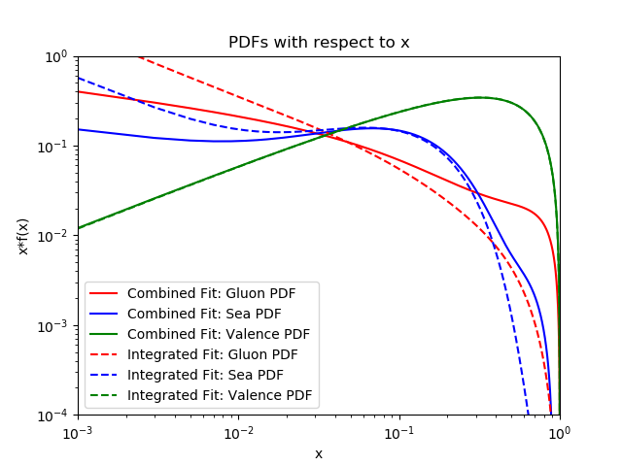
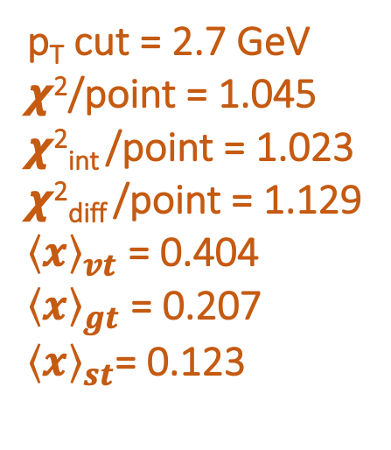
Fit Combining p_{T} Integrated with p_{T} Differential Data
p_{T} cut = 2.7 GeV
𝟀²/point = 1.045
𝟀²_{int} /point = 1.023
𝟀²_{diff} /point = 1.129
${\left\langle x\right\rangle }_{vt}$ = 0.404
${\left\langle x\right\rangle }_{gt}$ = 0.207
${\left\langle x\right\rangle }_{st}$= 0.123
*Gluon PDF divided by 10

Slide 56
Fit Combining p_{T} Integrated with p_{T} Differential Data
p_{T} cut = 2.7 GeV
𝟀²/point = 1.045
𝟀²_{int} /point = 1.023
𝟀²_{diff} /point = 1.129
Valence heavily constrained by p_{T} integrated data
*Gluon PDF divided by 10

Slide 57
Fit Combining p_{T} Integrated with p_{T} Differential Data
p_{T} cut = 2.7 GeV
𝟀²/point = 1.045
𝟀²_{int} /point = 1.023
𝟀²_{diff} /point = 1.129
Valence heavily constrained by p_{T} integrated data
Gluon increases significantly at high x
*Gluon PDF divided by 10

Slide 58
Fit Combining p_{T} Integrated with p_{T} Differential Data
p_{T} cut = 2.7 GeV
𝟀²/point = 1.045
𝟀²_{int} /point = 1.023
𝟀²_{diff} /point = 1.129
Valence heavily constrained by p_{T} integrated data
Gluon increases significantly at high x
Sea also increases at high x
*Gluon PDF divided by 10

Slide 59
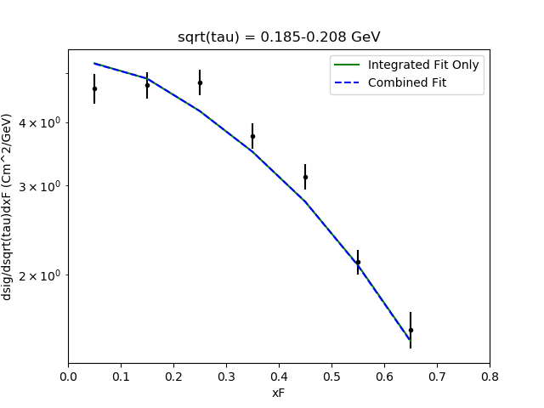
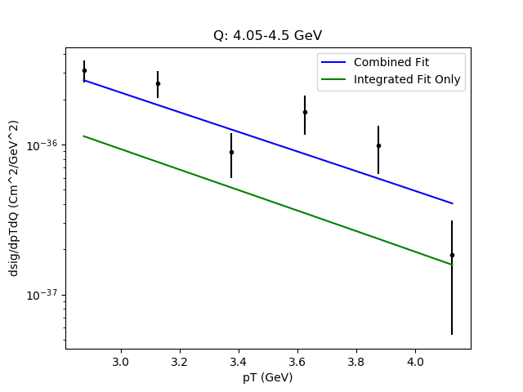
Data vs. Theory Combining p_{T} Integrated with p_{T} Differential Data

Slide 60
Data vs. Theory Combining p_{T} Integrated with p_{T} Differential Data
Fit of Integrated Data: Approximately the same
Fit of Differential Data: Significantly Improved with Combined Fit

Slide 61
Summary
FO calculation completed and implemented into a QCD global analysis code (JAM)

Slide 62
Summary
FO calculation completed and implemented into a QCD global analysis code (JAM)
Started exploratory studies of the p_{T} spectrum:

Slide 63
Summary
FO calculation completed and implemented into a QCD global analysis code (JAM)
Started exploratory studies of the p_{T} spectrum:
  PDFs with only p_{T} integrated data
  PDFs with only p_{T} differential data
  PDFs that combine the two
  Different p_{T} cuts to identify the ”large” pT region

Slide 64
Future Steps
Integrate leading neutron data from HERA to decouple the behavior of the gluon and the sea quarks
Complete a full Monte-Carlo analysis of the PDFs that probes all possible regions of parameter space

Slide 65
References
Barry et al., Phys. Rev. Lett. 121, 152001 (2018).
J.C. Collins, D.E. Soper, G. Sterman, Nucl. Phys. B, 250 (1985), p. 199
J. S. Conway et al., Phys. Rev. D 39, 92 (1989).
Talk by Jeff Owens, 2000 CTEQ Summer School, May 30-June7, 2000

Slide 66
Thank You!
Questions?

