Slide 1
Perspectives from DOE Nuclear Physics
JLAB User Meeting,
June 21-23, 2021

Slide 2
Budget Matters

Slide 3
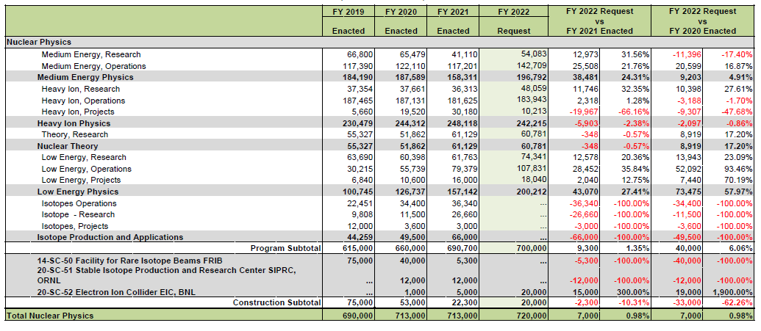
NP - FY 2022 President’s Request
(Dollars in thousands)

Slide 4
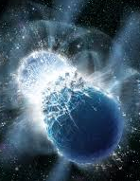
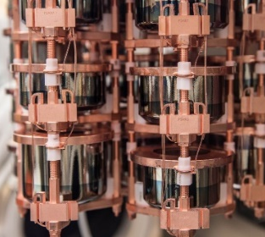
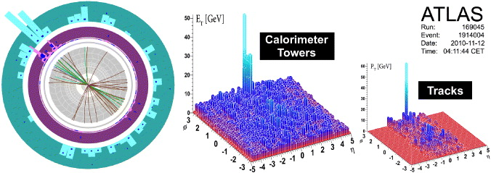
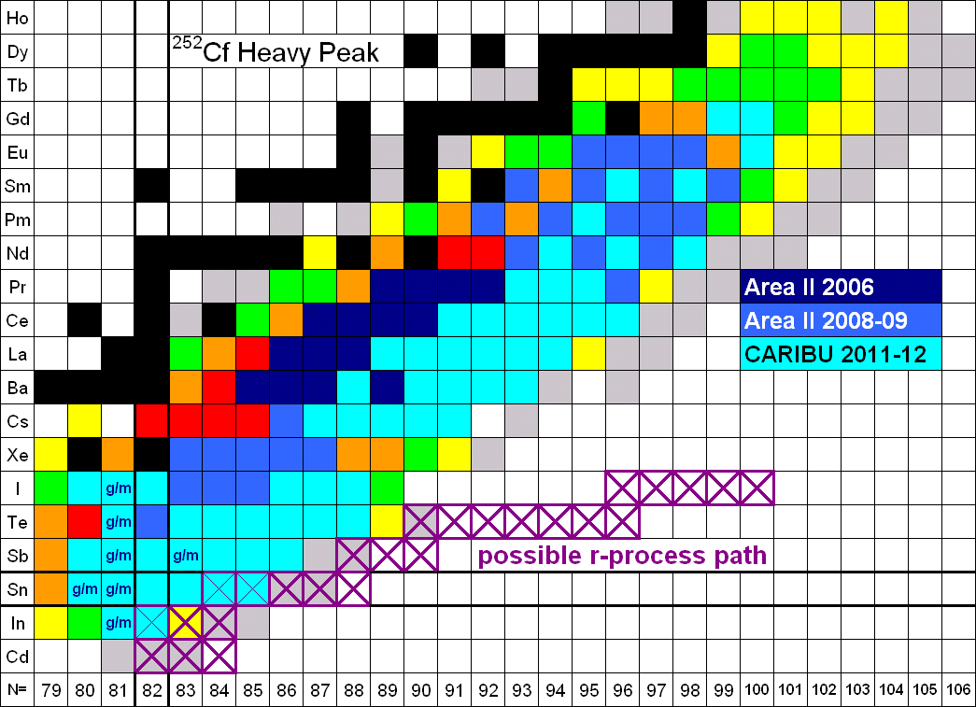
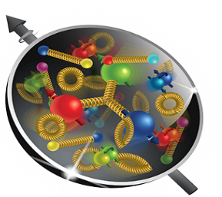
Nuclear Physics
Discovering, exploring, and understanding all forms of nuclear matter
      Understanding why matter takes on the specific forms observed in nature and how that knowledge can benefit energy, commerce, medicine, and national security, by discovering:
  How mass is created from energy in the interior of the proton using the future Electron-Ion Collider?
  What are the properties of the novel quark-gluon plasma discovered at RHIC?
  What is the mechanism underlying the confinement of quarks and gluons via CEBAF and RHIC?
  The search for new exotic particles and anomalous violations of nature’s symmetries at CEBAF
  The limits of nuclear existence? How are heavy elements made in the cosmos via FRIB and ATLAS?
  Is the neutrino its own anti-particle? Do the neutron’s precise properties point to new physics?
  The nature of the strong force in many-body systems via SciDAC?
  Advanced Nuclear Data for Space, Energy, and Research.

Slide 5
Nuclear Physics – FY 2022 Highlights
Discovering, exploring, and understanding all forms of nuclear matter
      Operations
The Request supports operations of the NP scientific user facilities to enable world-class science:
  RHIC operates at 90 percent optimal utilization and installs sPHENIX to study the Quark-Gluon Plasma.
  CEBAF operates at 90 percent of optimal utilization, enabling highest priority 12 GeV experiments and critical maintenance activities and cryomodule refurbishments.
  ATLAS operates at 93 percent of optimal utilization to enable the most compelling experiments in nuclear structure and astrophysics and invests in multi-user capabilities to increase utilization of the facility.
  FRIB transitions from a construction project to a scientific user facility and operates at 100% of optimal utilization to support research, beam studies and commissioning.
Projects
The Request also supports compelling major scientific investments:
  Completion of the super Pioneering High Energy Nuclear Interaction eXperiment (sPHENIX) MIE, to further RHIC’s scientific mission by studying high-rate jet production
  Continuation of the Gamma-Ray Energy Tracking Array (GRETA) MIE, to enable provision of advanced, high resolution gamma ray detection capabilities for FRIB.

Slide 6
Nuclear Physics – FY 2022 Highlights (cont.)
Discovering, exploring, and understanding all forms of nuclear matter
      Projects (cont.)
  Continuation of the Measurement of a Lepton-Lepton Electroweak Reaction (MOLLER) MIE to measure the parity-violating asymmetry in polarized electron-electron scattering with the 12 GeV CEBAF.
  Continuation of the Ton-scale Neutrinoless Double Beta Decay MIE to determine whether the neutrino is its own antiparticle.
  Continuation of the High Rigidity Spectrometer (HRS) research project at FRIB to maximize the rate of rare neutron-rich nuclei of central importance for understanding the synthesis of heavy elements in cosmic events.
The DOE Isotope Program is embedded in the Nuclear Physics budget in FY 2021 Enacted but is broken out as a Program separate from NP in the FY 2022 Request.
The Electron Ion Collider (EIC), of critical importance to maintain world-leadership in nuclear physics and accelerator science, receives its third year of OPC and TEC funding. OPC funding supports conceptual design efforts and R&D, while the TEC funding supports design efforts, long lead procurements and Project Engineering Design (PED) activities.

Slide 7
Nuclear Physics – FY 2022 Highlights (cont.)
Discovering, exploring, and understanding all forms of nuclear matter
      Research
      Funding is strengthened at national labs and universities conducting research in relativistic nuclear collisions, hadron physics, nuclear structure and nuclear astrophysics, fundamental symmetries and nuclear theory.
      NP participates in six crosscutting scientific initiatives:
        Accelerator Science and Technology Initiative – strengthening U.S. supply chain robustness to steward key technologies such as electron ion source developments and advanced approaches in SRF technology
        Artificial Intelligence and Machine Learning – R&D for automated optimization of accelerator performance and operation as well as algorithm development for data-analytics-driven discovery.
        Integrated Computational & Data Infrastructure – Cross-cutting cloud solutions to Big Data storage challenges in Nuclear Physics
        Microelectronics – R&D on detector materials, devices, advances in front-end electronics, and integrated sensor/processor architectures
        Quantum Information Science – leveraging discovery opportunities in sensing, simulation, and computing at the intersections of nuclear physics and QIS
        Reaching a New Energy Sciences Workforce (RENEW) - advancing a diverse, equitable, and inclusive research community

Slide 8
Summary of 2022 President’s Request Changes Relative to FY 2021 Enacted
FY 2021 Enacted | FY 2022 President’s Request
Core Research reduced 3.75% from FY20 Enacted (including COL, this is a 5.6% cut from constant effort in FY20). New ECA awards are made. | Core research in Medium Energy, Heavy Ions, and Theory is increased by 12% from FY21 Enacted. (After accounting for COL, this represents a ~10% increase over FY21 Enacted,.) The Fundamental Symmetries and Nuclear Structure and Nuclear Astrophysics portfolios are increased by 15% over FY21 Enacted.
LHC M&O commitments are met. | LHC M&O commitments are met.
FRIB Research flat with FY2020 and below the planned level. | FRIB Research is increased, but still below the planned level.
nEDM supported below planned profile. | nEDM supported significantly below planned profile, possibly impacting schedule.
SciDAC commitment are met. | SciDAC funding is increased to support SciDAC-5 (+$600k).
Nuclear Data slightly increased over FY20 Enacted. | Nuclear Data increased $3.5M from FY21 Enacted to support the expansion of experimental efforts.
Accelerator R&D subject to the 3.75% research reduction. | Accelerator R&D increased ~$1M over FY21 Enacted level.
QIS at $9.5M. | QIS increased to $10.5M.
NP ML/AI Initiative begins with $4M. | AI/ML Initiative support flat with FY21 Enacted ($4M).

Slide 9
Summary of 2022 Changes Relative to FY 2021
FY 2021 Enacted | FY 2022 President’s Request
 | Four new initiatives are supported: Reaching a New Energy Sciences Workforce (RENEW) - $3M Accelerator Science and Technology - $2M Integrated Computational & Data Infrastructure - $1M Microelectronics - $500k
Facility operations funding reduced by 3.75%. RHIC operates 24 weeks (100 % maximum) CEBAF operates 7 weeks (41 % maximum) ATLAS operates 39 weeks (93 % optimal) | Facilities operations supported at >90% of optimal. RHIC operates 18 weeks (90 % maximum) CEBAF operates 31 weeks (90 % optimal) ATLAS operates 39 weeks (93 % optimal) FRIB operates 12 weeks (100% of optimal)
FRIB operations supported at $50M. | FRIB Operations increased, but still slightly below planned levels ($77M in PR vs $82M planned)
FRIB construction at baselined $5.3M in final funding year.
EIC construction at TEC of $5M and OPC of $24.65M | EIC construction at TEC of $20M and OPC of $10M
Major Items of Equipment: GRETA reduced below planned levels ($6.6M) sPHENIX at planned baseline level ($5.53M) MOLLER at $5M TEC TSNLDBD at $1.4M TEC HRS at $3M TEC | Ongoing Major Item of Equipment: GRETA below planned levels ($6.6M) sPHENIX at baseline level ($0.2M) MOLLER at $7M TEC TSNLDBD at $1.44M TEC HRS at $3M TEC
Isotope Program embedded within NP budget | Isotope Program no longer embedded within NP budget

Slide 10


The 2015 Long Range Plan for Nuclear Science
Recommendations:
Capitalize on investments made to maintain U.S. leadership in nuclear science.
Develop and deploy a U.S.-led ton-scale neutrino-less double beta decay experiment.
Construct a high-energy high-luminosity polarized electron-ion collider (EIC) as the highest priority for new construction following the completion of FRIB.
Increase investment in small-scale and mid-scale projects and initiatives that enable forefront research at universities and laboratories.
NP continues to execute on the 2015 LRP Vision

Slide 11
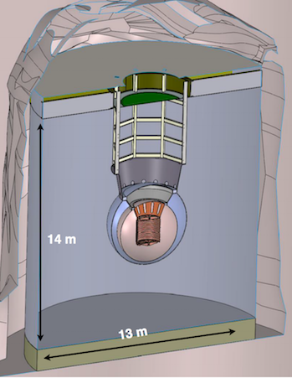
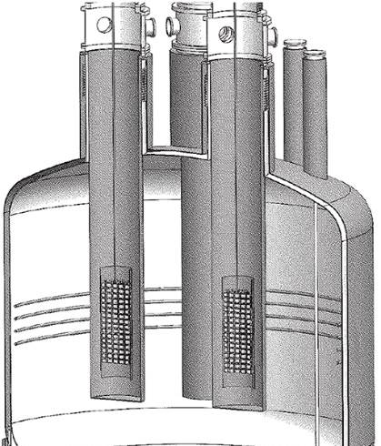
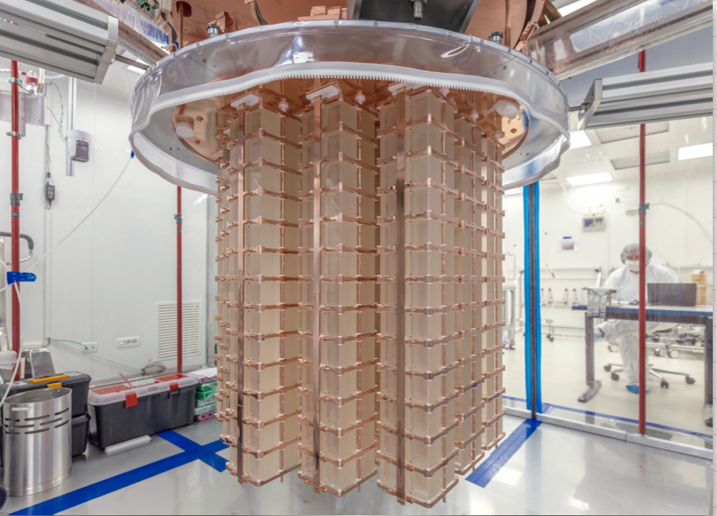
Neutrino-less Double Beta Decay
Research goals
  Discover whether the neutrino is its own anti-particle ?
  Discover why the neutrino mass is so small ?
  Discover whether a new unforeseen suite of particle exists ?
There are tree Front-Runner Technologies
  Scintillating bolometry (CUPID, ¹⁰⁰ Mo enriched Li₂Mo₄ crystals)
  Enriched ⁷⁶Ge crystals (LEGEND-1000, drifted charge, point contact detectors
  Liquid Xenon TPC (nEXO, light via APD, drifted ionization)
Background constraints are exceptionally challenging < 1 count/tom pf material/year
Also, possible sites
SURF (SD)
SnoLab (Canada)
Gran Sasso (Italy)
CUPID
nEXO
LEGEND

Slide 12
0νββ Progression
Ongoing interactions with potential international collaborators to introduce U.S. perspectives, hear European perspectives, and suggest a global approach to investment in DBD science
DBD Portfolio Review will be held July 13-16, 2021 to inform U.S. investment strategy. Instructions published by April 15, 2021.
North American – European Summit will be held September 27-29, 2021 to see if common ground exists for an international approach to DBD investment
Funding for ton-scale 0νββ is going to be challenging

Slide 13
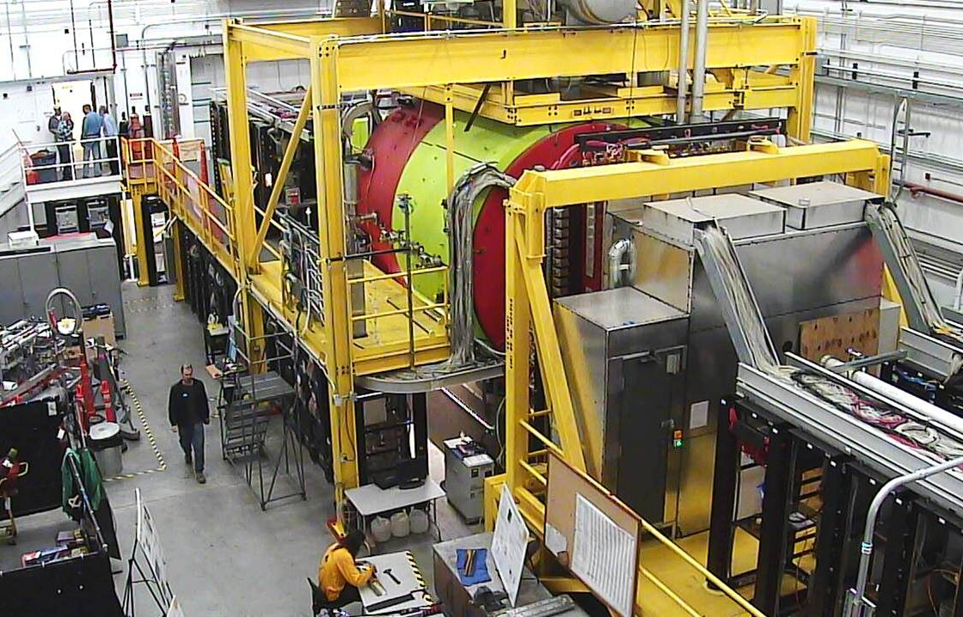
12 GeV CEBAF Science Program Continues
CEBAF Weeks Capped by CHL Install in FY21
New results from GlueX illuminate the mechanism of threshold J/Psi production and the upper limit on the pentaquark. The latter provides constraints on the structure of the LHCb pentaquark, favoring a molecular description.
Phys. Rev. Lett. 123, 072001(2019)
(Based on ~25% of collected data.)

Slide 14
New P-REX Results Unblinded !
The weak radius can be combined with the well-known charge density to obtain the baryon density of 208Pb
This is the first clean determination of the central baryon density of a heavy nucleus and is accurate to 2%
Provides an important benchmark to chiral EFT calculations that is closely related to nuclear saturation density
Result has direct relevance for bounding the radius of neutron stars in concert with neutron star merger data from LIGO
Rn-Rp[fm]

Slide 15
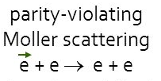
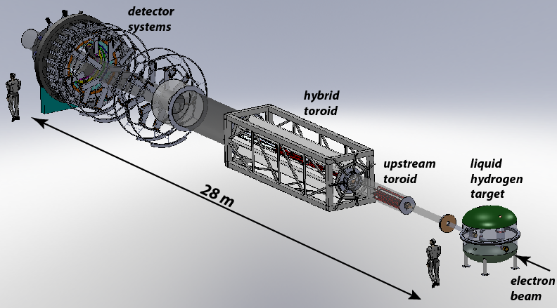
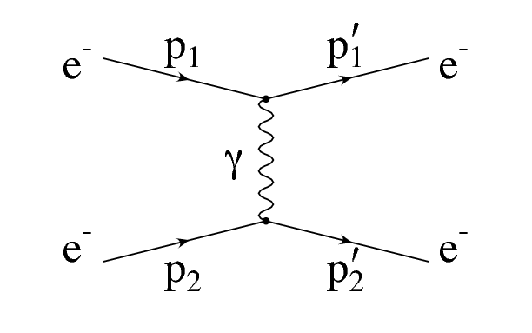
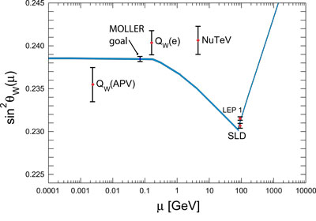
MOLLER: a “Must Do” Experiment To Point the Way to New Science
The scientific world rather desperately needs additional markers due to the consistency thus far of LHC data with Standard Model Predictions. Due to the technical challenge of constructing a next generation accelerator with very high accelerating gradients, those markers will have to come from “indirect” discovery experiments like MOLLER.
Z
In MOLLER, polarized electrons are scattered of unpolarized electrons. The amount of parity violation due to interference of the two possible exchange mechanisms (γ or Z) is precisely predictable in QED. (No messy quarks or color charge, or QCD to worry about, only quantum electrodynamics). The theory is so “clean” that like the g-2 approach, If the level of parity violation is greater than expected, a new particle must be the source of the discrepancy.
Projected sensitivity to Standard Model prediction
Project at CD-1, FY 2021 Enacted: $5M
SoLID Science Review is Underway

Slide 16
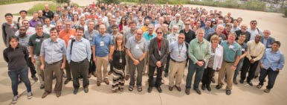
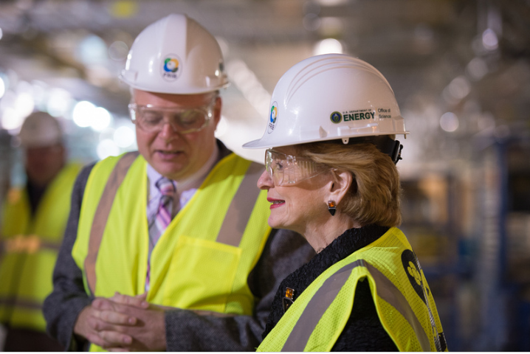
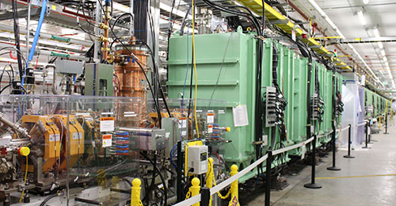
The Fourth, Newest Microscope: Facility for Rare Isotope Beams (FRIB)
FRIB issued a call for proposals to its 1500 member user group.
82 proposals received from 130 institutions in 30 countries requesting 9,784 hours of beam time
FRIB Program Advisory Committee Meeting held in May 2021.
First science in
spring of 2022
RHIC
FRIB
World Leadership in Nuclear Structure & Nuclear Astrophysics Research

Slide 17
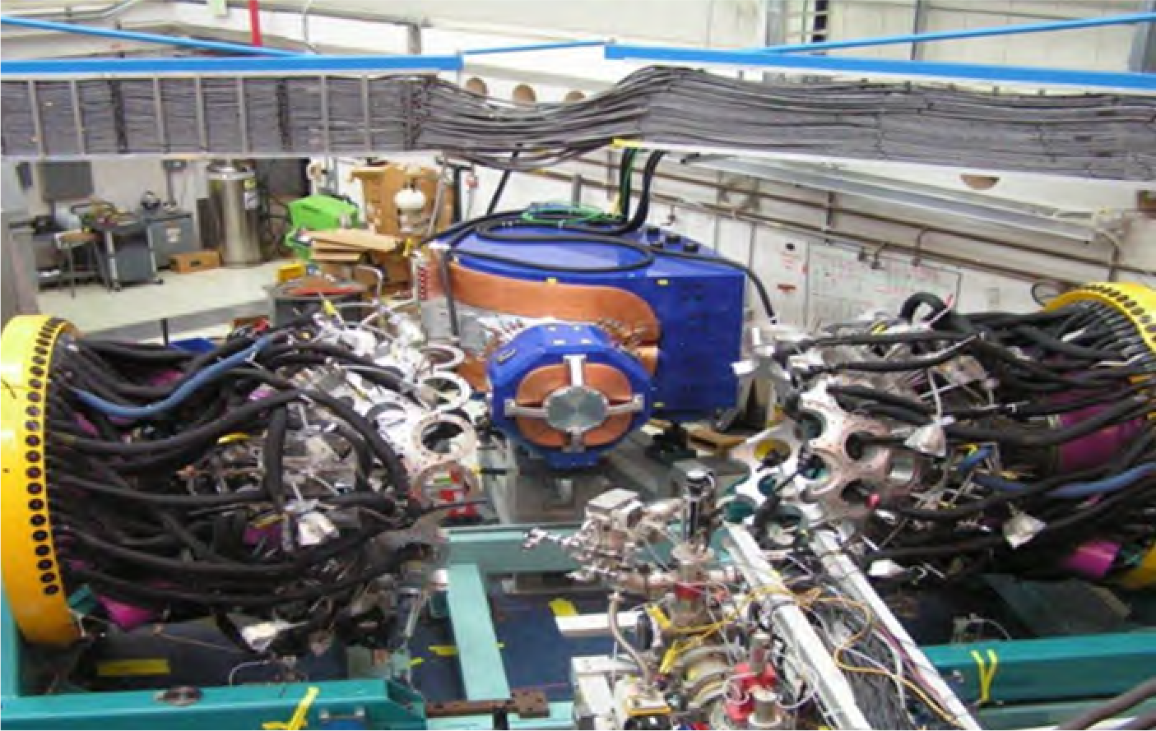
ATLAS Continues as a Premier Stable Beam Facility

Slide 18


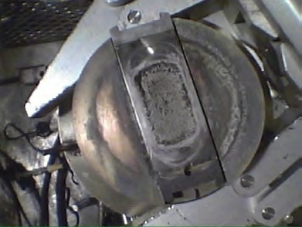
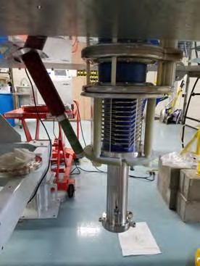
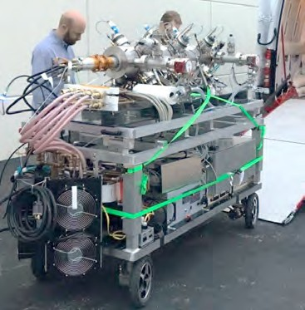


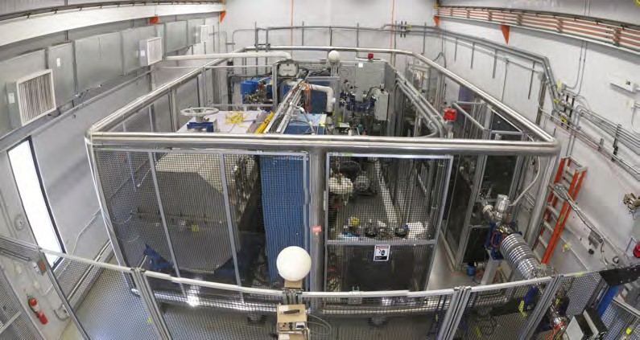
NEUTRON GENERATOR UPGRADE
Replace ²⁵²Cf source by neutron-induced fission on actinide foils
  More reliable source of fission products
  Operationally easier to maintain and operate
  Higher fission yield feeding in the ¹³²Sn region
OR
25

Slide 19
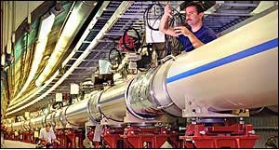
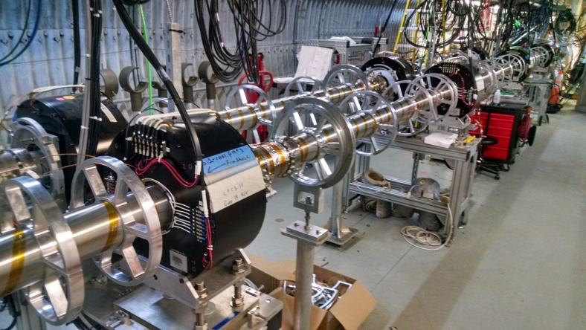
RHIC Machine Performance Continues to Set New Records
The continued focus at RHIC: search for a critical point between the phases of nuclear matter
LEReC
Cooling of low energy, bunched heavy ion beams (3.85–5.75 GeV/n) to increase luminosity
Project on track for use in low-energy RHIC runs
Consistently high facility availability (~85%)
No other facility worldwide, existing or planned, rivals RHIC in science reach and versatility as a heavy ion collider. It is the only polarized proton collider in the world.

Slide 20
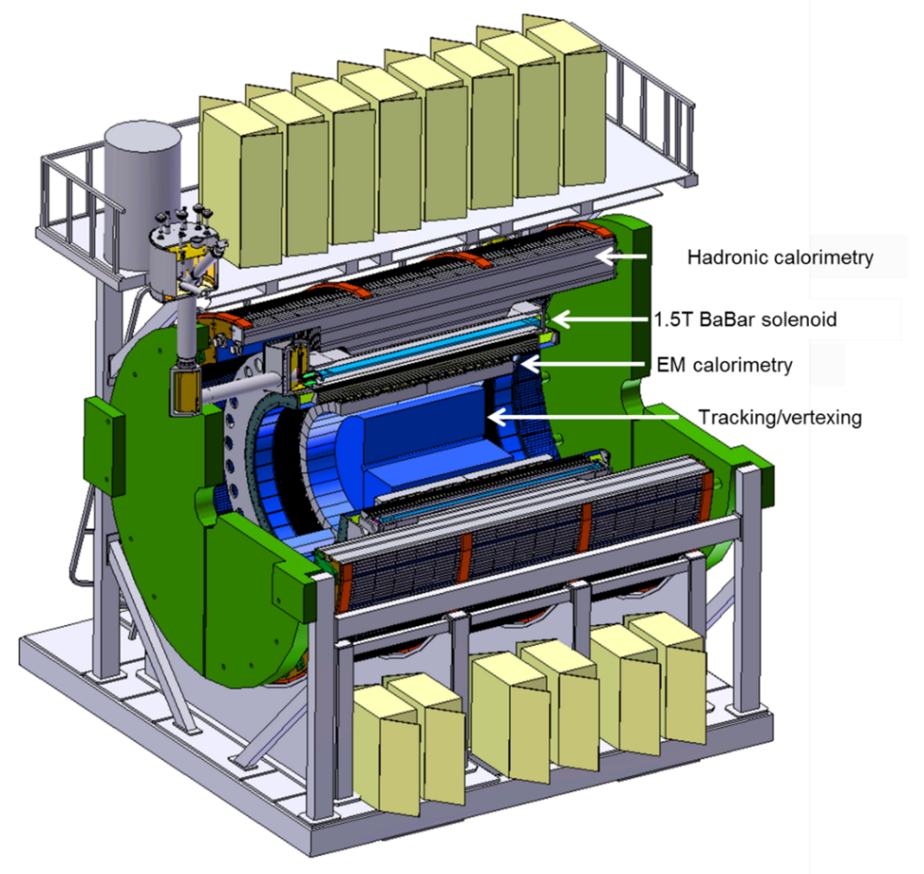
The sPHENIX Upgrade is Continued
mapping the character of the hadronic matter under extreme conditions by varying the temperature of the medium, the virtuality of the probe, and the length scale within the medium.
understanding the parton–medium interactions by studying heavy-flavor jets.
probing the effect of the quark–gluon plasma on the Upsilon states by comparing the p-p (proton-proton), p-A (proton-nucleus), and A-A (nucleus-nucleus) collisions.
August 16, 2018: CD-1 and CD-3a for long lead procurements
$6M Proposed from within the RHIC base for FY 2020 Request
CMS MTD Science Review is Underway
implemented from within RHIC base by limiting operations to one detector and periodically not operating facility.

Slide 21
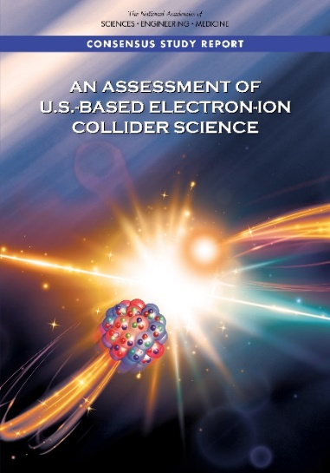
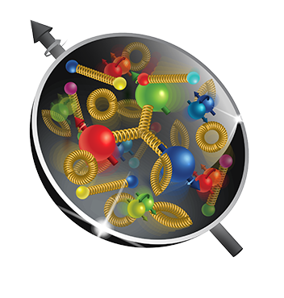
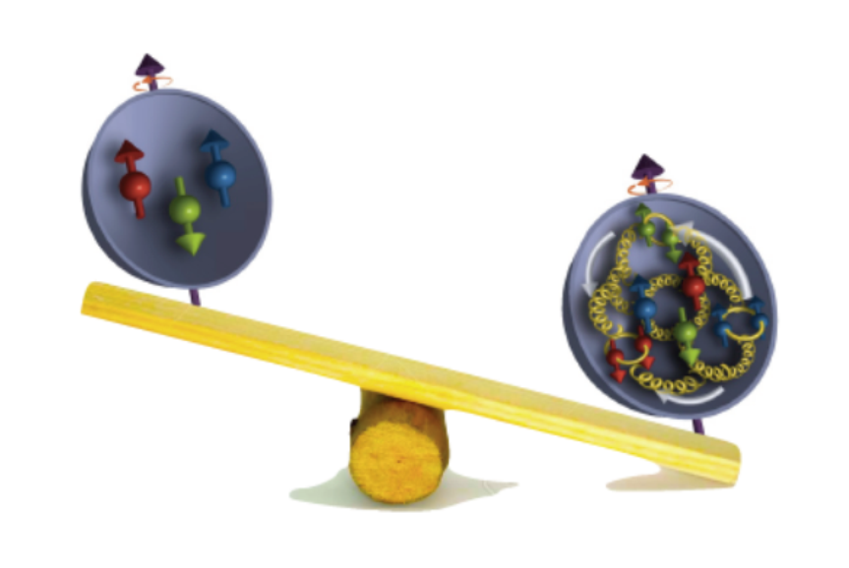
The Next Super High Power, High Energy Microscope:
The Electron-Ion Collider
National Academy of Science Report: AN ASSESSMENT OF U.S.-BASED ELECTRON-ION COLLIDER SCIENCE
“An EIC can uniquely address three profound questions
About nucleons—neutrons and protons—and how they
are assembled to form the nuclei of atoms:
• How does the mass of the nucleon arise?
• How does the spin of the nucleon arise?
• What are the emergent properties of dense systems of gluons?”
The EIC would be a unique facility & maintain leadership in nuclear science
The EIC would maintain leadership in the accelerator science and technology of colliders

Slide 22

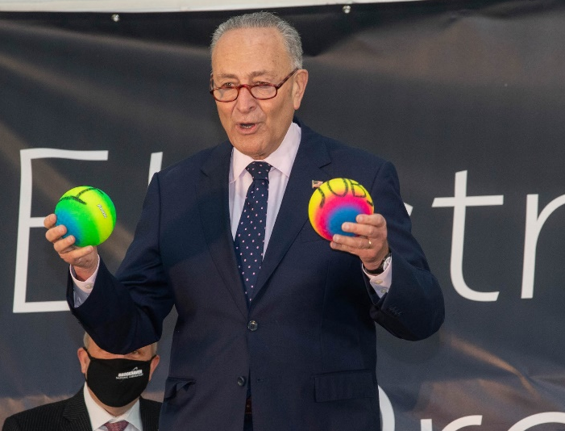

EIC CD-0, Site Selection, Project Start & Dedication in FY20
The EIC will be located at BNL and with TJNAF as a major partner. The realization of the EIC will be accomplished over the next decade at an estimated cost between $1.7 and $2.8 billion.
Utilize existing operational hadron collider; add electron storage ring, cooling in existing RHIC tunnel and electron injector.
EIC scope includes the machine upgrade to RHIC asset and two interactions regions with one of the interaction regions outfitted with a major detector. Working towards CD-1 in Q3 FY 2021
EIC Dedication September 18, 2020
The EIC will be a game-changing resource for the international nuclear physics community. DOE looks forward to engaging with the international community and the international funding agencies about potential collaborations and contributions to the EIC effort, in nuclear, accelerator and computer science.

Slide 23

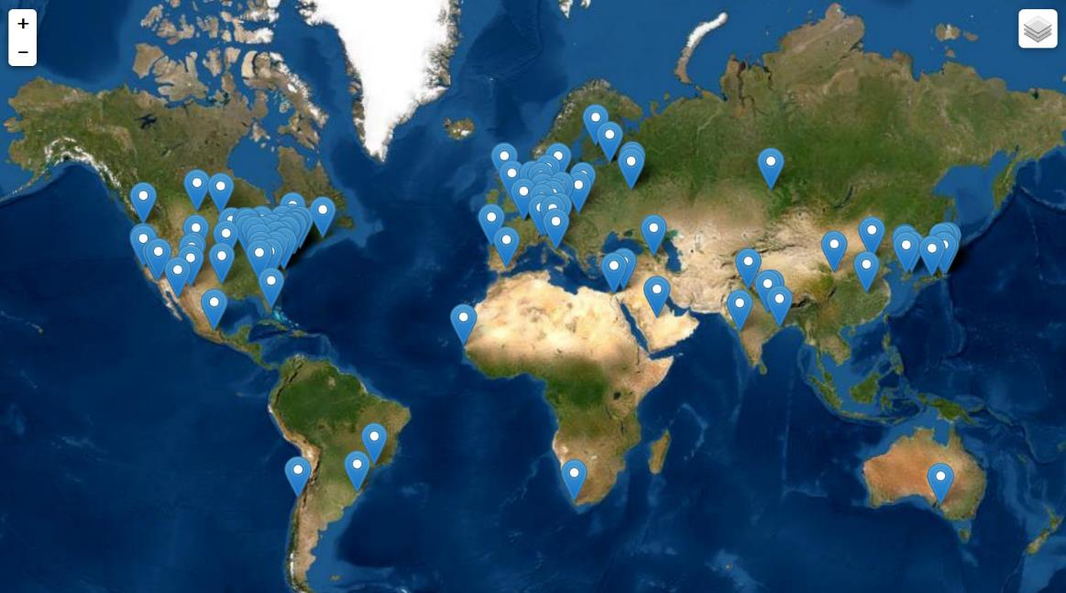
Worldwide Interest in EIC Physics
The EIC Users Group: EICUG.ORG
Formed 2016: 1110 collaborators, 32 countries, 235 institutions
Map of institution’s locations
Annual EICUG meeting
2016 UC Berkeley, CA
2016 Argonne, IL
2017 Trieste, Italy
2018 Washington, DC
2019 Paris, France
2020 Miami, FL
2021 Warsaw, Poland

Slide 24
The convergence of the Electron Ion Collider “Microscope” and the prospect of error corrected Quantum Computing is exceptionally exciting.
NP is contributing to the development of both

Slide 25
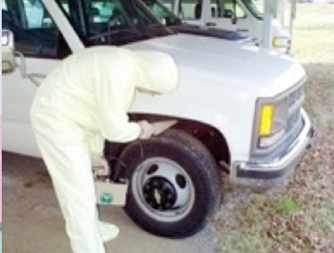
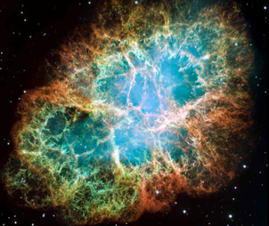
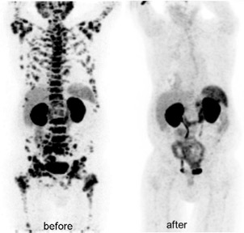
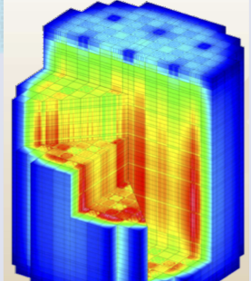
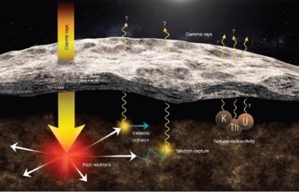
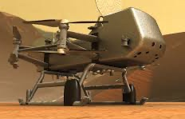
Many types of nuclear data are “crosscutting” to numerous applications
New & Traditional Frontiers Requiring Accurate Nuclear Data
Nonproliferation
Astrophysics
Materials Damage
Nuclear Data
Medicine
Energy
Elemental ID in Space Exploration
Gamma-rays
Cosmic rays
Fast neutrons
Natural
Radioactivity
NP Leads a Nuclear Data Interagency Working Group (NDIAWG) that has published 4 FOAs
Notes:
Replace figures as appropriate

Slide 26










Active Participants in WANDA and/or NDIAWG

Slide 27

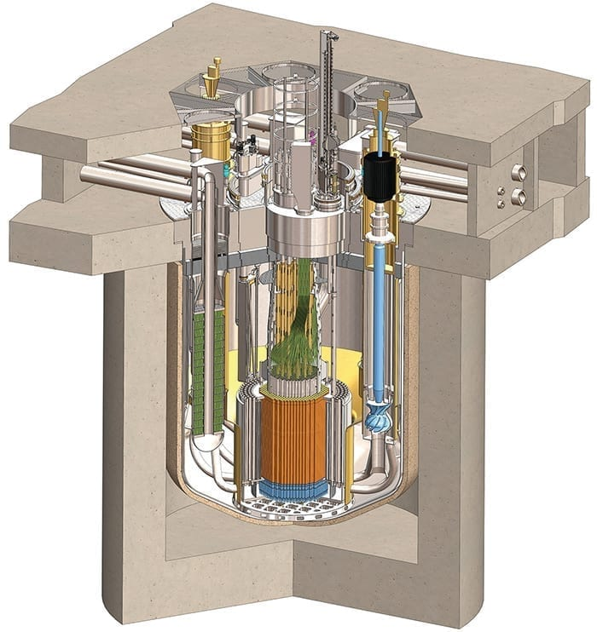
Next generation reactors use faster neutrons, different fuels, and coolants to achieve greater safety and modularity
In Support of Clean Energy Goals
$$neutron$$
$$multiplication$$
$$factor$$
Terrapower
$$Thermal$$
$$fision$$
$$factor$$
$$Thermal$$
$$Non−leakage$$
$$factor$$
$$Fast$$
$$Non−leakage$$
$$factor$$
$$Thermal$$
$$utilization$$
$$factor$$
$$Resonance$$
$$escape$$
$$factor$$
$$Fast$$
$$fission$$
$$factor$$
Kairos FHR
Non-existent or uncertain Nuclear Data needs to be redressed for new materials and fuels in order to correctly understand/model the neutronics in new designs at a high level of confidence
MCFR (Cl)
TRISO Pebble Fuel (U,C,Si)
Molten Salt Coolant
(Flibe)
https://nucleardata.berkeley.edu
SMR (Na)

Slide 28
Next generation reactors use faster neutrons, different fuels, and coolants to achieve greater safety and modularity
In Support of Clean Energy Goals
$$neutron$$
$$multiplication$$
$$factor$$
The harder neutron spectrum and different fuel introduce a dependence on types of nuclear data not explored
$$Thermal$$
$$fision$$
$$factor$$
$$Thermal$$
$$Non−leakage$$
$$factor$$
Neutron Spectra
$$Fast$$
$$Non−leakage$$
$$factor$$
$$Thermal$$
$$utilization$$
$$factor$$
$$Resonance$$
$$escape$$
$$factor$$
$$Fast$$
$$fission$$
$$factor$$
Non-existent or sparse Nuclear Data needs to be redressed for new neutron energy regime to correctly understand/model the neutronics
New
regime
Peak for old regime
https://nucleardata.berkeley.edu

Slide 29
Nuclear Data & Space Nuclear Propulsion
Presented to: Workshop on Applied Nuclear Data Activities (WANDA) 2021
Space Technology Mission Directorate
Technology Demonstration Mission Program
Space Nuclear Propulsion Project
Kelsa Palomares, AMA Inc. | January 25, 2020

Slide 30
Progress is Ongoing in Quantum Information Science

Slide 31
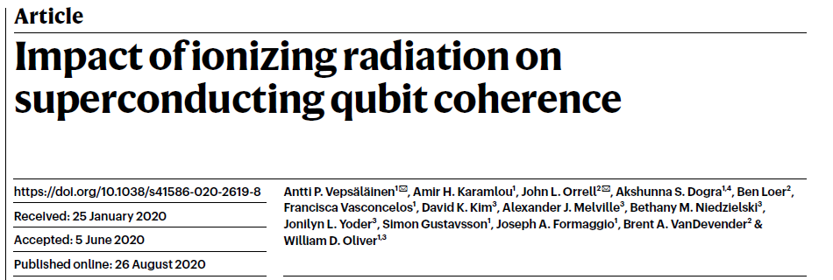
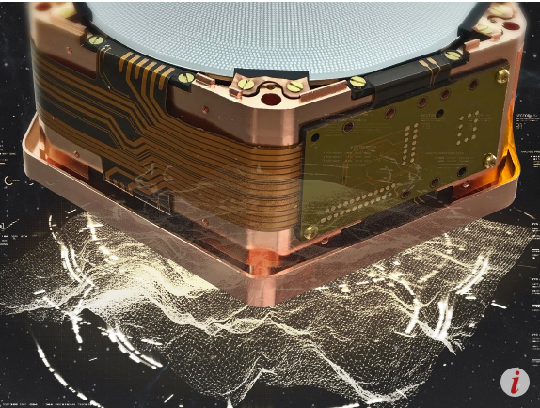
A Landmark Study Published in Journal Nature
Naturally occurring radiation produced by environmental radioactive materials and cosmic rays is enough to limit the useful lifetime of superconducting qubit state to just a few milliseconds… Identifying ionizing radiation as a dominant source of excess quasiparticles… is a first step towards developing to mitigate its impact on superconducting circuits, including those used for quantum computation and quantum sensing.
Popular press coverage: PNNL “Natural Radiation Can Interfere with Quantum Computers “and MIT Technology Review “Cosmic rays could pose a problem for future quantum computers “ https://www.pnnl.gov/news-media/natural-radiation-can-interfere-quantum-computers
https://www.technologyreview.com/2020/08/26/1007688/cosmic-rays-could-pose-a-problem-for-future-quantum-computers/
Independent, Future of Quantum Computing Could Be Disrupted by Space
https://www.independent.co.uk/life-style/gadgets-and-tech/news/quantum-computer-cosmic-rays-radiation-space-a9689946.html
The Vice, Particles From Space Are Messing With Our Quantum Computers, Scientists Discover
https://www.vice.com/en_us/article/wxqy5x/particles-from-space-are-messing-with-our-quantum-computers-scientists-discover
New Scientist, Quantum computers may be destroyed by high-energy particles from space
https://www.newscientist.com/article/2252933-quantum-computers-may-be-destroyed-by-high-energy-particles-from-space/
“Natural Radiation Can Interfere with Quantum Computers”

Slide 32
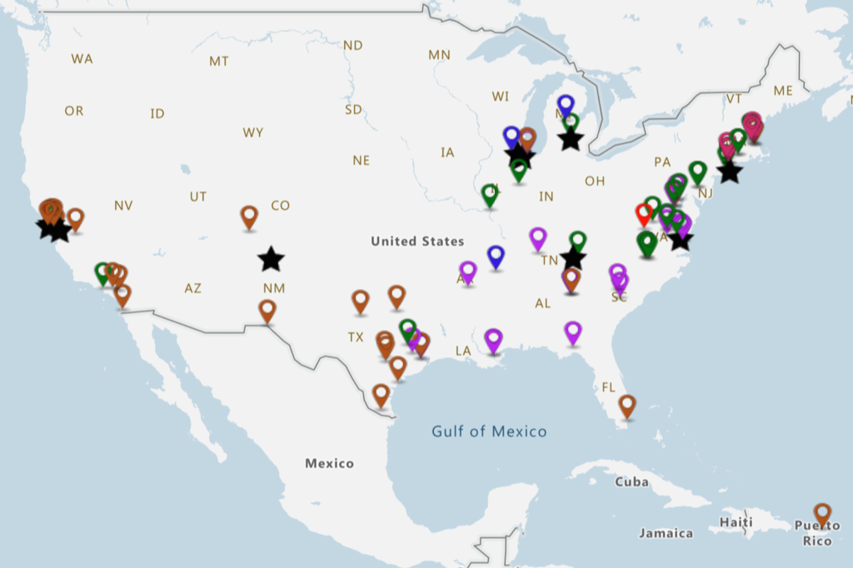


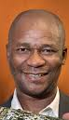
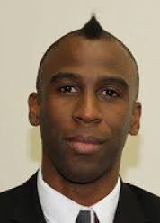
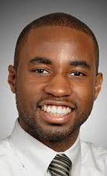
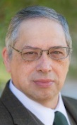





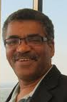


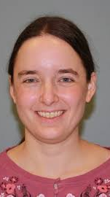

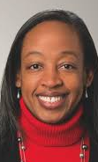

NP FY 2021 Highlights: NP/SC FOA Pilot Garners Strong Interest
NP received 36 proposals requesting funding to support over 200 traineeships across the country.
The proposed collaborations involve 91 potential participating institutions including
  9 National Labs,
  44 MSIs of which 18 are HBCUs and 2 are PBIs,
  9 Community Colleges, and
  2 Women’s Colleges.
FRIB

Slide 33
Additional NP DOE FOAs
FOA/Lab Call | Nuclear Data Interagency Working Group Research Program
FOA/Lab Call | Quantum Horizons: QIS Research and Innovation for Nuclear Science
FOA/Lab Call | Pilot Program for Traineeships to Broaden and Diversify the NP Workforce
FOA/Lab Call | Data Analytic for Autonomous Optimization and Control of Accelerators and Detectors

Slide 34
Other News Items
New Staff in DOE NP
  Xiaofeng Guo Nuclear Physics Computing
  Ivan Graff Nuclear Physics Major Initiatives
  Kenneth Hicks (IPA) Heavy Ion
  Paul Mantica (IPA) Technical Advisory/Facilities & Project Management Division
  Melissa Emerson (CONTR) Administrative Specialist
  Saryna Cameron (CONTR) Program Support Specialist
George Fai has retired
Richard Witt has returned to USNA (Hicks HI, Farkhondeh ECA)
New FOAs contemplated in QIS, Nuclear Data, Accelerator R&D, Traineeships to Broaden and Diversify

Slide 35
Office of Nuclear Physics
Associate Director’s Office Staff
Brian Knesel, Financial Management Specialist
VACANT, Financial Management Analyst
Linnette Quick, Program Assistant (CONTR)
Brenda May, Program Analyst
VACANT, International Cooperation and Outreach
Timothy J. Hallman, Associate Director
Melissa Emerson, Administrative Specialist (CONTR)
Physics Research Division
VACANT, Director
Christine Izzo, Program Support Specialist
Facilities & Project Management Division
Jehanne Gillo, Director
Saryna Cameron, Program Support Specialist (CONTR)
Paul Mantica (IPA), Technical Advisor
Latifa Elouadrhiri (Detailee)
Medium Energy & Quantum Information Science
Gulshan Rai, Technical Advisor
Heavy Ion Nuclear Physics
VACANT
Kenneth Hicks (IPA)
Advanced Technology R&D
Manouchehr Farkhondeh, Deputy
Nuclear Structure and Astrophysics
Sharon Stephenson
Nuclear Physics Facilities
James Sowinski
Nuclear Theory
VACANT
Nuclear Physics Major Initiatives
Ivan Graff
Nuclear Data
Keith Jankowski
Nuclear Physics Instrumentation
Elizabeth Bartosz
Fundamental Symmetries
Paul Sorensen
Industrial Concepts
Michelle Shinn
(IPA) – Intergovernmental Personnel Act
Nuclear Physics Computing
Xiaofeng Guo

Slide 36
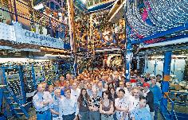
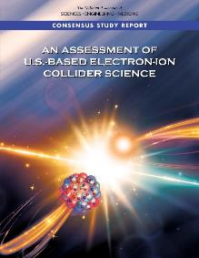
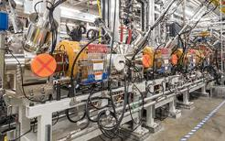



Overall, Progress in Implementing the LRP Has Been Good
RHIC
JLAB
Hall B
The vision to maintain U.S. leadership continues to be implemented: EIC construction; FRIB construction
ATLAS
At ANL
FRIB
World leading research supported at state-of-the-art NP National User Facilities
Pioneering experiments and research tools (MIEs) are created
Groundbreaking contributions to national cross-cutting priorities continue
FRIB
Underground Double Beta Decay Research

Slide 37
General Outlook
The experience with FY18 and FY19 budgets maybe similar in the next budget cycle.
We need to stay focused and continue to deliver important outcomes for the nation.
Delivering exciting discoveries, important scientific knowledge, technological advances, and workforce training is what we do.
We need to keep up the good work!

Slide 38

A Long Tradition of Partnership and Stewardship
There has been a long tradition in Nuclear Science of effective partnership between the community and the agencies in charting compelling scientific visions for the future of nuclear science.
Key factors:
Informed scientific knowledge as the basis for recommendations and next steps
Mutual respect among scientific sub-disciplines
Commitment to the greater good of nuclear science as a discipline
Meticulously level playing field leading to respect for process and outcomes
Deep appreciation for the wisdom of Ben Franklin
Staying united we can accomplish great things together
Division will setback the entire field and is the last thing needed right now

Slide 39
Additional Information

Slide 40






Two NP Centers of Excellence at TUNL and Texas A&M
The Triangle Universities Nuclear Laboratory (TUNL) is Center of Excellence that focuses on low-energy nuclear physics research. TUNL is a consortium Duke University, North Carolina State University, and the University of North Carolina at Chapel Hill comprising about 30 faculty members, 20 postdocs and research scientists, and 50 graduate students.
The Texas A&M University Cyclotron Institute jointly supported by DOE and the State of Texas focuses on conducting basic research, educating students in accelerator-based science and technology, and providing technical capabilities for a wide variety of applications in space science, materials science, analytical procedures and nuclear medicine.
The 88 inch cyclotron also plays a crucial role in space radiation effects chip testing for the Air Force

Slide 41















http://aruna.physics.fsu.edu
ARUNA-
10 members
~200 users
Association for Research at
University Nuclear Accelerators
FSU
John D. Fox Laboratory
U.Kentucky Accelerator
Ohio U Edwards Lab
U Mass Rad Lab
Texas A&M U. Cyclotron Lab.
Notre Dame Univ. ISNAP facilities
TUNL
HIGS
TUNL
Hope College
LENA
U of Washington CENPA
Ion Beam La
TUNL
Union College Ion Beam Lab
Tandem Lab

Slide 42
Safe nuclear energy is almost certainly part of a U.S. clean energy future. Accurate, reliable nuclear data is central to realizing that vision, terrestrially or “out of this world”.

Slide 43
Summary of 2021 Enacted Relative to FY 2020
Total, NP | 651,500 | 635,000 | -16,500
Total, NP Appropriation | 713,000 | 713,000 | -
FY 2020 Enacted | FY 2021 Enacted
Core Research reduced 5.5% from FY19 Enacted (including COL, this is a 7.4% cut from constant effort in FY19). New ECA awards were made. | Core research reduced 3.75% from FY20 Enacted. This reduction also includes a reduced number of new ECA awards in FY21.
LHC M&O commitments were met. | LHC M&O commitments met but subject to the research cut.
FRIB Research was supported as planned. | FRIB Research is reduced by 3.75% from FY20; planned ramp-up is not supported.
nEDM supported modestly below planned profile. | nEDM supported below planned profile, possibly impacting schedule.
SciDAC maintained relative to FY 2019 | SciDAC supported but subject to the research cut.
Nuclear Data held flat with FY19 Enacted | Nuclear Data research funds subject to the research cut. Experimental commitments met, but limited funding is available for new awards.
NP QIS at $6.8M (NP QIS flat with FY2019) | NP QIS at $9.5M, an increase of $2.7M from FY2020
Accelerator R&D was increased | Accelerator R&D is reduced by $1M beyond 3.75% cut.
Machine Learning/Artificial Intelligence awards were initiated through the SC ML/AI FOA. | The new ML/AI Initiative is supported with $4M of dedicated funds.

Slide 44
Summary of 2021 Enacted Relative to FY 2020
FY 2020 Enacted | FY 2021 Enacted
Facility operations at constant effort RHIC operates 28 weeks (100 % optimal) CEBAF operates 22.5 weeks (100 % maximum) ATLAS operates 41 weeks (90 % optimal) | Facilities operations funding is reduced by 3.75%. Estimated run times are: RHIC operates 24 weeks (100 % maximum) CEBAF operates 7 weeks (41 % maximum) ATLAS operates 39 weeks (92.6 % optimal)
FRIB operations supported at planned level $28.5M | FRIB ops supported slightly below planned levels ($50M vs $59.8M)
FRIB construction at baselined $40M | FRIB construction at baselined $5.3M
EIC construction at TEC of $1M and OPC of $10M | EIC construction at TEC of $5M and OPC of $24.65M
Ongoing Major Item of Equipment: GRETA reduced below planned levels ($6.6M) sPHENIX at planned baseline level ($9.52M) - SIPF at planned baseline level ($1.5M) | Ongoing Major Item of Equipment: GRETA flat with FY2020, below baselined level ($6.6M) sPHENIX at baseline level ($5.53M)
New Major Items of Equipment initiated - MOLLER at $2M TEC TSNLDBD at $1M TEC HRS at $1M TEC | Major Items of Equipment initiated in FY 2020 - MOLLER increased to $5M, but below planned level TSNLDBD at $1.4M TEC HRS at $3M TEC
Isotope Program at $60.5M | Isotope Program at $78M

Slide 45




























Office of Science User Facilities
Number of User Facilities
28
ALCF
OLCF
ESnet
EMSL
ARM
JGI
NERSC
SSRL
ALS
LCLS
NSLS-II
TMF
APS
FACET II
CFN
CINT
CNM
CNMS
SNS
HFIR
DIII-D
NSTX-U
Fermilab AC
RHIC
ATLAS
CEBAF
ATF
FRIB

Slide 46



Science-Driven Project Requirements
Project Design Goals
High Luminosity: L= 10³³ – 10³⁴cm⁻²sec⁻¹, 10 – 100 fb⁻¹/year
Highly Polarized Beams: 70%
Large Center of Mass Energy Range: E_{cm} = 20 – 140 GeV
Large Ion Species Range: protons – Uranium
Large Detector Acceptance and
Good Background Conditions
Accommodate a Second Interaction Region (IR)
Conceptual design scope and expected performance meets or exceed NSAC Long Range Plan (2015) and the EIC White Paper requirements endorsed by NAS (2018)
These challenging performance goals require a machine that is state-of-the-art

