Slide 1
Breaking the Myth of the “Non-Traditional” Physicist
The Real Story About Employment for Physics Graduates
Presented by Douglas W. Higinbotham for
Crystal Bailey of the American Physical Society

Slide 2
For the last several years, I have had the honor of serving on the APS carriers and professional development committee and I am going to share some of what I have learned with you today.
APS Committee on
Carriers and Professional Development (CCPD)
THIS TALK IS FOR YOU, SO PLEASE ASK QUESTIONS!

Slide 3
Where do Physicists Work?
What is a “traditional physicist”? A physics professor? A PhD researcher? The “most common” career path?
The AIP Statistical Research Center estimates that 1 in 6 physics bachelors will choose to finish a Physics PhD.
So ~17% of all Physics Degree holders will actually become Physics PhDs—and by extension “traditional physicists.”

Slide 4
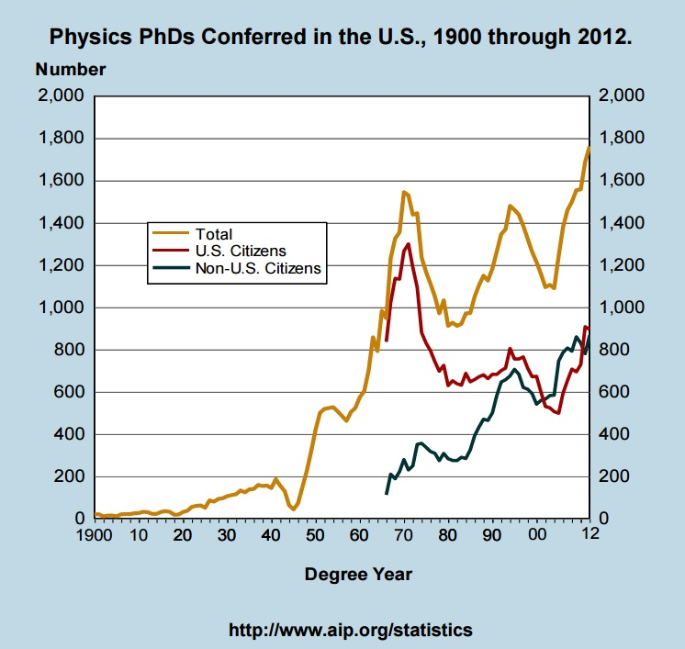
PhD Job Force: Supply
At the time of the 2014 report, the AIP Statistical Research center found the number of physics PhDs conferred in the US to be the highest in the past century: 1,762.
Based on current enrollments, we should expect PhD degree production to level off at around 1,700/year in the next four years.
Bottom line: the US can expect to continue putting large numbers of Physics PhDs into the workforce.

Slide 5
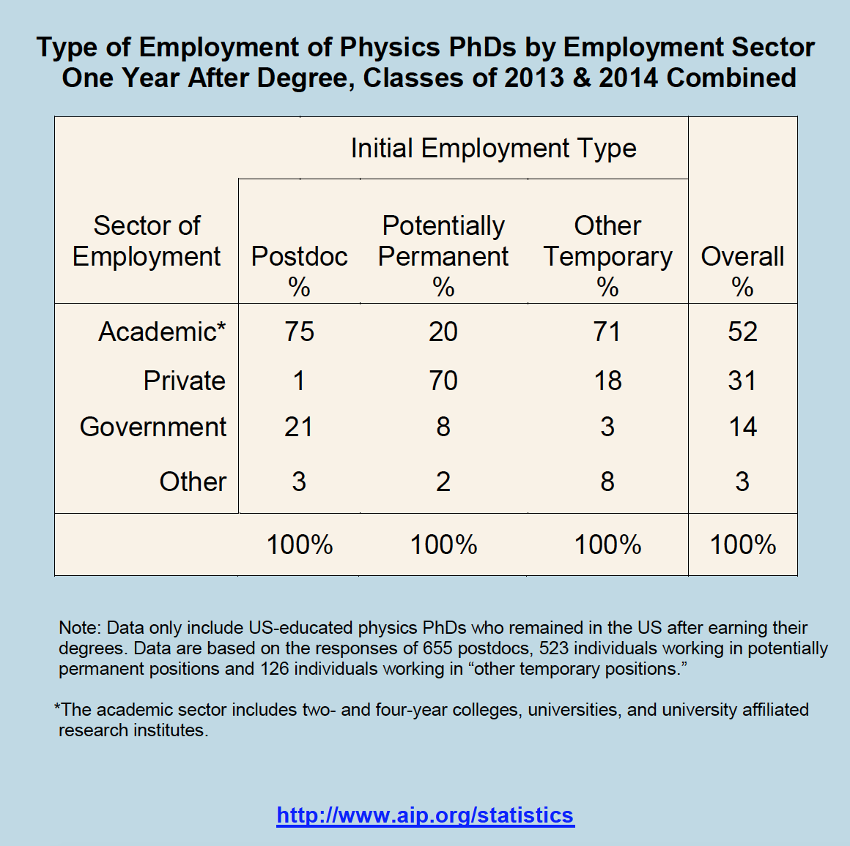
What are PhDs doing with their degrees?
The largest percentage of Physics PhDs found initial employment in postdoctoral and other temporary positions…
…but the vast majority of permanent jobs were in the private sector.

Slide 6
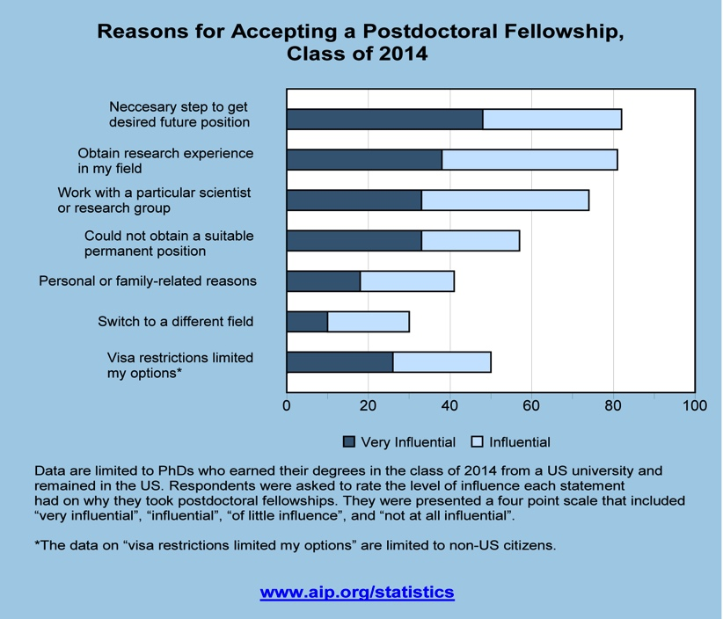
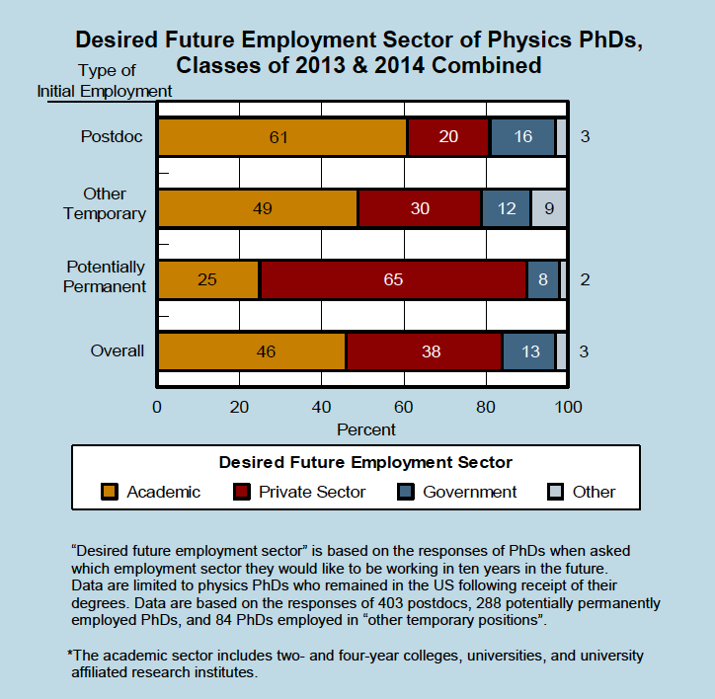
PhD Job Force: Demand
The vast majority of graduates who initially go into the academic sector are postdocs or temporary faculty. The remaining postdocs are mostly in national labs.
Most postdocs go into their positions in the hopes of moving toward permanent employment.
Overall, 46% of Physics PhDs surveyed expected to have permanent careers in academia.

Slide 7
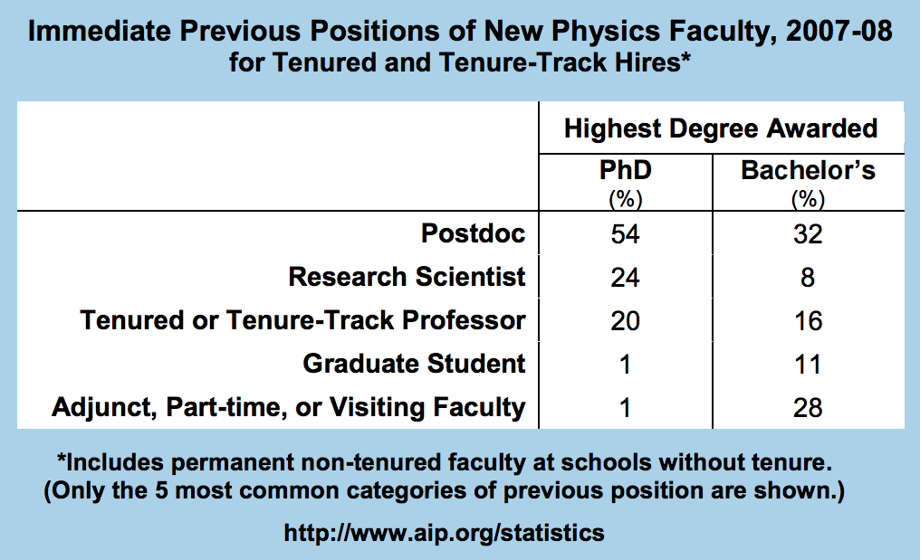
In fact, research shows that at PhD granting universities, previous experience as a postdoc (or as faculty) is a strong indicator of the likelihood of becoming a faculty hire.

Slide 8
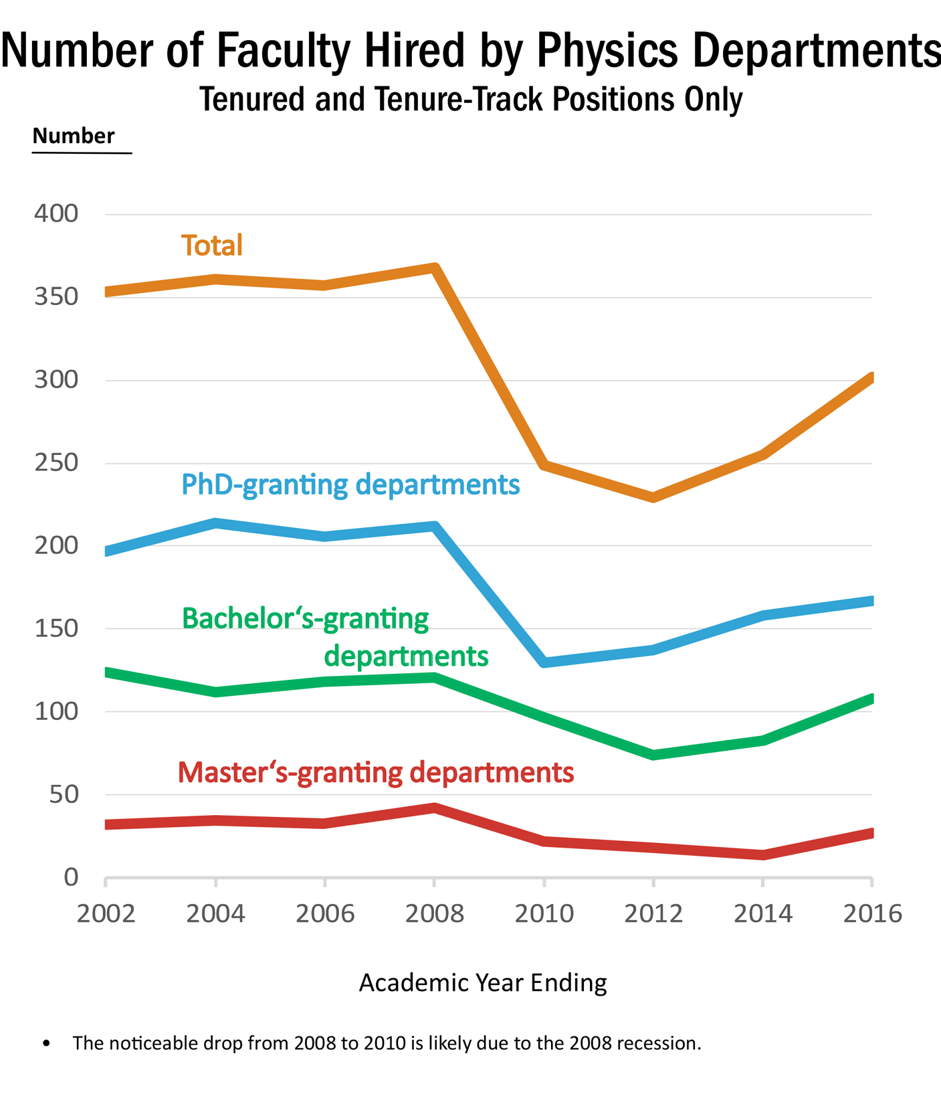
The number of departures of tenured and tenure-track faculty has changed little over time.
In 2012, ratio of new faculty/PhDs conferred: 12%

Slide 9
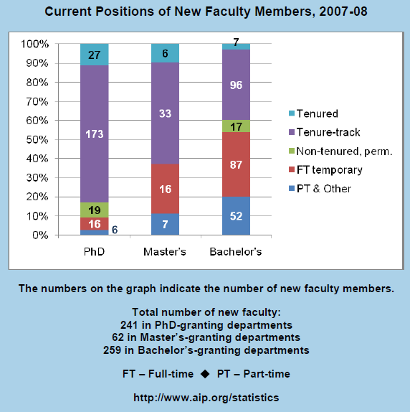
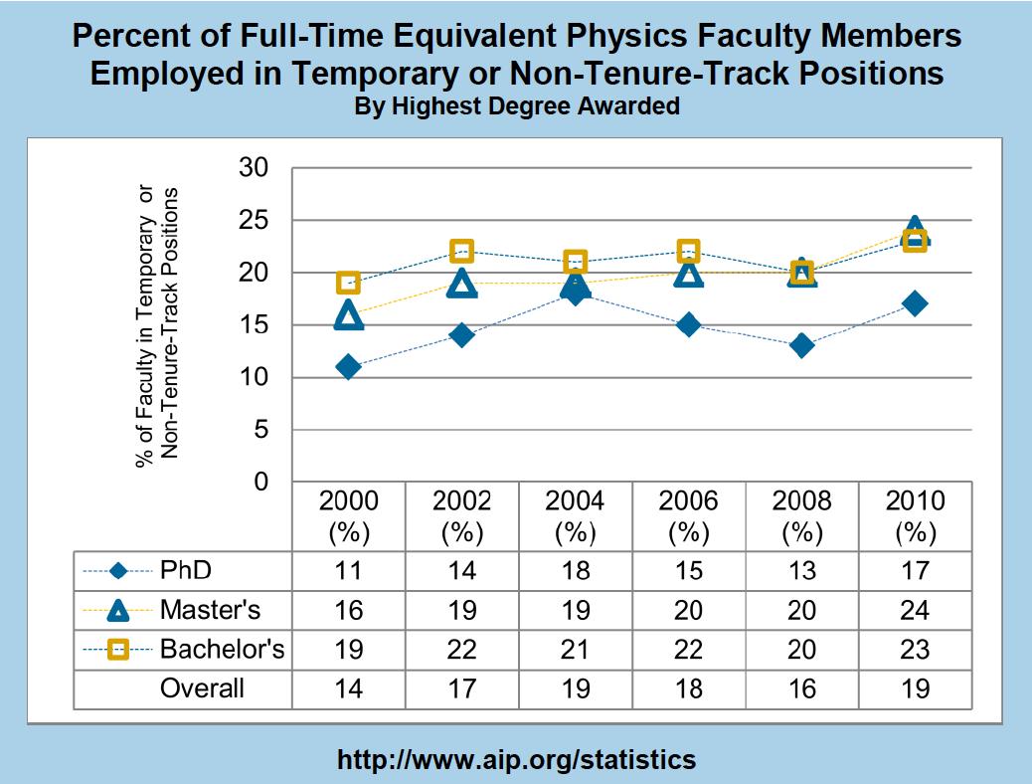
Not all faculty positions are created alike
The type of faculty position varies widely according to institution.
Many individuals who do get new faculty positions will spend time waiting for a desired situation to open up.
Bottom Line: the job market for faculty in universities and other institutions is very stable.
“Stable” means that overall, not many jobs are being lost. At the same time, not many are being created, either.
Given that we are graduating over 1,700 PhDs/yr, with more than half of them going into postdocs with an intention of continuing as physics faculty, supply will continue to outweigh demand for the tenure-track academic career path.

Slide 10
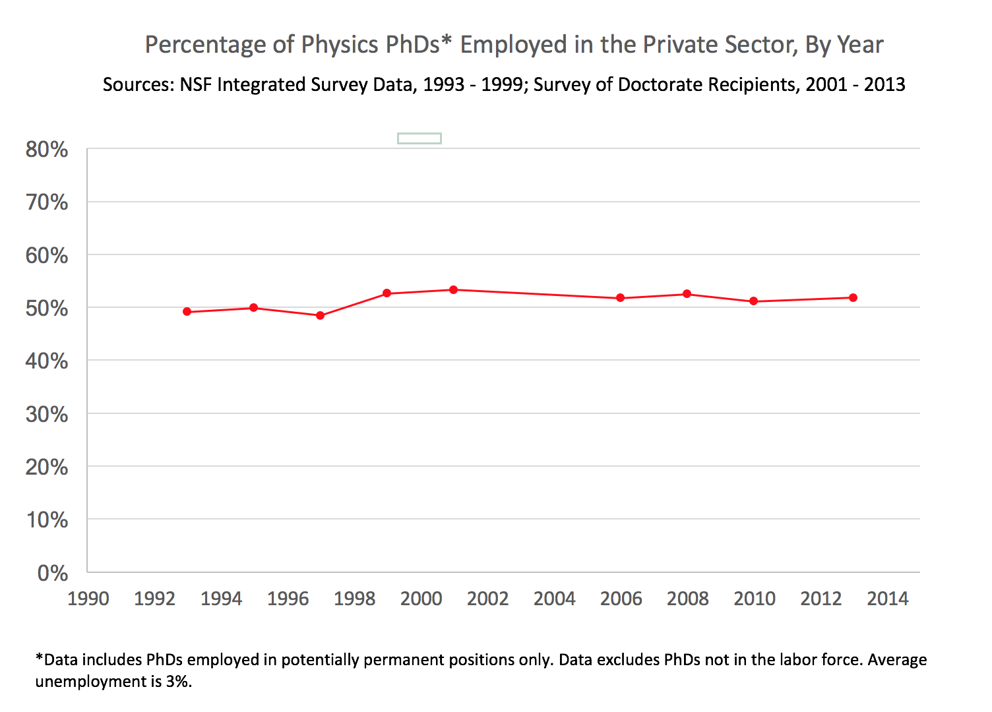
PhD Employment in the Private Sector
Recall that the majority (70%) of graduates who initially went into permanent employment positions were in the private sector.
According to the NSF Survey of Doctoral Recipients¹, in 2013 the private sector was the largest single permanent employment base of Physics PhDs in the workforce: about 52% (the next highest was 4 year colleges, at 34%). In 2010 this figure was 51%
This was also true in 2006, when the private sector employed 52% of Physics PhDs¹…
…and was even true in 1993, when the private sector again employed 49% of Physics PhDs (compared to 36% in 4-year colleges)².
Industry has been the largest employment base for Physics PhDs for decades.
¹NSF Survey of Doctoral Recipients, 2001 - 2013
²NSF Integrated Survey Data, 1993

Slide 11
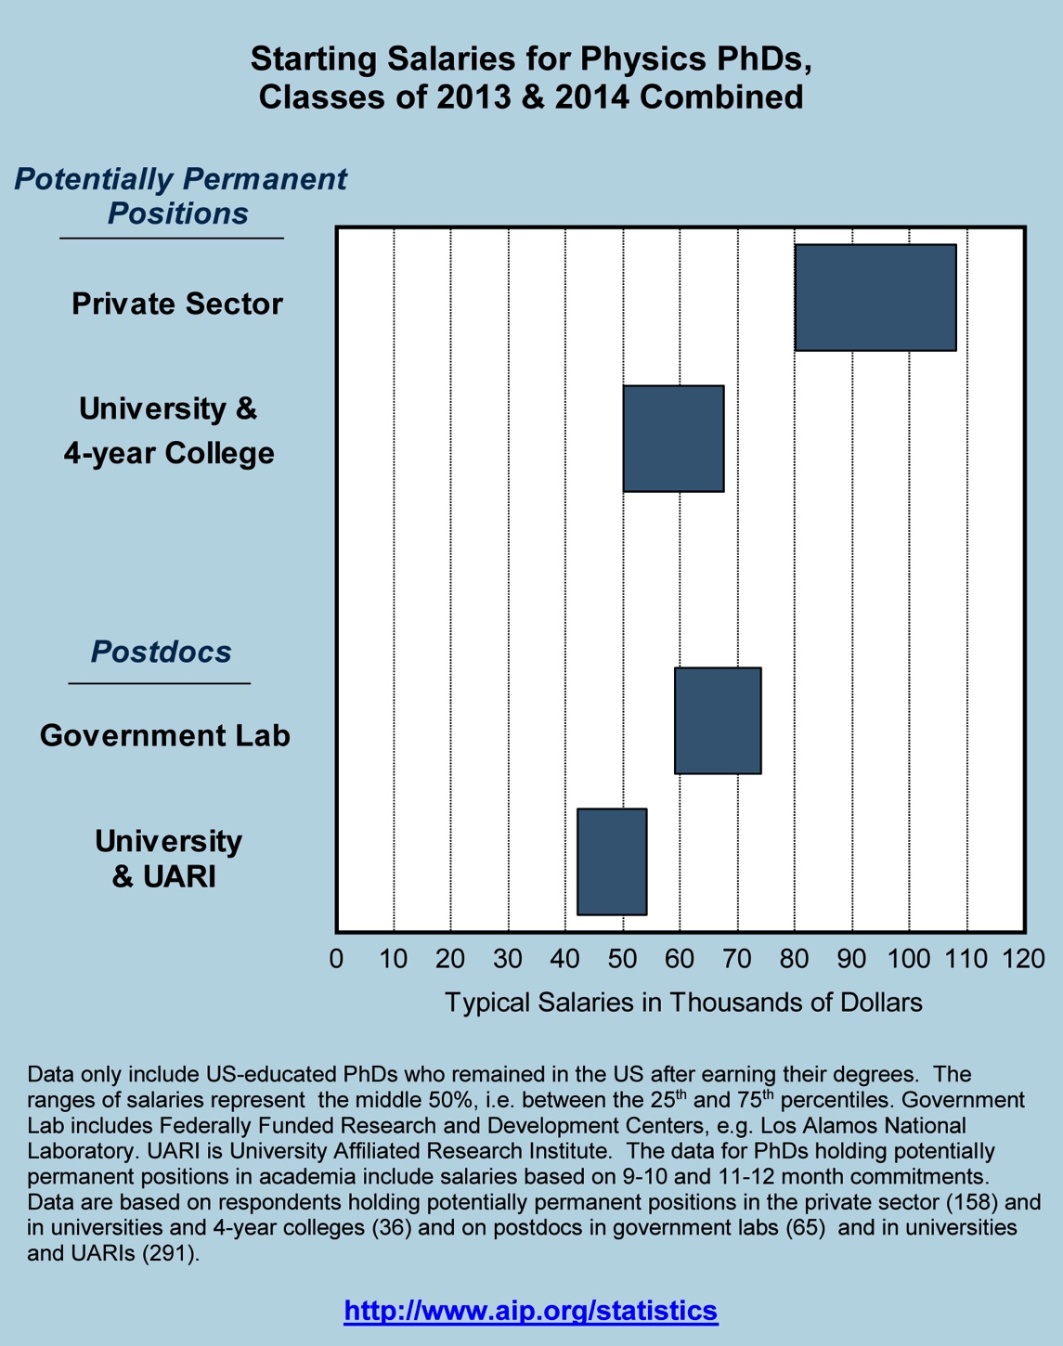
Not only does the private sector provide the largest number of jobs for physics PhDs, it also provides the highest-paying jobs, with a median starting salary near $95K.
By comparison, average typical starting salaries at Universities and 4-year colleges is around $60K…
…and a University postdoc position typically offers between the low $40K and $50K.
So, the private sector also offers well-paying employment to Physics PhDs.

Slide 12
But Won’t I Lose My Soul if I Go Into Industry?
NO!
Source: AIP Statistical Research Center Report Common Careers of Physics PhDs in the Private Sector, June 2015
Besides “physics,” typical areas of employment for PhDs in the private sector included Engineering, Computer Science, Business, Finance, Education, or Medical Services.

Slide 13
What about the non-PhD physicists?
According to the AIP Statistical Research Center, 83% of physics bachelors will not earn a Physics PhD.
Roughly one-third to one-half of Physics Bachelors will go straight into the workforce, mostly in STEM fields.
Another third will go into graduate study in Physics and Astronomy.
And the remainder will go into graduate study in other fields—including finance, law, and Medical Physics.
What types of employment are possible for these degree paths?

Slide 14
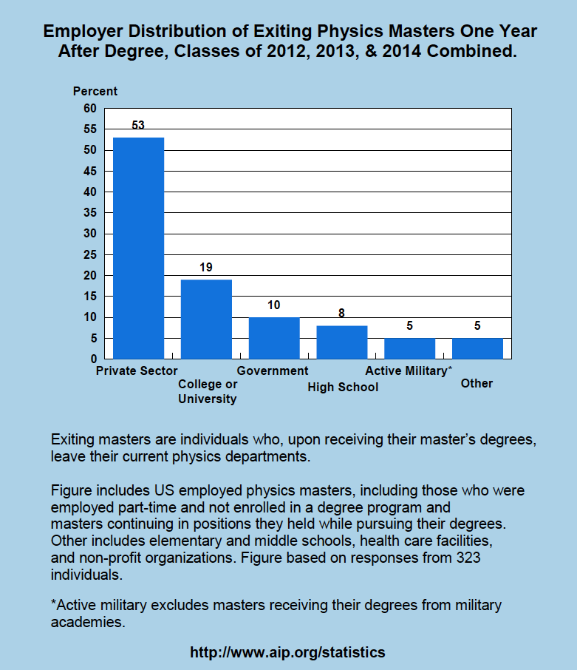
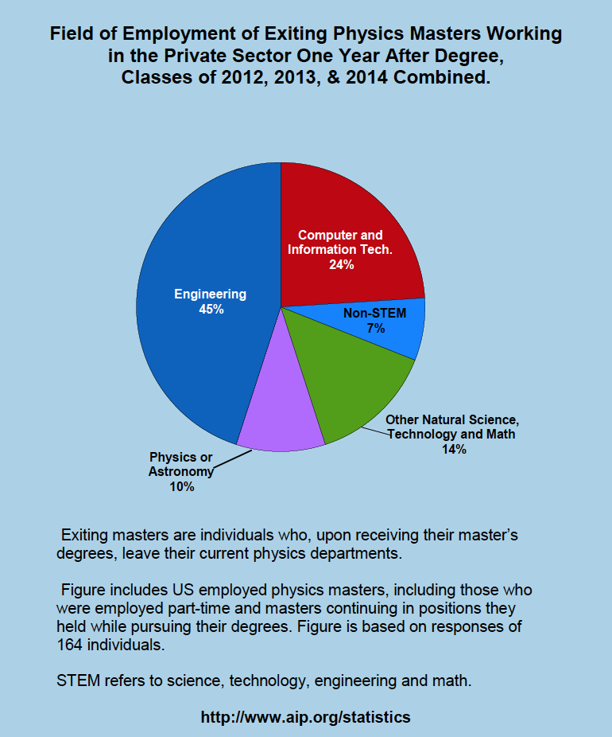
Initial Employment of Master’s Degrees
Between 2012-2014, about 44% of physics masters recipients entered or remained in the workforce.

Slide 15
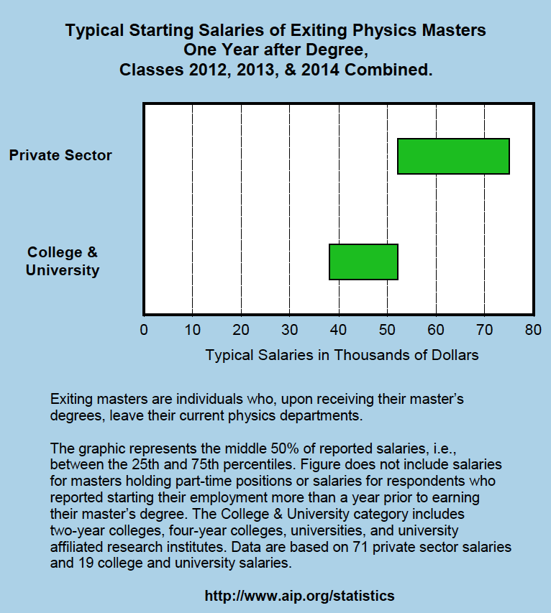
Not surprisingly, physics master’s degree holders working in the private sector earned considerably more than their colleagues at colleges and universities.
MS grads who earned their degree while working in the private sector earned considerably more (~$83K).
A physics master’s degree will open the door to more advanced positions in a variety of technical fields, with higher salaries.

Slide 16
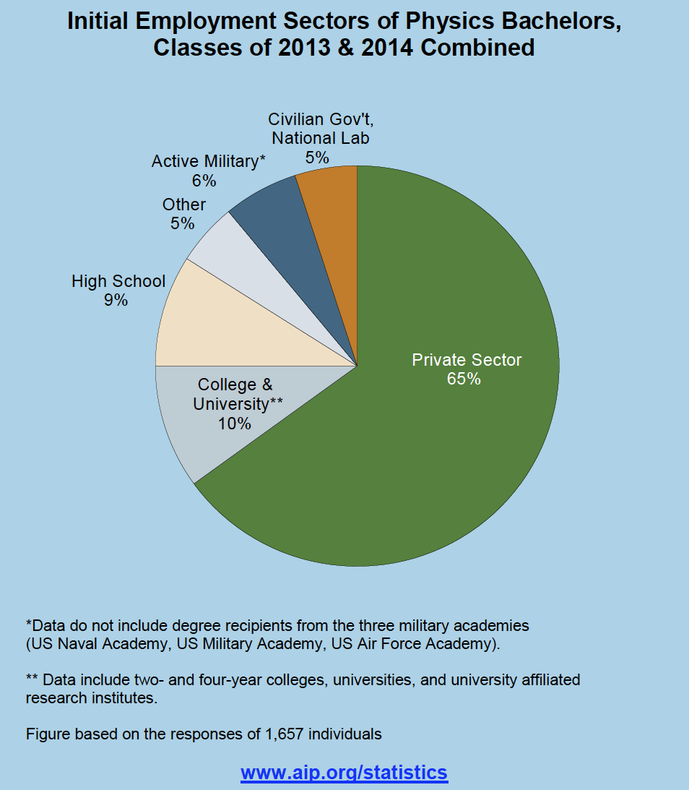
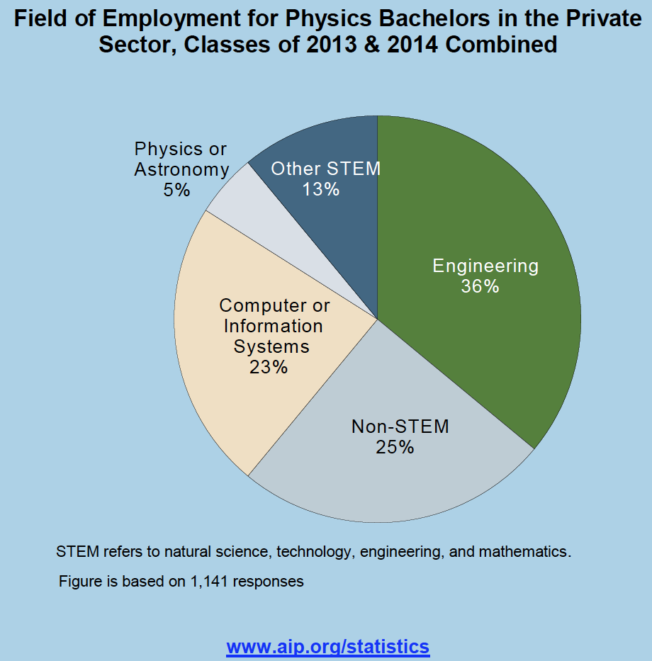
Initial Employment of Physics Bachelors
On average between 1995 and 2012, about 40% of physics bachelors went directly into the workforce after graduation.
Bottom line: at all degree paths, the largest initial employment sector for physics graduates is the private sector.

Slide 17
Why Are Physics Grads Valuable to Industry?
Employers in STEM fields value physics graduates in their companies as members of interdisciplinary teams
Standard physics curriculum creates familiarity with technologies commonly used in STEM workforce
Programming languages (e.g. Python, C++, Java, Fortran)
Circuit design and diagnostics (e.g. oscilloscopes, soldering)
Mathematical proficiency (e.g. differential equations, linear algebra)
Fabrication (e.g. lathes, bandsaws, screws)
Language of Job Descriptions³
Common job titles across STEM recruitments (including physics), e.g. “analyst,” “engineer,” “developer,” etc.
Common skills listed in recruitments for physics and engineering graduates:
perform testing/analysis develop/design implement run queries and reports
³APS Job Board search, 4-year degree job postings

Slide 18
What do STEM employers say?
“Engineering is about putting the period on the sentence. The engineer may write the code, but the physicist understands what it has to do with the larger context. Together they are very effective.”
Over 80% of surveyed employers⁴ agreed that physics majors:
Could easily grasp new knowledge and concepts
Were able to identify, formulate, and solve problems
Were able to successfully analyze and interpret data
Could competently use computer applications and databases
Were able to use current techniques/tools for technical practices
Could engage in continued learning and problem solving
⁴ABET Survey of applied and engineering physics graduates, Kettering University

Slide 19
What else do STEM employers say?
That physics graduates are also missing important training and experience:
Ability to design a system, component or process to meet a specific need⁵
Ability to function on multi-disciplinary teams^{5,6}
Ability to recognize value of diverse relationships (customers, supervisors, etc.)⁵
Leadership Skills⁵
Familiarity with basic business concepts (i.e. cost-benefit analysis, funding sources, IP, project management)^{5,6}
Communication skills (oral and written) – esp. how to tailor message to audience⁵
Real-world experience in companies before graduation⁶
Awareness of career paths outside of academia⁶
⁵ABET survey of applied and engineering physics graduates, Kettering University ⁶APS Workshop on Nat’l. Issues in Industrial Physics

Slide 20
To summarize:
Based on available information we can say the following about the physics discipline regarding student career preparedness:
Some content/knowledge overlap with other STEM disciplines.
e.g. particularly technical skills, techniques, equipment
Some characteristics which are distinct from other STEM disciplines.
ability to grasp wider scientific context of work
ability to formulate problem solutions from first principles (i.e. the people who start the process rather than “putting the period on the sentence”).
Important content is missing from typical physics training, including communication and leadership skills, an ability to function well in an interdisciplinary context, and an awareness of careers outside of academia.

Slide 21
What Can Students Do?
Perform a detailed self-assessment
Understand what you love doing, what you’re good at doing, and what you want. Think beyond job specifics.
Take advantage of existing tools to help you understand your strengths (e.g. the Strong® Interest Inventory).
Attend Informational Interviews
Use connections (LinkedIn® and alumni networks are especially helpful) to reach out to a company or industry you’re interested in.
Not only builds connections in the company, but gives you an “insider education” about that industry.
Build Your Network
Develop a “pitch”—be able to describe your background and what types of career paths you’re interested in a few sentences.
Talk to EVERYONE!!

Slide 22
Keep a Career Journal and Document Skills
Every experience gives you valuable transferrable skills. Write down every single one (don’t just focus on “hard science”). This list is a set of “building blocks” for every resume you will ever write.
Capitalize on Opportunity
Know good places to search for science and technology jobs (e.g. the APS Job Board).
Understand the skills the job requires, and honestly assess whether you have them, or would be interested in building them.
Know How to Write an Effective Resume (not a CV)!
They are not interchangeable!
Resumes are the only document appropriate for non-academic jobs, and should be only one page long.
Write a unique resume for every single position you apply for.
go.aps.org/physicsresume

Slide 23
Take Advantage of APS Resources!!
APS Online Professional Guidebook
Detailed advice on key aspects of career development.
Features 5-minute clips from the top APS careers webinars
APS webinar “Putting Your Science to Work,” with Peter Fiske
APS webinar “Career Self-Advocacy: How I Got A Six Figure Job in the Private Sector,” with Meghan Anzelc
Topics include self-assessment, networking, interviewing and negotiation strategies, and more.
go.aps.org/physicspdguide
APS Careers Website
APS Job Board
Physicist Profiles and Job Prospects pages
Employment and Salary Information
APS Webinars archive
www.aps.org/careers

Slide 24
Remember:
Academic Physics is not the most common path!
Most physics grads at all degree levels go into the private sector.
Many of those who do (especially at the PhD level) will do scientific research.
Students Can Plan Effectively by Broadening Your Focus
Use resources to learn about and prepare for career paths outside of academic physics.
Faculty & Mentors Can Help by Providing Better Career Awareness and Training to Students
Foster stronger industry connections/mentorship, and add workforce targeted experiences and content to existing physics curricula.

