Slide 1
User Facilities 2016 Users Group Board of Directors Update
Akers/Experimental Nuclear Physics January 14, 2016

Slide 2
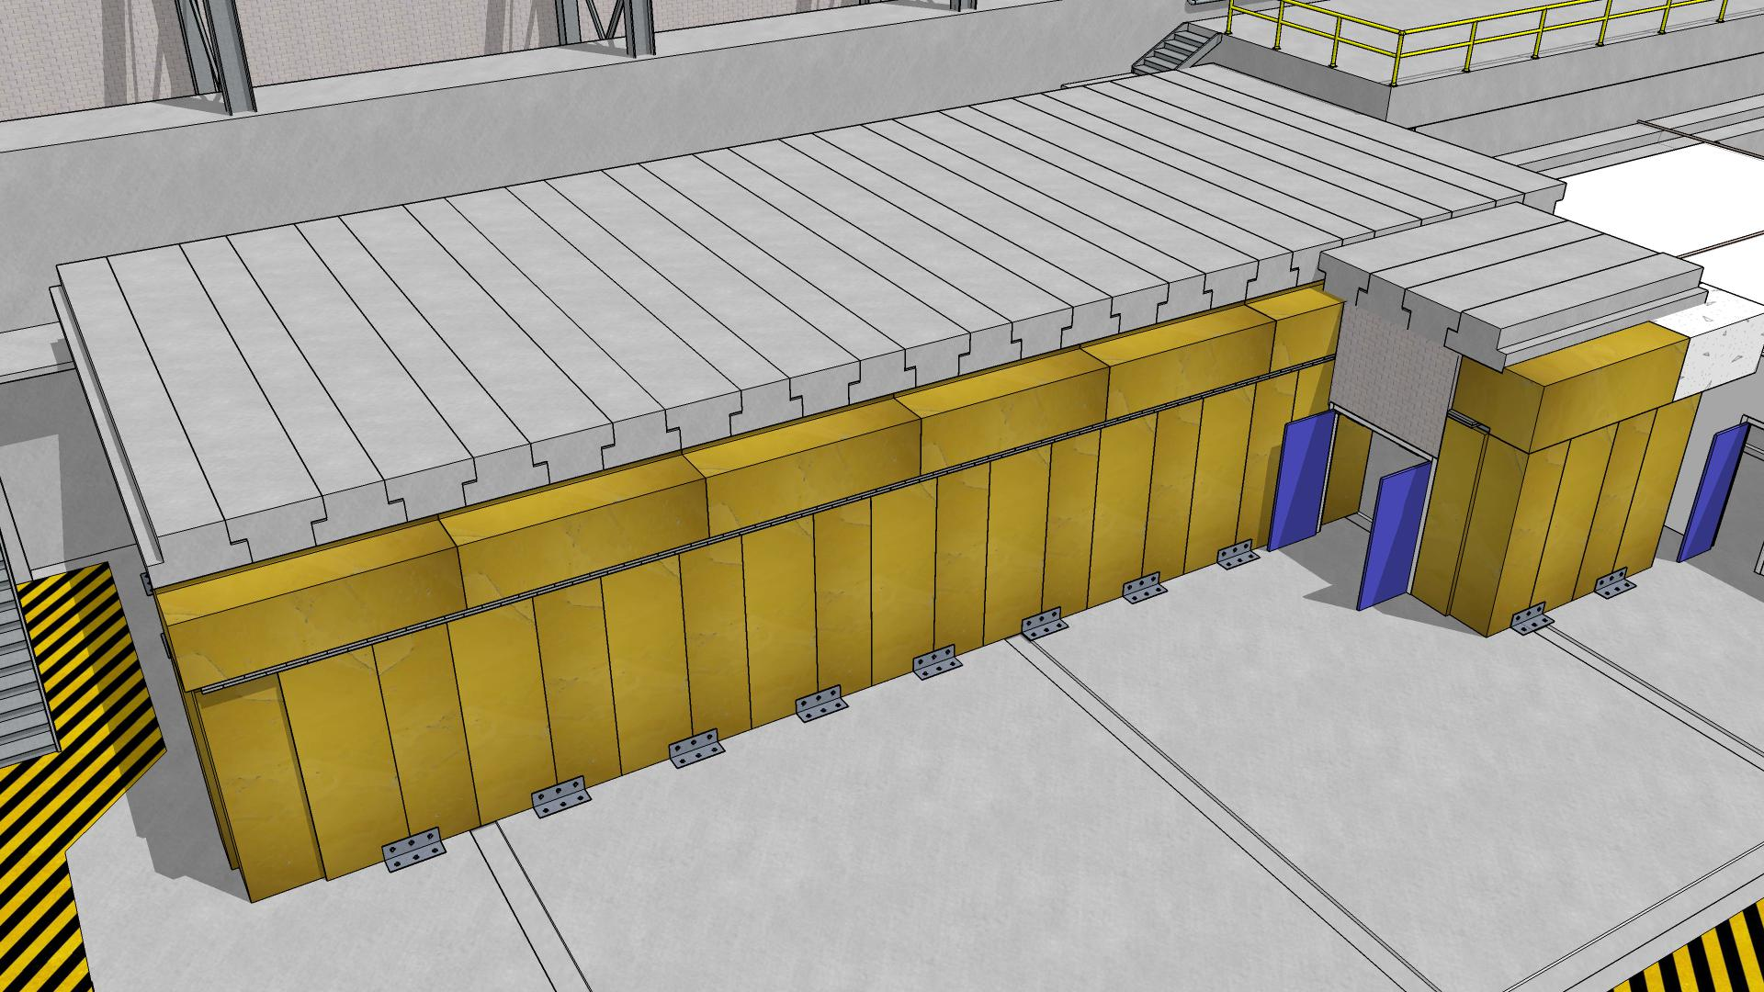
Experimental Nuclear Physics
Ongoing Projects / Injector Test Facility
Will be used to polarize Hall B HDIce Targets
Scheduled for Completion Late 2016
Akers/Experimental Nuclear Physics January 14, 2016

Slide 3
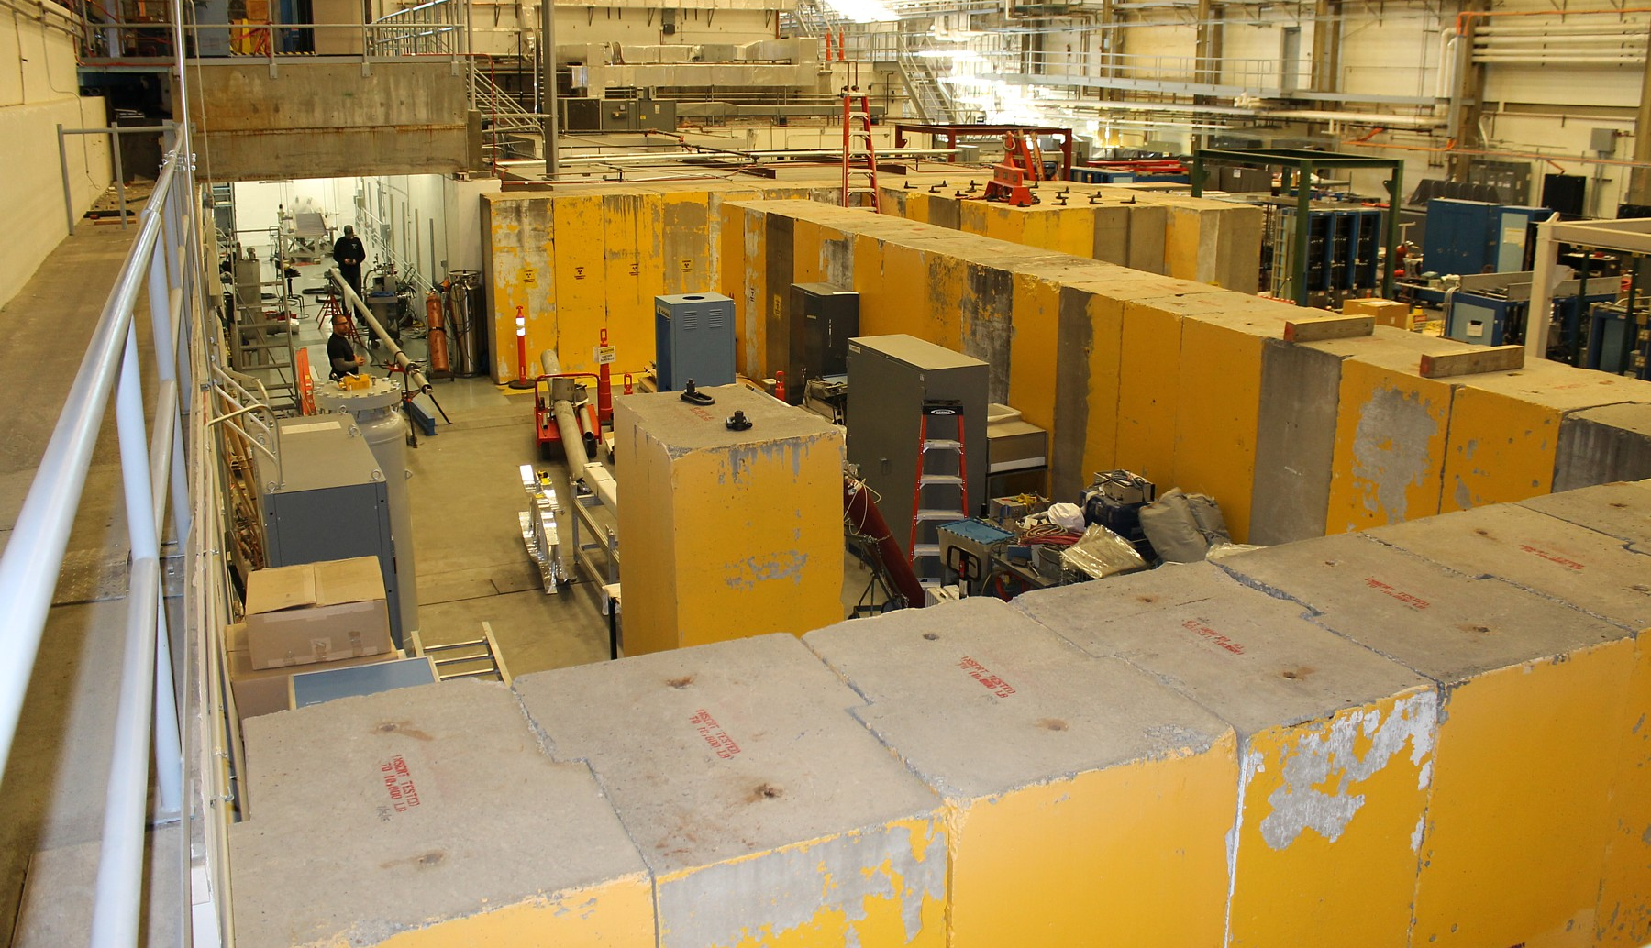
Experimental Nuclear Physics
Ongoing Projects / Injector Test Facility
Outer Shield Walls are Installed
Electrical Systems are Being Completed
Beamline Installation Continues
Akers/Experimental Nuclear Physics January 14, 2016

Slide 4
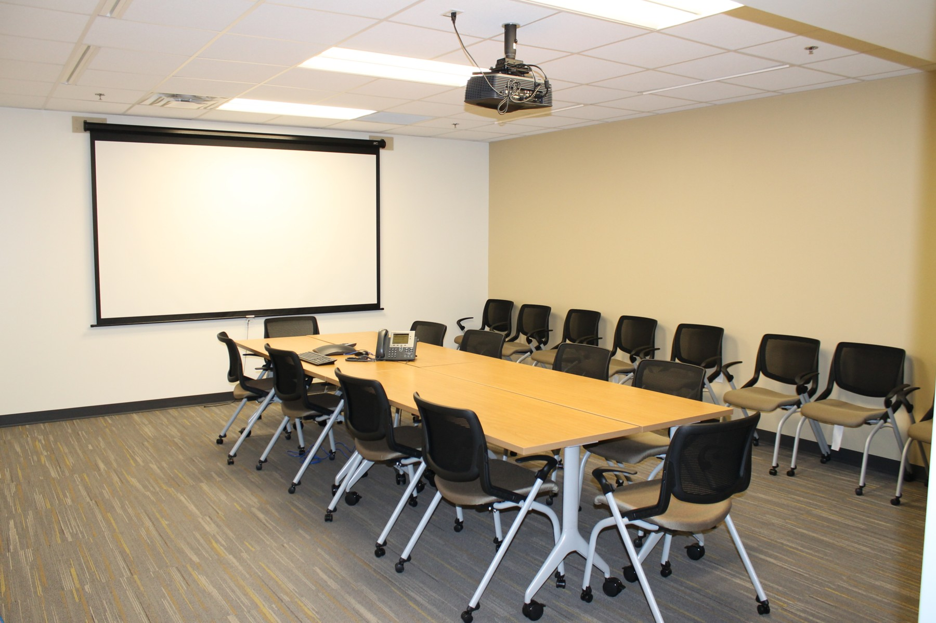
Experimental Nuclear Physics
Ongoing Projects / Counting House Improvements
Second Floor Conference Room Complete
Furnished as Specified by UGBOD 2015
Akers/Experimental Nuclear Physics January 14, 2016

Slide 5
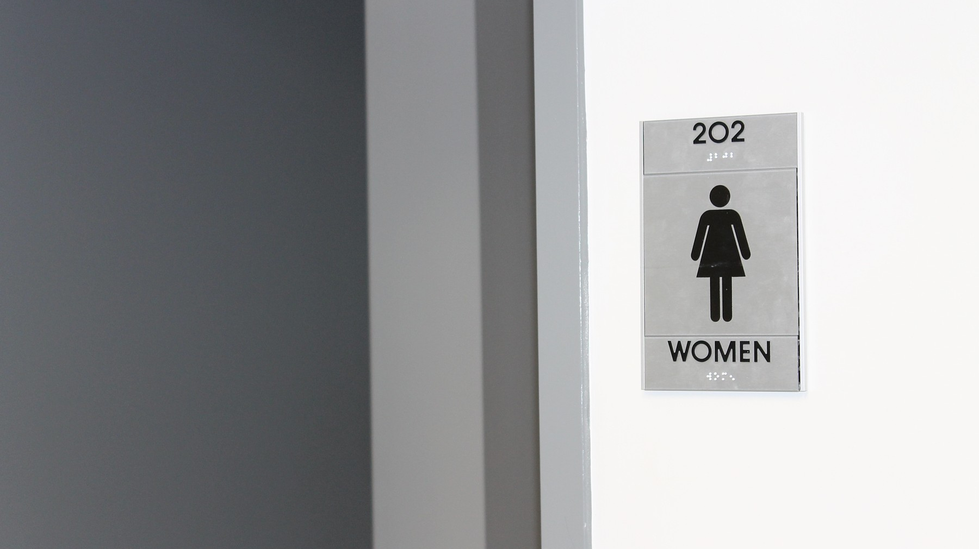
Experimental Nuclear Physics
Ongoing Projects / Counting House Improvements
By popular demand, a ladies room has been added to the building AND a sign has been installed identifying it as such.
Lesson Learned: Having a ladies room without a sign, is the same as having two men’s rooms.
Akers/Experimental Nuclear Physics January 14, 2016

Slide 6
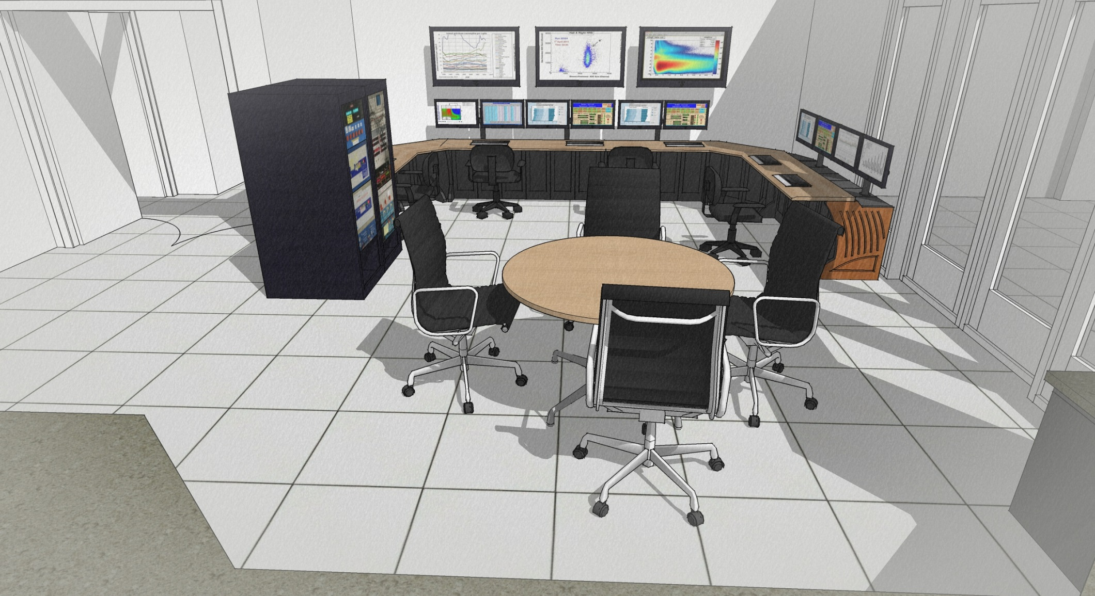
Experimental Nuclear Physics
Ongoing Projects / Counting House Improvements
Low-Profile Consoles have been procured for Hall C Counting Room
Installation will be completed this Spring
Akers/Experimental Nuclear Physics January 14, 2016

Slide 7
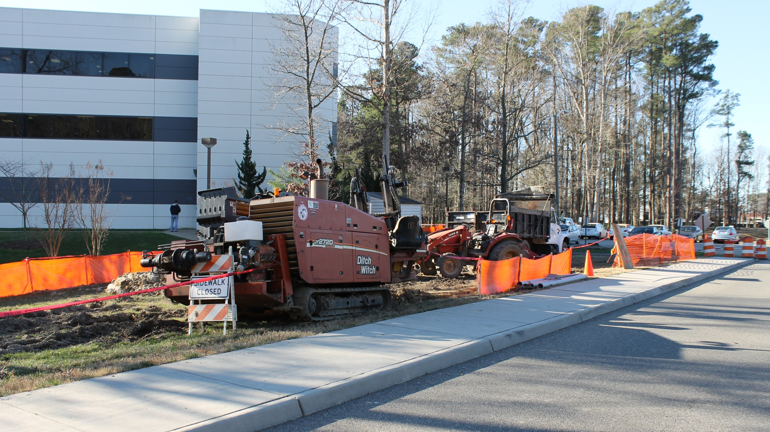
Experimental Nuclear Physics
Ongoing Projects / Utilities Infrastructure Modernization
Electrical Upgrade is Complete
Communications / Cooling Upgrades Continue
Earth moving work will be completed by March 2016
Akers/Experimental Nuclear Physics January 14, 2016

Slide 8
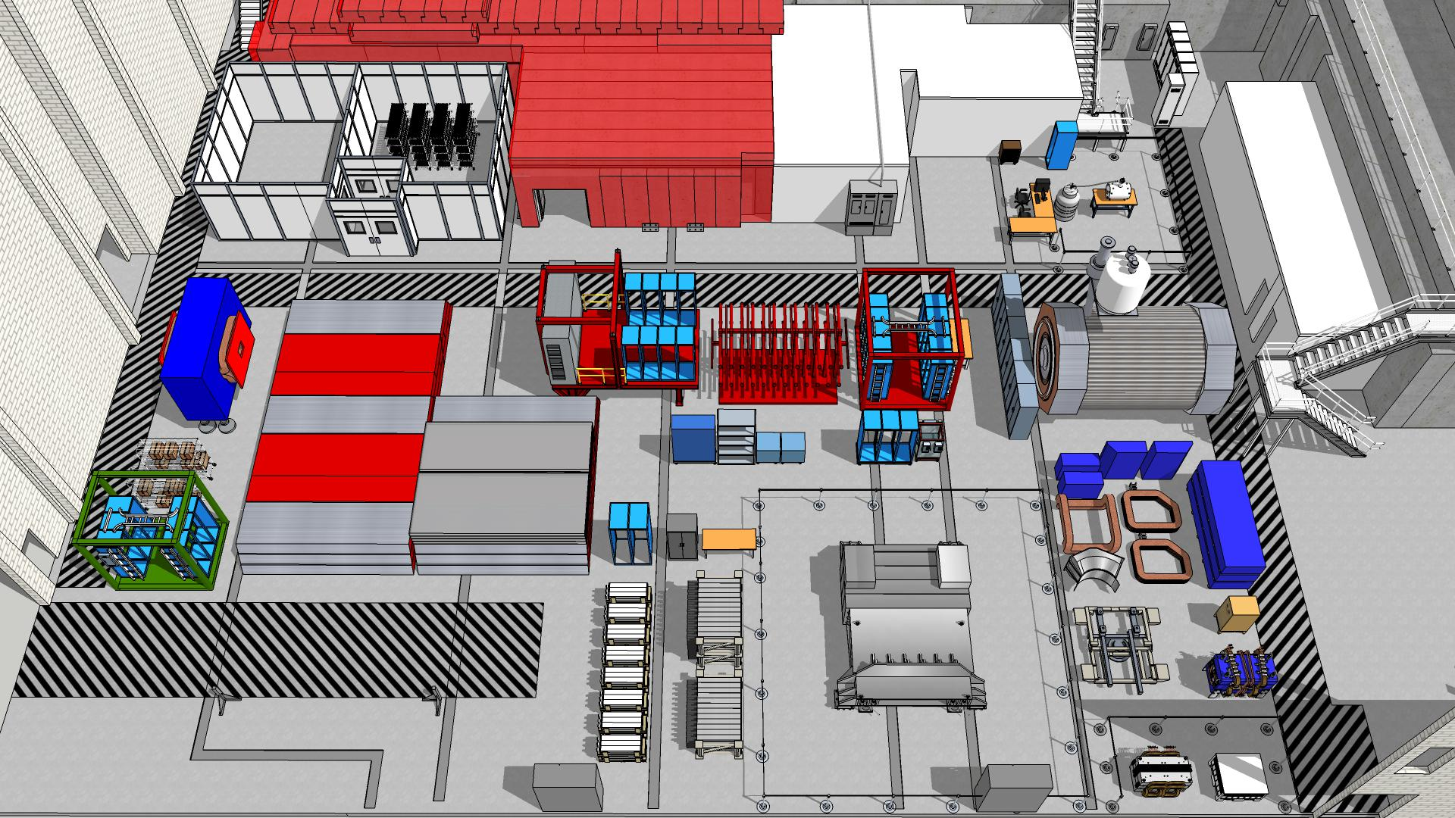
Experimental Nuclear Physics
Ongoing Projects / Material Staging
Draft Experimental Staging Plan Through 2025
Akers/Experimental Nuclear Physics January 14, 2016

Slide 9
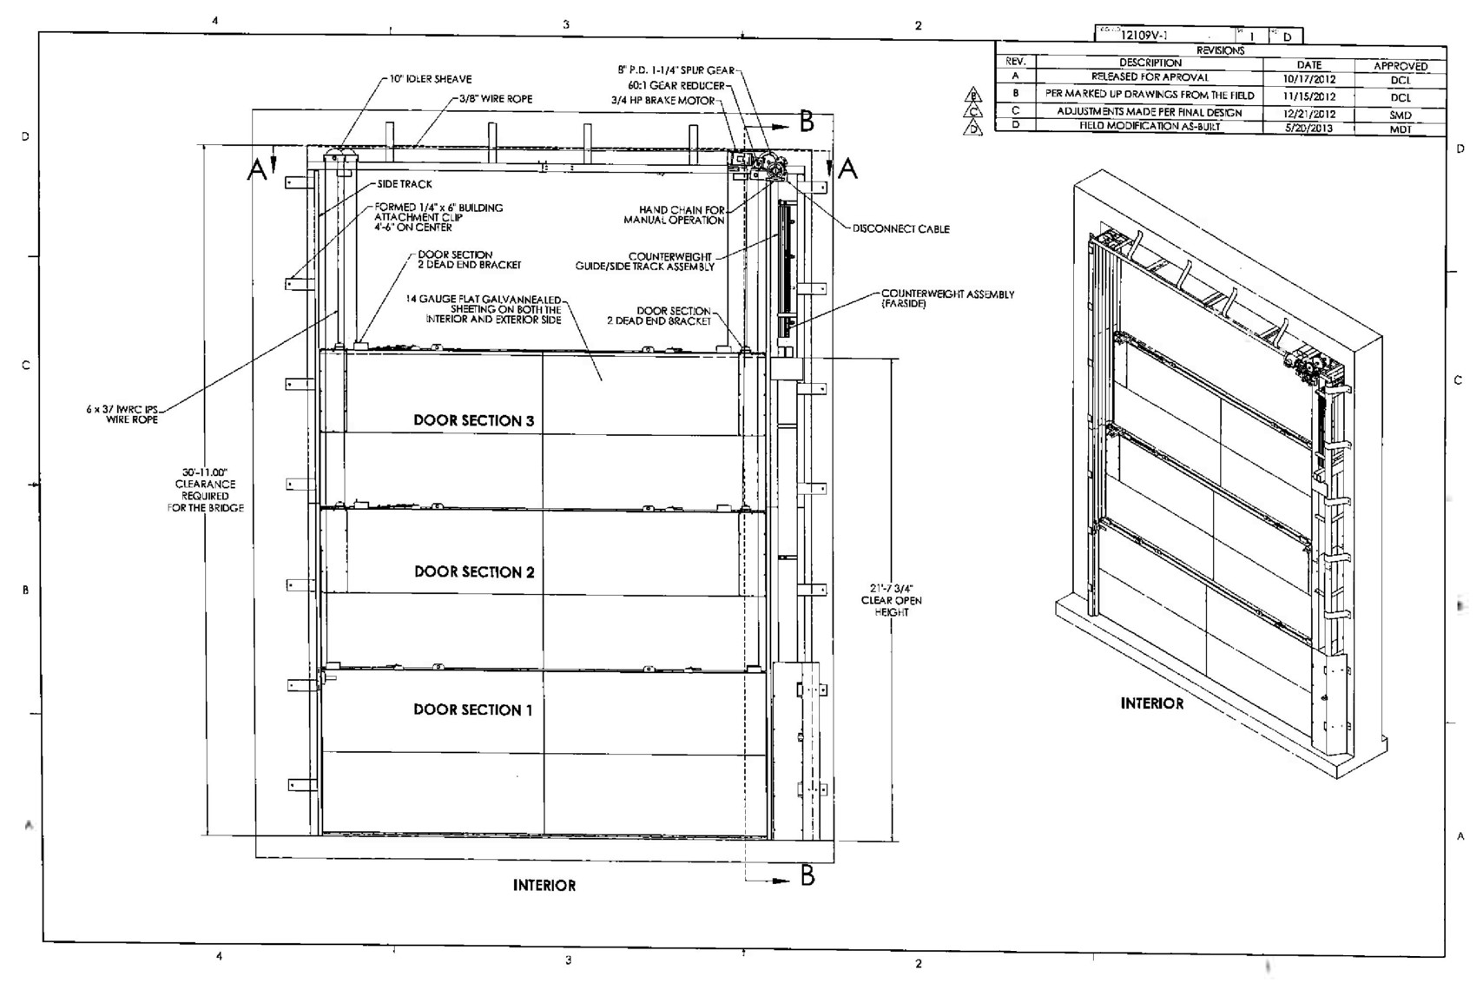
Experimental Nuclear Physics
Ongoing Projects / Automatic Flood Gates
Automatic Flood Gates have been procured for Halls A, B & C
Installation will be performed in FY-16
Akers/Experimental Nuclear Physics January 14, 2016

Slide 10
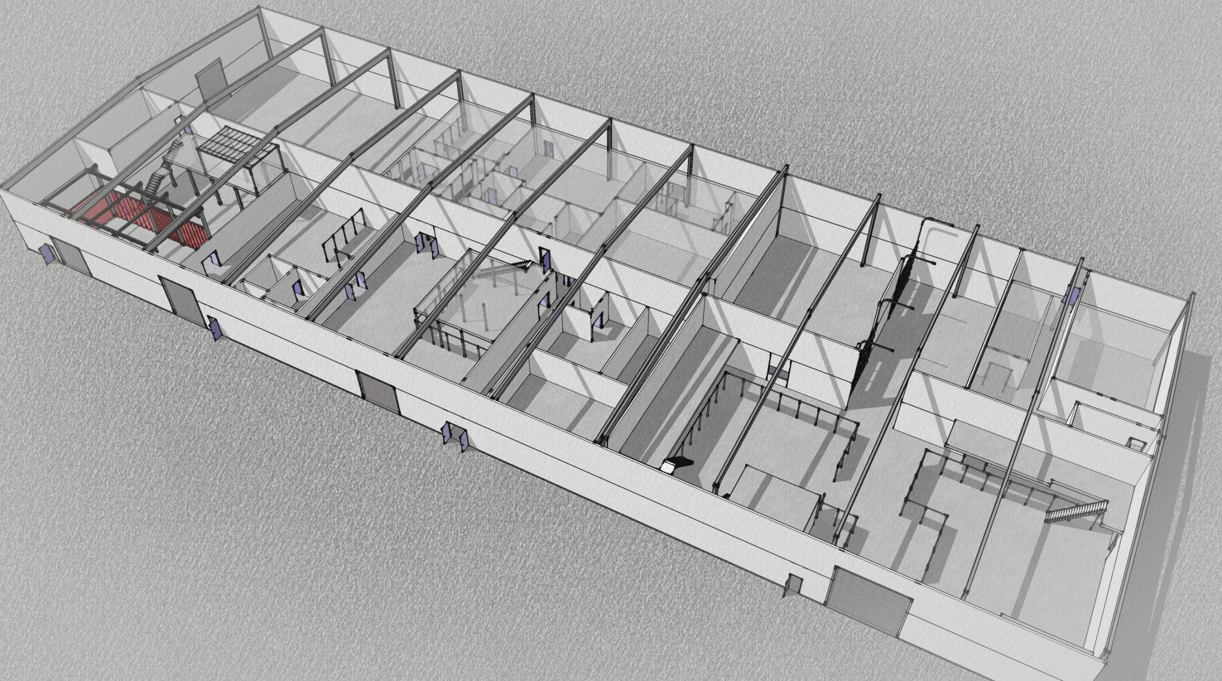
Experimental Nuclear Physics
Future Projects / EEL Renovations & Improvements
Update Interior Surfaces
Relocate Work Areas for Optimal Use
Improve Interior HVAC/Mechanical Systems
Akers/Experimental Nuclear Physics January 14, 2016

Slide 11
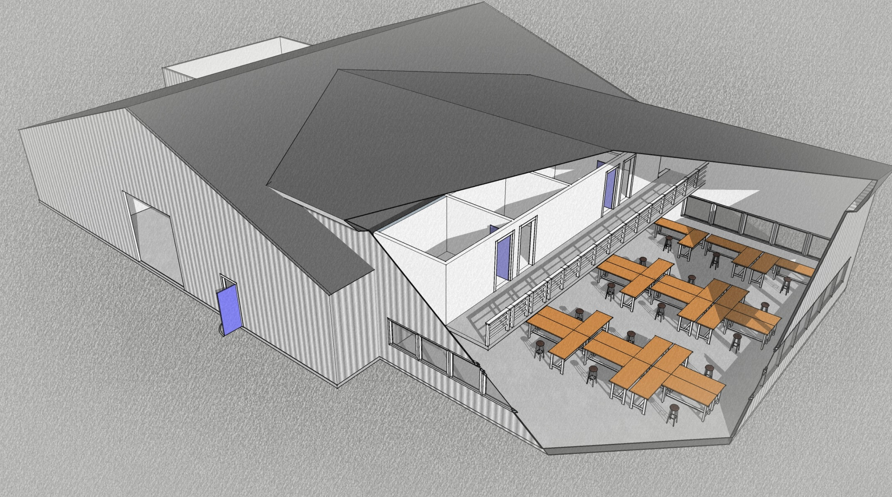
Experimental Nuclear Physics
Future Projects / Technical Staff Facility
CONCEPT ONLY
Expansion to the Existing Chalet
Places Technical Staff Adjacent to Halls A, B & C, and Counting House
Akers/Experimental Nuclear Physics January 14, 2016

