Slide 1
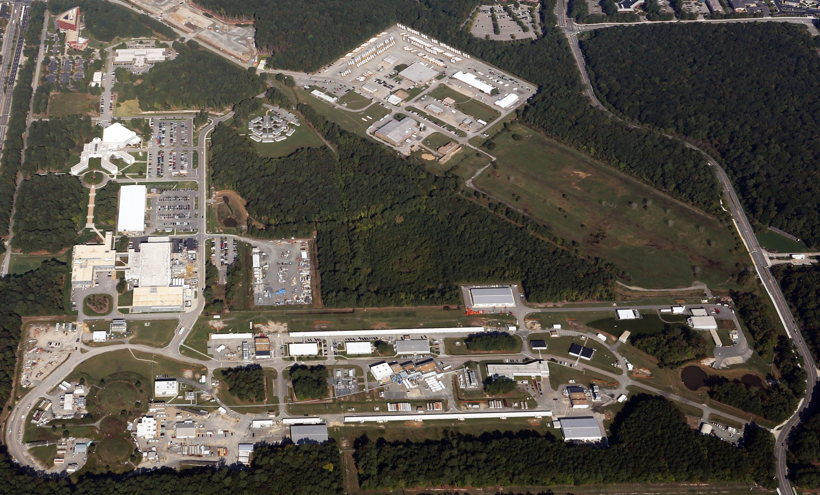
Report to UGBOD
Bob McKeown
January 14, 2016

Slide 2
Outline
Near term schedule
PAC business
MOLLER/SoLID
JLEIC
Outlook

Slide 3
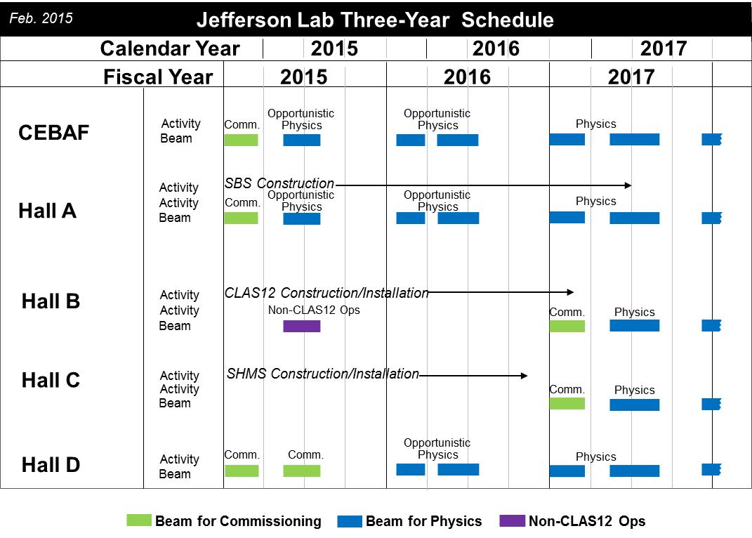
2017 commissioning
details to be updated
February 2016

Slide 4
Hall A Projected Experiment Schedule
CY 2015
Presented by T. Keppel at the July 2015 Hall A & C Coll. Meet.
CY 2016
CY 2017
CY 2018
SBS Start?
Moller, SoLID ???
Experiments listed in Italics represent potential schedule options, in no order
Red indicates PAC41 High Impact Experiments including SBS G_{E}^{p}

Slide 5
Hall B Schedule
On the critical path for 12-GeV Project ➔ 12 GeV Project has priority
Need to avoid even the appearance that 12 GeV Project does not get full priority under every circumstance
Best effort to recover some running of HPS and also provide planned running for PRAD
Hope to run HPS in February
(but only weekends will be possible this time)
Hope to install PRad in March
(if not in conflict with the 12 GeV Project)
Hope to run PRad in April/May
(we are considering a potential few-week extension as low-energy, single-Hall operation only, similar in scope as this year in May 2015)

Slide 6
Program Advisory Committee
Charge
Review new proposals, previously conditionally approved proposals, and letters of intent for experiments that will utilize the 12 GeV upgrade of CEBAF and provide advice on their scientific merit, technical feasibility and resource requirements.
Identify proposals that represent high quality physics within the range of scientific importance represented by the previously approved 12 GeV proposals and recommend for approval.
Also provide a recommendation on scientific rating and beam time allocation for proposals newly recommended for approval.
Identify other proposals with physics that have the potential for falling into this category pending clarification of scientific and/or technical issues and recommend for conditional approval. Provide comments on technical and scientific issues that should be addressed by the proponents prior to review at a future PAC.
PAC43 – July 2015
Results
PAC44 – July 2016 (proposals due June 6)

Slide 7
PAC43 Results
NUMBER | TITLE | CONTACT PERSON | HALL | DAYS REQUESTED | DAYS AWARDED | SCIENTIFIC RATE | PAC DECISION
PR12-15-001 | Measurement of the Generalized Polarizabilities of the Proton in Virtual Compton Scattering | N. Sparveris | C | 15 |  |  | C2
PR12-15-002 | The sidereal time variations of the Lorentz force and maximum attainable speed of electrons | B. Wojtsekhowski | Acc | 3.5 |  |  | Defer
PR12-15-003 | Polarization Observables in Wide-angle Compton Scattering at Photon Energies up to 8 GeV | B. Wojtsekhowski | A | 15 |  |  | Defer
PR12-15-004 | Deeply virtual Compton scattering on the neutron with a longitudinally polarized deuteron target | S. Niccolai | B | 125 |  |  | C2
PR12-15-005 | Measurements of the Quasi-Elastic and Elastic Deuteron Tensor Asymmetries | E. Long | C | 44.3 |  |  | C2
PR12-15-006 | Measurement of Tagged Deep Inelastic Scattering | C. Keppel | A | 27 | 27 | A- | C1
PR12-15-007 | Measurements of the Charge and Magnetic Form Factors of the Triton at Large Momentum Transfers | G. Petratos | A | 10 |  |  | Defer
PR12-15-008 | A study of the Lambda-N interaction through the high precision spectroscopy of Lambda-hypernuclei with electron beam | S. N. Nakamura | A | 73 |  |  | C2/D

Slide 8
PAC43 Call for Proposals
As we started with PAC40, the Hall B collaboration should submit proposals for complete run groups at one PAC meeting, where all of the anticipated physics associated with the proposed run group will be considered. Each run group can submit up to 4 individual proposals (up to 3 physics topics plus 1 summary of additional topics) and will be granted a maximum of 4 presentations corresponding to these proposals. The PAC may consider each of these for grading, but will attempt to provide an common assessment of the whole run group. New experimental proposals that run in parallel with previously approved run groups should be considered internally by the CLAS collaboration. It is also requested that documentation (e.g., proposal and report) from the internal review be submitted to the PAC for their information. A CLAS representative will have the opportunity to report on these to the PAC, and the PAC will then provide comments on them in its report. Proposed parallel running in other halls should be handled in a similar fashion.

Slide 9
12 GeV Approved Experiments by Physics Topics
Topic | Hall A | Hall B | Hall C | Hall D | Other | Total
The Hadron spectra as probes of QCD (GlueX and heavy baryon and meson spectroscopy) |  | 1 |  | 3 |  | 4
The transverse structure of the hadrons (Elastic and transition Form Factors) | 5 | 3 | 2 | 1 |  | 11
The longitudinal structure of the hadrons (Unpolarized and polarized parton distribution functions) | 2 | 3 | 6 |  |  | 11
The 3D structure of the hadrons (Generalized Parton Distributions and Transverse Momentum Distributions) | 5 | 9 | 7 |  |  | 21
Hadrons and cold nuclear matter (Medium modification of the nucleons, quark hadronization, N-N correlations, hypernuclear spectroscopy, few-body experiments) | 6 | 3 | 7 |  | 1 | 17
Low-energy tests of the Standard Model and Fundamental Symmetries | 3 | 1 |  | 1 | 1 | 6
TOTAL | 21 | 20 | 22 | 5 | 2 | 70

Slide 10
12 GeV Approved Experiments by PAC Days
Topic | Hall A | Hall B | Hall C | Hall D | Other | Total
The Hadron spectra as probes of QCD (GluEx and heavy baryon and meson spectroscopy) |  | 119 |  | 540 |  | 659
The transverse structure of the hadrons (Elastic and transition Form Factors) | 145.5 | 85 | 102 | 25 |  | 357.5
The longitudinal structure of the hadrons (Unpolarized and polarized parton distribution functions) | 65 | 230 | 165 |  |  | 460
The 3D structure of the hadrons (Generalized Parton Distributions and Transverse Momentum Distributions) | 409 | 872 | 212 |  |  | 1493
Hadrons and cold nuclear matter (Medium modification of the nucleons, quark hadronization, N-N correlations, hypernuclear spectroscopy, few-body experiments) | 180 | 175 | 201 |  | 14 | 570
Low-energy tests of the Standard Model and Fundamental Symmetries | 547 | 205 |  | 79 | 60 | 891
TOTAL | 1346.5 | 1686 | 680 | 644 | 74 | 4430.5
Total Approved Run Group Days (includes MIE) | 1346.5 | 671 | 667 | 644 | 74 | 3402.5
A Decade of Experiments

Slide 11
Jeopardy
Previous policy (6 GeV era):
The laboratory has a three-year Jeopardy Rule that was devised both to reduce the beamtime backlog and to ensure that the ratings of all approved experiments continue to accurately reflect their scientific priority. Jeopardy begins three years after a proposal is approved. Previously approved experiments that have not yet been run or scheduled must return to the PAC for a review of their status.
Will begin the process of “Jeopardy” in the next few years
Have requested input from JLab Users on the process

Slide 12
Efforts Are Being Made to Update the PAC Submission Page
Some highlights of the new submission page are
A dropdown box allowing you to select the proposal type, Proposal, Letter of Intent, Run group proposal etc.
The new system will allow more than one person to update the document, providing alerts as to the completion status to both participants
An email confirmation upon completion
Noteworthy changes
You will be prompted to complete each entry on the coversheets or input “Not applicable” Please note that inputting N/A implies that there will be no follow up request to the lab. An incomplete cover page will result in the proposal being rejected.
An author list is required for each proposal. The list can be uploaded using a CSV file format only
Assumed resource requirements section to provide any information regarding the assumed requirements for the resources needed
To ensure that these updates a satisfactory we are asking for a volunteer from the Board be available to test the system.

Slide 13
Efforts Are Being Made to Update the PAC Submission Page (Cont’d.)

Slide 14
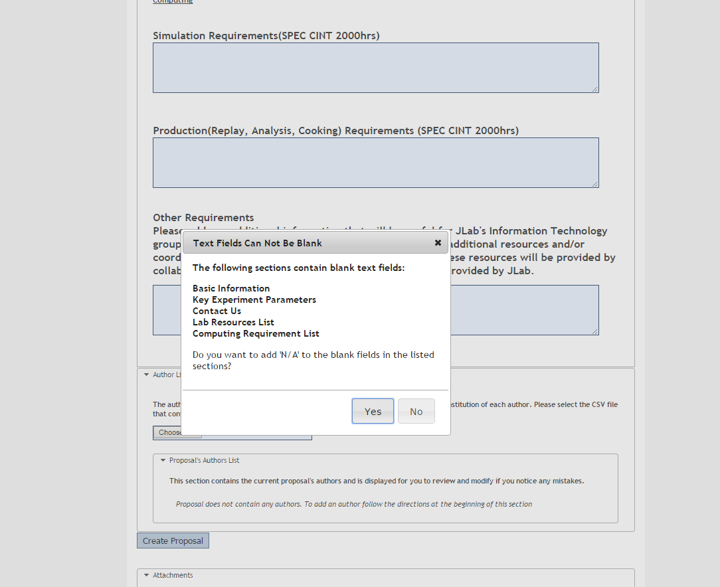
Efforts Are Being Made to Update the PAC Submission Page (Cont’d.)

Slide 15
Efforts Are Being Made to Update the PAC Submission Page (Cont’d.)

Slide 16
Receive Status Updates if Multiple Users are Working on the Submission

Slide 18
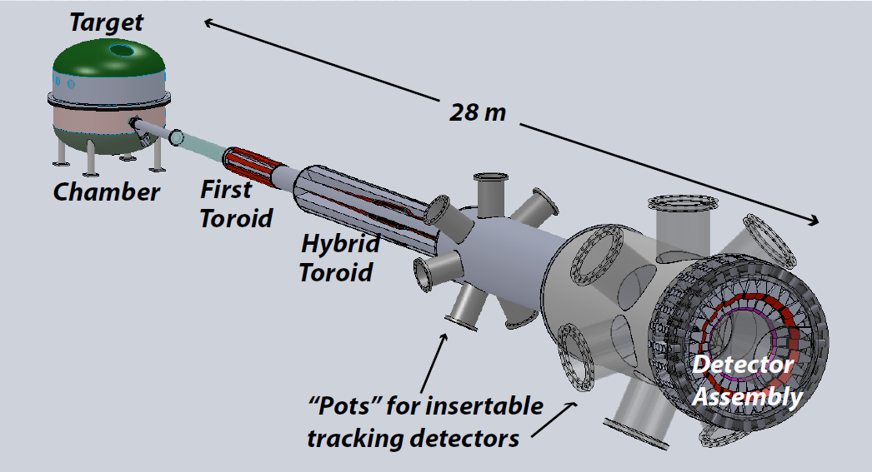
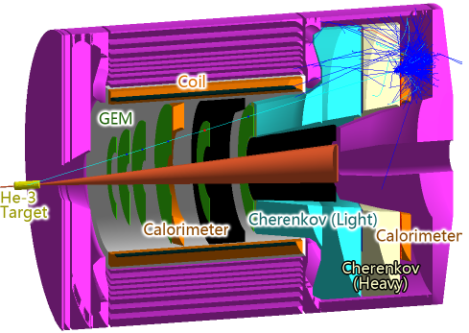
NSAC 2015 LRP
RECOMMENDATION IV
We recommend increasing investment in small-scale and mid-scale projects and initiatives that enable forefront research at universities and laboratories.
MOLLER
SoLID

Slide 19
Future Projects
MOLLER experiment
(Possible MIE – FY17-20)
– Standard Model Test
– DOE science review (September 2014) – strong endorsement
- Technical, cost & schedule reviews?
- Now hope for FY18 start
SoLID
– Chinese collaboration
– CLEO Solenoid 
– Director’s review (Feb. 2015)
 lots of good feedback
– Collaboration briefing to DOE-NP
(Nov. 2015)
Note: Feb. budget discussion with DOE/ONP

Slide 20
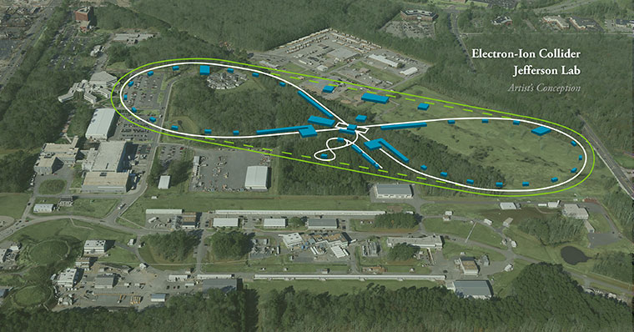
JLEIC: EIC at Jefferson Lab

Slide 21
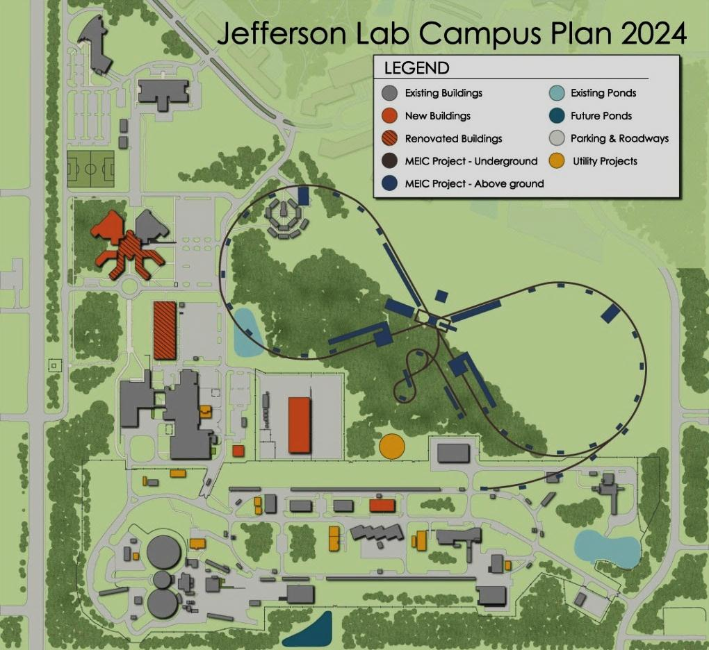
JLEIC: EIC at Jefferson Lab
JLab EIC Figure 8 Concept
Initial configuration:
3-10 GeV on 20-100 GeV ep/eA collider
Optimized for high ion beam polarization:
polarized deuterons
Luminosity:
up to few x 10³⁴ e-nucleons cm⁻² s⁻¹
Low technical risk
Upgradable to higher energies
250 GeV protons + 20 GeV electrons
Flexible timeframe for Construction
consistent w/running 12 GeV CEBAF
Thorough cost estimate completed
presented to NSAC EIC Review
Cost effective operations
Fulfills White Paper Requirements
Current Activities
Site evaluation (VA funds)
Accelerator, detector R&D
Design optimization
Cost reduction
Notes:
Deleted
Brightened graphic (no more shame); added current activities from previous version;
Mary Beth please format text

Slide 22
EIC Developments
EIC User meeting – Berkeley Jan. 6-9
– Next meeting Summer 2016
NAS study being planned
SLAC will be increasing involvement in JLEIC
– Responsible for e-ring
Rik Yoshida will join JLab March 2016 to lead the JLEIC physics/detector effort

Slide 23
EIC Timeline
Activity Name | 2010 | 2011 | 2012 | 2013 | 2014 | 2015 | 2016 | 2017 | 2018 | 2019 | 2020 | 2021 | 2022 | 2023 | 2024 | 2025
12 GeV Operations
12 GeV Upgrade
FRIB
EIC Physics Case
NSAC LRP
NAS Study
CD0
EIC Machine Design and R&D
CD1(Down-select)
CD2/CD3
EIC Construction
CD0 = DOE “Mission Need” statement; CD1 = technology and site selection (VA/NY)
CD2/CD3 = establish project baseline cost and schedule

Slide 24
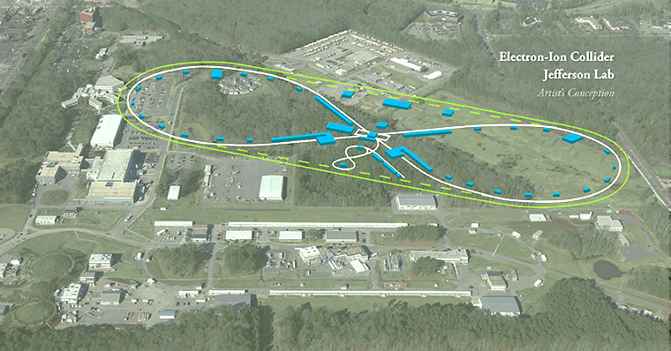
Summary
Commissioning, startup of physics program in progress
PAC44 in July 2016
Need to discuss Jeopardy process
MOLLER/SoLID slowly getting traction
CD Schedule for EIC beginning to gel
Exciting Times Ahead

Slide 25
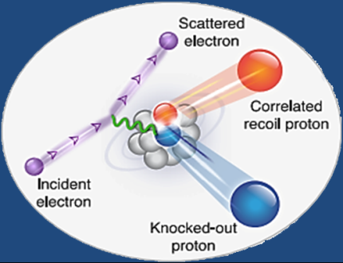
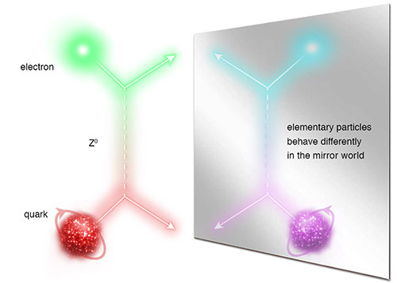
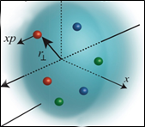
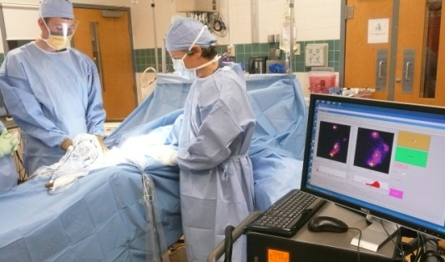
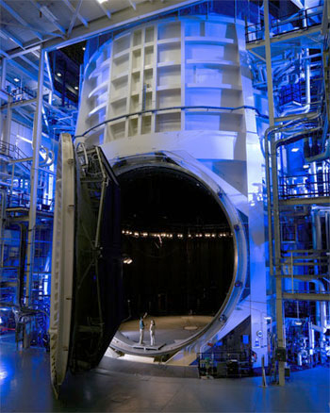
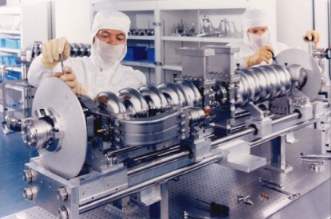
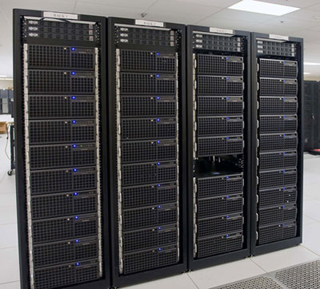
JLab: A Laboratory for Nuclear Science
Z⁰
Nuclear Structure
Fundamental
Forces & Symmetries
Structure of Hadrons
Medical Imaging
Nuclear Astrophysics
Accelerator S&T
Cryogenics
Theory & Computation

