Slide 1
Computing Update User Group Board of Directors Meeting Amber Boehnlein IT Division Director
Outline
IT Organization
Infrastructure
SciComp Update
External

Slide 2
IT Organization
Overall IT Staff
38 Staff
4 Students
CIO (1)
Computing and Networking Infrastructure (1)
Management Information Systems (7)
Scientific Computing (1)
Systems (7)
Networking and Telecom (4)
Helpdesk (3 + 4 Students)
Cyber Security (3)
Operations (4)
Software Development (2)
Research (3)
Library & Records Management (2)

Slide 3
Updates
Utilities Infrastructure Modernization proceeding
Data Center upgrades
Redundant networking
Data Center Consolidation—achieve power efficiency improvements
Looking at cloud services, esp. for sharing files.
Business processes for users—redesigned forms
PAC submission
Registration
User reporting requirements
“Report card items”—Cyber and Public access to Publications

Slide 4
Cyber Security
Subject of Federal Initiatives due to high profile breaches
JLAB has a proactive approach to improve cyber security
Network segmentation used to isolate functions, widely praised by external assessments
Phishing exercises to train staff
Bi-Yearly Penetration Testing and Vulnerability Scanning (Assessment)
Using publically available information as a spring board, they were able to get and crack 15 passwords
Not able to exploit due to network segmentation
JLAB uses Multi Factor Authentication (MFA) for the business sensitive systems, sensitive S&T and for privileged administrators
Will be further separating research and operations functions in response to DOE mandates
Extension MFA for staff
As currently understood, researchers will not be affected

Slide 5
JLAB Publications and Public Access Timeline
2013 – Public Access mandated by White House
2014 – DOE’s Public Access Plan approved by White House
Data management plan requirements for proposals
Publications: JLAB must provide final, peer-reviewed accepted manuscripts or final published documents that are
authored by JLAB authors or
produced as a result of work done at JLAB.
Is in the collaborator agreement
2015 –DOE’s Office of Scientific and Technical Information (OSTI) launches plan elements for Public Access
2016 – DOE Labs are ‘graded’ on compliance for publications submitted
JLAB working toward compliance success
We need help getting the word out!
(http://science.energy.gov/~/media/ascr/ascac/pdf/meetings/201512/OSTI_Action_Plan_Response_to_ASCAC-STI_Sub-committee_FINAL.pdf)

Slide 6
IT SciComp
Recent Infrastructure
Swif workflow tool deployed
Write-thru cache ready for deployment
IT expertise multi-threading—work with experiments for improved farm utilization
Hardware resources—FY15 Needs assessment in progress
900 servers
9500 conventional Intel cores
348 Nvidia GPUs
52 Intel Xeon Phi accelerators
10 Petabyte tape library (3 LQCD, 7 Physics)
1.5 Petabyte disk (+0.5PB soon)
10Gb redundant offset network link
Networking upgrades to 40 GB in Hall B
User survey will be open soon—Looking forward to feedback

Slide 7
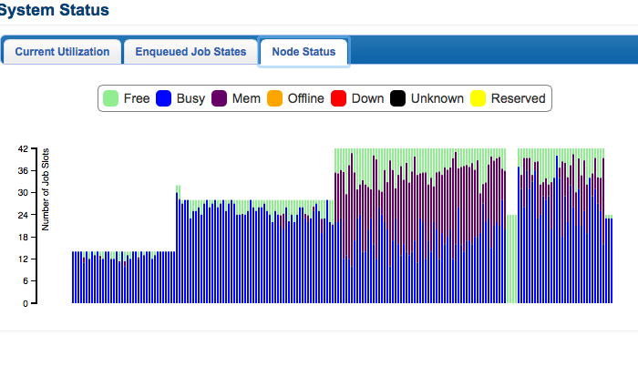
Web based Farm Status and monitoring tools
https://scicomp.jlab.org/scicomp/

Slide 8
S&C Reviews
Readiness Reviews with external panels roughly every 18 months
Halls are doing a self-assessment relative to the Feb 2015 Software and Computing review
Areas of opportunity to explore
Increase the engagement and dialog of IT Division with the experimental collaborations
Distributed Computing
Resource planning
Data Management/Data preservation
Software design
Tools and infrastructure

Slide 9
News Items
EIC Computing
Workshop last fall-Assessments
Workshop at JLAB March 16-18
HEP Software Foundation (http://hepsoftwarefoundation.org )
Knowledge Base—stubs to populate for Jlab experiments
Exascale 2025
ASCR NP planning workshop in June (announcement soon)
Exascale is projectized—Applications area gathering input
ASB is Jlab POC

Slide 10
Backup

Slide 11
HEP Software Foundation
Umbrella of community initiated activities
Organized out of CERN and BNL
Volunteer based
(in Europe ‘HEP’ also covers nuclear physics)
http://hepsoftwarefoundation.org
Packaging working group
Knowledge Base—stubs to populate for Jlab experiments
Can be a useful documenting tool for our own uses
In some cases, enable finding applications or infrastructure that could be adopted rather than developing in-house.

Slide 12
Workshops at Jefferson Lab
09/2015: Workshop EIC Software Meeting
organizers: Elke-Caroline Aschenauer (BNL), Markus Diefenthaler
workshop goals:
review software status with focus on detector and physics simulations
identify interfaces between existing BNL and JLab software
foster active collaboration
website: https://www.jlab.org/conferences/eicsw/
03/2016: Workshop Future Trends in NP Computing
organizers: Amber Boehnlein, Markus Diefenthaler, and Graham Heyes
workshop goals:
incubator for computing ideas in the the exascale era
identify ways to improve usability of NP Computing
identify ways to make new data faster available for physics analysis
identify best practices for NP Computing

Slide 13
Exascale-2025
Advanced Scientific Computing Research (ASCR) and NNSA
Build and deploy an Exascale Machine by 2025-27
Significant challenges: Parallel R&D paths
‘prototype’ machines at 100 petaflops and 300 petaflops
Scientific codes have to be developed
Intense development on underlying applied math libraries
Development of multi-scale simulations
“In Situ” visualization and data analysis
Workflows to support simultaneous simulations and experimental data analysis
Seamless Integration of different scale hardware resources
Seamless Integration of research data management
Fully funded, Project-like structure.
‘Applications’ area lead is gathering priorities through Working Group
Nuclear Physics/ASCR workshop in June (announcement soon)
Include Experimental as well as classic High Performance Computing applications.
Need to try to capture university input as well as DOE lab
http://science.energy.gov/ascr/ascac/meetings/201512/

