Slide 1



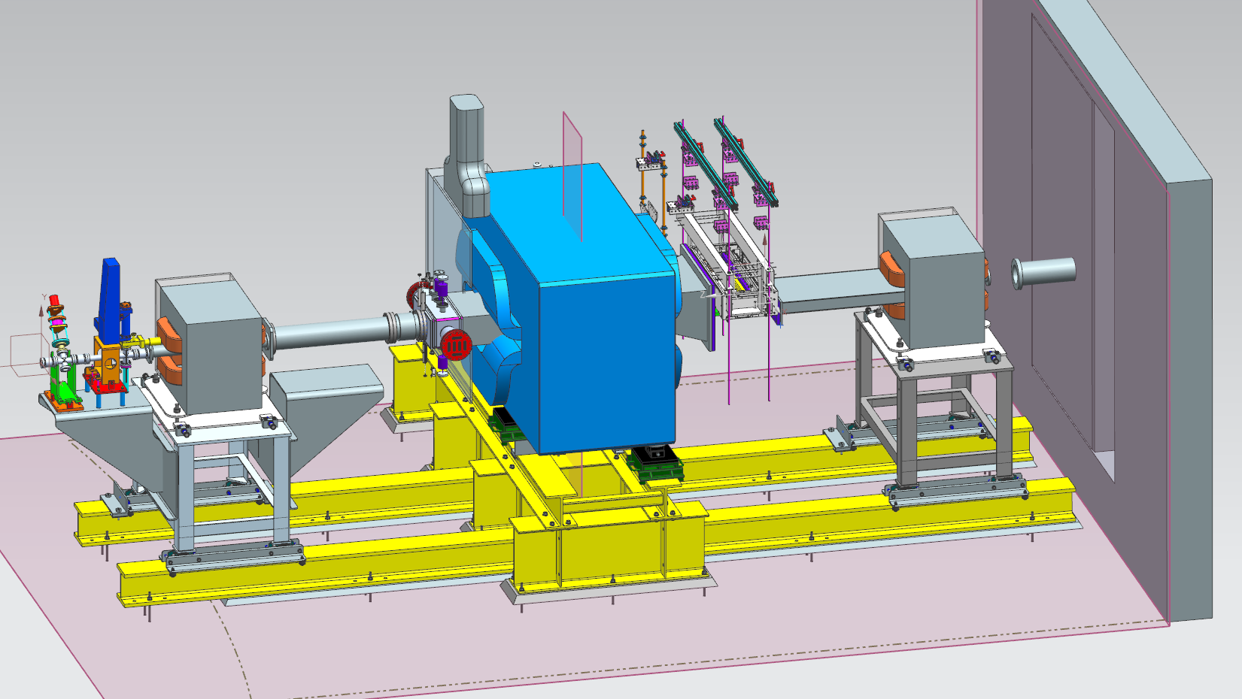
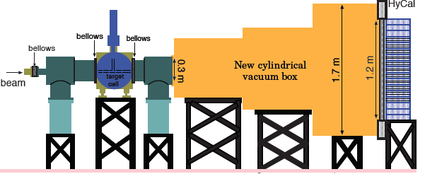
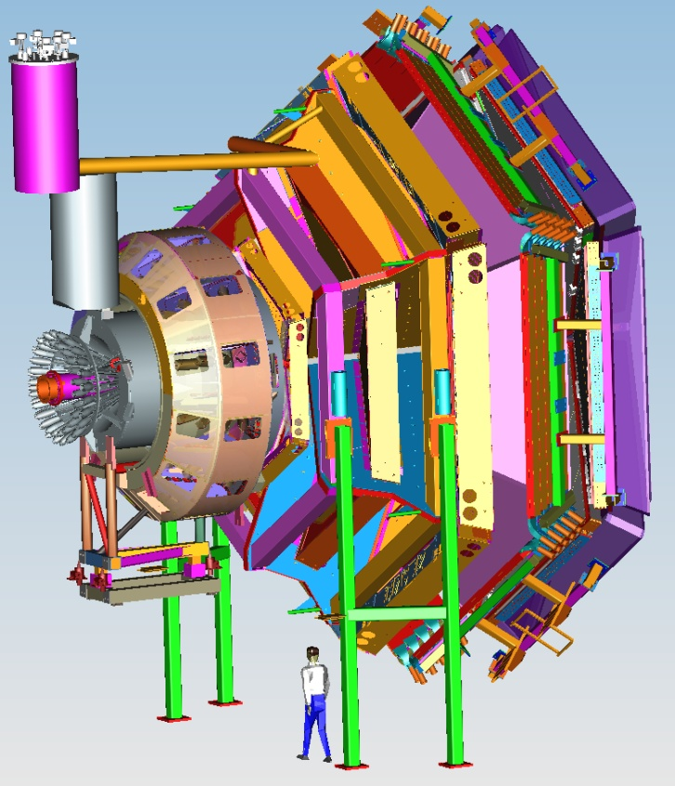


Status of Hall B
Volker D. Burkert
CLAS12
2015 publications
PRad & HPS status
CLAS12
CLAS12 upgrades
Schedule
Summary
User Group BoD Meeting
January 14, 2016

Slide 2
Physics Journal Publications
M. McCracken et al., Search for baryon-number and lepton-number violating decays of Λ hyperons using the CLAS detector at JLab,
PRD 92 (2015) 7, 072002.
D. Adikaram et al., Towards a resolution of the proton form factor problem: new electron/positron scattering data, PRL 114 (2015) 6, 062003
C. Colle et al., Mass dep. and Q.N. of SRC pairs from A(e,e’p) and A(e,e’pp), PRC 92, 024604, 2015
Or Hen, et al., Symmetry energy of nucleonic matter with tensor correlations, PRC 91, 025803, 2015
I. Senderovich et al., First measurement of the helicity asymmetry E inηphotoproduction on the proton, arXiv:1507.00325, PRL
N. Guler et al., Precise determination of the deuteron spin structure at low to moderate Q2 with CLAS and extraction of the neutron contribution, PRC 92 (2015) 5, 055201.
N. Zachariou et al, Determination of the Beam-Spin Asymmetry of Deuteron Photodisintegration in the Energy Region Eγ=1.1−2.3GeV, PRC 91, 055202 (2015)
H.S. Jo et al., Cross sections for the exclusive photon electro-production on the proton and GPDs, PRL 115 (2015) 21, 212003
S. Pisano, et al., Single and double spin asymmetries for deeply virtual Compton scattering measured with CLAS and a longitudinally polarized proton target, PRD 91 (2015) 5, 052014
E. Seder et al., Longitudinal Target-Spin Asymmetries for Deeply Virtual Compton Scattering, PRL 114, 089901 (2015)
I. Niculescu et al., Direct observation of q-h duality in the F2n structure function, PRC 91, 055206, 2015.
G. Aznauryan et al., Electroexcitation of theΔ(1232)3/2⁺ andΔ(1600)3/2⁺ in a light-front relativistic quark model, PRC 92 (2015) 3, 035211
S. Strauch et al., First Measurement of the Polarization Observable E in the p(γ,π⁺)n Reaction up to 2.25 GeV, PLB 750 (2015) 53
I.G. Aznauryan et al., Extracting meson-baryon contributions to the excitation of the N(1675)5/2⁻ nucleon resonance, PRC 92 (2015) 1, 015203
K. Park et al., Measurements of ep→e′π+n at W = 1.6 - 2.0 GeV and nucleon resonance electro-couplings at CLAS, PRC 91 (2015) 045203

Slide 3
PRad status
NSF/MRI: Duke U., MSU, NC A&T, NSU (ISU)
Passed ERR November 12 and scheduled to run in May 2016 contingent on non-interference with CLAS12 construction.
All mechanical design work complete and all parts are on order. Most of the pieces of the setup are on hands.
Main installation is scheduled to begin March 15. Some parts of the beam line will be installed earlier.
Windowless gas target is ready and will be installed on the beam line next week.
Two GEM chambers built at UVA and will be delivered to JLAB in two weeks.
HyCal operational
Remaining preparations to optimize the DAQ for GEM detectors and development of on-line software tools

Slide 4

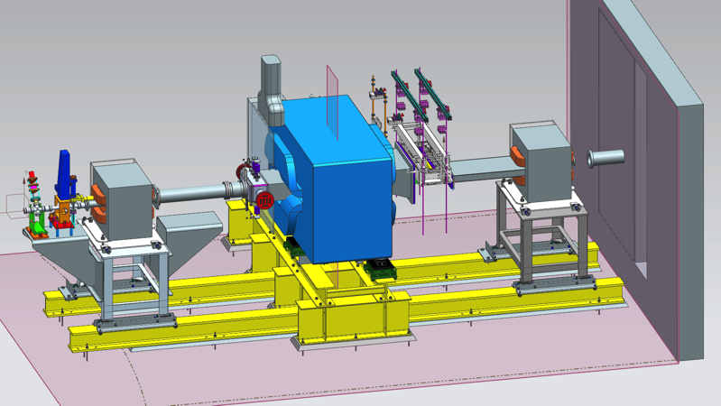
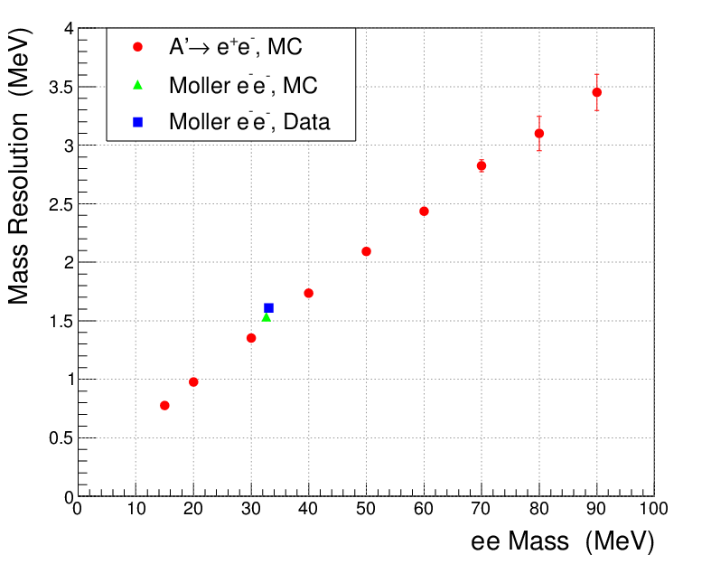
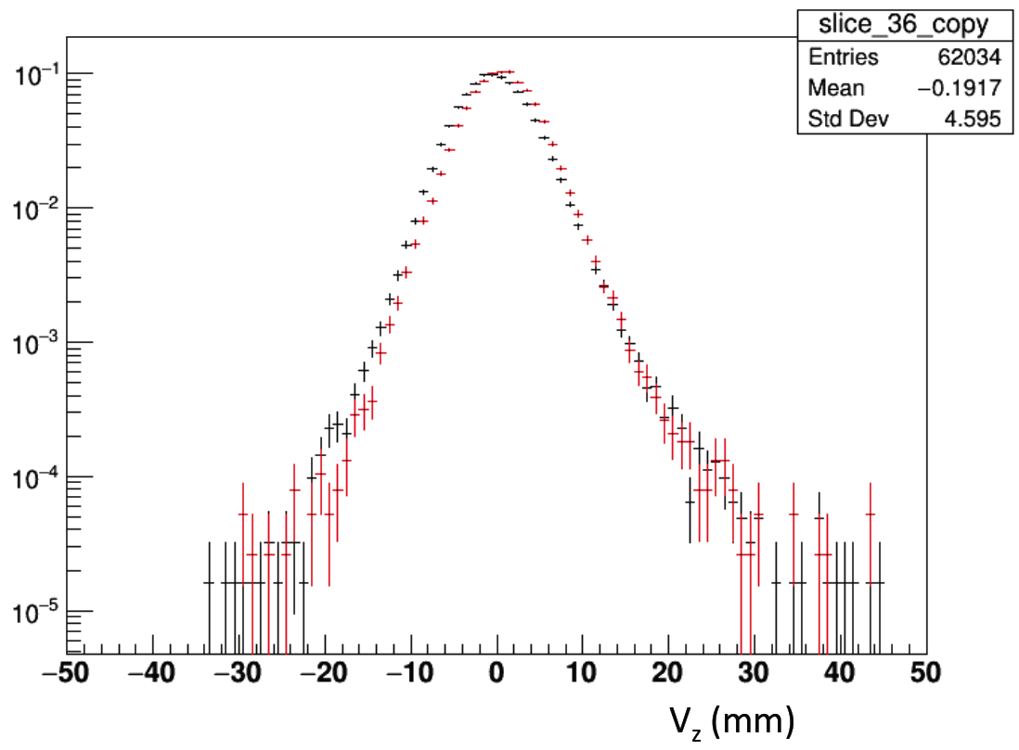
HPS Progress Report
Physics run May 4 - 18, 2015
with 1.05 GeV beam energy
Collected 2 PAC‐days of physics data with SVT Layer-I at 0.5 mm from the beam plane (θ_{min} = 15 mrad) at proposed run conditions - 50 nA beam current and 0.125 r.l W-target
Pass4 processing of 10% of unblinded data for calibration and analysis is complete
Analysis of various benchmark reactions (e⁻e⁻, e⁻γ, e⁻e⁺, e⁻A) showed remarkable agreement with expected performance from simulations
Ready for final processing, 100% of data, plan to start early February, will take 6 weeks to complete
1 GeV
2 PAC days at 1 GeV
2.2 GeV
4.4 GeV
Mass Resolution
Vertex distribution of pairs
Parameter | Proposal value | Measured value
Beam current | 50 nA | 50 nA
SVT occupancy | < 1% | 1%
Ecal rates | 0.5 MHz | 1.2 MHz
DAQ/trigg. rate | 18 kHz | 19 kHz
Pair mass res.* | 1.5 MeV | 1.6 MeV
Pair vertex res.♯ | 4.4 mm | 4.6 mm
Simulation
Data
E (GeV)
* At 34 MeV ♯ At 40 MeV

Slide 5

CLAS12 Equipment
Forward Detector (FD)
  - TORUS magnet
  HT Cherenkov Counter
  Drift chamber system
  LT Cherenkov Counter
  Forward ToF System
  Pre-shower calorimeter
  E.M. calorimeter
Central Detector (CD)
  SOLENOID magnet
  Silicon Vertex Tracker
  Central Time-of-Flight
Beamline
  Cryo Target
  Moller polarimeter
  - Shielding
  Photon Tagger
MM
CND
FT
Upgrade to the baseline
- Central Neutron Detector
  MicroMegas
  Forward Tagger
  RICH detector
  Polarized target (long.)
RICH

Slide 6
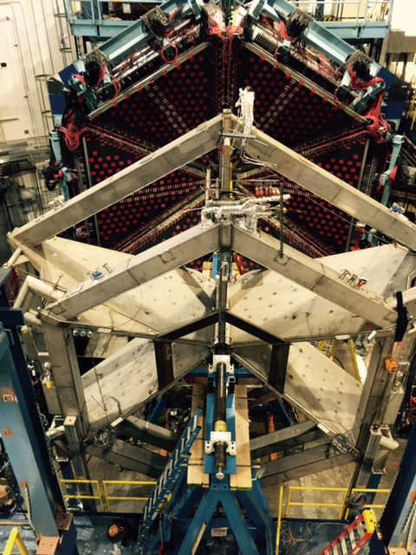
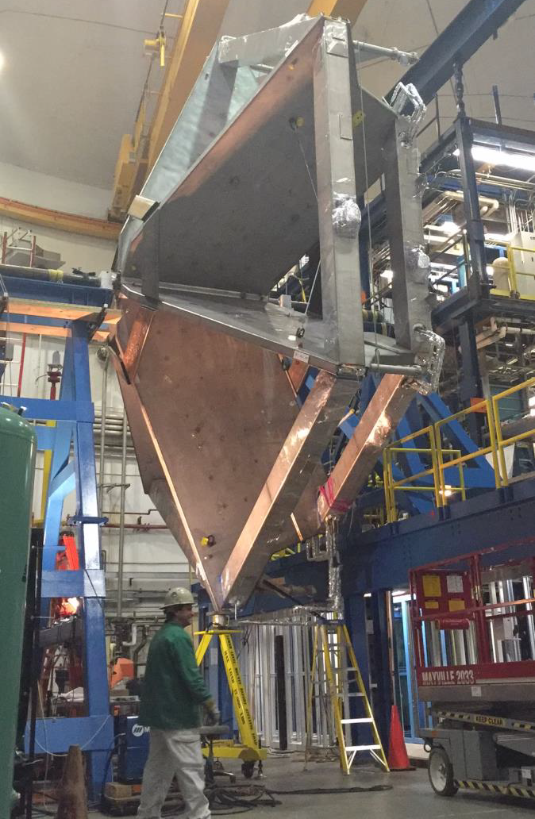
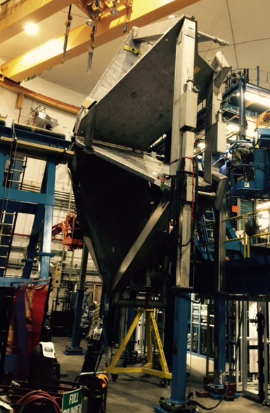
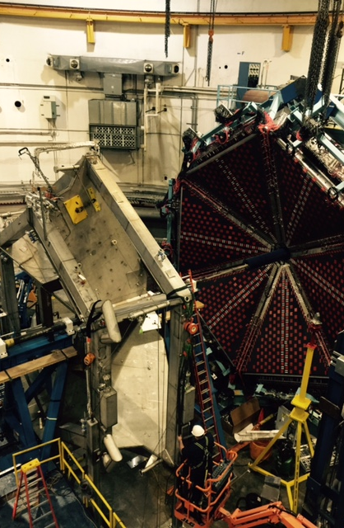
CLAS12
Status of Hall B
TORUS Magnet Installation
All coils and connections (electric, cryogenic) installed in Hall B
Pump down Mar 2016
Cool down expected April 2016
Magnet ramp up May 2016
Field mapping June 2016
Detector (DC) installation start July 2016
SOLENOID Magnet
4 of 5 coils winding complete, potting underway
Delivery of Magnet to JLab 09/2016
Expected to be operational 12/2016
Detector (CND, CTOF, SVT, MM) 12/2016
Beam Line Instrumentation
Commissioned during HPS run up to Faraday cup, BPMs, harps, halo counters.
Moeller quad moved for 12GeV operation
Moeller electron shield in design
Forward Carriage
FTOF1a, FTOF1b, PCAL and EC operational
LTCC & FTOF Panel 2 operational 02/03 2016

Slide 7
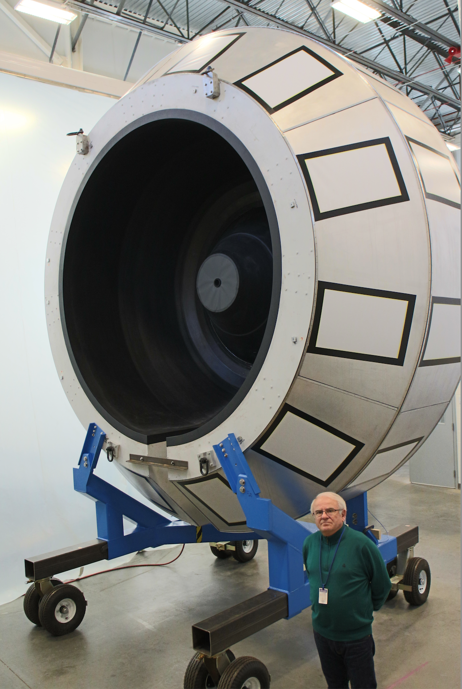
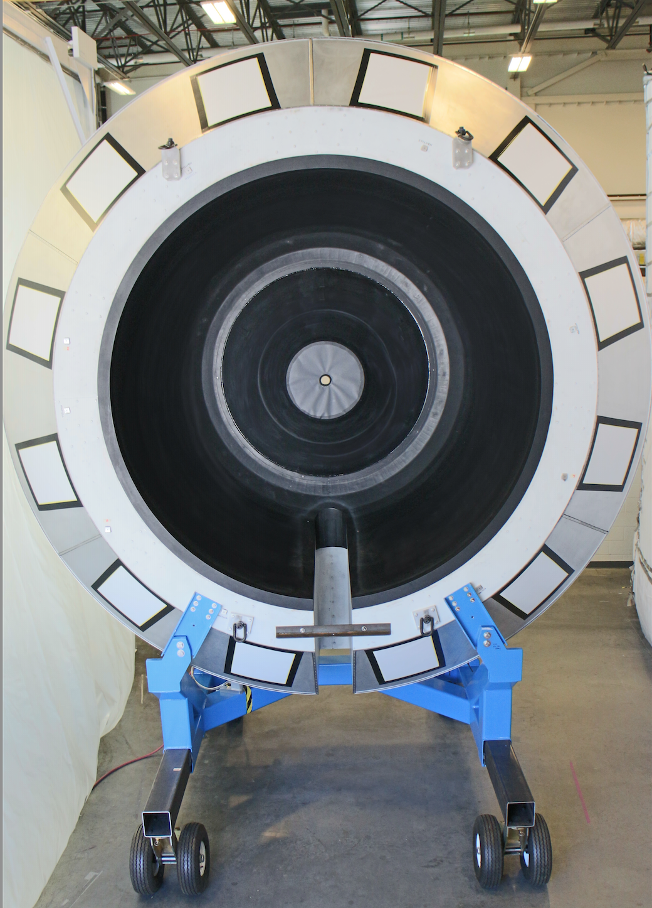
High Threshold CC
CLAS12
Project to be completed July 2015
Detector construction complete, now fine tuning operations

Slide 8
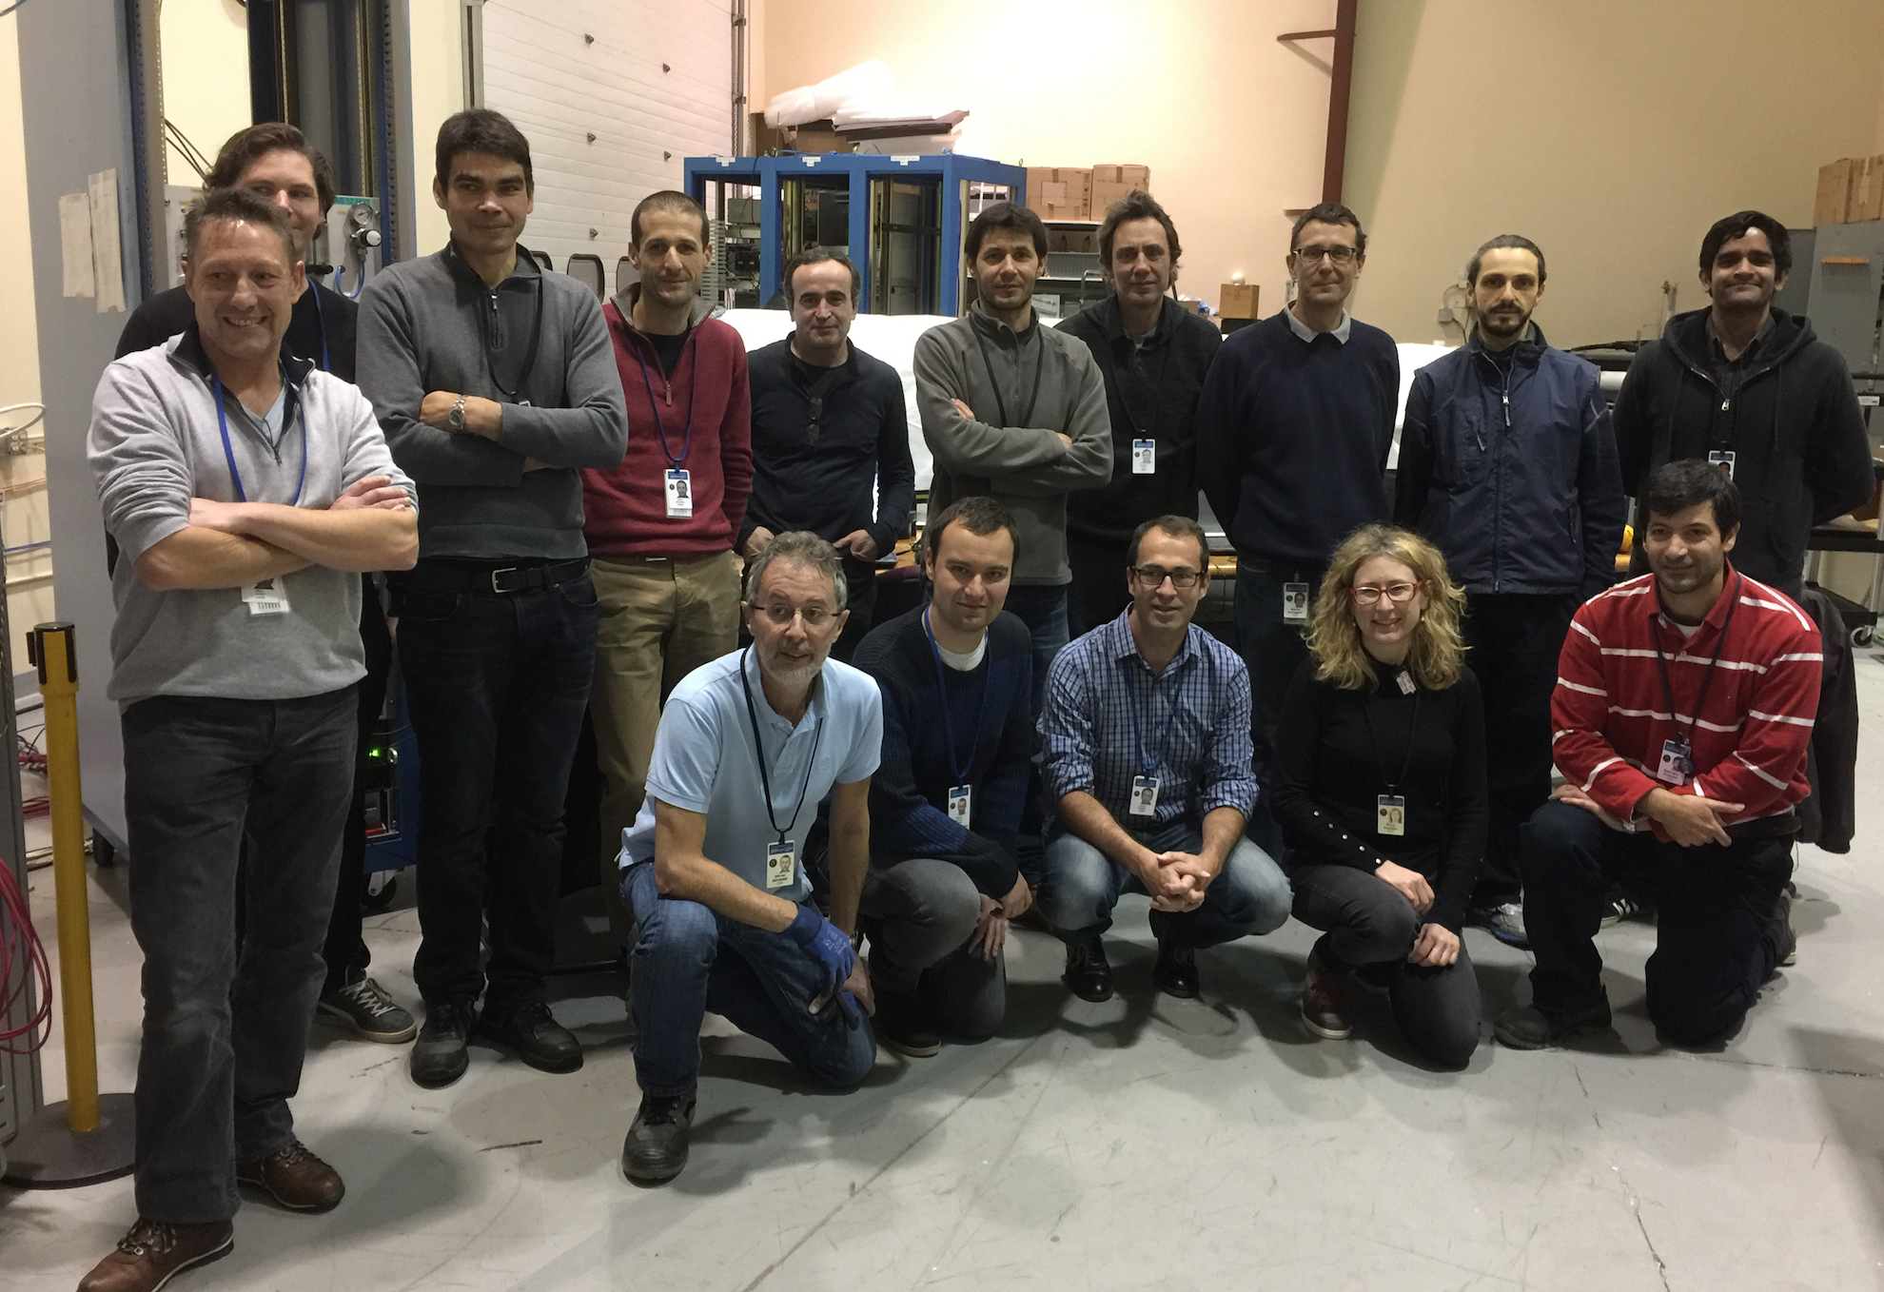
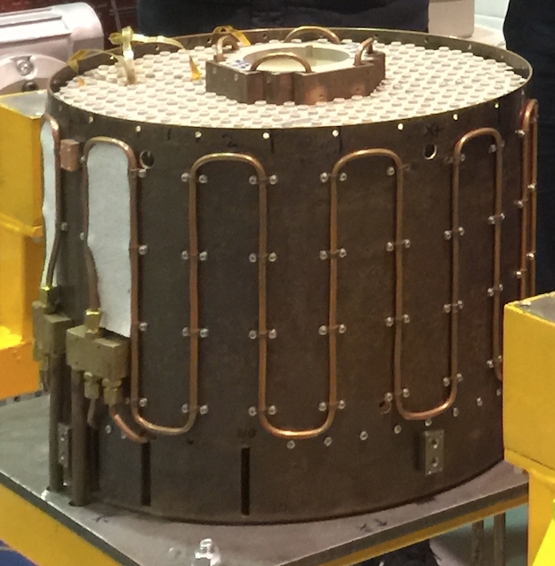
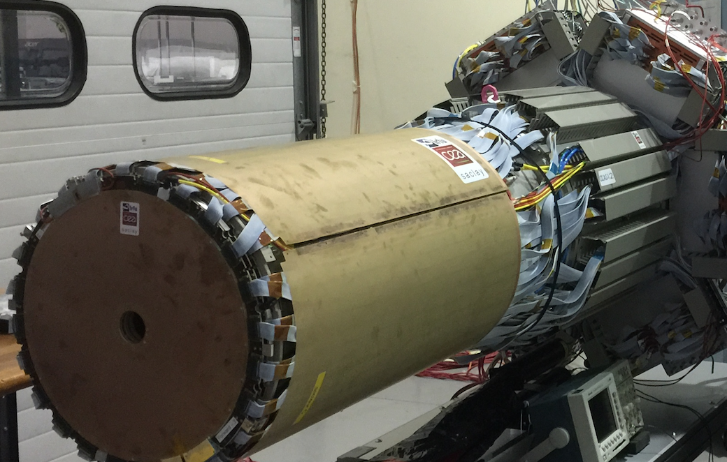
CEA & INFN teams assemble the MVT & FT
Nov. 7th – MVT in the Saclay cosmic bench
PbWO₄ calorimeter designed and built by the Genova/INFN team in preparation for testing.
The two layers of the MicroMegas Vertex Tracker designed and built by the CEA team have been assembled at JLab for integration with the Silicon Vertex Tracker.

Slide 9
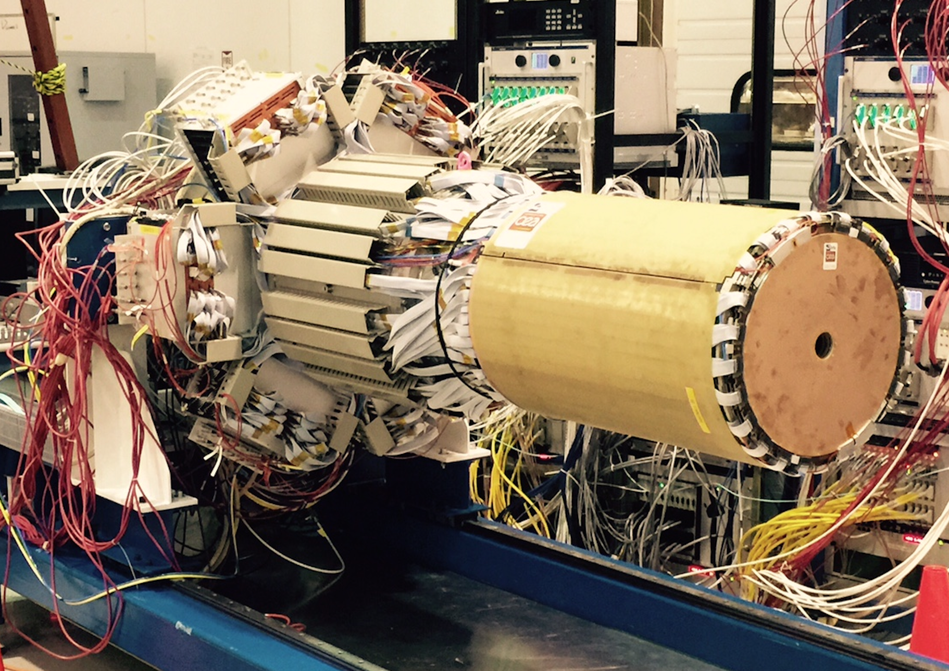
SVT & MM in Cosmic Ray Test

Slide 10

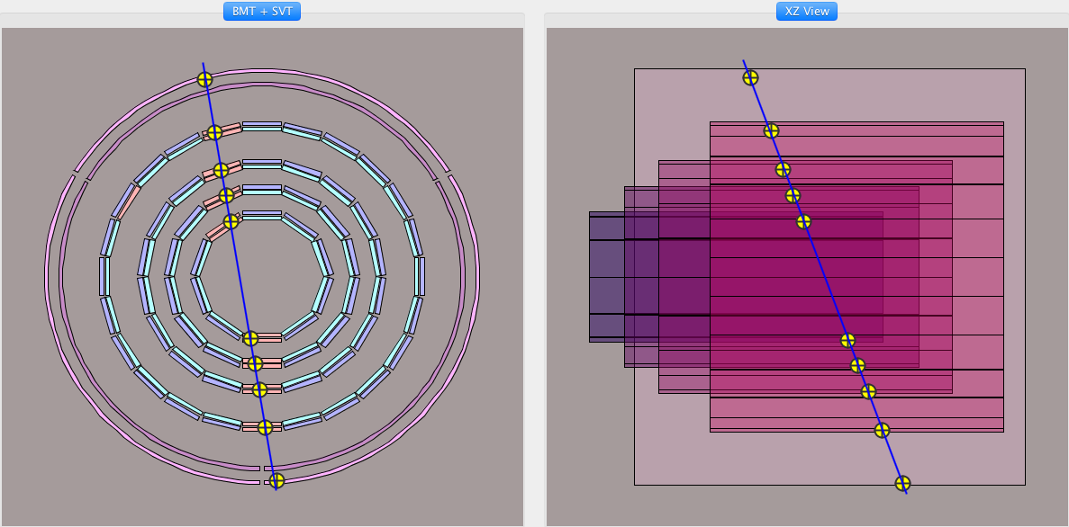
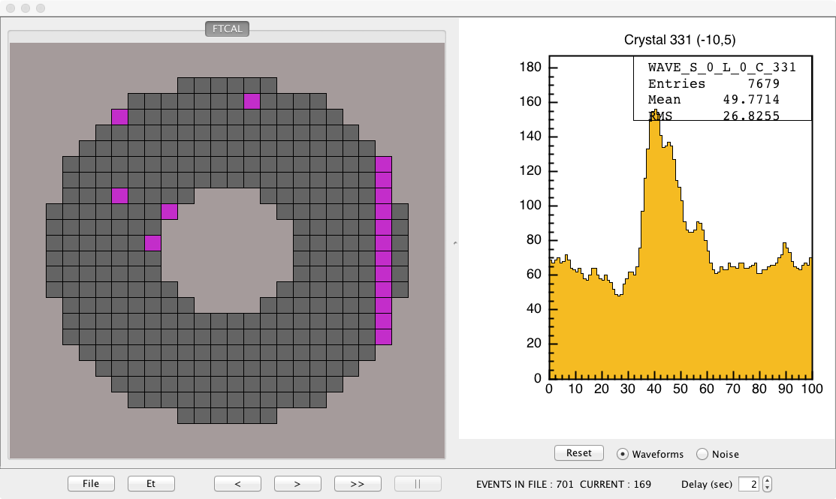
Cosmic Ray test of SVT/MM & FT
Combined test of 8 SVT layers (4 axial, 4 stereo) and 2 Micro Megas layers (1 axial, 1 circ.).
Final configuration will include 6 MicroMegas layers.
First reconstructed cosmic ray muon in SVT & MM
Cosmic ray test of Forward Tagger Calorimeter.
First detected cosmic ray muon in FT EC

Slide 11
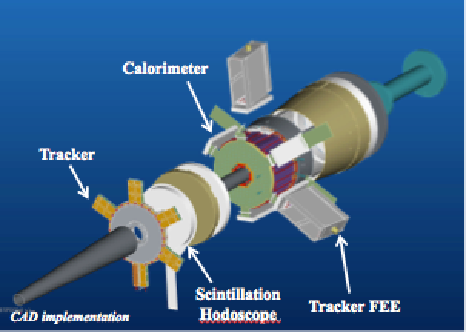
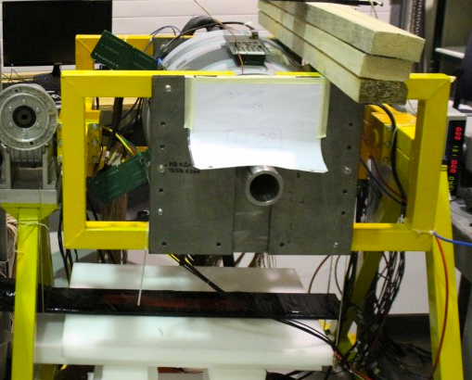
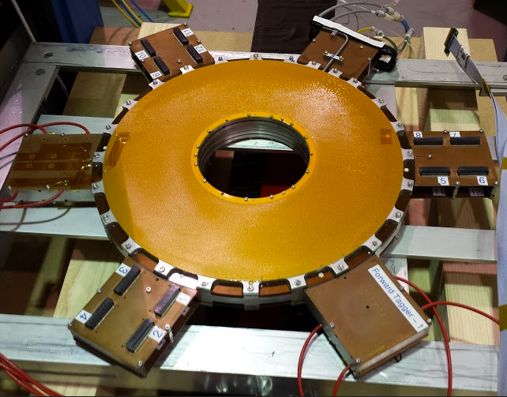
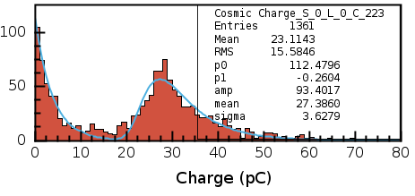
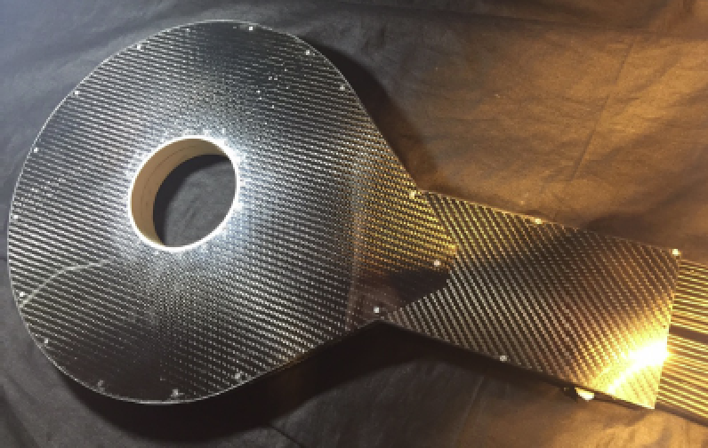
CLAS12
Forward Tagger (FT)
Detect electrons at small angle to perform quasi-real photo-production experiments.
Calorimeter: electron energy/momentum
  Photon energy (ν=E-E’), Polarization ε⁻¹ ≈1 + ν²/2EE’
PbWO₄ crystals with APD/SiPM readout (Genova)
Scintillation Hodoscope: veto for photons
Scintillator tiles with WLS readout (Edinburgh)
Tracker: electron angles, polarization plane
MicroMegas detectors (CEA).
FT-Cal assembled and under test at JLab
FT-Hodo shipped from Edinburgh to JLab
FT-Trk tested at Jlab
Full FT integration at JLab in spring 2016
Energy distribution of cosmic muons in a PbWO FT-Cal crsystal
FT-Cal cosmic test at JLab
FT-Trck
at JLab
FT-Hodo

Slide 12
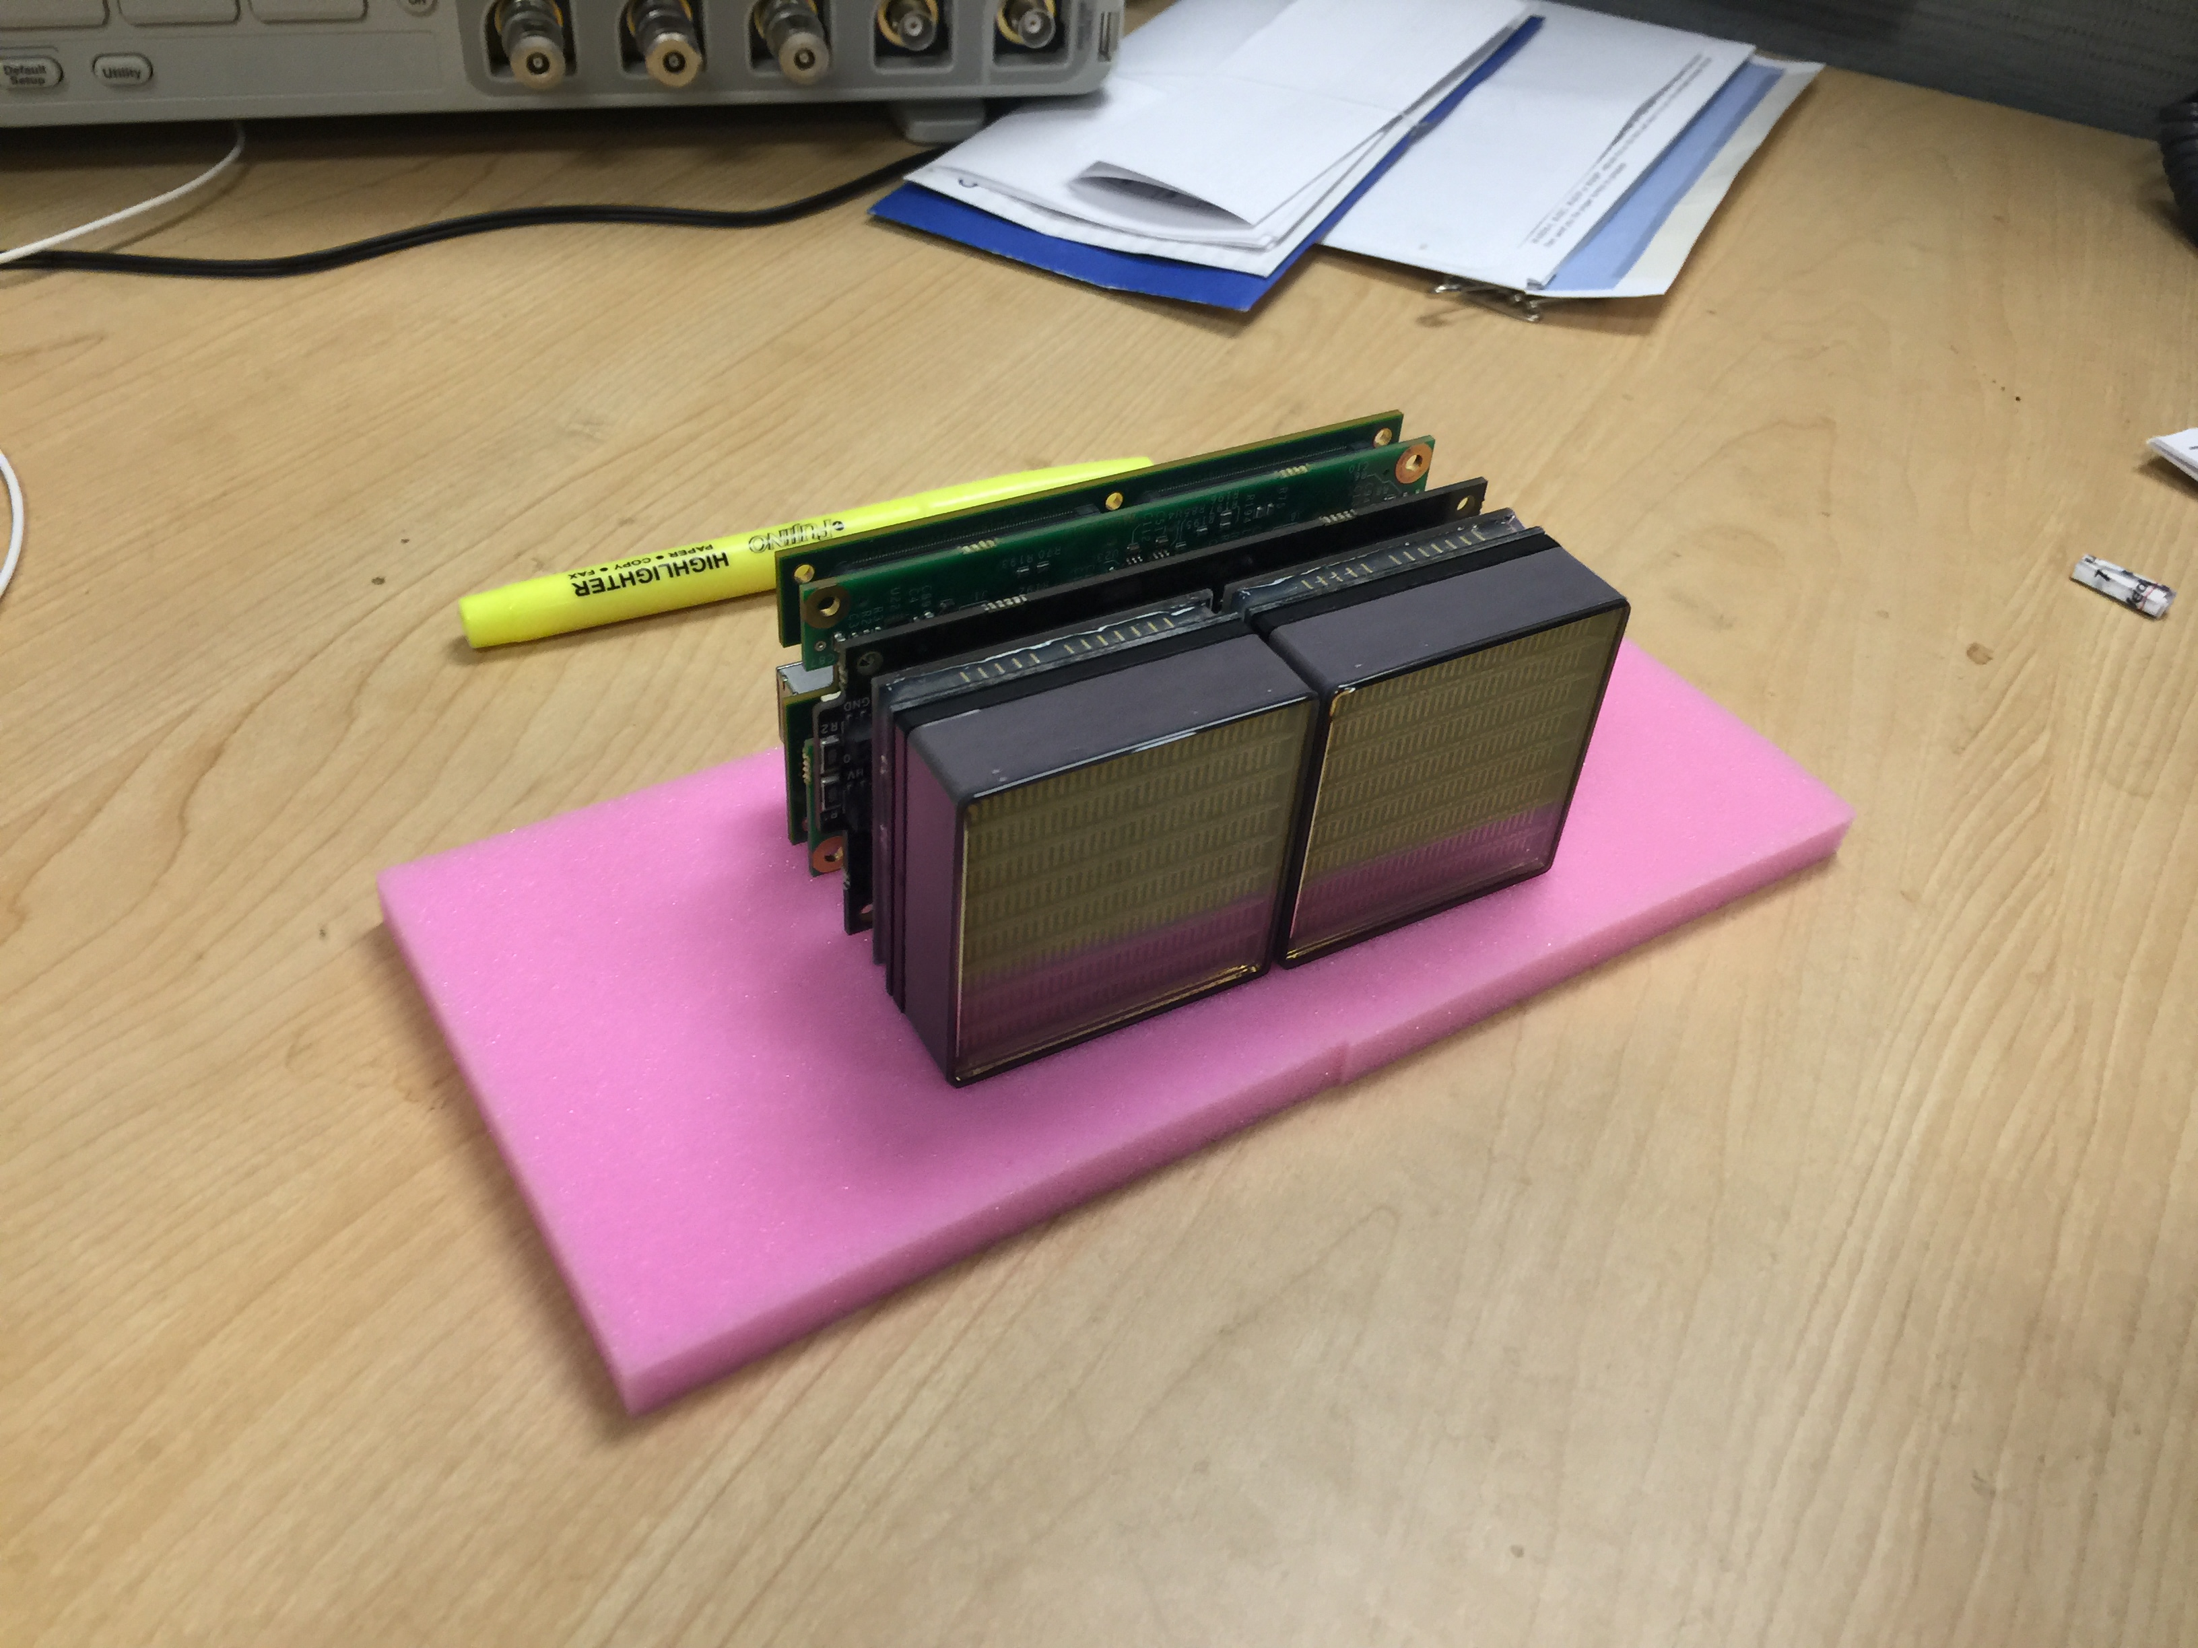
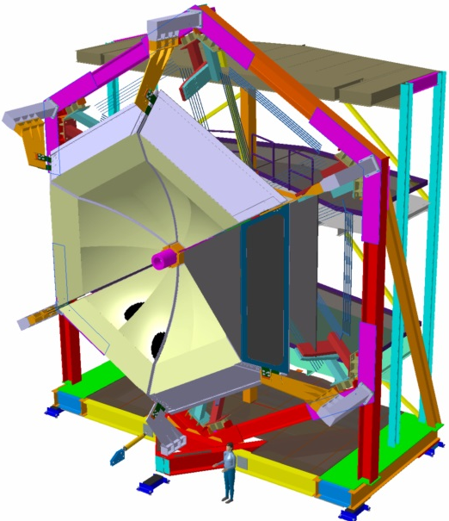
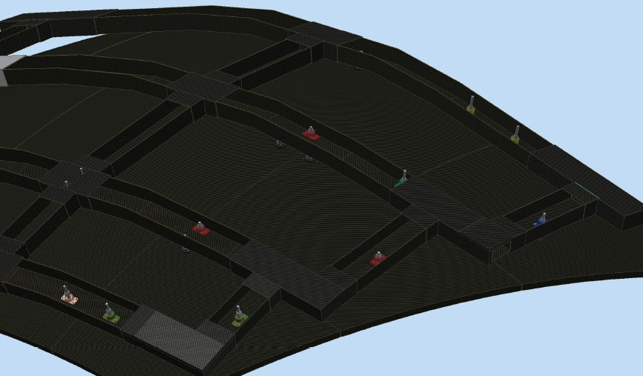
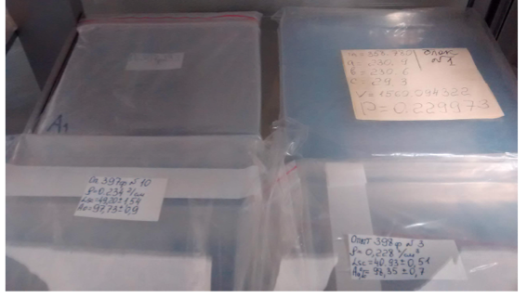
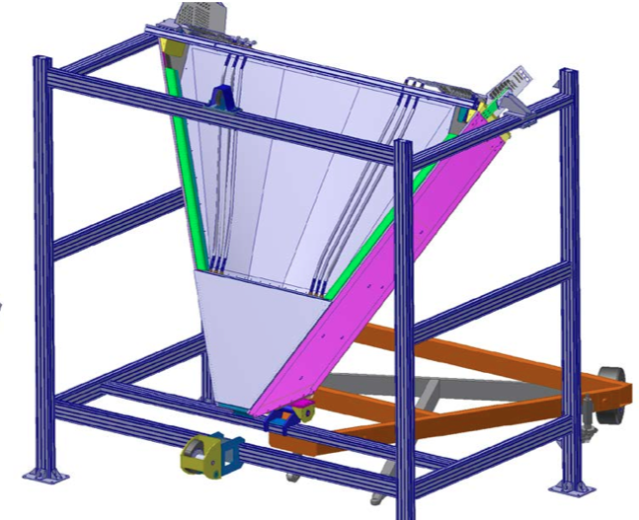
Ring Imaging Cherenkov Counter
All 430 Hamamatsu MA-PMTs delivered to Jlab. Procurement of the front-end electronics started.
Design of the spherical and planar mirrors completed and production of the mirrors started.
First 200 mm x 200 mm aerogel tiles delivered to Jlab.
RICH mechanical structure construction started.
Assembling and installation procedures established.
INFN, JLab, USM, UConn, ANL
1/14/16
UGBoD meeting, JLab January 14, 2016
12

Slide 13
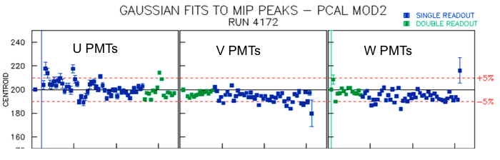
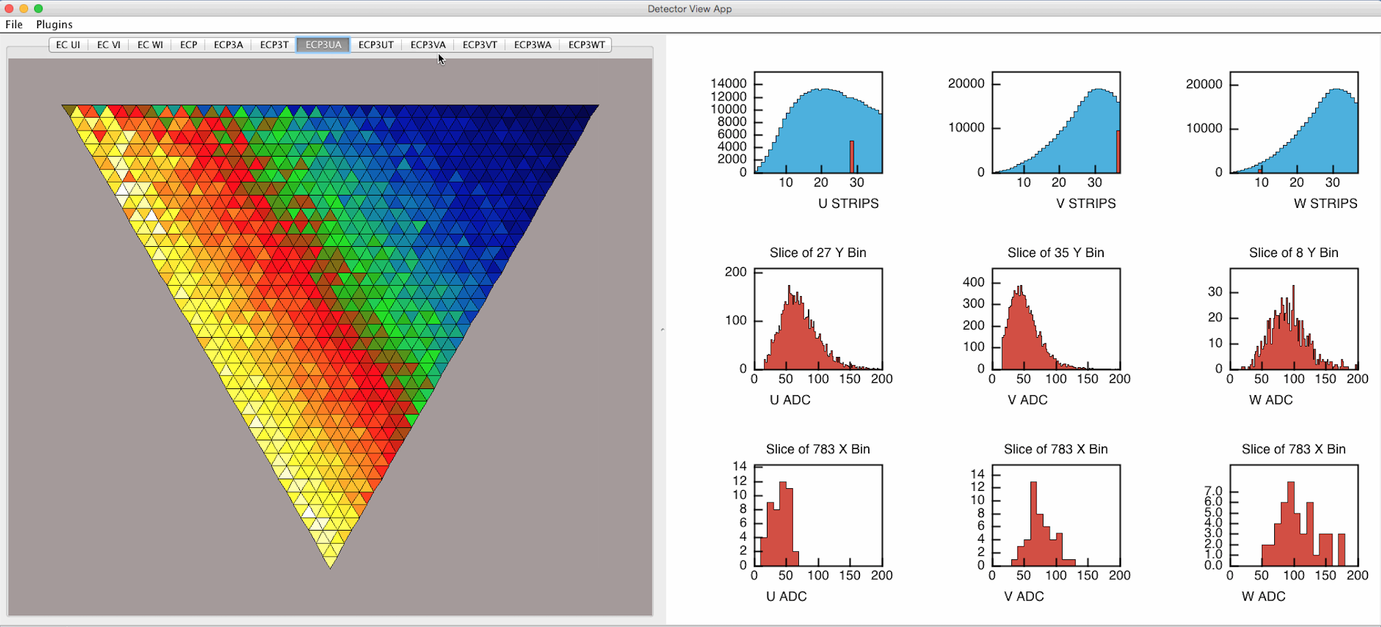
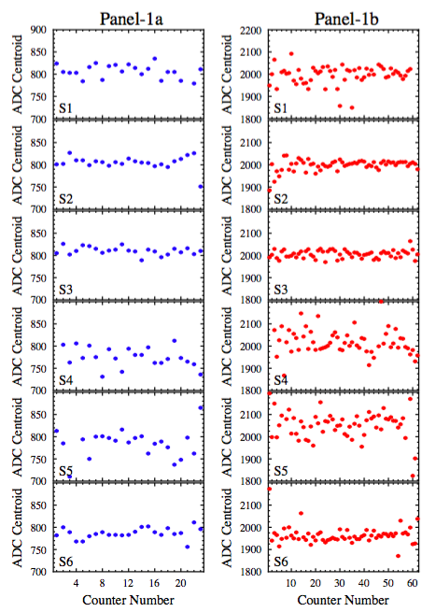
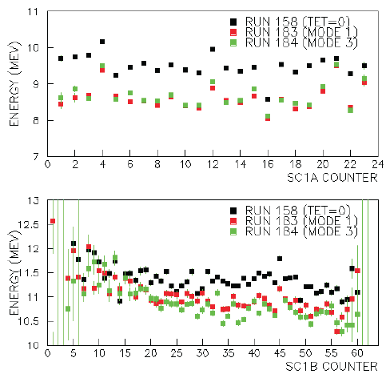
Calibration & Commissioning
CLAS12
Commissioning and calibration of CLAS12 subsystems in progress:
Commissioning With Beam (CWB)
  In progress:
    Revision of CWB plan
    Evaluation of particle rates at 11 and 6 GeV
    Simulation of detector backgrounds
  Focus of next months:
    Documentation and training
    Accurate testing of calibration software
    Detailed planning of online/offline shifts
FTOF EC PCAL | Advanced commissioning/calibration based on cosmics DAQ and FADC debugging in progress Algorithms porting to CLAS12 framework in progress
DC | cosmic ray calibration in progress
HTCC LTCC | PMT single-photoelectron calibration in progress Development of calibration suite started
SVT | Advanced commissioning/calibration stage Cosmic data analysis for alignment in progress Calibration software development within CLAS12 framework
CTOF | Cosmic ray calibration started Software development based on FTOF calibration suite
CND | Initial cosmic ray calibration completed Development of calibration suite started
FT | Initial cosmic ray calibration of FT-Cal completed Calibration suite development within CLAS12 framework
PCAL Gain Matching
EC monitoring GUI
FTOF MIP energy with different FADC readout modes
FTOF Cosmic ray ADC Calibration

Slide 14
Run Group Schedule – Tentative
Run Group | Days | 2015 | 2016 | 2017 | 2018 | 2019 | 2020 | 2021 | Remain
All Run Groups | 936 |  | CND | FT RICH |  |  | Trans. PT | 525 | 411
HPS | 180* | 2-3 | < 15
PRad | 15* |  | < 15 |  |  |  |  |  | ---
CLAS12 KPP |  |  |  | 15
RG-A (proton) | 139* |  |  | 20 50 |  |  |  |  | 69*
RG-F (BoNuS) | 42* |  |  |  | 40 |  |  |  | 2
RG-B (deut.) | 90* |  |  |  | 45 |  |  |  | 45*
RG-C (NH₃) | 120 |  |  |  | 15 | 45 |  |  | 60
RG-C-b (ND₃) | 65 |  |  |  |  | 35 |  |  | 30
RG-E (Hadr.) | 60 |  |  |  |  | 20 | 15 |  | 25
RG-G (TT) | 110* |  |  |  |  |  | 55 |  | 55
RG-D (CT) | 60 |  |  |  |  |  | 30 |  | 30
RG-K (LiD) | 55 |  |  |  |  |  |  | 55 | ---

Slide 15
SUMMARY
CLAS data continue to deliver important science in many areas
HPS took data opportunistically in 2Q 2015 and is planning for more data taking in 1Q 2016.
PRad building up science capability for opportunistic running in 2Q 2016.
All but one CLAS12 detectors are complete. CTOF expected to be complete this summer.
Superconducting Torus magnet on track for operation late spring. Solenoid delayed but expected to arrive in late summer 2016 for assembly with the cryogenic service tower.
CLAS12 Upgrade lead by European collaborators (Central Neutron Detector, Forward Tagger, Micromegas, RICH) are well on-track, several detector components being tested at JLab.
Software development on track to be ready on “Day 1” (9/2016). Planning for first physics run underway.

Slide 17
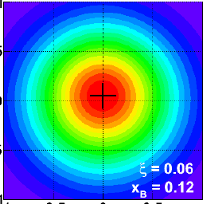
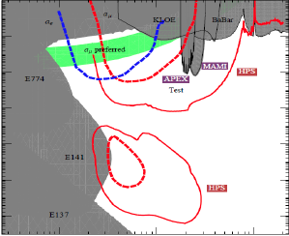
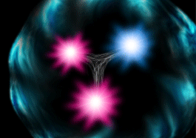
Plans for first years of Beam in Hall B
5 A-rated experiments in early running: HPS, PRad, pDVCS, nDVCS, pSIDIS, g₁^{p}/g₁^{n}
Construction & Installation
Commissioning & early 11 GeV Experiments
< 6 GeV beam
Installation
pDVCS & GPDs
pSIDIS &TMDs
neutron F2
g₁^{p} , g₁^{n} - large x
spin structure
QCD in nuclei
11 GeV
nDVCS & GPDs
nSIDIS & TMDs
CY 2015
CY 2016
CY 2017
CY 2018
CY 2019

Slide 18
Hall B
Physics Publications in refereed Journals
 | HSWG | DPWG | NPWG | ALL
2000 | - | 1 | 1 | 2
2001 | 2 | 3 | - | 5
2002 | 3 | - | 1 | 4
2003 | 7 | 4 | 1 | 12
2004 | 3 | 3 | 4 | 10
2005 | 7 | 3 | 2 | 12
2006 | 8 | 4 | 3 | 15
2007 | 7 | 2 | 3 | 12
2008 | 4 | 6 | 2 | 12
2009 | 8 | 7 | 4 | 19
2010 | 4 | 2 | 4 | 10
2011 | 3 | 1 | 4 | 8
2012 | 6 | 3 | 2 | 11
2013 | 8 | 6 | 2 | 16
2014 | 5 | 6 | 1 | 12
2015 | 4 | 5 | 3 | 12
2016 | (2) | (1) |  | (3)
SUM | 79 | 56 | 37 | 172
5
10
15
publ
subm.
updated 4 Jan 2016

Slide 19
Hall B Schedule for 2016
Heavy Photon Search (HPS) experiment (tent.) 1Q CY16
Proton Radius (PRad) experiment (tent.) 2Q CY16
Bringing CLAS12 Torus magnet online 2Q CY16
Bringing CLAS12 Solenoid magnet online 4Q CY16
CLAS12 Forward Detector Installation 1Q-4Q CY16
CLAS12 SVT & Upgrade Detectors 4Q CY16/1Q17
Preparations for CLAS12 KPP run in 1Q CY17
Preparations for CLAS12 engineering run in 2Q CY17

Slide 20
Commissioning and 1st experiment
CLAS12 software and detector commissioning and calibration
  Continuous progress for all systems
  Simulation and reconstruction is in very advanced stage
  Software first release May 2015
  Calibration in advanced stage for the forward carriage detectors and SVT, being finalized for the other systems.
  Detector alignment studies underway
  Aiming at first version of calibration suites by Spring 2016 to allow for at least 6 months of validation, improvements, documentation, tutorial and training
Commissioning with beam (CWB) and preparation of the first experiment
  CWB program developed and reviewed Jan 2015
  First collaboration workshop for the first experiment preparation October 2015
  Organization in place
  In progress:
    Revision of CWB plan underway
    Detailed schedule for the remaining online and offline tasks being refined
    Tools : Software validation, documentation and tutorial in preparation

Slide 21
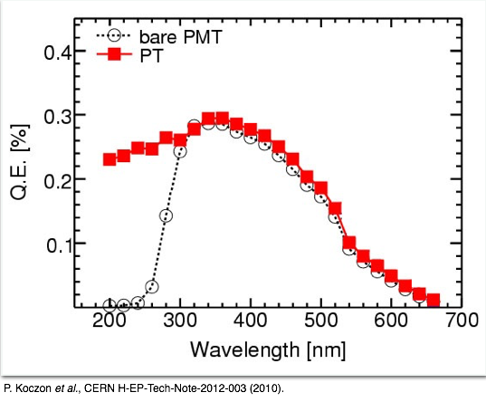
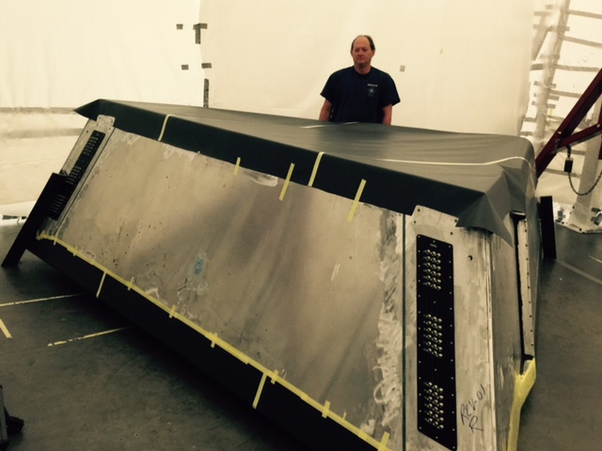
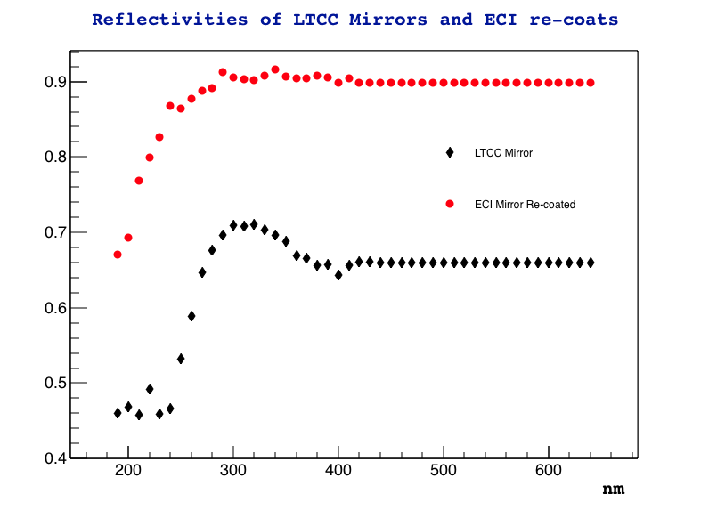
Low Threshold CC Status
CLAS12
  Hardware:
    Mirrors coating completed.
    PMTs refurbished.
    150 WC re-coated.
    New spine, new window, new patch panel.
    New in-base divider + amplifier.
Status as of 1/14/2016:
All 6 LTCC boxes completed. Box #6 being leak-checked.
LTCC detector #6 being gas sealed.
q.e. improvement with p-terphenyl
Typical before/after mirror reflectivity
1/11/2016

