Slide 1


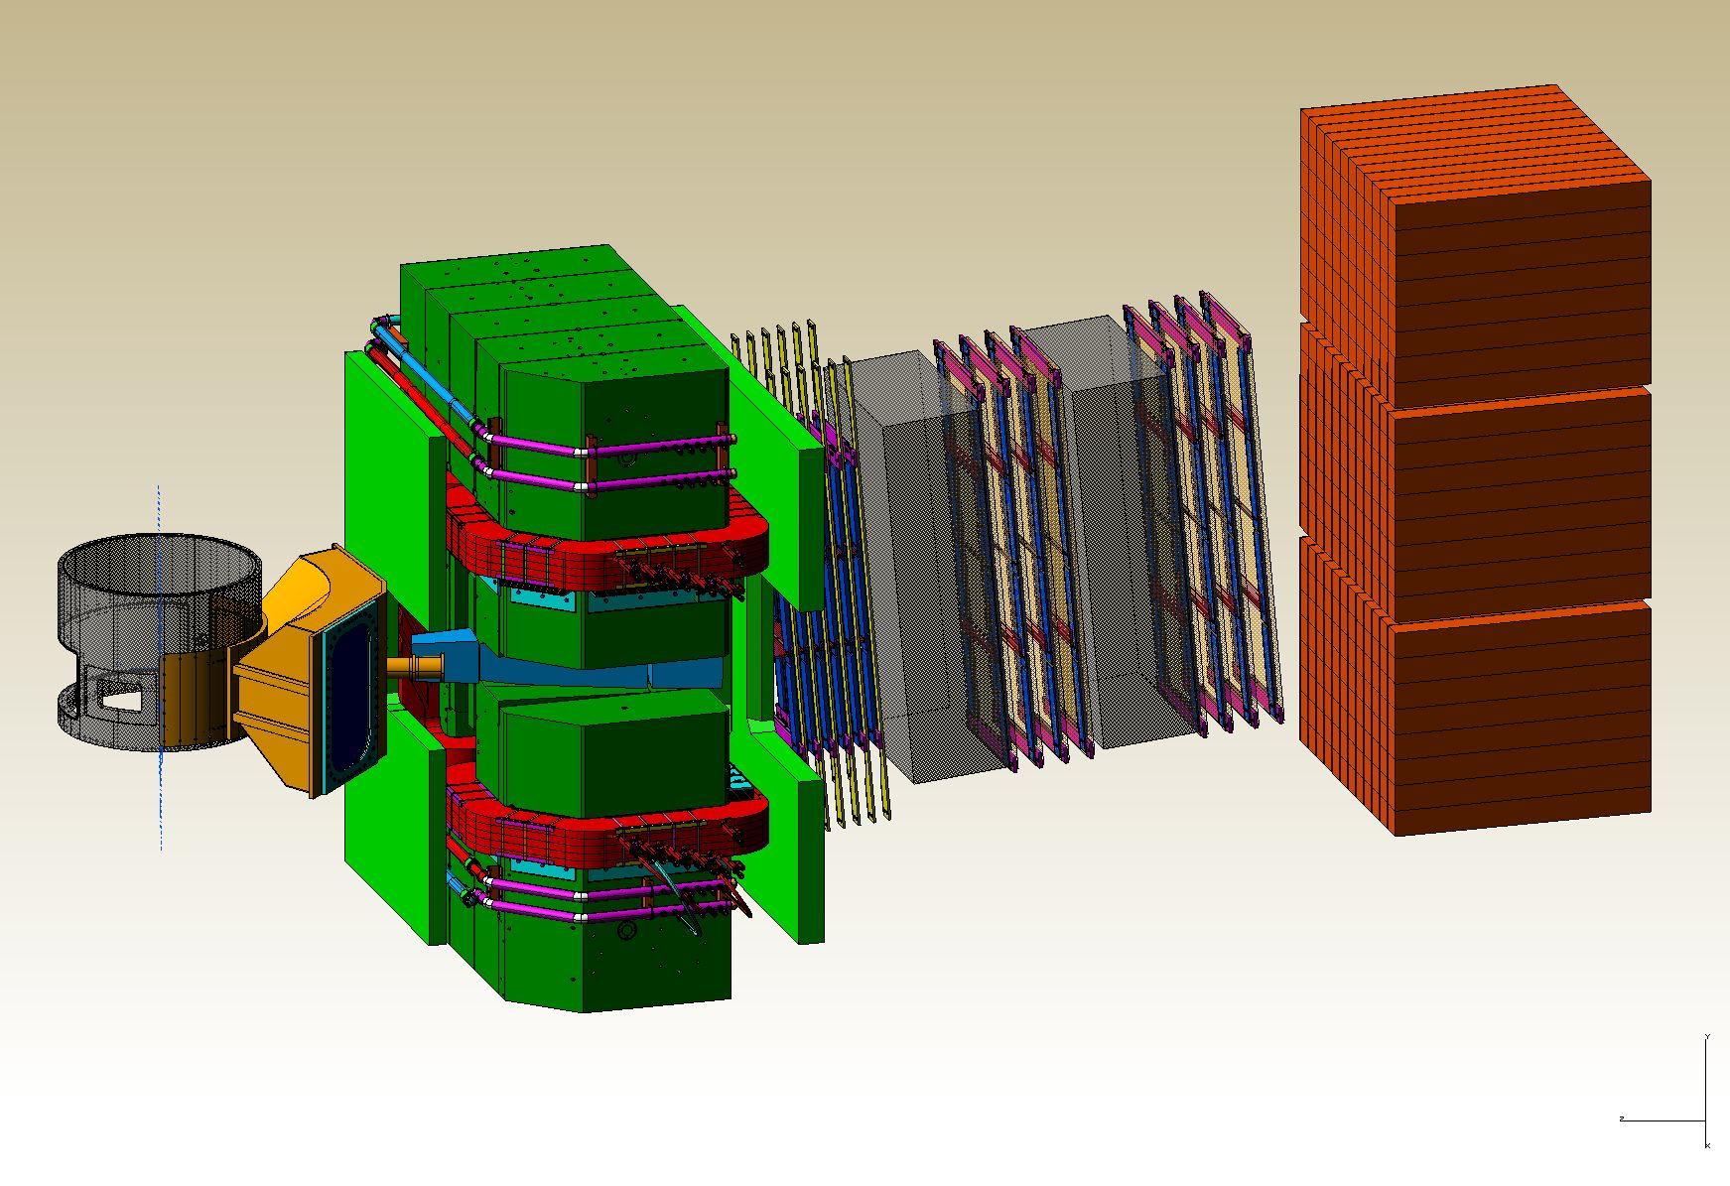
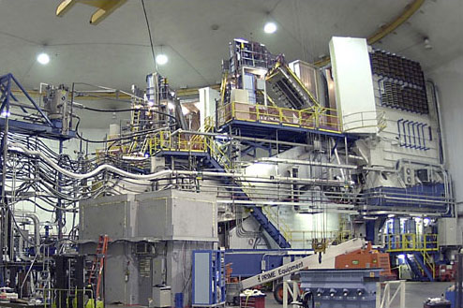
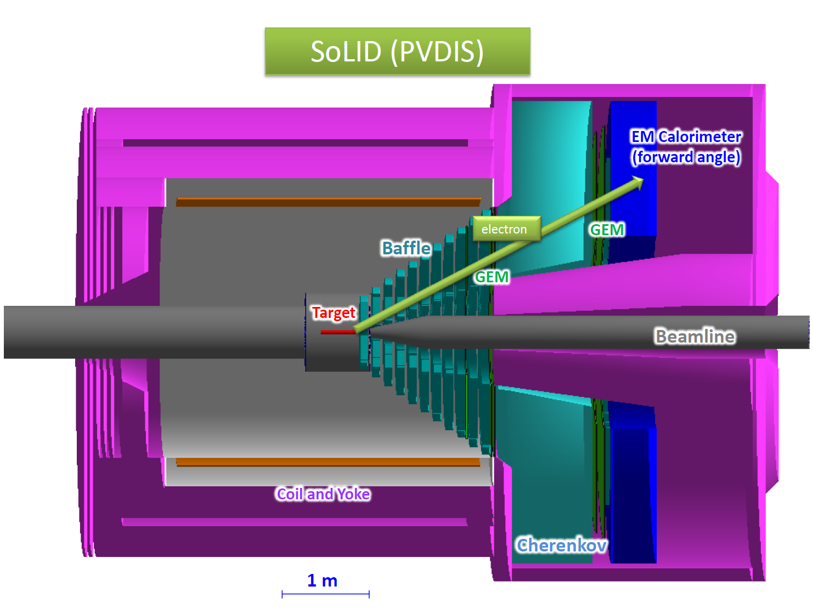
Hall A Update
Thia Keppel
User Group Board of Directors
January 2016

Slide 2
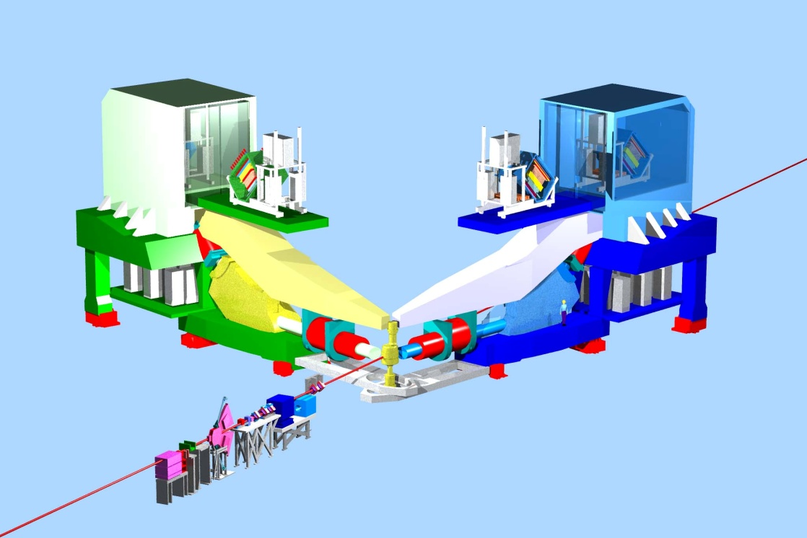
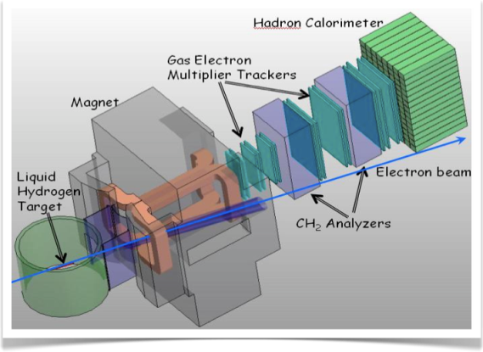
Hall A Planning - old
3 A-rated experiments in first years of running
G_{M}^{p} (HRS-R) and DVCS (HRS-L + calo) run is combined
Some flexibility incorporated
16 mo. Shutdown
12 GeV Commissioning
Early Experiments
DVCS-I and G_{M}^{p}
³H/³He APEX/PREX (A1n)
Access to GPDs
Photon calorimeter to be installed on floor
EM Form Factor
d/u at High x
Requires tritium target, venting system and BigBite spectrometer
Dark photon A’/Neutron skin
Both require additional small angle septum magnets
Neutron spin structure
Polarized 3He target
12 GeV Projects:
1. Moller polarimeter
2. Compton polarimeter
3. Energy measurement upgrade
SBS Experiments
EM Form Factors
at high Q²
SBS Project
11 GeV
SuperBigbite
Spectrometer
Beam 1st to Hall A
FY 2013
FY 2014
FY 2015
FY 2016
FY 2017
commissioning beam

Slide 3
Hall A Planning - now
3 A-rated experiments in first years of running
G_{M}^{p} (HRS-R) and DVCS (HRS-L + calo) run is combined
Some flexibility incorporated
16 mo. Shutdown
12 GeV Commissioning
Early Experiments
DVCS-I and G_{M}^{p}
³H/³He APEX/PREX (A1n)
Access to GPDs
Photon calorimeter to be installed on floor
EM Form Factor
d/u at High x
Requires tritium target, venting system and BigBite spectrometer
Dark photon A’/Neutron skin
Both require additional small angle septum magnets
Neutron spin structure
Polarized 3He target
12 GeV Projects:
1. Moller polarimeter
2. Compton polarimeter
3. Energy measurement upgrade
SBS Experiments
EM Form Factors
at high Q²
SBS Project
11 GeV
Beam 1st to Hall A
SuperBigbite
Spectrometer
FY 2013
FY 2014
FY 2015
FY 2016
FY 2017
commissioning beam

Slide 4
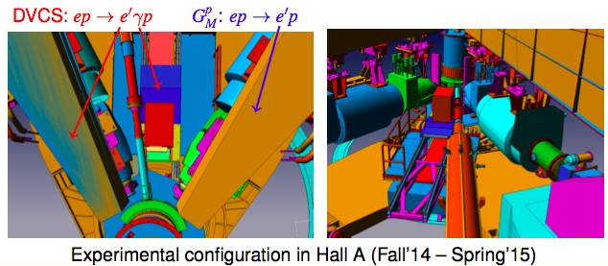
Hall A over the past year
Spring 2015:
E = 9.6 GeV, then E = 2.2 GeV (no physics)
New raster system commissioning
BPM & BCM calibrations
Compton polarimeter commissioning
HRS optics calibrations (R-HRS with SOS quad)
Target boiling studies
Fall 2015:
(no planned physics, so no target or
  spectrometers)
11 GeV successfully delivered to Hall
High current (up to ~55+ uAmps,
many trips at highest current)
New high field Moller polarimeter
  commissioning
Parity beamline instrumentation tests
Beam delivered through Compton
chicane
Now ready for physics!
Notes:
F2 and C12 scans good for acceptance studies

Slide 5
DVCS-I and G_{M}^{p}: Concurrent Experiments in Hall A at 11 GeV
10 calendar weeks in Spring’16
High impact experiment for 3D nucleon imaging
  Deeply Virtual Compton Scattering (DVCS) provides access to Generalized Parton Distributions (GPDs)
Will provide highest available Q² measurement of the DVCS cross section
  Demonstration of scaling critical to full JLab 12 GeV GPD program
DVCS
6.6
8.8
11 GeV
Fall’14
x
x
x
2
3
1 days
G_{M}^{p}
x
x
x
x
6.6
8.8
11 GeV
5 days
4
4
4
x
x
x
x
8.8
11 GeV
13
16 days
13
20
High Q² Form Factors
  Reducing G_{M}^{p} uncertainties will enable Super BigBite high impact program of Form Factor Measurements

Slide 6
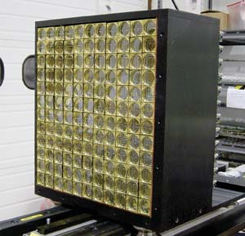
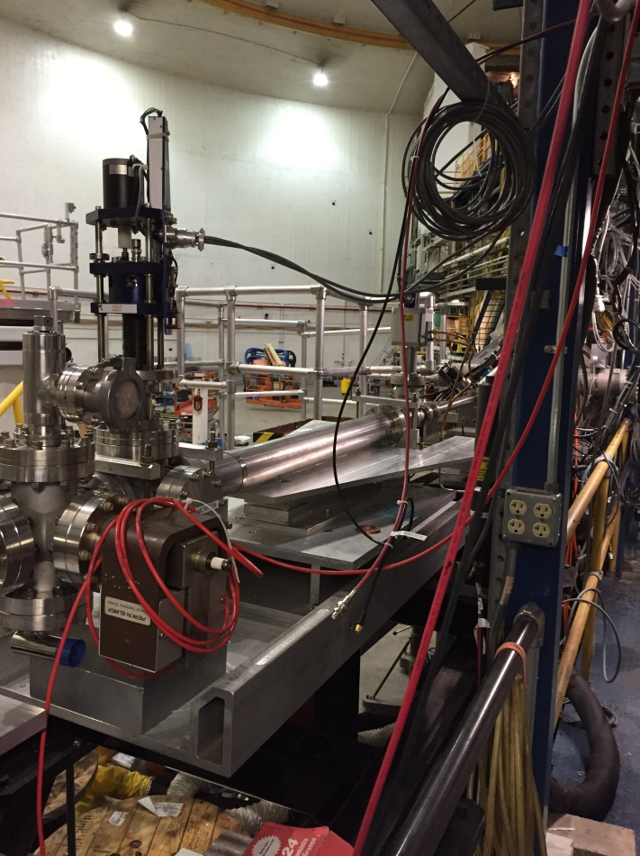
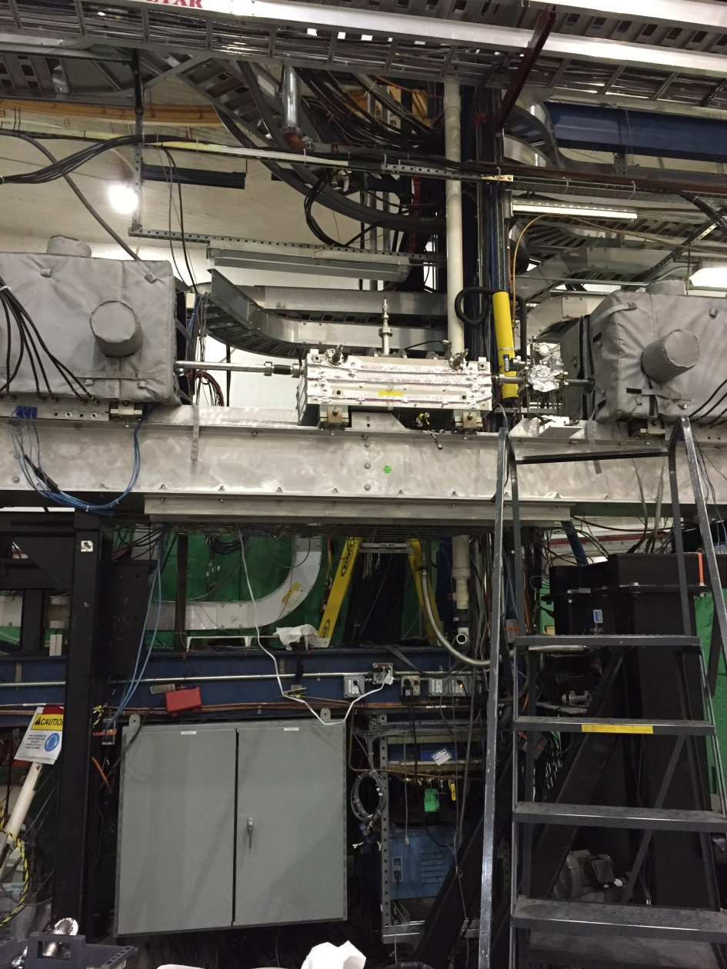
DVCS / G_{M}^{p} Experiments in the Hall now
Started up with the lab Fall 2014
Start up again February 4 with 20 uAmp, 11 GeV beam
Q1-R permanently replaced with old SOS quad
Problems with HRS Q1-L a concern
New Moller polarimeter, additional beamline instrumentation
New target test cell
Notes:
F2 and C12 scans good for acceptance studies

Slide 7
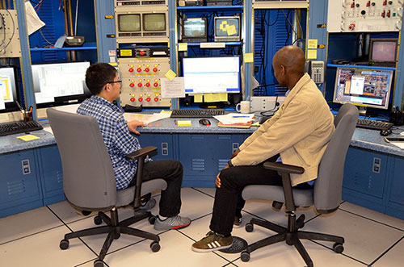
10 graduate students on site
DVCS, in no order…
ODU :Stacey Lee Allison and Hashir Rashad
OHIO: Mongi Diamini, Bishnu Karki
IPN Orsay : Frederic Georges
CMU : Alexa Johnson
GMp, in no order…
MIT: Barak Schmookler and Longwu Ou
W&M: Yang Wang
Hampton: Tir Gautam

Slide 8
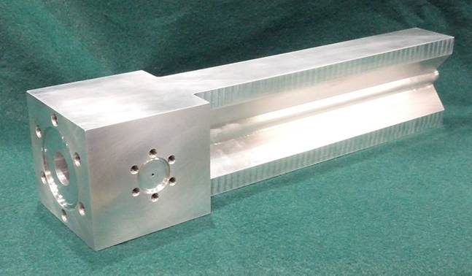
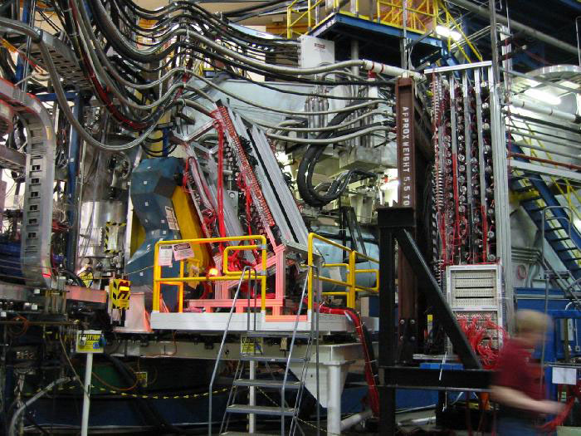
Tritium Experiment Preparations
Four experiments approved by PAC 42, 2 PAC 40 “high impact”
Successful target safety/design review September 2015
  Still a lot to do!
  Integration into the Hall
Combined experiment planning meeting December 2015
  Prepare for ERR
BigBite under (re-)construction in test lab
  Modified Cerenkov
  Plan to add SBS GEM plane
  Might not be used (meeting tomorrow!)

Slide 9
11 ³H graduate students on site (+1)
In no order…
Jason Bane (University of Tennesse) [DIS]
Shujie Li (UNH) [x>1]
Dien Nguyen (UVA ) [x>1]
Tyler Hague (Kent State)
Michael Nycz (Kent State)
Sheren Alsalmi (Kent State) [DIS]
Tong Su (Kent State) [DIS]
Cohen Erez (Tel Aviv University) [QE]
Danning Di (UVA) [DIS]
Scout Barcus (W&M) [Elastic]
TBD (ODU) [QE]

Slide 10
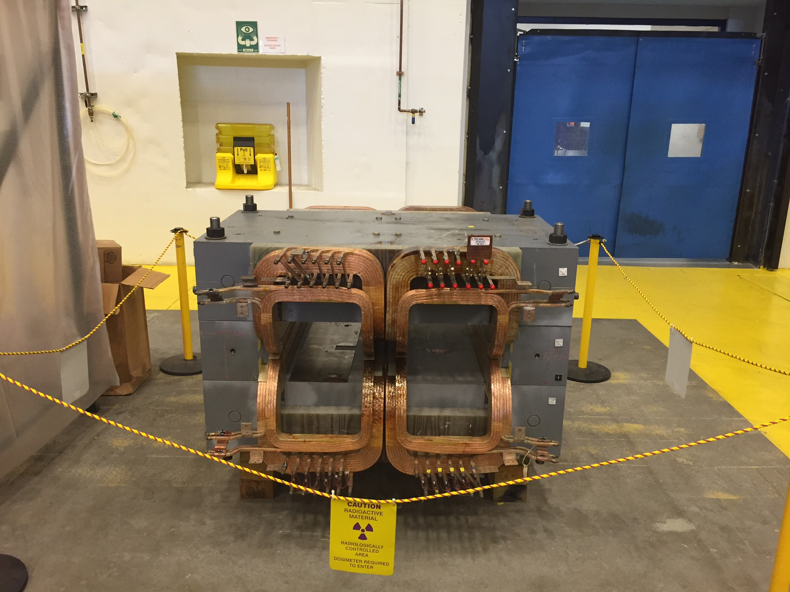
Beyond ³H
    Polarized ³He target improvements and continued development
        Convection, new lasers, metal windows, …
        Design report in January
    PREX/CREX
        Pb and diamond targets, new coils purchased (and here at lab)
        Combined target chamber, shielding designs underway
        Computation fluid dynamics for target design
        Beamline upgrades completed
          Second x,y,Q girder (from Hall C), new “Musson” cavity electronics, Hall C halo monitor installed in A, lumi monitors installed and first pass tests started
        Polarimetry
          Plan to continue to test Compton in Spring 2016 Run
          New high field Moller commissioning started
    APEX
        New septum magnet purchased by collaboration now in test lab
        Shielding designs underway
        Computation fluid dynamics for target design

Slide 11
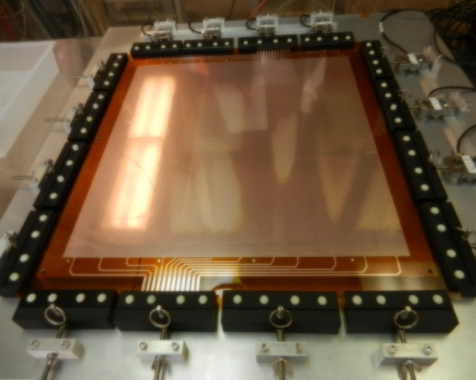
SBS Construction
Project started October 2013
  Successfully passed third annual review November 2015
  Some concerns about thermal annealing/design of ECAL and 3He target timelin
  Overall very positive, project on track
Spectrometer, ECAL work at JLab
  Power Supply in hall
  48D48 magnet modified, assembled, tested in test lab
  Working on support, stand (here at lab) beamline
GEM construction at UVA
Coordinate detector at Idaho State
HCAL Hadron calorimeter at CMU and Jlab (103/288 modules)

Slide 12
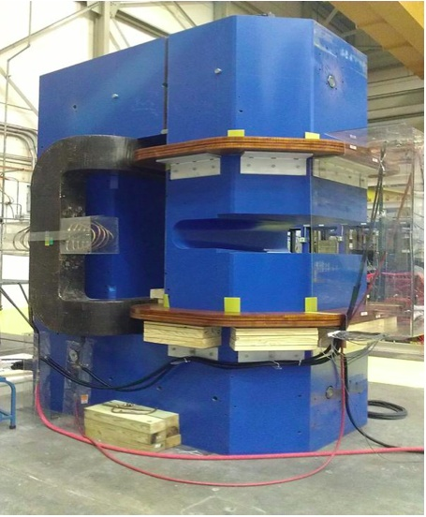
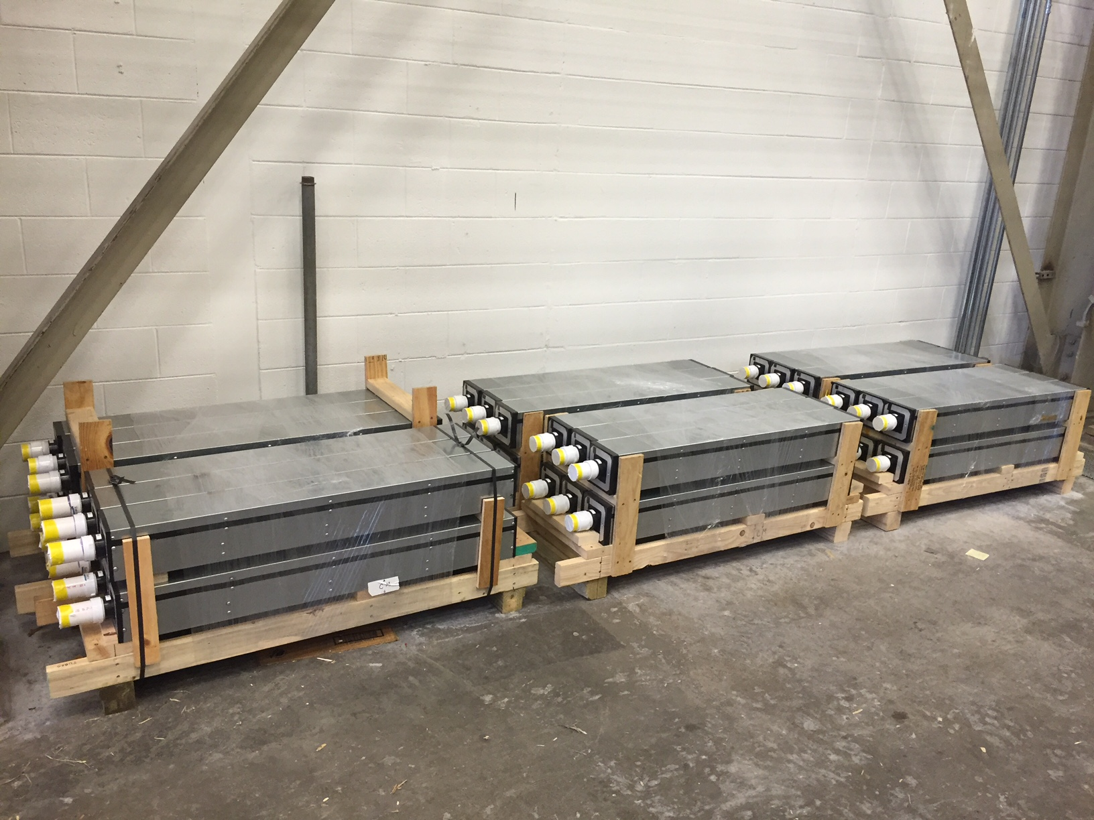
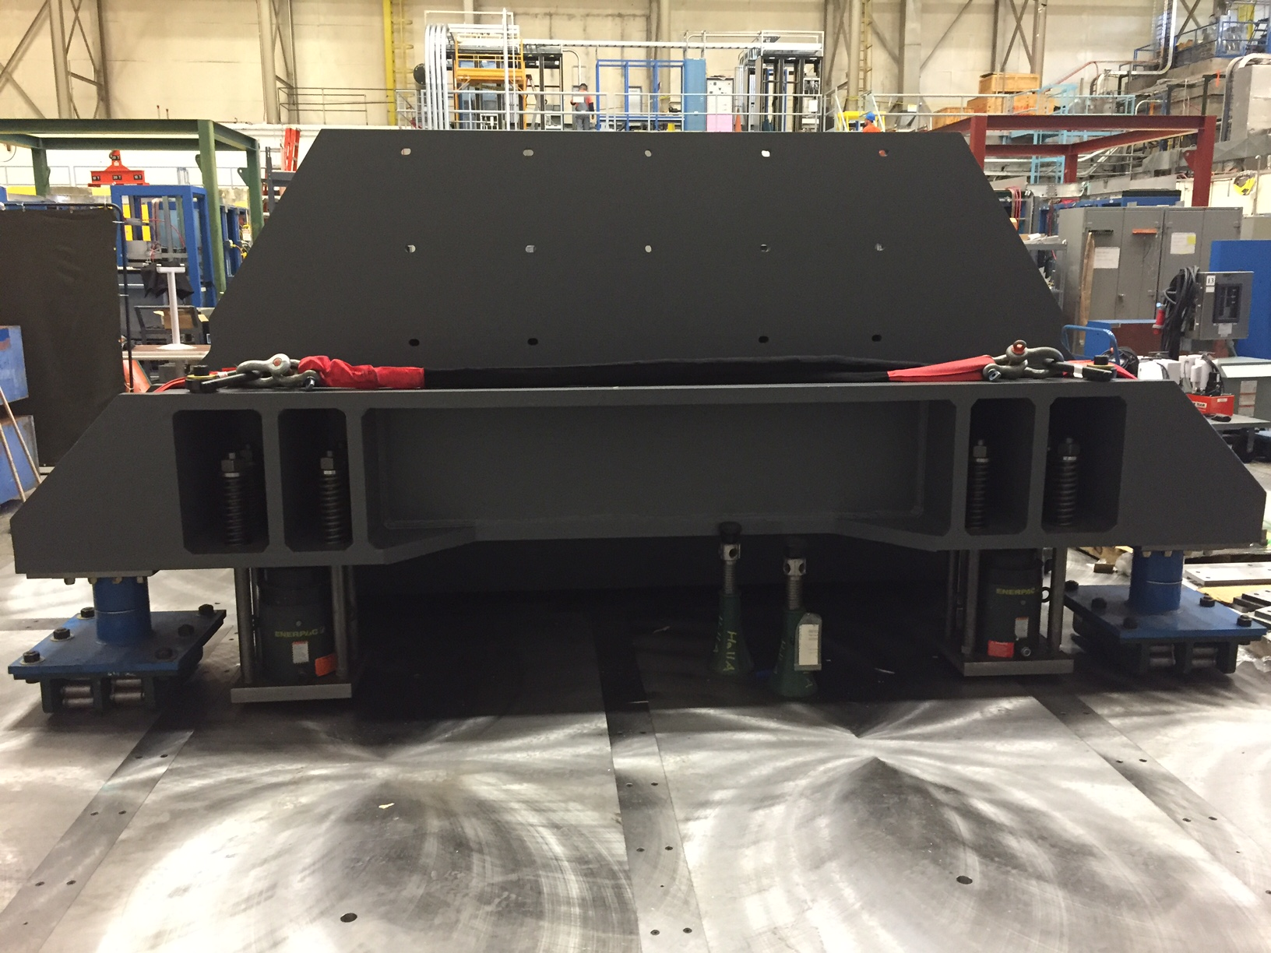

Slide 13
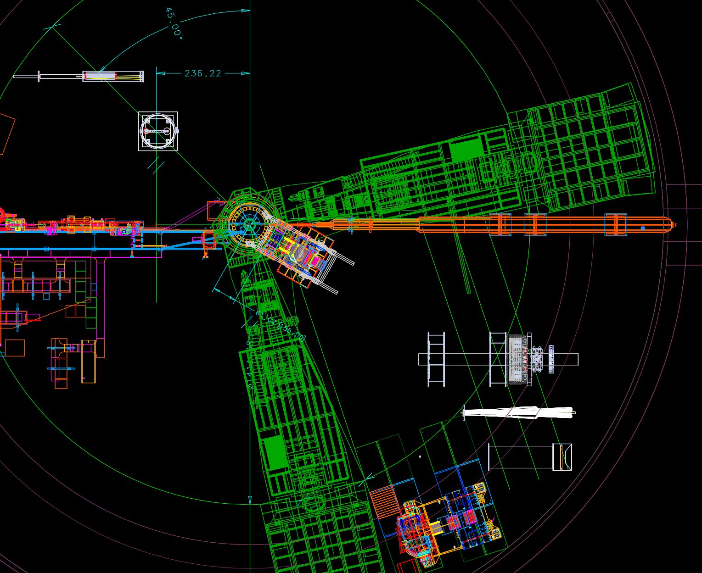
Moving to more future installations – MOLLER and SoLID

Slide 14
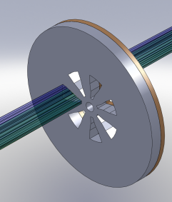
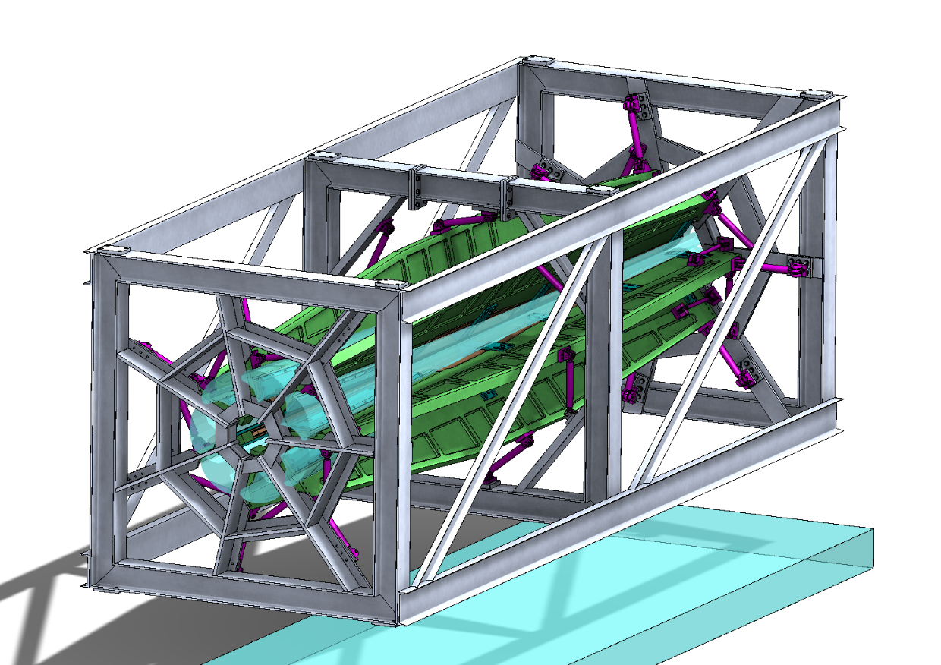
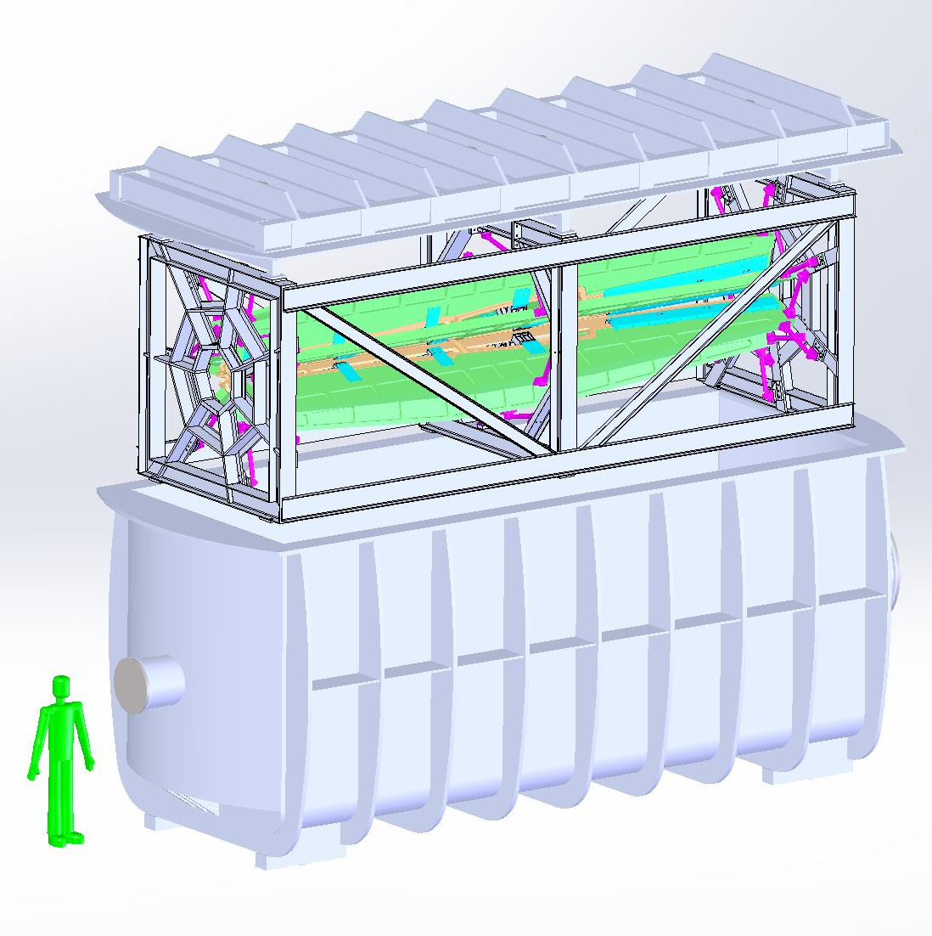
MOLLER
    Successful Science Review September 2014
    Supporting ongoing magnet and collimator development work at MIT
    New Moller polarimeter (in place)
    Anticipate Director’s cost, schedule, technical review in 2016
      Working on updating documentation
      Advanced conceptual design
    Looking towards CD0

Slide 15

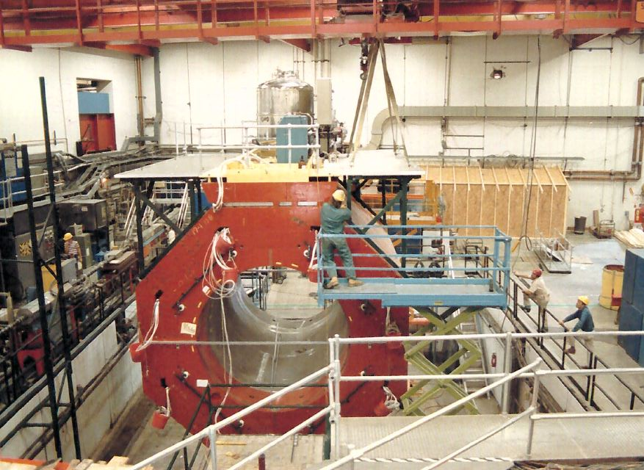
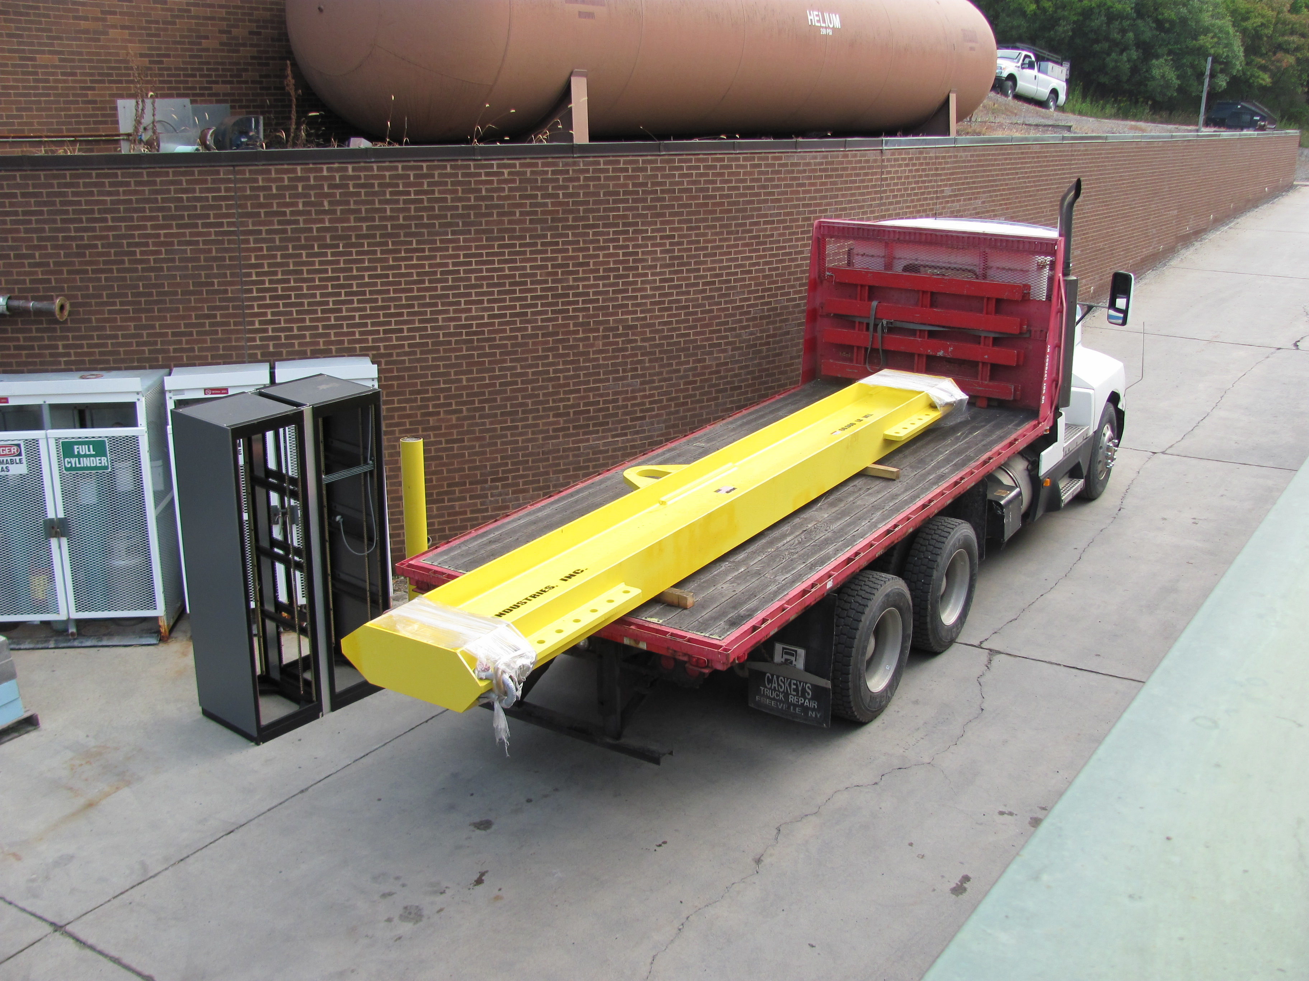
SoLID
    Director’s Review February 23,24, 2015
    Continued detector optimization
      Background studies
      Magnetic fields
    Cornell to disassemble solenoid through Summer 2016
      Assist and observe (Ed Folts Fall 2015 trip)
      Anticipate move to JLab Fall CY 2016
    Looking towards Science Review in 2017, CD0 in 2019

Slide 16
Questions?

Slide 17
Hall A Projected Experiment Schedule, updated 2/2015
Experiments in red represent PAC42 “high impact” experiments
Spring | Fall | Spring | Fall | Spring | Fall | Spring | Fall
DVCS –I/ GMp | DVCS –I/ GMp
 |  | DVCS –I/ GMp | ³H/³He group Ar(e,e’p)
 |  |  |  | ³H/³He group Ar(e,e’p) | TBD: APEX PREX12 CREX A₁^{n} DVCSII | TBD: APEX PREX12 CREX A₁^{n} DVCSII
 |  |  |  |  |  |  | SBS Start?
run “group”
run “group”
CY
2015
X
CY 2016
CY
2017
CY
2018

Slide 18
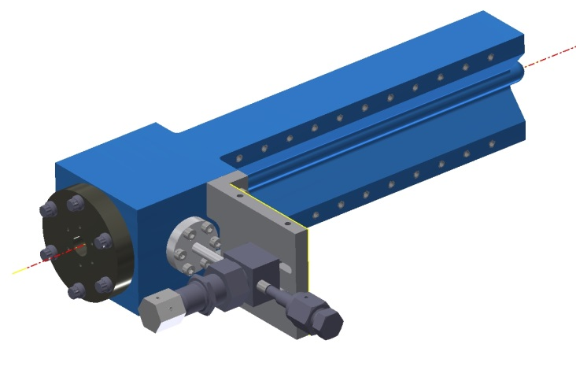
Jefferson Lab Tritium Target
Single “sealed” cell containing ~1100 Ci (0.11 g) of T2 gas
Filled at SRTE facility at SRS and shipped to JLAB
Conservative design philosophy
  Operational safety factors in excess of 10
  Design pressure ~200 psi at 295K
  Minimizing amount of T2 required
25 cm long with ID of 12.7mm
Cryogenically cooled to 40K by conduction

