Slide 1

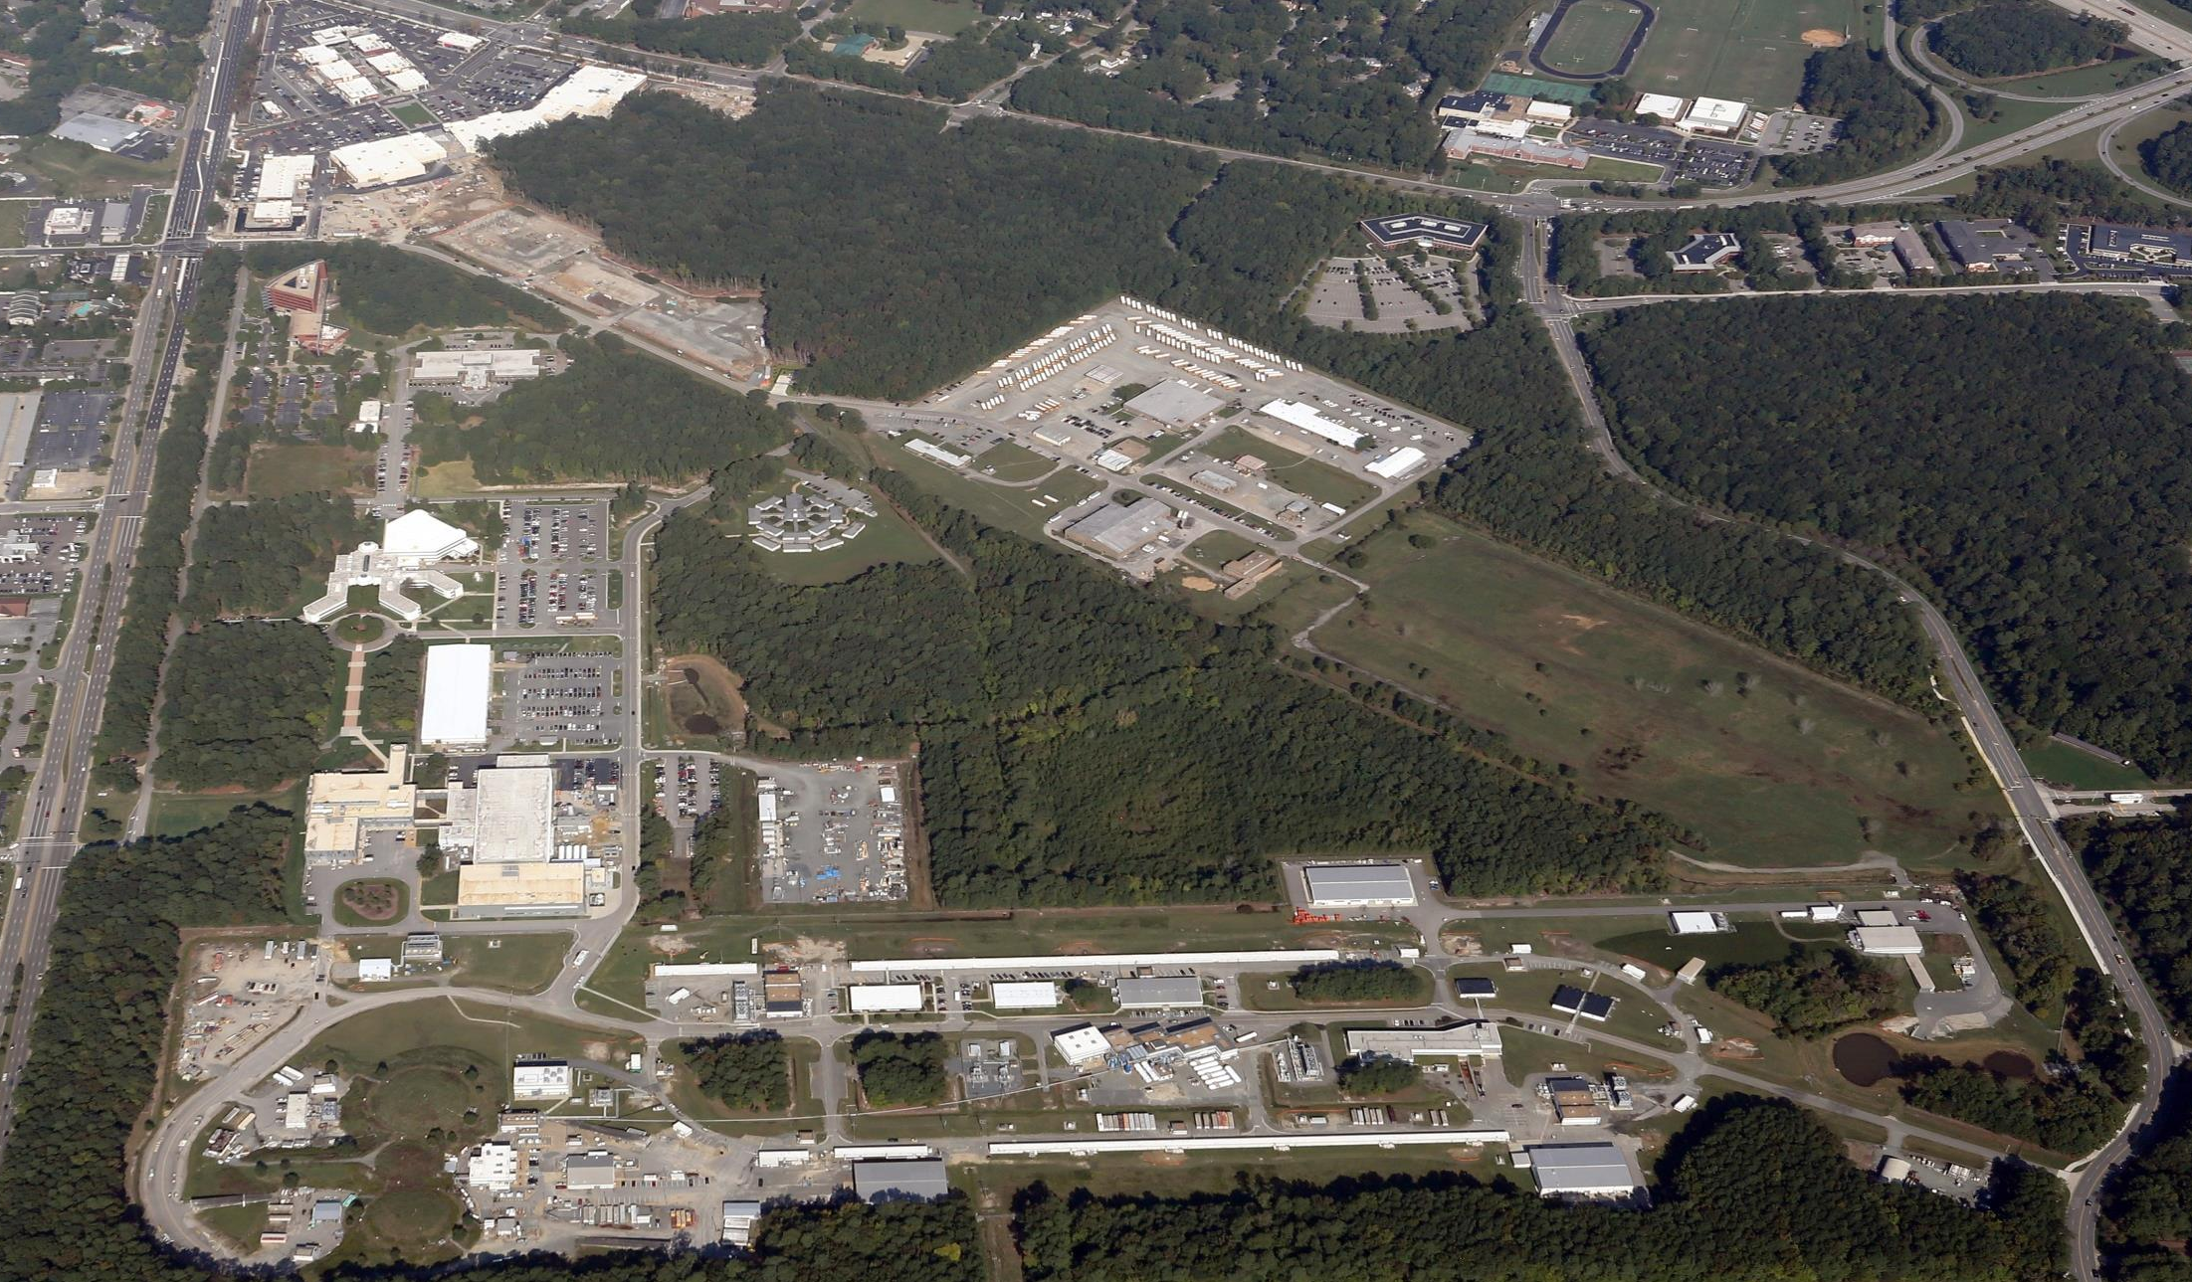
Jefferson Lab Status
Hugh Montgomery
Jefferson Lab Users Group Board of Directors, January 2016

Slide 2
Outline
Awards, Personnel News
12 GeV Upgrade Project Status
Science and Technology Review 2015
Funding
Land Status

Slide 3
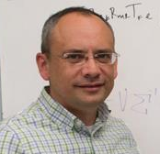


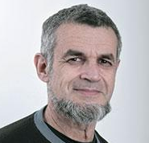
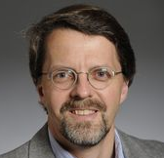
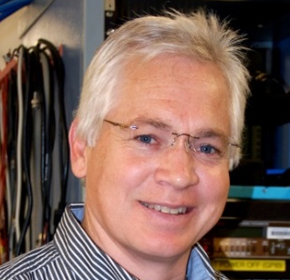
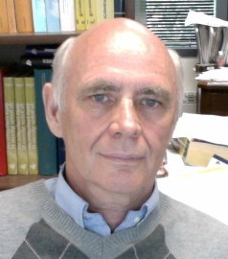
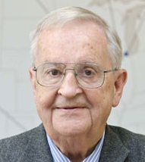
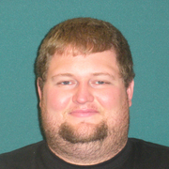
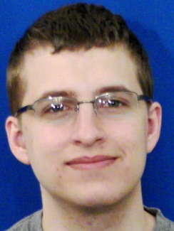
Awards
APS Fellows
Kostas Orginos (Jefferson Lab & College of W&M)
Xiaochao Zheng (Univ. of Virginia)
Peter Blunden
(Univ. of Manitoba)
Eli Piasetzky
(Tel Aviv University)
Reinhard Schumacher
(Carnegie Mellon Univ.)
Matt Poelker
(Jefferson Lab)
SESAPS 2015 Jesse W. Beams Research Prize
DNP Mentoring Award
DOE Office of Science
Graduate Student Research Program Awards
Anatoly Radyushkin
(Jefferson Lab & ODU)
Dirk Walecka
(Jefferson Lab Emeritus
& College of W&M)
Jason Bane
(Graduate Student –
Univ. of TN)
Matthew C. Burton
(Graduate Student – College of W&M)
Luke A. Robison
(Graduate Student – Northwestern Univ.)

Slide 4
Personnel News
Assistant Director
  Allison Lung
  Concentrating on resource management
Electron Ion Collider Physics Leadership
  Rik Yoshida (ex ZEUS, ATLAS, ANL) to join Jefferson Lab as leader of our EIC Physics Group
    In Exp. Physics Division
    Reporting to Bob McKeown
Chief Operating Officer
  Interviews scheduled for February
Head of Theory
  Position advertised
  Co-chairs Joe Carlson, LANL & Bob McKeown, Jefferson Lab.
  Members will be Charlotte Elster (Ohio U.), Franz Gross (Jefferson Lab emeritus), Frithjof Karsch (Bielefeld U. & BNL), Krishna Rajagopal (MIT), and Feng Yuan (LBNL)
  Input is requested

Slide 5
Accelerator Advisory Committee
Charter
The Jefferson Lab Accelerator Advisory Committee is asked to look at activities related to CEBAF Operations, the Jefferson Lab EIC proposal, and accelerator-related R&D. There are three primary topics for review and discussion:
1. CEBAF Operations
2. Jefferson Lab EIC
3. Accelerator-related R&D
Committee
Chair: Norbert Holtkamp (SLAC, Chair)
Oliver Bruning (CERN)
Wolfram Fischer (BNL)
Richard Milner (MIT)
Yoshishige Yamasaki (MSU-FRIB)
Eric Prebys (FNAL)
Marion White (ANL)

Slide 6
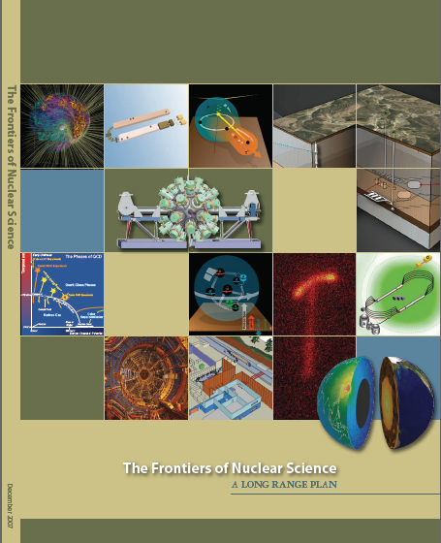
12 GeV Upgrade Project
Completion of the
12 GeV CEBAF Upgrade was ranked the highest priority in the 2007 NSAC Long Range Plan.
Upgrade is designed to build on existing facility: vast majority of accelerator and experimental equipment have continued use.
New Hall
Upgrade arc magnets
and supplies
Add 5 cryomodules
20 cryomodules
CHL upgrade
Add arc
20 cryomodules
TPC = $338M
ETC = ~$11M
Add 5 cryomodules
Project Scope (~96% complete):
Doubling the accelerator beam energy - DONE
New experimental Hall D and beam line - DONE
Civil construction including utilities - Done
Upgrades to Experimental Halls B & C - ~92%
Enhanced capabilities
in existing Halls
Maintain capability to deliver lower pass beam energies: 2.2, 4.4, 6.6….

Slide 7
Accelerator Performance
Fall 2015 Run
  12 GeV CW beam has been delivered to Hall D
  70 microamps of 11 GeV CW beam (770 kW) has been delivered to Hall A
  The RF trip rate of ~5 per hour with “spring 2016” running conditions has been established
  Beam emittance within the “initial years” specification has been achieved
  11 GeV beam separation has been demonstrated.
All conditions requested for Spring 2016 Run achieved.

Slide 8
Office of Science Projects
LCLS II
  CD1, and CD3 long lead approvals obtained
    Jefferson Lab lead: Joe Preble appointed
    Jefferson Lab very active in long lead procurements
    2nd (CHL-2 equivalent) Cryoplant included in project baseline; lots of discussion about “turn-down” capabilities – resolved.
    Cryomodule tooling in Test Lab – impressive
    N₂ doping results encouraging
  CD2 Review in December 2015
  Lab Directors’ Council is engaged (Holtkamp, Lockyer, Montgomery, Symons, Littlewood)
FRIB
  Cryo system work proceeding well
  Cryomodule work proceeding well
  Glasmacher Montgomery direct line as needed

Slide 9
Science and Technology Review (July 2015)
Panel Members
  Bruce Dunham – Cornell University
  Frank Maas – GSI and Johannes Gutenberg Univ., Mainz
  Ulrich Wiedner – Bochum Univ.
  Steven Vigdor – Indiana University
  Amanda Cooper-Sarkar – Oxford University
  Eric Swanson – University of Pittsburgh
  Norbert Holtkamp – SLAC National Accelerator Laboratory

Slide 10
Executive Summary
A day-one physics program in the field of strong quantum chromodynamics (QCD) was presented. Highlighted were studies of gluonic meson excitations, the nucleon spin puzzle, the 3D nucleon structure, parity-violating experiments, precision nuclear structure studies, tests of the standard model and a limited search for dark photon candidates. Overall, the planned 12 GeV physics program was judged by the panel as outstanding and highly competitive in the context of international activities. There is a well formulated and prepared series of physics experiments which should yield high impact, visible results in the first few years.
The majority of the research topics of the Theory Center are in support of the
experimental program at CEBAF. A fruitful collaboration exists between experiment and theory from the proposal stage up to data analysis. The international outreach and expansion of the role of the Theory Center is commendable. Development of milestones for amplitude construction relevant to spectroscopy experiments, extraction of Generalized Parton Distributions (GPDs) and Transverse Momentum dependent Distributions (TMDs) from experiments, and for lattice gauge computations concerning the production of hybrid mesons relevant to Hall D is strongly encouraged.

Slide 11
Executive Summary – Cont’d
Accelerator performance continues to be world class. The CEBAF delivered 10.5 GeV beam to Hall D for commissioning and simultaneously to Halls A and B. Beam performance at 10.5 GeV is generally better than required. A well-planned transition to operation following completion of the 12 GeV upgrade project is essential for JLab’s early physics programs to succeed. Construction and eventual installation of a spare C100 cryomodule was identified as a means to mitigate risk and ensure machine reliability. A proposed capability to deliver beam to all 4 halls simultaneously is an important improvement to provide more beam time to the users.
JLab is engaged in a number of high profile and important DOE projects which commit a substantial fraction of the staff. The cryogenic design and engineering team is the premier group in the U.S. and is doing an impressive job covering multiple projects (Linac Coherent Light Source II, FRIB, and 12 GeV) with lean staff. Management should work to develop new talent to maintain this important skill set for the U.S. and provide expertise for other DOE laboratories. The injector group was viewed as being at the top of the field for producing parity-quality polarized electron beams. The Laboratory was encouraged to continue to search for opportunities to develop new missions for the Low Energy Recirculating Facility. The laboratory was also encouraged to search for more external collaborators to help with the development of the Medium energy Electron-Ion Collider (MEIC) design.

Slide 12
Executive Summary – Cont’d
JLab staff demonstrates leadership and creativity in proposing and shaping the physics program for JLab. The leadership role JLab staff play in the community is evident from the numerous appointments of their staff to important committees that help guide the national program in nuclear science. The user community seems strongly engaged in contributing to both the near- and long-term health of the Laboratory. The Users’ Group seems reasonably content with the level of communications from the Laboratory regarding scheduling and priorities.
JLab management has effectively developed an early physics plan which addresses the challenging multi-dimensional balancing of priorities and early capabilities. Significant risks in development of the HDIce polarized target for the CEBAF Large Acceptance Spectrometer (CLAS12) detector were identified and Laboratory management should consider a decision point at which backup plans are developed. The Laboratory maintains an impressively broad expertise in accelerator design, construction and operation as well as cryogenic engineering. It will be important to have a well thought out succession plan to maintain these standards. It may be prudent for management to take a new look at the relative priorities and timelines of Accelerator Improvement Projects (AIPs) to mitigate of risks associated with maintaining full-energy performance. The JLab commitment to the Linac Coherent Light Source (LCLS-II) cryomodule fabrication involves a significant fraction of available SRF and cryogenic workforce and management will have to carefully monitor and manage the impact of possible delays on 12 GeV operations. The Laboratory’s safety record has improved since the peak years of 12 GeV construction. Management is commended for implementing a student safety mentorship program.

Slide 13

2015 NSAC Long Range Plan
NSAC = Nuclear Science Advisory Committee
Advise DOE and NSF on future of Nuclear Physics program every
5-7 years
Four recommendations
Two initiatives

Slide 14
NSAC 2015 LRP
RECOMMENDATION I
The progress achieved under the guidance of the 2007 Long Range Plan has reinforced U.S. world leadership in nuclear science. The highest priority in this 2015 Plan is to capitalize on the investments made.
With the imminent completion of the CEBAF 12-GeV Upgrade, its forefront program of using electrons to unfold the quark and gluon structure of hadrons and nuclei and to probe the Standard Model must be realized.
Expeditiously completing the Facility for Rare Isotope Beams (FRIB) construction is essential. Initiating its scientific program will revolutionize our understanding of nuclei and their role in the cosmos.
The targeted program of fundamental symmetries and neutrino research that opens new doors to physics beyond the Standard Model must be sustained.
The upgraded RHIC facility provides unique capabilities that must be utilized to explore the properties and phases of quark and gluon matter in the high temperatures of the early universe and to explore the spin structure of the proton.
The ordering of these four bullets follows the priority ordering of the 2007 plan.

Slide 15
NSAC 2015 LRP
RECOMMENDATION II
The excess of matter over antimatter in the universe is one of the most compelling mysteries in all of science. The observation of neutrinoless double beta decay in nuclei would immediately demonstrate that neutrinos are their own antiparticles and would have profound implications for our understanding of the matter-antimatter mystery.
We recommend the timely development and deployment of a U.S.-led ton-scale neutrinoless double beta decay experiment.

Slide 16
NSAC 2015 LRP
RECOMMENDATION III
Gluons, the carriers of the strong force, bind the quarks together inside nucleons and nuclei and generate nearly all of the visible mass in the universe. Despite their importance, fundamental questions remain about the role of gluons in nucleons and nuclei. These questions can only be answered with a powerful new electron ion collider (EIC), providing unprecedented precision and versatility. The realization of this instrument is enabled by recent advances in accelerator technology.
We recommend a high-energy high-luminosity polarized EIC as the highest priority for new facility construction following the completion of FRIB.

Slide 17
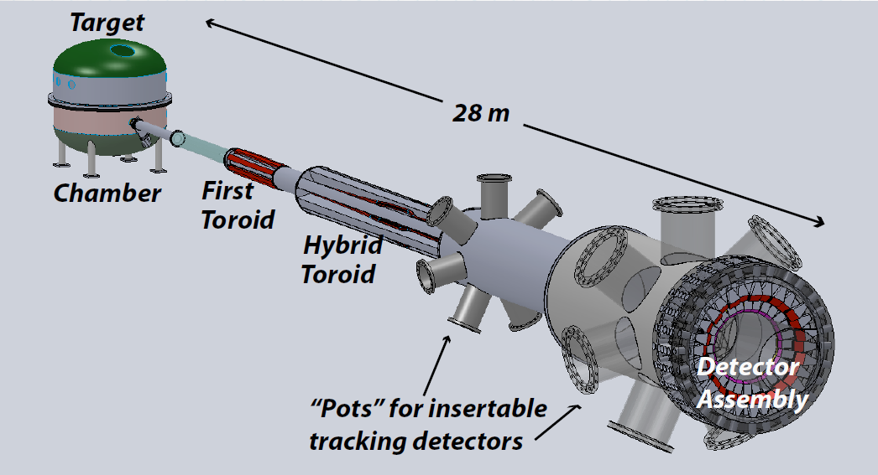

NSAC 2015 LRP
RECOMMENDATION IV
We recommend increasing investment in small-scale and mid-scale projects and initiatives that enable forefront research at universities and laboratories.
MOLLER
SoLID

Slide 18
NSAC 2015 LRP
Theory Initiative
  To meet the challenges and realize the full scientific potential of current and future experiments, we require new investments in theoretical and computational nuclear physics.
    Computational nuclear theory
    national FRIB theory alliance
    Expansion of Topical Collaborations Initiative
Initiative for Detector and Accelerator Research and Development
  US Leadership requires tools
    Vigorous detector and accelerator R&D in support of the neutrinoless double beta decay program and the EIC.

Slide 19
FY2016 Budget
ONP Guidance / FY16 President’s Budget Request supported ~ 16 weeks running
  This matched somewhat with some infrastructure work in CHL and the Utilities Infrastructure Modernization project which happened during the summer shutdown
  But we would have liked more running in FY16 and tried with Senate and House
Omnibus FY2016
  Office of Nuclear Physics received $-7.5M with respect to President’s Request
    Better than Senate and even than House marks
  Jefferson Lab share was $-1.5M
    We are holding running weeks, holding critical staff, squeezing elsewhere
FY2017
  Letter from 6 Senators supporting Nuclear Physics at LRP level
  “Directors” to visit Cherry Murray, Head of Office of Science on Jan. 16

Slide 20
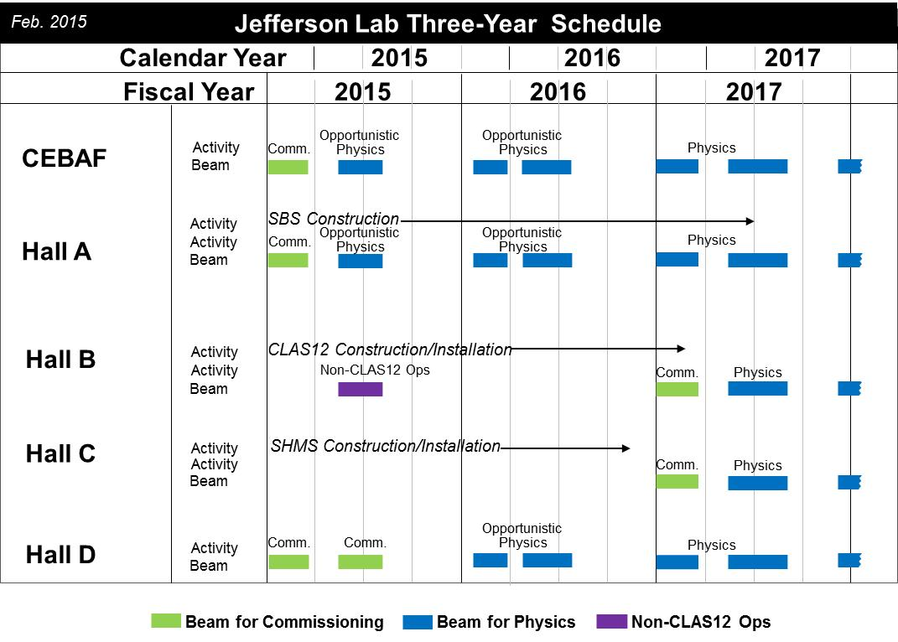
2017 commissioning
details to be updated
February 2016

Slide 21
Commonwealth of Virginia Funding
Special Request $4.2M in the FY15 - FY16 biennium to help improve Virginia’s competitive position for the Electron Ion Collider:
$3.7M in FY16 to complete the site studies
$0.25M in FY16 to attract a leading scientist to Virginia
Included in the Commonwealth of Virginia Budget
Request FY17-18 biennium
$2.4M for Accel. R&D with aim to further reduce technical risk has been included in the Governor’s Budget proposal.

Slide 22
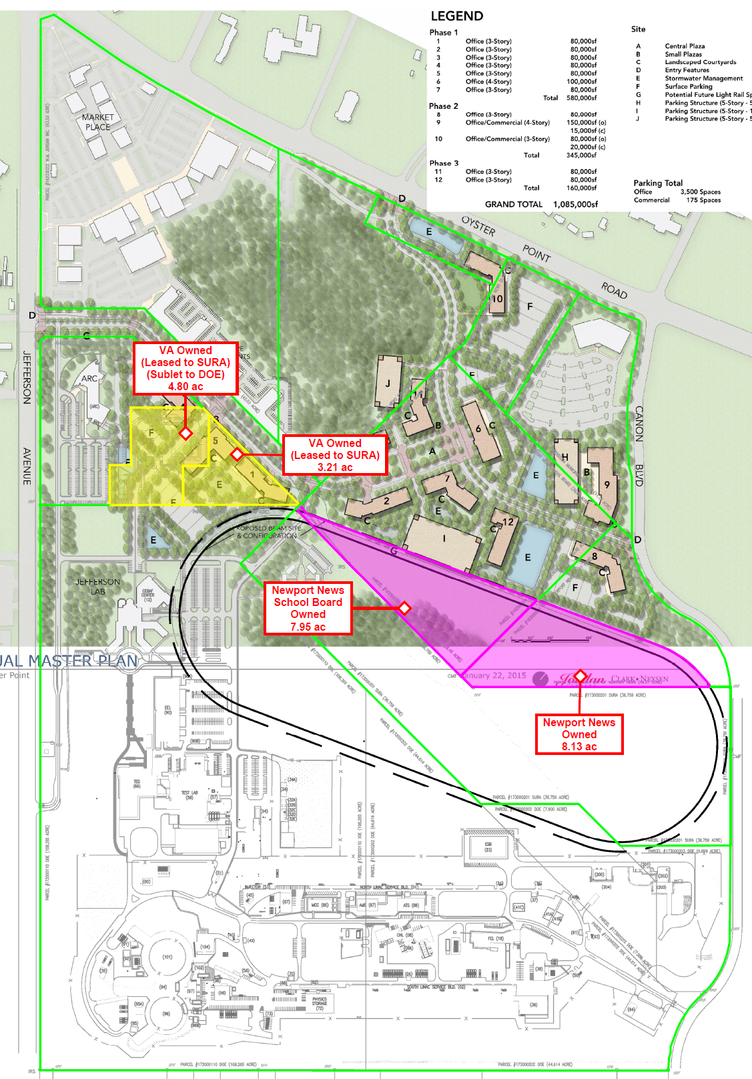
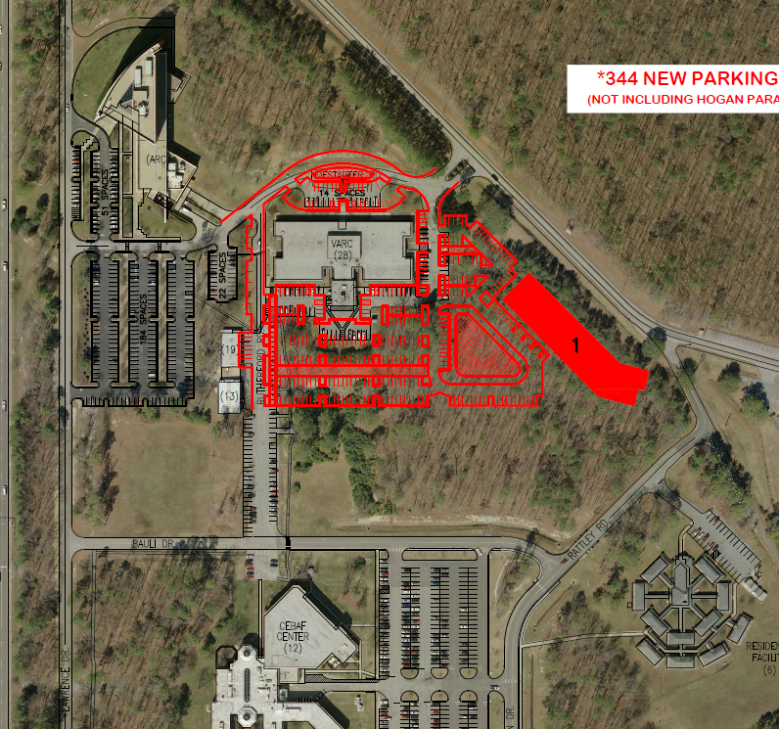
Land Situation
Long Term Sublease to DOE for VARC/SSC building land secured
  Use agreement for parking on Plot C2 in final negotiation
  Sale of “Plot C3 “ for Tech Centre development foreseen
MOU with City promising the “17 acres” of land needed for future expansion, for example the Electron Ion Collider has been signed

Slide 23
Summary
The Upgrade Project has made excellent progress with all the magnets compared to one year ago. There is still a lot of work, and continued tension, and attention to the issues but we are very pleased.
ONP Science and Technology review was stellar, we got several comments, which we are treating seriously, but no negative recommendations.
The NSAC Long Range Plan Report was a strong reinforcement for our strategy.
The EIC appears to be gaining considerable traction.
With considerable drive from JSA/SURA, the land needed for continued lab operations, and for eventual EIC or other expansion has been secured.

