Slide 1
Security Procedures
Security Program based on Risk Assessments
Low Risk
Security Elements
Guards (24/7; 2 roving patrols, 1 fixed @ guard house)
Buildings Secured (Campus 24/7; Accelerator Site after hours
Access Control
Visitor Control
Entrance through front door @ major buildings
Sign In Log @ major Buildings
Escorts
Video Surveillance – guard force multiplier
Annual Security Awareness Training
Signage/Postings

Slide 2
17 Dec 2016 Trespass Incident
Individual entered Accelerator Site via Entrance Gate
Warrant Issued for vehicle and federal Property trespass
Court date later this month

Slide 3
Actions Taken
Guard Force
Personnel Change
Retrained entire guard force
Additional Management oversight after hours
Physical
North and South Access Buildings Secured afterhours
Temporally blocked outgoing vehicle lane
Permanent fencing/gate being installed at entrance gate
Video camera enhancements – virtual boundary at entrance
3rd Party Audit of Access Control

Slide 4
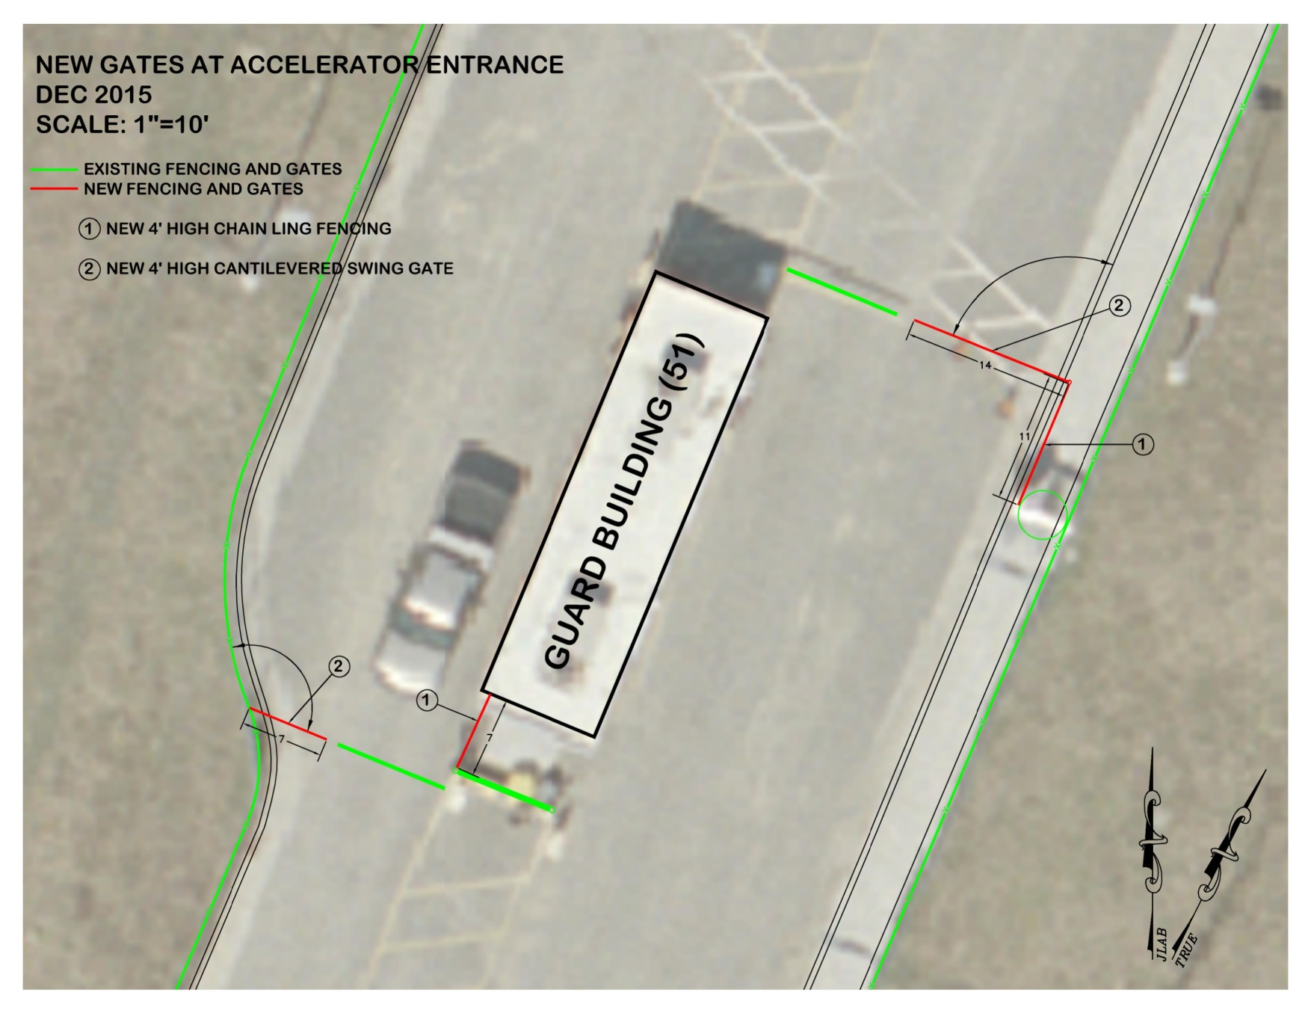
Modified Gate Entrance

Slide 5
Vulnerabilities
Unauthorized Personnel
Individuals without badge tailgating into buildings
Question unknown individuals entering buildings not using badge for entry
Escort visitors to the main desk to sign in
Visitors
Sign in at front desk at CEBAF Center, Support Services Center, Applied Research Center
Escorts required for visitors in buildings after 5 PM (except for special events)
Not Escorting Visitors/Contractors
Escorts must remain with visitors/contractors

