Slide 1


Report to UGBOD
R. D. McKeown
January 10, 2017

Slide 2
Outline
Recent highlights
Program Advisory Committee
Software Review
NSAC LRP, EIC
Outlook

Slide 3
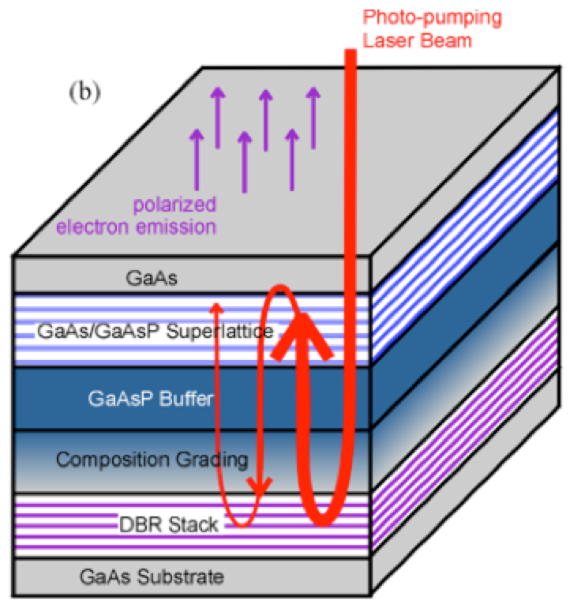
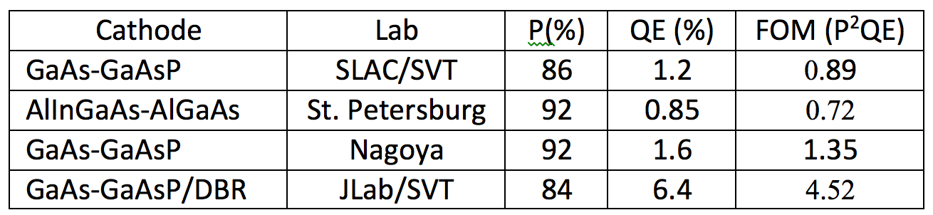
World Record High Polarization Photocathode
6.4% QE & 84% polarization at 776 nm from strained GaAs/GaAsP superlattice photocathode with GaAsP/AlAsP Distributed Bragg Reflector (DBR)
The highest QE & FOM of any reported high polarization photocathode
Possible to improve both QE & Pol
SBIR partnership
Photo-cathode
DBR
Substrate
Paper ready for SPIN and APL submission: W. Liu, S. Zhang, M. Stutzman, M. Poelker, Y. Chen, W. Lu, and A. Moy

Slide 4
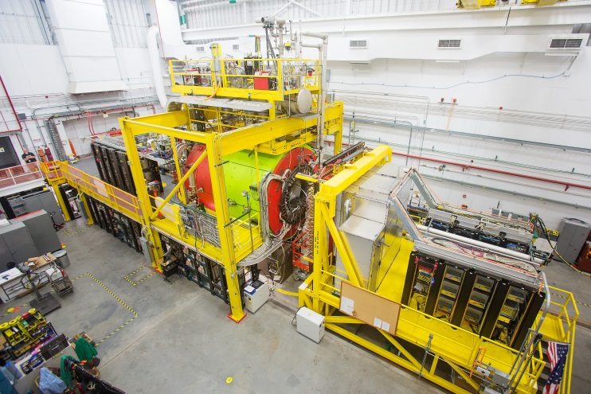
GlueX in Hall D
New experiment to study quark confinement
Commissioning complete
Detector functioning well
Production data-taking started
Poised to discover exotic hybrid mesons

Slide 5

Contributions to the 2016 DNP Meeting
All presentations are part of a GlueX-related minisymposium spanning several sessions and including both theory and experiment talks. GlueX collaborators will present:
Σ beam asymmetry of the π⁰ and η in GlueX. (PRL in preparation)
Photoproduction of the ρ (770) with GlueX.
Photoproduction of the η’(958) with GlueX.
Photoproduction of the ω (782) with GlueX.
A survey of multi-photon final states in GlueX.
Measurement of the η’ transition form factor in GlueX.
A Leptophobic Boson search in GlueX.
Excited ρ mesons in GlueX.
Photoproduction of J/ψ in GlueX.

Slide 6
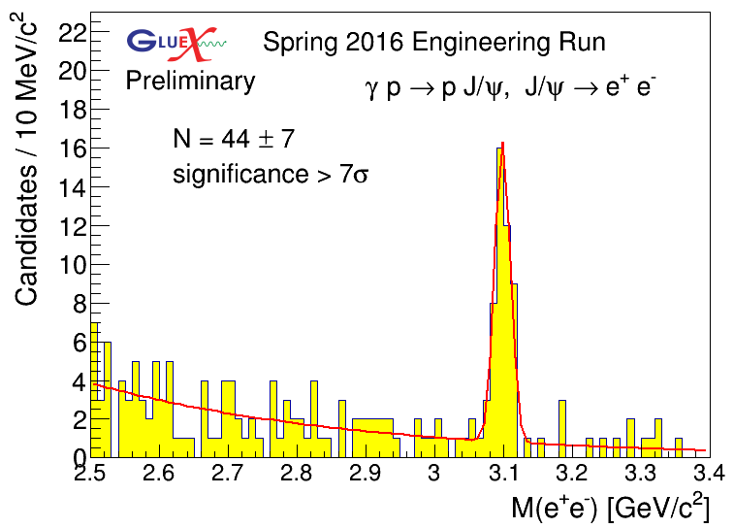
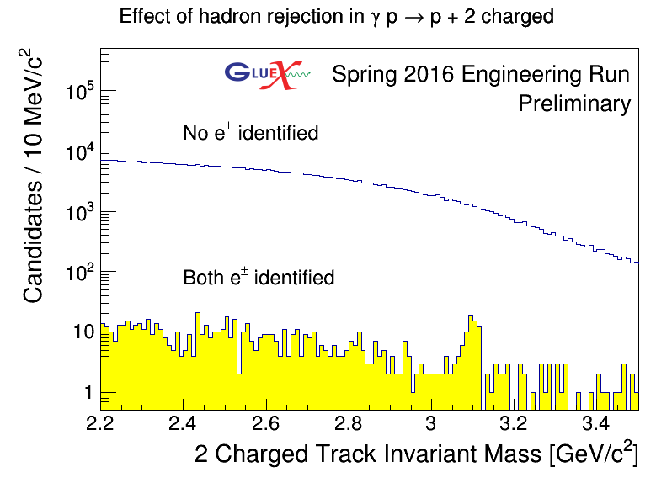
Observation of J/ψ Photoproduction in
Reconstruct exclusive final state:
Identify the p using timing and the e⁺ and e⁻ through p/E in the calorimeters.
By identifying both e+ and e-, we get over a factor of 100 in rejection power and a very clean signal.
First observation of charmonium at JLab!

Slide 7

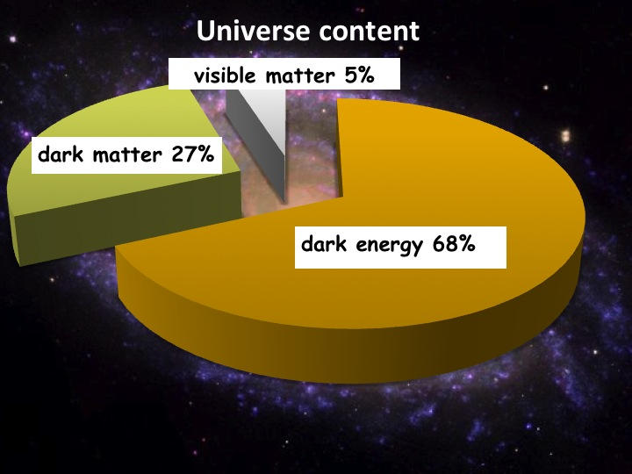
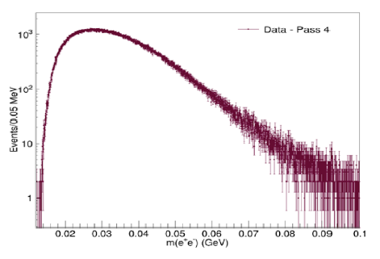
Heavy Photon Search
HPS searches for an electro-produced hidden sector photon (A’) which decays to e⁺e⁻ pairs
A’s could mediate dark matter annihilations and interactions with our matter
HPS identifies A’s with invariant mass and separated vertices
Status:
1 GeV data under analysis
  First results this summer fall?
2 GeV data acquired in spring 2016
  Results next year
More running in the future
NP-HEP Collaboration
Measured e⁺e⁻ Masses
Future Program: more HPS, APEX, DarkLIGHT

Slide 8
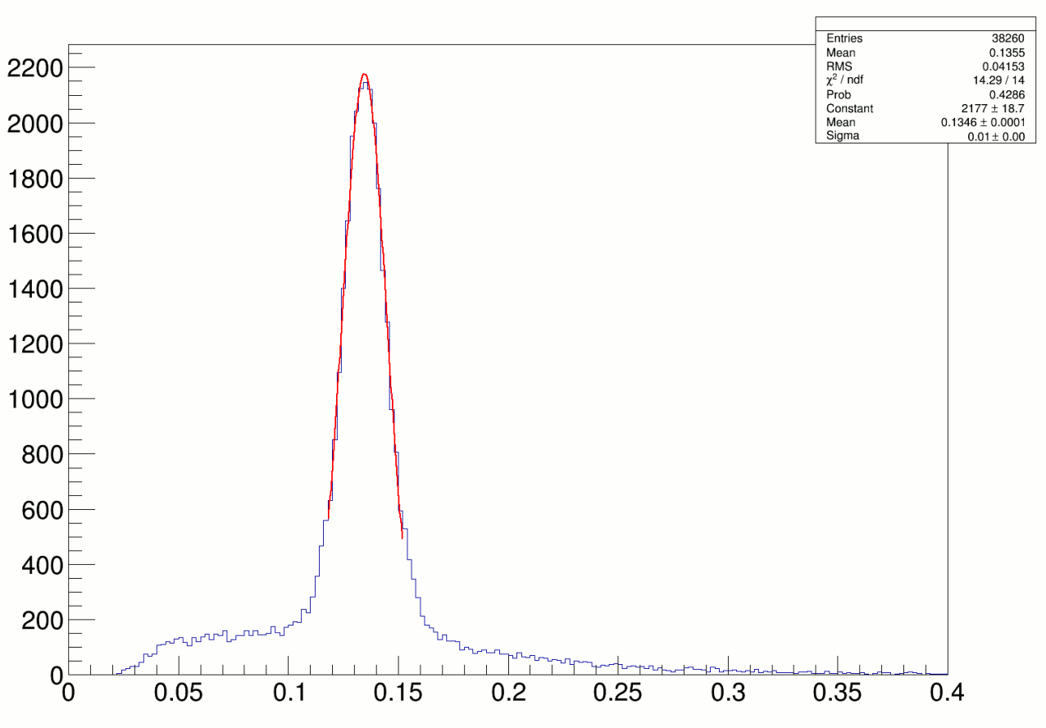
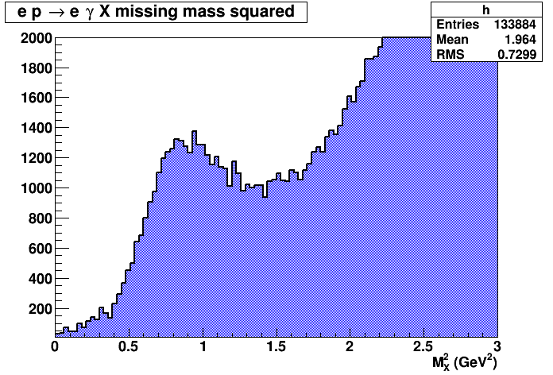
3D Imaging Program at 11 GeV
Hall A
Data reconstructed in calorimeter
Missing Mass Reconstruction
(1.5 h of beamtime)
High impact experiment for nucleon 3D imaging program
16% of experiment completed in 2014-2016

Slide 9
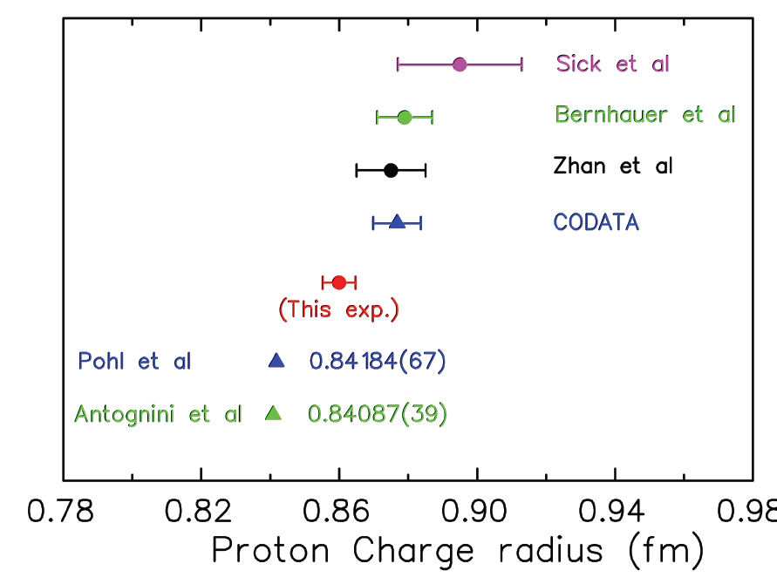


Solving the Proton Radius Puzzle
Elastic e-p
scattering
Atomic H
PRad@JLab:
(projected)
Muonic H
PRad: new experiment to
address proton radius @ JLab
NSF MRI: H₂ gas target
DOE GEM tracking detectors
Successful run in summer 2016!

Slide 10
PAC44
3 returning C2
9 new proposals
1 returning C2 run group
2 new run groups (Hall B)
3 run group additions
9 LOI’s
Scheduled for week of July 25
Proposals were due Monday, June 6, 2016
Charge:
Review new proposals, previously conditionally approved proposals, and letters of intent for experiments that will utilize the 12 GeV upgrade of CEBAF and provide advice on their scientific merit, technical feasibility and resource requirements.
Identify proposals with high-quality physics that, represent high quality physics within the range of scientific importance represented by the previously approved 12 GeV proposals and recommend for approval.
Also provide a recommendation on scientific rating and beam time allocation for proposals newly recommended for approval.
Identify other proposals with physics that have the potential for falling into this category pending clarification of scientific and/or technical issues and recommend for conditional approval. Provide comments on technical and scientific issues that should be addressed by the proponents prior to review at a future PAC.

Slide 11
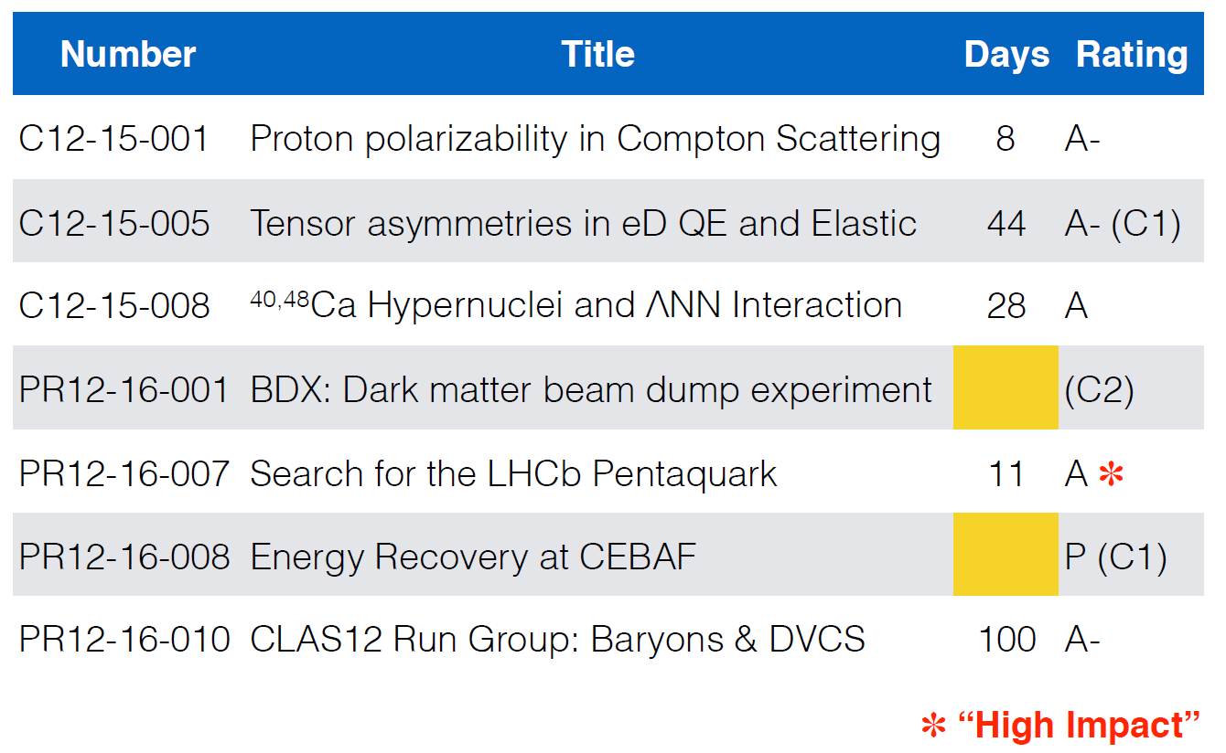
PAC44 Approvals

Slide 12
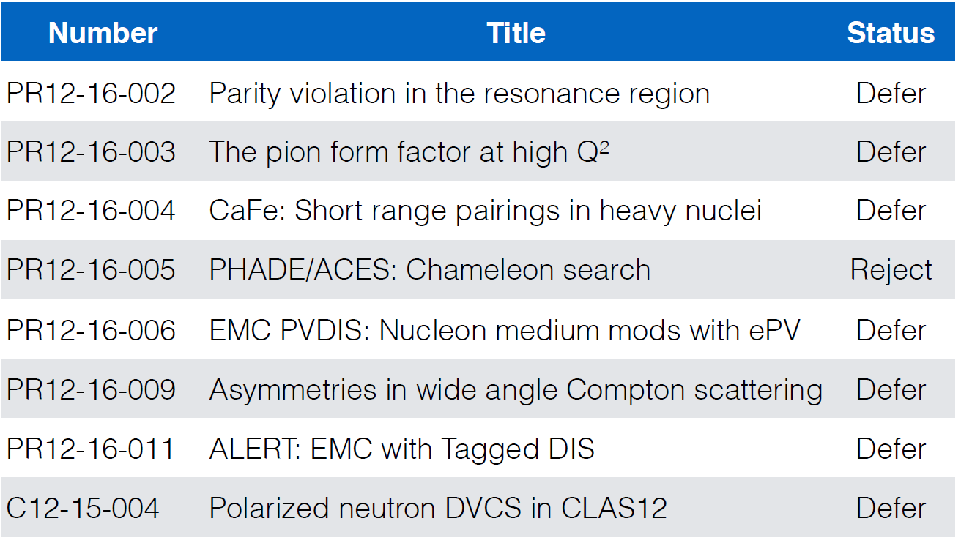
PAC44 Results

Slide 13
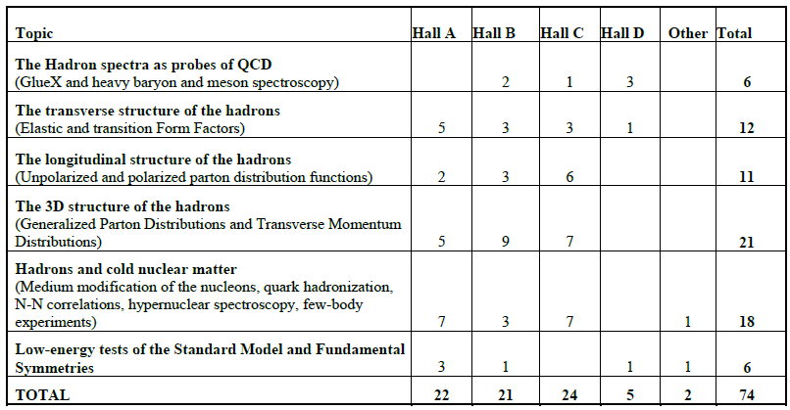
12 GeV Approved Experiments by Physics Topics

Slide 14
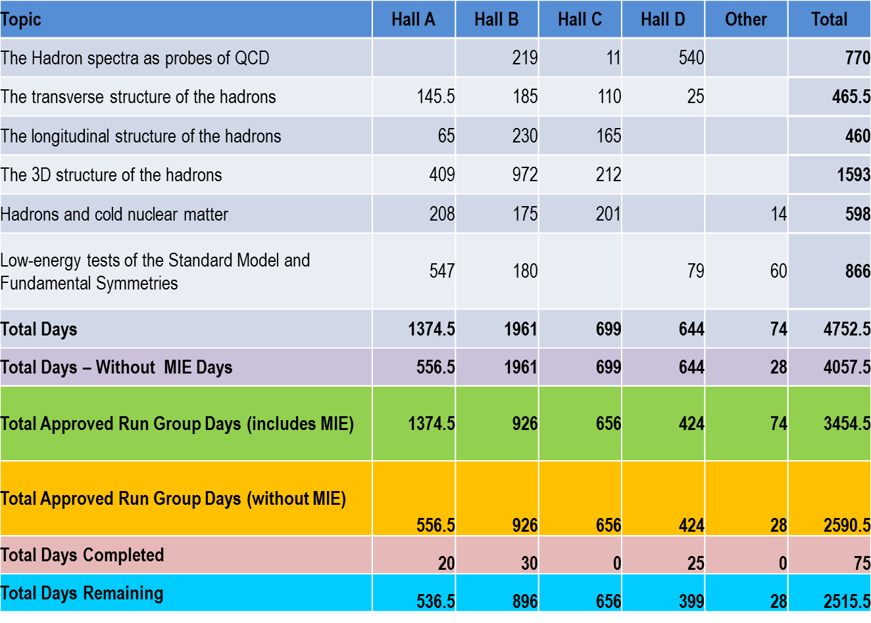
12 GeV Approved Experiments by PAC Days
A Decade of Experiments

Slide 15
Jeopardy
Process
Requested a proposal from UGBOD at January 2016 meeting. UGBOD gave some guidance, but not consensus.
Generated a proposal in April, sent to hall leaders and UGBOD. Got email feedback from UGBOD.
Added explanatory text to address feedback from UGBOD.
May 2016 – reached consensus on present draft for discussion at user meeting.
Rationale
Use normal yearly PAC for ~4 years to address all presently approved proposals that have not been scheduled, plus new proposals in the next few years. Estimate ~5-10 proposals per meeting
Will start in 2019 to reach steady state in 2024 - proposals that have been approved for 4 years or more but are not scheduled will be considered in Jeopardy.
Posted for User Comments – very minor feedback
Final Version Now Posted on PAC website

Slide 16
PAC45
Scheduled for week of July 10
Proposals due Monday, May 22, 2017
Issues:
Better communication on previously approved related proposals.
Stricter procedures on conflicts of interest
Propose new user chair role as observer/watchdog on above issues and others to ensure fairness and QA
Considering special presentations on
- compact photon source
- international context for K_{L} beam in Hall D

Slide 17
Software Review

Slide 18
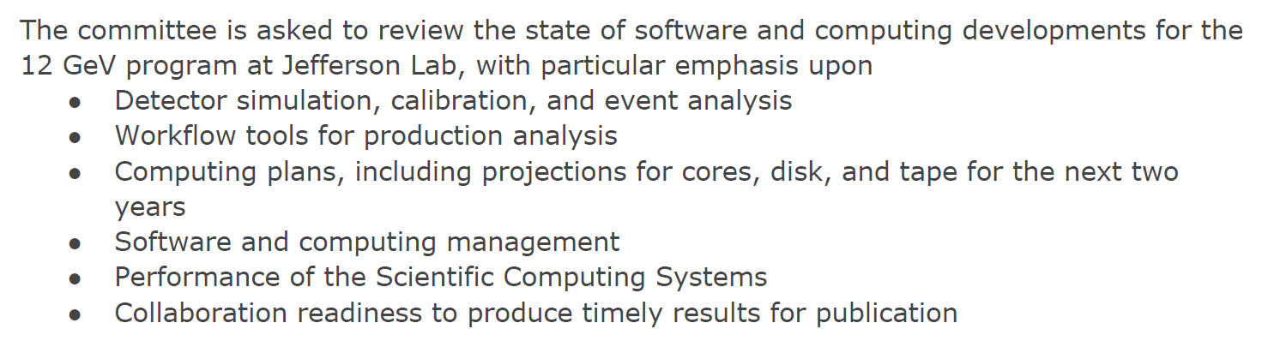
Charge
GlueX doing well with analysis in progress
Halls A/C delays not limited by software
Report almost final:
Many useful comments
Some recommendations, more like suggestions

Slide 19

2015 NSAC Long Range Plan
RECOMMENDATION I
The progress achieved under the guidance of the 2007 Long Range Plan has reinforced U.S. world leadership in nuclear science. The highest priority in this 2015 Plan is to capitalize on the investments made.
· Operate 12 GeV CEBAF
RECOMMENDATION II
We recommend the timely development and deployment of a U.S.-led ton-scale neutrinoless double beta decay experiment.
RECOMMENDATION III
We recommend a high-energy high-luminosity polarized EIC as the highest priority for new facility construction following the completion of FRIB.
· Jefferson Lab EIC (JLEIC) development
RECOMMENDATION IV
We recommend increasing investment in small-scale and mid-scale projects and initiatives that enable forefront research at universities and laboratories.
· MOLLER, SoLID

Slide 20
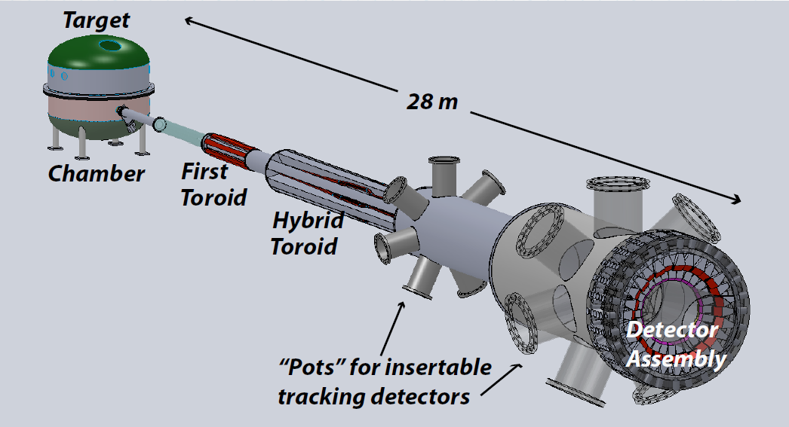

Future Projects
MOLLER experiment
(Possible MIE – FY17-20)
– Standard Model Test
– DOE science review (September 2014) – strong endorsement
– Director’s review held December 15-16, 2016
Technical, cost & schedule
Report due in mid January
– Still hope for FY18 start
SoLID
– CLEO Solenoid 
– Chinese collaboration
– Director’s review (Feb. 2015)
 new pre-CDR almost complete
– Collaboration briefing to DOE-NP
(Nov. 2015)

Slide 21

Electron Ion Collider
LRP Recommendation III
Exploring the Glue that Binds Us All
EIC Community
White Paper

Slide 22

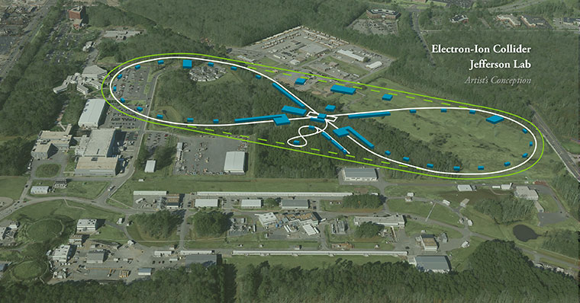
EIC at Jefferson Lab
JLab JLEIC Figure 8 Concept
Initial configuration:
  3-10 GeV on 20-100 GeV ep/eA collider
  Optimized for high ion beam polarization:
    polarized deuterons
  Luminosity:
    up to few x 10³⁴ e-nucleons cm⁻² s⁻¹
    Low technical risk
    Upgradable to higher energies
    250 GeV protons + 20 GeV electrons
    Flexible timeframe for Construction
    consistent w/running 12 GeV CEBAF
    Thorough cost estimate completed
    presented to NSAC EIC Review
    Cost effective operations
    Fulfills White Paper Requirements
Current Activities
Site evaluation (VA funds)
Accelerator, detector R&D
Design optimization
Cost reduction
Notes:
Deleted
Brightened graphic (no more shame); added current activities from previous version;
Mary Beth please format text

Slide 23
EIC Developments
EIC User meeting at ANL July 7-10, 2016
  UG charter, elections (IB chair – Christine Aidala)
  2017 EIC UG Meeting in Trieste, Italy
DOE-NP will increase EIC accel. R&D in FY17
– Through ‘tax’ on JLab/BNL
– Peer review held for November 29-December 2
- report to be released in mid January
National Academies Study, Chair Gordon Baym, University of Illinois, Urbana Champaign, first meeting projected for January 2017.

Slide 24
EIC R&D Panel Membership
Frank Zimmerman (CERN)
Oliver Bruning (CERN)
Reinhard Brinkmann (DESY) – Withdrawn, seeking replacement
George Dodson (ORNL)
John Lewellen (LANL)
Sergei Nagaitsev (FNAL)
Alexander Romanenko (FNAL)
John Seeman (SLAC)
John Corlett (LBNL)
Jie Wei (MSU)
Ying Wu (Duke)
Daniela Leitner (MSU)
John Tapia (LANL)
Kevin Jones (ORNL) (Chair)

Slide 25
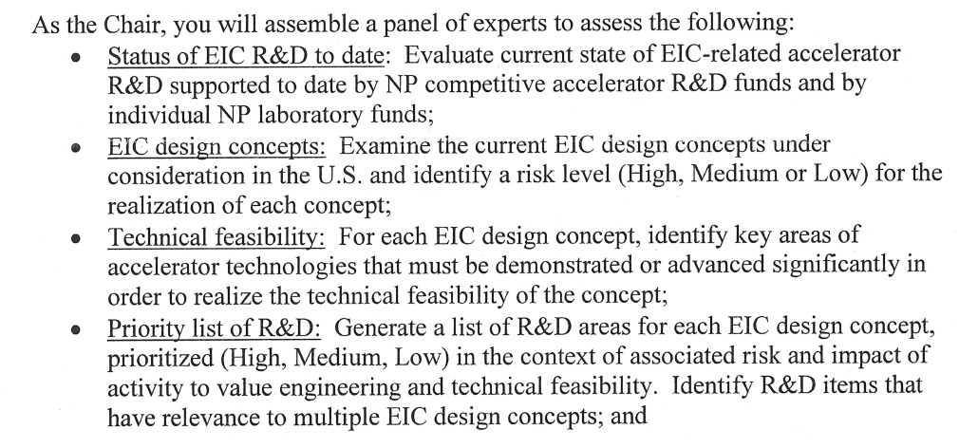
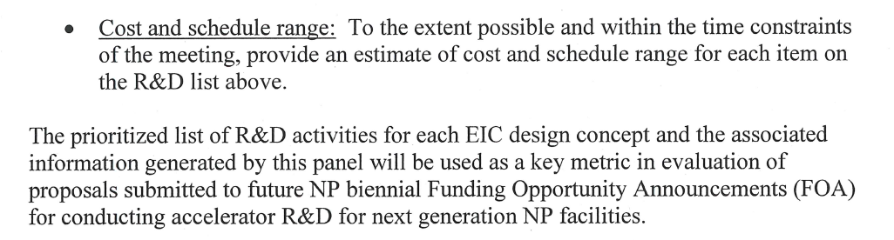
Charge to Panel

Slide 26
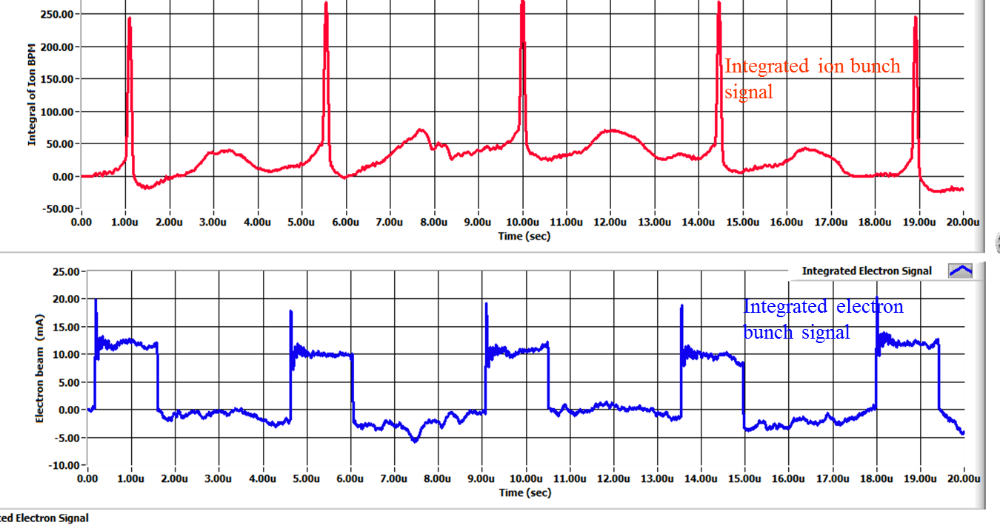
Bunched Ion Beam Cooling – preliminary results
A collaboration of JLAB and Institute of Modern Physics (IMP), China
The 1st experiment was carried out on May 17-22, 2016, at Lanzhou, China
A 7MeV/u ¹²C⁶⁺ ion beam stored in the IMP CSRm ring, either coasting or captured by 450kHz RF system (two long bunches)
Cooling of both coasting and bunched ion by a pulsed electron beam are observed: first successful step of experimental demonstration of bunched beam cooling
Data analysis both at IMP and JLAB is in progress
Initial 1D modeling with RF capture and bunching shows the ion cooling and synchrotron sideband effects, agree with experimental observations
Experiment data observation on BPMs
cooled ion bunches
uncooled ion bunches
Electron bunches 1.5μs

Slide 27
NAS Panel Membership
Ani Aprahamian, Co-Chair (University of Notre Dame)
Gordon Baym, Co-Chair (U. Illinois at Urbana-Champaign)
Christine Aidala (University of Michigan)
Richard Milner (MIT)
Ernst Sichtermann (LBNL)
Zein-Eddine Meziani (Temple University)
Thomas Schaefer (NC State University)
Michael Turner (University of Chicago)
Wick Haxton (University of California-Berkeley)
Kawtar Hafidi (Argonne)
Peter Braun-Munzinger (GSI)
Larry McLerran (University of Washington)
Haiyan Gao (Duke)
John Jowett (CERN)
First Meeting: Feb. 1-2

Slide 28
The Charge to the NAS Reviewers:
The committee will assess the scientific justification for a US domestic electron ion collider facility, taking in to account current international plans and existing domestic facility infrastructure. In preparing its report, the committee will address the role that such a facility could play in the future of nuclear physics, considering the field broadly, but placing emphasis on its potential scientific impact on quantum chromodynamics.

Slide 29
The Charge (continued…):
In particular, the committee will address the following questions:
What is the merit and significance of the science that could be addressed by an EIC facility and what is its importance in the overall context of research in nuclear physics and the physical sciences in general?
What are the capabilities of other facilities, existing and planned, domestic and abroad, to address the science opportunities afforded by an EIC? What unique scientific role could be played by a domestic EIC that is complementary to existing and planned facilities at home and abroad?
What are the benefits of US leadership in nuclear physics if a domestic EIC were constructed?
What are the benefits to other fields of science and to society of establishing such a facility in the US?

Slide 30


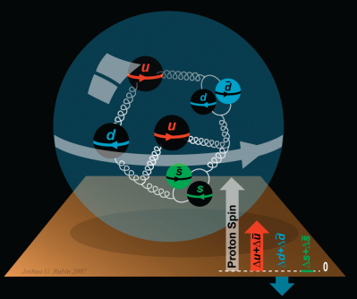
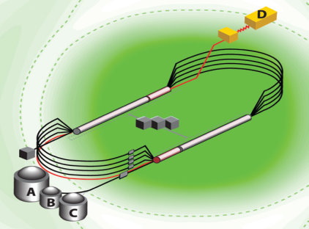
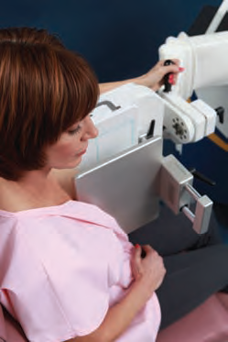
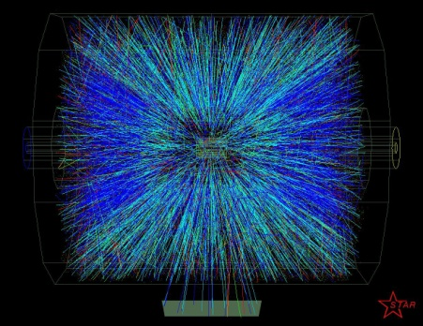


Summary and Outlook
Experiments on the floor have done well – hope for early results soon
PAC44 very active, new procedures being tested
Jeopardy policy in place
PAC45 scheduled with improvements
EIC science and designs are making good progress

Slide 31
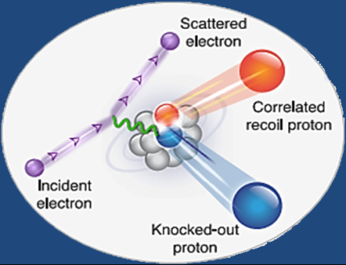

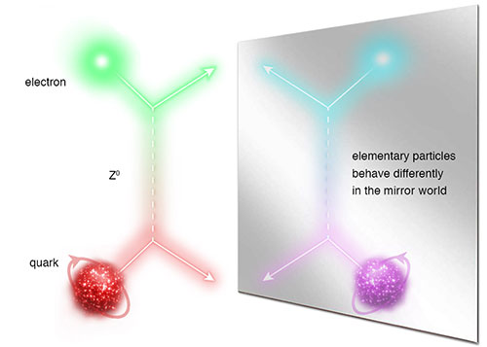
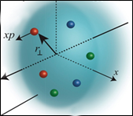
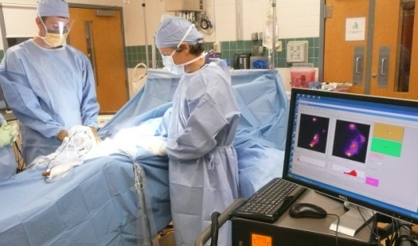
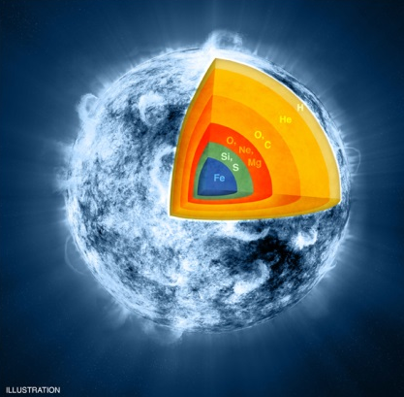
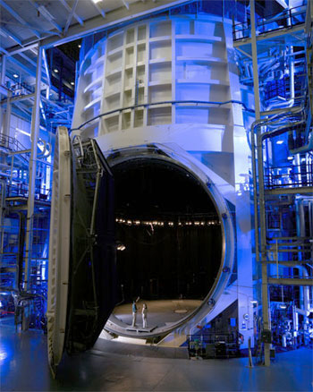
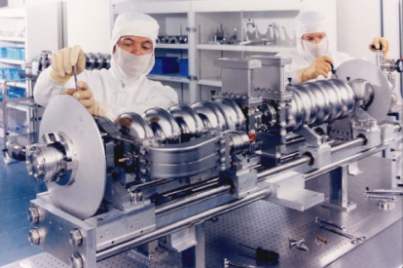
JLab: A Laboratory for Nuclear Science
Z⁰
Nuclear Structure
Fundamental
Forces & Symmetries
Structure of Hadrons
Medical Imaging
Nuclear Astrophysics
Accelerator S&T
Cryogenics
Theory & Computation

