Slide 1

User’s Group Board of Directors
Jefferson Lab Comments
January 10, 2017

Slide 2
Jefferson Lab Safety History FY2016
Last Recordable Injury – April 2016

Slide 3
Safety versus Schedule
I have often claimed safety trumps schedule:
  You worry about safety
  I will worry about the schedule
Soon after the last time I said that in an All Hands Meeting, we stepped out of line:
  We allowed urgency to install the Darklight Experiment test to overrule work planning
  Students “helping” did not have appropriate PPE, for example
  Techs stepped up to stop the individuals
  Division Level Management then STOPPED the WORK, until a plan was in place
This was rightly called out in Safety Culture Survey
  Indeed there was a breakdown
  Accelerator Division conducted a lessons learned exercise
  We discussed this extensively in the Director’s Safety Council, management at the division level understands not to fall into this trap, being reinforced down the line.
On a different note
  It is not often recognized that we invited the Users Group Board to be represented on the Director’s Safety Council. Ed Brash (CNU) has been attending our meetings for two to three years… he helped very actively when we tried to raise our game vis-à-vis student training and supervision.
    Thank you Ed.

Slide 4
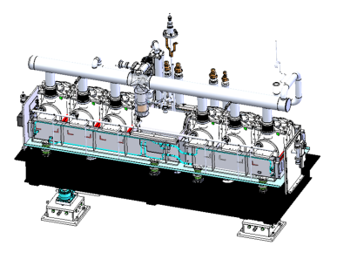
Collaborative Projects
 | LCLS II | FRIB
Description | 4 GeV superconducting linac in existing SLAC tunnel | New user facility at MSU for rare isotope studies
Collaboration | ANL, Cornell, FNAL, LBNL, SLAC, Jefferson Lab | MSU, State of Michigan, DOE SC, Jefferson Lab
Jefferson Lab Scope | Cryoplant design, acquisition & commissioning Cryomodule and cavities for half of linac Qo R&D, LLRF, machine physics | Cryogenic system design, procurement, fabrication, and integration Cryomodule engineering and design finalization
Status | ✓ CD 2/3A complete ✓ Several cryoplant procurements going well ✓ All cryomodule procurements placed ✓ Prototype cryomodule completed and started acceptance testing. | ✓ FDR for 2K cold compressors complete ✓ Beta 0.041 design complete - Beta 0.29 design underway
Prototype Cryomodule
β=0.29 Cryomodule
Both Projects are carefully managed.
Our participation is very much appreciated
Discussions to increase scope for each

Slide 5
FY17 Budget
  Nominally, first year of full operations in 12 GeV-era and Operations budget should have increased correspondingly.
  President’s Budget (NP = $636M) up 3%
    JLab Ops up $5.5M; but insufficient for full operation
    Major increases in isotope program (+$8M) and RHIC (+$7.5M)
  Senate Mark: $636M
    Language for FRIB construction and RHIC ops
  House Mark: $620M
    Language for FRIB construction, RHIC ops, and CEBAF ops
  No Federal Budget yet:
    Continuing Resolution (CR) until April 28.
    Held to FY16 level -
      NP $15.4M below Pres. Budget
      JLab $5.5M below Pres. Budget
NP=DOE Office of Nuclear Physics

Slide 6
FY17 Planning
Anticipate considerable uncertainty in transition between Administrations
NP additional Ops support?
  If a full year CR, NP has substantial shortfall
FY17 @ FY16 CR Budget level:
  Major impact on non-labor spending (travel, hardware, contract labor, etc.)
  Reduced Weeks of Accelerator Operation:
    FY17 @ Pres Budget = 23 weeks
    FY17 @ FY16 Level = 16 weeks
  Workforce:
    New/replacement hires limited to critical needs
    In extremis, forced vacations and furloughs would be considered
    Reduction in force not anticipated
U.S. has made a major investment in CEBAF. Laboratory has a clear mission, nuclear physics and accelerator technology, which is supported by DOE. We will work to mitigate negative effects of budget constraints on all aspects of the program, especially the workforce.

Slide 7
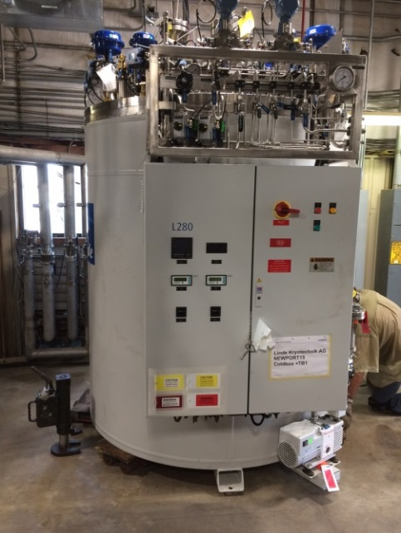
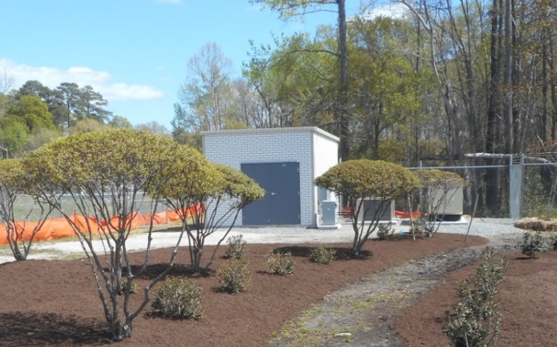
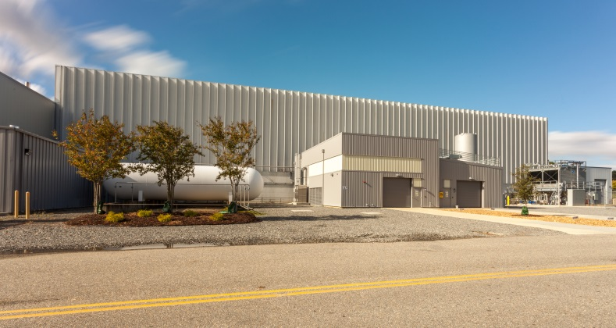
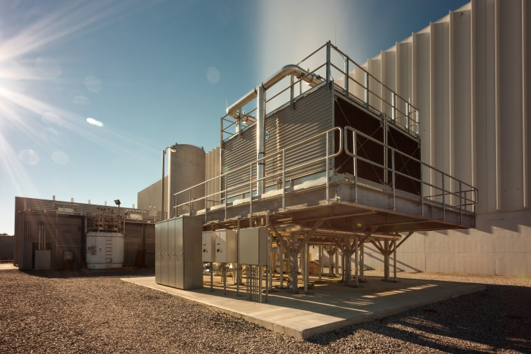
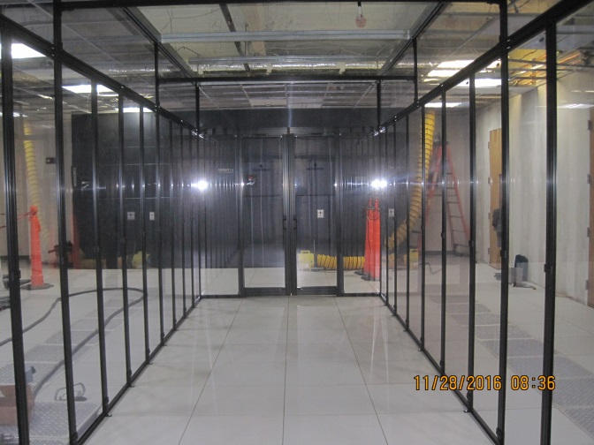
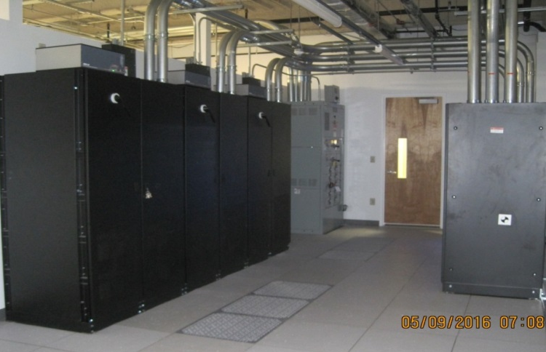
Utilities Infrastructure Modernization
Overall Progress → 89.2% complete
CTF Building – complete
CTF Equipment – 79% complete
C6 Warm Compressor – 85% complete
Communications – Complete
CTF Cooling Tower – Complete
Computer Center Consolidation – 12 % Complete
Computer Center Cooling & Power – Complete

Slide 8
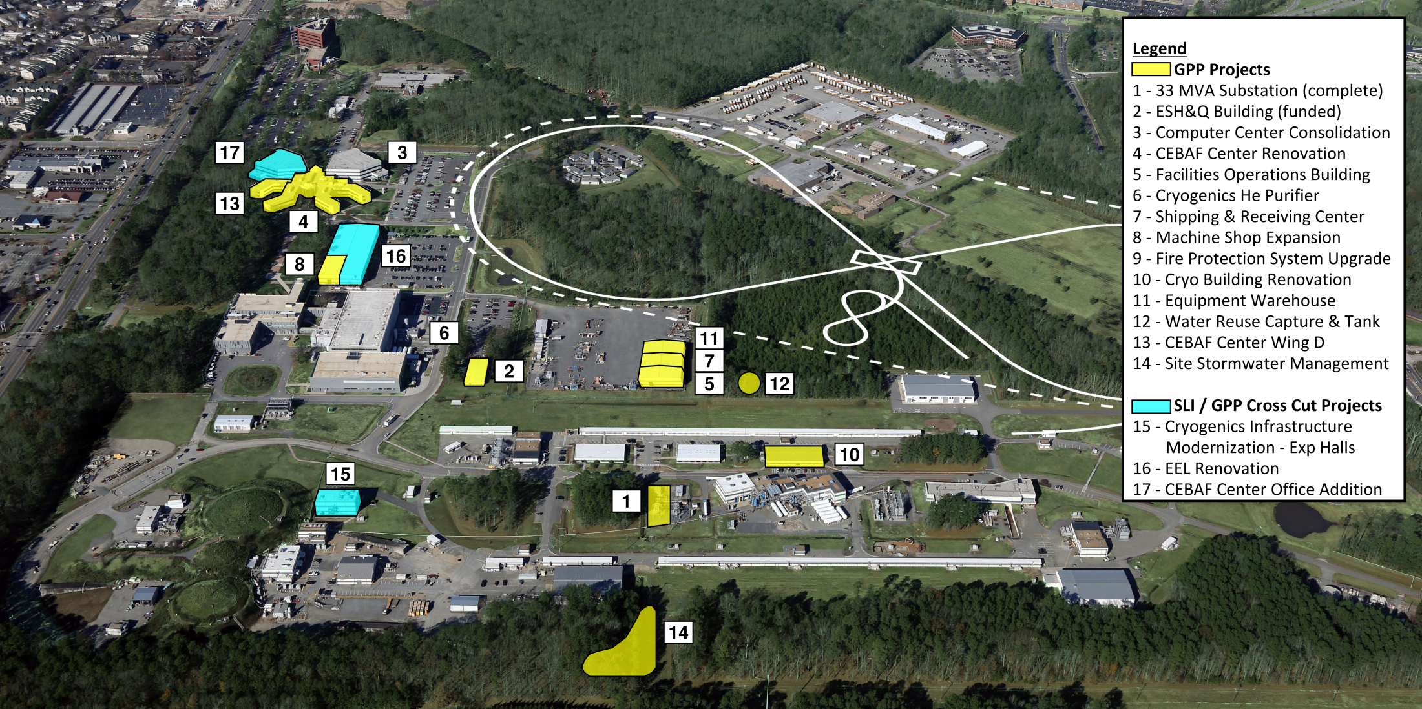
Jefferson Lab 2025 Campus Plan
We appreciate your support of the multiple traffic pattern changes.
We see the Hogan Road changes as a definite improvement to our access.

Slide 9
Director’s Perspective
Emphases
  Core Nuclear Physics
    Finish the upgrade project, safely, on time, and within budget.
    Full-time operations. Operations budgets continue to be a concern here.
    Reliability and Risk Mitigation
    Advance new NP projects beyond the upgrade
  Develop Jefferson Lab EIC design:
    Technical Designs, Collaboration, (Land now secured)
  Technology Collaborations
    Large projects, like FRIB and LCLS-II, within context of a Nuclear Physics program – management is key
  Management/Personnel
    Operations Functions: Facilities, Procurement, Financial Management, Budget Office, Human Resources, Information Technology, Legal, ES&H are vital to the functioning of the lab
What the lab can achieve depends on your efforts, Jefferson Lab successes will be your successes.
Jefferson Lab world- leading Nuclear Physics

Slide 10
Spares/discards follow

Slide 11
IT News
Multifactor Authentication – Planning to finish by Feb 28, 2017
  Deployment for JLab system administrators was completed on Sept 29 (DOE priority)
  Central computing will be split during Christmas Shutdown to separate Open Science functions from standard user requirement
  User feedback on implementation details was very useful.
  Most Lab employees will have to comply with MFA
    Are planning a group by group deployment
    Detailed plan available in December
SSL Decryption
  Most web traffic is now encrypted providing avenue of attack outside of existing scanning techniques.
  Using advanced features on the firewall to provide scans—working well
  Open to exemptions for file sharing services, banks…
  please let us know if you are having problems

Slide 12
JSA PEMP Grade Summary FY07 – FY16
S&T Performance Goals | FY07 | FY08 | FY09 | FY10 | FY11 | FY12 | FY13 | FY14 | FY15 | FY16
1.0 Accomplishment | A− | A | A− | A− | A− | A− | A− | A | A | A
2.0 Construction and Operations of User Research Facilities and Equipment | A | A | B+ | A− | A− | A− | B+ | B+ | A- | A-
3.0 Science and Technology Research Project/Program Management | A | A | A− | B+ | B+ | A- | A- | A− | A- | A-
Leadership and Stewardship | FY07 | FY08 | FY09 | FY10 | FY11 | FY12 | FY13 | FY14 | FY15 | FY16
4.0 Leadership and Stewardship of the Laboratory | A− | A− | B+ | B+ | B | B+ | B+ | A− | B | B+
M&O Performance Goals | FY07 | FY08 | FY09 | FY10 | FY11 | FY12 | FY13 | FY14 | FY15 | FY16
5.0 Integrated Safety, Health, and Environmental Protection | A− | A− | A− | B+ | B+ | B+ | B+ | B+ | B+ | A-
6.0 Business Systems Integrated Safety, Health, and Environmental Protection | A− | A− | B+ | B+ | B+ | B+ | B+ | B+ | B+ | B+
7.0 Operating, Maintaining, and Renewing Facility and Infrastructure Portfolio | A− | A− | A− | A− | B+ | A− | A− | A− | B+ | A-
8.0 Integrated Safeguards and Security Management and Emergency Management Systems | A− | A− | B+ | B+ | B+ | B+ | B+ | B+ | B+ | B+

