Slide 1
Diversity & Inclusion
Rhonda Barbosa, HR Director and Ethics Officer
Mary Logue, ESH&Q Associate Director and D&I Co-Chair

Slide 2
Agenda
Highlights of 2018 Diversity & Inclusion Activities
Implicit Bias Training Status Update
Diversity & Inclusion Council Survey
2019 Diversity & Inclusion Planned Activities

Slide 3
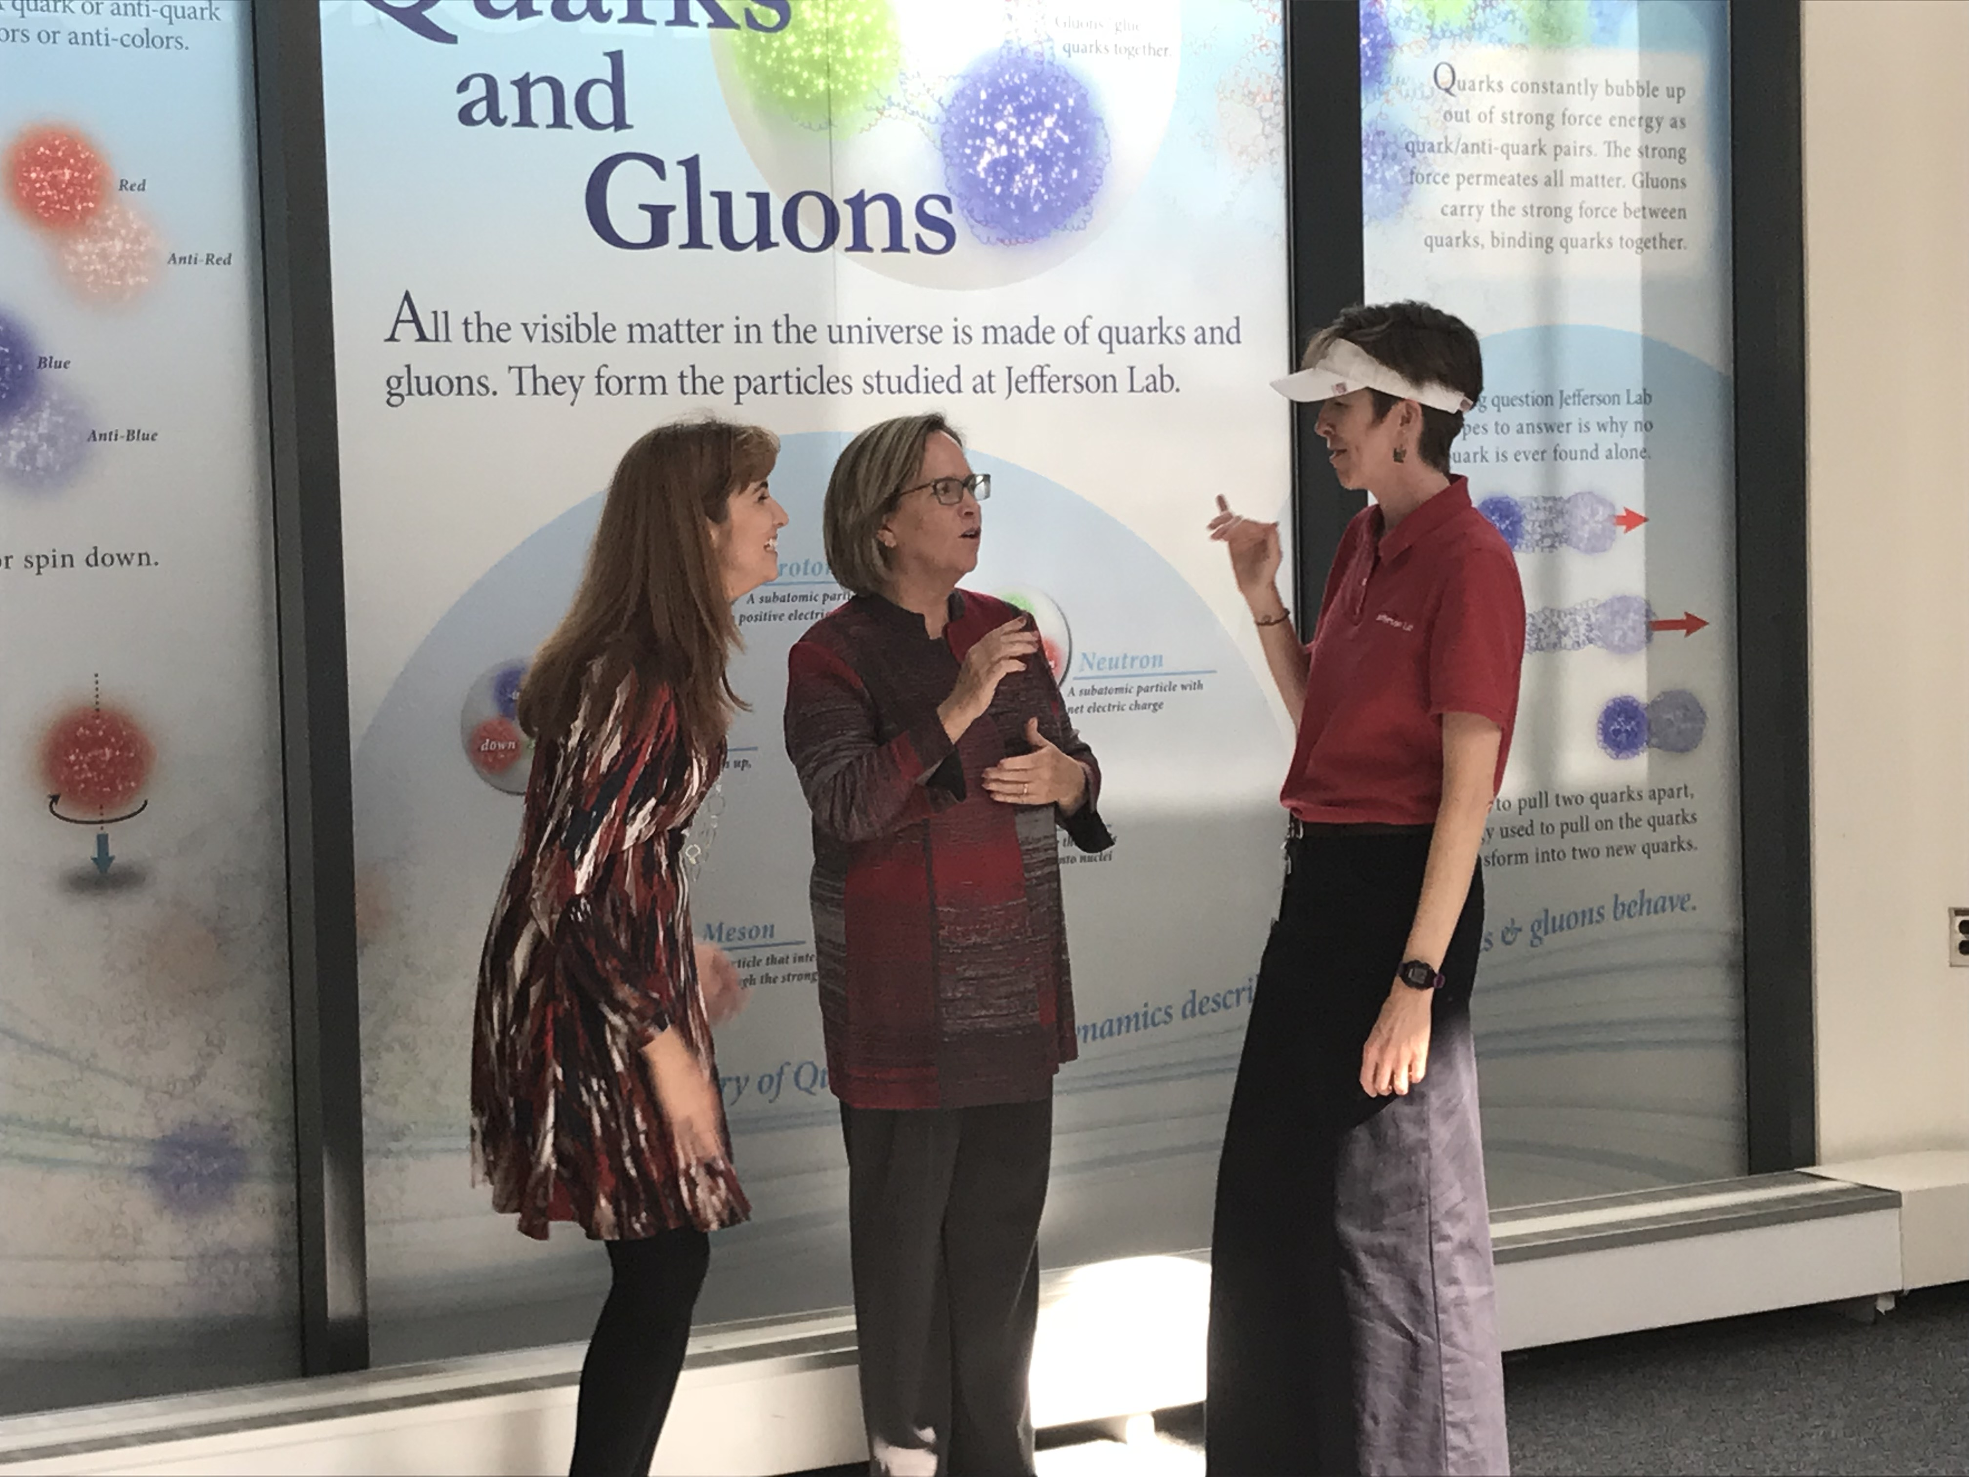
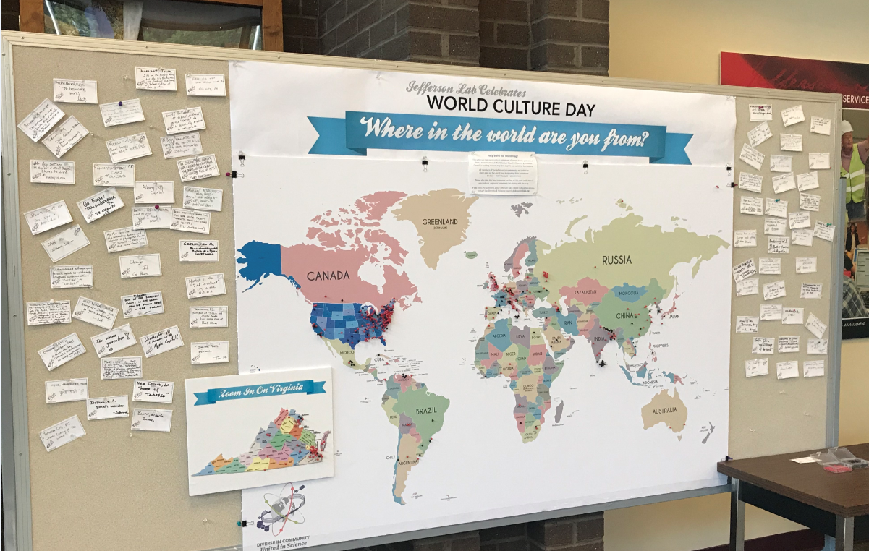
FY 2018 – Highlights
First D&I Colloquium (Fall 2017)
Dr. Jane Fernandes
Implicit Bias (Communications) Training Update
(~70% of staff completed trained)
National Laboratory Directors’ Council D&I Workshop
Sexual Harassment of Women: Climate, Culture, and Consequences in Academic Sciences, Engineering & Medicine
Intersection of the Law & #MeToo Movement
Champions for LGBTQ Life & Culture
Breakout sessions
Inclusion Insights – pilots & summer series
Higher Education Recruitment Consortium
Facilitated First World Culture Day
D&I Website updates (ongoing)

Slide 4
Survey Feedback
IMPLICIT BIAS TRAINING (Communications)
As a result of this class I better understand the impact of both medium and delivery on communication. (77% = Definitely)
A class format like this one (in person presentation with discussion is the best way to convey this information (71% = Absolutely)
Suggestions for improvement:
Role playing/Real Life examples
More direct conversations around issues of sexism and racism in workplace
More on institutional bias
Most useful:
Bias Discussion
Cultural Differences
Left Brain/Right Brain
Appreciate the time and effort spent on an important subject. Lots of good info. Useful link to implicit.harvard.edu
Discussions and 'real world' examples were interesting
DIVERSITY & INCLUSION COUNCIL ASSESSMENT
Surveyed Council Members 12/10/18
50% Response rate as of 1/4/2019
All feel efforts are having positive impact (agree or strongly agree)
77% have had someone talk to them due to their Council role
Participation in outreach noted as ‘lowest’ of priorities
Majority feel quarterly meetings appropriate

Slide 5
Diversity & Inclusion On the Horizon
Extend invitation for Users to participate in the Implicit Bias/Communication training course via Weekly Briefs/CUGA
Annual User Community Standards required reading document
Increase awareness of JLab’s Commitment to D&I with Users, Visitors & Others: Prominent display of Community Standards Poster highlighting elements of Inclusion, Professional Conduct, Core Values, & Resources)
Inclusion Survey (Q3 ‘19)
Inclusion Activities
World Culture Day (May ‘19)
Where in the world are you from?
Forming sub-committee
Ted Talk D&I Lunch Sessions
New Employee ‘Pulse Point Survey
AWS/TTR Launch (Q2 ‘19)
Training (Throughout FY19)
Implicit Bias/Barriers to Communication (monthly)
LGBTQ Safe Zone
Harassment Awareness Training
Offer Student Awareness training session online to undergraduate, graduate students. Currently facilitated with HUGS/SULI/REU students each summer
Host a forum to establish/foster community D&I relations with local employers

Slide 6
Back Up
Back Up Slide

Slide 7
2018 Overall Demographics

Slide 8
2017 Overall Demographics

