Slide 1


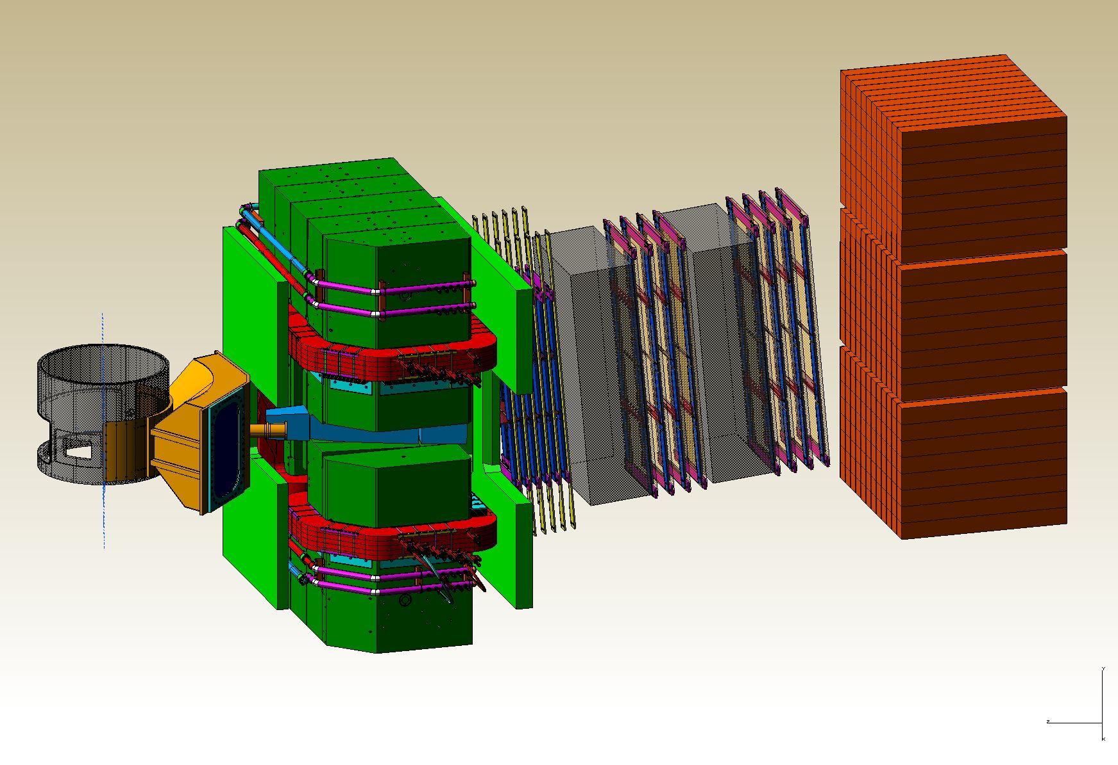
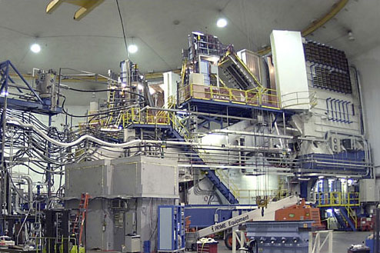
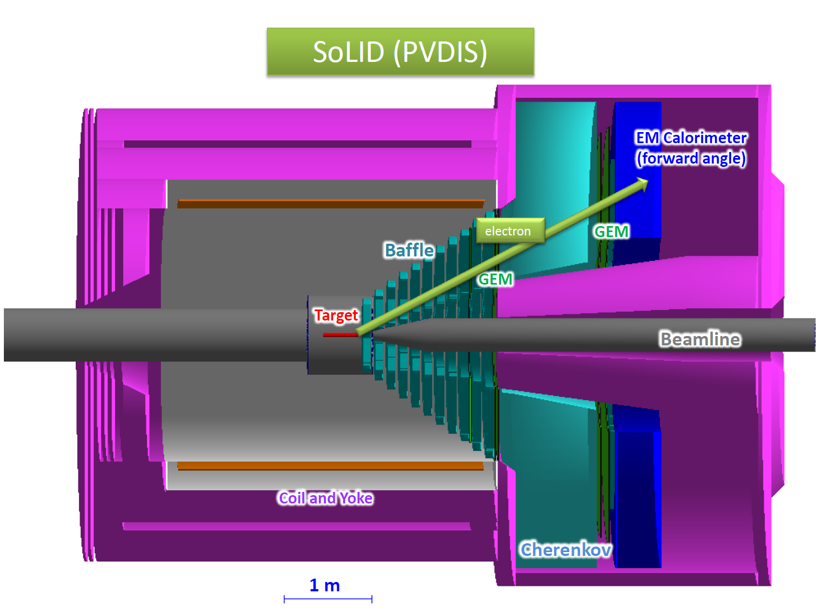
Hall A Update
Thia Keppel
User Group Board of Directors
June 2016

Slide 2
Hall A Projected Experiment Schedule, updated 1/2016
Experiments in red represent PAC42 “high impact” experiments
Spring | Fall | Spring | Fall | Spring | Fall | Spring | Fall
DVCS –I/ GMp | DVCS –I/ GMp
 |  | DVCS –I/ GMp | DVCS –I/ GMp
 |  |  |  | ³H/³He group Ar(e,e’p)* | ³H/³He group Ar(e,e’p)* | TBD: APEX PREX12 CREX A₁^{n} DVCSII
 |  |  |  |  |  |  | SBS Start?
CY
2015
X
CY 2016
CY
2017
CY
2018
*possible best effort
MOLLER, SoLID →

Slide 3
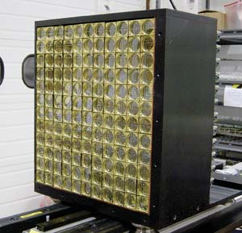
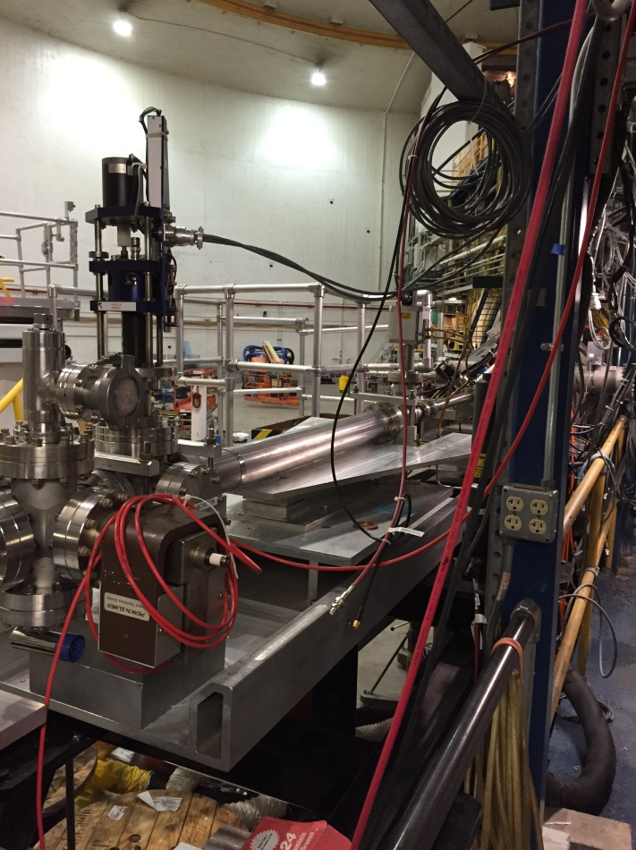
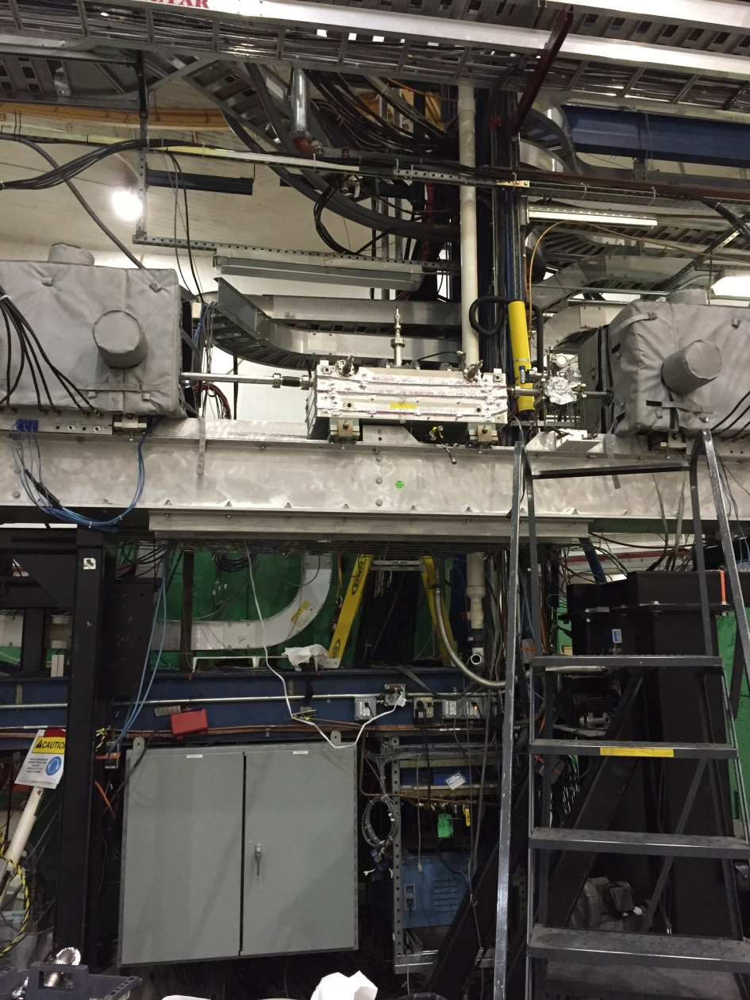
DVCS / G_{M}^{p} Experiments in the Hall now
Started up with the program Fall 2014
Started up again Spring 2015 with 20 uAmp, 11 GeV beam, resistive “SOS” quad on right arm
10 graduate students on site
Problems with HRS Q1-L limited momentum
New (high field) Moller polarimeter, additional beamline instrumentation
New target test cell
Notes:
F2 and C12 scans good for acceptance studies

Slide 4
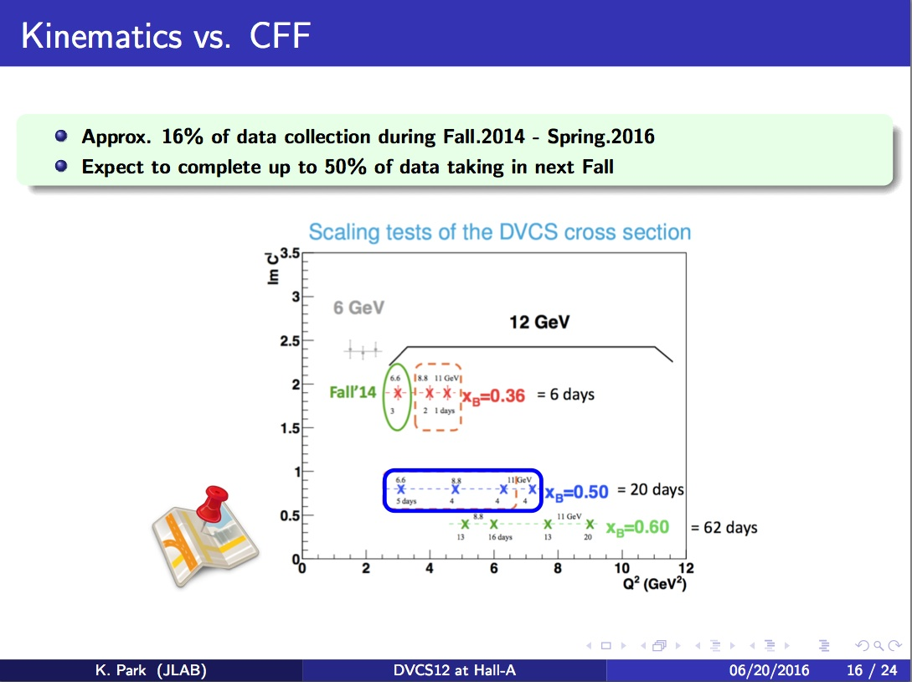
From K. Park talk at this User Group meeting

Slide 5
DVCS-I and G_{M}^{p}: Concurrent Experiments in Hall A at 11 GeV
Original projections for 10 calendar weeks in Spring’16
High impact experiment for 3D nucleon imaging
  Deeply Virtual Compton Scattering (DVCS) provides access to Generalized Parton Distributions (GPDs)
Will provide highest available Q² measurement of the DVCS cross section
  Demonstration of scaling critical to full JLab 12 GeV GPD program
DVCS
6.6
8.8
11 GeV
Fall’14
x
x
x
2
3
1 days
G_{M}^{p}
x
x
x
x
6.6
8.8
11 GeV
5 days
4
4
4
x
x
x
x
8.8
11 GeV
13
16 days
13
20
High Q² Form Factors
  Reducing G_{M}^{p} uncertainties will enable Super BigBite high impact program of Form Factor Measurements

Slide 6
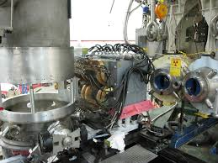
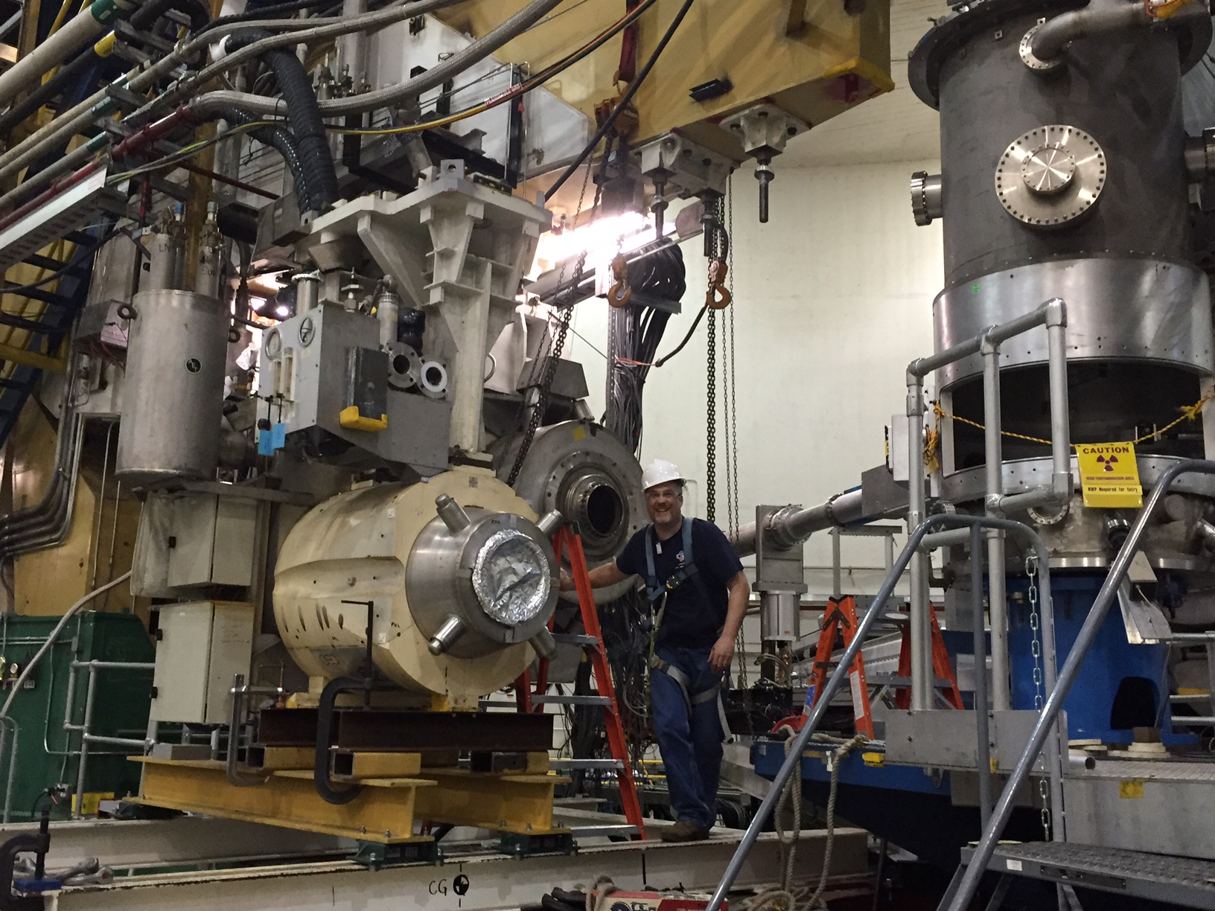
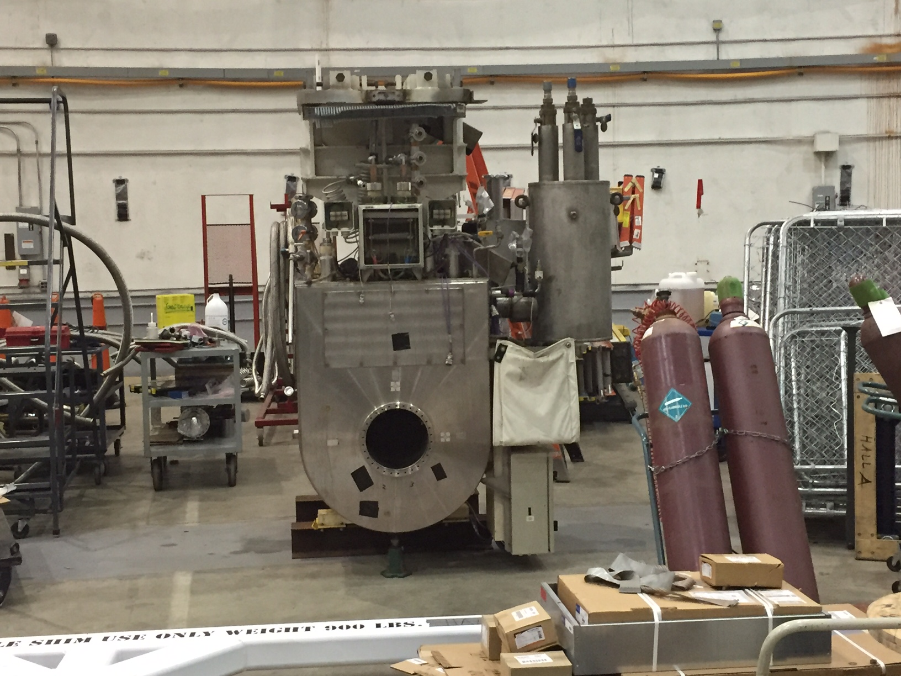
“New” Resistive Q1 Magnets
    SOS quad functioned well on HRS-R
      Multiple optics studies, data obtained by GMp/DVCS
    HRS-L new SOS twin due at lab this July 2016
      Install this summer
      Will permanently replace superconducting quads
    Mounts to allow forward/backward movement
    Power, water upgrades to Hall underway this Summer 2016
    - needed also for septum experiments, SBS, MOLLER

Slide 7
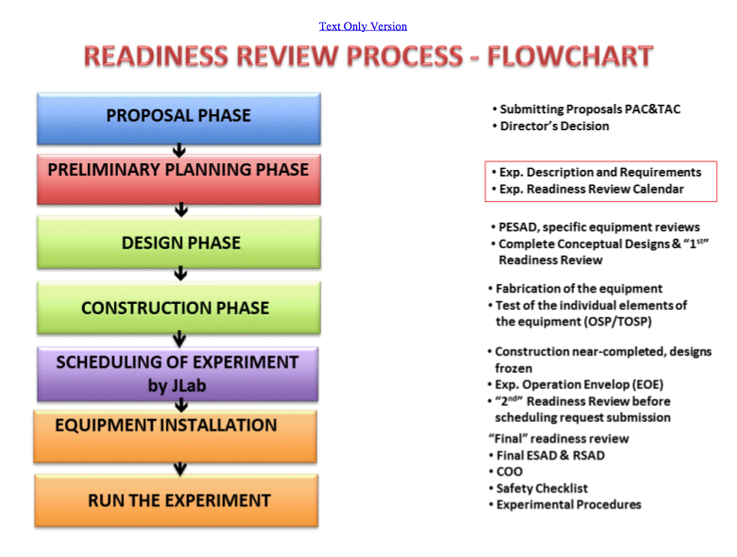
A lot of Hall A ERRs this year!!
Base equipment
DVCS/GMp
³H – OK to schedule, ~one more review
APEX – OK to schedule, ~one more review
PREX2/CREX – not yet OK to schedule, requires at least one more review
Ar(e,e’p) - July 21
http://www.jlab.org/div_dept/physics_division/experiments/scheduling.html

Slide 8
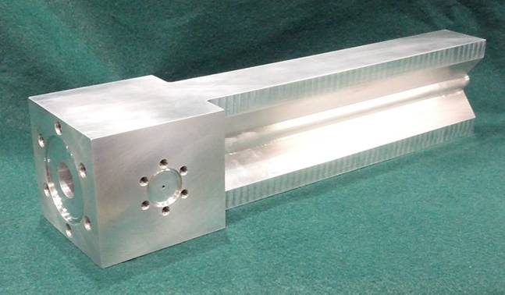
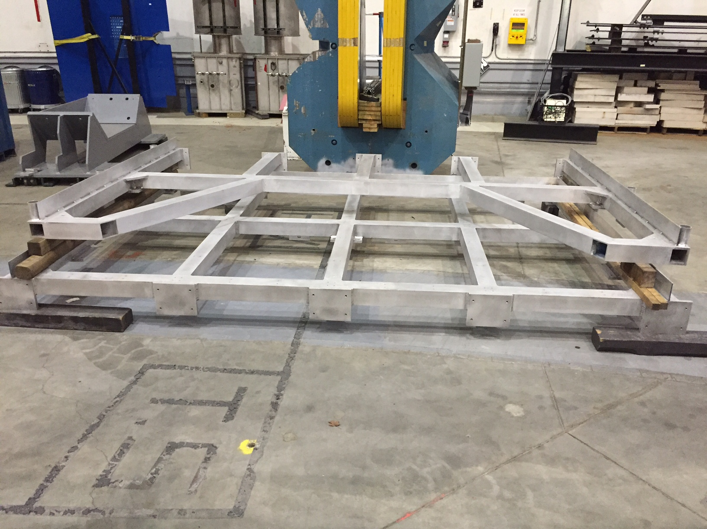
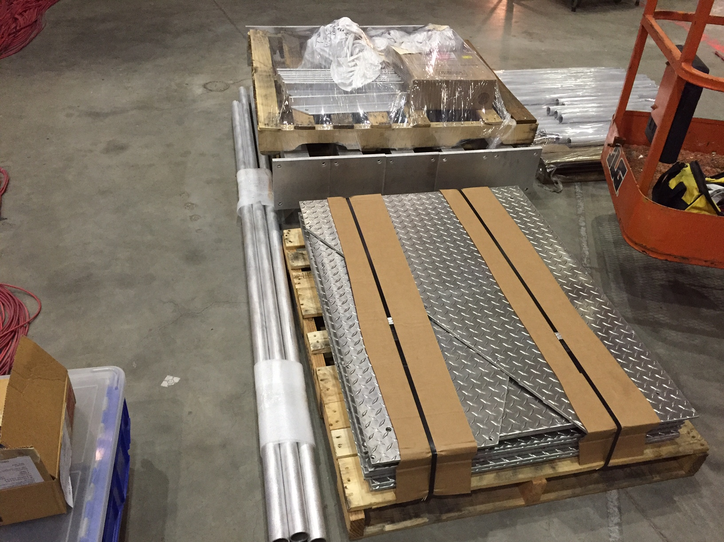
Tritium Experiment Preparations
Four experiments approved by PAC 42, 2 PAC 40 “high impact”
Successful target safety/design review September 2015
Successful ERR March 2016
BigBite no longer planned for use
Installation currently underway
  Vent system
  Power, water upgrades
  Target engineering
  Target installation platform
11 graduate students on site

Slide 9
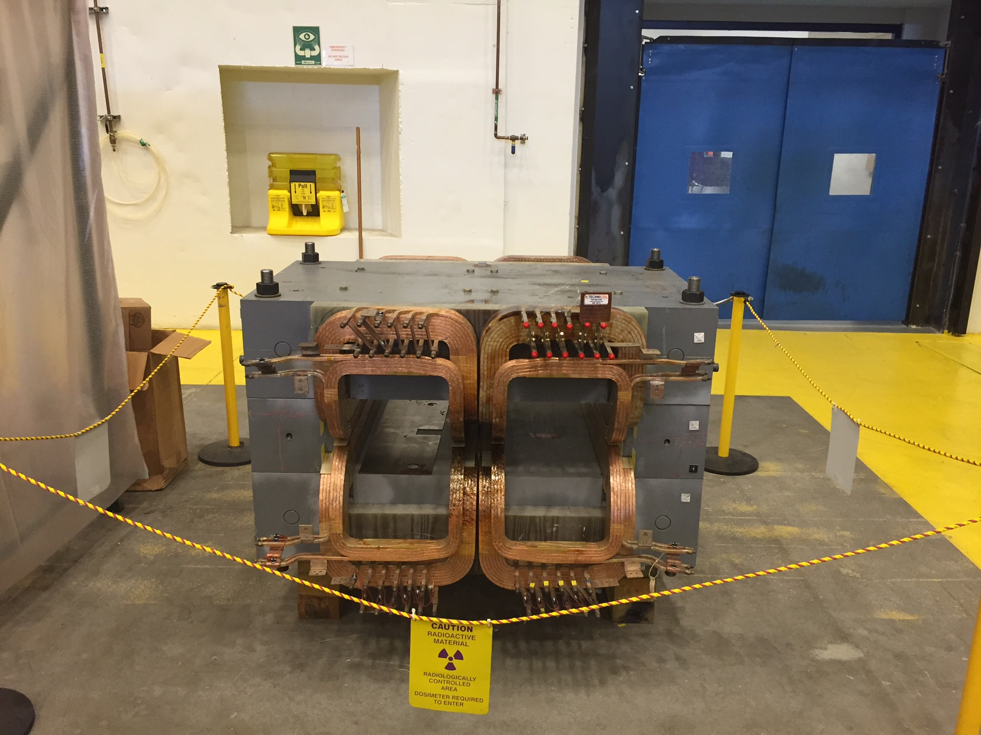
Beyond ³H
    Polarized ³He target improvements and continued development
        Convection, new lasers, metal windows, …
        Phase I upgrade of existing target – implementable in either Hall
        Phase II (SBS GEn type) design report draft in January
        Expect to freeze design this Summer
    PREX/CREX
        Pb and diamond targets, new coils purchased (and here at lab)
        Combined target chamber, shielding designs underway
        Computation fluid dynamics for target design
        Beamline upgrades
          Second x,y,Q girder (from Hall C), new “Musson” cavity electronics, Hall C halo
          monitor installed in A, lumi monitors installed and first pass tests started
        Polarimetry
          First Compton polarimetry accomplished in Spring 2016 Run
          New high field Moller commissioning in Spring 2016 run
    APEX
        New septum magnet purchased by collaboration now in test lab, added fittings and
        manifold
        Computation fluid dynamics for target design

Slide 10
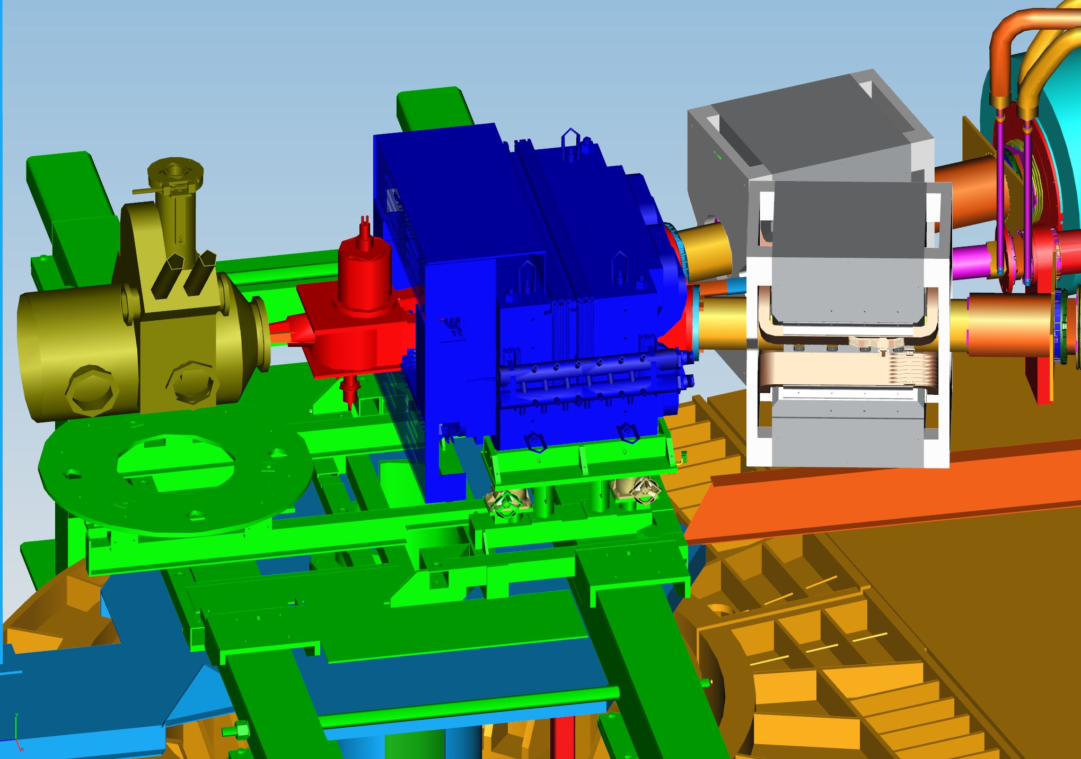
PREX2/CREX Hall Configuration
Resistive Q1 Magnets
Scattering Chamber
Collimator
Septum
Septum Support

Slide 11
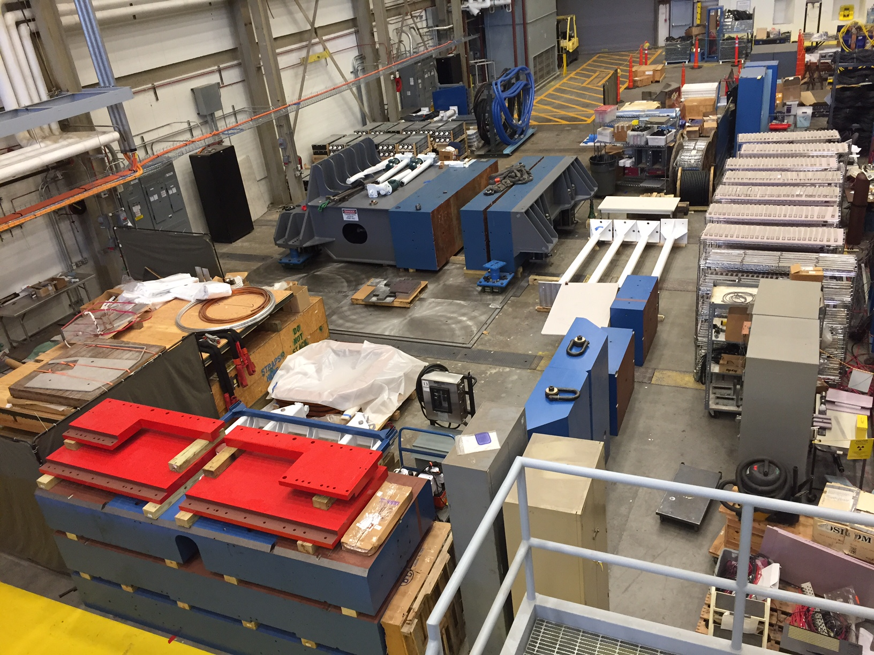
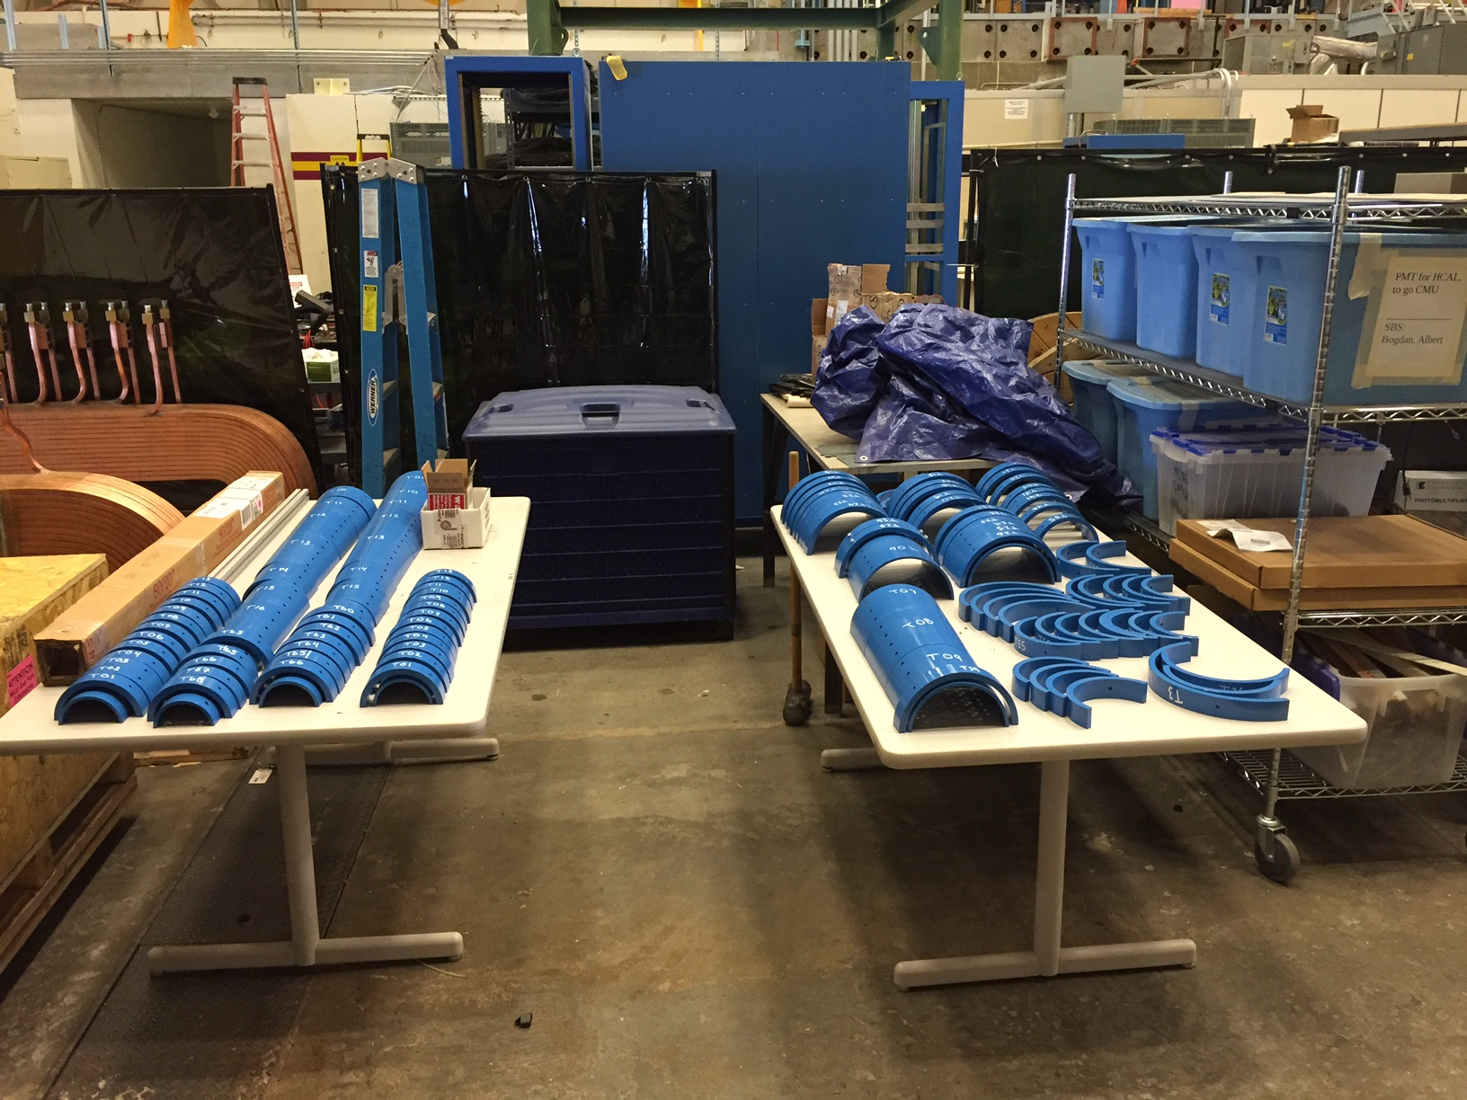
SBS Construction
Project started FY2013
  Successfully passed third annual review November 2015
  Preparing for Final in Fall 2016!
  Some concerns about thermal annealing/design of ECAL and 3He target timeline
  Overall very positive, project on track
Spectrometer, ECAL work at Jlab
GEM construction at UVA
Coordinate detector from Idaho State
HCAL Hadron calorimeter from CMU

Slide 12
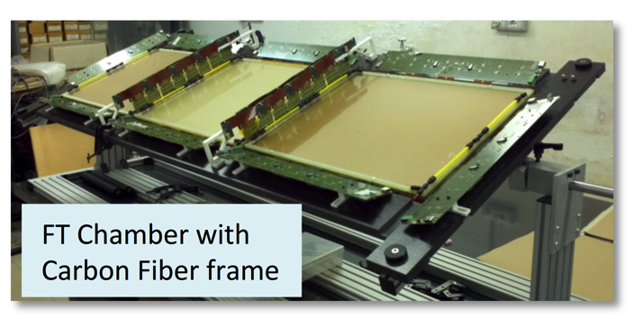
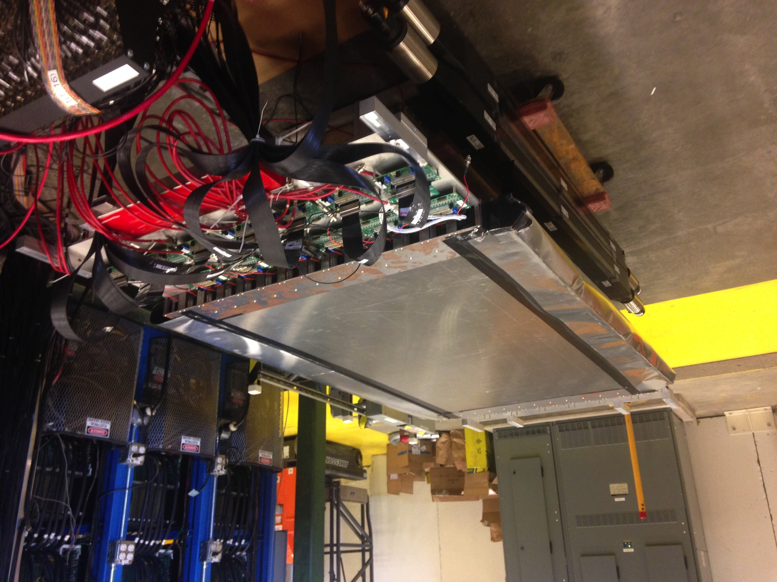
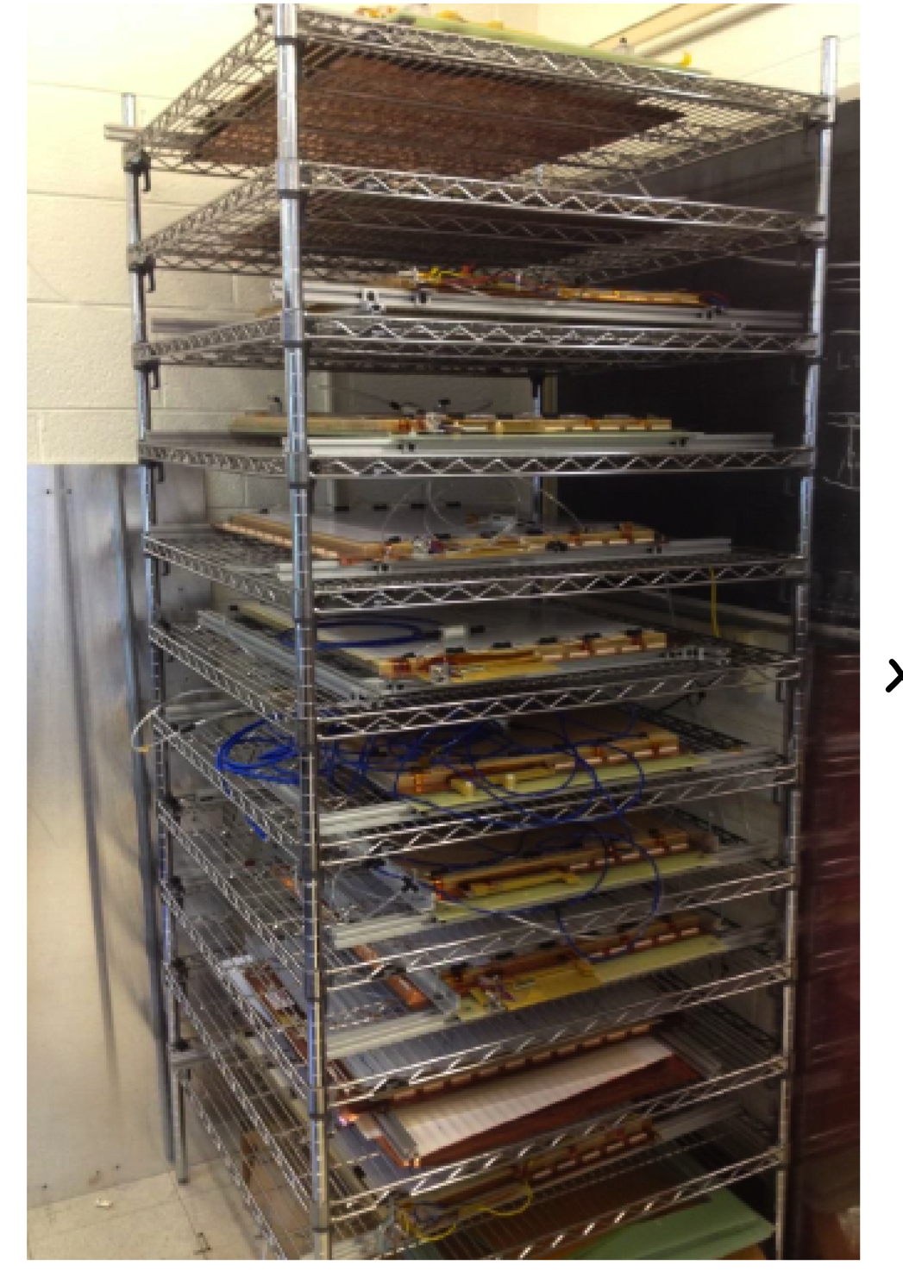
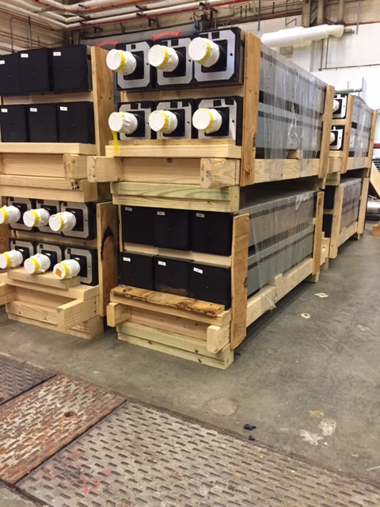
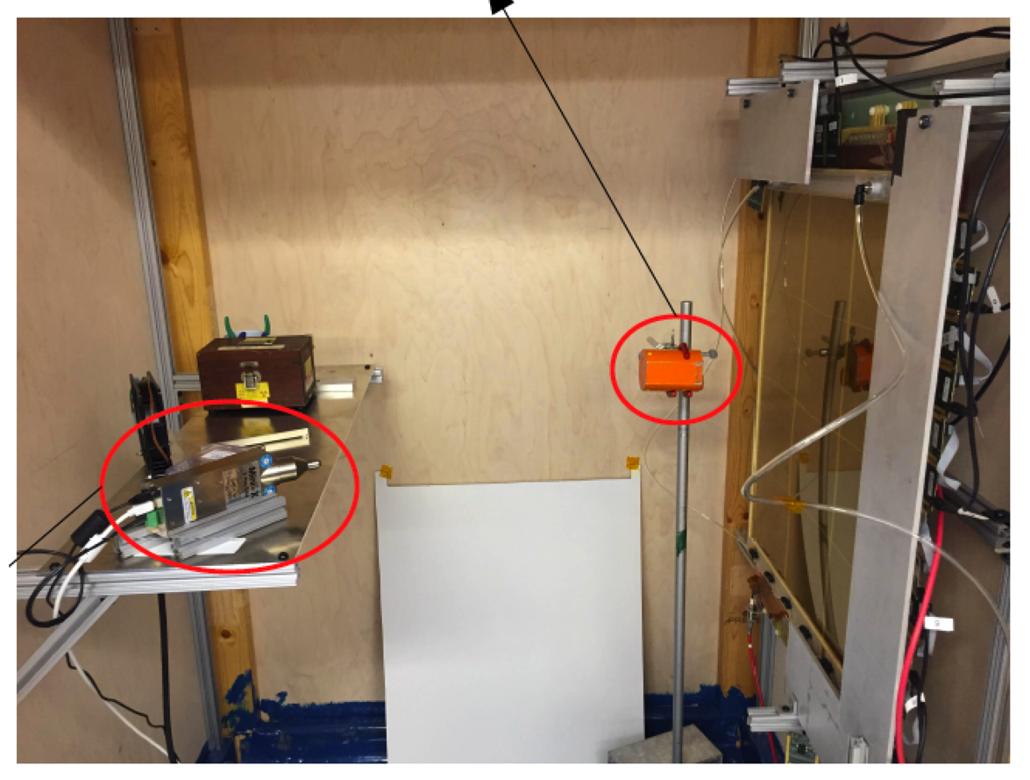
Super Bigbite Spectrometer (SBS) Detectors
CDET module 1 ready for cosmic testing with full data acquisition
INFN Front Tracker GEM chamber with carbon fiber frame at JLab
Rear GEM tracker modules at UVA, 32 constructed + 28 tested
UVa High rate X-ray testing setup for GEMs
168 out of 288 Hadron Calorimeter modules at JLab

Slide 13
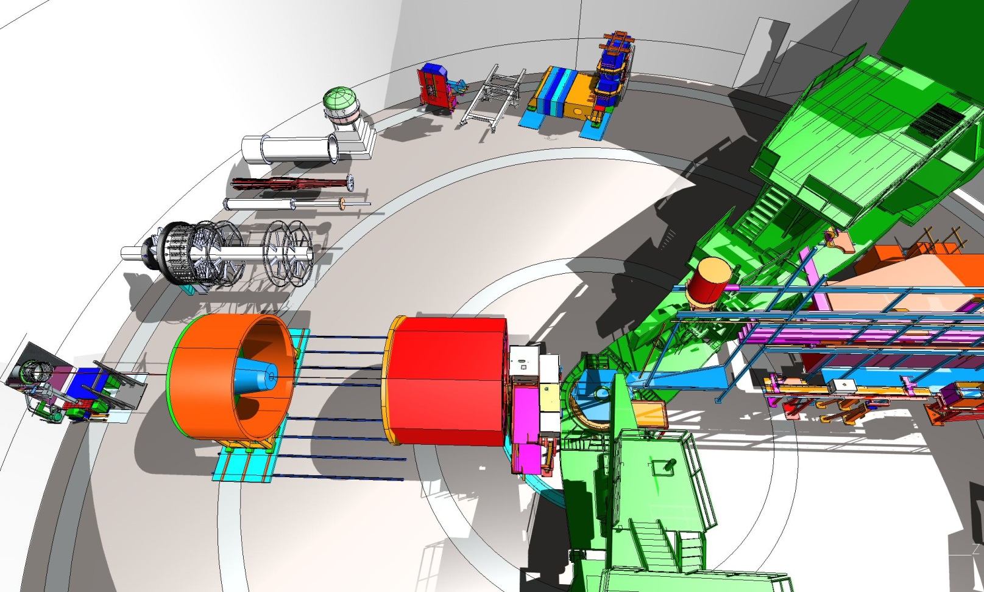
Moving to more future installations – MOLLER and SoLID

Slide 14
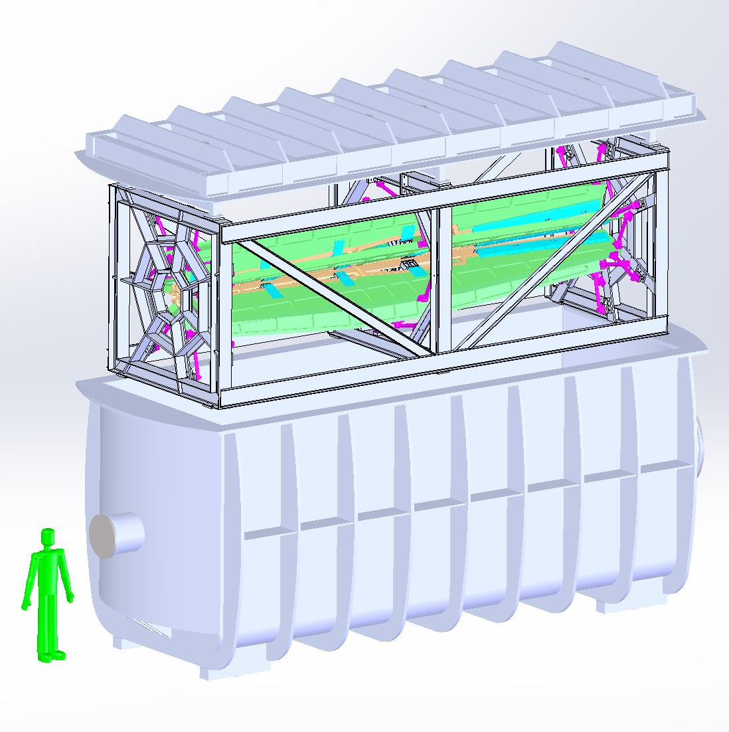
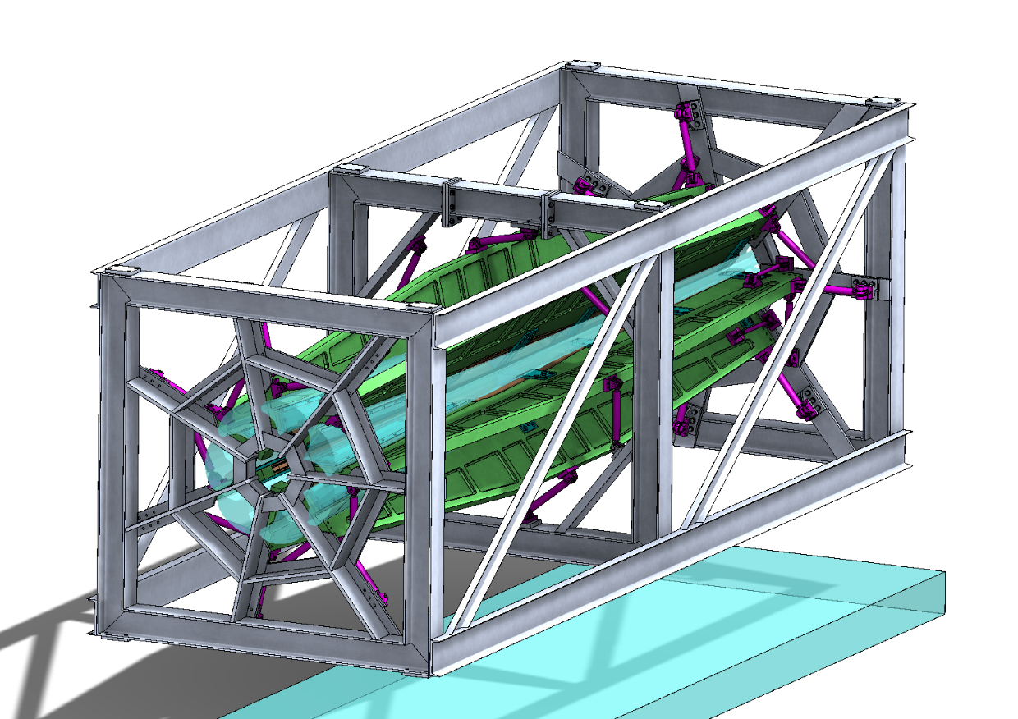
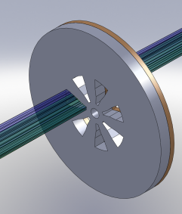
MOLLER
    Successful Science Review September 2014
    Supporting ongoing magnet and collimator development work at MIT
      July 2016 informal on site (at JLab) report
    New Moller polarimeter and parity beamline instrumentation in place, initial use in DVCS
    Anticipate Director’s cost, schedule, technical review late in 2016
      Working on updating documentation
    Looking towards CD0 2018

Slide 15
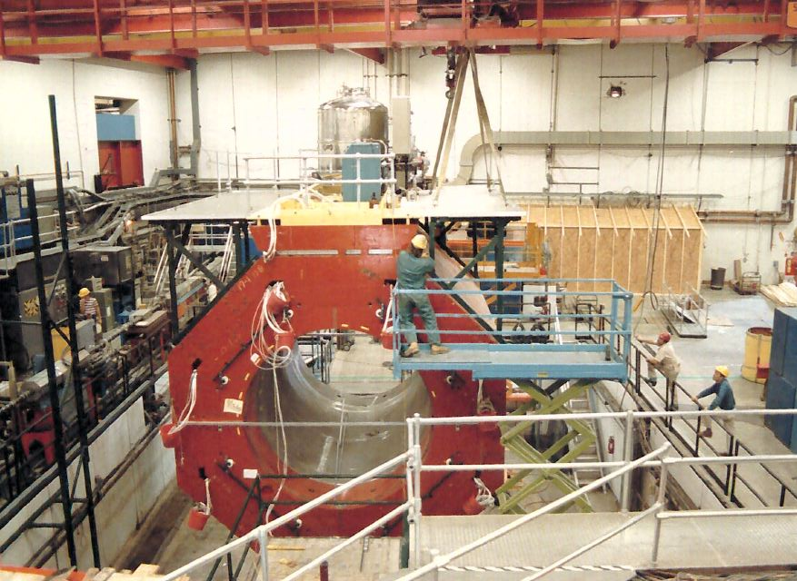

SoLID
    Director’s Review February 2015
    Looking towards Science Review in 2017, CD0 in 2019
    Continued detector optimization
      Background studies
      Magnetic fields
    Cost and manpower

Slide 16
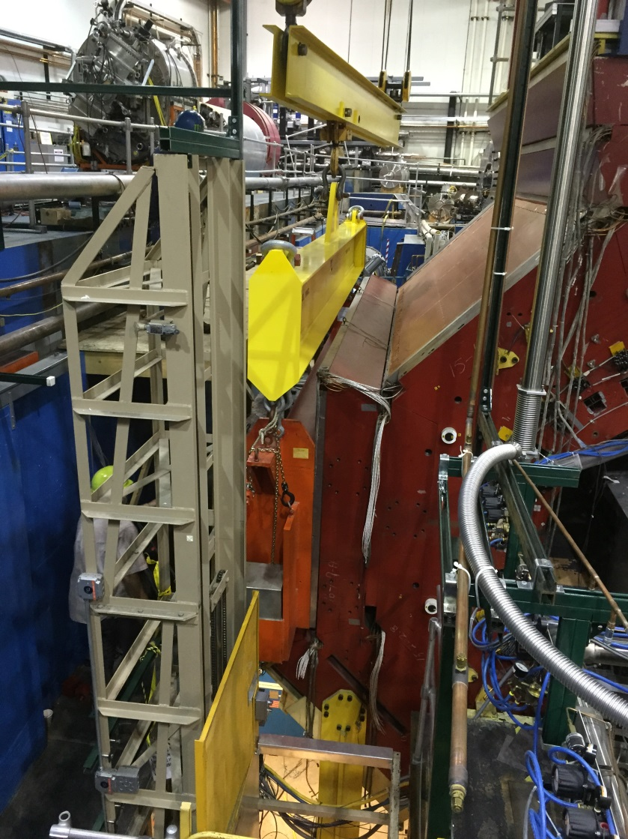
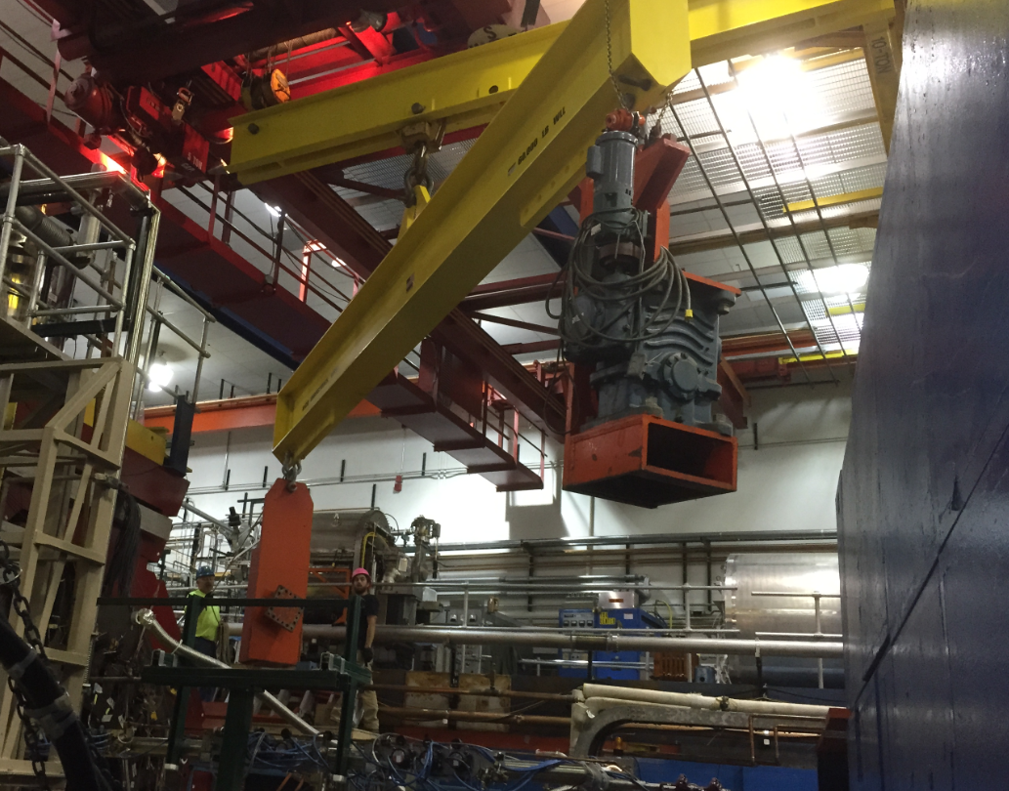
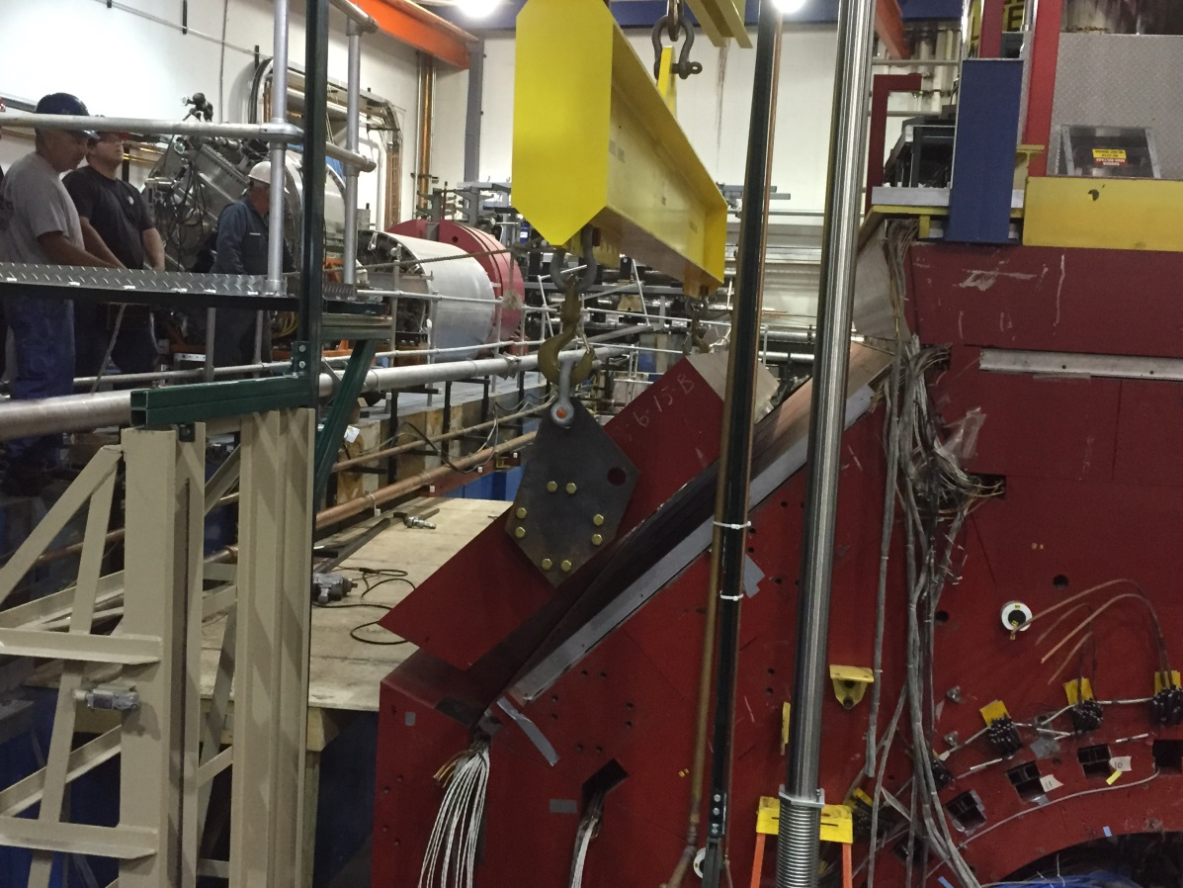
Transport and Storage of CLEO II
Disassembled and loaded on trucks for shipping by the Cornell personnel with oversight by Jefferson Lab this Summer/Fall CY 2016.
Will require 52 trucks to transport the magnet and related equipment.
We have identified all of the parts of the CLEO magnet, with sizes and weights, anticipating a need for storage of these parts at Jefferson Lab starting Summer 2016, total weight of 1,053k lbs.
The cryostat (44k lbs) and power supply will need to be stored in an environment-controlled area of approximately 400 square feet. Space in the Test Lab and utility needs have been requested.

Slide 17
Publications in 2016
d2n and A1n: D. Flay et al., arXiv:1603.03612 (submitted)
Proton radius: D. Higinbotham et al., Phys. Rev. C93 (2016) 5, 055207
elastic He3/He4: M. Petratos, M. Katramatou, et al., draft out to collaboration

Slide 18
Thanks!
Questions?

