Slide 1



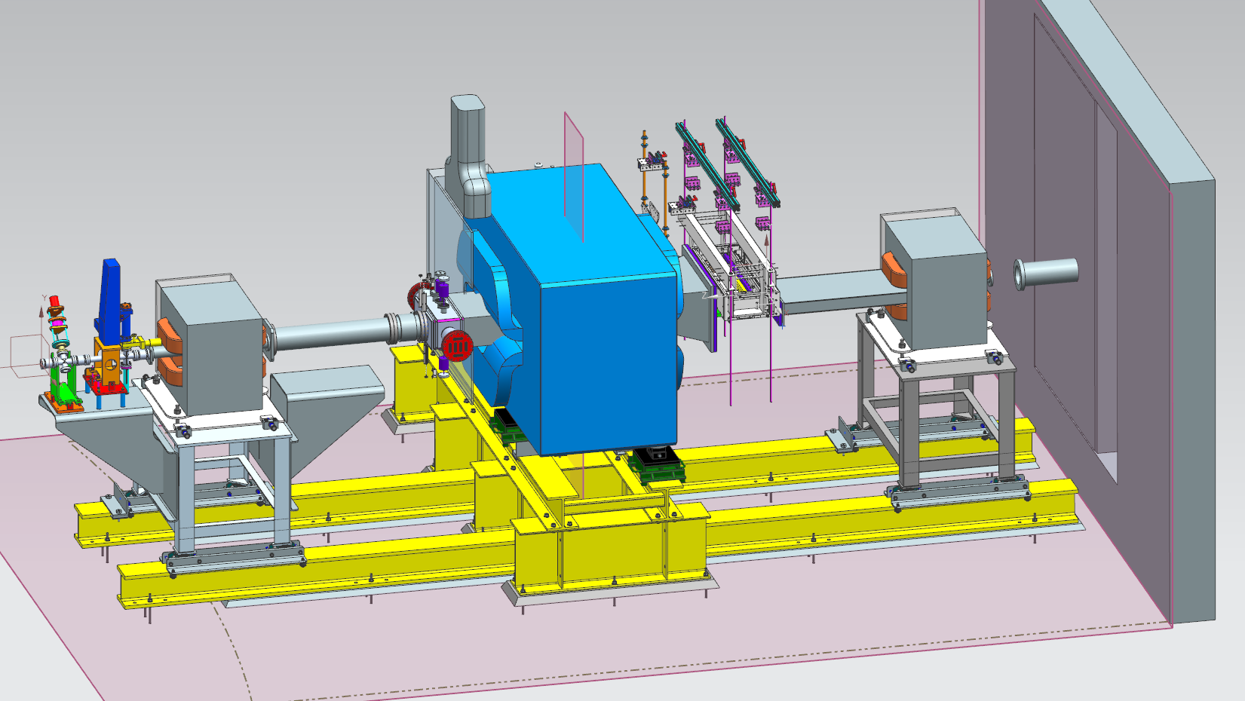
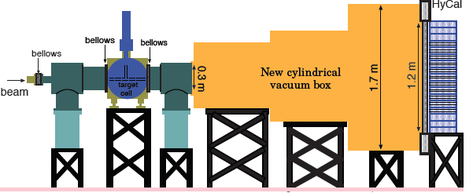
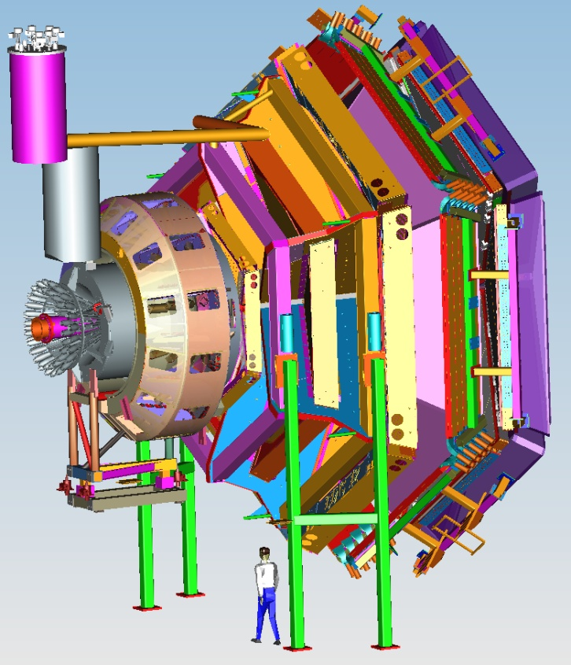


Status of Hall B
Volker D. Burkert
CLAS12
2016 publications
HPS update
PRAD status
CLAS12 + upgrades
Schedule
Conclusions
User Group BoD Meeting
June 21, 2016

Slide 2
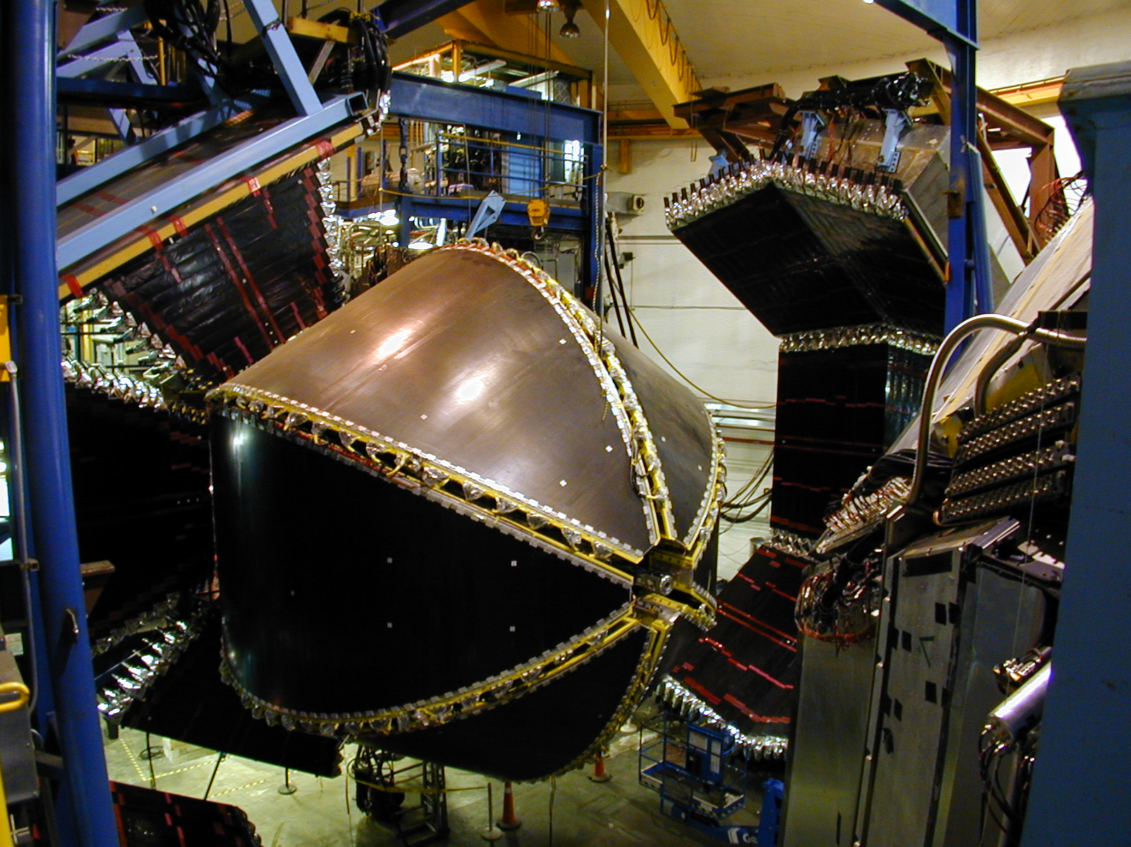
Publications since 01/2016 meeting
Senderovich et al., First measurement of the helicity asymmetry E inηphotoproduction on the proton, Phys.Letts. B755 (2016) 64
P. Bosted et al., Target and Beam-Target Spin Asymmetries in Excl. π+ and π−Electroproduction with 1.6 to 5.7 GeV Electrons, arXiv:1604.04350 (2016)
C. A. Paterson et al., Photoproduction of Λand Σhyperons using linearly polarized photon,
Phys. Rev. C.93.06520, 2016
V.I. Mokeev et al., New Results from the Studies of the N(1440)1/2+, N(1520)3/2−, andΔ(1620)1/2− Resonances in exclusive ep→epπ+π- Electroproduction with CLAS, Phys.Rev. C93, 025206, 2016
R. Dixon et al., Photoproduction of the f1(1285) Meson, Phys. Rev. C 93.065202, 2016

Slide 3

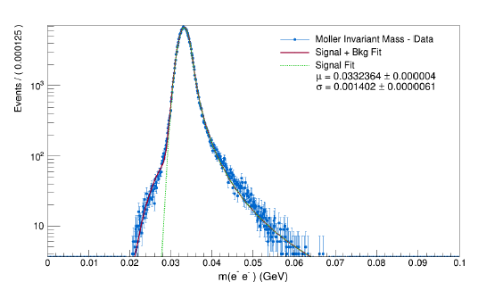
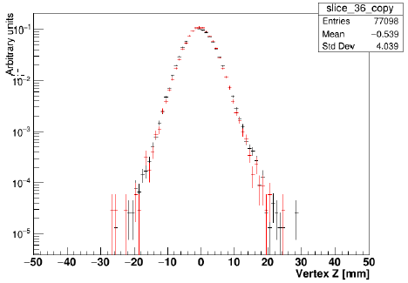
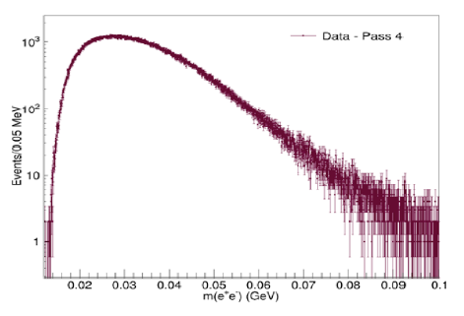
HPS Update
Hall B
HPS searches for an electro-produced hidden sector photon (A’) decaying to e⁺e⁻ pairs
A’s could mediate dark matter annihilations and interactions with our matter
HPS identifies A’s with invariant mass and separated vertices
2015 Engineering Run at 1.05 GeV
Successfully ran with SVT just 500 μm from electron beam!
Physics Readiness Documented: HPS works as designed
JLab has granted approval for full HPS run request (180 days – 15 used so far)
Bump Hunt Results from the 2015 run coming soon!
Mass Resolution ~ Design Vertex Tails as Simulated Measured e⁺e⁻ Masses

Slide 4
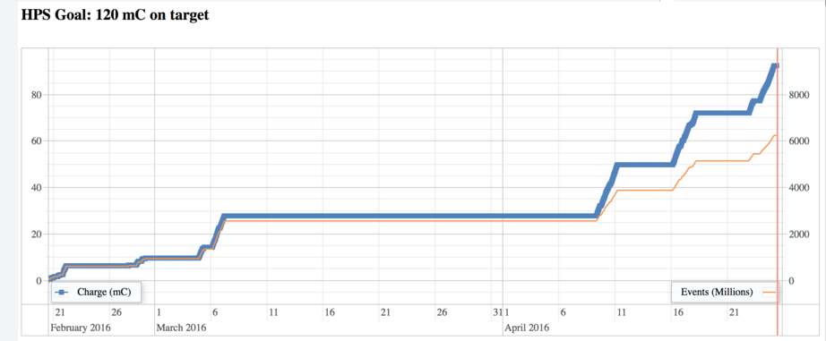
2016 Running
Hall B
Great Running
CHL and Machine Config Issues
First Good Weekend
CLAS12 construction required weekends-only running for HPS. Started Feb 4.
Last minute extension saves the day: three weeks in April. THANK YOU!
Achieved ~89% of goal. Plenty for a physics result at 2.3 GeV

Slide 5
A’ Search Underway
Hall B
First results at 1.05 GeV (~1.6 PAC days)
* Bump hunt due late summer will
cross-check well trod region.
* Vertex search end of 2016 will cover
virgin territory. New physics?
Results at 2.3 GeV (~ 5 PAC days)
* Both bump hunt and vertex search
analyses cover a higher mass window
* More new territory!
* Hope for results in 2017
HPS Future
* Hope to install upgrade before 2018
which will boost reach considerably
* Extended run at 4.4 GeV (2018?)
* More runs at 1.1 and 2.3 GeV
2 PAC days at 1 GeV
Bump
Vertex
1 GeV
2.2 GeV
4.4 GeV
1 week 1.1 GeV
1 week 2.2 GeV
2 week 4.4 GeV

Slide 6
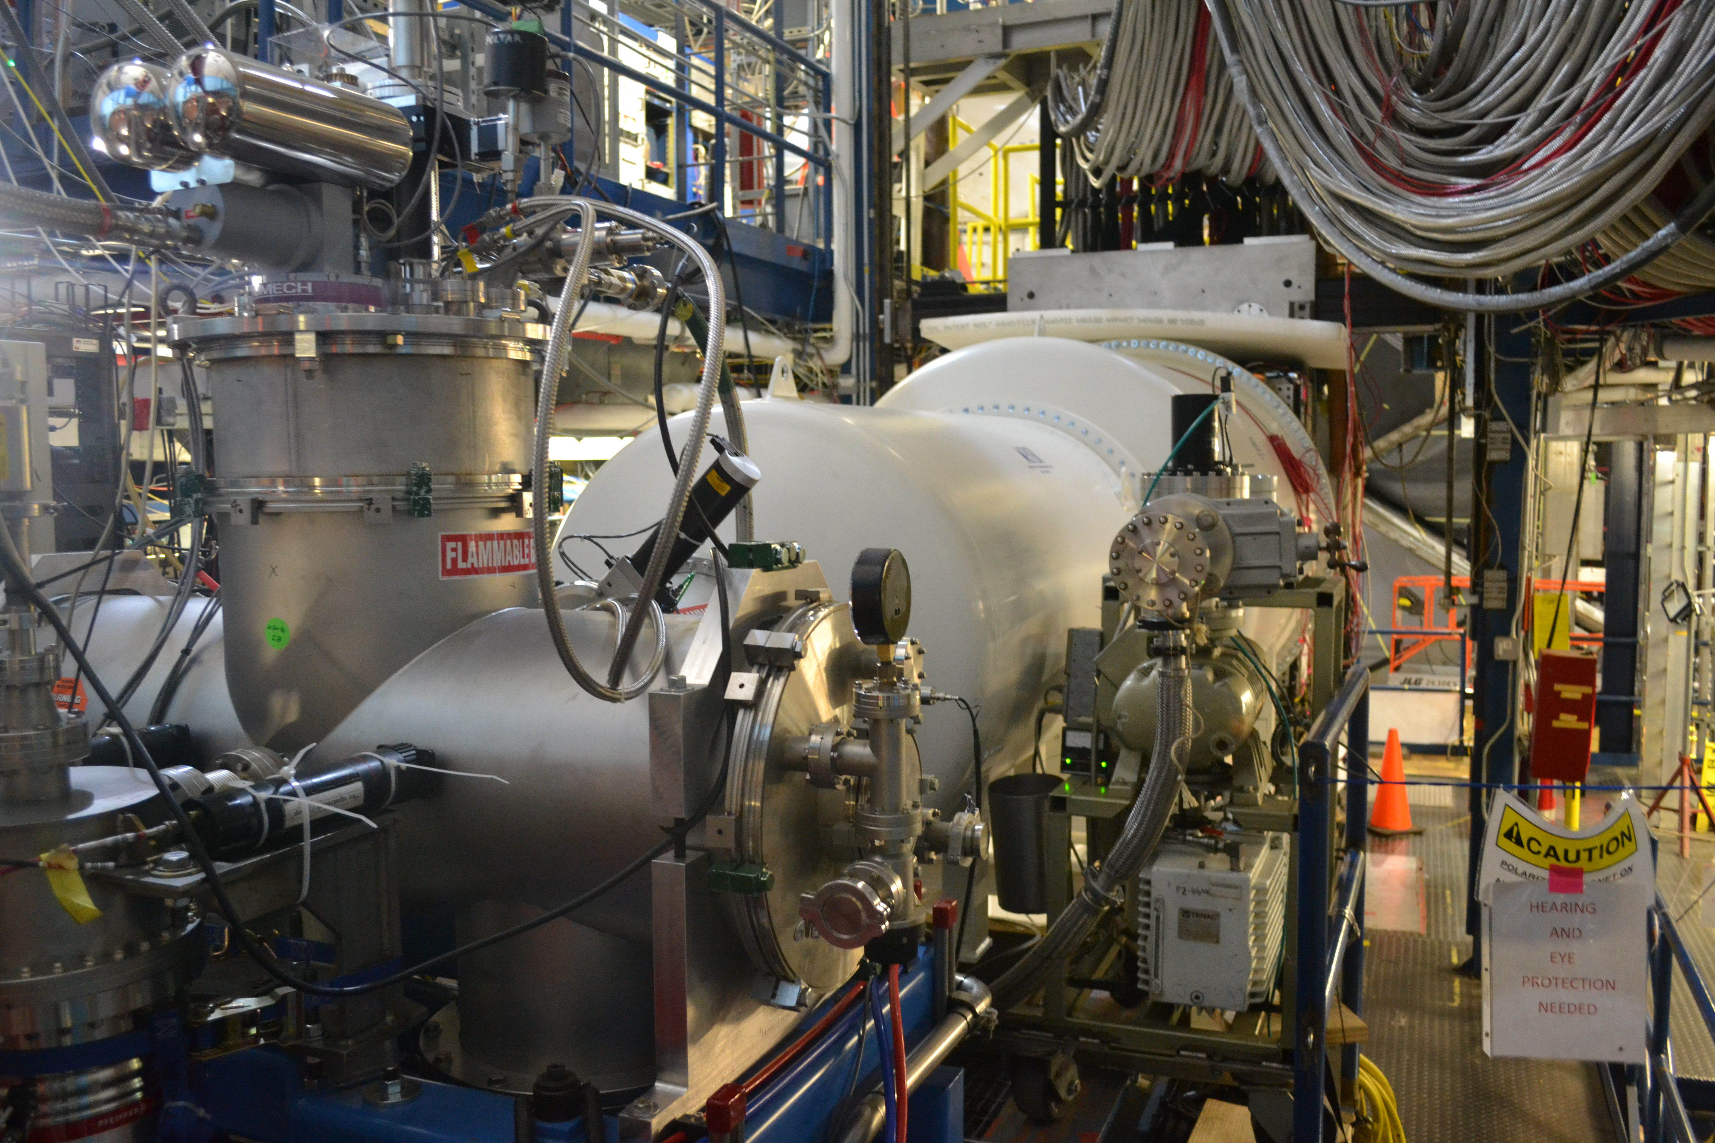
PRad Setup
Hall B
Components:
Open cell gas target, vacuum drift space, GEM tracker, HyCal
1.1 GeV Run:
# Events: 600M
~25% background
Event Rate: 5KHz
Data rate: 500MB/s
2.2 GeV Run:
So far 600M production events, taking production data until 6/22

Slide 7
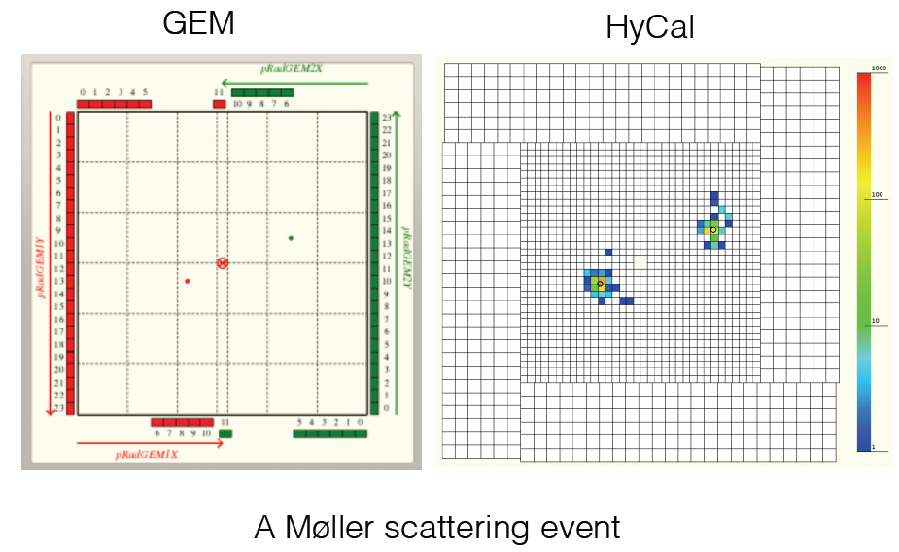
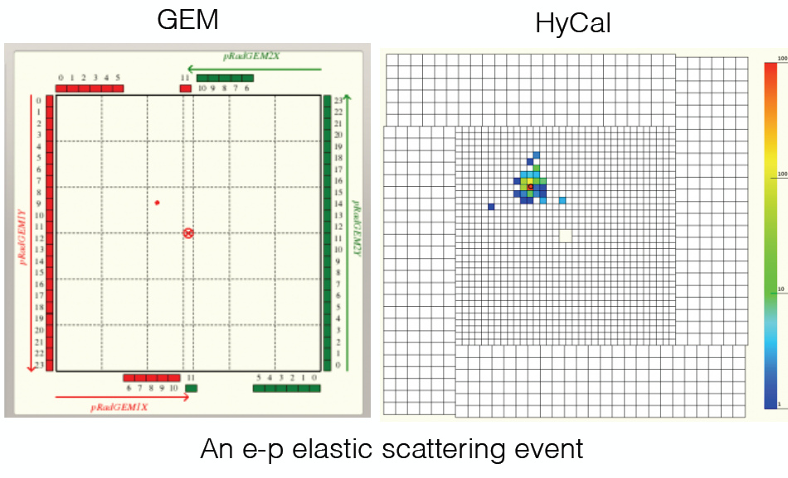
Events in HyCal & GEMs
Hall B
A Moller e⁻e⁻ event
An elastic ep event

Slide 8
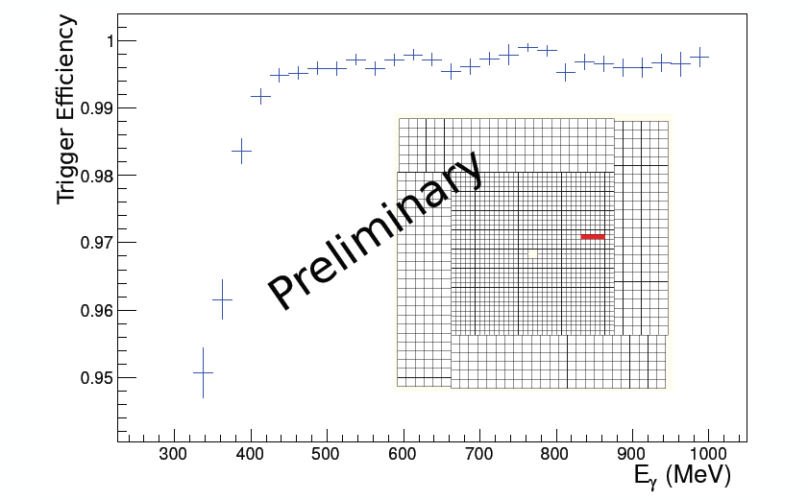
HyCal Trigger Efficiency
Hall B

Slide 9
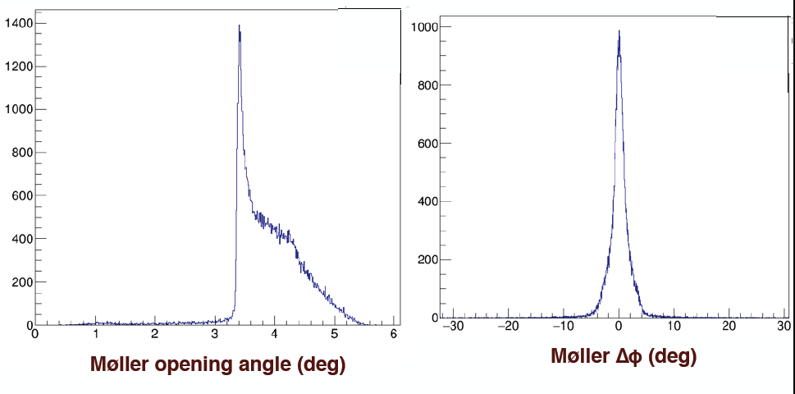
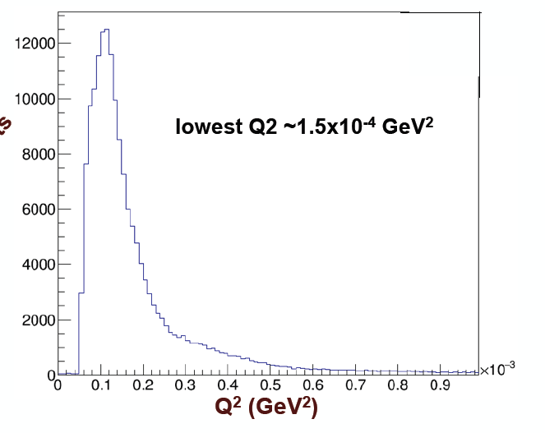
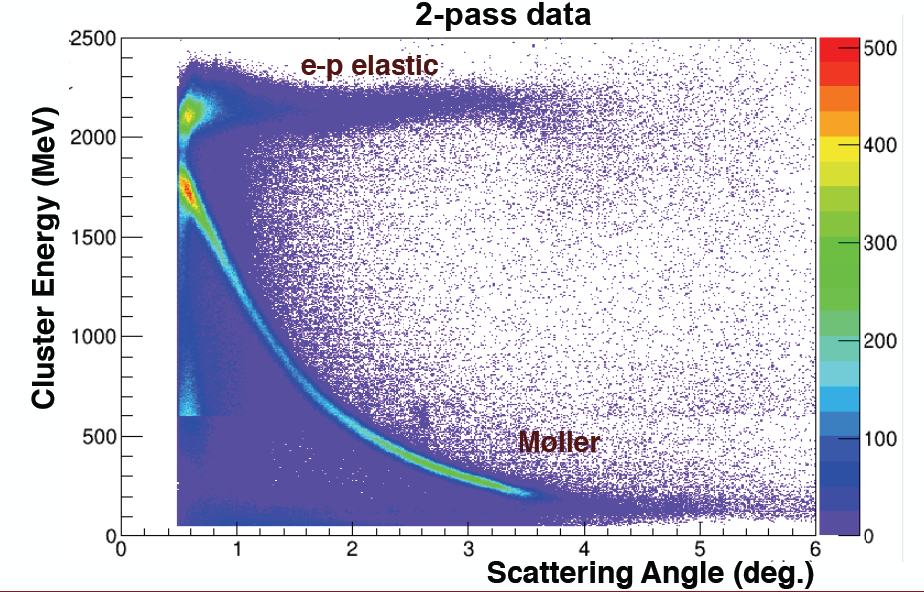
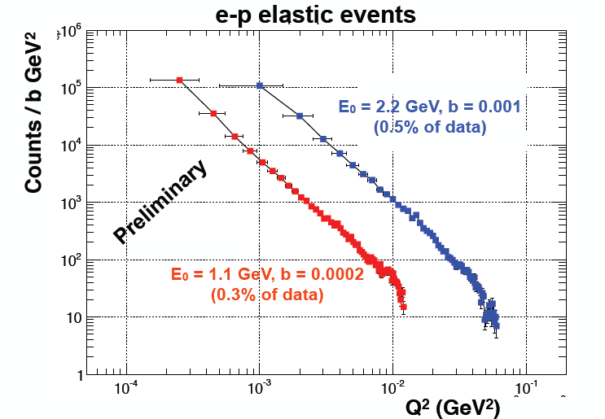
Moller e⁻e⁻ & Elastic ep
Hall B
Moller opening angle & co-planarity

Slide 10

Equipment
CLAS12
Hall B
Forward Detector (FD)
  - TORUS magnet
  HT Cherenkov Counter
  Drift chamber system
  LT Cherenkov Counter
  Forward ToF System
  Pre-shower calorimeter
  E.M. calorimeter
Central Detector (CD)
  SOLENOID magnet
  Silicon Vertex Tracker
  Central Time-of-Flight
Beamline
  Cryo Target
  Moller polarimeter
  - Shielding
  Photon Tagger
MM
CND
FT
Upgrade to the baseline
- Central Neutron Detector
  MicroMegas
  Forward Tagger
  RICH detector
  Polarized target
RICH

Slide 11
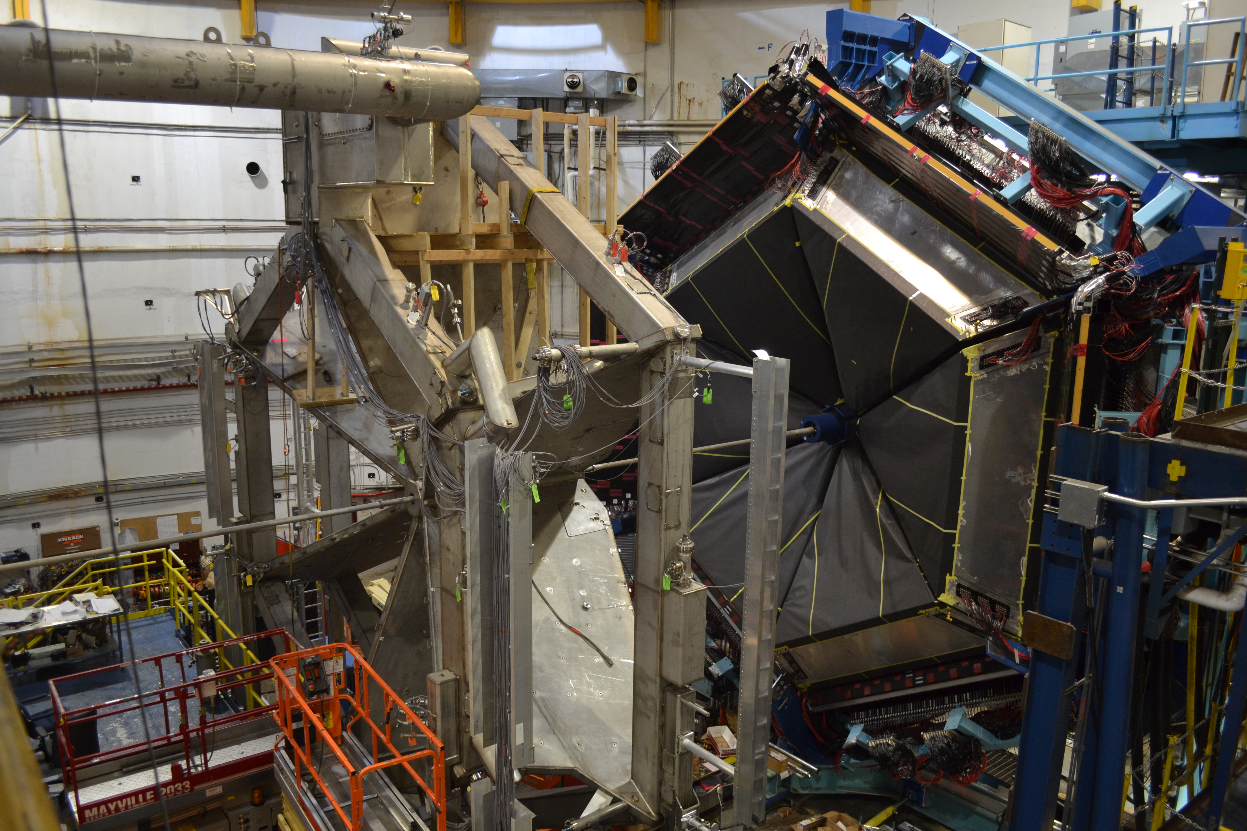
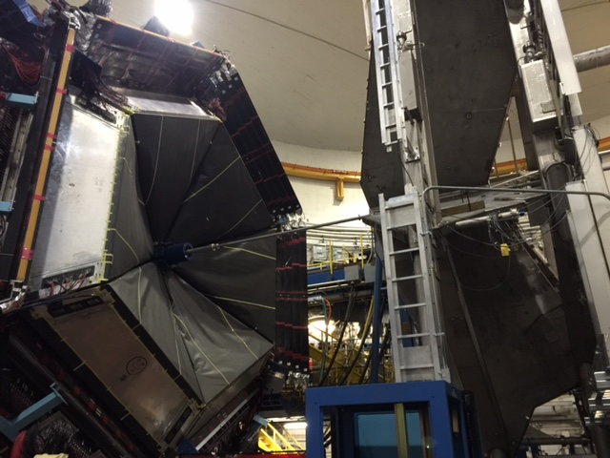
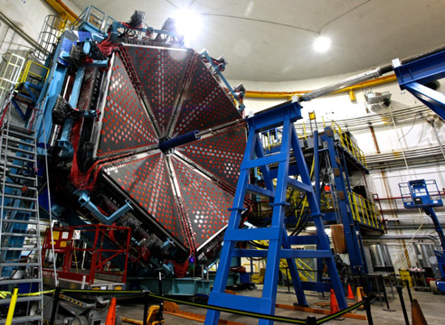
CLAS12
Hall B in February 2015
Hall B in February 2015
Hall B in June 2016
Hall B

Slide 12
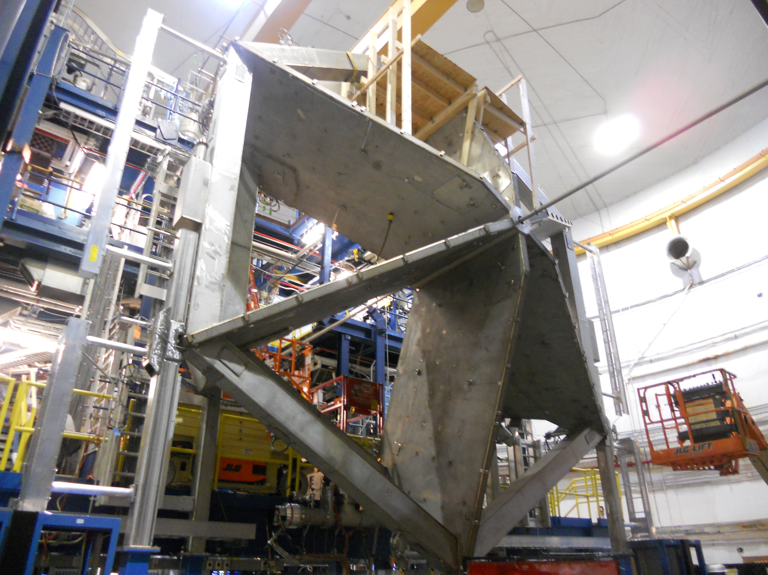
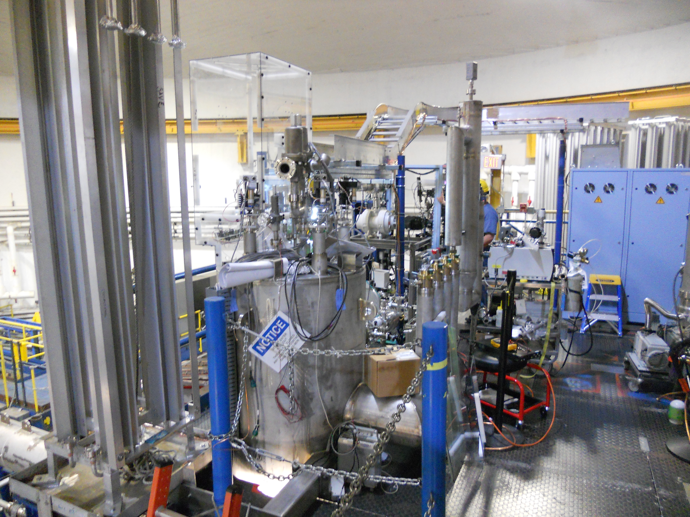
Torus Magnet Status
CLAS12
Hall B
Torus in Hall B
Torus Schedule
June 2016
Leak checking; pump down
Finish plumbing and piping
Instrumentation and controls
Cool-down readiness review
July 2016
Cool-down
Power-up readiness review
August 2016
Power tests
Field mapping
Cryogenic Distribution

Slide 13
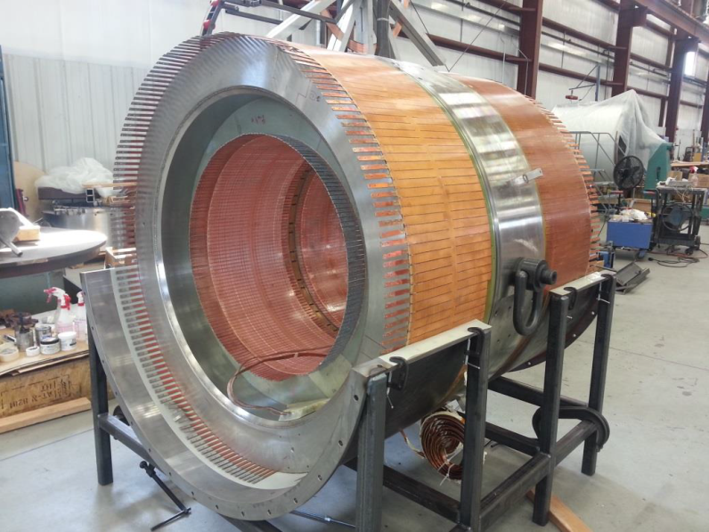
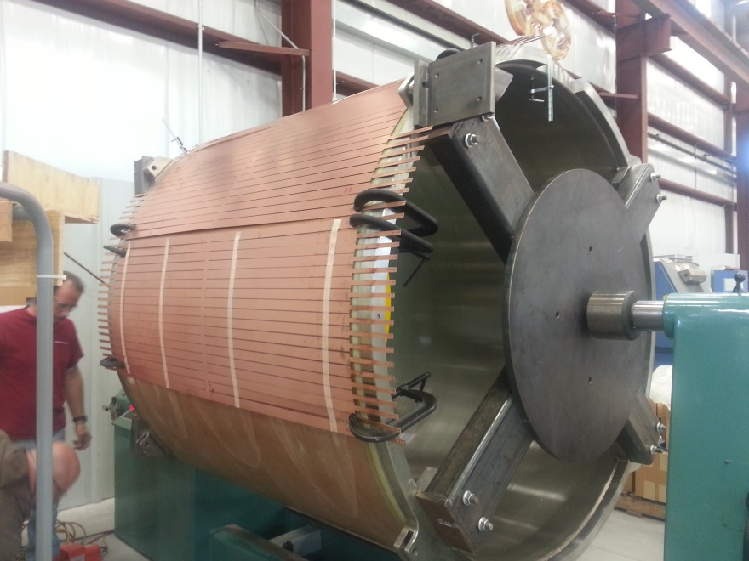
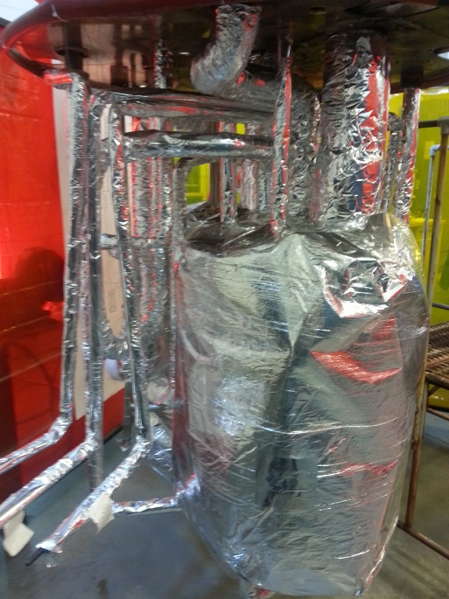
Solenoid Magnet Status
CLAS12
Hall B
Inner coil 1-4 assembly
Shield coil 5
6-9/2016: Cold mass assembly, 5 coils, thermal shield, MLI
10/2016: Final assembly, Installation of coils into cryostat; welding
11/2016: Tests at vendor; Ship to JLab
12/2016 – 2/2017: Add cryotower, Instrumentation and controls
2–3/2017: Cool-down, power tests, field mapping

Slide 14
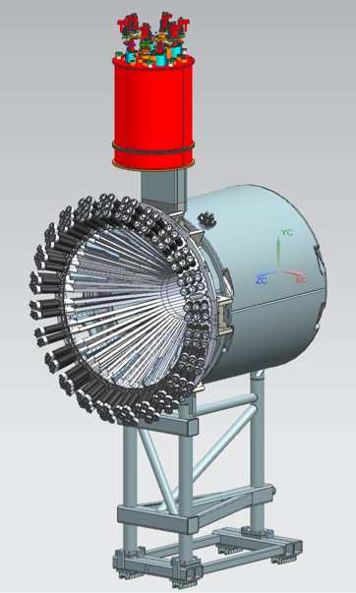

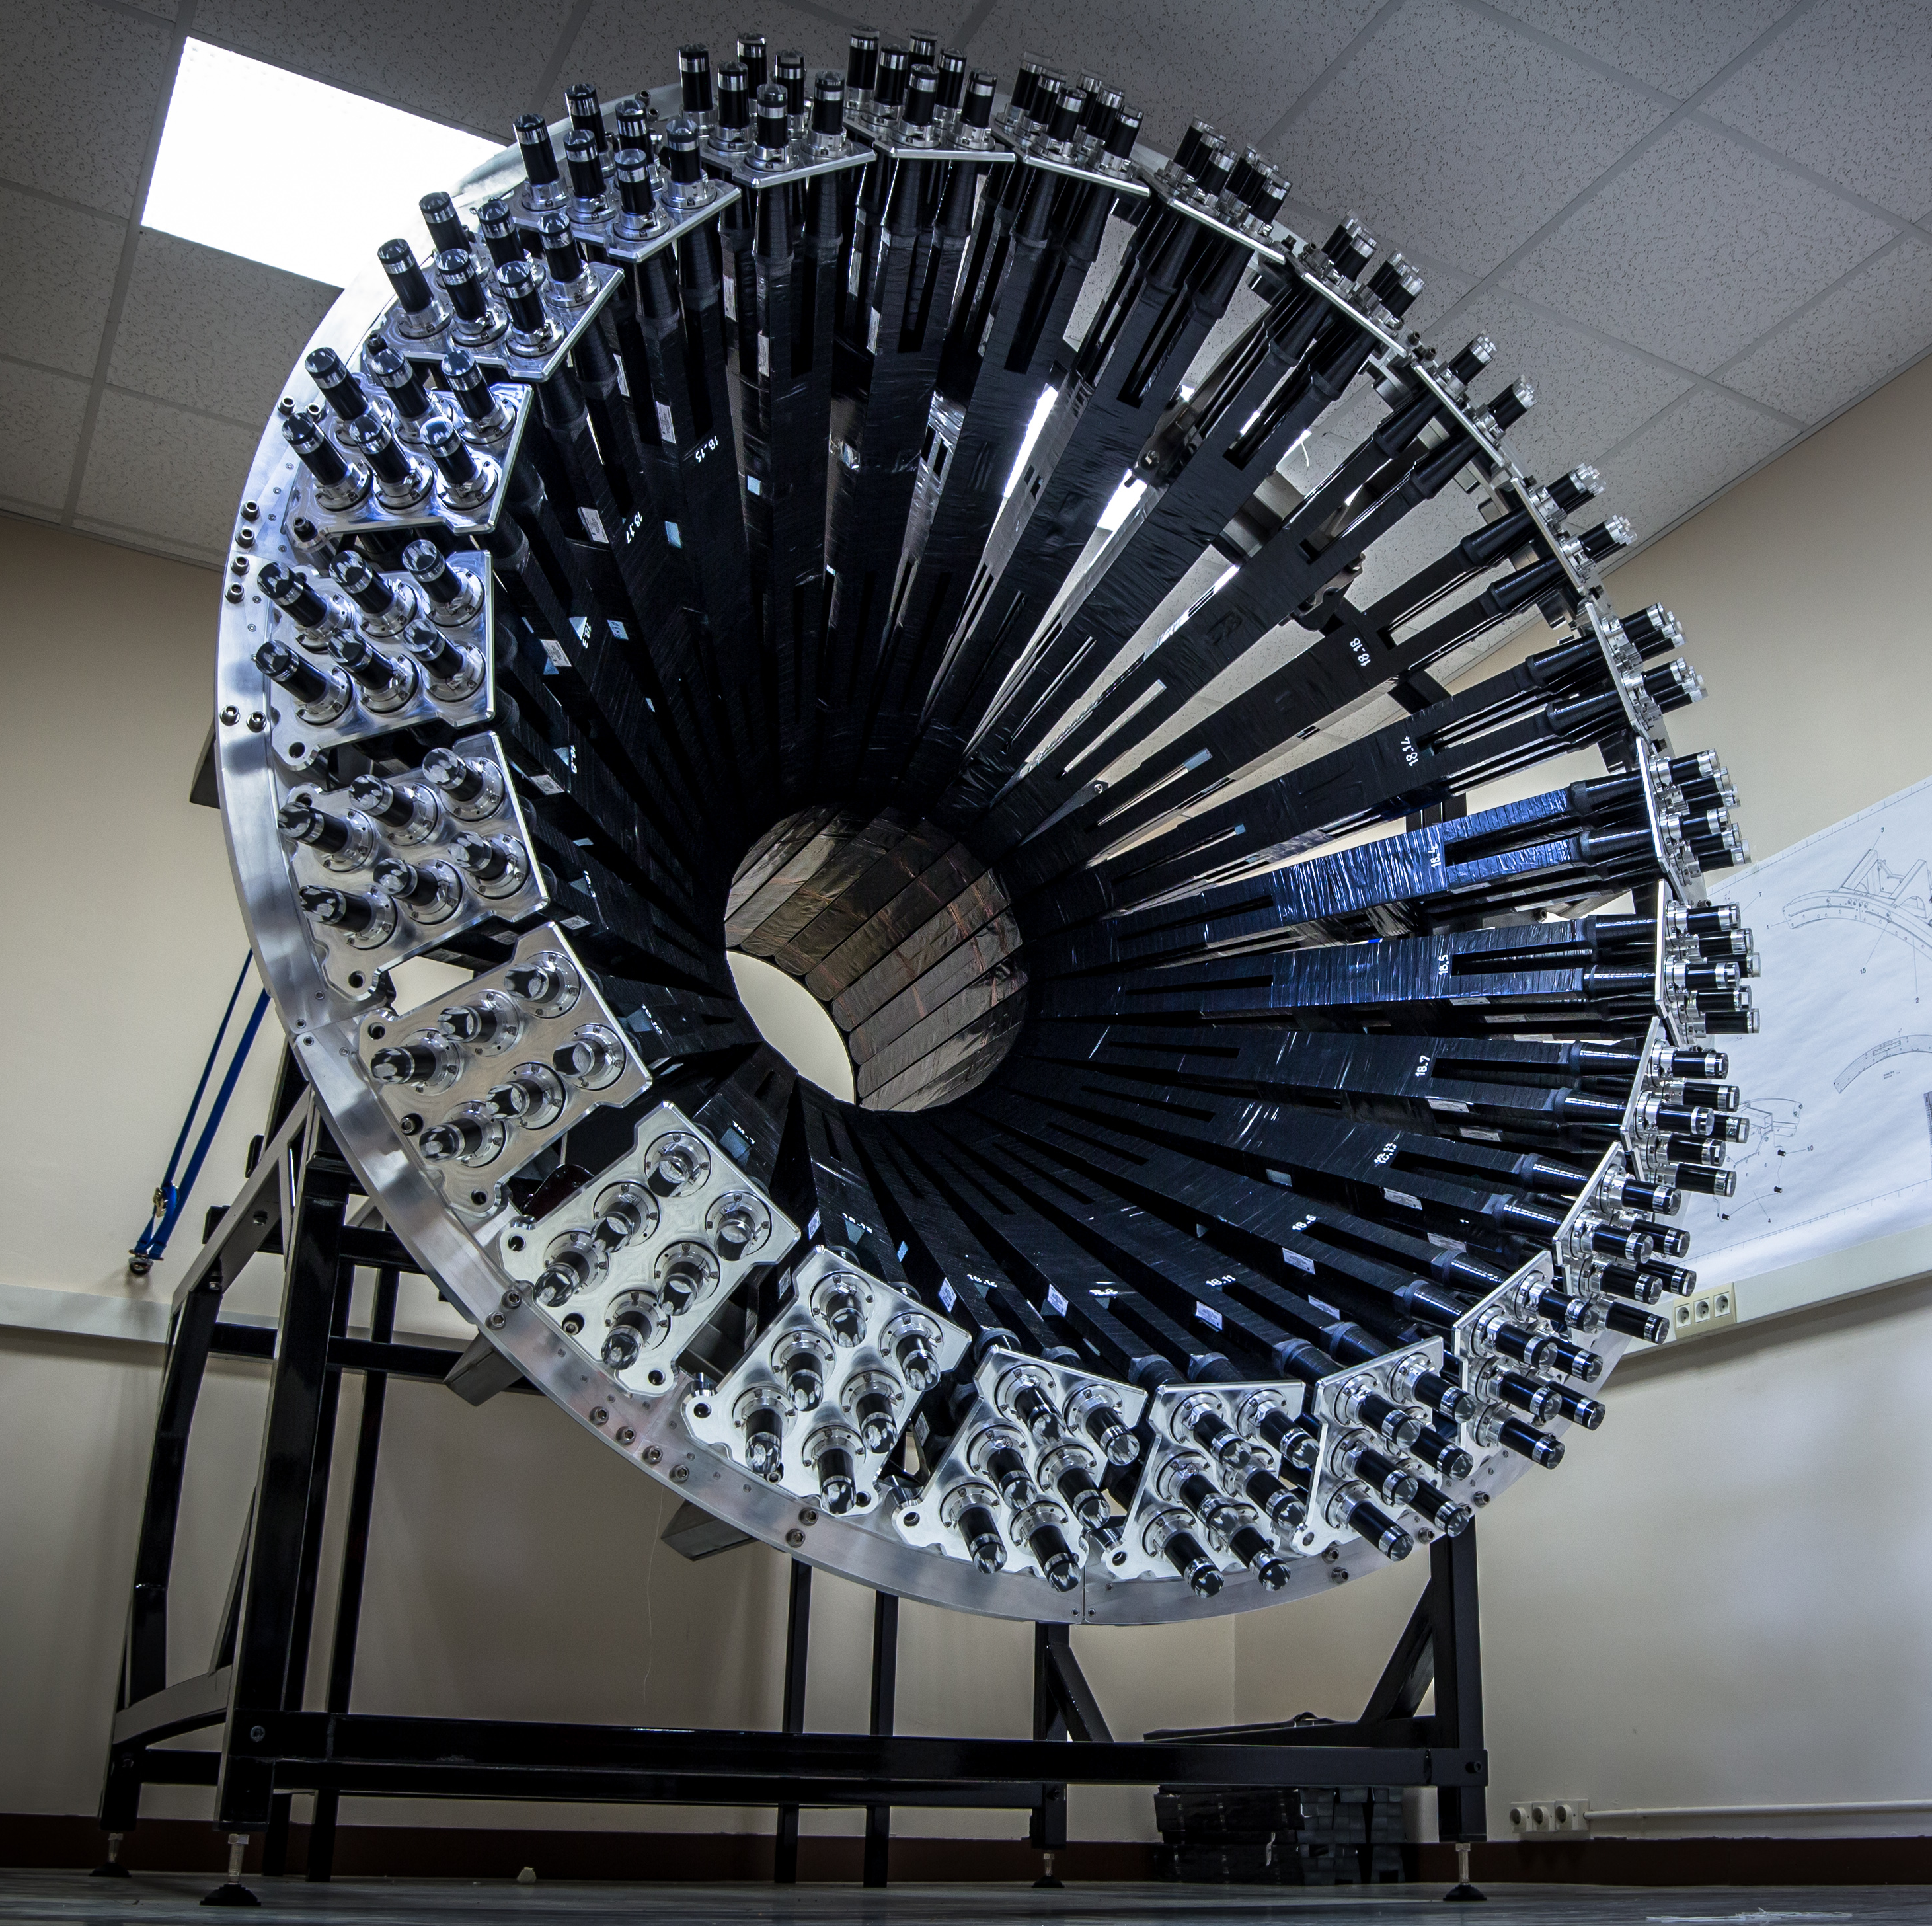
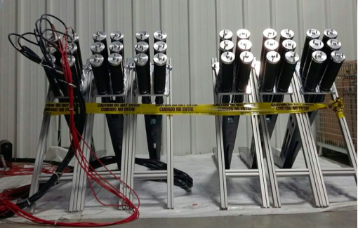
CLAS12
Central Neutron Detector
Hall B
CND is a scintillation bar-based counter designed to detect neutrons in the range from 0.2 to 1 GeV in the CLAS12 Central Detector θ: 35º → 125º.
Orsay University
CND is the first component
to be installed in CLAS12 CD
CND @ Orsay
CND @ JLab
Installation in CLAS12: Feb 2017

Slide 15


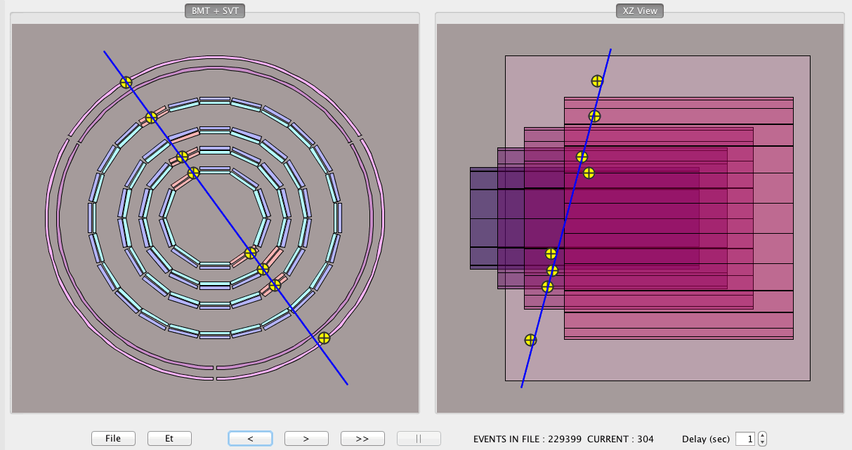
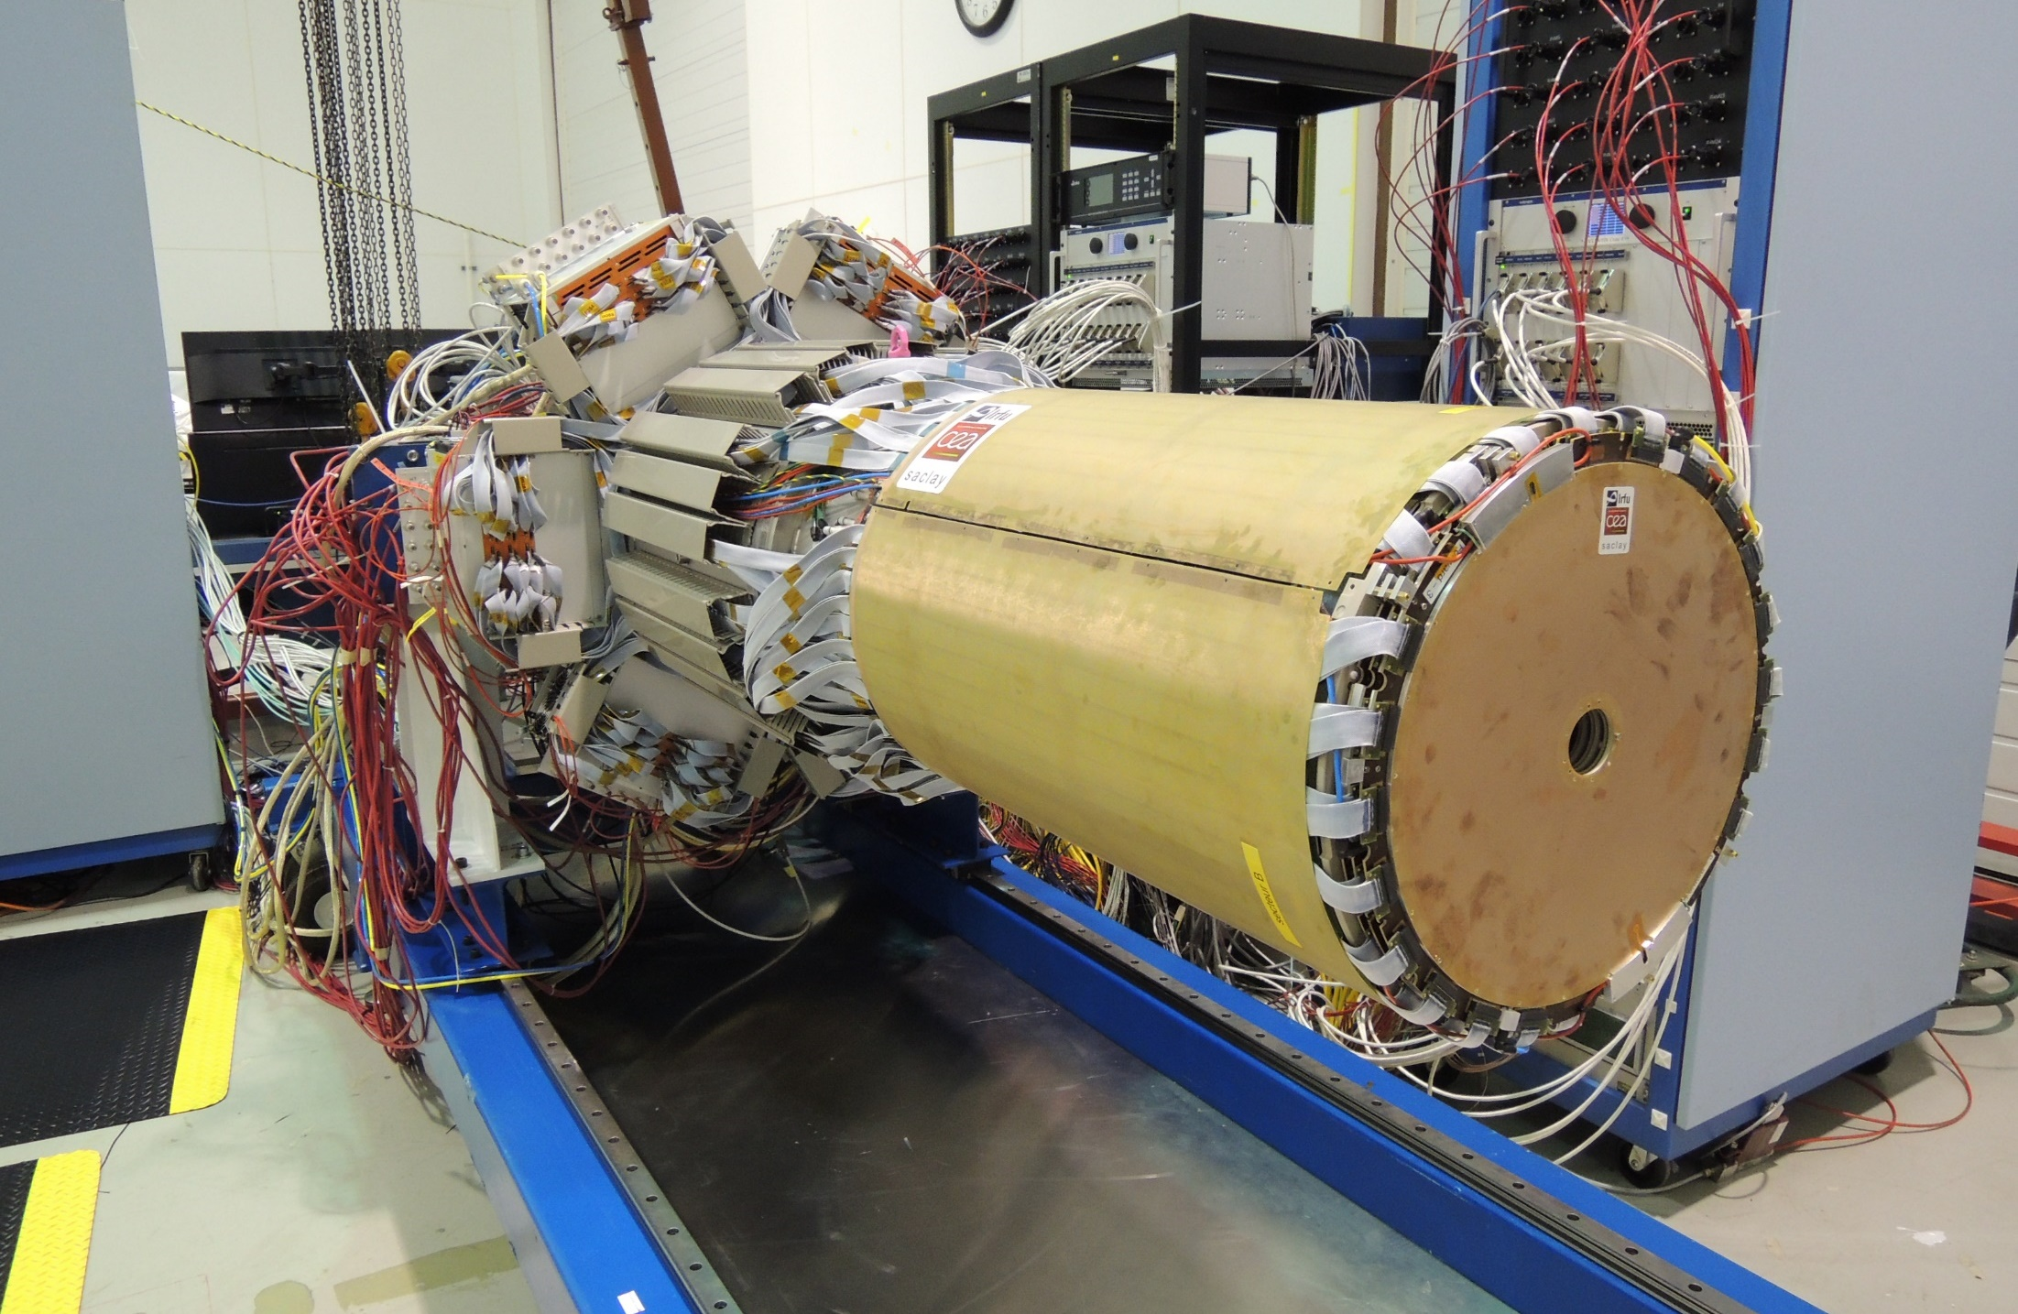
CLAS12
Micromegas Detector
Hall B
MM systems to improve tracking for CLAS12 operation:
Barrel tracking 35º → 125º (cylindrical); radially outward of SVT
Forward tracking 6º → 30º (circular/flat); complements DC
FT-Trk (circular flat); as part of FT for electron tracking
MVT+SVT integrated at JLab
1st cosmic ray events in SVT+MVT
Version SVT-8/BMT-2/FMT: Feb 2017
Version SVT-6/BMT-6: Jul 2017

Slide 16
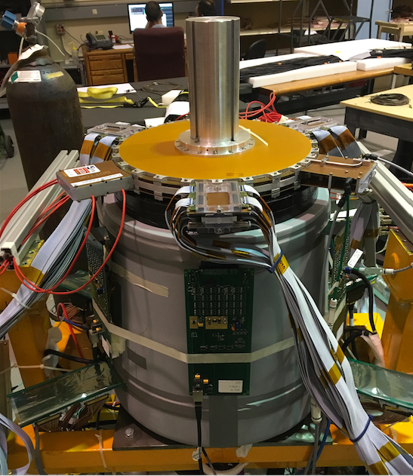
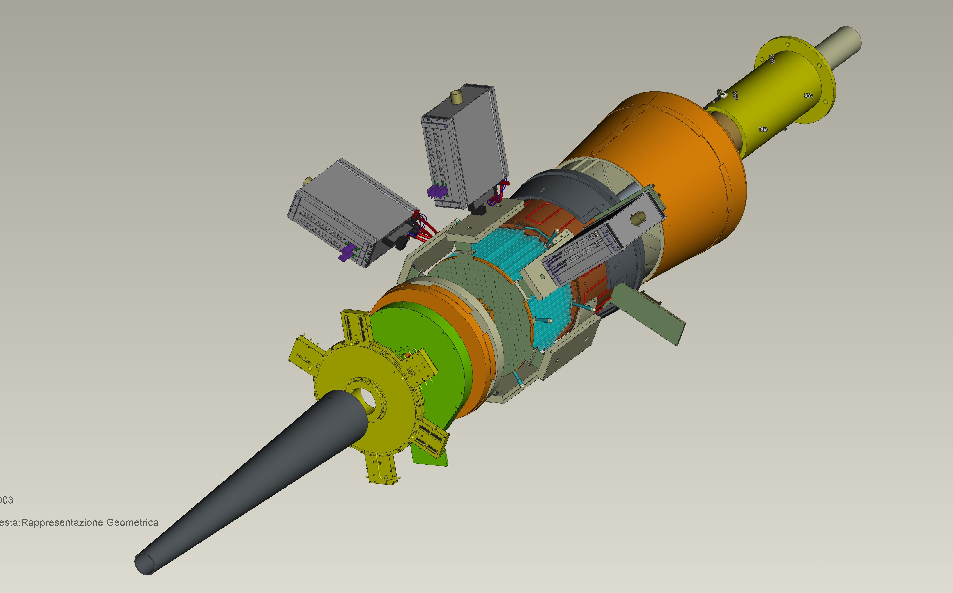

Forward Tagger
CLAS12
Hall B
FT designed to detect electrons and photons at small angles
Lead by: INFN-Genova
FT-Cal: calorimeter to measure electron energy/momentum;
  FT-Hodo: scintillation hodoscope to veto photons & backsplash;
FT-Trk: micro-mega detector to measure electron angles;
FT assembled in EEL at JLab
calorimeter
tracker
hodoscope
Schedule: Installation in CLAS12 - 11/2016

Slide 17
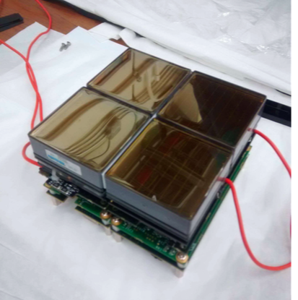
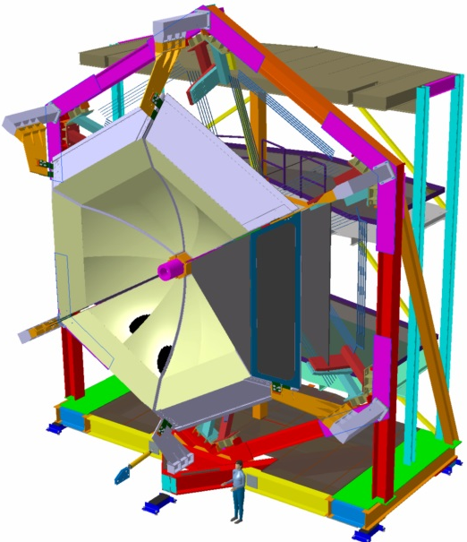
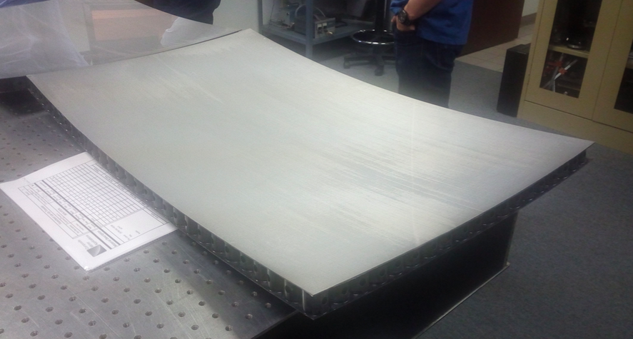
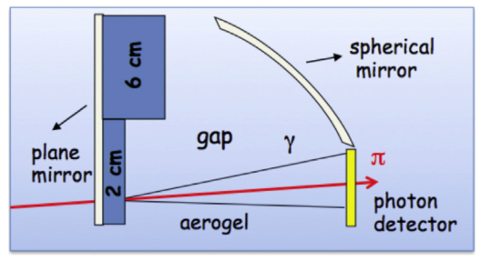
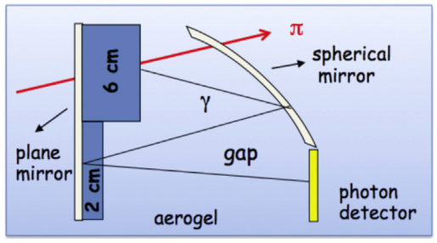
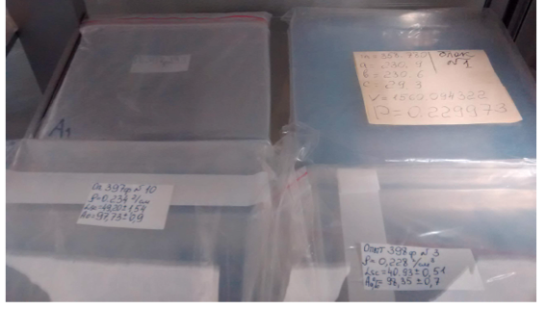
CLAS12
RICH Detector
Hall B
RICH designed to improve CLAS12 PID (π/K) for momenta in range from 3 – 8 GeV
Project is led by JLab and INFN;
involves University groups in Italy, US, Chile.
MA-PMTs
Spherical and planar mirrors
Schedule: Installation in CLAS12 - 9/2017
Aerogel radiators

Slide 18
Hall B Project Schedule
CLAS12
Hall B
2016 |  |  | 2017
J | J A S | O N D | J F M | A M J | J A S | O N D
Torus Leak Checking
Torus Pumpdown
Torus Cooldown
Torus Magnet Mapping
Install DC
Install FT
Solenoid Install & Test
Central Detector Install
Install HTCC
Cosmic Testing
Beamline Commissioning
KPP Commissioning
CVT Configure & Install
RICH Install
Engineering Run
Physics Run Group A
NP Div software review
ERR ancillary detectors
Hall B software
review
ERR CLAS12
Detector

Slide 19
Hall B Proposals for PAC44
RG A E12-06-108B Transition FF of the η’ Meson wit CLAS12 (M. Kunkel)
RG C E12-06-109A Deeply virtual Compton scattering w/ long. pol. deuterium (S. Niccolai)
New RG K (Confinement & Strong QCD)
- PR12-16-010 Nucleon resonance structure via KY electroproduction (D. Carman)
- PR12-16-010A A search for Hybrid Baryons in Hall with CLAS12 (A. D’Angelo)
- PR12-16-010B DVCS w/ CLAS12 at 6.6 and 8.8 GeV (L. Elouadrhiri)
New RG L (ALERT)
- PR12-16-011 Tagged EMC measurements on Light Nuclei (R. Dupre)
- PR12-16-011A Partonic Structure of Light Nuclei (Z.-E. Meziani)
- PR12-16-011B Tagged DVCS on Light Nuclei (W. Armstrong)
- PR12-16-011C Other Physics Opportunities with the ALERT Run Group
New RG M (tbd)
- C12-15-004 DVCS on the neutron with long. polarized deuteron target (S. Niccolai)
- C12-15-004A DIS on longitudinally polarized deuterium (S. Kuhn)
- C12-15-004B SIDIS on long. polarized deuterium (S. Pisano)
LOI-16-004 Electroproduction of muon pairs: Double DVCS & J/ψ (S. Stepanyan)

Slide 20
Run Group Schedule – Tentative
Run Group | Days | 2015 | 2016 | 2017 | 2018 | 2019 | 2020 | 2021 | Remain
All Run Groups | 936 |  | CND | FT RICH MM |  |  | Trans. PT | 481 | 455
HPS | 180* |  | 15 |  | 35 | 35 |  |  | 95
PRad | 15* |  | 15 |  |  |  |  |  | ---
CLAS12 KPP |  |  |  | 15
RG-A (proton) | 139* |  |  | 30/16 | 20 35 |  |  |  | 69*
RG-F (BoNuS) | 42* |  |  |  | 40 |  |  |  | 2
RG-B (deut.) | 90* |  |  |  |  | 45 |  |  | 45*
RG-C (NH₃) | 120 |  |  |  |  | 35 | 25 |  | 50
RG-C-b (ND₃) | 65 |  |  |  |  |  | 35 |  | 30
RG-E (Hadr.) | 60 |  |  |  |  |  | 35 |  | 25
RG-H (TT) | 110* |  |  |  |  |  |  | 45 | 65
RG-D (CT) | 60 |  |  |  |  |  |  | 30 | 30
RG-G (LiD) | 55 |  |  |  |  |  |  | 20 | 35

Slide 21
Summary
Hall B
Data collected with CLAS continue to generate important physics results
HPS and PRAD experiments producing High Impact physics results
CLAS12 on track for KPP verification in Spring 2017
Full complement of ancillary detectors on track for installation before the engineering run in Fall 2017
Expect run group A to take first physics data late 2017

Slide 22
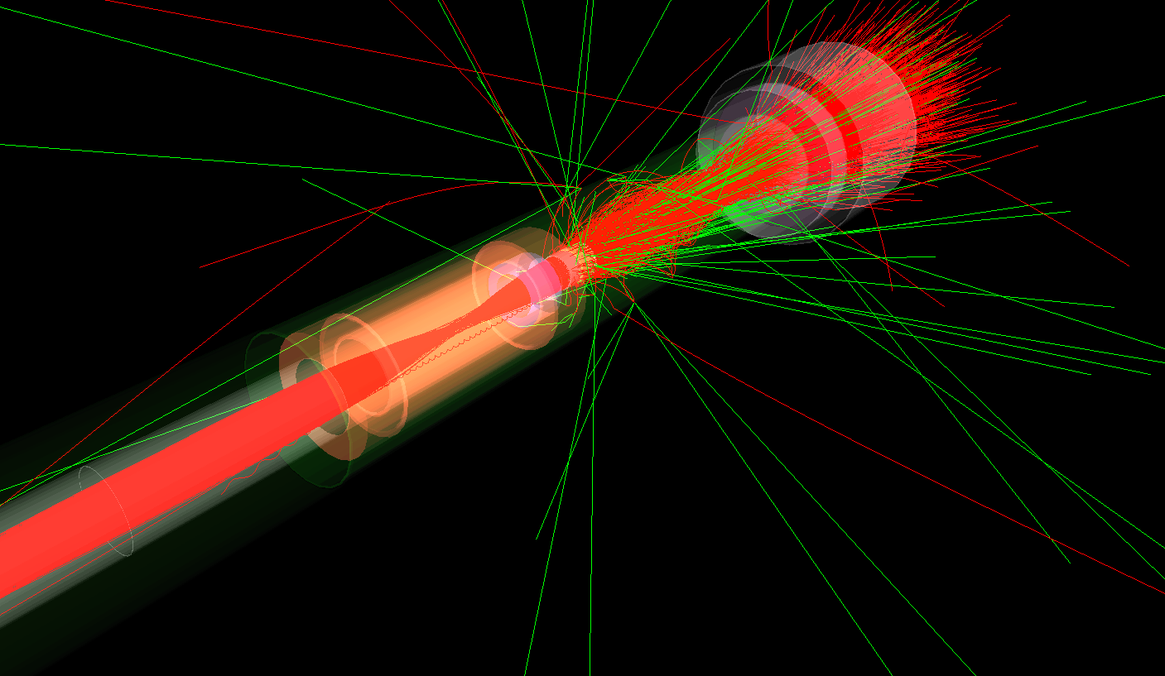
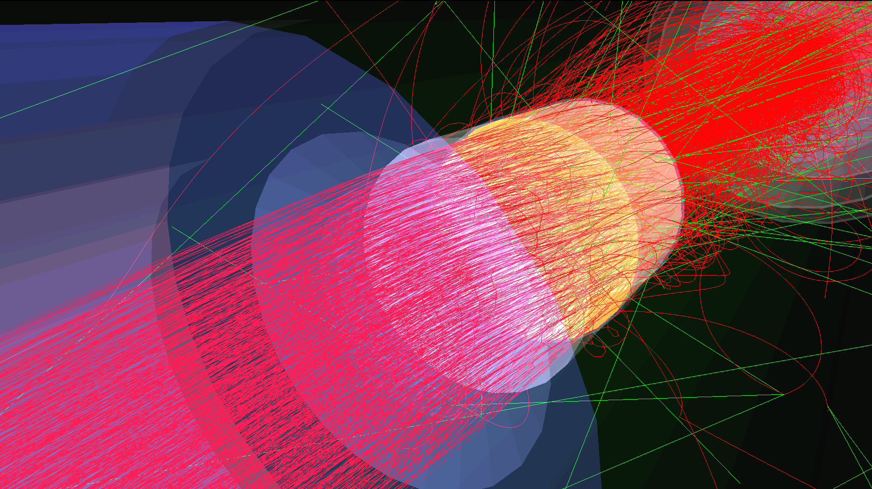
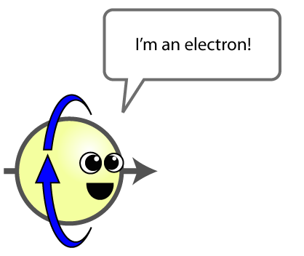
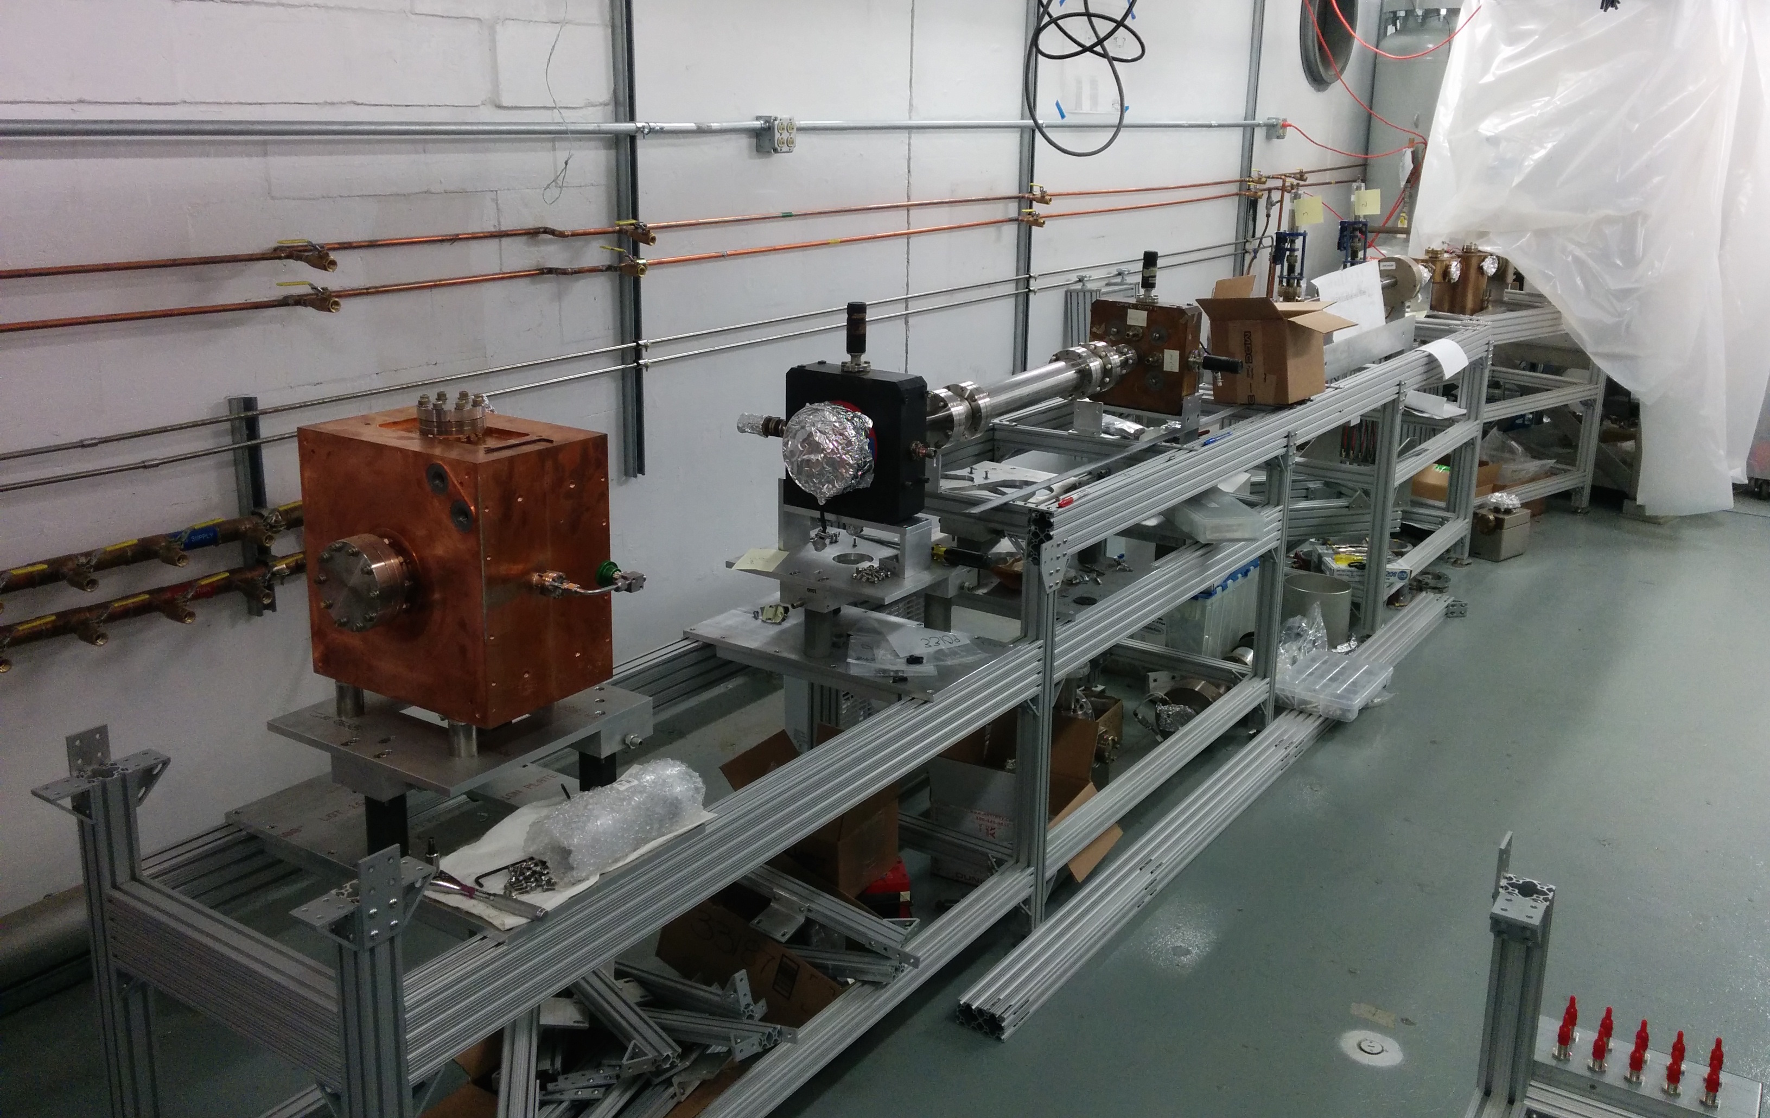
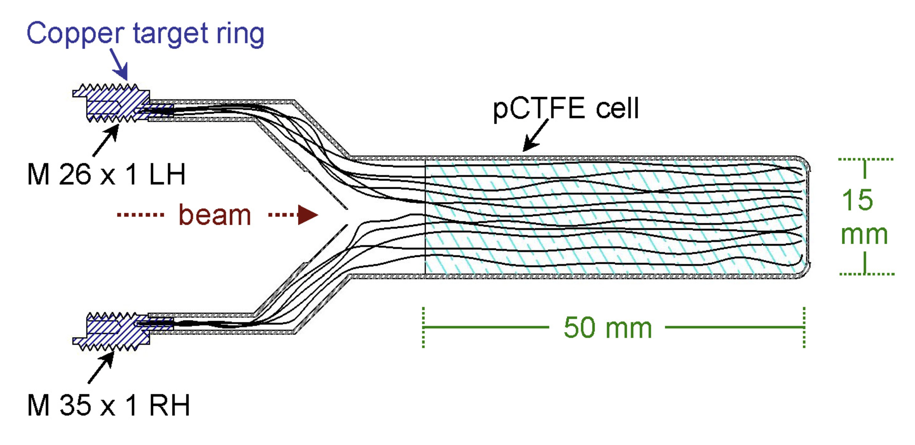
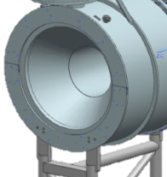
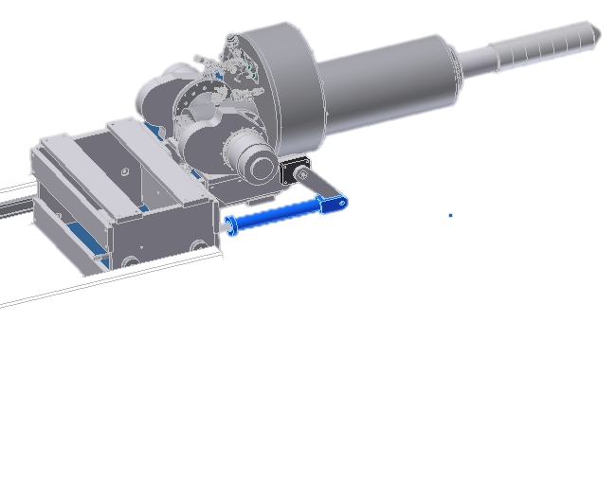
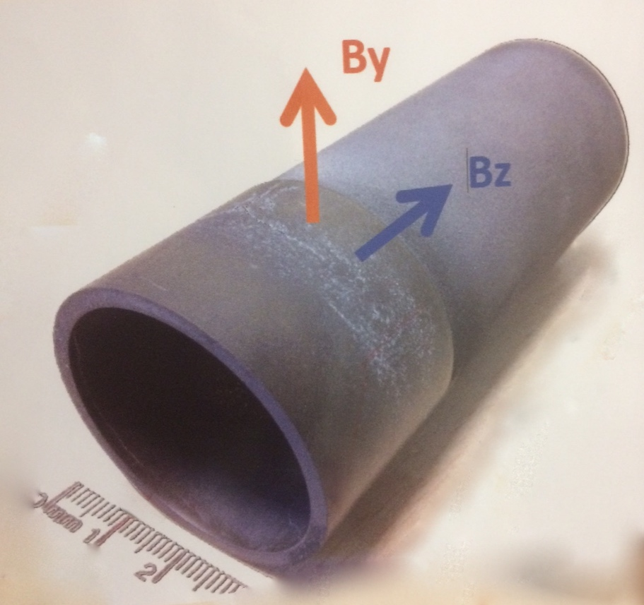
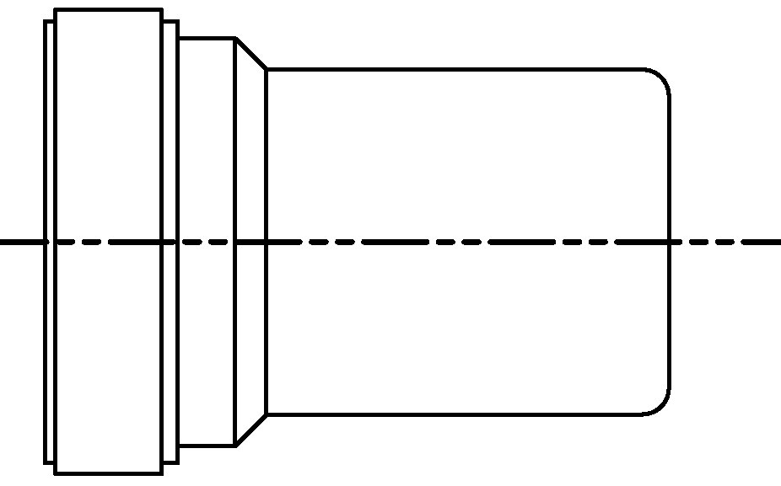
HDice
H
D
ice
Focusing by Solenoids:
Tune beam energy to
7.86 MeV
HD radius = 9.5 mm
ƔHD eHD:
New depolarization mechanisms arise with charged particle beams.
Solutions:
  - Faster Raster.
  - Better heat removal from HD.
  - RF alignment of electron
  spins with H spins.
Uniform illumination of target
Multiple scattering:
HD Length = 12.5 mm
eHD at UITF:
New accelerator under construction in Test Lab.
Will test HD performance with electron beams.
Results at 10 MeV directly relatable to CEBAF at 11 GeV.
Test beams on target in 2017
Ramming speed!
Maintaining transverse field in CLAS-12 Solenoid:
MgB₂: high-T_{C} superconductor used as a perfect diamagnet.
Protoype being tested in Ferrara, Italy.
Results show capability to trap ≈ 1 T transverse field.
Further tests in near future.
MgB₂
B
80 K
e–
MgB₂
4 K

