Slide 1
Introduction to Nuclear Physics
Rolf Ent (Jefferson Lab)
June 12th 2012
General Introduction: Cool facts about QCD and Nuclei
Why Electron Scattering?
CEBAF and the Jefferson Lab Experimental Equipment
Some limited set of Jefferson Lab Findings

Slide 2
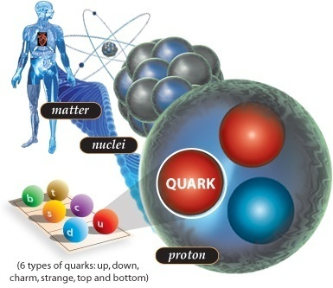
Cool Facts about QCD and Nuclei
Did you know that … ?
If an atom was the size of a football field, the (atomic) nucleus would be about the size of a marble.
Despite its tiny dimensions, the nucleus accounts for 99.9% of an atom’s mass.
Protons and neutrons swirl in a heavy atomic nucleus with speeds of up to some ¾ of c. More commonly, their speed is some ¼ the speed of light. The reason is because they are “strong-forced” to reside in a small space.
Quarks (and gluons) are “confined” to the even smaller space inside protons and neutrons. Because of this, they swirl around with the speed of light.

Slide 3
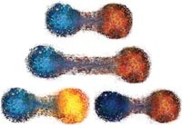
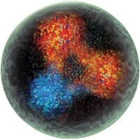
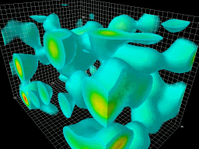
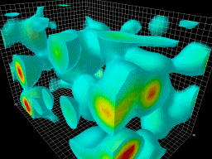
Cool Facts about QCD and Nuclei
Did you know that … ?
The strong force is so strong, that you can never find one quark alone (this is called “confinement”).
When pried even a little apart, quarks experience ten tons of force pulling them together again.
Quarks and gluons jiggle around at nearly light-speed, and extra gluons and quark/anti-quark pairs pop into existence one moment to disappear the next.
It is this flurry of activity, fueled by the energy of the gluons, that generates nearly all the mass of protons and neutrons, and thus ultimately of all the matter we see.
99% of your mass is due to this stored energy.
Even the QCD “vacuum” is not truly empty.
Long-distance gluonic fluctuations are an integral
part. Quarks have small mass themselves, but attain
an effective larger mass due to the fact that they attract these gluonic fluctuations around them
→ M(up) + M(up) + M(down) ~ 10 MeV << M(proton)

Slide 4
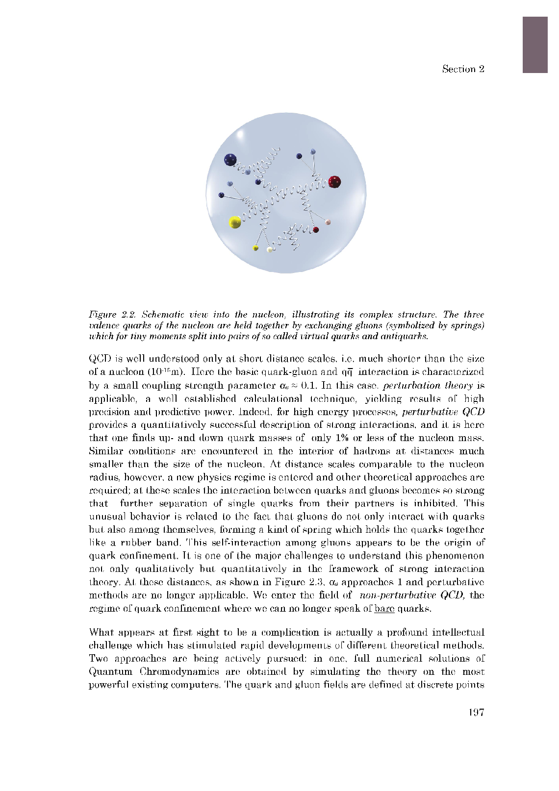
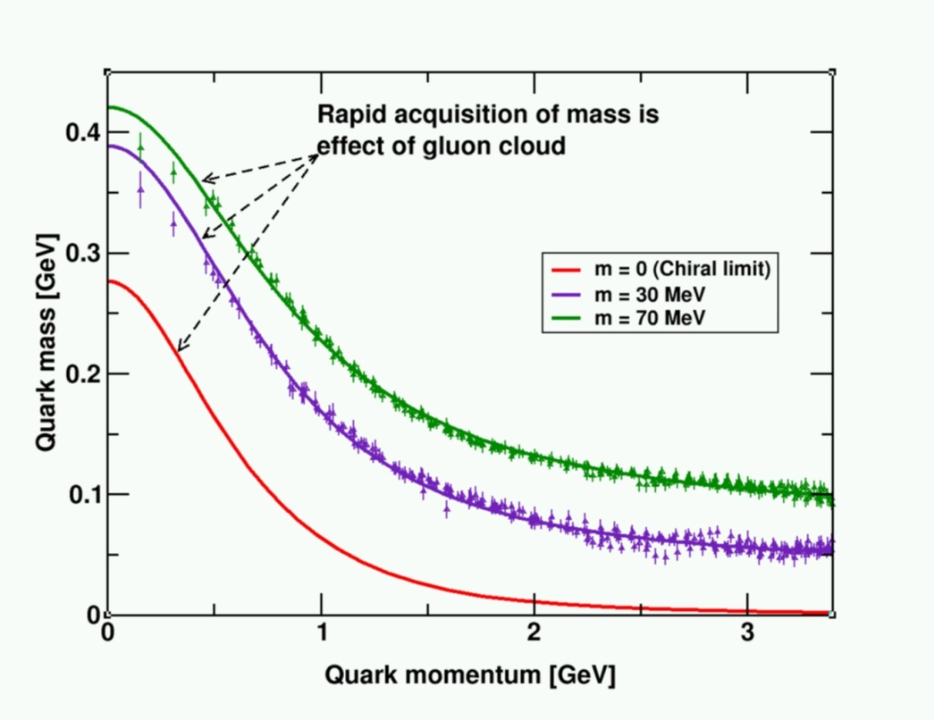
QCD and the Origin of Mass
99% of the proton’s mass/energy is due to the self-generating gluon field
  Higgs mechanism has almost no role here.
The similarity of mass between the proton and neutron arises from the fact that the gluon dynamics are the same
  Quarks contribute almost nothing.
M(up) + M(up) + M(down) ~ 10 MeV << M(proton)

Slide 5
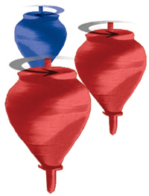
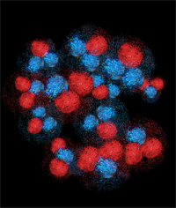
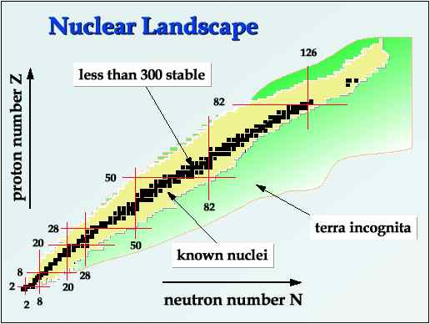
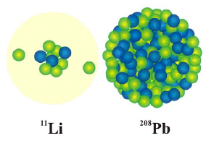
Cool Facts about QCD and Nuclei
Did you know that … ?
Nuclear physicists are trying to answer how basic properties like mass, shape, and spin come about from the flood of gluons, quark/anti-quark pairs, and a few ever-
present quarks
A small fraction of the force between quarks and gluons “leaks out” of protons and neutrons, and binds them together to form tiny nuclei. The long-range part of this process can be well described as if protons and neutrons exchange pions.
Nuclear physicists are only now starting to understand how this “leakage” occurs, and how it results in the impressive variety of nuclei found in nature.
A nucleus consisting of some 100 protons and 150 neutrons can be the same size as one with 3 protons and 8 neutrons.

Slide 6
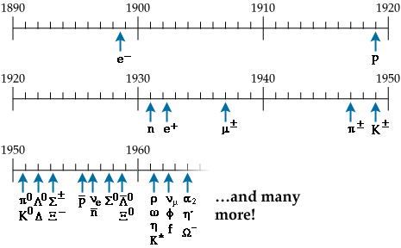
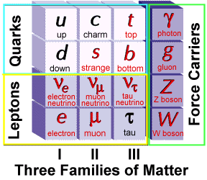
Elementary Particles
Protons , neutrons and electrons (p,n,e) build all the atoms.
Proton and neutrons make up 99.9% of the visible mass in the universe.
Dozens of new particles were discovered in the past century.
Strong interaction: strength can be 100 times the electromagnetic one
leptons (e,μ,ν,..): not involved in strong interaction
hadrons [mesons(π,K,…) and baryons(p,n,…)]: involved in strong interaction
Quarks & Gluons: QCD

Slide 7
k’ = (Ε’,k’)
Kinematics
k = (Ε,k)
Θ
Virtual photon → off-mass shell
q_{μ}q^{μ} = ν² – q² = 0
q = (ν,q)
Define two invariants:
Q² = -q_{μ}q^{μ} = -(k_{μ} – k_{μ}’)(k^{μ}-k’^{μ})
= -2m_{e}² + 2k_{μ}k’^{μ}
(me ~ 0) = 2k_{μ}k’^{μ}
(LAB) = 2(EE’ – k.k’)
= 2EE’(1-cos(Θ))
= 4EE’sin²(Θ/2)
only assumption: neglecting m_{e}²!!
2) 2Mν = 2p_{μ}q^{μ} = Q² + W² – M²
p = (Μ,0)
Undetected final state X
p’ = (sqrt(p’² + M’²),p’)
(→ p’² = M’² = W²) !!
Elastic scattering
→ W² = M² → Q² = 2M(E-E’)

Slide 8
Electron Scattering at Fixed Q²
Quark (fictitious)
Elastic
ν
Proton
Elastic
Δ
Deep Inelastic
N*
ν

Slide 9
Electron Scattering at Fixed Q²
Elastic
Nucleus
Deep Inelastic
Δ
Quasielastic
N*
ν
Proton
Elastic
Δ
Deep Inelastic
N*
ν

Slide 10
Extracting the (e,e’) cross section
N_{N} (cm⁻²)
e'
N_{e}
e
(ΔΩ_{e}, Δp_{e})
Scattering probability or cross section

Slide 11
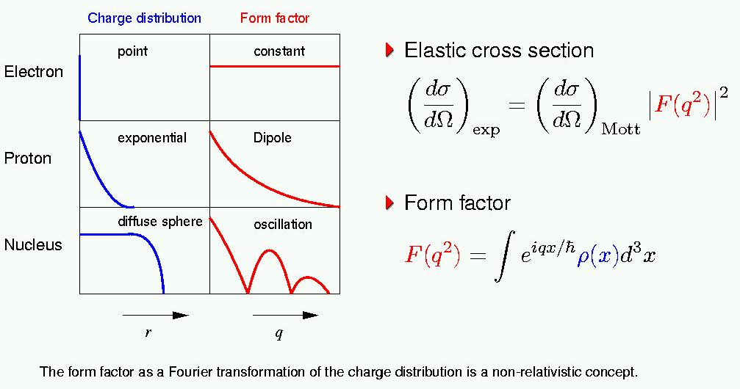
Electron-Charge Scattering
Form Factors characterize internal structure of particles

Slide 12
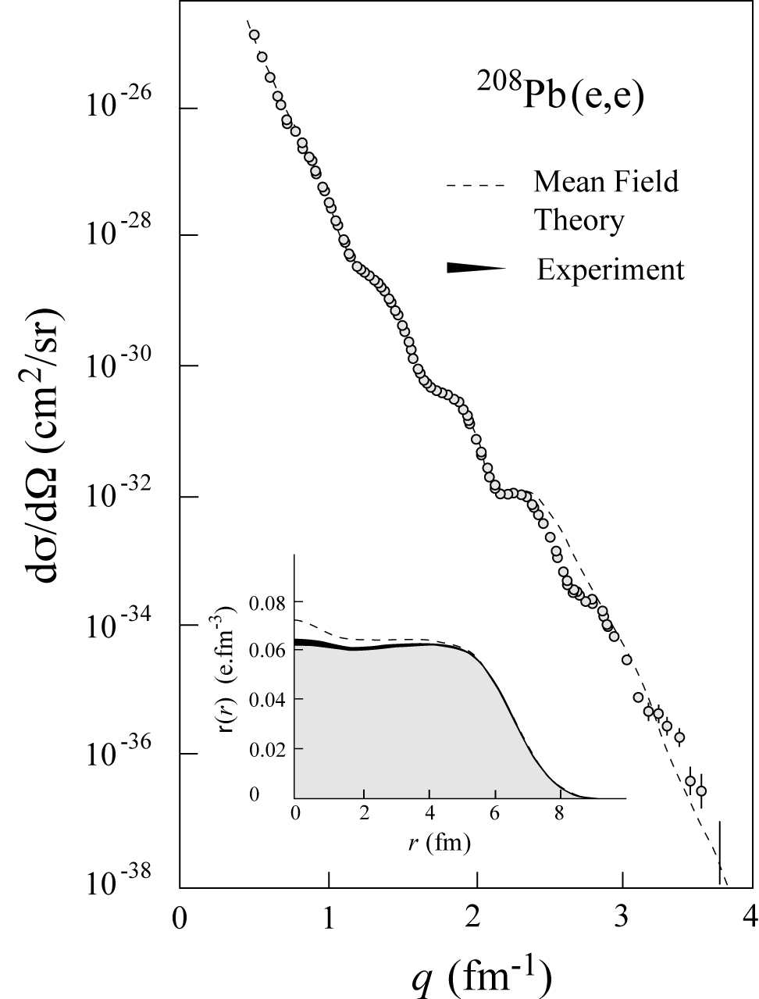
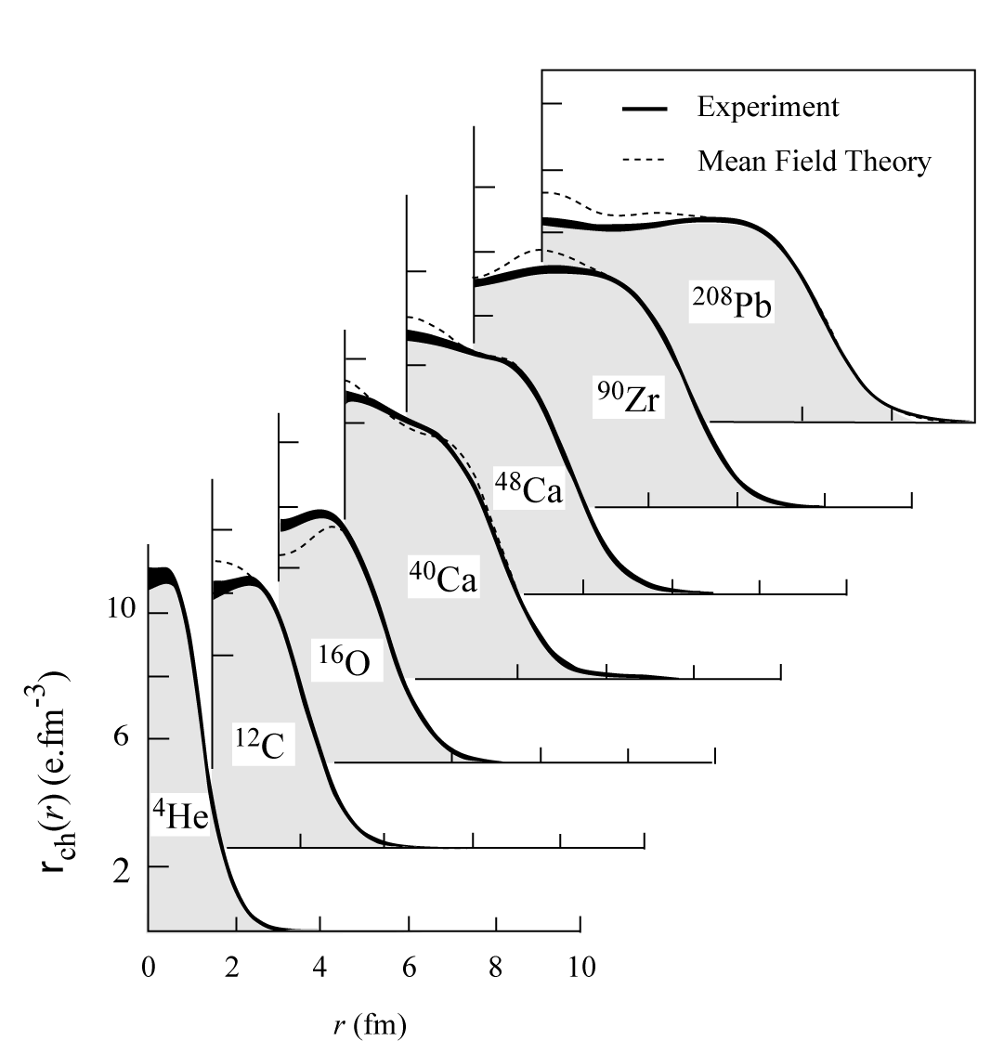
History - Charge Distributions
In ‘70s large data set was acquired on elastic electron scattering (mainly from Saclay) over large Q²-range and for variety of nuclei
“Model-independent” analysis provided accurate results on charge distribution well described by mean-field Density-Dependent Hartree-Fock calculations

Slide 13
A(e,e'p)B
p
scattering plane
e'
θ_{pq}
reaction plane
e
(ω,q)
p_{A–1}
φ_{x}
“out-of-plane” angle
In ERL_{e}: Q² ≡ – q_{μ}q ^{μ} = q² –ω ² = 4ee' sin²θ/2
Known: e and A + Detect: e’ and p → Infer:
Missing momentum: p_{m} = q – p = p_{A–1}
Missing mass: ε_{m} = ω –T_{p} – T_{A–1}

Slide 14
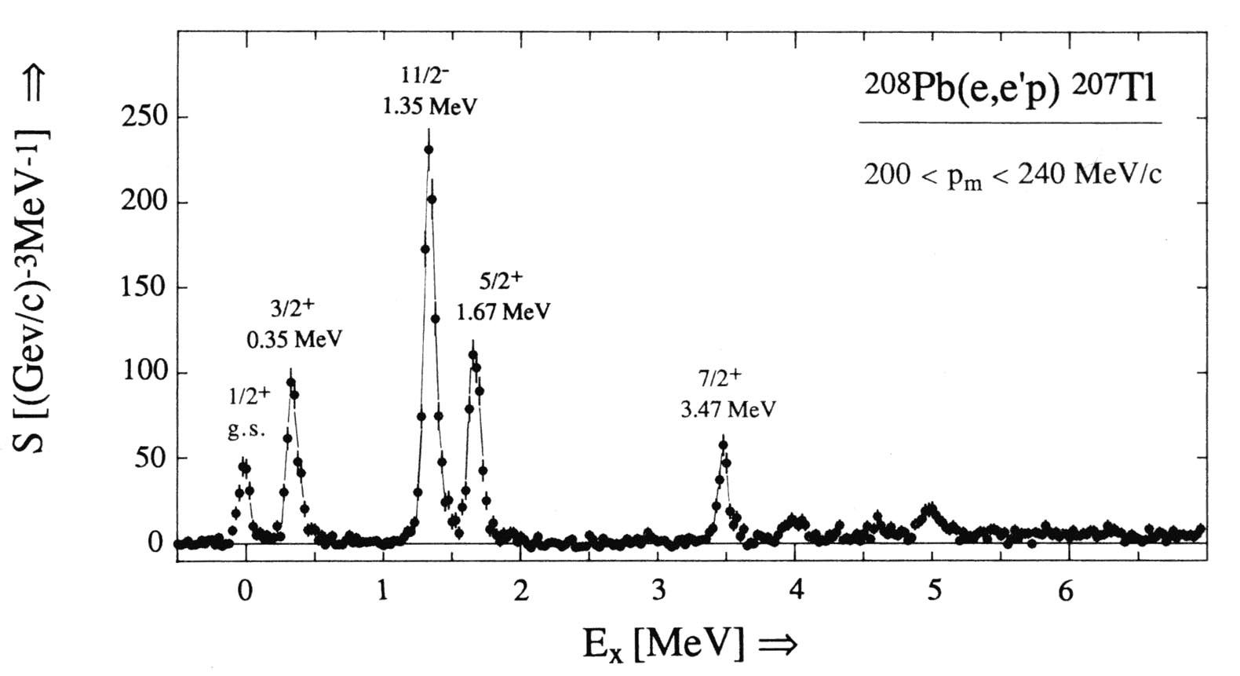
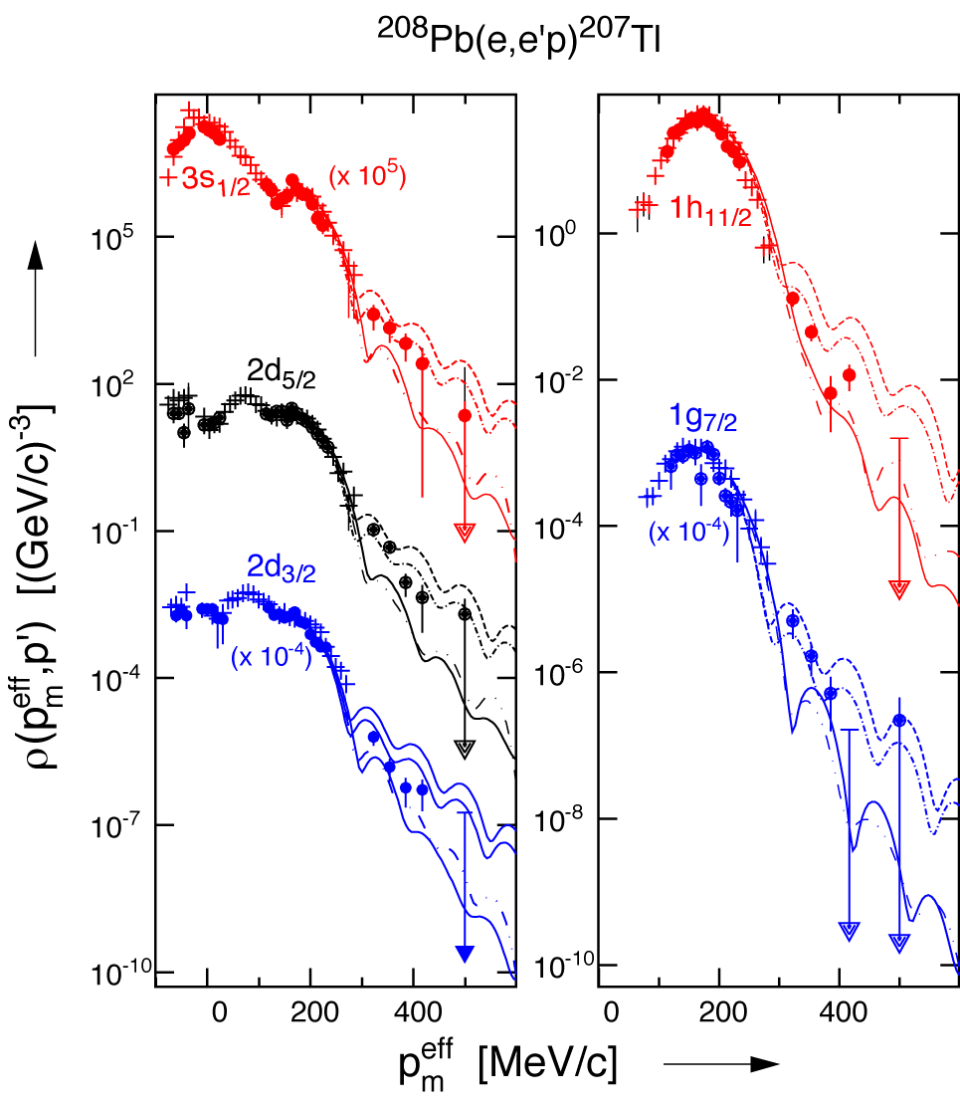
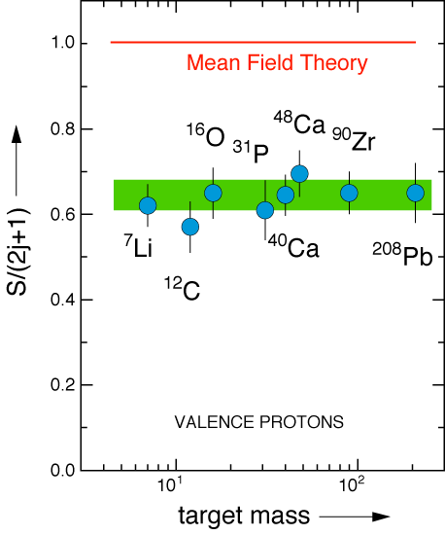
History - Proton Knock-out
ν
in binding
Visualizing the nuclear shell model
in momentum
Missing 20+% in the integral???

Slide 15
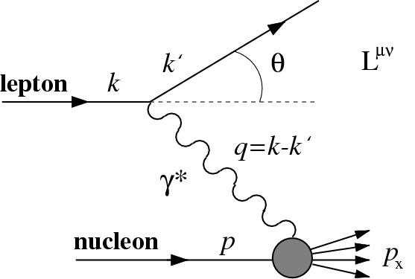
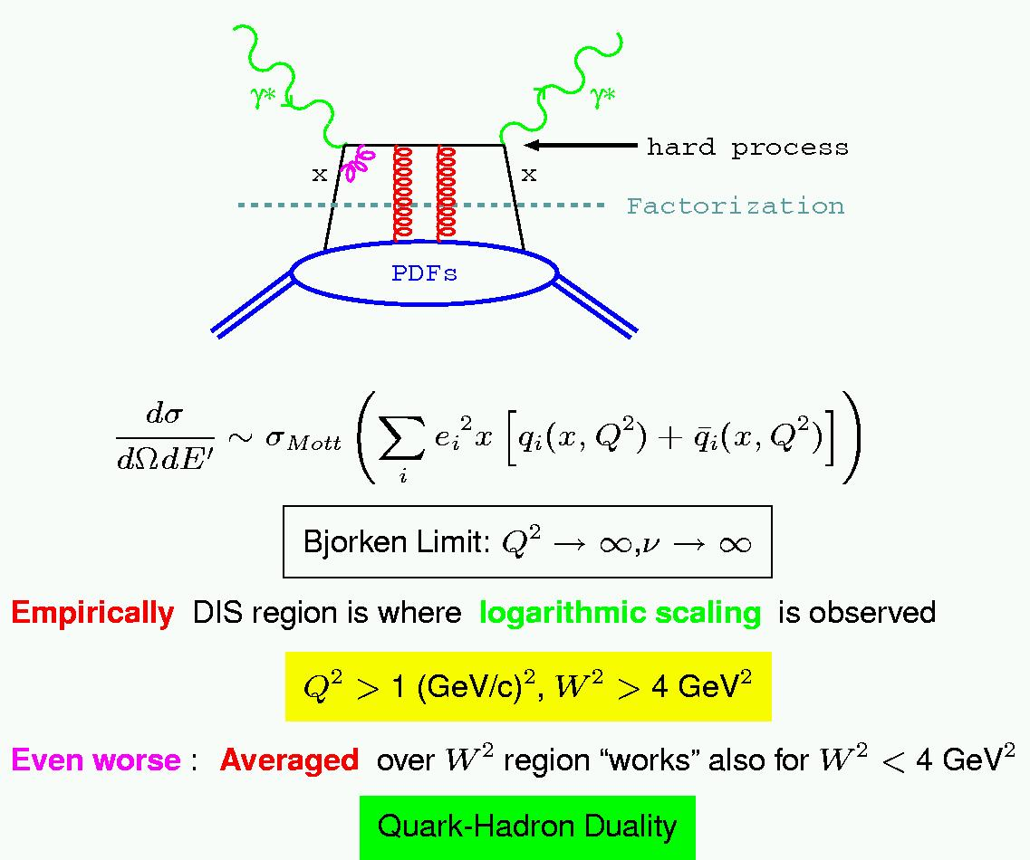
Deep Inelastic Scattering
2
=
In the limit of large Q², structure functions scale (with logarithmic corrections)
(Infinite Momentum Frame)
F₂ interpreted in the quark-parton model as the charge-weighted sum over quark distributions:
Empirically, DIS region is where logarithmic scaling is observed
Q² > 1 GeV², W² > 4 GeV²

Slide 16
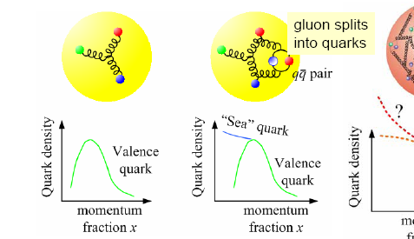
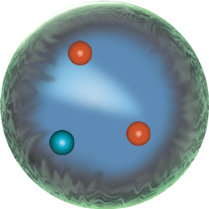
Parton Distribution Functions (PDFs)
PDF q(x): probability that a quark (or gluon) has fraction x of proton’s momentum
proton: uud + uū + dđ + …

Slide 17
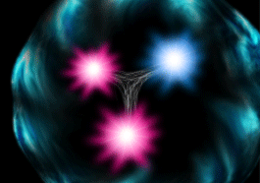
The Structure of the Proton
Naïve Quark Model: proton = uud (valence quarks)
QCD: proton = uud + uu + dd + ss + …
The proton sea has a non-trivial structure: u ≠ d
The proton is far more than just its up + up + down (valence) quark structure
Nuclear physicists are trying to answer how basic properties like mass, shape, and spin come about from the flood of gluons, quark/anti-quark
pairs, and a few ever-present quarks.

Slide 18
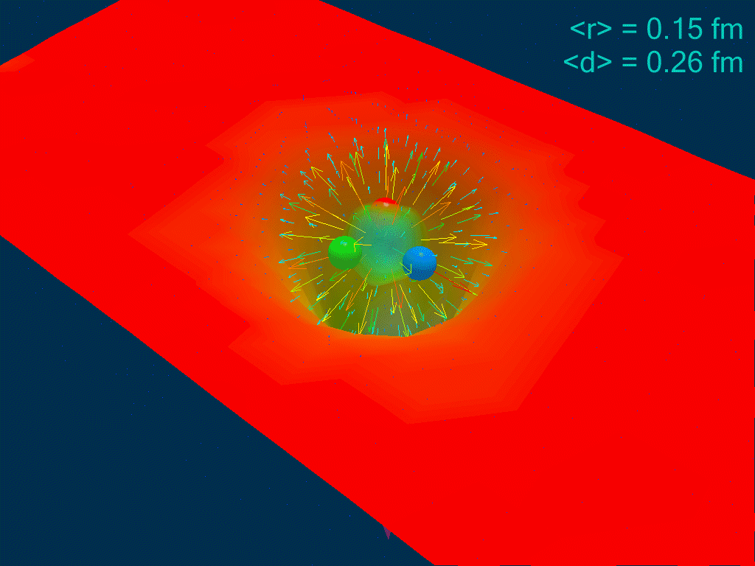
The QCD Lagrangian and Nuclear “Medium Modifications”
The QCD
vacuum
Long-distance gluonic fluctuations
Lattice calculation demonstrates reduction of chiral condensate of QCD vacuum in presence of hadronic matter
Does the quark structure of a nucleon get modified by the suppressed QCD vacuum fluctuations in a nucleus?
Leinweber, Signal et al.

Slide 19
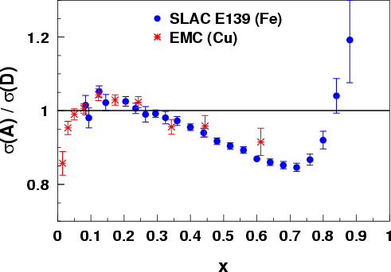
Quarks in Nuclei - History: the EMC Effect
Observation that structure functions are altered in nuclei stunned much of the HEP community 23 years ago
~1000 papers on the topic; the best models explain the curve by change of nucleon structure, BUT more data are needed to uniquely identify the origin
What is it that alters the quark momentum in the nucleus?
J. Ashman et al., Z. Phys. C57, 211 (1993)
J. Gomez et al., Phys. Rev. D49, 4348 (1994)
x
Notes:
Explain what the EMC effect is.
Point out the three regions and their conventional explanations.
Cannot be fully explained by conventional nuclear physics
Amazing that we still don’t know the answer after nearly a quarter of a century
Coverage extends at least to x=1.5

Slide 20
CEBAF’s Original Mission Statement
Key Mission and Principal Focus (1987):
The study of the largely unexplored transition between the nucleon-meson and the quark-gluon descriptions of nuclear matter.
The Role of Quarks in Nuclear Physics
Related Areas of Study:
Do individual nucleons change their size, shape, and quark structure in the nuclear medium?
Pushing the Limits of the Standard Model of Nuclear Physics
How do nucleons cluster in the nuclear medium?
What are the properties of the force which binds quarks into nucleons and nuclei at distances where this force is strong and the quark confinement mechanism is important?
Charge and Magnetization in Nucleons and Pions
The Onset of the Parton Model

Slide 21
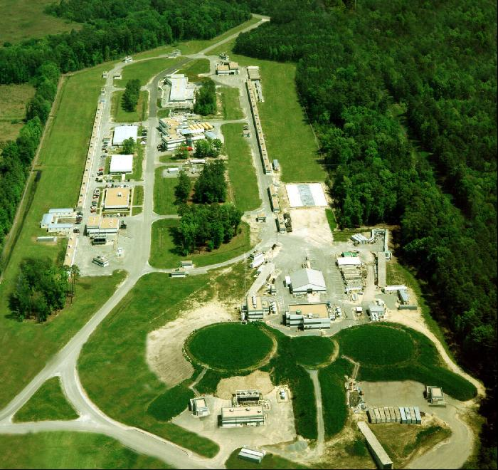
JLab accelerator CEBAF
Continuous Electron Beam
Energy 0.4 ─ 6.0 GeV
200 μA, polarization 85%
3 x 499 MHz operation
Simultaneous delivery 3 halls
A
B
C

Slide 22
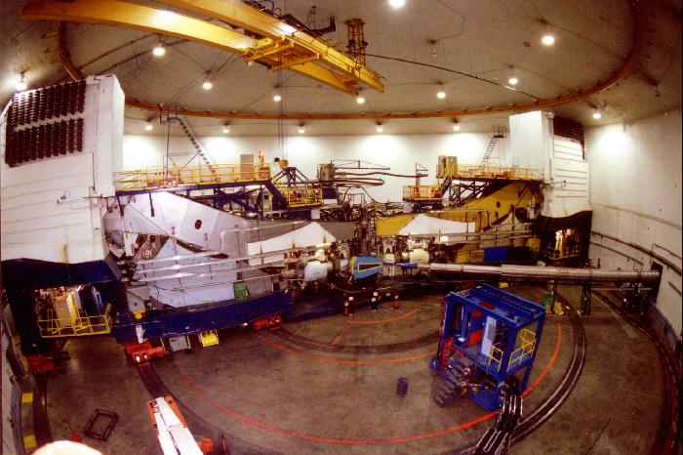
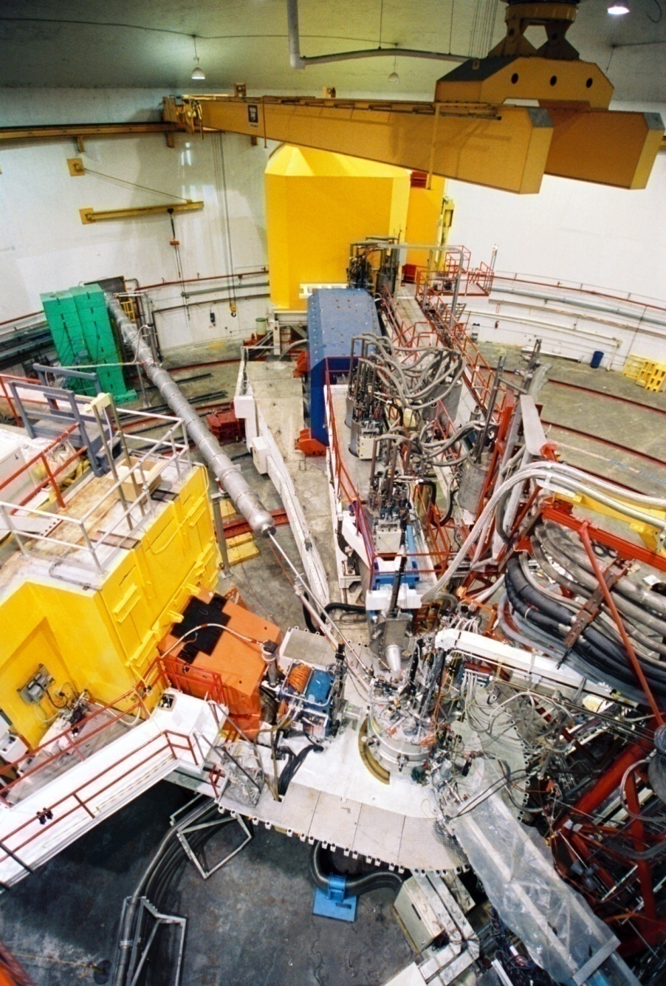
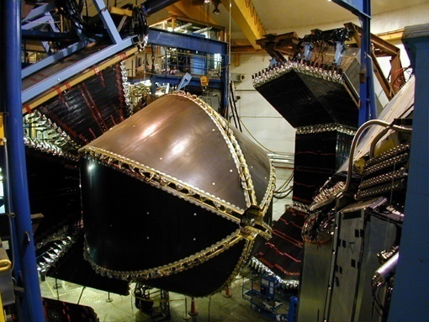
Halls A/B/C Base Equipment
Hall A (2 HRS)
Hall C (SOS/HMS)
Hall B (CLAS)

Slide 23
Hall B - CLAS (forward carriage and side clamshells retracted)
CLAS has more than 38,000 readout channels
Large angle EC
Panel 2 & 3TOF
Panel 4 TOF
Panel 1 TOF
Region 3 drift chamber
Cerenkov & Forward angle EC
CLAS Overview, B. Mecking & staff, collaborators, NIM A503 (2003) 513

Slide 24
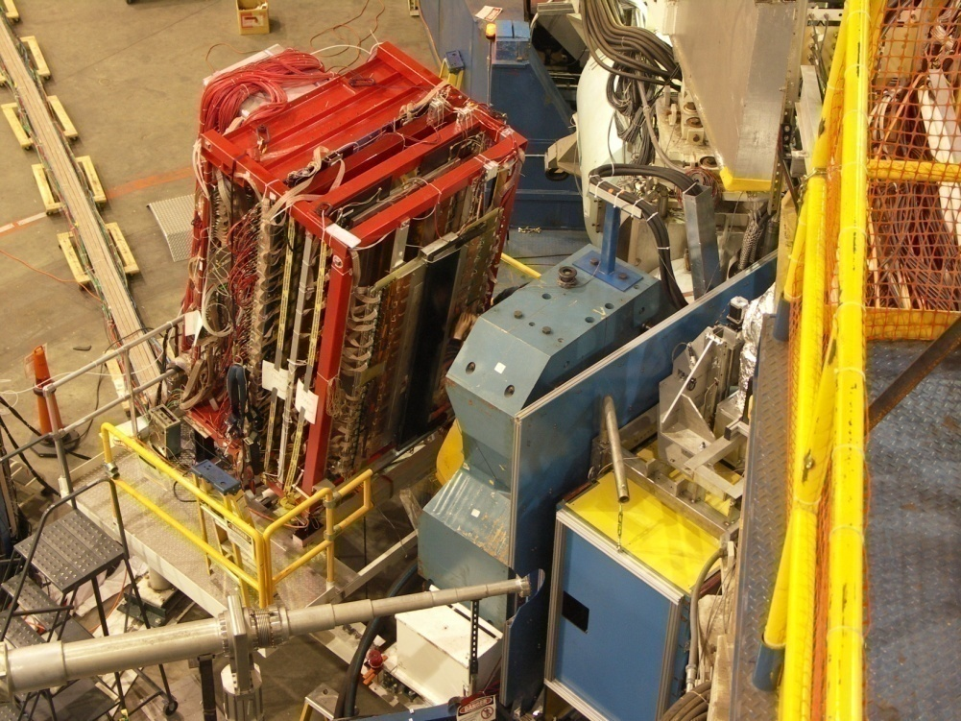
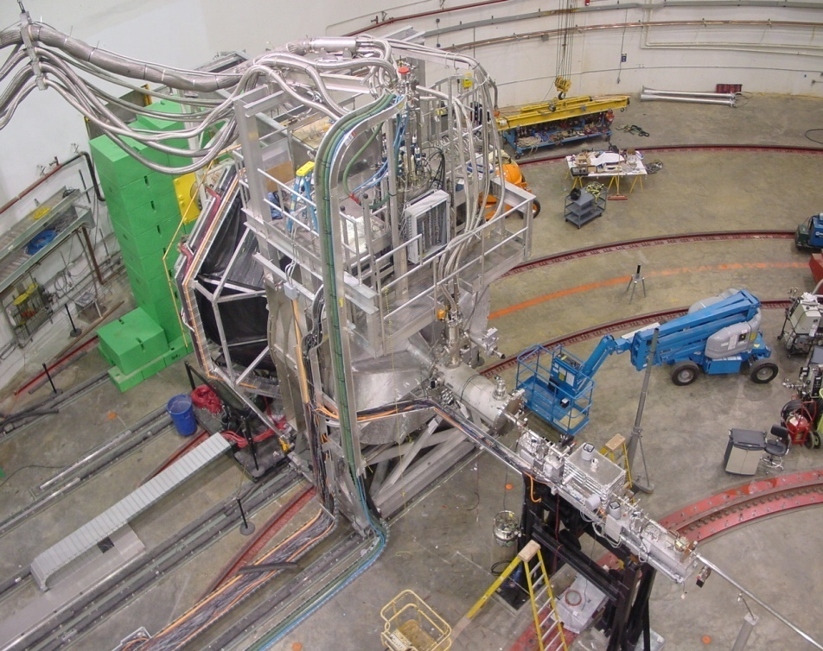
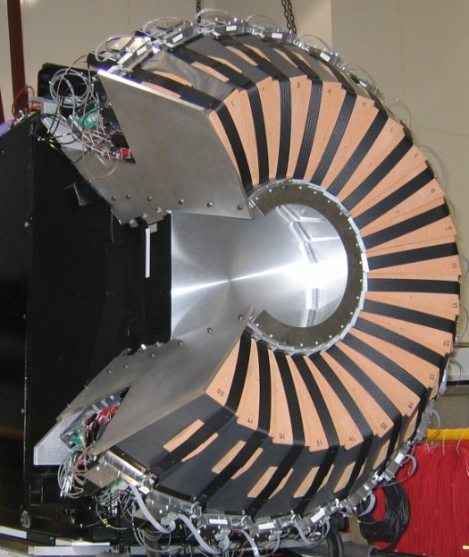
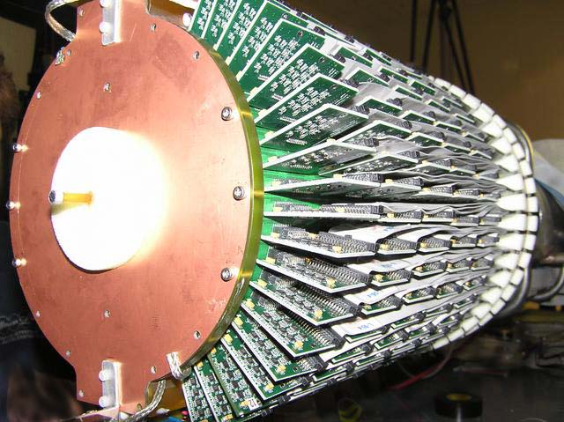
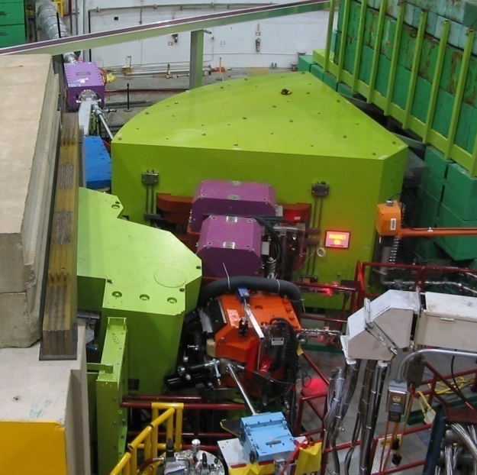
Ancillary Equipment and Experiment-Specific Apparatus
2006
2002-2007
G_{E}^{n} Electron Channel Setup
G0 Setup
2004
2005
2005
DVCS Proton Array
BONUS RTPC Detector
ENGE/HKS Setup

Slide 25
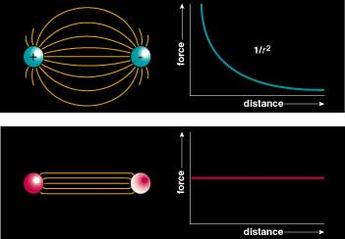
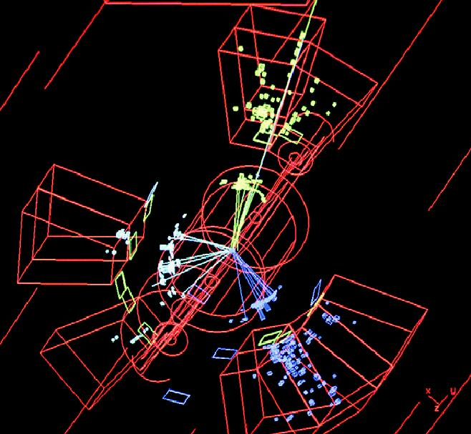
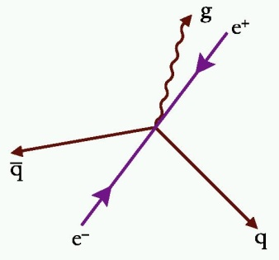
QCD and confinement
QCD
Asymptotic Freedom
Confinement
Small Distance
High Energy
Large Distance
Low Energy
Perturbative QCD
Strong QCD
High Energy Scattering
Gluon
Jets
Observed
Color Field: Because of self interaction, confining flux tubes form between static color charges

Slide 26
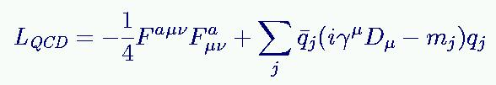



QCD and Nuclei
Gluons mediate the strong (color) force, just like photons mediate the electromagnetic force, but … gluons interact with themselves … which gives QCD unique properties
QCD Lagrangian: quarks and gluons
Nuclear Physics Model is an effective (but highly successful!)
model using free nucleons and mesons as degrees of freedom.

Slide 27
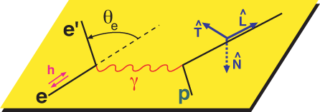
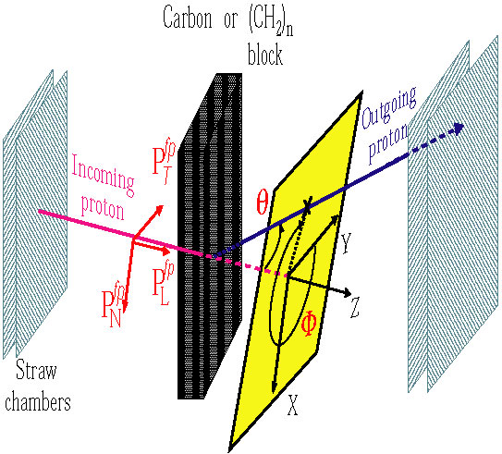
Revolutionized Polarized Beam Experiments!
Precise access to (small) charge form factor of proton utilizing polarization transfer technique: e + p → e’ + p
Focal Plane Polarimeter
G_{E} P’_{x} (E_{i} + E_{f}) Θ_{e}
G_{M} P’_{z} 2m 2
__ __ _____ __
= - tan
No error contributions from
analyzing power
beam polarimetry

Slide 28
Cross section for ep elastic

Slide 29
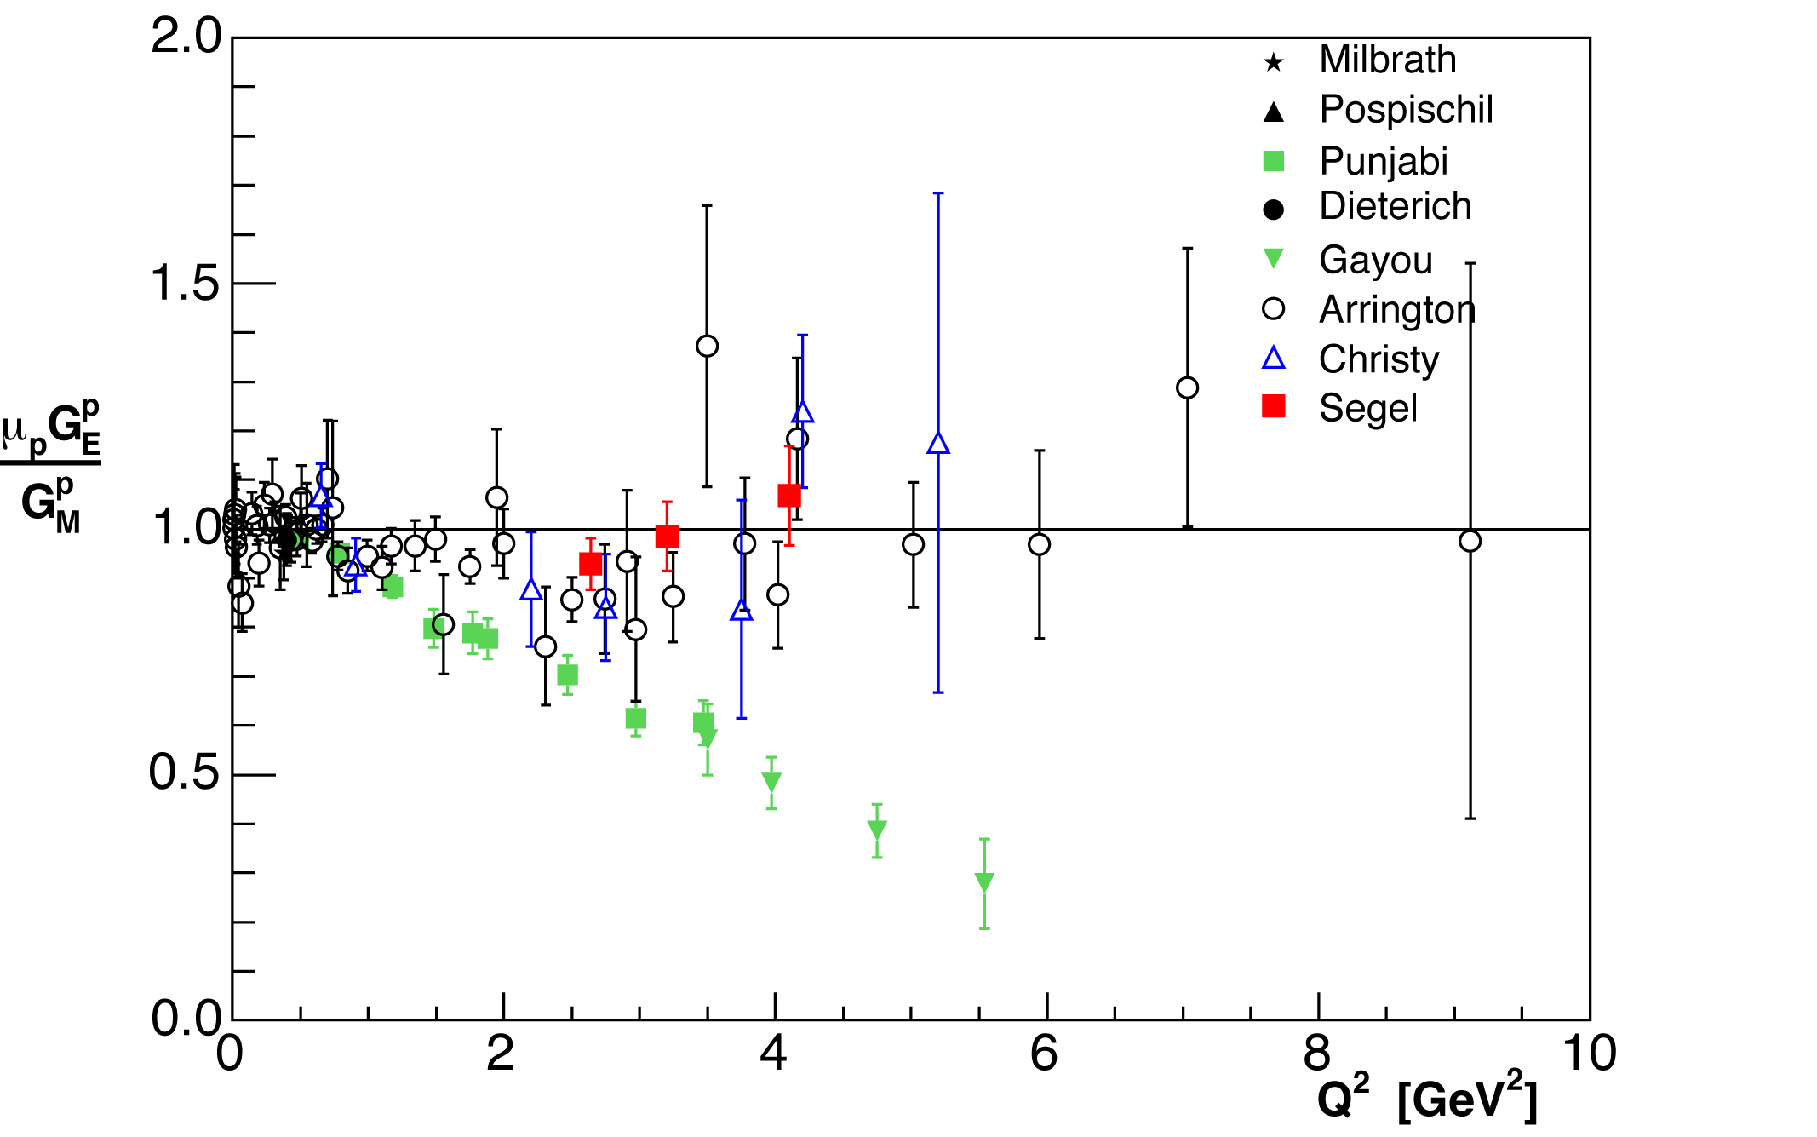
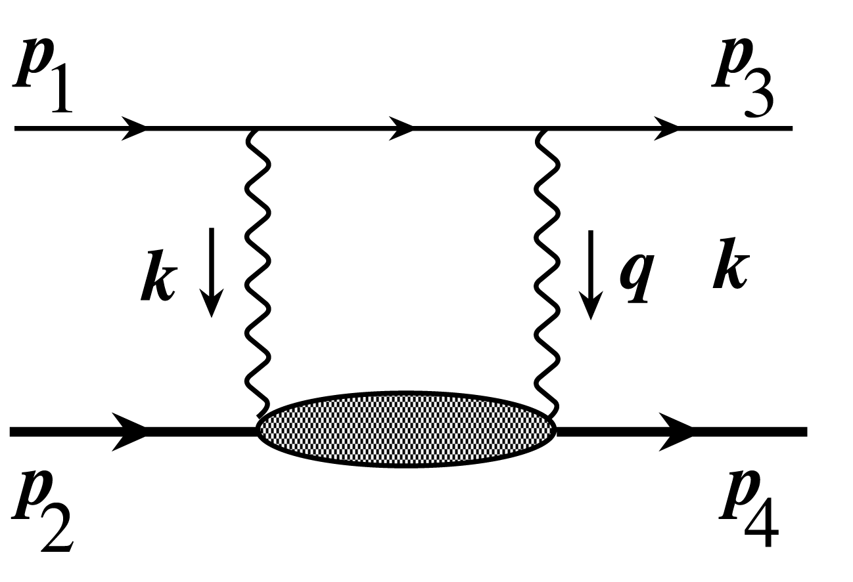
Proton charge and magnetism in 2006
2-γ exchange
important
Hall A
1) e + p → e’ + p
G_{E}^{p}/G_{M}^{p} constant
2) e + p → e’ + p
G_{E}^{p}/G_{M}^{p} drops with Q²
smaller distance →
charge depletion in interior of proton
Orbital motion of quarks play a key role
(Belitsky, Ji + Yuan PRL 91 (2003) 092003)

Slide 30
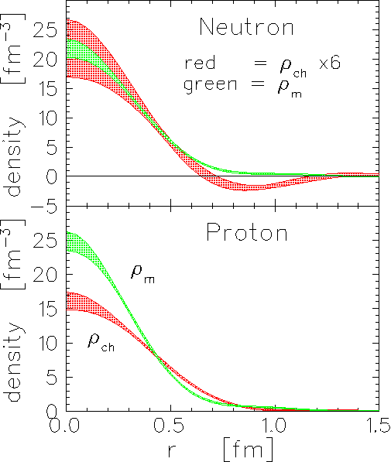
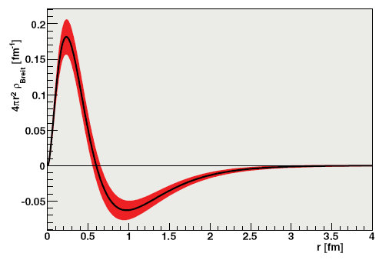
What about the neutron?
Neutron has no charge, but does have a charge distributions: n = p + π⁻, n = ddu. Use polarization and ²H(e,e’n) to access. “Guarantee” that electron hits a neutron AND electron transfers its polarization to this neutron.
charge and magnetization density
Properly normalized (volume integral) charge of course zero
J. J. Kelly, PRC 66 (2002) 065203

Slide 31
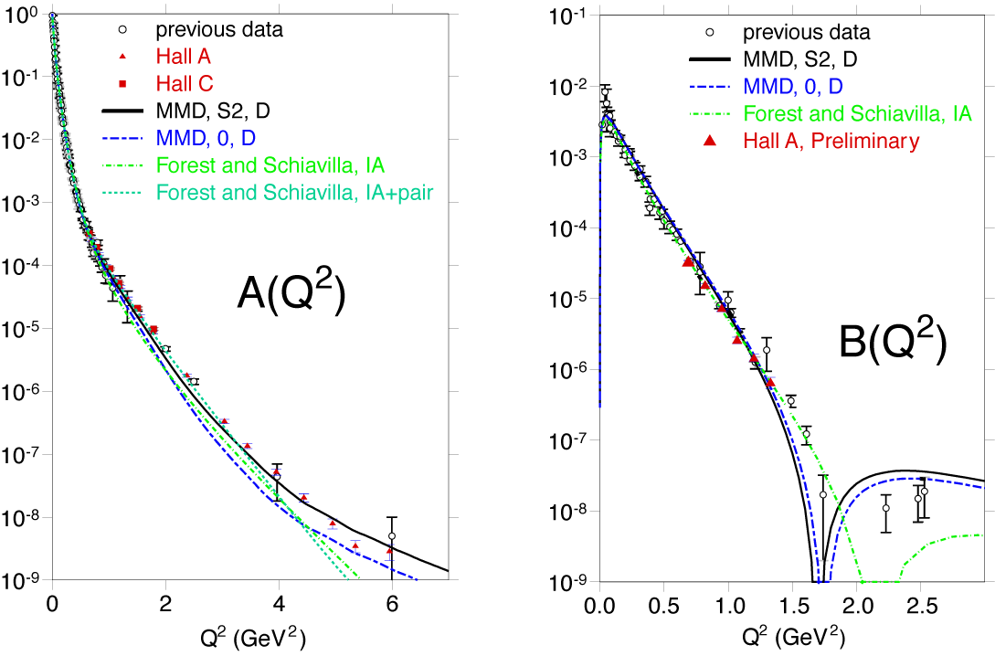
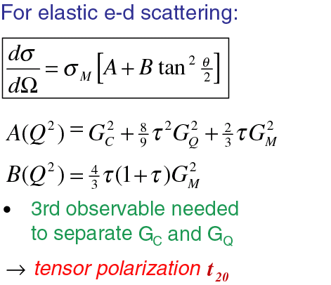
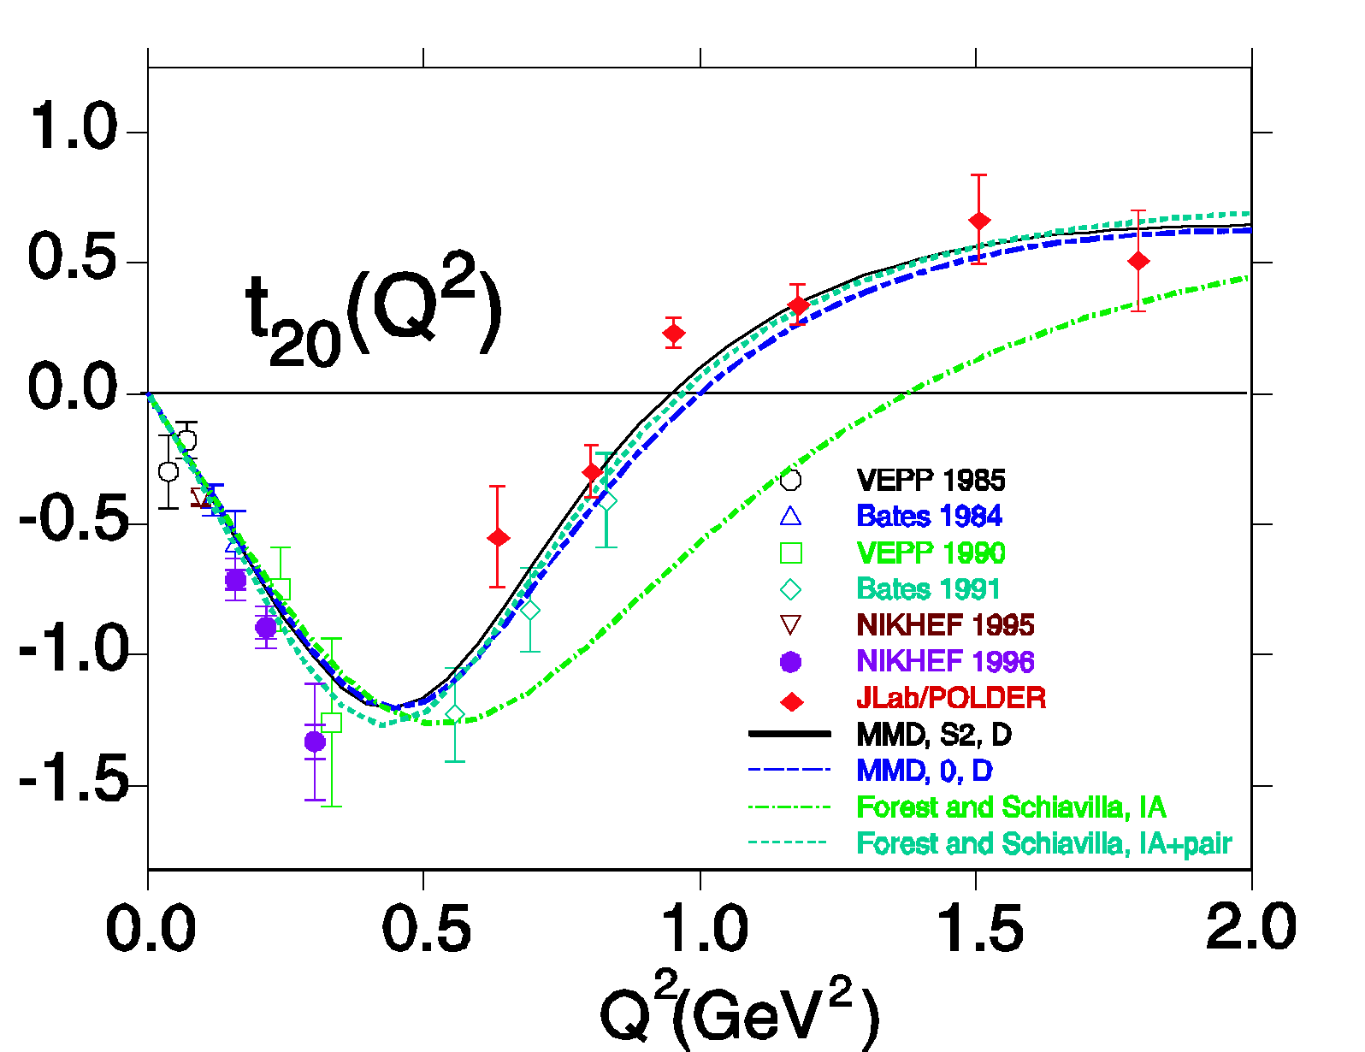
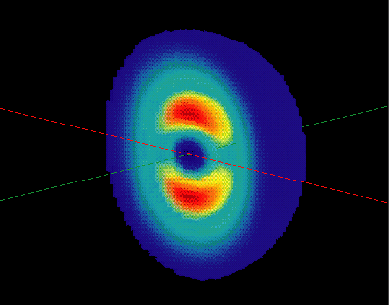

JLab Data Reveal Deuteron’s Size and Shape
Hall A
Combined Data ->
Deuteron’s Intrinsic Shape
The nucleon-based description works down to < 0.5 fm

Slide 32
CEBAF’s Original Mission Statement
Key Mission and Principal Focus (1987):
The study of the largely unexplored transition between the nucleon-meson and the quark-gluon descriptions of nuclear matter.
The Role of Quarks in Nuclear Physics
Related Areas of Study:
Do individual nucleons change their size, shape, and quark structure in the nuclear medium?
Pushing the Limits of the Standard Model of Nuclear Physics
How do nucleons cluster in the nuclear medium?
What are the properties of the force which binds quarks into nucleons and nuclei at distances where this force is strong and the quark confinement mechanism is important?
The Onset of the Parton Model
Use the Nuclear Arena to Study QCD

Slide 33
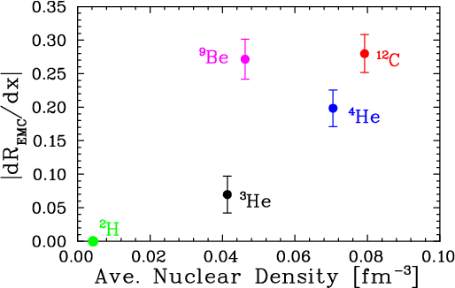


EMC Effect in very light nuclei
EMC effect scales with average nuclear density if we ignore Be
?
Be = 2 α clusters (⁴He nuclei) + “extra” neutron
Suggests EMC effect depends on local nuclear environment
dR/dx = slope of line fit to A/D ratio over region x=0.3 to 0.7
Nuclear density extracted from ab initio GFMC calculation – scaled by (A-1)/A to remove contribution to density from “struck” nucleon
C. Seely, A. Daniel, et al, PRL 103, 202301 (2009)

Slide 34




Proton Momenta in the nucleus
Similar shapes for few-body nuclei and nuclear matter at high k (=p_{m}).
Nuclear Matter
Short-range repulsive core gives rise to high proton momenta
²H
p
n
³He
⁴He
0 200 400 600 800 1000
P (MeV/c)

Slide 35


Short Range Correlations in Nuclei
CLAS
Hall A
A(e,e’)X, A = ³He, ⁴He, ¹²C, ⁵⁶Fe
Measured Composition ( %)
 | 1N state | 2N SRC | 3N SRC
²H | 96 ± 0.7 | 4.0 ± 0.7 | ---
³He | 92 ± 1.6 | 8.0 ± 1.6 | 0.18 ± 0.06
⁴He | 86 ± 3.3 | 15.4 ± 3.3 | 0.42 ± 0.14
¹²C | 80 ± 4.1 | 19.3 ± 4.1 | 0.55 ± 0.18
⁵⁶Fe | 76 ± 4.7 | 23.0 ± 4.7 | 0.79 ± 0.25
A(e,e’pN)X, A =¹²C
Proton-neutron rate is ~20 x proton-proton rate →
two nucleons close
together are almost
always a p-n pair!
Expected to be due to (short-range) tensor correlations.
Q²/2Mν

Slide 36

Short-Range Correlations (SRC) and European Muon Collaboration (EMC) Effect Are Correlated
EMC Slopes
0.35 ≤ X_{B} ≤ 0.7
Fomin et al, PRL 108, 092502 (2012)
SRC Scaling factors X_{B} ≥ 1.4
SRC: nucleons see strong repulsive core at short distances
EMC effect: quark momentum in nucleus is altered
Weinstein et al, PRL 106, 052301 (2011)

Slide 37



Lead (²⁰⁸Pb) Radius Experiment : PREX
Elastic Scattering Parity-Violating Asymmetry
Z⁰ : Clean Probe Couples Mainly to Neutrons
Applications : Nuclear Physics, Neutron Stars,
Atomic Parity, Heavy Ion Collisions
PREX
Rel. mean field
Nonrel. skyrme
A neutron skin of 0.2 fm or more has implications for our understanding of neutron stars and their ultimate fate
The Lead (²⁰⁸Pb) Radius Experiment (PREX) determines the neutron radius to be larger than the proton one by +0.35 fm (+0.15, -0.17).
This result represents model-independent confirmation of the existence of a neutron skin, with relevance for neutron star calculations.
Plans for follow-up experiment to reduce uncertainties by factor of three. This can quantitatively pin down the symmetry energy, an important contribution to the nuclear equation of state.

Slide 38
CEBAF’s Original Mission Statement
Key Mission and Principal Focus (1987):
The study of the largely unexplored transition between the nucleon-meson and the quark-gluon descriptions of nuclear matter.
The Role of Quarks in Nuclear Physics
Related Areas of Study:
Do individual nucleons change their size, shape, and quark structure in the nuclear medium?
Pushing the Limits of the Standard Model of Nuclear Physics
How do nucleons cluster in the nuclear medium?
What are the properties of the force which binds quarks into nucleons and nuclei at distances where this force is strong and the quark confinement mechanism is important?
Charge and Magnetization in Nucleons and Pions
The Onset of the Parton Model

Slide 39


The Double-Faced Strong Force
Confinement
Constituent
Quarks
Q > Λ
α_{s}(Q) large
Asymptotically
Free Quarks
Q >> Λ
α_{s}(Q) small
Nucleons
Q < Λ
α_{s}(Q) > 1
One parameter, Λ_{QCD},
~ Mass Scale or
Inverse Distance Scale
where a_{s}(Q) =
“Separates” Confinement
and Perturbative Regions
Mass and Radius of the Proton are (almost) completely governed by
q
∞
g
q
Λ_{QCD}≈0.213 GeV
Quark Model
Quark Parton Model
Notes:
Prevalence of loops.
LGT
focusing

Slide 40
Nuclear Physics in terms of protons, neutrons and pion exchange is a very good effective model.
Momentum transfer Q is negligible
Protons and Neutrons in terms of constituent (valence) quarks is a very decent effective model:
the Constituent Quark Model works surprisingly well.
Momentum transfer Q is small
Looking deep inside protons and neutrons, they are really balls of energy, with lots of gluons and quark-antiquark pairs popping in and out of existence.
Momentum transfer Q is “large”

Slide 41


A₁^{n} and A₁^{p} in valence (high-x) region
Introduce Polarization Degree of Freedom
A₁ in Parton Model ~
Measurement of spin asymmetries A₁^{n} and A₁^{p} allows for Δu + Δd flavor decomposition (at large x)
x = fraction of nucleon momentum
carried by struck quark
g₁ = A₁/F₁

Slide 42





The Spin of the Proton
Nobel Prize, 1943: "for his contribution to the development of the molecular ray method and his discovery of the magnetic moment of the proton"
μ_{p} = 2.5 nuclear magnetons, ± 10% (1933)
Proton spins are used to image the structure and function of the human body using the technique of magnetic resonance imaging.
Otto Stern
Paul C. Lauterbur
Sir Peter Mansfield
Nobel Prize, 2003: "for their discoveries concerning magnetic resonance imaging"

Slide 43
The Spin Structure of the Proton - Puzzles
μ_{p} = 2.5 nuclear magnetons, ± 10% (1933)
2002 experiment:
μ_{p} = 2.792847351(28) μ_{N}
μ_{n} = -1.91304274(45) μ_{N}
How do the quark
contributions add up?
How are charge and magnetism distributed?
2006 theory:
μ_{p} ~ 2.8 μ_{N}
μ_{n} ~ -1.8 μ_{N}
Proton helicity sum rule:
½ = ½ ΔΣ + ΔG + L_{q} + L_{g}
~ 0.3
Small?
“TMDs and GPDs”
? Large ?

Slide 44



The spatial distribution of quarks and the proton’s magnetism
Hall A
strange quarks do not play a substantial role in the long-range electromagnetic structure of nucleons
proton charge/magnetism
neutron charge/magnetism
proton response to Weak force
up
down
strange
~ 5%
1st Separation using G0, HAPPEx-II & HAPPEx-He, and A4 & SAMPLE data
smaller distance →

Slide 45


F₁^{d}/F₁^{u} with proton and neutron FFs
Assume no strange quarks
Use recent G_{E}^{p}/G_{M}^{p}, G_{M}^{n}, and G_{E}^{n}/G_{M}^{n} data
F₁^{d}/F₁^{u} ratio drops with Q² → down quark has more extended spatial charge distribution? Why?

Slide 46



Unified View of Nucleon Structure
W_{p}^{u}(x,k_{T},r ) Wigner distributions
6D Dist.
d³r
d²k_{T} dr_{z}
TMD PDFs f₁^{u}(x,k_{T}), .. h₁^{u}(x,k_{T})‏
GPDs/IPDs
3D imaging
dx &
Fourier Transformation
d²k_{T}
d²r_{T}
Form Factors
G_{E}(Q²),
G_{M}(Q²)‏
PDFs
f₁^{u}(x), .. h₁^{u}(x)‏
1D

Slide 47


What’s the use of GPDs?
1. Allows for a unified description of form factors and parton distributions
2. Describe correlations of quarks/gluons
3. Allows for Transverse Imaging
Fourier transform in momentum transfer
x < 0.1
x ~ 0.3
x ~ 0.8
gives transverse spatial distribution of quark (parton) with momentum fraction x
4. Allows access to quark angular momentum (in model-dependent way)

Slide 48

Next Round of DVCS Experiments: Hall B
α = A_{LU}(90) as a function of t
e
k'
γ
k
q
q'
γ*
p
p'
Indeed:
t-slope decreases as x_{B} increases

Slide 49

orbital angular momentum carried by quarks : solving the spin puzzle
e
k'
γ
k
q
q'
γ*
J_{d}
p
p'
At one value of x only
Ingredients:
1) GPD Modeling
2) HERMES ¹H(e,e’γ)p (transverse target spin asymmetry)
3) Hall A n(e,e’γ)n
(neutron-DVCS from ²H target)
Or independent: Lattice QCD!
J_{u}
Tremendous progress to constrain quark angular momenta
12 GeV will give final answers for quarks

Slide 50

12 GeV Projection for nucleon’s transverse spatial profile

Slide 51



New Observable Reveals Interesting Behavior of Quarks
Huang, et. al. PRL. 108, 052001 (2012)
Target:
(transversely)
polarized ³He ~ polarized neutron
1st measurement of A_{LT}
beam-target double-spin asymmetry
Indications:
A non-vanishing quark “transversal helicity” distribution, reveals alignment of quark spin transverse to neutron spin direction
Quark orbital motions
Notes:
Semi-inclusive deep inelastic scattering on a transversely polarized neutron (3He) target.
Curves from theory models:
WW-type: Wandzura-Wilczek, neglects higher-twist contributions, Kotzinian (2006).
LCCQM: light-cone constituent quark model, Boffi (2009), Pasquini (2008).
LCQDM: light-cone quark-diquark model, Zhu and Ma (2011).

Slide 52



New Opportunity: Search for A’ at Jefferson Lab
BNL “g-2” expt: Δa_{μ}(expt-thy) = (295±88) x 10⁻¹¹ (3.4 σ)
No evidence for SUSY at LHC (yet)
Another solution: A’, a massive neutral vector boson
- also useful for dark matter models
3 Jefferson Lab proposals:
g – 2 preferred!
APEX test run (Hall A) – published
HPS test run (Hall B) – complete
DarkLight test run (FEL) – July 2012

Slide 53
15+ Years of Physics Experiments at JLab
Experiments have successfully adressed original Mission Statement:
“The study of the largely unexplored transition between the nucleon-meson and the quark-gluon descriptions of nuclear matter”
Highlight 1: The Role of Quarks in Nuclear Physics
Probing the Limits of the Traditional Model of Nuclei
Emphasis has shifted to third sub-area of intended CEBAF research:
“What are the properties of the force which binds quarks into nucleons and nuclei at distances where this force is strong and
the quark confinement mechanism is important?”
Highlight 2: Charge and Magnetization in Nucleons and Pions
Highlight 3: The Onset of the Parton Model at Low Energies
Charge distribution in proton differs from magnetization distribution
Elusive charge distribution of neutron well mapped out to high resolution
Strange quarks play <5% role in mass of proton.
High quality hadronic structure function data at JLab at 6 GeV have been accumulated spanning the nucleon resonance and low-W² deep inelastic region. The data indicate a surprisingly smooth parton-hadron transition at relatively low Q², allowing, for x > 0.1, an unprecedented access to partons with the 12 GeV Upgrade, allowing to finally go beyond 1-dimensional snapshots.

Slide 54

Exposing the high-energy (dark) side of the nuclei
The Low Energy View of Nuclear Matter
  nucleus = protons + neutrons
  nucleon ↔ quark model
  quark model ↔ QCD
The High Energy View of Nuclear Matter
The visible Universe is generated by quarks, but dominated by the dark glue!
Remove
factor 20

Slide 55

Polarization transfer in ⁴He(e,e’p)³H
E93-049 (Hall A): Measured ⁴He(e,e’p)³H in quasi-elastic kinematics
for Q² = 0.5, 1.0, 1.6 and 2.6 (GeV/c)² using Focal Plane Polarimeter
Extracted “Superratio”: (P’_{x}/P’_{z}) in ⁴He/(P’_{x}/P’_{z}) in ¹H
Free electron-nucleon scattering
Bound nucleons → evaluation
within model
Reaction mechanism effects
minimal for A(e,e’p) about P_{m} = 0
→ Form Factors in the Nucleus
RPWIA
RDWIA
G_{E} P’_{x} (E_{i} + E_{f}) Θ_{e}
G_{M} P’_{z} 2m 2
__ __ _____ __
= - tan
~
G_{E} P’_{x} (E_{i} + E_{f}) Θ_{e}
G_{M} P’_{z} 2m 2
__ __ _____ __
~
= - tan

Slide 56

Generalized Parton Distributions and Nucleon Tomography
Accessible through (Deep) Exclusive Reactions
A Major new direction in Hadron Physics aimed at the 3-D mapping of the quark structure of the nucleon.
Simplest process:
Deep-Virtual Compton Scattering
k'
γ
e
k
q
q'
γ*
p
p'
z
x = Longitudinal momentum fraction
y
interference
pattern
Charge density distributions for u-quarks
3D image is obtained by rotation around the z-axis

Slide 57



Beyond form factors and quark distributions –
Generalized Parton Distributions (GPDs)
DVCS
e
BH
Simplest process: e + p → e’ + p + γ (DVCS).
Unprecedented set of Deeply Virtual Compton Scattering data accumulated in Halls A and B
e
p
p
Hall A data agree well with hard-scattering assumption

Slide 58

Hadrons in the Nuclear Medium
Nucleons and Mesons are not the fundamental entities
of the underlying theory.
At high densities a phase transition must occur to a
quark-gluon plasma.
At nuclear matter densities of 0.17 nucleons/fm³,
nucleon wave functions overlap considerably.
EMC effect: Change in the inclusive deep-inelastic
structure function of a nucleus relative to that of
a free nucleon.

Slide 59

Polarization transfer in ⁴He(e,e’p)³H
E93-049 (Hall A): Measured ⁴He(e,e’p)³H in quasi-elastic kinematics
for Q² = 0.5, 1.0, 1.6 and 2.6 (GeV/c)² using Focal Plane Polarimeter
Extracted “Superratio”: (P’_{x}/P’_{z}) in ⁴He/(P’_{x}/P’_{z}) in ¹H
RPWIA
RDWIA
+QMC
Medium Modifications of Nucleon Form Factor
Compared to calculations by Udias without and with inclusion of medium effects predicted by Thomas et al. (Quark Meson Coupling model).

Slide 60


x>1 (e,e’pN) Measurements
To study nucleon pairs at close proximity and their contributions to the large momentum tail of nucleons in nuclei.
R. Subedi et al., Science 320 (2008) 1476.
A pair with “large” relative
momentum between the nucleons and small center of mass momentum
high Q² to minimize reaction mechanism effects (Meson-Exchange Currents)
x>1 to suppress isobar contributions (Excitation of excited states of the nucleons)
parallel kinematics to suppress FSI (Final-State Interaction or rescattering effects)

Slide 61


Short Range Correlations in Nuclei
Hall A
CLAS → two-nucleon correlations contributed ~20% to the ¹²C wave function. Hall A → two nucleons close together are almost always a p-n pair.
Proton-neutron rate is ~20 x the proton-proton rate.
Expected to be due to short-range tensor correlations.
calculation

Slide 62


Cool Facts about QCD and Nuclei
Did you know that … ?
Nuclear physicists are trying to
answer how basic properties like
mass, shape, and spin come about
from the flood of gluons, quark/
anti-quark pairs, and a few ever-
present quarks.
Protons and neutrons were formed from quarks and gluons as the primordial scorching-hot fireball, produced in the Big Bang, expanded and cooled.
For the first time since this unique event, nuclear physicists are now recreating the matter that existed in the first fraction of a second in the laboratory.
One of the great mysteries scientists are exploring is why the pure energy of the Big Bang did not turn into equal amounts of matter and anti-matter.

Slide 63
Cool Facts about QCD and Nuclei
Did you know that … ?
A small fraction of the force between quarks and gluons “leaks out” of protons and neutrons, and binds them together to form tiny nuclei. The long-range part of this process can be well described as if protons and neutrons exchange pions.
Nuclear physicists are only now starting to understand how this “leakage” occurs, and how it results in the impressive variety of nuclei found in nature.
A nucleus consisting of some 100 protons and 150 neutrons can be the same size as one with 3 protons and 8 neutrons.

