Slide 1
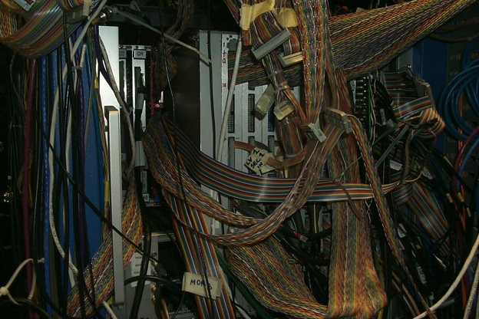
Data Acquisition Systems for Experimental Nuclear Physics
Graham Heyes

Slide 2
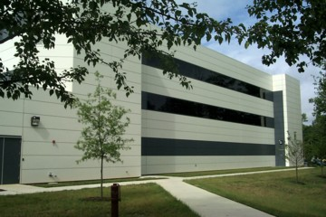
Introduction
Data acquisition support group.
  Support the operation of online (DAQ) systems in the halls and in testbeds
    Planning of new experiments.
    Debugging and maintenance of software and hardware.
    Adding new features.
  Custom electronics and software.
    Software to read out that hardware.
    Online displays and monitoring tools.
  Proactive R&D
    Recognizing issues the hall online groups may not see and having answers ready.
    Replacing obsolete hardware and software.
    Reducing cost and improving performance.
We’re in Here
Lab on the 1st Floor

Slide 3
What is this talk about...
What is Data Acquisition?
Digitization.
Triggering.
Readout.
System architectures.
Event building.
Data storage
Experiment control.

Slide 4
What is Data Acquisition?
The aim of a nuclear physics experiment is to gather data about nuclear interactions.
Particles pass through detectors and the detectors generate electrical signals.
These signals contain information about the particles - type, energy and trajectory.
The data acquisition system digitizes, formats and stores this information in a way which can be retrieved for later analysis.

Slide 5
Why is this an issue?
Data is generated from interactions in the detector and so has a random timing.
  Need to be ready for new data - limit dead time.
JLab experiments have high interaction (event) rates:
  Data rate = Trigger rate x Event Size.
The data is generated by sub-detectors that are physically distributed within the detector.
  Remember where the data came from.
  Gather the data into one data set or “event”.
Experiments run for months or years:
  Start and stop data taking in a controlled way.
  Monitor other parameters which describe the conditions under which the data was taken.

Slide 6
Digitization
Three basic types of measurements are made on the electrical signals coming from a detector.
  time - when the signal occurred.
  amplitude - how large the signal was.
  count - how many signals there were.
Three basic types of digitizer
  A TDC converts time into a number.
  An ADC converts an amplitude into a number.
  A Scaler counts pulses.

Slide 7
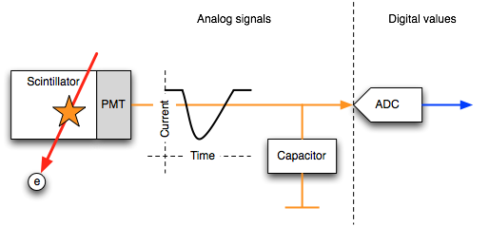
ADC example, a scintillator
A particle deposits energy in a scintillating material.
The scintillator converts that energy into light.
The Photo Multiplier converts the light into a pulse of electricity.
In this example a capacitor converts the pulse into a voltage which is proportional to the area of the the pulse (the total charge).
An Analog to Digital converter, ADC, converts the voltage into a digital value.

Slide 8
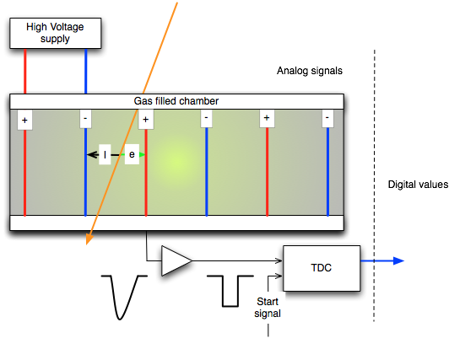
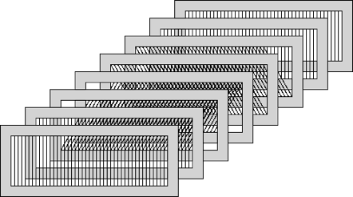
TDC example, a wire (or drift) chamber
A chamber contains planes of parallel wires and a special gas mixture. A high voltage is applied to the wires so that alternating wires are charged positive and negative.
A particle ionizes the gas. Ions drift to negatively charged wires and electrons to positive.
A signal from another detector is used to start a Time to Digital Converter (TDC).
The electrons produce a pulse which is used to stop the TDC.
The time value measures the distance the electrons drifted. In combination with the position of the sense wire this tells us where the particle crossed the plane.
Several planes are used to reconstruct the particle track in three dimensions.

Slide 9
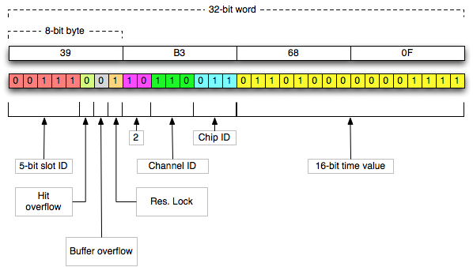
What does the data look like?
Example, a single 16-bit TDC value, half the data is status and location.

Slide 10
Sampling vs Integration
A traditional “integrating” ADC takes 6 to10 µsec to digitize and generates 1 data word representing the charge sum during the gate.
A 250 MHz Flash ADC samples every 4 nsec and generates ~10-15 data words that describe the pulse.

Slide 11
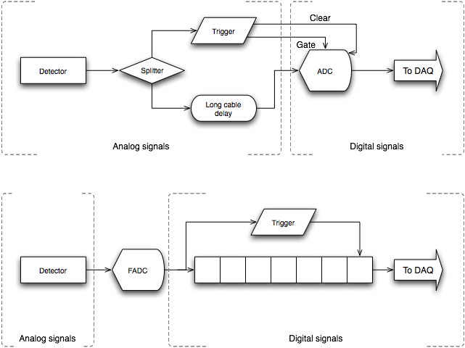
Pipelines - dead-timeless Readout
In a standard non-pipelined system the analog signal is delayed while the trigger logic forms the gate. Typical coax cables ~1 ns/foot, matching cable lengths was very important.
The ADC cannot process a new signal until it is read or cleared.
In a pipelined system a stream of ADC values are stored in a memory.
The trigger can then look-back in time to select relevant data or clear unwanted data so that the memory never fills.
11

Slide 12
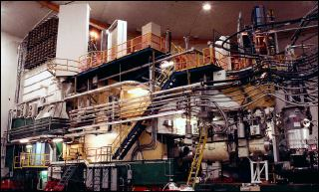
Oh, that “long cable” here it is in Hall-A.

Slide 13
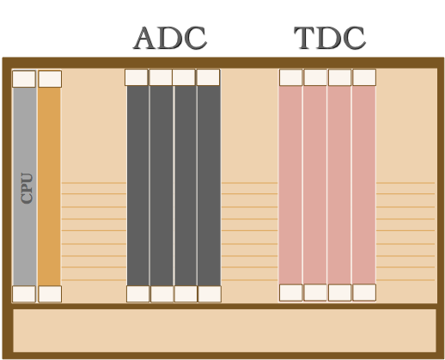
Modules/Buses
The previous examples showed a single ADC or TDC value, or channel.
The detectors at JLab have many thousands of channels. A group of channels is digitized by a multi-channel ADC or TDC board.
  Pack many digitizers onto one board.
  Pack many boards into a crate.
  Pack the crates into racks.
  Use standard backplane buses to link everything.
Example bus standards:
  CAMAC
  FASTBUS
  VME
  PCI.
13

Slide 14
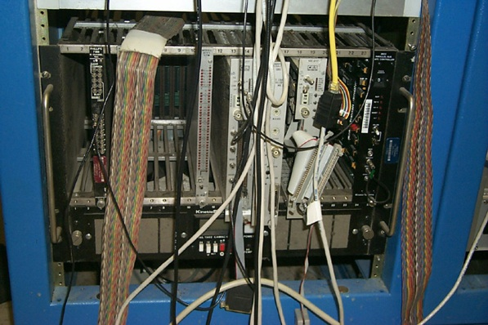
CAMAC
(Computer Automated Monitoring And Control)
Old IEEE Standard
24 bit bus.
Relatively slow
(3 MB/sec).
Small boards but built to last with small scale ICs or discrete components.
A lot still around.
Favorite for slow control systems.
14

Slide 15
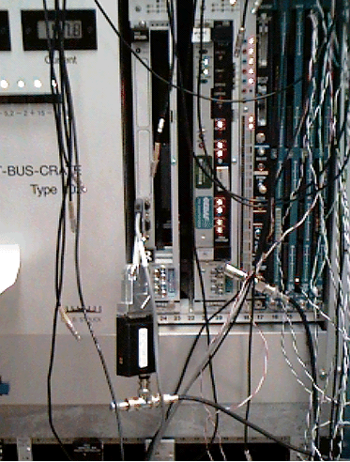
FASTBUS
Designed by physicists for physicists.
Large boards so high channel densities.
Fast 32 bit bus (40 MB/sec).
The majority of JLAB detectors in 6 GeV program were instrumented with FASTBUS.
Obsolete.
  No more commercial Vendors.
15

Slide 16
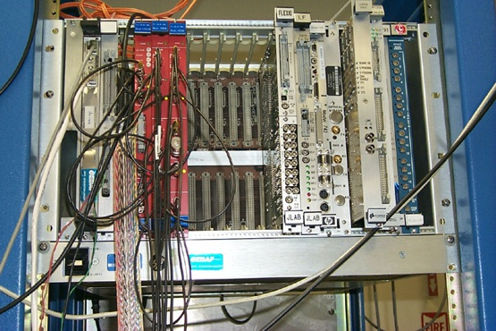
VME (Versa Module Europa)
(or Very Messy Environment)
IEEE standard for interconnecting modules.
32/64 bit bus (80MB/s)
Large number of commercial products (used heavily in the military).
VME64X provide bandwidth options (160-320 MB/s).
Smaller boards but modern FPGA chips mean this is not a problem.
Halls are transitioning to VME from FASTBUS.
16

Slide 17
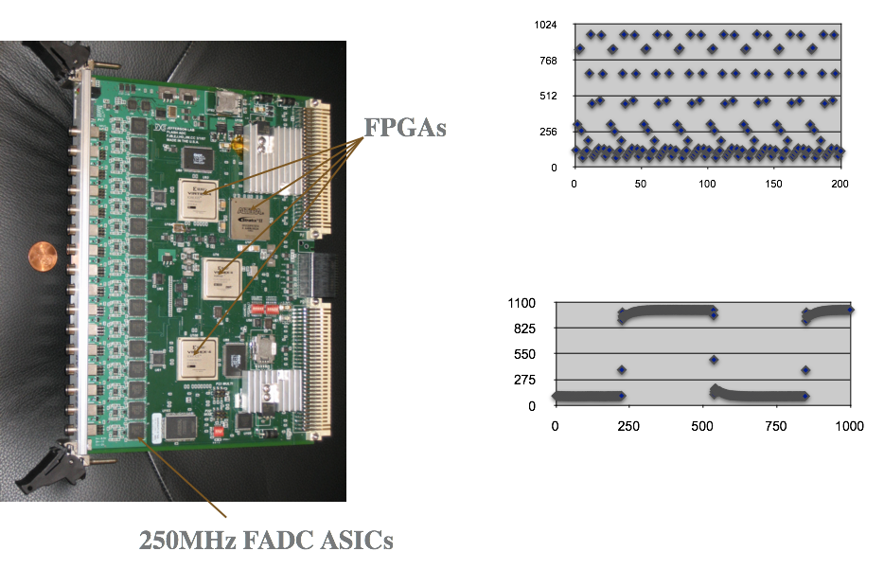
JLAB Flash ADC

Slide 18
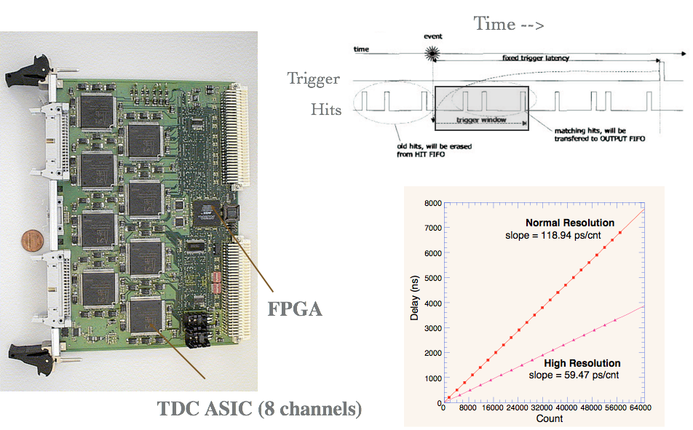
JLAB Pipeline TDC
18

Slide 19
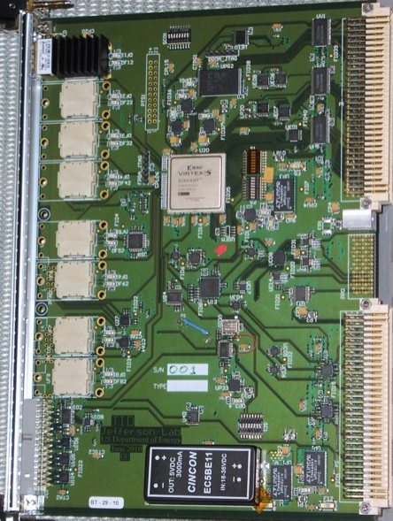
Trigger interface board
VME→PROM
(FPGA firmware)
Emergency/remote
re-programming
‘Legacy’
Trigger
Supervisor
Interface
Xilinx
VirtexV
LX30T-FG665
VME 64x
Eight
Optical Transceivers
HFBR-7924
VXS P0
TD mode: from SD
TI/TS mode: to SD
One dedicated link for redundant data collection
External I/O
(trg, clk…)
Trg/Clk/Syc
outputs
On row_C

Slide 20
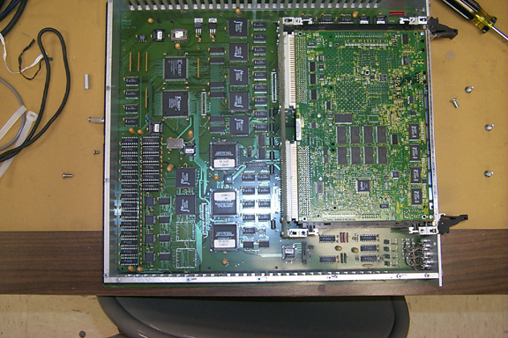
SFI FASTBUS to VME Controller
20

Slide 21
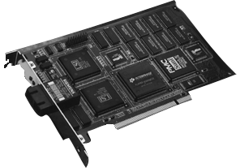
What about PCI (Peripheral Component Interconnect)?
It’s in every PC you buy today.
Fast 64 bit bus (33-66MHz, 266 - 532 MB/s).
Not much specialization for nuclear physics.
Small board size.
Different “flavors”
  PCI-X (133 MHz)
  cPCI (Bus “module” format)
  PMC (daughter card)
  PCI-Express (PCIe serial)
21

Slide 22
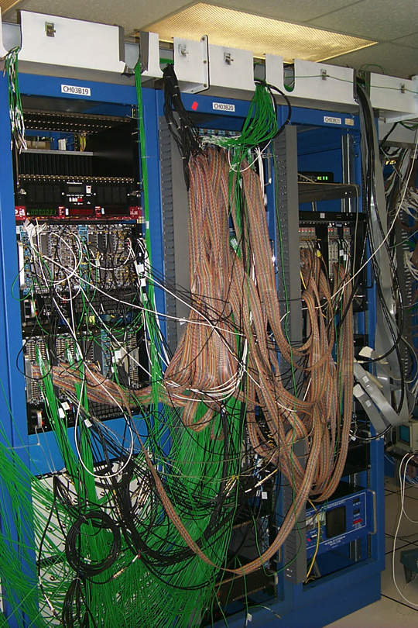
The Real World
Block diagrams are very pretty but when you add in the cables and racks it gets a little messy.
Cable lengths can be critical.
Reconfiguration is frequent so cable ties and trays are a hinderance.

Slide 23
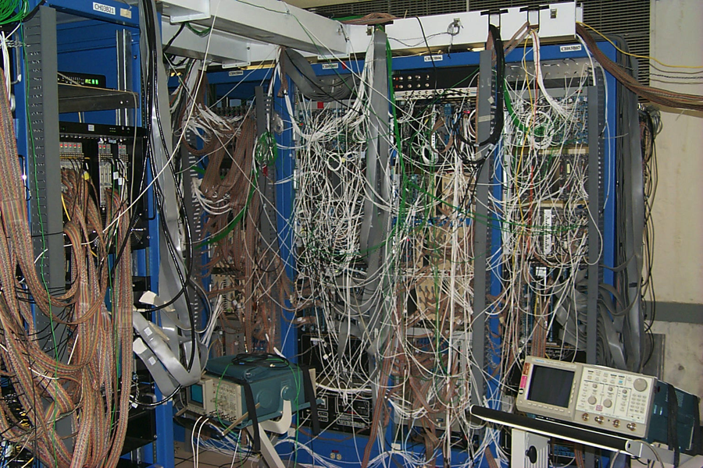
… and it gets worse!

Slide 24
Triggering
The data acquisition system needs to know when an interaction “Event” has occurred in the detector.
Signals from fast detectors, like scintillators, are combined by electronics or software to make a decision on when an event has occurred.
  Used as a start gate for slower detectors like drift chambers.
  Used as a filter to reject unwanted events - fast clear.
  Used to start the process of reading data off the digitizing electronics.

Slide 25
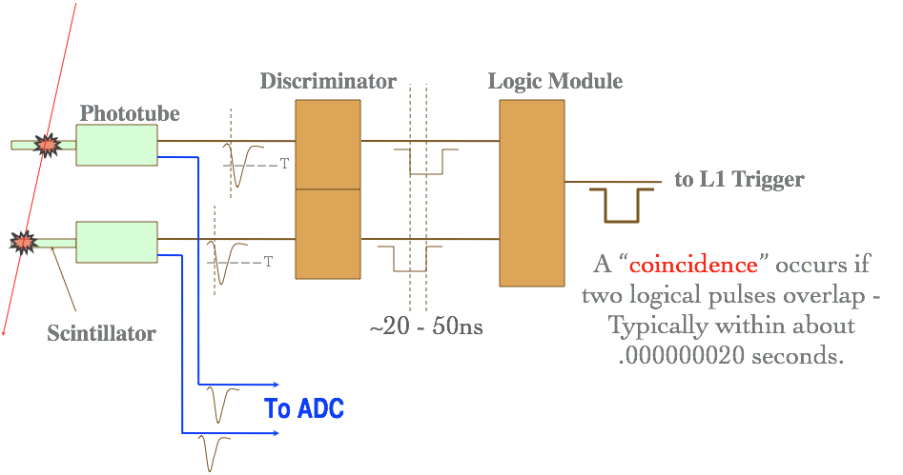
A Simple Trigger

Slide 26
Levels of trigger
Level 1 trigger
    A very fast hardware yes/no decision based on a few raw signals. For example, is there more than one hit in the scintillators?
Level 2 trigger
    A slower hardware decision based on derived information. For example, are there three tracks and is the total momentum above some value?
Level 3 trigger
    A very slow software decision based on running physics analysis code online.

Slide 27
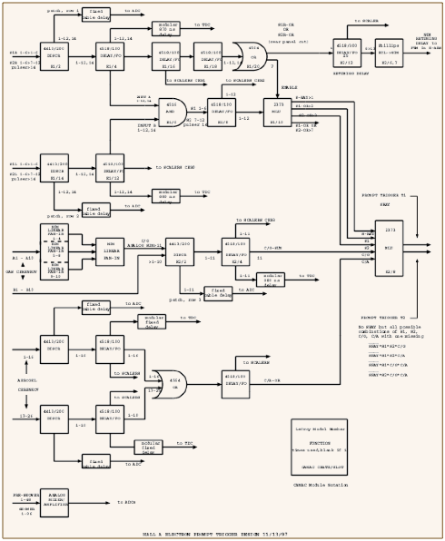
Hall A Trigger
27

Slide 28
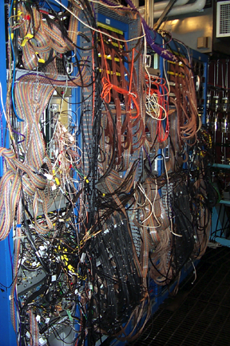
The real world again...
Hall B, CLAS Trigger
28

Slide 29
Readout
The individual boards holding ADCs and TDCs have limited storage capacity so the boards must be read and cleared.
Non-pipelined boards typically hold a single value per channel. They must be read and cleared before the next trigger can be accepted. The boards send a “busy” signal to the trigger. There is a period of time when events in the detector are missed, this is called dead-time.
Pipelined boards can take data until their memory is full. If they can be read faster than the rate at which they fill no triggers will be missed because of readout. This is called “dead-time-less” readout.

Slide 30
Event formatting
The data comes from different detectors and events.
  Need to identify the detector.
  Need to identify which event the data came from.
  Need to make analysis easier.
There is a lot of data.
  Format must be compact.
Analysis can take years.
  Format should be self documenting or at least stable.

Slide 31
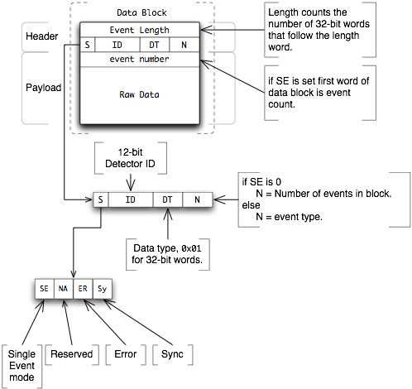
Event data format
We define a data type container called a bank. The bank header tells you how much data is in the bank, what sort of data it is and where it came from.
The data type field in the header can specify that the bank contains other banks or simple data types like integer values.
This nesting of banks within banks allows data structures of arbitrary complexity.
The source of the data is identified by a numeric code. A dictionary must be provided that translates the codes into something meaningful to humans.
A format without an external dictionary is called “self-describing”.
This format can be made self-describing by defining that the first bank in a data file contains the dictionary and the dictionary format.

Slide 32
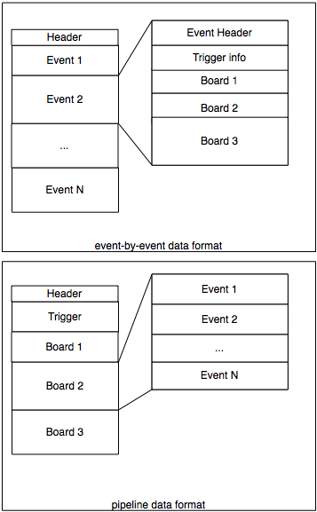
A complication of pipelined readout
Imagine that a bank containing data is generated by a detector. The detector readout can be event-by-event or pipelined.
In event-by-event mode.
  The block contains N banks, one per event.
  The events contain a bank for each board.
In pipeline mode.
  The block contains banks from each board.
  The bank from each board contains data from N events.
  Trigger data for all N events is in one bank.
When the data blocks from different detectors are merged the blocks from pipelines must be untangled.

Slide 33
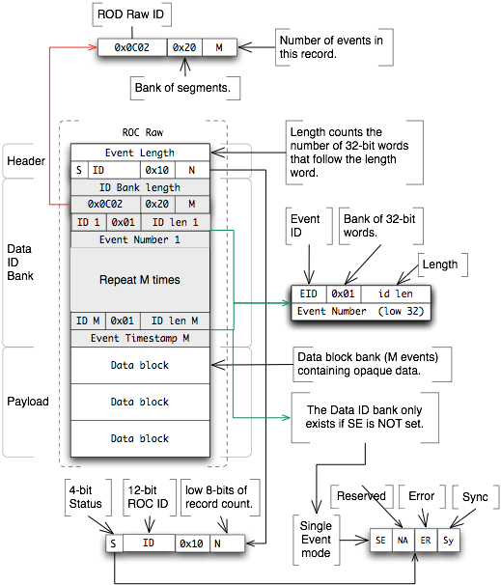
Pipelined format example
Bank - container for other data
Segment - bank with a short header
Raw data - 32-bit words
The outer header tells us this is a “bank of banks”
The first bank is a bank of “segments” which are special short banks that save space by only having 16-bit length and header.
The “payload banks” may be banks of raw data or banks of some other data type

Slide 34
DAQ Architecture
Front-end Systems
  The data is distributed in many crates at different locations, these are called front-end crates since they are close to the detector.
Data transport and back-end systems
  The data from the front-end crates is transported to systems that further manipulate the data and store it for later analysis. These are called back-end systems.
Event Building
  One type of back-end system is software or hardware that takes data from each front-end system and collects event fragments together to form complete events. This is called the Event Builder (EB).

Slide 35
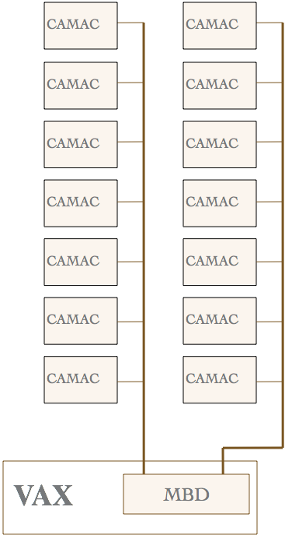
1980‘s DAQ System
Data Transport methods:
DAQ systems were custom-built for each detector using specialized hardware
  CAMAC
  FASTBUS
  NIM
Single Mainframe CPU systems processed the data and connected to the DAQ using custom electronics.
  Fast parallel inter-crate branch bus.
  Community wide standards not used outside of physics.
  Not widely available.

Slide 36
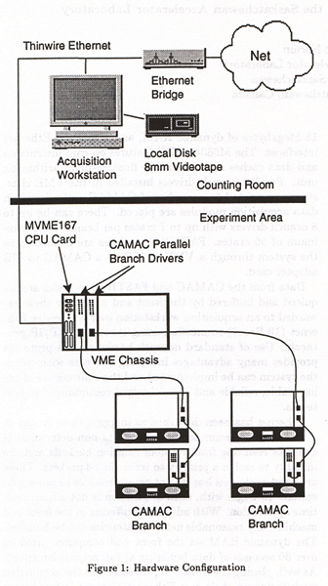
Network based DAQ (1980s to 90s)
During the late 1980’s Ethernet network hardware was becoming cheap enough and fast enough that it could compete with the custom data transport methods.
Microprocessors replaced mini and mainframe systems for readout.
Television drove down the price of tape storage. (but it was unreliable!)
Pro
  Widely available commercial hardware.
  Standardization.
Con
  Still slow for large experiments.

Slide 37
An unexpected benefit of documentation...
The integration of VAX and VALET-plus data acquisition software
Heyes, G.; Wessels, B.; Perrin, Y.; Bagnara, R.; Berners-Lee, T.; Carena, W.; Divia, R.; Parkman, C.; Petersen, J.; Tremblet, L.
Nuclear Science, IEEE Transactions on
Volume 36, Issue 5, Oct 1989 Page(s):1572 - 1576
Digital Object Identifier 10.1109/23.41106
Summary:The VALET-plus is a CERN-developed modular microcomputer system that is based on the Motorola 68K family of microprocessors in a VME environment and has had wide success as a stand-alone test and data-acquisition system. Recently, several experiments at CERN have started to use multiple VALET-plus systems controlled from VAXes or VAXstations.
In the late 1980’s I was working for the DAQ group at CERN on a DAQ system with a microprocessor front end and a VAX back end using Ethernet to move the data and the CERN RPC protocol to communicate over the network.
The author of the CERN RPC software was someone called Tim Berners-Lee.
Our documentation was good but hard to keep track of and relied on paper copies.
Tim was working on another project called hypertext so we wouldn’t have to keep printing stuff out and mailing it.
Tim is now “Sir Tim” and is credited with inventing the World Wide Web.

Slide 38
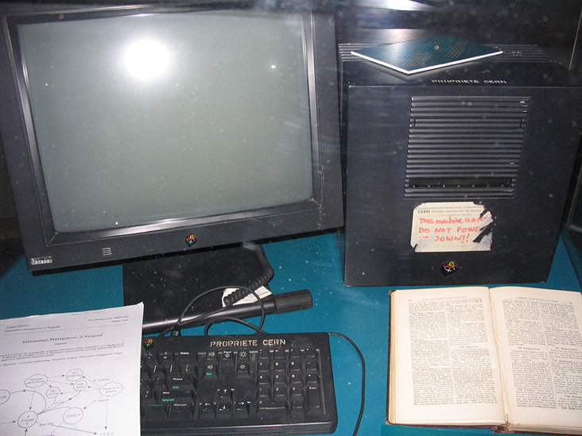
You know you’re getting old when stuff you once used shows up in a museum.
This is the Next Workstation we used to debug the DAQ code. Later in it’s life it became the world’s first web server and is now in the CERN museum.
The Next was manufactured by a company founded by one Steve Jobs who is also famous for other things.

Slide 39
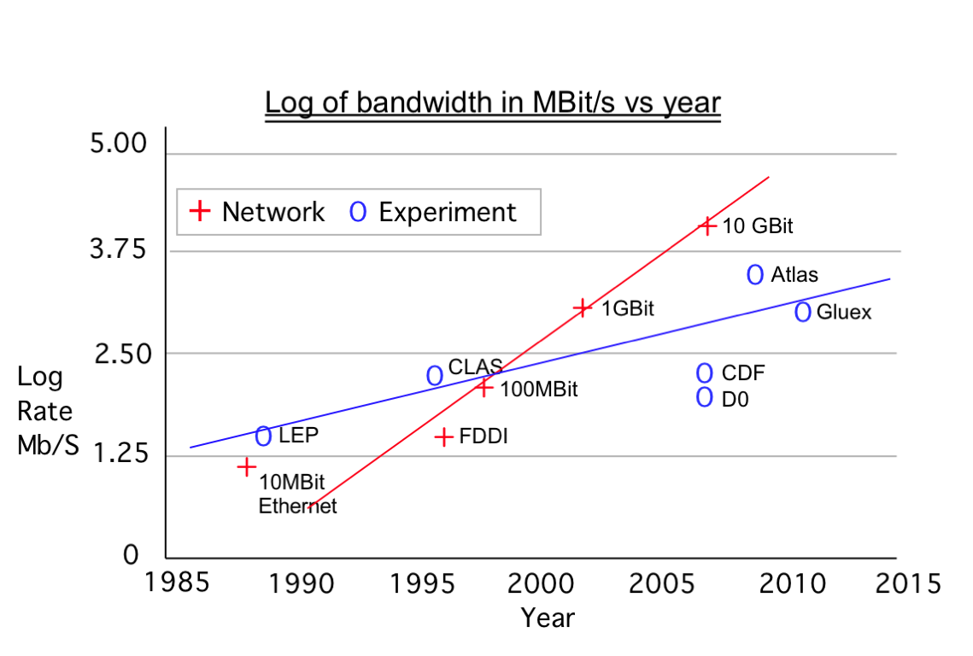
Why the web is important to this talk?
All of the data at JLab is now transported using commercial network hardware.

Slide 40
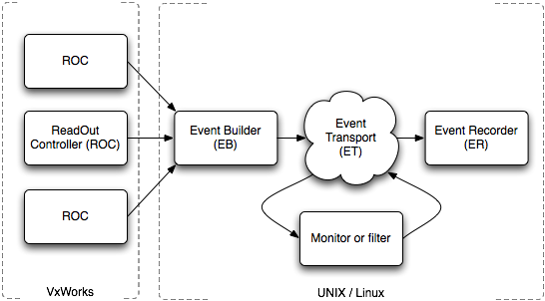
Event Building
The detectors are spread over a physical volume of space.
Bits and pieces of events arrive at different times from different places.
All the parts of the event need to be collected together and packaged with other information needed by the analysis.
The Event builder is a very fast collating machine.

Slide 41
CODA version 2 “Push” Architecture
Detectors
Real-Time OS
Linux or Unix style OS
Network
41

Slide 42
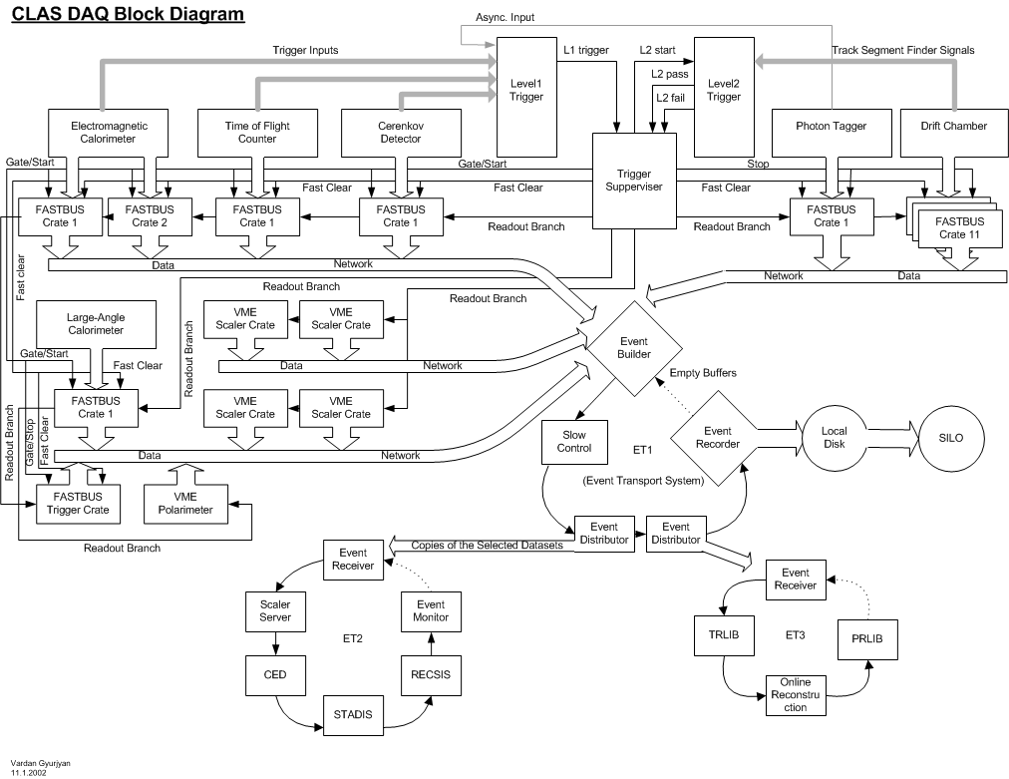
ECAL
TOF
CerD
Tagger
DC
LA-CAL
EB
ET1
ER
Hall B
ET2
ET3
42

Slide 43
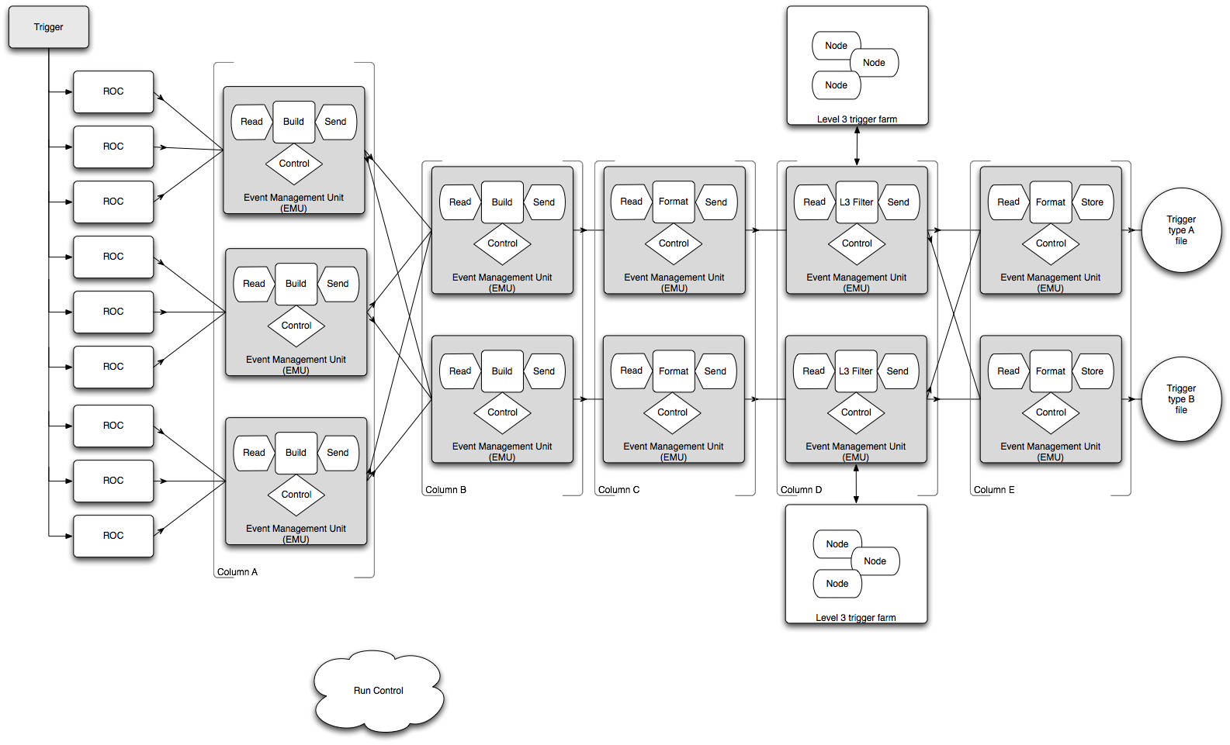
CODA version 3 Distributed parallel event building.

Slide 44
Event storage
Since the goal is to store data we need somewhere to put it.
At JLAB 6 GeV experiments run at 2-35 MB/s.
12 GeV experiments will run between 200-300 MB/s
The fastest storage method is to disk!!
The cheapest storage method is tape.
Stage data to disk then backup to tape.
  Eliminates tape from the dead time equation.
The tape drives must be fast (and robotic). Fast, robotic tape drives are expensive and fragile!!
  Have enough disk to run for 48 hours.
Aim for tape to be the limiting factor in DAQ speed.

Slide 45
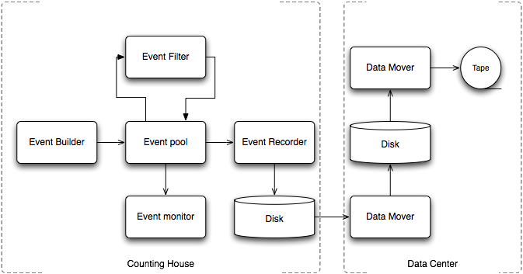
Tape Storage

Slide 46
Other things
Experiment Control
  A talk all by itself!
Monitoring/online Analysis
  Monitor data quality.
  Level 3 trigger.
Slow controls
  Covers all of the other aspects of the experiment which needs to be monitored or controlled.
    Power supply voltages.
    Magnetic fields
    Beam position
    Target position
    Vacuum pressure
    Coffee Maker
46

Slide 47
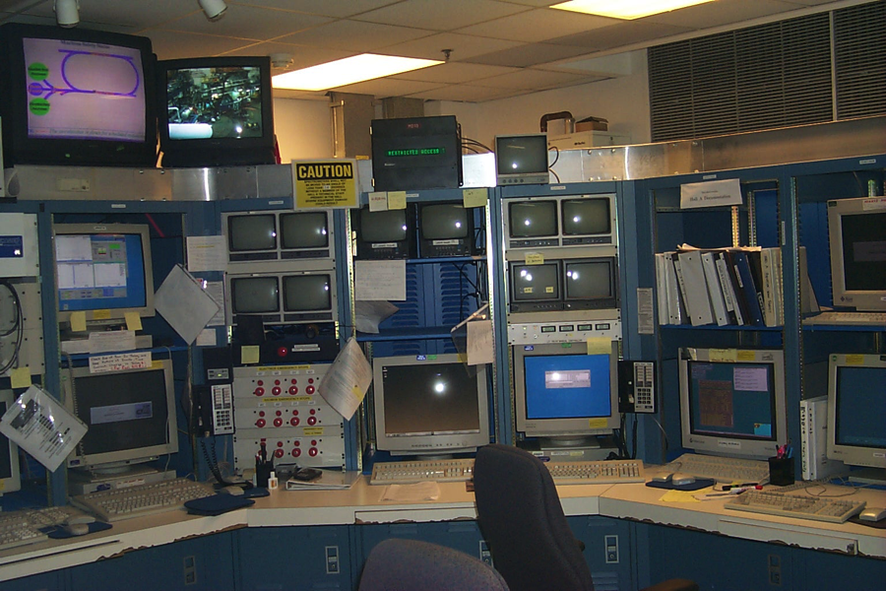
The real world, again
47

Slide 48
What next?
Technology is always changing.
  No more physics centric busses like Fastbus, CAMAC and NIM.
  Very few commercial vendors of “off the shelf” DAQ hardware.
  Big HEP, like LHC, uses very custom electronics
  Computer hardware becoming faster (CPU, RAM, NET)
    More can be done in software.
    Brute force methods replacing subtle code.
  What was real time moves to hardware in FPGAs.
  Serial fiber links replacing electrical signals for trigger.
  We are writing modular, customizable and reusable software. We are using Java in many places so that we can become OS independent.
    Ultrix -> HP-UX -> Solaris -> Linux ===> JAVA
  In the 1990‘s microprocessors allowed much of the function of DAQ hardware to be replaced by software.
  In the 2000‘s FPGAs , DSPs, ASICs etc allowed functionality to move back into hardware (or at least firmware) at higher speeds than microprocessors can reach.
48

Slide 49
Last slide
Data acquisition is an interesting field because it is always changing.
  New experiments.
  New hardware.
  New operating systems.
The rapid advances in networking and computing technology have meant that flexibility is important.
With only a small group of experts it would be very easy to use technology that would be obsolete before it is deployed.
Physicists become DAQ experts because it is fun!

Slide 50
Thank you! that’s all folks…
50

