Slide 1
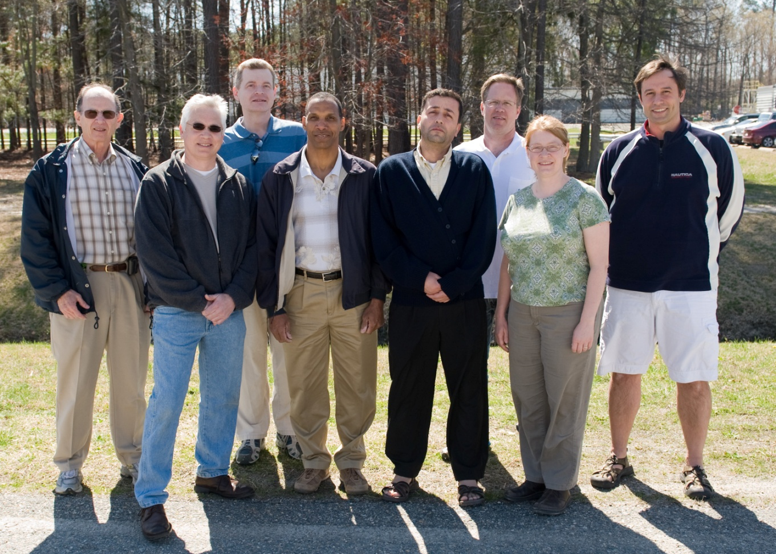
Performance of multi-alkali cathode in JLAB DC gun:
First Results
JLAB: P. Adderley, J. Clark, S. Covert, J. Grames, J. Hansknecht, R. Mammei, M. Poelker, M. Stutzman, R. Suleiman, K. Surles-Law, J. McCarter, M. BastaniNejad, Md. A. Mamun, A. Adeyemi, L. Thomeer, J. Dumas, B. Josey, P. Heuer
Brookhaven National Lab: T. Rao, J. Smedly, J. Walsh
JLAB Pizza Lunch July 20, 2011

Slide 2
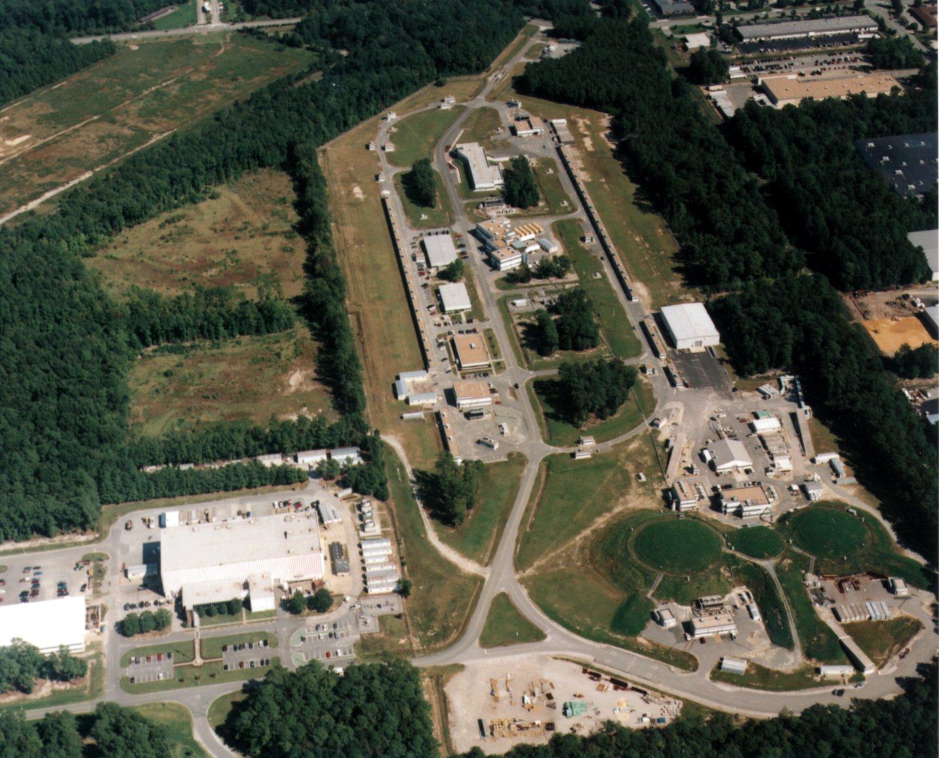
Jefferson Lab Accelerator Site
Arcs
2 SRF Linacs (600 MeV)
CEBAF Injector
Test Lab
Injector Test Stand
Arcs
3 Experimental Halls

Slide 3
What is a Photocathode
Dipole layers of
Cesium + NF₃
Reduces Work Function
Negative Electron Affinity (NEA)
Bare GaAs surface
Large Work Function
Positive Electron Affinity (PEA)
NEA Surface Activation
PEA=4.07 eV
-
-
Δ^{NEA} ~ 0.2 eV
Conduction
Band
E_{gap}
Valence
Band
+
Light
GaAs
Vacuum
GaAs
Vacuum
Some Definitions
Photocathode Lifetime
The QE evolution while extracting the electrons

Slide 4

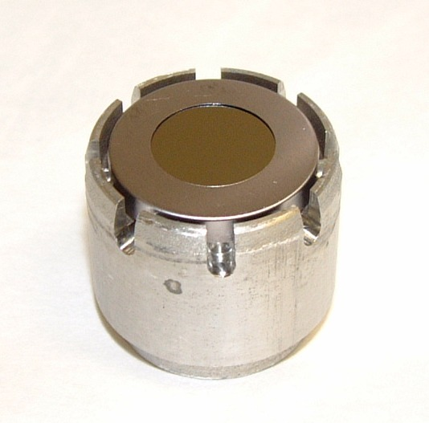
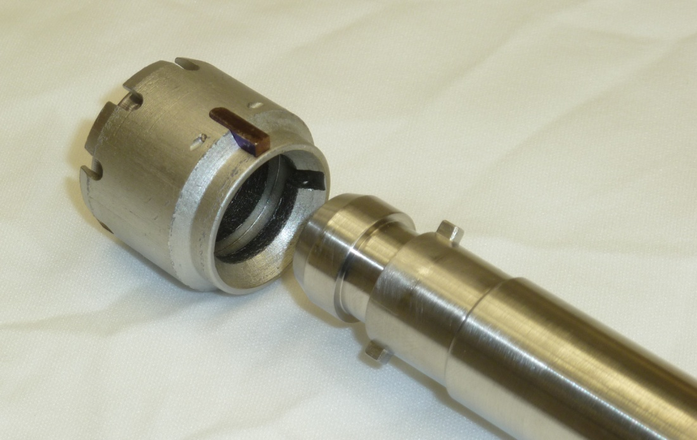
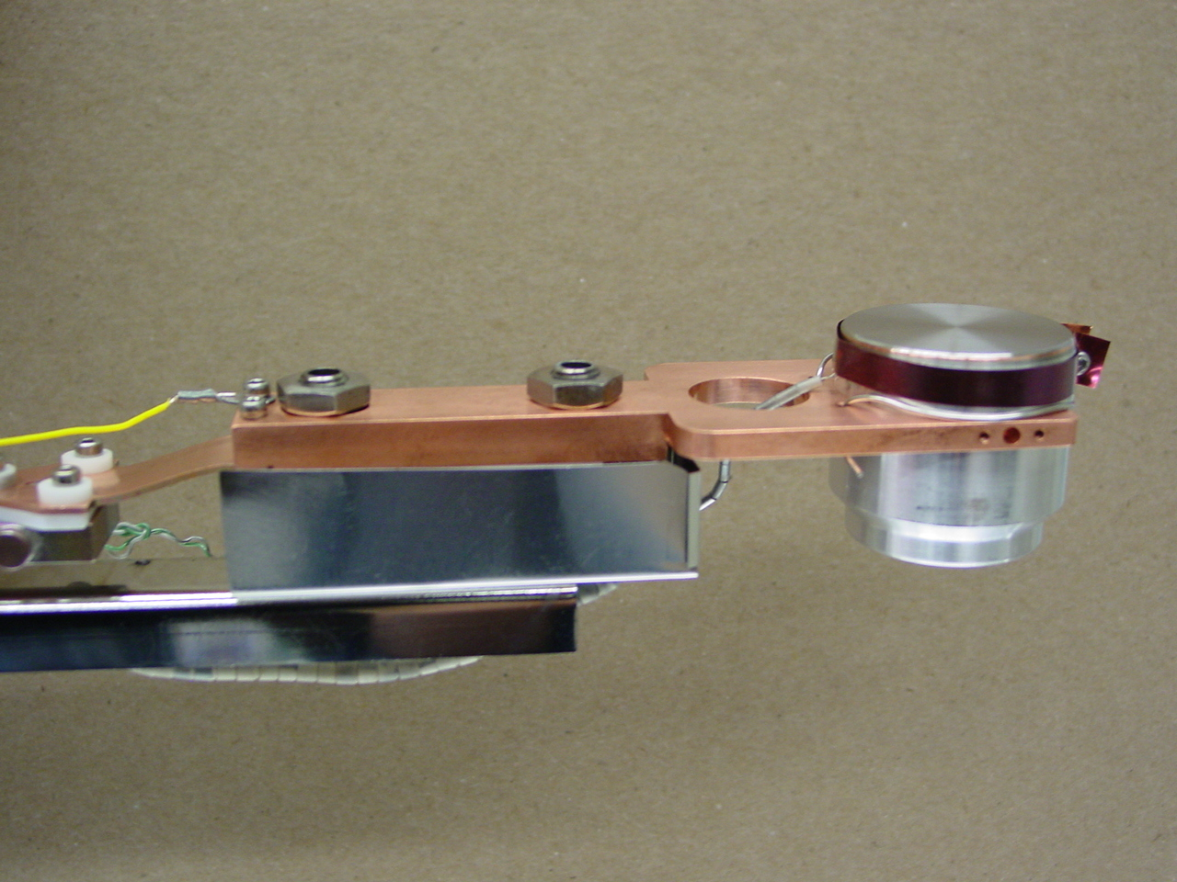
Jlab DC High Voltage Gun
Preparation/Manipulation Chamber
Photocathode substrate is bonded to a puck
Puck is inserted into the Prep Chamber
Several different manipulators move the puck such that it can be inserted into the HV chamber
HV cable
Suitcase Port
HV Chamber
Puck (Mo)
Ring (Ta)
GaAs
Puck Stop (rolling)
Manipulator Key (male)
Puck Key (female)
K₂CsSb coated puck
Standard Jlab Photocathode substrate holder/Puck: Usually GaAs, or GaAs super lattice

Slide 5
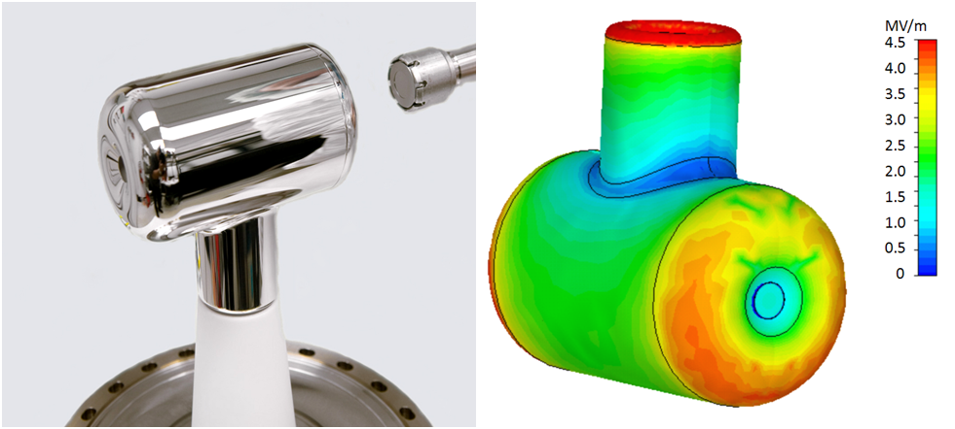
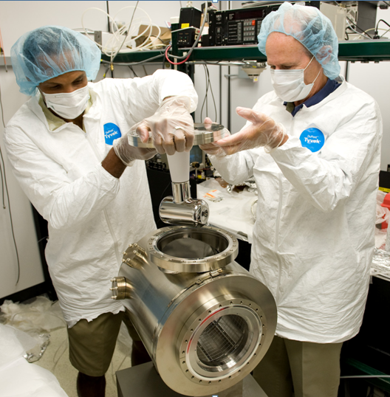
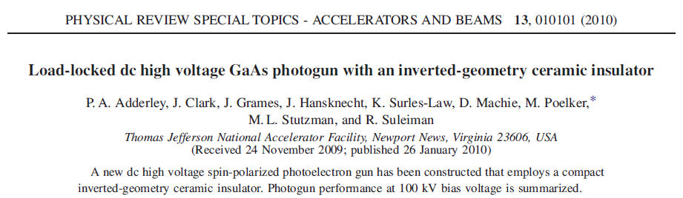
Heart of the JLab HV DC Gun
Sent to Ammeter
Puck
ebeam
Laser
Anode Ring
Apply -HV
Electric field of the Cathode Electrode
Cathode Electrode with Inverted Ceramic Geometry
Installing the Cathode Electrode

Slide 6
Motivations
Coherent ion cooler required for the electron ion collider requires 100mA of unpolarized electrons.
Current and future Free Electron Lasers would like 10mA to 100mA of unpolarized electrons.
NEA photocathode based on GaAs activated surfaces has been demonstrated to be able to provide high brightness electron beam
Nevertheless the surface sensitivity to ion back bombardment during high average current delivery is still an issue; the surface becomes damaged → lifetime
Unlike the GaAs, multi-alkali photoemission is based on bulk material properties rather than surface effects: we expect longer lifetime for a multi-alkali photocathode

Slide 7
State of the Art
Laboratory | Los Alamos | CEA | Wuppertal | BOEING
Project | HIBAF/APEX | ELSA | SRF injector | APLE
Year | 1993 | 1990 | 1989 | 1993
Cathode | CsK₂Sb | CsK₂Sb | Cs₃Sb | CsK₂Sb
Recent efforts have been made to obtain a reliable photoinjector source using alkali antimonide-based photocathodes
The Boeing 433 MHz NC gun, operating with CsK₂Sb (typ. QE 8% at 543 nm) photocathode, ran with 35 mA average current (still the world record for warm injector), but the lifetime of the cathode was limited to few hours due to the poor vacuum conditions

Slide 8
Alkali antimonides photocathodes
PMT industries developed reliable procedure to growth photosensitive layer based on multialkali materials with QE in visible spectra up to 43%
Alkali based photocathode could provide a few % QE at the FEL injector wavelength (532 nm) with very long lifetime
    Cs₃Sb
    CsK₂Sb
    NaK₂Sb
Hamamatsu

Slide 9
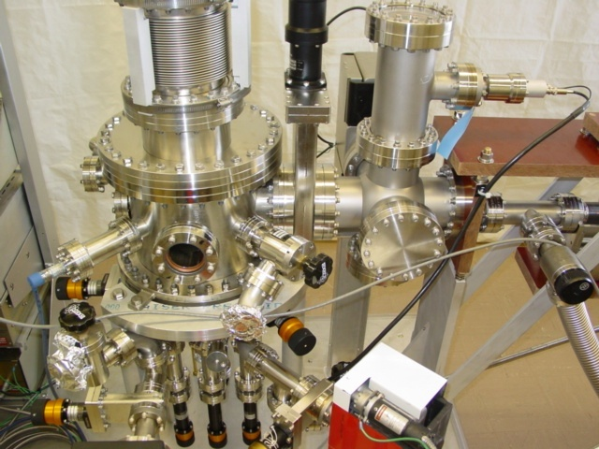
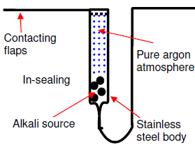
Multi-alkali Deposition System at BNL
Substrate heated around ~130°C
Sb, K, and Cs evaporated in successive layers and allowed to diffuse to form K₂CsSb
Several hundred nm built up
QE is monitored during the Cs evaporations with green laser
Cs
Bi₂Cs/BiCs₃
Substrate Puck
Typical Cs evaporation source
Sb
K
Cs
Must connect to a load-lock transport system to move substrate/puck
Some oxide on the photocathode will improve the QE slightly, but if K₂CsSb is handled in air, the entire film oxides which kills the QE

Slide 10
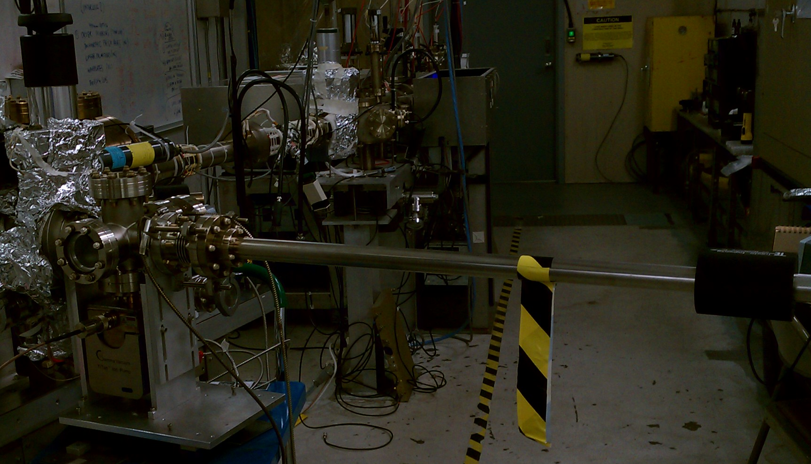
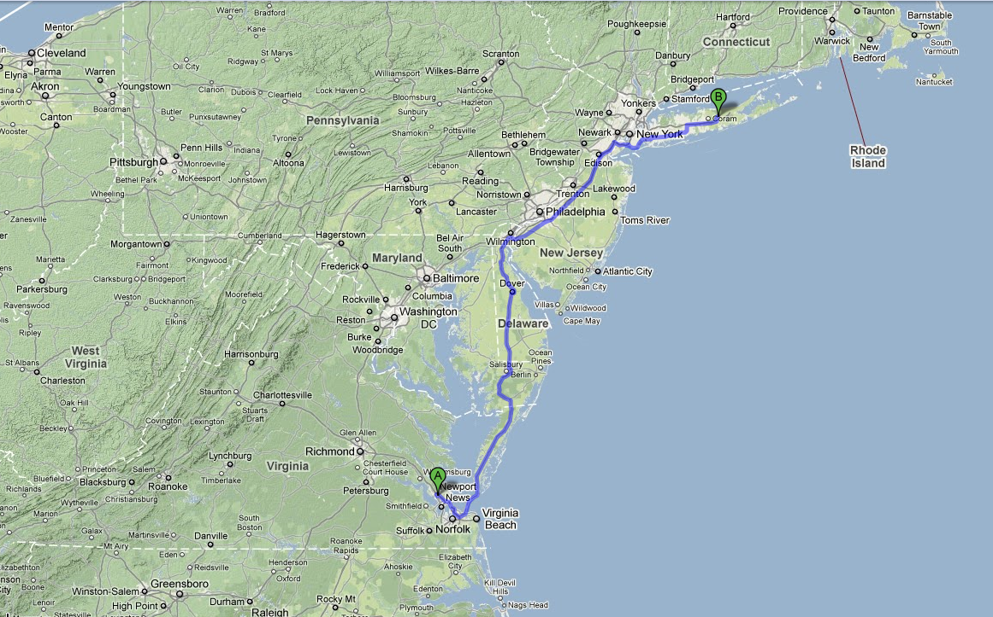
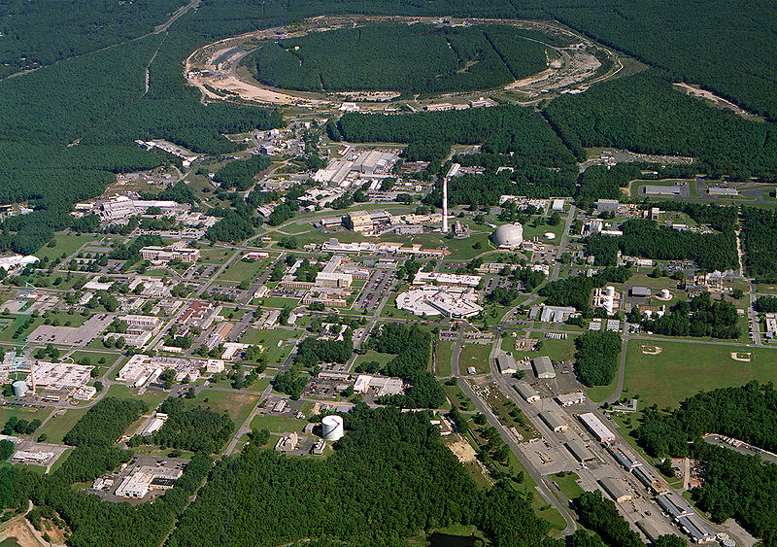
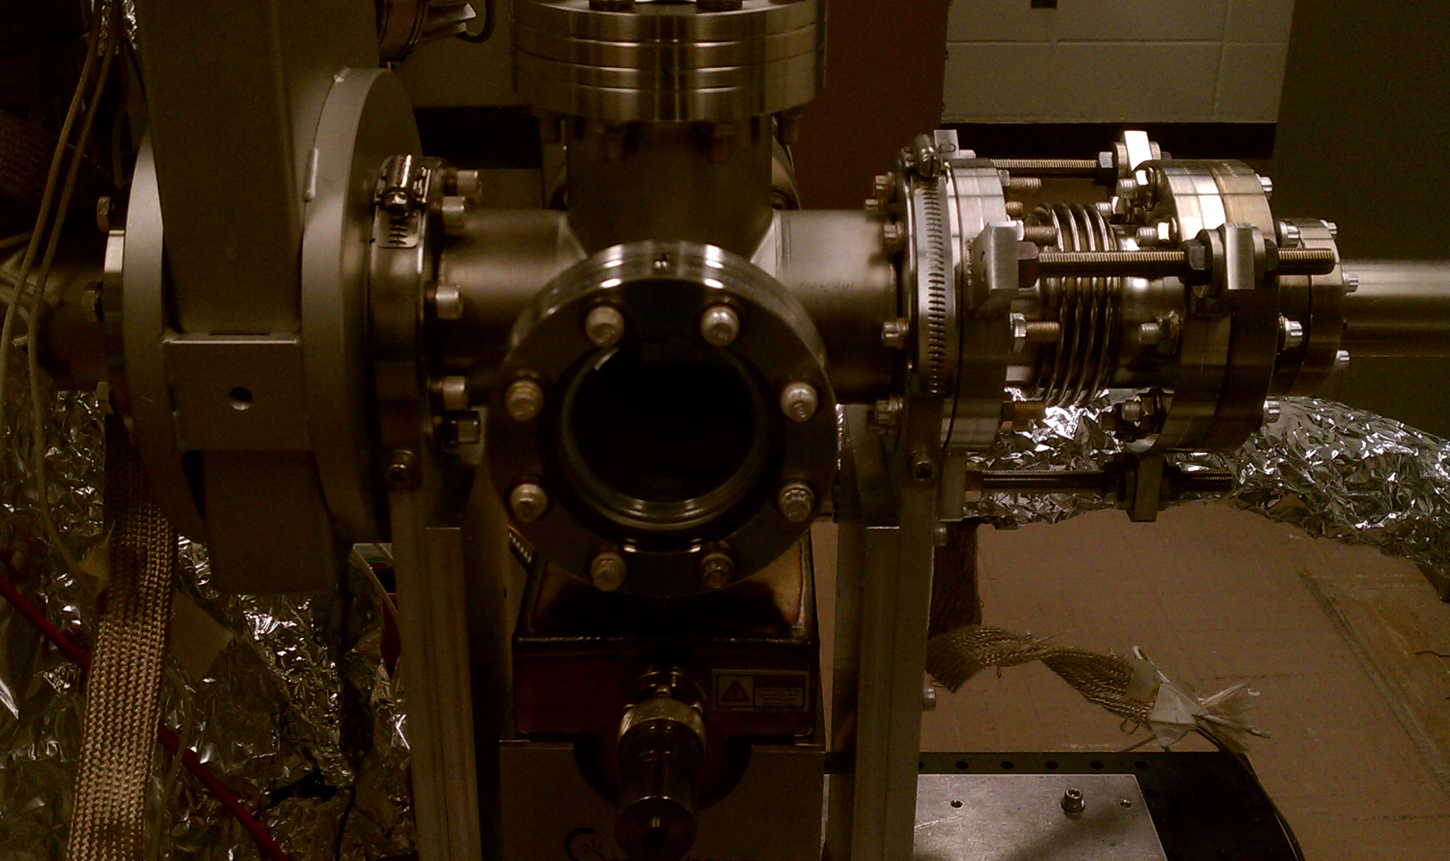
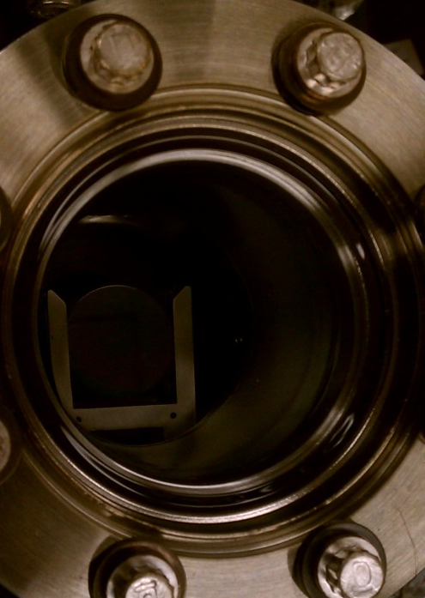
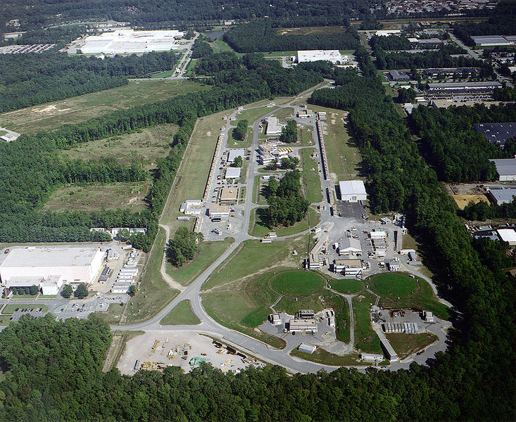
Use Vacuum Suitcase to transport K₂CsSb Puck
6-way Cross Suitcase
Photocathode made at BNL
Rotating/translating manipulator
Manipulator
Viewports
Transported to JLab
Gatevalve
Puck in the Garage
Ion Pump

Slide 11
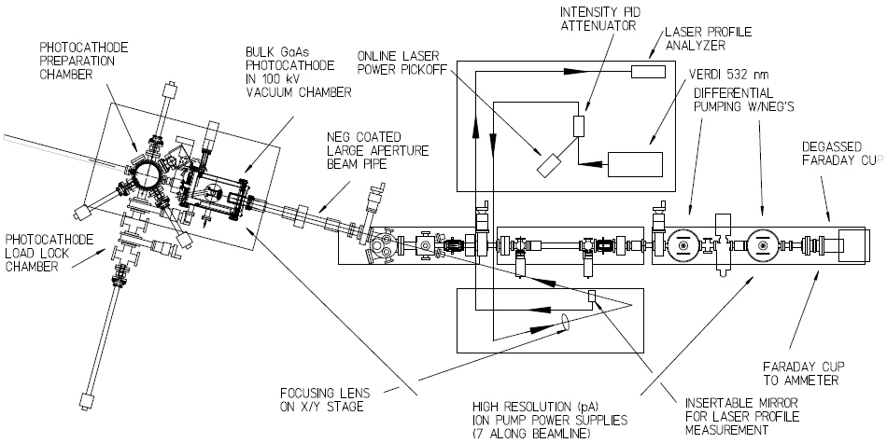
Injector Test Cave
Laser Table #1
Prep/Puck Manipulation Chamber
High Voltage Gun Chamber/cylinder
Laser Vacuum viewport
Water Cooled Beam Dump
Vacuum Suitcase
Laser Table #2
Several Correctors Magnets
Focusing Solenoids
Low Current Beam Viewers
Ion and NEG pumps

Slide 12
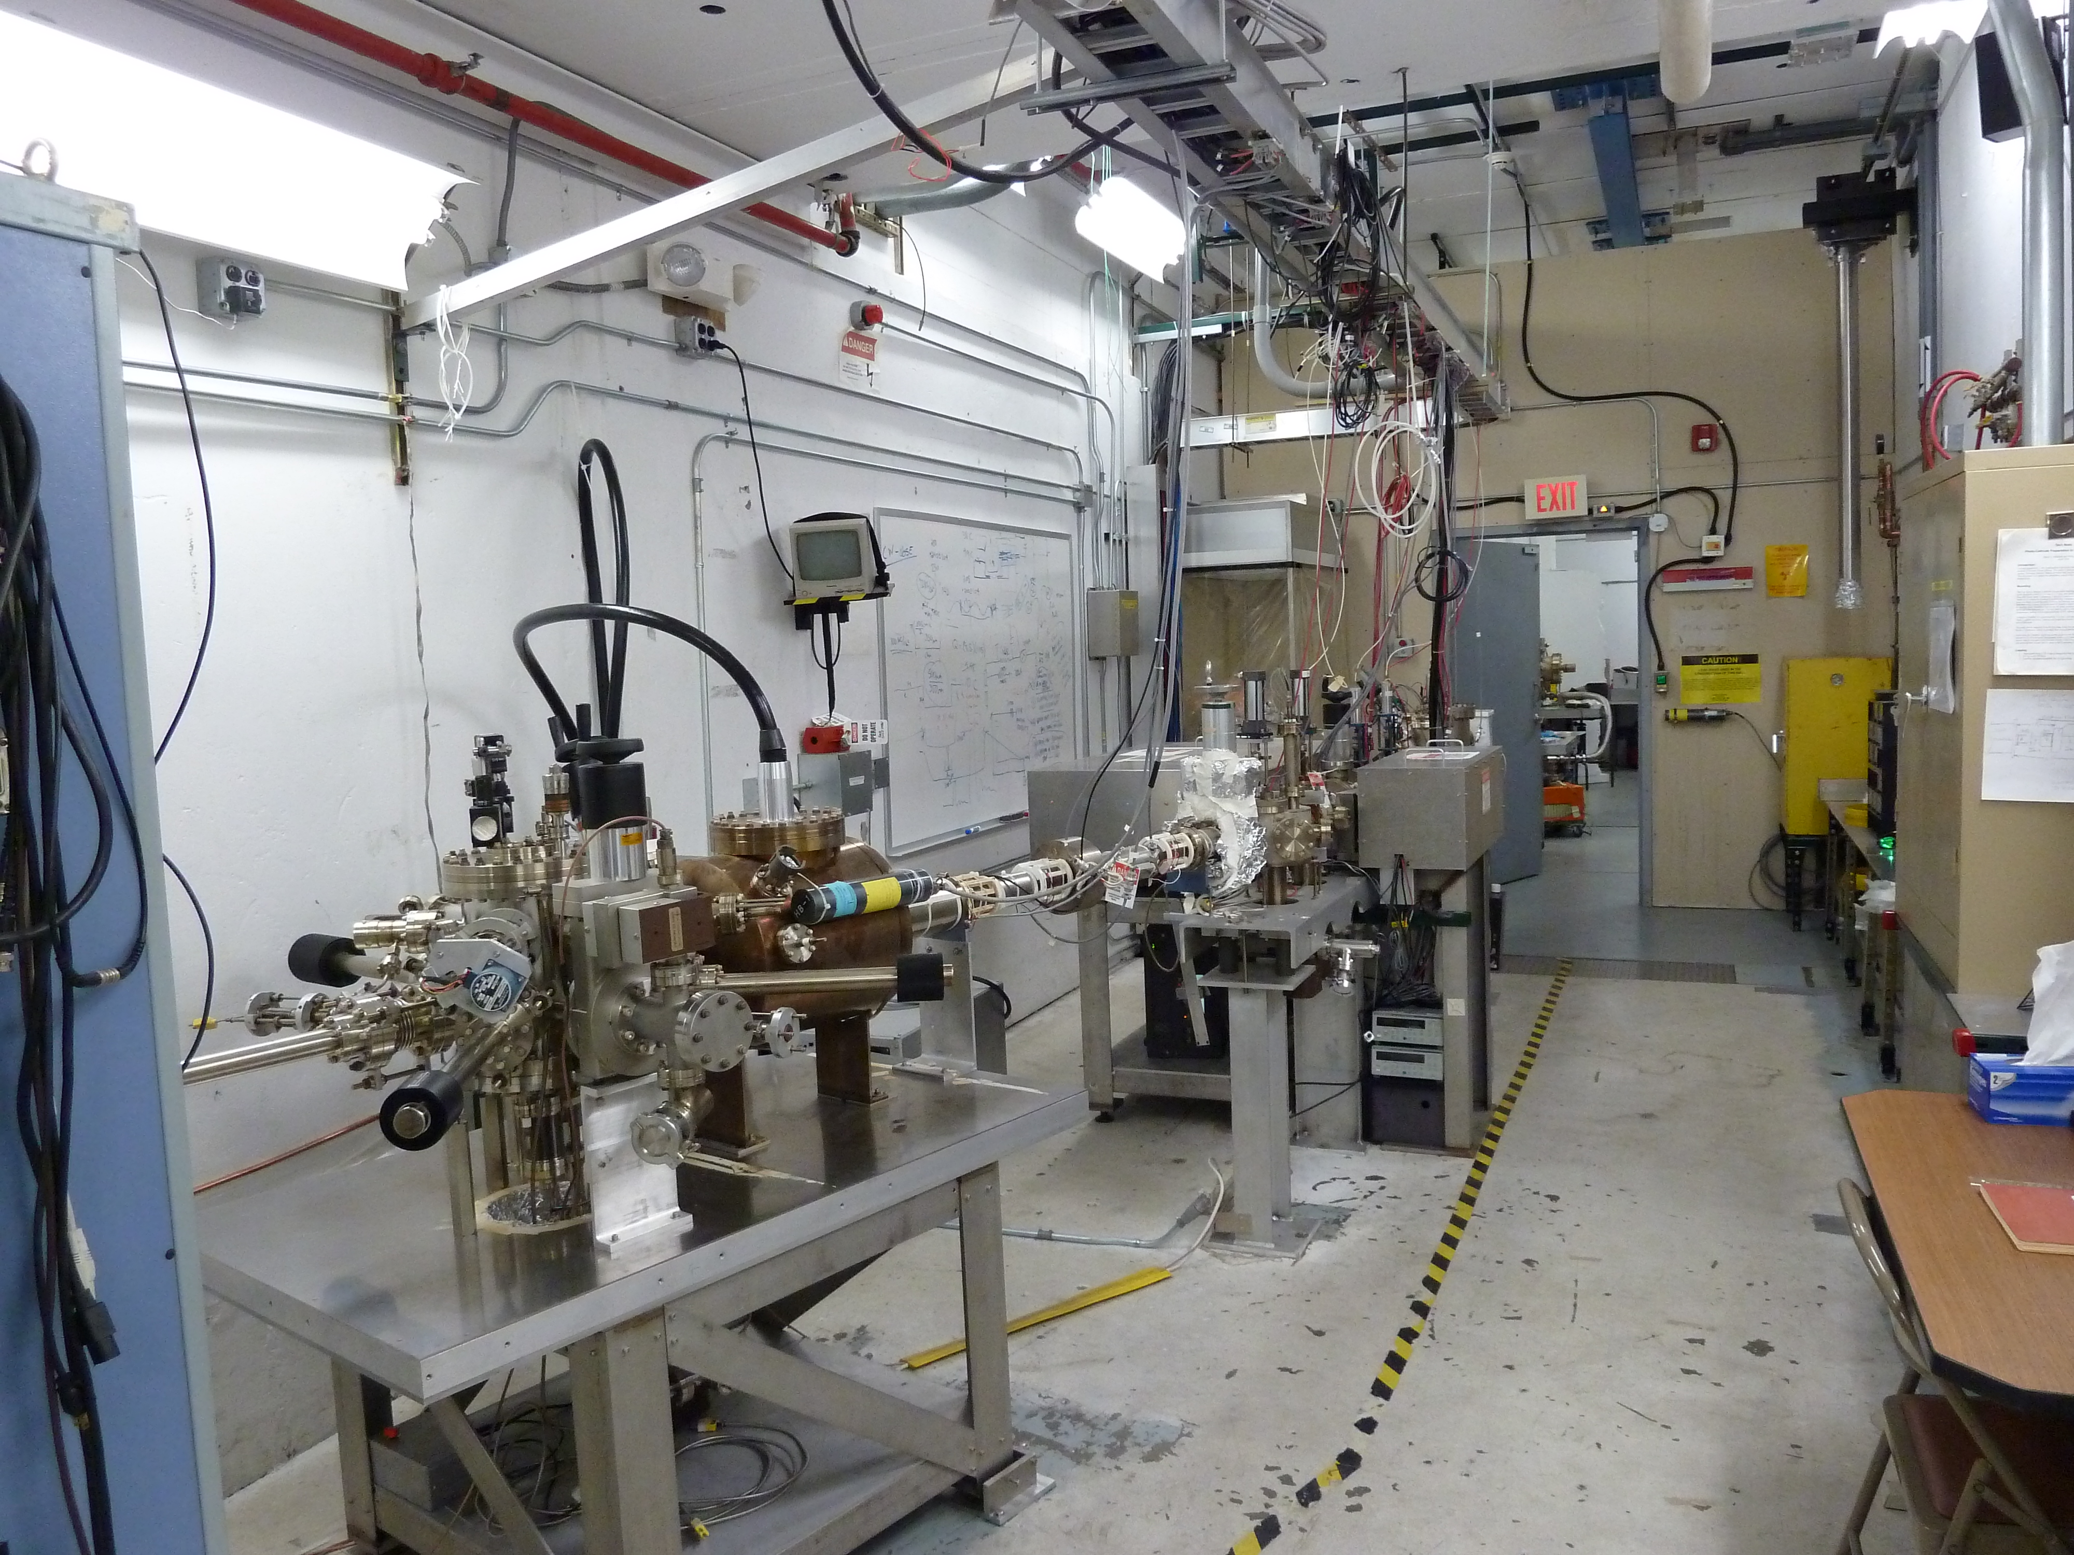
Injector Test Stand (South Cave)
Lead Lined Wall
High Voltage Gun Chamber/cylinder with HV Cable
Prep/Puck Manipulation Chamber
Laser Table #1
Laser Table #2

Slide 13
What is our Data?
Bias anode ring +300V send attracted electron current to ammeter
We measure QE, QE, and more QE
Anode Ring
QE Scans
Dark Lifetime QE scans across the entire puck
→What is the QE vs time without beam?
QE of entire puck after beam running
→Looking for QE change in places other than
the illuminated spot
Photocathode Lifetime (τ in Coulombs)
QE of illuminated spot during beam running
→Ion bombardment/vacuum burst effects
ebeam
Scan laser over surface
What we vary:
Spot on photocathode, size of laser spot, wavelength of laser, ebeam current, operating vacuum level, and operator/tune
What we monitor:
vacuum levels, anode current, X-rays at certain beam line locations, laser power drifts

Slide 14
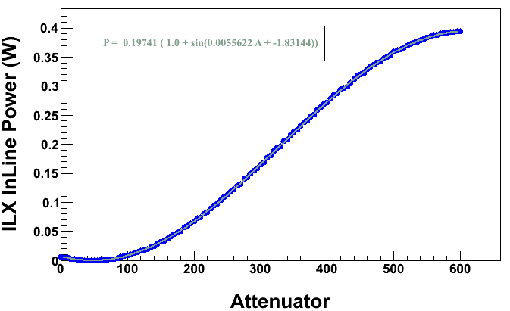
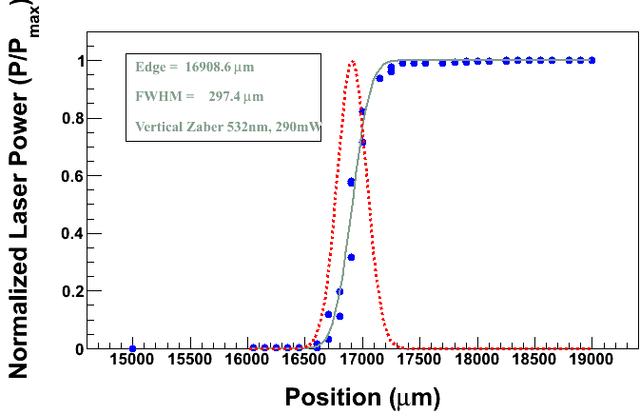
Adjusting the Laser Power
Vary the laser power:
Linearly polarize the light
Vary the polarization using a ½ wave plate
Send through linear polarizer again.
Laser Power Calibration
Linear polarizer
Linear polarizer
Focusing lens
Laser
Measurement of the spot size
To Photocathode
Rotating ½ Wave plate
Dump light
Dump Power Meter
Laser Table Diagram

Slide 15
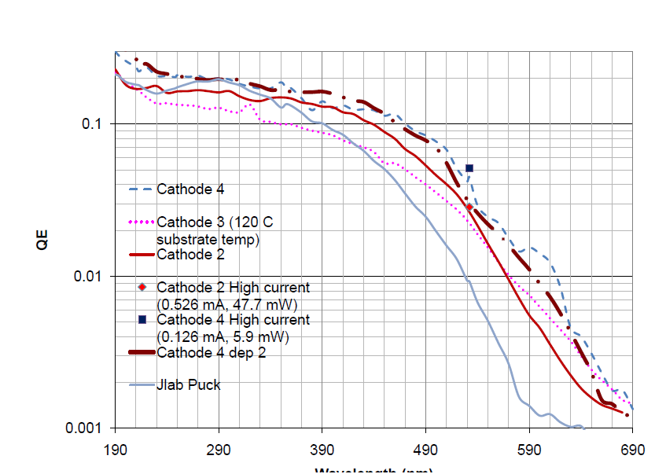
Spectral Scan of BNL’s K₂CsSb
This is the what we have to start
Wavelength (nm)
BNL ran out of K towards the end of the deposition
So the QE wasn’t optimal for visible wavelengths

Slide 16
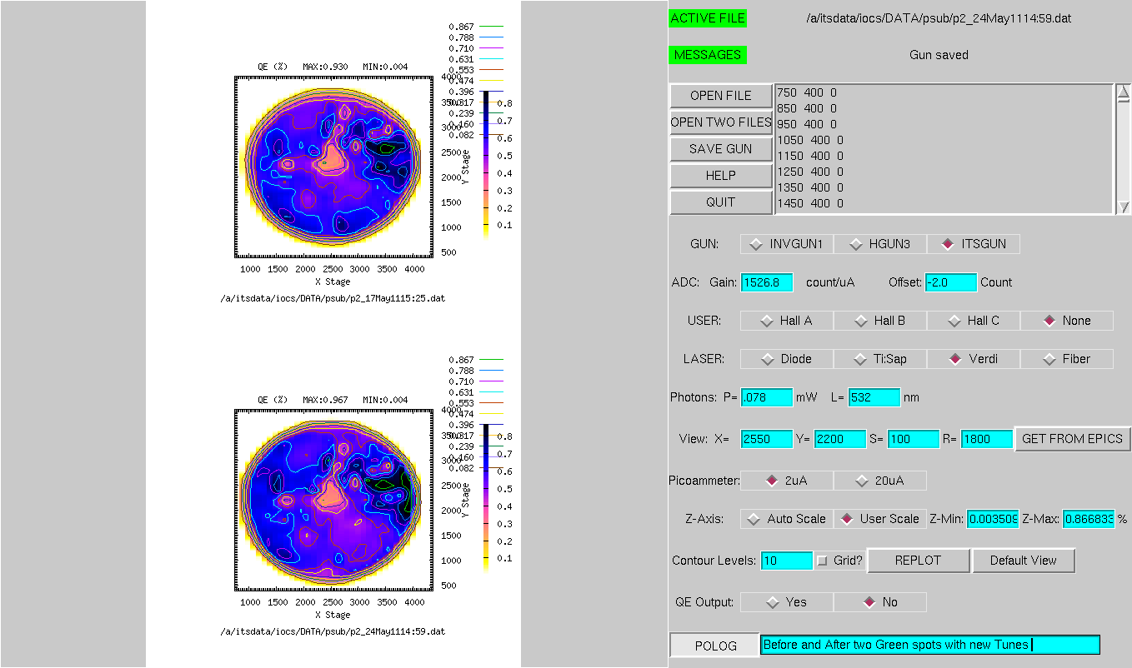
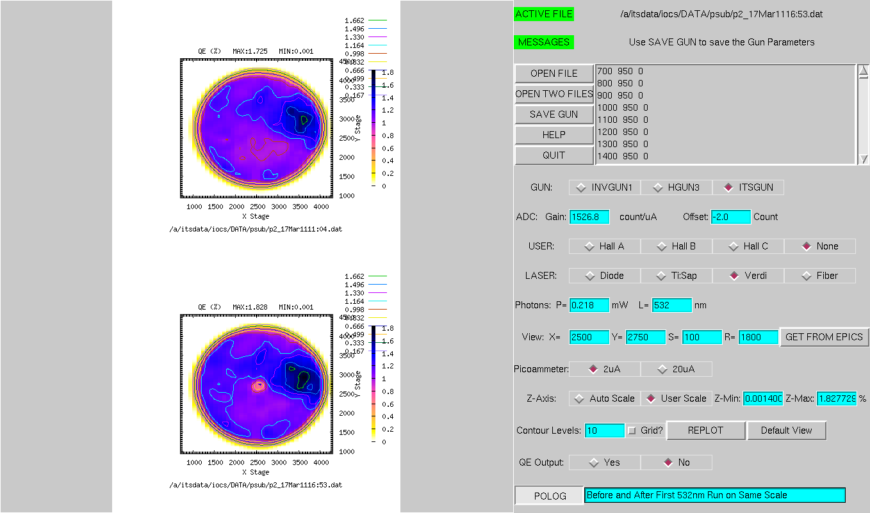
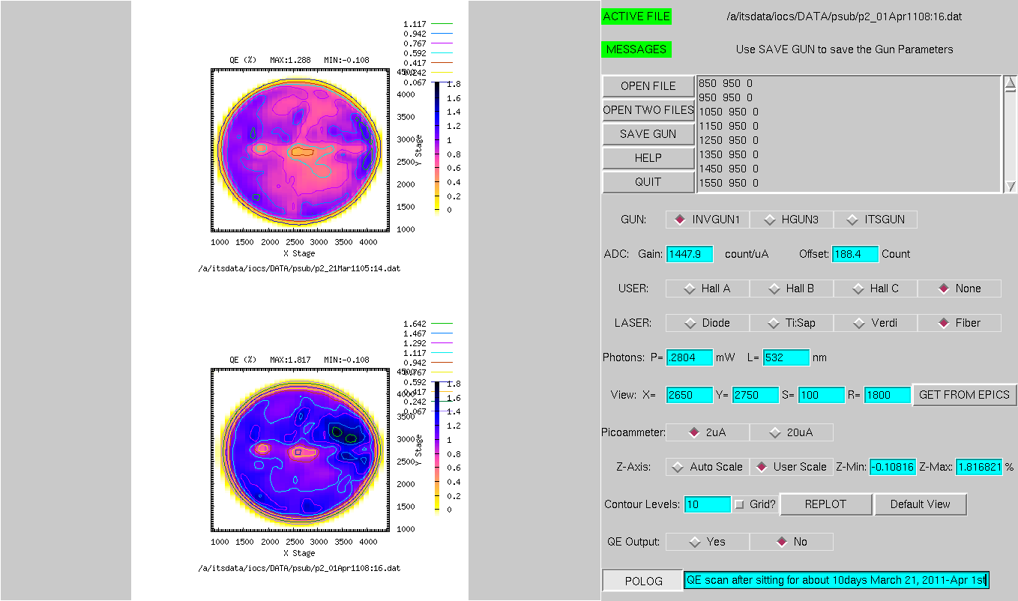
First Runs: 532nm, 350 μm spot, 100 kV Voltage
12.7mm
%
%
QE after transport; still good!
QE after six 100kV 1mA runs; some degradation
%
%
QE after sitting in 11 days - it recovers!
QE hole at the center from first run

Slide 17
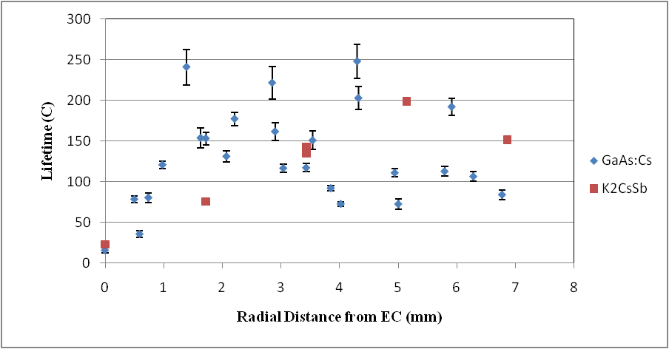
PAC 11 Paper Lifetime Plot
1mA, 532nm, 350um, 100kV Gun
Similar lifetime numbers for 200 kV and 100 kV with different operator
Lifetimes comparable to GaAs:Cs, not that impressive at 532nm
Switch to 440nm wavelength (850 micron spot)

Slide 18
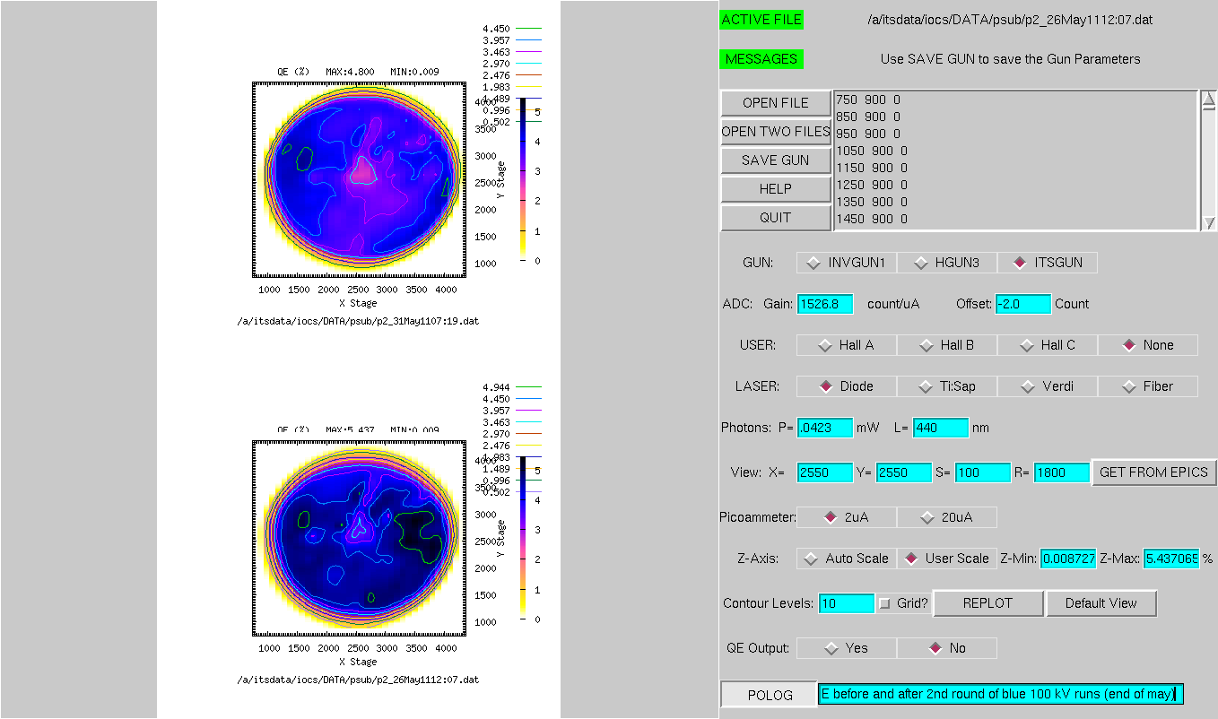
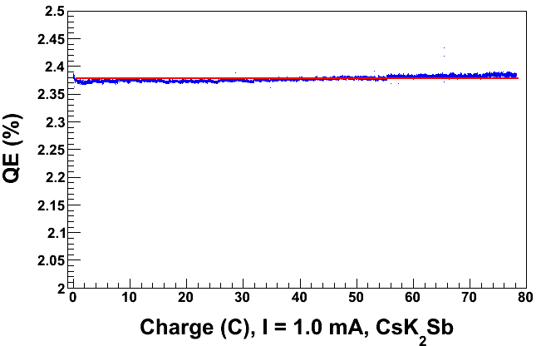
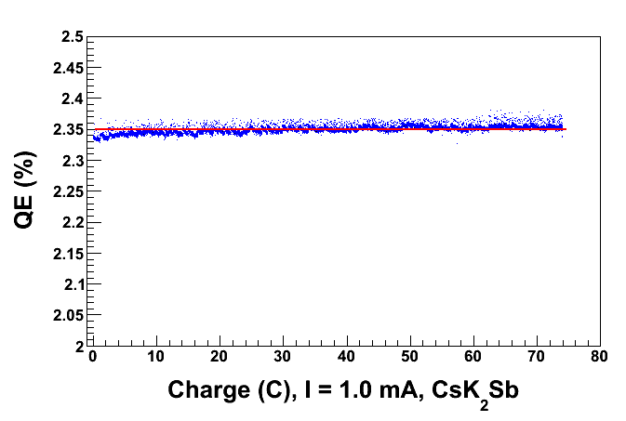
440nm, 850μm, 1mA Lifetime Runs
Typical 1mA lifetime run with Blue at the EC
100 kV Gun
200 kV Gun
QE scan after sitting for 48hours
Runs made different beam line tunes/operators and various spots around photocathode
No QE decrease in any of the runs;
actually, the QE seems to increase
QE scan after several runs
Now go to higher currents

Slide 19
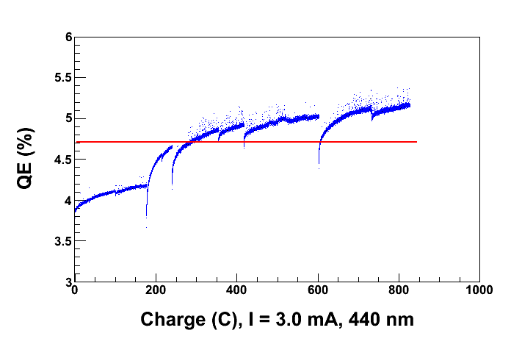
3.0 mA, 200 kV, 440 nm, 850 μm spot
Extracted 825 C from 3500x/2800y
QE keeps increasing over time
Big vacuum event in gun caused jump at 195 C
Robust Photocathode: vacuum bursts just a temporary loss of QE
Vacuum bursts are due to full active area and poor spatial quality of blue laser beam (halo).
Run ended with beam dumped in valve … next slide

Slide 20
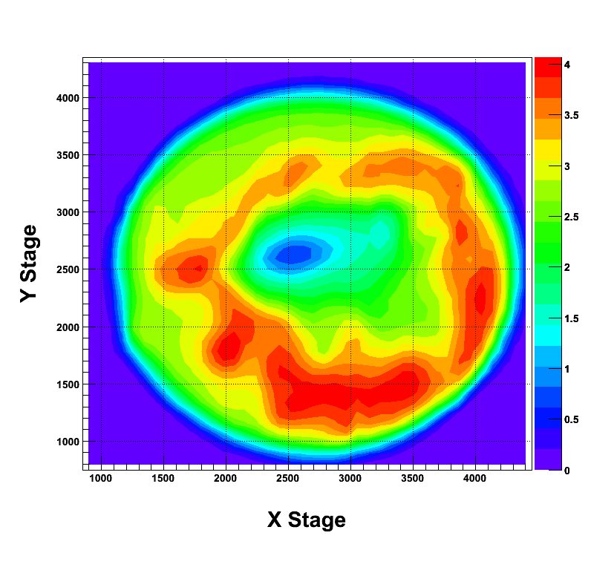
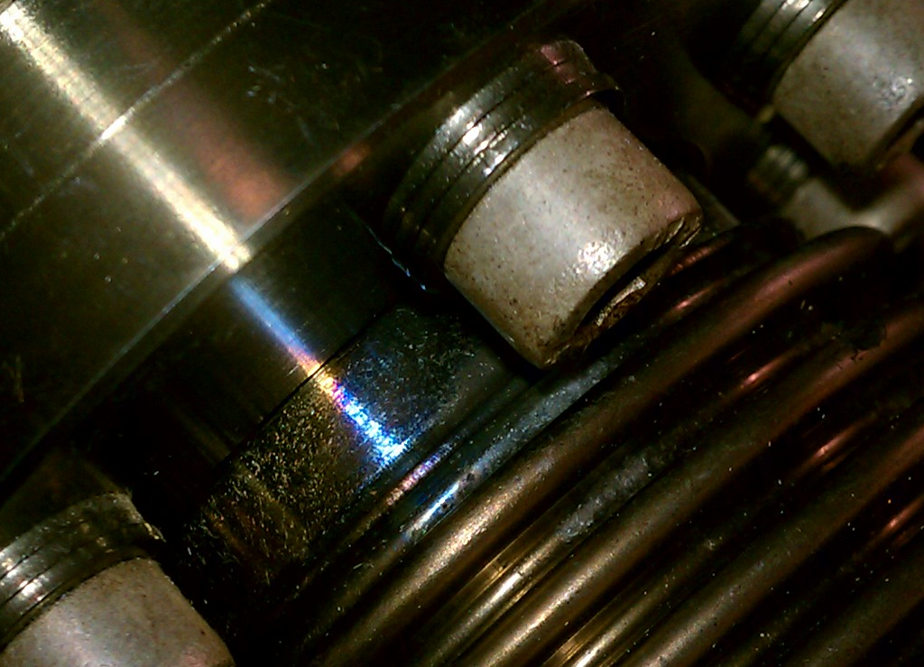
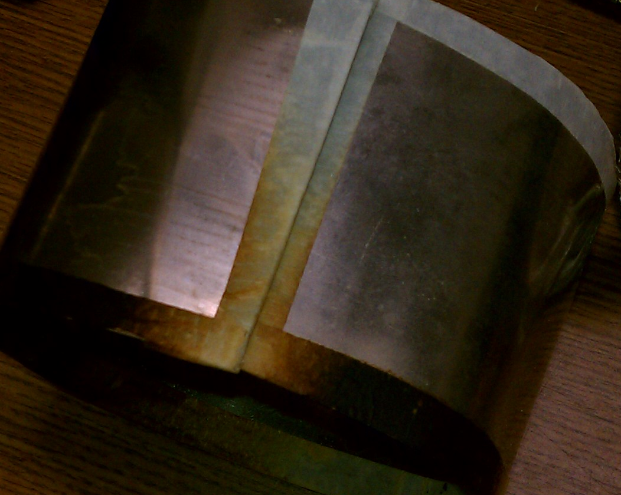
Beam dumped in valve
Power glitch caused correctors to steer beam into the Y-Chamber valve
2 to 3 mA of beam ran in 5×10⁻¹⁰ Torr vacuum for 3 hours
QE at EC is gone and overall QE was reduced …
QE scan with 440nm (850 micron spot)
Beam hit end of Bellows
About where we were running 3500x/2800y
Mu Metal case over bellows
The masking tape covering the edges is burned

Slide 21
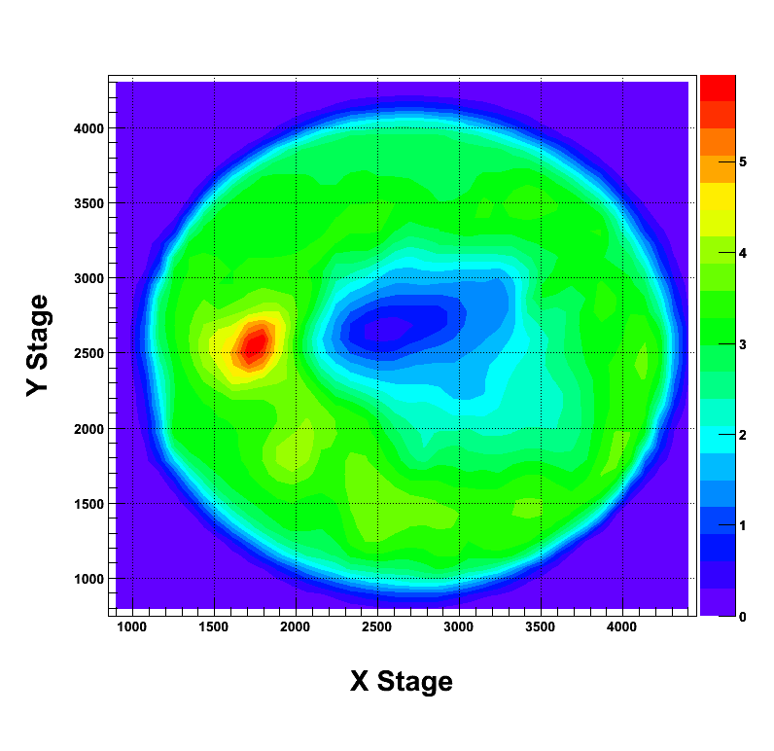
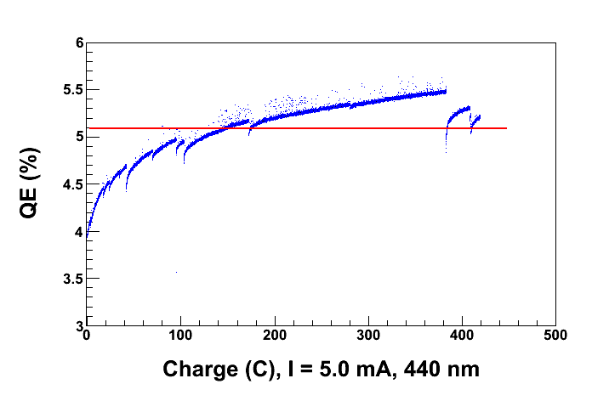
5.0 mA, 200 kV, 440 nm, 850 μm spot
QE scan after running
419 C from 1750x/2500y
So the Cathode is not dead after the big beam on bellows event.
In fact it seems that the rate of change (increase) of QE increases with more laser power
Is this a photochemistry effect or a heating effect?
Try this with 532nm light to see what this does, if the QE increases now with 532nm, it suggests more of a heating effect

Slide 22
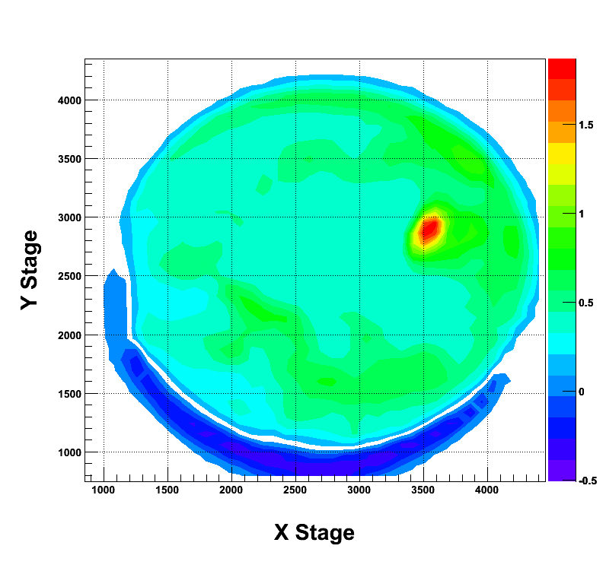
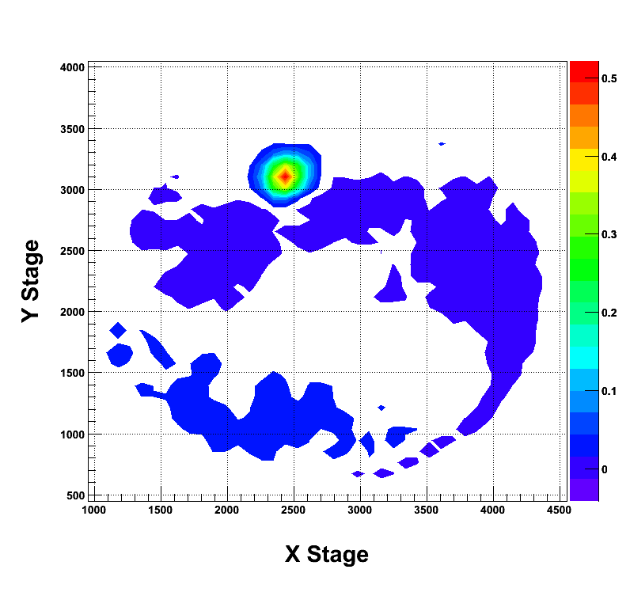
Laser Heating?
QE difference after heating 3500/2800 for 12 hours with 440 nm and 211 mW
QE difference after heating 2450/3100 for 2 hours with 532 nm and 672 mW
Also there is overall QE recovery from sitting in vacuum
So now the QE increases with both 440nm and 532nm light
Lets do some green lifetime runs now

Slide 23
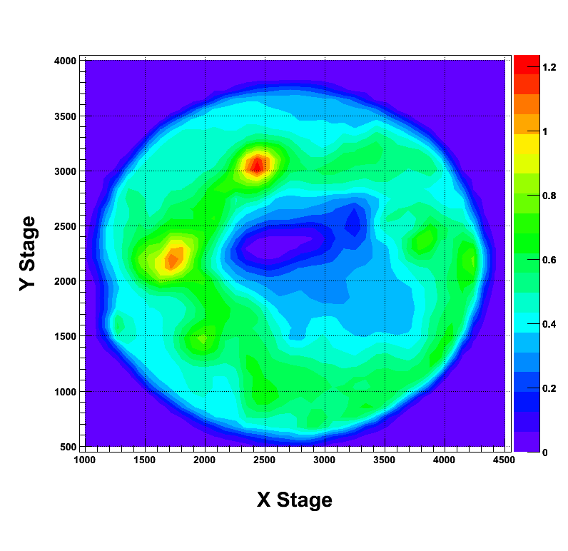
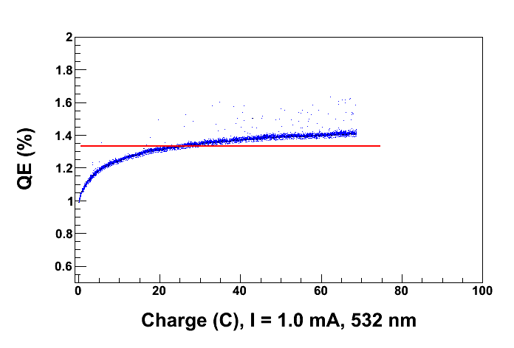
1.0 mA, 200 kV, 532 nm, 350 μm spot
QE after Run
68.7 C from 3800x/2300y
Don’t see a QE hole now!
Hypothesis:
K source was depleted toward end of fabrication
Top mystery layer got sputtered off during vacuum event
Afterwards, photocathode has proper Stoichiometry
No QE decrease
Alternatively, maybe added something to the cathode, like oxygen, to change its properties/work function?

Slide 24
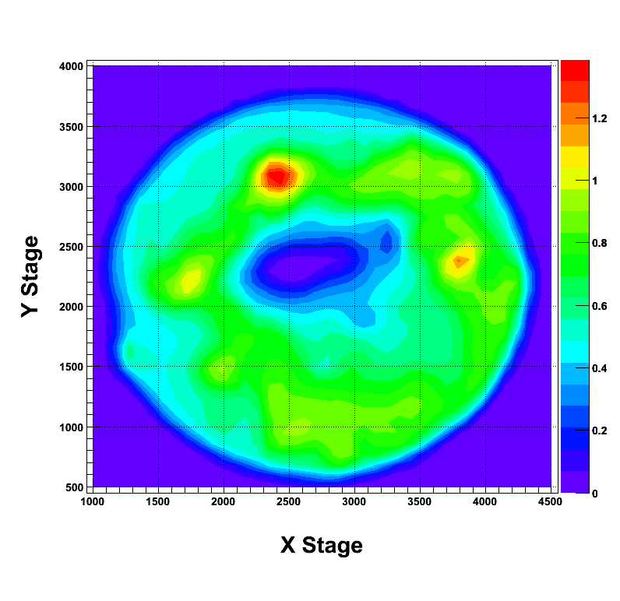
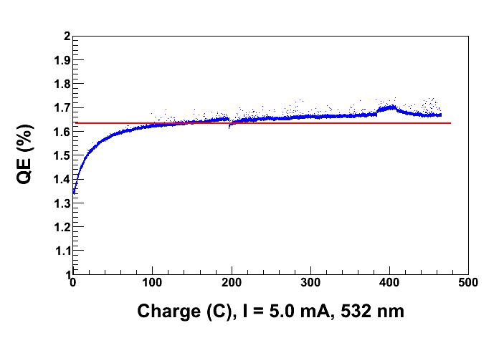
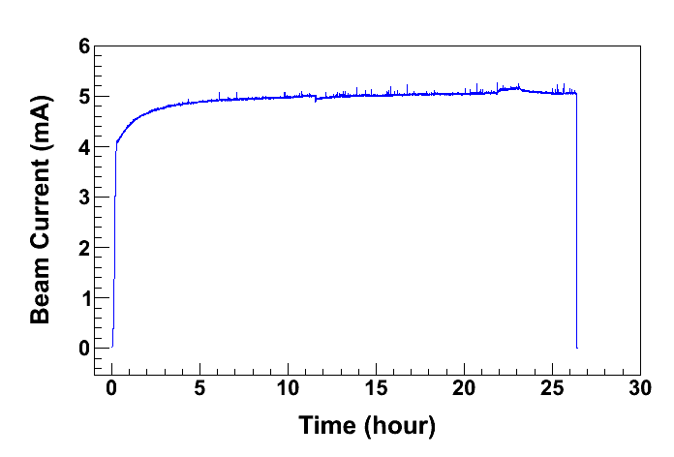
5.0 mA, 200 kV, 532 nm, 350 μm spot
465 C from 2400x/3100y
Run # 3, 5.0mA run
Run #2, 3mA ,caused the QE here to increase
Now lets push the current to 20mA

Slide 25
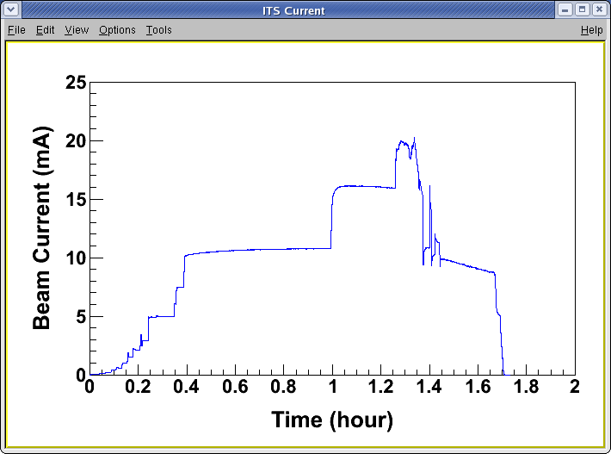
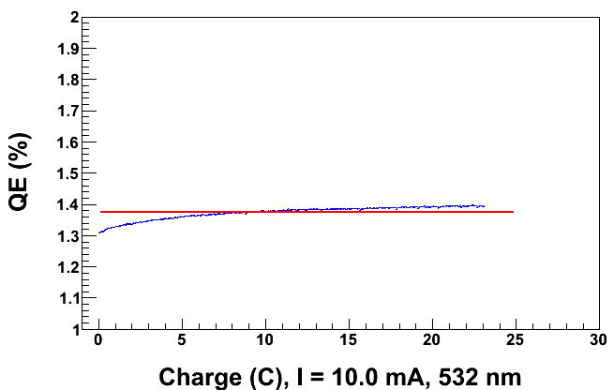
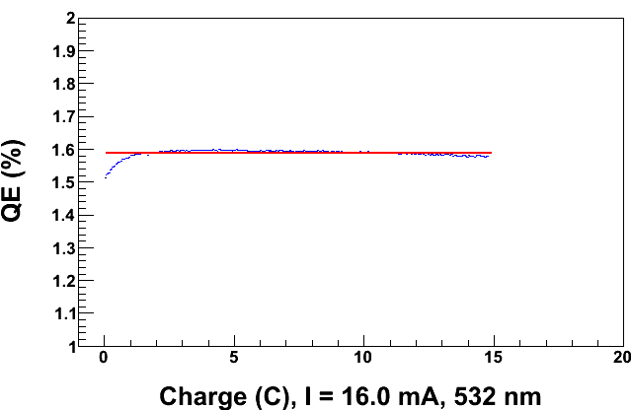
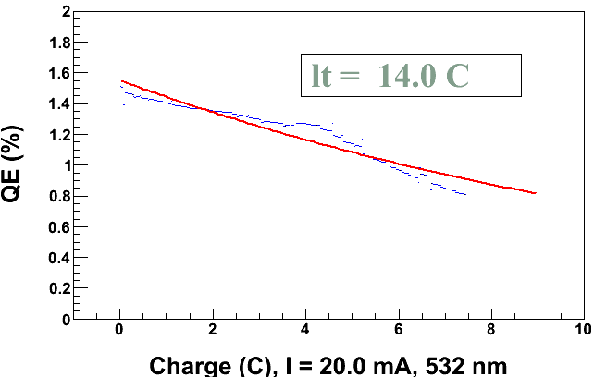
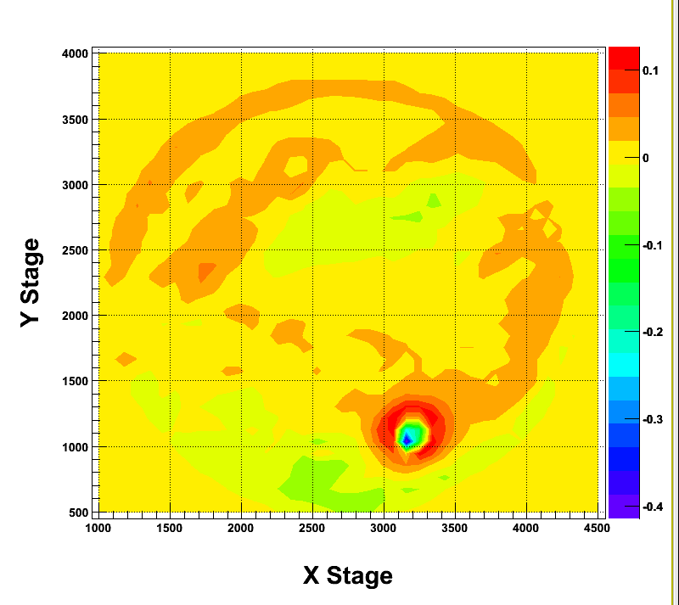
20mA, 100kV, 532nm, 350μm spot
Things were “normal” at 10mA
Then we see a slight QE decline at 16mA
Sharp QE decline at 20mA
QE Change before and after the run
Ran with 100kV to ensure dump wouldn’t get too hot.
Dump temperature went up to about 40°C
→ Not a problem
QE change plot shows QE decline at center of the laser spot

Slide 26
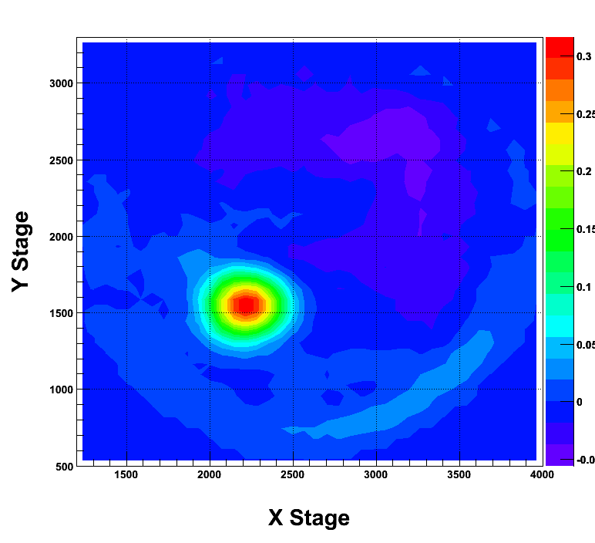
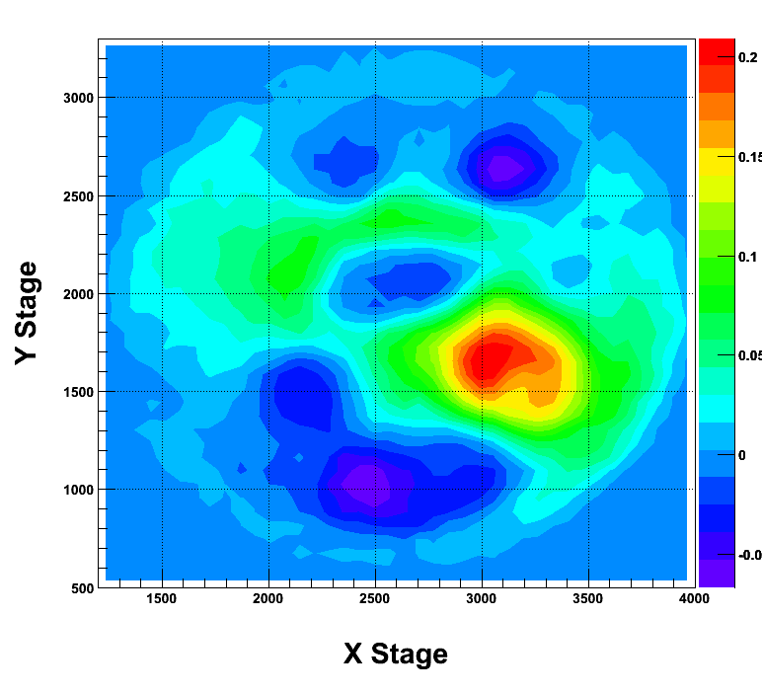
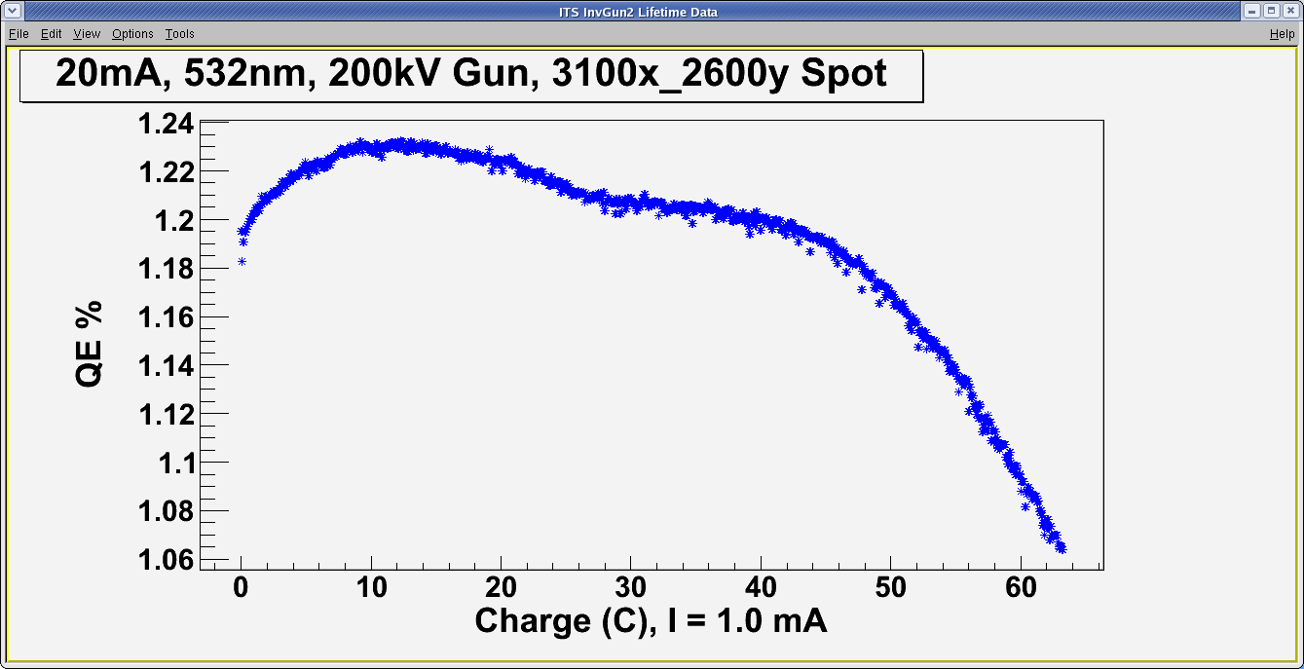
20mA, 200kV, 532nm, 800μm spot
If it is really laser heating, then lets decrease the power density by increasing the spot size and first watch for QE decline from illuminating a spot before running beam
We may be on the edge of a critical temperature from going to 30-90mins at this power density because of the change shape of the QE distribution
After heating 2250x/1500y with ~4W for 30mins.
After heating 3200x/1500y with ~4W for 1.5hr.
Needed laser power near 4.5W to get beam current up to 20mA.
Beam shape was very large and the radiation/vacuum along the beam pipe was larger than expected.

Slide 27
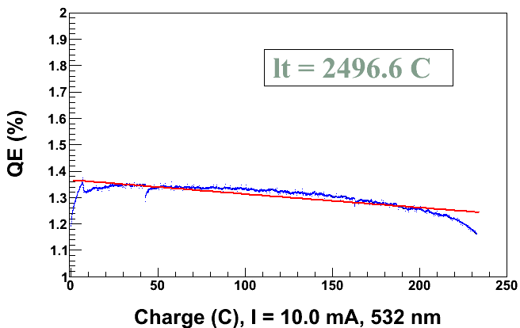
10 mA, 200 kV, 532 nm, 350 μm spot
QE increasing. Same behavior as 20mA ramp up.
Sharp QE decline similar to the 20mA (800micron/532nm) runs
Is this Cs/oxide loss?
Did QE fully recover from the vacuum event?
Vacuum event

Slide 28
Summary
Cathode is extremely robust in terms of vacuum levels/bursts
“Infinite” lifetime with DC blue laser up to 5mA
“Infinite” with blue AND green after bellows incident, up to 5mA
Laser heating seems to be a factor in QE increase during run
  Promoting the desired stoichiometry?
  Removing contaminants?
Still need to study effect of varying operating vacuum
Want to try “cesiating” the surface
Surface science techniques to measure composition and profile
Obtain new high QE K₂CsSb photocathode from BNL to repeat these studies and explore effects from RF pulsed laser

Slide 30

Ion Back-bombardment

Slide 31



HV Conditioning and Field Emission
Inside the Gun Chamber
Floating Anode
connected to
Pico-ammeter
Macor glass-ceramic
spacer
100 MΩ
Conditioning
Resistor
We now have 200kV gun with no field emission:
Hand and Buffered Chemical Polished Large Grain Niobium material
Transformer
Oil Tank
A Short for Beam
Delivery

Slide 32


Prepare for “Bad” Vacuum Lifetime Run
Heated NEGS around Gun to get H2 environment up to ~E-9 Torr levels. Used Extractor Gauge on Gun Chamber to correlate pressure to ion pump current
QE after 4hr NEG at 5A, then 3hr NEG at 9.3A, then 1hr NEG at 8A.
Total of 9 hours in much higher H2 environment.
QE is still about the same as in good vacuum.

Slide 33
Motivations (1)
Provide experimental data to fill the voids on fundamental parameters still missed
Dowell et al., NIM-A, 622, (2010) 685-697

Slide 34

Imperfect Vacuum = Finite Lifetime
Ion back-bombardment – with characteristic QE “trench” from laser spot to electrostatic center of photocathode – damages the NEA of GaAs
High energy ions are focused to electrostatic center: create QE “hole”. We don’t run beam from electrostatic center
QE can be restored, but takes about 8 hours to heat and reactivate
Residual
Gas
Laser
Photocathode “QE scan”
  Active area = 5 mm
  Laser size = 0.4 mm
Can run beam from 6 locations (spots) before heating and reactivating

Slide 35


Reduce Outgassing & Improve Pumping
Primary source of gas in Polarized Gun: hydrogen outgassing
To reduce outgassing:
  Reduce thick flange area
  HV Chamber 400°C bake for 10 days
Pump system combines:
  Non-Evaporable Getters (NEGs) (Zr-V-Fe)
  Ion Pumps
Ion Pump
NEGs
Outgassing rate: 1.0×10⁻¹³ Torr.L/s.cm²
Extractor Gauge: 2.0×10⁻¹² Torr (raw value), our lowest value

Slide 36

Finite lifetime due to ion back-bombardment
Lesson: it is extremely important to manage ALL of the extracted beam. Beam from outside 5 mm active area can hit beam-pipe walls, degrade vacuum, reduce lifetime

Slide 37
Benefits of Higher Gun Voltage
Reduce space-charge-induced emittance growth, maintain small transverse beam profile and short bunch-length. In other words, make a “stiff” beam right from the gun
Address current density limitation due to Child’s Law (Space Charge Limit)
Reduce problems associated with Surface Charge Limit (i.e., QE reduction at high laser power)
Prolong Charge Lifetime
Biggest Obstacle: Field Emission and HV Breakdown… which lead to bad vacuum and photocathode death

Slide 38
Emittance and Brightness
Normalized Emittance from GaAs:
q | Bunch Charge (= 0.4 pC, 200 μA and 499 MHz)
E_{s} | Electric Field at GaAs surface
T_{eff} | Effective Temperature of GaAs (= 300 – 400 K, 780 nm)
k_{B}T_{eff} | Thermal Energy (= 34 meV)
Gun HV (kV) | E_{s} (MV/m) | ε_{n} (μm)
100 | 2.0 | 0.011
140 | 2.8 | 0.009
200 | 4.0 | 0.008
Normalized Brightness:
Brightness is proportional to Gun HV

Slide 39
Bulk GaAs
Laser excitation from P_{3/2} to S_{1/2} : E_{gap} < E_{γ} < E_{gap}+Δ
Electron Polarization:
E
E
J
S_{1/2}
-1/2
+1/2
S_{1/2}
E_{gap}=1.42 eV
σ+
3
3
σ-
1
P_{3/2}
E_{F}
P_{3/2}
Δ=0.34 eV
-3/2
-1/2
+1/2
+3/2
P_{1/2}
-1/2
+1/2
P_{1/2}
k
m_{j}
σ+: Right-handed circularly polarized light
σ- : Left-handed circularly polarized light
Reverse electron polarization by reversing light polarization

Slide 40
Higher P: Breaking GaAs Degeneracy
Split degeneracy of P_{3/2} : Introduce strain on GaAs crystal by growing it on substrate (GaAsP) with different lattice constant
High polarization by laser excitation from P_{3/2} to S_{1/2} :
  E_{gap} < E_{γ} < E_{gap}+δ
m_{j} = -1/2
+1/2
S_{1/2}
σ+
σ-
E_{gap}
P_{3/2}
m_{j} = -3/2
+3/2
δ=20–50
meV
-1/2
+1/2
Higher QE: Alternating layers of GaAs and GaAsP – Superlattice GaAs

Slide 41
GaAs Photocathode Evolution
Bulk GaAs
Strained GaAs:
GaAs on GaAsP
Superlattice GaAs:
Layers of GaAs on GaAsP
100 nm
100 nm
625 μm
2 μm
14 Layers
350 μm
QE ~ 20%, 120 μA/mW
Unpolarized @ 532 nm
QE ~ 5%, 30 μA/mW
Pol ~ 40% @ 780 nm
QE ~ 0.2%, 1 μA/mW
Pol ~ 75% @ 850 nm
No strain relaxation
QE ~ 1%, 6 μA/mW
Pol ~ 85% @ 780 nm
λ (nm) | E_{γ} (eV) | Color
532 | 2.33 | Green
780 | 1.59 | NIR
850 | 1.46 | NIR
E_{γ} = hc/λ
hc = 1240 eV.nm

