Slide 1
CEBAF Overview
June 28, 2011
Michael Spata
Staff Scientist
Jefferson Science Associates
Center for Advanced Studies of Accelerators

Slide 2
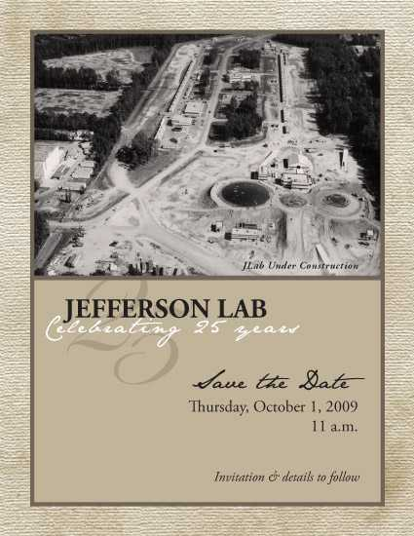
Outline
  CEBAF Timeline
  Machine Overview
  Injector
  Linear Accelerators
  Recirculation Arcs
  Extraction Systems
  Beam Specifications
  12 GeV Upgrade
  Control Room
  Questions

Slide 3
CEBAF Timeline
1984 DOE provides funding for new facility
1987 Construction Begins on CEBAF
1995 First Physics Experiments Begin
1997 4 GeV Three-Hall Simultaneous Operations
2004 12 GeV Upgrade Development Team Formed
2004 Engineering/Design of 12 GeV Machine Begins
2005 C-50 Program to Reach 6 GeV Begins
6 GeV Operations until May 2012
12 GeV Installation in 2011 and 2012
12 GeV Commissioning starting in 2013

Slide 4
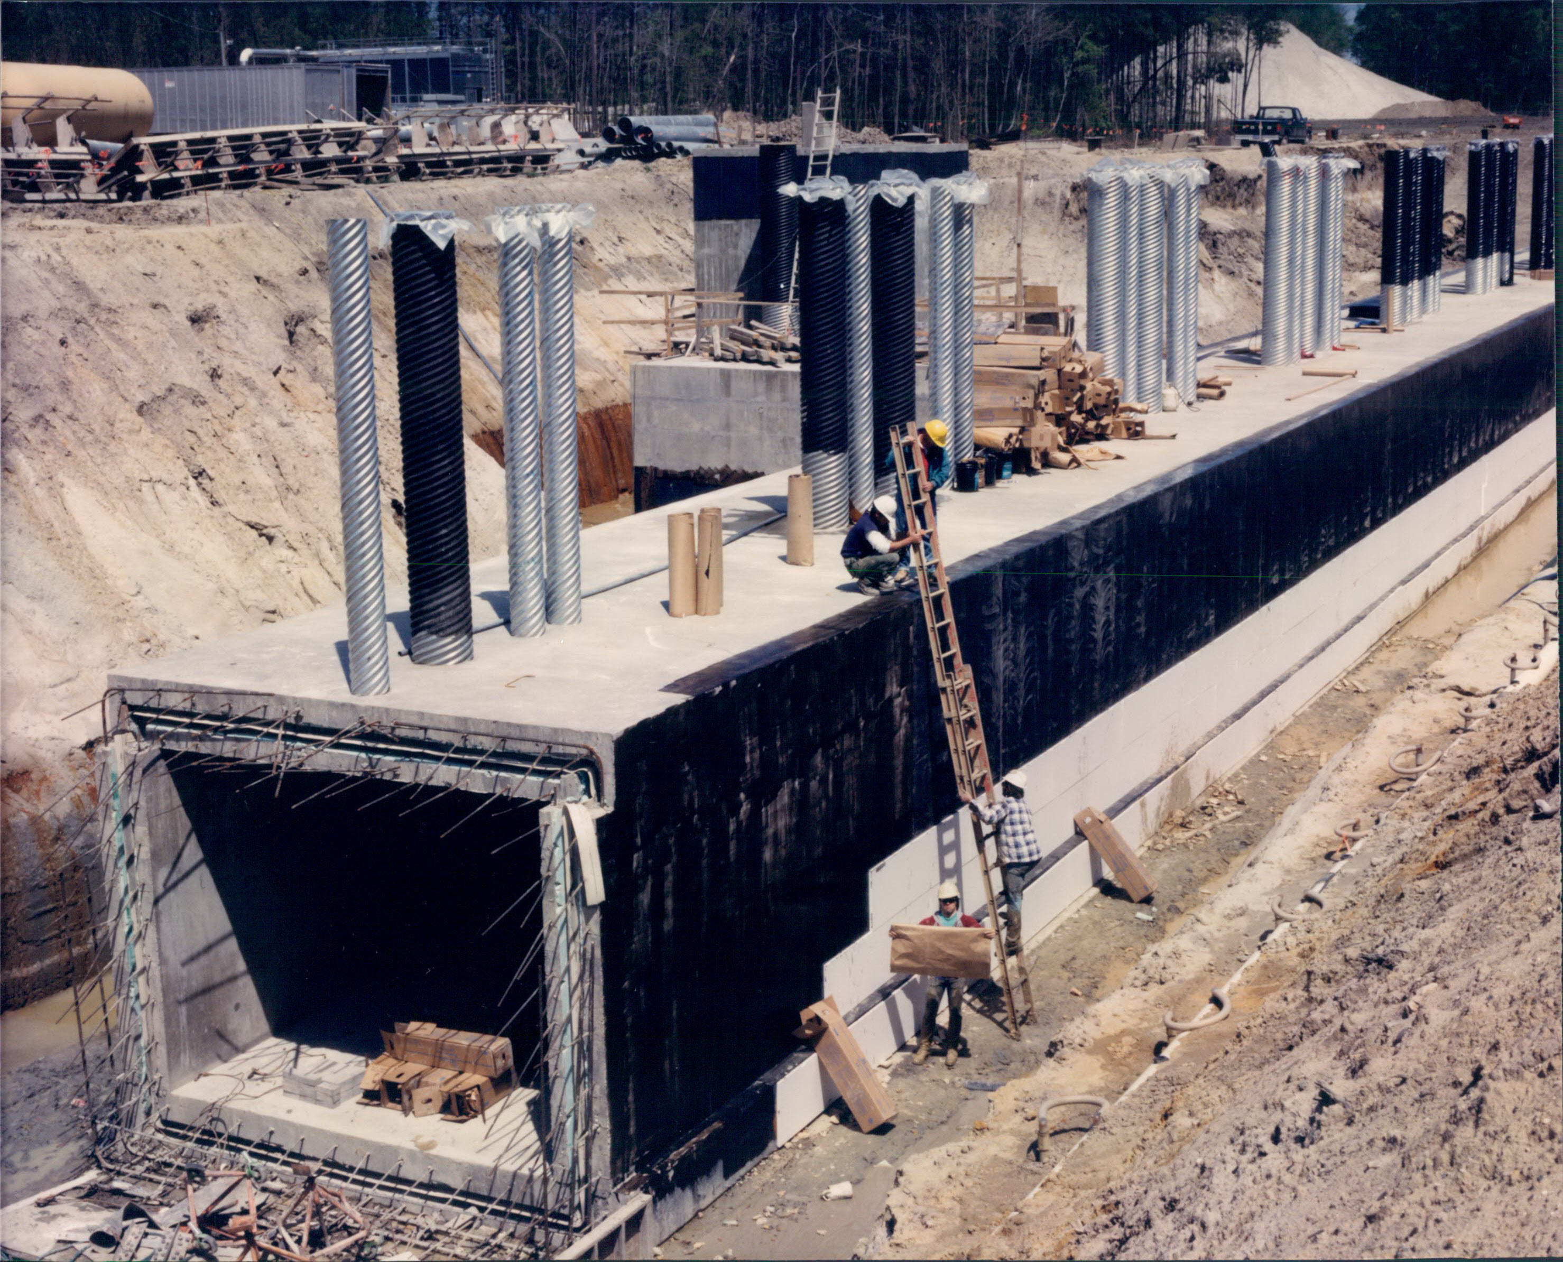

Slide 5
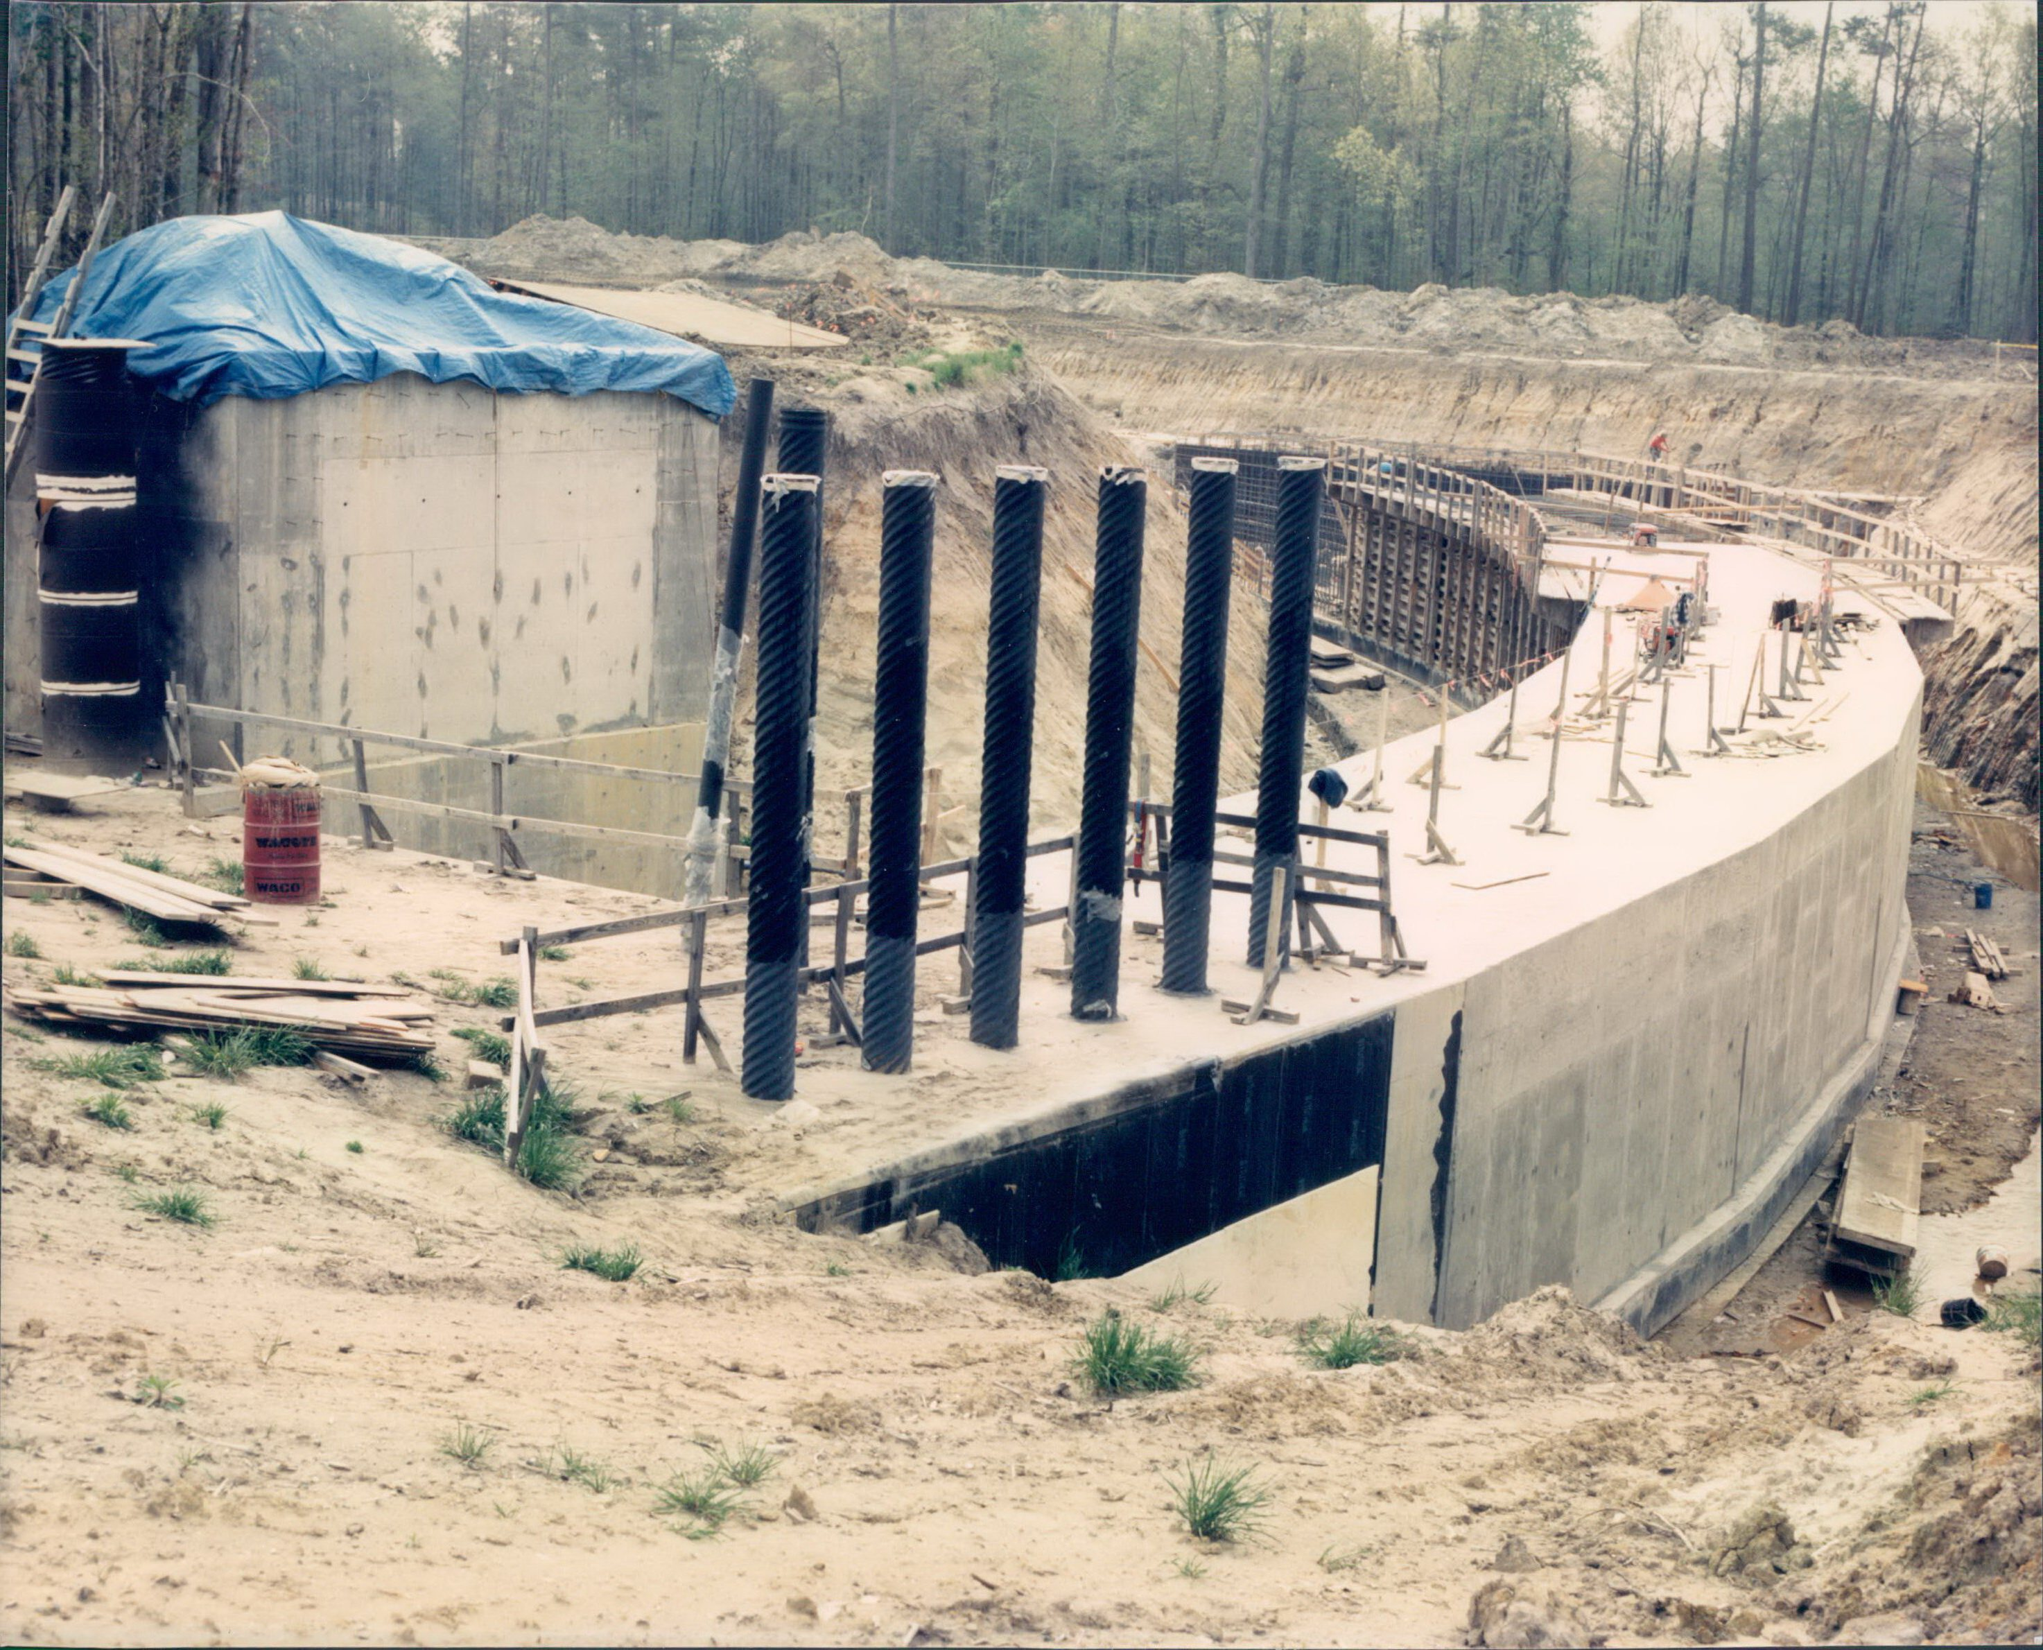

Slide 6
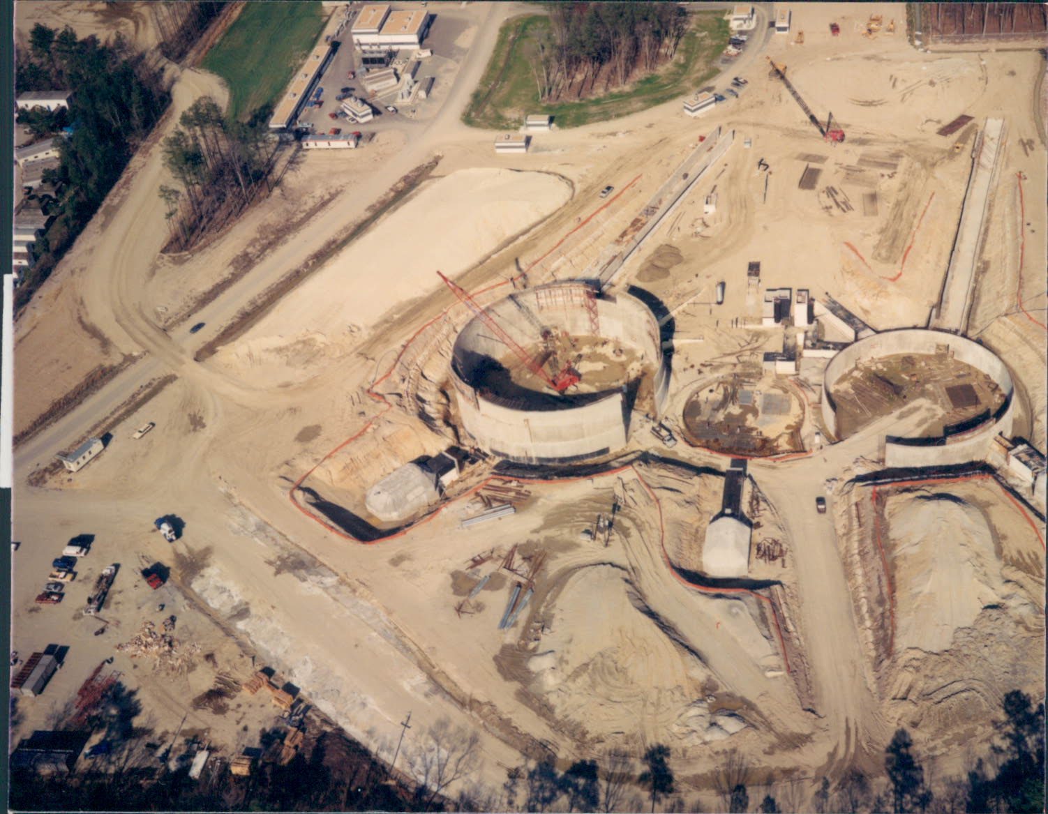

Slide 7
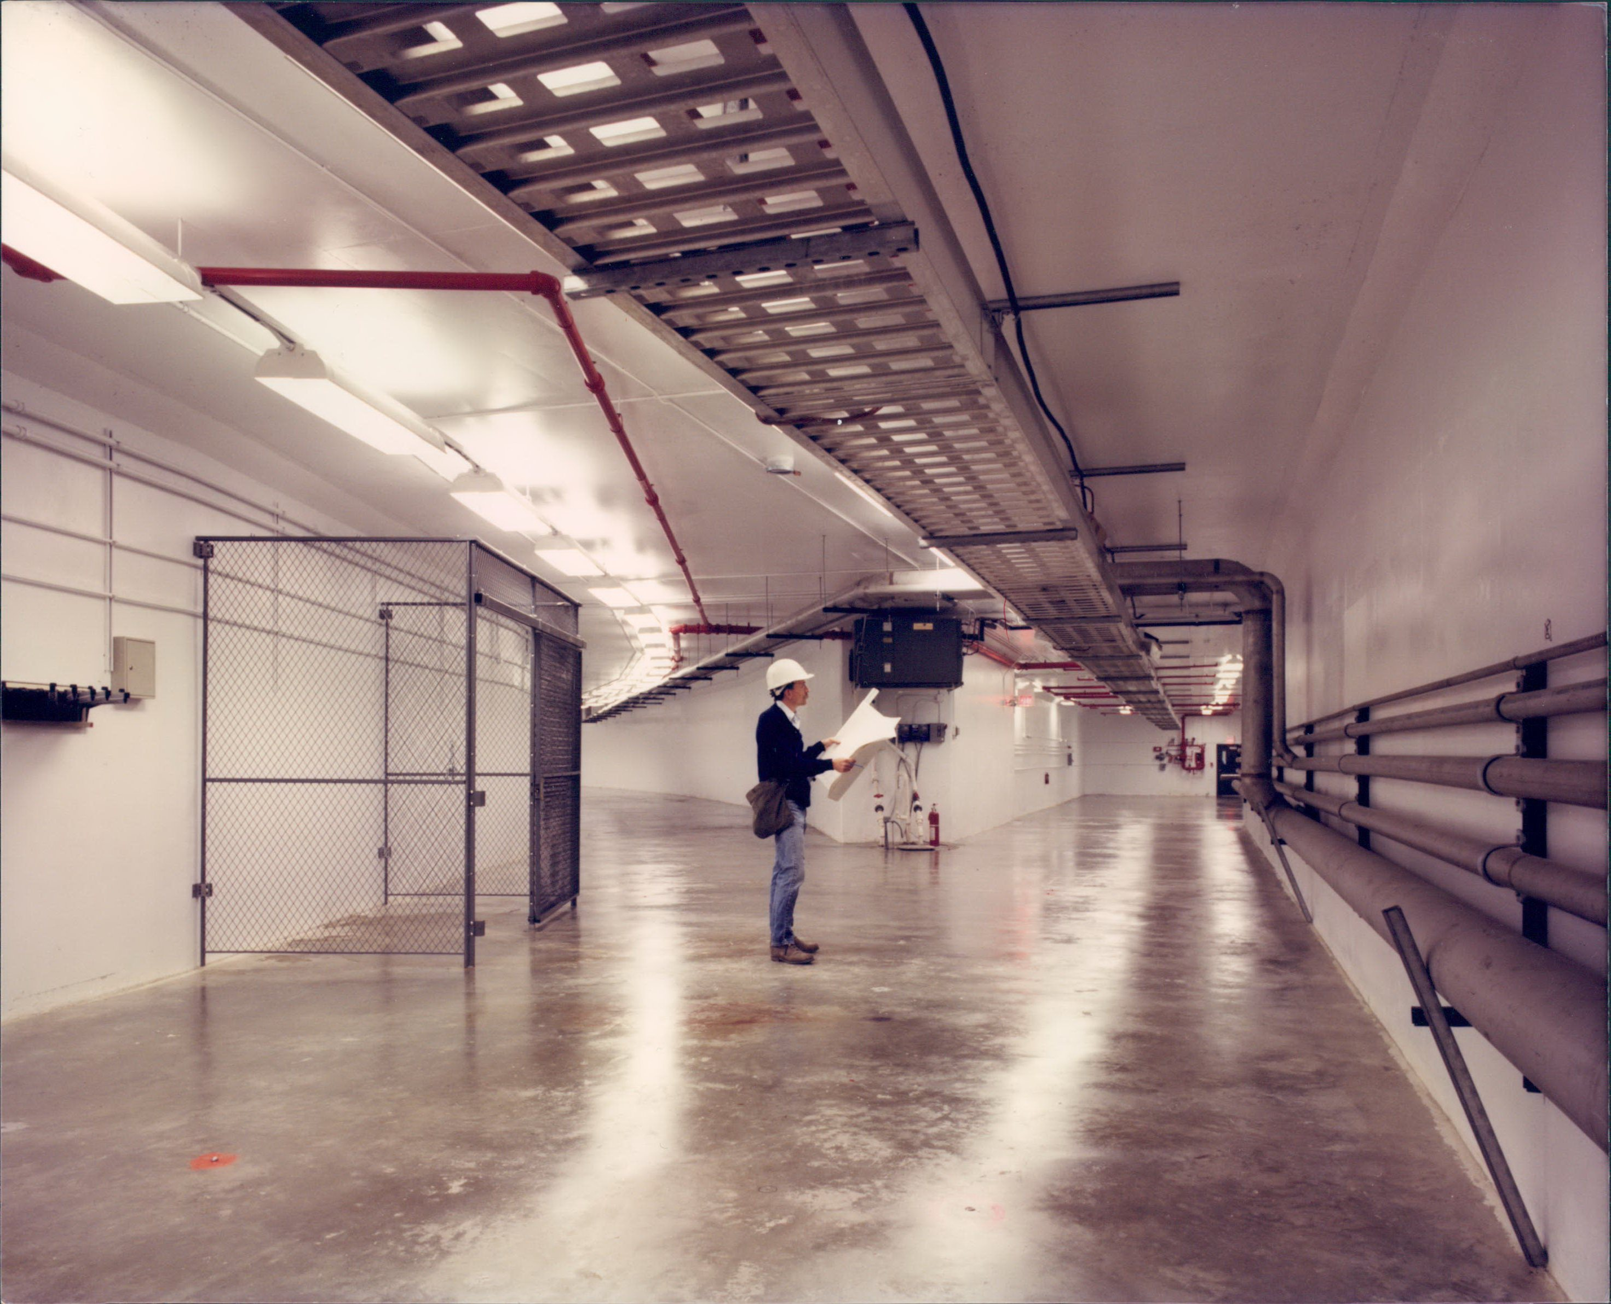

Slide 8
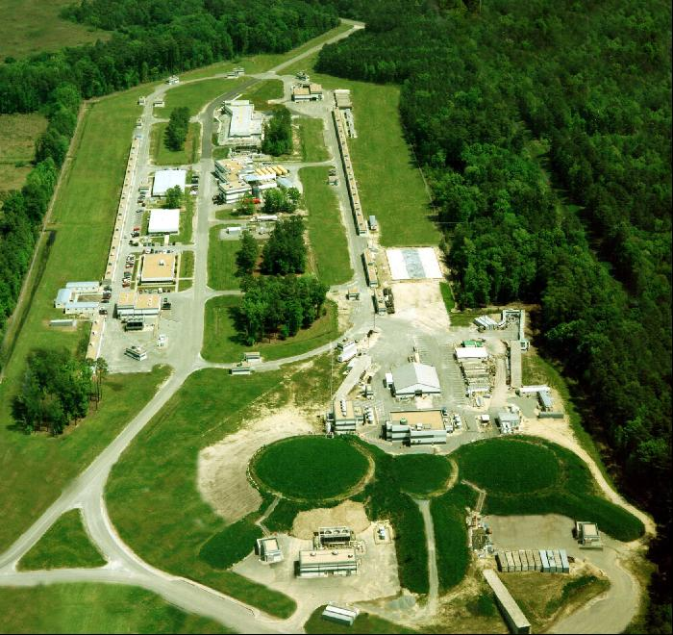
Aerial View
5-pass CW Electron Accelerator
Three user facilities (A, B, C)
CW photo Injector
Two 1497 MHz Linacs
Two Recirculation Arcs
Dynamic Physics Program Requiring Frequent Energy & Pass Changes
>85% Polarization
Small Helicity-Correlated Beam Asymmetries
N

Slide 9
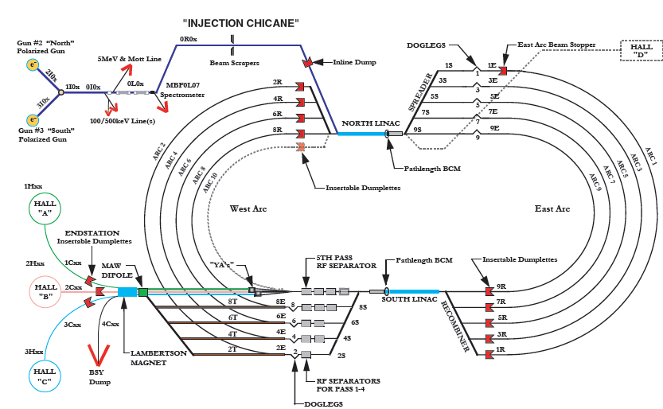
CEBAF Beamline
N

Slide 10
Outline
  CEBAF Historical Timeline
  Machine Overview
  Injector
  Linear Accelerators
  Recirculation Arcs
  Extraction Systems
  Beam Specifications
  12 GeV Upgrade
  Control Room
  Questions

Slide 11
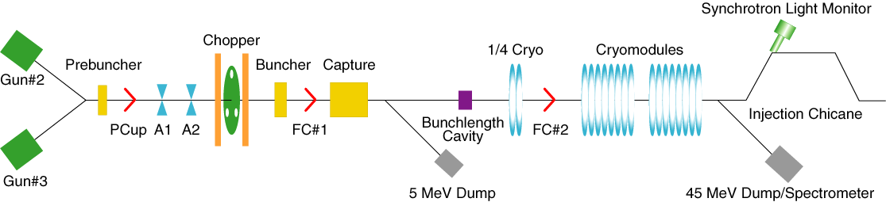
Injector Layout
6.3 MeV Dump
.
67 MeV Dump

Slide 12
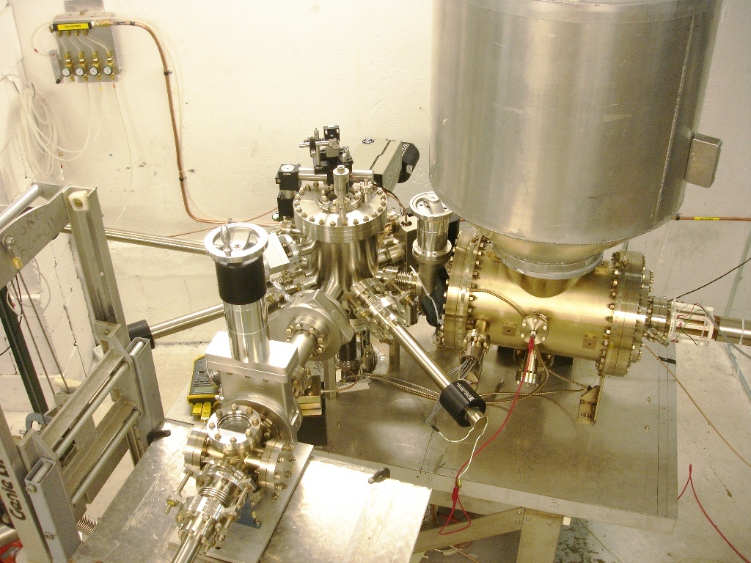
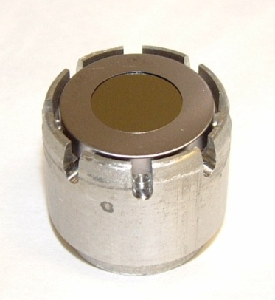
Load Lock Photocathode Gun
Goal: 8 hours swap photocathode
Present: ~12 hours
Heat/activation chamber
x4
Small bake Load region
Suitcase
NEG-coated HV chamber

Slide 13
Synchronous Photoinjection
Laser light that shines on the photocathode is RF pulsed at 499 MHz and creates an RF microstructure on the electron beam
499 MHz is a sub-harmonic of the fundamental accelerator operating frequency 1497 MHz
During three-hall operations, three separate 499 MHz lasers—one for each hall—are used to generate three interlaced electron beams
Use pulsed light to extract electrons only when we need them.
  This prolongs operating lifetime of the cathode.

Slide 14
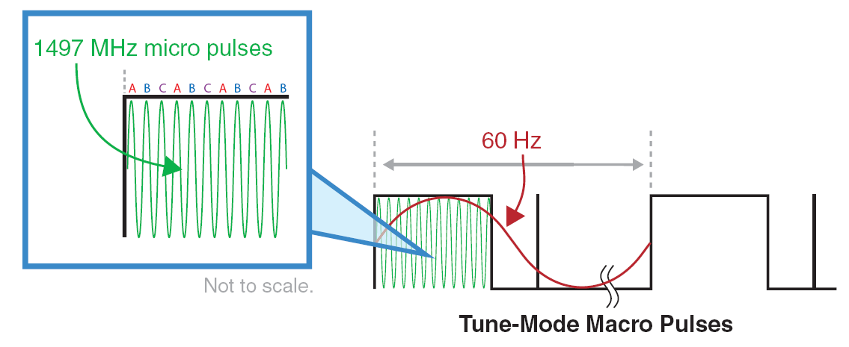
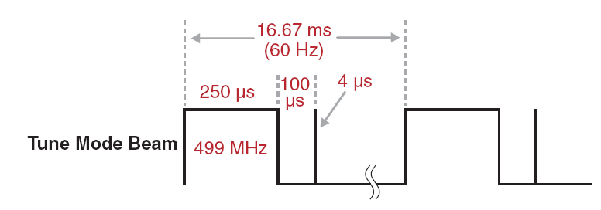
Beam Formation

Slide 15
Beam Formation

Slide 16
Chopping System
  Beam from 130 keV photocathode gun is sent through 499 MHz chopper cavity
  Transverse orthogonal magnetic fields rotate the beam in a circle of ~1.5 cm radius
  Slits at 240°, 0° and 120° degrees allow bunches of electrons to pass
  Chopper slits and laser intensity are individually controlled to regulate currents for Halls A, B & C
  The three beams are recombined by another 499 MHz chopper cavity

Slide 17

Chopping System
B
C
A
Beam
Beam
Beam
Beam
Beam
Beam
Beam
Beam
Beam
Beam
Beam
Beam
Beam
Beam
Beam
Beam
Beam
Beam
Beam
Beam
Beam
Beam
Beam
Chopper #1
RF Cavity (499 MHz)
Lens
Master Slit
Lens
Chopper #2
RF Cavity (499 MHz)

Slide 18
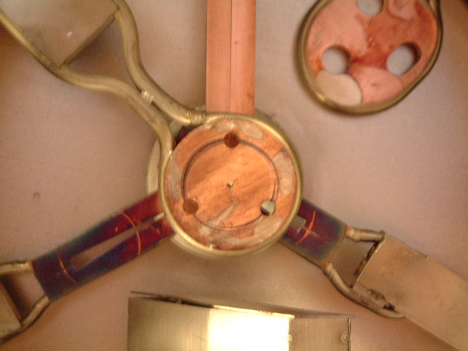
Chopping System

Slide 19
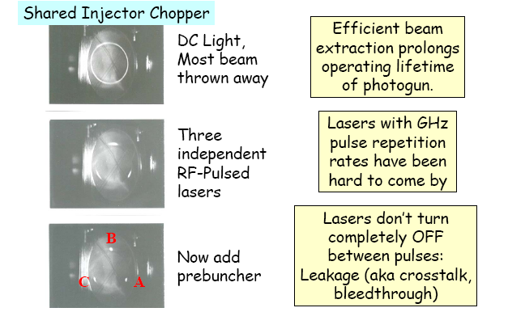
Chopper System

Slide 20
Beam in a Longitudinal E Field
Accelerating
Debunching
Bunching
Decelerating

Slide 21
Injector Layout
6.3 MeV Dump
.
67 MeV Dump

Slide 22
Longitudinal Bunch Optimization
  Measure the time of arrival of the bunch at a high frequency cavity (5.988 GHz) downstream of the buncher cavity
  Move the phases of the chopper cavities and re-measure the time of arrival
  Plot the time of arrival as a function of the phase
  Each point is the center of gravity of the beam
  By moving the center of gravity, the result mimics the behavior of particles distributed along the bunch
  CEBAF bunch is less than 10 picoseconds long
  This measurement is accurate to 15 femtoseconds

Slide 23
Injector Layout
6.3 MeV Dump
.
67 MeV Dump

Slide 24
Outline
  CEBAF Historical Timeline
  Machine Overview
  Injector
  Linear Accelerators
  Recirculation Arcs
  Extraction Systems
  Beam Specifications
  12 GeV Upgrade
  Control Room
  Questions

Slide 25
CEBAF Beamline

Slide 26
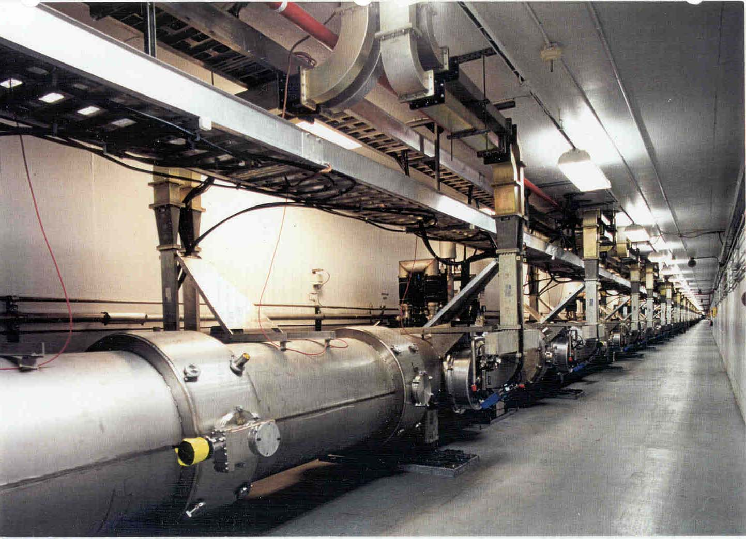
Linear Accelerator

Slide 27
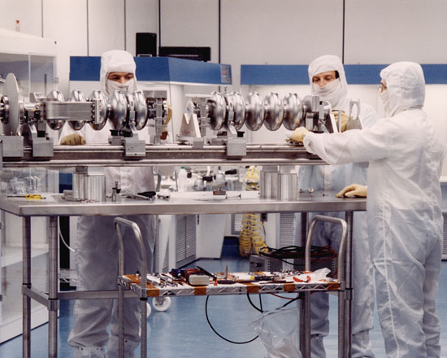
CEBAF 5-Cell Cavity
CEBAF 5-cell cavities operate at 1497 MHz with an active length of 50 cm each
There are eight cavities per cryomodule

Slide 28
Cavity Performance
Gradient specification of CEBAF cavities was 5 MV/m
Average gradient of cavities installed was 7.3 MV/m
Two approaches to improve performance of cavities
  Helium processing and waveguide vacuum processing
    Carried out in situ
    Reduction in cavity electron emission (field emission) and waveguide gas discharge
  C50 program in place to take least capable cryomodules out of the machine and refurbish them

Slide 29
Cavity Performance

Slide 30
Cavity Performance
Installation | FY07 | FY08 | FY09 | FY10 | FY11 | FY12 | FY13 | FY14 | FY15 | FY16
C50 | 3 | 3 | 3 | 1 | - | - | 1 | 2 | 2 | 2
C100 build | - | - | - | 3 | 4 | 3 | - | - | - | -
C100 install | - | - | - | - | 2 | - | 8 | - | - | -
New/Refurbished Cryomodule Capability
C50 | 3x50 MeV | 3x50 MeV | 3x50 MeV | 50 MeV | - | - | 50 MeV | 2x50 MeV | 2x50 MeV | 2x50 MeV
C100 |  |  |  |  | 2x100 MeV |  | 8x100 MeV | - | - | -
Hall A, B, C Max Energy | 5.1 GeV | 5.9 GeV | 6 GeV | 6 GeV | 6 GeV | 6 GeV | 11 GeV | 11 GeV | 11 GeV | 11 GeV
Overhead | - | - | 0.5 GeV | 0.6 GeV | 0.6 GeV | 0.6 GeV | 1.1 GeV | 1.2 GeV | 1.3 GeV | 1.4 GeV
Hall D Max Energy | - | - | - | - | - | - | 12 GeV | 12 GeV | 12 GeV | 12 GeV
Overhead |  |  |  |  |  |  | 1.1 GeV | 1.2 GeV | 1.3 GeV | 1.4 GeV

Slide 31
Evolving Standard for CEBAF Cavities
1.00E+11
l
Baseline
l
e-polished
l
l
l
l
l
l
l
l
l
l
l
l
l
l
l
l
l
l
l
l
l
l
l
l
l
l
l
l
l
l
l
l
l
l
l
l
1.00E+10
l
l
l
♦
♦
l
l
l
l
l
Spec for
12 GeV
cavities
l
Same shape
7-cells
l
Qo
Original CEBAF
♦
1.00E+9
10.00E+7
0
2
4
6
8
10
12
14
16
18
20
Eacc [MV/m]

Slide 32
Outline
  CEBAF Historical Timeline
  Machine Overview
  Injector
  Linear Accelerators
  Recirculation Arcs
  Extraction Systems
  Beam Specifications
  12 GeV Upgrade
  Control Room
  Questions

Slide 33
CEBAF Beamline

Slide 34
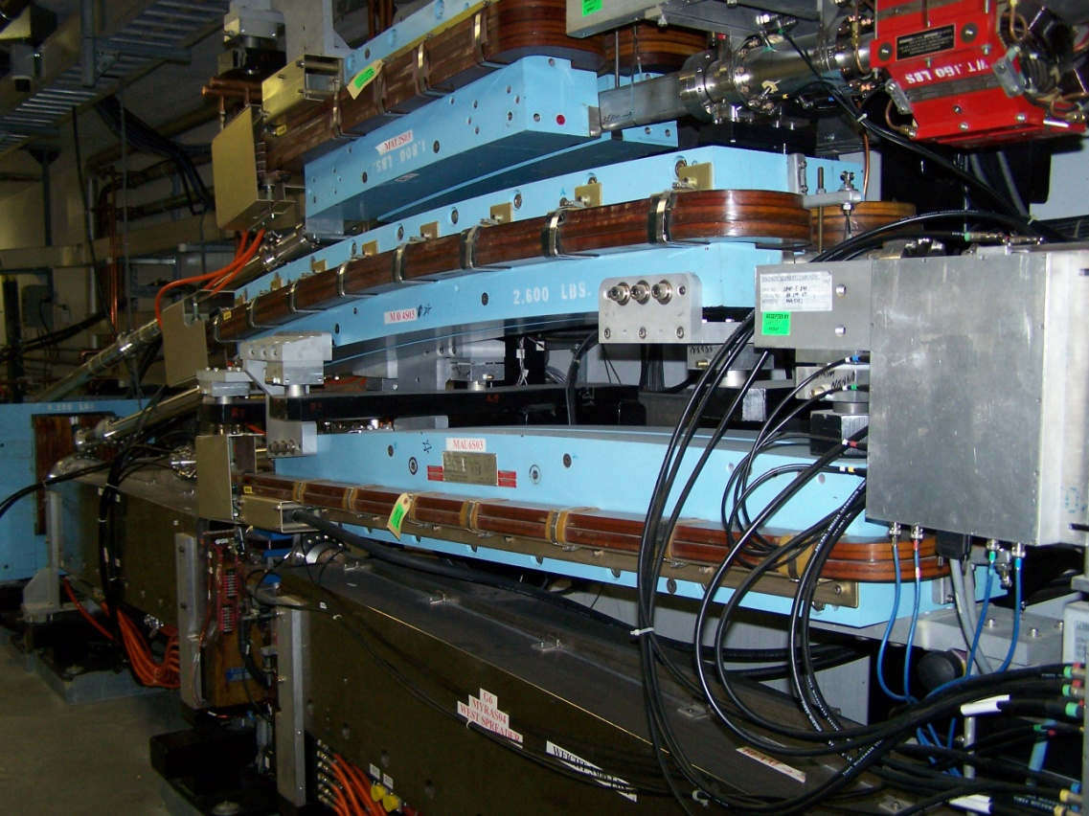
Arc Transport Magnets
  Spreader and recombiner sections of the machine connect linear accelerators to recirculation arcs
  Magnetic dipoles and septa are powered in series with different arcs

Slide 35
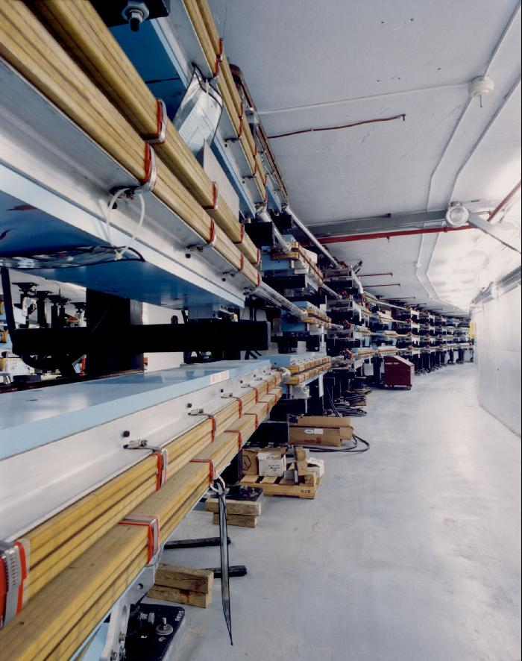
Arc Transport Magnets
  Recirculation arcs transport the beam between linacs
  Low energy beam at the top
  High energy beam at the bottom
  16 or 32 dipoles are used to complete the 180 degree bend

Slide 36
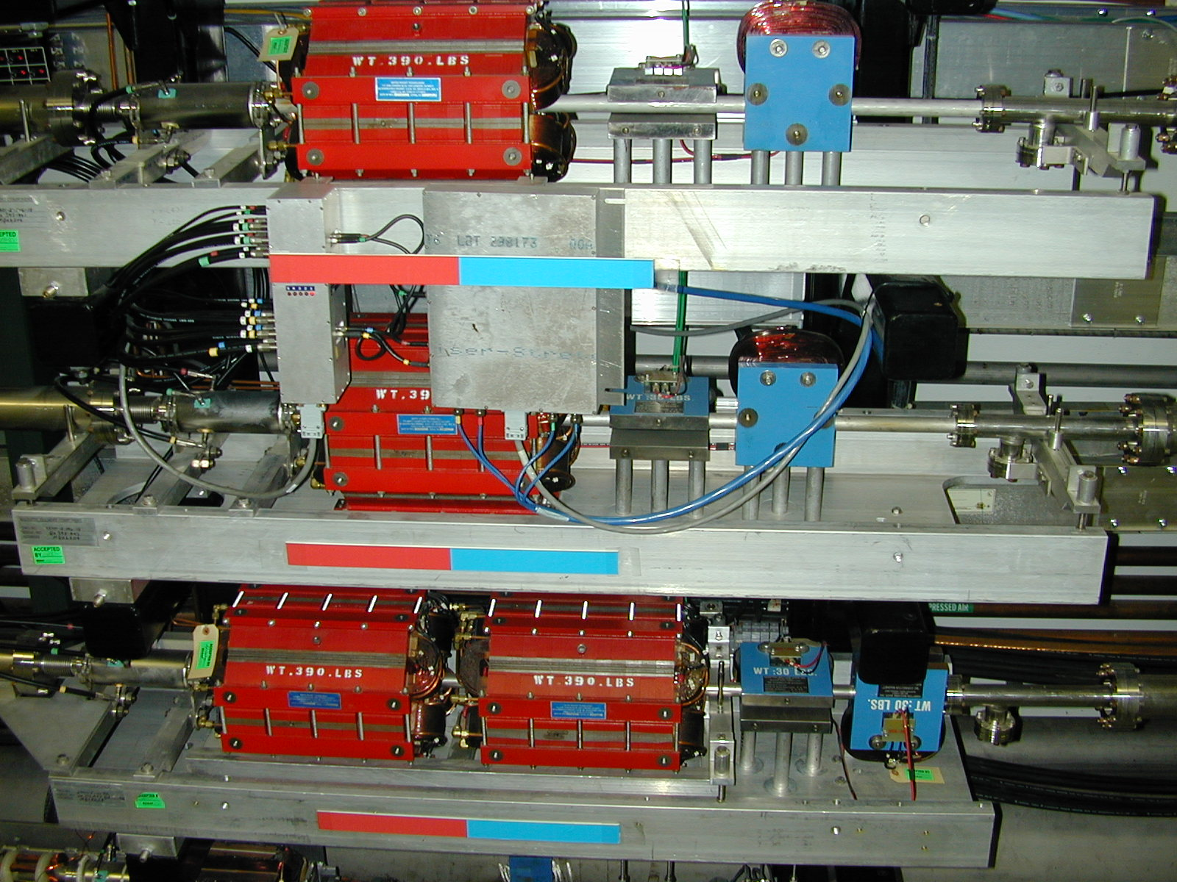
Typical Magnet Assembly

Slide 37
Outline
  CEBAF Historical Timeline
  Machine Overview
  Injector
  Linear Accelerators
  Recirculation Arcs
  Extraction Systems
  Beam Specifications
  12 GeV Upgrade
  Control Room
  Questions

Slide 38
Beam Extraction
  Any single user can receive beam from the first four passes
  All three users may receive beam from the fifth pass
  Time-dependent transverse kicks are applied to the microbunch structure to selectively direct beams along the correct path
  Accomplished with RF Separator cavities operating at 499 MHz
  Also use dipoles and quadrupoles at fixed field strengths to change the path of the beam

Slide 39
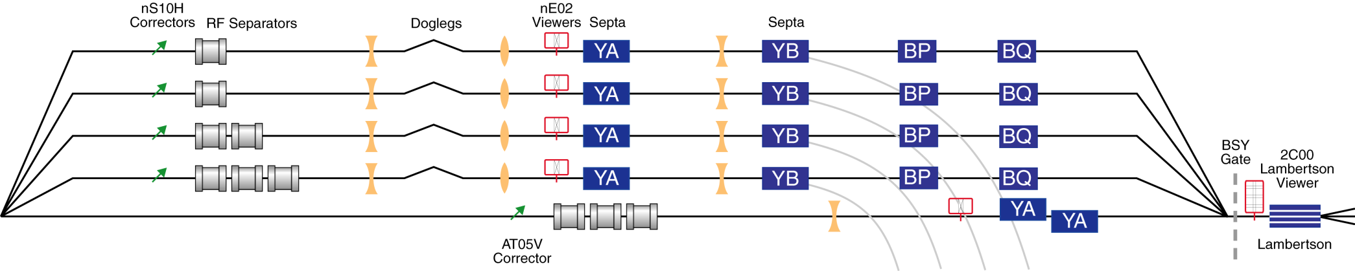
Extraction System
Extraction system consists of RF Separators, Septa and Dipole magnets
1-4 pass uses horizontal separation to deflect one beam to halls A, B or C
5th pass uses vertical separation and all 3 halls can have the maximum energy at the same time

Slide 40
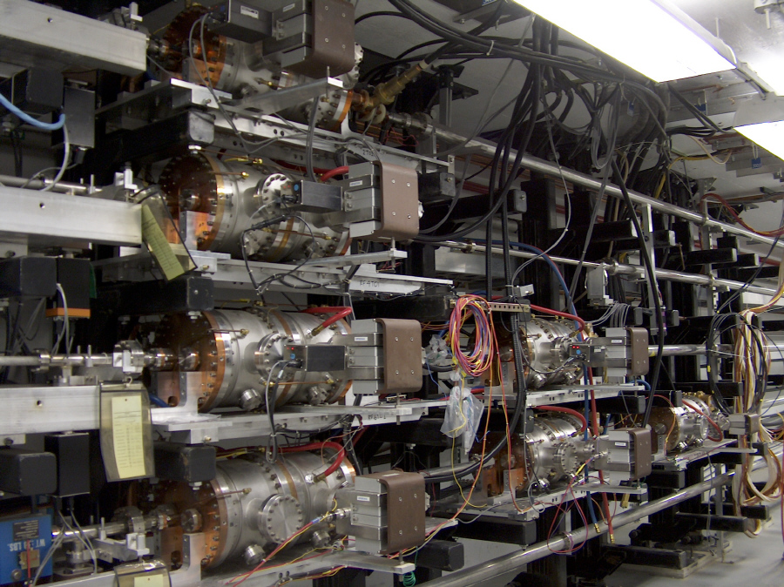
499 MHz RF Separator Cavities

Slide 41
Horizontal Extraction System
B
A
C
C
A, B
C
B
A

Slide 42
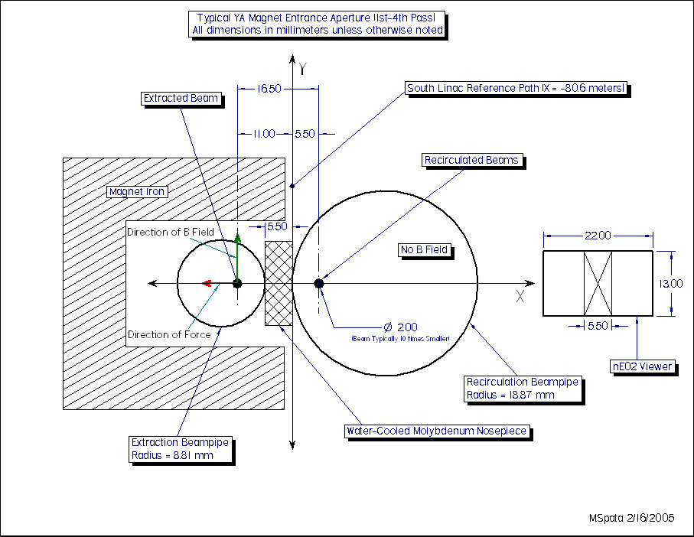
Horizontal Extraction Septa

Slide 43
Vertical Extraction System
A
C
B
A
B
C
A
B
C

Slide 44
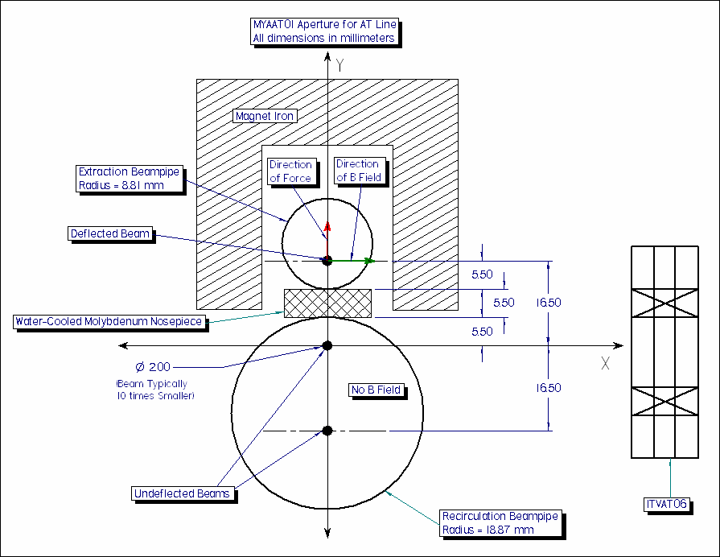
Vertical Extraction Septa

Slide 45
Outline
  CEBAF Historical Timeline
  Machine Overview
  Injector
  Linear Accelerators
  Recirculation Arcs
  Extraction Systems
  Beam Specifications
  12 GeV Upgrade
  Control Room
  Questions

Slide 46
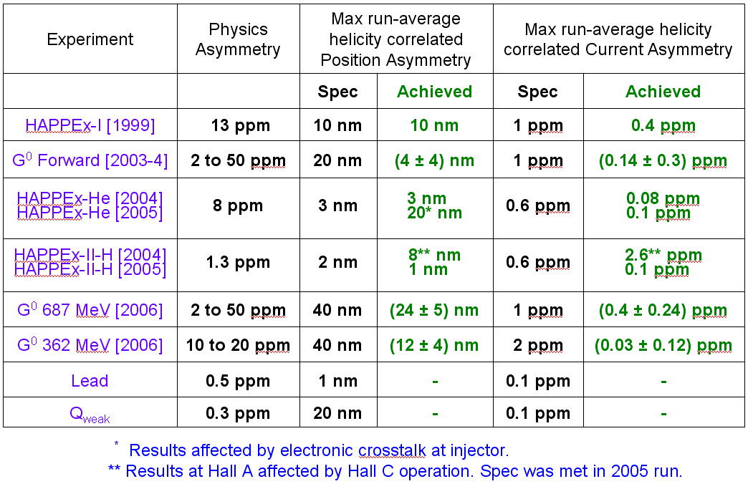
Parity Quality Beam

Slide 47
Outline
  CEBAF Historical Timeline
  Machine Overview
  Injector
  Linear Accelerators
  Recirculation Arcs
  Extraction Systems
  Beam Specifications
  12 GeV Upgrade
  Control Room
  Questions

Slide 48



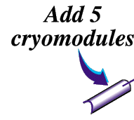



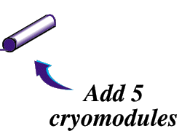
12
6 GeV CEBAF
11
Upgrade magnets and power supplies
CHL-2
Two 0.6 GV linacs
1.1
New cryomodules get new rf zones
48

Slide 49
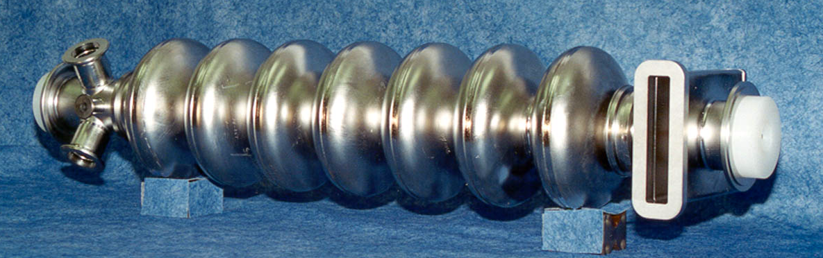
Cryomodule System: Cavity Design
Upgraded SRF Cavity for CEBAF
7-cell 1497 MHz niobium

Slide 50
Cryomodule Assembly

Slide 51
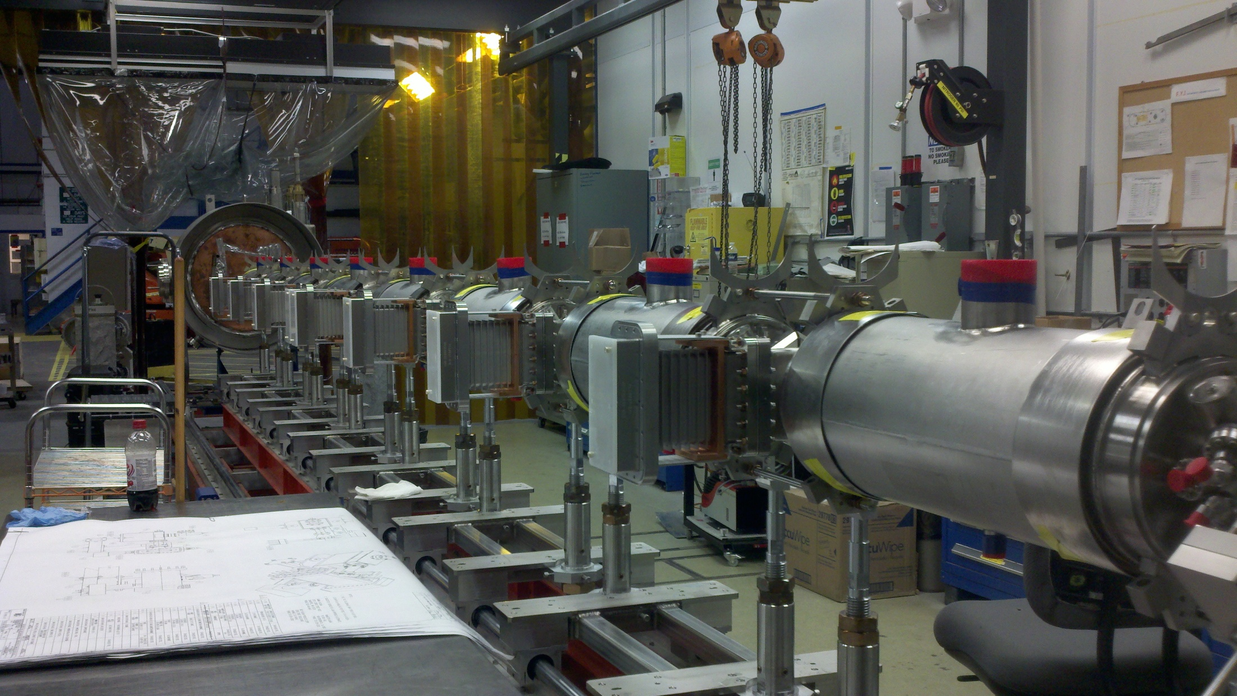
Cryomodule Assembly

Slide 52
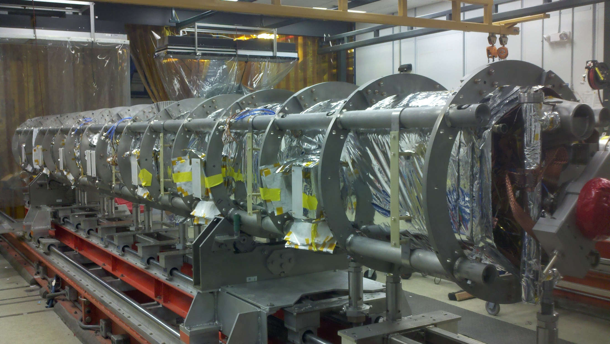
Cryomodule Assembly

Slide 53
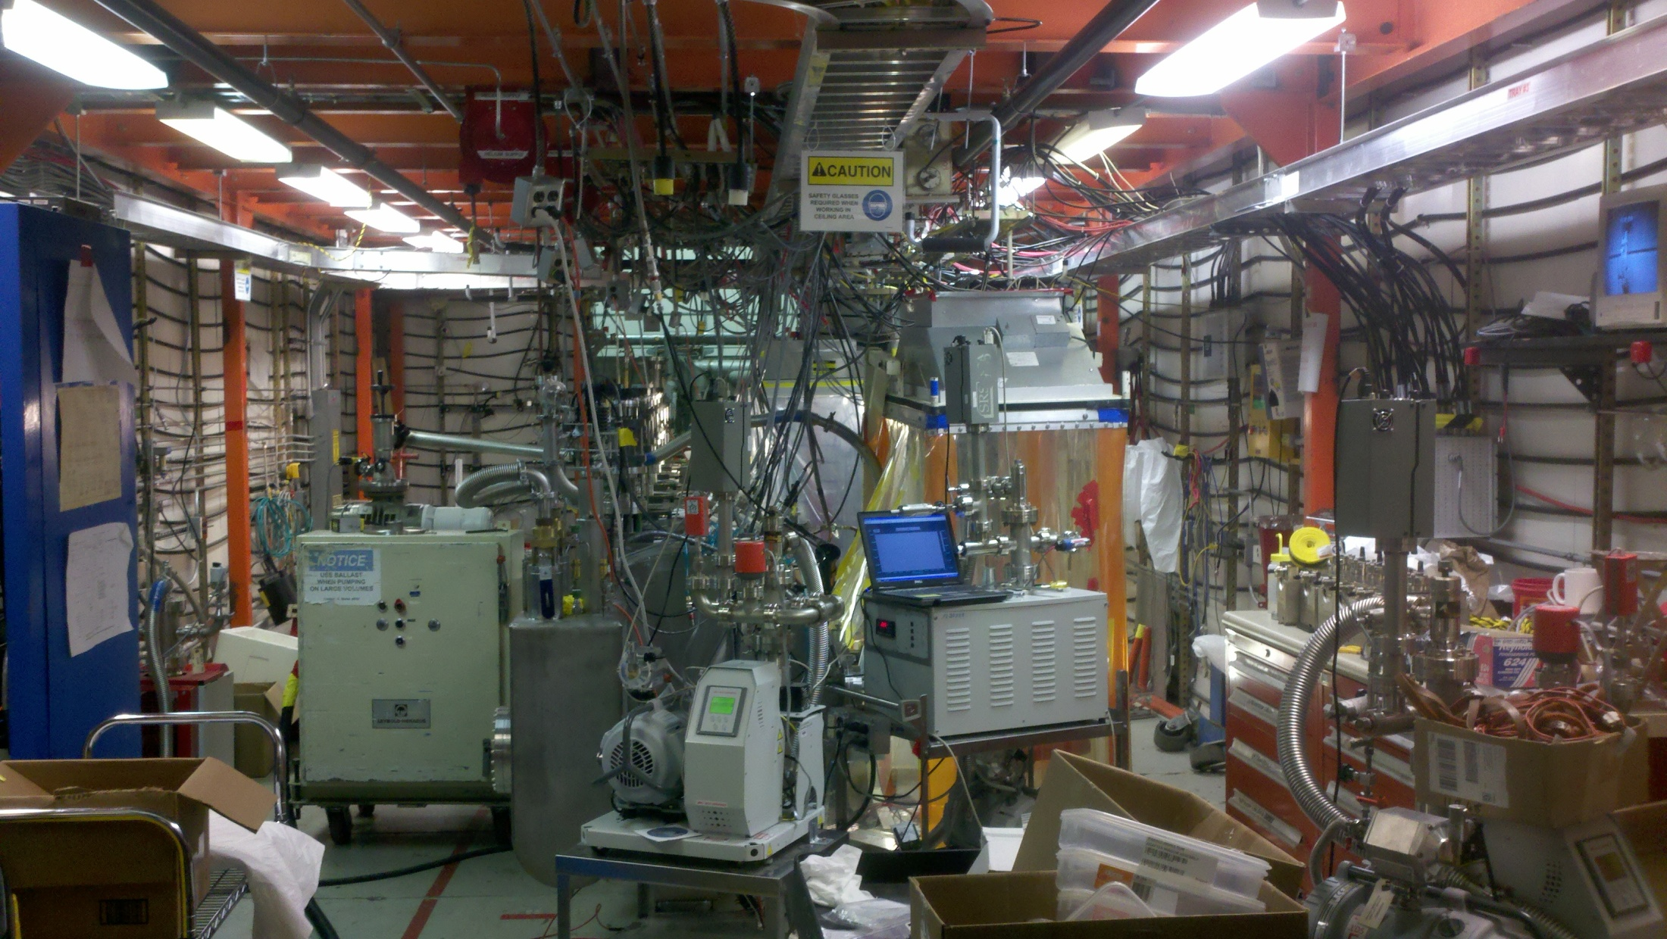
Cryomodule Testing

Slide 54
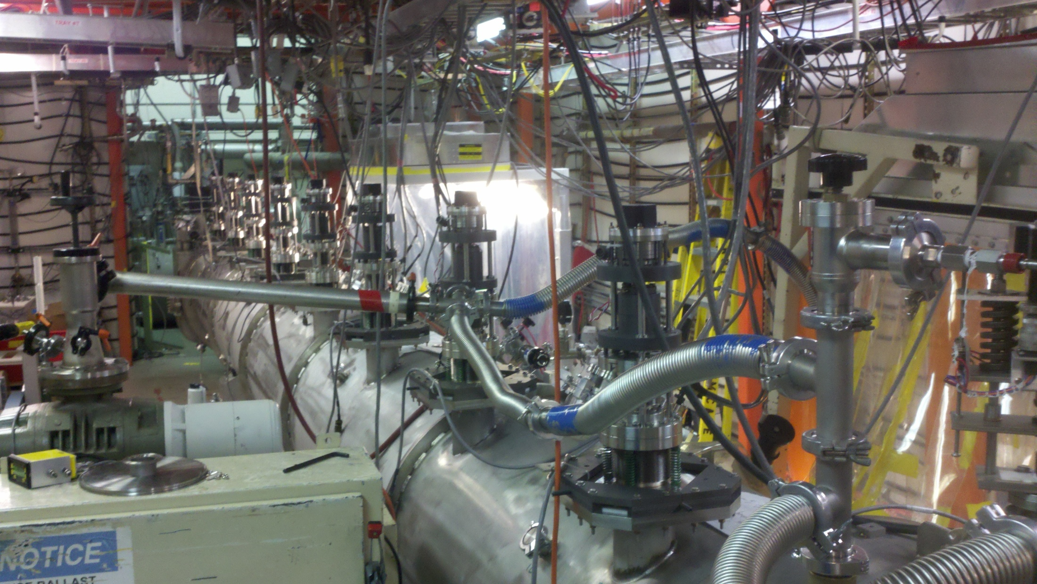
Cryomodule Testing

Slide 55
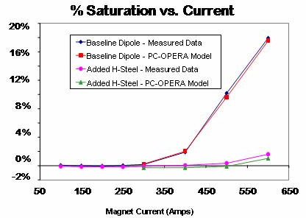
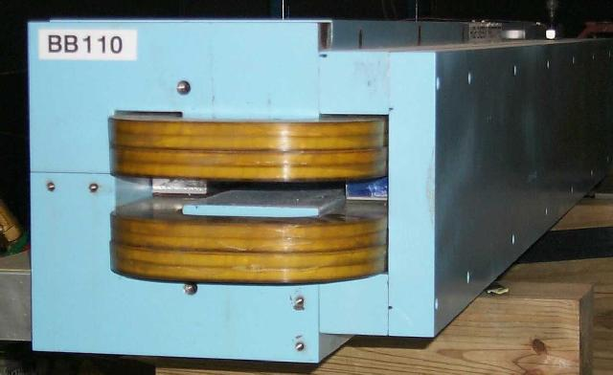
12 GeV Magnet Upgrades
Dipoles
  Arcs will have C-style dipoles modified with added H-Steel to limit saturation
  Halls B & C lines will have similar changes
  Dipoles will be removed from stands for safe H-Steel installation and mapped for quality control
Quads
  The majority of the existing quadrupoles can meet the 12 GeV needs without modification
  Upgrade other quads only as needed; Double Power Supply current, Double up quads with new PS, or one new higher strength quadrupole magnet design
Prototype dipole with added H-Steel

Slide 56
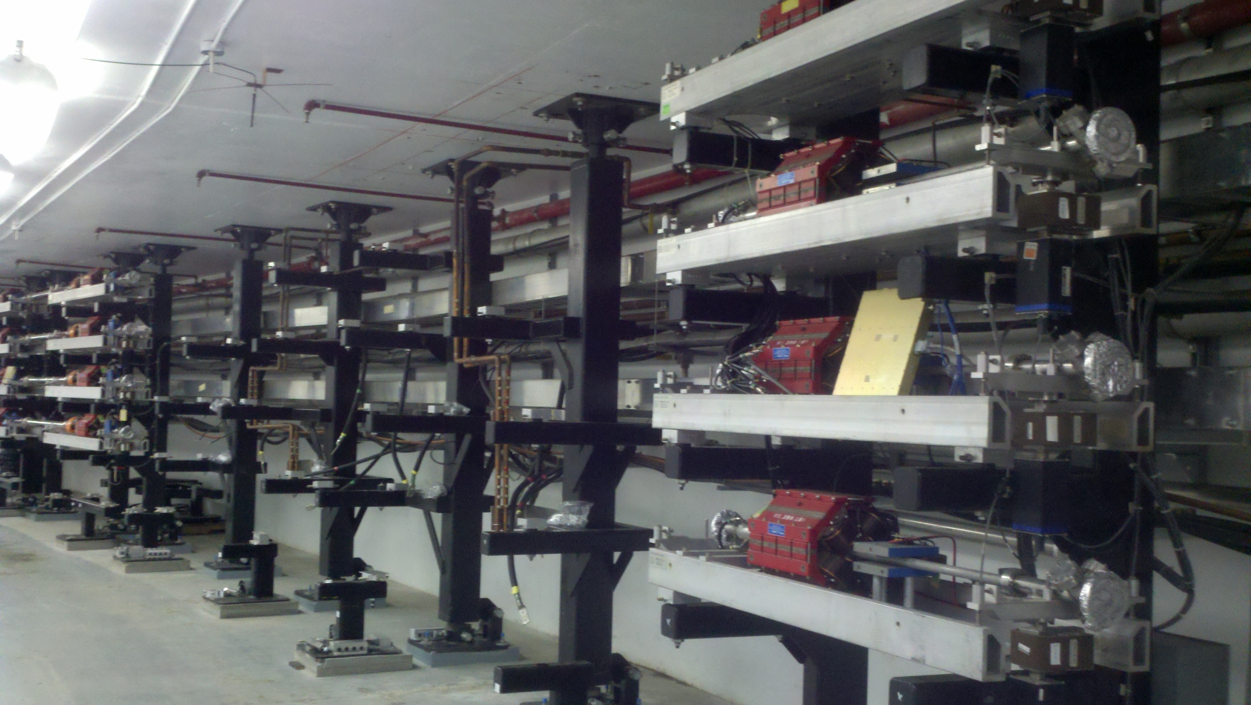
Arc Transport Magnets

Slide 57
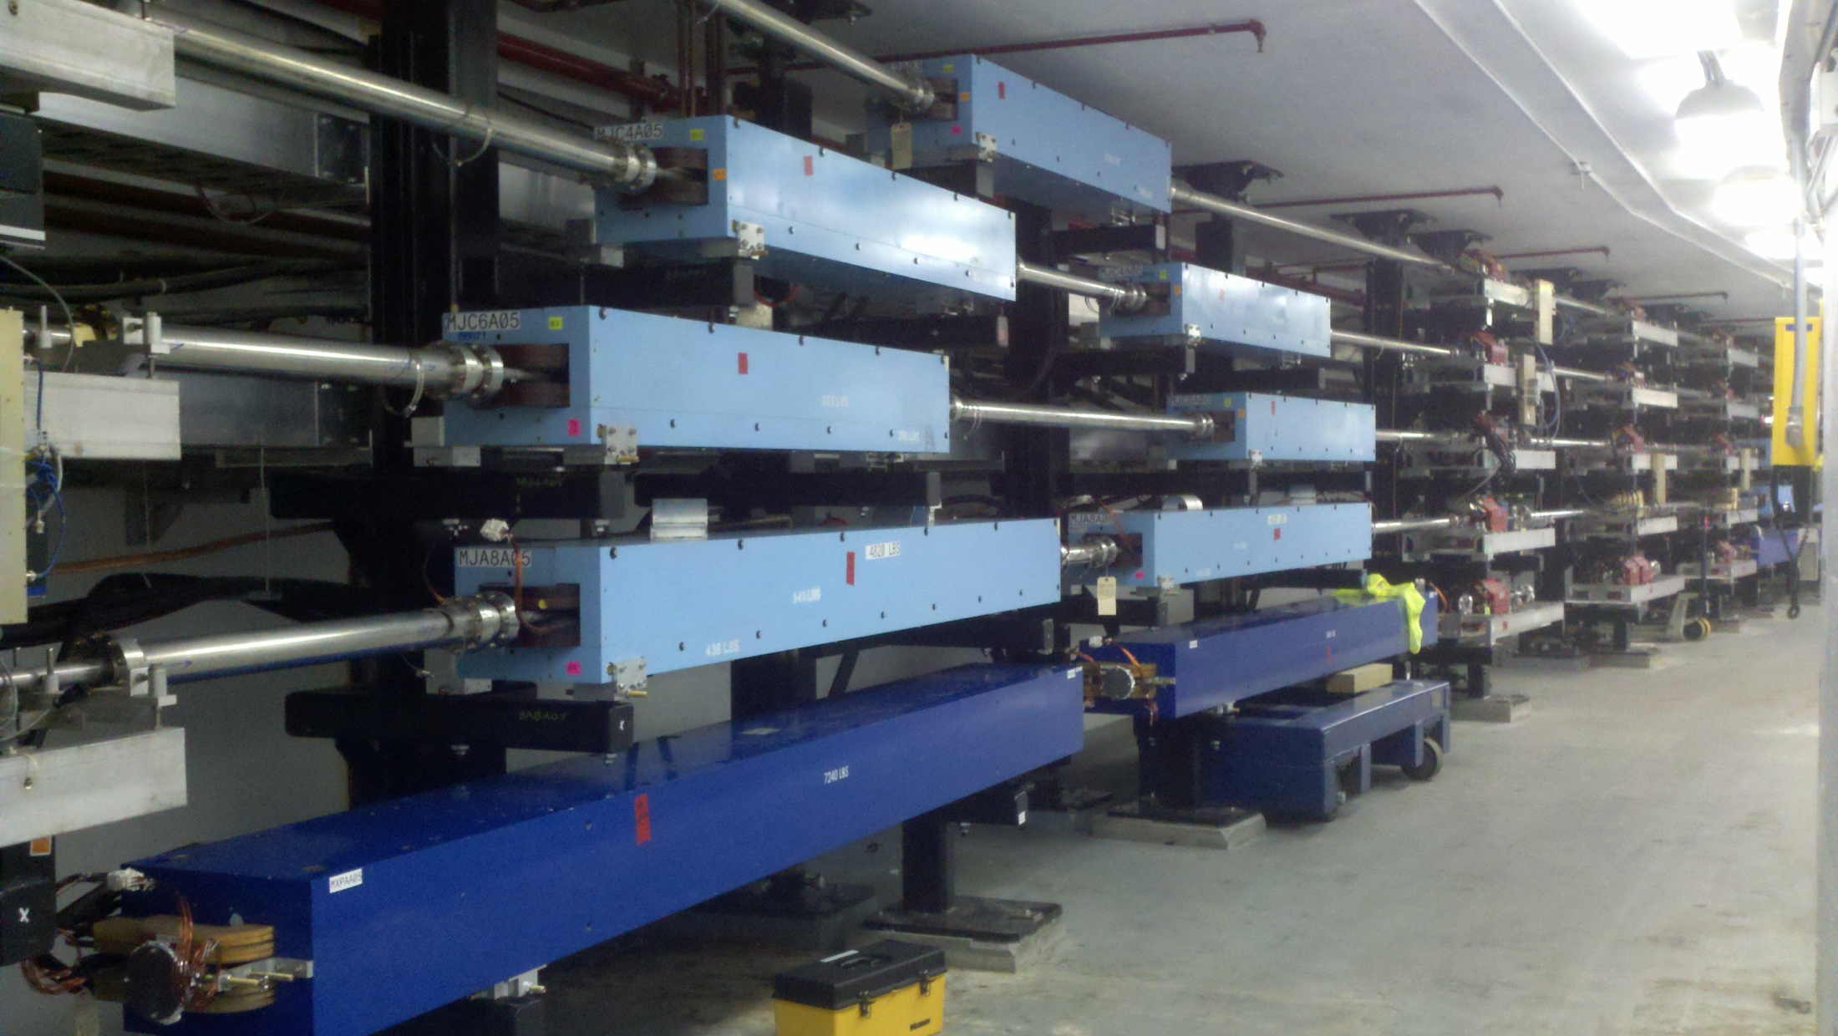
Arc Transport Magnets

Slide 58
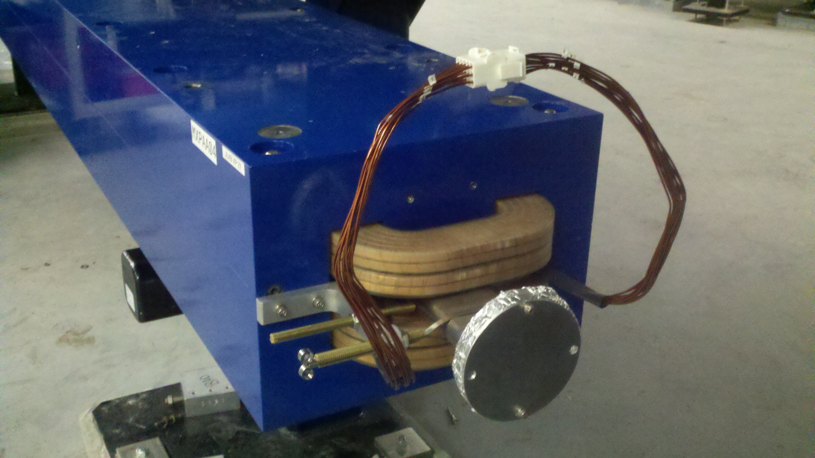
Arc Transport Magnets

Slide 59
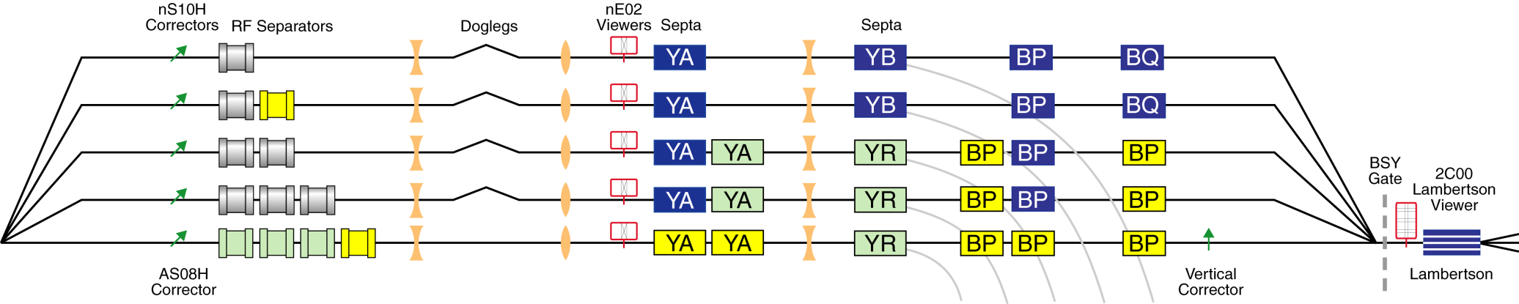
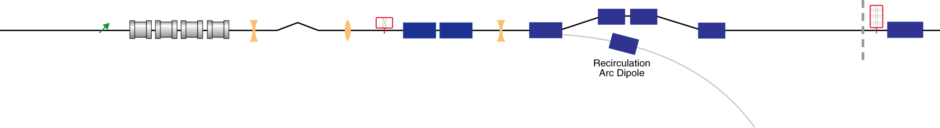
12 GeV Extraction
New
Relocated
12 GeV Upgrade Elevation View
Pass 1
Pass 2
Pass 3
Pass 4
Pass 5
Recirculation ARCS
Horizontally deflecting septa
Horizontally deflecting RF cavities (499MHz, copper)
Horizontally deflecting dipoles
12 GeV Upgrade Plan View

Slide 60
12 GeV Project Timeline

Slide 61
Outline
  CEBAF Historical Timeline
  Machine Overview
  Injector
  Linear Accelerators
  Recirculation Arcs
  Extraction Systems
  Beam Specifications
  12 GeV Upgrade
  Control Room
  Questions

Slide 62
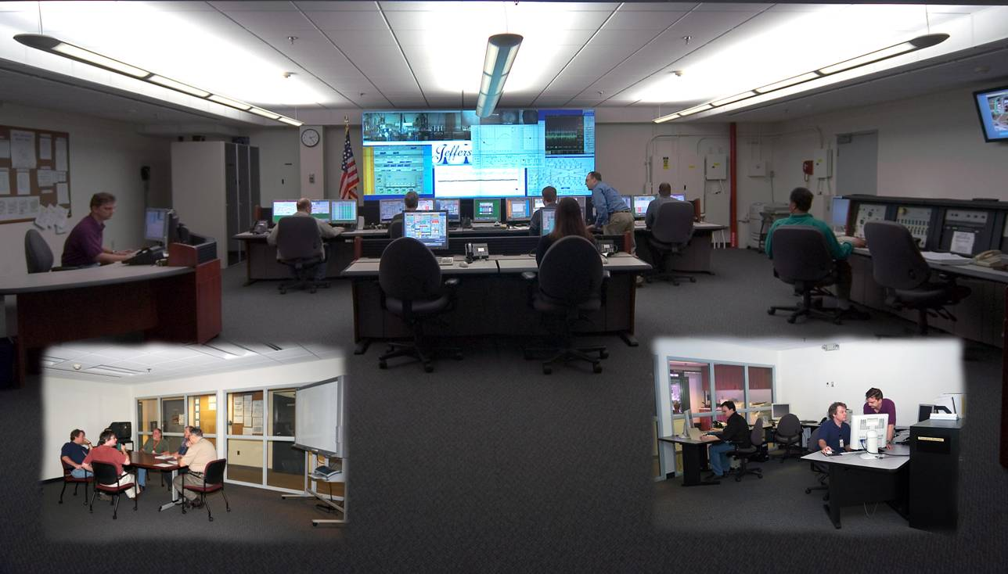
MCC Control Room

Slide 63
Outline
  CEBAF Historical Timeline
  Machine Overview
  Injector
  Linear Accelerators
  Recirculation Arcs
  Extraction Systems
  Beam Specifications
  12 GeV Upgrade
  Control Room
  Questions
Thanks!

