Slide 1
Superconducting detectors and electronics
Alexandre Camsonne
Hall A
JLAB Pizza seminar
September 24th 2014

Slide 2
Outline
Experiments and experimental requirements
Superconductivity quick overview
Superconducting detector
  Overview superconducting detectors
  Superconducting Nanowire technique
    Superconducting nanowire Single Photon detector
    Superconducting nanowire avalanche photodiode
  Properties of superconducting nanowire
Superconducting electronics
  Discriminator
  Rapid Single Quantum Flux electronics and Josephson Junction : Clock, ADC, TDC, memory
Fabrication
  Metallization process
  Lithography process
Possible applications
  Ring Imaging Cherenkov and time of flight
  Photosensor
  Tracker
R&D
Conclusion

Slide 3
Jefferson Laboratory
Superconducting accelerator
  1499 MHz bunch continuous wave
  2.2 to 11 GeV in Hall A,B,C
  Up to 80 uA
Cryogenic target
  15 cm to 1 m target
Maximum luminosity around 2x10³⁹ cm⁻²s⁻¹
(LHC 5x10³⁴ cm⁻²s⁻¹ )

Slide 4
DVCS / Double DVCS
γ∗ + p
γ‘(∗) + p’
l⁺ + l⁻
Guidal and Vanderhaegen : Double deeply virtual Compton scattering off the nucleon (arXiv:hep-ph/0208275v1 30 Aug 2002)
Belitsky Radyushkin : Unraveling hadron structure with generalized parton distributions (arXiv:hep-ph/0504030v3 27 Jun 2005)

Slide 5
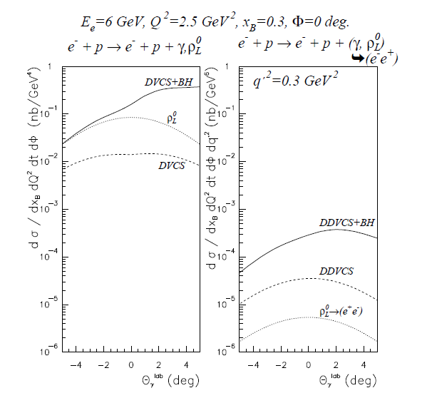
DDVCS cross section
VGG model
Order of
~0.1 pb = 10⁻³⁶cm²
About 100 smaller than DVCS
Virtual Beth and Heitler
Interference term enhanced by BH
Contributions from mesons small when far from meson mass

Slide 6
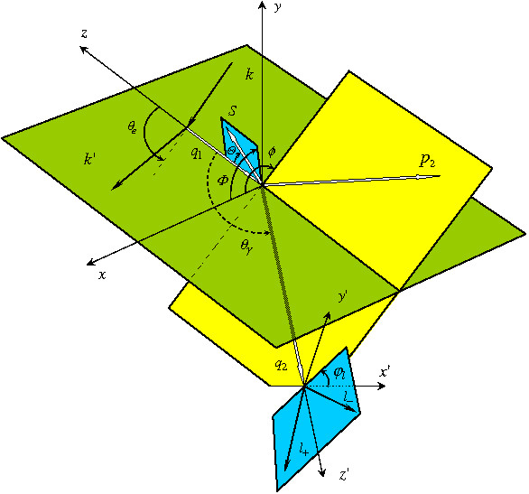
Double Deeply Virtual Compton Scattering
Δ = p1-p2 = q2-q1
p = p1+p2
q = ½ (q1+q2)
scattered electron
Q²= − q²
ξ =
Q²
2p.q
scattered proton
η =
Δ.q
outgoing virtual photon
p.q
Q²= -(k-k’)²
x_{bj}=
Q²
2p₁q₁
lepton pair from virtual photon

Slide 7


Kinematical coverage
JLab 11 GeV
25 GeV
40 GeV
DVCS
η = ξ
2
H^{u}(η , ξ)
2
$$Q^{2}<M_{l^{+}l^{−}}^{}$$
$$Q^{2}>M_{l^{+}l^{−}}^{}$$
DVCS only probes η = ξ
line
Example with model of GPD H for up quark
Jlab : Q²>0
Kinematical range increases with beam energy ( larger dilepton mass )
η
ξ

Slide 8
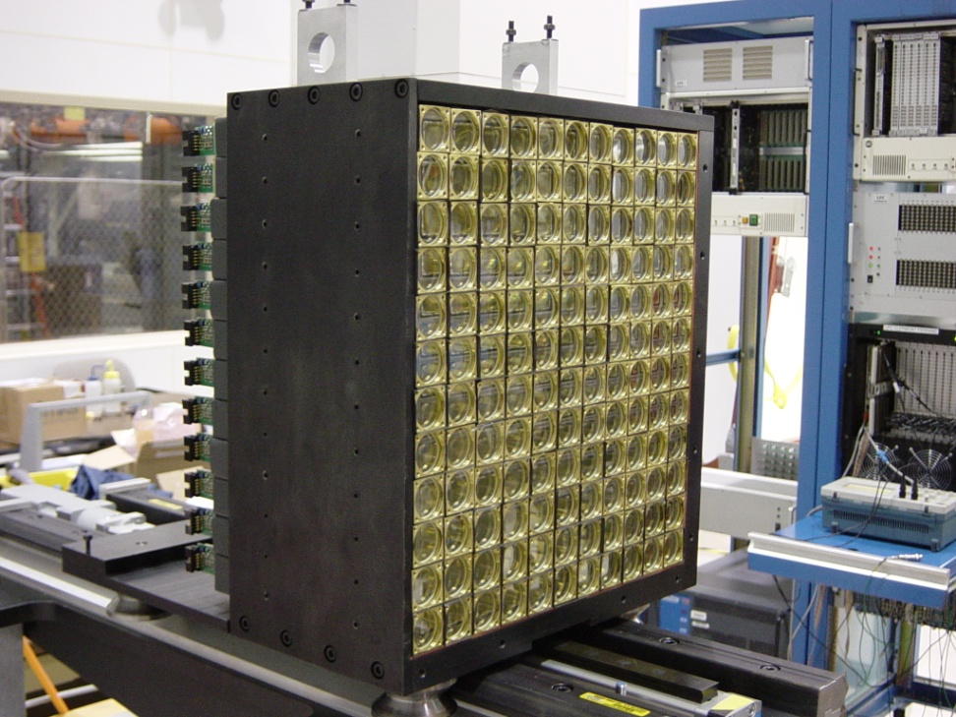
DVCS experiment in Hall A (2005)
11x12 = 132 blocks
3cmx3cmx18.6cm
110 cm from the target
1msr per block
Lead fluoride
  Pure Cerenkov : not sensitive to charged hadronic background
  density 7.77 g.cm³
  X₀=0.93 cm length=20X₀
  Molière radius = 2.2 cm
  Good radiation hardness
  1 Photoelectron per MeV,
  Energy resolution 4 .2GeV :
  2.4 %
  Position resolution:
  2 mm
PMT R7700 Hamamatsu
  8 stages
  Gain : 10⁴
  Rise time 2 ns
  FWHM 6 ns
Notes:
Le calorimetre
Nous avons construit un calorimetre electromagnetique pour cette experience.
Il est constitue d’une matrice de 11x12 blocs de fluorure de plomb.
Le fluorure de plomb a les proprietes physique suivantes :
Densite 7.7g.cm-3
Rayon de moliere 2.2 cm
X0= 0.93cm La longueur des blocs a ete choisie a 20 longueur de radiations
Radiation hard
Pure Cerenkov : pulse plus court, elimine une partie du bruit de basse energie.
Les blocs sont associes a des PMT Hamamatsu R7700 8 etages gain nominal 104
Pulse de 1 GeV

Slide 9
Experimental setup
High luminosity running possible by
reducing secondary background source with an increased exit beam pipe
15 cm
Liquid H₂
target
5 cm
110 cm
beam dump
PbF₂
Scattering chamber 1 cm Al as shielding

Slide 10
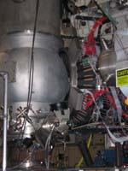
DVCS in Hall A
2005 setup
Scintillator proton array
Calorimeter

Slide 11
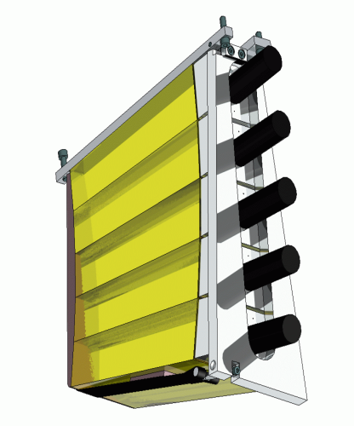
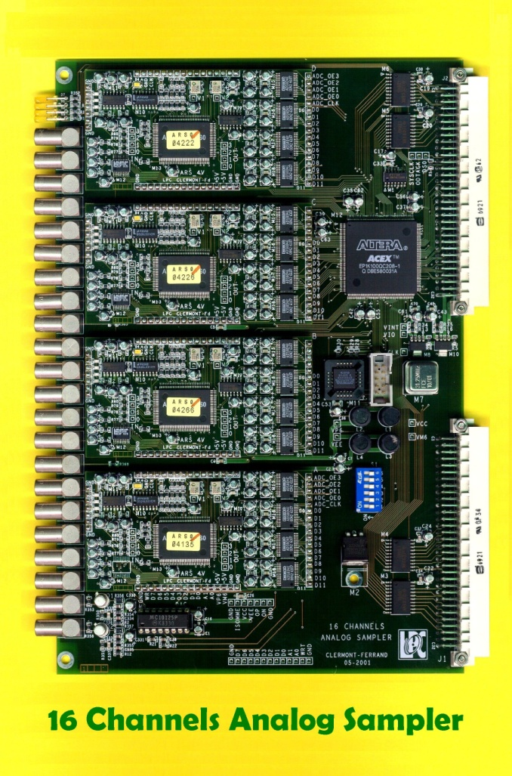
PMT detector signal
Sampling system
  1GHz Analog Memory sampling system
Proton
Array
Proton array signal
128 samples
289 channels
1 sample of 1ns coded on 12 bits
PbF₂
Equivalent to one digital oscilloscope put on each detector channel

Slide 12
Pile up events
Resolve pile up at
5 ns level
20% of events with pile-up
Timing resolution
0.6 ns
Singles rate in one block up to 1 MHz
Notes:
voila le resultat du de l’ajustement pour deux pulses.

Slide 13
From first DVCS experiment
Luminosity
    was limited by proton array
    DC current from low energy background draws current
2010 experiment
  Calorimeter only
  Limited by pile up and DC current
  Calorimeter crystal radiation damage

Slide 14
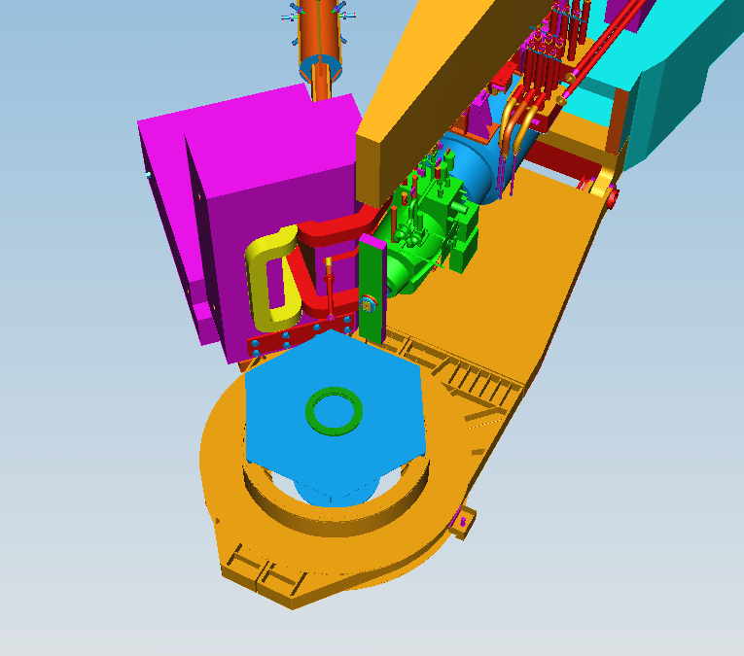
Double DVCS with SuperBigBite

Slide 15
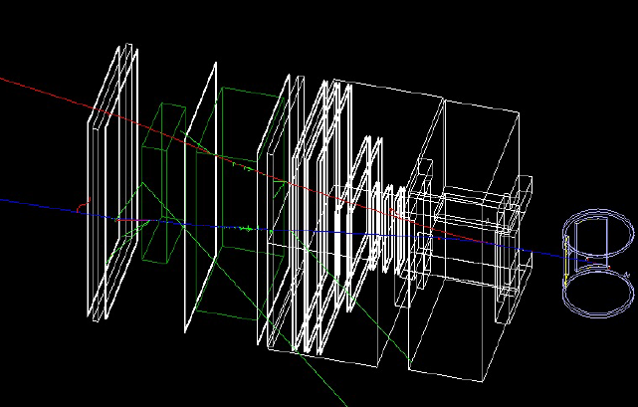
Double DVCS with SuperBigBite
LAC
Big Cal
SRC lead wall
2D Micromegas
HCAL
GEMs

Slide 16
Double DVCS with SuperBigBite
Trigger on dimuons events which go through all the detector
Can add a lot of absorber in front of the calorimeter
Need to have good resolution on moment
  Minimum shielding for the trackers
  Trackers limiting factor , currently plan to use GEM (timing resolution about 1ns, rate up to 10 KHz / cm² )

Slide 17
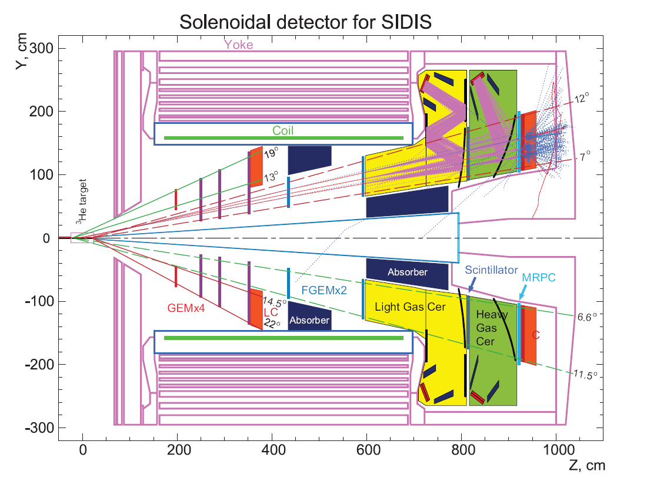
SoLID DDVCS layout
Scintillator +
trackers
Muon ID and trigger

Slide 18
Detector aging
Most detector based on ionization ( GEM, PMTs, silicon detector ) and charge multiplication have aging
    Photocathode damage
    Surface contamination reduces multiplication
Radiation damage
  Semiconductor junction can be damaged by radiation

Slide 19
Improvement needed for detector
Shorter pulse : fastest PMT ~ 10 ns
( MCP PMT : 1 ns but expensive )
Good timing resolution (reduce pile-up and improve particle identification )
  PMTs and scintillator : 100 ps
  MRPC : 80 to 50 ps
  Silicon strip : few ns
Radiation hardness
Long lifetime
Costs ( silicon detector are expensive )
Operation at cryogenic temperatures for close to target measurement

Slide 20
Superconductor
When cooled down under critical Temperature Tc, electron tend to pair and can . Current can flow without seeing resistivity ( no joule effect )
Critical current : maximum current that can be carried by the superconductor. Transition to conductor above current (Magnet quench )
Temperatures from 4 K to 70 K
Typically used at Jefferson Laboratory
  Superconducting RF cavities
  Superconducting magnets
  Superconducting electronics ( superconducting processor )
  Superconducting detectors

Slide 21
Superconducting detectors
Transition Edge Sensor
  Place at Tc and measure variation of resistivity
  Very good energy resolution
Superconducting Quantum Interference Device : loop with two Josephson Junction, act as magnetometer

Slide 22
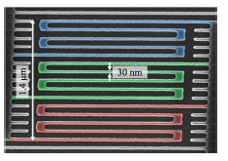
Single Superconducting Nanowire Photon Detectors (SNSPD)
Thin superconducting stripe of 5 to 10 nm thickness
Meander geometry to maximize surface, typical width of strip 10 nm and length about 100 nm
Signal speed depends on material, substrate and geometry
Mostly developed for astrophysics with IR sensitivity : Nasa Jet Propulsion Laboratory, Lincoln Laboratory ….

Slide 23
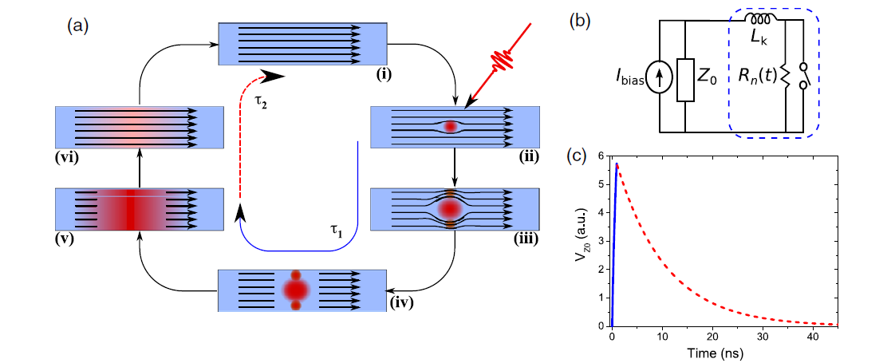
Single Superconducting Nanowire Photon Detectors (SNSPD)
Review : Chandra M Natarajan et al 2012 Supercond. Sci. Technol. 25 063001 doi:10.1088/0953-2048/25/6/063001

Slide 24
Nice features of SNSPD
Fast
Not based on ionization
Sensitivity can be tuned be varying thickness and width of the strip ( X-ray sensitivity to IR )
Very good timing resolution

Slide 25
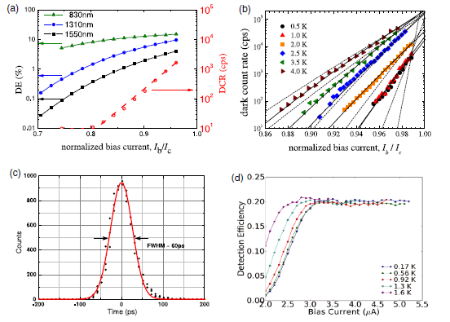
SNSPD typical properties

Slide 26
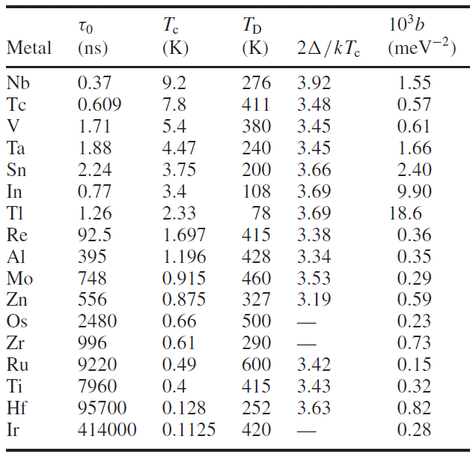
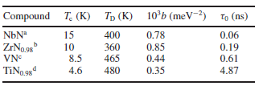
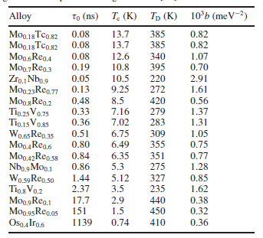

Superconductors properties
L Parlato et al 2005 Supercond. Sci. Technol. 18 1244 doi:10.1088/0953-2048/18/9/018

Slide 27
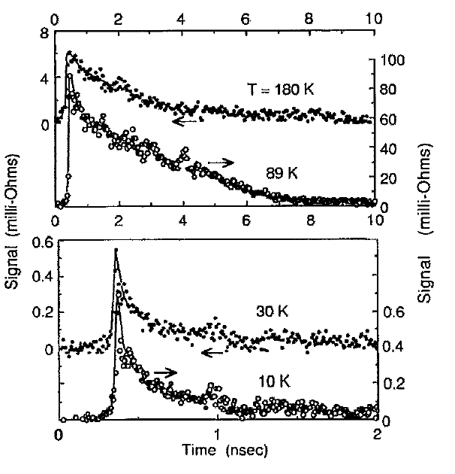
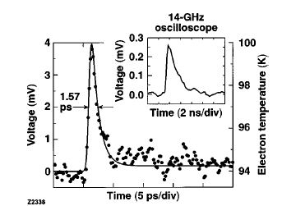
YBaCuO
Nonbolometric photoresponse of YBa2Cu3O7 films
Mark Johnson
Citation: Applied Physics Letters 59, 1371 (1991); doi: 10.1063/1.105312
Intrinsic picosecond response times of Y–Ba–Cu–O superconducting photodetectors
M. Lindgren, M. Currie, C. Williams, T. Y. Hsiang, P. M. Fauchet, Roman Sobolewski, S. H. Moffat, R. A. Hughes
, J. S. Preston, and F. A. Hegmann
Applied Physics Letters 74, 853 (1999); doi: 10.1063/1.123388

Slide 28
YBaCuO
High-Speed Y–Ba–Cu–O Direct Detection System for Monitoring Picosecond THz Pulses
Reached 30 ps timing resolution with YBaCuO limited by readout electronics

Slide 29
Fabrication process
Similar to microelectronics
  Metal deposition
  Lithography
  Etching

Slide 30
Metal deposition
Sputtering process
Process being developed at Jefferson Laboratory
( Superconducting Radio Frequency group ) Anne-Marie Valente Feliciano

Slide 31
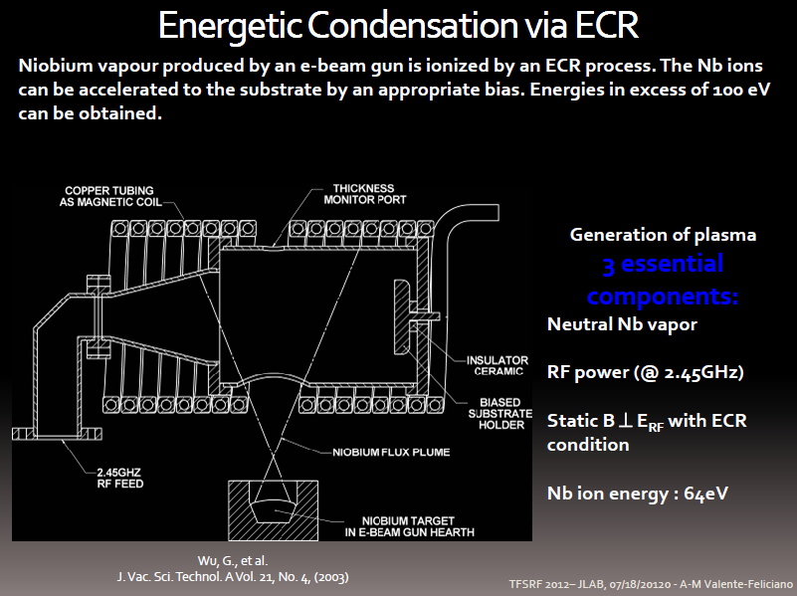

Slide 32
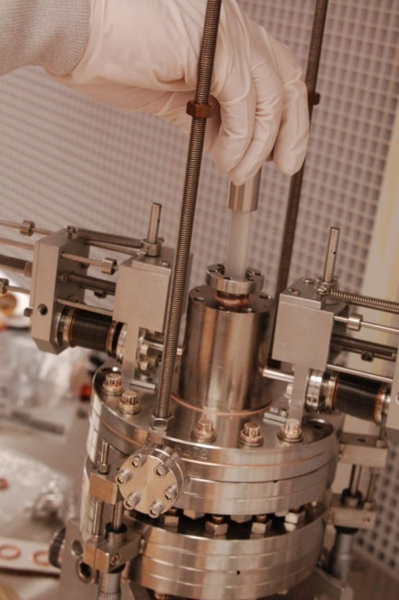
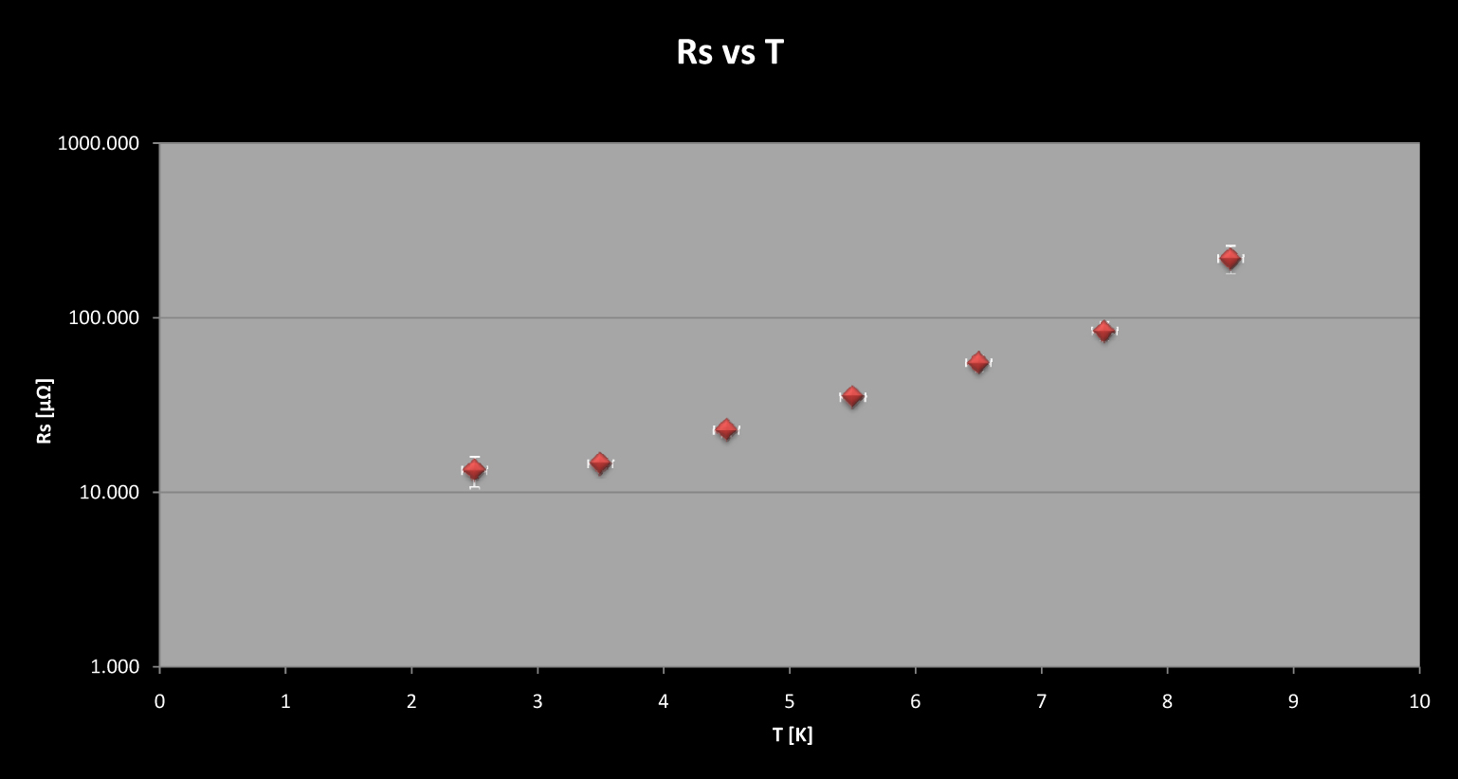
Connecting Structure & Performance for SRF Surfaces
Measurement with the SIC cavity
(TE₀₁₁ sapphire-loaded cylindrical Nb cavity) Surface impedance as a function of magnetic field and temperature from 1.9 K to 4.8 K.
Normal state surface impedance at 10 K, from which the surface value of electronic mean free path and surface H_{c1} can be determined.
Superconducting penetration depth, λ, at low field will be measured by carefully tracking the cavity frequency with temperature as the sample temperature is swept slowly back and forth across the transition temperature (SIC sensitivity: 30 Hz/nm) while the rest of the cavity is held at 2 K.
MATERIAL PROPERTIES
Tc – easy coarse measure of intragrain quality of the film
RRR – convenient assessment of aggregate defect density

Slide 33
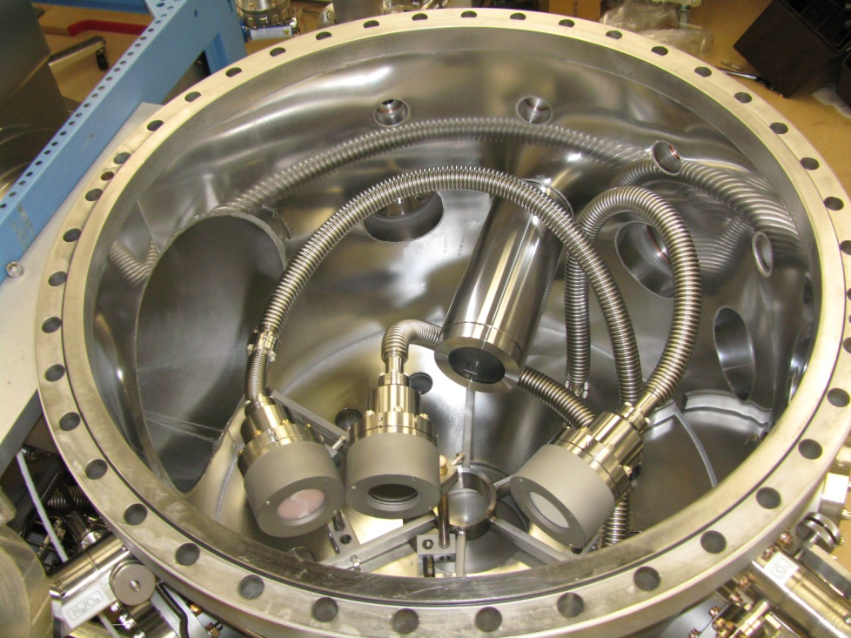
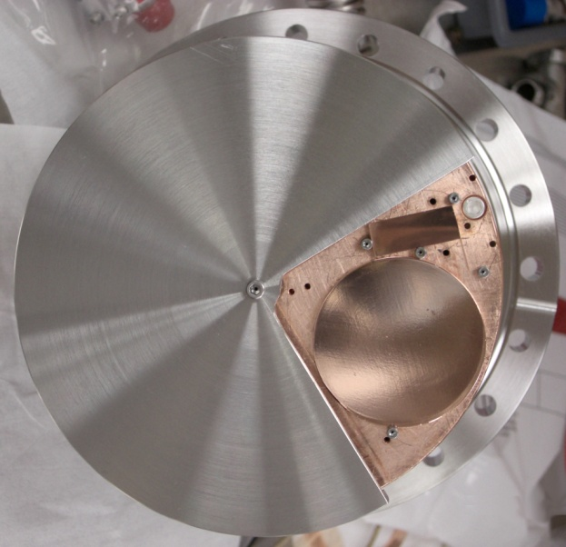
New UHV Multi-technique deposition system under commissioning @ JLab
A unique, versatile thin film deposition system
enabling multiple coating techniques in-situ
Designed to enable rapid exploration of the production parameter space of:
              Nb films
              Alternative material films like NbN, NbTiN
              S-I-S multilayer structures based on these compounds
NbTiN, NbN, Mo₃Re, V₃Si coatings
with Reactive Sputtering and
High Power Pulse Magnetron Sputtering in self-sputtering mode
& MgO coating with RF sputtering

Slide 34
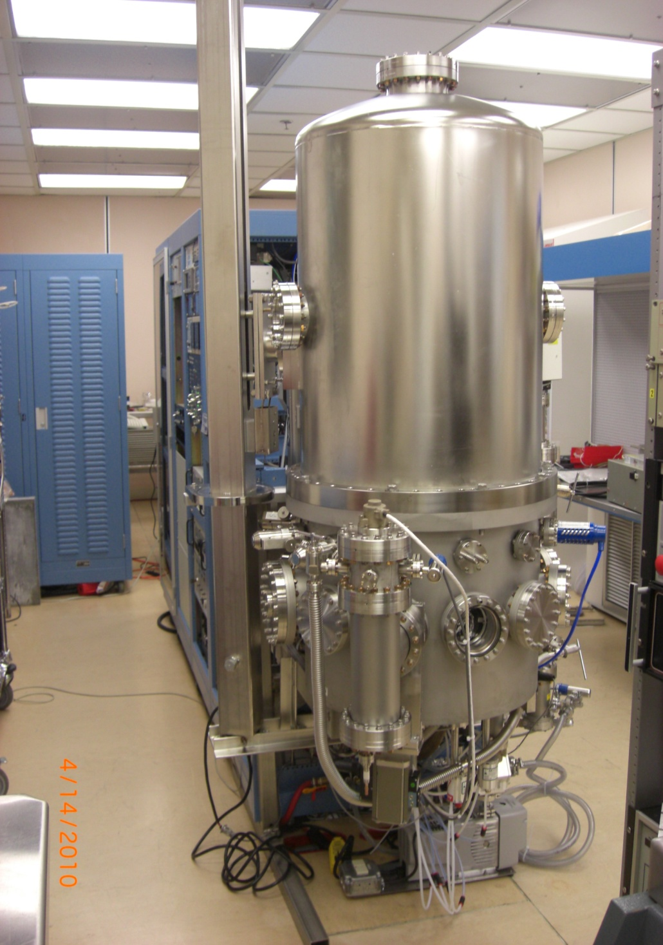
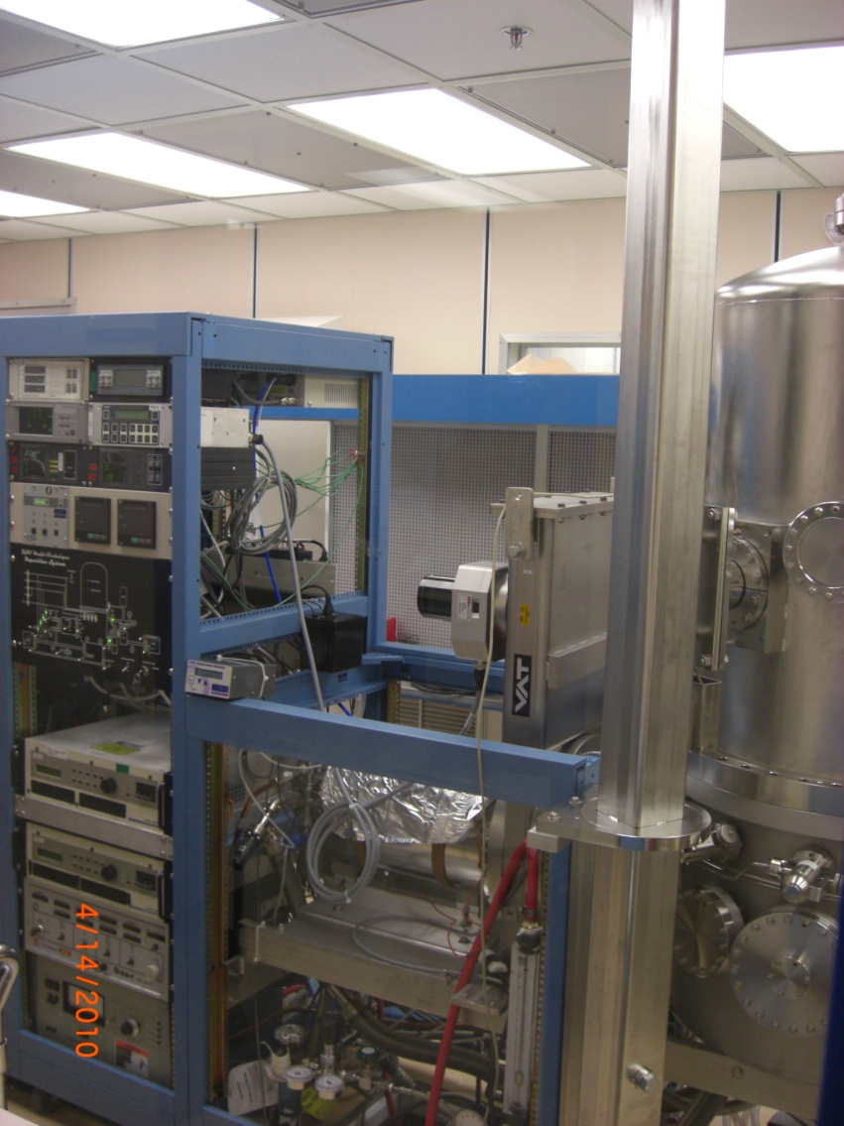
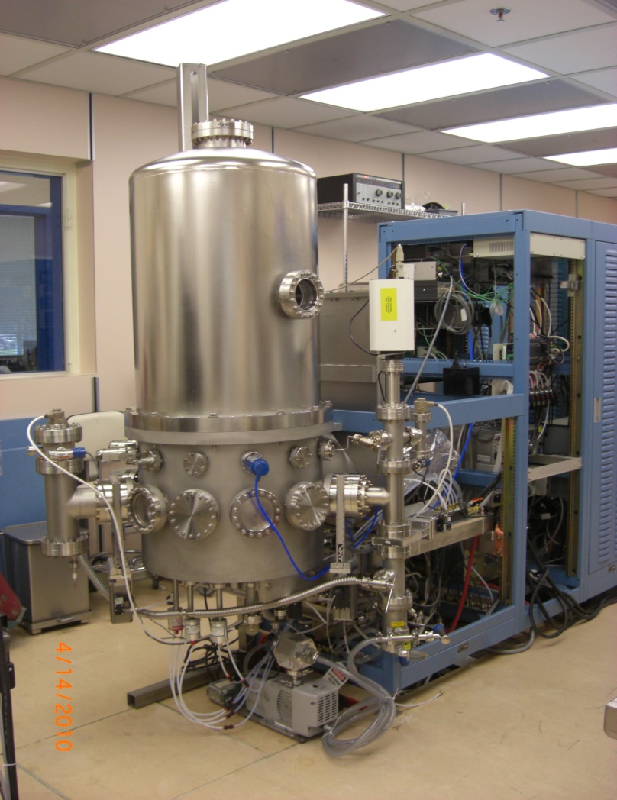
Superconducting Thin Films
Base pressure without baking
2x10⁻⁹Torr
UV desorption system
NEG chamber
3 magnetrons (DC, RF)
Self-sputtered magnetron
Ion source
RGA chamber with differential pumping
Thickness monitors
Substrates

Slide 35
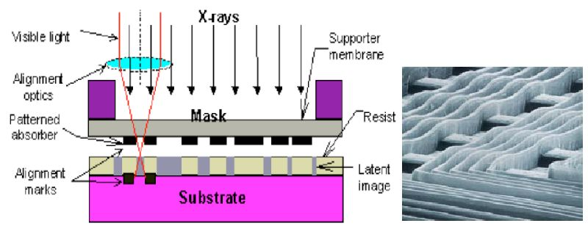
Lithography techniques
X-ray lithography
X-ray diffraction lithography
Visible / UV optical lithography
Electron beam lithography

Slide 36
Possible X ray sources at JLAB
1keV X-rays
1.5 GeV electrons
FEL
Accelerator ARC magnets
Synchrotron Light Source facilities ( SNLS at BNL )

Slide 37
Superconducting electronics
Detector are fast, need fast electronics to take advantage
Detector will be in Helium bath, integrated superconducting electronics can reduce
Need to redevelop standard electronics tools
  Amplifier
  Discriminator
  Logic
  Analog to Digital Converter
  Time to Digital Converter

Slide 38
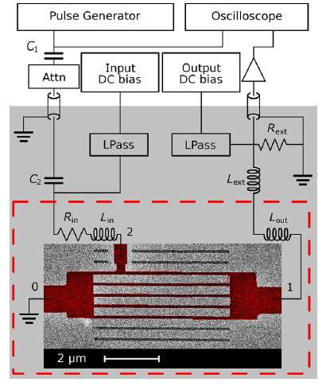
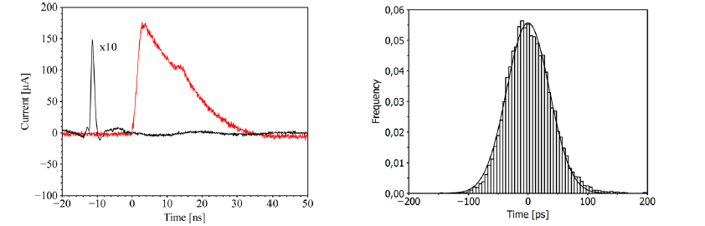
Discriminator
Characterization of superconducting pulse discriminators based on parallel NbN nanostriplines
M Ejrnaes et al 2011 Supercond. Sci. Technol. 24 035018 doi:10.1088/0953-2048/24/3/035018

Slide 39
Josephson junction
When current is sent on the superconductor loop interrupted by a non superconducting material or insulator it goes through the insulator by tunnel effect
An AC voltage appears when current is above critical current
Very accurate Voltage to Frequency converter

Slide 40
Rapid Flux Single Quantum electronics
In a superconducting loop, magnetic flux is quantized hence the current, those unit are used as based to RFSQ electronics
http://www.hypres.com
  Clock
  Dmitri E. Kirichenko and Igor V. Vernik, “High Quality On-Chip Long Annular Josephson Junction Clock Source for Digital Superconducting Electronics,” IEEE Trans. Appl. Supercond., 15, 296-299, June 2005
  ADC
  O. A. Mukhanov, V. K. Semenov, I. V. Vernik, A. M. Kadin, D. Gupta, D. K. Brock, I. Rochwarger, T. V. Filippov, and Y. A. Polyakov, “High resolution ADC operating up to 19.6 GHz clock frequency,” Supercond. Sci. Technolol. 14, 1065-1070, 2001.
  TDCs
    A. F. Kirichenko, S. Sarwana, O. A. Mukhanov, I. V. Vernik, Y. Zhang, J. H. Kang, and J. M. Vogt, “RSFQ Time Digitizing System,” IEEE Trans. Appl. Supercond., vol. 11, no. 1, pp. 978-981, Mar. 2001.

Slide 41
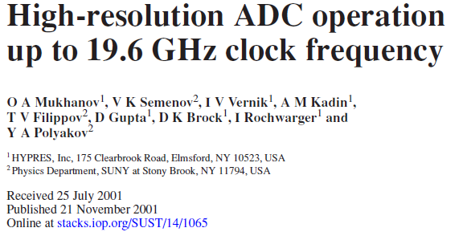
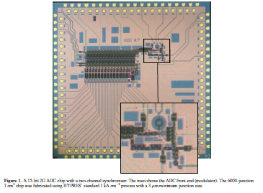
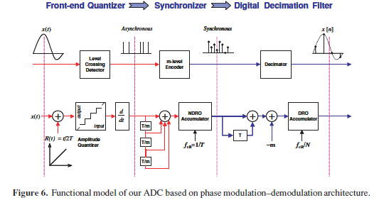
Analog to Digital Converter

Slide 42
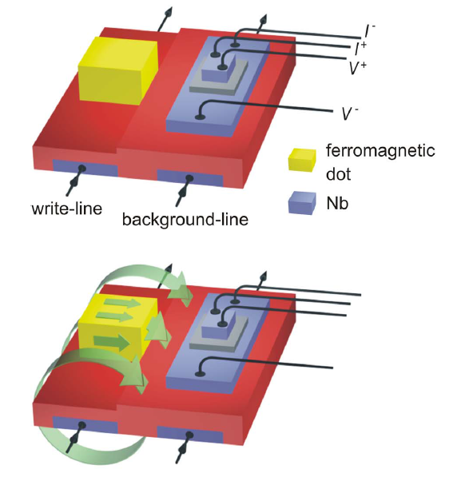
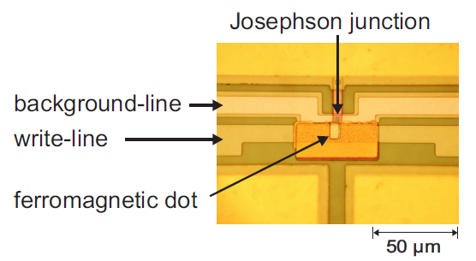
Ferromagnetic superconducting memory
New Memory Concept for Superconducting Electronics ( R. Held )

Slide 43
Detectors application
Cerenkov based detectors : RICH and time of flight
PMT replacement
Scintillator based detectors
Minimum ionizing particle tracker
Liquid Helium detector

Slide 44
RICH and time of flight
Proximity focusing RICH
Usually based on CsI photocathodes
Usually 10 ns timing resolution with current ASICs
Low rate capability

Slide 45
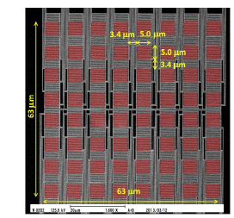
Photocounting sensor
Similar to silicon PMT
Very dense array of single photo sensor : number of photons simply equal to number of cells firing
Multipixel SNSPD
  8 x8 produced
Ideally 256x256 with digital readout electronics
64-pixel NbTiN superconducting nanowire single-photon detector array for spatially resolved photon detection
Shigehito Miki,1,* Taro Yamashita,1 Zhen Wang,1,2 and Hirotaka Terai1

Slide 46
Liquid Helium detector
Helium has very fast UV scintillation and slower component
Liquid helium flow
Ionization and scintillation
SNSPD array

Slide 47
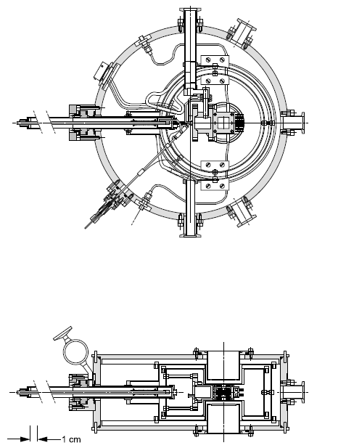
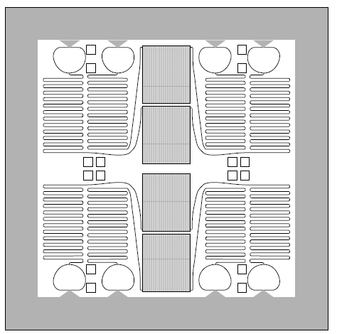
Superconducting strip detector
Superconducting NbN Microstrip Detectors (1999 ) RD 39 Collaboration R. Wedenig and T.O. Niinikoski CERN et al
Could see charged alpha
But could not detect minimum ionizing particle at that time because of electronics sensitivity

Slide 48
Recoil detector for coherent DVCS
D + γ∗
He4 + γ∗ -> He4 + γ
D + γ
Cryotarget cell
e-
e-
Recoil deuterium or He4

Slide 49
R&D
Production of large detectors
  X-ray diffraction lithography for producing large amount
Test of substrates to reduce reset time : sapphire, graphene, kapton…
Effect of magnetic field
Gas and radiators working at cryogenic temperature
Optimize thicknesses for UV and charged particles
Test of superconductors properties
Integrated electronics
  Photodetector
  High resolution timing and sampling
  Data reduction

Slide 50
Conclusion
Superconducting detectors are a attractive for places where cryogenics is available
They are very fast and have very good timing resolution ( potentially picosecond level )
Could operate close from cryogenic target
Radiation tolerance and aging have to be studied but potentially better than ionization detector for metal superconductors
Jefferson Laboratory is a good place to do R&D on superconducting detectors
Could allow to take advantage of full luminosity available at Jefferson Laboratory

