Slide 1
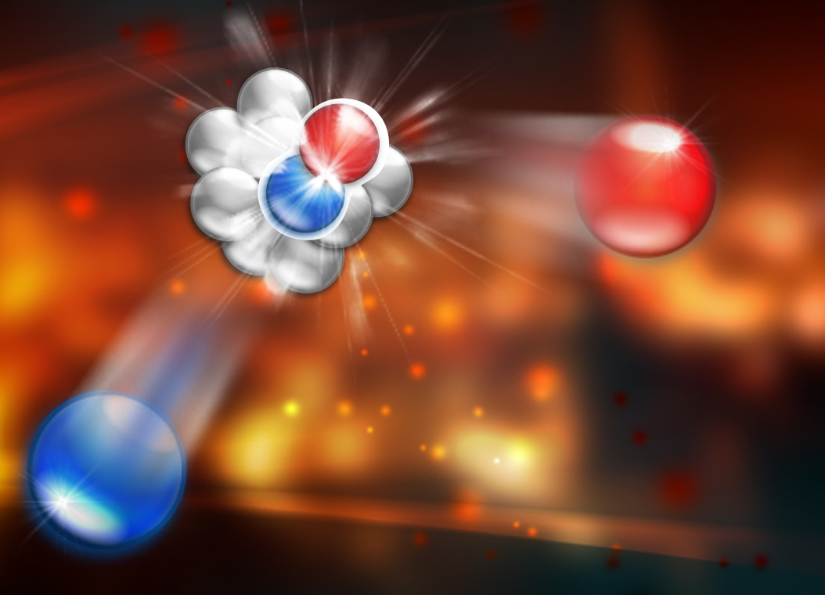
Life Cycle of a Nuclear Physics Experiment
by
Douglas W. Higinbotham

Slide 2
Life Cycle of Nuclear Physics Experiment
Idea (questions)
Proposal
Defense (only 1/3 of proposals past this point)
Jeopardy after 3 years (i.e. defend again)
Funding (no money, no experiment)
Construction
Readiness Reviews
Running
Analysis (generates Ph.D.’s in nuclear physics)
Publications (new questions)

Slide 3
Example

Slide 4
Idea for an experiment
Neutrino scientist want to use an Argon target to learn about neutrino via nucleon interactions
BUT experiment says the nucleus cannot just be treated as free nucleons.
Create an experiment to better understand Argon so that we can correctly extract information about neutrino-nucleon interactions!
IDEA DEVELOPED OVER TIME

Slide 5
But why cannot we just treat nucleons in the nucleus as free?!
The nucleons in the nucleus are just held together by MeV forces with masses of GeV, so cannot be all that important . . .

Slide 6
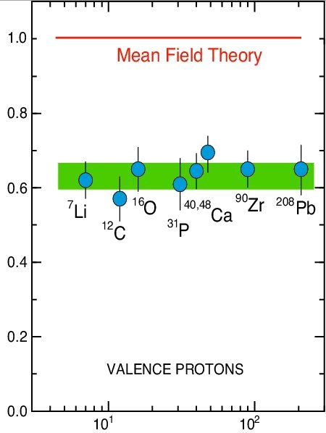
Measurement of nucleon knock-out
Independent-Particle Shell-Model
is based upon the assumption that
each nucleon moves independently
in an average potential (mean field)
induced by the surrounding nucleons
SPECTROSCOPIC STRENGTH
Data shows that mean field alone isn’t good enough for doing precise measurements!
Target Mass

Slide 7
Deep Inelastic EMC Effect
J. Seely et al., Phys, Rev. Lett. 103 (2009) 202301.

Slide 8
Modern Neutrino Example
Correlations Effecting The Result of Neutrino Scattering Data

Slide 9
How do you do the experiment?

Slide 10
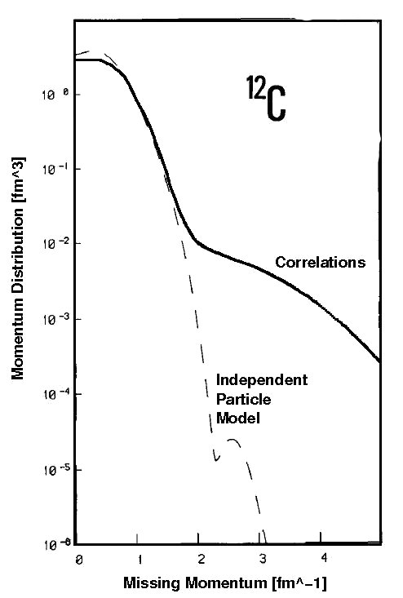
Realistic Momentum Distribution
Benhar et al., Phys. Lett. B 177 (1986) 135.

Slide 11
Momentum Distributions
C. Ciofi degli Att and S. Simula, Phys. Rev. C 53 (1996) 1689.
At high initial momentums n_{A}(p) = N * n_{D}(p)

Slide 12
Quasi-Elastic Electron Scattering
p
scattering plane
e'
θ_{pq}
reaction plane
e
(ω,q)
p_{A–1}
φ_{x}
“out-of-plane” angle
Energy transfer: ω = e – e’
Four-momentum transfer: Q² ≡ – q_{μ}q ^{μ} = q² –ω ²
Missing momentum: p_{m} = q – p = p_{A–1}

Slide 13
Where to do the experiment?

Slide 14
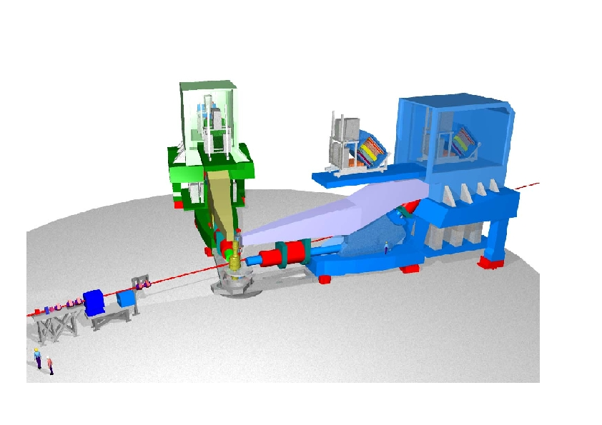
Jefferson Lab's Hall A

Slide 15
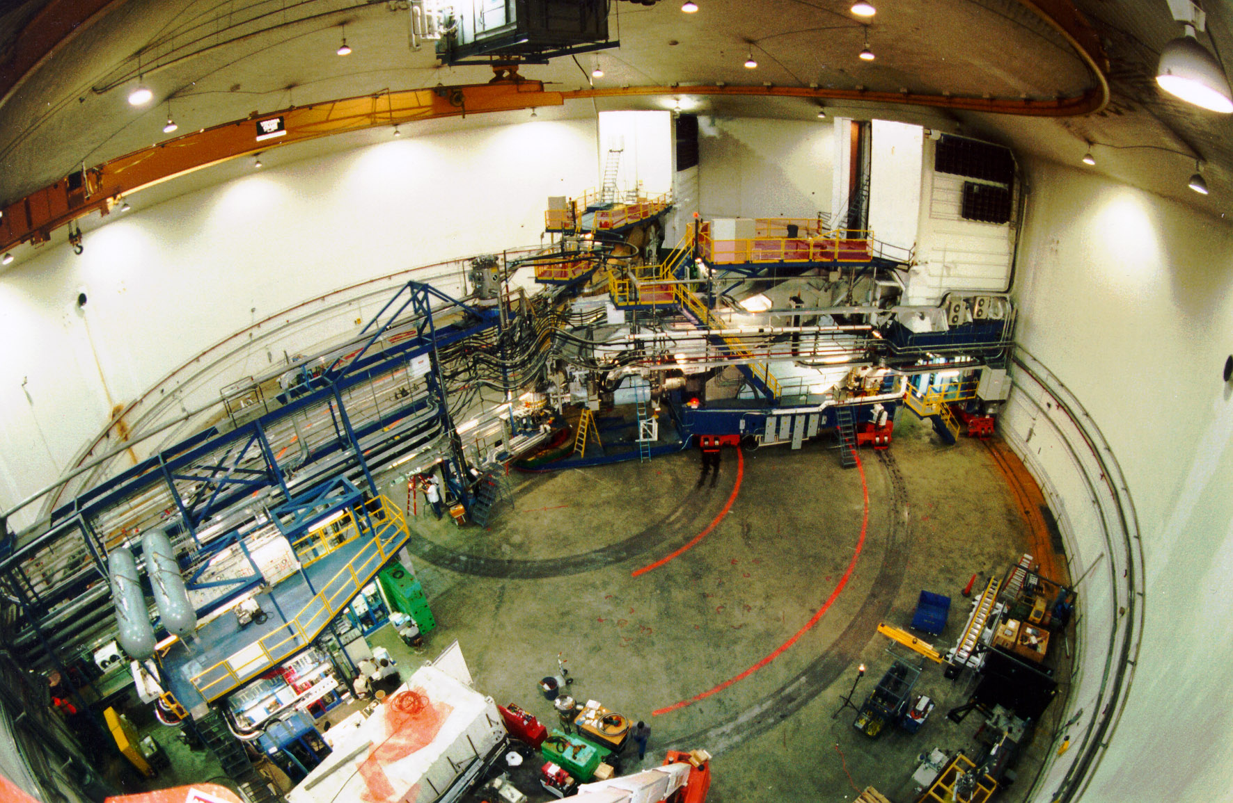
Jefferson Lab’s Hall A

Slide 16
Proposal and defense . . .
NEXT WEEK

Slide 17
Planning, Scheduling, & Running
If not approved at Jefferson Lab experiment would likely move to Mainz where it could be done but not as well.

Slide 18
Analysis, Analysis, Analysis
Two or Three Ph.D. Students
Two Years Of Work
Taking Information about passage of particles through matter.
Determining Physics Quantities at the Vertex.
Comparing with Theory

Slide 19
Publications
While explaining your work to others is the last step,
in many ways it is the most important!

Slide 20
2014 Example Review
Ar(e,e’p) Experiment (what)
Upcoming neutrino exp. will use Ar target
IDEA: We really should understand the nuclear physics of nucleons in Ar before using it as a effective nucleon target. (why)
Collaboration Formed (who)
Best Facility for doing the exp. Picked (where)
PAC Defense Next Week (to what extent)
If approved, start planning for experiment (when)
Run Experiment and Analyze Data (how)
Publish Results (to what effect)

Slide 21
And now time for hardest question you can ask some who does basic research.

Slide 22
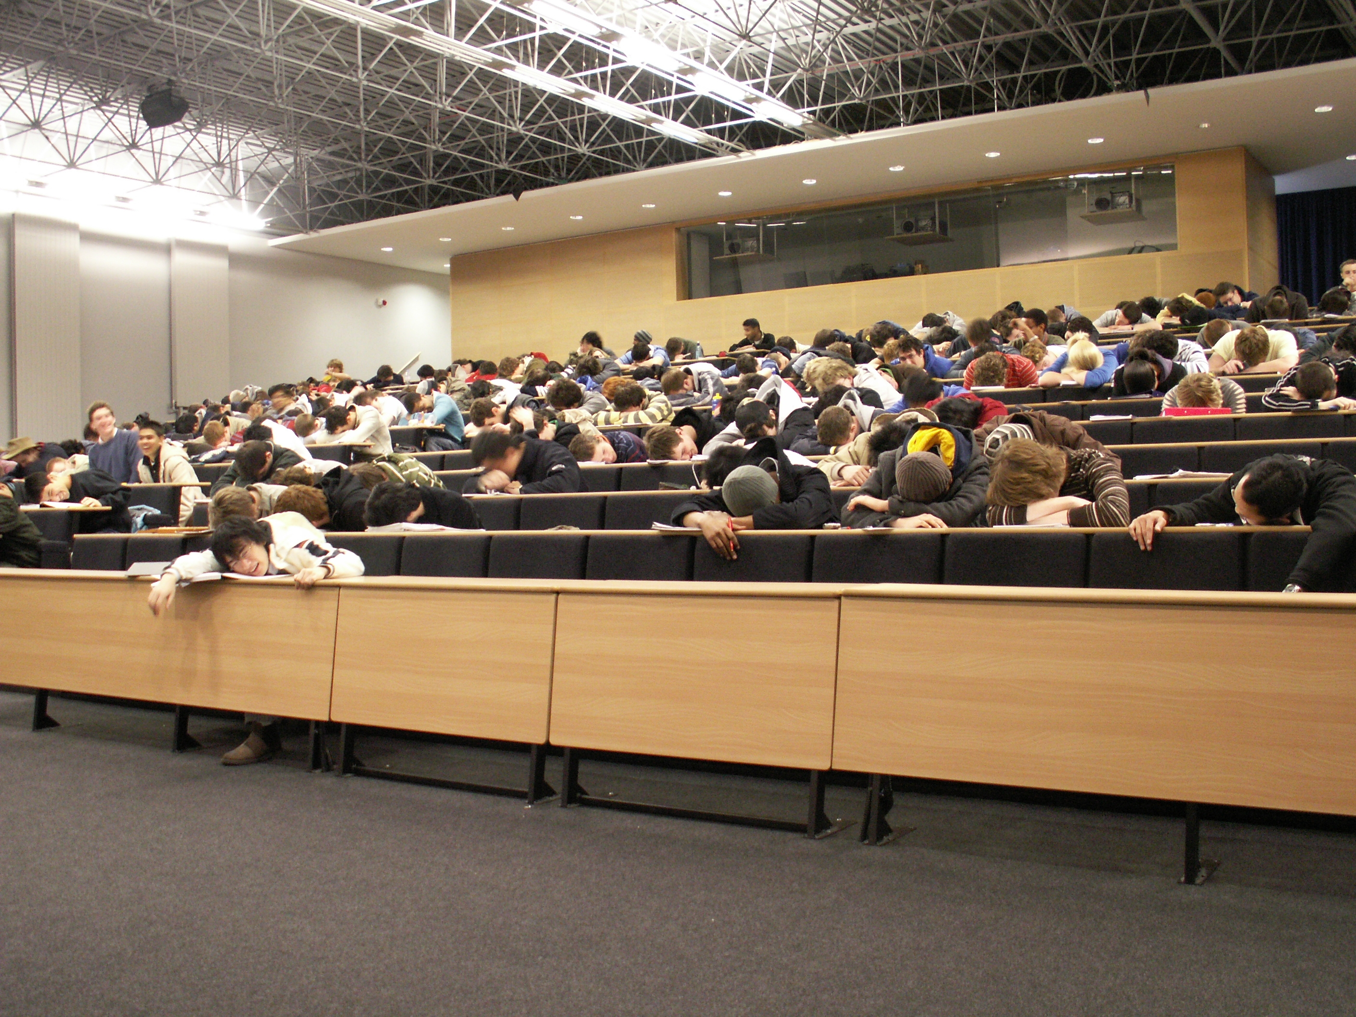
Who Cares?!

Slide 23
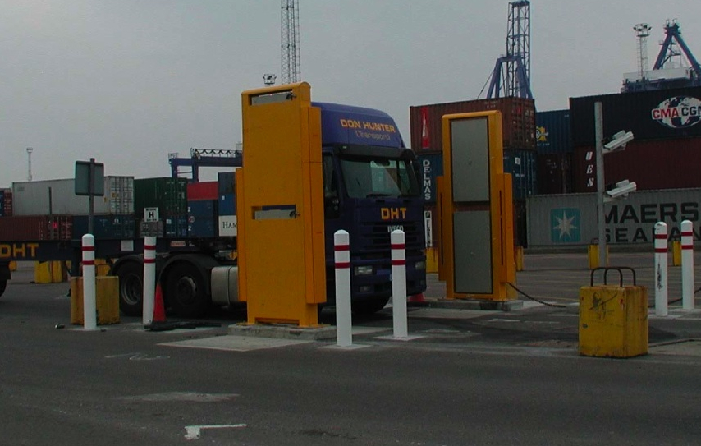
Kathy McCormick Cares
Homeland Security

Slide 24
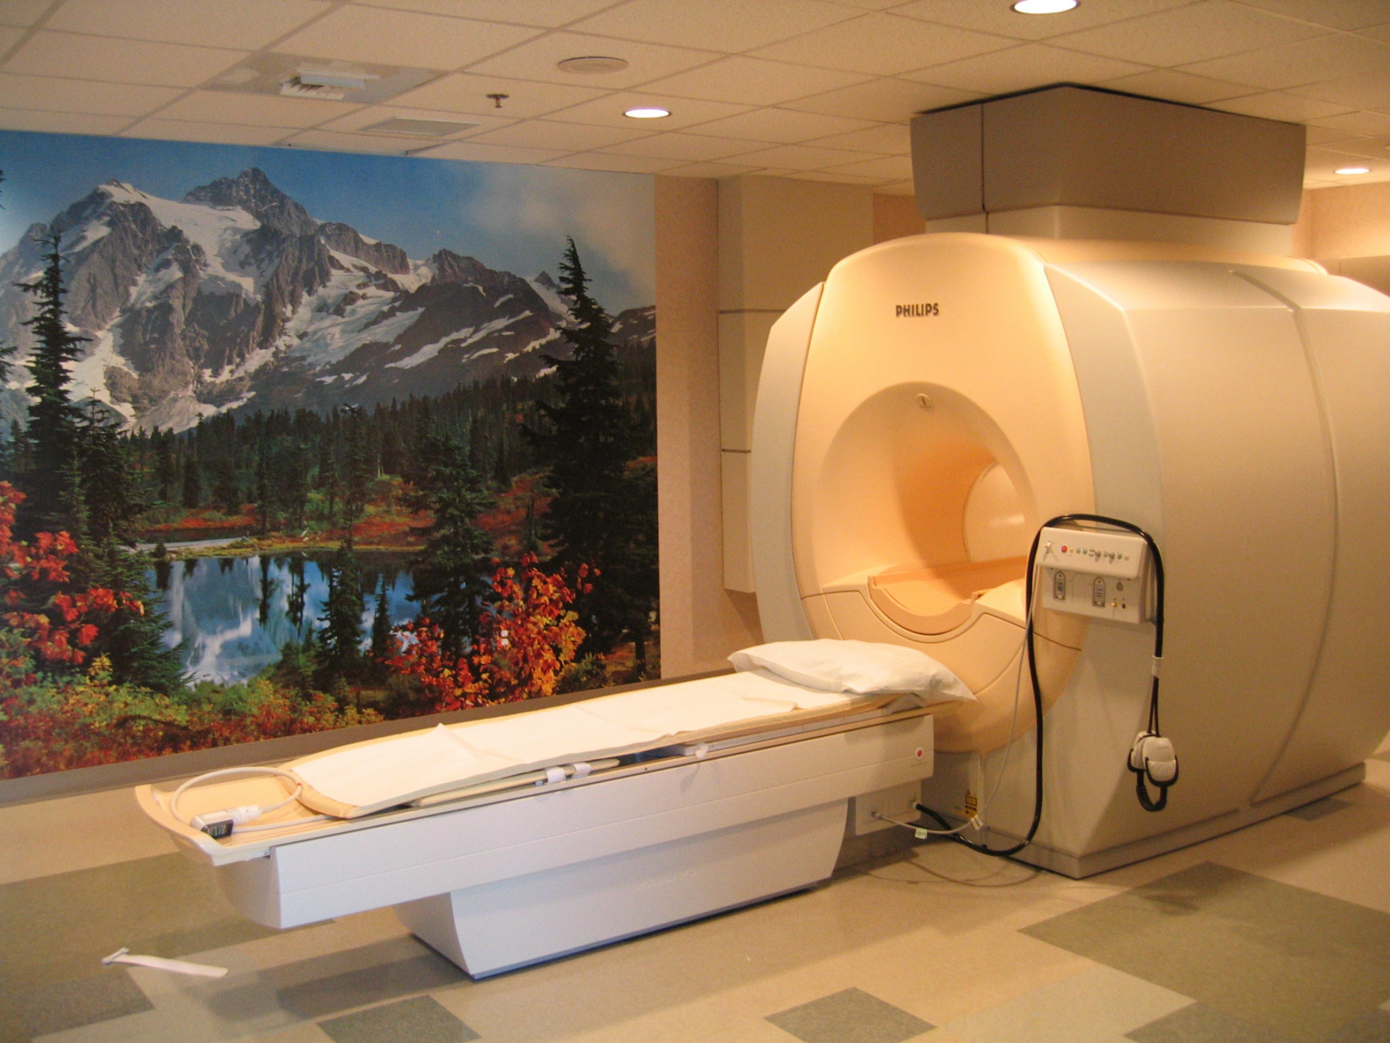
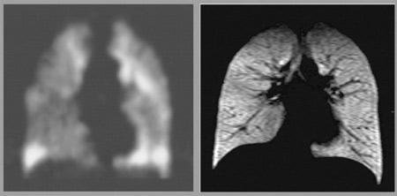
Gordon Cates cares
MRI Imaging The Lungs

Slide 25
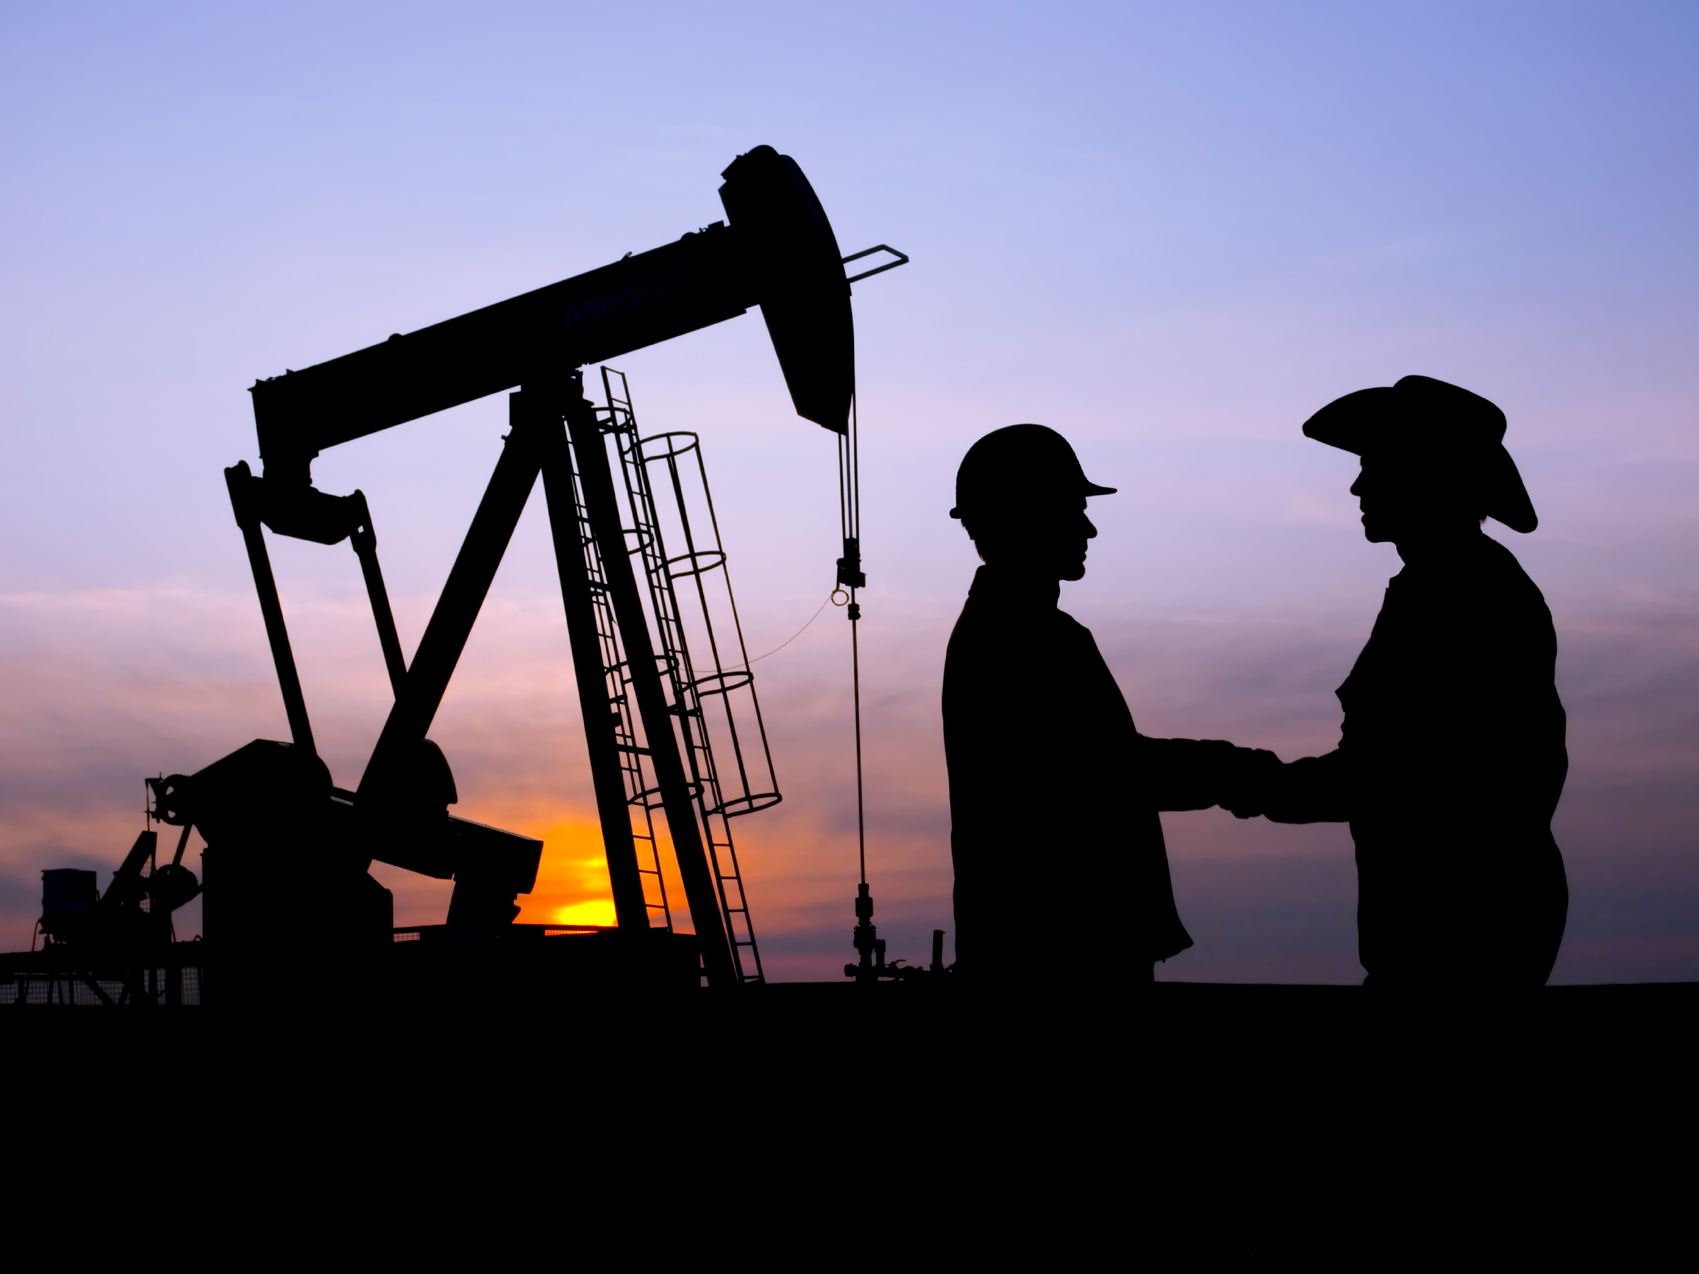
Tancredi Botto Cares
Schumburger Oil Exploration

Slide 26
Cynthia Keppel Cares
Hampton Proton Therapy

Slide 27
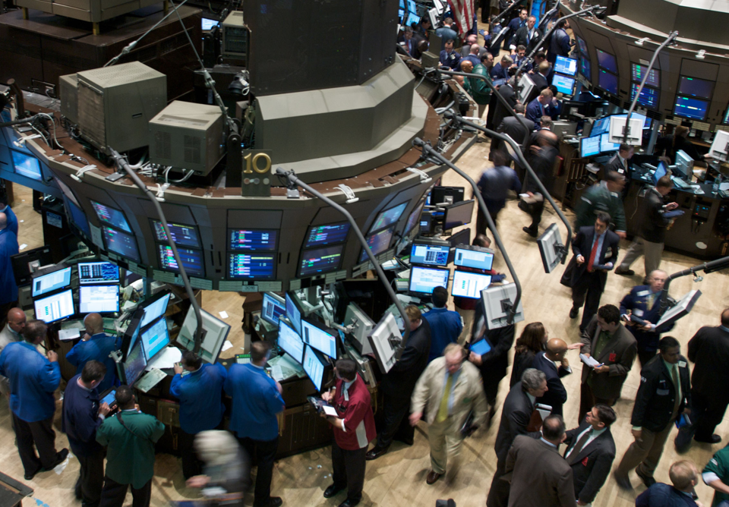
James Simons Cares 88th Richest Person In The World
Renaissance Technologies
Notes:
Renaissance Technologies,

Slide 28
Time to wake-up and ask questions!
- or at least try to find the Dutch soccer fan in the Hall A collaboration below -

