Slide 1
Continuous Electron Beam Accelerator Facility Overview
Michael Spata
Director
Center for The Advanced Studies of Accelerators
Summer Lecture Series 6/16/15

Slide 2
Outline
Introduction
Jefferson Lab Overview
Scope of the 12 GeV Upgrade
Accelerator Overview
Beamline overview
Extraction System
Hardware Subsystems
Diagnostics and Tuning Techniques
High Level Applications Software
SRF Cryomodule Operations
Beam Requirements
Commissioning Progress and Future Plans

Slide 3
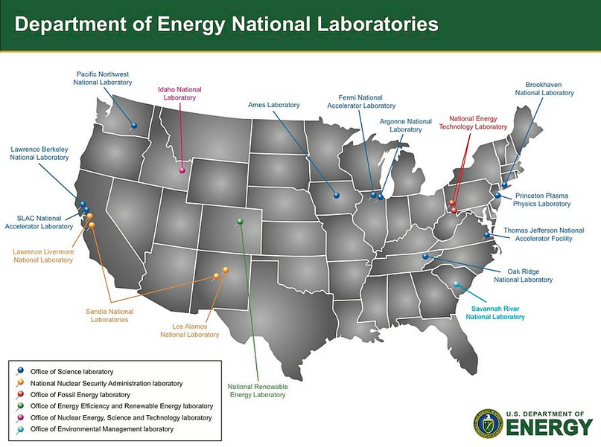
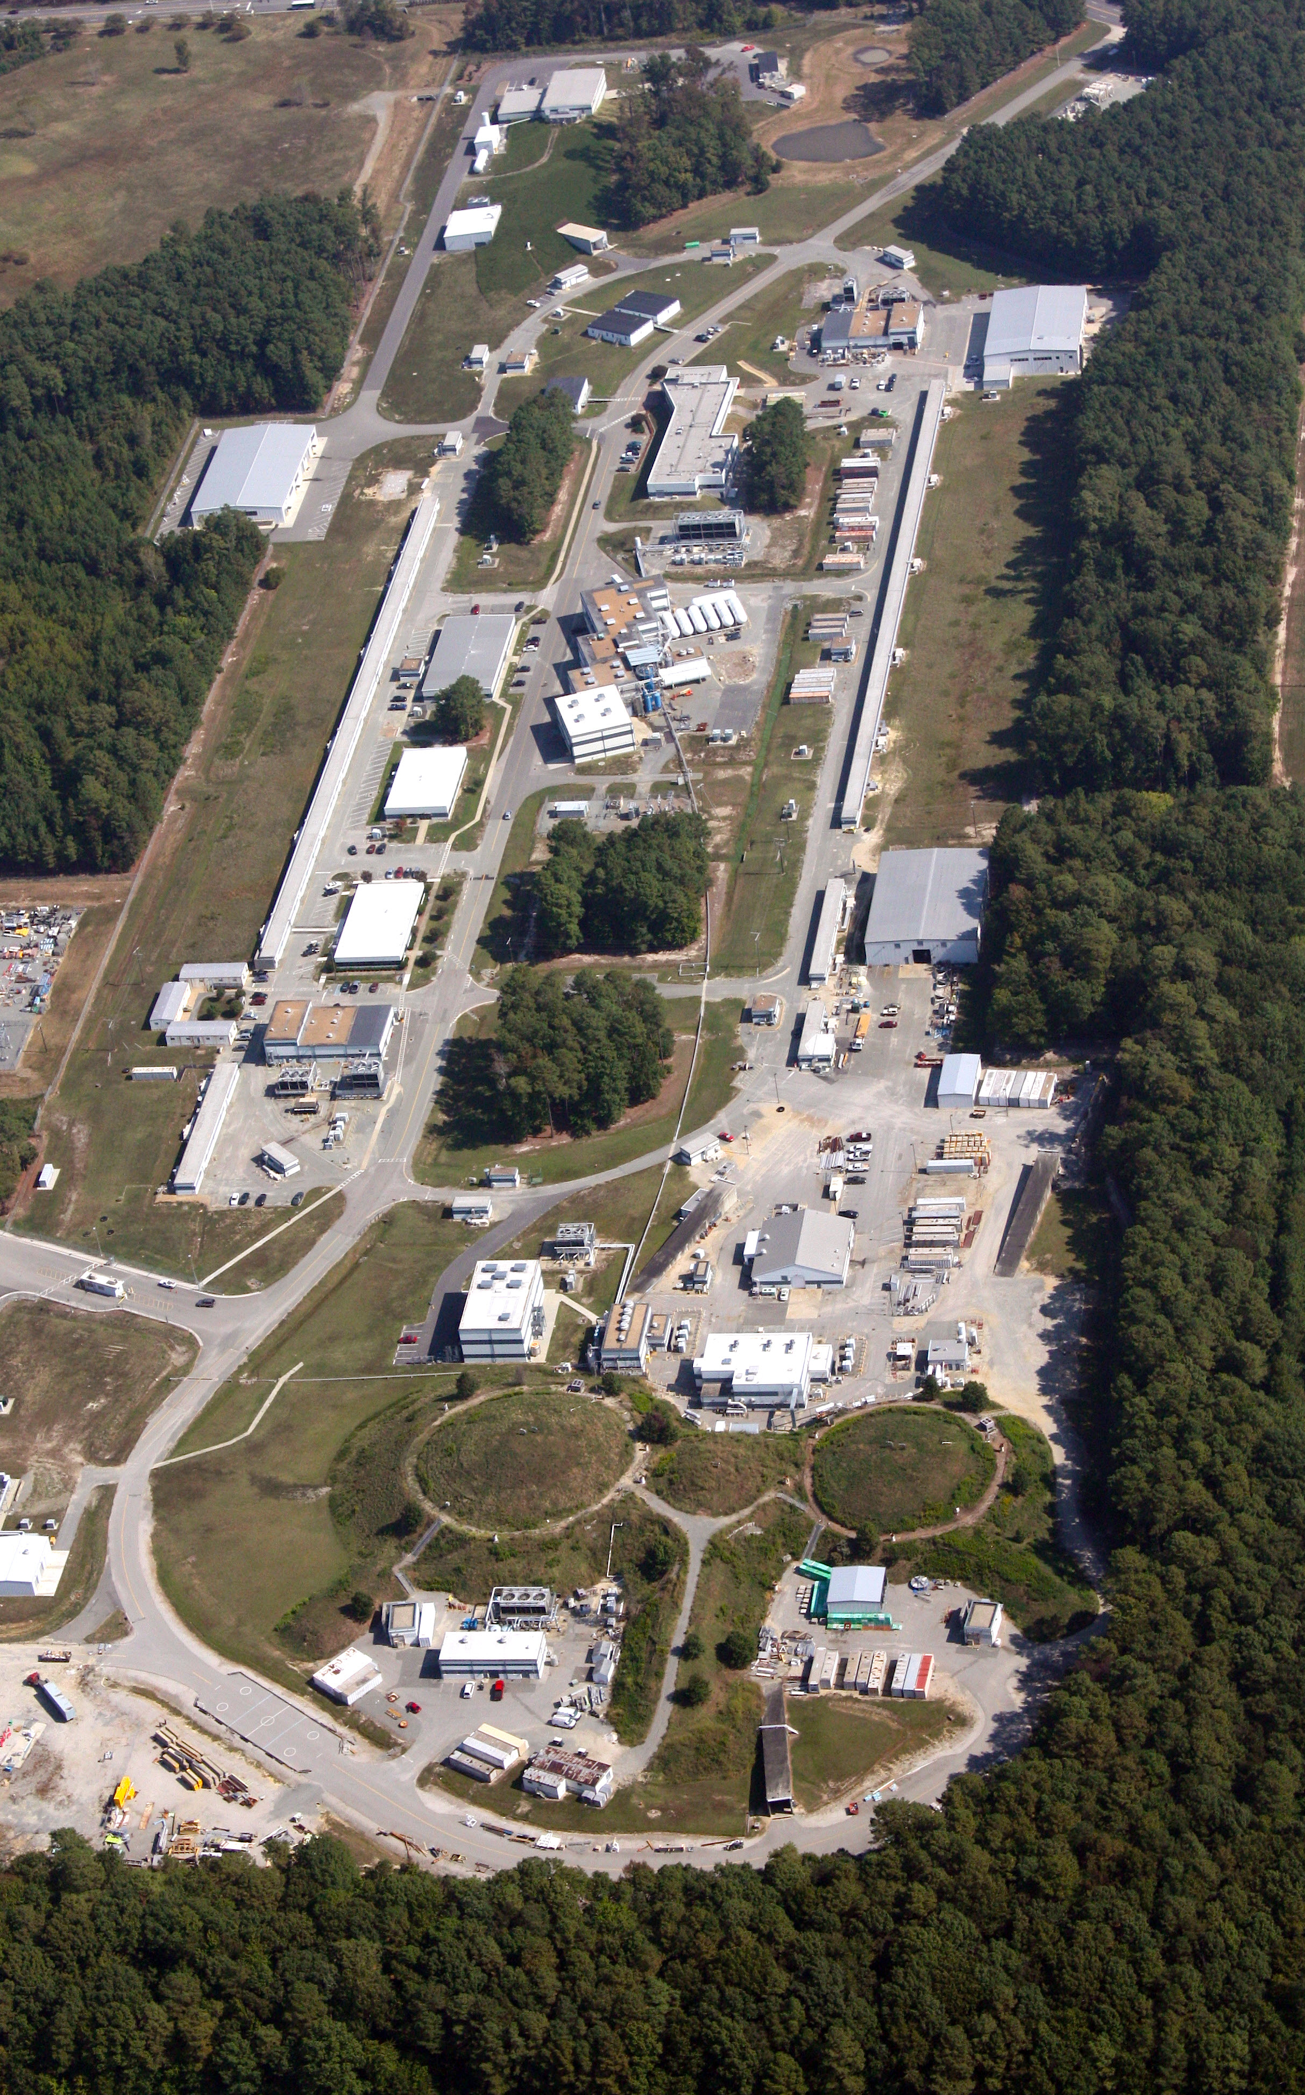
Jefferson Lab Overview
Core Competencies
Nuclear Physics Research
SRF Technology Leadership
Polarized Electron Sources
Cryogenics Research and Development
Accelerator Physics and Diagnostics Development

Slide 4
Jefferson Lab Overview
Quick Facts
180 M$ annual operating budget
759 Full Time Employees
1,385 Active Users
Produces ~1/3 of US PhDs in Nuclear Physics
169 acres and 80 buildings and trailers

Slide 5
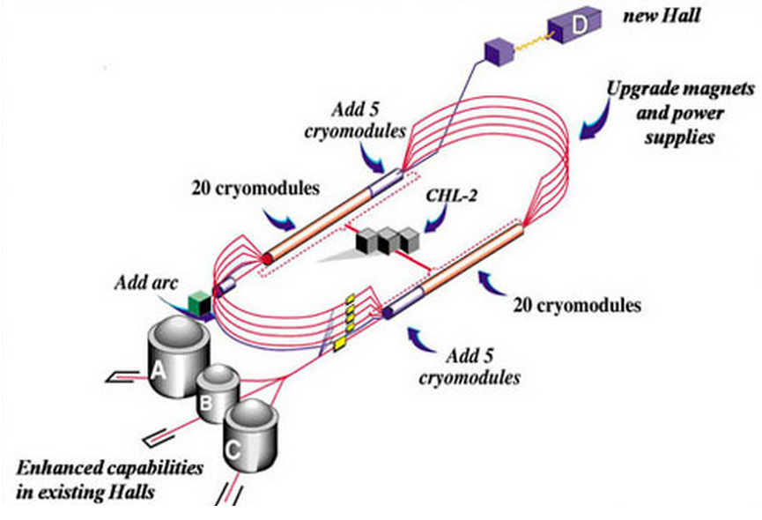
Scope of the 12 GeV Upgrade
Add 5 high performance cryomdules in each linac and their associated LLRF Systems
Double the capacity of the Central Helium Liquefier
Upgrade magnets and power supplies for recirculation arcs
Upgrade Extraction, Instrumentation and Diagnostics, and Safety Systems
Add new beamlines for Arc 10 and Hall D
Add new experimental Hall D and upgrade existing Halls

Slide 6
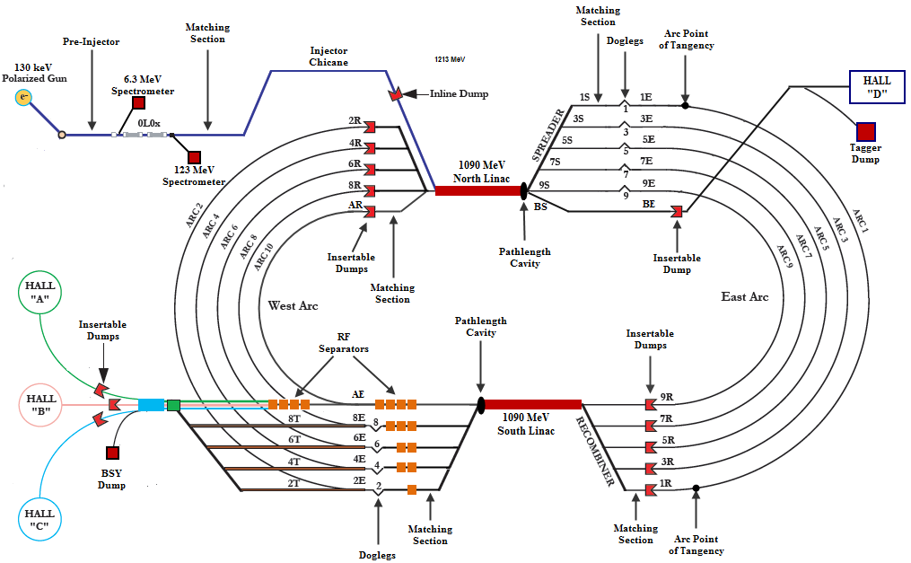
CEBAF Overview
12051MeV
2303 MeV
1213 MeV
4483 MeV
3393 MeV
6660 MeV
5573 MeV
8836 MeV
7747 MeV
11006 MeV
9922 MeV
11006 MeV

Slide 7
CEBAF Injector
~150 m
Source provides > 80% polarized electrons with variable bunch charge
Interleaved micro-bunch structure at 499 MHz or 249.5 MHz depending on physics program
Bunching cavities to control longitudinal size of beam
Faraday cups to measure beam current
Aperture A1 and A2 to collimate the beam and minimize transverse phase space extent
Chopper system to independently control beam intensity for each experiment
Capture RF system to transition to relativistic energy
18 SRF cavities accelerate beam to 123 MeV beam for injection into the North Linac
Spectrometers to measure energy of the electron beam

Slide 8
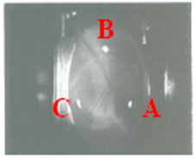
Chopping System
B
C
A
Beam
Beam
Beam
Beam
Beam
Beam
Beam
Beam
Beam
Beam
Beam
Beam
Beam
Beam
Beam
Beam
Beam
Beam
Beam
Beam
Beam
Beam
Beam
Chopper #1 RF Cavity (499 MHz)
Lens
Master Slit
Lens
Chopper #2 RF Cavity (499 MHz)

Slide 9
CEBAF Injector
~150 m
Source provides > 80% polarized electrons with variable bunch charge
Interleaved micro-bunch structure at 499 MHz or 249.5 MHz depending on physics program
Bunching cavities to control longitudinal size of beam
Faraday cups to measure beam current
Aperture A1 and A2 to collimate the beam and minimize transverse phase space extent
Chopper system to independently control beam intensity for each experiment
Capture RF system to transition to relativistic energy
18 SRF cavities accelerate beam to 123 MeV beam for injection into the North Linac
Spectrometers to measure energy of the electron beam

Slide 10
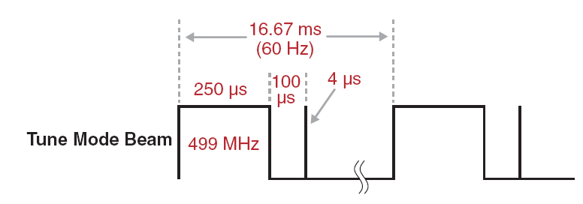
CEBAF Beam Structure
Accelerator tuning is always done using low average power beam.
The 250 μs pulse width at 60 Hz provides a 1.5% duty cycle.
Nominal pulse height is 4 μA.
Beam power is 720 W for a 12 GeV beam at this duty factor.
The 4 μs trailing pulse is for measuring linac BPM orbits and linac arrival time.
3 interleaved 499 MHz bunch trains injected into 1497 MHz Linacs
4-Hall operations uses 249.5 MHz bunch trains

Slide 11
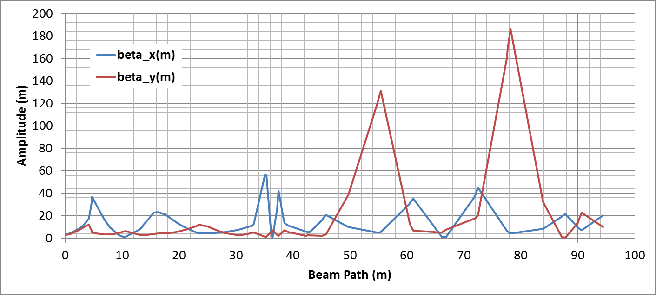
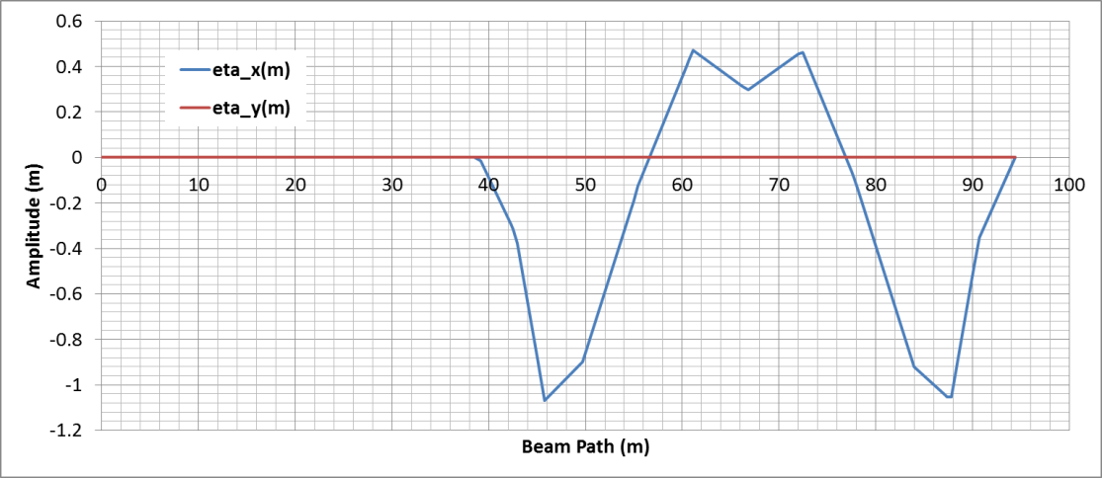
CEBAF Injector
Injector Optics:
Segment shown begins at exit of ¼ cryomodule and ends at exit of last chicane dipole.
Matching section for measuring emittance and then adjusting quad strengths to match the beam to the entrance of the North Linac.
Chicane provides achromatic and isochronous transport of 123 MeV beam to the North Linac.
Chicane is horizontally dispersion suppressed.
Horizontal
Chicane
Matching Section

Slide 12
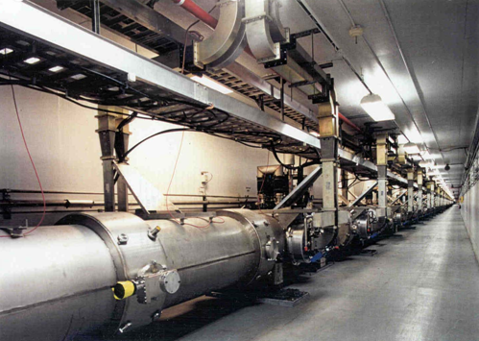
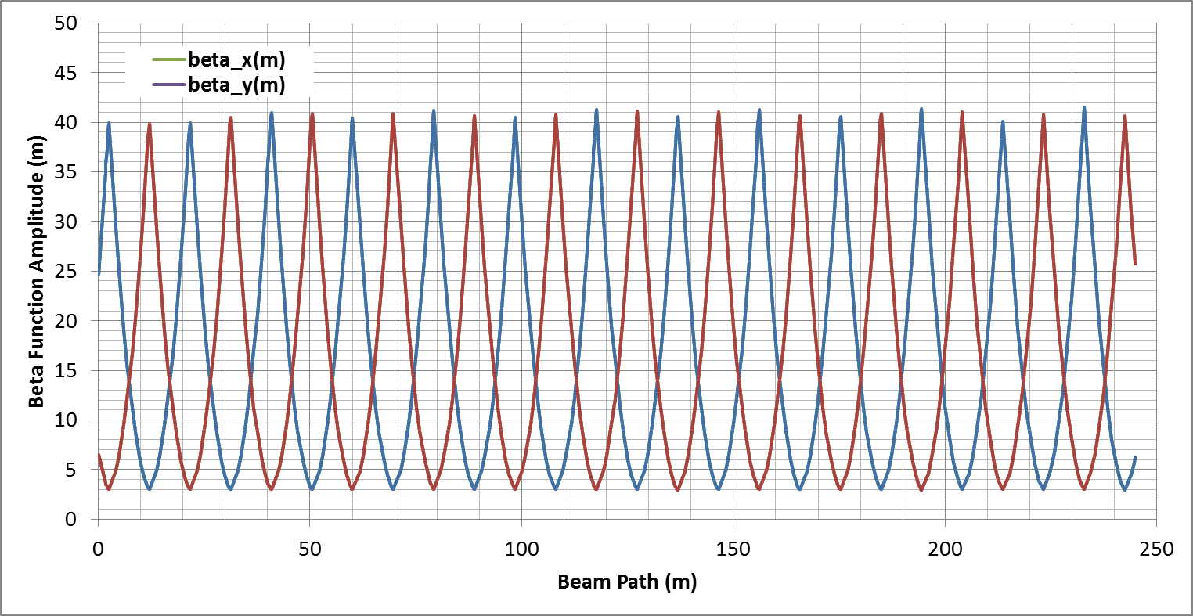
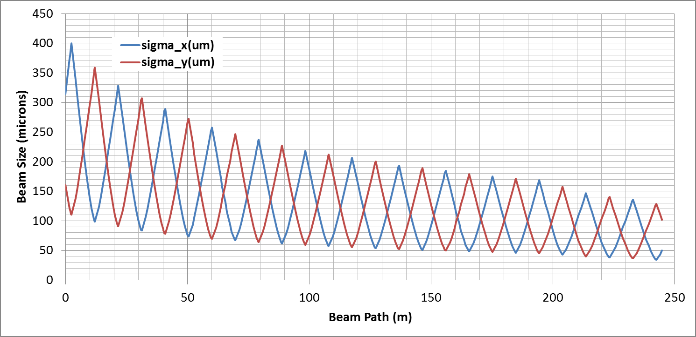
North and South Linacs
North and South Linac Optics:
9.6 m FODO channel with cryomodules between quadrupoles.
Beam injected with large spot size and damps as the beam is accelerated.
Skew quads in lattice around C20 and C50 cryomodules to correct for skew moment in cavity fields.
C100s have no skew moment.
Designed to provide 1090 MeV for a 12 GeV CEBAF

Slide 13
Spreaders and Recombiners
Spreader/Recombiner layout:
Vertically achromatic system designed to accept broad range of multi-pass input parameters for recirculation transport.
Final step heights in ½ meter increments above lowest pass.
Quads in step control the vertical dispersion.
Recombiner is mirror-symmetric to the Spreader.
West Spreader
West Recombiner

Slide 14
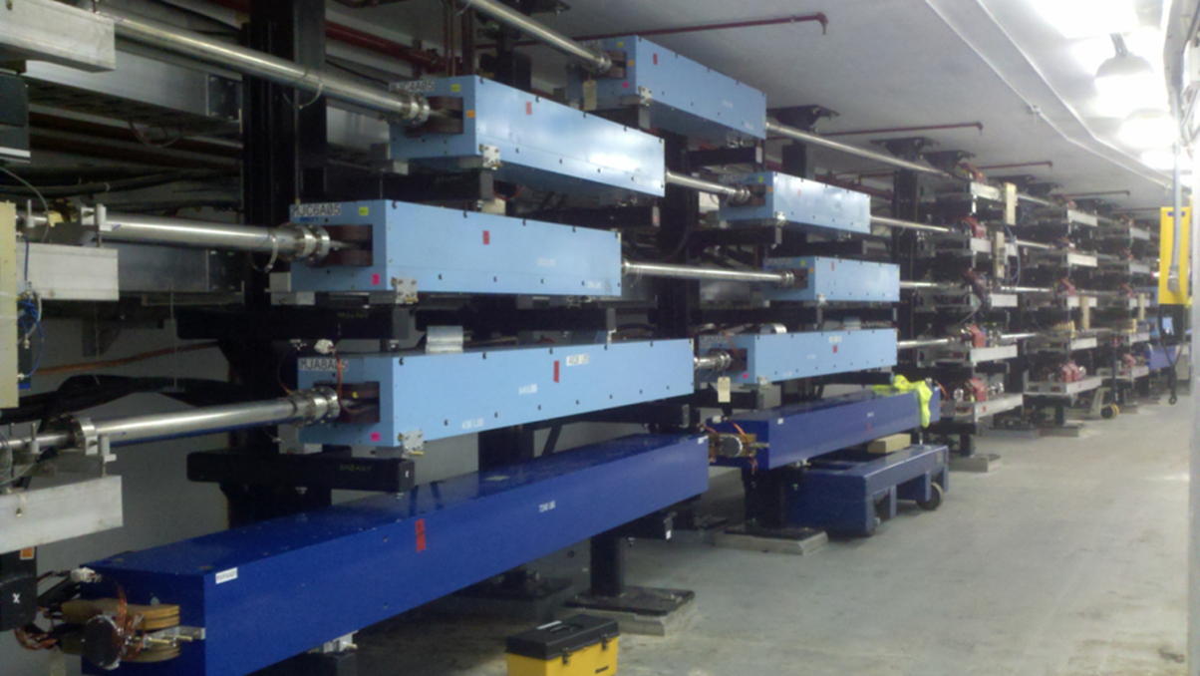
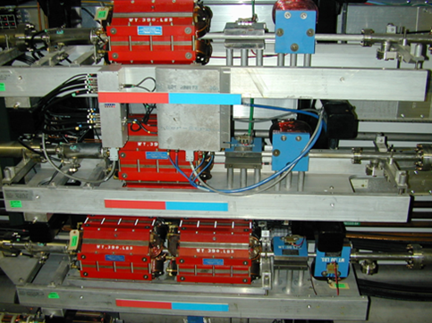
CEBAF Recirculation Arcs
Arc layout:
Sixteen dipoles for Arc 1 and Arc 2 and thirty-two dipoles for Arc 3-10.
The recirculating Pi bends are at a radius of 80 m.
Each Arc has 32 quadrupole girders grouped in 4 families to control achromaticity, momentum compaction and the betatron tune.
Beam Position Monitors at the entrance of quadrupoles.
Horizontal and vertical correctors throughout to control the beam orbit.
Arc Dipoles
Arc Quadrupole Girders

Slide 15
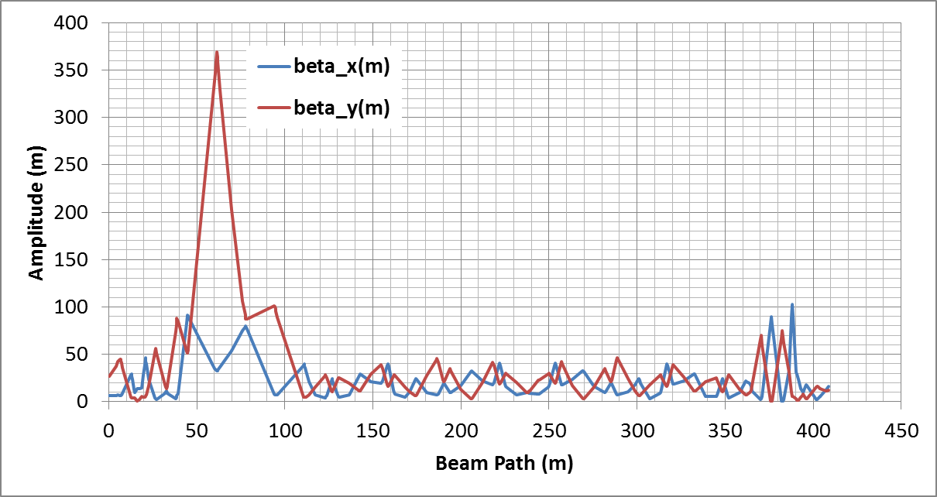
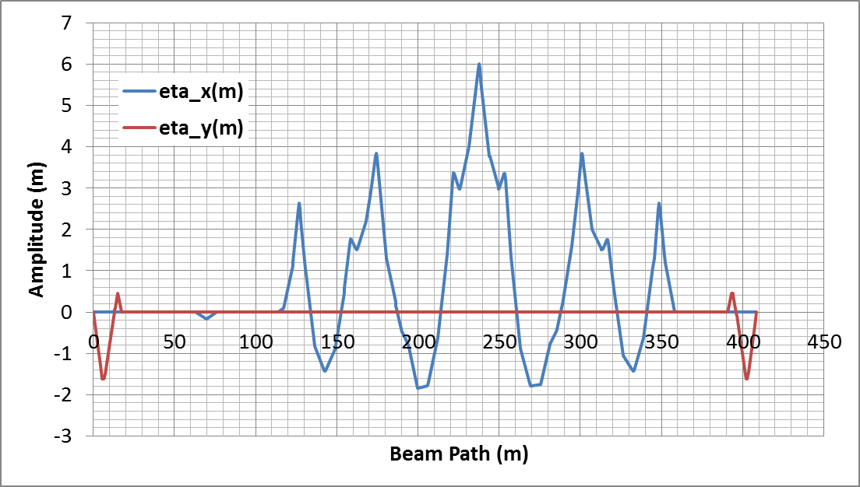
1st and 2nd Recirculation Arcs
Arc 1/2 Optics:
Segment begins at start of the Spreader and ends at the exit of the Recombiner.
Matching section in Spreader for matching the beam to the Arc.
Matching section in Recombiner for matching to the Linac.
Quads in vertical steps are used to null the vertical dispersion.
Quads near peaks of dispersion function within the Arc are used to null the horizontal dispersion and control M₅₆.
Enhanced horizontal dispersion in Arcs 1/2 provide better resolution for energy monitoring.
Vertical Dispersion Knobs
Horizontal
Dispersion Knobs
Vertical Dispersion Knobs
Matching Section
Matching Section

Slide 16
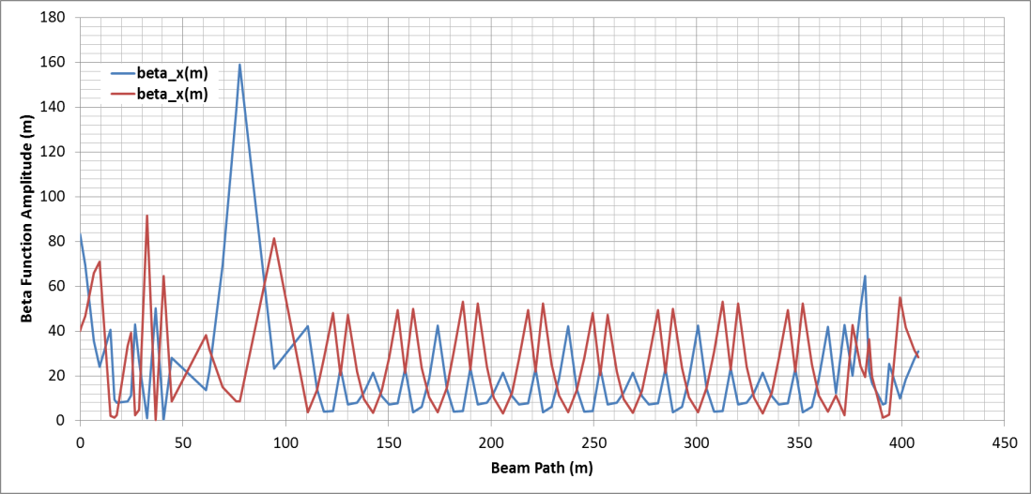
Higher Energy Arcs
Arc 3-10 Optics
The design optics for the upper Arcs is represented below.
Matching section in Spreader for matching the beam to the Arc.
Matching section in Recombiner for matching to the Linac.
Quads in vertical steps are used to null the vertical dispersion.
Quads near peaks of dispersion function within the Arc are used to null the horizontal dispersion and control M₅₆.
Amplitude of vertical dispersion peaks go down with pass count due to the smaller elevation change.
Insertable
Dump
Horizontal
Dispersion Knobs
Matching Section
Vertical Dispersion Knobs
Vertical Dispersion Knobs
Matching Section

Slide 17
Extraction Region
12051MeV
2303 MeV
1213 MeV
4483 MeV
3393 MeV
6660 MeV
5573 MeV
8836 MeV
7747 MeV
11006 MeV
9922 MeV
11006 MeV

Slide 18
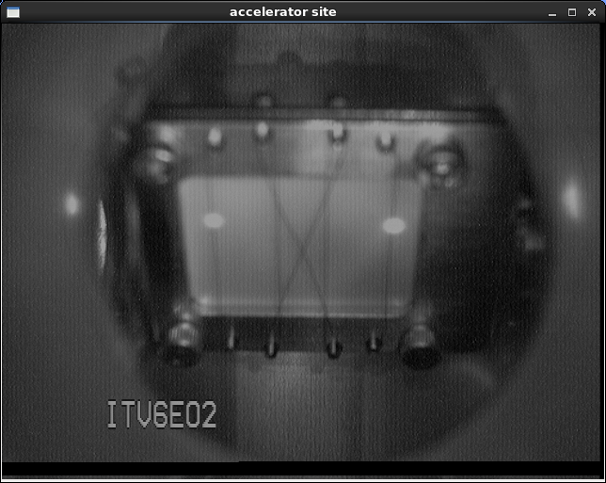
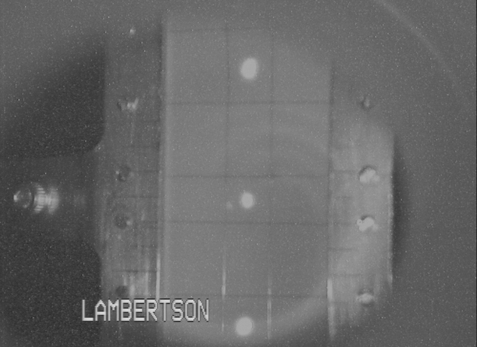
Extraction System
Overall configuration:
Horizontal extraction systems at 500 MHz for 1st through 4th pass
Vertical extraction system at 500 MHz for 5th pass
New horizontal extraction system at 750 MHz for 5th pass
Pass 1
Pass 2
Pass 3
Pass 4
Pass 5
Extraction Elevation View
West Arc Beamlines

Slide 19
RF Separation – 1st through 4th Pass
A
B
C
Turn on RF separator
Hall Lasers
Hall A: 500 MHz
Beam to Halls
B
B
B
B
B
B
B
B
B
B
Hall B: 500 MHz
B
B
B
B
B
B
B
B
B
Beam
B
B
B
B
Hall C: 500 MHz
B
B
B
B
B
B
B
B
B
B
B
B
B
B
B
B
B
B
B
B
B
B
B
B
B
B
C
B
C
A
B
C
A
B
C
A
B
C
A
C
A
B
C
A
B
C
A
B
B
C
C
A
A
B
B
C
A
B
C
A
B
C
A
B
C
C
C
C
C
C
A
B
C
A
B
C
C
C
C
A
C
A
C
A
C
A
A
C
C
A
C
A
C
A
A
A
A
C
A
C
A
C
A
A
C
C
A
A
C
A
A
A
C
A
C
A
C
A
A
C
A
C
C
A
C
A
C
A
C
A
C
C
A
C
A
C
A
C
A
C
A
C
C
A
C
A
C
A
C
A
C
A
C
A
C
A
C
C
C
A
C
B
C
A
B
C
C
A
C
A
C
A
A
C
C
A
C
A
C
A
A
A
C
C
Accelerator
Frequency
1500 MHz
C
C
Recirculated
Beams
Separator frequency is 1/3 of the fundamental frequency
RF Separator Cavity
500 MHz
Beams begin to separate
A
B
C
A
B
C
A
B
C
A
B
C
A
B
C
A
B
C
A
B
C
A
B
C

Slide 20
Halls A,B,C 5th Pass Vertical Separation
To Halls A,B,C
A
A
A
A
Beam
A
B
A
C
B
A
B
B
B
A
B
B
Accelerator
Frequency
1500 MHz
C
C
C
C
C
RF Separator Cavity
500 MHz

Slide 21
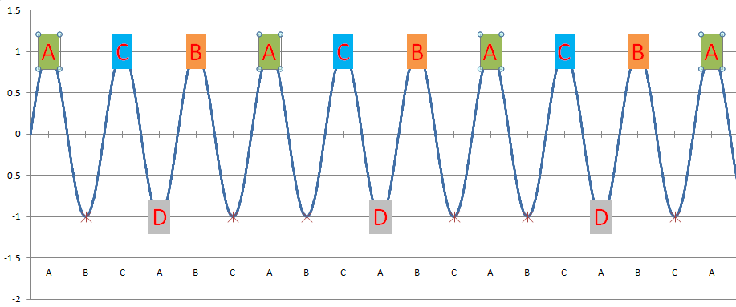
RF Separation – 5th Pass Horizontal
A
B
C
Existing
Frequency
Proposed
Frequency
A/B/C separator is located downstream
C
A
B
C
A
B
C
A
B
Turn on RF separator
Beam to Halls
500 MHz
750 MHz
A
A
C
C
B
B
A
A
A
C
B
A
C
A
C
B
A
C
A
C
B
A
C
C
A
C
A
C
B
A
A
A
C
Beam
A
C
B
A
A
C
A
C
B
A
A
B
A
C
B
A
B
A
C
B
A
B
A
C
B
B
A
C
B
A
C
B
A
B
A
B
C
D
C
B
C
A
C
C
C
C
C
C
B
C
A
C
B
A
C
C
A
B
C
A
B
C
A
B
C
A
C
A
B
C
A
B
C
A
B
B
C
C
A
A
B
B
C
B
A
C
B
A
C
A
A
B
A
C
A
C
B
A
C
B
A
D
A
C
B
A
A
C
A
C
B
A
C
B
A
C
B
C
B
Hall Lasers
Hall A: 250 MHz
Hall B: 250 MHz
Hall C: 250 MHz
C
Accelerator
Frequency
1500 MHz
C
B
A
C
B
C
B
C
B
C
C
A
C
B
C
A
B
C
C
B
A
C
B
B
C
B
A
C
B
B
B
B
C
B
A
C
B
B
C
B
A
C
B
C
B
A
C
B
C
D
C
B
B
A
A
C
C
B
B
Hall D
Beam
(existing hall lasers run at 500 MHz)
Hall D: 250 MHz
Separator frequency is 1/2 of the fundamental frequency
5th Pass RF Separator Cavity
750 MHz
Empty Buckets – Cutting the laser pulse rate for each hall in half (from 500 MHz to 250 MHz) leaves “empty buckets”, which are directed to Hall D
Every other “bucket” goes to Hall D
Four-Hall Operation!
(D+3)
New Hall D laser fills empty buckets at 250 MHz
A
B
C
A
B
C
A
B
C
A
B
C
A
B
C
A
B
C
A
B
C
A
B
C

Slide 22
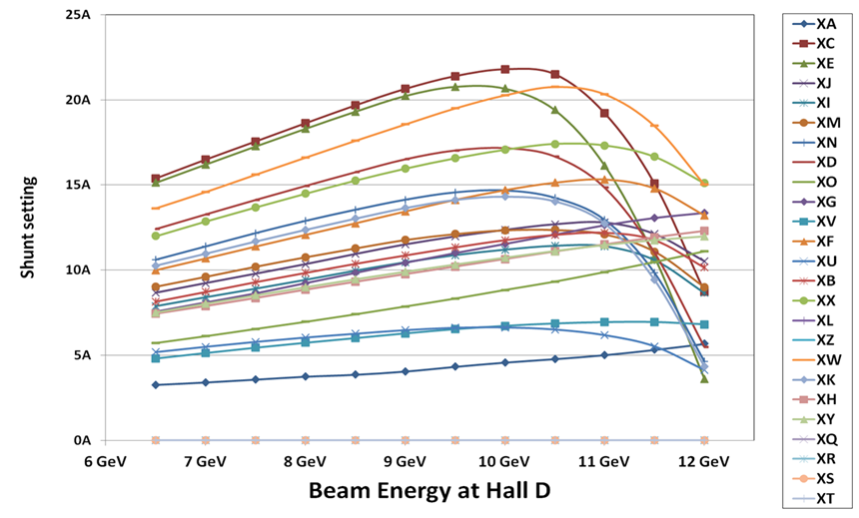
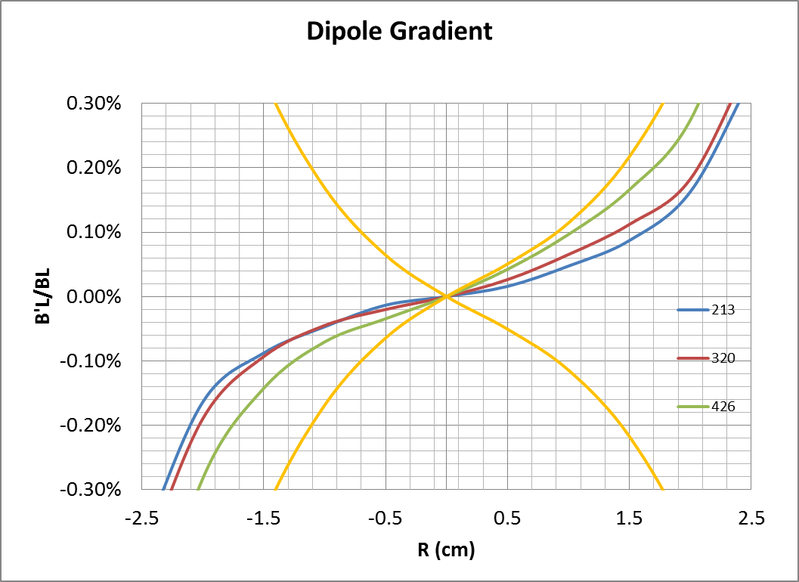
Magnets
Magnet Measurement Facility Data
All dipole and septa magnets measured for field quality.
All quad families measured for field quality.
Integrated field and dipole gradient data entered into the CEBAF Element Database.
Control system gets information from the CEBAF Element Database.
Count | Description
32 | New 4m dipole magnets, Arc-10
256 | Large dipole refurbishments (add steel and/or new coil packs)
110 | Large (>1m) dipole magnets removed and measured
130 | New quadrupole magnets
120 | New corrector magnets

Slide 23
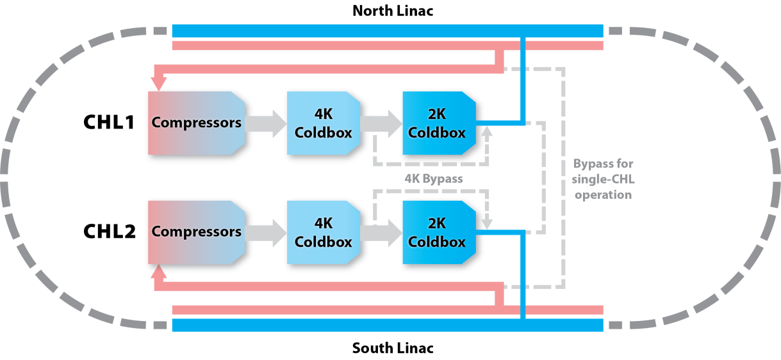
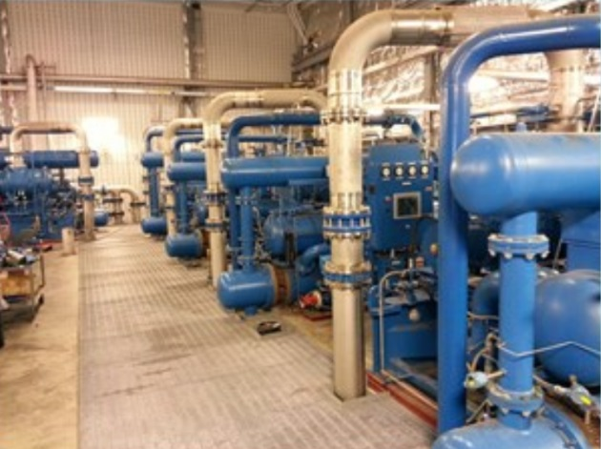
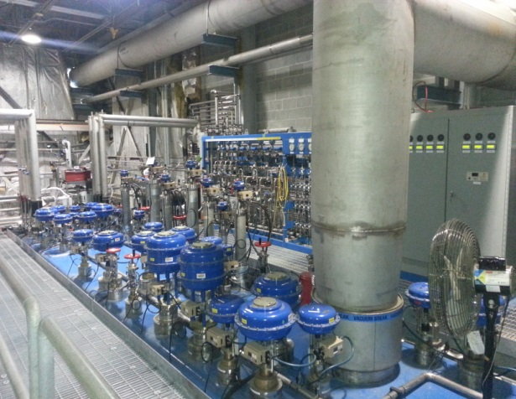
Cryogenics
New
CHL1
4.6 kW @2.1 K
250 g/s
5.5 MW
CHL2
4.8 kW @2.1 K
250 g/s
3.8 MW
New
 | Years of Operation
CHL1 | 1991 – Present
CHL2 (12GeV) | 2013 – Present
2K Coldbox #1 | 1994 - 2000 2013 – Present
2K Coldbox #2 | 2000 - Present

Slide 24
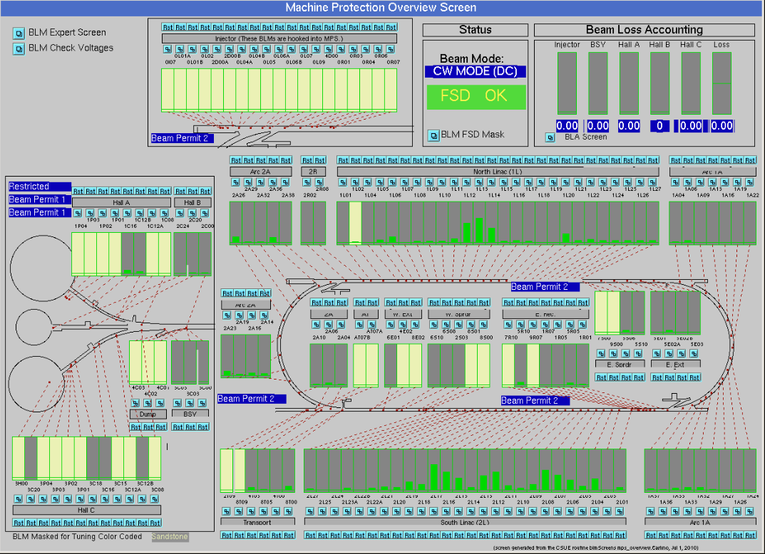
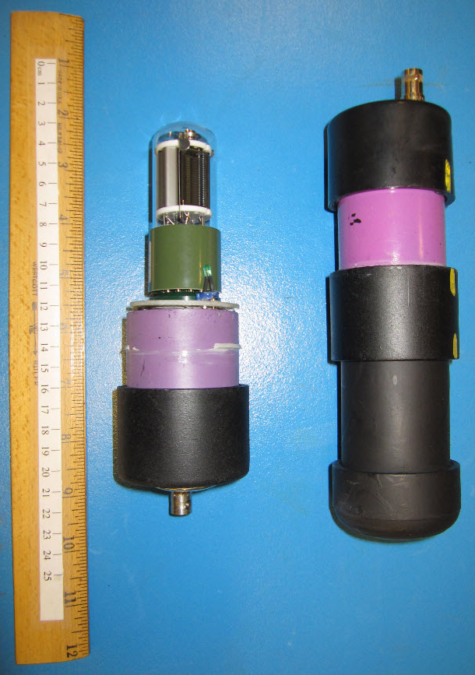
Machine Protection
Beam Loss Monitors – photomultiplier tubes located throughout the Injector and in key places around the ring for loss detection.
Beam-based determination of voltage thresholds and trip points
Photomultiplier Tube
Beam Loss Monitor Distribution Around the Accelerator

Slide 25
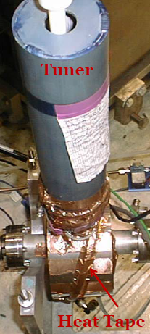
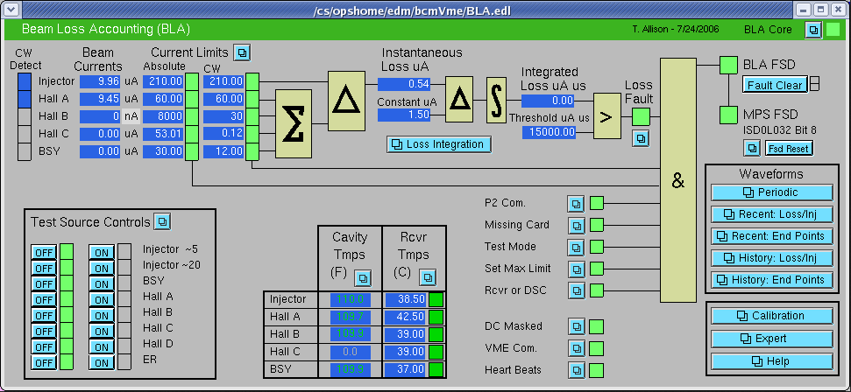
Machine Protection
Beam Loss Accounting System – Beam Current Monitors at the end of the Injector and in front of each CW-capable Beam Dump. Calibrated relative to Faraday Cup II.
Beam current leaving the Injector is compared to the sum of currents entering beam dumps. Difference interpreted as loss with beam terminated if the integrated loss exceeds 15000 mA-μs.
Beam Loss Accounting System
BCM Cavity

Slide 26
Diagnostics
Bunch Length Monitors
6 GHz pill box cavities for optimizing longitudinal beam profile in the Injector.
Commissioning an interferometer as an online diagnostic
Beam Viewers
Insertable flag for monitoring general beam quality. Located in all beamlines for measuring spot evolution. Also used in dispersive locations to phase cavities.
Beam Position Monitors
4-wire M15 and M20 style in all existing beamlines and the new ARC 10. Additional BPMs added to new Spreaders and Recombiners.
Stripline style BPMs newly developed for the Hall D beamline.
Pathlength Monitors
499 MHz pill box cavities located at the end of the linacs to measure arrival time of the beam for each pass.
Beam profile monitors
Wire Scanners used for matching in the injector, at the entrance of each Arc and in front of the 2 kW beam dumps for Halls A, B, C and D.
Synchrotron Light Monitors in Injector, Arc 1, Arc 2, Arc 10, and Hall beamlines.

Slide 27
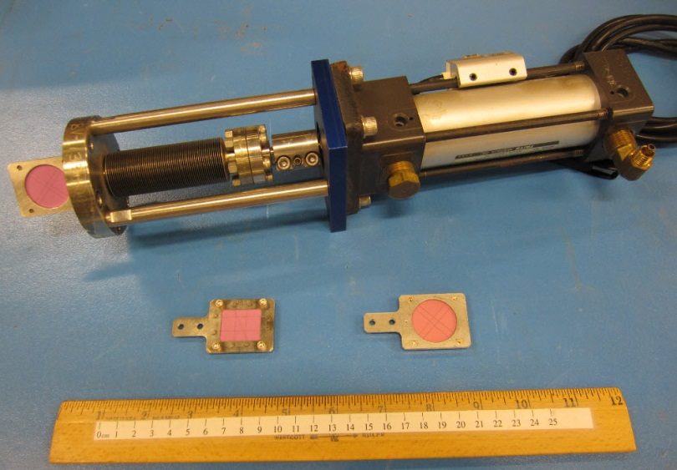
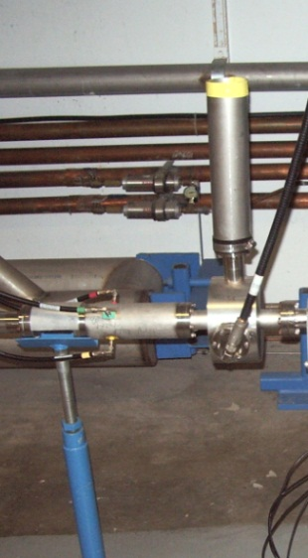
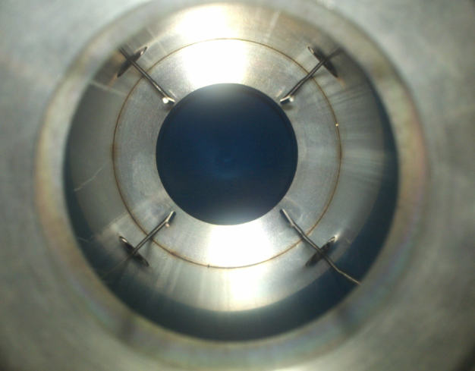
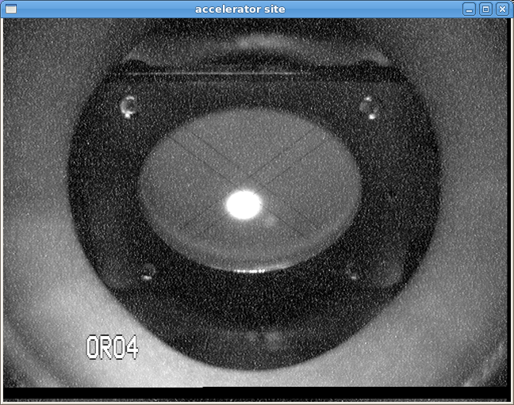
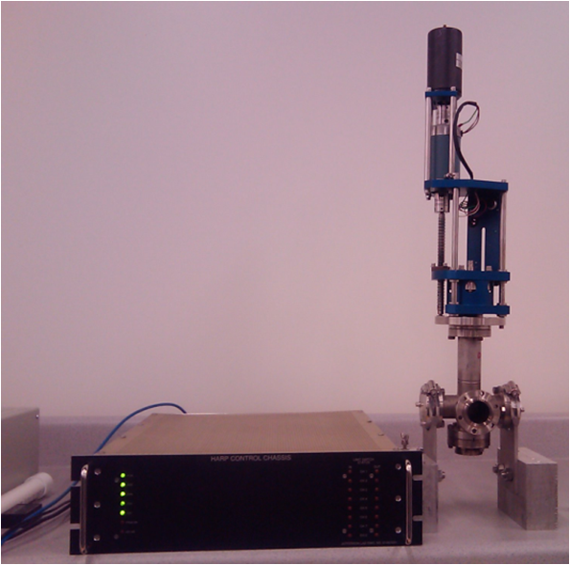
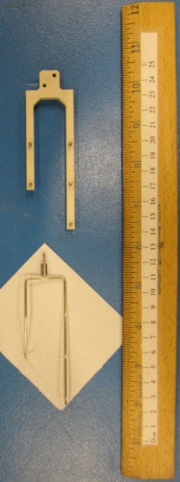
Existing Diagnostics
Beam Viewers
Antenna-Style Beam Position Monitor
Pathlength Cavity
New Style
Old Style
Beam on Viewer in Chicane
Wire Scanner and Electronics
Wire Scanner Forks

Slide 28
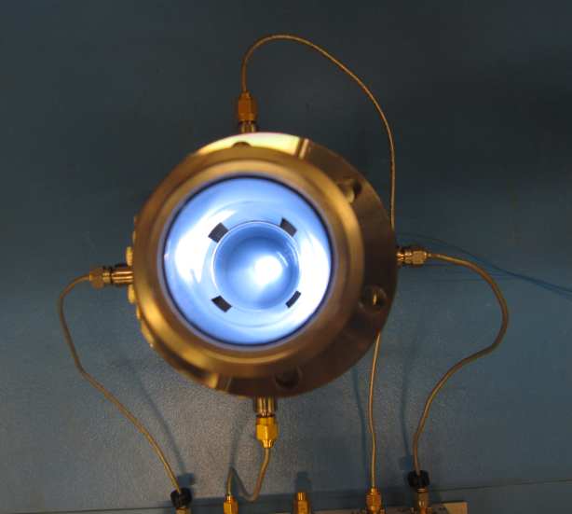
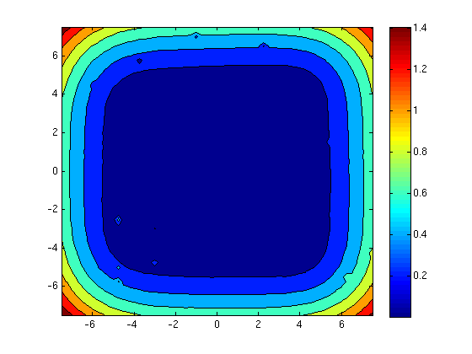
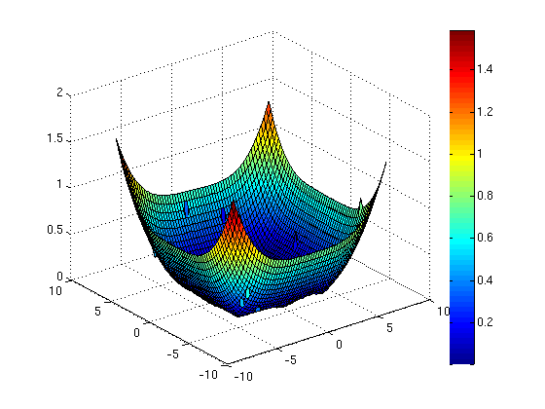
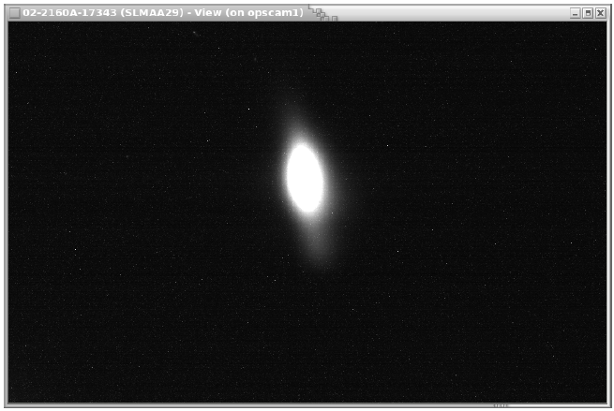
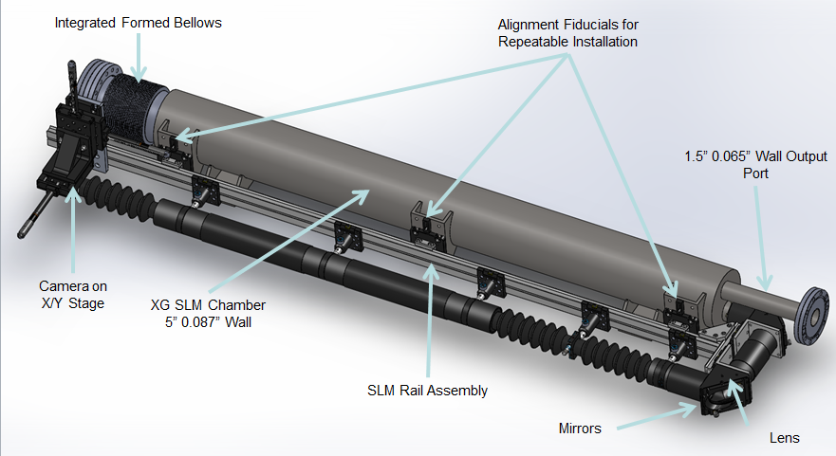
Diagnostics for New Beamlines
Map of BPM Response from Stretched-Wire Test Stand
Stripline Beam Position Monitor
Synchrotron Light Monitor
Synchrotron Light from 9 GeV Beam in Arc10

Slide 29
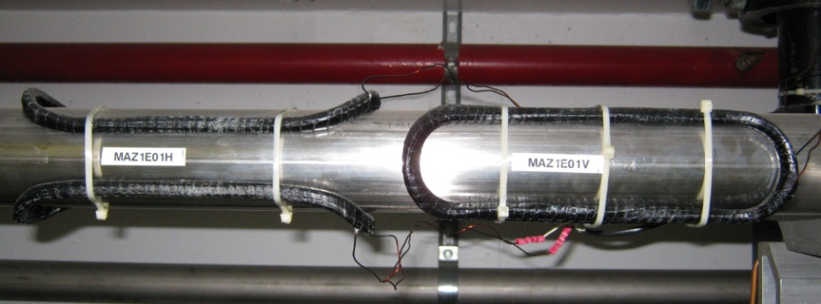
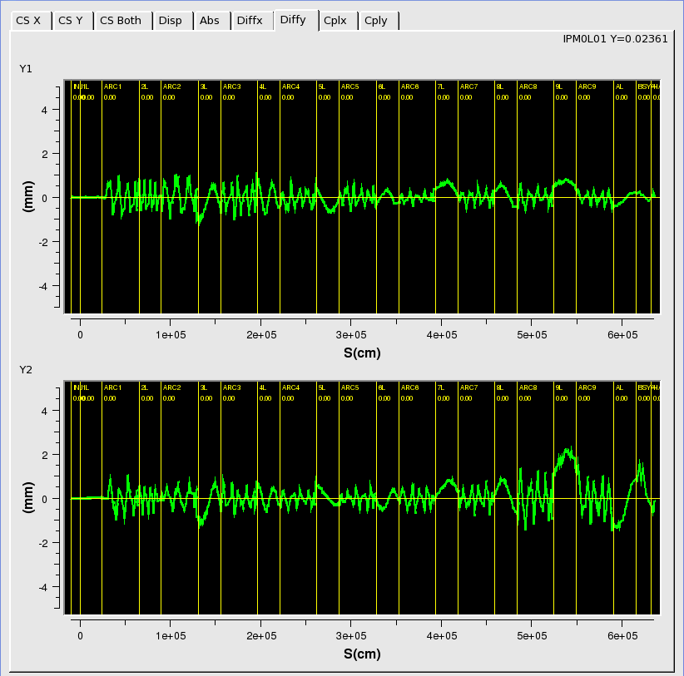
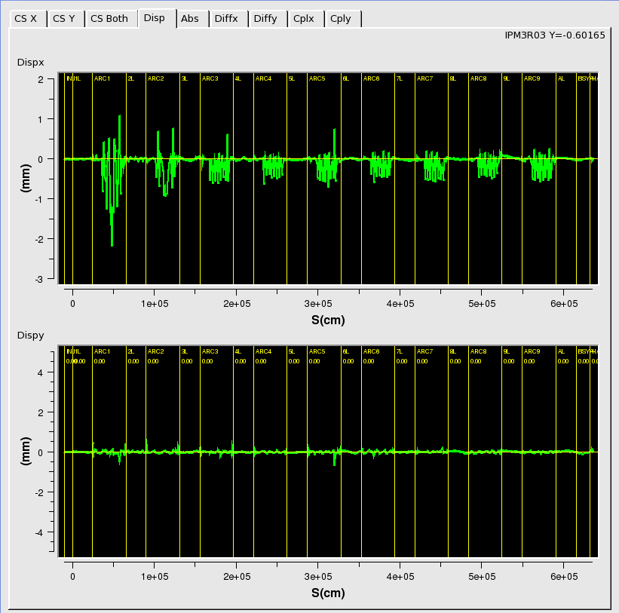
30 Hz Differential Orbit Tuning
Air-core kicker magnets in Arc 1 are used to provide differential orbit data at 30 Hz.
System uses two kickers in each plane separated by a phase advance of 90 degrees.
The left figure shows the differential orbits for the y-plane.
System also used to modulate the energy in the North Linac at 30 Hz to measure/minimize dispersion leakage.
A pair of 30 Hz. Kicker magnets in Arc 1
Differential orbits in the Vertical Plane
Horizontal and Vertical Dispersion Pattern

Slide 30
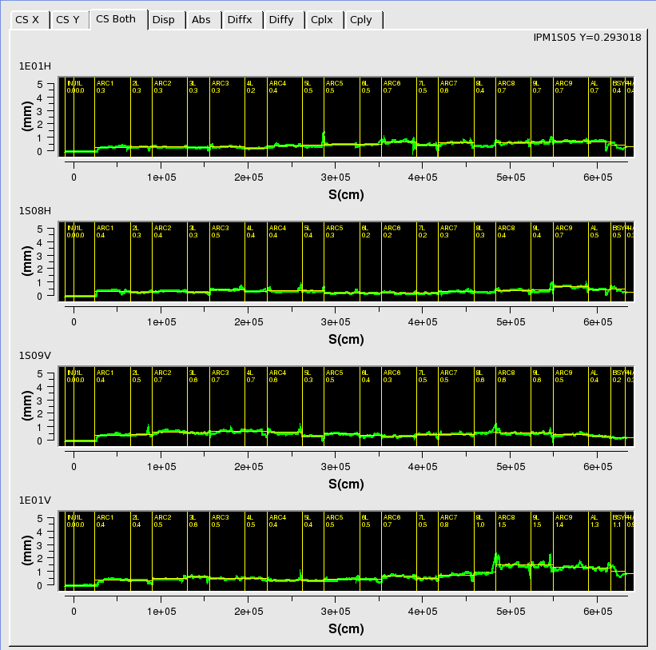
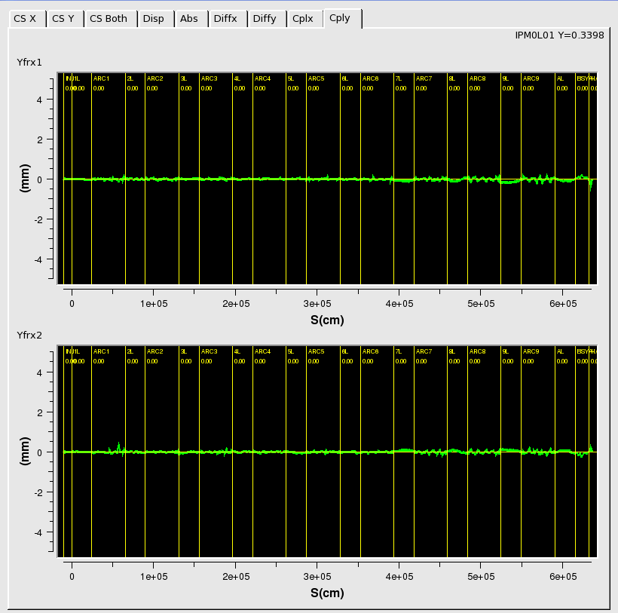
Courant-Snyder Tuning
The Courant-Snyder Invariant refers to the invariance of the phase-space beam ellipse as it traverses the accelerator
$ε=β{x′}^{2}+2 αxx^{′}+γxx^{2}$.
The 30 Hz beam position data is analyzed to calculate the normalized invariant and compare to model.
Lower left figure shows a reasonably well-tuned result for each of the four kickers.
The same system is used to report the extent of the X-Y coupling errors in the system.
Courant-Snyder Invariant for Four Differential Orbits
Coupling to Y-plane from X Differential Orbits

Slide 31
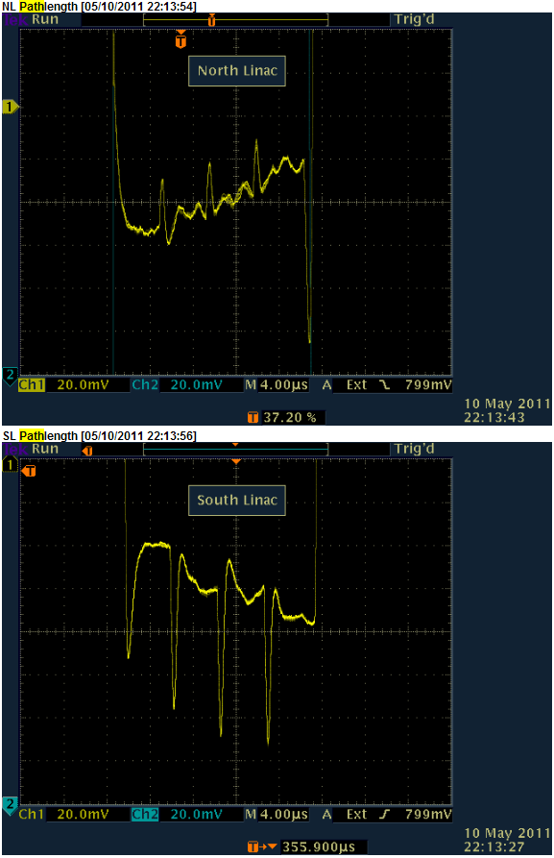
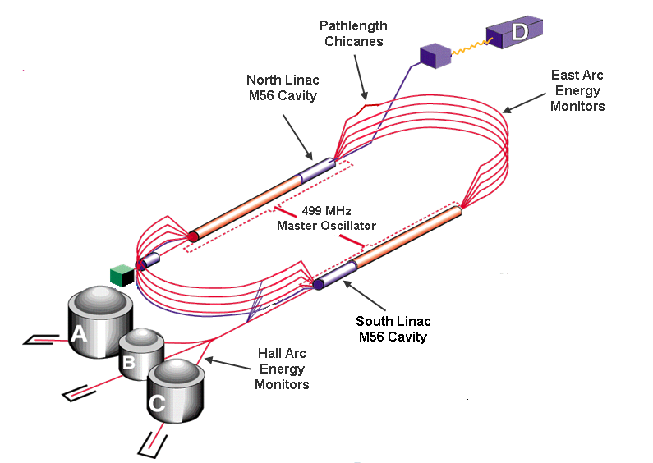
Pathlength Compensation
Arrival time in linacs depends on distance travelled.
The pass-pass length of the machine needs to be an integral number of RF wavelengths for peak acceleration.
Changes in pathlength due to uniform expansion of the tunnel are compensated with changes to the RF frequency of the Master Oscillator.

Slide 32
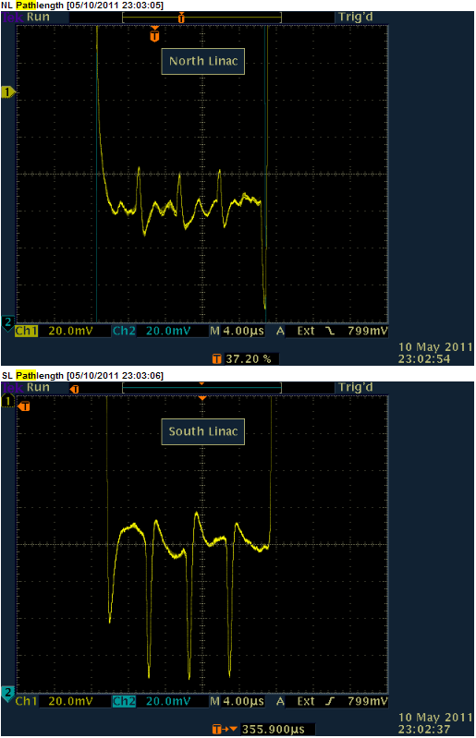
Pathlength Compensation
Pathlength optimized after 100 Hz shift in the 1497 MHz Master Oscillator.
Pathlength chicanes compensate for residual non-uniform changes to the overall machine length.

Slide 33
Model-Based Operations
Pre-Injector
Layout
New
Injector/LINAC
Layout
New
Spreader and
Recombiner
Layout
Survey
and
Alignment
Cryomodule
Commissioning
Element Coordinates
E_{max}
Q₀
Survey
Coordinates
Historic
Hall A, B, C
Layout
elegant-based
Model
Element Coordinates
CEBAF
Element
Database
CEBAF
Control
System
Accelerator
Settings
TWISS Parameters
ARC 1-9
Layout
Field
Maps
Field Requirements
New
ARC 10
Beamline
Magnet
Measurement
Facility
New
Extraction
Layout
New
Hall D
Beamline

Slide 34
High Level Applications Software
elegant Download Tool (new)
Determines machine settings from required energies and prepares them for download to the accelerator.
Injector Energy Management
Sets cavity gradients and quadrupole settings for the Injector cryomodules.
Linac Energy Management
Sets cavity gradients and quadrupole settings for the linac cryomodules.
Autosteer
Minimizes transverse orbit errors for a beamline segment.
AutoQuad
Determines the magnetic center of a quad relative to the electrical center of an adjacent BPM.
Phaser
Maintains the optimal phase of the SRF cavities in the accelerator.

Slide 35
High Level Applications Software
RF Gradient Calibration
Calibrates the gradients of the SRF cavities relative to a standard using the down beam Arc to measure the energy.
qsUtility
Used for taking multi-harp emittance data.
QTSnyder
Tool for tuning the optics in the main accelerator. Used to minimize errors in the Courant-Snyder invariant.
Orbit Locks
Used to stabilize the beam position and angle at key points around the machine. Two correctors in each plane are used to maintain the orbit.
Energy Locks
Used to stabilize the beam energy in the North and South Linacs using Arc 1 and Arc 2 as a spectrometer.

Slide 36
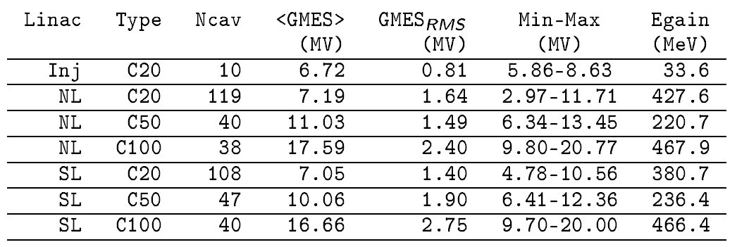
Cryomodule Commissioning
All 418 SRF cavities were commissioned in advance of beam operations.
Measured:
Maximum accelerating gradient
Cavity Q₀s
Field emission survey

Slide 37
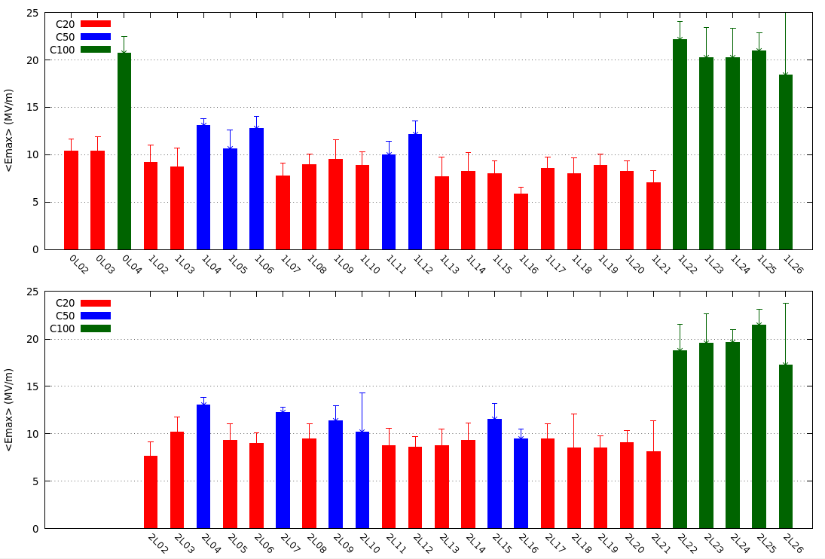
Average Cavity Gradient (per Module)
Inj. & North Linac
17.5 MV/m
South Linac
17.5 MV/m

Slide 38
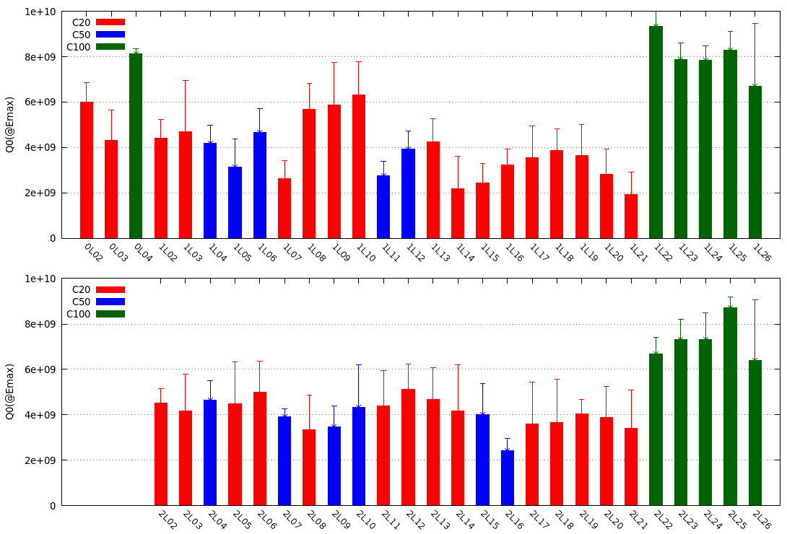
Average Cavity Q0 (per module)
Inj. & North Linac
South Linac

Slide 39
Optimizing the SRF Performance
Multiple options for reaching the availability goals over time:
Improve C20 trip models, maximize gradient/minimize trip rate.
C50 program, one C50 refurbishment is in progress.
Build more C100s.
In-situ Helium Processing to reduce field emission.

Slide 40
Gradient Maintenance
He processing of all cavities planned for Summer 2015
C20 performance degradation:
0.14 MV/m – year (~22 MeV/pass - year).
Cause of degradation is unknown, actively being investigated.
C50/C100 insufficient data to date to reliably estimate degradation, if any.
Commissioning vs. Operations cavity performance:
$78\%<\frac{Operational Gradient}{Commissioning Gradient}<94\%$

Slide 41
Helium Processing
Helium Processing of a CEBAF Cryomodule:
Introduce helium gas into cavity vacuum space.
Run RF to clean cavity surfaces.
Warm up and pump down to remove residual gas.
Improves high-field Q, reduces x-ray production and greatly reduces incidence of arcing at the cold ceramic window.

Slide 42
Commissioning Milestones
Achievements to date
Deliver 2.2 GeV Beam to the 2R dump
Commissioned all beamlines except Hall C
Deliver greater than 10 GeV in 5.5 passes to Hall D
Commissioned the extraction systems
Delivered beam for Physics to three halls simultaneously

Slide 43
Commissioning Milestones
Meeting Beam Size Requirements
First data from Scattered Electrons in Hall A
10.5 GeV Beam to Hall D Ramp
8 Hour Availability for 2.2 GeV Run
Six Beams in the NL for the First Time
Emittance Scan During the Last Run

Slide 44
Commissioning Milestones
CW beam, E>10 GeV, 5.5pass beam to Hall-D
First photons into the new experimental hall
Hall-D detector commissioning
RF separation (1-4 pass), first simultaneous multiple users in the 12GeV era
Vertical Extraction
Sustained 3-Hall operations
4-pass, RF separated
A-beam (4-pass)
1-pass, RF separated
B-beam (1-pass)
5.5-pass

Slide 45
Commissioning Milestones
A & D beam horizontally separated on 5th pass at 9.6 GeV
750 MHz Separators

Slide 46
Next Phase of Beam Operations
Some of the challenges to refine CEBAF Operations:
Optimizing the performance of the SRF Systems.
Understanding Synchrotron Radiation Effects.
Synchrotron Radiation Compensation Coils.
Minimizing emittance growth due to synchrotron radiation losses.
Model Development - Reduce amplitude of tuning quads.
Emittance measurements at the entrance of each arc.
Linear Optics from Closed Orbit (LOCO) – measure body gradients of Spreader, Arc and Recombiner dipoles.
RayTrace – measure phase-space pseudo-ellipse using coordinated corrector kicks in x-plane and y-plane. Compare to model of phase-space evolution to look for point sources of model errors.
Ramp energy to 12 GeV to Hall D.
Dogleg Upgrade.
Tunnel Air Conditioning.

Slide 47
Future Run Plans
Summer 2015 Shutdown
Major installation work is planned for this shutdown that will enable us to make the push to 12 GeV for the first time. The highlights for the shutdown are:
Installation of a C50 cryomodule.
Installation of the tunnel air conditioning.
Completion of a lab wide upgrade of the power distribution, cooling towers and network.
Helium processing of SRF cryomodules to reduce field emission and increase the energy reach of the linacs.
Fall 2015 Run
Demonstrate 12 GeV capability for the first time.
Finalize optics setup, energy scaling and procedures.

Slide 48
Beam Physics Requirements
Beam/beamline requirements @ 11-12 GeV: Initial requirements

Slide 49
Beam Physics Requirements
Beam/beamline requirements @ 11-12 GeV: Requirements after 2+ years

Slide 50
MCC Control Room
The END…Thanks!

