Slide 1
SRF Science and Technology
Grigory Eremeev
30 June 2015

Slide 2
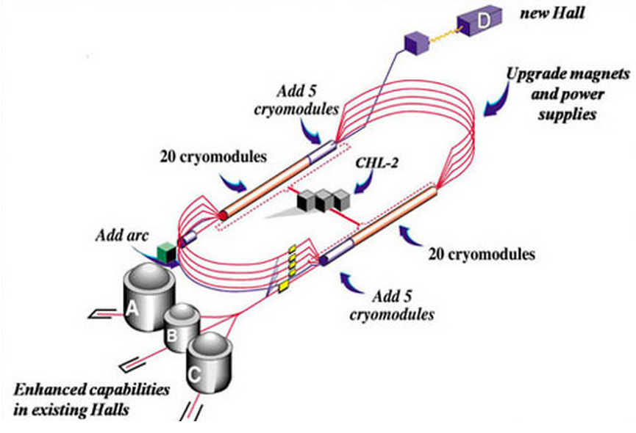
CEBAF 12 GeV Upgrade
Add 5 high performance cryomdules in each linac and their associated LLRF Systems
Double the capacity of the Central Helium Liquefier
Upgrade magnets and power supplies for recirculation arcs
Upgrade Extraction, Instrumentation and Diagnostics, and Safety Systems
Add new beamlines for Arc 10 and Hall D
Add new experimental Hall D and upgrade existing Halls

Slide 3
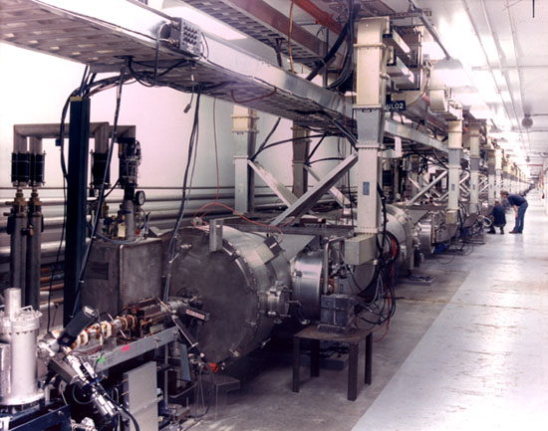
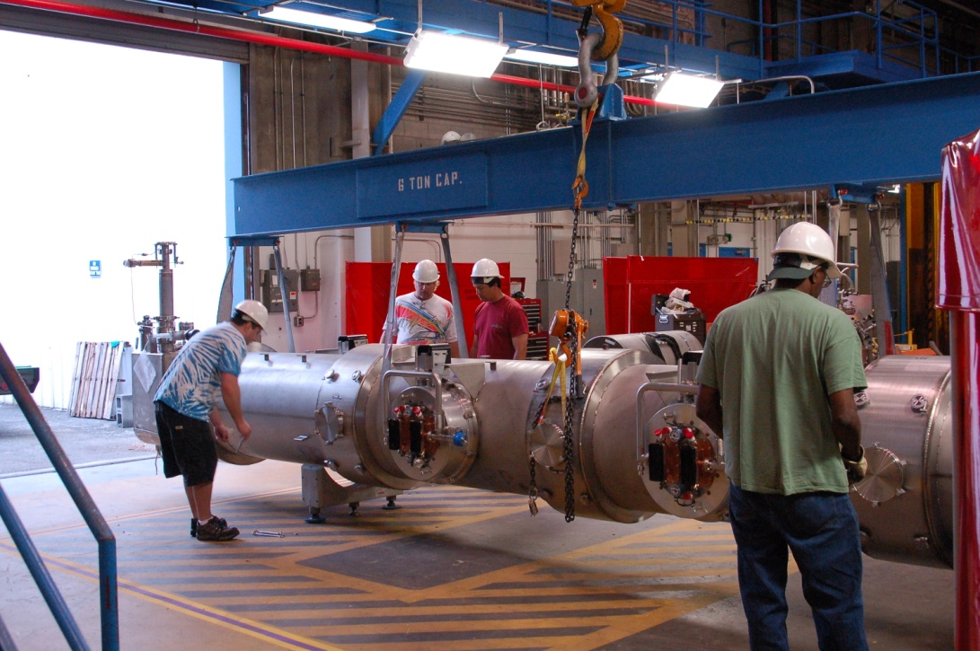
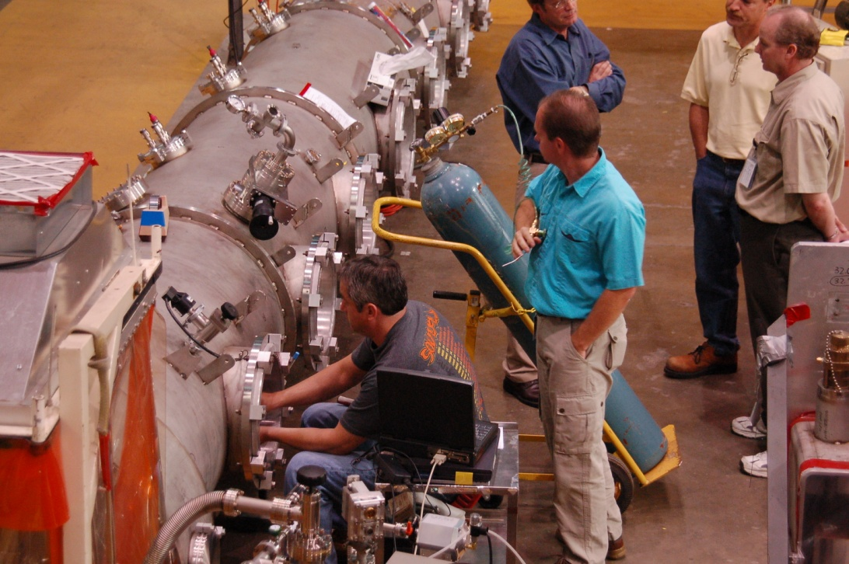
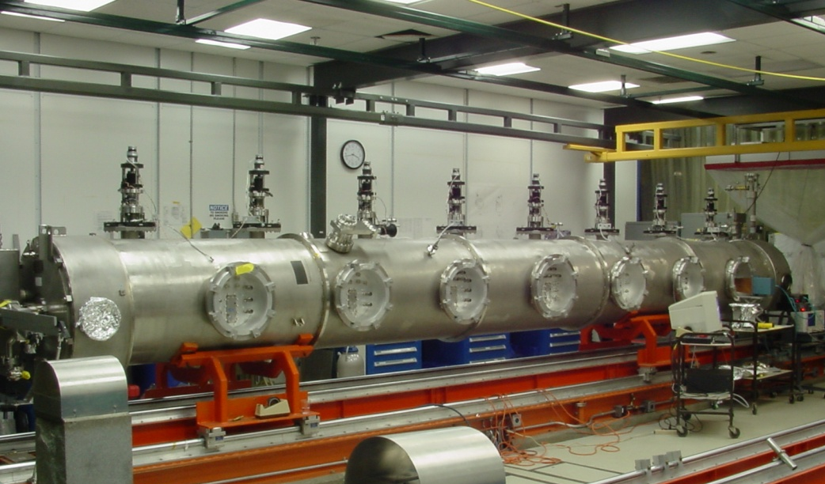
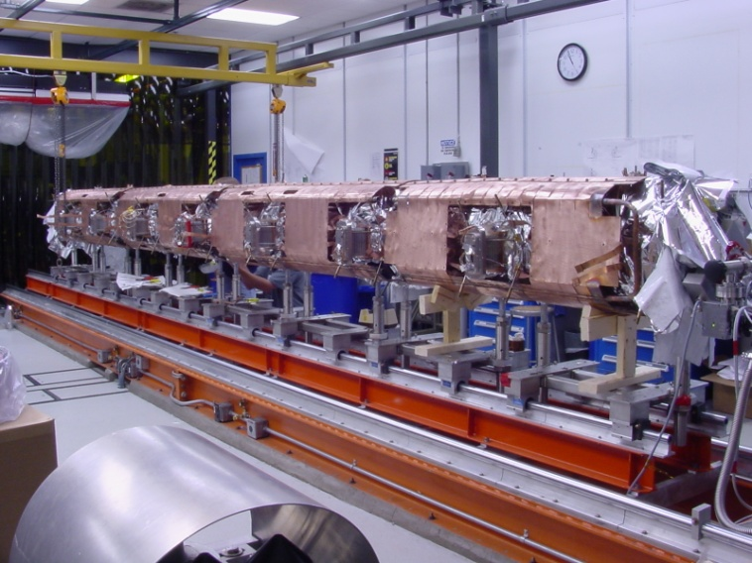
SRF technology photo gallery

Slide 4
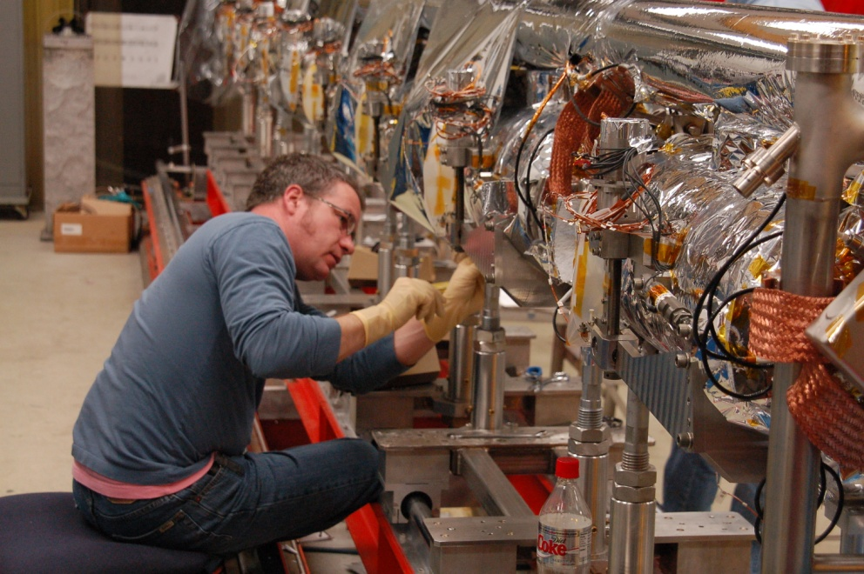
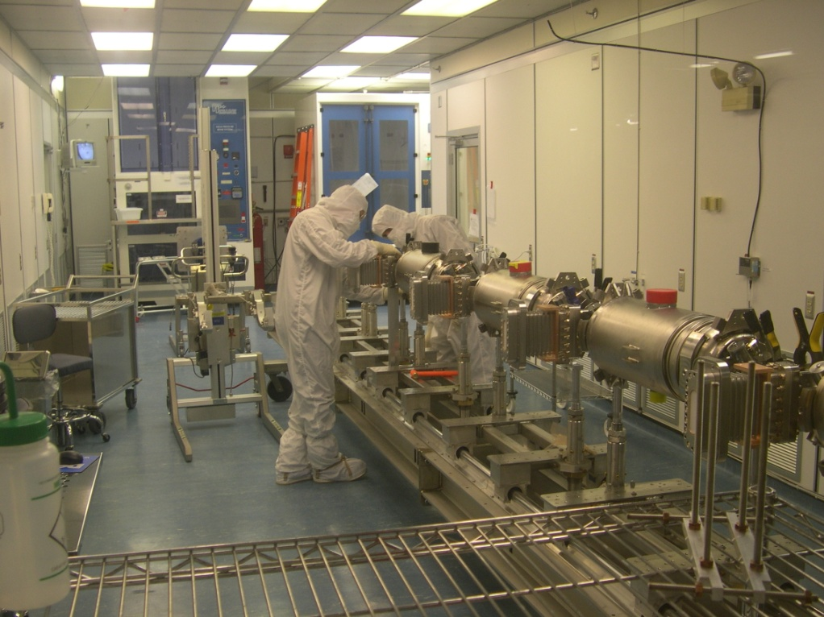
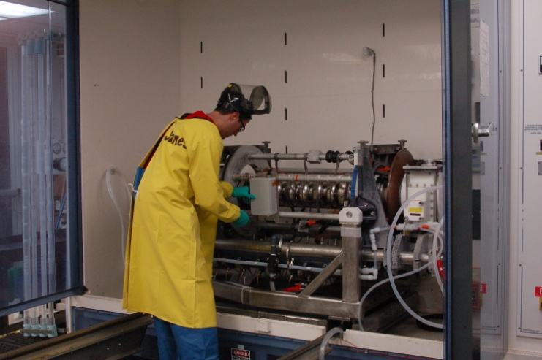
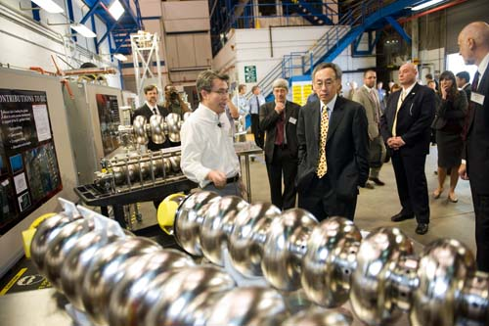
SRF technology photo gallery

Slide 5
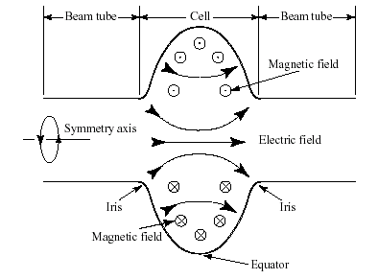
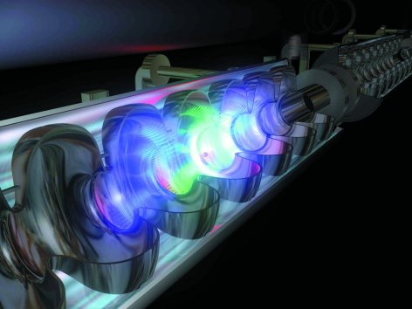
Cavity fundamentals
Conducting cavities can be filled with electromagnetic energy. This energy is then transferred to charged particles flying along the cavity axis.
Lowest frequency eigen-mode has a longitudinal electric field → use this mode for acceleration
Typical RF frequency: 0.4 GHz to 4 GHz
Higher-Order (higher frequency) modes: unwanted → need damping

Slide 6
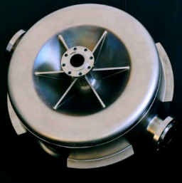
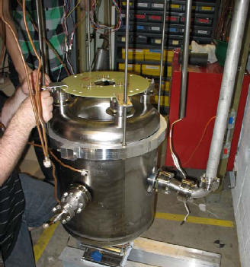
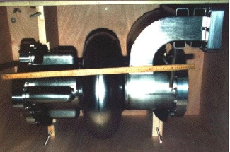
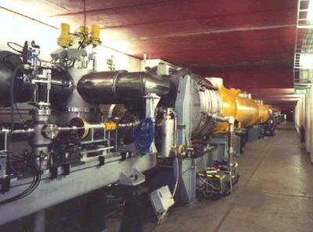
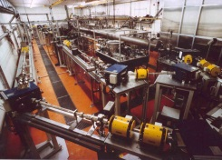
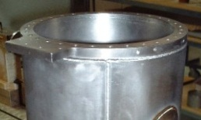
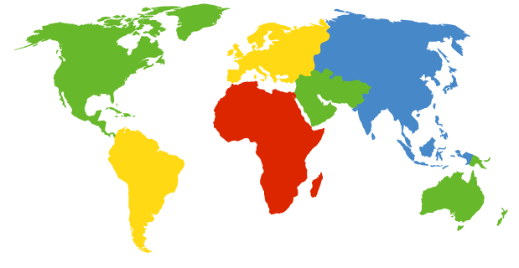
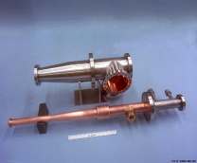
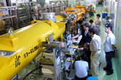
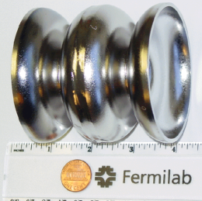
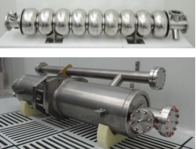
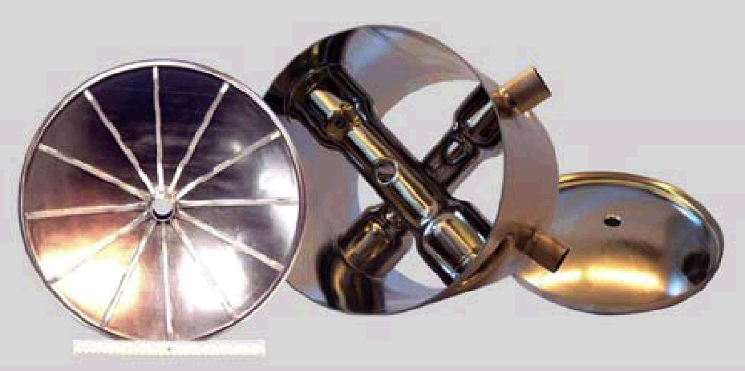
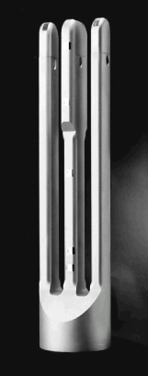
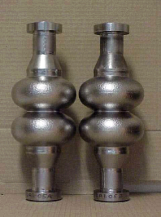
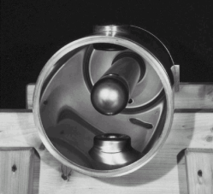
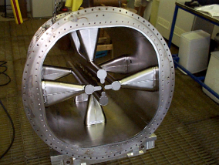
SRF globally
TRIUMF
MSU/FRIB
CERN
DESY/FLASH/XFEL
TU Darmstadt
Peking
University
CESR
LANL
KEK
FNAL
ANL
IHEP
Australian
National
University
JLab
CEA
Orsay
CEA Saclay
INFN Legnaro
INFN Genoa
INFN Milan

Slide 7
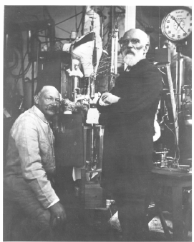
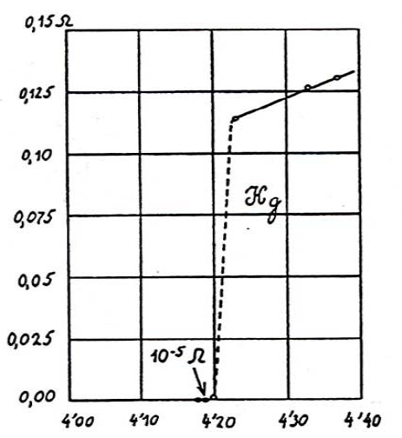
SRF ≡ Superconducting Radio Frequency
SRF science is the study of superconducting RF properties of particular materials as well as designs of accelerator systems to provide understanding of performance limitations in accelerator systems.

Slide 8
SRF ≡ Superconducting Radio Frequency
SRF technology exploits superconducting materials to provide high performance, energy efficient accelerator systems.
1972: First superconducting accelerator based on L-band 1300 MHz niobium cavities @ Stanford High Energy Physics Lab
CEBAF was the first large-scale application of SRF in the US – constructed 1987-1993: ~ 1 km long
XFEL accelerator in Europe is currently under construction 2009-2015: ~ 2 km long
LCLS-II @ Stanford Linear Collider Complex scheduled for construction in 2016-2018: ~ 1 km long, 35 cryomodules
Proposed ILC accelerator 20??-20??: ~ 30 km long, 2000 cryomodules
Essentially all new large accelerators being planned in the world aim to exploit this technology.

Slide 9
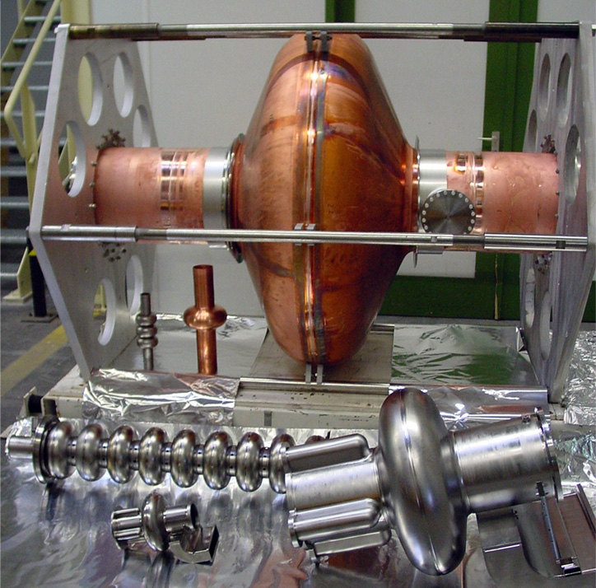
Niobium, the material of choice
Niobium – best superconducting properties among all pure metals:
T_{c} ~ 9.25 K;
H_{c} ~ 2000 Oe;
R_{bcs} ~ .00001 mΩ at 2 K
THE CAVITY
Nb : R_{s} ~ .00001 mΩ
Cu: Rs ~ 10 mΩ
↓
Q^{nb} ~ 10¹¹ up to
E_{acc} = 5·10⁷ Volts per meter
Cavity
cavity

Slide 10
11
10
Ideal?
10
Q₀
10
Real
Real
Real
9
10
8
10
0
20
40
60
E_{acc}, MV/m

Slide 11
“Physics of dirt”, Pauli 1933
Limitation:
Thermal breakdown
High field Q-reduction
High-purity Nb, sheet inspection, CBP, etc
Electropolishing,
low temperature baking, …
Solution:
1975
3 MV/m
1985
6 MV/m
1990
15 MV/m
1995
25 MV/m
2000
40 MV/m
2010
50 MV/m
Electron multiplication
Electron field emission
Limitation:
Quench
Improved cavity shape
High-pressure rinsing, cleanroom procedures
Further improved cavity shapes
Solution:

Slide 12
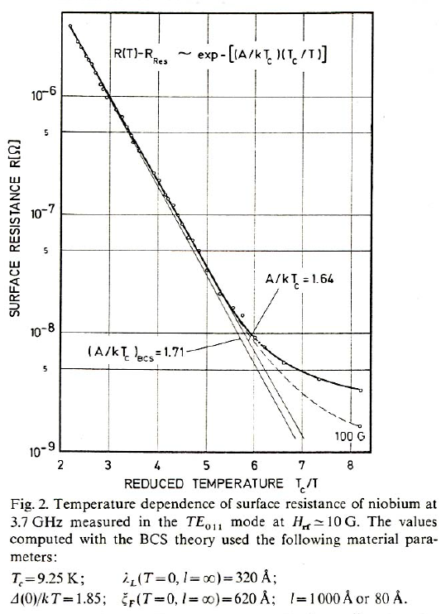
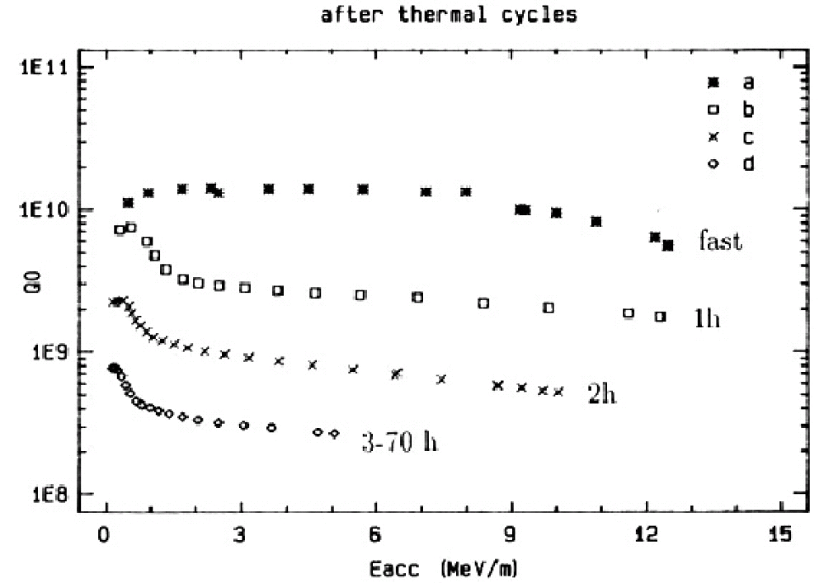
Residual resistance
RF surface resistance of SRF cavities level off to a constant level at low temperatures, which is not predicted by BCS theory of superconductivity

Slide 13
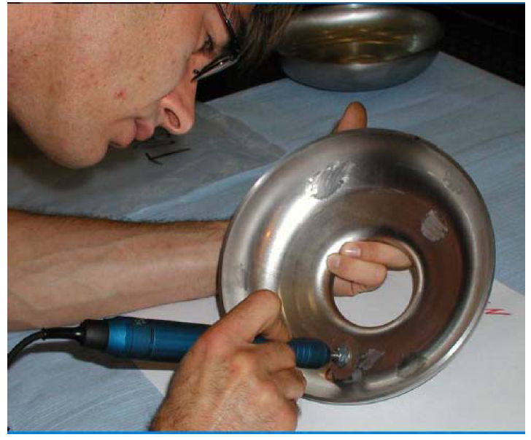
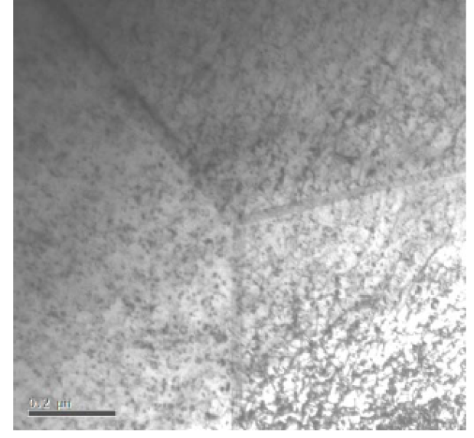
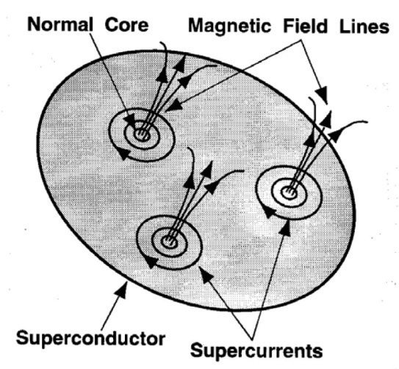
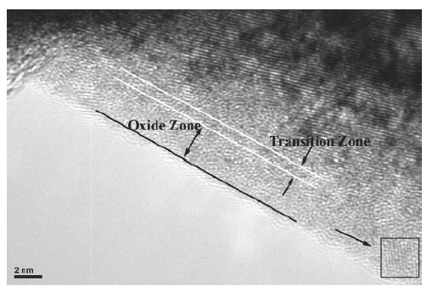
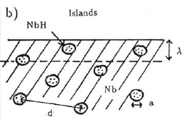
Residual resistance
Lattice damage
Earth magnetic field = 0.5 Gauss => Rs ~ 100 nOhm => Q0 ~ 10⁸
Hydrogen is readily absorbed by Nb at room temperature and has high diffusion rate even at low temperature, which leads to formation of lossy NbH clusters below 100 K.
Nb₂O₅ oxide is a “good” dielectric, but NbO₂ and NbO are poor conductors/semiconductors.

Slide 14
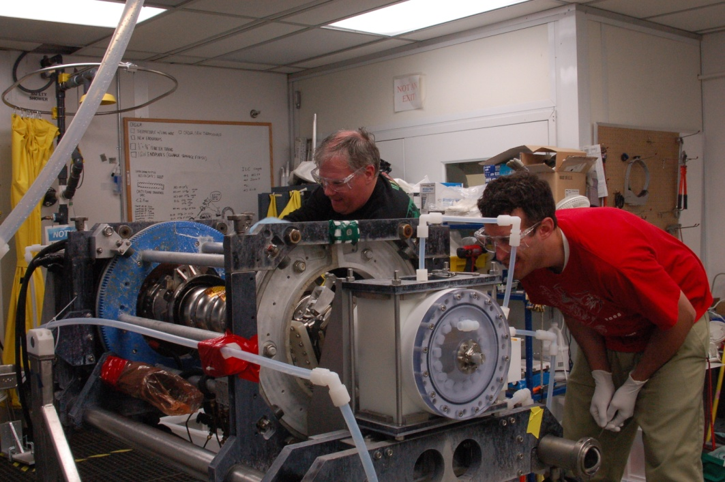
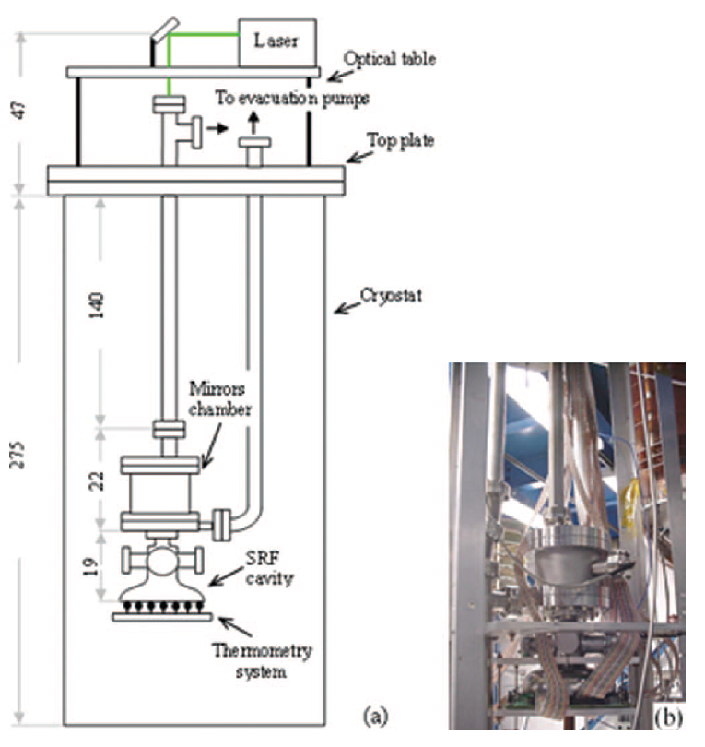
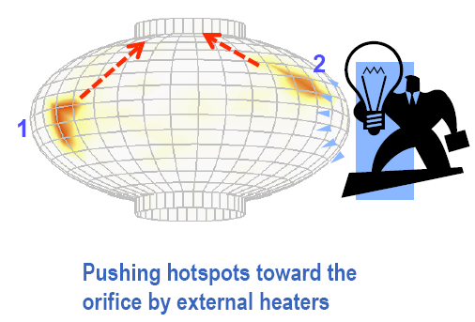
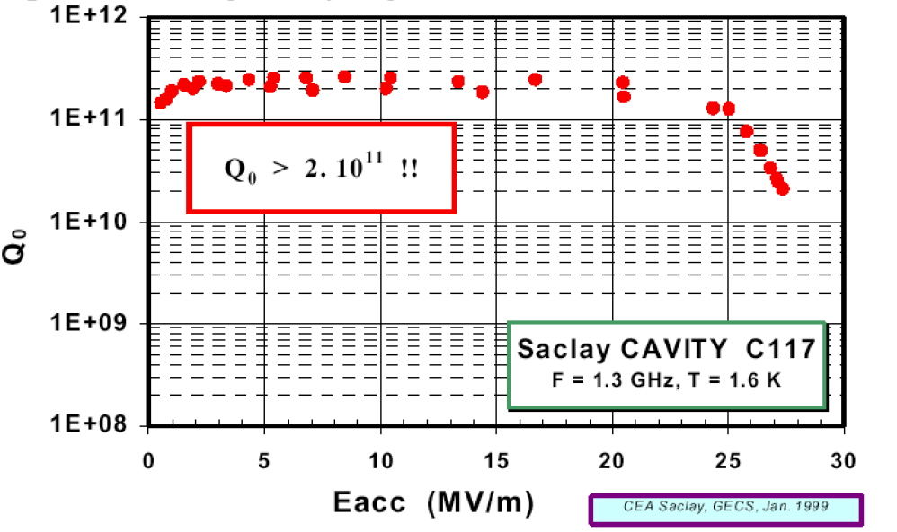
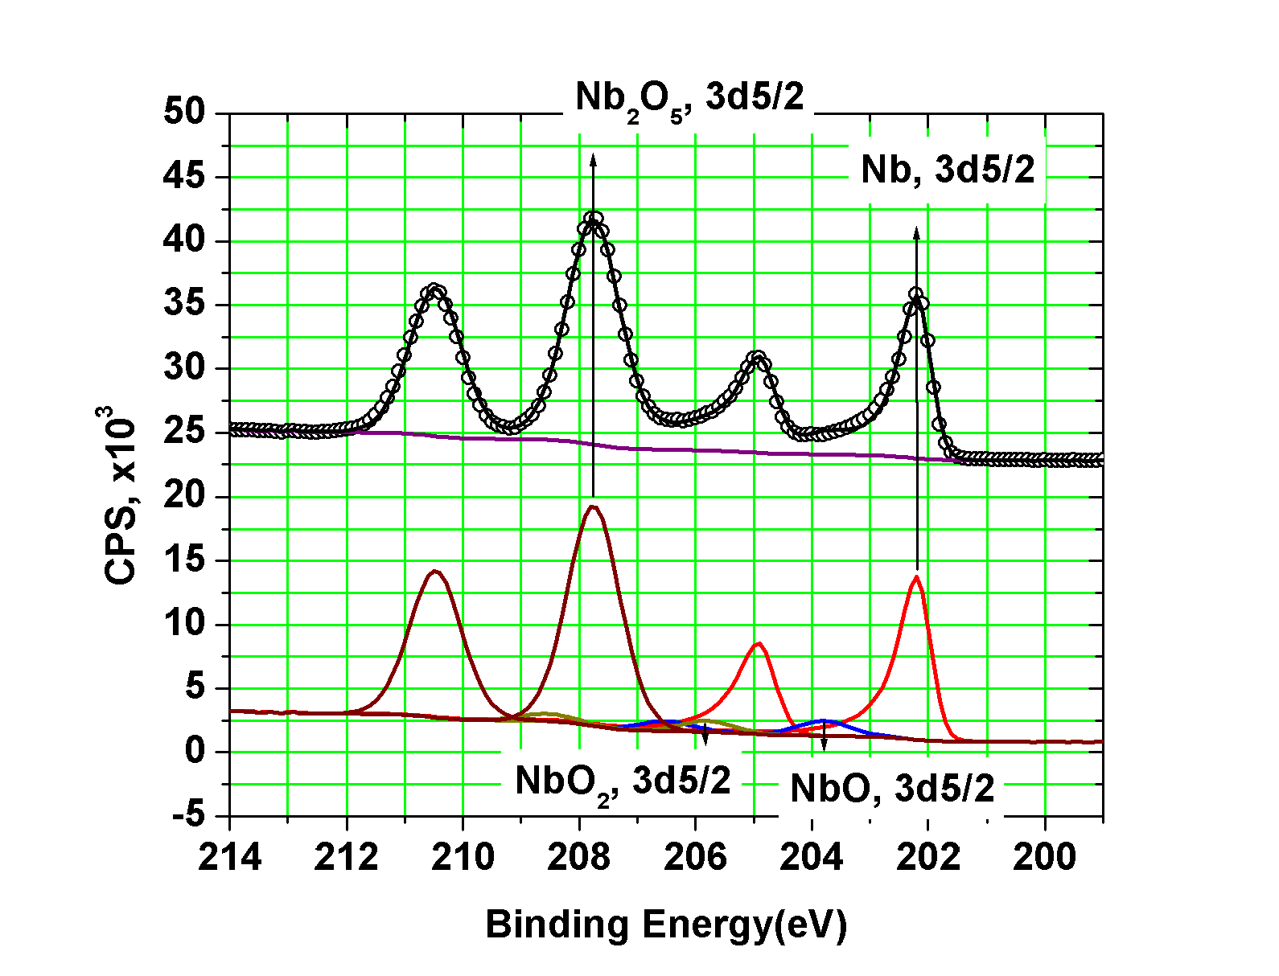
Residual resistance
Etch the damage layer and contamination with chemistry
Pushing magnetic fluxiods from high current areas with thermal gradients
High quality factors and low residual resistances < 0.5 nOhm has been achieved.

Slide 15
Limitation:
Thermal breakdown
High field Q-reduction
High-purity Nb, sheet inspection, CBP, etc
Electropolishing,
low temperature baking, …
Solution:
1975
3 MV/m
1985
6 MV/m
1990
15 MV/m
1995
25 MV/m
2000
40 MV/m
2010
50 MV/m
Electron multiplication
Electron field emission
Limitation:
Quench
Improved cavity shape
High-pressure rinsing, cleanroom procedures
Further improved cavity shapes
Solution:
High field Q-reduction

Slide 16
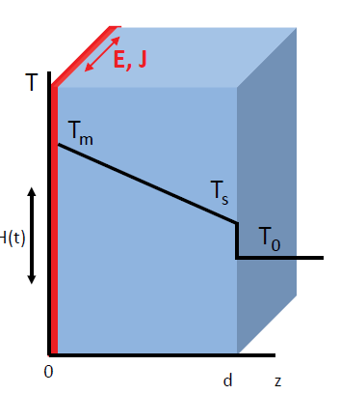
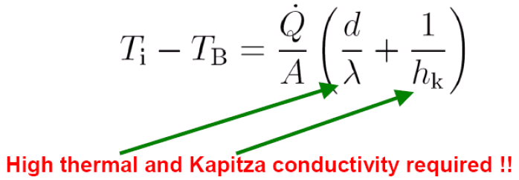
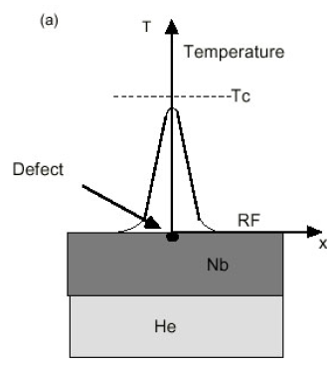
Thermal breakdown
Small size particles on RF surface coupled with poor thermal conductivity of Nb wall at low temperatures can cause thermal breakdown
Thermal breakdown occurs when the heat generated on RF surface exceeds the heat conduction capacity from RF surface through cavity wall and Nb-He interface to liquid helium bath

Slide 17
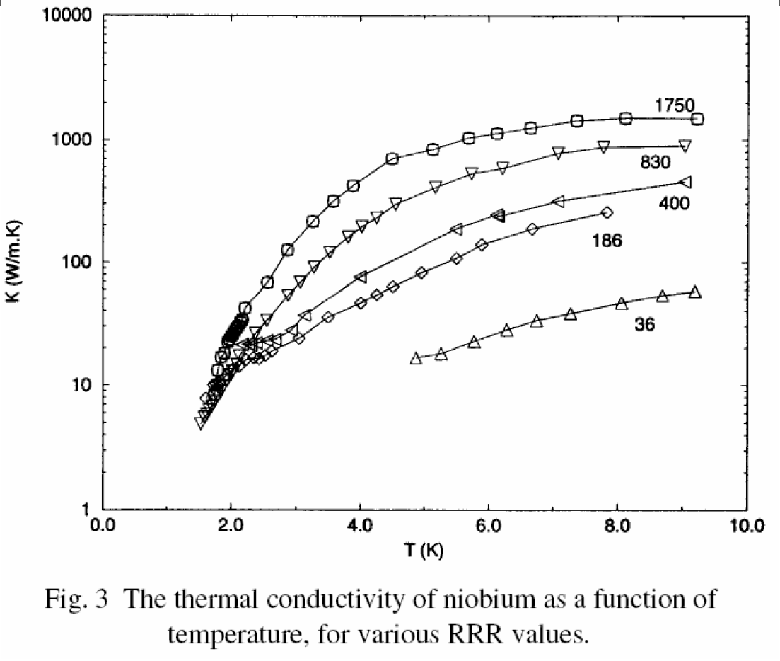
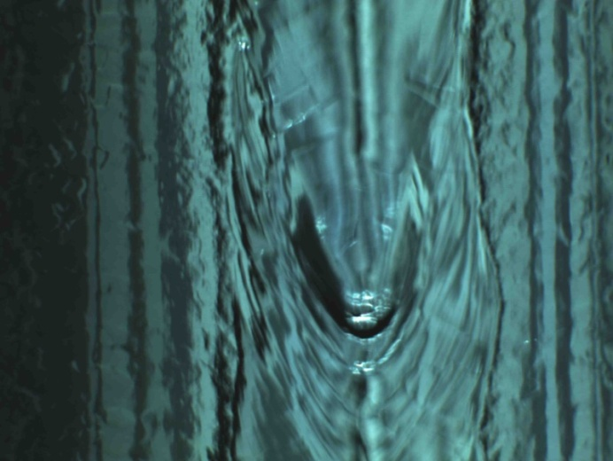
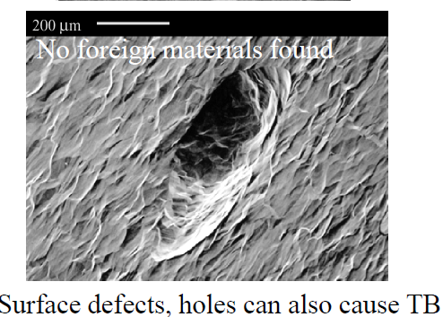
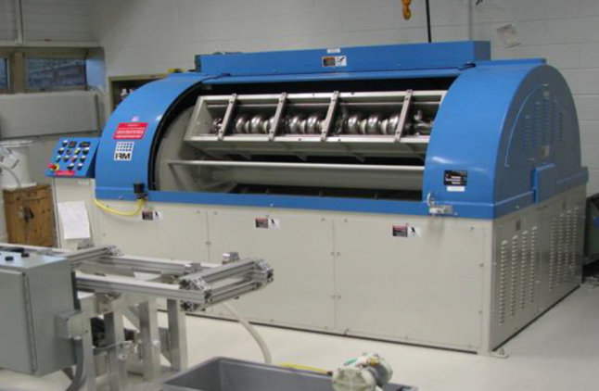
Thermal breakdown
Defects on niobium surface is a common occurrence especially close to the electron beam weld regions, where niobium melting (Tm=2700 K) and rapid solidification occur.

Slide 18
Limitation:
Thermal breakdown
High field Q-reduction
High-purity Nb, sheet inspection, CBP, etc
Electropolishing,
low temperature baking, …
Solution:
1975
3 MV/m
1985
6 MV/m
1990
15 MV/m
1995
25 MV/m
2000
40 MV/m
2010
50 MV/m
Electron multiplication
Electron field emission
Limitation:
Quench
Improved cavity shape
High-pressure rinsing, cleanroom procedures
Further improved cavity shapes
Solution:
High field Q-reduction

Slide 19
Electron field emission
Electron current is not expected from Nb surface below GV/m. Experiments with single-crystal Nb samples show FE onset higher than 1 GV/m
Tip-on-tip model

Slide 20
Electron field emission

Slide 21
Limitation:
Thermal breakdown
High field Q-reduction
High-purity Nb, sheet inspection, CBP, etc
Electropolishing,
low temperature baking, …
Solution:
1975
3 MV/m
1985
6 MV/m
1990
15 MV/m
1995
25 MV/m
2000
40 MV/m
2010
50 MV/m
Electron multiplication
Electron field emission
Limitation:
Quench
Improved cavity shape
High-pressure rinsing, cleanroom procedures
Further improved cavity shapes
Solution:

Slide 22
High field quench
Reduction of surface magnetic field by increasing magnetic volume

Slide 23
Ideal?
11
10
Ideal?
10
Q₀
10
Real
Real
Real
9
10
8
10
0
20
40
60
E_{acc}, MV/m

Slide 24
Unexpectedly, a reduction in resistance (or inversely, an increase in Q) with field have been recently seen on a number of heat treated cavities.

Slide 25
Higher gradients?
Limitation:
Thermal breakdown
High field Q-reduction
High-purity Nb, sheet inspection, CBP, etc
Electropolishing,
low temperature baking, …
Solution:
?
1975
3 MV/m
1985
6 MV/m
1990
15 MV/m
1995
25 MV/m
2000
40 MV/m
2010
50 MV/m
Electron multiplication
Electron field emission
Limitation:
Quench
Improved cavity shape
High-pressure rinsing, cleanroom procedures
Further improved cavity shapes
Solution:
High field Q-reduction

Slide 26
Path forward?
Material | T_{c} (K) | ρ_{n}(μΩcm) | H_{c}(0) [T] | H_{c1}(0) [T] | H_{c2}(0) [T] | λ(0) [nm]
Nb | 9.2 | 2 | 0.2 | 0.17 | 0.4 | 40
NbN | 16.2 | 70 | 0.23 | 0.02 | 15 | 200
NbTiN | 17.5 | 35 |  | 0.03 |  | 151
Nb₃Sn | 18 | 20 | 0.54 | 0.05 | 30 | 85
V₃Si | 17
Mo₃Re | 15 |  | 0.43 | 0.03 | 3.5 | 140
MgB₂ | 40 |  | 0.43 | 0.03 | 3.5 | 140
50 nm of Nb₃Sn

Slide 27
Bulk Nb₃Sn

Slide 28
Nb on Cu
Bulk Nb
40 MV/m +

Slide 29
JLab SRF in Summary
State-of-the-art manufacturing, processing and testing facilities for SRF cavities
Ongoing R&D for LCLS-II, MEIC, and other projects
Preparing for production of LCLS-II cryomodules
Consulting with others on future projects
World class R&D projects:
Cavity design and simulation (high current)
Material development (large-grain Nb, thin films)
Surface processing (electropolishing)
Basic SRF physics (understanding anomalous RF losses)
Reduce cost and improve reliability of SRF accelerators worldwide

Slide 30
Thank you for listening and I hope you are having a great summer at JLab!

