Slide 1
Extracting the Proton Radius from Electron Scattering Data Why the proton radius is smaller in Virginia
Douglas W. Higinbotham

Slide 2
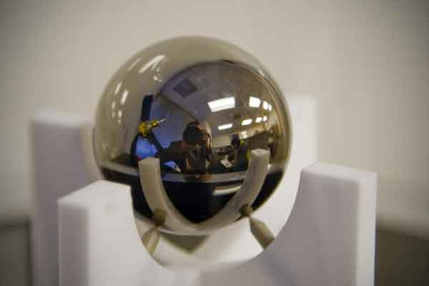
How many ways can YOU determine the radius of a perfect sphere?!
Image of the sphere created to test theory of relativity on the Gravity Probe B spacecraft.

Slide 3
Some Answers
Diameter = 2 r
Area = π r²
Volume = 4/3 π r³ (displacement of water)
Momentum of Inertia
2/5 m r² (solid sphere)
2/3 m r² (hollow sphere)

Slide 4
Charge Radius of the Proton
Proton is hard as there are currently only a few ways to get the radius
Atomic Hydrogen Lamb Shift ( ~ 0.88 fm )
Muonic Hydrogen Lamb Shift ( ~ 0.84 fm)
And of course elastic electron scattering!
Heavy nuclei are relatively easy (little recoil)
Measure charge form factor
Take Fourier Transform
Even better if you measure a diffraction minimum!

Slide 5
Rosenbluth Formula
From relativistic quantum mechanics one can derive the the formula electron-proton
scattering where one has assumed the exchange of a single virtual photon.
where G_{e} and G_{m} take into account the finite size of the proton.
G_{E} = G_{E}(Q²), G_{M} = G_{M} (Q²); G_{E}(0)=1, G_{M}(0) = μ_{p}
Q² = 4 E E’ sin²(θ/2) and τ = Q² /4m_{p}²

Slide 6
Standard Dipole Radius: 0.81(1) fm
L.N. Hand, D.G. Miler, and R. Wilson, Rev. Mod. Physics 35 (1963) 335.
Due to its light mass, relativistic corrections make the proton radius more challenging.
For the proton, we extract the radius by determining the slope of Ge at q²=0.
Took the data that was available, fit it with Taylor N=1 and 2,, and got the slope at q² = 0.
DO IT YOURSELF!! If you make different choices you will get slightly different answers!

Slide 7
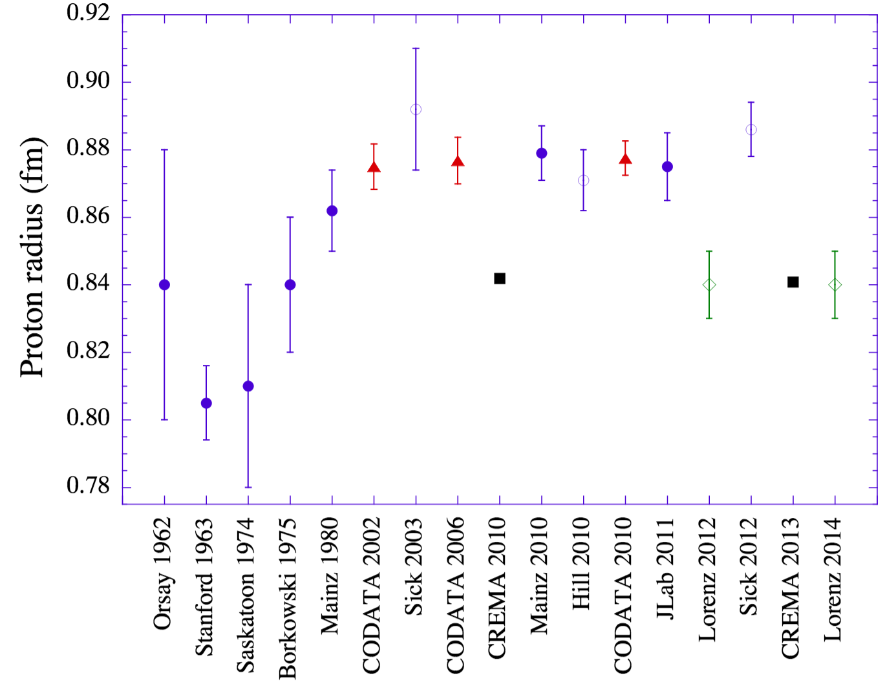
Proton Radius vs. Time
V. Punjabi et al., Eur. Phys. J. A51 (2015) 79.

Slide 8
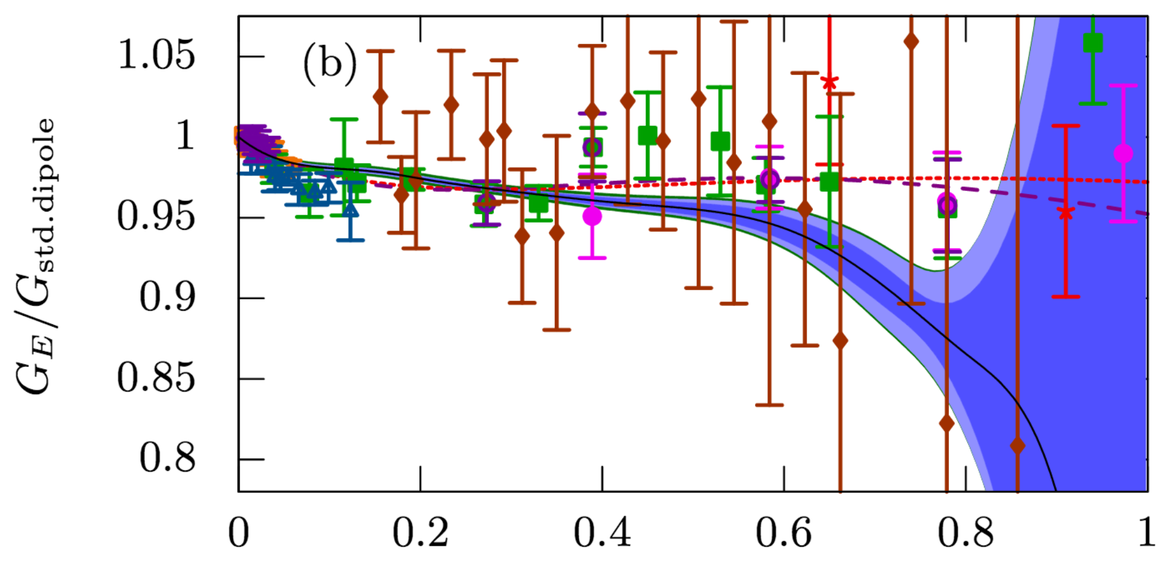
Mainz 2014 G_{e} (Blue Band)
From J. Bernauer et al., Phys Rev. C90 (2014) 015206.
Note the spline G_{e} fit at high q² starts to fall as soon as it is not constrained by their data.

Slide 9
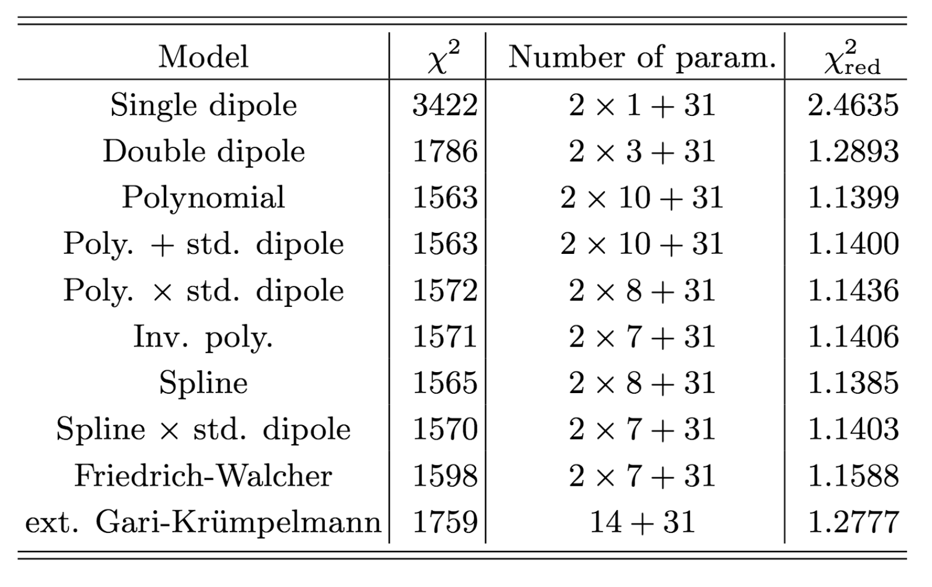
Mainz 2014 Fitting Results (G_{e} & G_{m})
Did not follow a standard statistical method, such as an f-test, to determine number of parameters. Instead, the authors just state chi2 <1600 are “analyses with the good models.”
PLEASE READ: Data Reduction and Error Analysis for the Physical Sciences by Bevington &Robinson and don’t just use chi2 to judge which fit is most likely. (i.e. probabilities)

Slide 10
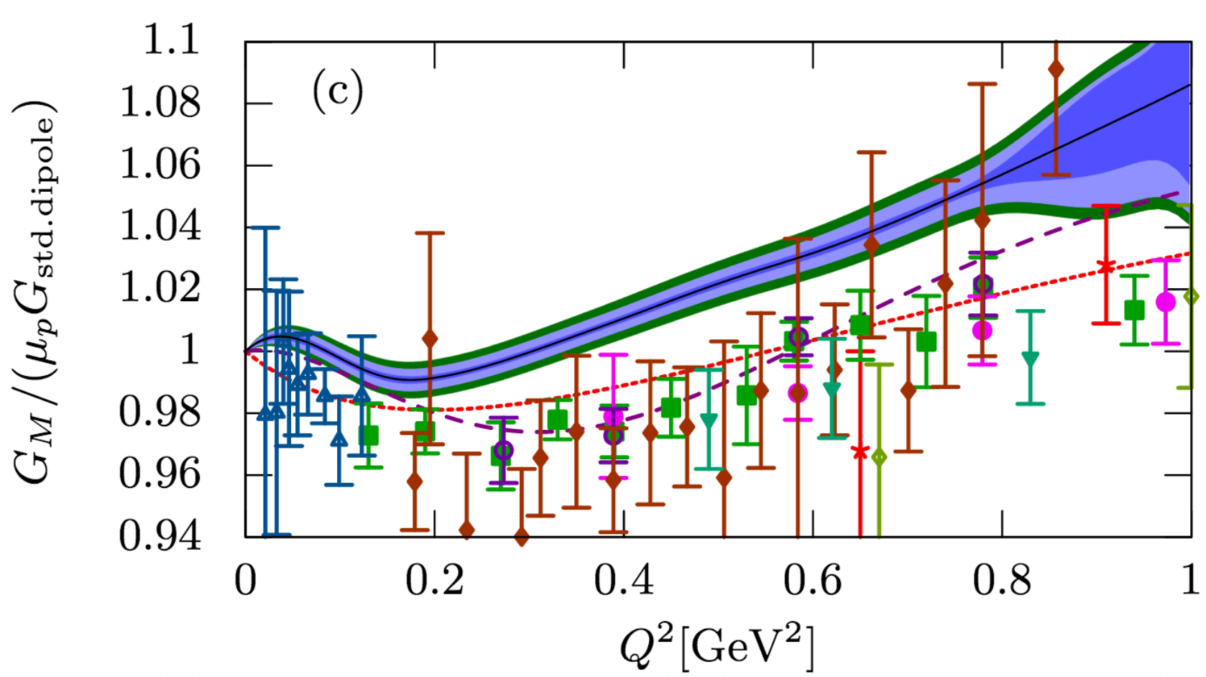
Tension With World G_{m} Results
From J. Bernauer et al., Phys Rev. C90 (2014) 015206.
The 1.6% shift that is suggested by their “double dipole” fit would bring Mainz to the world data.
NOTE: G_{e} and G_{m} do not need to be the same function!

Slide 11
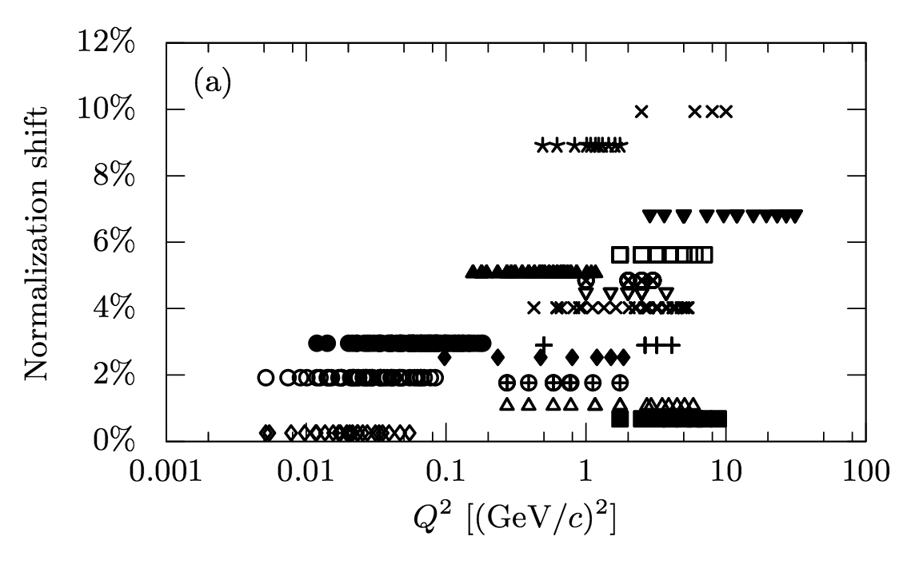
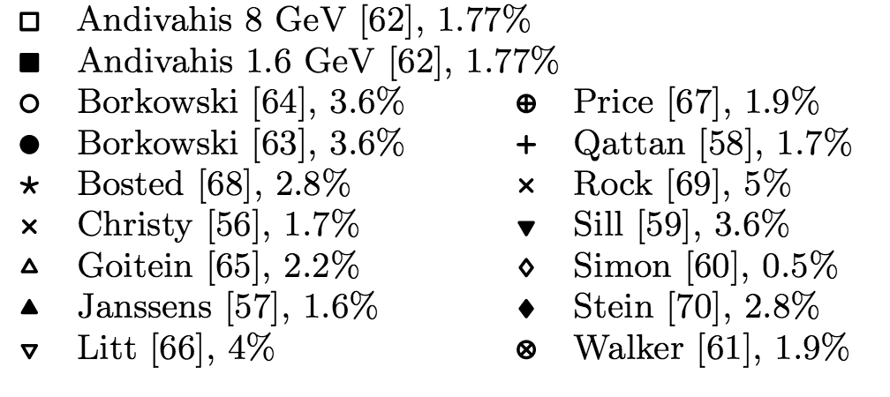
Spline Fit Normalization Shifts of World Data
Fig 19 of Bernauer et al., Phys. Rev. C90 (2014) 015206.
Experiments and uncertainties
“As can be seen, all shifts are positive, i.e., the actual cross sections as reconstructed
by the fit are large then the values quoted. … While it may look strange that all shifts are positive, the mean of the normalization falls together with the shift of the oldest measurement [57], …” - Bernauer et al.
Completely dismissing the fact their fit disagrees with world data?!

Slide 12
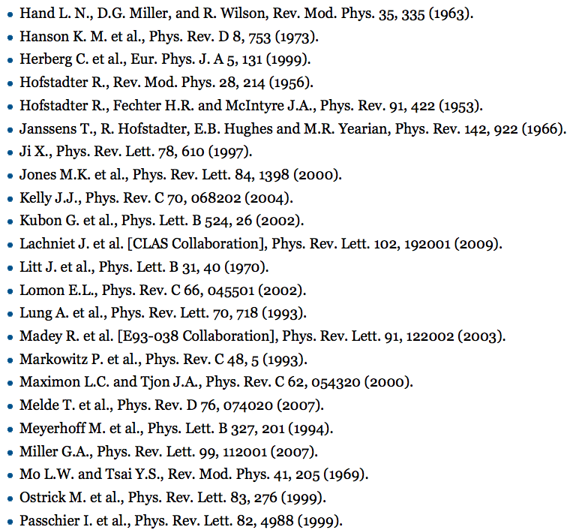
Saskatoon 1974 (elastic recoil proton)
missing from MANY global fits
As of 2 Feb. 2016, not even listed in the extensive Scholarpedia proton form factor articles : http://www.scholarpedia.org/article/Nucleon_Form_factors
J. J. Murphy, II, Y. M. Shin, and D. M. Skopik,
Proton form factor from 0.15 to 097 fm-2,
Phys. Rev. C 9 (1974) 2125.
Please add here! ->

Slide 13
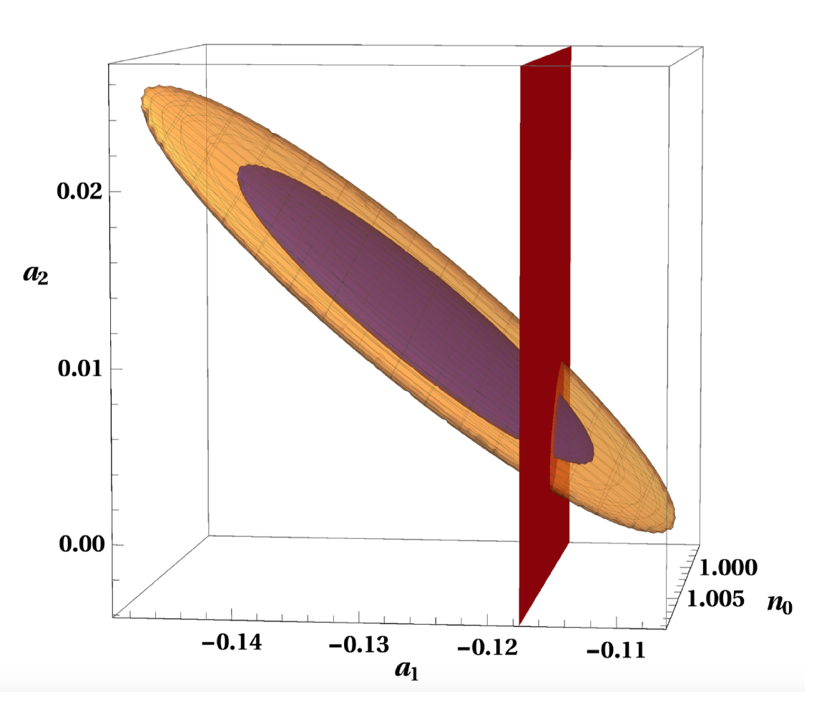
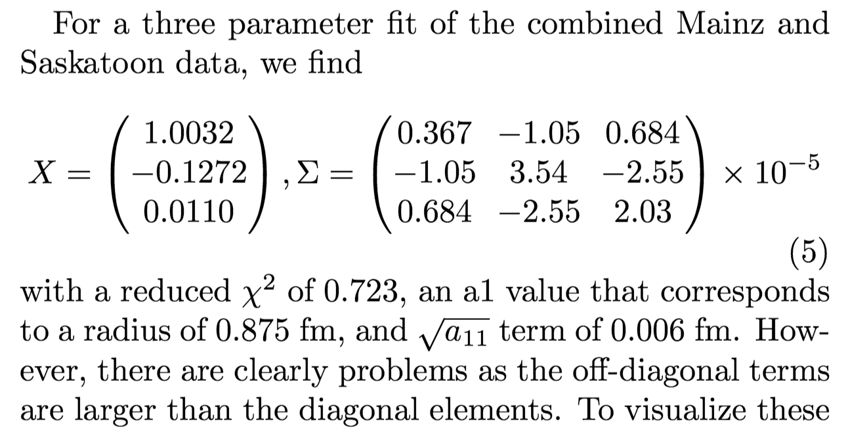
Mainz80 and Saskatoon74
Prior to new Mainz results ~2010: Lowest, High Precision G_{e} Measurements
Continued Fraction fit of this set of data
produces a similar result.
“DISCOVERED” BY MOVING THE LAST DATA POINT ONE SIGMA AND SEEING THE EFFECT ON THE RESULT
Thus, a three parameter fit of the full range of data agrees with both 0.84fm and 0.88fm radius.
Doing f-tests (see Bevington) one finds that going to second order isn’t justified by the data!

Slide 14
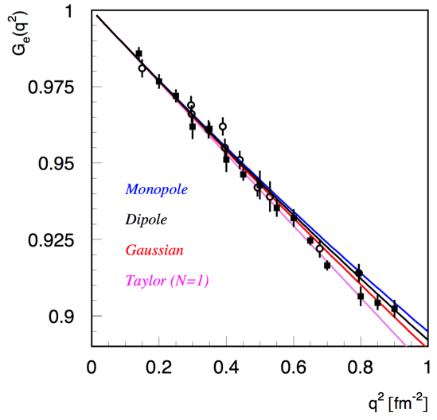
Back To The Taylor Extrapolations . . .
Hand et al.’s ideas but now with MUCH better data
D.W.H. et.al.,arXiv:1510.01293
K. Griffioen et. al., arXiv: 1509.0667
Classic Data from Mainz and Saskatoon data
0.84(1)fm
New Mainz data re-analysis
1 fm ⁻² = 0.0389 GeV²
Latest Mainz data

Slide 15
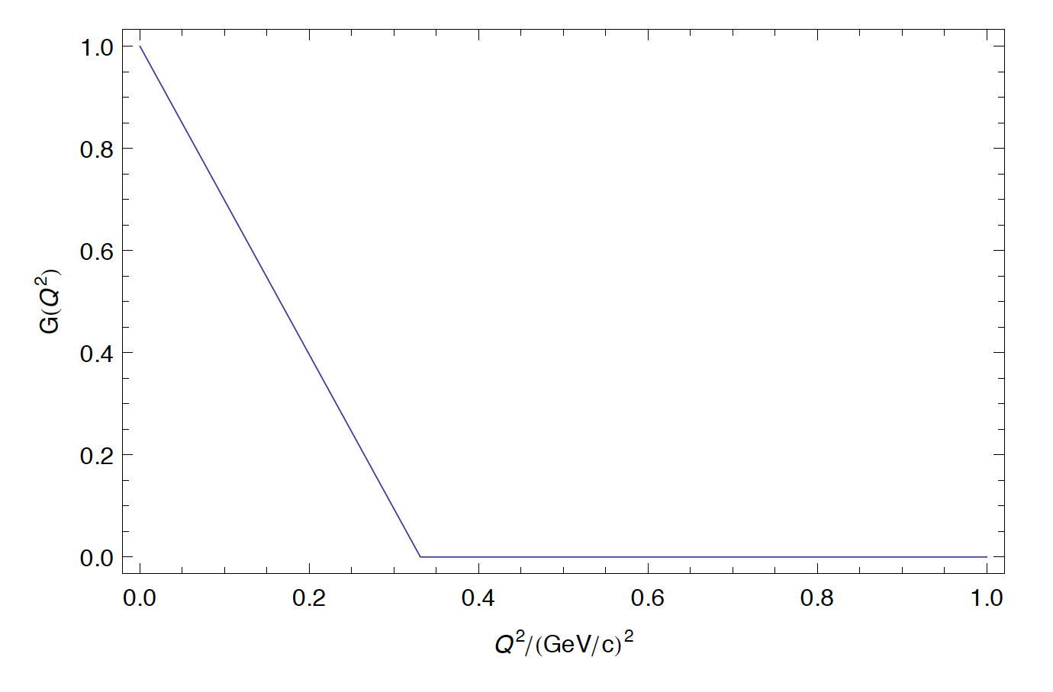
from comment arXiv:1511.00479
Of course the linear function doesn’t work to all Q², though it is amusing to note
this function does have a charge radius of 0.84 fm.

Slide 16
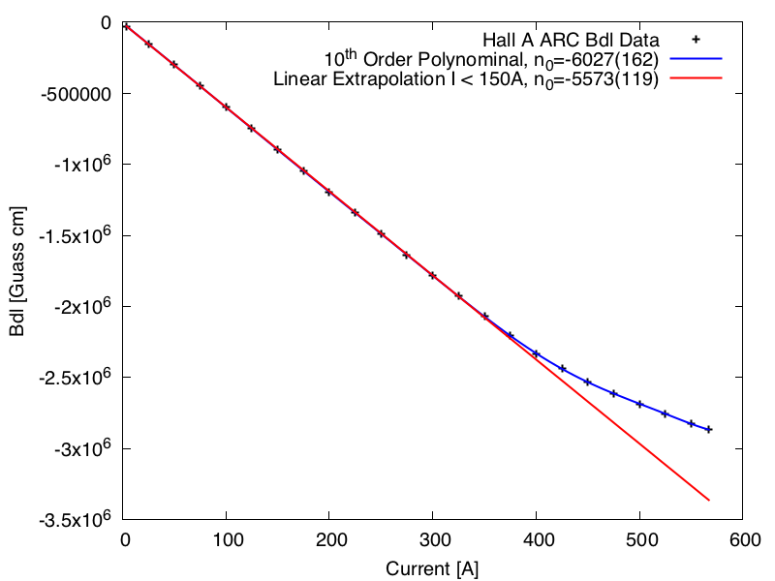
Example of Precision vs. Accuracy
Shown with simply with asymptotic standard error which can be very misleading . . .
data used in linear fit
Hall A 9th Dipole Magnet Data
Linear Fit of Low Current Data Accurately Extrapolates The Residual Field n₀ (also extrapolates from 150A to 300A)
The 10th Order Polynomial Fit Precisely Describes The Data But Doesn’t Extrapolate Well

Slide 17
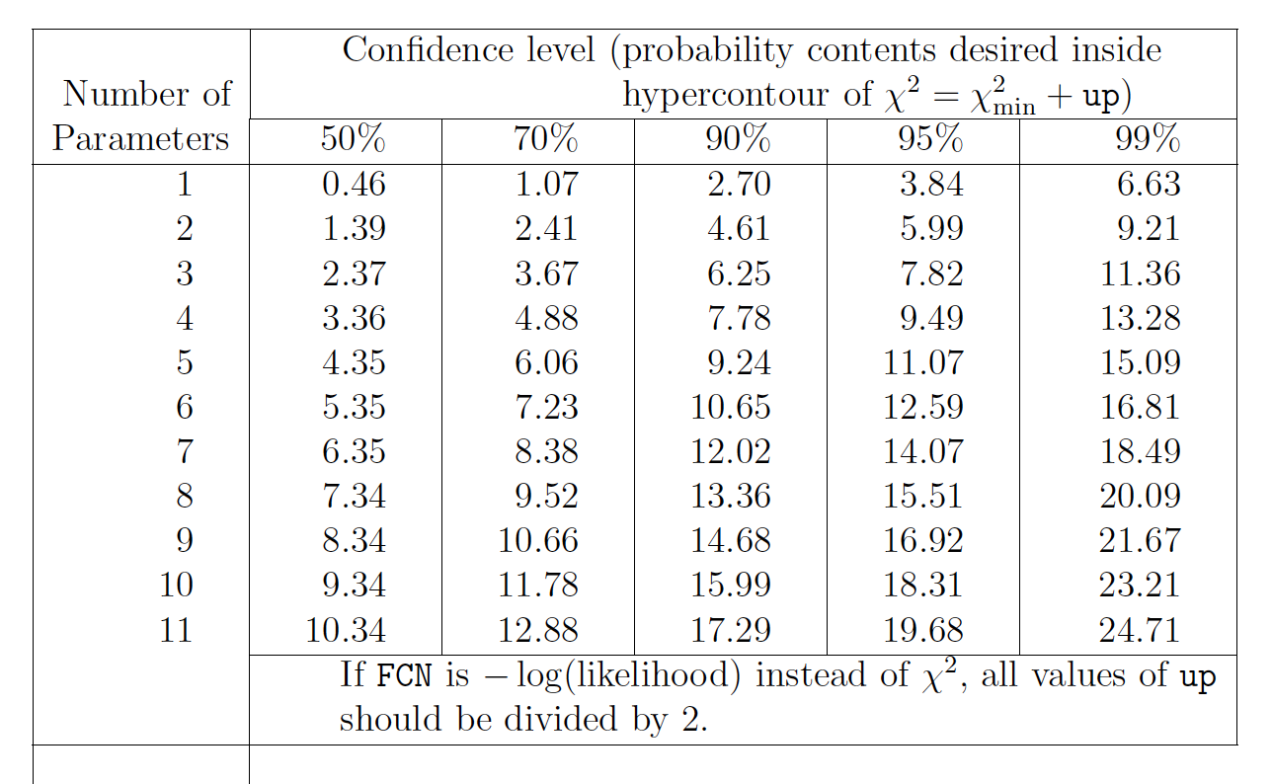
Multivariate Errors
As per the particle data handbook, one should
be using a co-variance matrix and calculating the
probably content of the hyper-countour of the
fit. Default setting of Miniut of “up” is one.
Standard Errors often underestimate true
uncertainties. (manual of gnuplot fitting has an
Explicate warning about this)

Slide 18
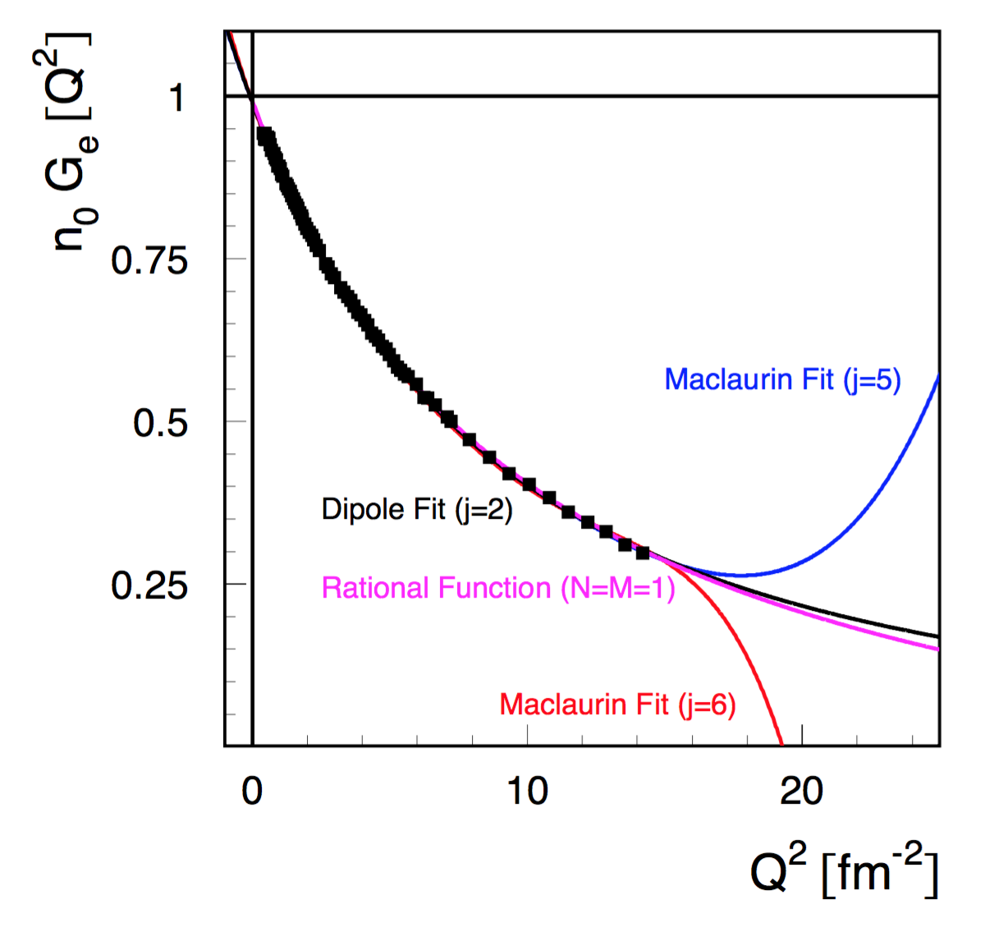
Fits of the Mainz 2014 G_{E} Rosenbluth Data
Rational Function & Dipole give radius of ~0.84 fm with Maclaurin (j=5 & 6)

Slide 19
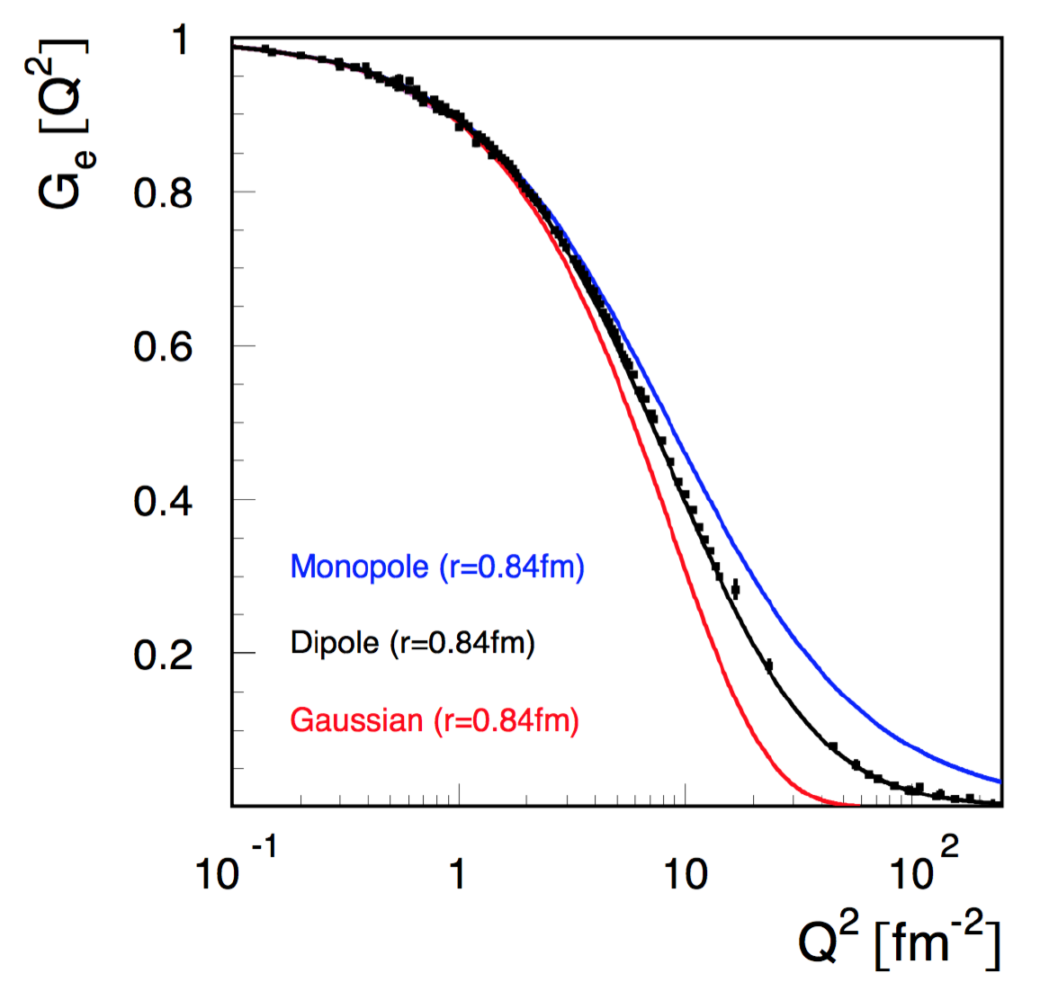
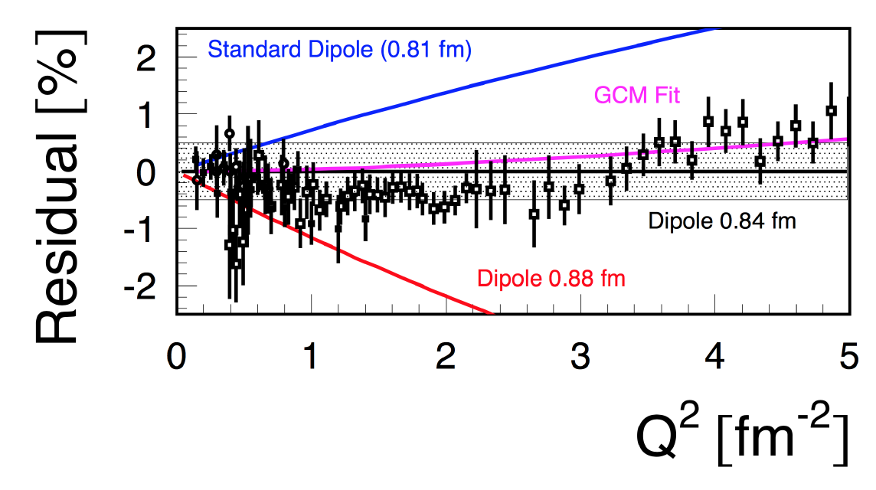
Charge Form Factor with Dipole (0.84fm)
Using the classic data along with the Mainz 2014 “Rosenbluth” G_{E} Results
Data shown with 1/sqrt(N) errors only.
Gray error is a 0.5% systematic error band.
Within the range of the Mainz data, this result is very similar to Griffioen’s CF (N=4) fit.

Slide 20
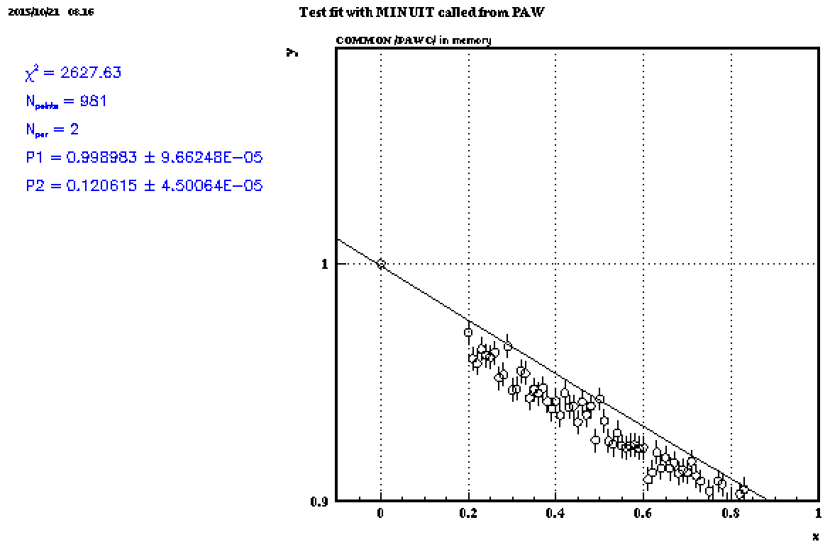
The Problem with the intercept
FAUX DATA: Real function y(x) = 0.985*( 1 + 0.1176*x)**(-2) randomized point-to-point & systematically shifted (i.e. the normalization isn’t perfect)
i.e. if you fit this data without letting the end point float . . . reduced chi² = 2.7 !

Slide 21
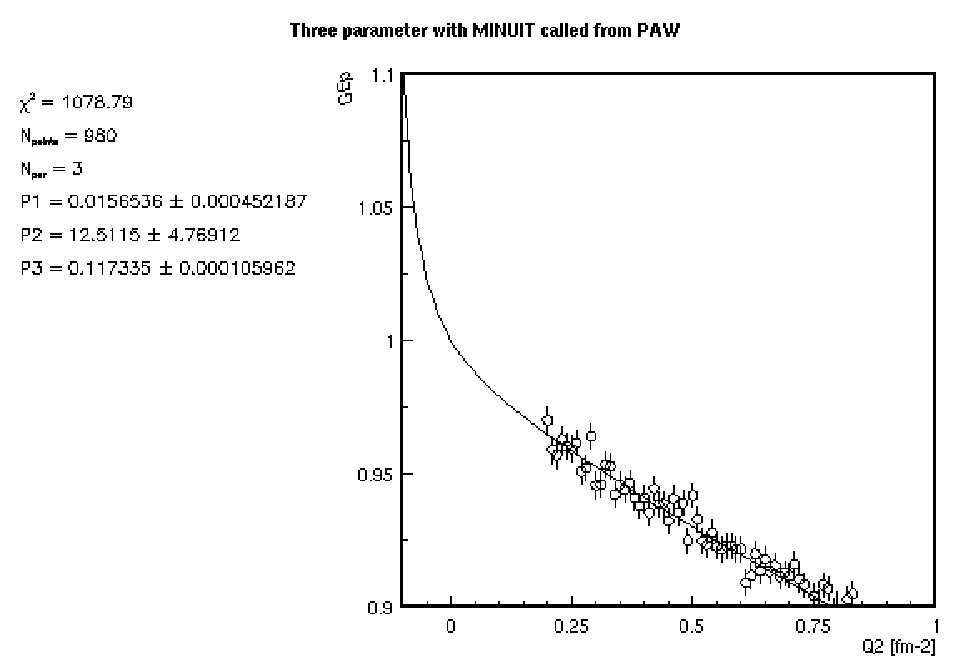
Same Faux Data Now Fit with Double Dipole
Note: Now you get the same result with or without the intercept point.
FAUX DATA: Real function y(x) = 0.985*( 1 + 0.1176*x)**(-2) randomized point-to-point & systematically shifted (i.e. the normalization isn’t perfect by 1.5%)
Reduced chi2 very close to one, BUT this wasn’t the original function!!

Slide 22
Mainz 2014 Fitting Results (G_{e} & G_{m})
The Mainz 2014 supplemental material has all the data and an example Python fitting script.

Slide 23
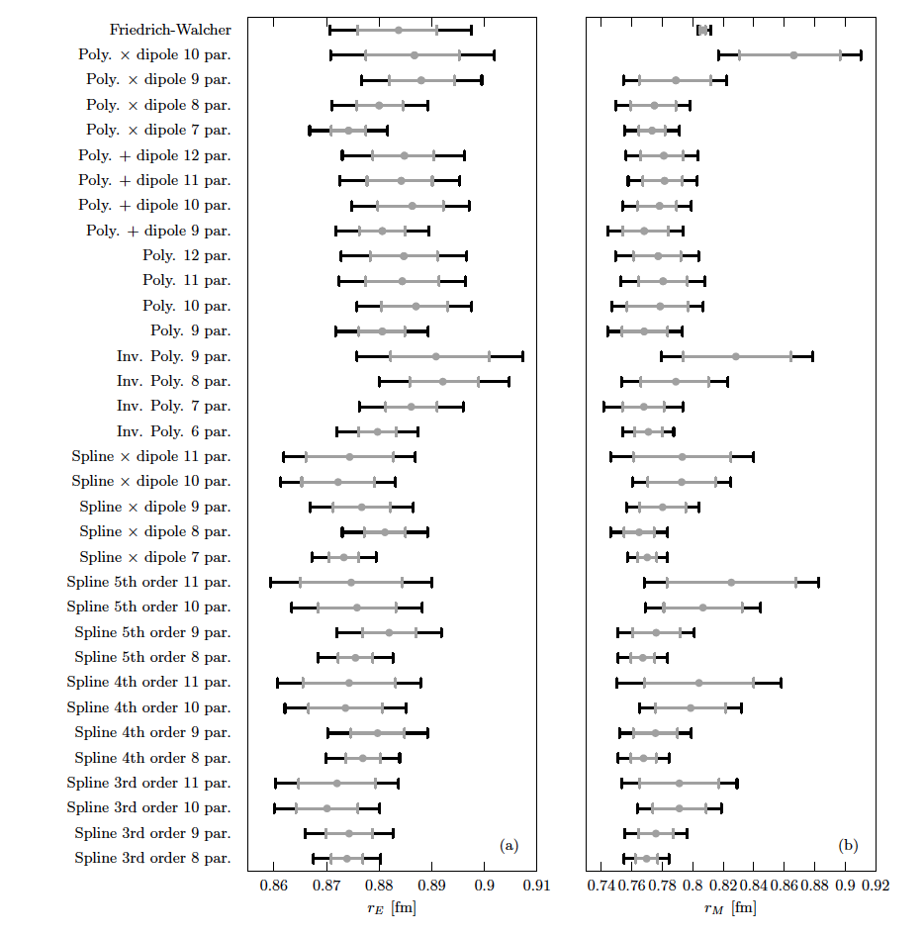
The Mainz Phys. Rev. C Only Shows High Order Fits !?

Slide 24
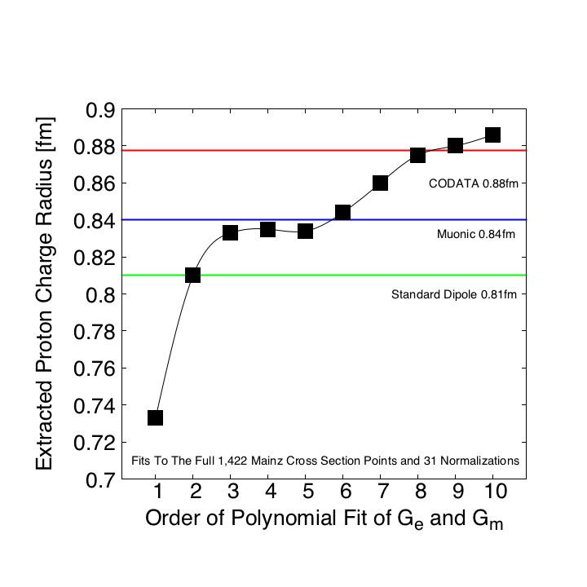
Proton Radius vs. Order of Polynomial Fits
Fits to the full Mainz 2014 Data Set Using A Python Fitting Code That Reproduces The PRC Results
R² (goodness of fit measure which runs 0 to 1) gets to 0.97 by 4th order and 0.98 by 10th.

Slide 25
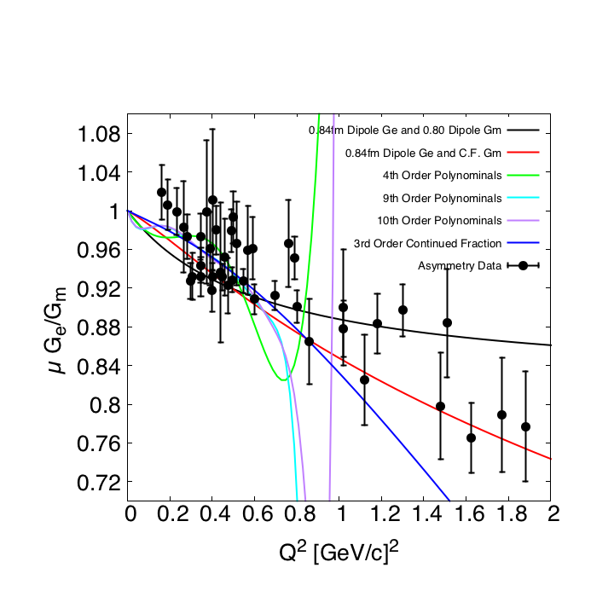
But how well do these high order fits do against data not included in the fit?!
Using the full Mainz data and a Python fitting code based on the Mainz fitting routine.
The lower order fits to the Mainz data also give agreement with world G_{M} & a smaller radius…

Slide 26
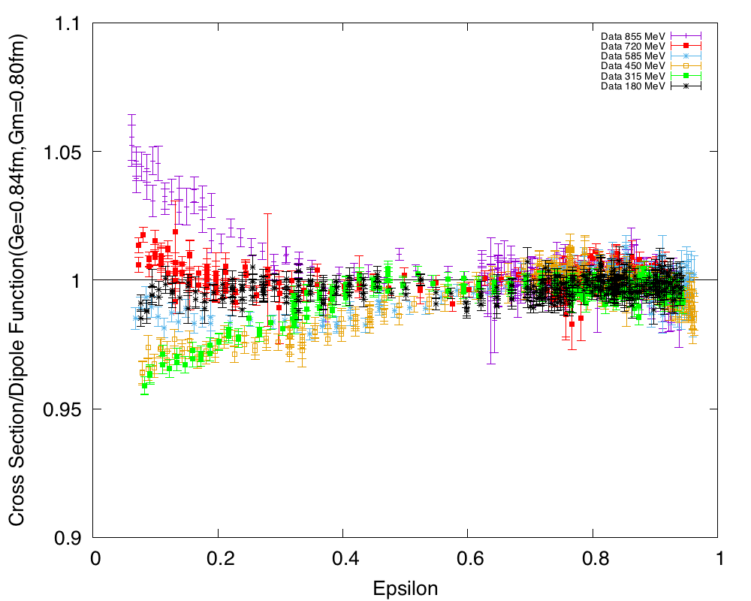
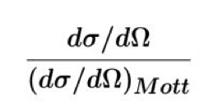
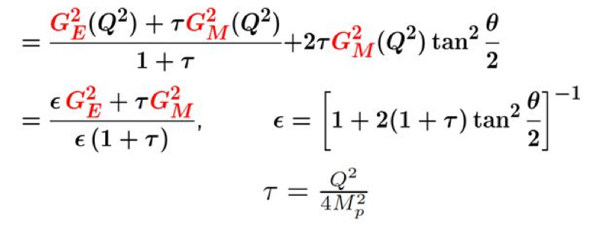
So what is going on?!
It is the back angle data (i.e. G_{M} dominated) that is driving the chi2 for the lower order fits.

Slide 27
Same Data Plotted vs. Q²
Extreme Back Angle Data That Is Approaching A Singularity
NOTE: Q² = Q²(E,theta) has a kinematic max., Q²_{max}(E,180º), which these fits nicely reproduce

Slide 28
Summary
One can find different proton radii depending on the function used for the fit (model dependence).
Linear Extrapolations of the lowest q² data (Maclaurin sereis
N=1) give results consistent with muonic hydrogen (~0.84 fm)
Advantages of low Q²: floating normalization and tiny G_{m} contribution. (model independence)
Do NOT just shift the low Q² data without redoing the normalization (i.e. if you add a correction to the cross sections, you need to start over with the normalization procedure otherwise you are biasing the result by shifting the points without moving the intercept)
Currently working with better extrapolation functions (i.e. Rational Fractions & Chebyshev polynominals) to do our own fit to the full set Mainz 2014 published data.
Our preliminary model independent fits results agree with Griffioen, Carlson, Maddox’s fit and world G_{m} data… but what about all the other global fits!?

Slide 29
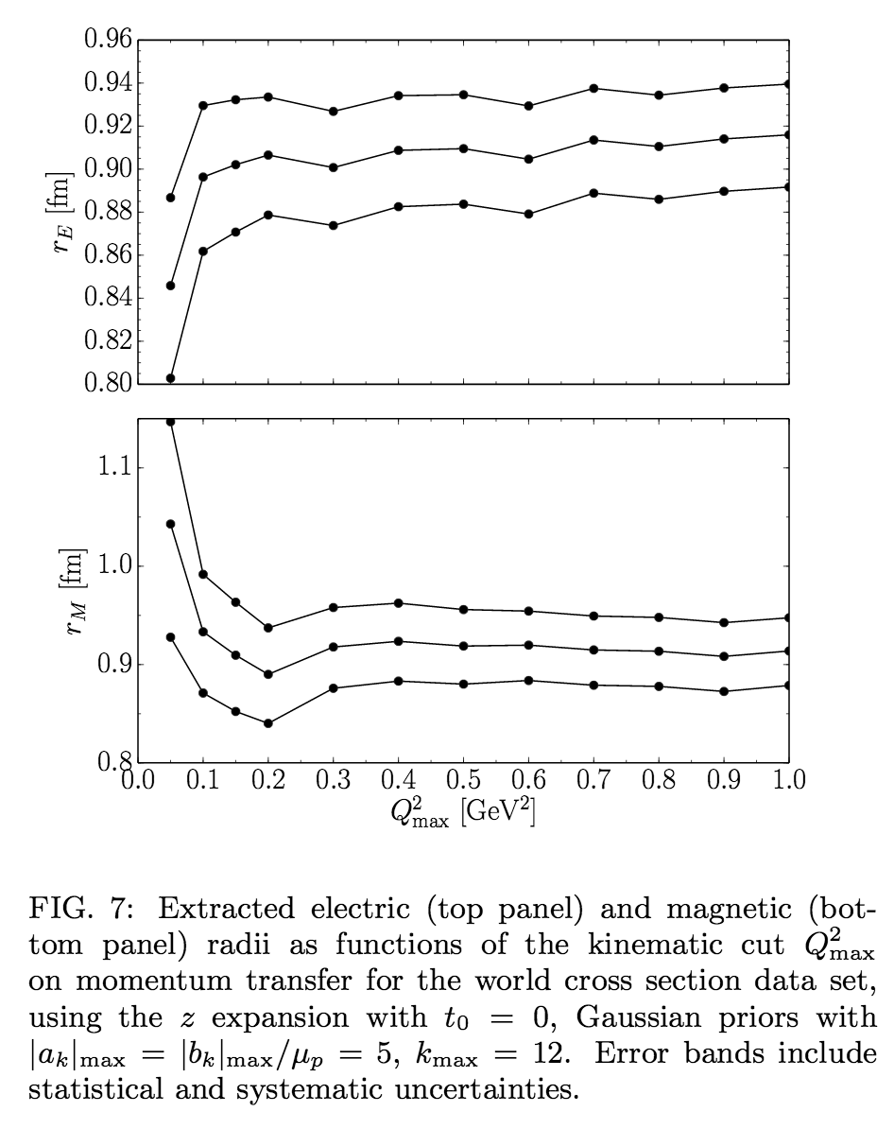
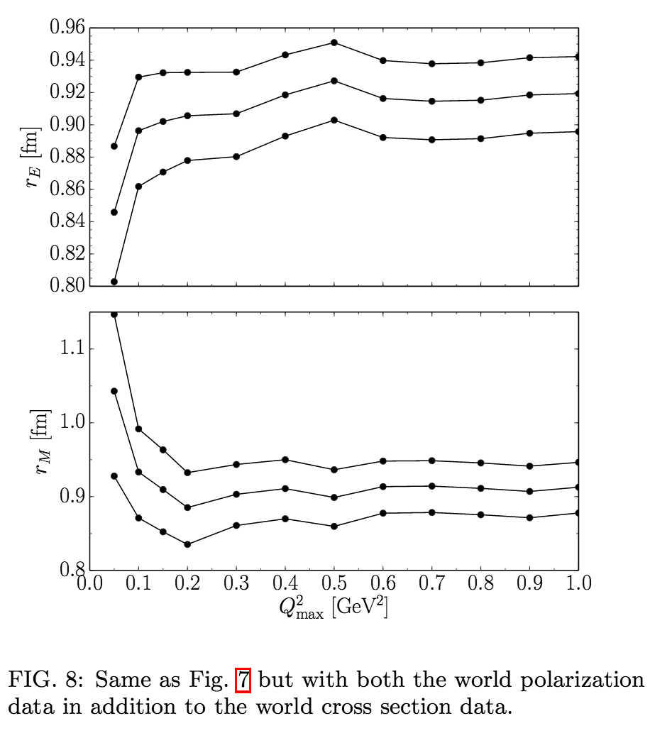
Global Fit vs Cutoff in Q²
Gabriel Lee, John R. Arrington, and Richard Hill, Phys. Rev. D92 (2015) 013013
Very Low q² G_{e} dominates the cross section & very high q² G_{m} dominates the cross section.
(i.e. for this fit it depends on which why you look at the plot)

Slide 30
