Slide 1
The Discovery of the Quark
Mac Mestayer, Jlab
the discovery of the nucleus - “Rutherford scattering”
  method: measure scattering rates vs. angle
the discovery of quarks
  evidence that the proton is not a ‘point’ particle
  evidence for charged “partons” inside the proton
  properties ( frac. charge, spin, momentum )
the continuing search
  details of quark-pair creation
detectors
Notes:
Hello and thanks for the opportunity to talk about a simple but engrossing quest of particle physics - to find the smallest bit of matter. I’ll start off with a review of the discovery of the nucleus by Prof. Rutherford and his co-workers. This experiment illustrates the method we still use to study subatomic particles: direct a beam of particles at a target and count the number of particles coming off per second at various angles and momenta. I’ll then move on to the 1950’s as physicists started to explore the inner structure of the proton. I’ll then talk about the studies in the 1970’s that revealed that the proton was composed of sub-constituents called partons, and will discuss various measurements which led to the classification of these partons as definite particles called quarks, and the establishment of a new theory of quarks and quark forces called Quantum Chromodynamics (your recent speaker, Prof. Wilczek got the Nobel Prize for this).
I’ll then move on to more modern studies whose goal is to understand the nature of q-qbar pair creation…. and on the way I’ll talk about experimental equipment.

Slide 2
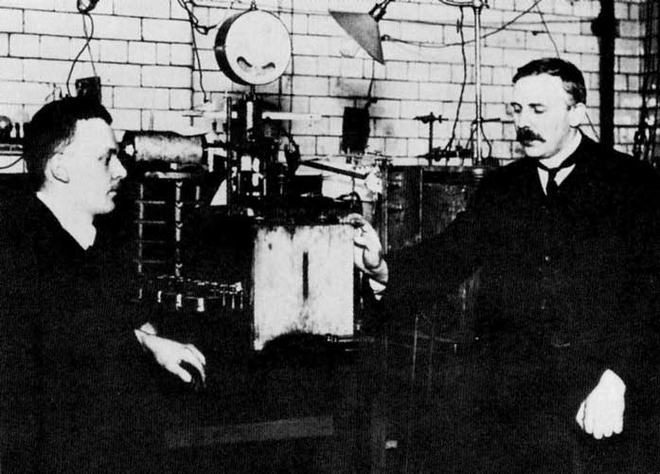
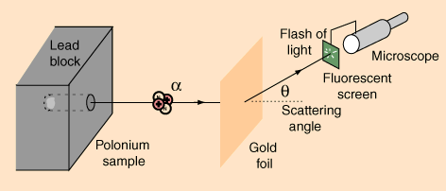
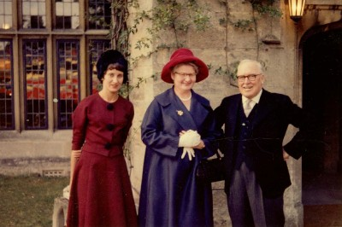
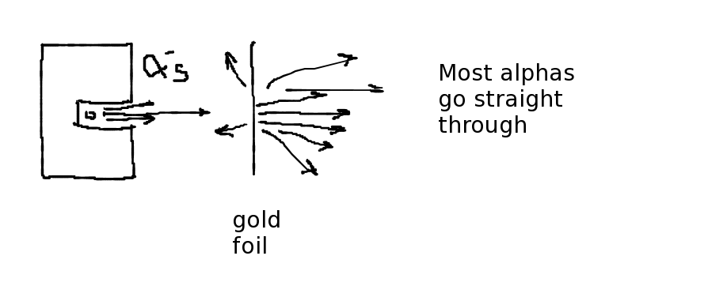
Atomic structure
(1897) electron discovered
→ how is it arranged with the positive charge?
Lord Kelvin - “raisin pudding” model
→ electrons are ‘raisins’ embedded in a positive ‘pudding’
at University of Manchester; use α-particles as a beam
Rutherford, Geiger, Marsden: (professor) (post-doc) (undergrad)
Hans Geiger Ernest Rutherford
but- a few at large-angle !
‘backscatters’ due to small,
heavy nucleus
Ernest Marsden
Notes:
Now for a brief review of Rutherford scattering: you’ll see that the method for probing sub-atomic structure is still the same today as in Rutherford’s time - but the equipment has changed considerably.
The situation at the beginning of the last century was that the electron had been discovered and the next question was “how are these negative particles combined with some kind of positively-charged material to give neutral matter?”
Lord Kelvin proposed a “raisin pudding” model with the “raisins” being electrons. Meanwhile our trio of professor, post-doc and undergrad (Ernest Rutherford, Hans Geiger and Ernest Marsden) were performing a scattering experiment.
The “beam” consisted of alpha-particles from the radioactive decay of radon; and the target was a thin gold foil. The detector was a fluorescent screen (ZnS) in a darkened room coupled with a microscope and the tired eyeballs of the post-doc or student. They counted individual “hits” when the deflected alpha’s struck the screen; recording the scattering rate and the angle of the instrument.
Most went through, but surprisingly for followers of the “raisin pudding” models, some scattered back at large angles.

Slide 3
relation between rates and angle
“beams-eye” view
side-view → scattering angle
distant approach → small angle
θ
impact parameter “DOCA”
measure at 4
angle settings
4 rings of approach distance
More area for small-angle scattering → higher rates
Notes:
Now I want to briefly review the relationship between rates of scattering and the angle of scattering and what it implies about the size of the target particle: in this case the nucleus of the gold atom.
Because the force falls off like 1/r^2; the scattering angle is smaller for beam particles which approach the scattering center far off-center. This is similar to the motion of comets. I’m showing the picture for an attractive force, but a similar picture works for repulsive forces.
Secondly, when we measure the rate vs. angle, we are measuring in a certain angular range, for example, maybe between 20 and 30 degrees (it depends on the aperture of the recording instrument). This is illustrated by the colored wedge-shaped areas shown here. To be explicit, consider that we take measurements at 4 angle settings.
Now looking at the target nucleon from the beam’s point of view, we see that the distance that the beam particle is off-axis from a “direct hit”, known as the distance-of-closest-approach or “impact parameter” corresponds to a particular angle for the scattered particle: the closer the approach the larger the angle.
Now at the tiny distances we’re considering, the beam is a random “scatter-shot” in terms of DOCA. Now you can see that there is more area at larger DOCA’s so there are higher rates for large DOCA (small angles).

Slide 4
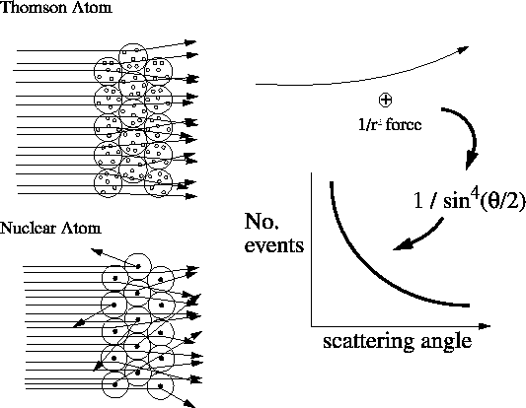
The “Rutherford scattering”* experiment
* done by Geiger and Marsden
Rutherford did calculations like orbital mechanics ; using 1/r² electrostatic forces and a massive charged center.
Knowing the charge of the nucleus and the alpha particle, he estimated that the nucleus was smaller than 10⁻¹² cm.
Notes:
Qualitatively, the observation of large-angle scatters ruled out the “raisin-pudding” model.
Rutherford came up with a model of what was going on; that the atom was composed of a very small but heavy nucleus surrounded by a cloud of light electrons.
He used orbital mechanics equations (like Newton) assuming a 1/r2 force (ala Maxwell) and could match the data. The 1/r2 force gave a 1/sin^4(theta/2) distribution of scattering angles for the alpha’s which matched the observations. Since he knew the force (because he knew the charges of the gold nucleus and the alpha) and since he also knew the energy of the alphas, the fact that he observed a perfect 1/r2 force told him that the nucleus was smaller than 3 * 10-12 cm (otherwise, the alphas would have penetrated inside the nucleus and experienced a smaller force due to the smaller amount of enclosed charge)
The nucleus was discovered … and a method was established: measure scattering rate as a function of angle … used over and over to the present day …

Slide 5
Probing deeper & deeper into the Nucleus
Observation | Who/When | Conclusion
many large-angle scatters | Rutherford, Geiger, Marsden, 1907 | nucleus is massive, concentrated in one place
scattering angle ~ 1/sin⁴θ/2 | “ | force ~ 1/r², just like comets’ orbits; R_{nucleus} < 10⁻¹² cm
eP elastic scattering, fall-off from expected ang. dist’n | Hofstadter, 1957 | probe has penetrated within proton, proton has a finite size of ~1 fermi
eP inelastic rates depend only on ratio of mom./energy “scaling” | Taylor, Friedman, Kendall, 1977 | electron is scattering elastically from a structureless component of the proton, a “parton”
detailed kinematics of scattering | Perl, Hanson, theorists | “partons” have fractional charge, spin ½ → partons are “quarks” !!
detailed pattern of scale-breaking | the troops | theory of the quark dynamics: QCD

Slide 6
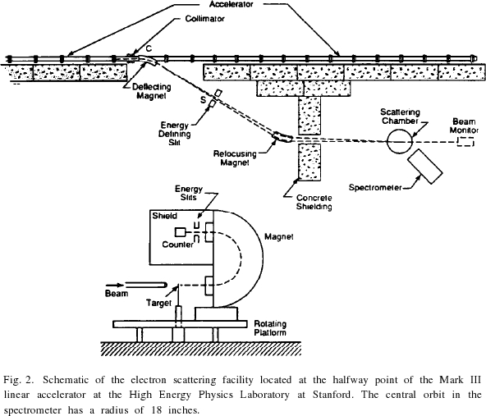
Electron Scattering - Bigger & Better
(1950’s) Cornell & Stanford Univ’s built electron accelerators to study the structure of the nucleus, and even of the proton.
Electron scattering from Hydrogen
→ deviation from 1 / sin⁴(θ/2)
→ proton is NOT a point particle
→ radius (proton) ~ 10⁻¹³ cm
1 m.
Notes:
I now “fast-forward” to the mid 1950’s; the atom is known to consist of a small, massive nucleus composed of protons and neutrons surrounded by electrons in various orbits with known angular momentum. Still, no one knows the internal structure of the proton. It could possibly even be a ‘point’ particle although it seemed to have too large of a magnetic moment.
Anyway, in the 50’s, Stanford and Cornell Universities began building electron accelerators using microwave technology developed during world war II.
At Stanford in the High Energy Physics Laboratory on campus a pivotal measurement was done: electrons were scattered elastically from protons (in other words, and electron strikes a proton and they both stay intact and fly away from one another, much like the elastic collisions in pool, and not like the inelastic collision of a snowball as it shatters on your back.)
Although the scattering is still caused by electromagnetic forces, they observed a deviation from the expected angular behavior.
Before I show the results, here is what the experimental equipment looked like - a few hundred MeV electron accelerator; a beam deflection system that brought the beam on target, and a moveable spectrometer to measure the rate of scattered electrons at various angles.
Note two things about the detector: the counting was now automated (recording of electronic signals) and the detector size was on the order of meters.

Slide 7
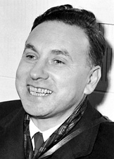
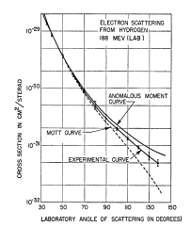
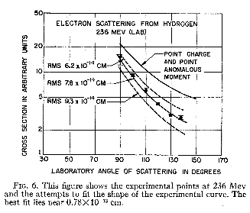
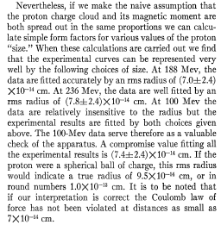
Proton has a finite size
Electron scattering from proton, Hofstadter, McAllister (1955)
Experimentalists defer to future theory, BUT make a conjecture !
… that they are measuring the proton’s size;
~ 10⁻¹³ cm radius
… and Coulomb’s law holds.
a two-page paper !
Robert Hofstadter
Notes:
Here are the published results from a 1955 paper by Hofstadter and his co-worker. Note that it’s a two-page paper. The normalized counting rates are graphed versus the angle of the detector. They are compared to a theoretical curve which accounted for the known charge and magnetic moment of the proton. The cross-section is lower than the theoretical curve by a factor of two or more.
The experimenters acknowledge that there calculations are simple, perhaps even naïve, but they conjecture that the electron beam is actually penetrating inside the proton, and thus not feeling the full effect of the charge and magnetic moment. If they interpret their data as being due to a finite size, then they measure the radius of the proton to be about 10^-13 cm.

Slide 8
Probing deeper & deeper into the Nucleus
Observation | Who/When | Conclusion
many large-angle scatters | Rutherford, Geiger, Marsden, 1907 | nucleus is massive, concentrated in one place
scattering angle ~ 1/sin⁴θ/2 | “ | force ~ 1/r², just like comets’ orbits; R_{nucleus} < 3 * 10⁻¹² cm
eP elastic scattering, fall-off from expected ang. dist’n | Hofstadter, 1957 | probe has penetrated within proton, proton has a finite size of ~1 fermi (10⁻¹³ cm)
eP inelastic rates depend only on ratio of mom./energy “scaling” | Taylor, Friedman, Kendall, 1977 | electron is scattering elastically from a structureless component of the proton, a “parton”
detailed kinematics of scattering | Perl, Hanson, theorists | “partons” have fractional charge, spin ½ → partons are “quarks” !!
detailed pattern of scale-breaking | the troops | theory of the quark dynamics: QCD

Slide 9
Elastic → inelastic scattering
If the object stays intact →elastic.
one pool ball hitting another: elastic
snow-ball striking the side of the house: inelastic
eP → eP : elastic
eP → eNπ⁺: inelastic
electron scattering
→ exchange of a photon
π+
Proton
electron
Neutron
photon
electron
Proton
Notes:
Okay, now we’re approaching the 70’s and further experiments about the internal structure of the proton. The beam energies were higher and many of these new experiments were “inelastic”, meaning that the electron “shattered” the proton. In elastic scattering the target remains intact with no internal excitation of energy; in inelastic scattering there is some energy internal to the object - in this case the outgoing target material consists not just of the proton alone but of two or more particles flying away.
I illustrate the situation graphically in terms of a simple diagram which shows the transfer of energy and momentum from the electron to the target proton via and exchanged unit of the electro-magnetic field - the photon.
The scattered electron recoiled from the nuclear remnants which consisted of two or more particles; for example a neutron and a pi- or a proton and a pi0 (charge is conserved). For now, just take these various kinds of particles (baryons, mesons, etc.) as given. They had been discovered over the years but their structure was unknown.

Slide 10
Momentum & energy transfer for elastic scattering
Momentum & energy transfer for inelastic scattering
W (mass of the final state)
π+
M (mass of the final state)
electron
P’
Relativistic equations for momentum and energy exchange from electron to photon to proton.
q
Proton
Neutron
photon
P
electron
Proton
4-momentum transfer squared, Q², and energy transfer, ν are NOT proportional
4-momentum transfer squared, Q², and energy transfer, ν are proportional
Notes:
Here I want to start laying the groundwork so you can understand the concept of scaling - the discovery of which showed that when electrons scattered from a proton (even if it broke up into extra particles) it acted like it was scattering elastically from components - repeat this.
I will now review the equation for the conservation of both momentum and energy using a relativistic formula; that is using the notion of the “4-vector” which combines the 3 components of momentum and the 4th component of energy using rules which conform to Einstein’s theory of relativity.
First, I write the equation for the conservation of 4-momentum (energy and momentum) for elastic scattering; q + p = p’ where q is the 4-momentum of the photon, p the 4-momentum of the target proton and p’ the 4-momentum of the recoiling proton.
After squaring and re-arranging terms, we get the result qsq = 2mnu; this proportionality between the 4-momentum squared, qsq, and the energy transfer, nu, is a hallmark of elastic scattering. Note that these two quantities are experimentally determined if we know the beam energy and the momentum and angle of the scattered electron - formulas shown.
For elastic scattering, note that the 4-moment transfer (squared), qsq, is proportional to the energy transfer, nu.
Now, we will consider the general case of inelastic scattering - where the outgoing object is no longer a single proton but a group of particles with energy and momentum corresponding to a relativistic mass, denoted by W.
Note now, that for inelastic scattering, qsq is NO LONGER proportional to nu because the final mass, W, is different than the initial target mass, m.

Slide 11
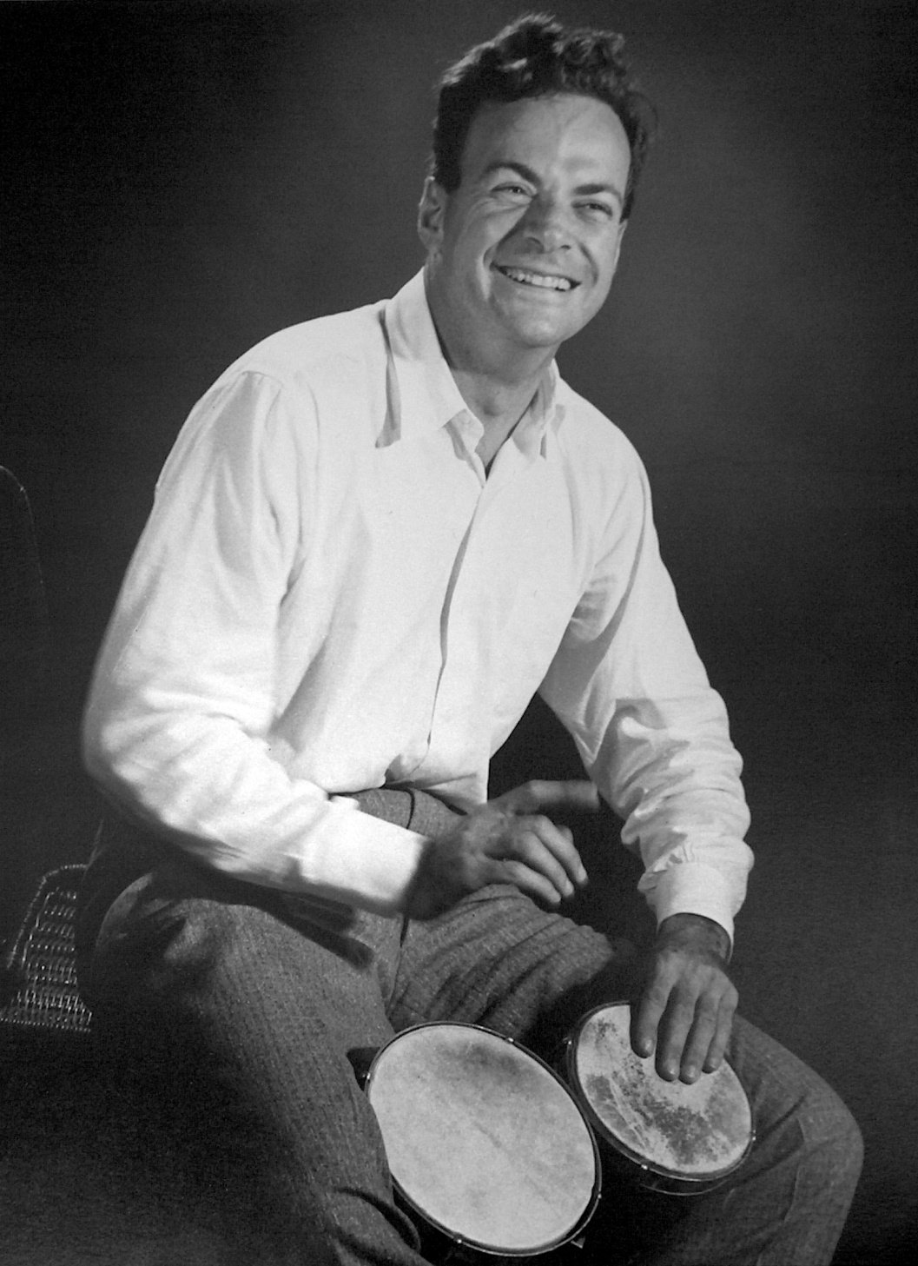
Deep inelastic scattering → “elastic scattering” (off partons)
Inelastic scattering → elastic scattering from “parton” followed by “hadronization” → Q² now proportional to ν again !
Excited State
mass = W
electron
pion
electron
Neutron
photon
photon
electron
Proton
electron
Proton
Richard Feynman
Notes:
In the late 60’s, a number of physicists were speculating on the internal structure of the ‘zoo’ of newly-discovered particles.
An idea was put forward by Richard Feynman that perhaps the proton was composed of parts, called “partons”. He speculated that when the momentum transfer, qsq was high enough (and by the uncertainty principle, the photon “size” is small enough) that inelastic scattering was simply elastic scattering of the electron from one of these partons followed by the ensuing break-up of the proton.
Note his method: he made a model for part of the problem (the initial scattering) but relegated to a ‘black box’ the ensuing evolution of these flying-apart partons into the observed particles. This method is often used by physicists to divide and conquer a problem.
How can we test this idea ?? By seeing if the proportionality between qsq and nu shows us again, indicating elastic scattering !!!
Here’s a picture of Feynman, undoubtedly one of the most intuitively intelligent physicists of the 20th century.

Slide 12
“Elastic” scattering from a parton
How is x defined?
Proton’s structure revealed by scattering rate which depends on:
  charge (squared) of the components
  momentum distribution: f(x)
Rate ~ f(Q²,v) → f(x)
as Q², ν → large
Excited State
mass = W
electron
P’
q
photon
xP
electron
Proton
Notes:
I’ll again write the equation for the conservation of 4-momenta (energy and momentum) but this time assuming that the electron’s 4-momentum is transferred via a photon ELASTICALLY to a single parton which flies away with the same mass as before the scattering.
In Feynman’s picture, the parton was assumed to carry a fraction, x, of the total 4-momentum of the proton.
After writing the equation, squaring and re-arranging terms, you can see that we now have a measure of this fraction, x, in terms of experimentally-defined quantities: qsq and nu.
The simple but radical ideas was that the inelastic scattering process proceeds by elastic scattering from structure-less sub-constituents followed by a universal but not-understood.
The experimental signature would be that once qsq was large enough so that the photon’s size was small enough to probe inside the proton that the rate would become a product of the charge^squared of the partons times the probability that the struck parton had fraction x of the proton’s momentum times a constant factor representing the emergence of real particles.
Since, in general, it was know that inelastic scattering could depend on qsq and nu separately, the predicted experimental signature was that once qsq was high-enough the scattering rate would only depend on the RATIO of qsq/nu and not on both independently - this was called ‘scaling’.

Slide 13
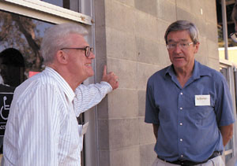
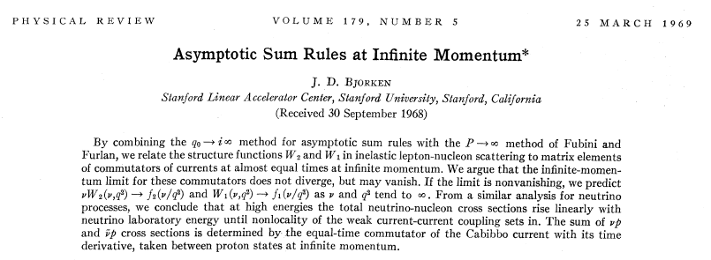
“Bjorken scaling”
Richard Taylor
James Bjorken
“scaling”: function of two variables becomes a function of their ratio.
Notes:
At about the same time as Feynman was intuiting that inelastic scattering was due to elastic scattering from partons, James Bjorken was publishing a more mathematically-dense paper proving that an essential element of this picture, scale invariance, followed from sum rules evaluated in the so-called ‘infinite momentum frame’.
In simple terms, when the center-of-mass collision of the photon and proton takes place at high enough momentum, the reaction is so fast that the partons can’t interact with their neighbors and thus act as though they are ‘alone’ or ‘free’. He derived these results from purely theoretical considerations of the relativistic and quantum mechanical structure of the interaction developed by a group of theorists.
Here’s a picture of my advisor, Dick Taylor (on the left) talking with BJ as he was known.
It was a great time to be a grad student: Bj, Stan Brodsky, Richard Blankenbecler and the various experimentalists were all very accessible.
Story about my oral exam; Aharanov - Bohm effect; BJ’s response: curiosity

Slide 14
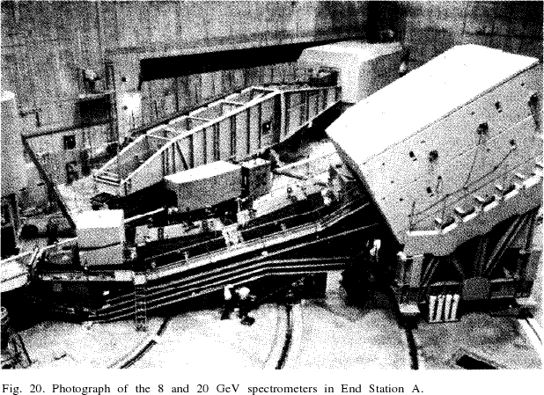
Big detectors to look for small objects
Notes:
Okay, it was hypothesized that the proton is made of ‘parts’, and that these parts might reveal themselves through ‘scaling’, where the normalized scattering (which in general depends on BOTH qsq and nu) suddenly becomes a function of their ratio only, once the photon gets ‘small enough’ (qsq > 1 gev squared).
So, experiments were done with the SLAC spectrometers, shown here …
These are large devices - note the people in the foreground - but functionally simple and similar to Rutherford’s apparatus. They can be rolled around (very slowly) on rails to a particular viewing angle; and in addition to measuring the angle of the scattered electron they had magnets which bent the electrons in a curve leading to particle counters in the well-shielded detector ‘huts’ - so only those electrons with a certain specified momentum range would be accepted.
I did my thesis on data from the big guy in the back ( the ‘20 GeV’ spectrometer ) …

Slide 15
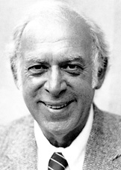
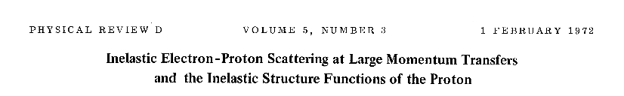
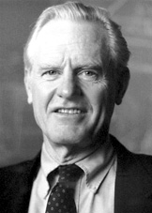
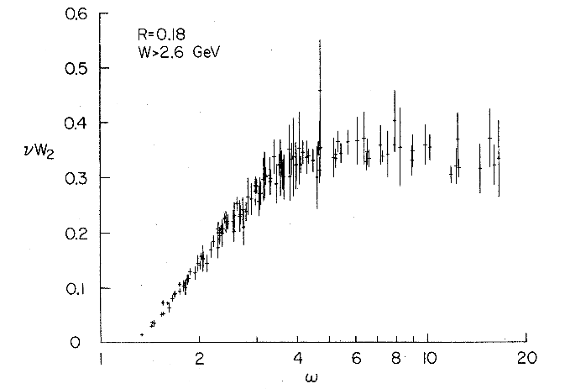
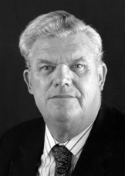
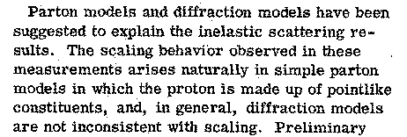
Scaling seen → partons inside proton
Data from many different energies (4.5 - 18 GeV) and three angles (18, 26, 34⁰⁾
overplotted, but they lie on one curve if plotted versus 1/x.
Jerry Friedman
F (x)
Henry Kendall
1/x
Richard Taylor
Notes:
Here is the highly-cited experimental results from 1972 that established the phenomenology of ‘scaling’ which was the signature for the existence of point particle (structure-less) components of the proton.
The normalized rates from 3 different angle settings and many different settings of the beam energy are all plotted on the same graph as a function of x (actually 1/x). In general one would expect that each of these different angular data-sets would form its own disctinct curve, but you can see that ALL of the data lie on a single curve - that is they depend only on the ratio of qsq/2 m nu = x, and not on qsq and nu separately.
‘Scaling’ was observed, and the experimentalists concluded that they were seeing point particle within the proton.
These men got the Nobel prize for discovering “scaling”, bottom one is my PhD advisor, Dick Taylor; from Medicine Hat; very colorful; describe a flat, featureless cross-section as “flat as pee in a pan”. His hero was an atomic physicist he told me about who would do spectroscopy with an unknown (to him) calibration constant for the energy scale of his experimental spectra. He would do the analysis and on the day of submission for publication, he would unlock the number and multiply all of his spectra by this amount to set the energy scale and send it out for publication, WHETHER OR NOT THE VARIOUS PEAKS AGREED WITH ALREADY-PUBLISHED SPECTRA. Now, that is honesty!

Slide 16
Discovery of “partons”
    “Scaling” observed: functions of Q² and ν become function of x only, where x = Q² / 2mν.
    Explained by electron scattering elastically off ‘point’ particles which carry a fraction (x) of the proton’s 4-momenta (p_{q} = x P).
    “Partons” discovered, what is spin, charge?
Notes:
So, partons were discovered - but what kind of particles were they? What was their spin? 1/2? Like electrons and protons? … or zero or one like photon and mesons? Also, what was their charge? zero or some integer like all the known particles? … or a fractional value which had been hypothesized in the mid-60’s theoretical quark model used as a numerogical device to classify the known particles …
To answer these questions, I’ll first show you an experiment that measured the spin of the quark and then I’ll show you a compilation of experiments that measures integral of the scattering rate as a function of x which is sensitive to the assumed charge of the partons.
First, the spin experiment …

Slide 17
Probing deeper & deeper into the Nucleus
Observation | Who/When | Conclusion
many large-angle scatters | Rutherford, Geiger, Marsden, 1907 | nucleus is massive, concentrated in one place
scattering angle ~ 1/sin⁴θ/2 | “ | force ~ 1/r², just like comets’ orbits; R_{nucleus} < 10⁻¹³ cm
eP elastic scattering, fall-off from expected ang. dist’n | Hofstadter, 1957 | probe has penetrated within proton, proton has a finite size of ~1 fermi
eP inelastic rates depend only on ratio of mom./energy “scaling” | Taylor, Friedman, Kendall, 1977 | electron is scattering elastically from a structureless component of the proton, a “parton”
detailed kinematics of scattering | Perl, Hanson, theorists | “partons” have fractional charge, spin ½ → partons are “quarks” !!
detailed pattern of scale-breaking | the troops | theory of the quark dynamics: QCD

Slide 18
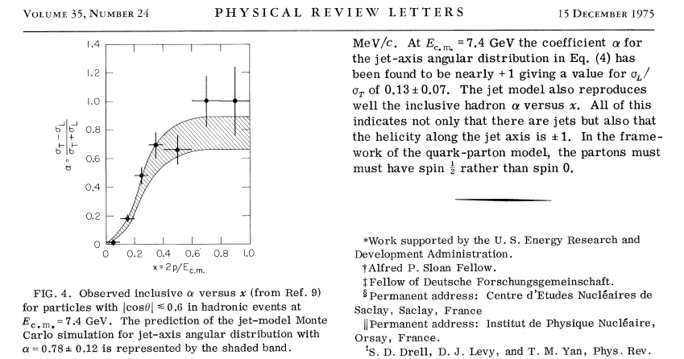
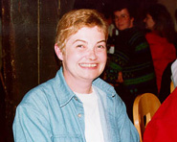
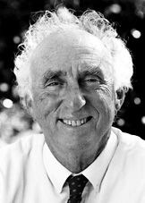
angle of “jets” → quarks are spin 1/2
Gail Hanson
Marty Perl
Notes:
As an aside, not everyone ‘believed’ in quarks in the mid-70’s; we used to have big discussions among the grad students - do you ‘believe’ in quarks? Are they ‘real’ or just a mathematical trick? Here is the result from 1975 that convince me, personally, that quarks were real - as real as electrons or protons.
A 4-page paper! Paper was the thesis of Gail Hanson, advisor Martin Perl, with data taken at the SPEAR storage ring at SLAC. They measured e+e- annihilation into particles; in particular, into events that looked like two ‘jets’ of particles flying apart. They showed that the angular distribution of these ‘jets’ (presumably the ‘contrails’ following quark production) were close to a 1+cos2(th/2) shape - this is just what you might expect if e+e- scattered elastically into e+e- !! Quarks acted just like electrons which are certainly real - so quarks must be real.
There are other ways to measure the spin of the quark -

Slide 19
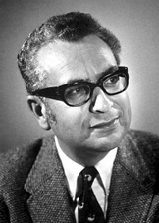
Other properties of partons
Experiment measures charge & momentum distribution
Quark model of 1964 proposed the new particles (excited protons) were composed of three “quarks” with charge 2/3 or -1/3 → total charge: 2,1,0,-1
If partons are quarks, they carry only 60% of the proton’s momentum !!
What carries the remainder ?
Murray Gell-Mann
Notes:
Murray Gell-Mann won the 1969 Nobel Prize for his theories which classified the many observed particles with a simple numerological scheme - each ‘baryon’ is composed of three quarks each of which can have a charge of 2/3 or -1/3: so you can have particles with charge +2, +1, 0, -1. At the time it was not thought by most people that these were actually particles.
But now, we have an experimental quantity which was sensitive to the charge of the quarks. If you put in the hypothesized values of the charge (2/3, 2/3 and -1/3 for those quarks in the proton) you got a result that was in the ball-park, but it showed that the charged partons (quarks) only carried 60% of the proton’s momenta - what carried the rest?

Slide 20
Quarks discovered!!
fractionally charged, spin ½ partons
→ Quarks are discovered
… but many mysteries remained
- what carries the rest of the proton’s momentum ?
- does ‘scaling’ hold exactly ?
- let’s see
Notes:
To re-capitulate, by the mid-70’s most physicists ‘believed’ in quarks - but the nature of the presumably neutral force-field binding them together inside the proton was unknown. There was a lot of theoretical progress being made, but I’ll concentrate on the experiments. First of all, does ‘scaling’ hold exactly? … and if not, what does it imply? Let’s see.

Slide 21
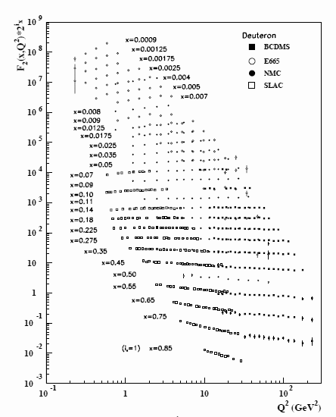
Pattern of scaling violation
Structure function is NOT a function of x only; depends on Q².
Small-x values INCREASE with Q².
Large-x values DECREASE with Q².
quarks are radiating energy !
(probability increases with Q²)
WHAT are they radiating ?
-quanta of the strong color field
GLUONS
This pattern of scale-breaking can be calculated using QCD.
F₂(x,q²)
‘lines’ at constant x
Q² (GeV²)
Notes:
Here I show data from the particle physics handbook (our ‘bible’). What is plotted here is the normalized scattering rate versus 4-momentum transferred (squared) qsq. Note that the observed rates cover 10 orders of magnitude and the qsq scale goes from 1 GeV squared to hundreds. Each line of data comes from a constant value of x, so if scaling holds exactly, these lines should be flat - they are not.
These data cover the work of 4 labs and hundreds of man and woman-years of effort. If the particle booklet is our bible, this is our cathedral.
Now, you can see a simple pattern to scaling violation. At small values of x, the rates increase with incresing qsq; but they decrease with qsq for large values of x. This is what you’d expect if a high-momentum quark (large x) were to absorb a high-qsq photon - it might radiate momentum (via a gluon) and thus lower its momentum. This would appear as fewer quarks at high momentum than observed at low qsq. This is further evidence that the gluons of the force field are as real as the quarks.
We were still waiting for a viable theory of both the quarks and gluons - the quantum field theory based on Maxwell’s equations did not match the data.

Slide 22
Evidence for QCD
Missing momentum & pattern of scaling violation
  Explained by “gluon radiation”
  analogous to bremsstrahlung (X-ray machines)
How can electrons scatter from quarks elastically?
  they act like free particles, but are bound in the proton !
If you probe the proton at small distances (high Q²), the quark responds as if it is not bound (free), but as it moves away to larger distances, it feels the attractive force (like a rubber band).
This is not like electromagnetism !!
Notes:
To summarize;
- the pattern of scaling violation pointed to the existence of a gluonic force-field but there remained the overall mystery of how a quark which is bound strongly inside the proton could act as if it were free by apparently scattering elastically from a high-qsq photon.

Slide 23
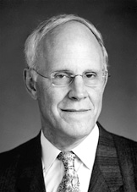
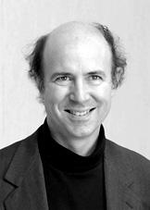
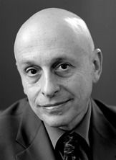
asymptotic freedom & QCD
David Gross
David Politzer
Frank Wilczek
“for the discovery of asymptotic freedom in the theory of the strong interaction” 2004 Nobel Prize in Physics
Notes:
I will not go into the development of the theory known as Quantum Chromo-Dynamics (QCD for short). But these three men got the Nobel prize for showing that QCD could account for the apparent ‘freedom’ of the quark during high-qsq electron scattering.
David Gross, David Politzer and Franck Wilczek got the 2004 Nobel Prize for the discovery of asymptotic freedom. Professor Wilczek gave you a colloguium about a month ago on current investigations into the nature of the vacuum, including the nature of ‘dark matter’ and ‘dark energy’.

Slide 24
Quarks: what next?
QCD: well-established as the theory of the strong interactions → forces between quarks
BUT, it’s a strongly-interacting field theory → very difficult to SOLVE the equations
INSTEAD, people GUESS solutions based on qualitative aspects of QCD … and work out the consequences.
Notes:
So - QCD is well established in the 80’s as THE field theory describing matter, but it is very difficult to solve the equations - so one approach is to use qualitative aspects of the theory to guess possible physical states and see if they can explain experimental data (similar to the experimental discovery of ‘bucky-balls’ which are physical manifestation of atomic theory - which is old and well-established but no one imagined that atoms could look like soccer balls until they were observed in experiment !!

Slide 25
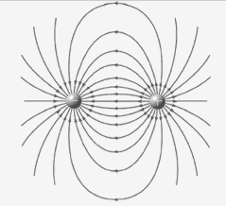

Gluons: the strong force-field
Because of self-interactions the field lines compress into a tube.
The field energy grows linearly with separation → constant force
~ 1 GeV/fm
(16 TONS !!)
Notes:
One curious aspect of QCD is that the carriers of the force field, the gluons, attract each other as well as causing the attractive force between quarks. Unlike the electric field (which gives a 1/r^2 force) the gluonic field was thought to collapse into a tube of force-field with constant energy density per unit length giving a constant force between quarks - in familiar units, quarks are held together inside of particle with a force of 16 tons.

Slide 26
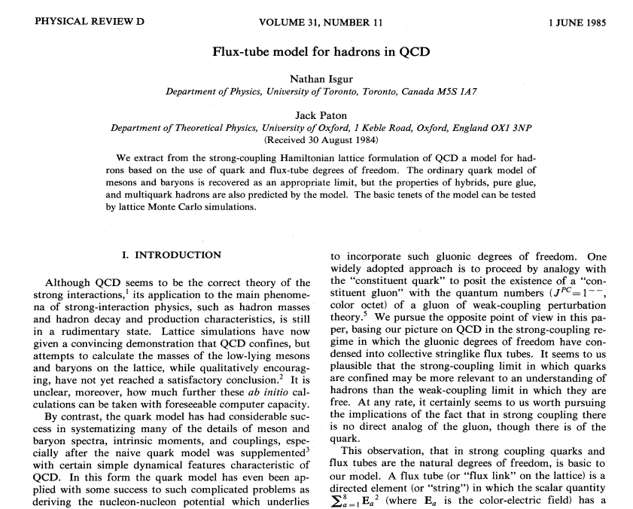
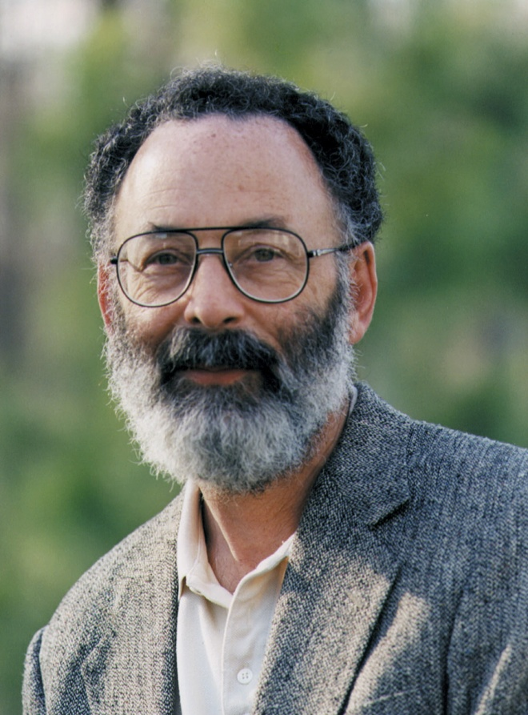
Nathan Isgur
Notes:
Nathan Isgur, who was the long-time chief scientist at Jlab was a creative physicist in the ilk of Feynman and Bjorken. He had an encyclopedic knowledge of experimental and theoretical physics, and could do very nitty-gritty mathematical calculations, but he also relied heavily on his intuition. He strongly felt that at low energies that the effective degrees of freedom was the (constituent) quark and the flux-tube.
Here’s a picture of Nathan. Like the theorists I told you about at SLAC, Nathan was very accessible to experimentalists and actually seemed to enjoy naïve questions.
So, how can we determine if flux-tubes are ‘real’?? By breaking them !! that is, studying q-qbar pair creation among other ways - first, let me show you how detectors have evolved since the 70’s

Slide 27
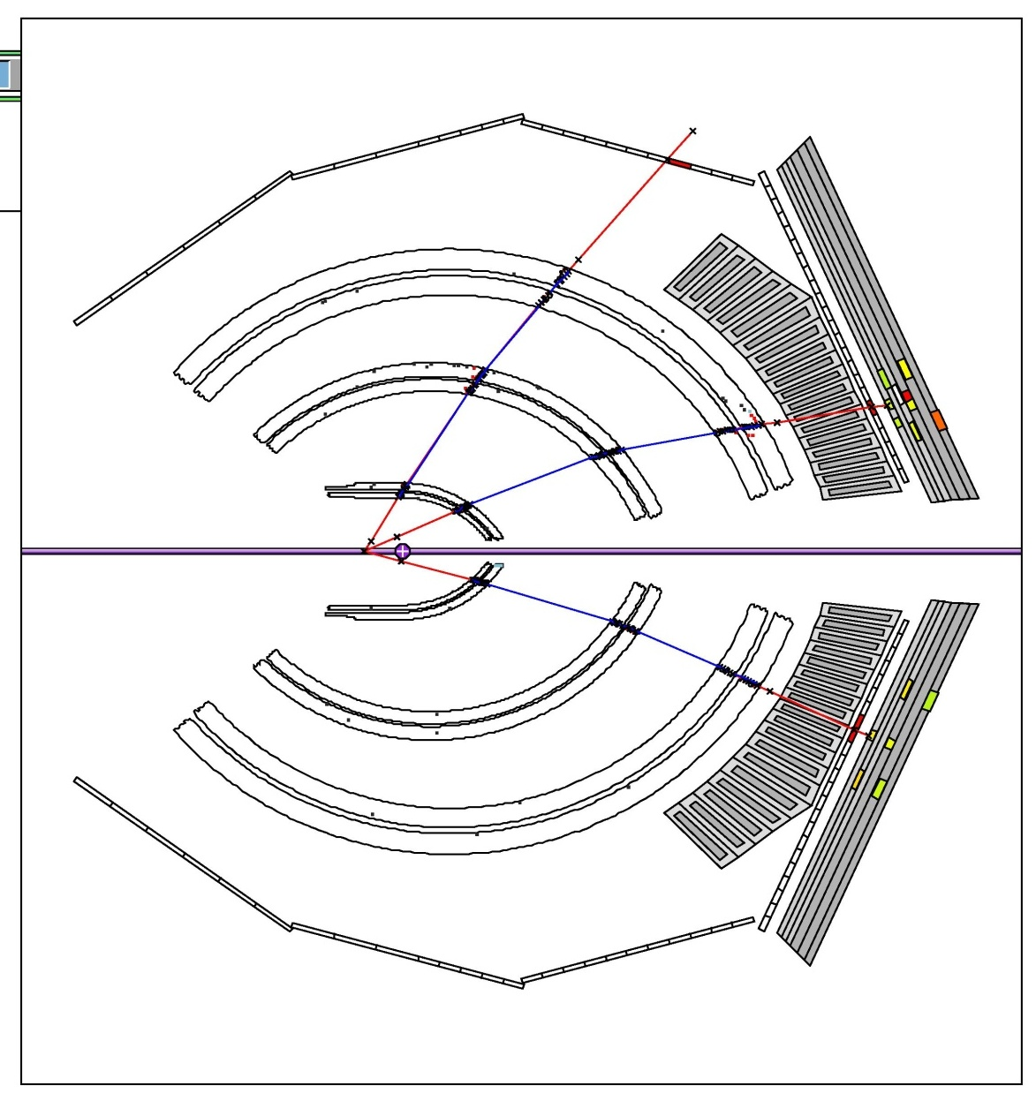
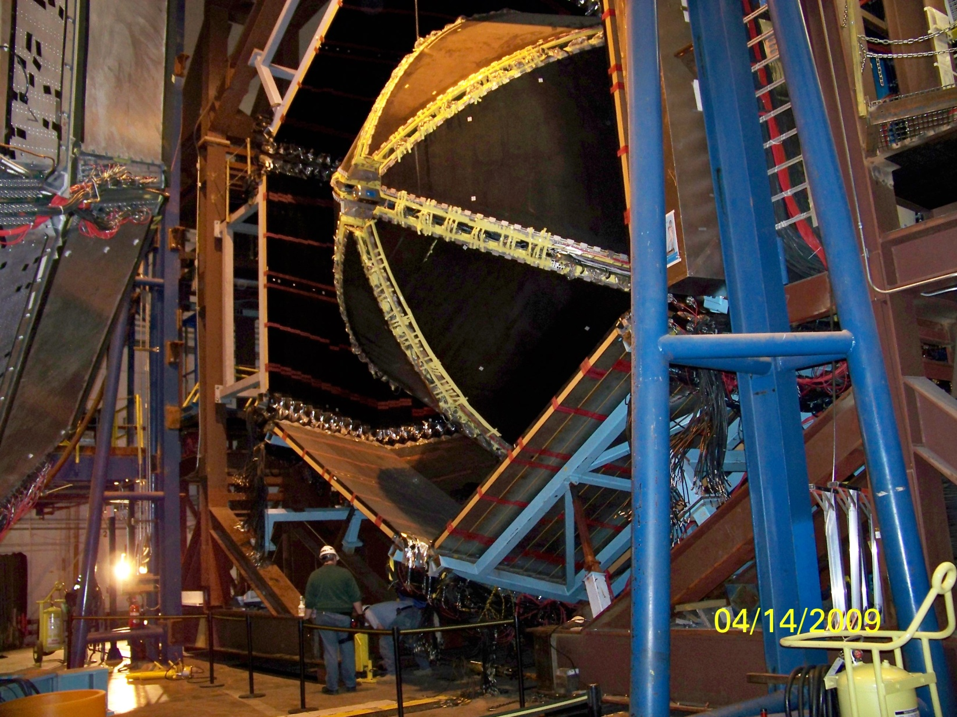
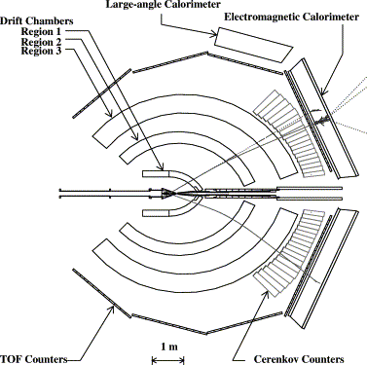
A Modern Particle Detector
CLAS detector:
-magnetic spectrometer
(curvature ~ 1/p)
-drift chambers (tracking)
-scintillators (timing)
-calorimeters (energy, e/π)
-Cerenkov (e/π)
--------------------------------
Fast: > 2000 evts/sec
Large acceptance > 2π sr
Notes:
Here is a picture of a modern detector - one that I work on at Jlab, known as the CLAS detector.
It’s large (see the person in the foreground).
To describe its functioning, I show a single-event displayed on a cut through the detector.
The detectors magnet and tracking chambers allow our computer programs to detect particles: their curvature determines their momentum (more curvature, less momentum). We also have timing counters and counters which respond to the total energy of the particles.
Also note that this detector can in principle see all of the outgoing particles …. and it is fast, recording events at several thousand per second.

Slide 28
Geiger counter: gas ionization by particles
cosmic ray
tube
gas
wire
(at high voltage,
~ 2000 V)
~1 ionization/ 300 mm
1 - 10 electrons / ionization
~ 100 electrons/cm
Notes:
I’ll just show you a couple of details of the tracking chambers, which I work on.
They are just generalizations of the Geiger tube. Remember Hans Geiger, Rutherford’s post-doc? Well, he went on to invent the Geiger tube; a much faster, more efficient and automatic particle detector than the human eyeball - motivated partly by eye-strain!
Here’s how it works …

Slide 29
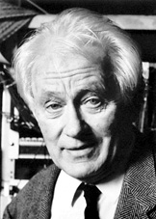
“drifting” of the electrons
wire at positive voltage
electrons drift to the wire
strike a molecule every 2 μm
velocity ~ 50 μm/ns
signal
Time Difference
New Idea - increase the accuracy of the tube by measuring the time difference between the wire signal and another prompt signal
signal
Georges Charpak
Timing counter
Notes:
Geiger tubes are efficient at detecting particles, but their accuracy is limited - you only knew that the particle passed through the tube, but not where.
A knew idea used the time of the signal (compared to an external timing signal) to measure the time of drift of the ionization electrons - and hence, how far away the track was.
Georges Charpak received the Nobel Prize for this discovery.

Slide 30
how tracking works
wires with signals shown in yellow;
circle radius ~ drift time
Wire chamber
- looking along the wires
minimize rms between
track and calculated distance
Notes:
here is a schematic view of a drift chamber looking down the wires; there are not tubes, but the wires are arranged in a hexagonal pattern - here is the pattern of field lines from the negative to the positive wire - similar to a Geiger tube but much less mass to scatter the particles and mess up our measurements.
Here’s how tracking works ….

Slide 31
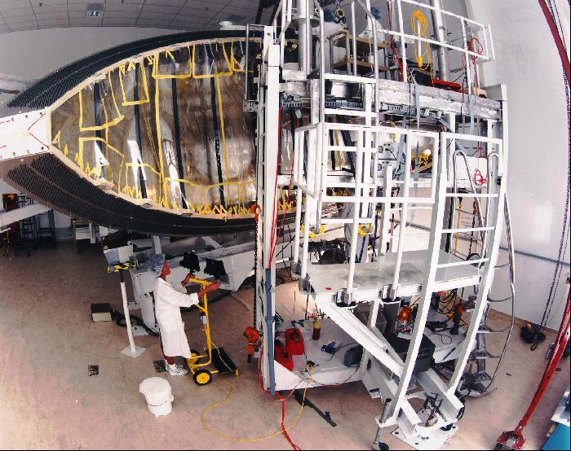
First, we had to build them, ~1995
Notes:
First, we had to build them - 1995
Incidentally, we are building new chambers with a simpler design for the Jlab upgrade and just strung our first wire (80,000 total!) last week.

Slide 32
Now, we can analyse the data
Analysis:
Detect Electron
  Cerenkov with C₄F₁₀
  e.m. shower counter
Identify Kaon & Proton
  time of flight: ~100 ps
  p/K separation to 2 GeV/c
Missing-mass for Λ
  good resolution: 0.5% dp/p
  separate Λ from Σ⁰
e p → K+ Λ : experiment at CLAS
Notes:
Here is a single-event display illustrating how a modern analysis proceeds;
particles are identified by measuring their momentum (track curvature), velocity (elapsed time) and energy (in the case of electrons) from a calorimeter.

Slide 33



it takes all types …
experimenters
theorists
detector builders
Notes:
It takes all kinds of people with different skills to make a significant physics discovery.
They all have the 3 essential properties of a good scientist: intelligence, curiosity, honesty.

Slide 34
Summary: the discovery of the quark
}
Rutherford conceives scattering experiments
  measures rate vs. angle
  nuclear radius less than 10⁻¹² cm
elastic e-p scattering rate deviates from 1/sin⁴(θ/2) → proton has finite size
inelastic e-p scattering ‘scales’ → point-like “partons” in proton
angular distribution of ‘jets’ → partons have spin 1/2
earlier quark model suggested charge 2/3, -1/3 → partons are quarks !!
asymptotic freedom explained → quarks act free, but cannot escape alone
Questions remain:
nature of flux-tube, dynamics of quark-pair creation…
modern detectors are bigger and better
“It does no harm to the mystery to understand a little about it.”
- Richard Feynman
Notes:
The quark was discovered using a technique invented by Rutherford; scattering a beam of particles from a target of Hydrogen. After the invention of quantum mechanics and the nuclear atom, the discovery proceeded in two stages: first, elastic e-p scattering showed that the proton had a finite (non-zero) size; and second, at high values of transferred momentum and energy, the observed deep inelastic scattering showed ‘scaling’ an expected consequence of scattering from point-like constituents.
The very successful theory of QCD explained most of these data, but questions remain about how the quarks which are flying apart from each other can ‘hadronize’, that is, turn into long-lived particles which we can see in our detectors. One question that I am personally interested in is what is the spin-state of the q-qbar which presumably ‘breaks’ the flux-tube, but there are other mysteries which we are investigating.
I’ll close with a quotation from Richard Feynman -

Slide 35
Probing deeper & deeper into the Nucleus
Observation | Who/When | Conclusion
many large-angle scatters | Rutherford, Geiger, Marsden, 1907 | nucleus is massive, concentrated in one place
scattering angle ~ 1/sin⁴θ/2 | “ | force ~ 1/r², just like comets’ orbits; R_{nucleus} < 10⁻¹³ cm
eP elastic scattering, fall-off from expected ang. dist’n | Hofstadter, 1957 | probe has penetrated within proton, proton has a finite size of ~1 fermi
eP inelastic rates depend only on ratio of mom./energy “scaling” | Taylor, Friedman, Kendall, 1977 | electron is scattering elastically from a structureless component of the proton, a “parton”
detailed kinematics of scattering | Perl, Hanson, theorists | “partons” have fractional charge, spin ½ → partons are “quarks” !!
detailed pattern of scale-breaking | the troops | theory of the quark dynamics: QCD
Notes:
I now “fast-forward” to the mid 1950’s; the atom is known to consist of a small, massive nucleus composed of protons and neutrons surrounded by electrons in various orbits with known angular momentum. Still, no one knows the internal structure of the proton. It could possibly even be a ‘point’ particle although it seemed to have too large of a magnetic moment.
Anyway, in the 50’s, Stanford and Cornell Universities began building electron accelerators using microwave technology developed during world war II.
At Stanford in the High Energy Physics Laboratory on campus a pivotal measurement was done: electrons were scattered elastically from protons (in other words, and electron strikes a proton and they both stay intact and fly away from one another, much like the elastic collisions in pool, and not like the inelastic collision of a snowball as it shatters on your back.)
Although the scattering is still caused by electromagnetic forces, they observed a deviation from the expected angular behavior.
Before I show the results, here is what the experimental equipment looked like - a few hundred MeV electron accelerator; a beam deflection system that brought the beam on target, and a moveable spectrometer to measure the rate of scattered electrons at various angles.
Note two things about the detector: the counting was now automated (recording of electronic signals) and the detector size was on the order of meters.

Slide 36
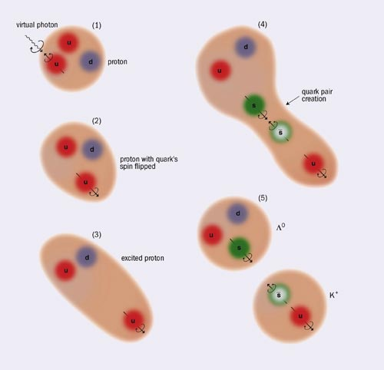
Λ polarization probes quark-pair creation
‘flux-tube’ broken by the creation of a q-q pair !
An ‘escaping’ quark always gets a partner anti-quark !
note spin correlation
Notes:
We analysed those types of events in terms of the polarization of the Lambda particle; we published our results in PRL, but I’ll show you a figure from a popular article which we published in the CERN newletter.
It’s a cartoon illustrating our physics conclusion from that PRL article.
A quark absorbs the moment from the photon and gets polarized. It flies away from its sister quarks, stretching the flux-tube which finally breaks with the production of a quark-anti-quark pair. If the pair is produced with their spins anti-aligned, the outgoing Lambda will have the experimentally observed polarization. So we conjectured that q-qbar pairs are produced with anti-aligned spins, contrary to popular theoretical models.

Slide 37
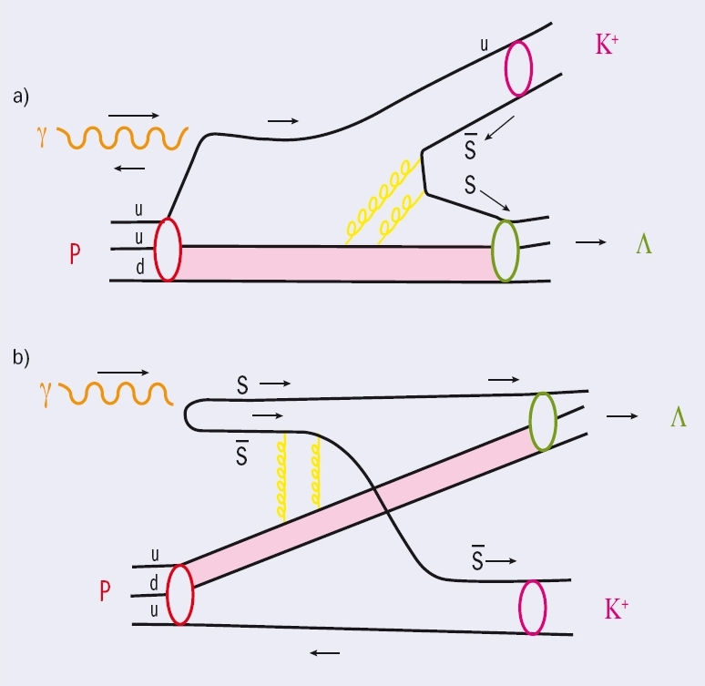
Two model explanations …
Two views of how the Λ is polarized:
top: u-quark polarized; sbar polarization selected opposite; s-sbar in spin-0 state
bottom: s and s-bar polarized directly by photon
Both can explain Λ polarization !
On-going studies to distinguish between the two models.
Notes:
We published a follow-up story in the CERN Courier; showing a cartoon of our original model along with an alternative picture advocated by a colleague from CMU.
Unfortunately, the both can explain the observed polarization - but we’ve come up with a couple of new experiments to distinguish between them … but that’s for a future talk ..

Slide 38
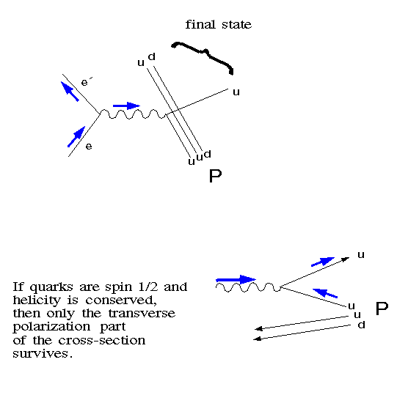
Polarized photon scattering → parton spin
Electron scatters from charged partons;
exchange of a virtual photon
virtual photon is polarized
(carries spin-transfer from electron)
transverse polarization
( electric field is transverse )
spin along momentum vector
→ spin 1/2 if σ_{T} dominates

Slide 39
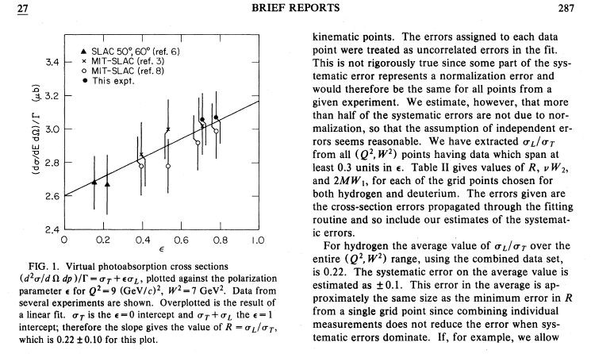
σ_{L}/σ_{T} is small → partons are spin 1/2
Notes:
Another example of curiosity: Feynman. When I was finishing my PhD I gave a talk at CalTech. Both Feynman and Murray Gell-Mann were in the audience. I was pretty nervous. One of the largest sources of systematic error in my analysis (a Rosenbluth separation) was our understanding of the spectrometer optics. To calibrate things we put up a grid of metal bars at the entrance to the spectrometer and observed the “shadow” cast by these bars as they scattered electrons incident upon them. Now, this was my life at the time, but it’s pretty dry stuff. Yet at the end of my talk Feynman asked me “So, basically, the accuracy of your data depends on these “jail bar” measurements?” He had paid attention! to me!! A lowly grad student … and he had grasped the essential experimental point.

Slide 40
relation between rates and angle
More area for small-angle scattering → higher rates

Slide 41
Two model explanations …
Two views of how the Λ is polarized:
top: u-quark polarized; sbar polarization selected opposite; s-sbar in spin-0 state
bottom: s and s-bar polarized directly by photon
On-going studies to distinguish between the two models.
→ measure Λ polarization for production of K*⁺ Λ final state
K*⁺
K*⁺

Slide 42
Quark Pair Creation
Quark-pair creation: “kernel” of exclusive production
What field couples to the q-q current?
u
d
S
Λ
N
P
ss produced
From flux-tube
d
s-quark → Λ K⁺ final state
d-quark → N π⁺ final state
u-quark → P π⁰ final state
measure ratio of rates
different ratios
u
ss produced from photon
s
u
K⁺
s
u
d
s
u
Λ
π⁺
K⁺
d
π⁰
u

Slide 43
Using Exclusive Production to Study Quark Pair Creation
Lund model: successful phenomenology for hadron production; e.g. in e⁺e⁻ reactions
                color flux-tube broken by qq production
  production rate depends on constituent quark mass
  : : ~ 1 : 1 : 0.2
Vector meson dominance: photon fluctuates into a virtual qq meson
  production rate depends on quark charge
  : : ~ 1: 0.25 : 0.25
uu
dd
ss
uu
dd
ss

Slide 44
Kaon Identification
Hyperon Missing Mass
Kaon candidates after timing cut
Λ, Σ⁰
Mass = P / γ β (GeV)
Missing Mass (GeV)
  e p g e’ K⁺ (X)

