Slide 1
Hampton University Proton Therapy Institute
Careers After Graduate School
Vahagn Nazaryan, Ph.D.
Executive Director, HUPTI
January 18, 2017

Slide 2
Industrial Physics – Application Driven
Focus on Application
“Product” Driven Environment
Subject Matter Expert
Have relevant skills, experiences to enter the field
Cross-functional environment
Critical role in supporting the technology
Research and Development opportunities

Slide 3
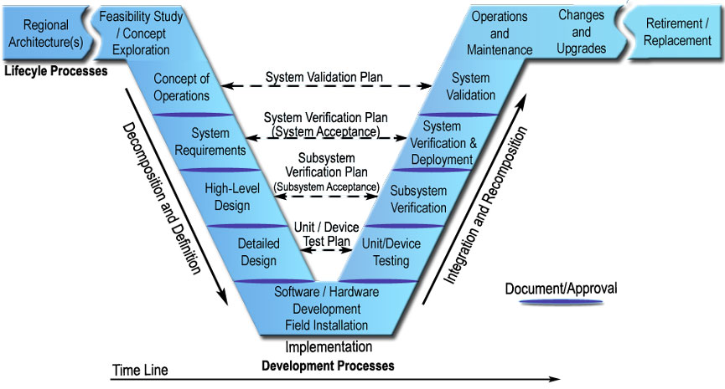
The Art of Product Development
Notes:
One of the first things that strikes you about the "V" is the symmetry between the left and right sides of the model. This symmetry reflects the relationship between the steps on the left and the steps on the right. The system definition that is generated on the left is ultimately used to verify the system on the right. For example, the user needs and performance measures that are identified in the Concept of Operations are the basis for the System Validation Plan that is used to validate the system at the end of project development. Similarly, a System Verification Plan is developed with the System Requirements so that the engineers consider how to verify each requirement as the requirements are written.
The connections between the left and right are indicated by the arrows that cross the "V", showing how plans developed on the left drive the process on the right. These connections provide continuity between the beginning and end of project development and ensure that the engineers are focused on the completion of the project from the beginning. The connections between the left and right sides of the model reflect one of the systems engineering principles – start with your eye on the finish line.

Slide 4
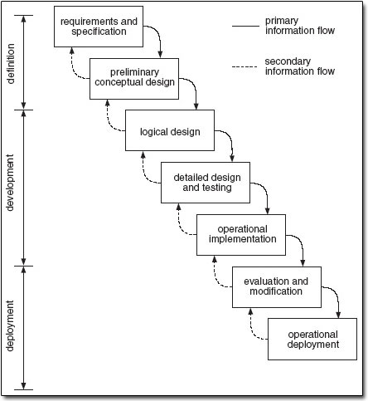
Systems Engineering – A Waterfall Model
Conception
Initiation
Analysis
Design
Construction
Testing
Production
/Implementation
Maintenance
Notes:
The waterfall development model originates in the manufacturing and construction industries; highly structured physical environments in which after-the-fact changes are prohibitively costly, if not impossible.
The waterfall model is a sequential design process, often used in software development processes, in which progress is seen as flowing steadily downwards (like a waterfall) through the phases of Conception, Initiation, Analysis, Design, Construction, Testing, Production/Implementation, and Maintenance.

Slide 5
Physics – HealthCare Industry
Various opportunities in
Radiation and Health Physics
Imaging Physics and Technologies
Accelerator Physics
Responsible for aspects of technology development, Validation and Verification, Clinical Implementation
Quality Management, Industry Standards, Federal and Sate Regulations

Slide 6
Physics – HealthCare Industry
Cross-functional, team environment
Exposure to and close collaboration with Engineering (electrical, mechanical, software)
Deadlines and Commitments
Hierarchical Institution (typically)
Growth and promotion opportunities
Risk and Reward

Slide 7
Industrial Physics – Medical
Transition to Medical Physics from different specialty physics areas
Graduate program in Medical Physics
Postdoc or Clinical Residency in Medical Physics
Commission on Accreditation of Medical Physics Educational Programs (CAMPEP) for clinically oriented carriers
Experience working in HealthCare

Slide 8
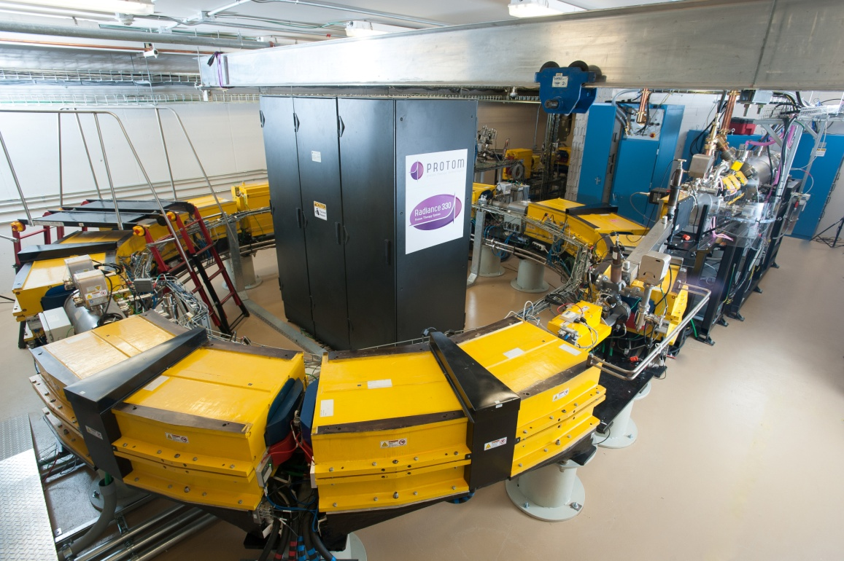
Radiance 330® - Synchrotron
Variable energy: 70 to 250 MeV for therapy; up to 330 MeV for proton radiography and tomography
Small beam emittance
Scanning equipped
Safety
Maintainability

Slide 9
Beam Transport Line

Slide 10
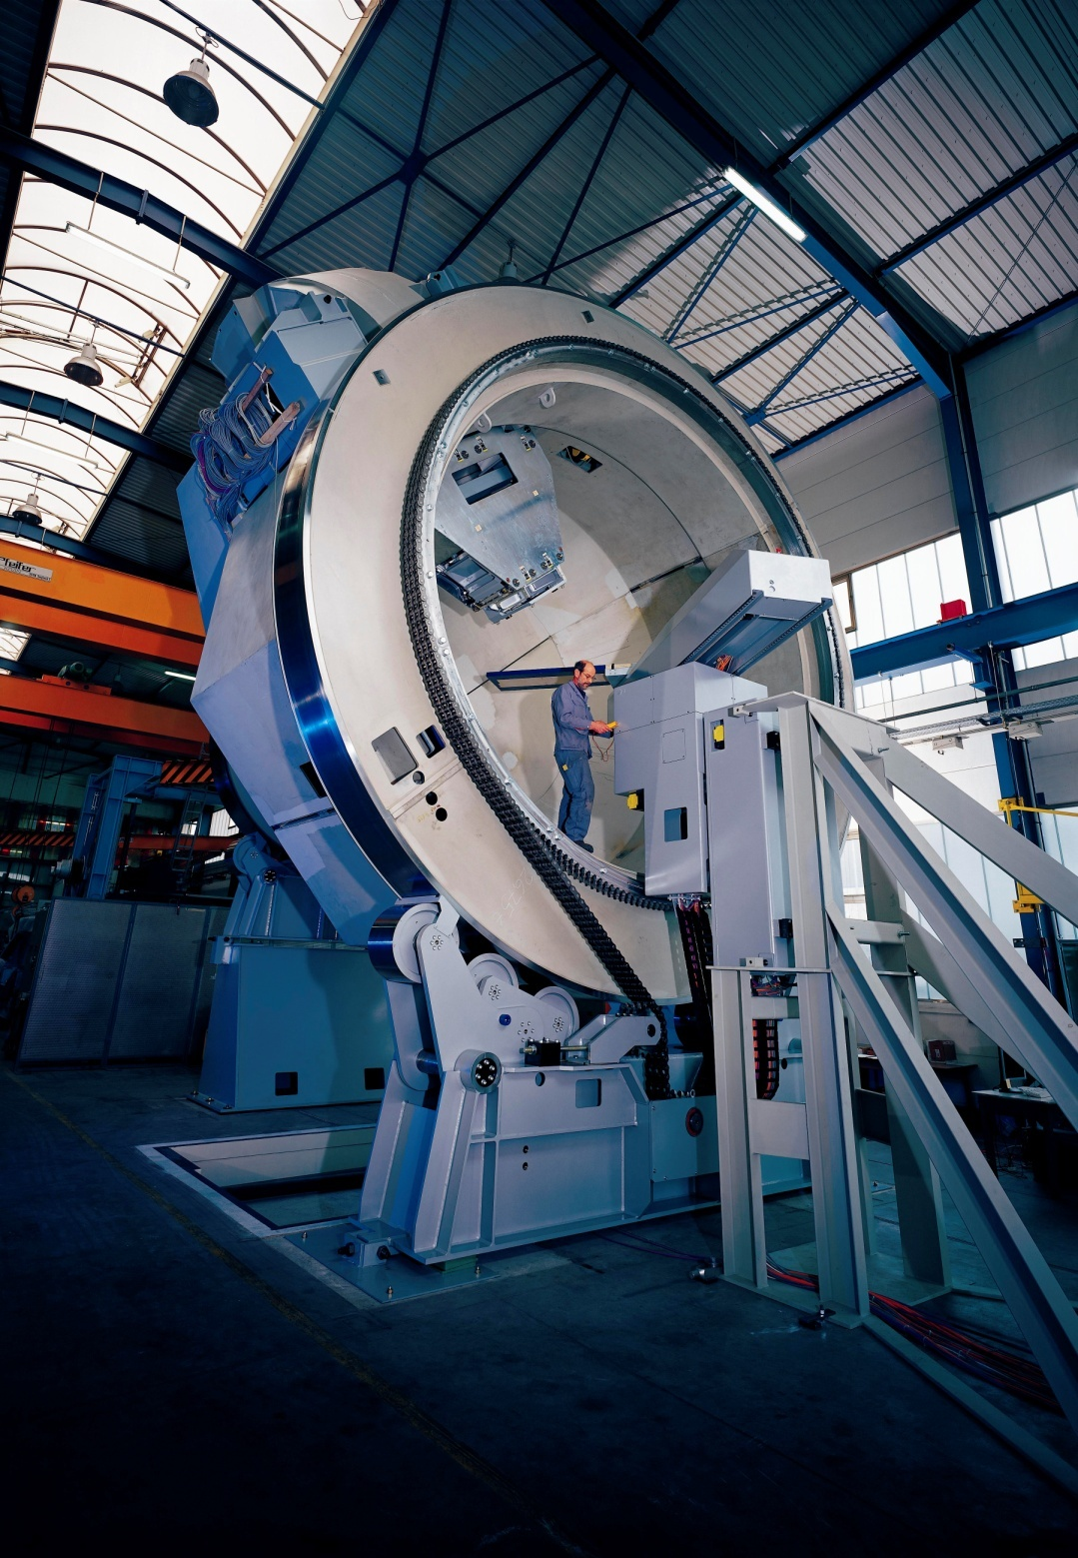
A brief tour…
Most of the ~40 ft. tall, 90 ton, gantry is concealed by the walls and floor of the treatment room--the patient only sees the front of the proton nozzle rotating prior to treatment
The gantry supports all equipment necessary for controlling and monitoring patient treatment.
Rinecker Proton Therapy Centre (Munich)
MPRI (IUCF)

Slide 11
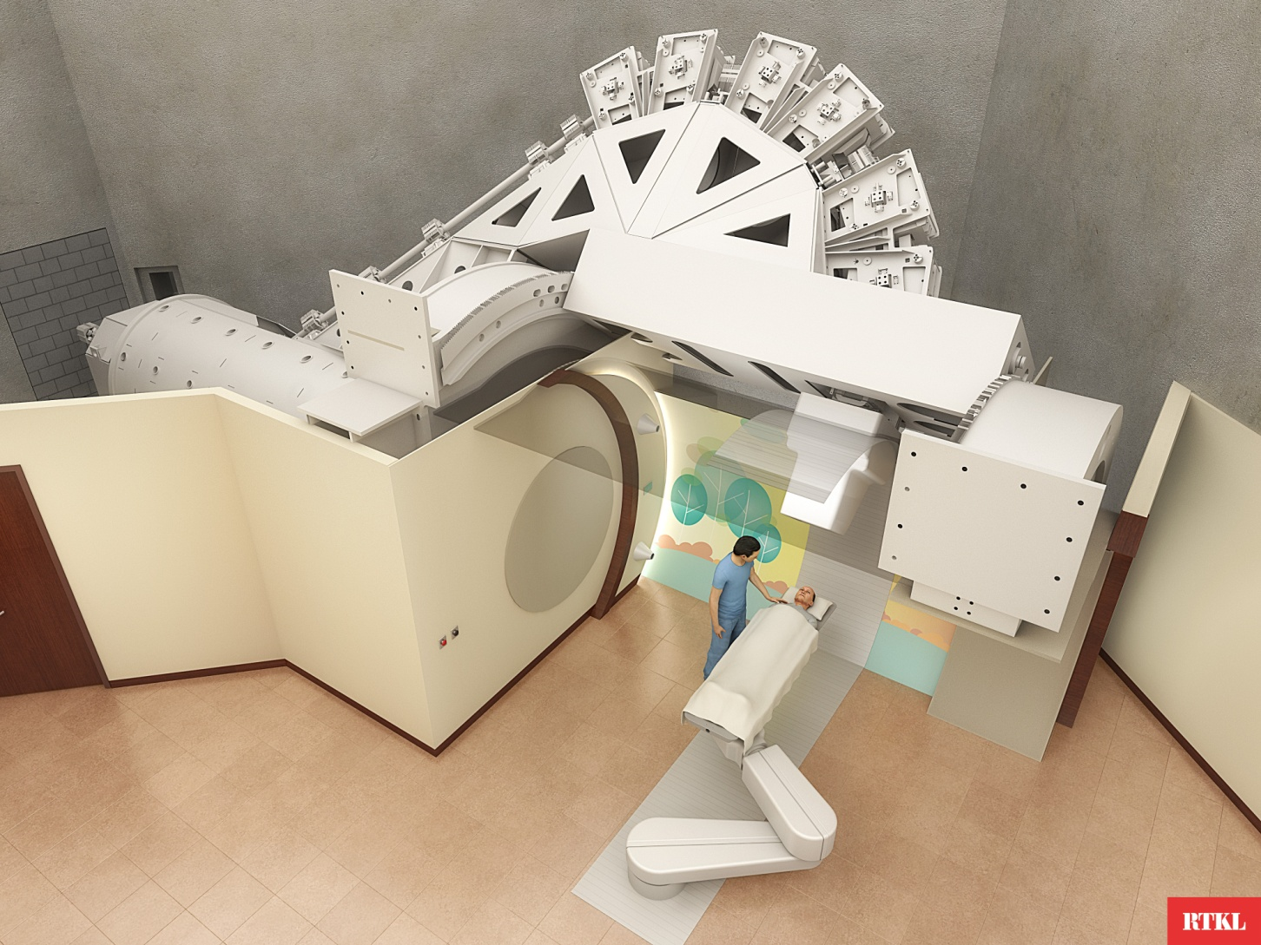
Gantry Treatment Room

Slide 12
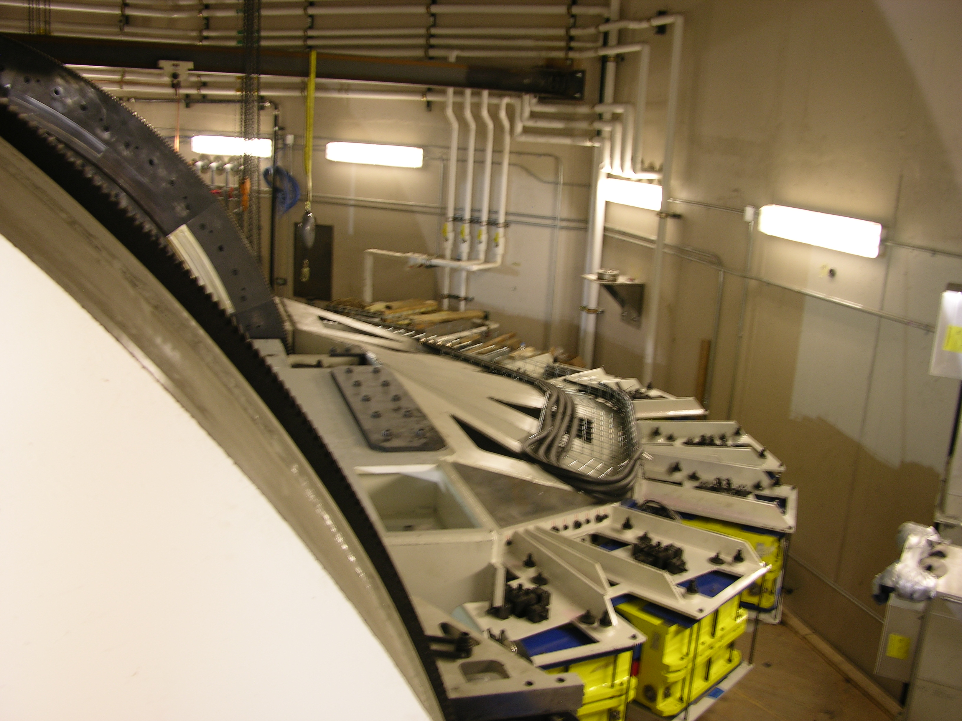

Slide 13
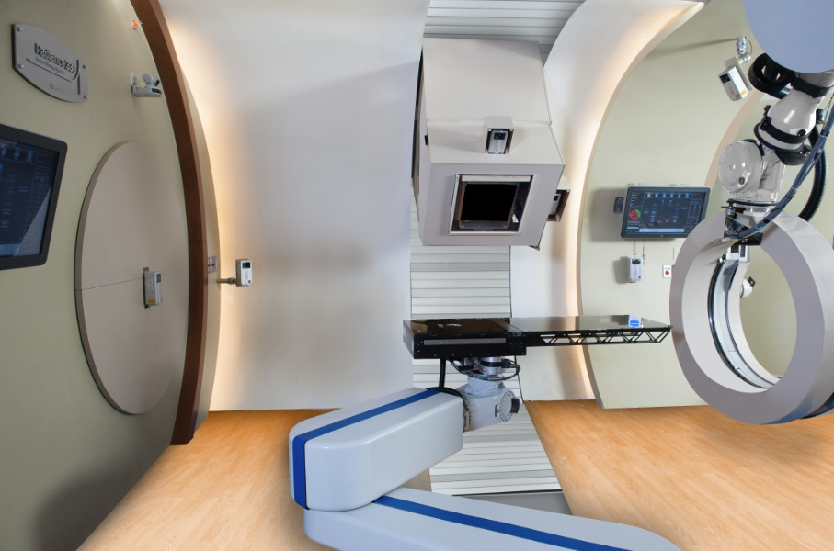
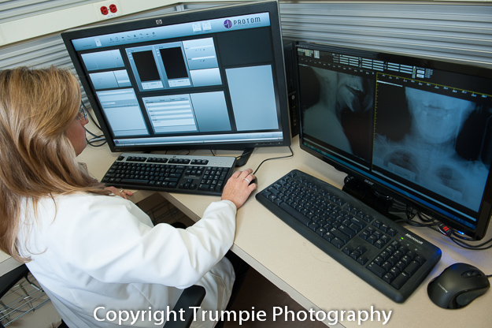
Control room and in-room machine components
Treatment Delivery Control System (TDCS) & 2D Imaging display
Motion Control System (MCS) & Workflow
Patient Positioning System (PPS)
Gantry Positioning
X-Ray / Imaging Positioning System (XPS)

Slide 14
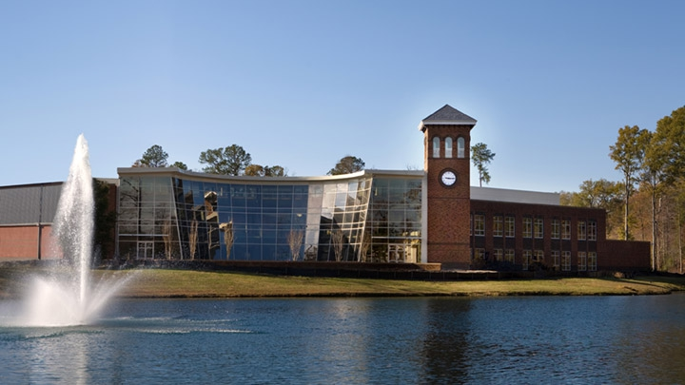
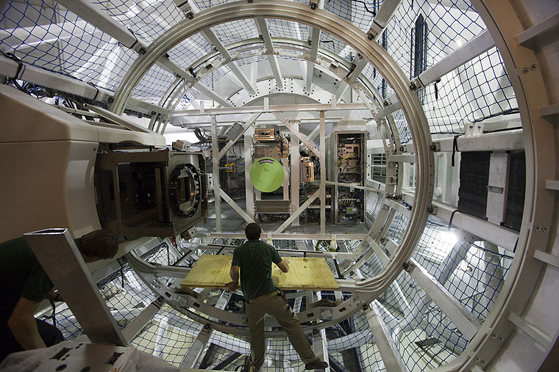
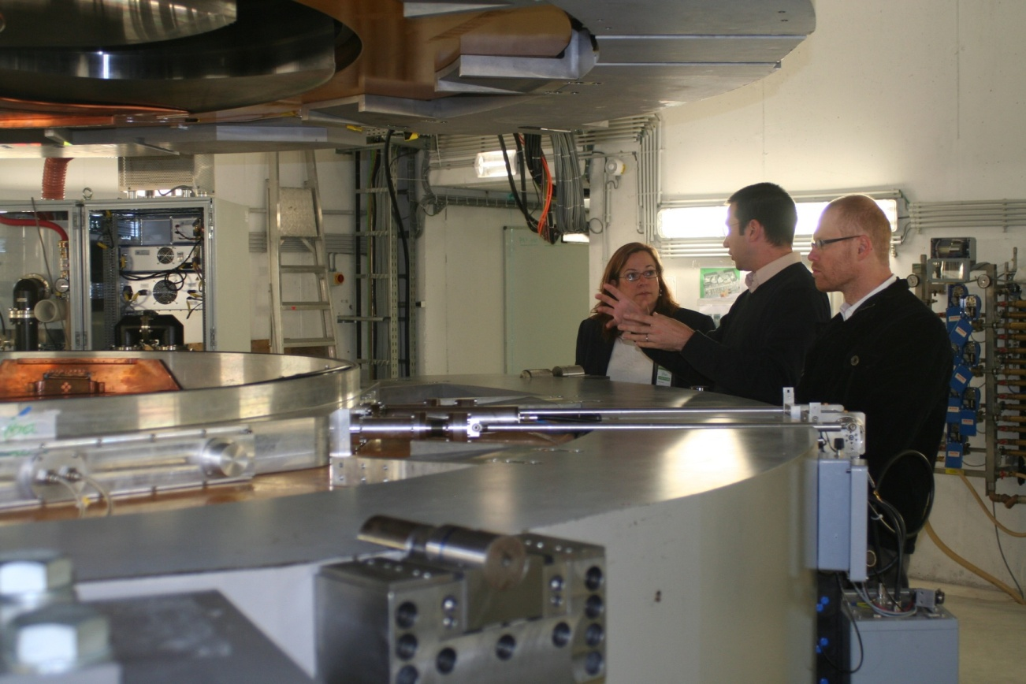
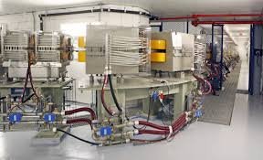
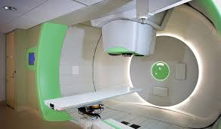
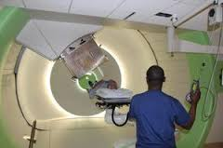
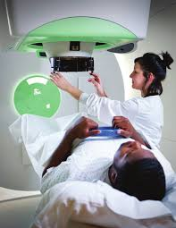
HUPTI’S Tevchnology

Slide 15
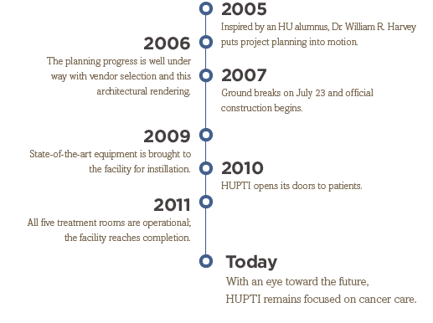
Hampton University Proton Therapy Institute
HUPTI is a genuine national resource: a $225M state-of-the-art
cancer treatment facility and the nation’s largest stand-alone proton beam treatment facility.
Five treatment rooms
Dedicated Research line
PET/CT imaging suite
Most advanced proton therapy technology available

Slide 16
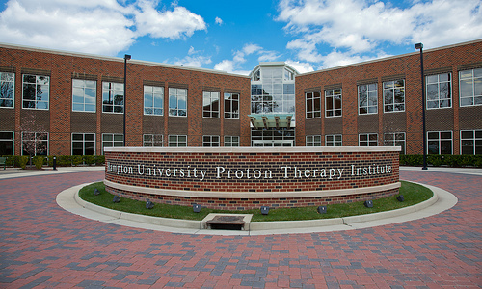
HUPTI IS A UNIQUE RESOURCE IN THE FIGHT AGAINST CANCER
The HUPTI treats a variety of cancer types, including prostate, lung, and breast cancers – all of which are associated with the highest incidence rates in the Commonwealth and nationally.
There is a vast underserved need, and most patients eligible for proton radiotherapy will not be able to receive this treatment. In fact, the Massachusetts General Hospital proton center recently published an article describing the difficulty in making decisions regarding patient selection for proton therapy, given their proton therapy waiting lists.

Slide 17
Career
A career is an individual's journey through learning, work and other aspects of life.
…is an activity in which participants climb up, down or across natural formations or artificial walls. The goal is to reach the summit of a formation or the endpoint of a usually pre-defined route without falling.

Slide 18
Questions?
Thank you!

Slide 19
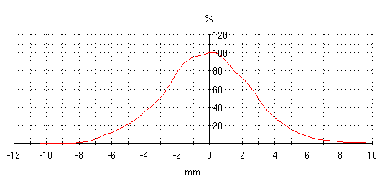
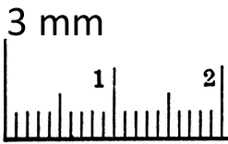
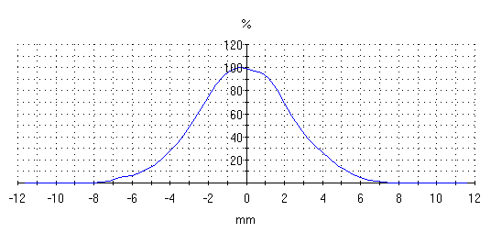
Clinical Utility
Scanning Beam Spot Size
Radiance 330 3mm-6mm σ
in air, at isocenter
Crossplane profile (horizontal scan) for 250 MeV.
Spot size = 2.57 mm.
Inplane profile (vertical scan) for 250 MeV. Spot size = 2.41 mm.

