Slide 1
Introduction to Accelerators
S. Alex Bogacz
Jefferson Lab
Summer Lecture Series
June 5, 2018

Slide 2
Outline
Electromagnetism
  Maxwell’s Equations
  Electromagnetic Waves: Intensity, Power Density
Relativity
  Lorentz Force
  Relativistic Particle Motion
Accelerators
  Fundamental Accelerator Ideas: Lawrence’s Cyclotron
  Building Blocks: RF cavities, Bends, Quadrupoles
Jefferson Lab Accelerators
  12 GeV CEBAF Recirculating Linear Accelerator (RLA)
  Free Electron Laser (FEL/LERF)

Slide 3
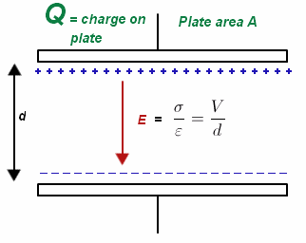
Fundamental Concepts
Electric Field
E

Slide 4
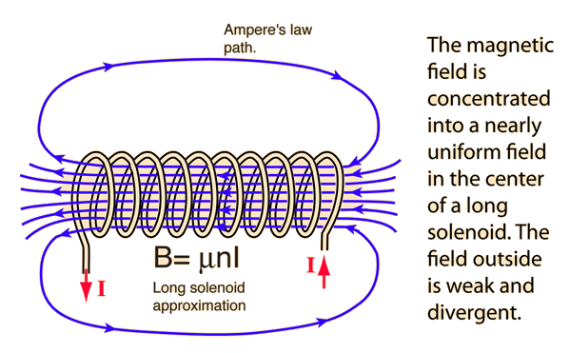
Fundamental Concepts
Magnetic Field
B = μnI

Slide 5
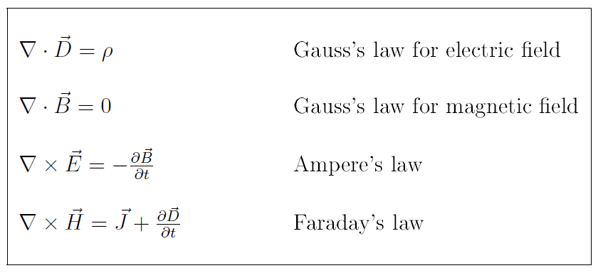

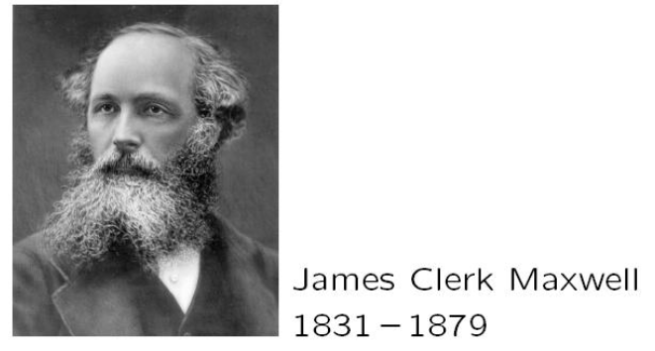


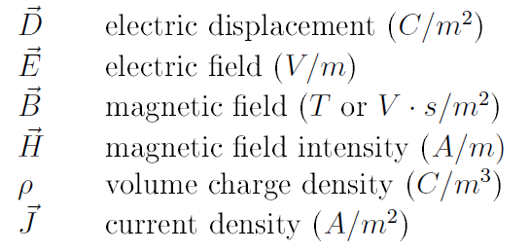

Maxwell’s Equations

Slide 6




Maxwell’s Equations (physical picture)
)
(Ampere’s Law)

Slide 7

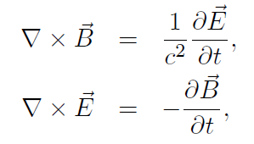



Maxwell’s Equations (in free space)
/

Slide 8




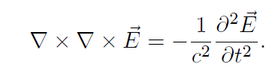
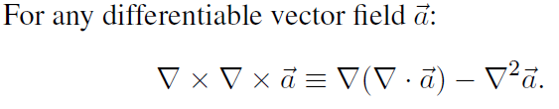

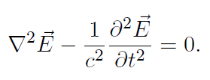


Electromagnetic Waves (in free space)

Slide 9
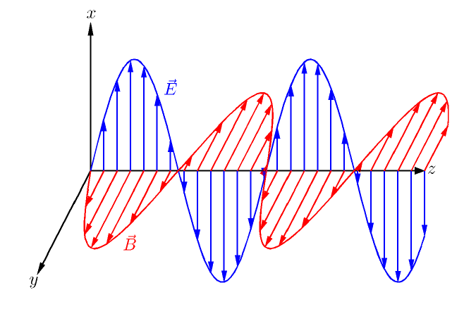
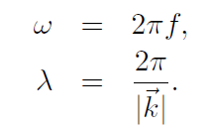



Plane Wave Solutions

Slide 10




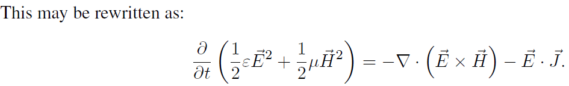
Electromagnetic Energy Conservation
−

Slide 11
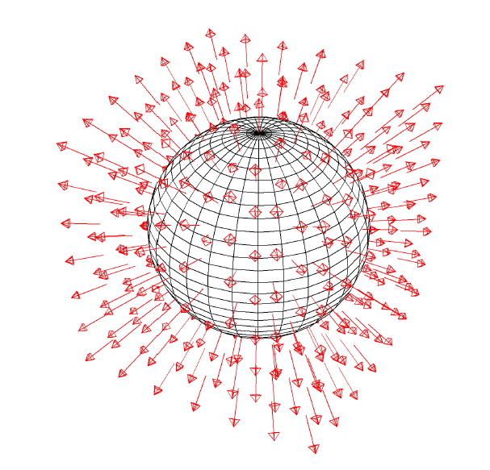
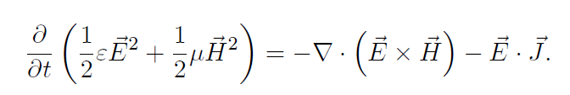
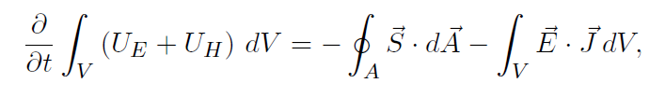
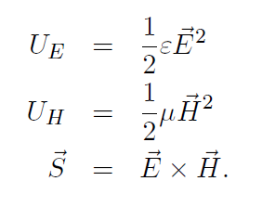



Poynting’s Theorem
Intensity = [Power/Area]

Slide 12
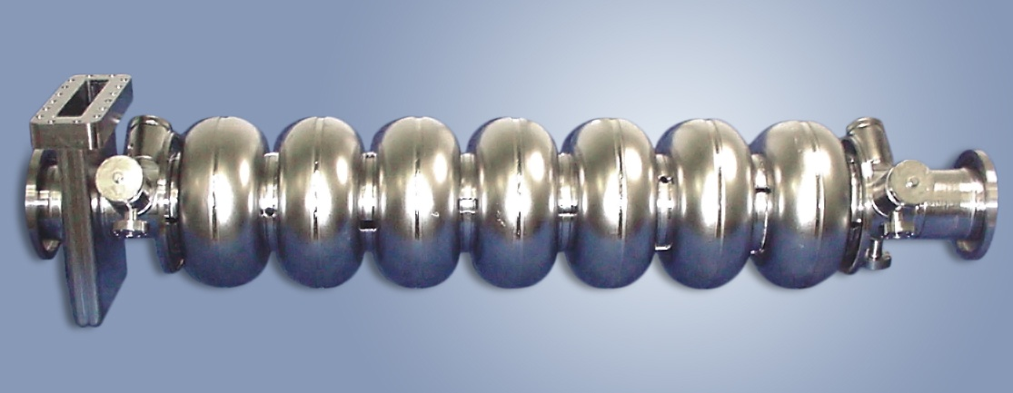
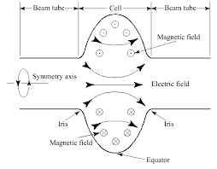
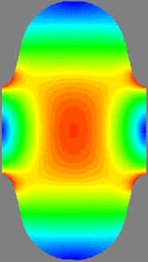
Jefferson Lab Accelerating Cavities

Slide 13
Jefferson Lab Accelerating Cavities

Slide 14
Energy Units
When a particle is accelerated, i.e., its energy is changed by an electromagnetic field, it must have fallen through an Electric Field. For electrostatic accelerating fields the energy change is
q charge, Φ, the electrostatic potentials before and after the motion through the electric field. Therefore, particle energy can be conveniently expressed in units of the “equivalent” electrostatic potential change needed to accelerate the particle to the given energy. Definition: 1 eV, or 1 electron volt, is the energy acquired by 1 electron falling through a one volt potential difference.

Slide 15
More Energy Units
To convert rest mass to eV use Einstein relation
where m is the rest mass. For electrons
Recent “best fit” value 0.51099906 MeV

Slide 16
Reference Frames and Lorentz Transformation
The lab frame vs moving frame
Invariance of space-time interval (Minkowski)
Lorentz transformation of four-vectors
  For example, time/space coordinates in z velocity boost
Notes:
successive boosts do not commute (Thomas precession and spin)

Slide 17
Four-Velocity and Four-Momentum
The proper time interval dτ=dt/γ is Lorentz invariant
So one can define a velocity 4-vector
We can also make a 4-momentum
Double-check that Minkowski norms are invariant
Notes:
dtau/dt = gamma, NOT gamma^2

Slide 18
Relativistic Newton Equation
But now one can define a four-vector force in terms of four-momenta and proper time:
We are primarily concerned with electrodynamics, so now we must make the classical electromagnetic Lorentz force that obeys Lorentz transformations

Slide 19
Relativistic Electromagnetism
Classical electromagnetic potentials can be shown to combine to a four-potential (with c = 1):
The field-strength tensor is related to the four-potential
  E/B fields Lorentz transform with factors of γ, (βγ)
Notes:
c=1

Slide 20
Relativistic Electromagnetism II
The relativistic electromagnetic force equation becomes
It turns out, one can re-write this in somewhat simpler form
  That is, “classical” Lorentz force equation holds, if one treats the momentum as relativistic,

Slide 21
Particle Motion in Constant Magnetic Field (E = 0)
In a constant magnetic field, charged particles move in circular arcs of radius ρ with constant angular velocity ω:
  For we then have:
                or

Slide 22
Magnetic Rigidity: Bending Radius vs Momentum
Particle beam
Accelerator (magnets, geometry)
This is such a useful expression in accelerator physics that it has its own name: ‘magnetic rigidity’
Ratio of momentum to charge
  How hard (or easy) is a particle to deflect?
  Often expressed in [T-m] (easy to calculate B)
A very useful expression:
Notes:
Perpendicular B!
Add q[e] (or Z) to last equation
Be careful; very low-energy people may define rigidity relative to KE rather than p
RHIC: dAu tradeoff

Slide 23
Cyclotron Frequency
Another very useful expression for particle angular frequency in a constant field: cyclotron frequency
In the nonrelativistic approximation
Revolution frequency is independent of radius or energy!

Slide 24
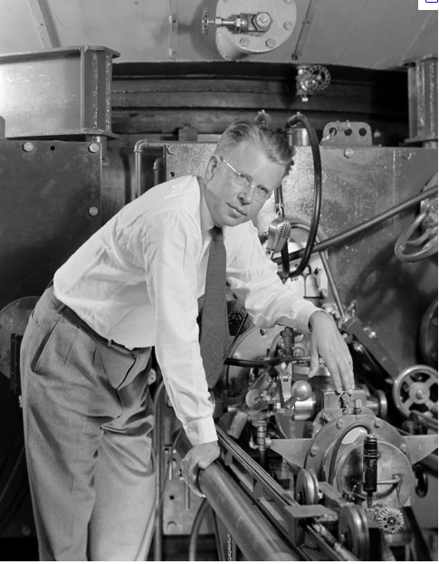
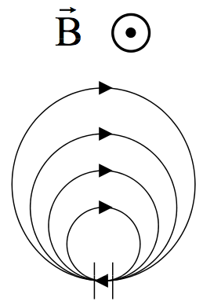
Lawrence’s Question (circa 1930)
Can one repeatedly spiral and accelerate particles through the same potential gap, to re-use it many times?
Ernest Orlando Lawrence
Accelerating gap ΔΦ

Slide 25
Cyclotron Motion Again
The radius of the oscillation r = v₀/Ω_{c} is proportional to the velocity after the gap. Therefore, the particle takes the same amount of time to come around to the gap, independent of the actual particle energy (only in the non-relativistic approximation). Establish a resonance (equality) between RF frequency and particle transverse oscillation frequency, also known as the Cyclotron Frequency

Slide 26
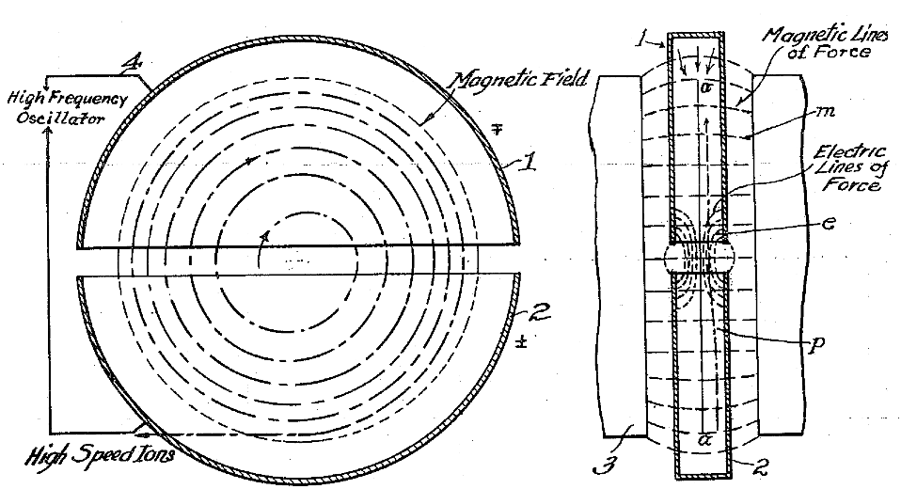
All the Fundamentals of an Accelerator
1934 patent 1948384
  Two accelerating gaps per turn!

Slide 27
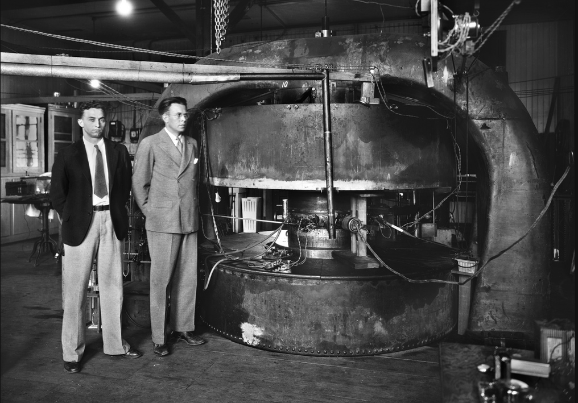
Lawrence’s 27”/69 cm 5 MeV Cyclotron
M.S. Livingston and E.O. Lawrence, 1934
Notes:
Yes, this is the same M. (Morton) Stanley Livingston that built the Cosmotron and AGS, “Courant/Snyder/Livingston”
Livingston was Lawrence’s student and his thesis work was to build cyclotrons!

Slide 28
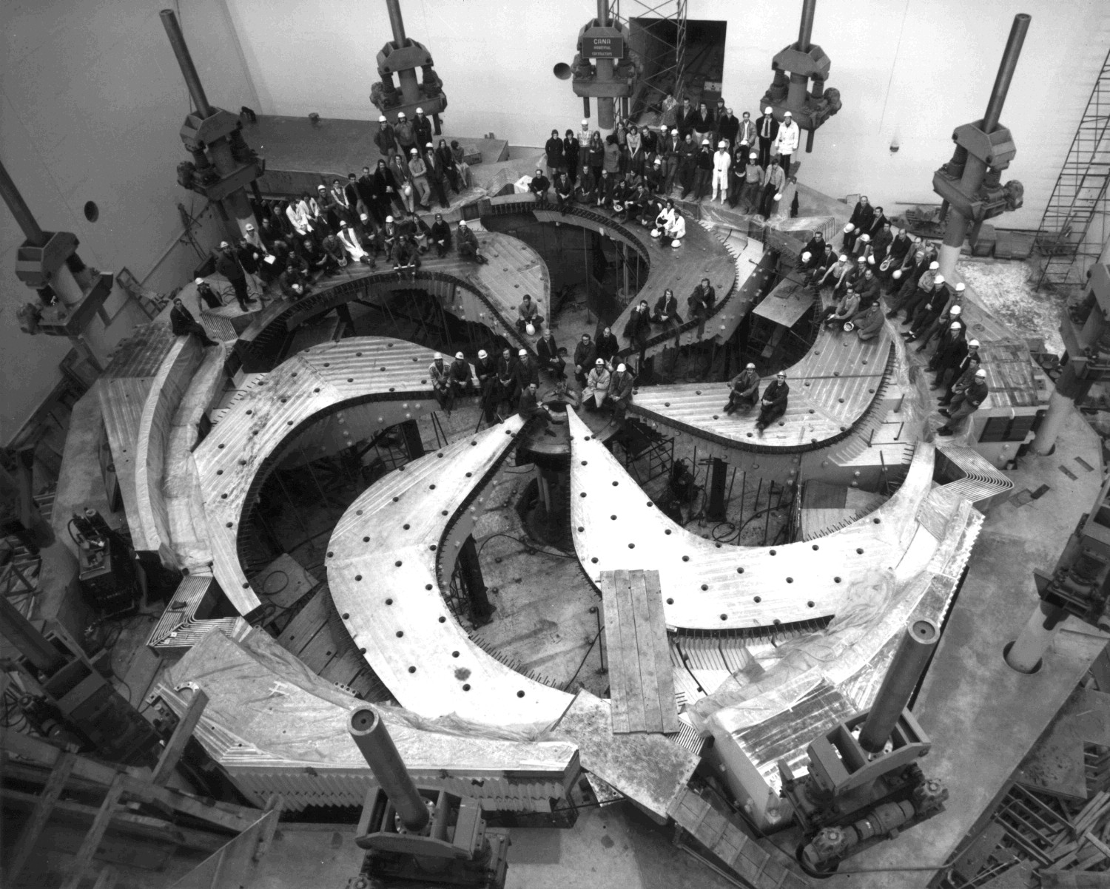
TRIUMF 500 MeV Proton Cyclotron
M.S. Livingston and E.O. Lawrence, 1934
Notes:
Yes, this is the same M. (Morton) Stanley Livingston that built the Cosmotron and AGS, “Courant/Snyder/Livingston”
Livingston was Lawrence’s student and his thesis work was to build cyclotrons!

Slide 29
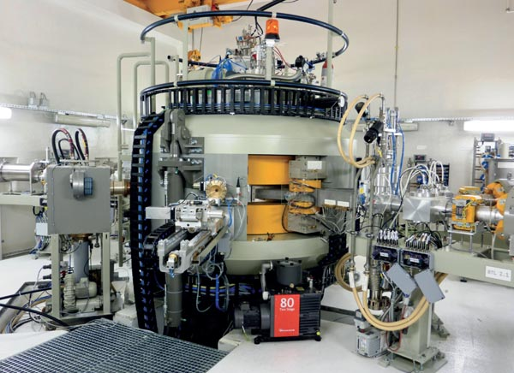
Modern Medical Cyclotron (IBA)
M.S. Livingston and E.O. Lawrence, 1934
Notes:
Yes, this is the same M. (Morton) Stanley Livingston that built the Cosmotron and AGS, “Courant/Snyder/Livingston”
Livingston was Lawrence’s student and his thesis work was to build cyclotrons!

Slide 30
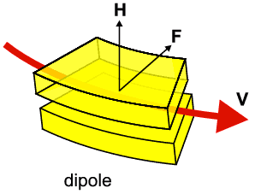
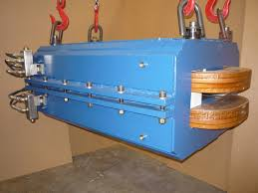
Dipole (Bend) Magnet
Rectangular Magnet
Sector Magnet
θ/2
θ/2
θ
ρ
ρ

Slide 31
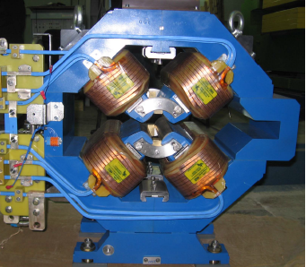
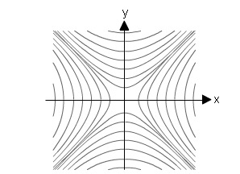
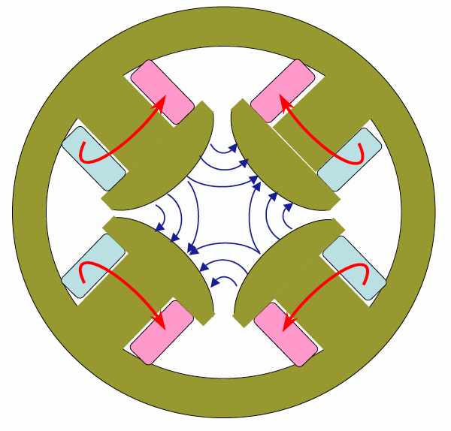
Quadrupole (Lenz) Magnet
N
S
S
N

Slide 32
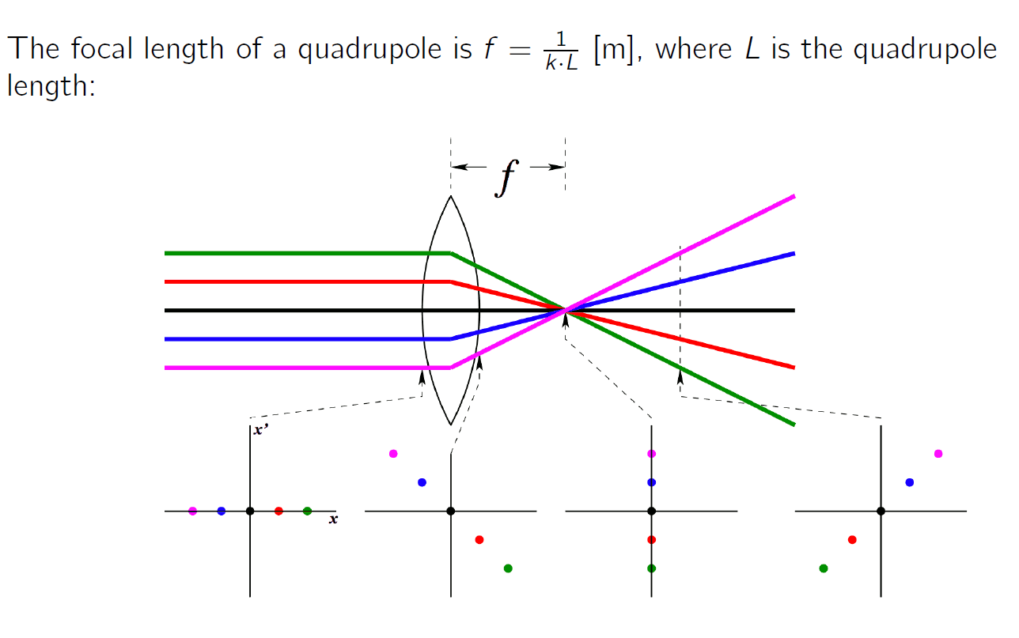

Focal Length of a Quadrupole

Slide 33
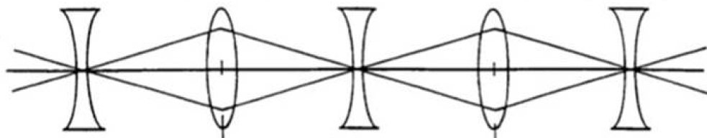
Strong Focusing – FODO Lattice
In a quadrupole magnet field that focuses in one transverse direction, defocuses in the other
Question: is it possible to develop a system that focuses in both directions simultaneously?
Strong focusing: alternate the signs of focusing and defocusing: achieve net focusing!

Slide 34
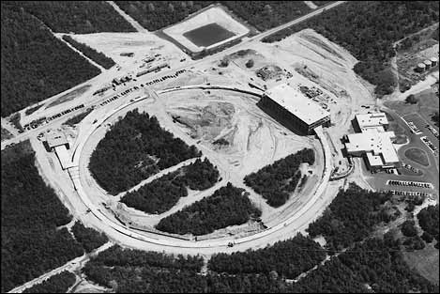
Alternating Gradient Synchrotron (AGS)

Slide 35
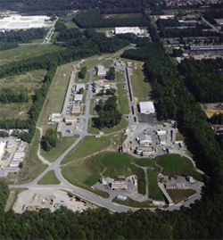
Jefferson Lab

Slide 36
12 GeV CEBAF
Parameter | Max. Value
Energy | 12 GeV
Current | 100 μA
Charge | 0.2 pC
12 GeV
1.09 GeV/pass
1.09 GeV/pass
123 MeV
11 GeV
Parameter | RMS
σ_{t} | 0.7 ps
σ_{ΔE/E} | 0.01 %
ε_{x,y} | 1 mm-mrad

Slide 37
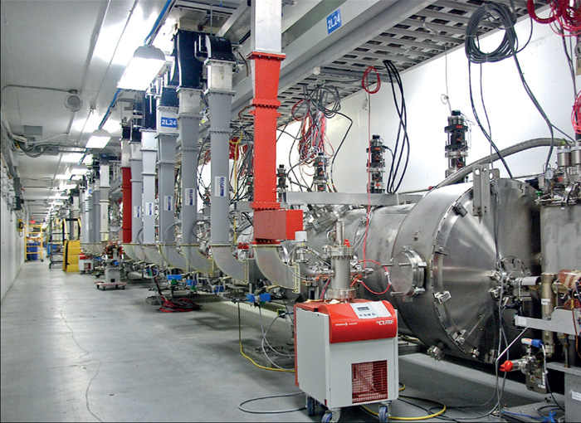
New 12 GeV Linac

Slide 38
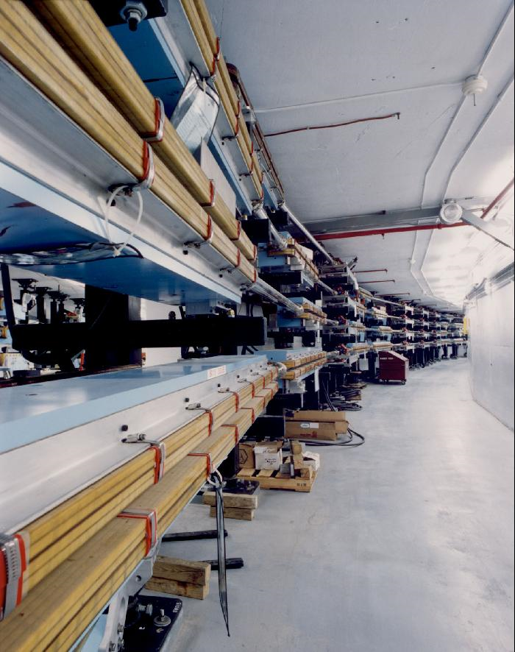
CEBAF Arcs

Slide 39
Energy Recovery – Fundamental Idea
Energy recovery in RF-fields – braking the DC limit
λ_{Rf}
E_{Out} = E_{Inj}
E_{Inj}
L = n · λ + λ / 2
E = E_{Inj} + ΔE
(β ~ 1)
Energy Flow = Acceleration
→ Energy Storage in the beam (loss free)
→ Energy Recovery = Deceleration

Slide 40
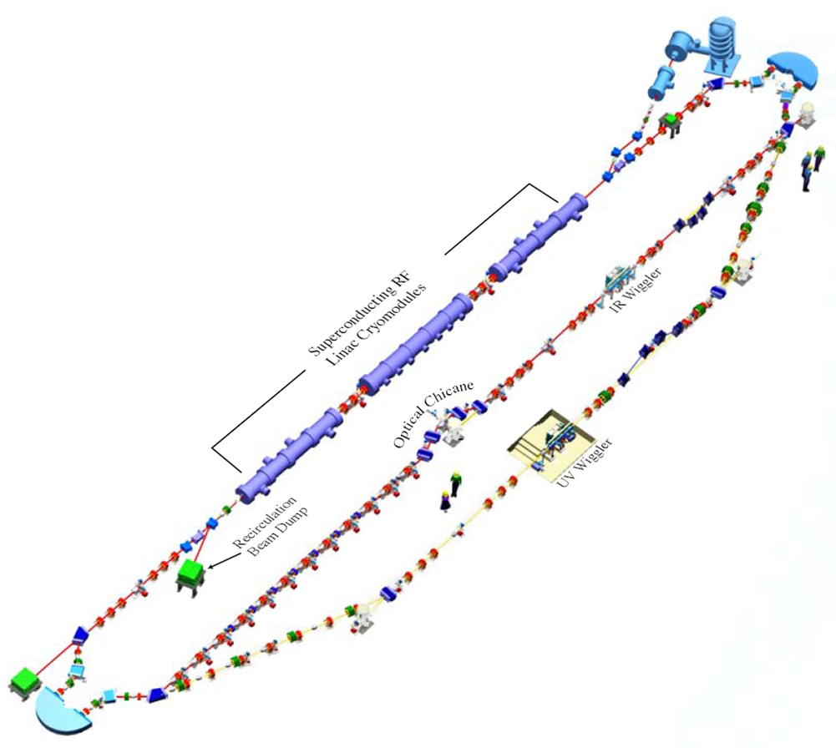
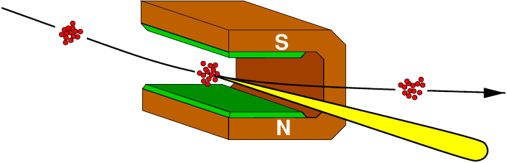
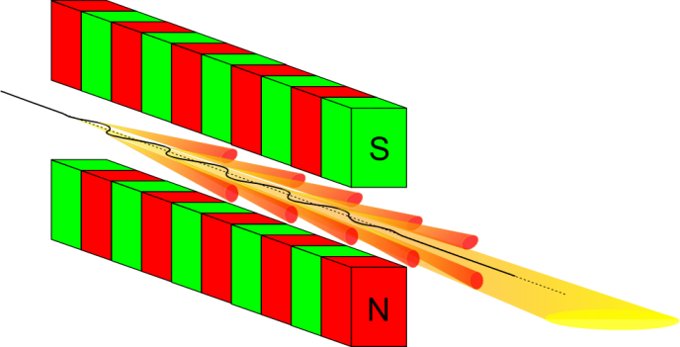
FEL/LERF (Low Energy Recirculator Facility)
Parameter | Max. Value
Energy | 170 MeV
Current | 8 mA
Charge | 150 pC
Parameter | RMS
σ_{t} (injected/FEL) | 3.3/0.12 ps
σ_{ΔE/E} (injected/FEL) | 0.15/0.5 %
ε_{x,y} (normalized) | 15 mm-mrad

Slide 41
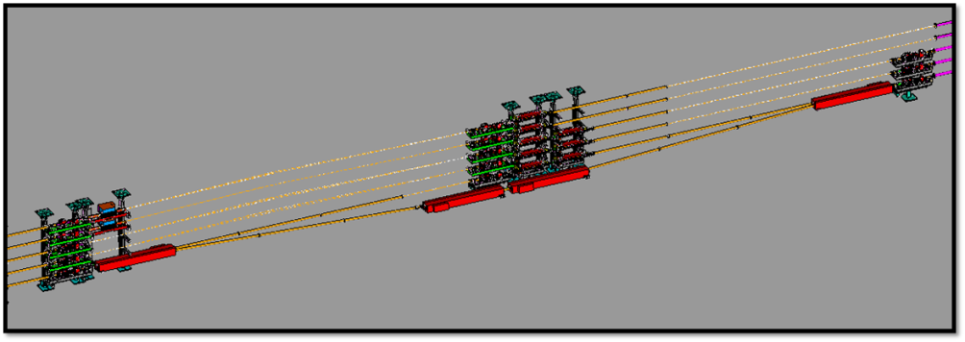
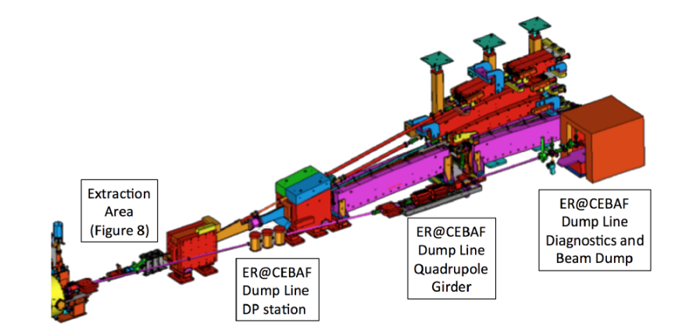
CEBAF Energy Recovery Linac
11 GeV
Δs = λ/2

Slide 42
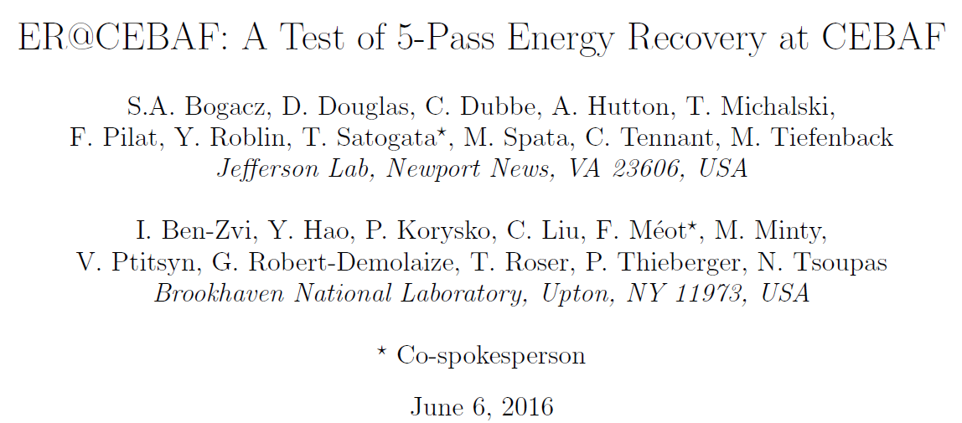
CEBAF Energy Recovery Linac
90:1
98.9% ERL
η_{ERL} = E_{inj}/E_{final}
Δs = λ/2
123 MeV

Slide 43
Summary
In this lecture we have introduced fundamental properties of the electromagnetic field as well as elements of the relativistic particle dynamics.
We have also highlighted some of the most important ideas in accelerator design and described fundamental building blocks of modern accelerators.
Finally, we have introduced the main accelerators at Jefferson Lab: 12 GeV CEBAF and the FEL/LERF.

Slide 44
Thank you for your attention!
Questions?

