Slide 1
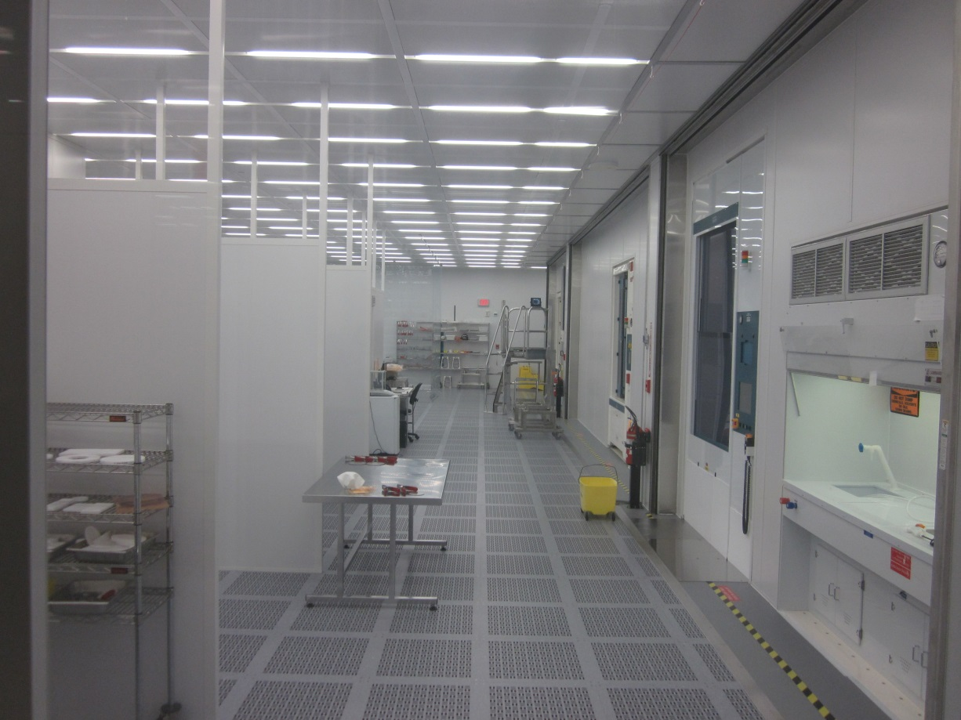
SRF Science and Technology
Grigory Eremeev
20 June 2019

Slide 2
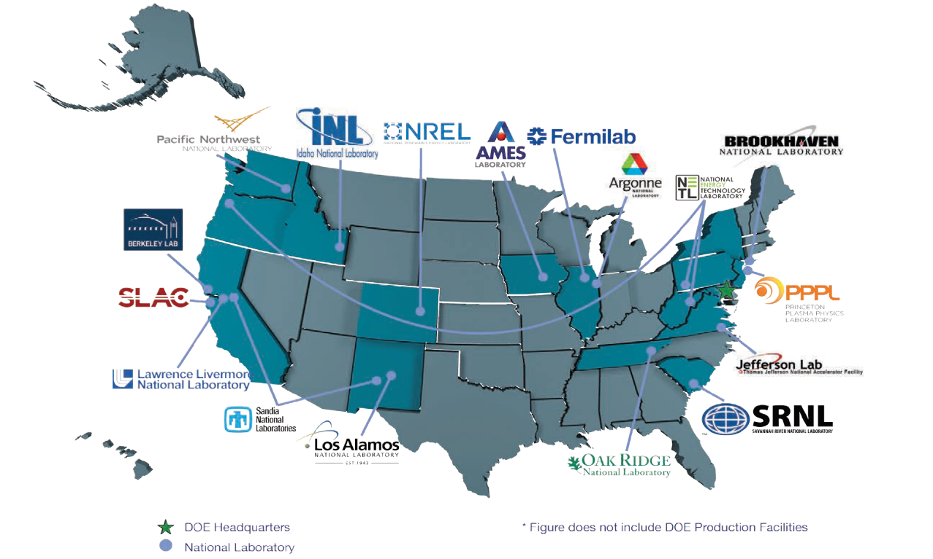
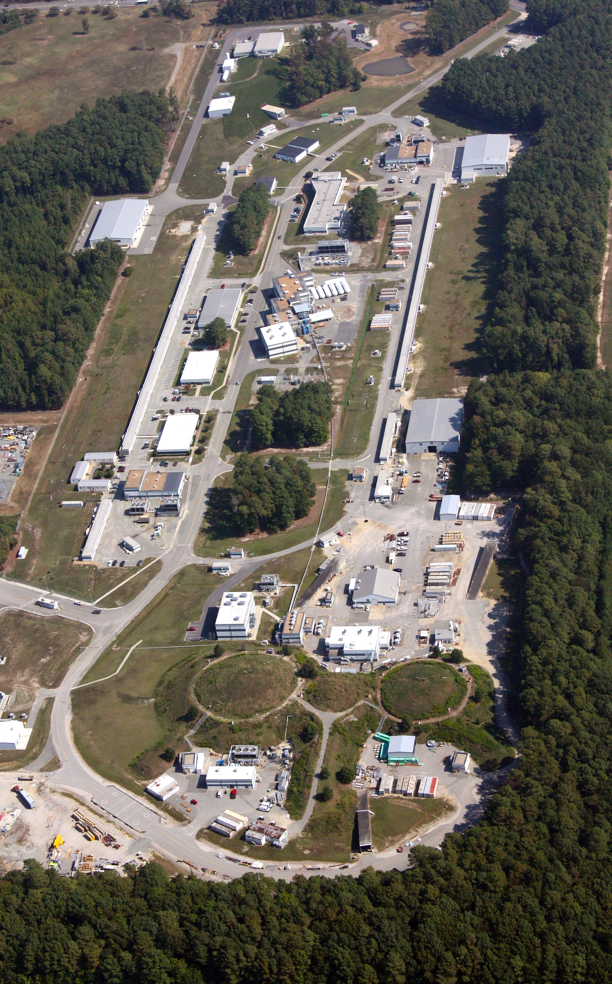
Jefferson Lab Overview
Core Competencies
  Accelerator Science and Technology
  Large Scale User Facilities/Advanced Instrumentation
  Nuclear Physics
Mission Unique Facilities
  Continuous Electron Beam Accelerator Facility

Slide 3
CEBAF @ 12 GeV
Constructed 1987-1993: ~ 1 km long
First large high-power CW recirculating e-linac based on SRF technology
Recent energy upgrade to 12 GeV
New Hall
Upgrade arc magnets
and supplies
Add 5 cryomodules
20 cryomodules
CHL upgrade
Add arc
20 cryomodules
Add 5 cryomodules
  10 new high performance cryomodules
  Double the capacity of the Central Helium Liquefier
  Upgrade magnets and power supplies for recirculation arcs
  Upgrade Extraction, Instrumentation and Diagnostics, and Safety Systems
  Add new beamlines for Arc 10 and Hall D
  Add new experimental Hall D and upgrade existing Halls
Enhanced capabilities
in existing Halls

Slide 4
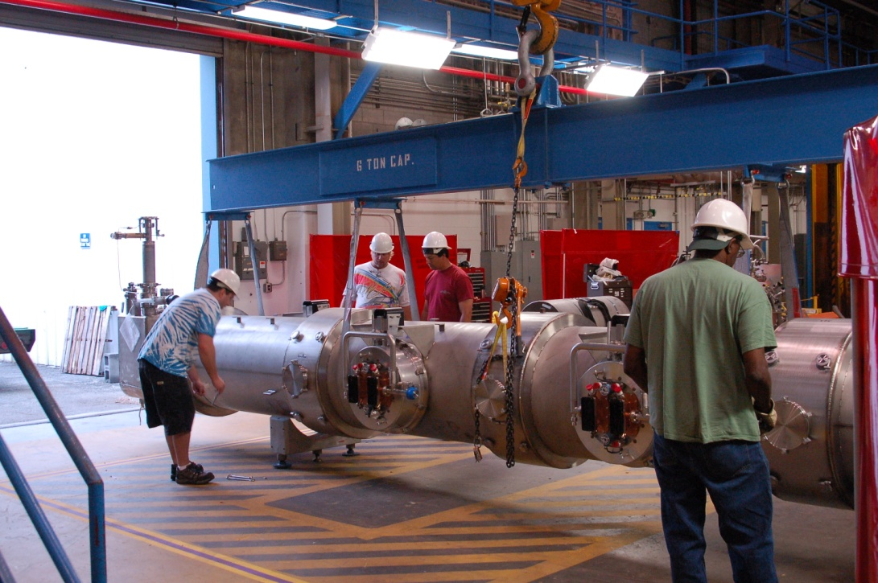
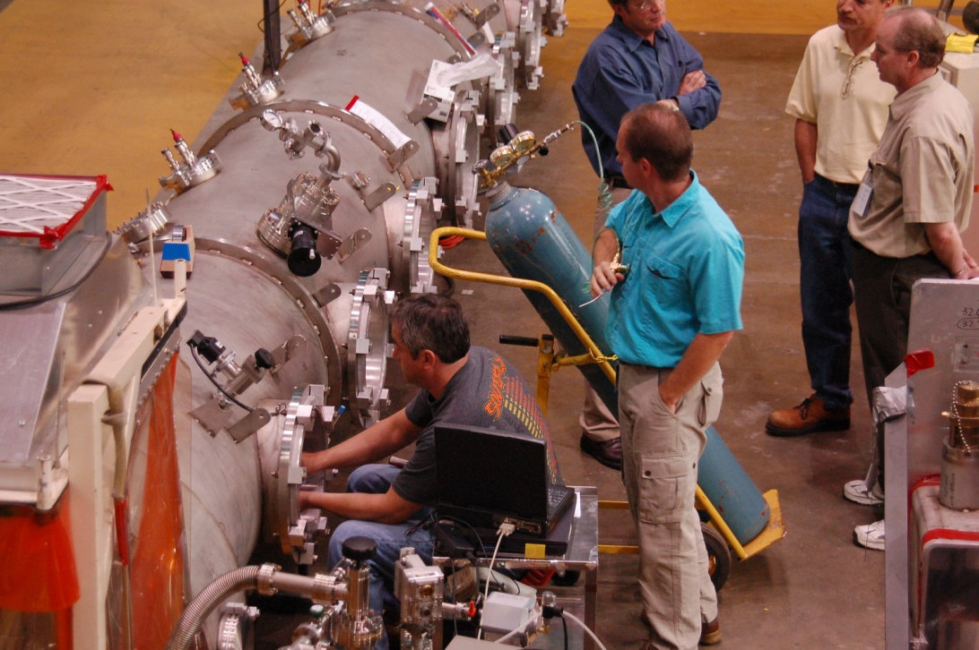
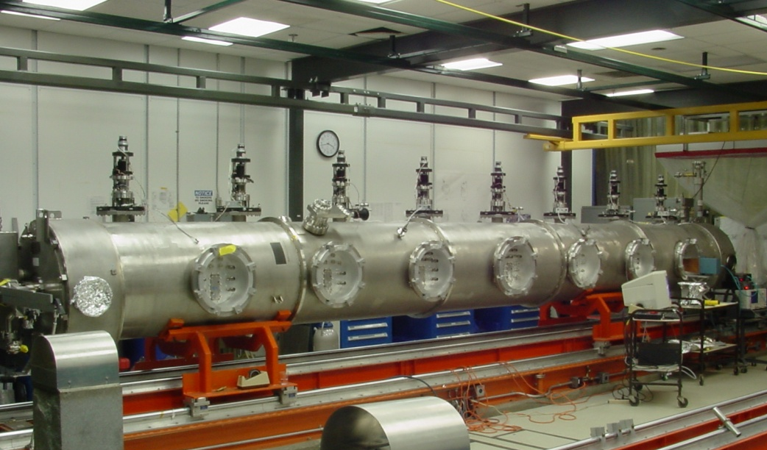
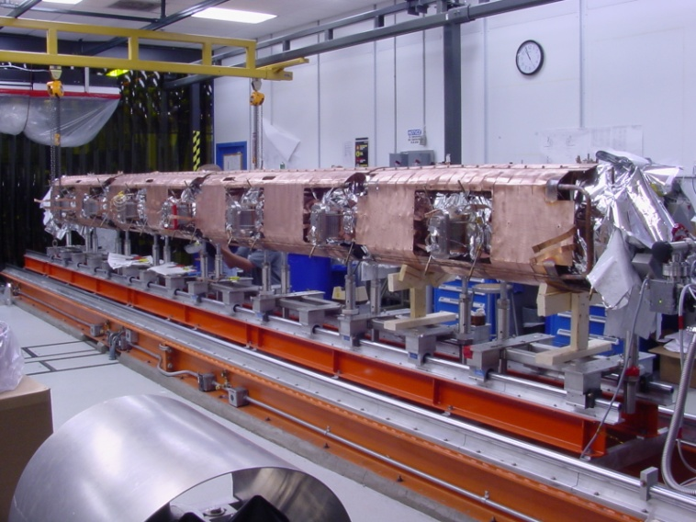
SRF technology photo gallery

Slide 5
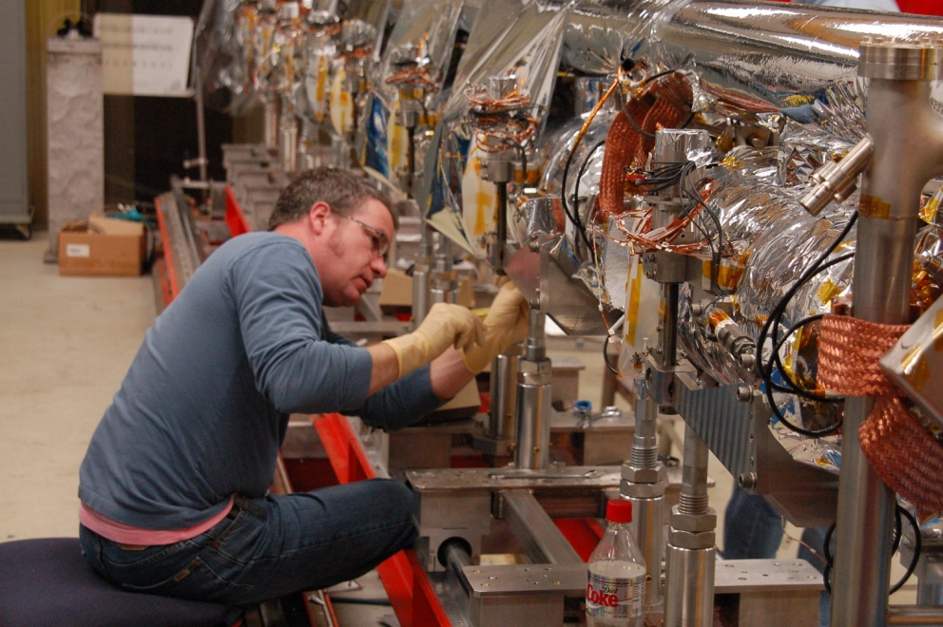
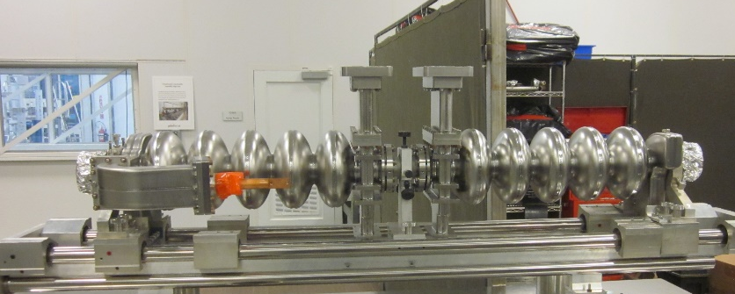
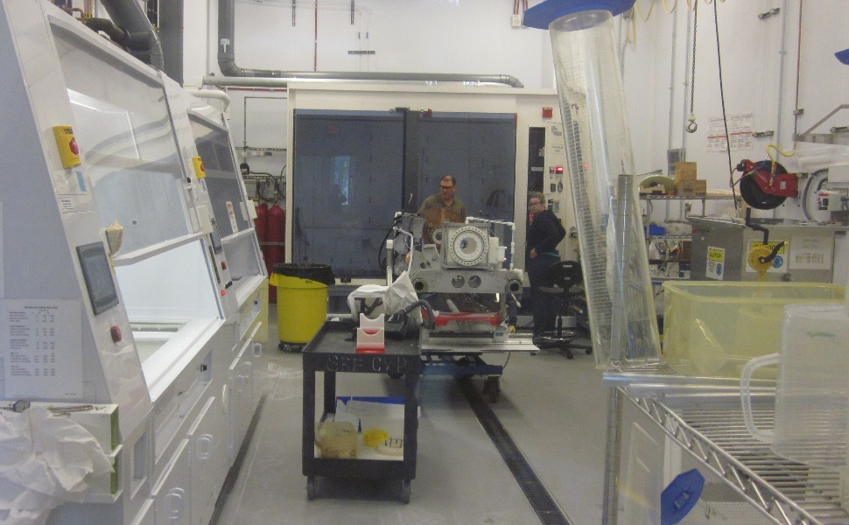
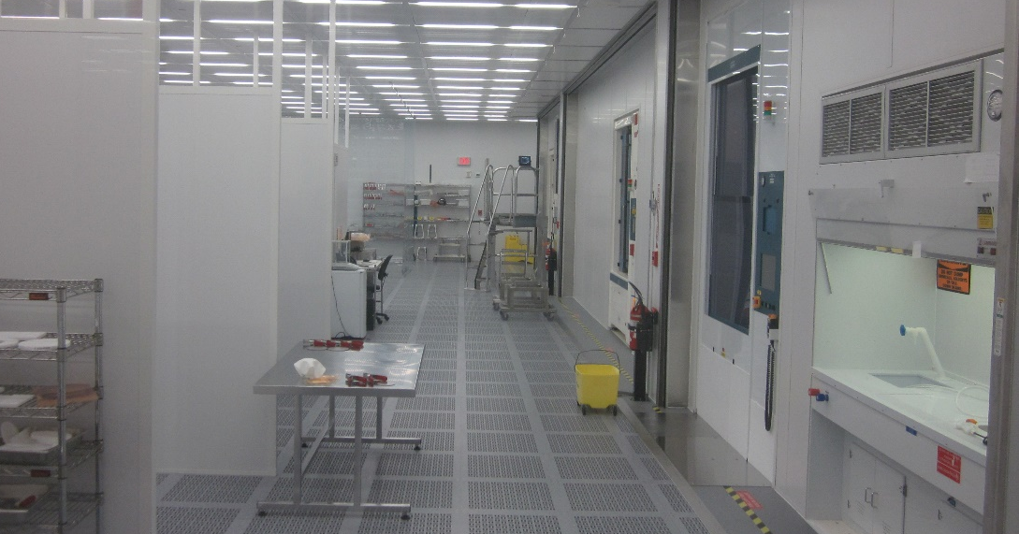
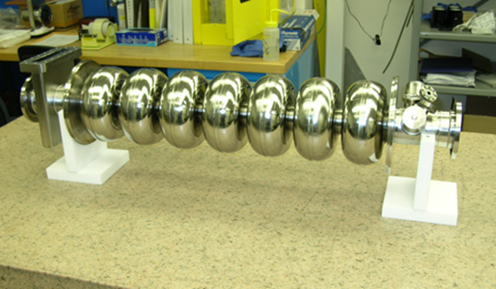
SRF technology photo gallery

Slide 6
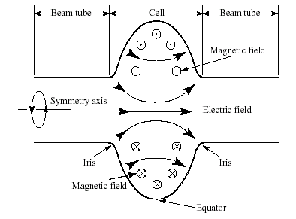
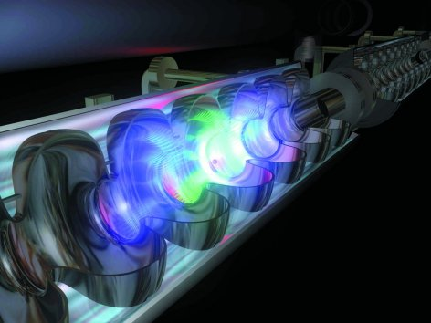
Cavity fundamentals
Conducting cavities can be filled with electromagnetic energy. This energy is then transferred to charged particles flying along the cavity axis.
Lowest frequency eigen-mode has a longitudinal electric field → use this mode for acceleration
Typical RF frequency: 0.4 GHz to 4 GHz
Higher-Order (higher frequency) modes: unwanted → need damping

Slide 7
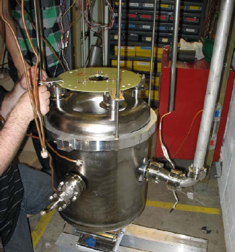
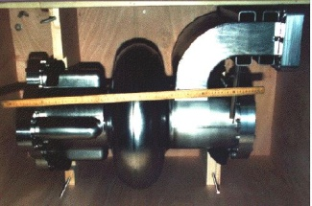
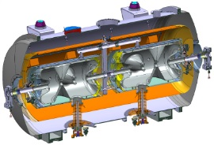
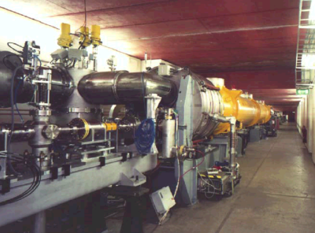
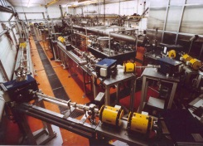
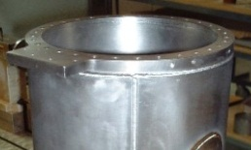
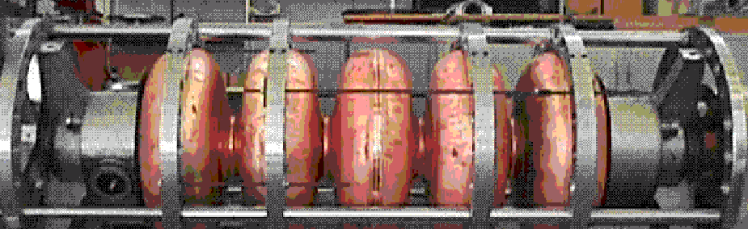
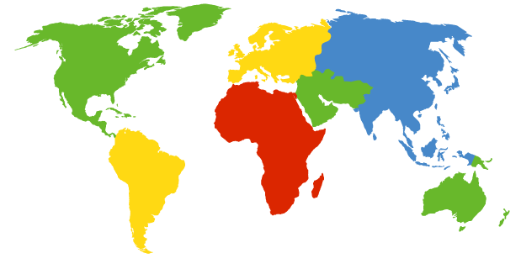
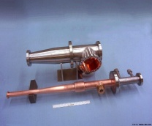
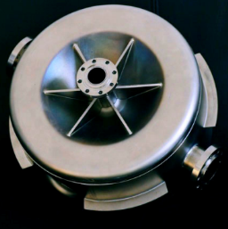
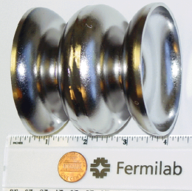
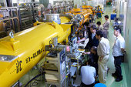
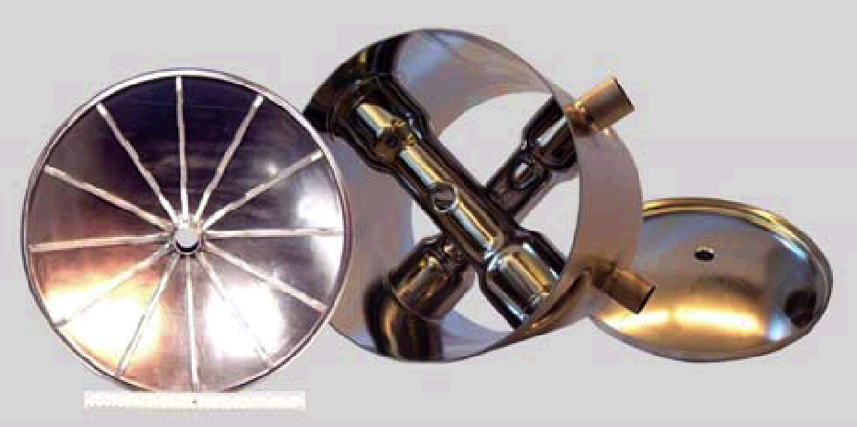
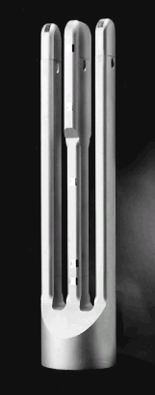
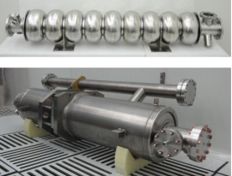
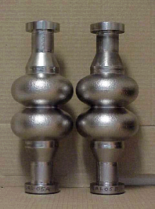
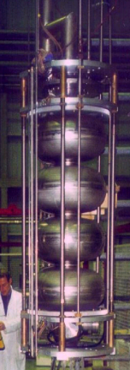
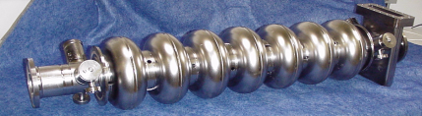
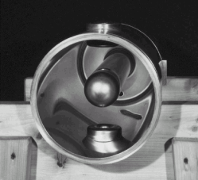
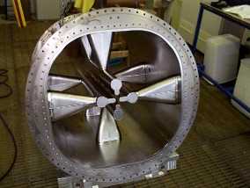
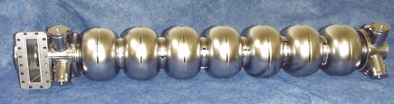
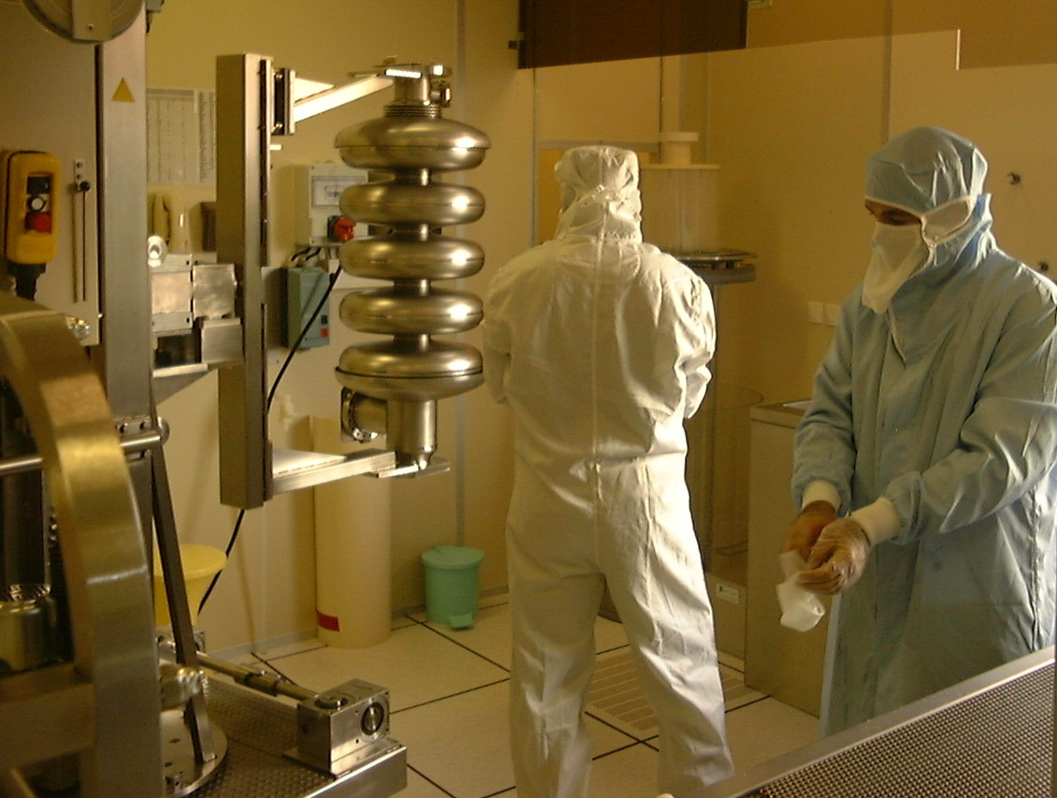
SRF globally
CERN
ESS
DESY/FLASH/XFEL
TU Darmstadt
TRIUMF
MSU/FRIB
CESR
LANL
FNAL
Peking
University
SLAC
ANL
KEK
IHEP
Australian
National
University
JLab
CEA
Orsay
CEA Saclay
INFN Legnaro
INFN Genoa
INFN Milan

Slide 8
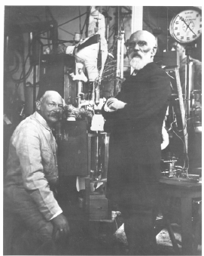
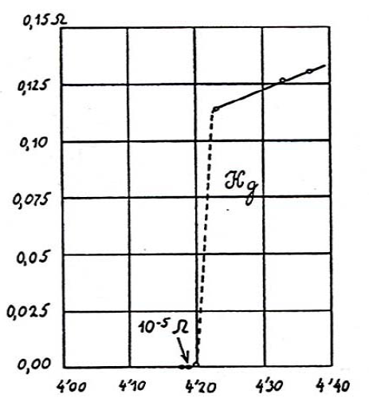
SRF ≡ Superconducting Radio Frequency
SRF science is the study of superconducting RF properties of particular materials as well as designs of accelerator systems to provide understanding of performance limitations in accelerator systems.

Slide 9
SRF ≡ Superconducting Radio Frequency
SRF technology exploits superconducting materials to provide high performance, energy efficient accelerator systems.
1972: First superconducting accelerator based on L-band 1300 MHz niobium cavities @ Stanford High Energy Physics Lab
CEBAF was the first large-scale application of SRF in the US – constructed 1987-1993: ~ 1 km long
XFEL accelerator in Europe is built 2009-2015: ~ 2 km long
LCLS-II @ Stanford Linear Collider Complex currently under construction 2016-2020: ~ 1 km long, 35 cryomodules
Proposed ILC accelerator 20??-20??: ~ 30 km long, ~ 1000 cryomodules
Essentially all new large accelerators being planned in the world aim to exploit this technology.

Slide 10
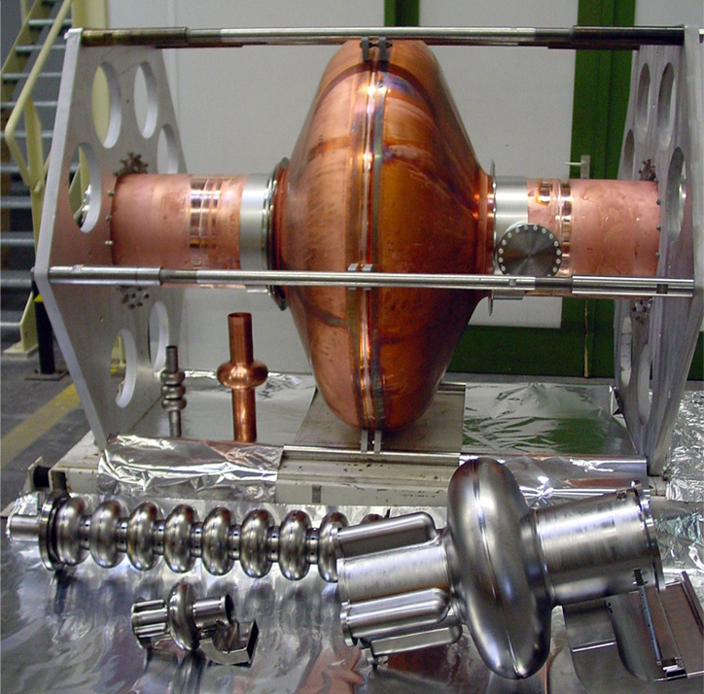
Niobium, the material of choice
Niobium – best superconducting properties among all pure metals:
    T_{c} ~ 9.25 K;
    H_{c} ~ 2000 Oe;
    R_{bcs} ~ .00001 mΩ at 2 K
THE CAVITY
Nb : R_{s} ~ .00001 mΩ
Cu: Rs ~ 10 mΩ
↓
Q^{nb} ~ 10¹¹ up to
E_{acc} = 5·10⁷ Volts per meter
Cavity
cavity

Slide 11
11
10
Ideal?
10
Q₀
10
Real
Real
Real
9
10
8
10
0
20
40
60
E_{acc}, MV/m

Slide 12
“Physics of dirt”, Pauli 1933
Limitation:
Thermal breakdown
High field Q-reduction
High-purity Nb, sheet inspection, CBP, etc
Electropolishing,
low temperature baking, …
Solution:
1975
3 MV/m
1985
6 MV/m
1990
15 MV/m
1995
25 MV/m
2000
40 MV/m
2010
50 MV/m
Electron multiplication
Electron field emission
Limitation:
Quench
Improved cavity shape
High-pressure rinsing, cleanroom procedures
Further improved cavity shapes
Solution:

Slide 13
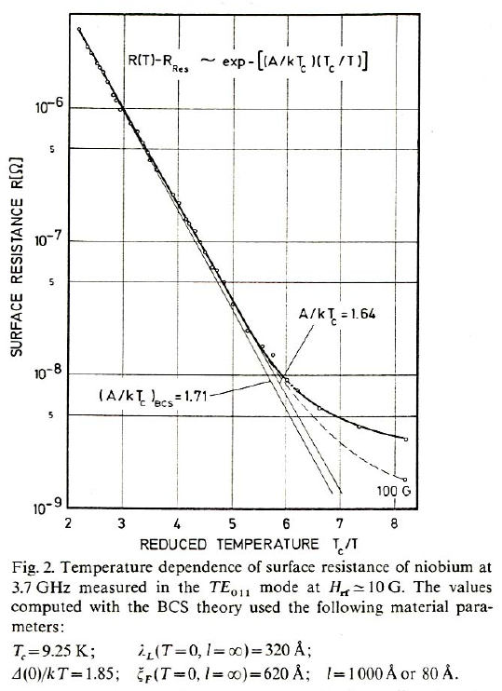
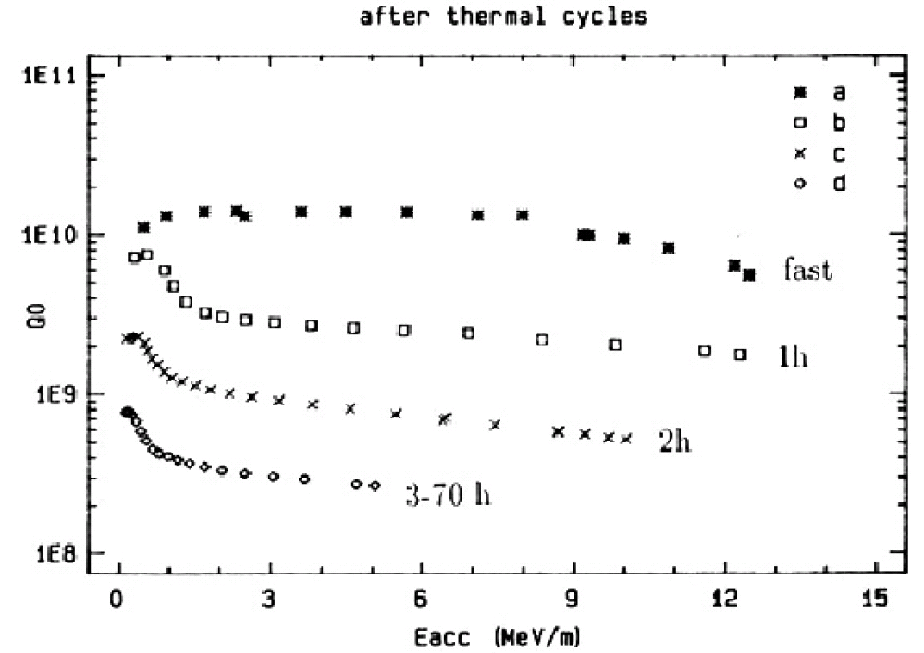
Residual resistance
RF surface resistance of SRF cavities level off to a constant level at low temperatures, which is not predicted by BCS theory of superconductivity

Slide 14
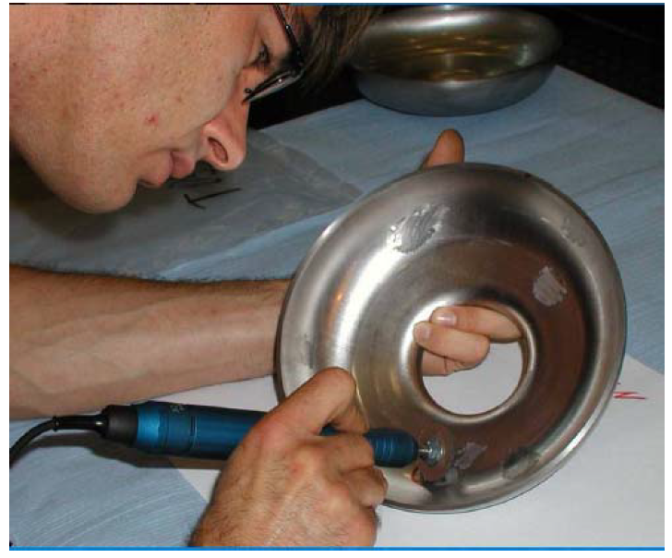
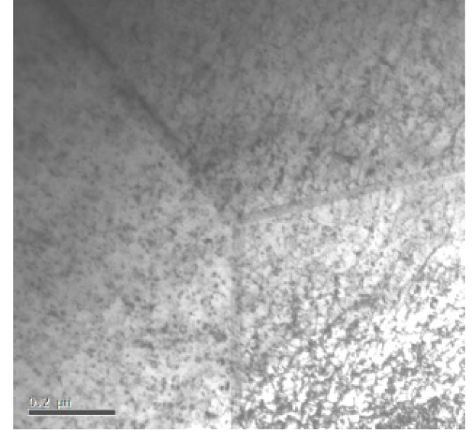
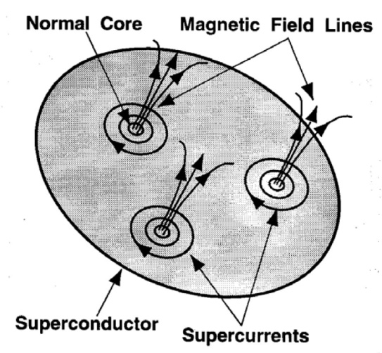
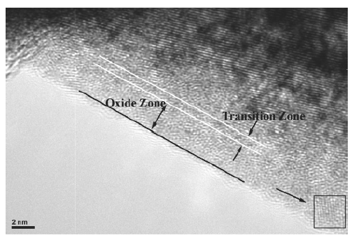
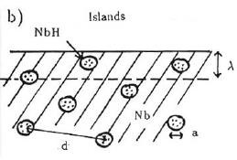
Residual resistance
Lattice damage
Earth magnetic field = 0.5 Gauss => Rs ~ 100 nOhm => Q0 ~ 10⁸
Hydrogen is readily absorbed by Nb at room temperature and has high diffusion rate even at low temperature, which leads to formation of lossy NbH clusters below 100 K.
Nb₂O₅ oxide is a “good” dielectric, but NbO₂ and NbO are poor conductors/semiconductors.

Slide 15
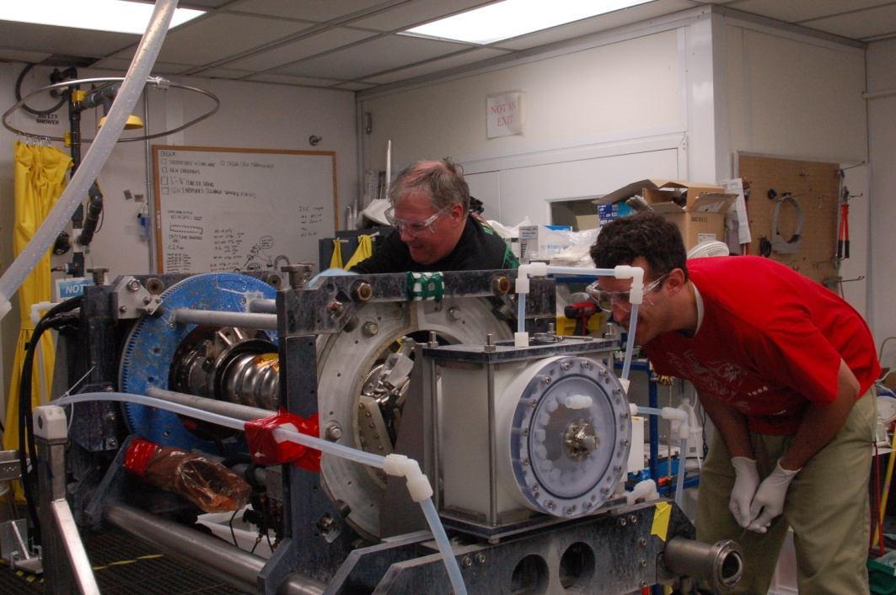
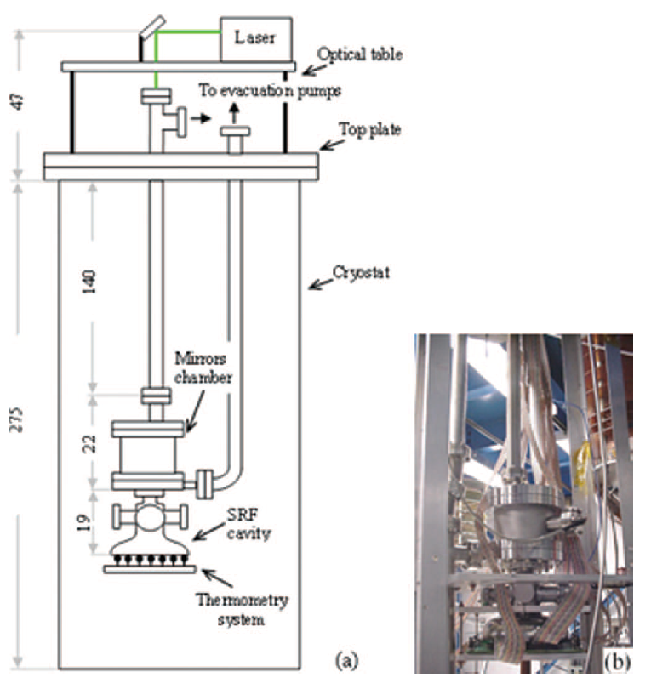
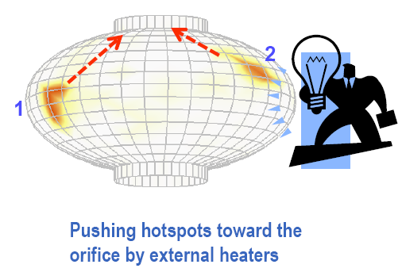
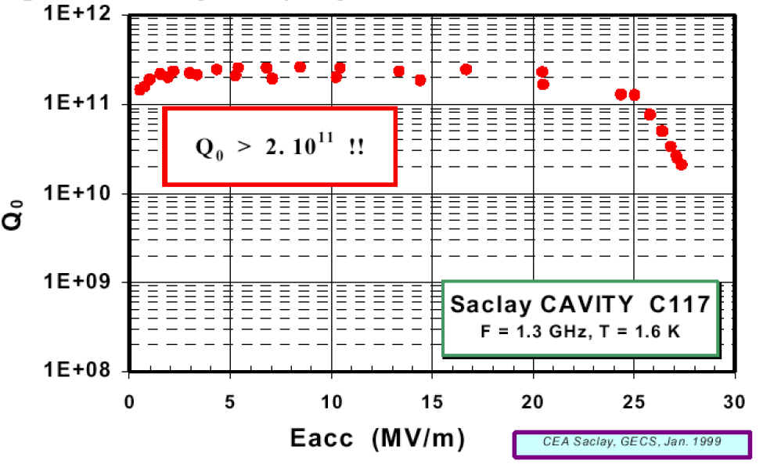

Residual resistance
Etch the damage layer and contamination with chemistry
Pushing magnetic fluxiods from high current areas with thermal gradients
High quality factors and low residual resistances < 0.5 nOhm has been achieved.

Slide 16
Limitation:
Thermal breakdown
High field Q-reduction
High-purity Nb, sheet inspection, CBP, etc
Electropolishing,
low temperature baking, …
Solution:
1975
3 MV/m
1985
6 MV/m
1990
15 MV/m
1995
25 MV/m
2000
40 MV/m
2010
50 MV/m
Electron multiplication
Electron field emission
Limitation:
Quench
Improved cavity shape
High-pressure rinsing, cleanroom procedures
Further improved cavity shapes
Solution:
High field Q-reduction

Slide 17



Thermal breakdown
Small size particles on RF surface coupled with poor thermal conductivity of Nb wall at low temperatures can cause thermal breakdown
Thermal breakdown occurs when the heat generated on RF surface exceeds the heat conduction capacity from RF surface through cavity wall and Nb-He interface to liquid helium bath

Slide 18





Thermal breakdown
Defects on niobium surface is a common occurrence especially close to the electron beam weld regions, where niobium melting (Tm=2700 K) and rapid solidification occur.

Slide 19
Limitation:
Thermal breakdown
High field Q-reduction
High-purity Nb, sheet inspection, CBP, etc
Electropolishing,
low temperature baking, …
Solution:
1975
3 MV/m
1985
6 MV/m
1990
15 MV/m
1995
25 MV/m
2000
40 MV/m
2010
50 MV/m
Electron multiplication
Electron field emission
Limitation:
Quench
Improved cavity shape
High-pressure rinsing, cleanroom procedures
Further improved cavity shapes
Solution:
High field Q-reduction

Slide 20

Electron field emission

Slide 21

Electron field emission

Slide 22

Electron field emission

Slide 23

Electron field emission

Slide 24




Electron field emission
Wilhelm Röntgen
A

Slide 25


Electron field emission
Fowler-Nordheim
Φ – material work function
k – effective surface area
E – electric field
β – field enhancement factor
Electron current is not expected from Nb surface below GV/m.
Experiments with single-crystal Nb samples show FE onset higher than 1 GV/m

Slide 26


Electron field emission
A. Dangwal et al., PRST-AB 12, 023501 (2009).
A. Navitski et al., PRST-AB 16, 112001 (2013).

Slide 27



Electron field emission
Intrinsic FE measurements revealed anisotropic values of 4.02 and 3.8 for (111) and (100) orientations of Nb, respectively.

Slide 28



Electron field emission
Tip-on-tip model

Slide 29

Electron field emission

Slide 30



Electron field emission

Slide 31
Limitation:
Thermal breakdown
High field Q-reduction
High-purity Nb, sheet inspection, CBP, etc
Electropolishing,
low temperature baking, …
Solution:
1975
3 MV/m
1985
6 MV/m
1990
15 MV/m
1995
25 MV/m
2000
40 MV/m
2010
50 MV/m
Electron multiplication
Electron field emission
Limitation:
Quench
Improved cavity shape
High-pressure rinsing, cleanroom procedures
Further improved cavity shapes
Solution:

Slide 32


High field quench
Reduction of surface magnetic field by increasing magnetic volume

Slide 33
Ideal?
11
10
Ideal?
10
Q₀
10
Real
Real
Real
9
10
8
10
0
20
40
60
E_{acc}, MV/m

Slide 34



Unexpectedly, a reduction in resistance (or inversely, an increase in Q) with field have been recently seen on a number of heat treated cavities.

Slide 35

Higher gradients?
Limitation:
Thermal breakdown
High field Q-reduction
High-purity Nb, sheet inspection, CBP, etc
Electropolishing,
low temperature baking, …
Solution:
?
1975
3 MV/m
1985
6 MV/m
1990
15 MV/m
1995
25 MV/m
2000
40 MV/m
2010
50 MV/m
Electron multiplication
Electron field emission
Limitation:
Quench
Improved cavity shape
High-pressure rinsing, cleanroom procedures
Further improved cavity shapes
Solution:
High field Q-reduction

Slide 36




Path forward?
Material | T_{c} (K) | ρ_{n}(μΩcm) | H_{c}(0) [T] | H_{c1}(0) [T] | H_{c2}(0) [T] | λ(0) [nm]
Nb | 9.2 | 2 | 0.2 | 0.17 | 0.4 | 40
NbN | 16.2 | 70 | 0.23 | 0.02 | 15 | 200
NbTiN | 17.5 | 35 |  | 0.03 |  | 151
Nb₃Sn | 18 | 20 | 0.54 | 0.05 | 30 | 85
V₃Si | 17
Mo₃Re | 15 |  | 0.43 | 0.03 | 3.5 | 140
MgB₂ | 40 |  | 0.43 | 0.03 | 3.5 | 140
50 nm of Nb₃Sn

Slide 37



Bulk Nb₃Sn

Slide 38




Nb on Cu
Bulk Nb
40 MV/m +

Slide 39
JLab SRF in Summary
State-of-the-art manufacturing, processing and testing facilities for SRF cavities
  Ongoing R&D for LCLS-II/LCLS-II-HE, JLEIC, SNS PPU, and other projects
  Production of LCLS-II cryomodules
  Consulting with others on future projects
World class R&D projects:
  Cavity design and simulation (high gradient, high current)
  Material development (large-grain Nb, thin films, new materials)
  Surface processing (electropolishing, mechanical polishing, etc)
  Basic SRF physics (understanding RF losses in superconductors)
Reduce cost and improve reliability of SRF accelerators worldwide

Slide 40
Thank you for listening!
I hope you have a great summer at Jefferson Lab!

