Slide 1
Scintillation Detectors
Introduction
Components
  Scintillator
  Light Guides
  Light Sensors
    Photomultiplier Tubes
    Silicon Photomultipliers
Formalism/Electronics
Application to Particle Identification
Elton Smith -- Jlab Summer Lecture Series

Slide 2
Experiment basics
B field ~ 5/3 T
p = 0.3 B R = 1.5 GeV/c
L = ½ π R = 4.71 m
β_{π} = p/√p²+m_{π}² = 0.9957
β_{Κ} = p/√p²+m_{Κ}² = 0.9496
R = 3m
t_{π} = L/β_{π}c = 15.77 ns
t_{Κ} = L/β_{Κ}c = 16.53 ns
Δt_{πK} = 0.76 ns

Slide 3
Experiment basics
B field ~ 5/3 T
p = 0.3 B R = 1.5 GeV/c
L = ½ π R = 4.71 m
β_{π} = p/√p²+m_{π}² = 0.9957
β_{Κ} = p/√p²+m_{Κ}² = 0.9496
R = 3m
t_{π} = L/β_{π}c = 15.77 ns
t_{Κ} = L/β_{Κ}c = 16.53 ns
Δt_{πK} = 0.76 ns
Particle Identification by time-of-flight (TOF) requires
Measurements with accuracies of ~ 0.1 ns

Slide 4
Measure the Flight Time between two Scintillators
450 ns
Stop
Disc
20 cm
TDC
Start
Disc
300 cm
400 cm
100 cm

Slide 5
Measure the Flight Time between two Scintillators
450 ns
Particle Trajectory
Stop
Disc
20 cm
TDC
Start
Disc
300 cm
400 cm
100 cm

Slide 6
Propagation velocities
c = 30 cm/ns
v_{scint} = c/n = 20 cm/ns
v_{eff} = 16 cm/ns
v_{pmt} = 0.6 cm/ns
v_{cable} = 20 cm/ns
Δt ~ 0.1 ns
Δx ~ 3 cm

Slide 7
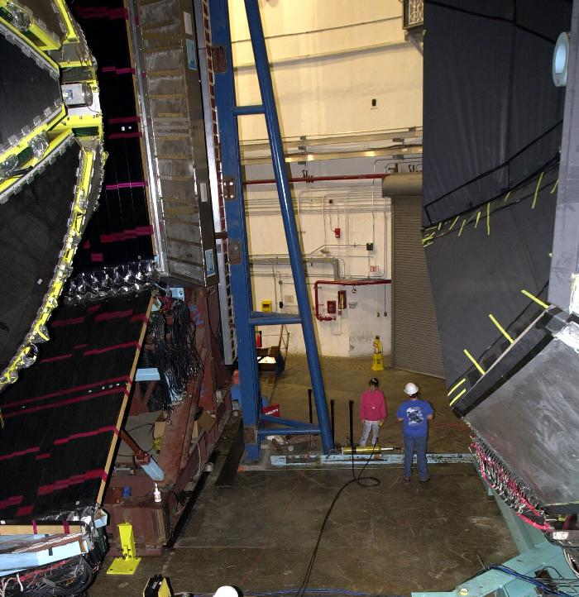
CLAS detector with FC pulled apart

Slide 8
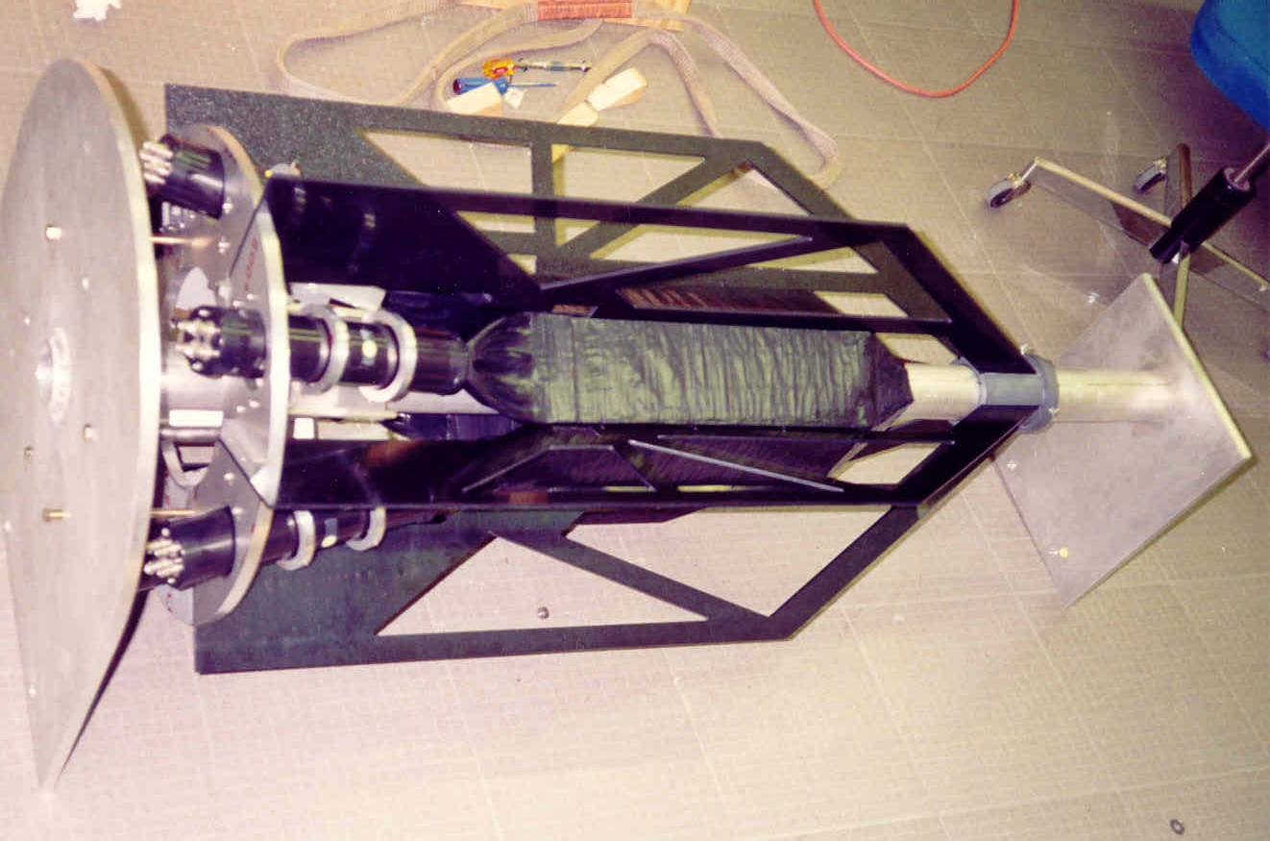
Start counter assembly

Slide 9
Scintillator types
Organic
  Liquid
    Economical
    messy
  Solid
    Fast decay time
    long attenuation length
    Emission spectra
Inorganic (crystals)
  Anthracene
    Unused standard
  NaI, CsI
    Excellent γ resolution
    Slow decay time
  Lead Tungstate (PbWO₄)
    High density and resolution

Slide 10
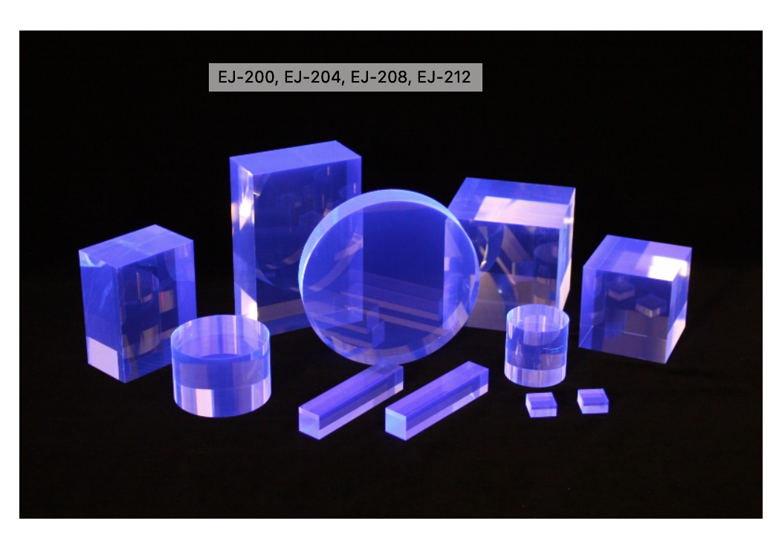
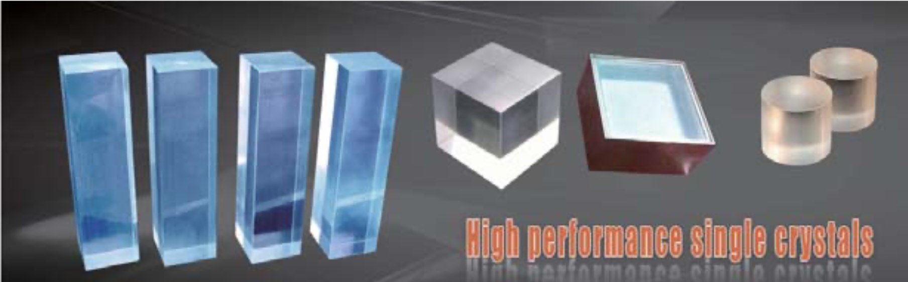
Solid scintillators, examples
plastic
Eljen Technologies
EPIC Crystal Co., China

Slide 11
Scintillator types
Organic
  Liquid
    Economical
    messy
  Solid
    Fast decay time
    long attenuation length
    Emission spectra
Inorganic (crystals)
  Anthracene
    Unused standard
  NaI, CsI
    Excellent γ resolution
    Slow decay time
  Lead Tungstate (PbWO₄)
    High density and resolution

Slide 12
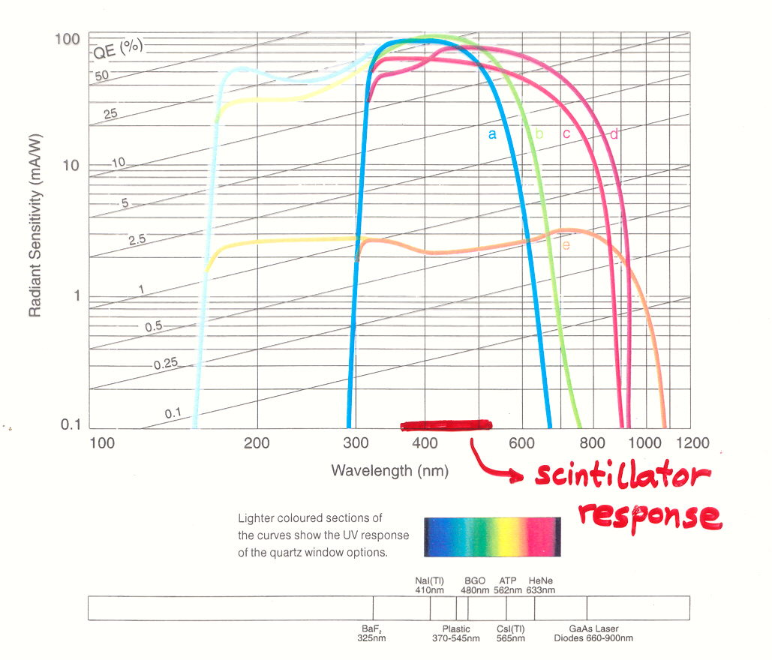
Scintillators: Light Spectrum
Photomultipliers and Accessories
Electron Tubes Ltd (1996)

Slide 13
Light Collection: Light guides
Goals
  Match (rectangular) scintillator to (circular) pmt
  Optimize light collection for applications
Types
  Plastic
  Air
  None
  “Winston” shapes

Slide 14
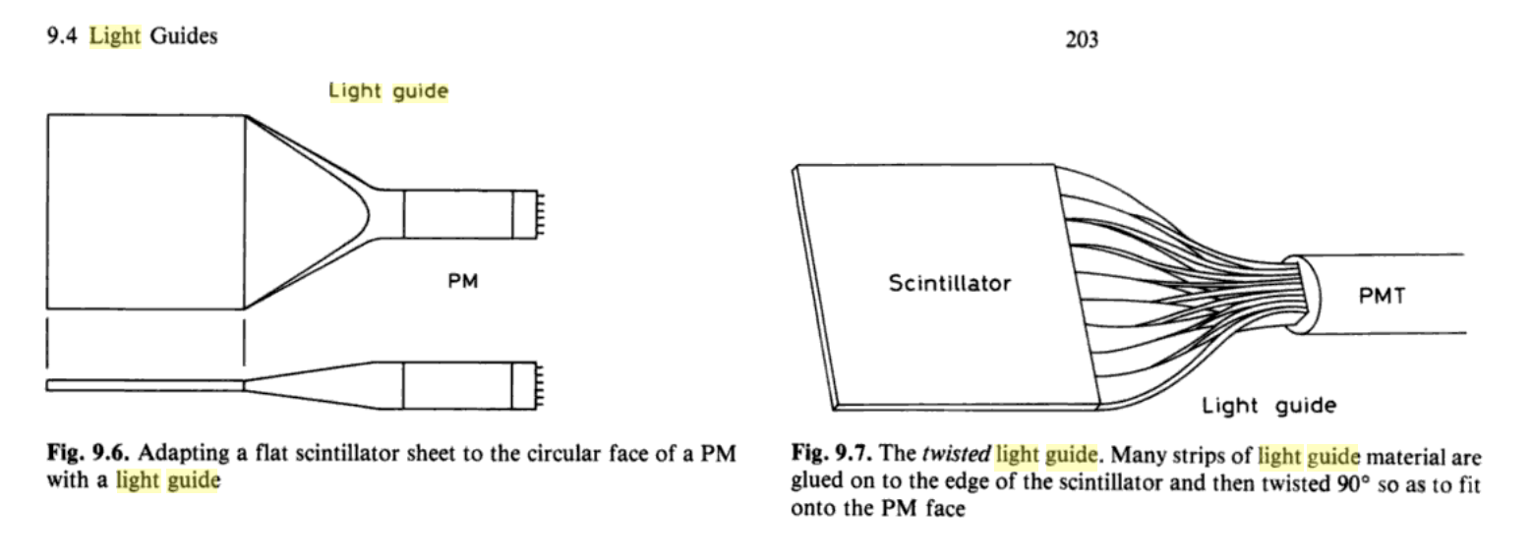
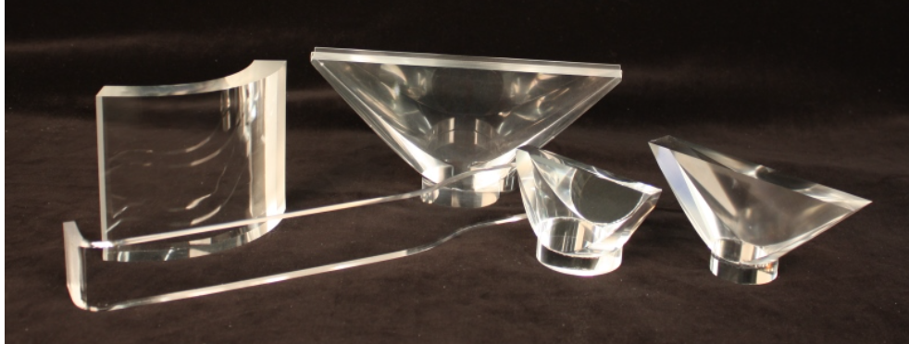
Light guides, examples
Techniques for Nuclear and
Particle Physics, W.R. Leo
Eljen Technologies

Slide 15
Reflective/Refractive boundaries
Scintillator
n = 1.58
acrylic
PMT glass
n = 1.5

Slide 16
Reflective/Refractive boundaries
Scintillator
n = 1.58
acrylic
PMT glass
n = 1.5

Slide 17
Reflective/Refractive boundaries
mirror
Scintillator
n = 1.58
PMT glass
n = 1.5
Air

Slide 18
Reflective/Refractive boundaries
mirror
Scintillator
n = 1.58
PMT glass
n = 1.5
Air
(reflectance at normal incidence)

Slide 19
Reflective/Refractive boundaries
air
Scintillator
n = 1.58
PMT glass
n = 1.5

Slide 20
Reflective/Refractive boundaries
air
Scintillator
n = 1.58
PMT glass
n = 1.5

Slide 21
Reflective/Refractive boundaries
air
Scintillator
n = 1.58
PMT glass
n = 1.5

Slide 22
Reflective/Refractive boundaries
Scintillator
n = 1.58
acrylic
PMT glass
n = 1.5
Acceptance of incident rays at fixed angle depends
on position at the exit face of the scintillator

Slide 23
Reflective/Refractive boundaries
Scintillator
n = 1.58
acrylic
PMT glass
n = 1.5
Acceptance of incident rays at fixed angle depends
on position at the exit face of the scintillator

Slide 24
Reflective/Refractive boundaries
Scintillator
n = 1.58
acrylic
PMT glass
n = 1.5
Large-angle
ray lost
Acceptance of incident rays at fixed angle depends
on position at the exit face of the scintillator
Rule of thumb: Acceptance is given by the ratio of output/input areas

Slide 25
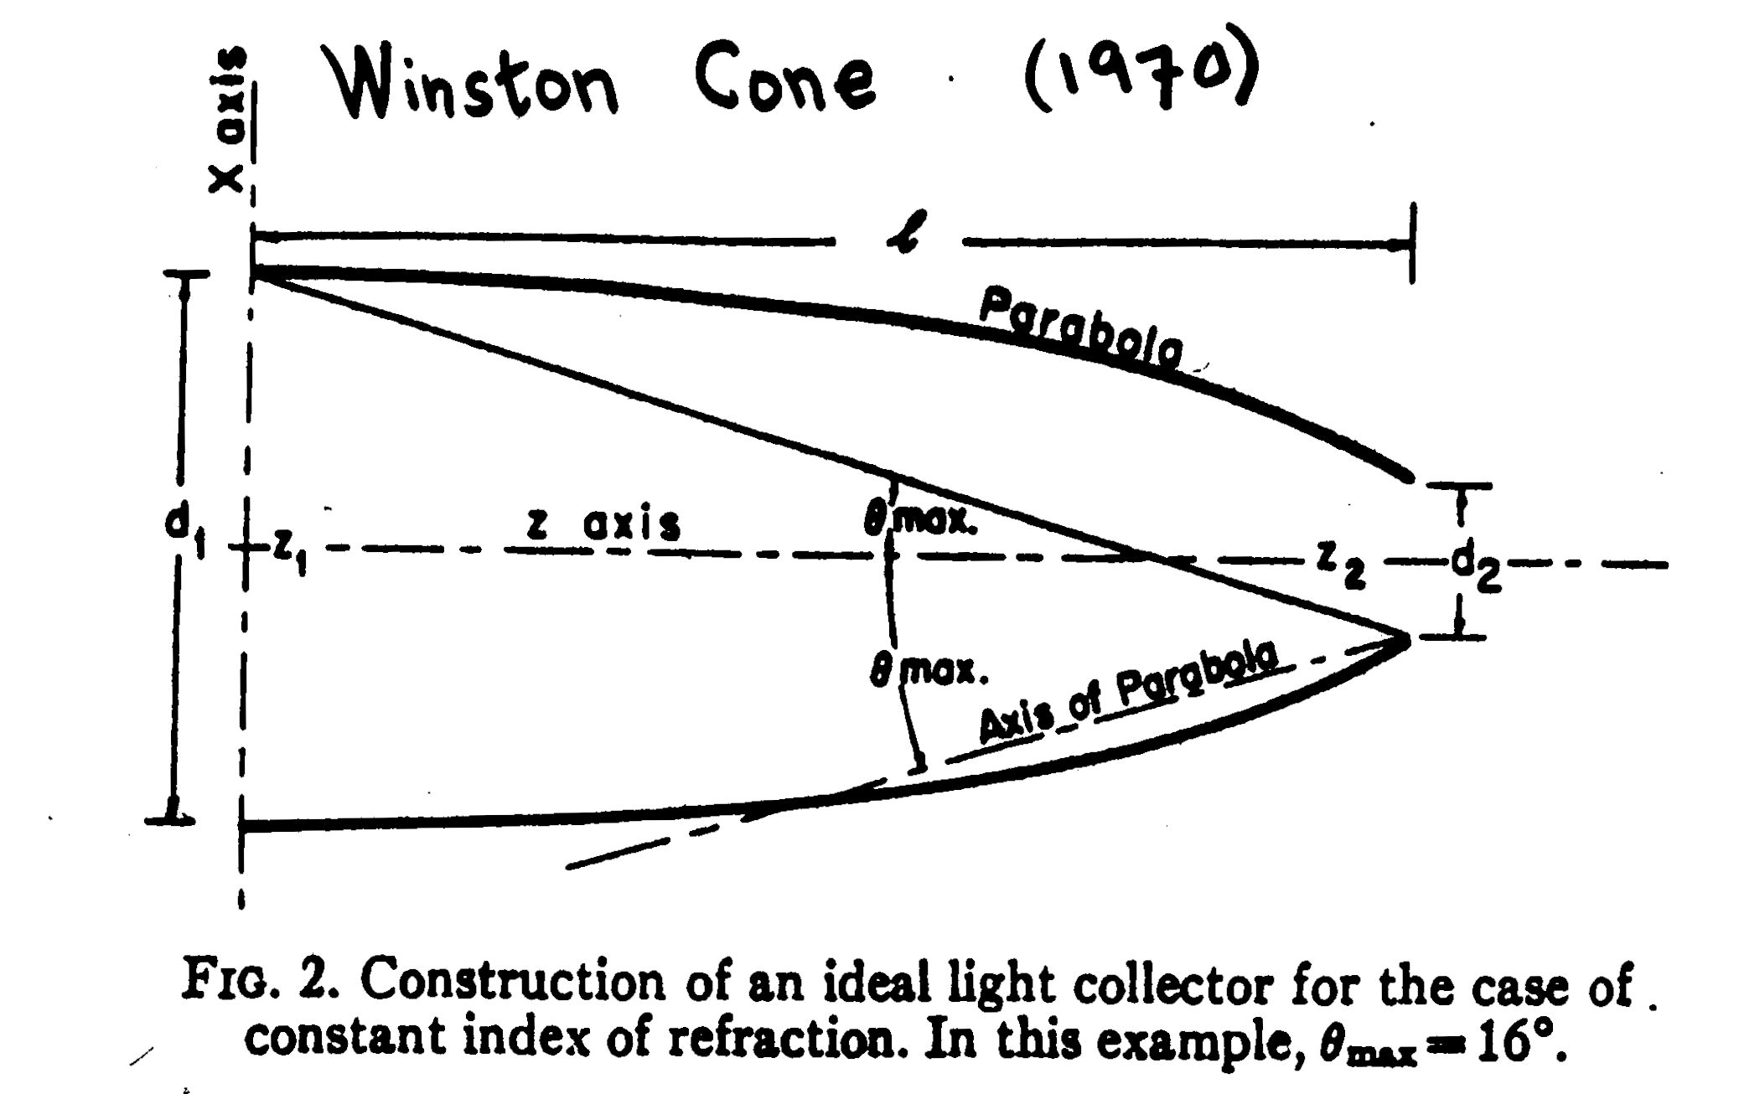
Winston Cones - special geometry
Rev. Sci. Instrum. 41 (1970) 413-418

Slide 26
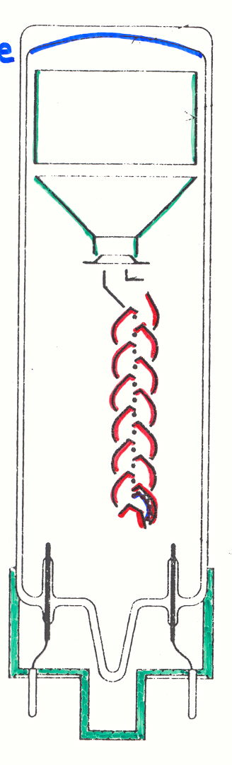
Photomultiplier tube, sensitive light meter
Gain ~ V^{αN} ~ 10⁶ - 10⁷
Electrodes
Anode
Photocathode
N Dynodes
56 AVP pmt

Slide 27
Photomultiplier tube, sensitive light meter
Gain ~ V^{αN} ~ 10⁶ - 10⁷
Electrodes
Anode
γ
e⁻
Photocathode
N Dynodes
Photomultiplier Tubes
Principles and Applications, Photonis (2002)
56 AVP pmt

Slide 28
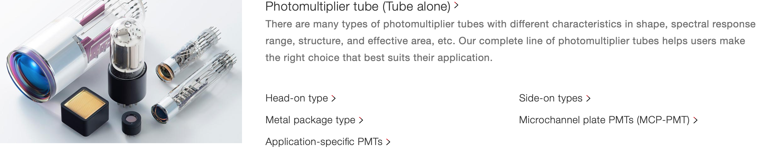
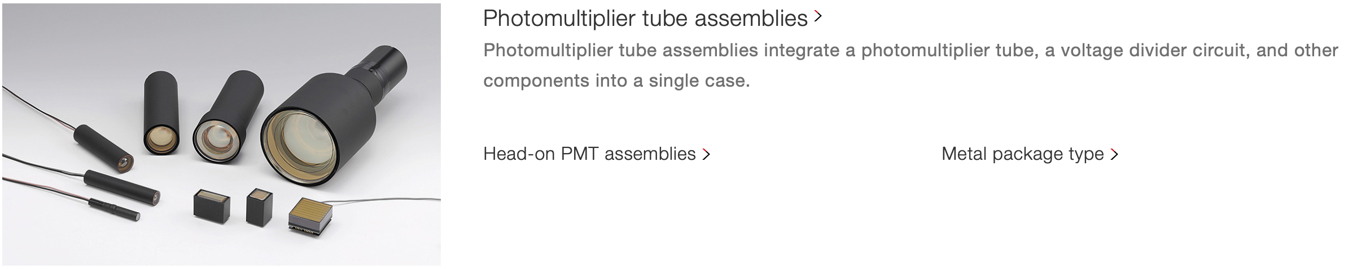
Examples from Hamamatsu

Slide 29
High voltage (~1500 – 2500 V)
Positive (cathode at ground)
  low noise, capacitative coupling
Negative
  Anode at ground (no HV on signal)
No (high) voltage
  Cockcroft-Walton bases

Slide 30
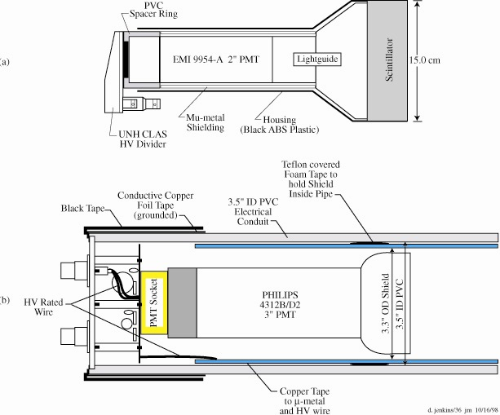
Housing
NIM A432 (1999) 265

Slide 31
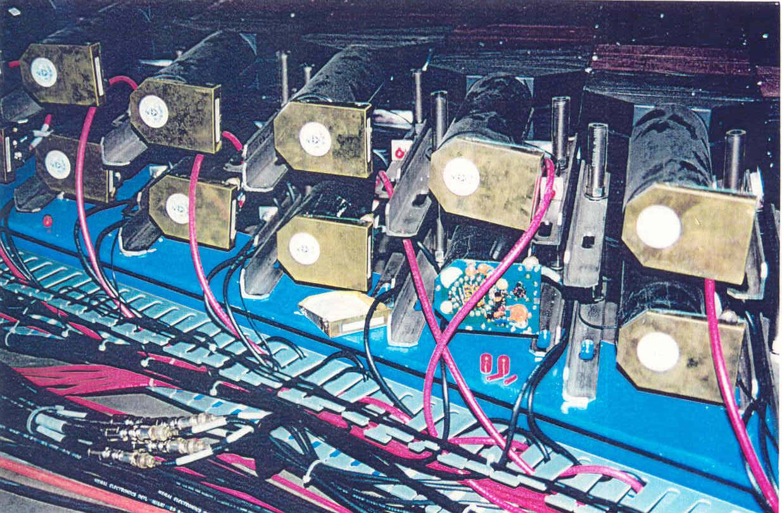
Compact divider design

Slide 32
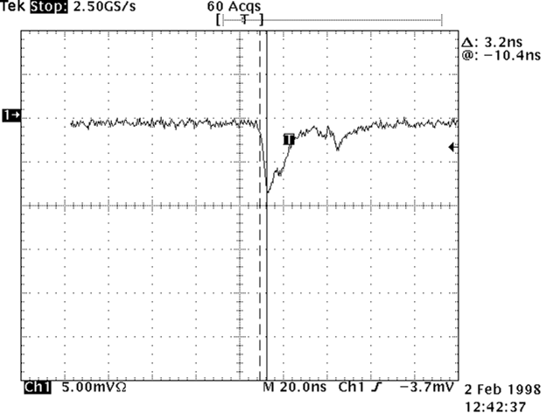
Single photoelectron signal

Slide 33
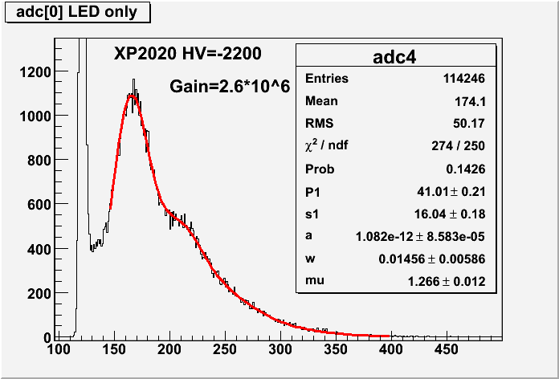
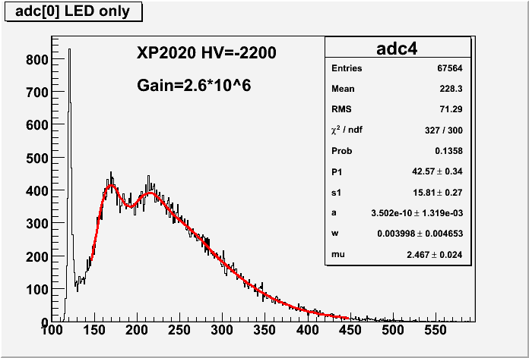
PMT single p.e. spectra (noise)
ADC (counts)
ADC (counts)

Slide 34
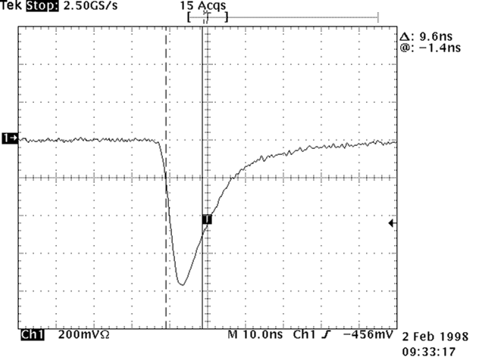
Signal for passing tracks

Slide 35
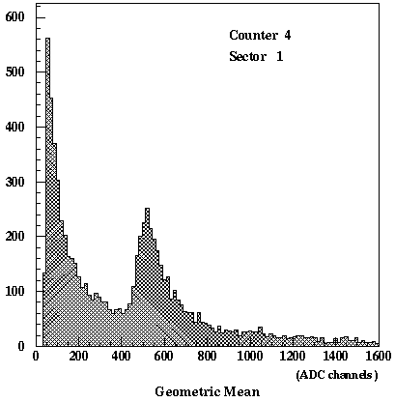
Energy deposited in scintillator

Slide 36
Energy deposited in scintillator
Minimum-ionizing peak
pions, electrons

Slide 37
Energy deposited in scintillator
Photons and “corner clippers”
Minimum-ionizing peak
pions, electrons

Slide 38
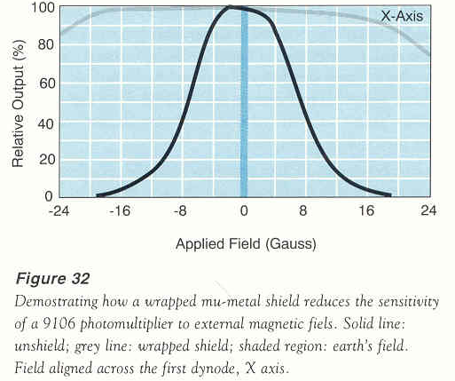
Effect of magnetic field on pmt
Photomultipliers and Accessories
Electron Tubes Ltd (1996)

Slide 39
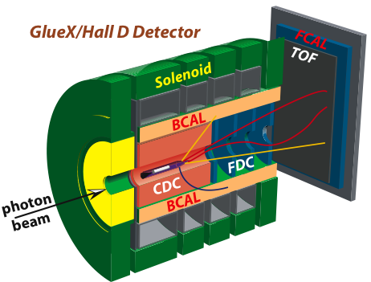
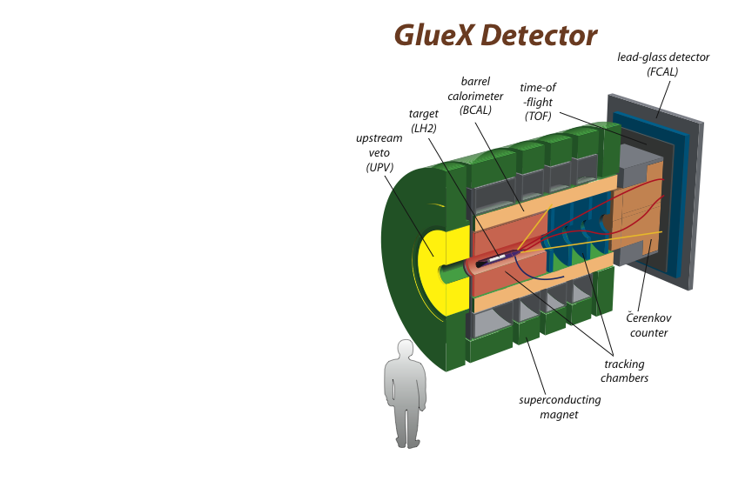
Hall D – GlueX detector
Time-
of-flight
(tof)
Pb-glass detector (Fcal)
Hermetic detection
of charged and
neutral particles in
solenoid magnet
Barrel
Calorimeter
(Bcal)
Target
(LH₂)
Flux (peak) ~ 2x10⁷ γ/s
18,000 FADCs
4,000 pipeline TDCs
50 KHz L1 trigger
600 MB/s to tape
Tagger Spectrometer
(Upstream)
Tracking
Cathode strips
Drift chambers
Straw tubes
Superconducting 2 T solenoid

Slide 40
Hall D – GlueX detector
Time-
of-flight
(tof)
Pb-glass detector (Fcal)
Hermetic detection
of charged and
neutral particles in
solenoid magnet
Barrel
Calorimeter
(Bcal)
Target
(LH₂)
Flux (peak) ~ 2x10⁷ γ/s
18,000 FADCs
4,000 pipeline TDCs
50 KHz L1 trigger
600 MB/s to tape
What to do in a Magnetic Field?
Tagger Spectrometer
(Upstream)
Tracking
Cathode strips
Drift chambers
Straw tubes
Superconducting 2 T solenoid

Slide 41
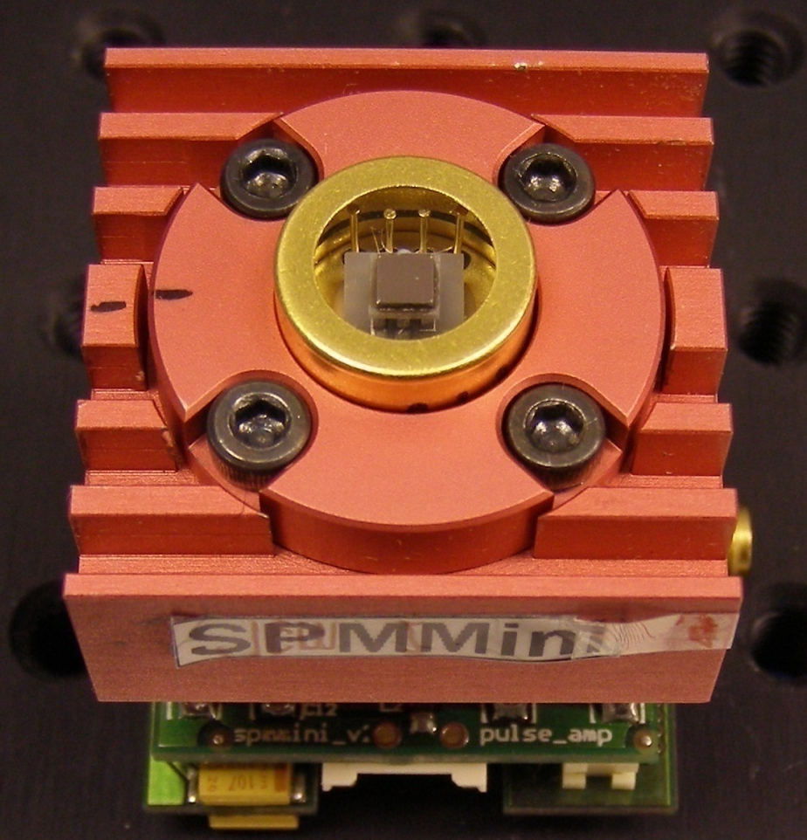
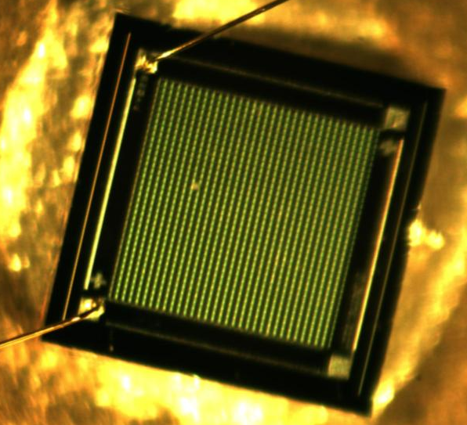
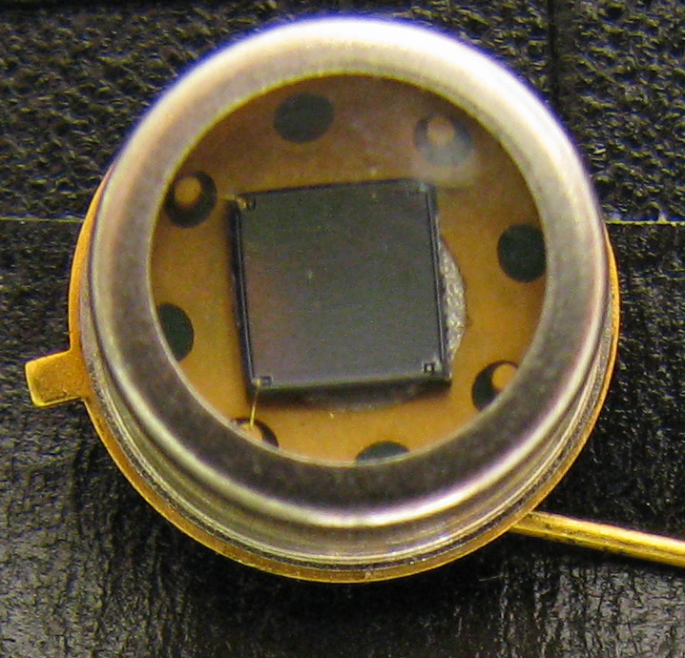
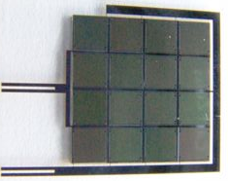
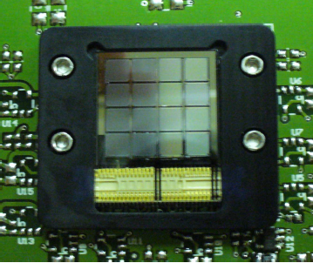
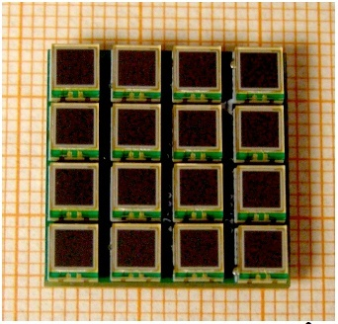
Some history in photos

Slide 42
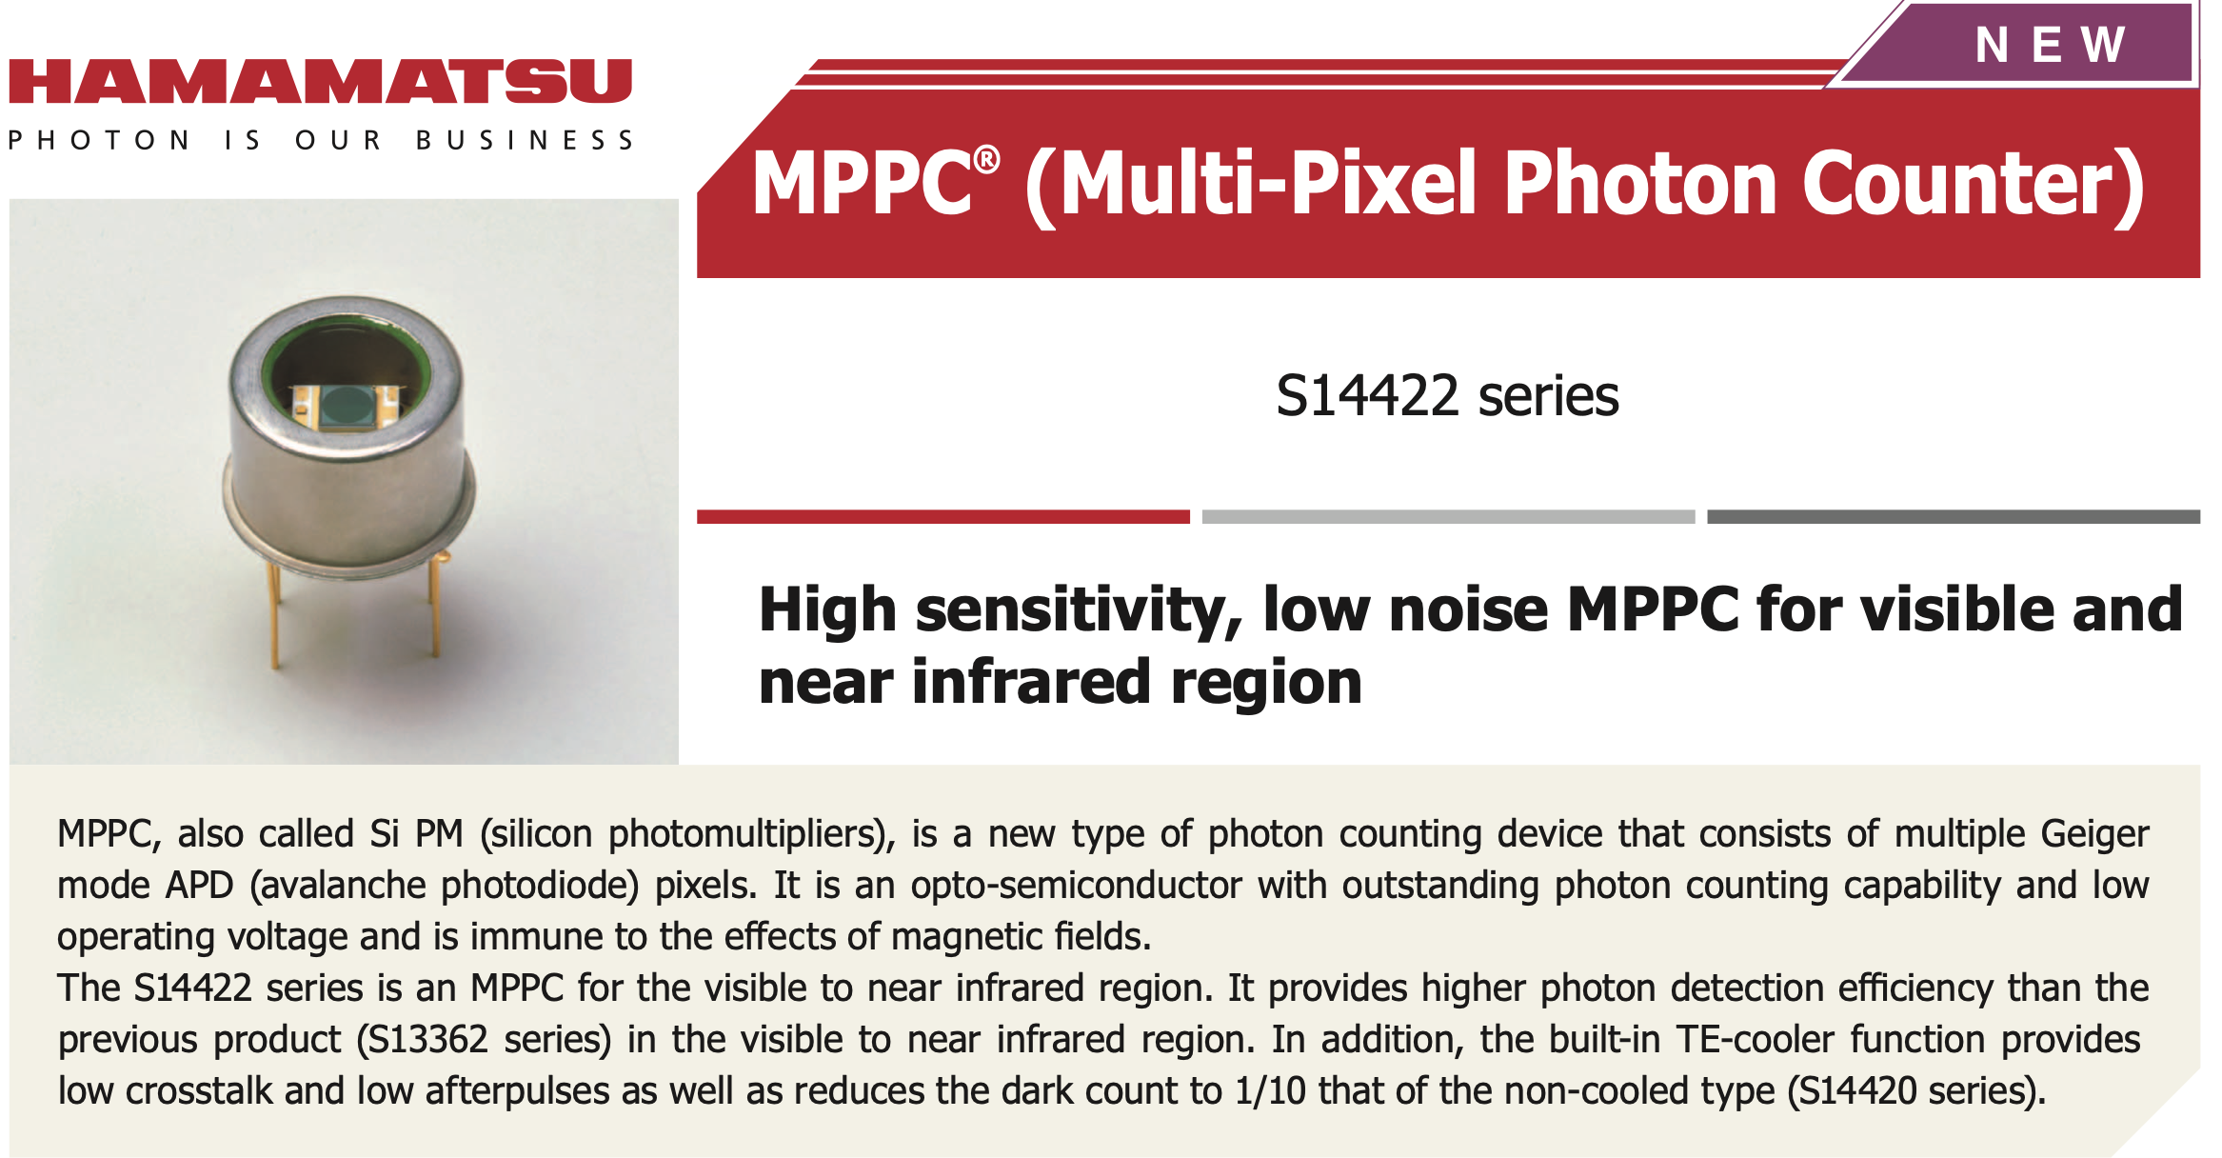
Example, Hamamatsu SiPM

Slide 43
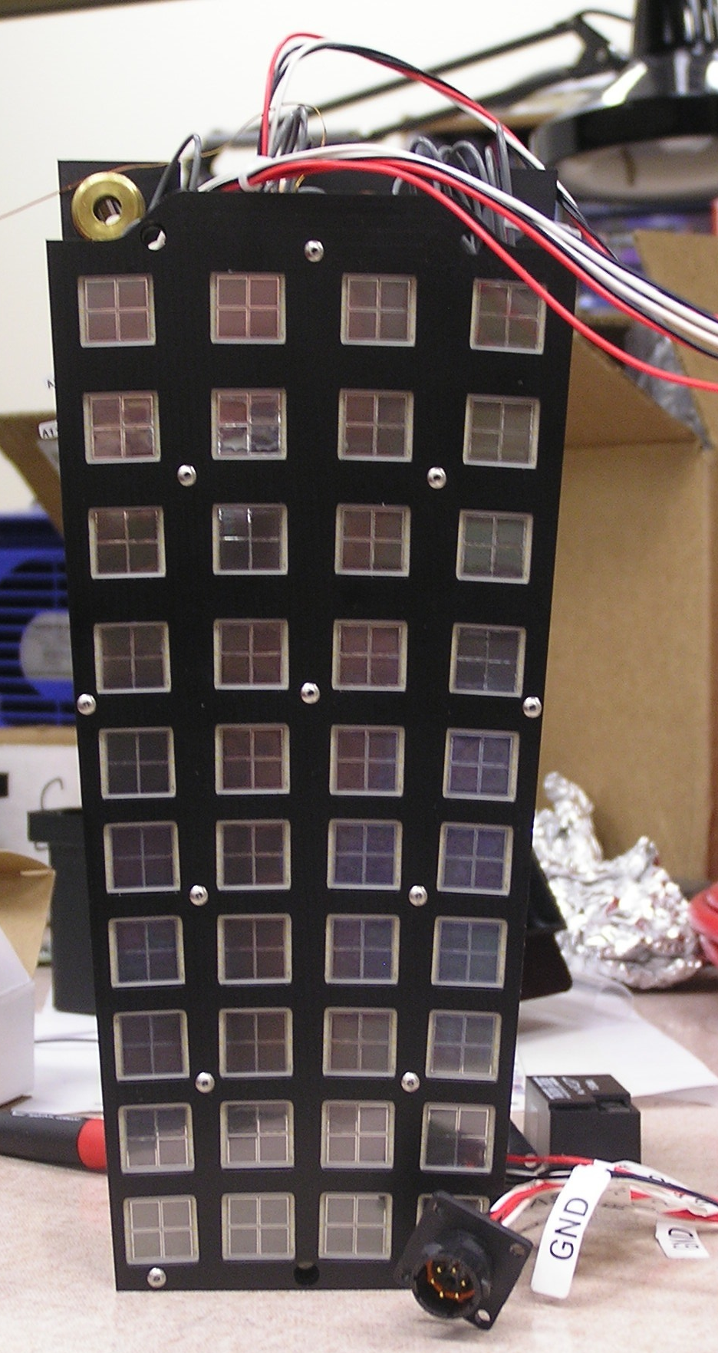
Hamamatsu S12045 arrays
4x4 array of 3x3 mm² sensor
Area = 12.7 x 12.7 mm²
57600 pixels
NIM A896 (2018) 24

Slide 44
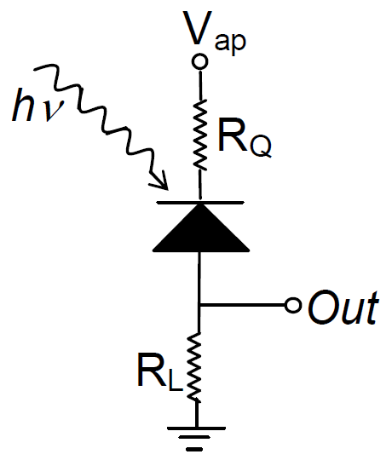
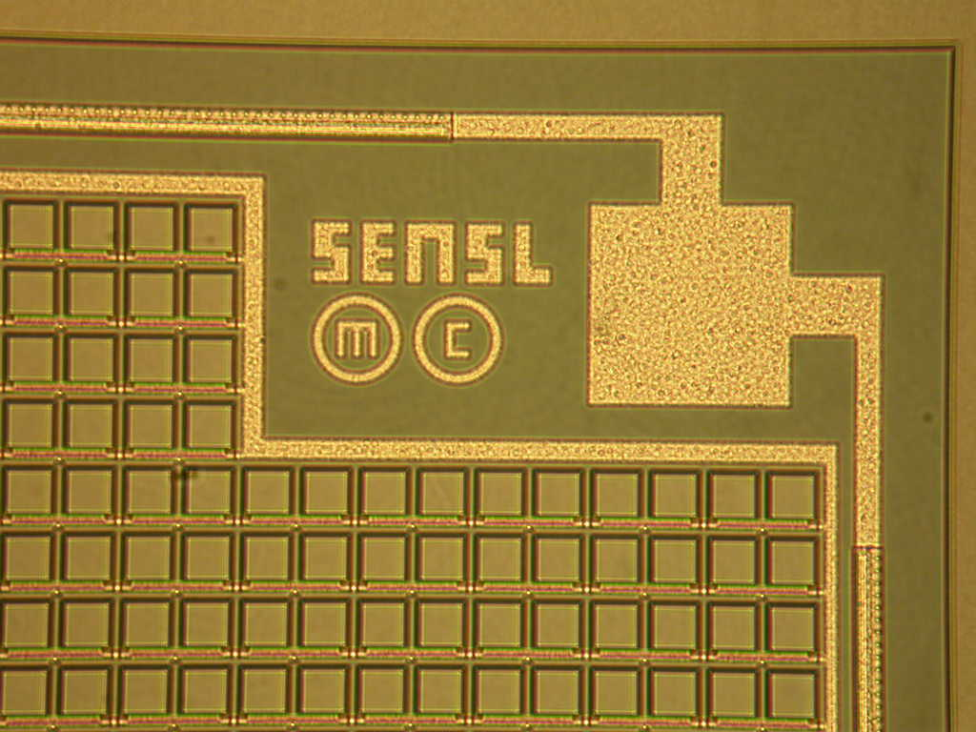
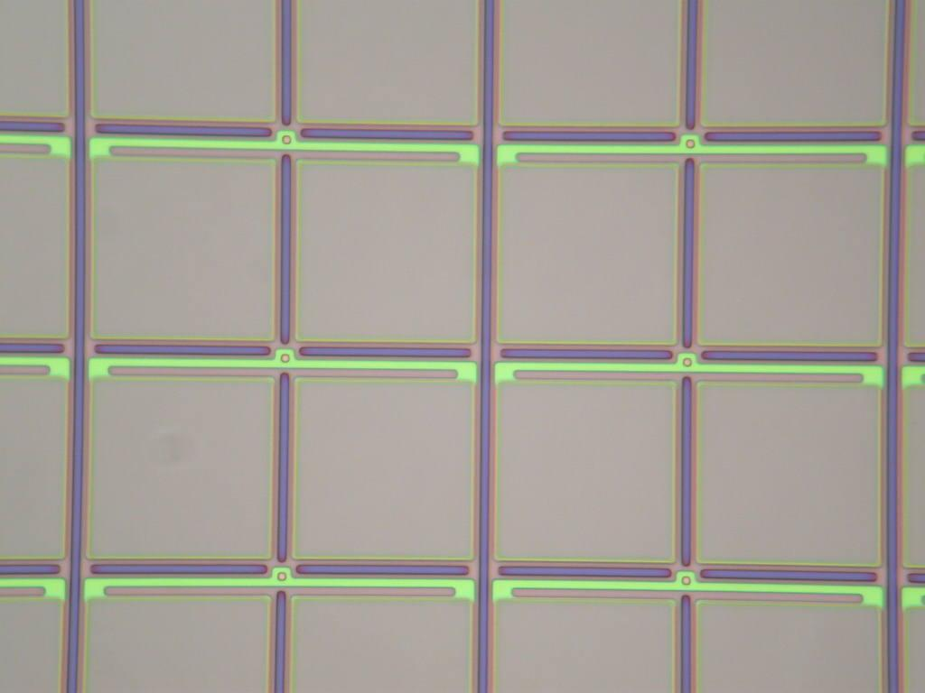
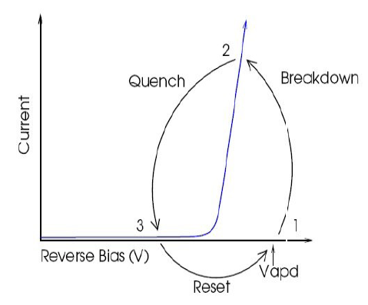
Multipixel Limited Geiger mode APD
Quenching
Resister
R_{Q}
Geiger-APD array
Photosensitive surface
20-100 µm Geiger APD pixel
Incident photon initiates avalanche
Quenched by resister ➔ device reset
Sum the pixels –> photon counter
Notes:
Each pixel is G-APD – operated in reverse biased mode above some threshold voltage (“breakdown voltage”)
device is metastable – incoming photon can actuate geiger mode avalanche – high gain – quenching resistor uses up charge and brings system back to down to metastable state again
put these G-APD pixels into array connected in parallel (each with own quenching resistor) – as long as photon intensity low enough – essentially count up number of fired pixels to count photons
other slides of interest ➔ 31

Slide 45
Multipixel Limited Geiger mode APD
Quenching
Resister
R_{Q}
Geiger-APD array
Photosensitive surface
20-100 µm Geiger APD pixel
Incident photon initiates avalanche
Quenched by resister ➔ device reset
Sum the pixels –> photon counter
Insensitive to Magnetic Fields!
Notes:
Each pixel is G-APD – operated in reverse biased mode above some threshold voltage (“breakdown voltage”)
device is metastable – incoming photon can actuate geiger mode avalanche – high gain – quenching resistor uses up charge and brings system back to down to metastable state again
put these G-APD pixels into array connected in parallel (each with own quenching resistor) – as long as photon intensity low enough – essentially count up number of fired pixels to count photons
other slides of interest ➔ 31

Slide 46
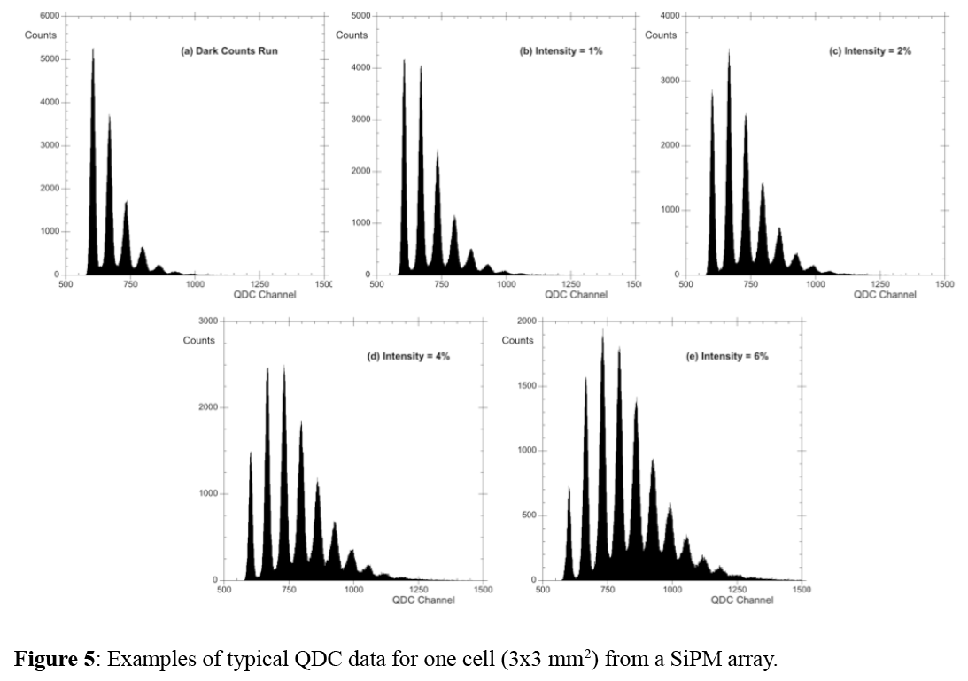
SiPM (3x3 mm²) single p.e. spectra
Dark Counts
Filter=1%
Filter=2%
Pedestal
Filter=4%
Filter=6%

Slide 47
Measure the Flight Time between two Scintillators
Particle Trajectory
450 ns
Stop
Disc
20 cm
TDC
Start
Disc
300 cm
400 cm
100 cm

Slide 48
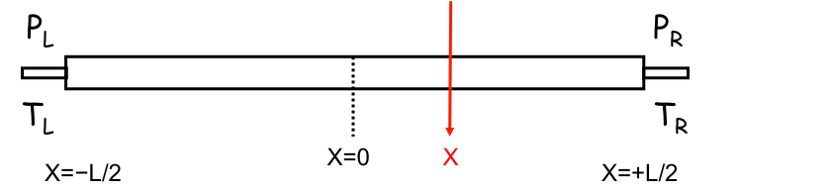
Formalism: Measure time and position
Mean is independent of position!

Slide 49
Experiment basics
B field ~ 5/3 T
p = 0.3 B R = 1.5 GeV/c
L = ½ π R = 4.71 m
β_{π} = p/√p²+m_{π}² = 0.9957
β_{Κ} = p/√p²+m_{Κ}² = 0.9496
R = 3m
t_{π} = L/β_{π}c = 15.77 ns
t_{Κ} = L/β_{Κ}c = 16.53 ns
Δt_{πK} = 0.76 ns

Slide 50
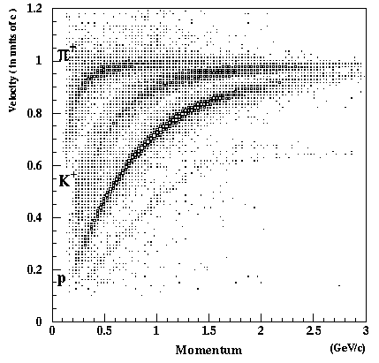
Particle ID by “tof”: β vs p plot
π⁺
K⁺
p

Slide 51
Summary
  Scintillation counters have a few simple components
  Trigger and time-of-flight systems are built out of these counters
  Fast response allows for accurate timing
  New solid-state light sensors are now available, which allow use in high magnetic fields
  Combining the timing information from scintillator detectors with momentum measurements from tracking detectors, one can determine the mass of passing particles.

Slide 52
Backup slides

Slide 53
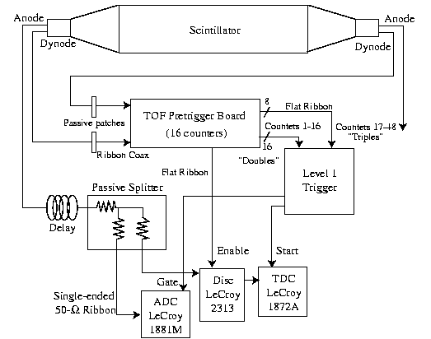
Electronics
anode
dynode
trigger
Measure time
Measure pulse height

Slide 54
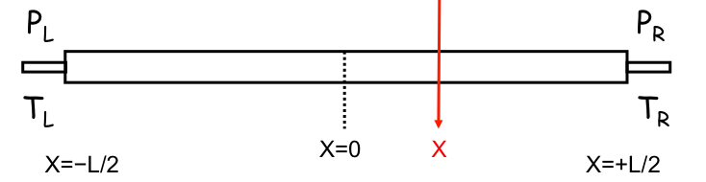
Formalism: Measure energy loss
Geometric mean is independent of position!

Slide 55
Example: Kaon mass resolution by TOF
For a flight path of d = 500 cm
Assume experimental resolutions of

