Slide 1
Jefferson Lab in the Future
David J. Dean
Deputy Director for Science
Presented To:
Jefferson Lab User Organization
February 5, 2024

Slide 2

Outline
What lies ahead for CEBAF
  Complete Moller install
  Compete for SoLID
  Continue Upgrade Planning
What lies ahead for HPDF
What lies ahead for Jefferson Laboratory?

Slide 3

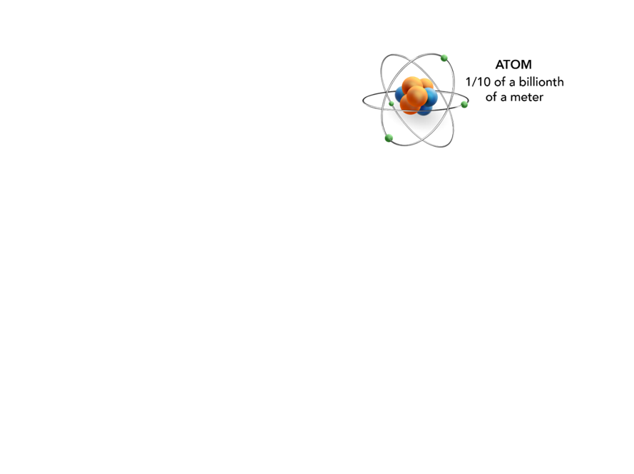
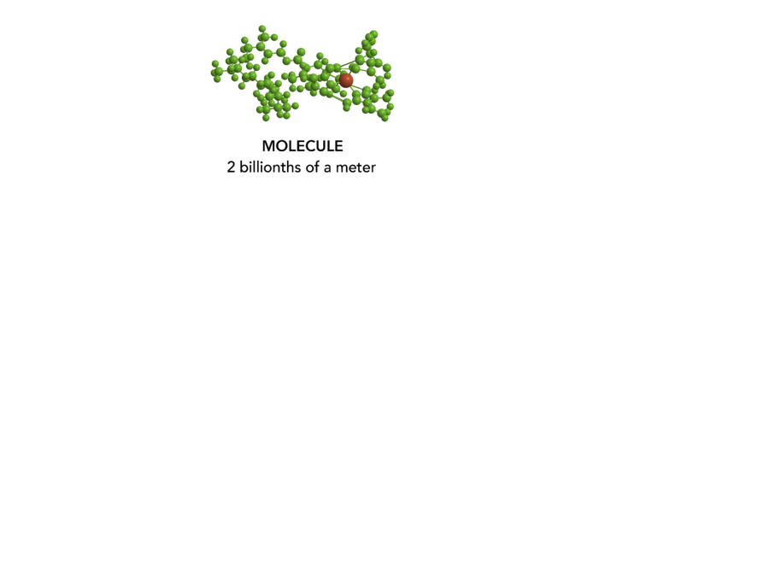

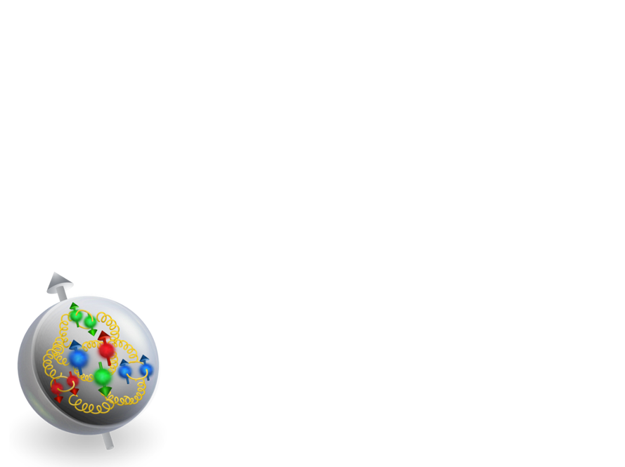
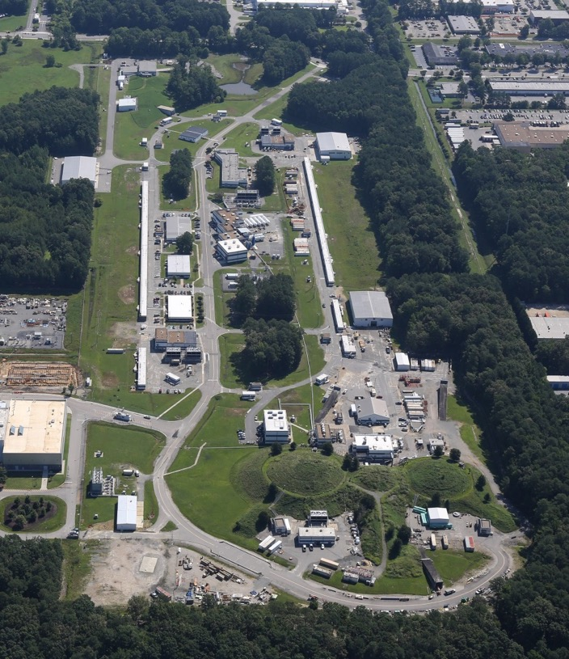

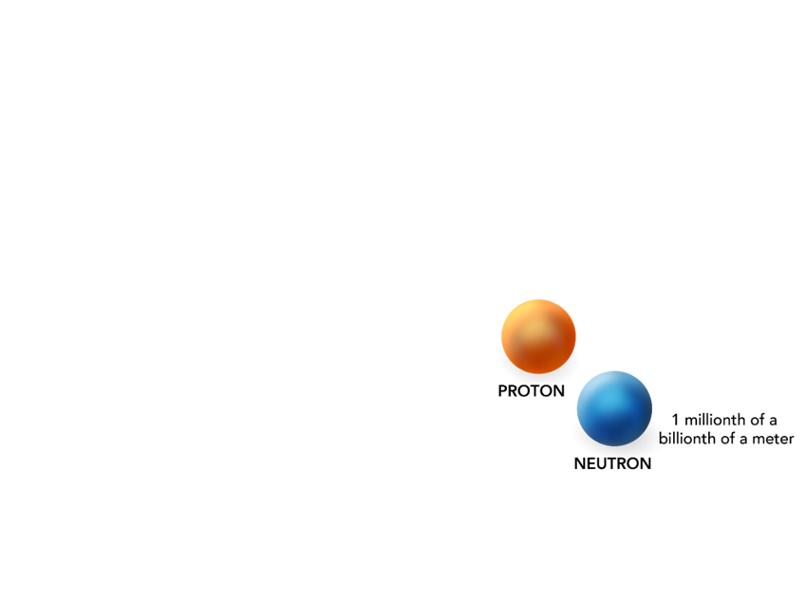
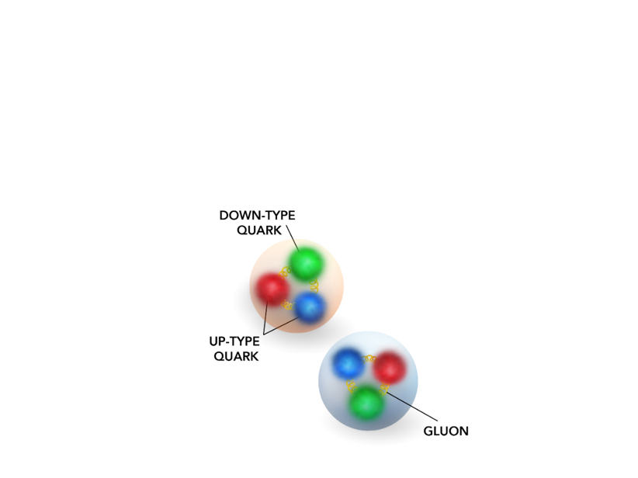
JLab Explores Matter at the Most Fundamental Level
Why is no quark ever found alone?
What does the interior of a proton “look” like?
Why is the proton mass so much greater than its “parts”?
How does the force that holds protons and neutrons together arise from the force between quarks?

Slide 4
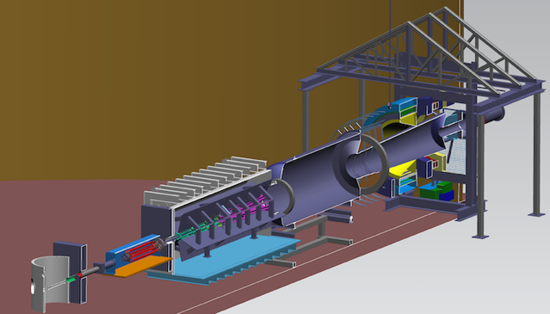
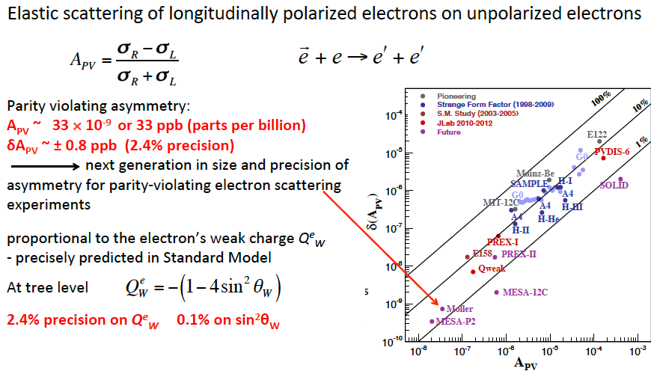
Probing the Standard Model to 27 TEV
Moller will probe energy regions for Beyond Standard Model Physics to ~27 TeV in this Q-weak sector
LHC energies: 13 TeV
From Mark Pitt

Slide 5
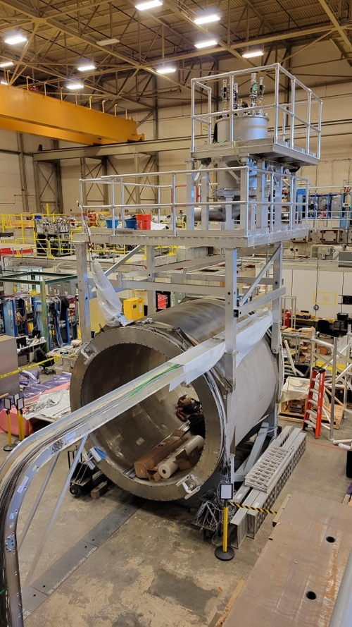
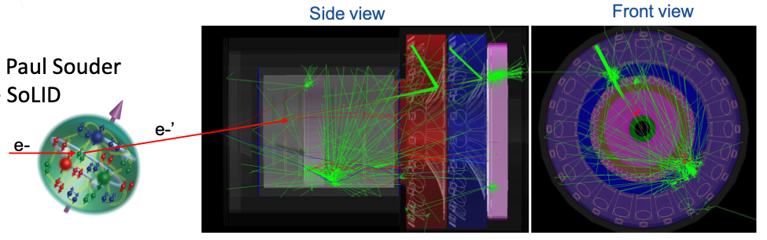
SoLID fully enables CEBAF 12 GeV at the intensity frontier
Nucleon spin, proton mass, BSM experiments require precision measurements of small cross sections and asymmetries, combined with multiple particle detection
There is a critical need for a high luminosity 10³⁷-10³⁹ cm⁻²s⁻¹ and large acceptance working in tandem
Science reach
  Precision 3D momentum imaging in the valence quark region
  Exploring the origin of the proton mass and gluonic force in the non-perturbative regime
  Beyond Standard Model searches in tandem with Moller
Magnet test

Slide 6
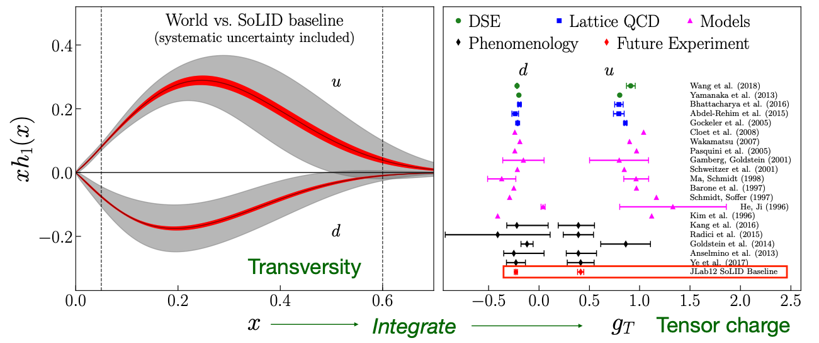
Simi inclusive deep inelastic scattering (SIDIS) at 12 GeV with Solid

Slide 7
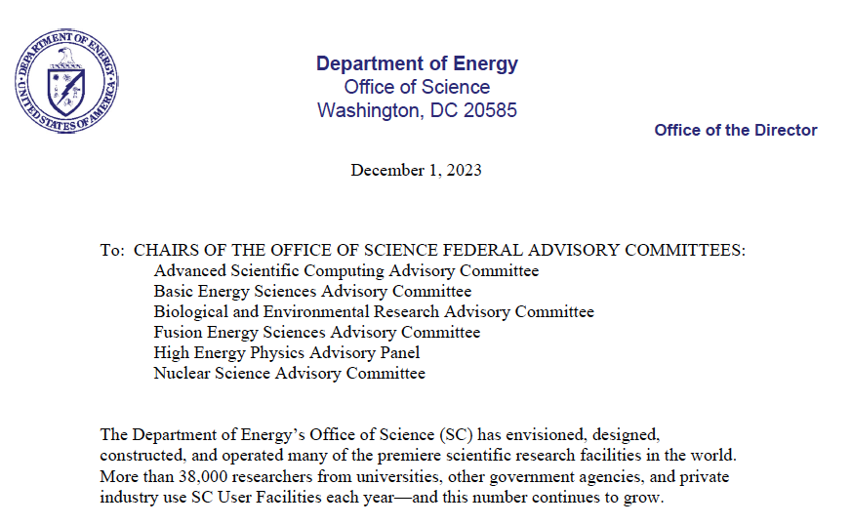
We will continue to pursue SoLID
From the LRP (under Recommendation 4): Strategic opportunities exist to realize a range of projects that lay the foundation for the discovery science of tomorrow. These projects include the 400 MeV/u energy upgrade to FRIB (FRIB400), the Solenoidal Large Intensity Device (SoLID) at Jefferson Lab, targeted upgrades for the LHC heavy ion program, emerging technologies for measurements of neutrino mass and electric dipole moments, and other initiatives that are presented in the body of this report.
NEW CHARGE
Consider what new or upgraded facilities in your disciplines will be necessary to position SC at the forefront of scientific discovery.
Discuss each of these facilities in terms of two criteria
  The potential to contribute to world-leading science in the next decade
  The readiness for construction

Slide 8
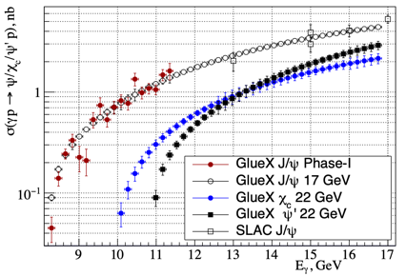
Scientific vignettes for the 22 GeV upgrade
How does QCD generate hadrons?
Are there pure exotic states?
Can we harness threshold charmonium production to probe proton/gluon properties?
Q² evolution of the γ_{v}pN* electrocouplings could offer an insight into hadron mass generation and the emergence of the N* structure from QCD
Simulations indicate JLab22 is the only foreseeable facility to extend these measurements up to 30 GeV² and down to α_{s}/π=0.15 where non-and perturbative QCD coexist.
Direct (photon) probe of the
$Z_{c}→J/ψπ$ coupling without rescattering effects provides unique complementary data to constrain interpretation of $e^{+}e^{−}$ data.
Exclusive charmonium production near threshold probes gluon/mass properties of proton (mass radius, gravitational form factors, D-term, anomalous contribution to proton mass), however
  assuming factorization
  assuming two-gluon exchange

Slide 9
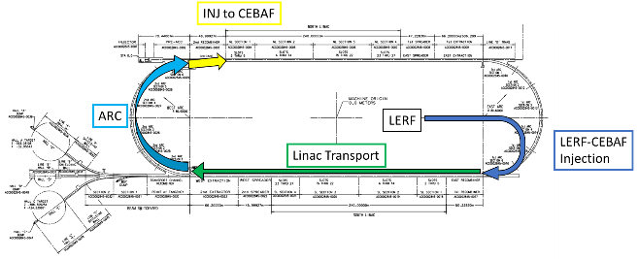
Technically feasible, cost effective, and innovative path
Capitalizing on recent science insights and US-led accelerator science and technology innovations, develop a staged program at the luminosity frontier
Positrons (e+) in the LERF (former FEL) with transport to CEBAF (validation of the scattering formalism)
Energy Upgrade for 650 MeV Electron (e-) Injection in the LERF
Replace arcs on each side with new FFA permanent magnet arcs to upgrade to 22 GeV
A small group is developing preCDR documentation (1-2 years): R&D via LDRD and programmatic underway

Slide 10
Notional CEBAF & upgrade schedule (FY24 – FY42)
Accelerator team has worked up an early schedule and cost estimate
  Schedule assumptions based on a notional timing of when funds might be available (near EIC ramp down based on EIC V3 profile)
  For completeness, Moller and SoLID (part of 12 GeV program) are shown; positron source dev shown
Activities | Fiscal Year
 | 24 | 25 | 26 | 27 | 28 | 29 | 30 | 31 | 32 | 33 | 34 | 35 | 36 | 37 | 38 | 39 | 40 | 41
Moller (413.3B)
SoLID (science rev)
Positron Source Dev
Pre-Project Dev
Upgrade Phase 1
Transport comm/e+
Upgrade Phase 2
CEBAF Up
FY23 $$
Phase 1: tie LERF to CEBAF & injector for e+ $101M ($78M – $152M)
Phase 2: High Energy Upgrade (includes FFAs) $244M ($188M – $366M)
Total cost (Class 4 estimate) $345M ($265M – $517M)

Slide 11
What lies ahead for the
High Performance Data Facility

Slide 12
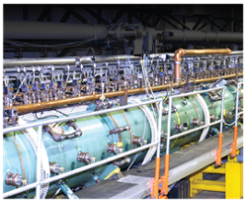
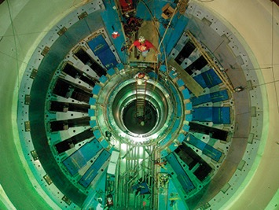
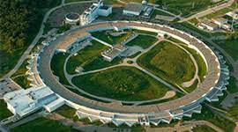
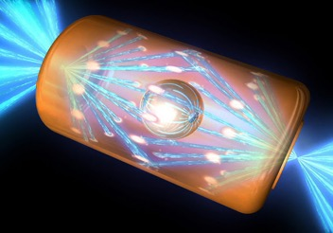


DOE’s Unique Position for AI Leadership
Operates the most capable computing systems and the world’s largest collection of advanced experimental facilities.
Responsible for US nuclear security through deep partnerships across government
Largest producer of classified and unclassified scientific data in the world
Strongest foundation combining physical, biological, environmental, energy, mathematical, and computing sciences
Largest scientific workforce in the world
Strong ties with private sector technology and energy organizations and stakeholders
World’s best experimental facilities and supercomputers

Slide 13

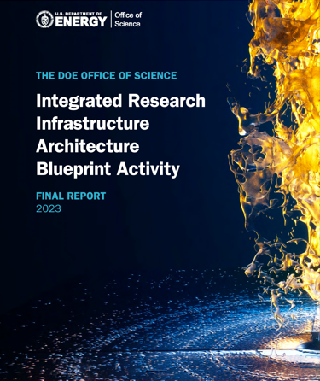
DOE has been Collecting Broad Community Input
Cross Cutting AI Themes
Advanced materials properties, interfaces and inverse design
Software engineering and programming
Robotics for autonomous discovery
Prediction and control of complex engineered systems
Surrogates for high-performance computing
Foundation, Assured AI for scientific Knowledge
Time Sensitive Patterns
Data Integration Intensive Patterns
Long-Term Campaign Patterns
Types of Data ‘Patterns’ to be supported by HPDF

Slide 14
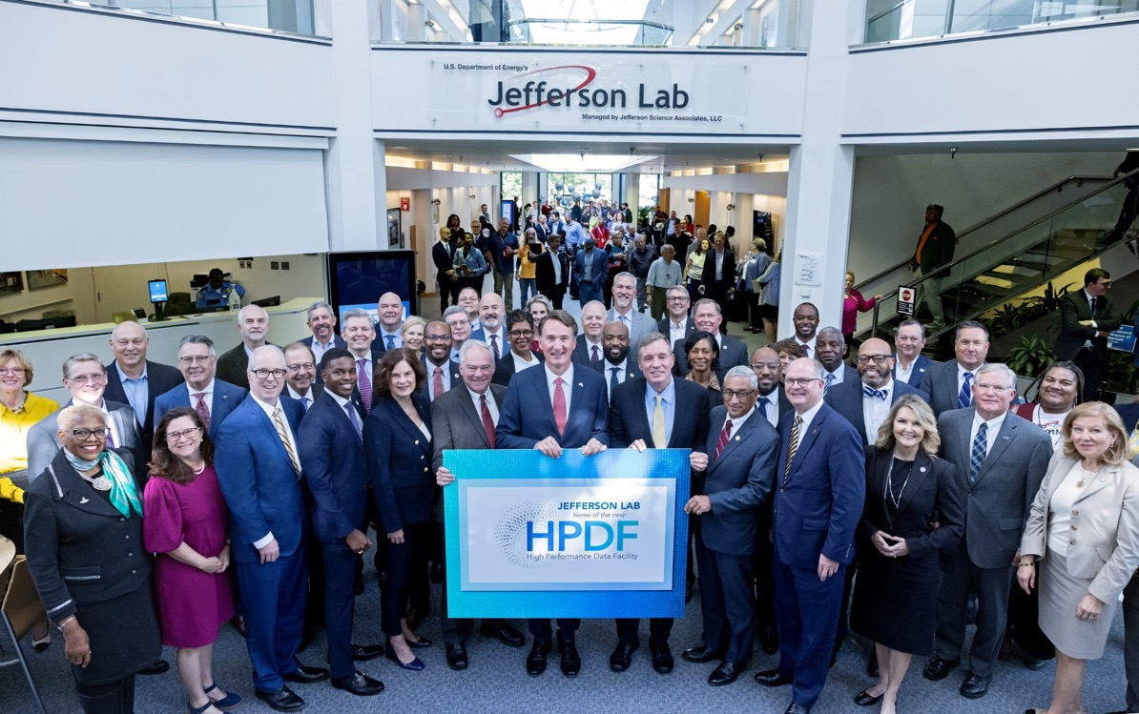
JLab leads The High Performance Data Facility!
In partnership with LBNL
HPDF: A $300-500M world-leading, state-of-the-art high-performance data facility.
Purpose-built to provide researchers with the tools needed for big data
Enables the Department of Energy’s Integrated Research Infrastructure program: seamless integration of scientific facilities, computational resources, and
data science capabilities
Enabled by $50M commitment
from the Commonwealth of Virginia
THE 29th NATIONAL USER FACILITY

Slide 15
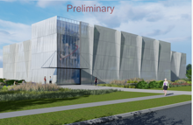
The future for HPDF
Plan, Plan, execute
This is a DOE O 413.3B project
Requires a new building (the JLDC)
Requires early access capability
Requires software, middleware, and hardware development
Promises to connect the Office of Science through the Integrated Research Infrastructure
FY24: $2M (on Award)
FY24: $8M (later in FY)
FY25: Ramp

Slide 16
What lies ahead for the
Jefferson Lab
Questions?

Slide 17
An impactful Nuclear Physics Laboratory
Nuclear Physics future
  Run the 12 GeV program (1st Recommendation in FY23 LRP)
  Execute SoLID
  (4th recommendation)
  Contribute to EIC
  (3rd recommendation)
  Plan for e+ and 22 GeV
  (in the text)
  Build an EIC research program
  Exploit opportunities
  (Dark Matter; neutrino nucleus;…)
I: The highest priority of the nuclear science community is to capitalize on the extraordinary opportunities for scientific discovery made possible by the substantial and sustained investments of the United States. We must draw on the talents of all in the nation to achieve this goal.
III: We recommend the expeditious completion of the EIC as the highest priority for facility construction.
IV: We recommend capitalizing on the unique ways in which nuclear physics can advance discovery science and applications for society by investing in additional projects and new strategic opportunities.

Slide 18
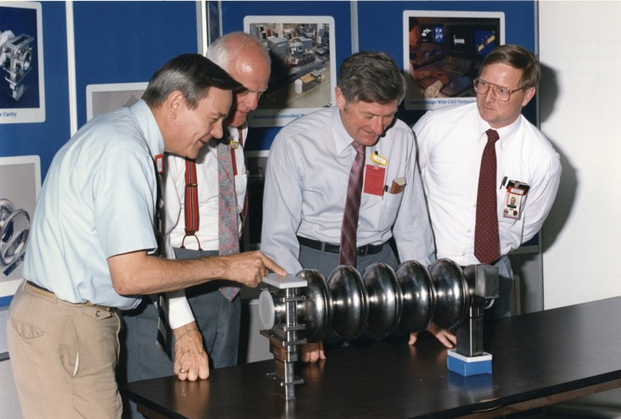
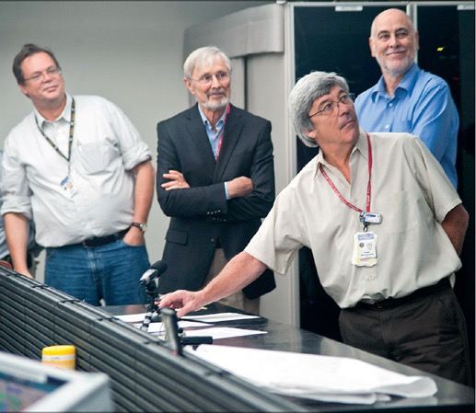
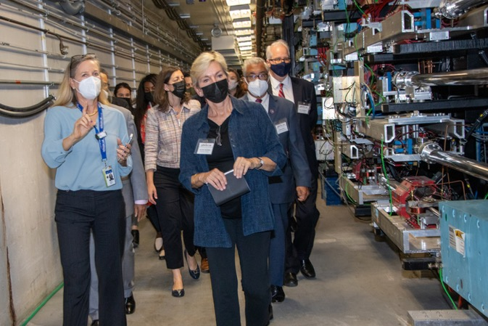
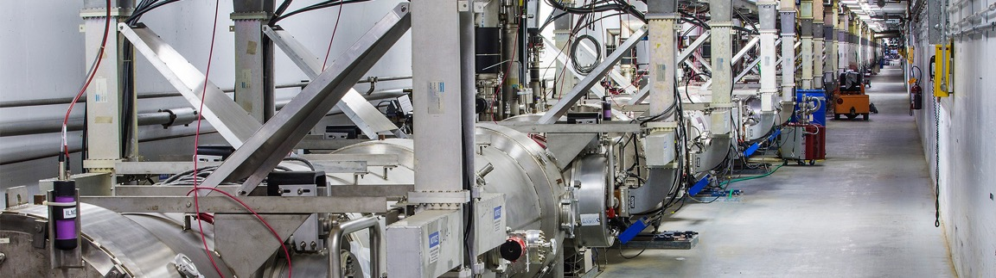
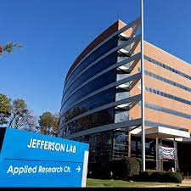

JLab’s Past Will Lead to an Exciting Future
What we do today will enable a vibrant future into the 2040s and beyond

