Slide 1

Ce⁺BAF: Status Update
Status of concepts
Technical status
3-Year e+ R&D plan
Year in review
Joe Grames (Ce⁺BAF WG)

Slide 2

12 GeV Ce⁺BAF : Polarized Electron or Polarized Positron Beams
Machine Parameter | Electrons | Positrons
Hall Multiplicity | 4 | 1 or 2
Energy (ABC/D) | 11/12 GeV | 11/12 GeV
Beam Repetition | 249.5/499 MHz | 249.5/499 MHz
Duty Factor | 100% cw | 100% cw
Unpolarized Intensity | 170 µA | > 1 µA
Polarized Intensity | 170 µA | > 100 nA
Beam Polarization | > 85% | > 60%
Fast/Slow Helicity Reversal | 1920 Hz/Yes | 1920 Hz/Yes

Slide 3
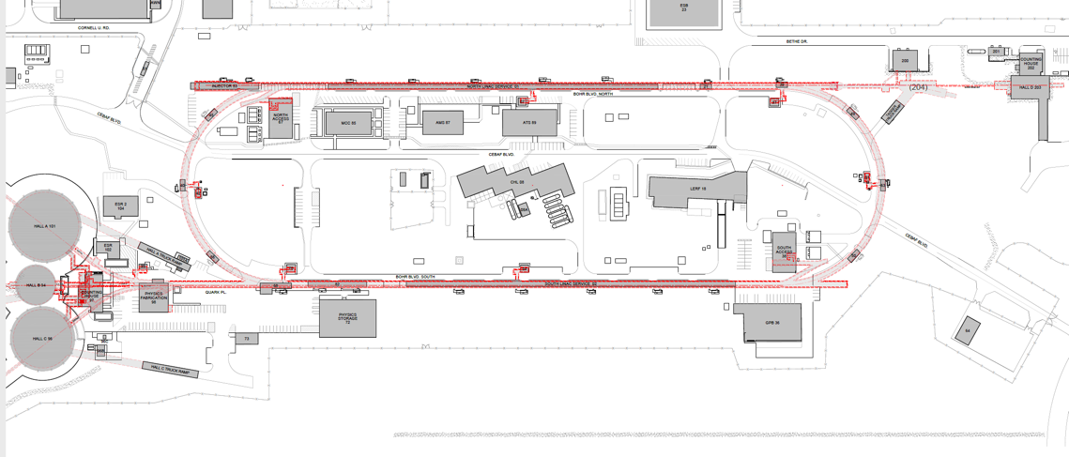
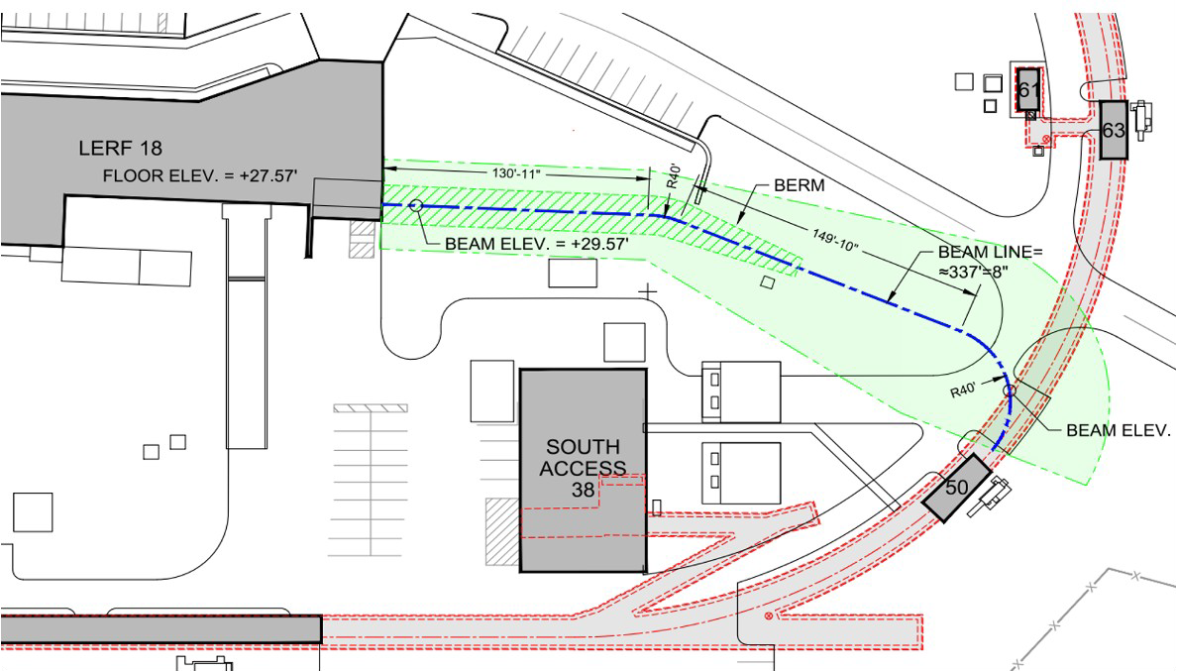
Turning the LERF into a Positron Injector Facility
New Beamline
to CEBAF Tunnel
CEBAF Polarized
Electron Injector
123 MeV e⁺ Beam
Injected to NL
New e⁺ Injector
at LERF
123 MeV e⁺
New Transport Line
along SL and West Arc

Slide 4
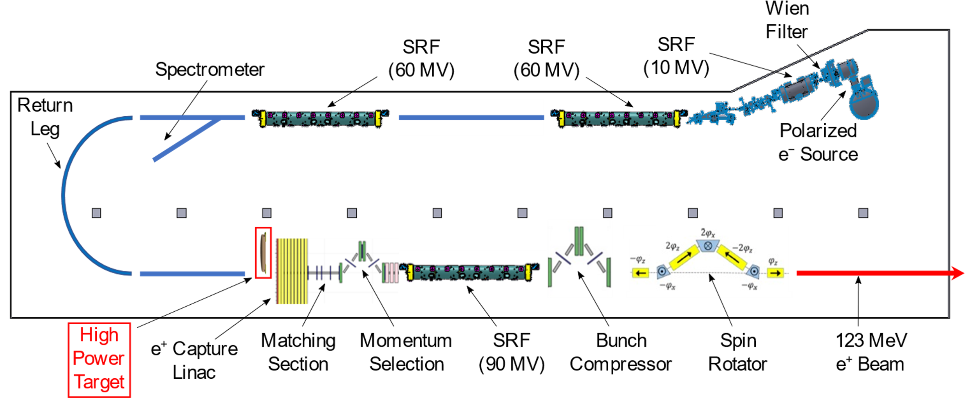
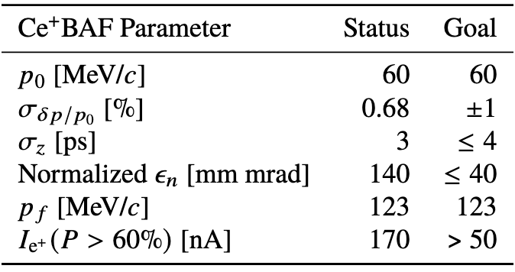
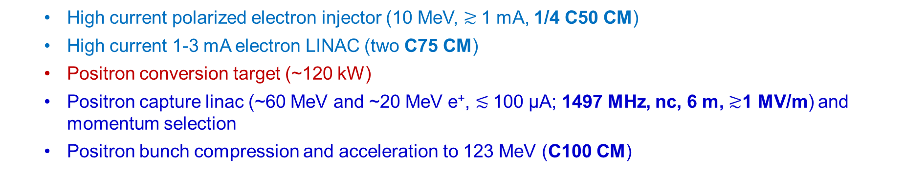
LERF Polarized Positron Injector Concept
  High current polarized electron injector (10 MeV, $≳$1 mA, 1/4 C50 CM)
  High current 1-3 mA electron LINAC (two C75 CM)
  Positron conversion target (~120 kW)
  Positron capture linac (~60 MeV and ~20 MeV e⁺, $≲$100 µA; 1497 MHz, nc, 6 m, $≳$1 MV/m) and momentum selection
  Positron bunch compression and acceleration to 123 MeV (C100 CM)

Slide 5
Ce+BAF : delivering three types of beam
Beam | Comment
Primary e- beam | Use a bypass beam line, e- directly from PES (w/ Wien)
Secondary e- beam (degraded) | Use same bypass beam line, e- facsimile of e+ distribution (but at higher intensity, polarized, w/ Wien)
Secondary e+ beam | Use new e+ injector, only collect e+ ; fixed e- and photon dumps (simplifies layout)

Slide 6
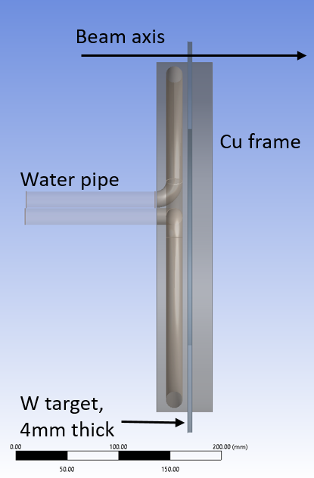
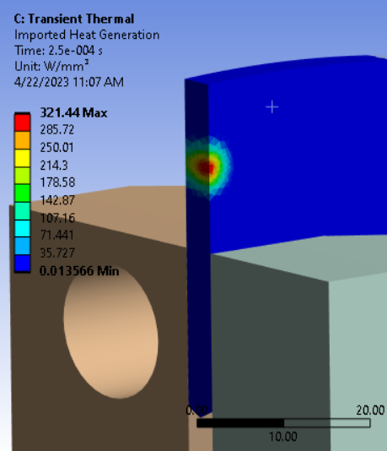
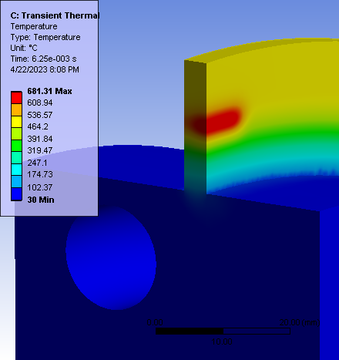
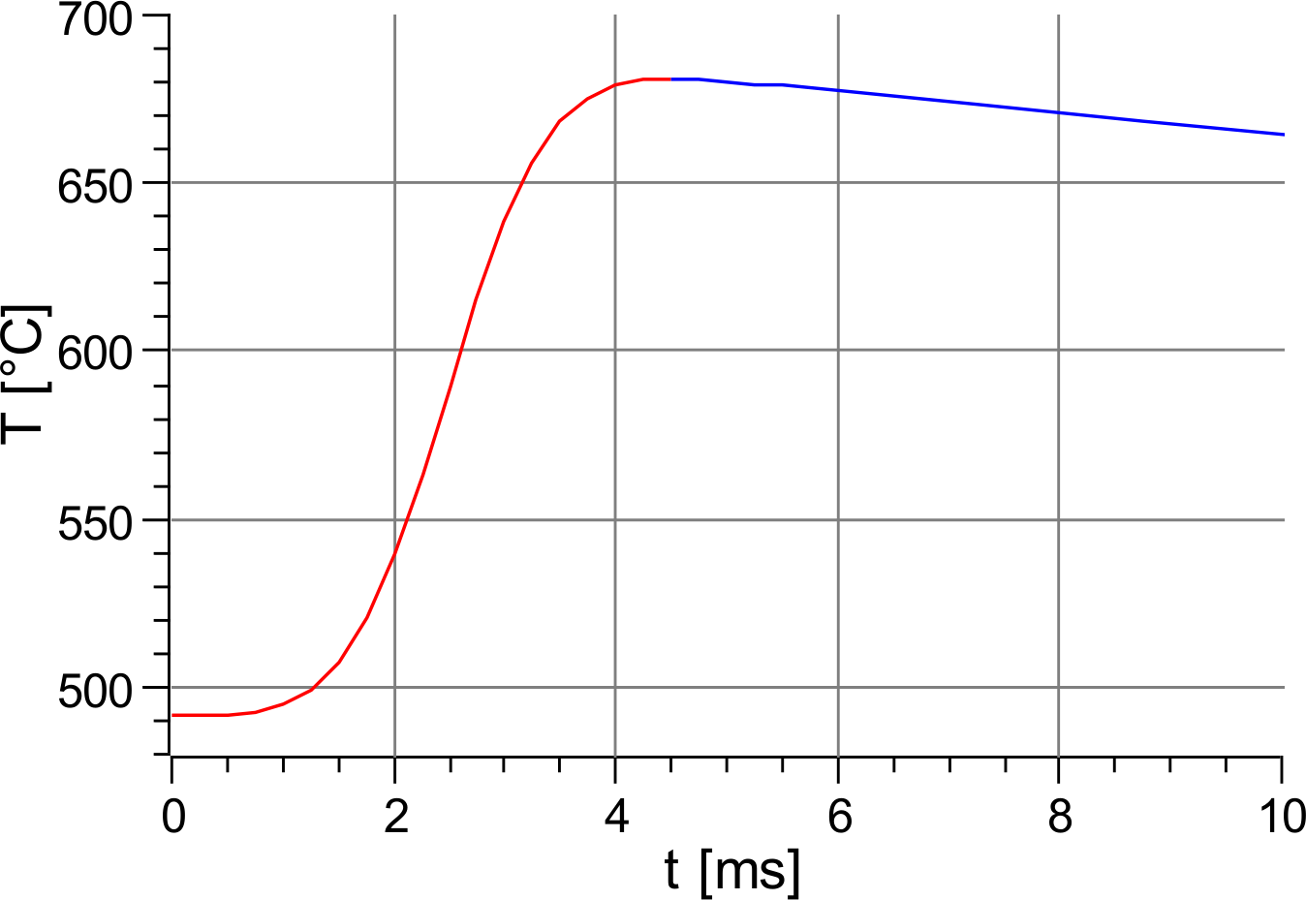
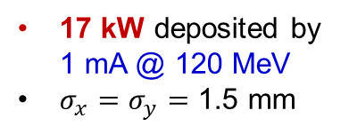
Concept and Challenges of High-Power Target
Target Concept (Side View)
Heat by Beam
Temperature in Rot. Target
A. Ushakov et al, IPAC’23
Cycling Temperature
Some parameters of currently considered high-power e⁺ target:
~40 cm target diameter
2 Hz rot. frequency
8 mm radius of water channel
0.3 kg/s water mass flow (1.5 m/s)
Target Challenges:
High power deposited by beam → cool and rotate
Radiation damage → rotate
Material fatigue cause by cycling temperature → study material properties under realistic conditions
17 kW deposited by 1 mA @ 120 MeV
$σ_{x}=σ_{y}=$ 1.5 mm

Slide 7
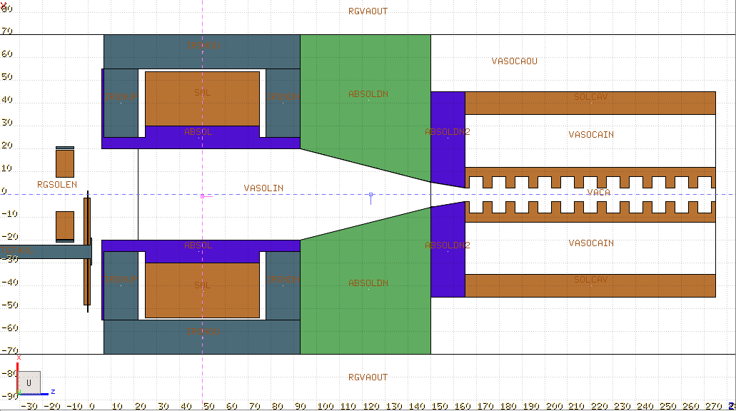
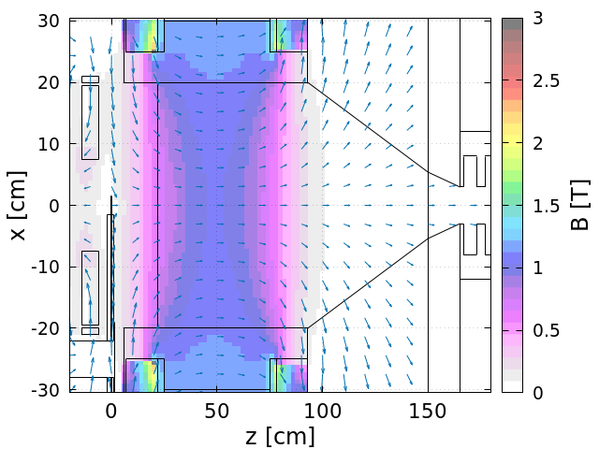
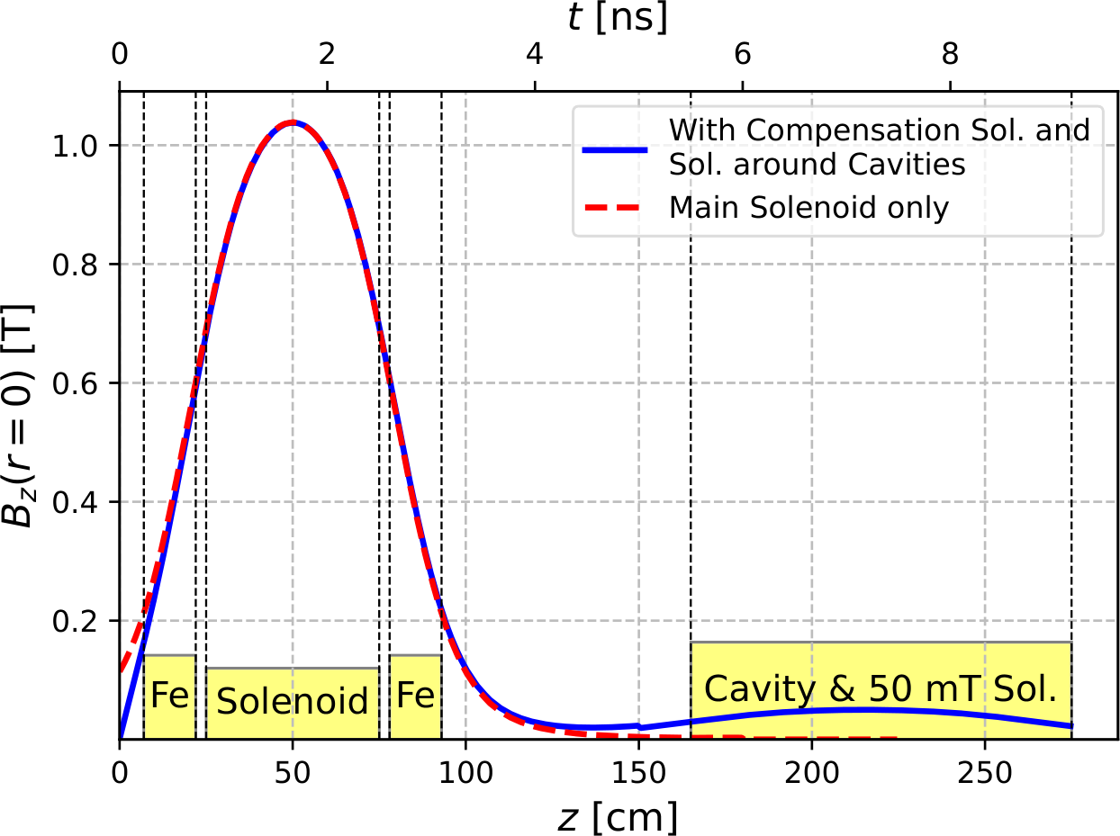
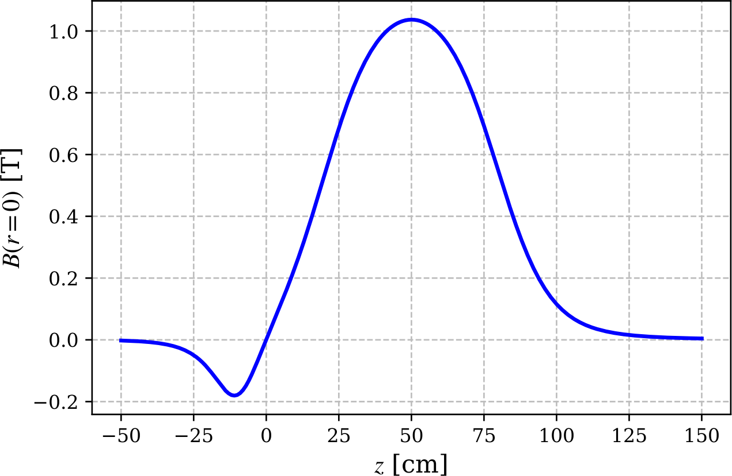
Model with Compensation Solenoid and Cavities
Geometry (FLUKA)
Compens.
Solenoid
Main Solenoid
Absorbers
Target
e⁺
Cavity
Conductor of comp. sol.:
L = 8 cm
R_{in} = 7.5 cm
R_{out} = 19.5 cm
Conductor of main sol.:
L = 50 cm
R_{in} = 30 cm
R_{out} = 54 cm
Solenoids modeled by J. Benesch
Same 15 mm square Cu conductor
with 11 mm hole
for both main and compensation
solenoids
j ≈ 446 A/cm²
B_{max}(r = 0) = 1.03 T
Water flow:
~500 cc/sec, 18 bar

Slide 8
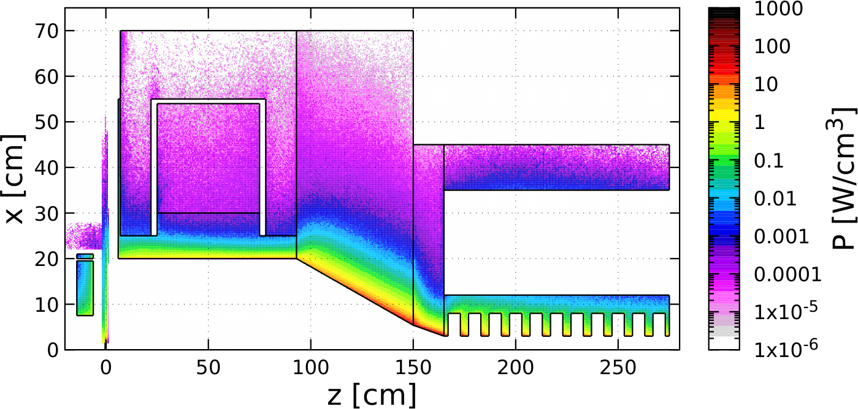
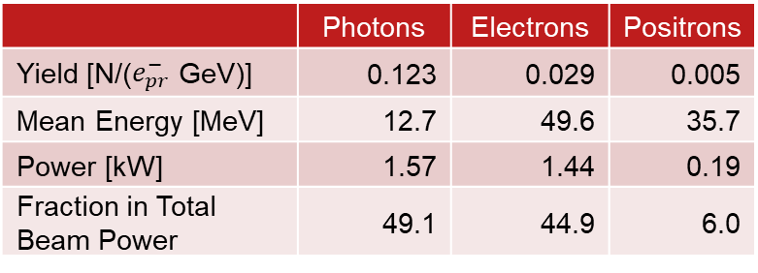
Distribution of Power Deposed by 1 mA @ 120 MeV e‒ Beam
 | Power [kW]
Target | 18.11
Compensation Solenoid | 0.74
Coil of Main Solenoid | 0.02
Iron of Main Solenoid | 0.06
W10Cu Absorber inside Main Solenoid | 18.88
TZM Absorber (99.4% Mo, 0.5% Ti, 0.1% Zr) | 58.66
W10Cu Absorber upstream Cavities | 12.50
Solenoid around Cavity | 0.12
Cu Cavities | 6.50
Total Absorbed Power | 115.56 (96.3%)
Beam Power at z = 275 cm, r < 3cm | 3.20
Steel
TZM
Cu Coil
Cu Coil
W10Cu
W10Cu
Cu Cavities*
Compensation
Solenoid
Target
 | Photons | Electrons | Positrons
Yield [N/($e_{pr}^{−}$ GeV)] | 0.123 | 0.029 | 0.005
Mean Energy [MeV] | 12.7 | 49.6 | 35.7
Power [kW] | 1.57 | 1.44 | 0.19
Fraction in Total Beam Power | 49.1 | 44.9 | 6.0
Mechanical design and simulations of temperature,
thermal stress, radiation damage and
optimization of whole e⁺ capture system
have to be done / will be continued
* No E-field in cavities

Slide 9
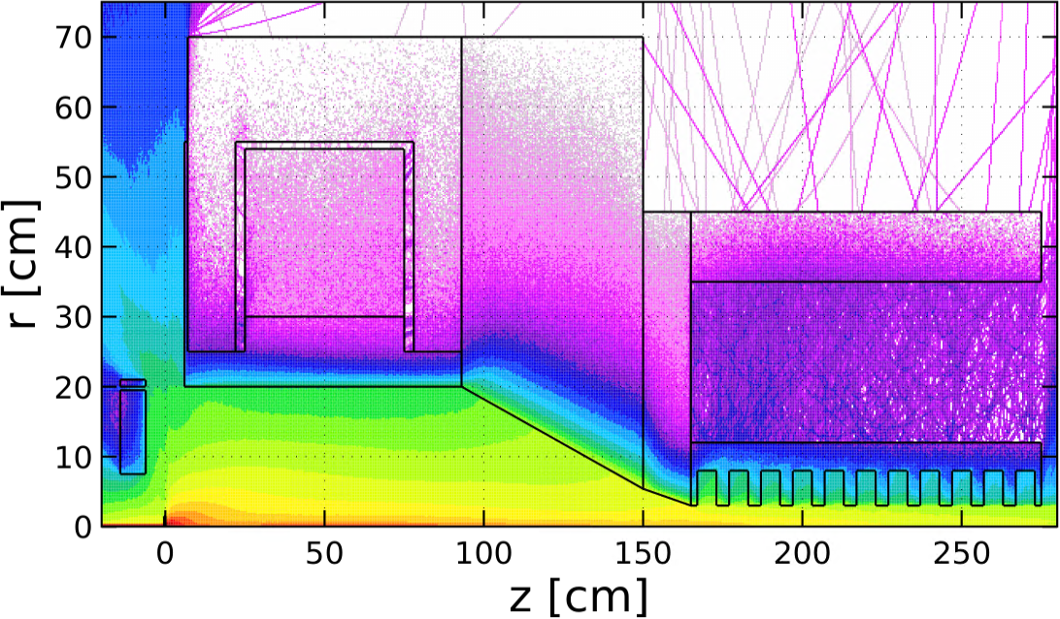
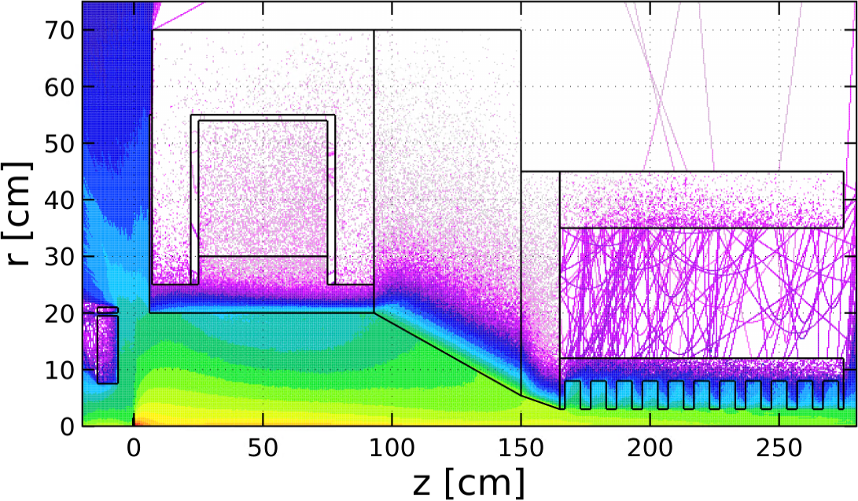
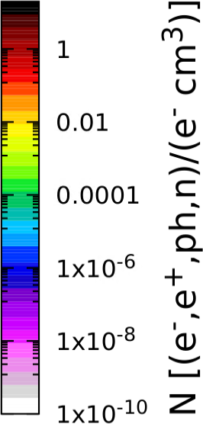
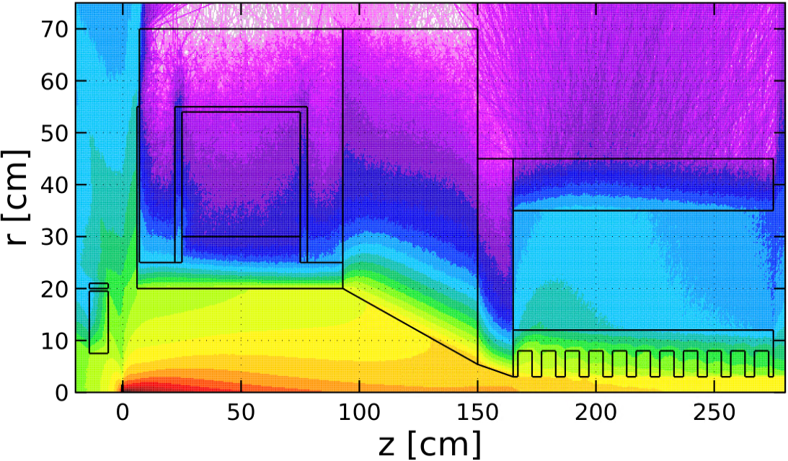
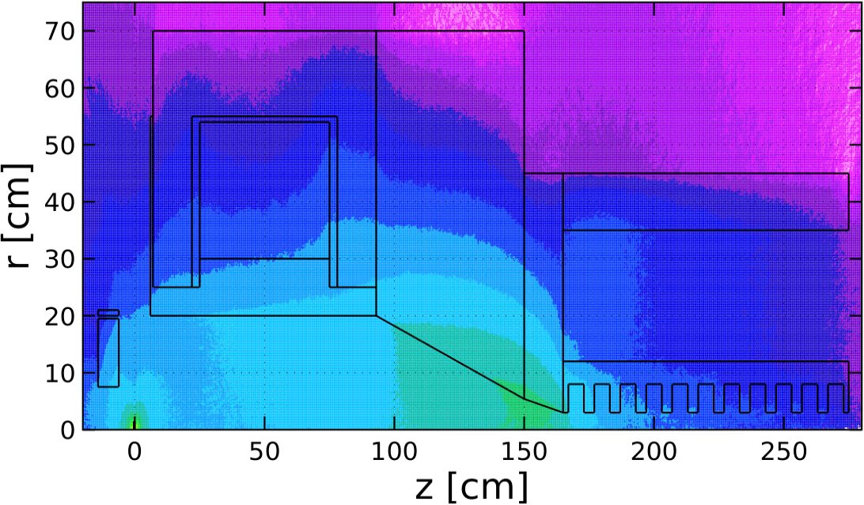
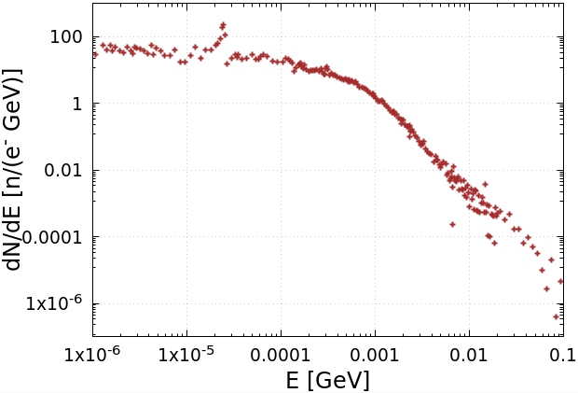


Spatial Distributions of e‒, e⁺, γ and n. Neutron Energy and Yield
Electrons
Positrons
We have begun working with the Radiation Control Department on radiation shielding
Photons
Neutrons
Energy Spectrum of Neutrons
Neutron Yield:
$Y_{n}=9.2∙{10}^{−3}$ ${n/e}_{pr}^{−}$
$(5.7∙{10}^{13}$ $n/s)$

Slide 10
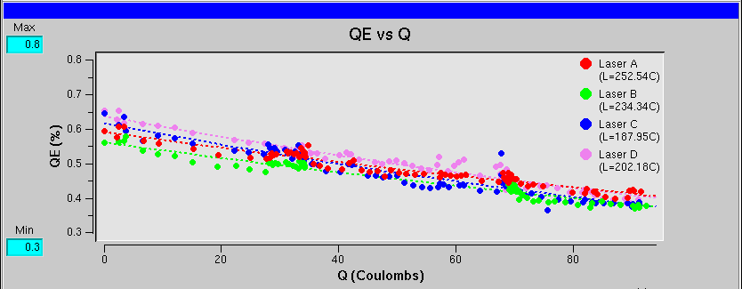
CEBAF polarized e- source @ 1 mA?
High polarization at 1 mA
[µA]
Gun2 Photocathode (Fall 2016 – Spring 2017)
QE = QE₀ e ^{-(Q/Lifetime)}
We have demonstrated polarization from the CEBAF PES remains steady up to 1 mA/499 MHz
The charge lifetime (at 0.2 mA) is about 200 C
This would provide only 2-3 days of positrons
Lifetime ~200 C (σ_{4D} ~ 1mm, I~200 μA)
Slide by J. Grames
Gun vacuum ~ 1x10⁻¹² Torr

Slide 11
CEBAF lifetime improvement with biased anode (GaAs/GaAsP)
Ions downstream of the anode are repelled back towards the beamline by the positive anode potential
Improving charge lifetime of CEBAF photogun
J. T. Yoskowitz et al., 12th Int. Particle Acc. Conf. IPAC2021, Campinas, SP, Brazil, doi:10.18429/JACoW-IPAC2021-WEPAB104
With a >400 C lifetime we could operate at 1 mA for almost 1 week
Slide by J. Grames

Slide 12
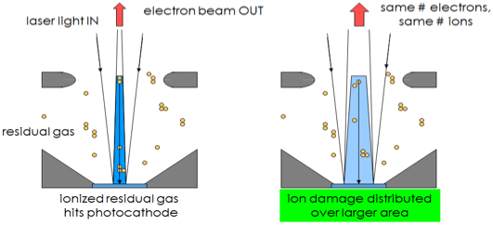
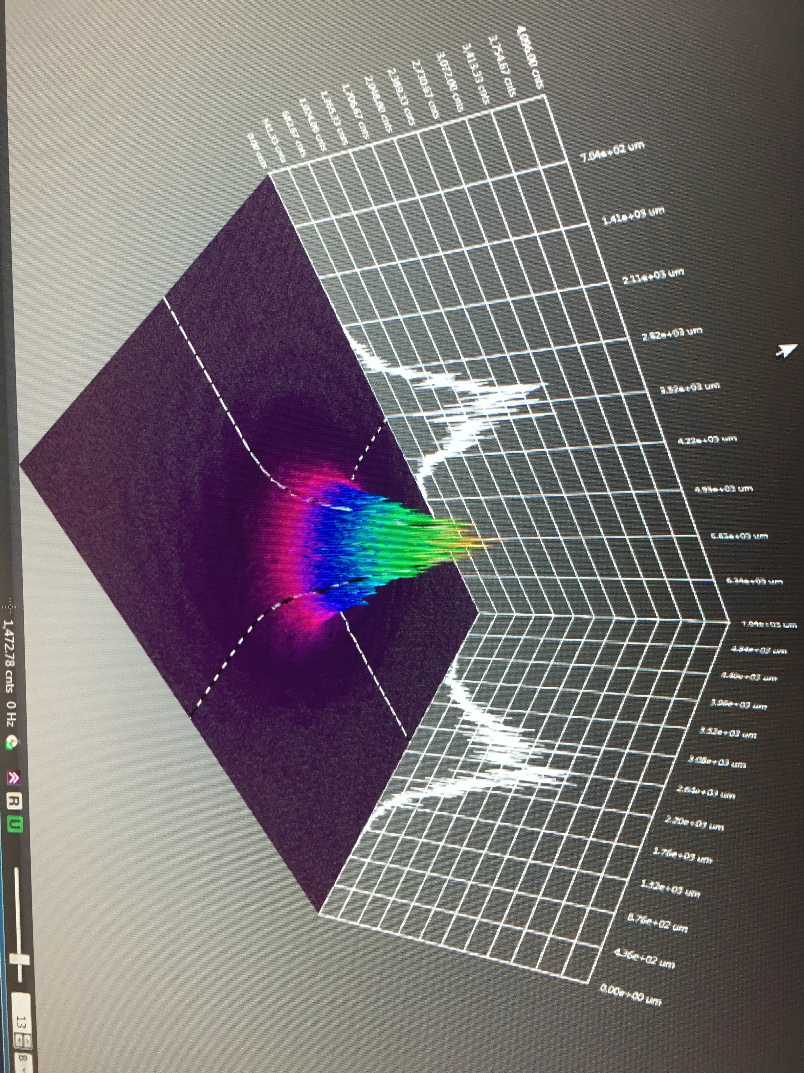

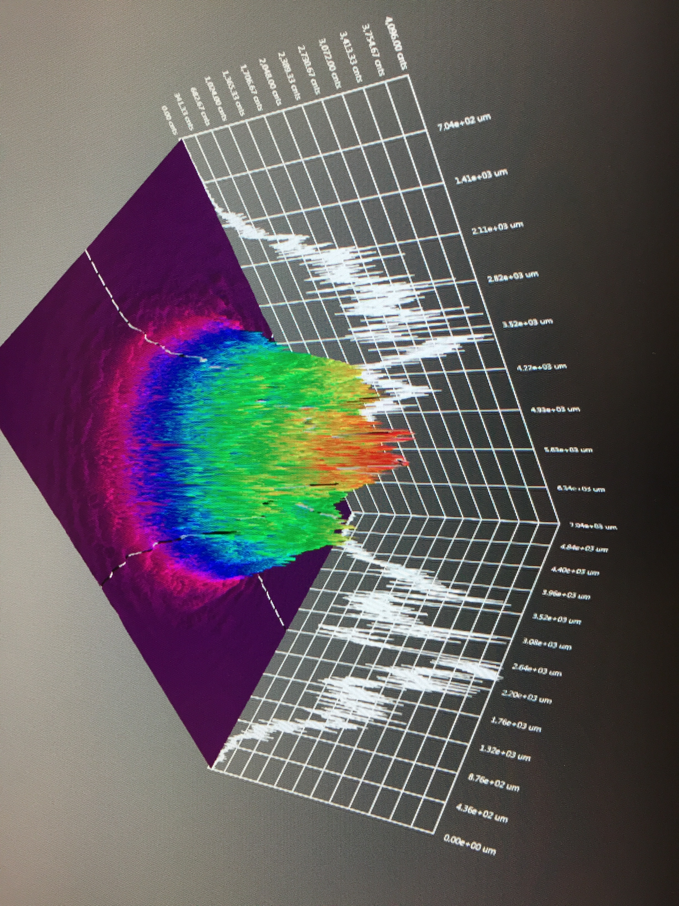
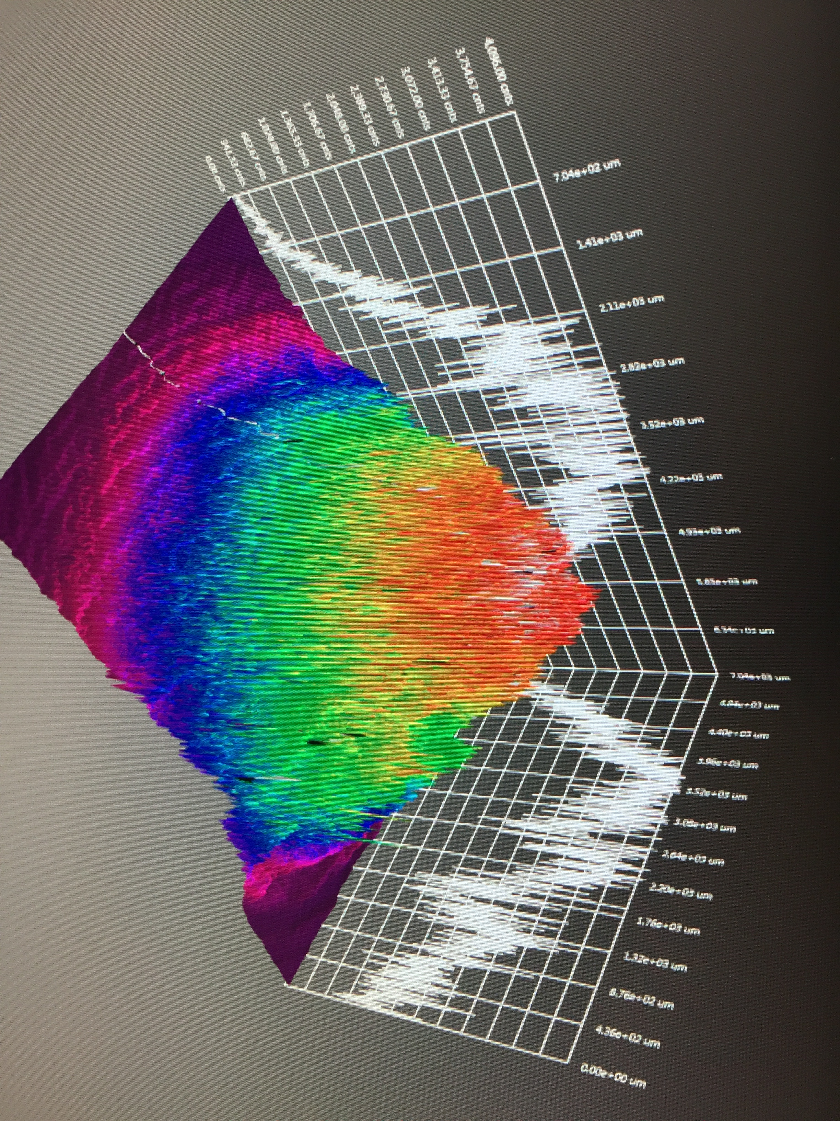
GaAs/GaAsP charge lifetime at milliamp current
Results from PSTP’17 suggests increasing laser spot size is viable to exceed >500 C lifetime; however we need to build another gun to test this assertion.
J. Grames, P. Adderley, J. Hansknecht, R. Kazimi, M. Poelker, D. Moser, M. Stutzman, S. Zhang, “Milliampere beam studies using high polarization photocathodes at the CEBAF Photoinjector” Polarized Sources, Targets and Polarimeters Workshop, Dajeon South Korea (2017)
4𝜎 ~ 10 mm
Days
Trend we want to realize
CEBAF (<1 mm²)
4𝜎 ~ 1 mm

Slide 13
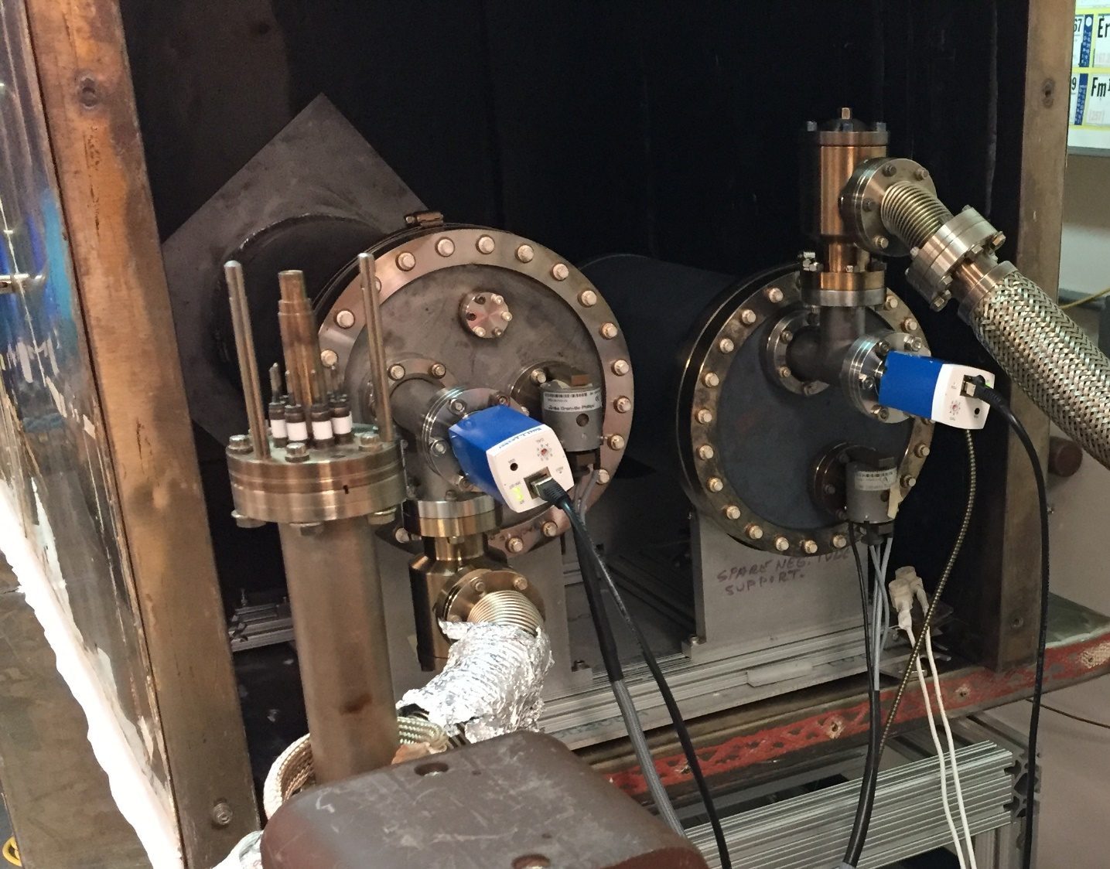
Two weeks @ 1 mA ≈ 1 kC
low carbon steel
(reduce outgassing)
By increasing the laser size and biasing the anode charge lifetimes of 1 kC might be possible
Ce⁺BAF
Gun Charge in 2 weeks [Coulombs]
anode biasing
CEBAF
large laser size
Gun Current to make positrons [mA]

Slide 14
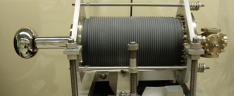
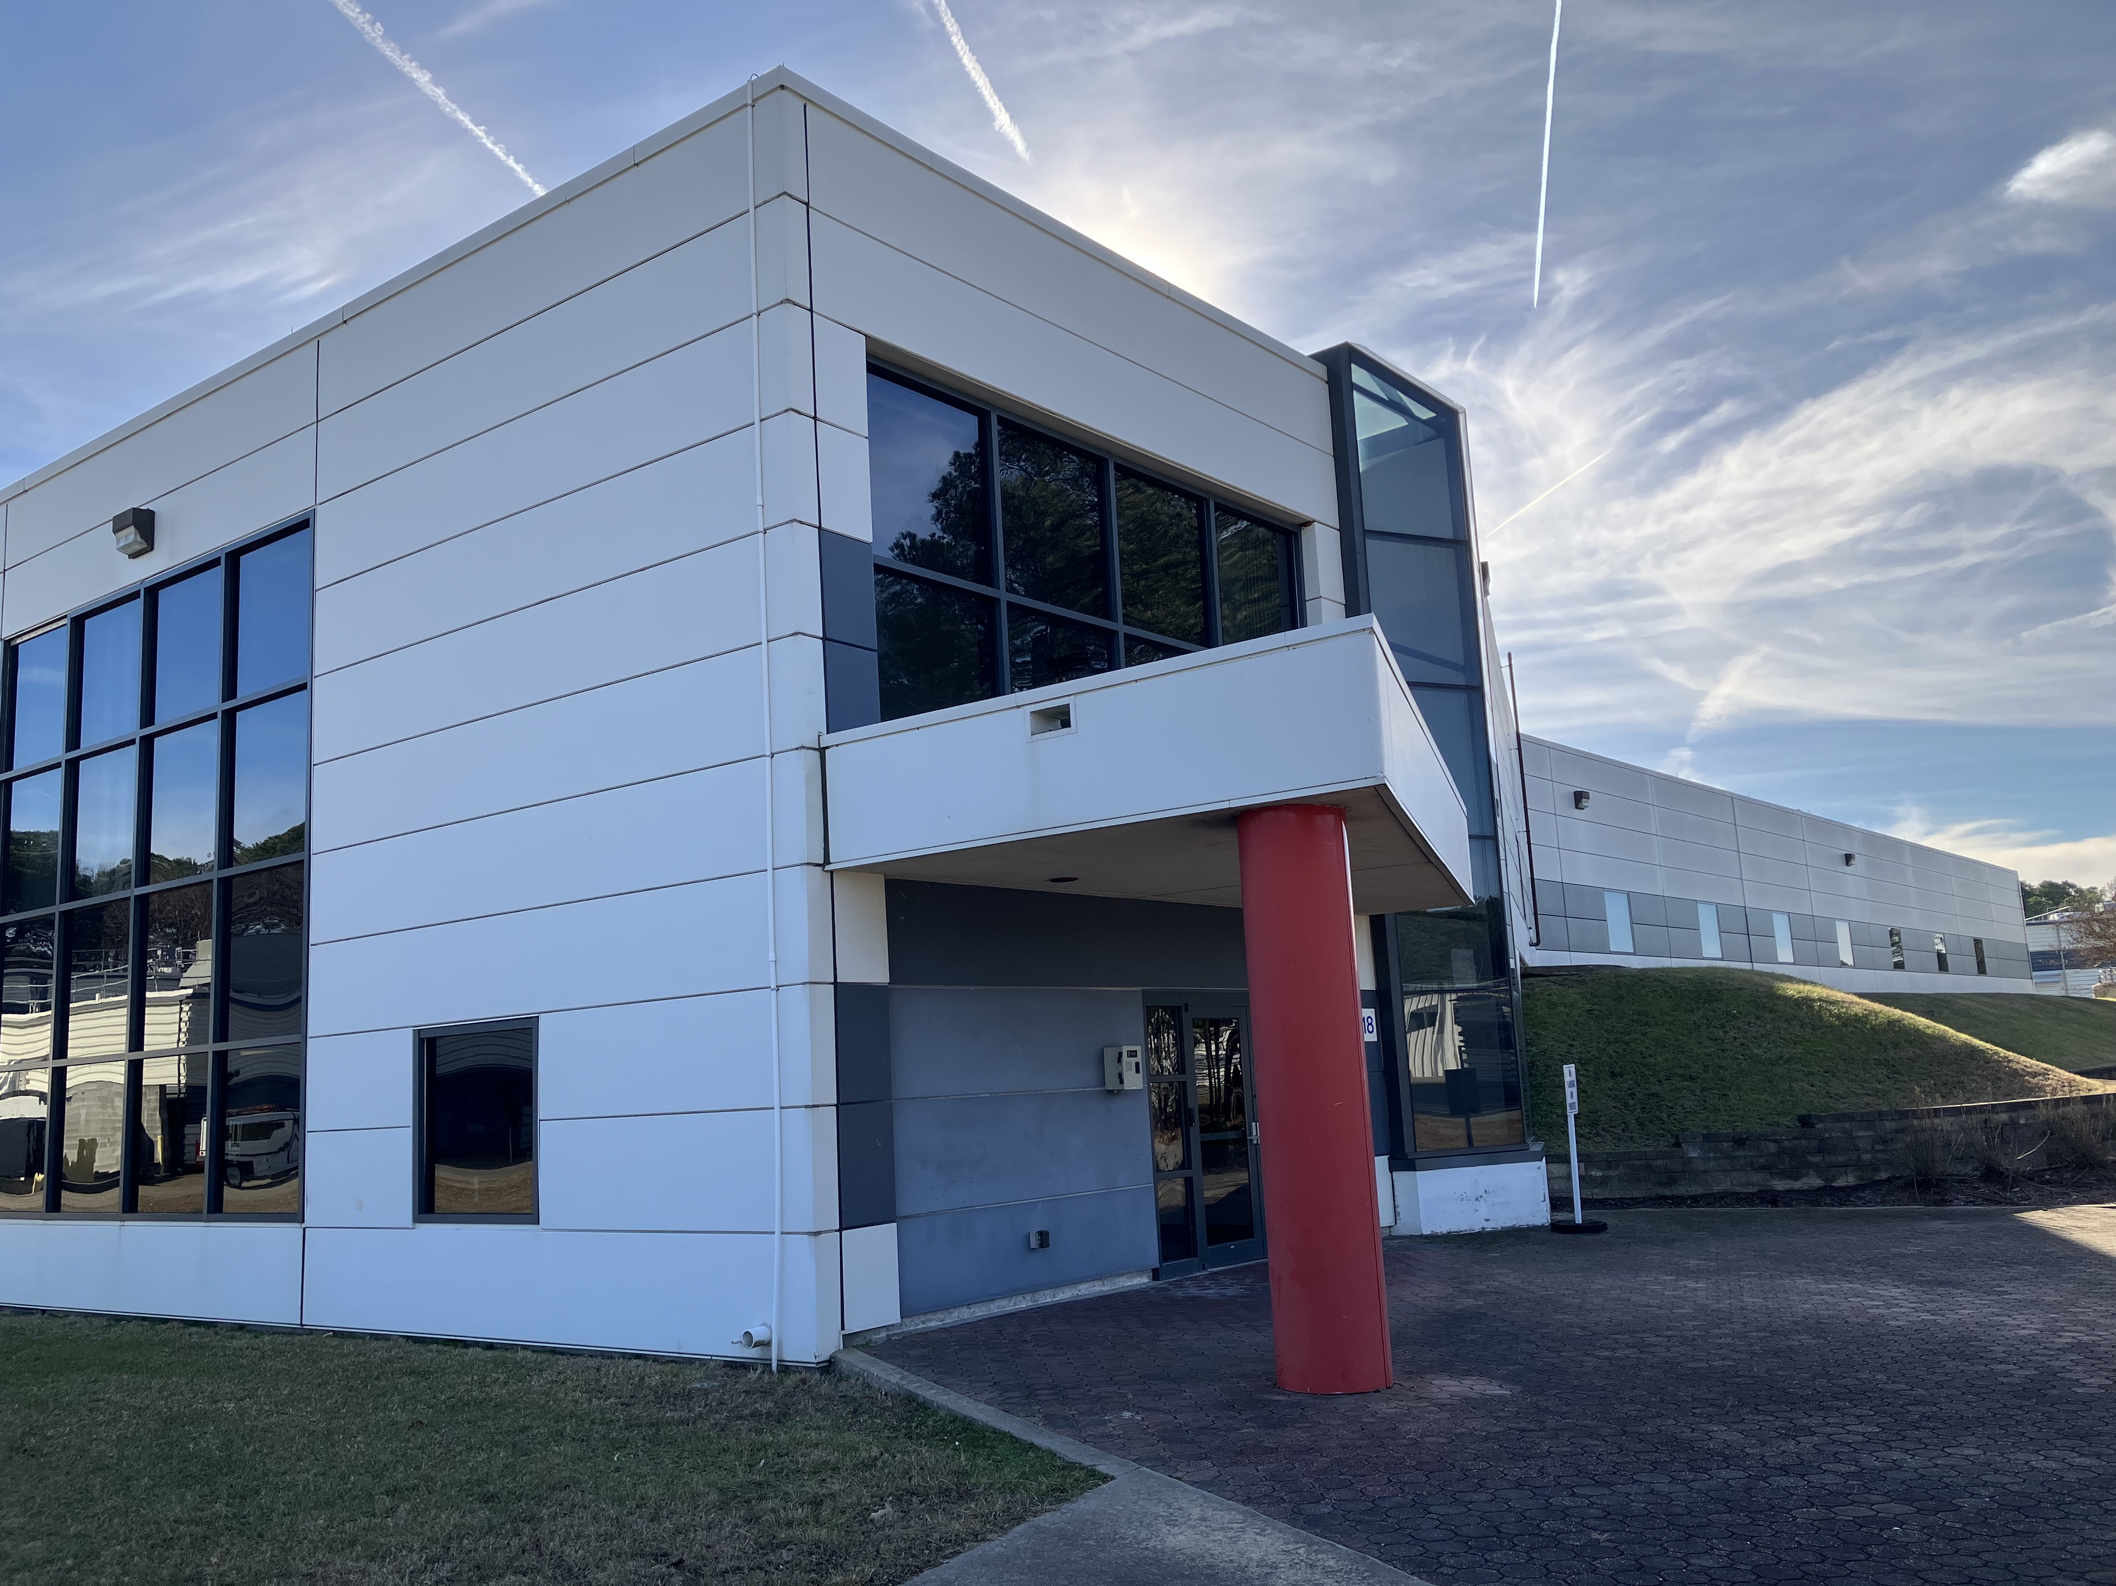
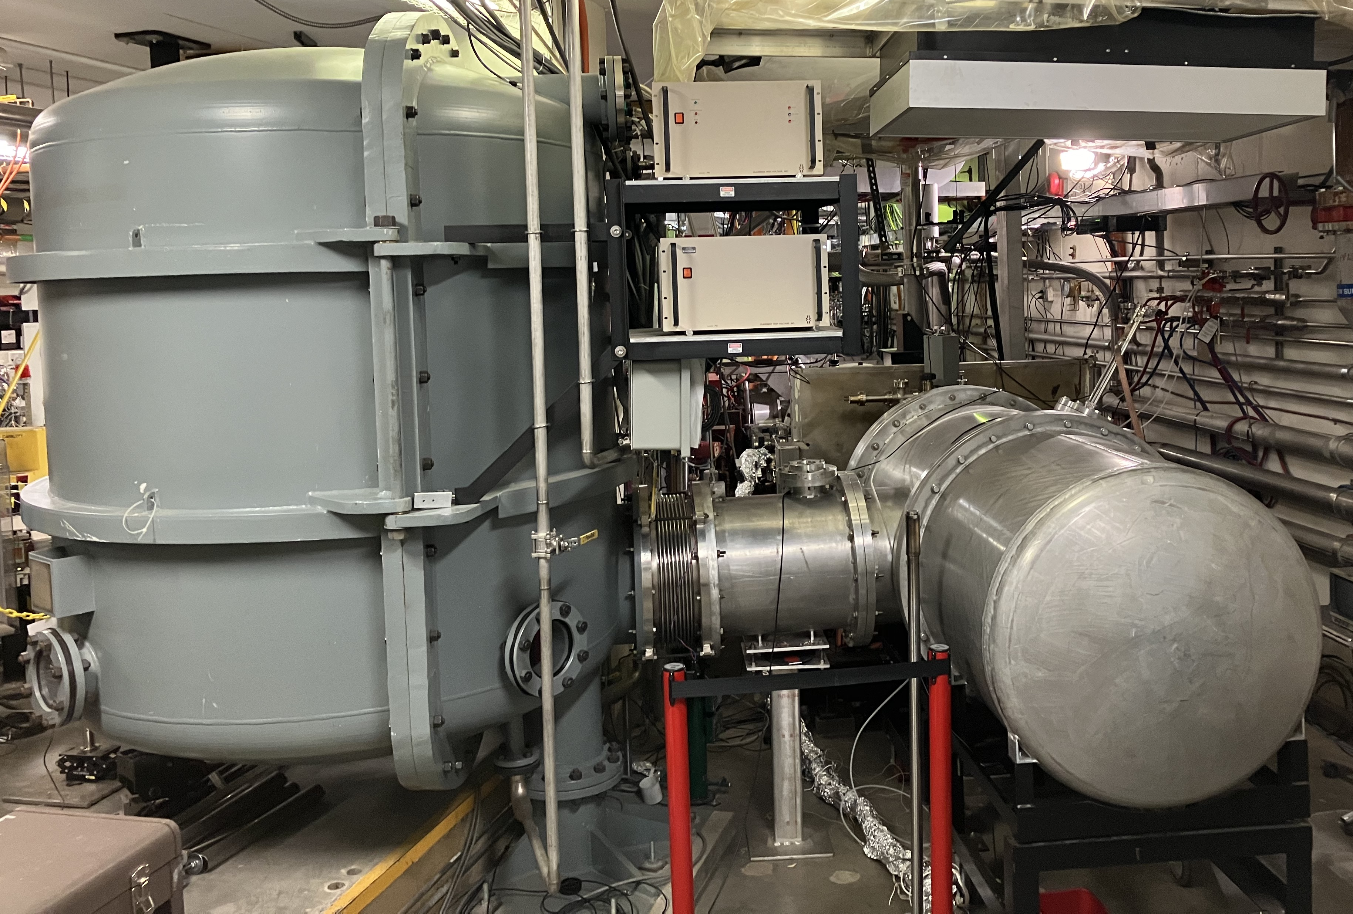
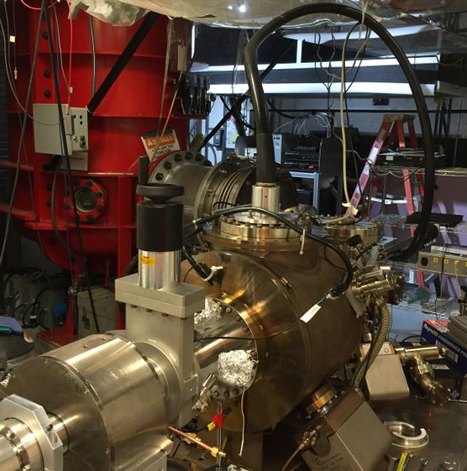
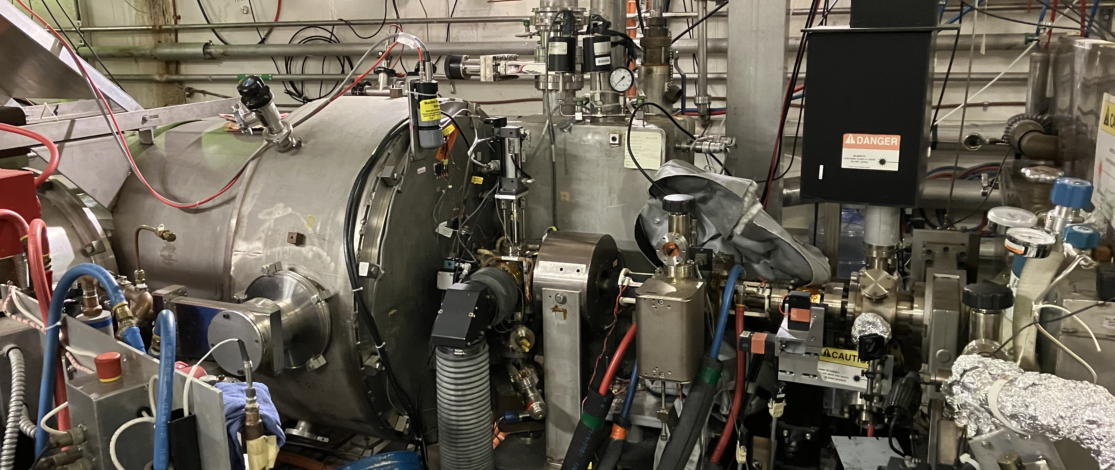
Restore LERF 100 kW/10MeV capability
LERF vent-bake gun
The prototype load-locked mA photogun could replace the LERF vent-bake photogun in the 10 MeV/10 mA injector
The Gun Test Stand gun could be modified as the first prototype mA polarized gun
SRF is preparing to repair the 10 MeV booster

Slide 15
3 Year e+ R&D plan
Conceptual Development
  write a pCDR by Spring 2025
  sustain core staff of scientific and engineering labor
Critical Tasks – experimental R&D to address highest risk components
  ~1mA polarized e- source
  ~10kW rotating water-cooled heavy metal target
  normal-conducting CW capture cavity
  generation, transport and diagnostics for large emittance beams
LERF – restoring 100kW/10MeV capability for a beam and target test area
  Year1 – install CEBAF-style load-lock gun and drive laser
  Year2 – install repaired QCM and commission 10 MeV beam
  Year3 – use LERF to irradiate and test targets with >50 kW/10MeV

Slide 16
Publications, Projects/Proposals in last year…
PhD Theses
  S. Habet (University of Paris-Saclay), "Concept of a polarized positron source for CEBAF“, Dec 2023
Conferences/Workshops/Meetings
  Y. Roblin, "The CEBAF positron beam upgrade“, CLAS12 Workshop, Paris, Mar 21-24, 2023, talk
  J. Grames et al., "Status of Ce+BAF: Polarized Positron Beam Capability at CEBAF 12 GeV", IPAC’23, MOPL152
  A. Ushakov et al, "Conceptual Design of a High-Power Target for Positron Production at CEBAF", IPAC’23, WEPM120
  A. Sy et al., "Degrader beamline design at the CEBAF injector for machine acceptance studies", IPAC’23, MOPM081
  S. Habet, “Optimization of CW Polarized Positron Source for JLab”, LCWS, May 15-19, 2023, talk
  A. Ushakov et al., “High Power Solid Target for Positron Source at CEBAF”, LCWS, May 15-19, 2023, talk
  Y. Roblin, "Status of the Ce+BAF project", JLab User Organization Annual Meeting, June 26-28, 2023, talk
  J. Grames, “A positron beam at CEBAF”, SPIN2023, Sep 24-29, 2023, talk
  S. Covrig, “CFD Sims of High-Power Converter Targets”, US-Japan Collaboration Meeting, Oct 25, 2023, talk
  A. Ushakov, “Integration of 120 kW target into e+ source”, US-Japan Collaboration Meeting, Oct 25, 2023, talk
Funded Projects
  SLAC/JLab, KEK “Advanced electron and positron source concepts”, US-Japan Sci. & Tech. Coop. Prog. in HEP – DOE, 07/2023-06/2024
  Xelera “A high power positron converter based on recirculating free surface liquid metal jets in a vacuum”, SBIR Phase I, 02/2023-03/2024
  “Assessing CEBAF using degraded beams for the Ce+BAF positron upgrade”, JLab LDRD, FY23-FY24
  IJCLab (Orsay) “Polarized electrons, positrons and polarimetry (P3E)”, EU’s Horizon 2020 program, 06/2019-10/2023

Slide 17
Publications, Projects/Proposals since Last JLAAC Meeting (Continued)
IPAC'24, Nashville, May 19-24, 2024 (abstracts submitted)
  Joe Grames et al., “Status of positron beams at Jefferson Lab (Ce+BAF)”
  Silviu Covrig et al., “Computational fluid dynamics design of a very high-power rotating positron target”
  Tim Lengler et al., “Characterization of irradiation damages to positron source materials”
  Andriy Ushakov et al., “Simulations of positron capture at Ce+BAF”
  Shaoheng Wang et al., “Capture cavities for the CW polarized positron source Ce+BAF”
  Amy Sy et al., “Towards large phase space beams at the CEBAF injector”
  Victor Lizárraga Rubio et al., “Computational simulations and beamline optimizations for an electron beam degrader at CEBAF”
Pending Proposals
  SLAC/JLab, KEK “Advanced positron source concepts”, US-Japan Sci. & Tech. Coop. Prog. in HEP – DOE, 07/2024-06/2026
  Xelera “A high power positron converter based on recirculating free surface liquid metal jets in a vacuum”, SBIR PHASE II, 04/2024-04/2026
  IJCLab (Orsay) “High-power positron production target”, ANR (France), 01/2025, 3 years

Slide 18







Acknowledgements
I would like to acknowledge the Ce⁺BAF Working Group and all those who have been supportive to this progression of activity.
J. Benesch, M. Bruker, A. Bogacz, L. Cardman, J. Conway, S. Covrig, P. Degtiarenko, J. Grames, J. Gubeli, C. Gulliford, S. Habet, C. Hernandez-Garcia, D. Higinbotham, A. Hofler, R. Kazimi, M. Kostin, V. Kostroun, F. Lin, V. Lizarraga-Rubio, T. Michalski, S. Nagaitsev, M. Poelker, E. Pozdeyev, N. Raut, R. Rimmer, Y. Roblin, A. Seryi, K. Smolenski, M. Spata, R. Suleiman, A. Sy, D. Turner, C. Valerio, E. Voutier, J. Yoskowitz, S. Wang, S. Zhang

