Slide 1
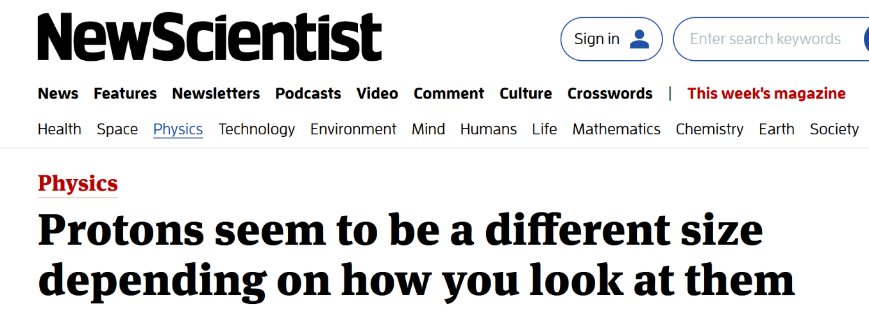
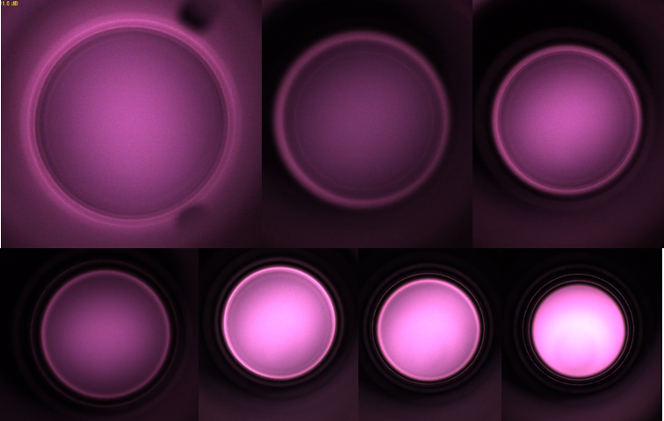
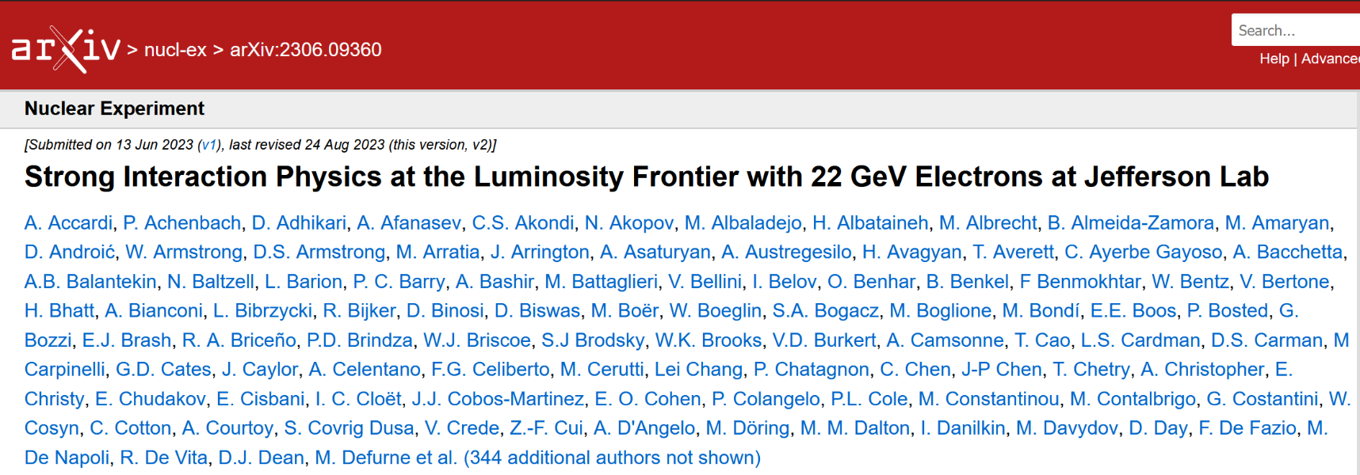
Jefferson Lab Highlights
12 GeV scientific era is going strong
High-profile results emerging from 12 GeV program
On track for > 30 weeks operation in FY24
Performance improvements from CEBAF Performance Plan
Successful partnership with BNL in management, design, construction of EIC Project; successful CD-3a review
Developed CEBAF Upgrade strategy to provide positron beams and a 22 GeV energy upgrade
Completed Re-organization of Accelerator and Engineering Divisions to better align resources and accountability for CEBAF Operations
Multi-Lab Partnerships: SNS PPU nearly complete; LCLS-II HE in full production
Significant developments in Safety
Recent hires Strengthen Accelerator Division team
Major developments to diversify Jefferson Lab’s scientific mission
Plasma processing of SRF cavities

Slide 2
Jefferson Lab Organization and Leadership Team
2

Slide 3
Jefferson Lab’s Science and Technology Vision
Computational Science & Technology
Accelerator Science & Technology
Nuclear Physics at CEBAF
Electron-Ion Collider
Vibrant nuclear physics research program at CEBAF with optimal 34 weeks/yr supporting ~1,900 annual users
MOLLER Project
Future CEBAF Upgrade opportunities complementary to EIC
Theory and computation supporting NP goals
Partnering with BNL in the management, design, and construction of the Electron-Ion Collider Project
Leadership in EIC scientific program
Leadership of the Generic EIC–related Detector R&D Program
Vision for world-leading first-of-its-kind Data-intensive scientific computing facility: High Performance Data Facility
Beginning HPDF activities in partnership with LBNL
Accelerator component production for DOE construction projects partnering across the National Lab complex.
Develop CEBAF upgrade concepts
R&D in accelerator, detectors and applications in nuclear imaging and medicine
S&T thrusts are synergistic and mutually supportive
3

Slide 4
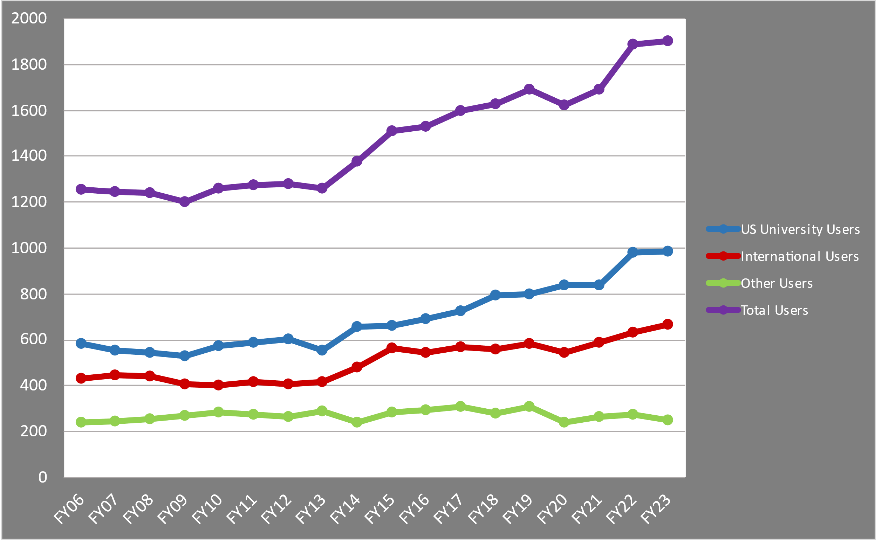
Our User Community is Growing
4

Slide 5
CEBAF Weeks of Operations
CEBAF Priorities
Supporting user program at > 30 weeks operation per year
Improving CEBAF capability to operate at higher energy with acceptable beam trip rates
Improve CEBAF reliability
Acquire critical spares to mitigate extended beam interruptions
2K Cold Box
Accelerator Shutdown

Slide 6
CEBAF Physics Schedule

Slide 7
The High Performance Data Facility is coming to Jefferson Lab!
HPDF: a $300-500M world-leading, state-of-the-art high performance computing facility purpose-built to provide researchers with the tools needed for Big Data
HPDF enables the Integrated Research Infrastructure program: the seamless integration of DOE user facilities, computational resources and data science and management capabilities in real-time
Enabled by $50M commitment from the Commonwealth of Virginia
7

Slide 8
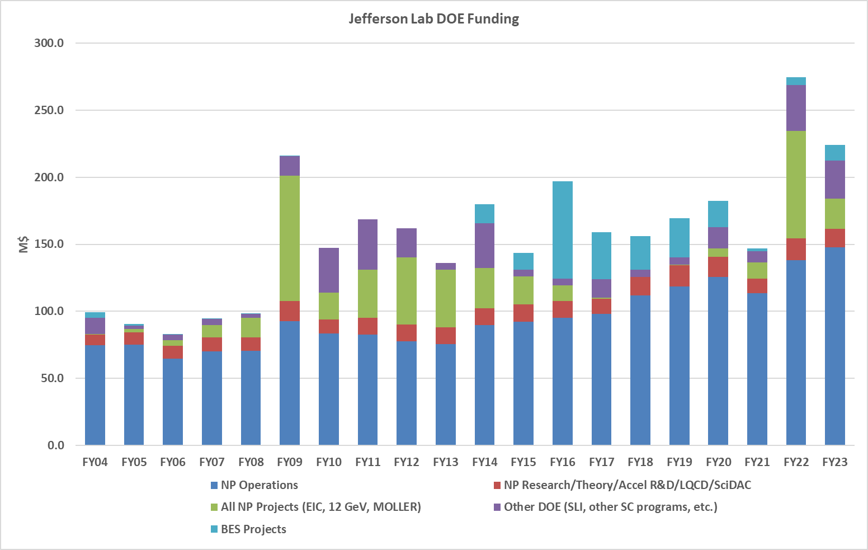
Jefferson Lab is Growing
8

Slide 9
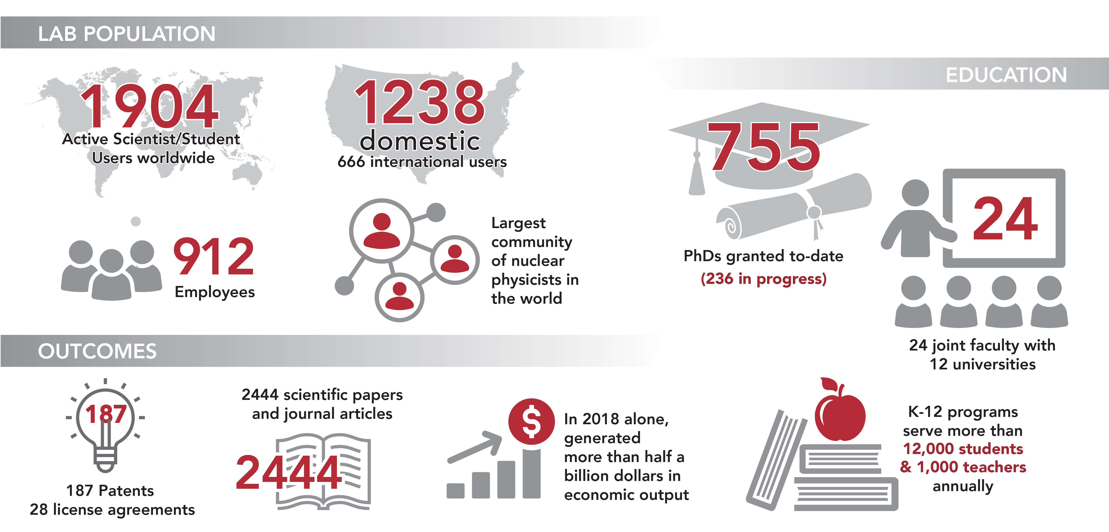
Jefferson Lab By The Numbers

Slide 10
Safety as an Uncompromising Value: Several significant developments
Two significant near-miss events (no injuries) in May/June 2023
A worker did not perform zero-voltage verification and began work on a live 480V circuit
A worker did not LOTO an RF power source; delivered power to an open waveguide
Meanwhile, DOE-SC guidance issued (May 2023) to ensure after-hours high-risk/high-consequence work is carried out only with full resources and capabilities and with DOE approval
Actions:
Initiated Lab-wide LOTO pause/restart; proceeded through restart process to verify work planning and control, appropriate supervision and PPE, and observed adherence to procedure
Suspended all high-hazard work at Jefferson Lab June 16; restarted such work on a case-by-case basis
Suspended planned work outside of normal 6am-6pm schedule; performed case-by-case evaluation of planned off-hours tasks; initiated revised process with more limited scope
Pulled forward transition to electronic permit administration (ePAS) system for work planning and control and hazard identification; went “live” on January 8, 2024.
Jefferson Lab is consistently in the top half of DOE-SC labs in injury rates (#3 in TRC in FY23)

Slide 11
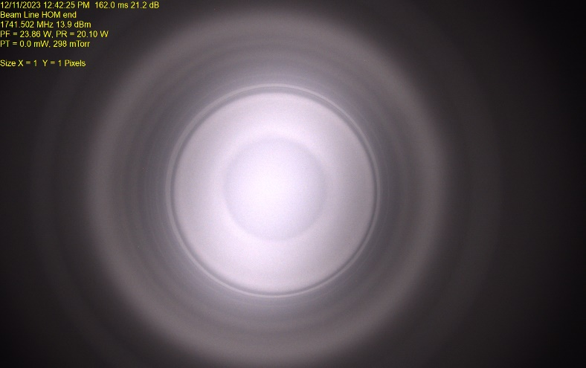
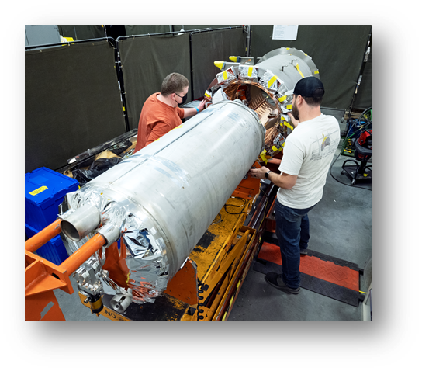
Perspective: Challenges, Risks, Opportunities
Highest priority: delivering scientific results from the 12 GeV Program
Robust, reliable operation at > 30 weeks per year
Achieving required energy performance and gradient margin
Robust operations funding
Simultaneously delivering CEBAF and EIC commitments
Moving forward with the CEBAF Energy Upgrade
Maintaining good performance on JLab’s BES project deliverables as we carry out the CPP plan
Image of plasma in C75 cavity
Sustaining and advancing our SRF capabilities
Recruiting and retention of staff and rampup for EIC
Exploring potential applications beyond Discovery Science
DOE CD-3A/Status Independent Project Review, Nov. 14-16, 2023

