Slide 1
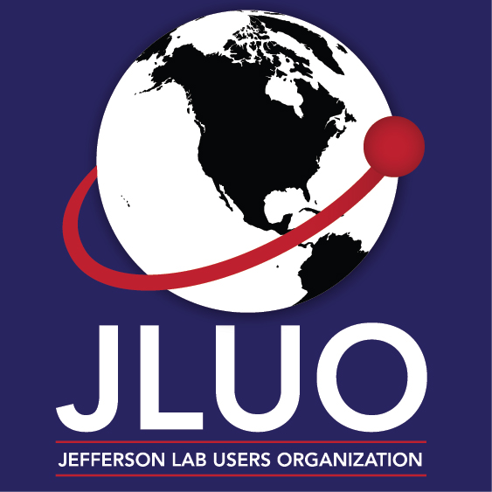
JLUO Board Meeting
February 7, 2024
Elizabeth L. Lawson
SURA Chief of Laboratory Services
JSA Board Liaison & Secretary

Slide 2
JSA Initiatives Fund Program
Since inception in 2006, JSA has awarded over $8.0M for over 500 projects. These projects:
Further the scientific outreach and enhance the Lab’s scientific and technology programs
Leverage commitments and resources of others, including the Lab itself
Benefit the Lab’s extended user community

Slide 3
JSA Initiatives Fund Program
JSA Announces $500k Initiatives Fund Program Awards for FY24
Graduate and undergraduate fellowships: Providing hands-on research experience and mentorship for the next generation of scientists
Scientific meeting support: Facilitating the exchange of ideas and collaboration among researchers at conferences and workshops
Education and career development: Equipping students and early-career scientists with the skills and knowledge needed to thrive in the scientific workforce
STEM activities: Inspiring future generations of scientists through outreach programs and educational initiatives
Student prizes and awards: Recognizing and encouraging outstanding research achievements among young scientists

Slide 4
JSA Initiatives Fund Program
JSA/JLab Graduate Fellowships
Over 260 fellowships to students from 24 SURA universities since 1998
Nine AY23-24 awards to:
John Boyd, UVa
Justin Cammarota, W&M
Marco Carrillo, ODU
Sean Jeffas, UVa
Pushpa Pandey, ODU
Jason Phelan, MIT
Tommaso Rainaldi, ODU
Sara Ratliff, GWU
Abhyuday Sharda, UTenn
JSA Accepting Applications for AY2024-25 Graduate Fellowship Program Application Deadline: February 16, 2024

Slide 5
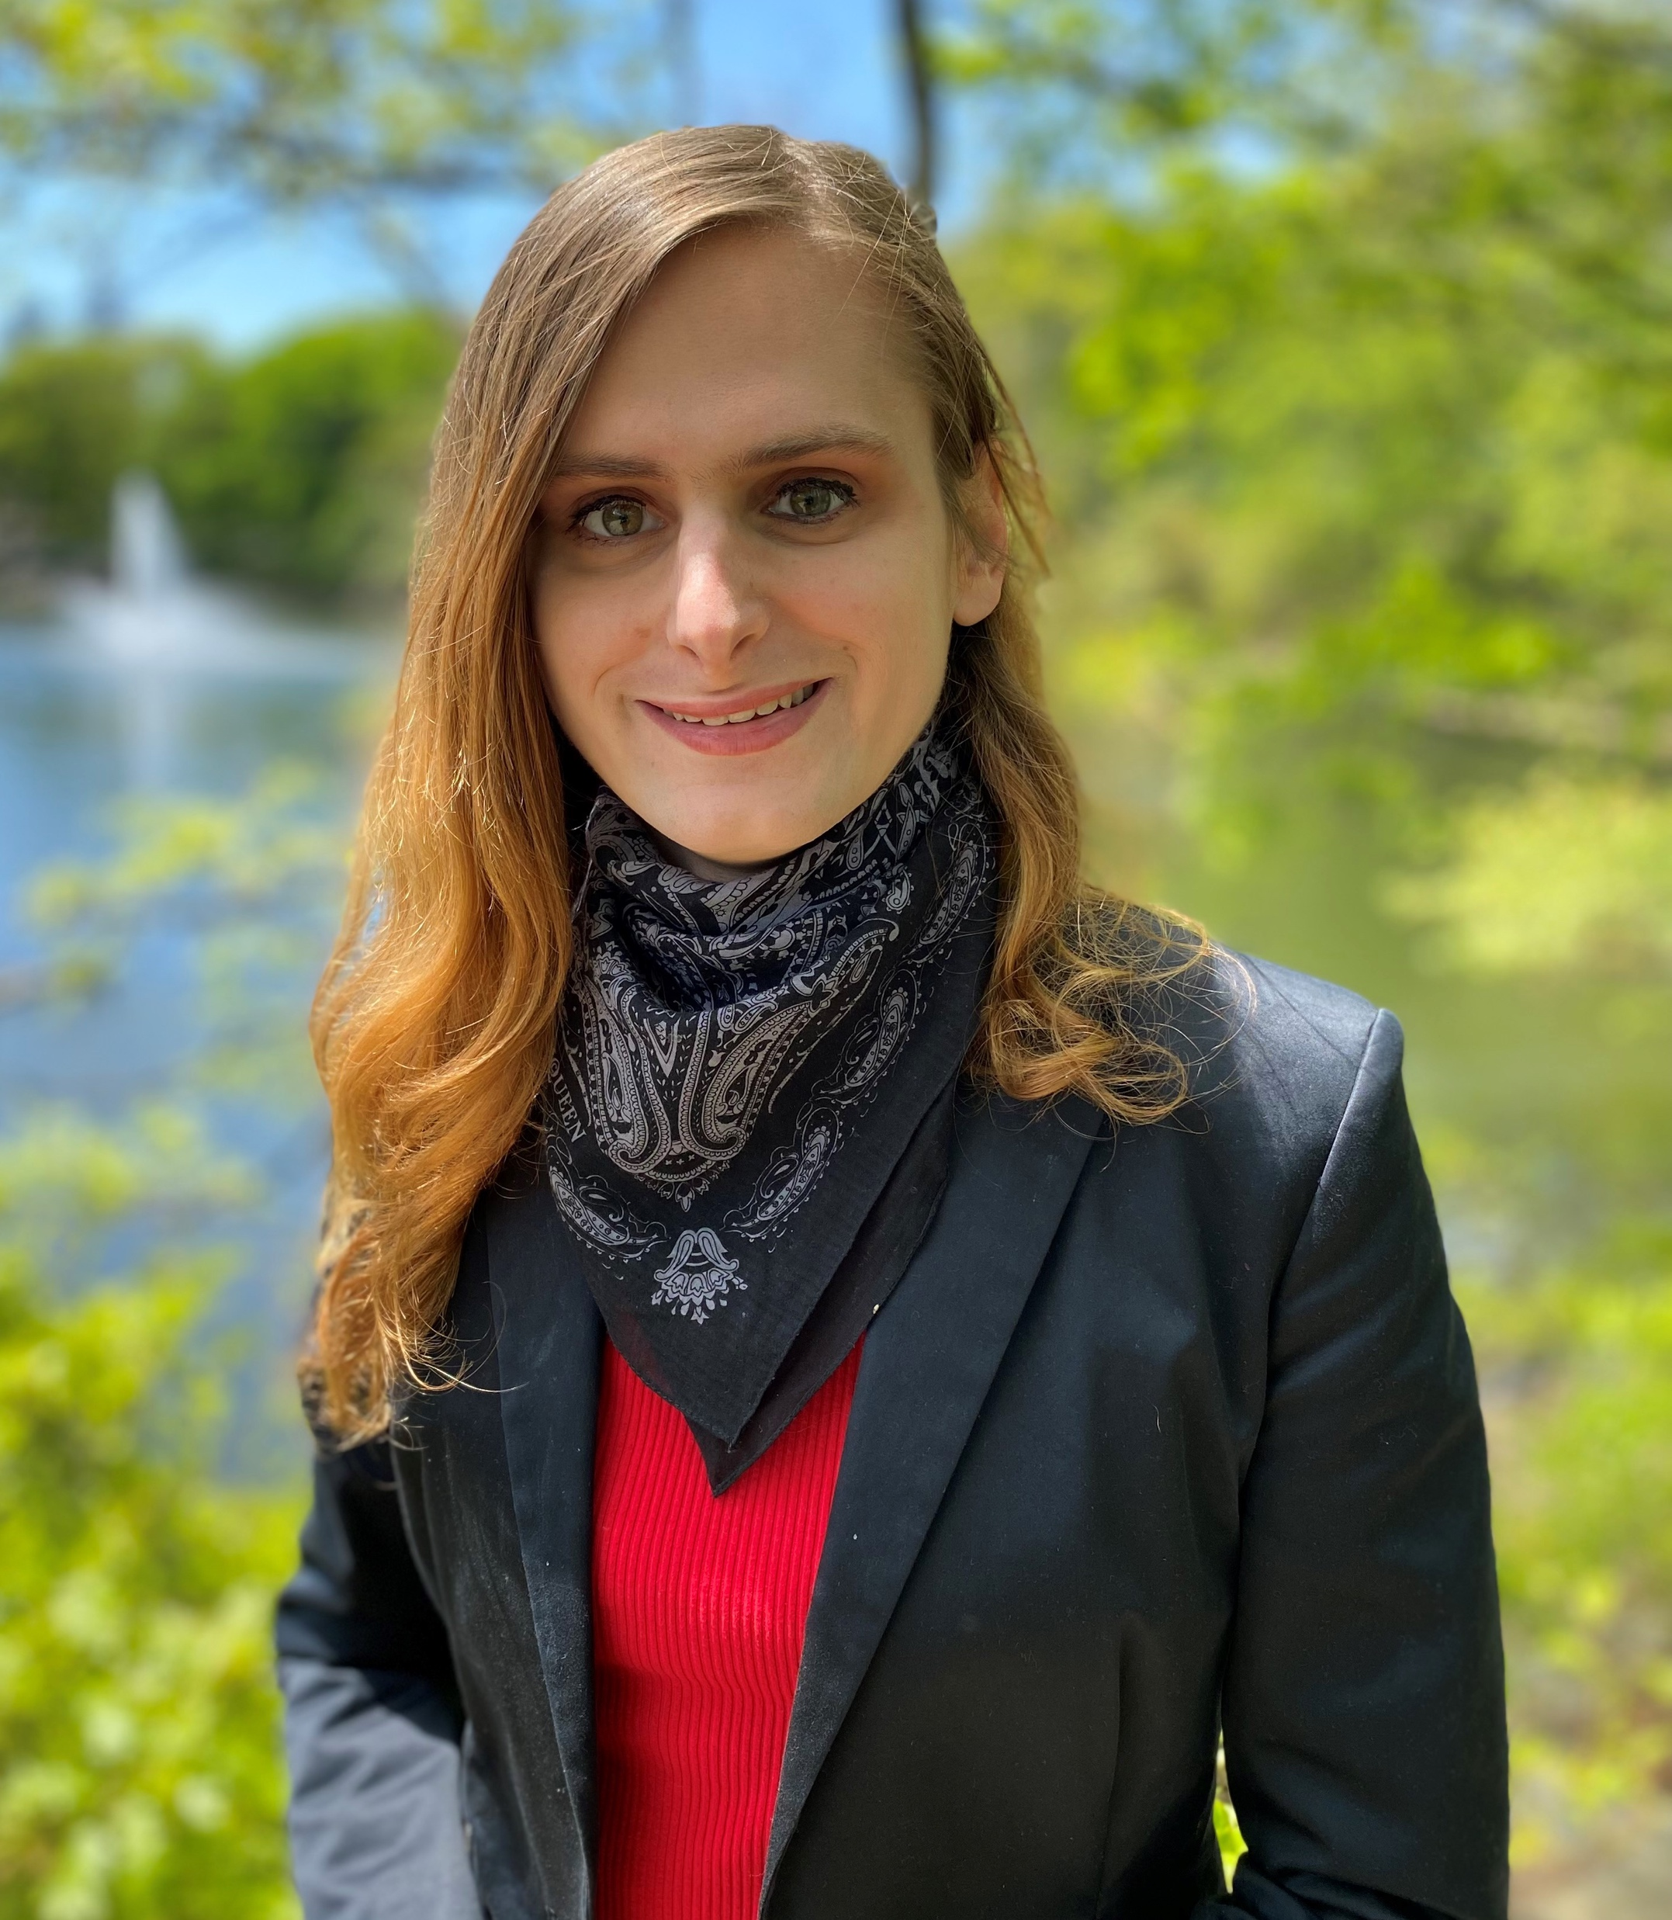
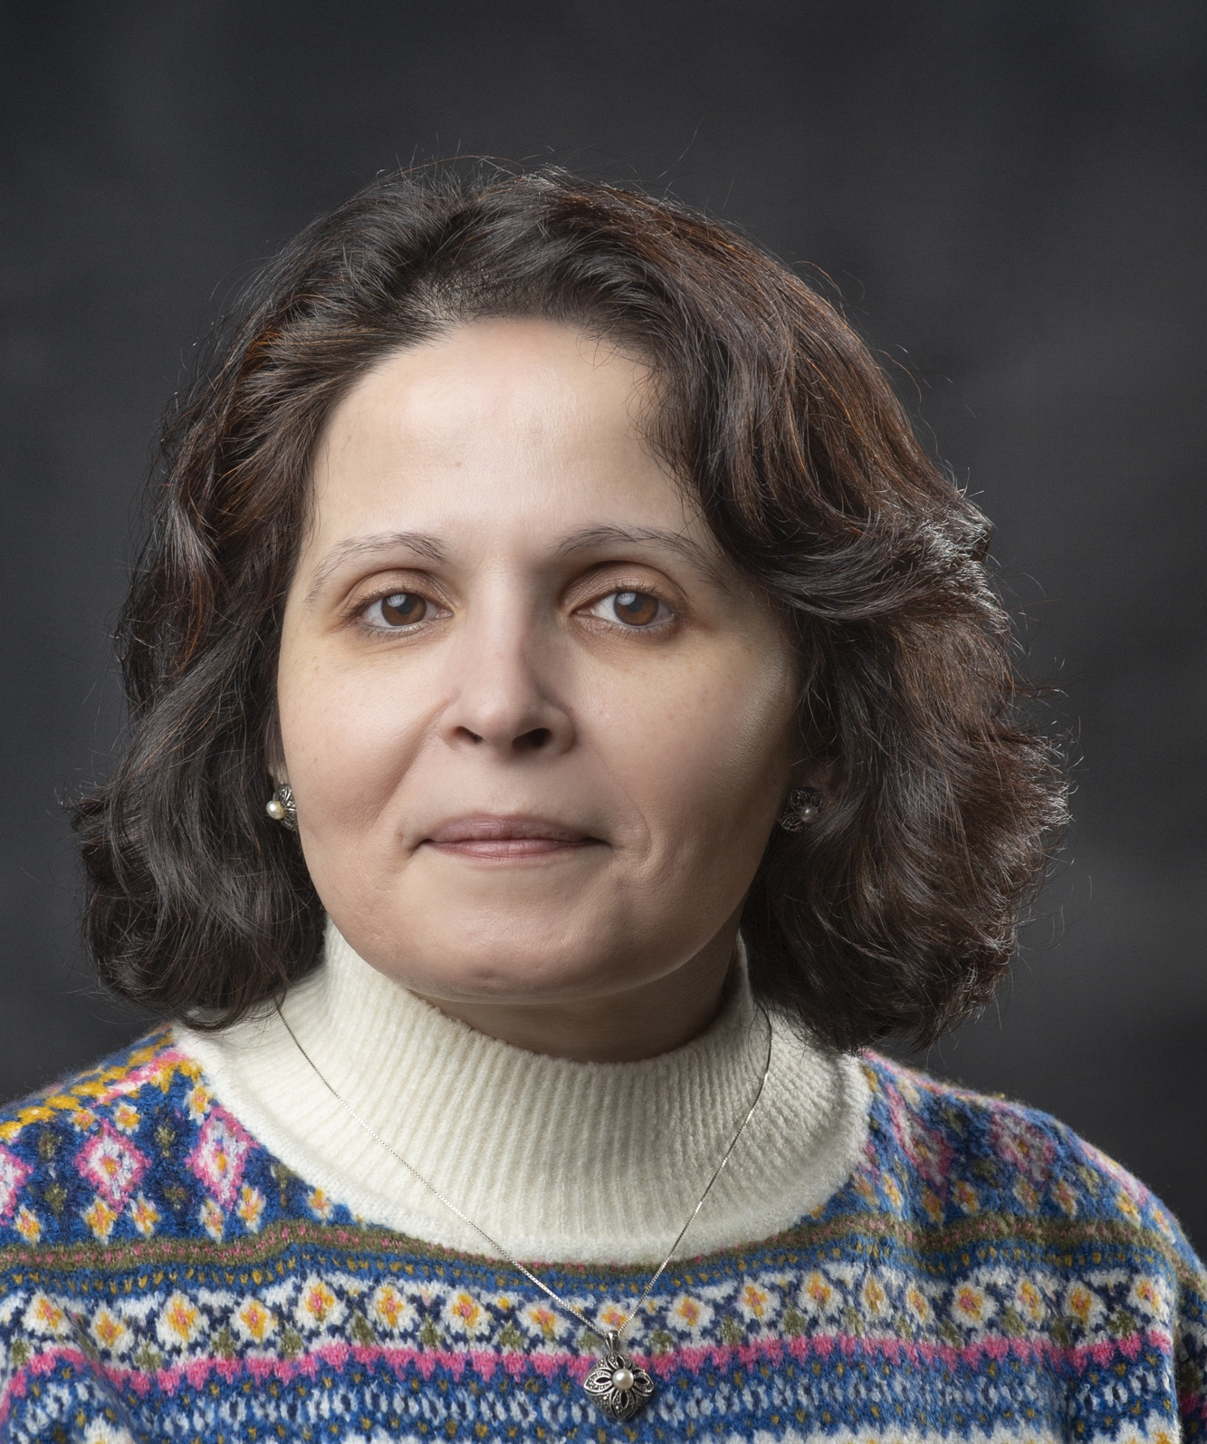
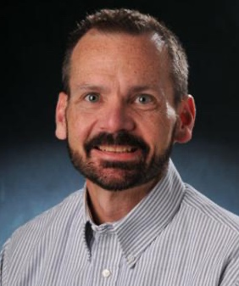
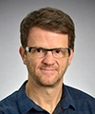
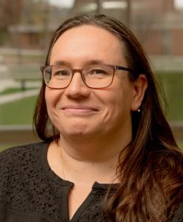
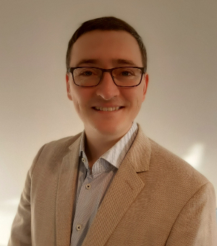
JSA Initiatives Fund Program
JSA Thesis Prize
Nominations Open – March 8
JSA/JLab Sabbatical Support
Since 1997, over 40 awards to faculty
2023 Awardee:
Allison Zec
JSA Postdoctoral Research Prize
Applications Open – March 8
Lamiaa El Fassi
Mississippi State University
Edward Kinney
University of Colorado Boulder
Zisis Papandreou
University of Regina
Julie Roche
Ohio University
2023 Awardee:
Peter Hurck
AY2023-24 Awardees
JSA Accepting Applications for Sabbatical / Research Leave Support
Application Deadline: February 16, 2024

Slide 6
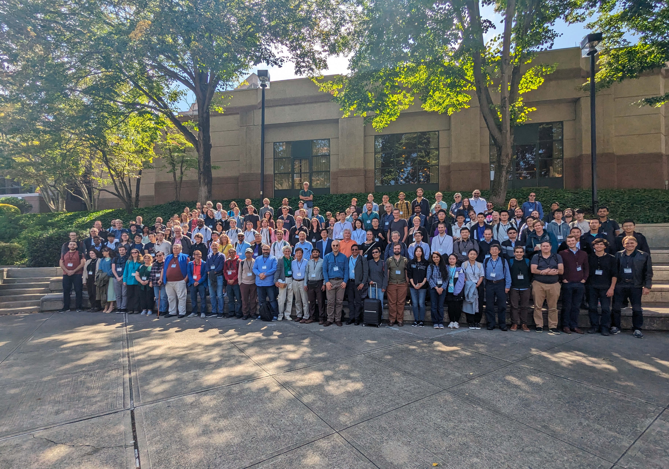
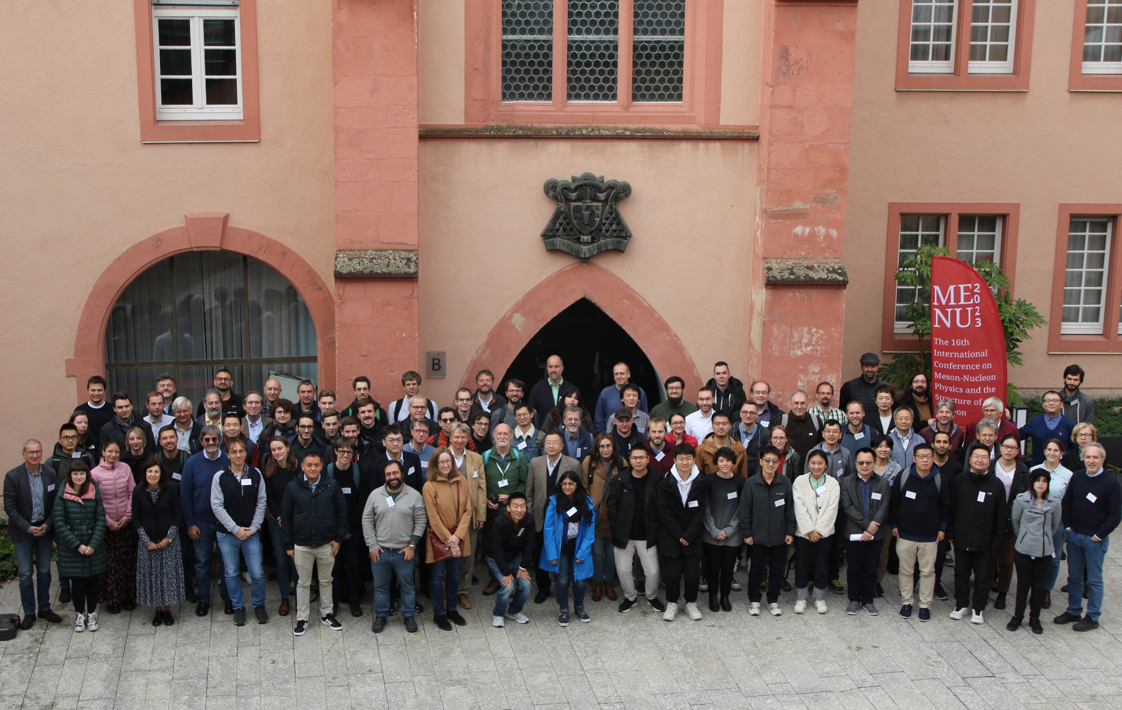
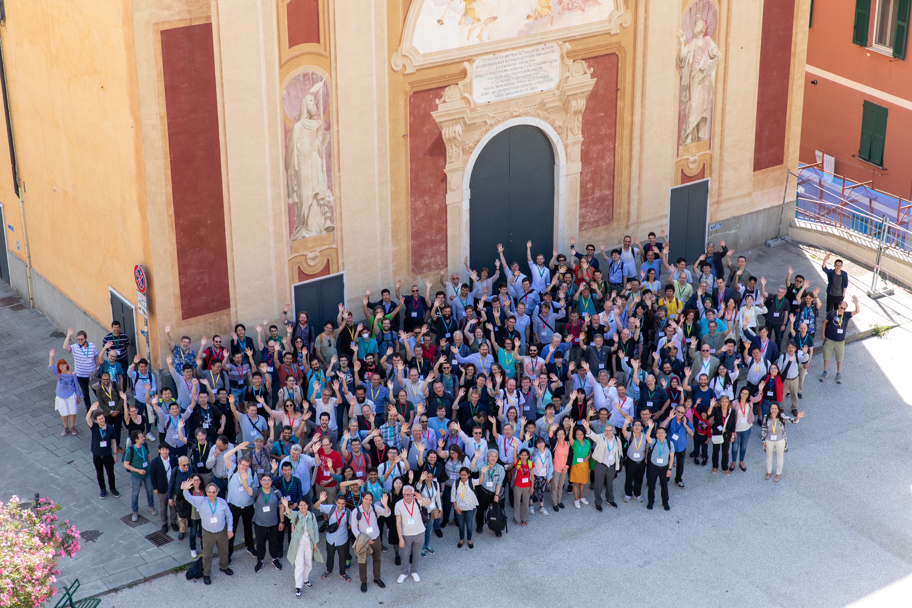
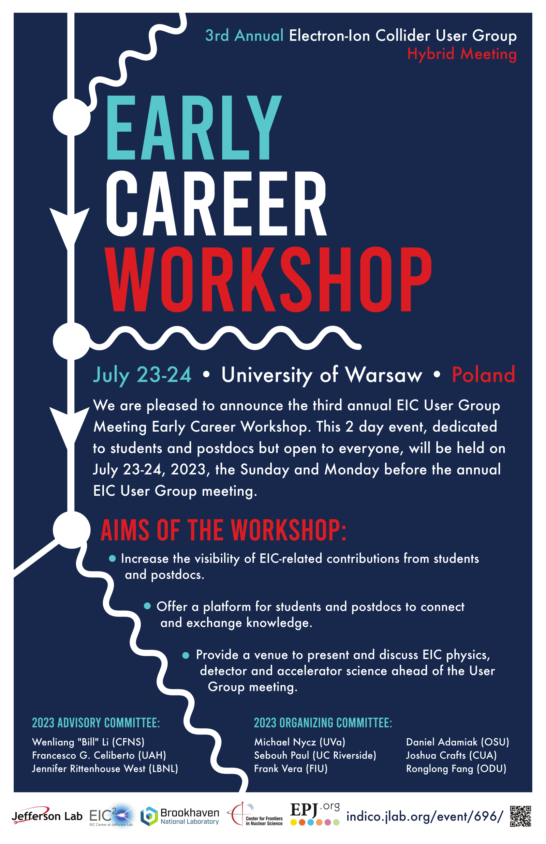
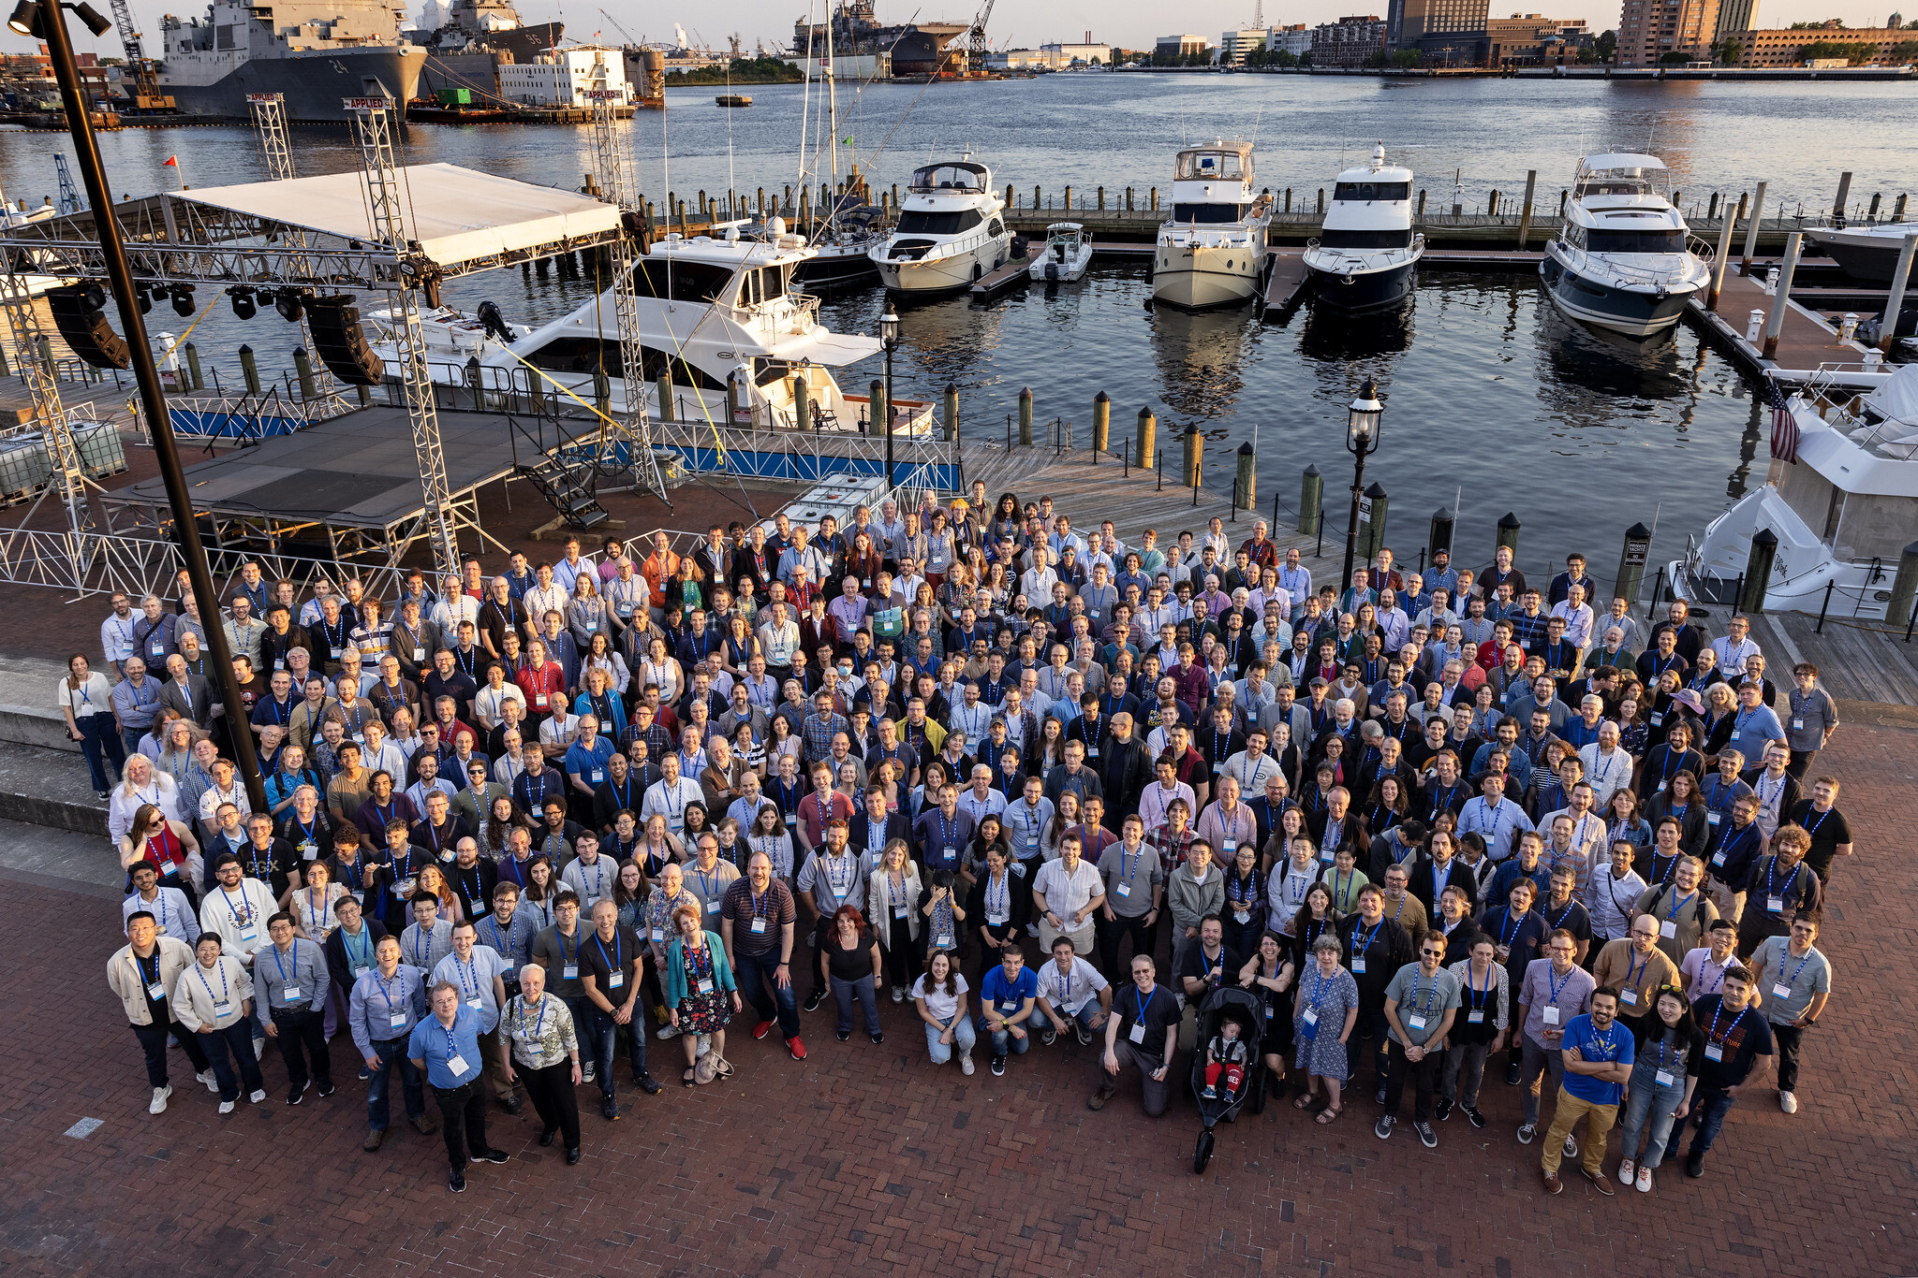
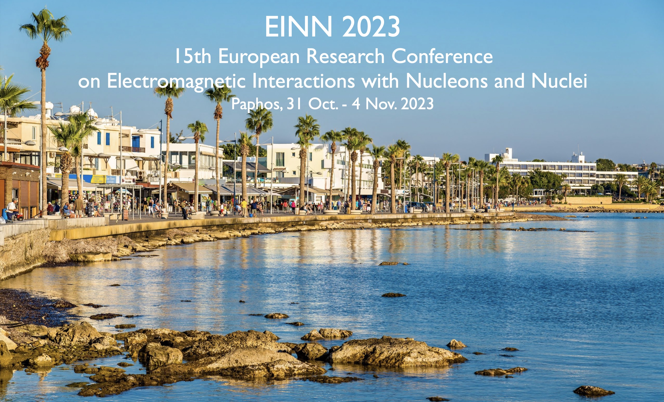
JSA Initiatives Fund Program
Initiatives Fund Program supported over 275 students, young researchers, and JLab users to attend, present, and participate in workshops and conferences
Spin Symposium 2023
Duke University
MENU 2023
Mainz, Germany
Hadron 2023
Genova, Italy
CHEP 2023
Norfolk, VA

Slide 7
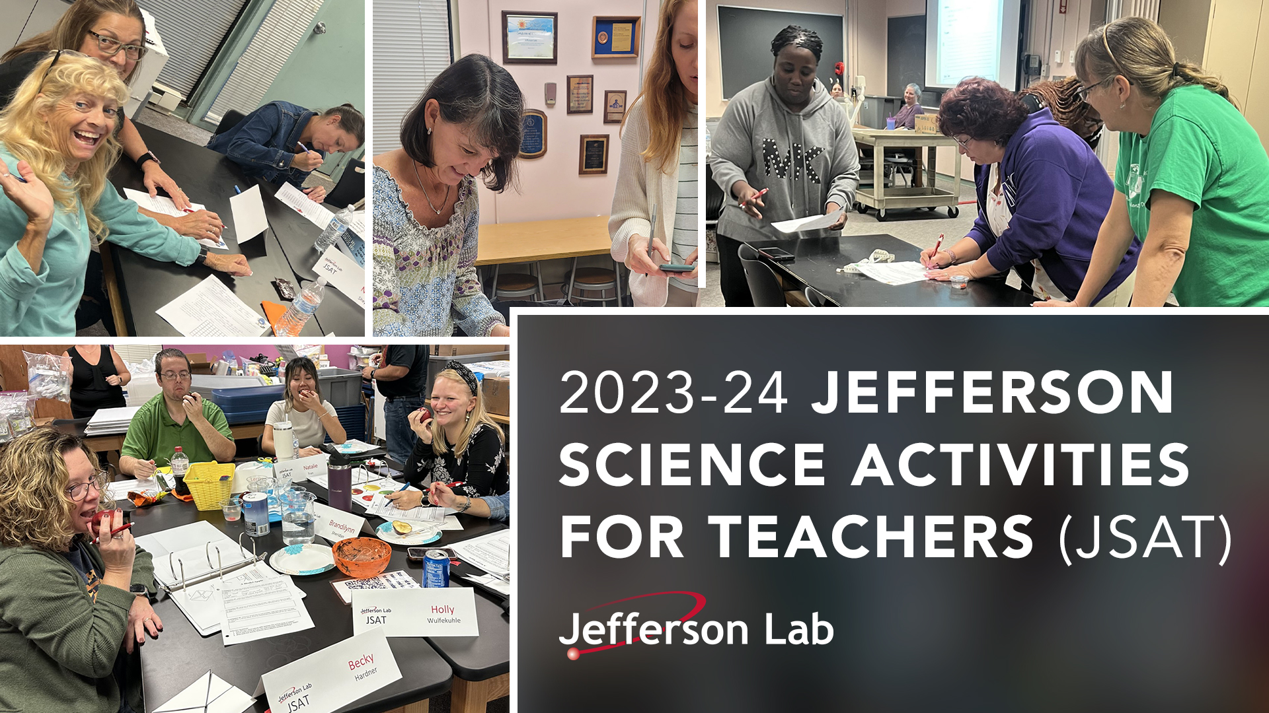
JSA Initiatives Fund Program
Initiatives Fund Program supports K-12 STEM education through JSAT
Professional development and networking opportunity for 5th, 6th, and 8th grade teachers (~60 teachers per year)
During twice-a-month, 2-hour sessions, JSAT provides hands-on activities and experiments to help teachers bring science to life in the classroom
Activities and topics follow the SOL standards for Virginia. Teachers receive a small stipend and recertification points
JSAT, highlighted on the JLab Science Education site including its annual curriculum, reaches out to thousands of students
Program culminates with annual Virginia Region II Jefferson Lab Teacher Night, when JSAT teachers demonstrate activities and physical science teaching methods

Slide 8
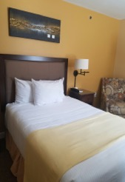
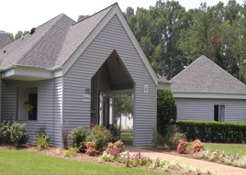
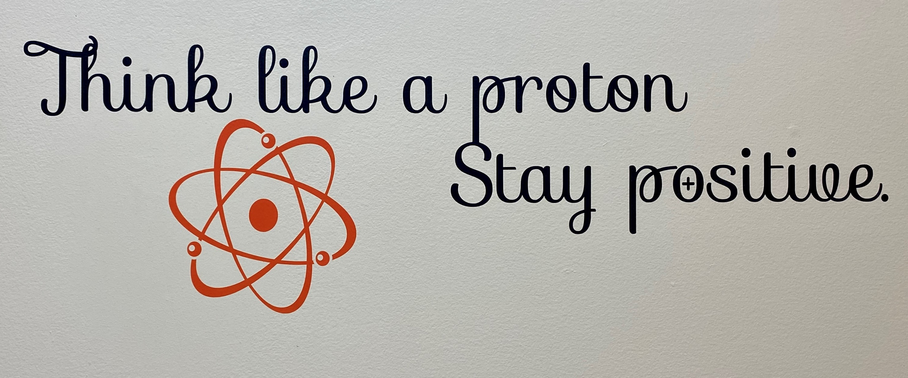
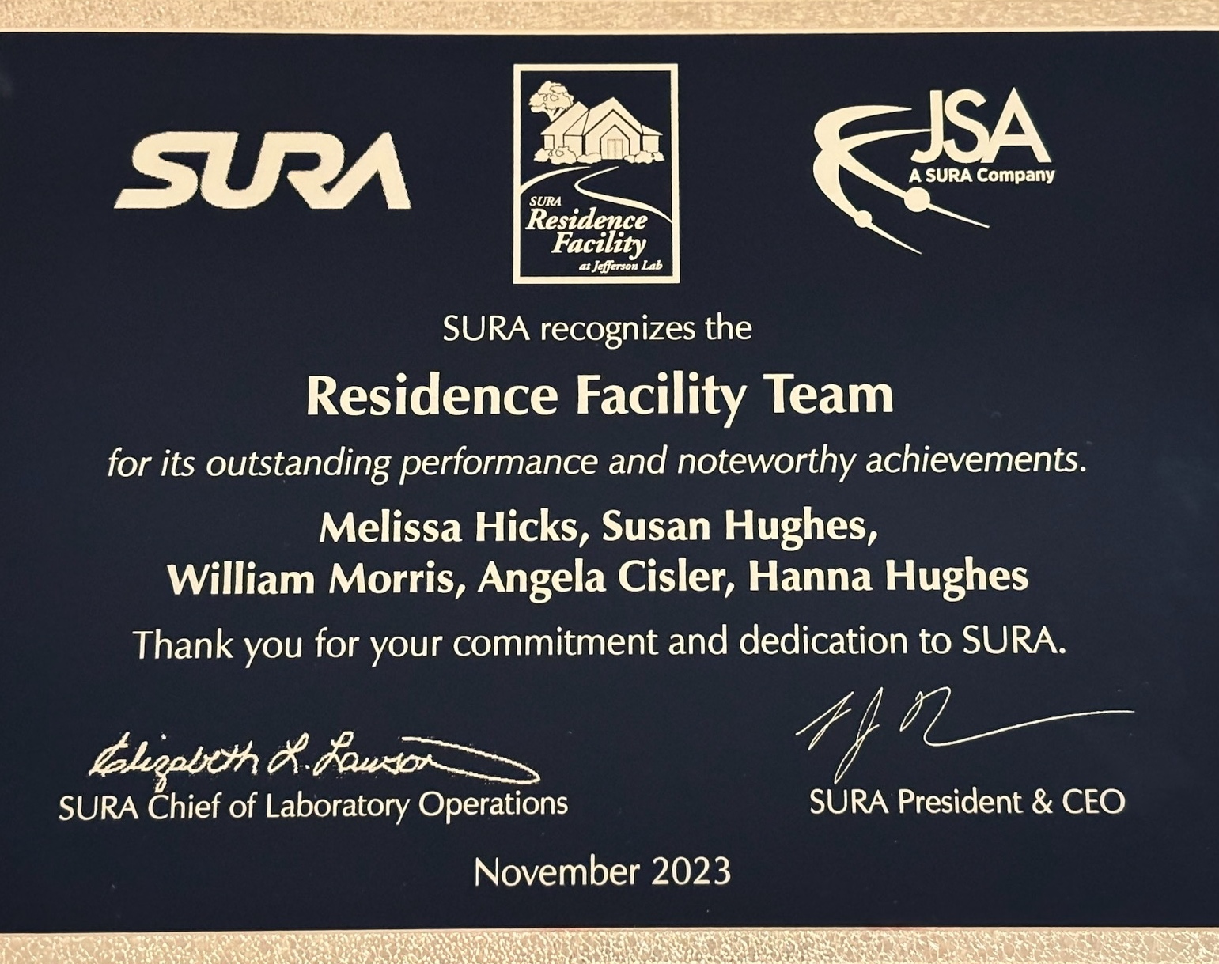
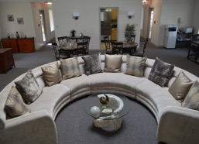
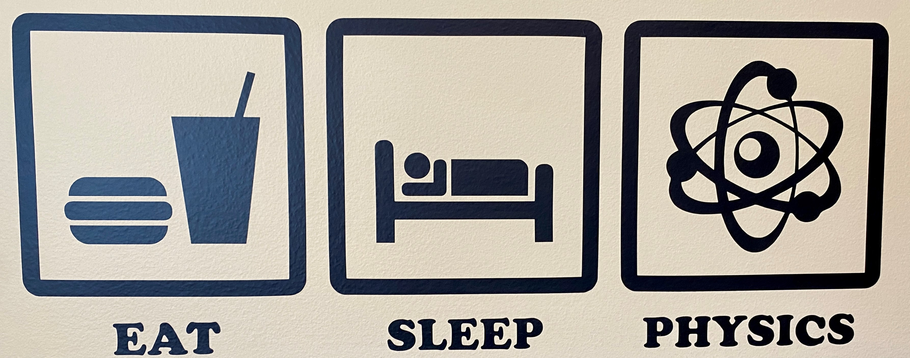
SURA Residence Facility
Achieved break-even FY23 operations
Guest survey results: 95.0
Q1 FY24: Residence Facility was the home to 133 users on site to work shifts, do experiments, attend meetings, etc.

