Slide 1
DIVERSITY, EQUITY, INCLUSION & ACCESSIBILITY
DEIA Discussion
Jefferson Lab User Board of Directors Meeting
Jennifer Carter, DEIA Program Manager
Shana Mathews, DEIA Specialist

Slide 2
Key DEIA Topics
Introduction of DEIA Program Manager and DEIA Specialist (new position)
Scientific User DEIA Goals for FY2024
Launch of Scientific User Focus Group
Addition of Post Doc to DEIA Council
Communication Updates
Q&A

Slide 3
Diversity, Equity, Inclusion and Accessibly Team
Jennifer Carter – DEIA Program Manager
jcarter@jlab.org
757-269-6822
Support Service Center (SSC) Room 45
Shana Matthews – DEIA Specialist
shana@jlab.org
757-269-7027
Support Services Center (SSC) Room 45
DEIA Website: Diversity, Equity, Inclusion and Accessibility | Jefferson Lab (jlab.org)

Slide 4
Scientific Users DEIA FY24 Goals (Marco, Holly and Olga are council members)
Goals | Objectives | Metrics
Increase User activity in DEIA | Create User and Student/Postdoc focus groups Encourage collaborations to invite DEIA leadership to speak | Increased participation in surveys Number of attendees in focus groups and reaching out to the Board/Council
Increase support and resources to Users | Clarify the reporting guidelines and subsequent steps for Users Support collaborations including DEIA in by-laws/codes of conduct/etc. | Improved collaboration by-laws and DEIA support Feedback from Users on reporting in focus group and private discussions
Increase User representation to DEIA | Add Student/Postdoc representative to the Council Review DEIA literature to ensure language and guidelines include User needs | More Users in attendance at Council meetings Improved literature and material from the lab
FY24 DEIA Council Goal Template

Slide 5
Launch of Scientific Users Focus Group
Scheduled for March 7, 2024 at 11:30 AM ET – 12:30 PM ET
Lab Leadership Sponsor – Thia Keppel
User Board Sponsors – Holly Szumila-Vance and Olga Cortes (also part of DEIA Council)
Event will be advertised on the SWISS screens, JLab weekly for Users, Users website, DEIA website and through proactive communication with Lorelei to User Community
Topics will cover:
Upcoming DEIA Heritage Events
Upcoming DEIA Focus Groups
Where to find DEIA information and how to communicate a concern
Open discussion on DEIA topics Users want to hear more about

Slide 6
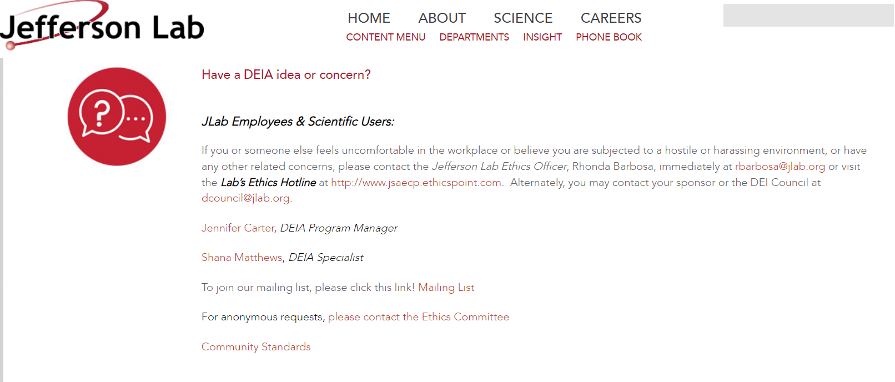
Updates to DEIA website to ensure easier access for Users

Slide 7
Focus Group Meeting Schedule
Demographic Focus Group ​ | Executive ​ Sponsor​ | Date​ | Location​
Family Focus Group​ | Marla Schuchman​ | 2/7/24 @ ​ 2:00-3:00 PM​ | Click here to join the meeting​ Meeting ID: 160 002 0499​ Passcode: 624096​
Gender Focus Group​ | Gail Frayne​ | 2/8/24 @ ​ 2:00-3:00 PM​ | Click here to join the meeting​ Meeting ID: 161 770 4575​ Passcode: 938400​
Administrative Roles Focus Group​ | Steve Smith​ | 2/22/24 @ ​ 2:00-3:00 PM​ | Click here to join the meeting​ Meeting ID: 161 805 0172​ Passcode: 061011​
LGBTQ+ Focus Group​ | Jianwei Qiu​ | 2/27/24 @ 10:00-11:00 AM​ | Click here to join the meeting​ Meeting ID: 161 173 5451​ Passcode: 740388​
Race Focus Group​ | Lauren Hansen​ | 3/5/24 @ ​ 1:00-2:00 PM​ | Click here to join the meeting​ Meeting ID: 160 972 0957​ Passcode: 631894​
Scientific Users Focus Group​ | Thia Keppel | 3/7/2024 @ 11:00 AM – 12:00 PM | Join Zoom Meeting Meeting ID: 160 683 1567 Passcode: 444640

Slide 8
Monthly Heritage & DEIA Initiatives
February | Black History Month Guest Speaker: Dr. Marvin Chiles Feb. 23, 11:00 AM – 12:00 PM, CEBAF Center F113 Zoom Link | July | National Civility Month
March | National Women's History Month Guest Speakers: JLab Women’s Panel March 21, 2:00-3:00 PM, CEBAF Center F113 | September | National Hispanic Heritage Month National Suicide Prevention Month
April | Autism Acceptance Month | October | National Disability Employment Awareness Month
May | Asian Pacific Heritage Month Mental Health Awareness Month Guest Speaker: Dr. Kristie Norwood, Licensed Clinical Psychologist & Director of the Student Counseling, HU May 21, 2024, at 2:00-3:00 PM | November | National Native American Heritage Month
June | LGBTQ+ Pride Month Juneteenth | December | Universal Human Rights Month

Slide 9
Upcoming DEIA training
On a quarterly basis we have two new courses we will be offering.
These will be optional for those wish to attend in the lab community
Psychological Safety in the Workplace
How to be a good Ally
Would you be interested in joining a DEIA book club?
The first book will be Crucial Conversations (Patterson, Genny, McMillan & Switzler, 3rd edition)
Contact Shana Matthews @ shana.jlab.org for more information

Slide 10
Questions?

