Slide 1
Jefferson Lab EIC Group
EIC Partner Project
Jim Fast
Katherine Wilson
Physics Division
Cynthia Keppel
Patrizia Rossi
EIC Project:
A few new hires (e.g., EE-I with FEG, SS-I/II for detector) but mainly help from others, like some dedicated ME’s and MD’s from Engineering Division, and part-time help from scientists and support groups in Physics Division. For example, the RDI group for MPGDs and HRPPDs, the DSG group for hpDIRC.
EIC Science:
Small EIC Group, with help from many (part-time) interested others in various JLab Divisions and the user community, like for work on the Yellow Report, the detector proposals, the EIC software and computing. In addition, much help from EIC fellowships coming in through EIC2 Center.
EIC
Rolf Ent
EIC Project
EIC Group
Markus Diefenthaler
Yulia Furletova
F-X Girod
Dmitry Romanov
Christian Weiss*
EIC CAMs
David Abbott*
Fernando Barbosa*
Brian Eng*
Yulia Furletova*
David Gaskell*
Renuka Rajput-Ghoshal*
Beni Zihlmann*
EIC Detector
Walt Akers* (SE)
Joel Watkins (SE)
Arshak Asaturyan
Sourav Tarafdar
EIC Work Coordinator
Andrew Lumanog
Sarah Ballard
Caleb Graham
TBD
TBD
EIC Center
Doug Higinbotham*
EIC Center Fellows
EIC Detector Group:
Some hires to ensure we remain on track, including detector scientists and system engineers. The electrical engineers are within the FEG.
EIC Technical Group:
Like a Hall Group. These are for Physics Division projects, their 2023/2024 emphasis is MOLLER

Slide 2
EIC@JLab Physics Group Mission
The mission of Jefferson Lab’s Electron-Ion Collider (EIC) Group is to advance the science program of the EIC, to support the EIC project, and to provide a regional hub for analyzing future EIC data. The specific goals of the EIC Group are to:
  Accelerate femtoscale microscopy of atomic nuclei and the understanding of the underlying quark-gluon dynamics. To achieve this, leverage the synergy between nuclear science at Jefferson Lab and the EIC, as well as the triad of advanced detector technologies, scientific computing and nuclear theory.
  Develop novel or improved detector technologies to enhance science opportunities at Jefferson Lab, the EIC, and/or for technology transfer. Facilitate detector R&D in test setups and parasitic beam tests using Jefferson Lab’s facilities.
  Create a modular simulation, reconstruction and analysis toolkit for the fully integrated EIC detector and interaction region, which is fully compatible with the envisioned compute-detector integration using streaming readout, AI/ML, and heterogeneous computing.
  Provide scientific guidance for the EIC project using the modular simulation, reconstruction, and analysis toolkit for detector and physics studies to guide detector design, construction, and commissioning.
  Maintain and promote a close connection between the EIC and the Users community at Jefferson Lab, utilizing their expertise in nuclear physics experimentation and theory, as well as computational and accelerator science, while encouraging new opportunities for collaboration and synergy.
  Mentor the future nuclear physics workforce towards the co-hosted EIC science program.
  Foster a collaborative and inclusive scientific community to advance cutting-edge research at EIC.
In blue are research components
Items 1. and 3. are topics of synergy with advanced computing

Slide 3
Jefferson Lab Main EIC Detector Areas
JLab has already known responsibility in:
Magnet
Computing and Software – synergy with streaming/advanced computing
Electronics and DAQ/Computing coordination – synergy with streaming/advanced computing
CAMs for tracking, particle id, far-forward/-backward, magnet, electronics, DAQ/computing
Electron Polarimetry
Ongoing JLab Interest Areas – together with Jefferson Lab/EIC users:
muRWell MPGD; E&D for GEM-based trackers (outer MPGD, Disks) – synergy with MPGD Center
High-performance DIRC – E&D, assembly, synergy with GlueX/DIRC work and infrastructure
(EEEmCAL backup for) Backward EM Calorimeter – synergy with earlier NPS, FCAL-II work
(INFN backup for) dRICH – synergy with earlier CLAS12 RICH work
HRPPD evaluation – synergy with ongoing work with/interest in LAPPDs for PId detectors
E&D for pfRICH, dRICH and far-forward/far-backward – deliver on known responsibilities

Slide 4
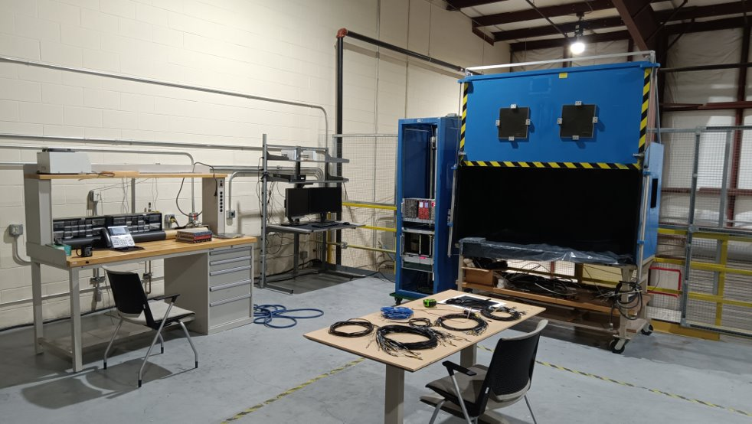
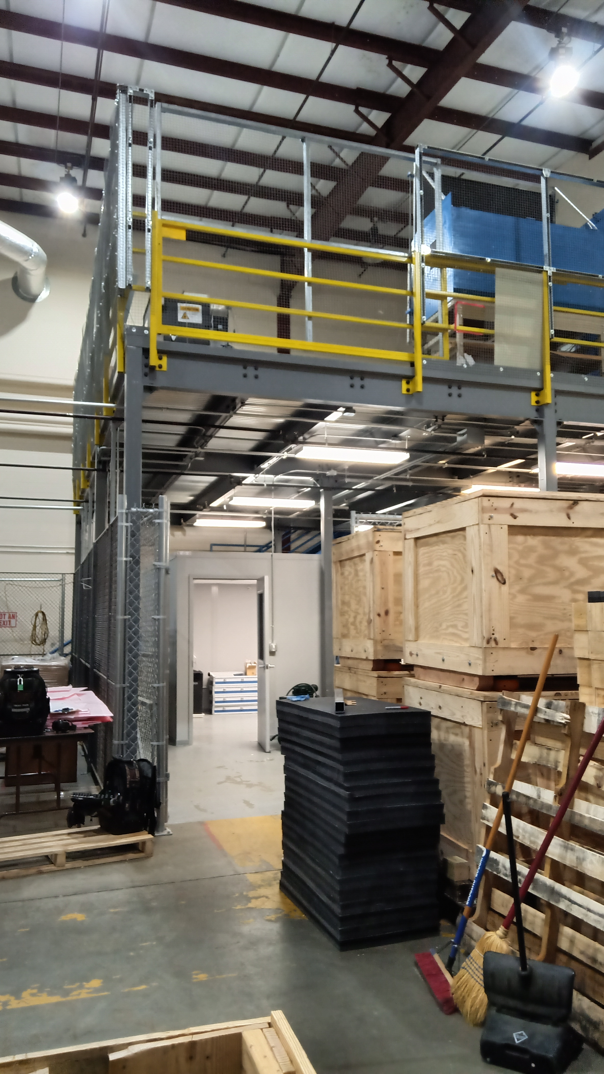
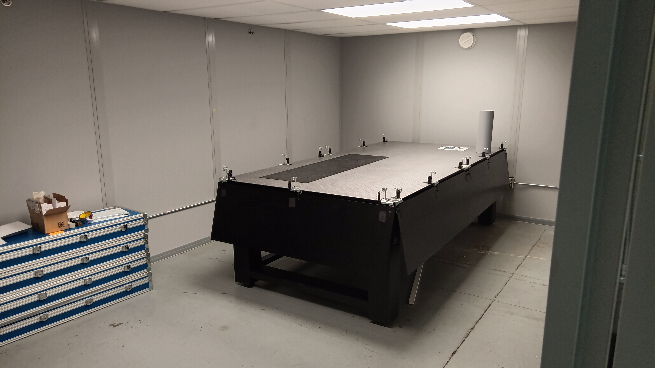
EEL-108(A) Mezzanine and Clean Room​
EEL-108A Mezzanine
Optical breadboard for the dark box
3D motion stage
PC, electronic rack with WEINER and NIM crate in place for HRPPD (and other photonsensor) testing
EEL-108A Clean Room
Large (flat!) optical table
Laser and alignment diagnostics
Cabinet for bar storage
EEL-108 (next to EEL-108A)
Clean Tent (ex-Hall D FCAL-2) to receive DIRC bar boxes
Further assembly space
Test Lab NPS Clean Room
PbWO4 crystal QA checks
Also: INDRA facility, EEL-109 FEG work space, etc.
EEL 108 Mezzanine for testing EIC HRPPDs
Clean room for EIC DIRC Quartz bars

Slide 5
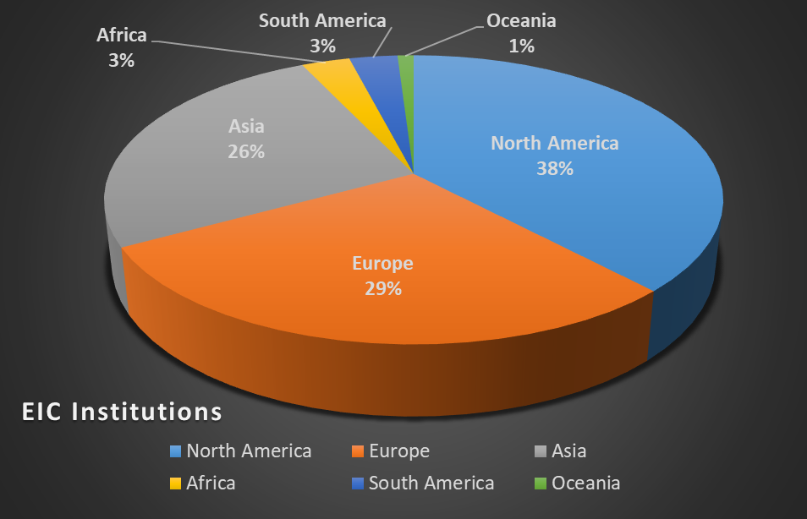
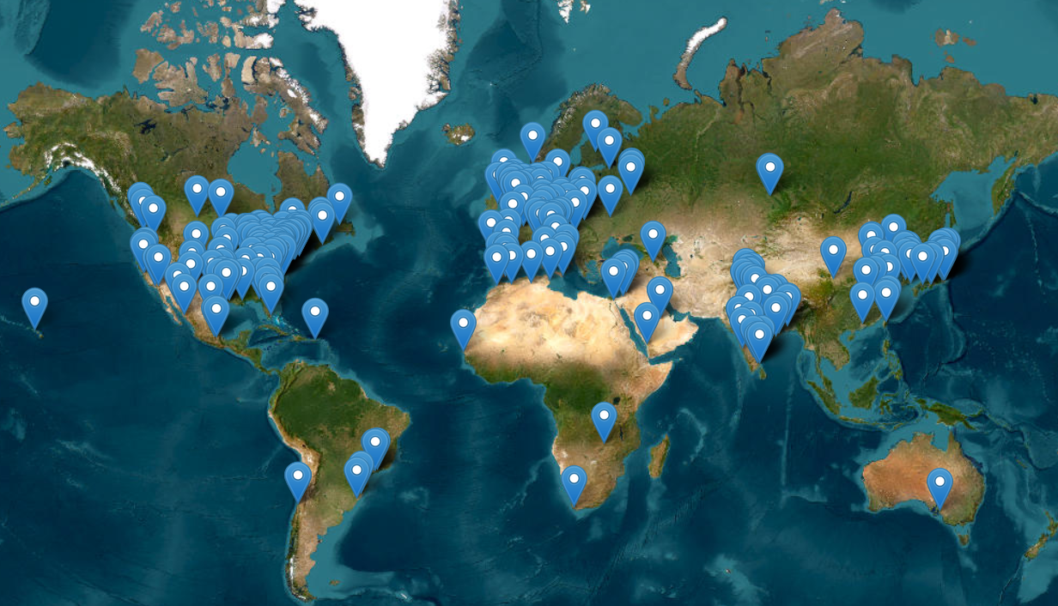
EIC Community of Users
EIC User Group formed in 2016: https://eicug.org/
Status January 2024:
Collaborators 1440
Institutions 295
Countries 40
Annual EICUG meeting
2016 UC Berkeley, CA
2016 Argonne, IL
2017 Trieste, Italy
2018 CUA, Washington, DC
2019 Paris, France
2020 FIU, Miami, FL
2021 VUU, VA & UCR, CA
2022 Stony Brook U, NY
2023 Warsaw, Poland
2024 Lehigh U, PA

Slide 6
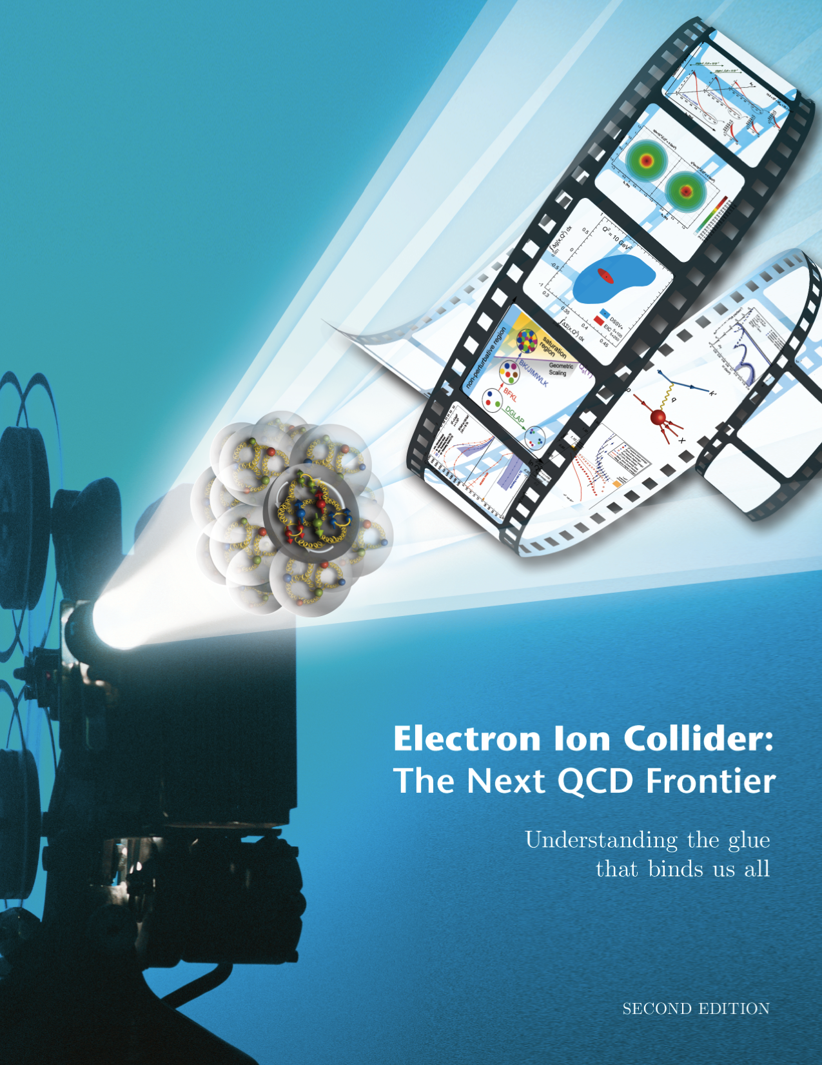
EIC Science is Well Known and Highly Cited
EIC White Paper that guided the EIC science written following a 10-week program at the Institute for Nuclear Theory
  Electron-Ion Collider: The Next QCD Frontier: understanding the glue that binds us all
  arXiV:1212.1701 & Eur. Phys. J. A 52 (2016) 9, 268 – 1554 citations (01/28/2024)
Year-long EIC User Group driven EIC Yellow Report activity (December 2019 – February 2021)
  Science Requirements and Detector Concepts for the EIC – The Yellow Report set the (initial) EIC detector requirements.
  arXiv:2103.05419 & Nucl. Phys. A 1026 (2022) 122447 – 726 citations (01/28/2024)
2024: Year-long ePIC driven activity to draft a Technical Design Report – plan to be published as was WP and YR.
Requirements have then been further updated during proposal and follow-up processes

Slide 8
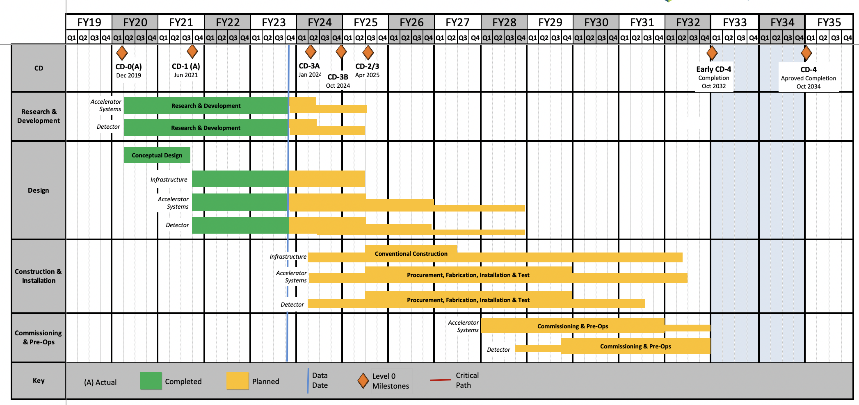
EIC Schedule
CD-3A:
Approve start of long-lead procurements
CD-3A items passed final design review
All interfaces related to them are frozen
Waiting for ESAAB meeting for authorization
Construction Phase
Conclusion of
RHIC Operation
Science Phase
CD-2:
Approve prelim. design for all subdetectors
Design Maturity: >60%
Need “pre-”TDR (or draft TDR)
Baseline project in scope, cost, schedule
The thinner bars indicate that R&D and design
can continue at a small level beyond CD-2 and CD-3
CD-3:
Approve final design for all subdetectors
Design Maturity: ~90%
Need full TDR
    EIC Critical Decision Plan
    CD-0/Site Selection December 2019 ✓
    CD-1 June 2021 ✓
    CD-3A January 2024
    CD-3B October 2024
    CD-2/3 April 2025
    early CD-4 October 2032
    CD-4 October 2034
Speculation based on EIC accelerator project status, on still uncertain FY24 and FY25 budget scenarios, and projected RHIC FY24 run:
CD-3B Approval Dec. 2024
RHIC operations conclude at end of FY25, in September 2025
CD-2/3 Approval Dec. 2025, Possibility of CD-3C as needed.

