Slide 1
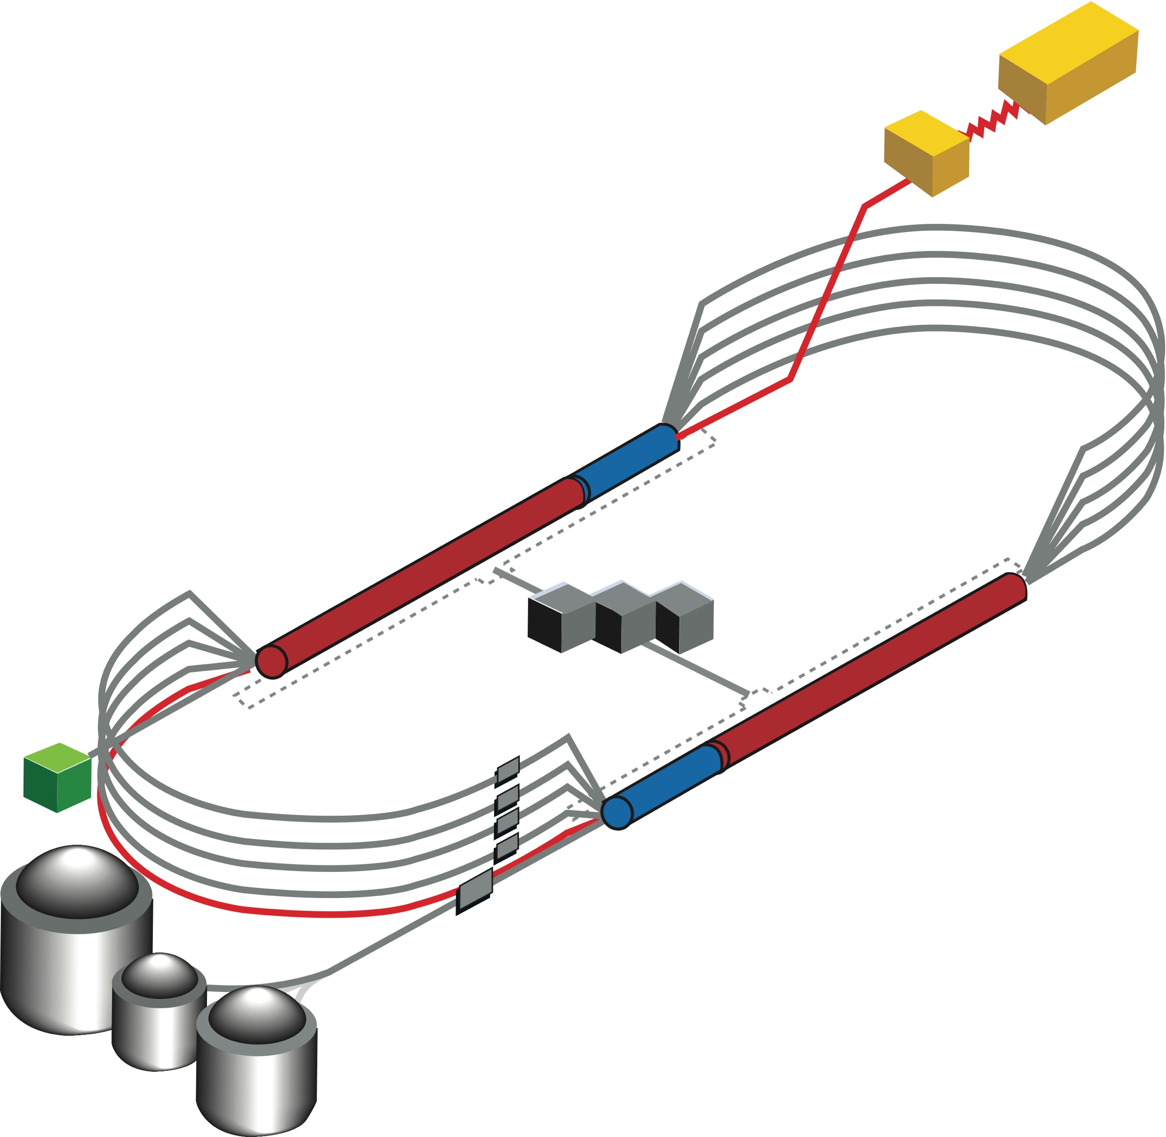
22 GeV CEBAF FFA* Energy Upgrade
Developing a pre-conceptual design for additional FFA* racetrack in the existing CEBAF tunnel to reach the top energy of about 22 GeV
TOF
1.1 GeV
1.1 GeV
650 MeV
*FFA (Fixed Field Alternating-Gradient)
TOF
Alex Bogacz
Accelerator Physics Group Leader
  Recirculate 4 + 6 times to get to 22 GeV
  Alternative staging scenario:
    4 + 5 passes with 1.1 GeV/linac to get to 20 GeV
    Upgrade linac energy to 1.21 GeV/linac to get to 22 GeV
JLUO Meeting
February 7, 2024

Slide 2
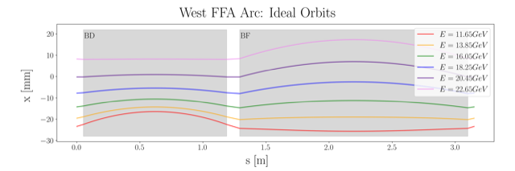
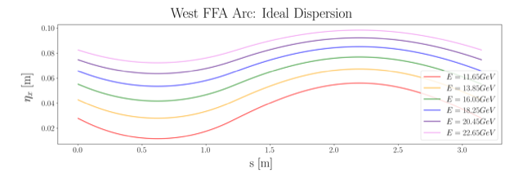
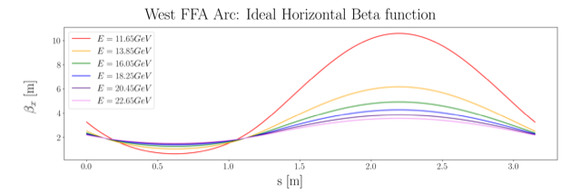
Non Scaling FFA Arc − Compact FODO Cell
orbits
Large momentum acceptance FFA cell, configured with combined function magnets capable of transporting six beams with energies spanning a factor of two
Arc composed of 75 cells, L_{cell} = 3.15 m
Closely spaced orbits for all six beams (~ 4 cm)
Low betas (~ a few m)
Extremally low dispersions (a few cm) - Virtue of combined function FFA magnets
dispersions
beta functions

Slide 3

Permanent Magnet Design
Very compact compared to conventional electro magnets
Allows for accommodating 6 additional passes in CEBAF tunnel
Provides power and cost savings
Concept successfully tested at
Open mid-plane geometry
Focusing Magnet BF
G_{F}= -41.13 T/m
L_{QF}= 1.67 m
B_{F}= -0.812 T
Defocusing Magnet BD
G_{D}= 43.44 T/m
L_{BD}= 1.24 m
B_{D}= -0.593 T
12 cm
12 cm
13 cm
13 cm

Slide 4
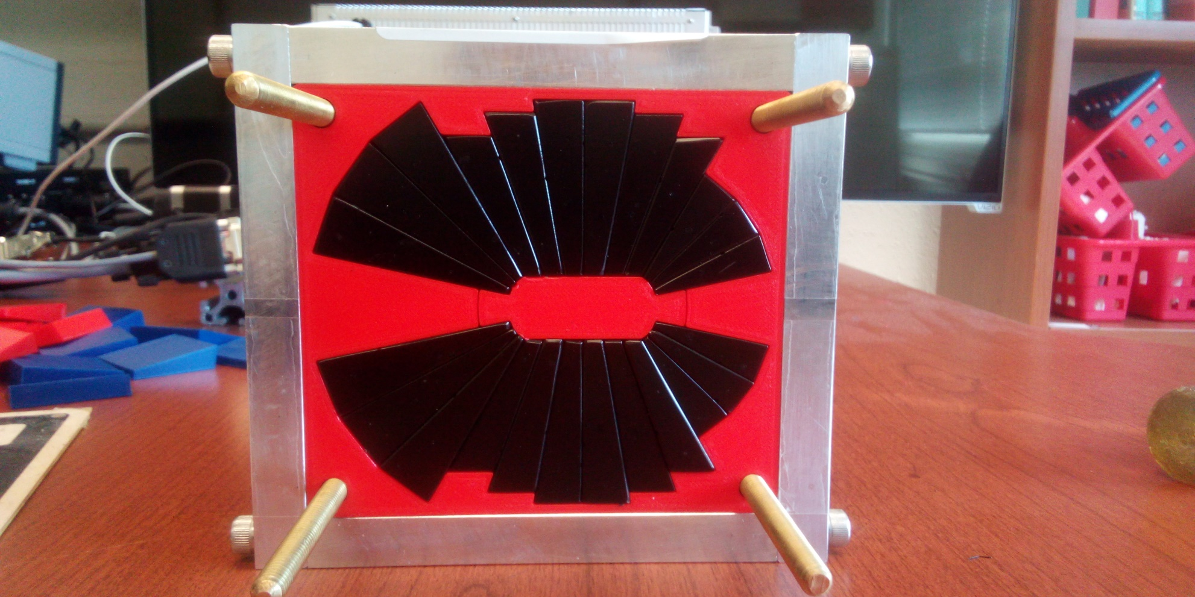
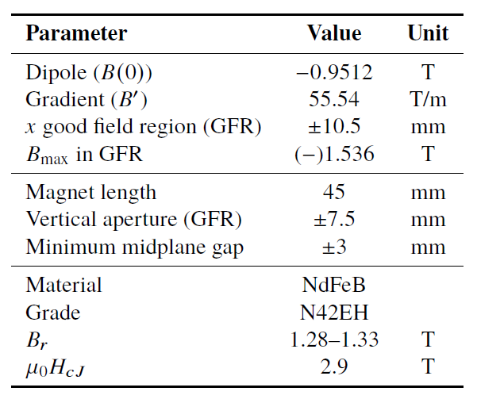

Prototype Magnet
Prototype open-midplane BF magnet successfully built and evaluated for mechanical integrity
>1.5 Tesla measured in good field region
Field accuracy of ${10}^{−3}$
Test of radiation resilience at CEBAF - LDRD project started Oct. 1, 2023 (see next presentation)

Slide 5
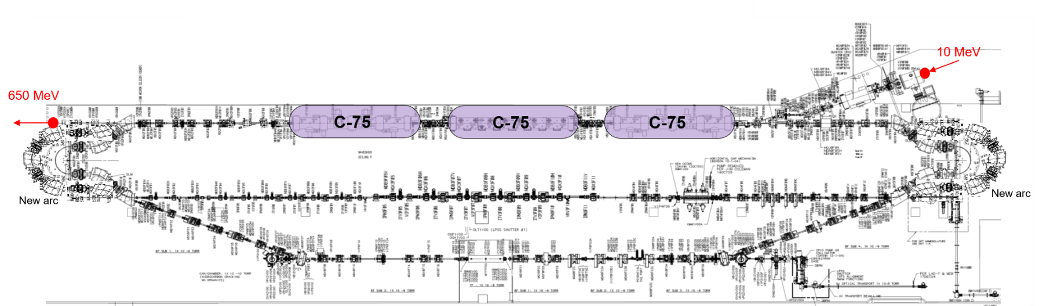
Injector Upgrade − 650 MeV Recirculating Injector
With the present 123 MeV injector, the difference in the first and final pass energies in the North Linac is too large (1:175) to effectively control the beam.
650 MeV recirculating injector (3-pass) based on LERF will allow a manageable difference in energies (1:33)

Slide 6
Electron/positron injector vault is required for 12 GeV e⁺ and 22 GeV e⁻
123 MeV e⁺ and 650 MeV e⁻
Joe Grames
‘Green beamline’ is a cost effective option for staging positron and energy upgrades:
123 MeV e⁺ for 12 GeV CEBAF
650 MeV e⁻ for 22 GeV CEBAF Energy Upgrade

Slide 7

Energy loss, Emittance dilution and Energy spread
  Doubling the energy, while staying within current CEBAF footprint, makes the synchrotron radiation effects of paramount importance.
  Quantum nature of a ‘recoil’ effect on electrons due to photon emission makes significant impact on both the transverse and longitudinal beam dynamics, leading to cumulative emittance growth (transverse and longitudinal).
Energy loss
Emittance dilution
Natural energy spread
Maximize $ρ$, minimize H
  Total energy loss of 990 MeV
  Cumulative emittance dilution (transverse and longitudinal) at 22 GeV (after 4 CEBAF + 6 FFA passes)

Slide 8

Alternative Staging Scenario
Step I - Start with 4 passes (electromagnetic arcs) + 5 (rather than 6) FFA passes assuming 1.1 GeV/linac → Final energy drops to 20 GeV
Step II - Then, upgrade linac energy to 1.21 GeV/linac (cryomodule upgrades) → Regains final energy back to 22 GeV (in 4 + 5 FFA passes )
Motivation - Increasing linac energy flexibility, ΔE/E
  FFA permanent magnets, as presently designed, are at limit of their aperture and strength, to accommodate 6 orbits of different energy within energy acceptance from about 11 GeV to 22 GeV (West FFA Arc)
  As a result, the requirement on the linac energy is 1.1 GeV 1%
    This is very tight, and would not allow for flexibility (like we have now), to slightly reduce energy, if, e.g., several cavities de-rated, or one of the cryomodules bypassed
    Furthermore, linac energy flexibility is now used to optimize polarization to multiple halls in combination with the Wien filter; with a fixed linac energy, only one hall can get polarized beam
2.2
E [GeV]
11.6
21.7

Slide 9
Increasing Linac Energy Flexibility, ΔE/E
    Changing the linac energy by more than 1%, either the top or bottom pass will fall out of the range
    Adding a sextupole component to permanent magnets may extend the energy acceptance (still under study)
  Assuming only 5 FFA passes (to about 20 GeV) the linac energy flexibility is greatly enhanced
2.2
E [GeV]
11.6
21.7
E [GeV]
2.2
E [GeV]
2.2
  Increasing linac energy from 1.1 to 1.21 GeV boosts the lowest pass energy by 1.1 GeV (5×0.22 GeV) and brings the final energy back to about 22 GeV with adequate linac energy flexibility
19.4
11.6
19.4
11.6
2.42
E [GeV]
12.7
21.7

Slide 10

Summary
Present Baseline (1.1 GeV/linac with an upgrade path to 1.2 GeV/linac)
  650 MeV Recirculating Injector (additional three C-75 cryomodules)
  Recirculate 4 passes with the current CEBAF
  Plus Additional 5-6 passes via a single FFA: 10 – 22 GeV
Non Scaling FFA Arc Architecture configured with compact FODO cells
  Beta and dispersion matching to the linacs through cell-by-cell variation (length, bend)
  Open mid-plane permanent magnet design: B-field ≤ 1 T, Gradient ≤ 50 T/m
Synchrotron Radiation impact on beam quality:
  Net transverse emittance dilution (normalized): 80 mm mrad
  Net natural energy spread: 1.5×10⁻³
  Net synchrotron radiated energy: 1 GeV
$$σ=\sqrt{β\frac{ε_{N}}{γ}}$$
at 22 GeV, β = 20 m → σ = 175 microns
at 22 GeV → ΔE = 33 MeV

Slide 11
Near Term Strategy (next 3 years)
Accelerator design focus for the next few years should be on:
  Developing a pre-conceptual design for additional FFA racetrack in the existing CEBAF tunnel to reach the top energy of about 22 GeV (current baseline), more specifically:
    Complete optics design for a pair of FFA arcs, including merger transitions to linacs
    TOF Splitters design for NE and SW arc ends, including momentum compaction compensation and beta matching
    Extraction system design capable of delivering all FFA passes (1-5) to A,B,C (same energy) and one pass above to D
    Finalize multi-pass linac optics based on strongly focusing triplets
    650 MeV recirculating injector design (in the LERF vault)
    Carry out S2E simulation including errors
    Implement a robust correction system
    Complete emittance dilution budget (longitudinal and transverse) via tracking studies
22 GeV CEBAF FFA Energy Upgrade
11

Slide 12
Near Term Strategy (next 3 years) – cont.
Technical design focus for the next few years should be on:
  Testing resilience of permanent magnets in CEBAF beam environment
  Developing a prototype FFA FODO cell and testing its performance with multi GeV beams at CEBAF, more specifically:
    Orbit mapping for different energies
    Beam based optics measurement and validation
    Validating effectiveness of orbit correction system
  Designing and prototyping special magnets, more specifically:
    Compact Splitter magnets
    Vertical septa for extraction system
    RF separator multi cell cavities
22 GeV CEBAF FFA Energy Upgrade
12

Slide 13
Near Term Strategy – Funding Aspects
Previous funding level as of FY23
  2 FTE effort in CASA
  0.5 FTE effort at BNL funded by JLAB
Current funding level as of FY24
  2 FTE effort in CASA
  0.5 FTE new Grunder Fellow
  1 FTE LDRD
  0.5 FTE effort at BNL funded by JLAB should continue
Ramp-up of funding level to produce a pre-CDR, FY25-26
  2.5 FTE effort in CASA should continue
  1 FTE new post-doc
  1 FTE LDRD
  2 FTE FOA
  0.5 FTE effort at BNL funded by JLAB should continue
22 GeV CEBAF FFA Energy Upgrade
13

Slide 14
FY23 – Highlights
Error sensitivity studies were completed on the first 4 full passes with relocated arcs, spreaders, and recombiners.
A summer student explored a neural network approach to an optimized correction scheme.
Exploratory studies of low emittance lattices for the horizontal splitters have been carried out.
A white paper on ‘Physics opportunities with 22 GeV CEBAF’, including a technical section on accelerator design was released on ArXiv.
The FFA’23 International Workshop and School on Fixed-Field Alternating Gradient accelerators was hosted by JLAB.
One-year support for BNL collaborators in the 22 GeV FFA@CEBAF effort at 0.5 FTE level started on June 1.
Recruitment for a new Grunder Fellow to work on positron and 22 GeV upgrades is under way.
22 GeV CEBAF FFA Energy Upgrade
14

Slide 15
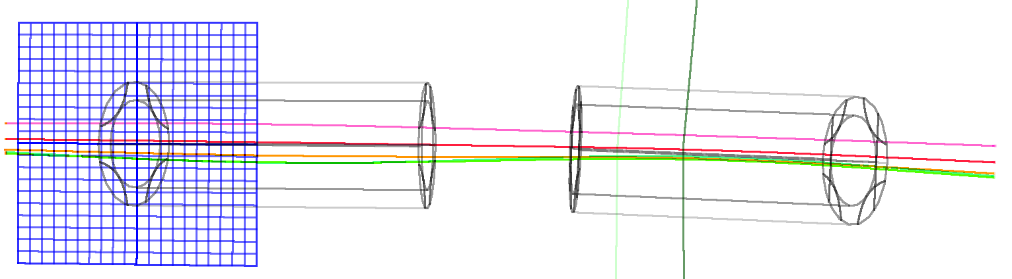




Thanks for your attention!
22 GeV CEBAF FFA Energy Upgrade

Slide 16
Backup Slides

Slide 17

The FFA@CEBAF Collaboration
R. M. Bodenstein, S.A. Bogacz, A.M. Coxe, K.E. Deitrick, B.R. Gamage, R. Kazimi, D. Khan, G.A. Krafft, E.A. Nissen, K.E. Price, Y.R. Roblin, R. Ruber, T. Satogata, A. Seryi, Jefferson Lab
J.S. Berg, S.J. Brooks, D. Trbojevic, Brookhaven National Lab
V.S. Morozov, Oak Ridge National Lab
G.H. Hoffstaetter, Cornell University
D. Douglas, Douglas Consulting

Slide 18
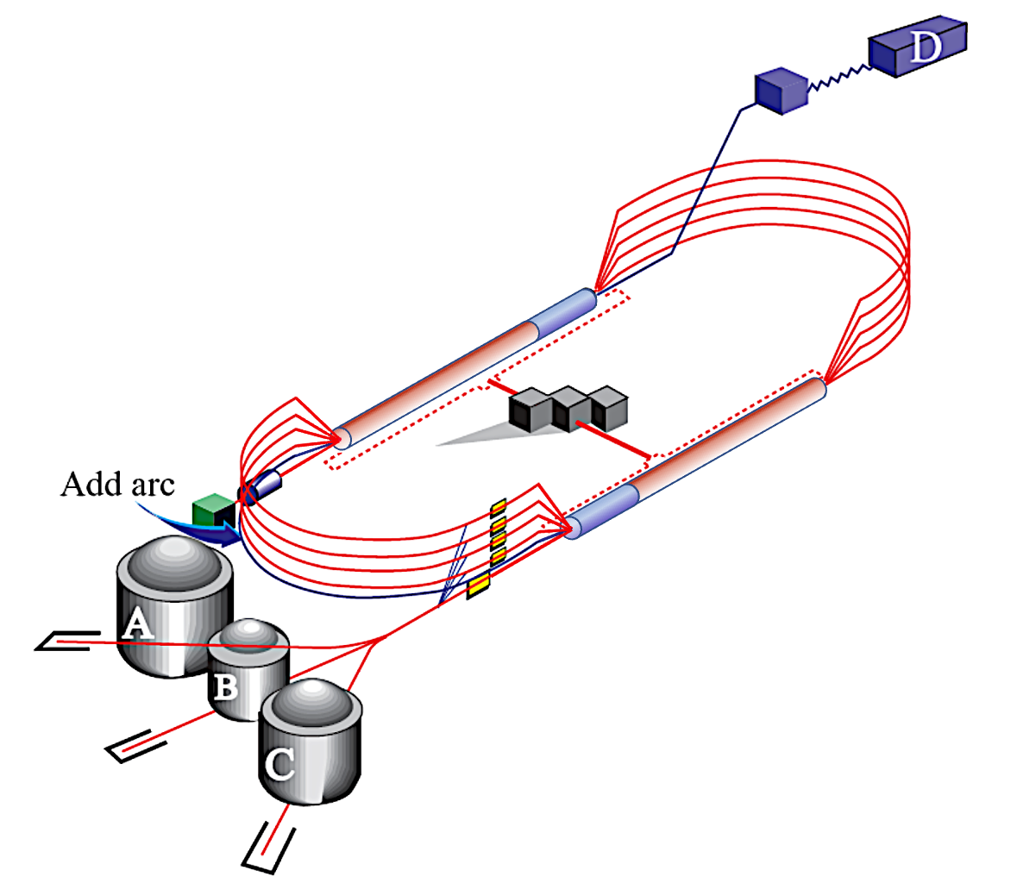
CEBAF Energy Upgrade 10.55 → 23.75 GeV
4 existing lines + 6 FFA turns
12 GeV
23.75 GeV
Injector at 650 MeV
1.75 GeV
3.95 GeV
6.15 GeV
23.75 GeV
8.35 GeV
EAST FFA
Energy range
80.6 m
#1-10.55 GeV
#2-12.75 GeV
#3-14.95 GeV
#4-17.15 GeV
#5-19.35 GeV
#6-21.55 GeV
1.75
3.95
6.15
1.1 GeV
8.35
0.65 GeV
2.85 GeV
5.05 GeV
7.25
1.75 GeV
9.45
1.1 GeV
0.650
80.6 m
2.85 GeV
Energy range
5.05 GeV
7.25 GeV
22.65 GeV
9.45 GeV
WEST FFA
#1-11.65 GeV
#2-13.85 GeV
#3-16.05 GeV
#4-18.25 GeV
#5-20.45 GeV
#6-22.65 GeV
22 GeV CEBAF FFA Energy Upgrade
18

Slide 19
FFA Arc Error Sensitivity Studies
Machine Errors (misalignments and field errors)
Error studies, diagnostics, correction schemes
6-pass Orbit Excursions in FFA Arcs
0.016
0
-0.016
Orbit Excursion (m)
0
12
s (m)
Survey (positioning) errors were taken from a normal distribution but capped at a misalignment magnitude of 0.1 mm
Field and gradient errors were capped at 1% of the intended field.
12

Slide 20
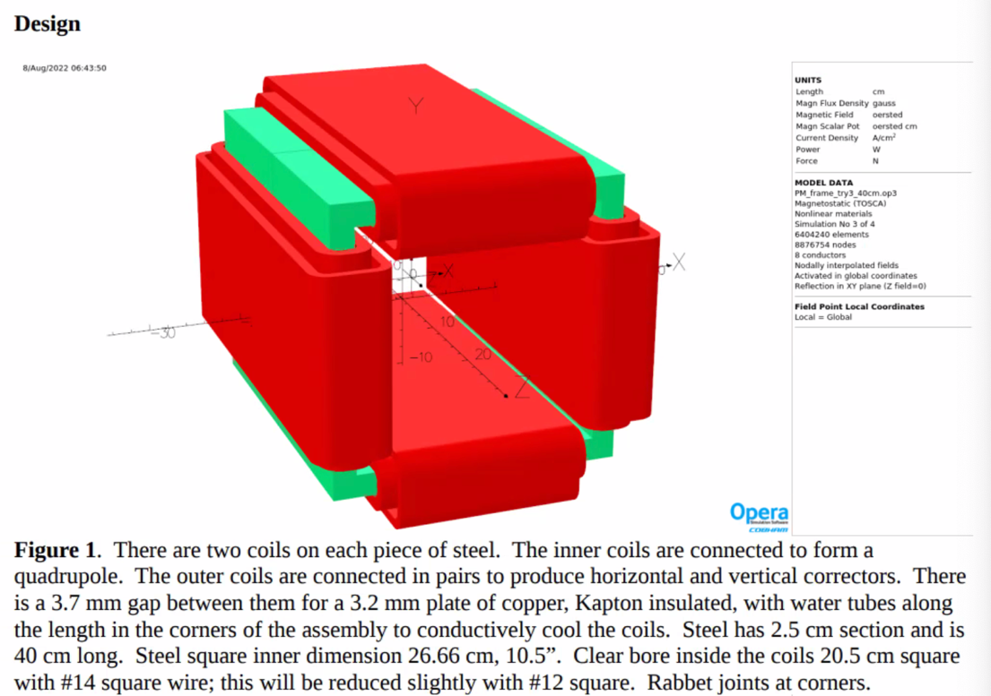
Panofsky Quad Window Corrector
Corrections and Error Resilience
Jay Benesch
Correction studies are underway (PhD Thesis project of Alex Coxe)
Stability of the beam dynamics not too demanding to error tolerances…
Currently under study…
  Requirements for beam position and Twiss at the transition to the recombiner
  Understanding of beam quality tolerances at the arc’s exit

Slide 21
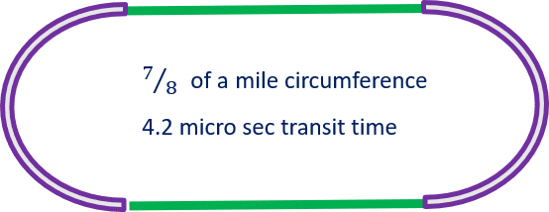
Distinguishing multi-pass beams - BPM multiplexing scheme at CEBAF
Measuring distinct energy orbits in the FFA arcs by employing beam time structure to multiplex BPMs (currently used in our linacs - 5 beams).
To measure orbits for different linac passes we use ‘tune beam’ with the following time structure (repeating at 60 Hz):
  250 micro sec of continuous beam
  followed by a 100 micro sec gap
  and then 4 micro sec ‘trail’ of continuous beam.
The transit time around the machine is 4.2 micro sec, so appropriately gated electronics can distinguish, from which pass the 4 micro sec ‘trailing’ pulse is coming from. The same, or similar scheme could be extended to the FFA arcs.
at 60 Hz
22 GeV CEBAF FFA Energy Upgrade
21

Slide 22
Synergy Between the Positron Source and 650 MeV Injector
Joe Grames
Positron program ends prior to 22 GeV FFA, so LERF can be repurposed for 650 MeV electrons.
Compact 10 mA P-Gun, Wien filter, 10 MeV e- injector
SRF to accelerate e⁻ to 120 MeV
SRF to accelerate e+ to 123 MeV

