Slide 1
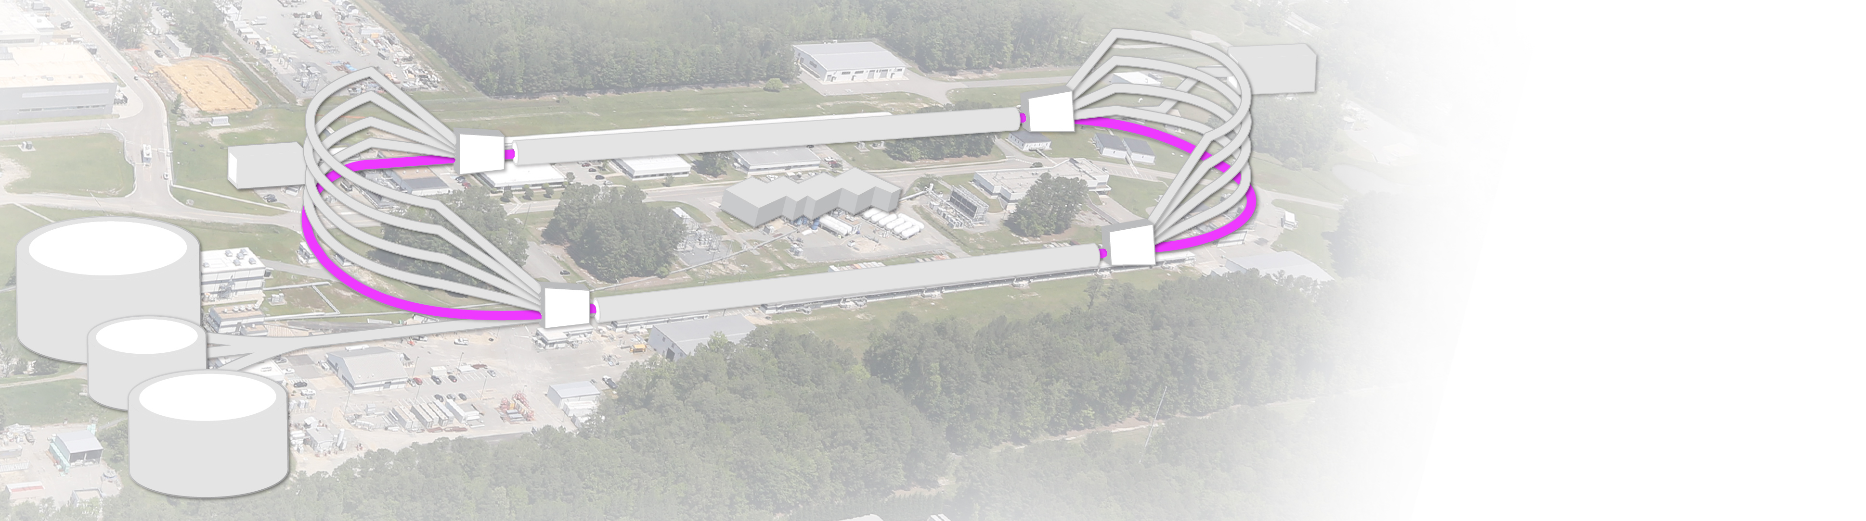
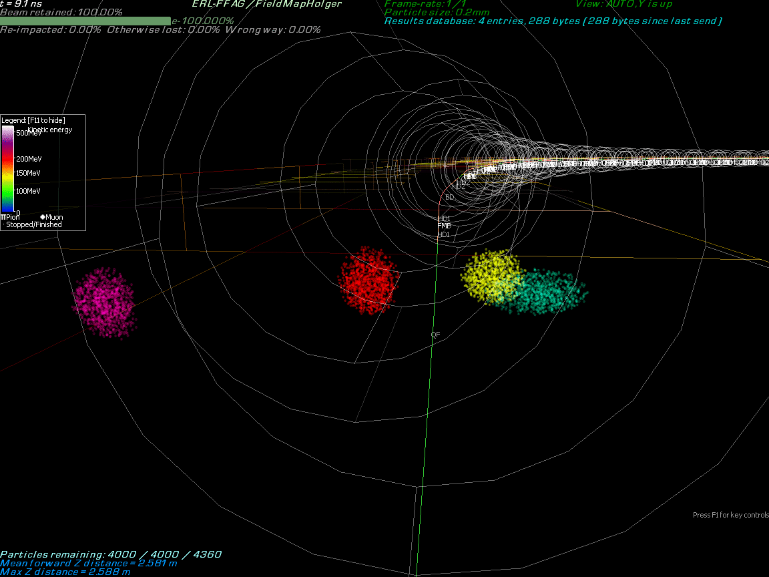

CEBAF Upgrades: 22 GeV & Positron @ 12 GeV
NEW 650 MeV injector
Electron/positron injector vault
Replace the highest recirculation arcs with two FFA ARCS
Recirculate 4 + 6.5 times to get to 22 GeV
‘Green beamline’: cost-effective option for staging positron and energy upgrades:
123 MeV e⁺ for 12 GeV CEBAF
650 MeV e⁻ for 22 GeV CEBAF
Dedicated R&D programs to:
add a positron source capable to produce 100 nA polarized and 1 μA unpolarized positron beams.
Test FFA magnet prototype at CEBAF
Enabling Technology:
Novel permanent magnets - like
(power & cost savings)

Slide 2
Planning the Future Program (beyond the current 12 GeV): Study Group
We are just at the beginning of a lengthy process which includes physics and technical planning, and we want to maintain momentum toward a major facility upgrade of CEBAF.
White Papers for both the positron and the higher energy programs are available.
A small study group (11 people) for the science and technology of both the 12 GeV positrons, and the 22 GeV energy upgrade has been set up. We may expand the group as needed to meet that end goal.
The study group meets monthly to both plan for the upgrade and to report on progress toward it.
Refine the scientific case for both the e+ and the 22 GeV programs.
Understand community/science requirements for the positron beam (e.g., polarizability, energy, intensity, fast switching between e+ and e- beams) and translating those into source requirements and machine operations requirements.
Define a roadmap for development of the technology for the positrons and for the 22 GeV beams.
Define the R&D path needed to fill gaps in our capability to reach polarized positrons and 22 GeV beams.
Report on progress of the group in defining our path forward (JSA board, S&T Mission Committee, DOE/NP)
The ultimate outcome of this group would be the preCDR

Slide 3
Higher Energy Physics Study Group
In parallel with the study group, a smaller group (6 people), led by M. Shepherd has been set up with the aim to:
  dig deep and find a deeper message about the importance of JLab science and its energy upgrade
  find the physics story to make a compelling case.
This exercise is related to, but decoupled from a separate exercise that is to validate, with extensive simulation, that we can deliver the key projected results with experimental apparatus.
The plan is to take one chapter at a time from the white paper and try to have a discussion about the fundamental ideas and specifically what is gained by the 22 GeV upgrade. This exercise requires to critically evaluate arguments, have an open-minded approach and be ready to ask apparently basic questions!
The final goal is not to have over-simplified propaganda, but a rich, scientifically accurate story that is most accessible and interesting to people in the broader particle/nuclear community.
The group meets monthly in person ( Zoom option is available just in case). The final goal is to have 35-40 “distillate” pages for the physics chapter of the preCDR.

Slide 4
More actions…
A workshop will be held at the Frascati National Lab of INFN on December 9-13, 2024 on the CEBAF energy upgrade.
The next Positron Working Group Workshop will take place at the George Washington University from March 18th to 20th, 2024.
Get multiple invited talks on the upgrades.
The revised version of the White Paper “Strong Interaction Physics at the Luminosity Frontier with 22 GeV Electrons at Jefferson Lab” has been submitted to EPJA yesterday.

